Slide 1
GPS on Bench Marks for NSRS Modernization
Infrastructure, Resilience, and Preparing for the Future
National Geodetic Survey Monthly Webinar Series
January 13th, 2022
Today’s Presenters:
Galen Scott, NGS Constituent Resources Manager & GPSonBM Team Lead
Dr. Jacob Heck, Acting Chief of NGS Geosciences Research Division & Great Lakes Regional Geodetic Advisor
Mick Heberlein, Central Office Survey Coordinator, Wisconsin Department of Transportation
GPSonBM Team:
  Dr. Kevin Ahlgren, Geodesist & Geoid Modeler
  Brian Shaw, NGS GIS Team Lead & Rocky Mountain Geodetic Advisor

Slide 2
Acknowledgments –
Real People behind the Scenes
In response to the GPSonBM program, individuals and teams across the country in Federal, State, City, and County level agencies, private sector firms, & academic institutions have increased monthly average number of OPUS Shared Solutions from 213 in 2017 to 1,480 in 2021, an almost 7x increase in 4 years!
I’d like to offer a Big Thanks to people across NGS that have risen to the challenge:
OPUS Team
Mark Recovery Team
Geodetic Advisors
Communications and Outreach Team
Field Operations Branch

Slide 3
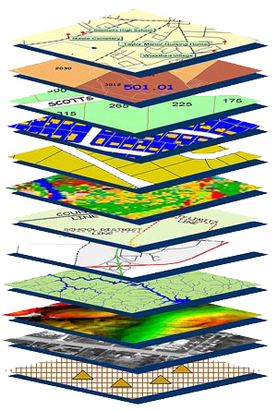
Accurate maps begin with
accurate coordinates!
Geodetic control (NSRS) is the foundation layer for all geospatial products.
Easiest way to think of “geodetic control”:
Points with Coordinates
***Soon to be Coordinates as a function of time
Without a geodetic control “base map” layer, GIS applications will not align properly!
Geodetic control needs to be more accurate than any survey or map which builds upon it
Notes:
Digital services must ensure geo-referenced data collected and published are consistent with NOAA’s National Spatial Reference System (NSRS), which provides the foundation for all positioning and navigation activities in the United States and is defined and maintained by NGS.

Slide 4
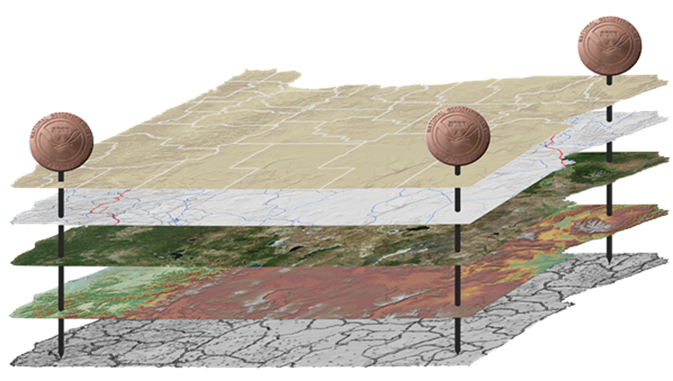
The National Spatial Reference System (NSRS)
NGS defines, maintains and provides access to the NSRS to meet our Nation’s economic, social & environmental needs
North American Datum of 1983 (NAD 83)
North American Vertical Datum of 1988 (NAVD 88)
Latitude • Longitude • Elevation • Gravity • Shoreline Position
+ changes over time
Today’s NSRS
Notes:
The National Spatial Reference System is the United States’ geospatial infrastructure from which all positioning (with the exclusion of military/Department of Defense) is referenced to.
This system provides a consistent framework that allows people to use data in the same reference system to perform analysis and make meaningful comparisons and decisions from that analysis.
The National Spatial Reference System (NSRS) includes latitude, longitude and elevation in addition to the National Shoreline and geodetic control. You can think about geodetic control is the “base map” layer at the base of GIS applications that will get everything aligned.
Two datums that make up the backbone of the NSRS today are:
North American Datum of 1983 (NAD 83)
North American Vertical Datum of 1988 (NAVD 88)
In the future, there will be four Terrestrial Reference Frames, one per tectonic plate.
North American Terrestrial Reference Frame (NATREF 2022)
Caribbean Terrestrial Reference Frame (CATREF 2022)
Pacific Terrestrial Reference Frame (PATREF 2022)
Marianas Terrestrial Reference Frame (MATREF 2022)
And one gravimetric geoid model (GEOID2022) that will cover the entire north western Hemisphere of the Earth and serve as the foundation for the :
North America and Pacific Geopotential Datum (NAPGD 2022)

Slide 5

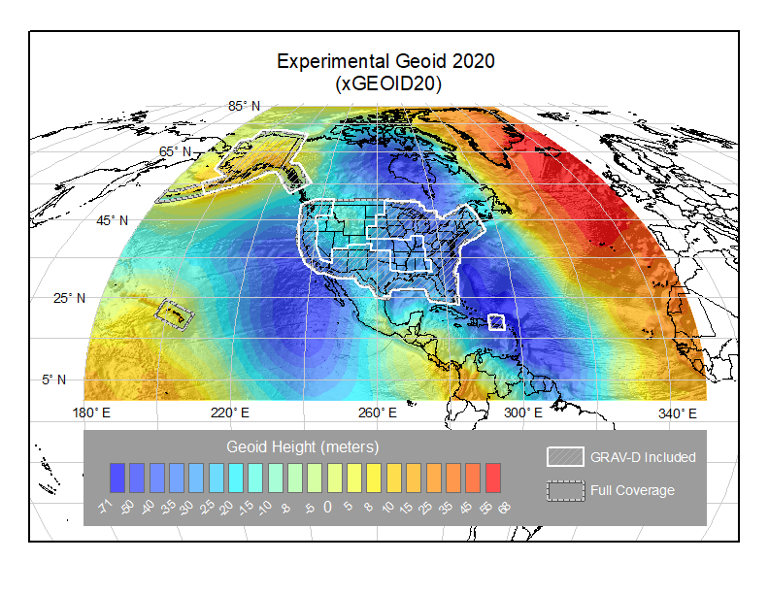
The National Spatial Reference System (NSRS)
NGS defines, maintains and provides access to the NSRS to meet our Nation’s economic, social & environmental needs
Latitude • Longitude • Elevation • Gravity • Shoreline Position
+ changes over time
North American Terrestrial Reference Frame (NATRF 2022)
Caribbean Terrestrial Reference Frame (CATRF 2022)
Pacific Terrestrial Reference Frame (PATRF 2022)
Marianas Terrestrial Reference Frame (MATRF 2022)
North America and Pacific Geopotential Datum (NAPGD 2022)
Tomorrow’s NSRS
Notes:
The National Spatial Reference System is the United States’ geospatial infrastructure from which all positioning (with the exclusion of military/Department of Defense) is referenced to.
This system provides a consistent framework that allows people to use data in the same reference system to perform analysis and make meaningful comparisons and decisions from that analysis.
The National Spatial Reference System (NSRS) includes latitude, longitude and elevation in addition to the National Shoreline and geodetic control. You can think about geodetic control is the “base map” layer at the base of GIS applications that will get everything aligned.
Two datums that make up the backbone of the NSRS today are:
North American Datum of 1983 (NAD 83)
North American Vertical Datum of 1988 (NAVD 88)
In the future, there will be four Terrestrial Reference Frames, one per tectonic plate.
North American Terrestrial Reference Frame (NATREF 2022)
Caribbean Terrestrial Reference Frame (CATREF 2022)
Pacific Terrestrial Reference Frame (PATREF 2022)
Marianas Terrestrial Reference Frame (MATREF 2022)
And one gravimetric geoid model (GEOID2022) that will cover the entire north western Hemisphere of the Earth and serve as the foundation for the :
North America and Pacific Geopotential Datum (NAPGD 2022)

Slide 6
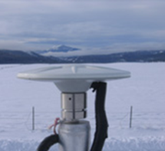

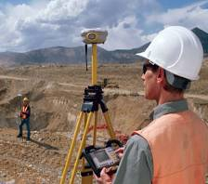


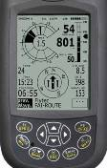





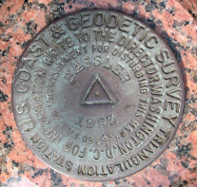
NGS Provides the Geospatial Infrastructure
Critical to Our Economy through the NSRS
Aviation
CORS
Satellite
Operations
Surveying
and Mapping
Disaster Response
Precision Agriculture
Personal
Navigation
Navigation
Oil Exploration
Fishing and Boating
Trucking and Shipping
Survey Marks
Notes:
For more information see 2019 Report: Scaling the Heights: Socio-Economic Study of the NGS Gravity Program
NGS-Gravity-Program-Socio-Economic-Report.pdf (noaa.gov)
Study Values NGS Gravity Program at $4.2 to $13.3 Billion over Ten Years
Friday, November 1, 2019
A new study estimates the value of the NGS Gravity Program to be between $4.2 and $13.3 billion over ten years, with a middle scenario of $8.7 billion. The socio-economic study was conducted for NGS by ARCBridge Consulting of Herndon, Virginia. The NGS Gravity Program uses information about the gravity field to provide more accurate elevation data (or "heights") for the United States. The improved heights will result from a new vertical height reference system created from the Gravity Program's GRAV-D Project (Gravity for the Redefinition of the American Vertical Datum), which lets surveyors and scientists employ GPS to determine more precise and accurate elevations than currently possible, in less time and with less effort.

Slide 7

The NSRS is Critical to Planning for Resilience of Built and Natural Infrastructure
Wetlands, Coral Reefs, and Mangroves provide over $23 Billion per year in storm protection and water quality improvements.
The Modernized NSRS will provide more accurate and consistent heights for community planners and protected area managers to make informed decisions
https://coast.noaa.gov/states/fast-facts/natural-infrastructure.html

Slide 8
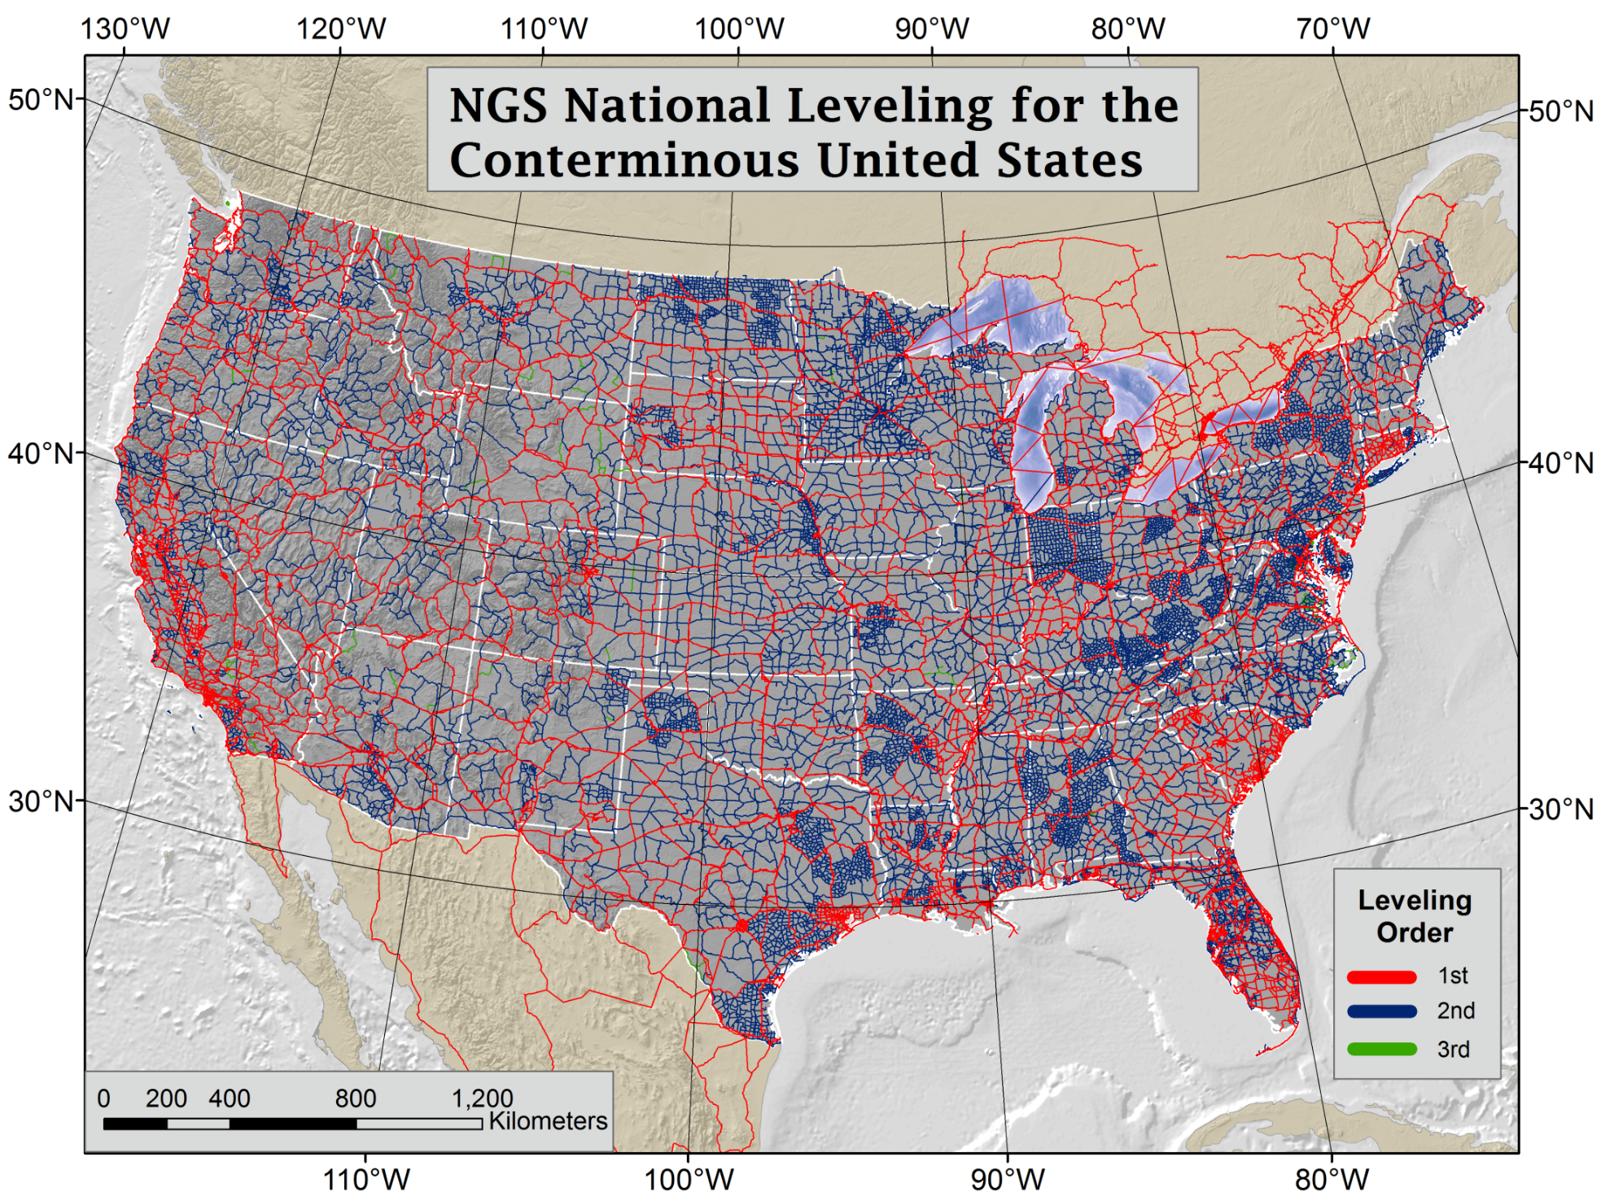
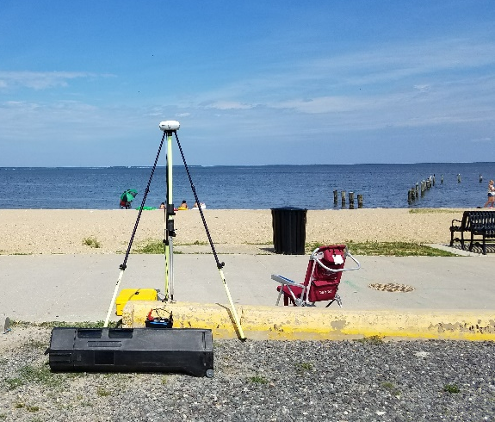
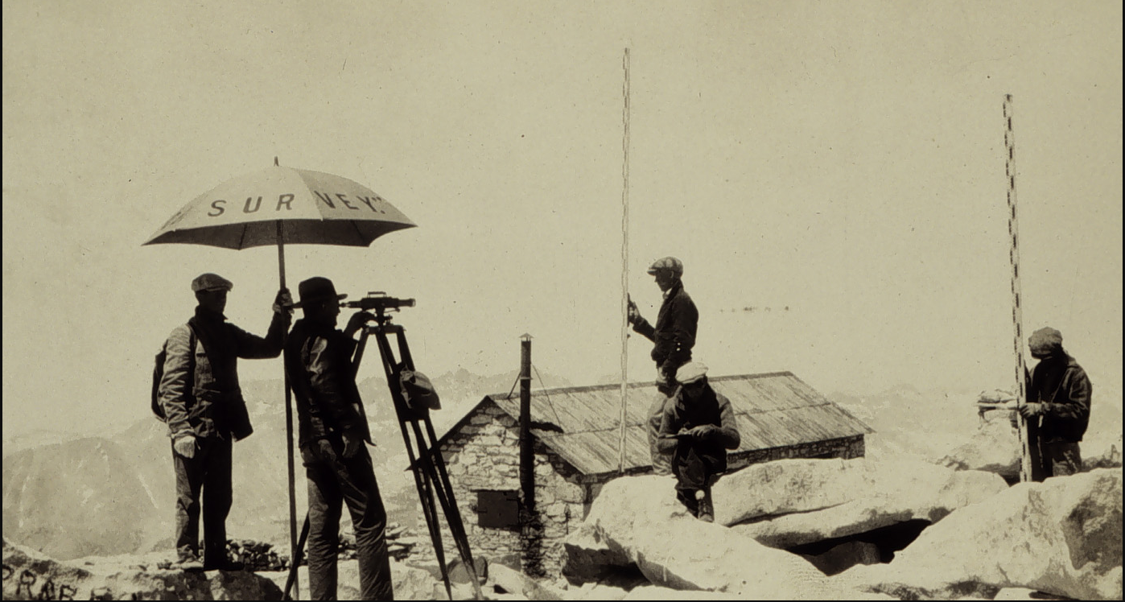
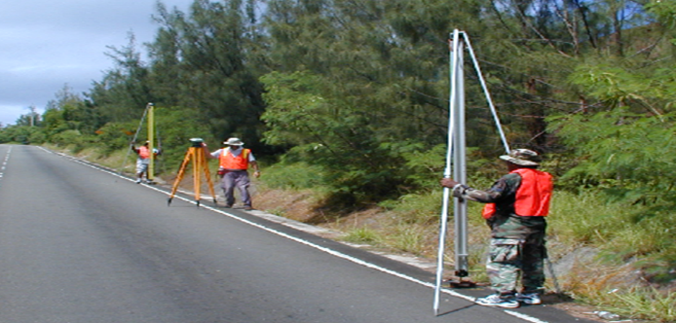
Current US Vertical Datum: NAVD 88
North American Vertical Datum of 1988
Orthometric Heights tell you which way water will flow
And then came GPS…
NAVD 88 consists of about 800,000 bench marks connected by about 2.2M km of leveling observed over a span of 80+ years and all adjusted together.
Notes:
NAVD 88 consists of about 800,000 bench marks and ~2.2M km of leveling. Data was collecting over many decades by roving bands of surveyors who walked across the country multiple times over the years, east to west, north to south and back again. It is currently the official vertical datum of the US and is required for federal mapping projects.
GPS data on those leveled marks were used to create GEOID18 – the model used to derive NAVD88 heights from GPS ellipsoid heights, as well as the transformation tools that will be released with NAPGD2022.
NAVD 88 was an incredible effort and employed the best technology and scientific understanding at the time
BUT:
ACCESS!
Leveling is time intensive and expensive
Access has historically been through passive control, bench marks that you must find
Accuracy!
Distance dependent errors can build up, making the overall network less reliable
Bench mark can move over time , Only as reliable as the last observation
Consistency!
Modernized NSRS will eliminate systematic errors in current datums
Aligned with global reference frames
Integrated system for both positions and heights (“elevations”)
But, long time period during which things were moving that we could not adequately account for
New reference frames will give coordinates at specific reference epochs and the IFDM will move coordinates through time from the survey epoch to the reference epoch.

Slide 9
NAVD 88 Issues
NAVD 88 suffers from unknown movements before, during and after its original adjustment
By way of example…
1954: Leveling Performed to bench mark
House
House
House
BM
BM
BM
1991: Original 1954 leveling data is used to compute the NAVD 88 height which is then published for this BM
1954-1991: Subsidence
H₈₈(published)
H₈₈(true)
NAVD 88 zero height surface
Obviously the true height relative to the NAVD 88
zero surface is not the published NAVD 88 height

Slide 10
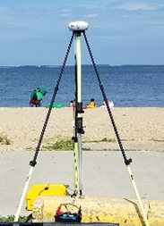
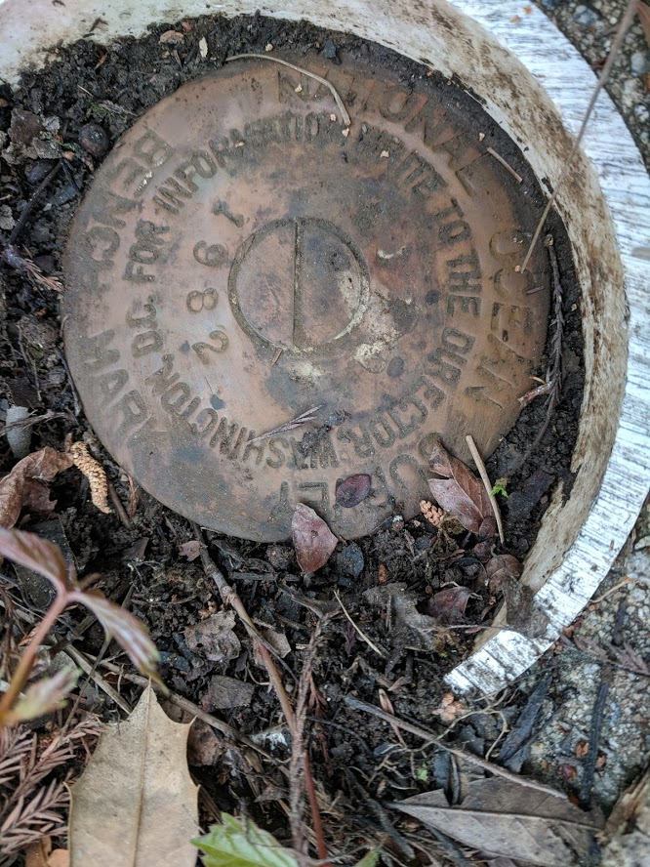

Why NSRS Modernization?
ACCESS
                GNSS equipment is fast, inexpensive, reliable (and improving)
              Reduces reliance on finding survey control (“bench marks”)
ACCURACY
              Insensitive to distance dependent errors; reliable
              Immune to bench mark stability (referenced to CORS)
CONSISTENCY
Main Driver:
Align with GNSS
              Eliminates systematic errors in current datums
              Aligned with global reference frames
              Integrated system for both positions and heights (“elevations”)
Notes:
ACCESS!
GNSS equipment is fast, inexpensive, reliable (and improving)
Reduces reliance on finding survey control (“bench marks”)
Accuracy!
Insensitive to distance dependent errors; reliable
Immune to bench mark stability (referenced to CORS)
Consistency!
Eliminates systematic errors in current datums
Aligned with global reference frames
Integrated system for both positions and heights (“elevations”)

Slide 11
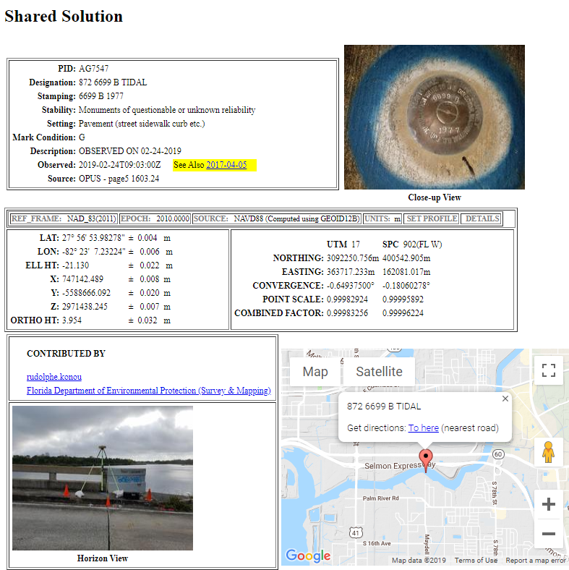
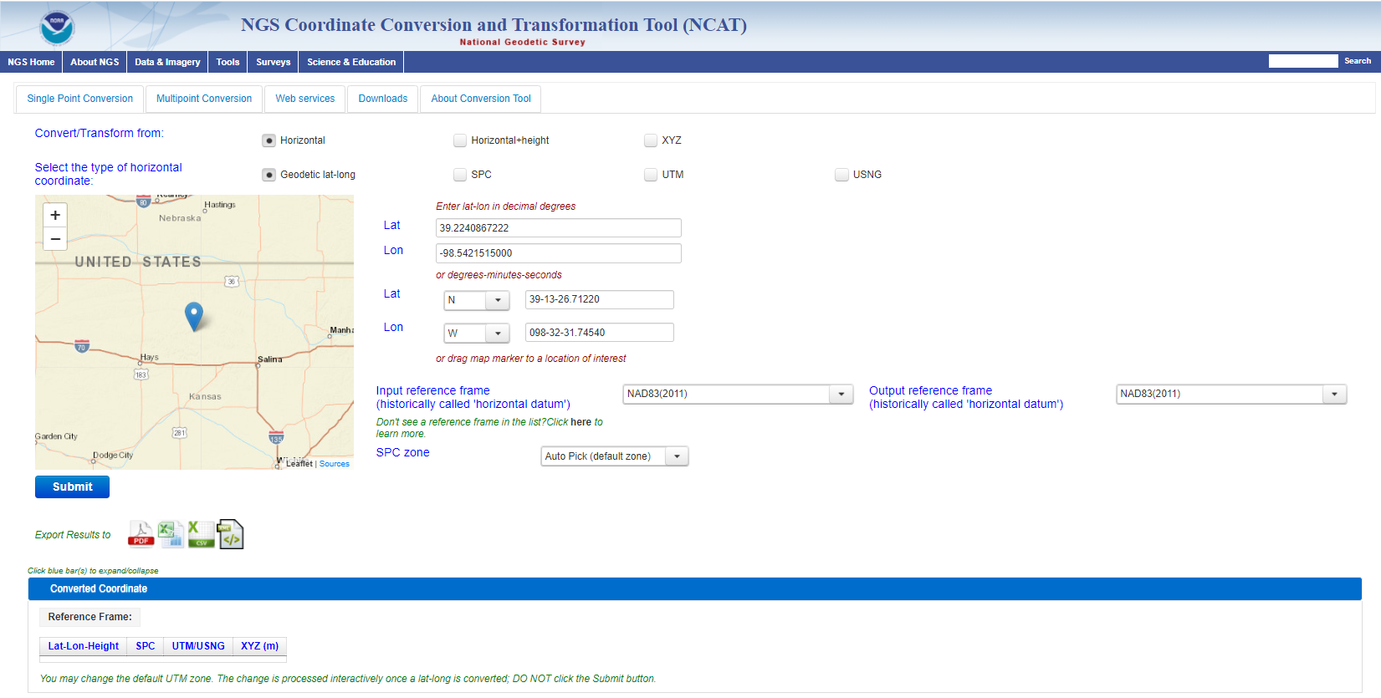
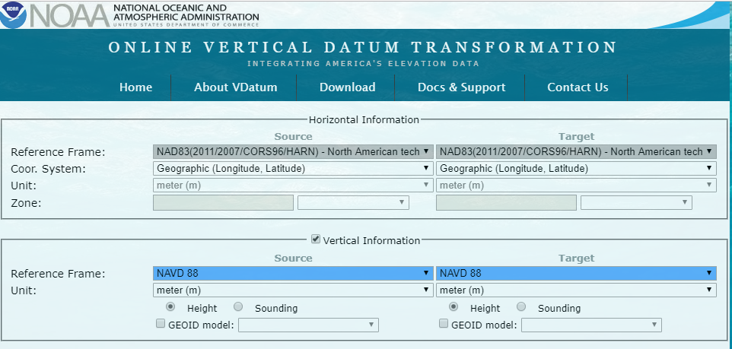
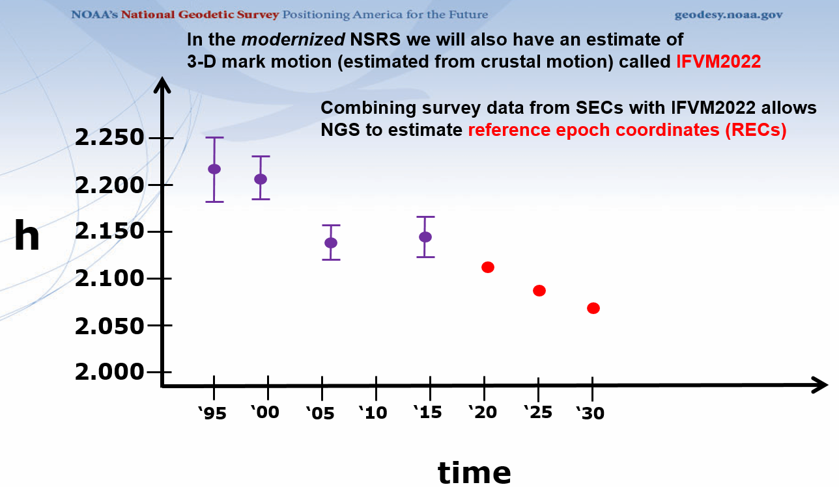
GPS on Bench Marks - What & Why?
GPS on Bench Marks is about preparing the country and our communities to take full advantage of the benefits of the Modernized NSRS, by collecting new GPS observations on bench marks with published NAVD 88 heights.
Primary GPSonBM Campaign Benefits:
2020.0 Reference Epoch Coordinates (REC’s)
Data for NAVD 88 – NAPGD2022 Transformation Tools
Build time series of observations in areas of motion
Added benefits:
Evaluate gravimetric geoid models
Check your RTN results
Update and maintain passive control marks
Identify marks suspected of movement
Notes:
NGS’ GPSonBM program is now requesting data to build the models that NCAT and VDatum will use to transform geospatial data from existing datums to the Modernized National Spatial Reference System.
These are the benefits that we derive that other countries could derive as well. The processes, tools, workflow, and technical specifications that we have developed can be applied in other places. We are keeping in house the definition of the NSRS, outsourcing the observations to realize the frames
Went back to marks that were set before that are no longer accessible or gpsable – so this provides ongoing maintenance. Marks were set open fields and now are developments – road widening (Chicago grew)
revisit Geodetic infrastructure regularly for maintenance

Slide 12
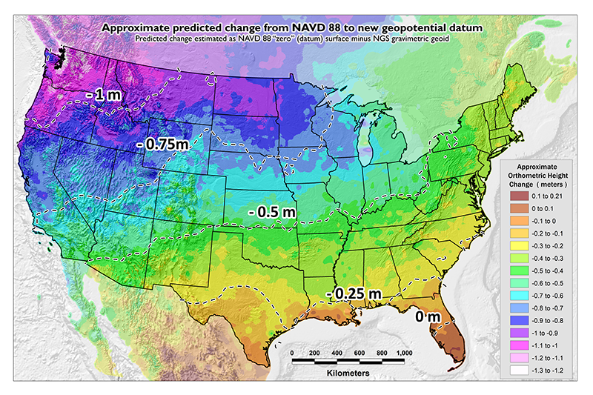
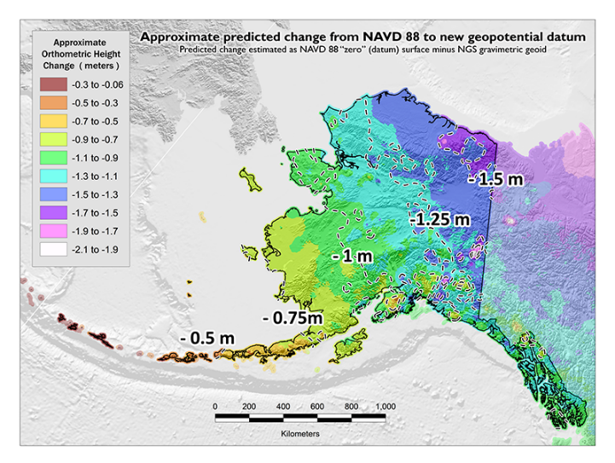
GPSonBM Measurements Connect
Current and Future Datums
The relationship between the old and new datums vary by location. GPSonBM data is used to measure that relationship. The accuracy of the transformations in any particular place will be directly related to the density of GPSonBM data available in that area.
  In moving from NAVD 88 to NAPGD2022, there will be a Shift: A one-time 0 to 2 meter jump in orthometric heights
  -From fixing biases and/or tilts in NAVD 88
PID: EZ0840
GPSonBM data is used to measure the Shift

Slide 13
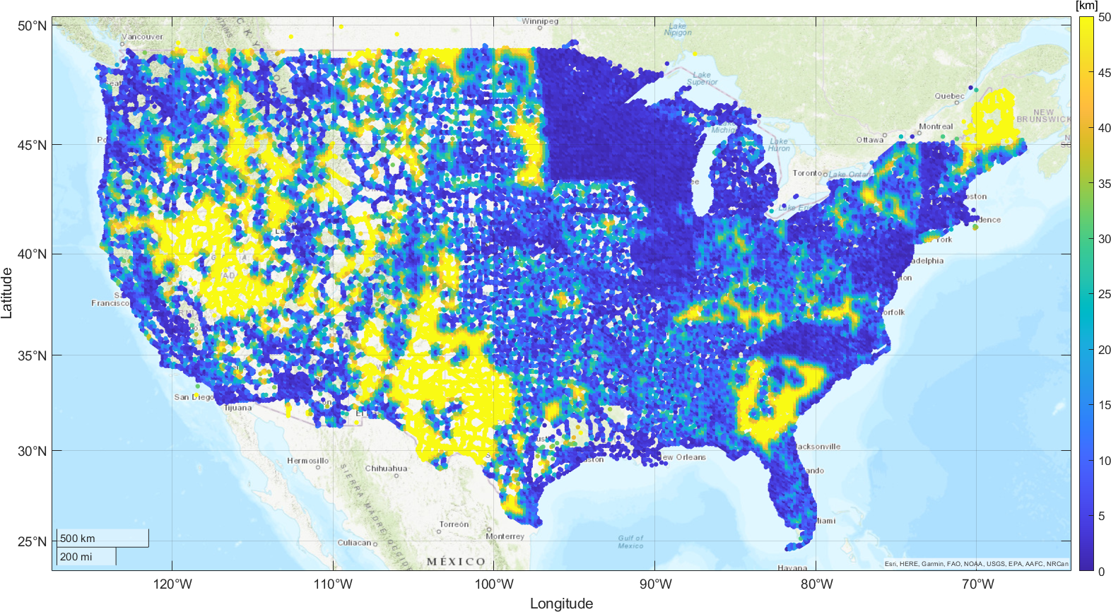
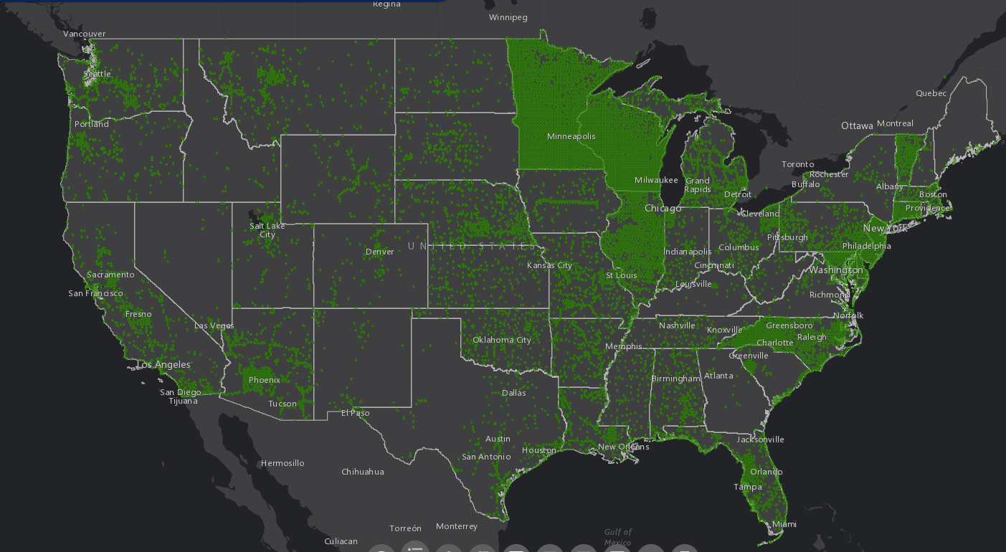
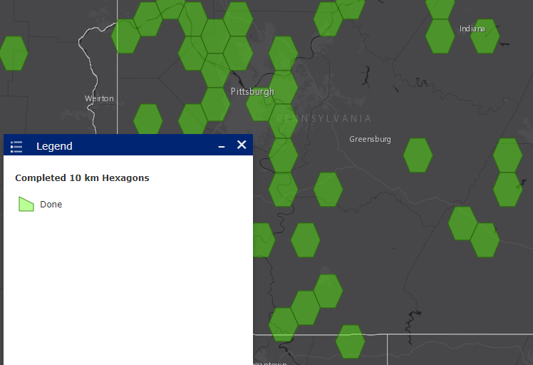
2022 Transformation Tool Campaign
NGS will make a national scale, mapping grade transformation tool with the data we have in the NGS Database and Shared through OPUS. We must interpolate over areas with data gaps.
Uncertainties in the transformed coordinates will grow larger as the distance from a GPSonBM data point increases.

Slide 14
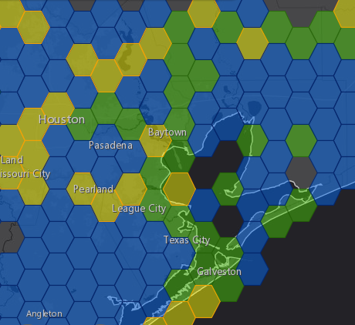
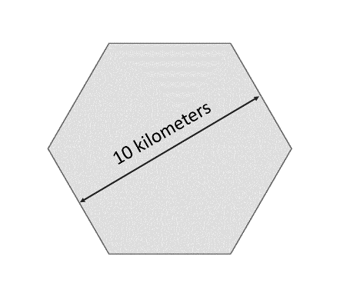
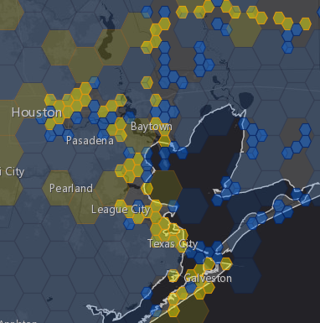
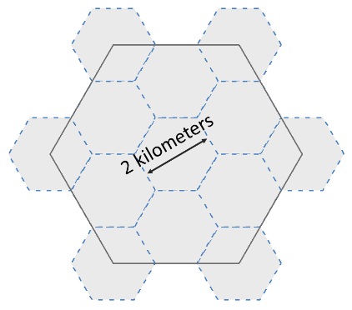



National Coverage and Local Densification
NGS has a National Coverage goal of 10 km spacing 10 km hexagons illustrate this coverage on the map
Priority marks within each hexagon are selected automatically based on their metadata
Once the 10 km goal is reached, the opportunity to densify the model and improve local results is unlocked. 2 km hexagons appear along with new priority marks within those hexagons
10 km
Priority A Hexagons are Gold
Hexagons where we have the data we need are marked Done and colored Green
Priority B hexagons are Blue
2 km
Notes:
Opportunity exists to densify local areas with data at up to 2 km spacing to increase accuracy and better resolve complex areas with topographic relief

Slide 15
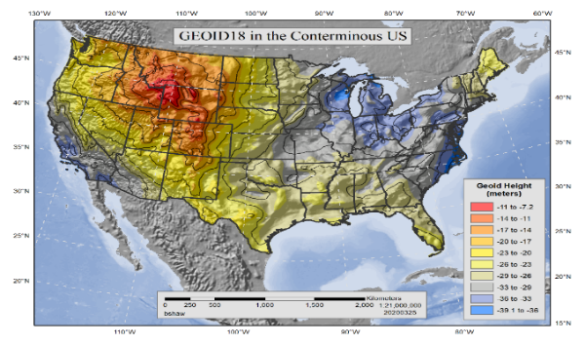
GPSonBM is Driving a Surge in Shared OPUS Solutions
Modernized NSRS will be Realized through Shared GNSS Data
2021 NSRS Mod Campaign
2020 Transformation Tool Campaign
2018 GEOID18 Campaign
2019 Transformation Tool Campaign Launch
Notes:
GPSonBM History overview:
2007- Launched OPUS Database / Sharing
2014 -2017 – Outreach event for National Surveyor’s Week – People asked for specific target marks – started with static lists
2018 – GEOID 18 Campaign – Priority marks & 30km spacing goal
2019 – 2021 – Transformation Tool Campaign – 10km goal
2021 and on – NSRS Modernization Preparation –REC’s & SEC’s

Slide 16
Break to Live Demo
GPS on Bench Marks for the Transformation Tool
GPS on BM Transformation Tool Progress Dashboard
OPUS Shared Solutions Dashboard
OPUS & OPUS Projects

Slide 17
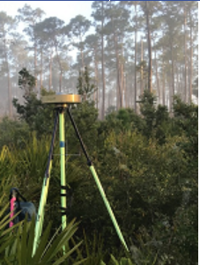


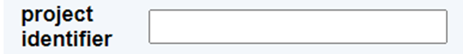
Data Contribution Routes
 | via OPUS option “share my solution” | via OPUS option “project ID”
WHAT DATA? | minimal one receiver, one 4+ hour observation | more; many receivers, redundant sessions, network adjusted by project manager
USE, in transformation tool | Will be used in modeling, existing BMs only (with published ortho heights) | Will be used in modeling, all marks, as projects publish new NGS datasheets with ortho hieghts
USE, in current generation datasheets | for all marks, results appear as ‘shared solutions’ = not published geodetic control for existing BM datasheets only, updates “SCALED”>“HD_HELD2” coordinates | for all marks, results appear as NGS datasheets = published geodetic control
USE, in next generation datasheets | will be published with 2020.00 RECs in the modernized NSRS
see also, mark recovery to update mark descriptions and add photos

Slide 18
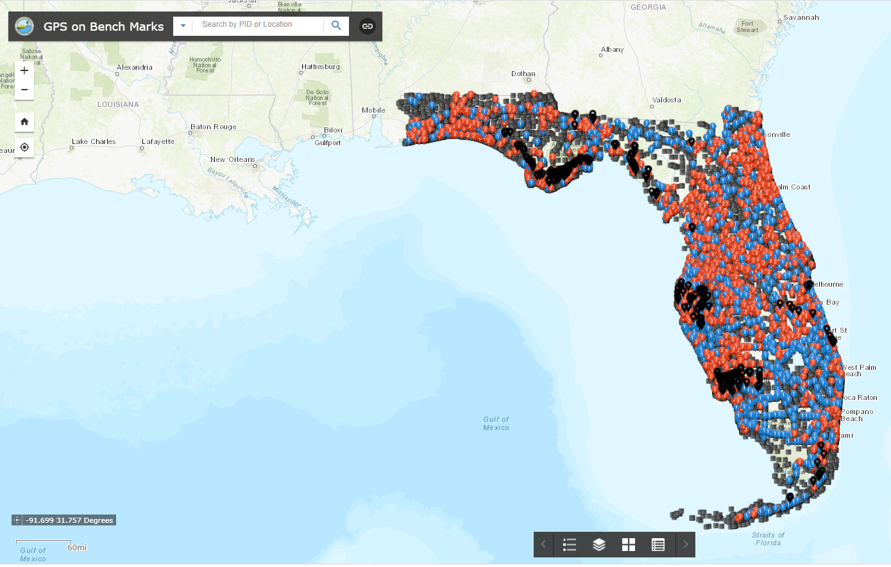
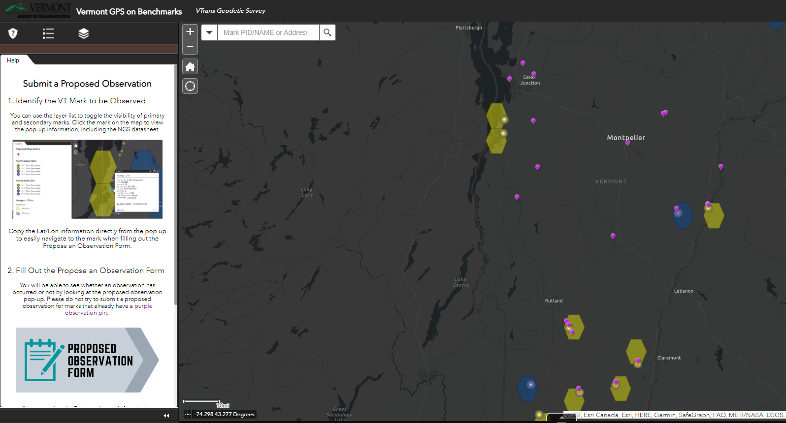
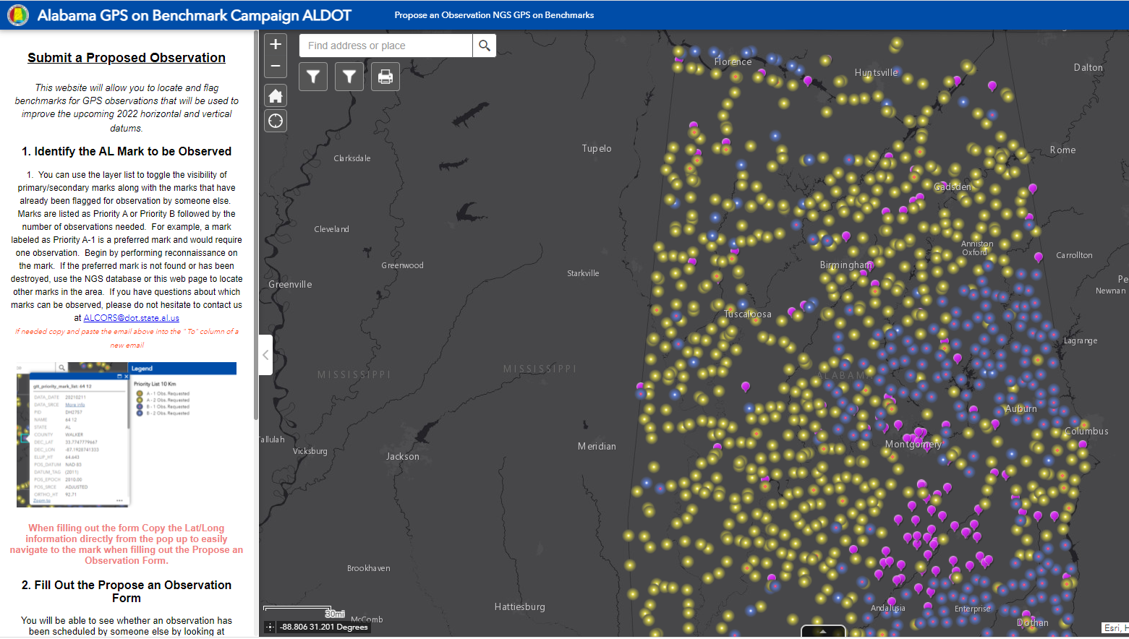
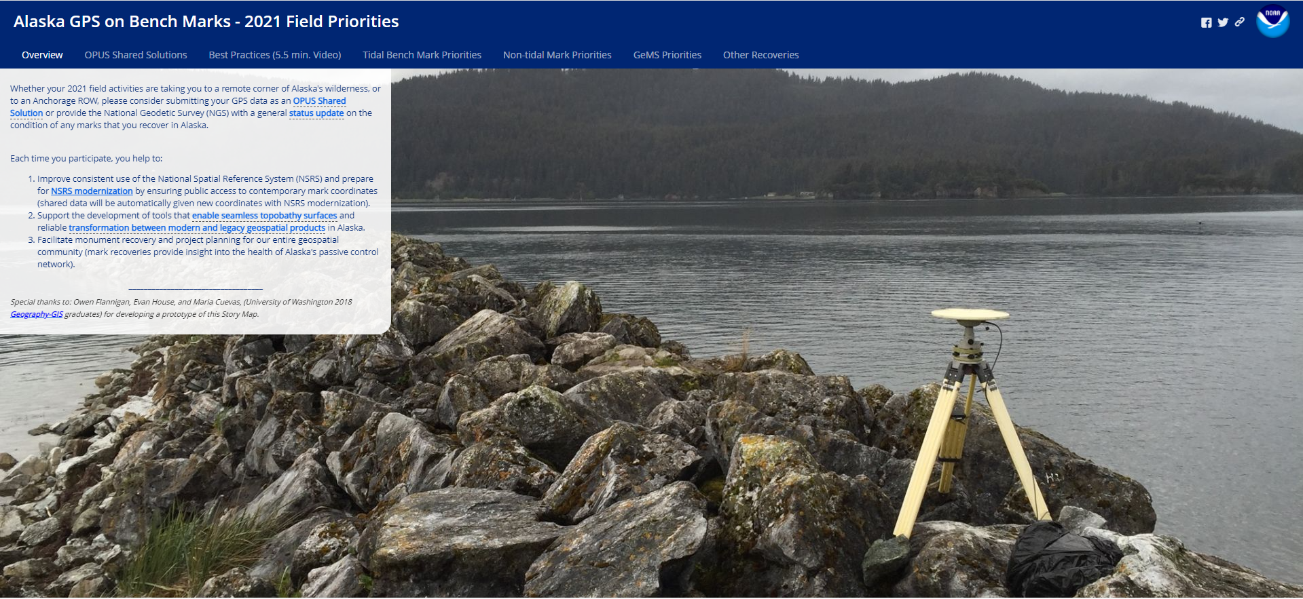
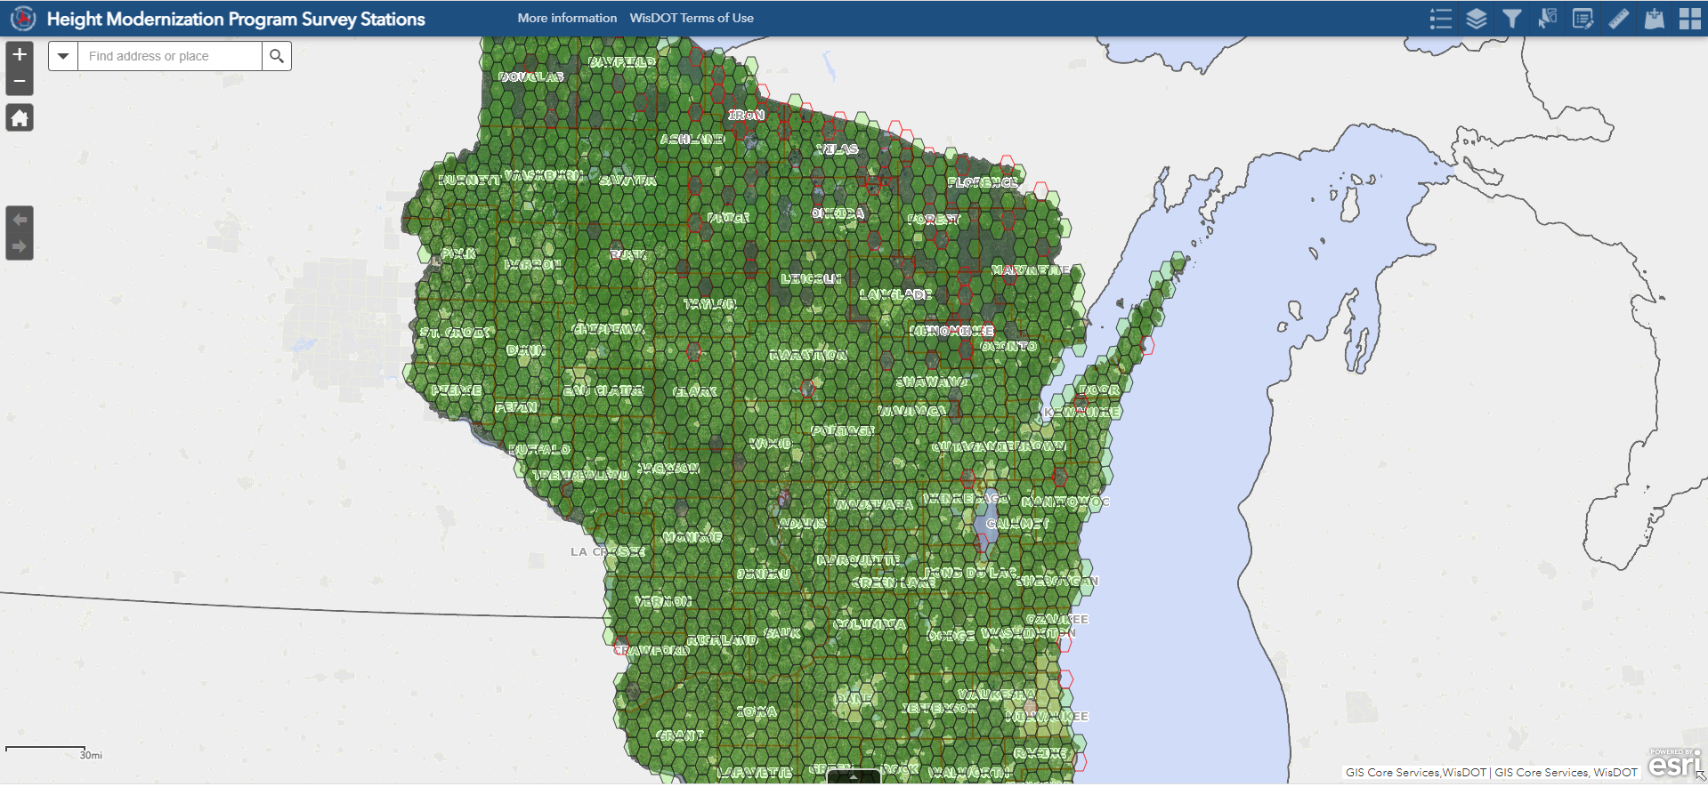
State Based Maps for Collaboration Coordination
Florida
Alabama
Vermont
Alaska
Maps update automatically when NGS updates the gtt_priority_service Feature Server (~weekly on Mondays)
Wisconsin

Slide 19
To Mick and Jacob

Slide 20
Help Build the Nation’s Geodetic Infrastructure
Consider adding a section in your Standards for Location Surveys that encourages or requires participation in NGS GPS on Bench Marks, unless caveat caveat caveat…
Procedures and the data collected will meet guidelines as described on the NGS website at https://www.ngs.noaa.gov/GPSonBM/ and be submitted to NGS and XDOT Survey Division
XDOT Survey Division requirements for GPS on Bench Marks (GPSonBM) are as follows:
Consult the NGS GPSonBM web map and recon Bench Marks listed as Primary or Secondary marks for all the 10 km hexagons near or around the project
Find marks and submit mark recovery reports to NGS
Collect GPS observations on at least 2 BM’s per project, more are preferable, spacing should be spread evenly
BMs must be physically occupied, no offsets
In areas with topographic relief, the 2km targets on the NGS GPSonBM web map should also be considered
Copies of the NGS OPUS Shared Solutions or updated Datasheets must be provided to XDOT Survey Division in the Final Submittal of the project
Thanks to Steve Telford at Oklahoma DOT

Slide 21
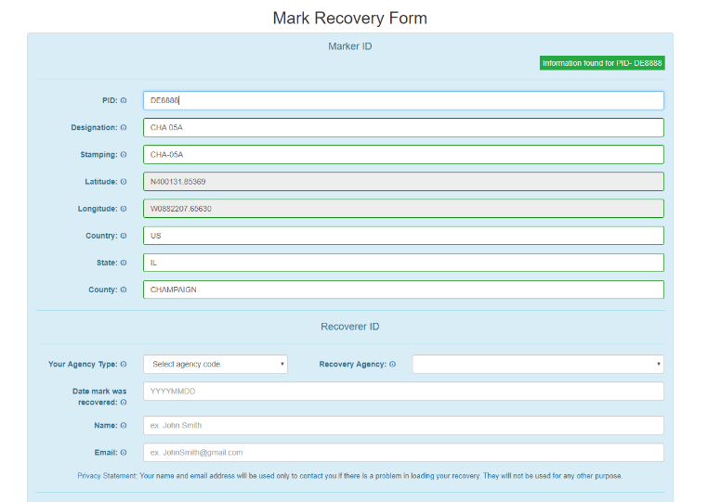
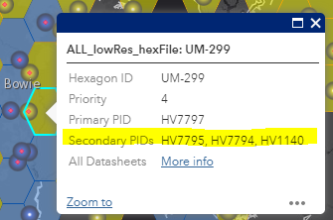

FAQ’s #1
Q: What is the deadline to submit GPSonBM for the Transformation Tool?
A: December 31, 2022 – so that observations can be used to create 2020.0 Reference Epoch Coordinates (See Blueprint 3 -Working in the Modernized NSRS)
Q: Can we submit previous observations?
A: Yes! Observations made within the past 3 years may be submitted if you have the required metadata and pictures.
Q: What do we do if we can’t find the priority mark or if it not observable with GPS?
A: 1) Submit a Mark Recovery with the new Mark Recovery Form.
2) Find and observe an secondary mark listed in the hexagon layer on the web map.

Slide 22
FAQ’s #2
Q: Can we submit offset observations for marks that are not GPS-able?
A: Not for now, unless you follow the NGS Mark Reset Procedures. In the future, OPUS 6.0 will enable you to process and adjust GPS, leveling, and total station observations together, and submit them to NGS.
Q: Can we submit less than 4 hours of data?
A: Yes, but only by using OPUS Projects to Bluebook the data.
Q: Can we submit RTK observations?
A: YES! The recently released BETA version of OPUS Projects 5.0 enables processing of Hybrid Survey Networks that include both static and real-time observations uploaded in the new GVX vector exchange file format.

Slide 23
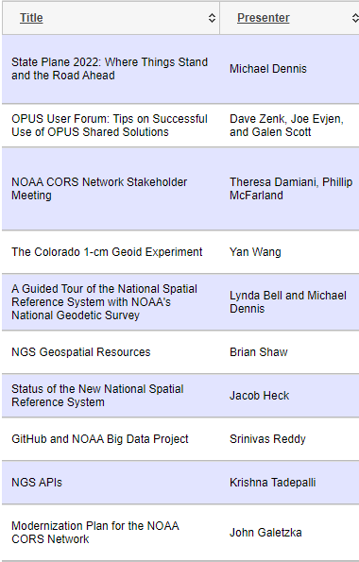
Recent Resources
NGS OPUS User Forum: Tips on Successful Use of OPUS Shared Solutions from 11/30/21 – Available in NGS Presentation Library
A guide to the latest Beta NGS Map – December 2021 GPS World – by Dave Zilkoski
GNSS on Bench Marks? – January 2022 xyHt - by Gavin Shrock
NSPS “Surveyor Says!” Podcast with Tim Burch – January 2022-
https://geodesy.noaa.gov/web/science_edu/presentations_library/

Slide 24
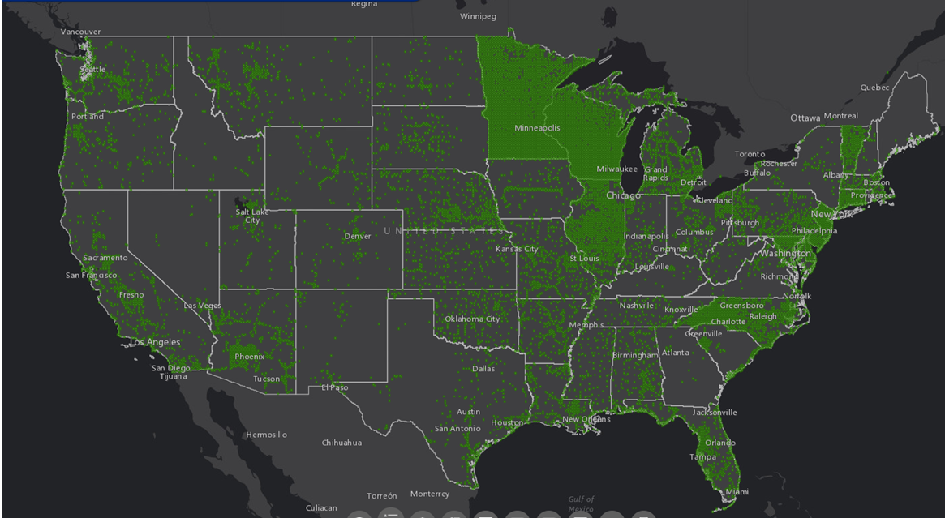
The future is already here —
it's just not very evenly distributed.
- William Gibson
Contact the GPSonBM team:
ngs.gpsonbm@noaa.gov
Provide Feedback:
ngs.feedback@noaa.gov

