Slide 1
NADCON 5, VERTCON 3 and NCAT 2
Dru Smith
Krishna Tadepalli
Andria Bilich
NOAA’s National Geodetic Survey

Slide 2
Outline
Brief history of NGS toolkit
Brief review of NADCON 5.0 release 20160901
VERTCON 3.0 release 20190601
NCAT 2.0

Slide 3
Brief info about the NGS toolkit

Slide 4
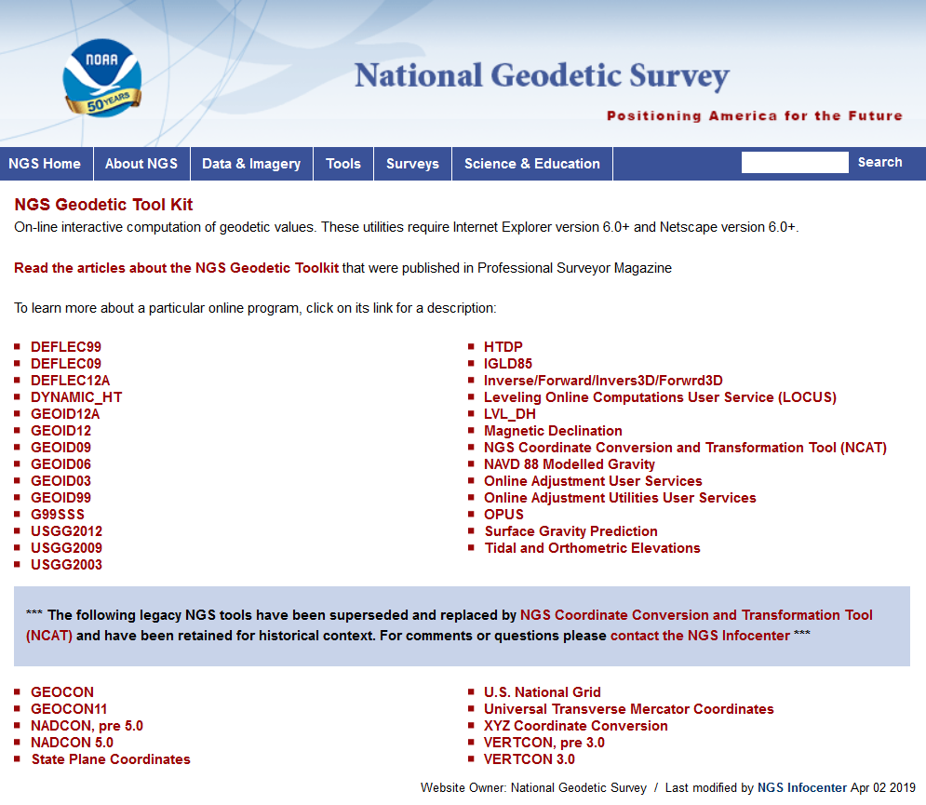
NGS Toolkit

Slide 5
Improve the Toolkit
The Old:
VERTCON
NADCON
All Hybrid Geoid Models
All Gravimetric Geoid Models
All Hybrid DOV Models
All Gravimetric DOV Models
14 parameter transformations in HTDP
XYZWIN
UTMS
USNG
GGPCGP
SPC83
DYNAMIC_HT
IGLD85
CALIBRATE
Translev
WinDESC
LOCUS
LOOP
MTEN4
“Tidal and Orthometric Elevations”
INVERSE
FORWARD
INVERS3D
FORWRD3D
The Old:
“Online Adjustment User Services”
GEOCON
GEOCON11
LVL_DH
ConvbinConvascii
ENHANCEMENTS
Gethvlist
INTERORB
TOLADD
Surface Gravity Prediction in the Conterminous USA
NAVD 88 Gravity Computations
HTDP (geodynamics)
Magnetic Declination
CORPSCON
Integrate into
NCAT/VDatum
Deprecate
Replace
w/ GRAV2022
Integrate into
OPUS
Replace w/ IFVM2022
Move to “exo-NGS”
software page
Integrate into NSRS Database
The New:
EPP2022
IFVM2022
SPCS2022
GEOID2022
GRAV2022
More…
Integrate into one new piece of code

Slide 6
Brief refresher on NADCON 5.0 release 20160901
A complete webinar on NADCON 5.0 release 20160901 was presented on September 8, 2016
and was recorded and available at:
https://www.ngs.noaa.gov/web/science_edu/webinar_series/Nadcon5.shtml

Slide 7
NADCON 5.0 release 20160901
Replaces all previous versions of NADCON, GEOCON or GEOCON11
Transforms latitude, longitude and (if applicable) ellipsoid heights

Slide 8
Summary of transformations
Region | Chronological list of supported datums/datum realizations for each region
CONUS | USSD | NAD 27 | NAD 83(1986) | NAD 83(HARN) | NAD 83(FBN)* | NAD 83(NSRS2007) | NAD 83(2011) epoch 2010.00
Alaska (St Paul) | SP1897 | SP1952 | NAD 83(1986) | NAD 83(1992) | NAD 83(NSRS2007) | NAD 83(2011) epoch 2010.00
Alaska (St George) | SG1897 | SG1952 | NAD 83(1986) | NAD 83(1992) | NAD 83(NSRS2007) | NAD 83(2011) epoch 2010.00
Alaska (St Lawrence) | SL1952 | NAD 83(1986) | NAD 83(1992) | NAD 83(NSRS2007) | NAD 83(2011) epoch 2010.00
Alaska (other) | NAD 27 | NAD 83(1986) | NAD 83(1992) | NAD 83(NSRS2007) | NAD 83(2011) epoch 2010.00
Hawaii | OHD | NAD 83(1986) | NAD 83(1993) | NAD 83(PA11) epoch 2010.00
PR / USVI | PR40 | NAD 83(1986) | NAD 83(1993) | NAD 83(1997) | NAD 83(2002) | NAD 83(NSRS2007) | NAD 83(2011) epoch 2010.00
Guam / CNMI | GU63 | NAD 83(1993) | NAD 83(2002) | NAD 83(MA11) epoch 2010.00
Am. Samoa | AS62 | NAD 83(1993) | NAD 83(2002) | NAD 83(PA11) epoch 2010.00
Two neighboring red entries will have an ellipsoid height transformation, in addition to latitude and longitude
* The NAD 83(FBN) realization only exists in 19 states within CONUS. In the other 29 states and D.C.,
the transformation connects NAD 83(HARN) directly to NAD 83(NSRS2007)

Slide 9
NAD 27 / NAD 83(1986) / Longitude / CONUS

Slide 10
VERTCON 3.0 release 20190601

Slide 11
“VERTCON 2.1” meant…
The grid of NGVD 29 / NAVD 88 transformations
CONUS only
The FORTRAN code to read and interpolate that grid
The compiled FORTRAN code, as an .exe file
Notes:
There are actually 3 “NAD 83”s, NAD 83(2011), NAD 83(PA11) and NAD 83(MA11)
There are also many more vertical datums than NAVD 88 in the NSRS, each one for specific states or territories that have no line of sight to CONUS/Alaska

Slide 12
“VERTCON 3.0” means
The project “VERTCON 3.0”, which created:
The build software “VERTCON 3.0” which was run to create:
A set of transformation grids and transformation uncertainty grids called “VERTCON 3.0 release 20190601”
Instructions on how to implement “VERTCON 3.0 release 20190601” inside NCAT and VDatum
VERTCON 3.0 does not stand alone. Its functionality is accessed only through NCAT and VDatum via the instructions which operate upon the grids.
Instructions example: “use biquadratic interpolation”
Notes:
There are actually 3 “NAD 83”s, NAD 83(2011), NAD 83(PA11) and NAD 83(MA11)
There are also many more vertical datums than NAVD 88 in the NSRS, each one for specific states or territories that have no line of sight to CONUS/Alaska

Slide 13
History

Slide 14
Historical Overview
From 1807 until 1899
Local leveling, tied to a single tide gage
1899, 1903, 1907, 1912
First coast-to-coast (CONUS) networks
1st through 4th “general adjustment” of continental leveling network
Could each be called a “vertical datum”
Not well documented
No data in the IDB
Not part of the VERTCON 3.0 project

Slide 15
Historical Overview
1929
Sea Level Datum of 1929
Renamed National Geodetic Vertical Datum of 1929 (NGVD 29) in 1973
1963
Guam Vertical Datum of 1963 (GUVD 63)
The only other vertical datum in the IDB prior to NAVD 88
Indeterminate years..
“Local Tidal” heights turned in to NGS.

Slide 16
Historical Overview
1991
NAVD 88
No official report, but lots of related documentation
October 1992
VERTCON 1.0
No public documentation. Very short lived.
May 1994
VERTCON 2.0
New grid, different than VERTCON 1.0
2003
VERTCON 2.1
Same grid as VERTCON 2.0

Slide 17
Historical Overview
2009
American Samoa Vertical Datum of 2002 (ASVD 02)
Northern Mariana Vertical Datum of 2003 (NMVD 03)
Guam Vertical Datum of 2004 (GUVD 04)
2011
Virgin Islands Vertical Datum of 2009 (VIVD 09)
2012
Puerto Rico Vertical Datum of 2002 (PRVD 02)
Note that Hawaii has never had an official vertical datum in the NSRS

Slide 18
VERTCON 3.0 vs 2.1 in CONUS
VERTCON 2.1 reflected all NGVD 29/NAVD 88 data as of 1994
NGS continued to load new NAVD 88 heights from 1994-2019
New or superseded, very few had any time tag
VERTCON 3.0 built “regional updates” to the VERTCON 2.1 grid
To respect existing grid, but
To allow for large systematic changes for the 23 years of new data

Slide 19
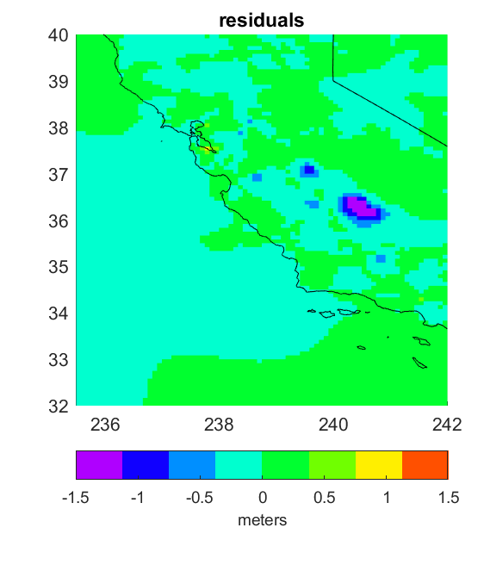
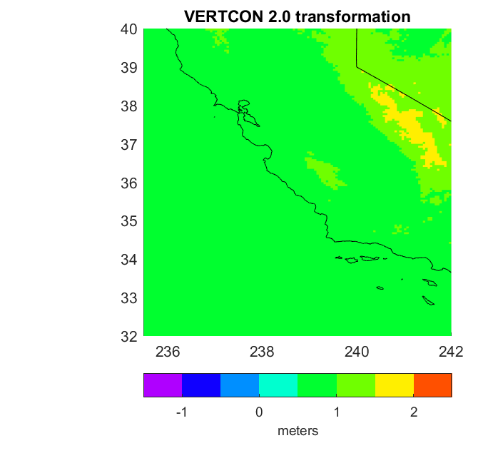
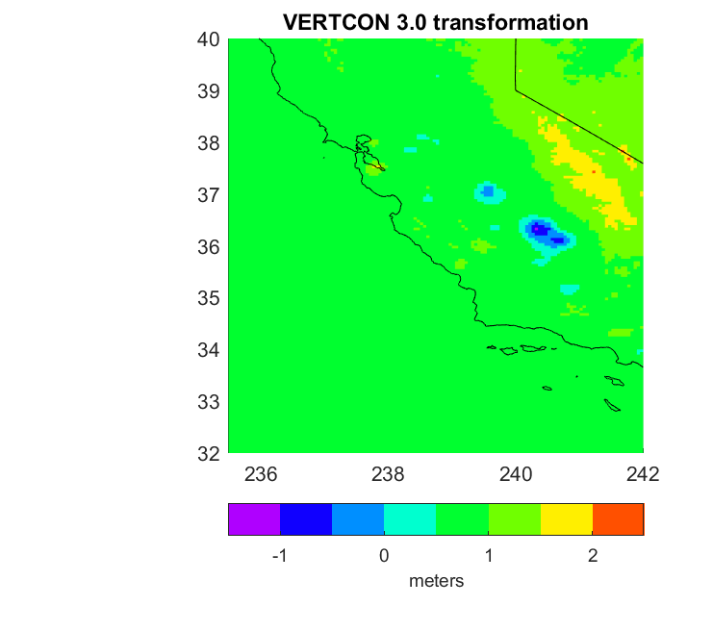
CONUS: Remove / Compute / Restore

Slide 20
NGVD 29 / NAVD 88 / CONUS

Slide 21
Goals

Slide 22
Goals for VERTCON 3.0 project
Create build software capable of supporting “…to NAPGD2022 epoch 2020.00” transformations
Improve current vertical datum transformation support for CONUS/NGVD 29/NAVD 88
While minimizing disruption for those who’ve been using VERTCON 2.0/2.1
Expand current vertical datum transformation support beyond CONUS/NGVD 29/NAVD 88, if possible
Document everything meticulously

Slide 23
Issues

Slide 24
Issues: Realizations
NAVD 88 has not had nationwide “realizations” like NAD 83
Thus datasheets for three bench marks may have these lines:
AA3501* NAVD 88 ORTHO HEIGHT - 48.543 (meters) 159.26 (feet) ADJUSTED
AA0706* NAVD 88 ORTHO HEIGHT - 3.648 (meters) 11.97 (feet) ADJUSTED
AA7459* NAVD 88 ORTHO HEIGHT - 128.748 (meters) 422.40 (feet) ADJUSTED
Without any way to know that these heights were computed from leveling in 2001, 1982 and 2012 respectively

Slide 25
Issues: Other
Last published datasheet height disagreed with last height loaded into database
“Local Tidal” heights lacking metadata
Mislabeled NGVD 29 heights in Alaska
Height sources needed to be considered before data could be gridded
Trig heights, and others acted as outliers

Slide 26
Error estimates
VERTCON 3.0 release 20190601 contains geographically dependent error estimates
Different from 2.1 which said “about 2 cm” as the accuracy for the entirety of CONUS

Slide 27
Error estimates : NGVD 29 / NAVD 88 / CONUS

Slide 28
Summary
VERTCON 3.0 release 20190601 supports these transformations:
Old Datum | New Datum | Region
NGVD 29 | NAVD 88 | CONUS
NGVD 29 | NAVD 88 | ALASKA
LT | PRVD 02 | PR
LT | VIVD 09 | VI
LT | ASVD 02 | AS
LT | NMVD 03 | CNMI
GUVD 63 | GUVD 04 | GUAM

