Slide 1
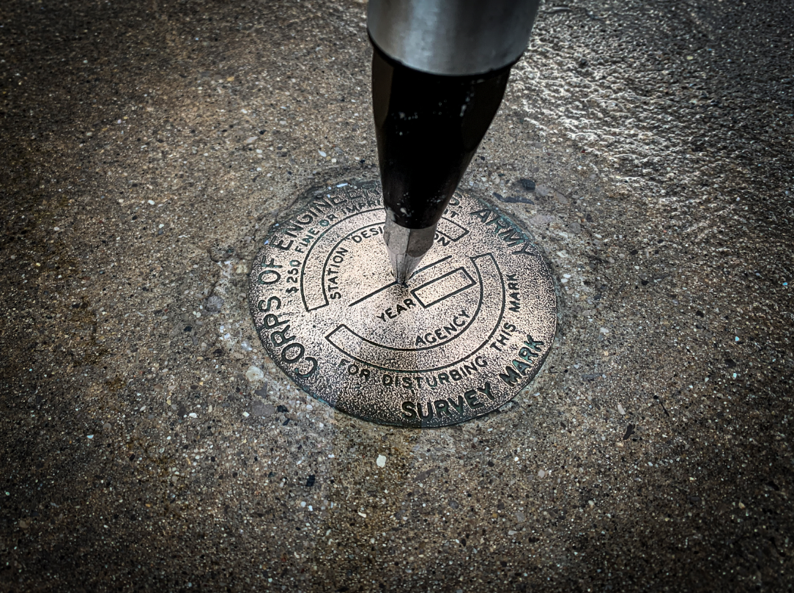
International Great Lakes Datum (IGLD) GNSS Campaign
A case study for leveraging digital tools to enhance QA/QC on large scale static GNSS observation campaign
Notes:
This presentation explores how NGS has leverage digital tools to streamline field operations.
Today we will talk about:
ESRI web and Field Maps
GNSS Log App for iOS
OPUS Projects by NGS
And how the development and implementation of these tools was put to the test during the IGLD GNSS Survey conducted in the summer of 2022

Slide 2
International Great Lakes Datum (IGLD)
Prior Presentations at FIG Working Week 2023
Monday, 29 May
11:30–13:00
Ryan Hippenstiel, John May, Jacob Heck (USA), Michael Craymer and Rachel van Herpt (Canada):
The 2022 GNSS Survey for a New International Great Lakes Datum: Overcoming Challenges with International Planning and Digital Tools (12007)
Tuesday, 30 May
11:30–13:00
Daniel Roman (USA) and John Crowley (Canada):
Dynamic Heights for the International Great Lakes Datum of 2020 (11980)
Notes:
We will not dive into the details of the IGLD today,
For further detail information about the International Great Lakes Datum, please refer to the presentations done on Monday and Tuesday of this week

Slide 3
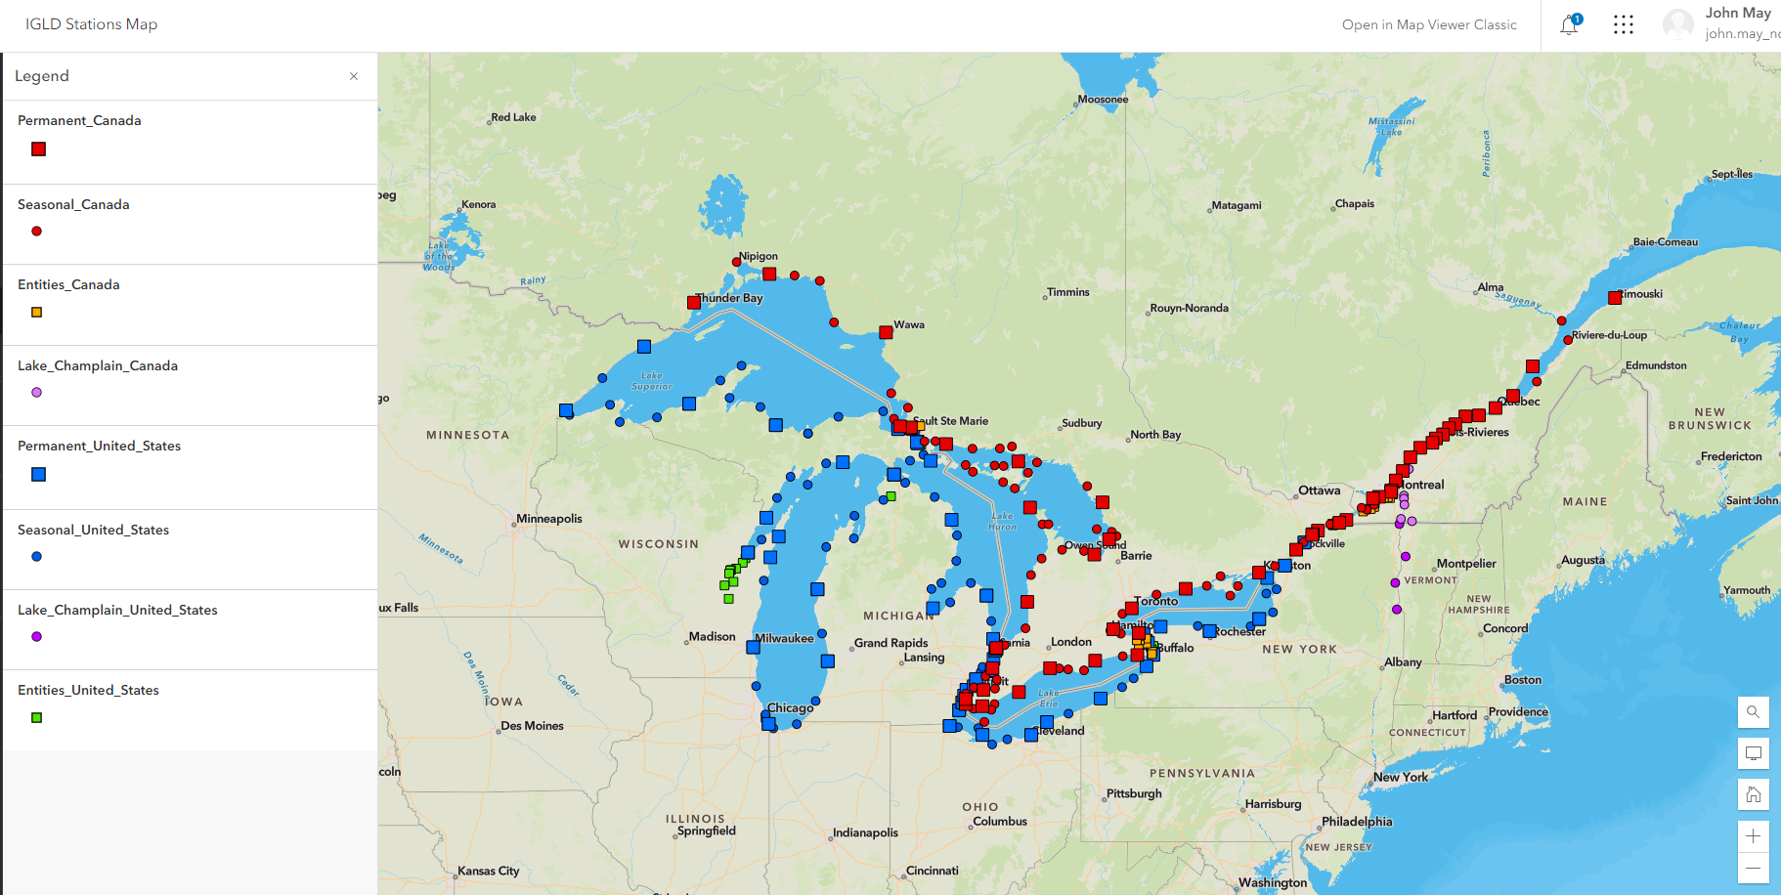
Scope of the IGLD GNSS Survey
Notes:
The focus of this presentation is to discuss the planning and execution of the IGLD GNSS survey observations on US benchmarks by the National Geodetic Survey.
The complete IGLD GNSS Survey included 186 US Benchmarks observed by NGS and its partners; and 179 Canadian Benchmarks observed by CGS and its partners.
The survey area encompasses multiple time zones (2200 kilometers) along the International Border between the United States and Canada in North America

Slide 4
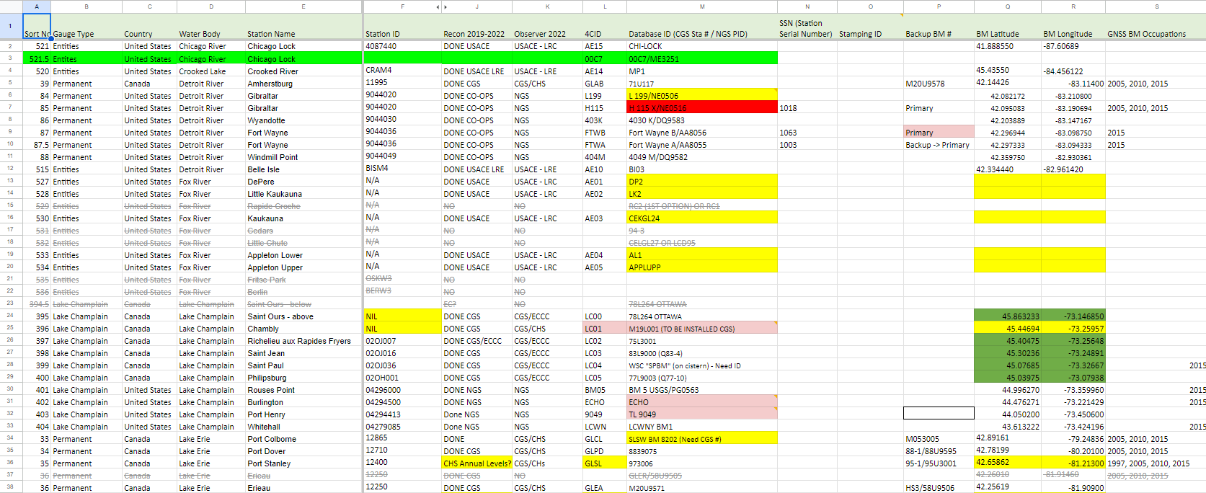
Survey parameters were established by
Binational Planning Group
Notes:
The observation parameters for the IGLD Survey were established by a Binational Planning Group.
The Planning group met monthly to choose benchmarks and establish a timeframe and a set of standard practices to conduct the survey
The planning group identified each Benchmarks for GNSS Observation. Those benchmarks were listed in a master spreadsheet.
The Observation Parameters were established by the planning committee:
Minimum GNSS receiver specifications
GNSS antenna specifications
the GNSS Constellation and collection rates to record
Tripod and Mast Setup requirements
Specific occupation parameters
Each observation session consisted of two independent 24 hour occupations. By independent, I mean each occupation was done with a different receiver/antenna combination
The first occupation started at 13:00 GMT, the second at 16:00 GMT, allowing 3 hours to change equipment between occupations
Observation sessions were done on Mon-Tues and Thu-Fri, leaving Wednesday and Saturday for travel between sites.

Slide 5
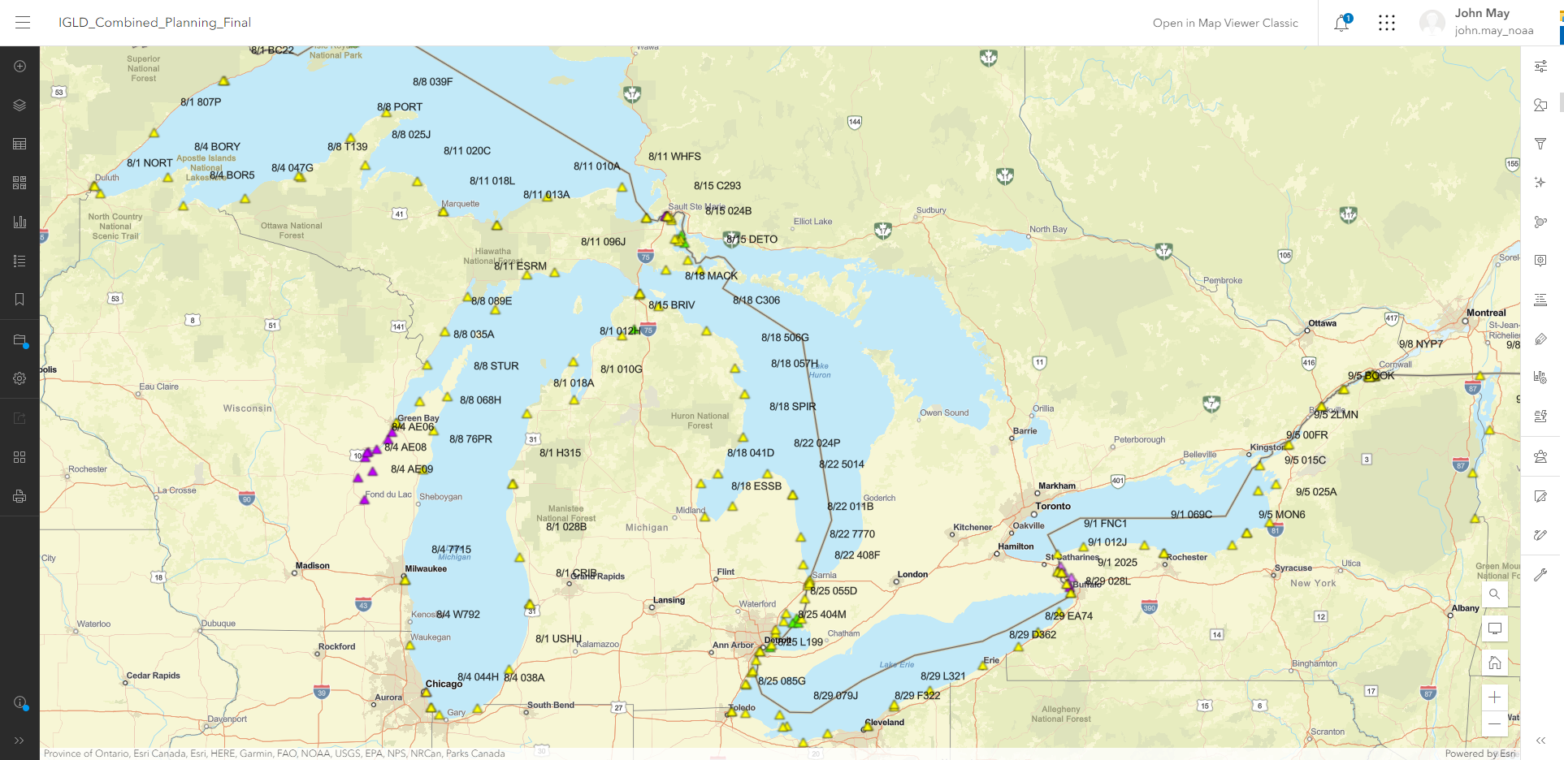
Pre-Survey Logistics
Notes:
When FOB was tasked to begin the survey, the first step was to convert the spreadsheet to a GIS map
Benchmarks were grouped into observation sets and then group into Sessions.
This allowed us to determine the optimal number of observers to minimize drive times while maintaining cross border vector ties, that is trying to match the geographical progress of the Canadian Surveyors to maximize simultaneous cross border observations
The map also allowed us to
Identify and label benchmarks to be observed by partners,
Determine movement Logistics between sessions,
Optimize the locations backup personnel and equipment
address security concerns and
potential regional weather concerns

Slide 6
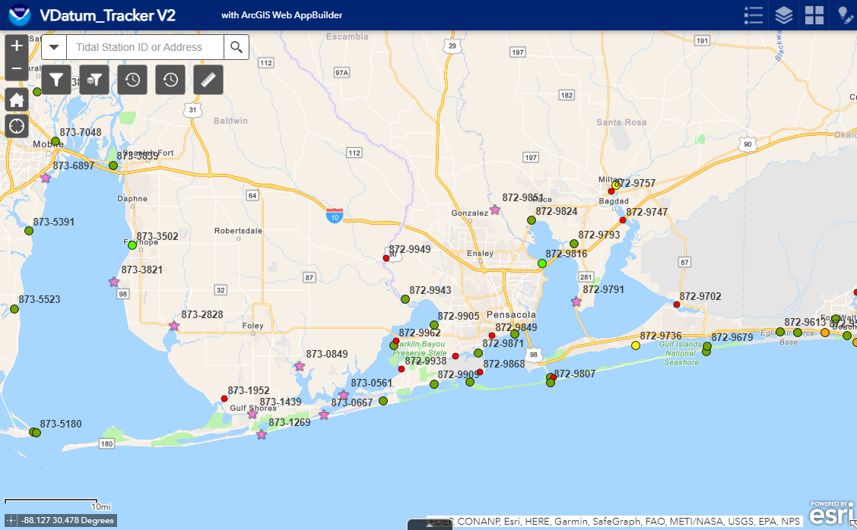
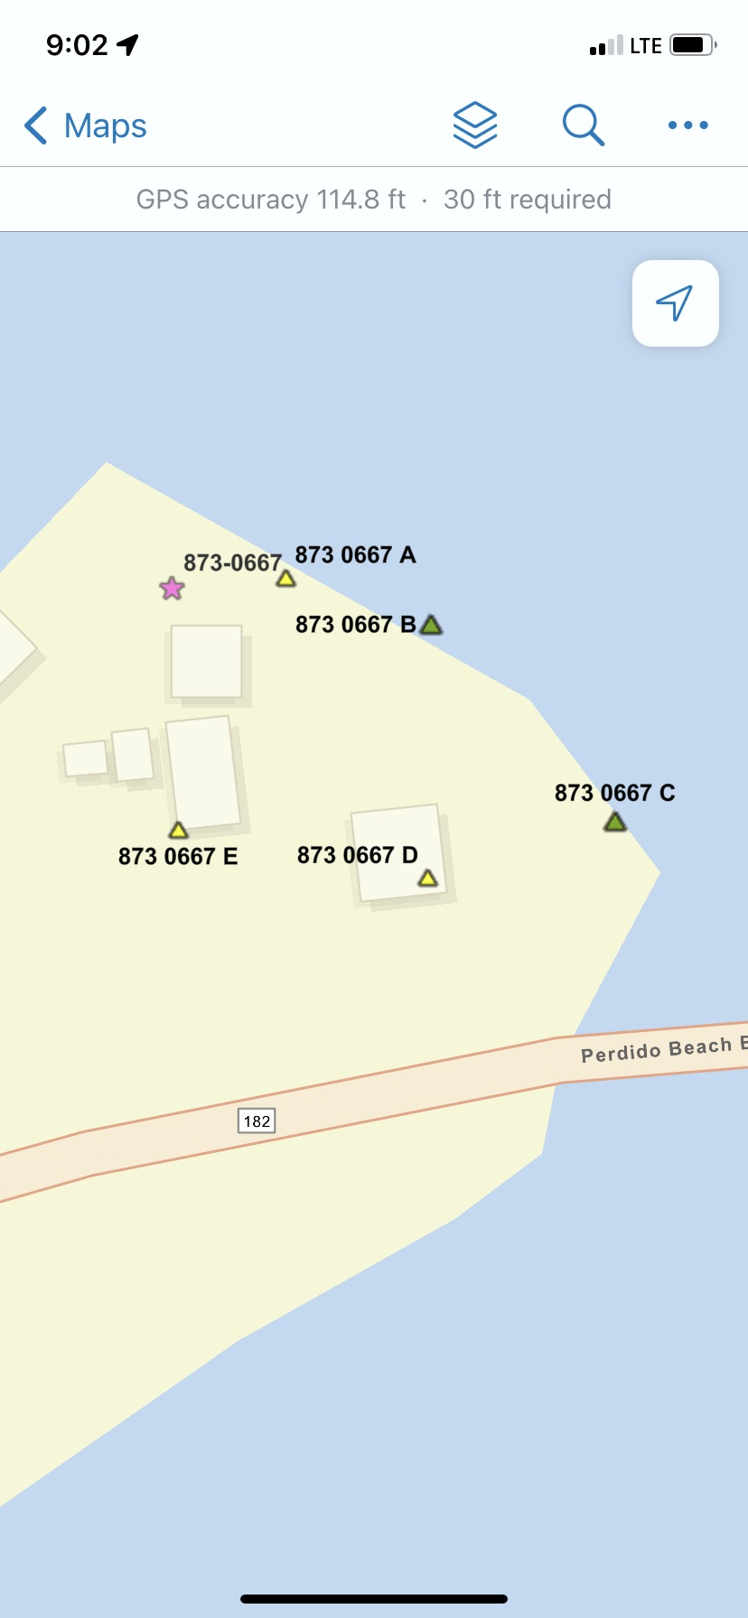
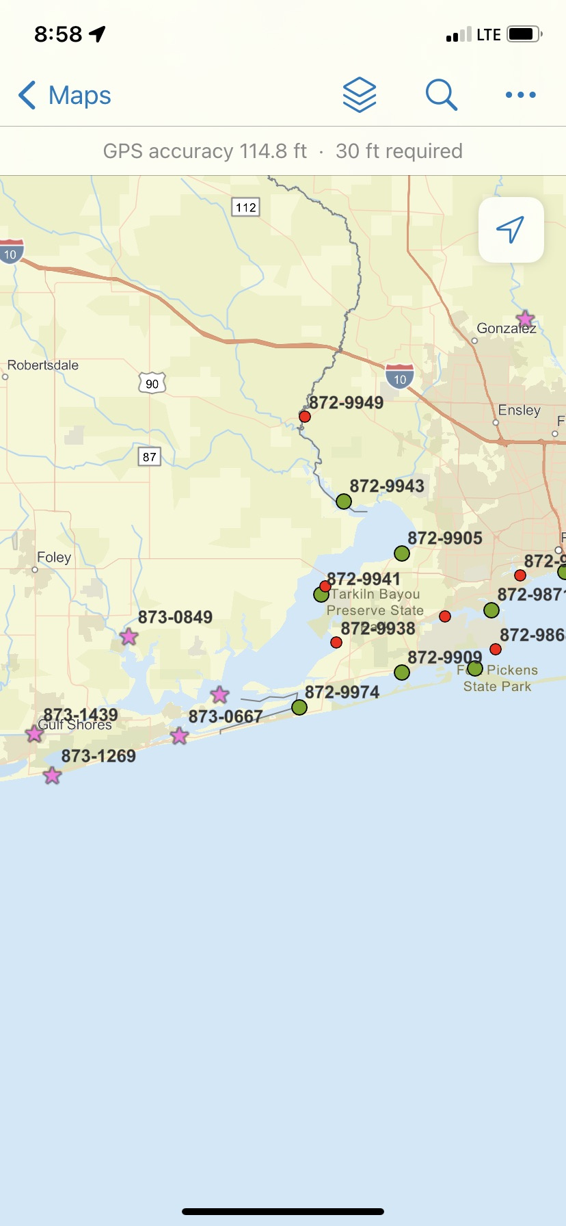
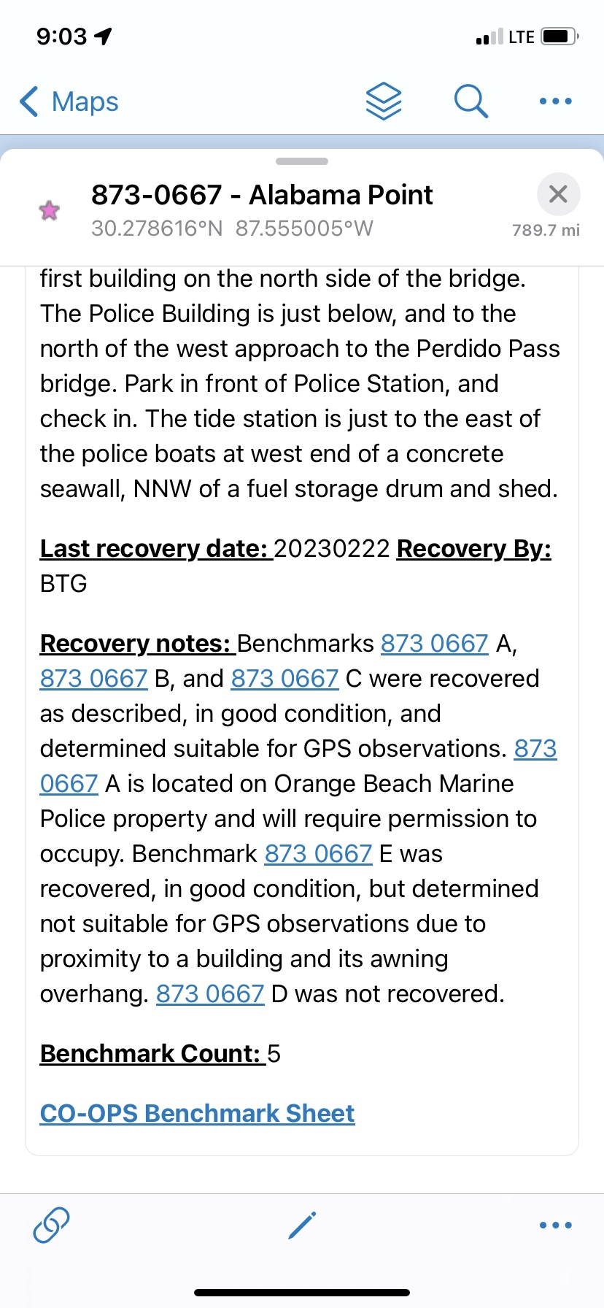
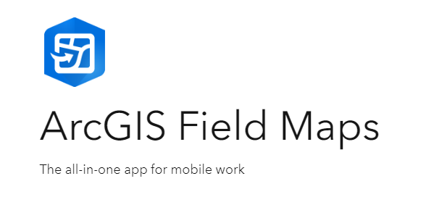
Find
Document
Locate
https://www.esri.com/en-us/arcgis/products/arcgis-field-maps/overview
Notes:
The creation of the IGLD web map allowed the integration with ESRI Field Maps
FOB has used Field Maps for a number of years in the Vdatum program.

Slide 7
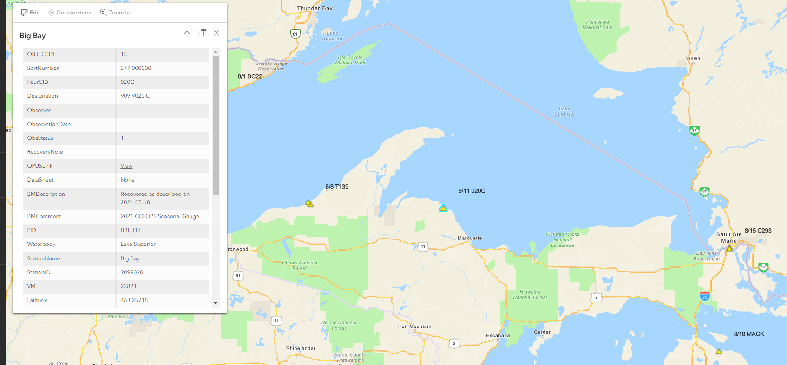
IGLD Survey Web Map
Notes:
Integrating and linking the web map to the mobile device leverages the observers ability to download data sheets, access the device location, review opus share links and retrieve recovery information from past ILGD surveys
In addition to a master layer of each benchmark, We developed observer specific layers to unclutter the observer experience during the campaign
By User friendly labeling we set
Observer Initials and session start date for the master layer
Session Start Date and 4CID identifier for observer layers
There are numerous capabilities and advantages from this approach
Observers can limit their visibility to only the benchmarks they are assigned
The observer can use the device GPS location for assistance in locating benchmarks
The observer can also access description and witness information,
update observation status,
access built-in navigation and driving directions
The web map also enabled upper management to have access to real-time observation status

Slide 8
QA/QC System
Quality Control
Quality Assurance
Training
Operational Protocols
Paperless Protocol
Data Protocol
Communication Protocol
Notes:
The next step was to formulate a QA/QC System
A successful QA/QC system combines training and operational protocols to return the highest quality results for our efforts
Identifying error sources
Properly Calibrating all equipment
Preparing for equipment failures
Operational Protocols
Developing a communication protocol
Setting up a group text for GNSS setups
Established system for reporting iregularities
Data Protocol
Establishing a QA manager
Google drive prepopulated with 4CID folders
Daily file checks, rinex checks, photograph checks
Incorporated a OPUS project for preliminary observation results
Paperless Protocol
Mitigating systematic user errors
GNSS Log app

Slide 9
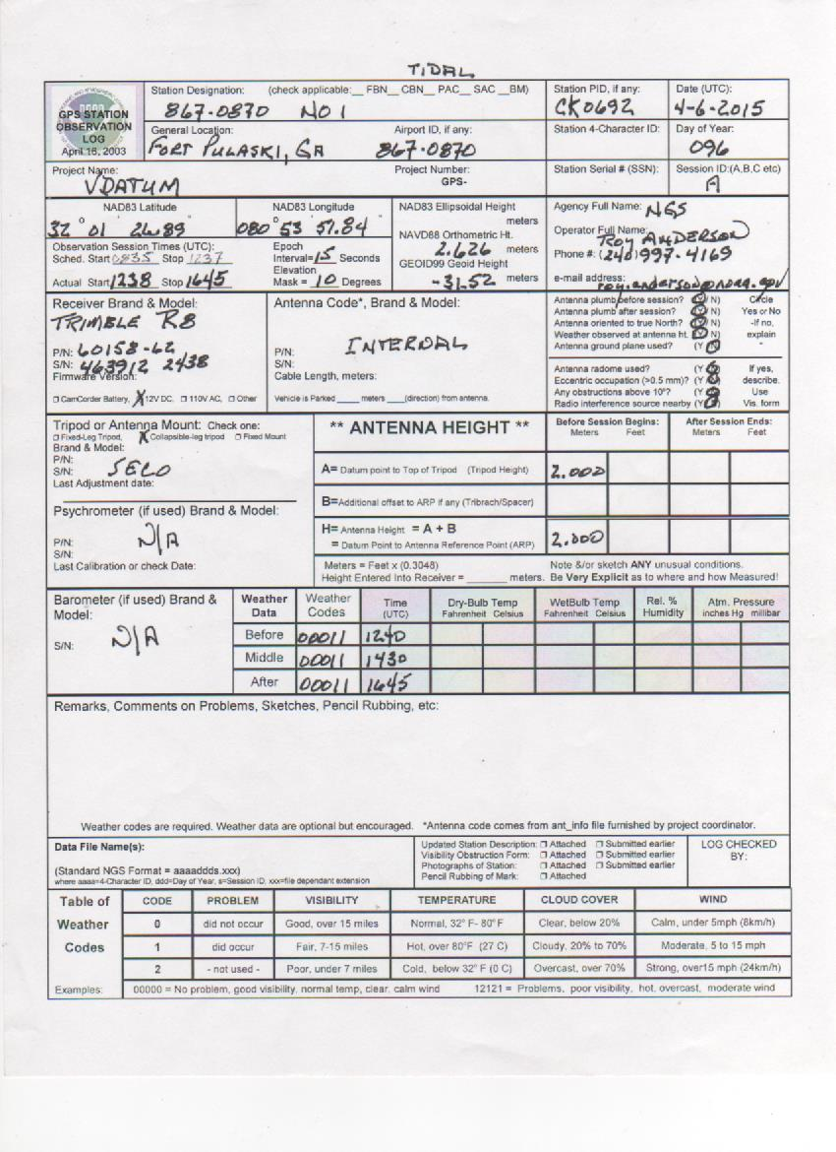
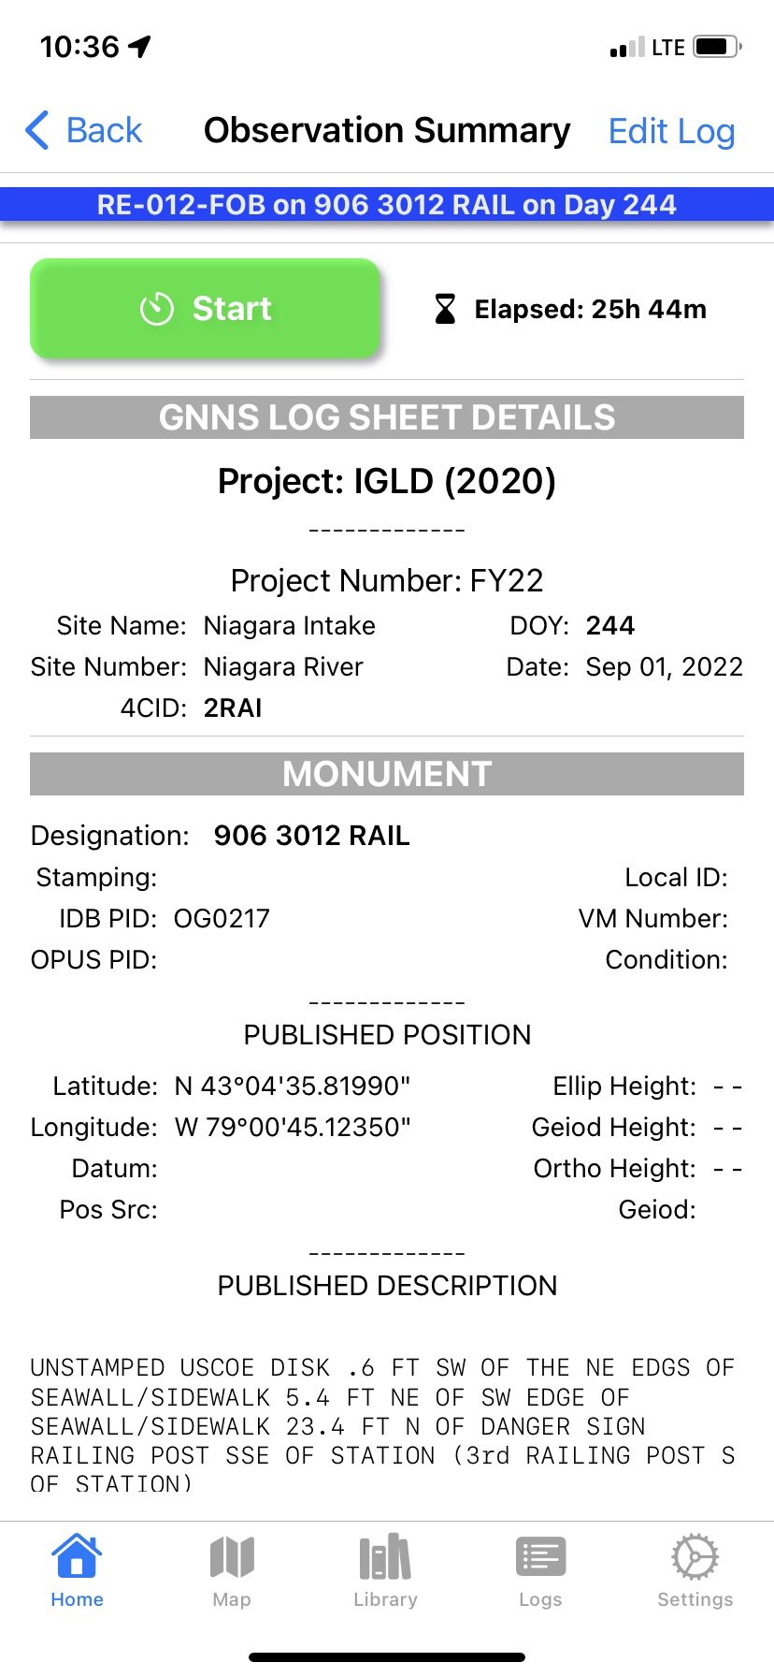
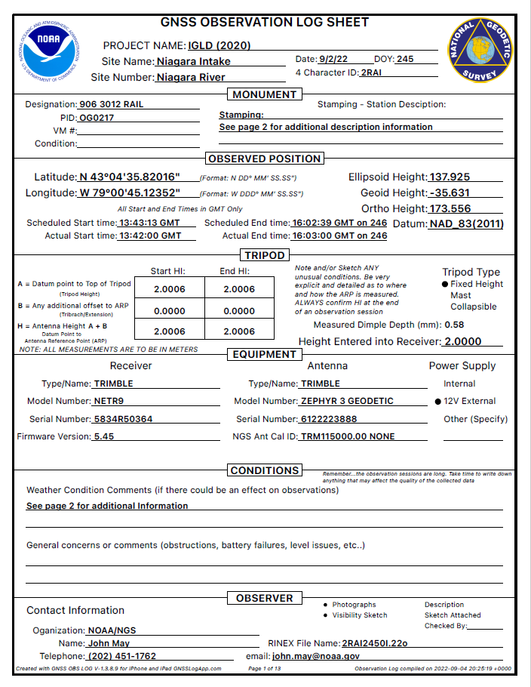
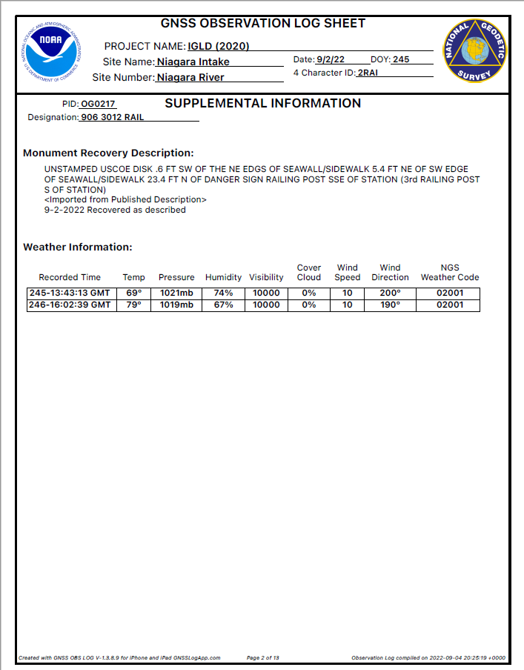
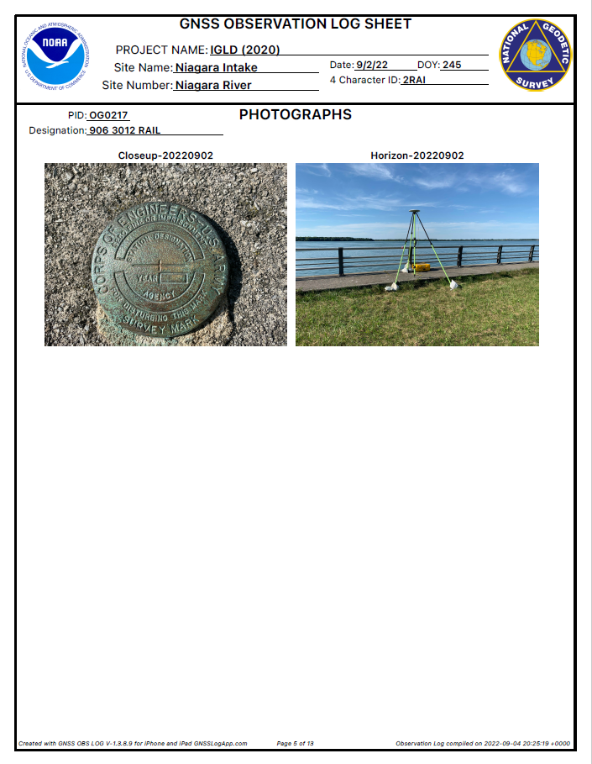
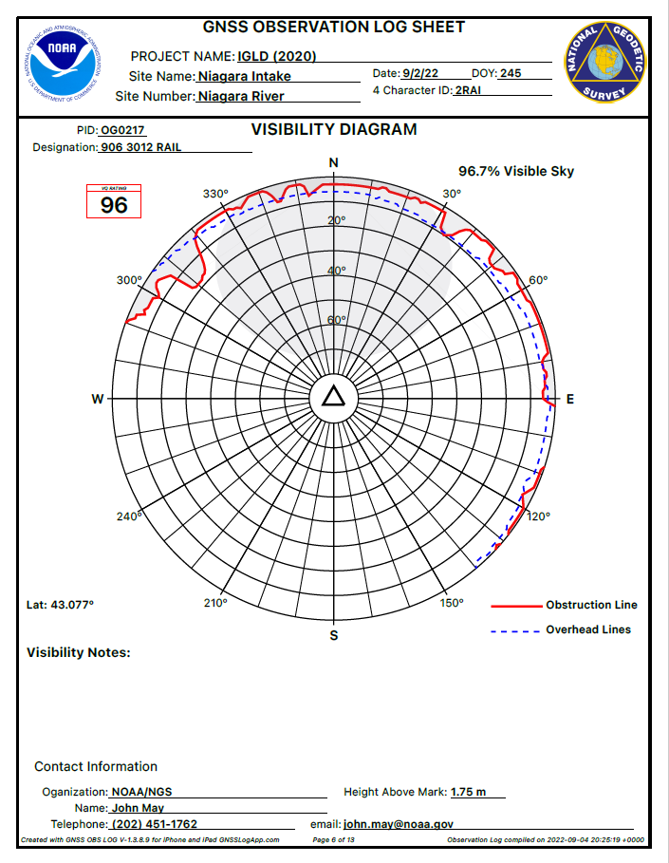
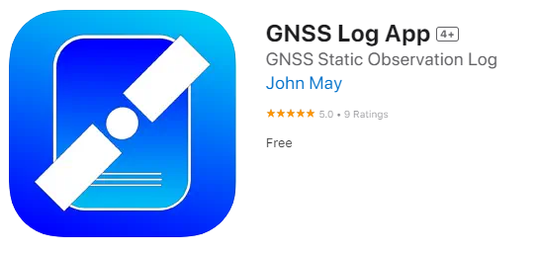
Hand Written paper Logs
Clean, Digital PDF Logs
https://apps.apple.com/us/app/gnss-log-app/id1554968869?platform=iphone
Notes:
FOB has adopted a paperless protocol as part of the National Ocean Service zero waste initiative
The most time consuming and error prone task of the field observer is the repetitive completion of the observation log
GNSS Log app is a mobile device app for iPhone or iPad

Slide 10
Utilizes a Library of reusable Equipment
Observation Logs can be exported to PDF and shared via email, text, airdrop, etc.
Leverages the Device GPS, Camera and Motion sensors
Eliminates common transcription errors
Free on the App Store for iPhone and iPad
https://apps.apple.com/us/app/gnss-log-app/id1554968869?platform=iphone
Notes:
All of the equipment information was common among all of the observers.
Each monument and site was converted from the Planning committee spreadsheet to a datafile common to the web map and the observation log library.
This eliminated any typo variations typical of multiple observers of different backgrounds.
The commonality and standardization of the observation log significantly reduced the daily review time by the Quality Assurance Manager

Slide 11
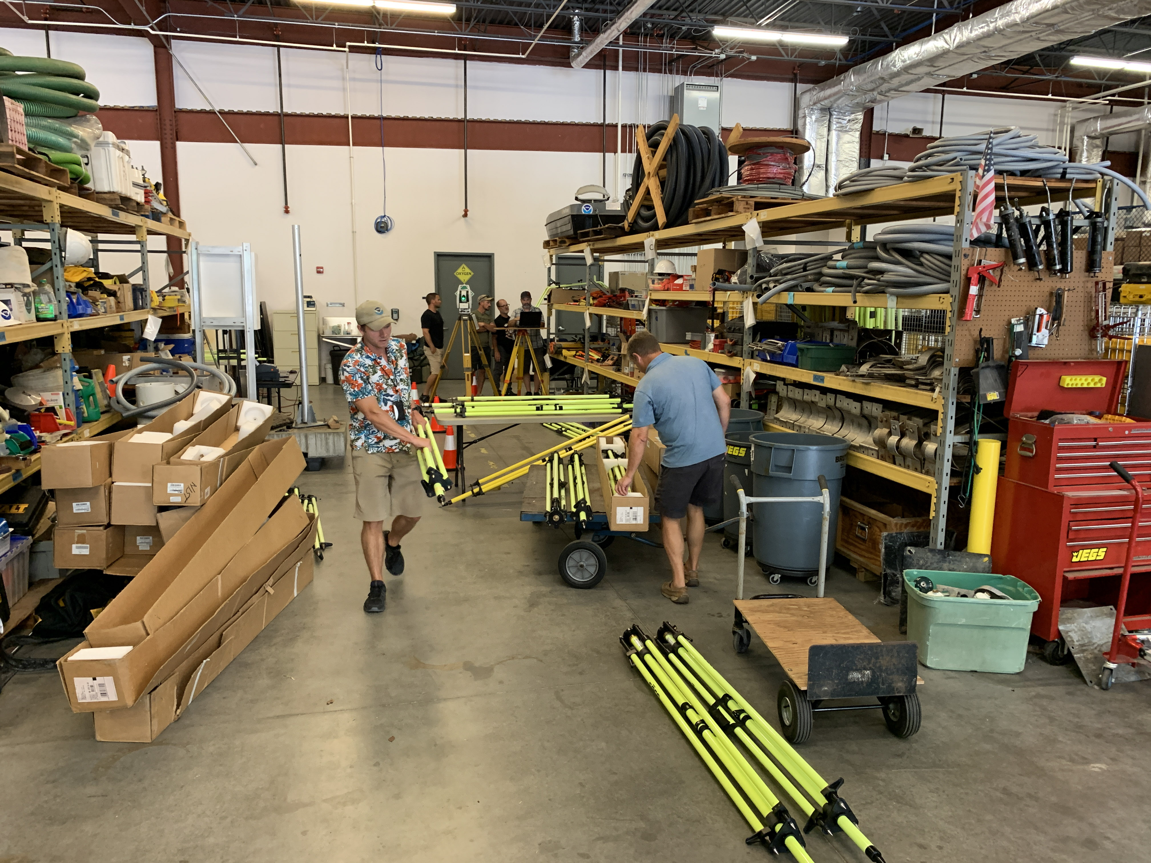
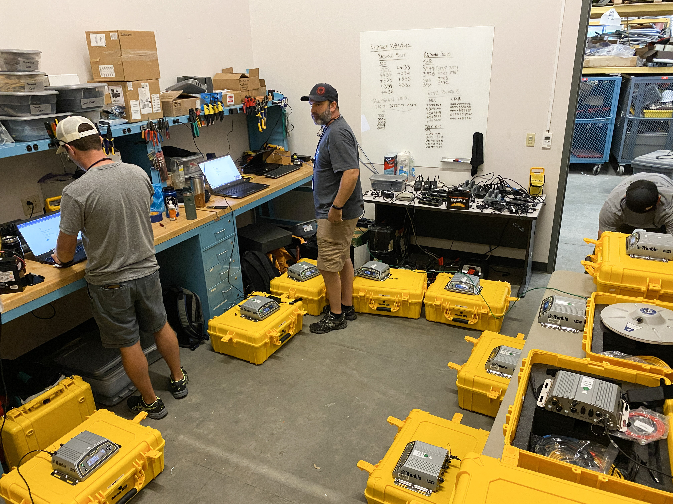
Equipment Preparation
Notes:
The next step in preparation was to ready the equipment
Calibrate each Tripod to 0.1mm
Clone receiver configuration files
Establish an equipment inventory checklist for each observer

Slide 12
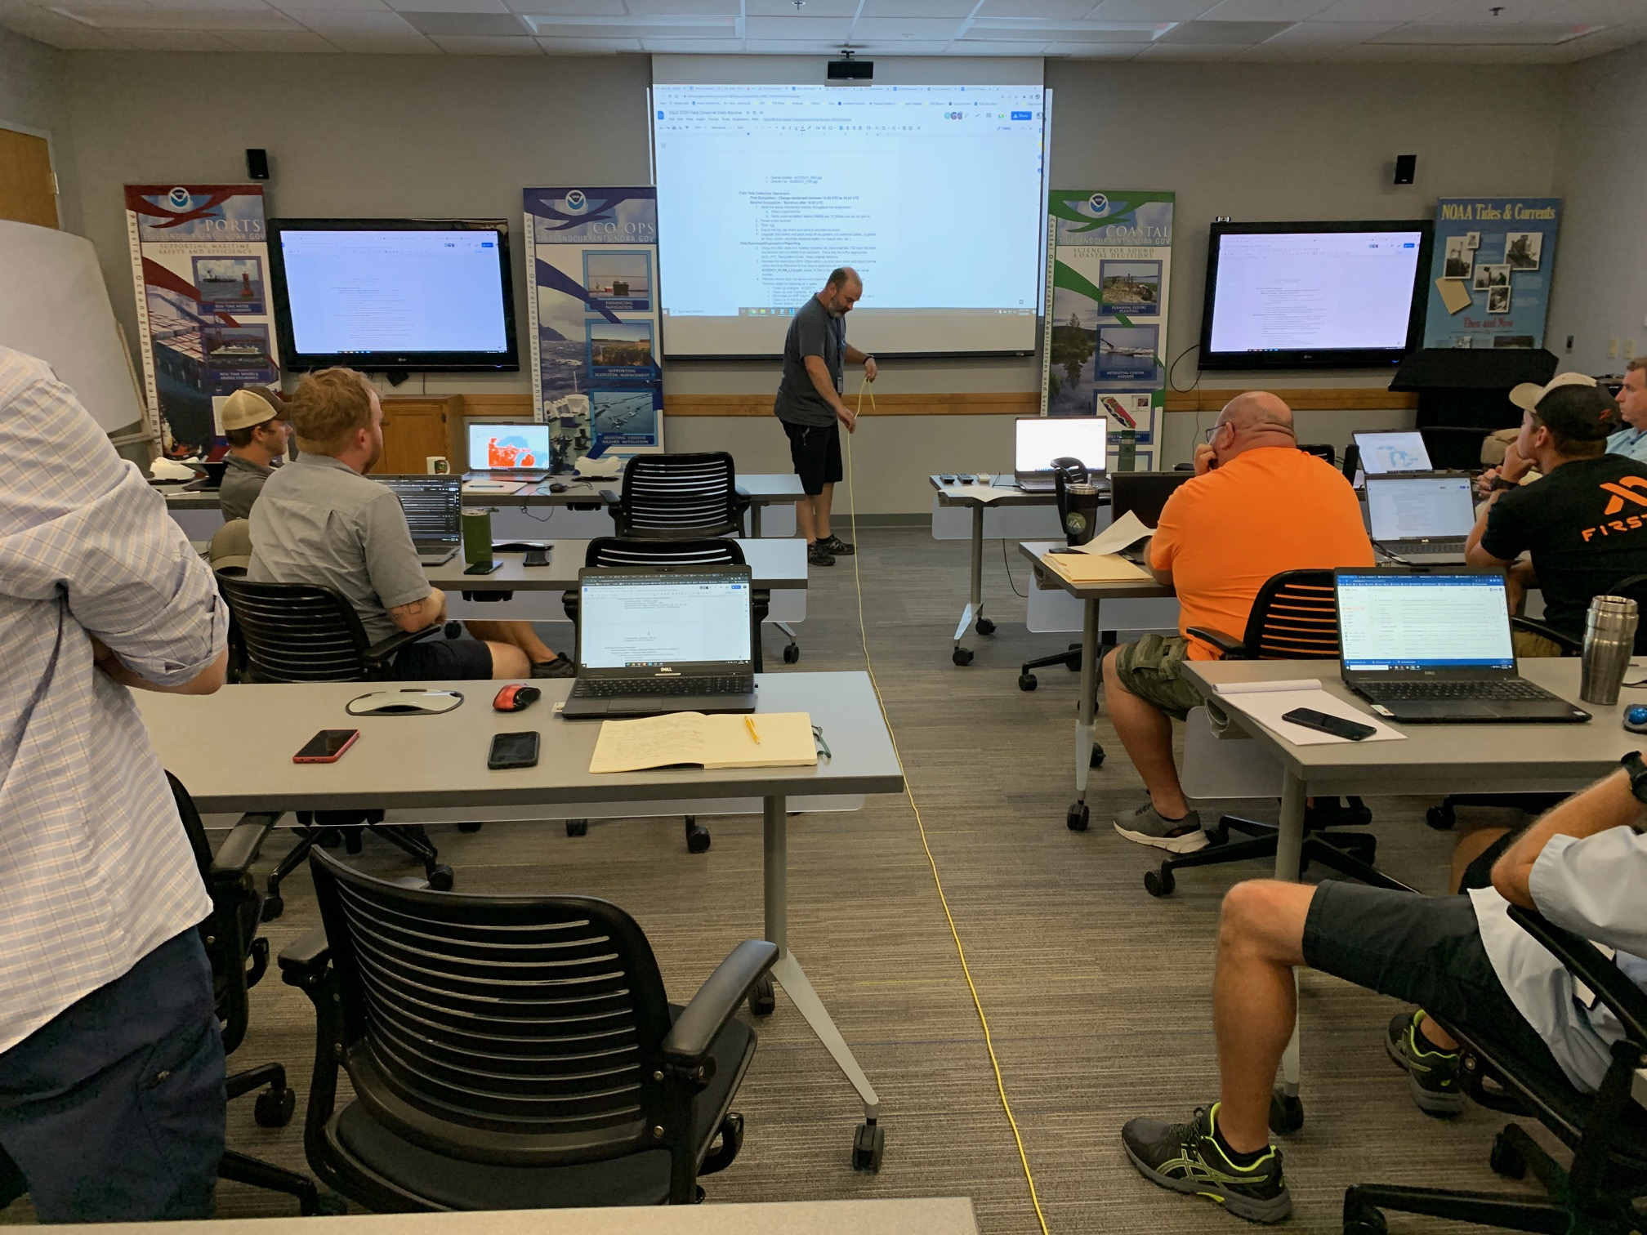
Training
Use of Field Maps
Use of GNSS Log App
Communication protocols
Security protocols
Daily observer routine
Notes:
FOB Conducted a full day of training. The training was held in-person and broadcast remotely through goggle meets.
The training covered
Use of ESRI Field Maps
Accessing observer layers
Updating observation status
Use of GNSS Log App
Communication protocols
Security protocols
Daily observer routine

Slide 13
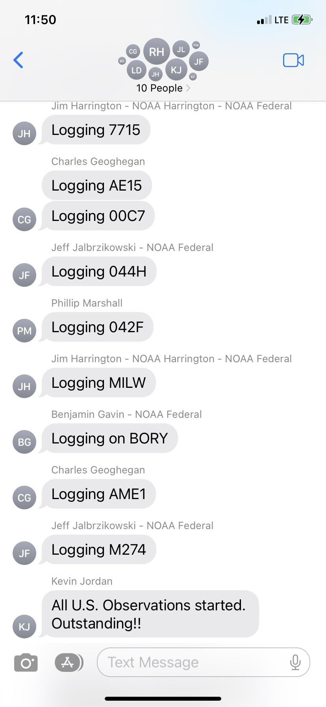
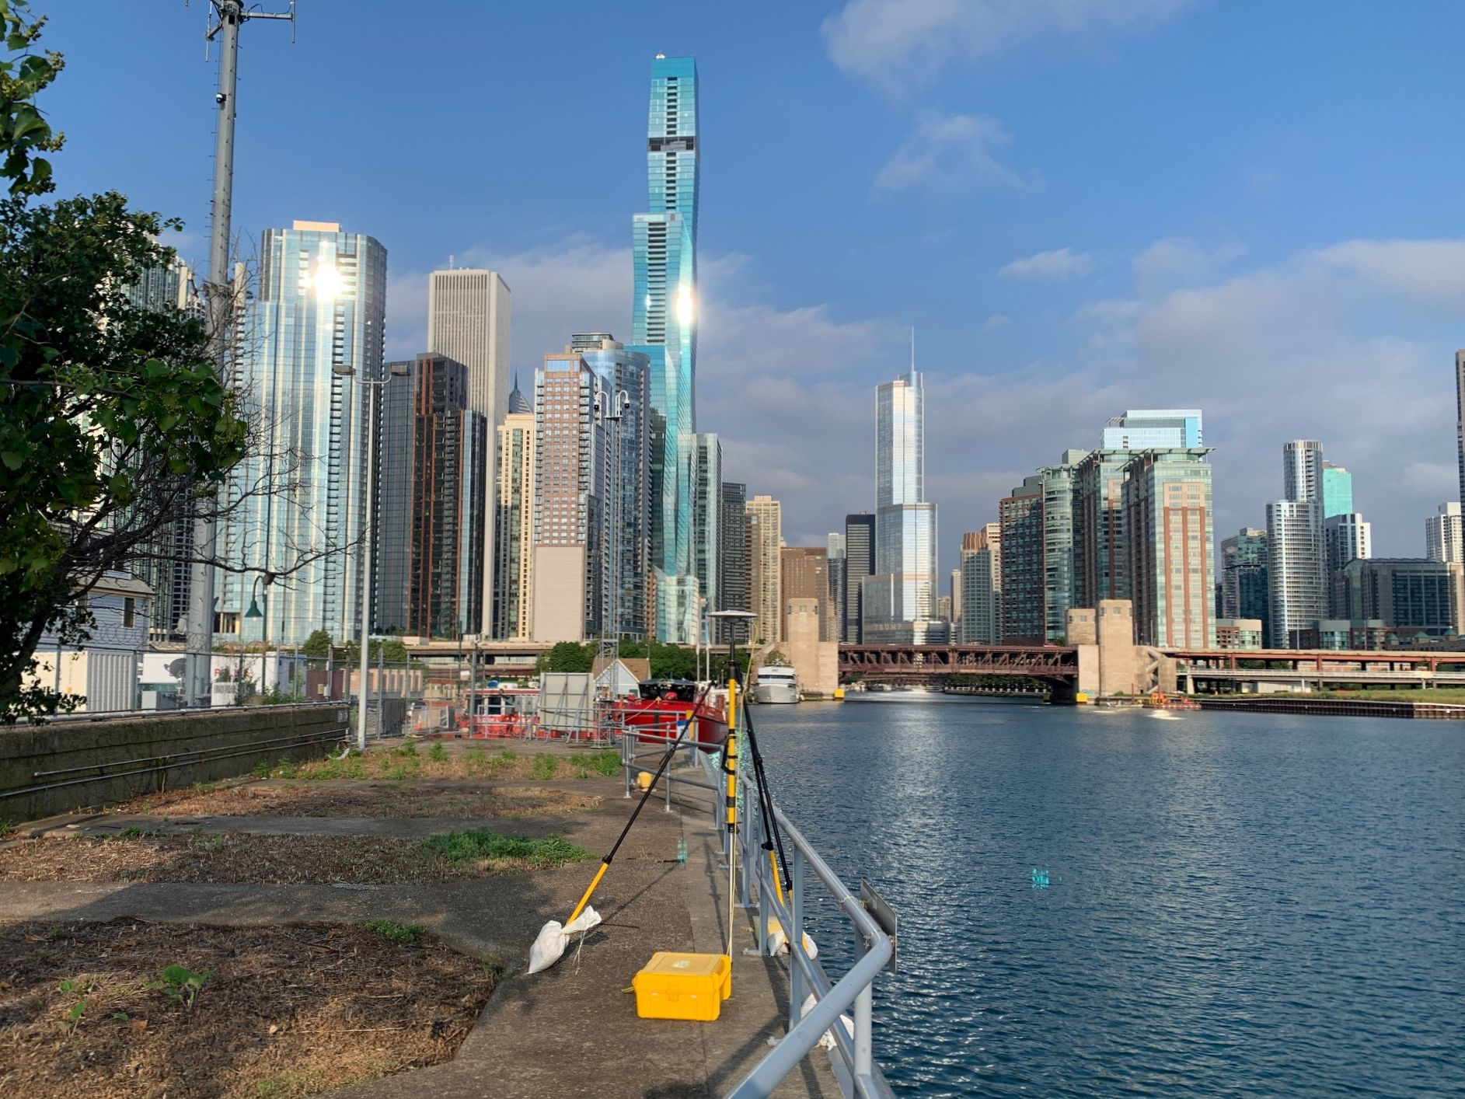
Conducting the Survey
Notes:
The survey began August 1st and ended September 9th
Mobilization
Crews started on the Western end of Lake Superior and began circling Lake Michigan
Triage Personnel stationed in Green Bay, with Jacob Heck as backup in Ann Arbor, Michigan
Partners in the Chicago, Green Bay and Sault St. Marie and Lake St. Clair areas. FOB personnel supplied equipment and training as needed
The Data Flow was done daily with near real time quality checks. Each observation was submitted to OPUS and included in the campaign OPUS Project for preliminary review
Observers made daily updates to observation status on the web map
The QA Manager:
Monitored the group text to insure all observations were performed
Reviewed each observation folder for the correct files
Examined each Rinex File for correct metadata in the header
Reviewed each photograph
Ensured session parameters were observed
Generated Status Reports for each session and transmitted back to headquarters.

Slide 14
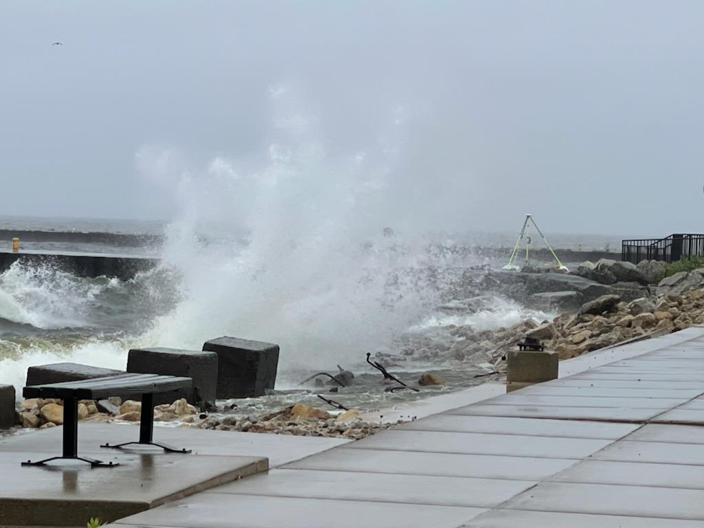
Issues Encountered
Notes:
Power
One battery failed and shortened an observation
Weather
One observation was delayed by one day because of high waves impacting the setup.
Mechanical
No serious mechanical issues
Equipment Security
No equipment was stolen or tampered with
Personnel
All completed the observations without incident
Data
All US Data was uploaded to OPUS Projects and available on the shared drive within 3 days of the end of the campaign

Slide 15
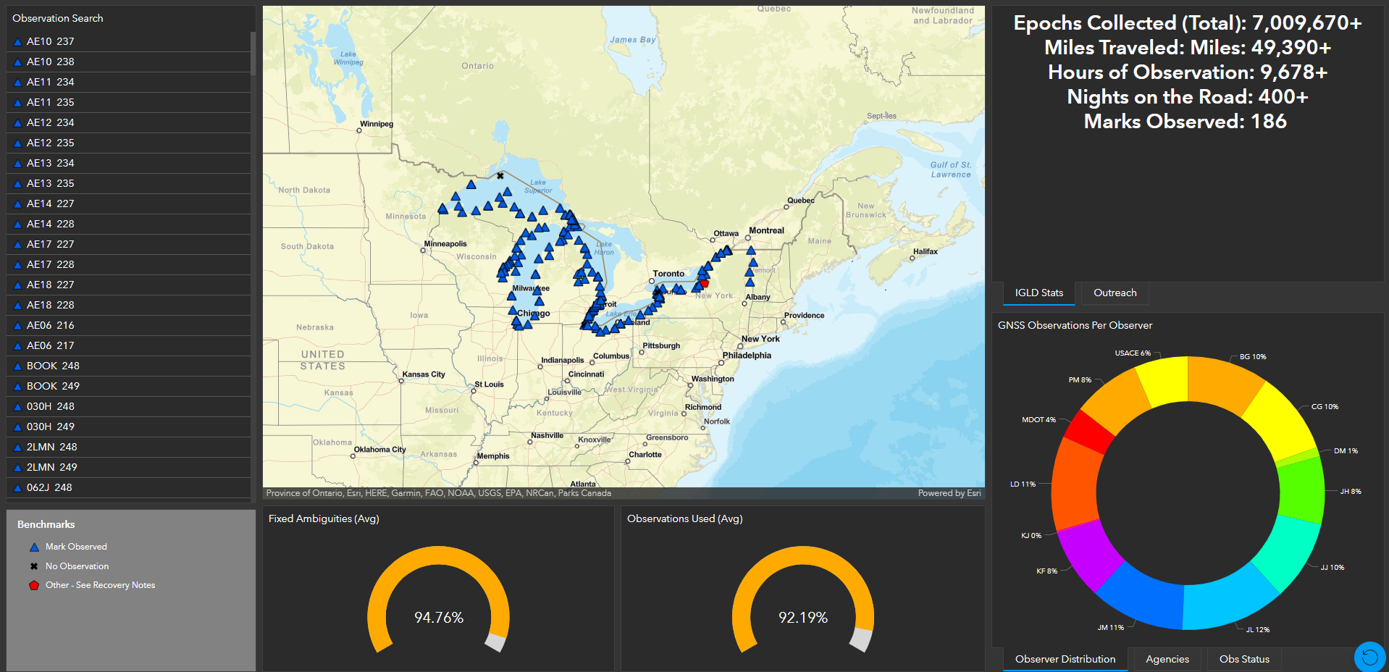
Results
Notes:
Post survey brief was conducted internally at FOB for discussion of operations
The survey was completed on-time, within budget.
Due to the successful implementation of the QA/QC System, no marks had to be re-observed after the campaign ended.
A ESRI Dashboard was created to summarize the success of the survey and to brief stakeholders

Slide 16
Summary and Questions
Notes:
In summary, The field operation branch of the national geodetic survey leveraged the use of
ESRI products for on-device mapping and database management
GNSS Log App for iPhone for consistent observation metadata
Cloud based data storage for file transfer and backup
OPUS Projects for preliminary quality metrics
For further information, please contact
John P. May, P.S., P.E.- Cartographer
NOAA/National Geodetic Survey
Field Operations Branch
672 Independence Parkway
Chesapeake, VA 23320
(202) 451-1762

