Slide 1
NGS Field Operations Branch
Real-Time Surveying
FIG Working Week 2023
May 31, 2023 Kevin Jordan, Lead Cartographer
Notes:
Good Afternoon everyone. I was hoping to take some time today to show off FOB’s use of RTK for Past, Present and Future surveys while leveraging the capabilities of OPUS Projects 5.
Who has experience using RTK or RTN technology?
Who has accessed the NSRS via OPUS or OPUS Projects?

Slide 2
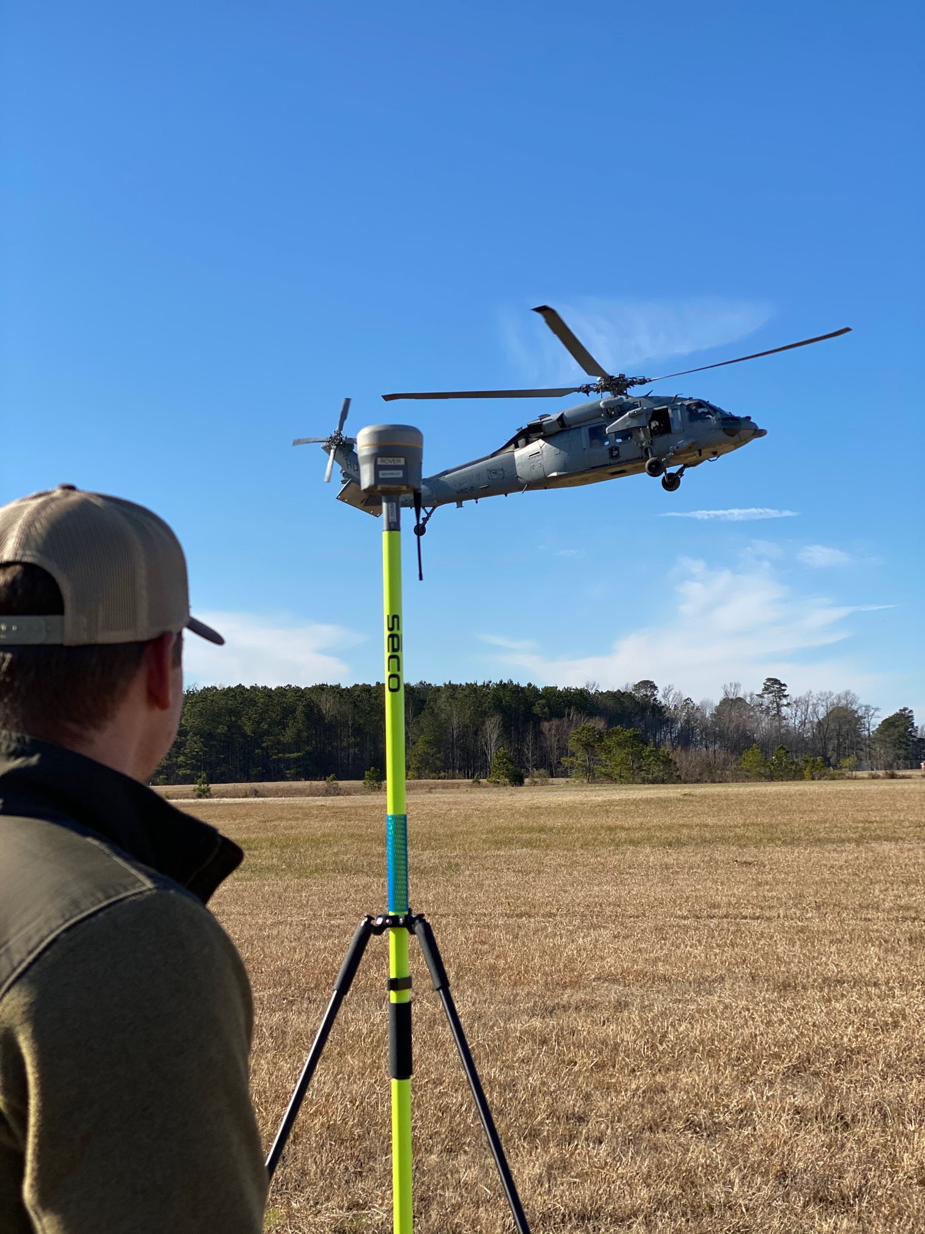
Previous Surveys
NGS FOB RTK Over the Years
Aeronautical Survey Program (ASP)
Topo/Bathy LiDAR Support
NOAA Restoration Days
National Estuarine Research Reserve System (NERRS) Training
Internal testing and support
Notes:
Real Time Kinematic (RTK) Technology has evolved over the years but early on, the NGS Field Operations Branch saw the value of acquiring real-time corrections from base stations occupying NSRS passive control. Much of the usage centered around using RTK for the Aeronautical Survey Program and updating aeronautical charts. Other mission deployments of RTK were used to support Topo/Bathy LiDAR, NOAA Restoration days, NERRS Training, as well as internal testing of RTK to help develop OPUS Projects 5 and GVX file format.

Slide 3
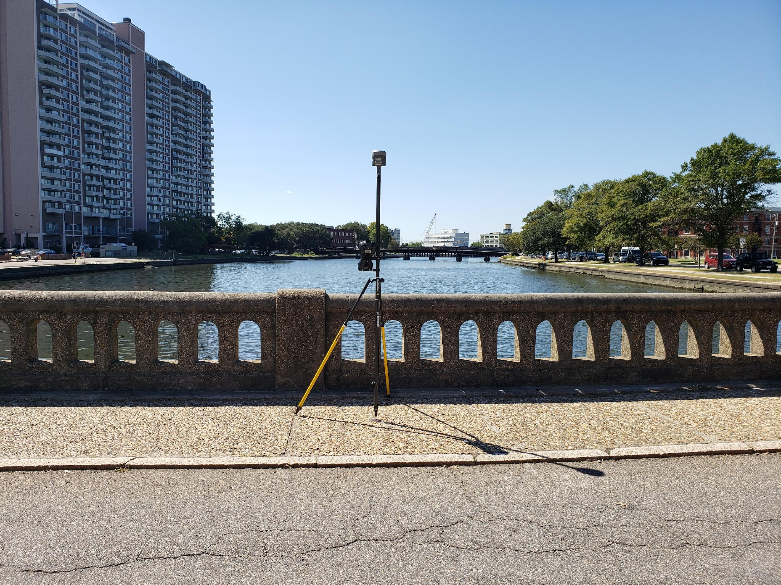
Previous Surveys
2019 Old Dominion University (ODU)
Coastal Resiliency Projects
Temporary Control for NSRS alignment
Notes:
NGS is often called upon to provide field support to Universities, State & Federal agencies and Scientific Partners, advising on best-practices for field survey data collection and alignment to the National Spatial Reference System (NSRS).
In this particular case, given our proximity to the coastal areas of Virginia, NGS Field Operations Branch has a useful role in providing support. The 2019 Blue Line Project was initiated by the local Old Dominion University to illustrate future sea level impacts in some of Norfolk’s flood prone areas.

Slide 4
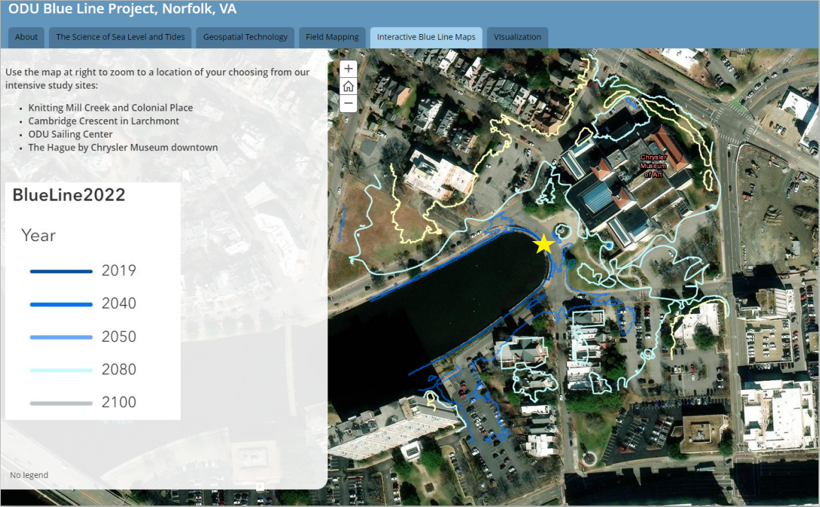
Previous Surveys
2019 Old Dominion University (ODU)
Coastal Resiliency Projects
Temporary Control for NSRS alignment
2019 Blue Line Project
Notes:
Using a local passive control monument for our base station, NGS provided NSRS alignment of temporary control and imagery registration collected by the University by using RTK. The one shown is in the Hague by the Chrysler Museum. The topo lines represented are where predicted tidal flooding will occur. Using eco-friendly paint, university students marked these topo lines and invited the community during the 2019 King Tide to visualize where the current year as well as 30, 50, and 80 year high water marks would be.

Slide 5
Previous Surveys
2021 ODU/Elizabeth River Project
Static GNSS
RTN (Vendor Based)
Aerial Photo Control
Topo
Notes:
In 2021, NGS provided survey support for the Elizabeth River Project; a non-profit effort to restore the health of the waterway.

Slide 6
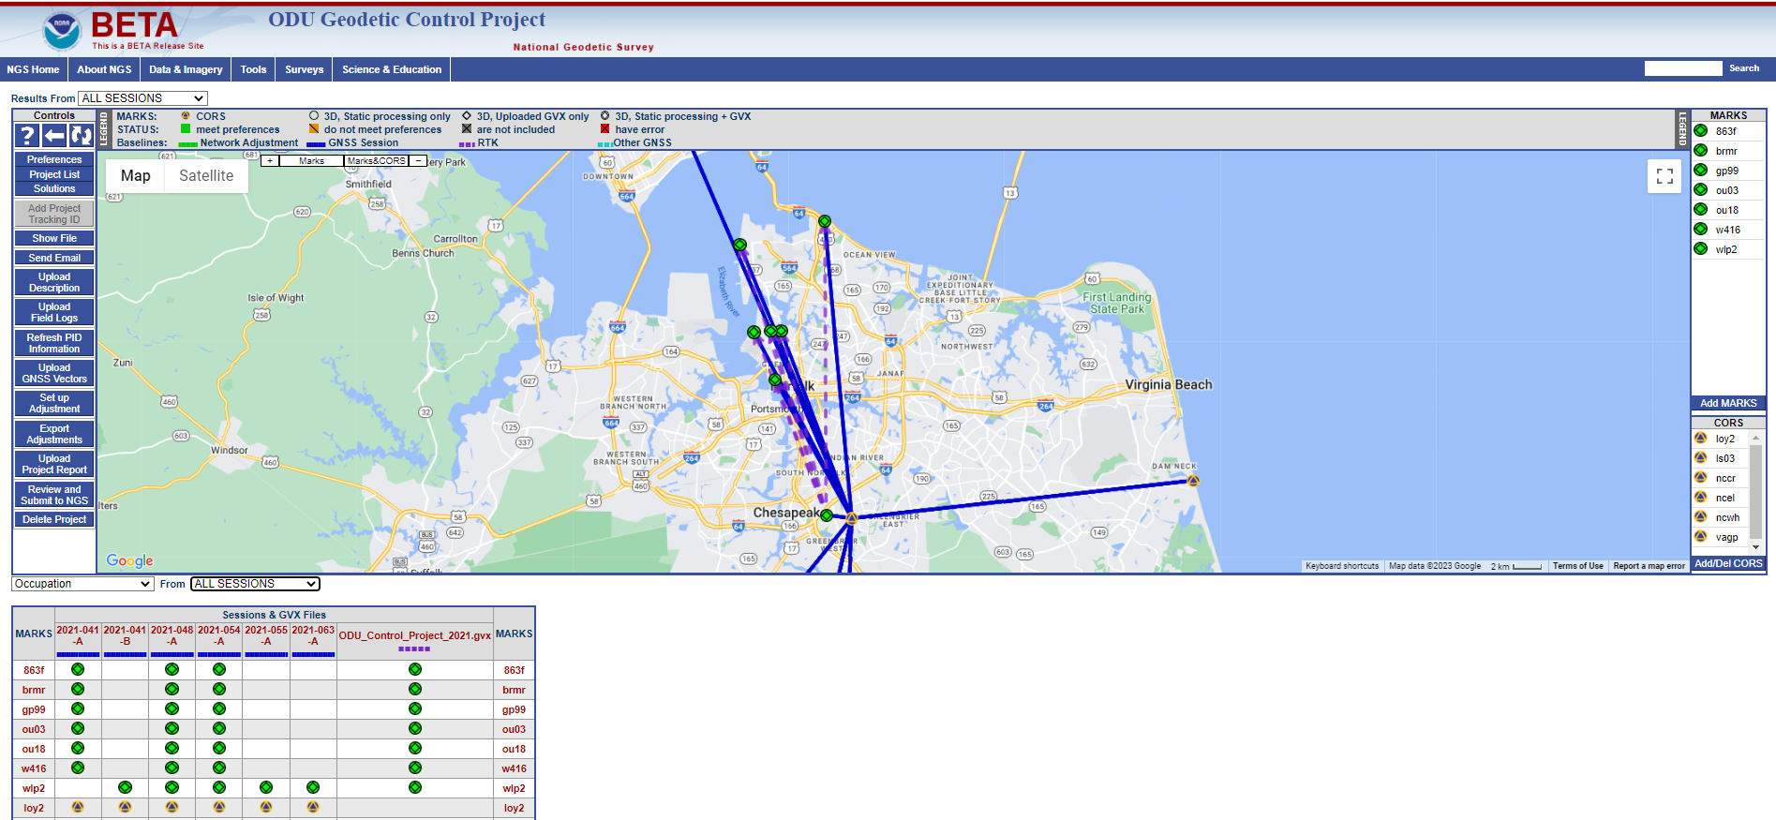
Previous Surveys
2021 ODU/Elizabeth River Project
Static & RTN Occupations
Use of OPUS Projects 5.1 for Static & RTN alignment to the NSRS
Notes:
This project is a bit different because we used a combination of Static GPS as well as RTN vectors emanating from the regional Vendor Network. Combining these data in OPUS Projects became a useful tool for processing and alignment of RTN Vectors to the NSRS. If you have been following OPUS Projects 5 (Now available on Production), this project may seem familiar as it is currently being used for training purposes by our Regional Advisors.
OPUS Projects 5.1 is the latest standard for aligning Static and RTK data to the NSRS through the NOAA CORS Network (NCN)

Slide 7
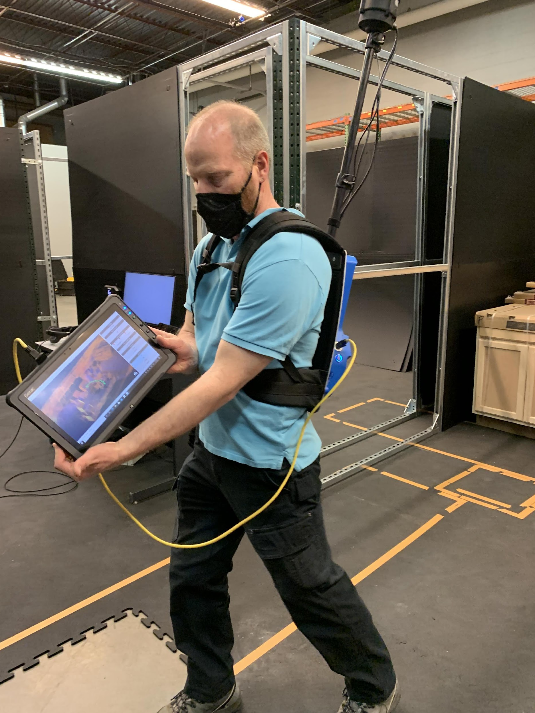
Modern Surveys
U.S. Department of Commerce’s National Telecommunications and Information Administration (NTIA)
First Responder Network Authority (FirstNet) Test Facility – Boulder, CO
Static & RTK Occupations
Terrestrial Surveying (indoors)
Use of OPUS Projects 5.1 for Static and RTK alignment to the NSRS
Traverse Adjustment and Alignment to NSRS
Notes:
Changing gears: In 2022, we coordinated with the NTIA’s FirstNet Test Facility to provide a network of indoor control monuments aligned to the NSRS. The FirstNet Authority is responsible for supporting testing of indoor localization technologies being developed for Public Safety -SUCH AS- low or no visibility situations using heads-up displays or augmented reality for first responders. The goal was to align a network of about 20 indoor targets, but to achieve this our field team needed to implement a strategy to first establish outdoor control marks and align them to the NSRS, then use these marks to tie-in the interior marks using a total station. To succeed in this, we utilized Static GPS, RTK, and Terrestrial methods for field collection. In processing, we utilized OPUS Projects 5 for Static and RTK alignment, then finally vendor software for traverse adjustment and transformation to the adjusted new NSRS-tied control.

Slide 8
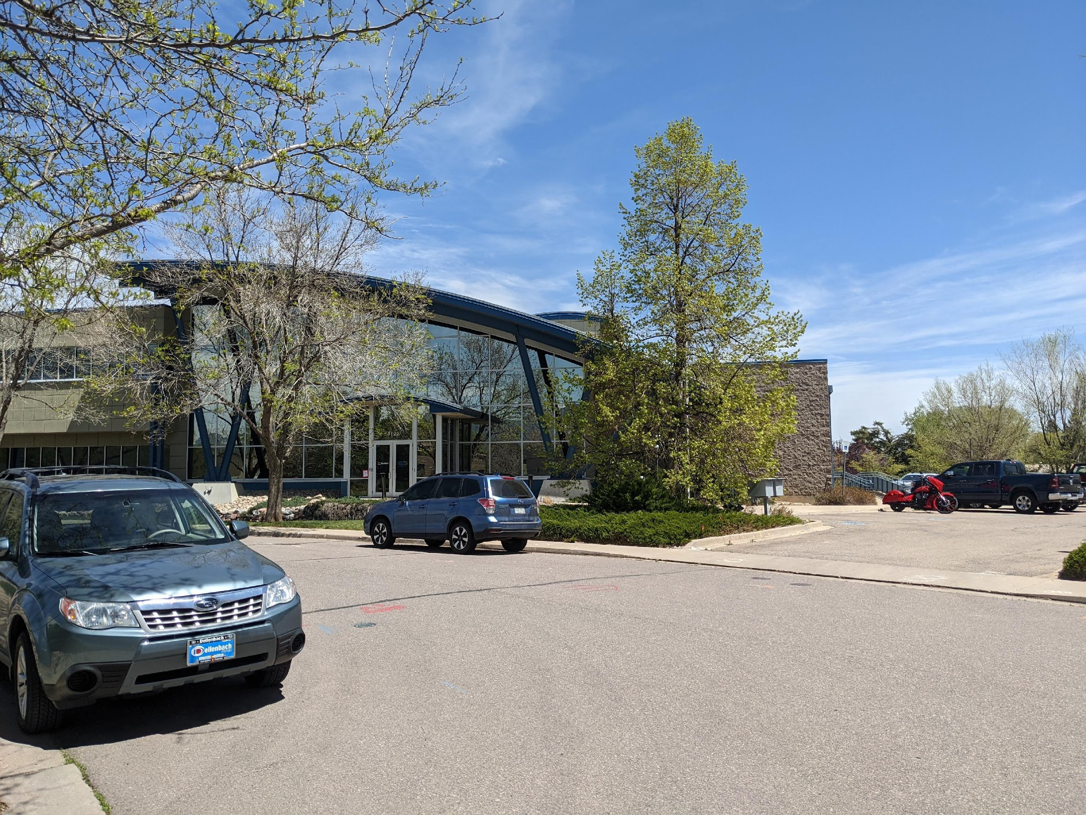
U.S. Department of Commerce’s National Telecommunications and Information Administration (NTIA)
Notes:
The grounds were accessible to the public and there were very few areas to be able to establish control for GNSS occupation for any extended duration. SO - Short duration RTK observations were planned for the outside control marks.

Slide 9
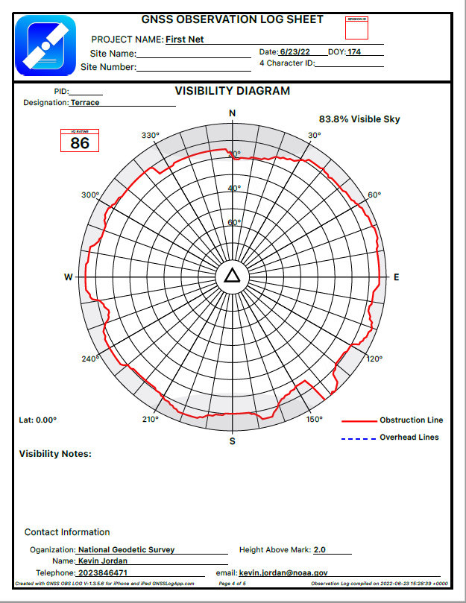
Notes:
Rather than an RTN connection to a vendor network, we decided to perform single-base/single-rover RTK, but as mentioned before, the facility and grounds were not isolated from the public, EXCEPT that a 2nd floor terrace was available to setup a temporary base station that collected continuously throughout the duration of the project. A Trimble NetR9 with Zephyr3 antenna was setup to collect the static file. Paired with an RTK Bridge, we were also capable of transmitting RTK corrections. Since we were not occupying a survey monument, an autonomous base was defined to begin the Job. As you can see from the visibility diagram, the station was mostly clear from about 20° to zenith in all directions, sufficiently maximizing GNSS satellite coverage.

Slide 10
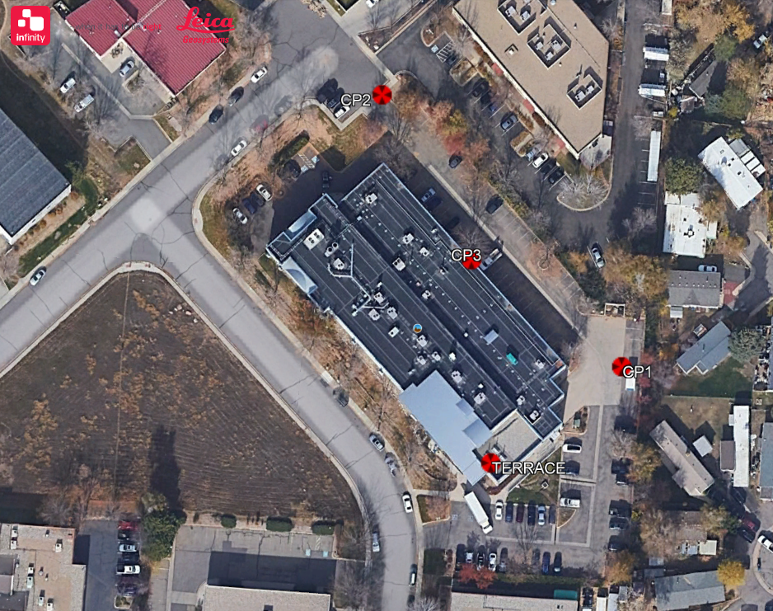
Notes:
Using the RTK base station, we measured vectors to the two outdoor control marks we established to the North and East of the building. These marks were chosen on THIS side of the building since the turning point location (labeled as CP3) was our access point into the building from a loading door.

Slide 11
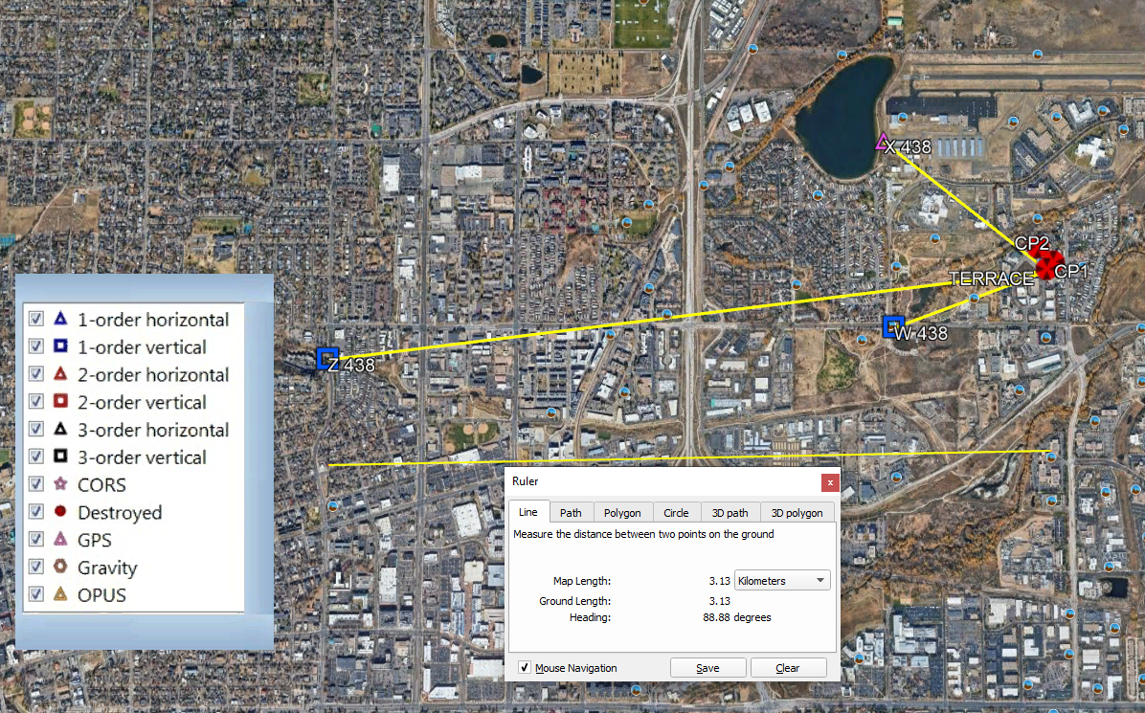
Notes:
Since the terrace base station was a temporary station with no identifiable datum point, as a NSRS gut-check, we decided to tie to the local passive control network. This network consisted of three NAVD 88 bench marks and one Horizontal mark. These were selected not necessarily to control the final set of coordinates, but rather to provide additional confidence to the NSRS CORS tie.

Slide 12
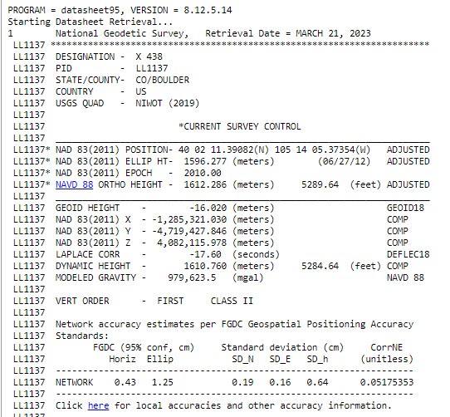
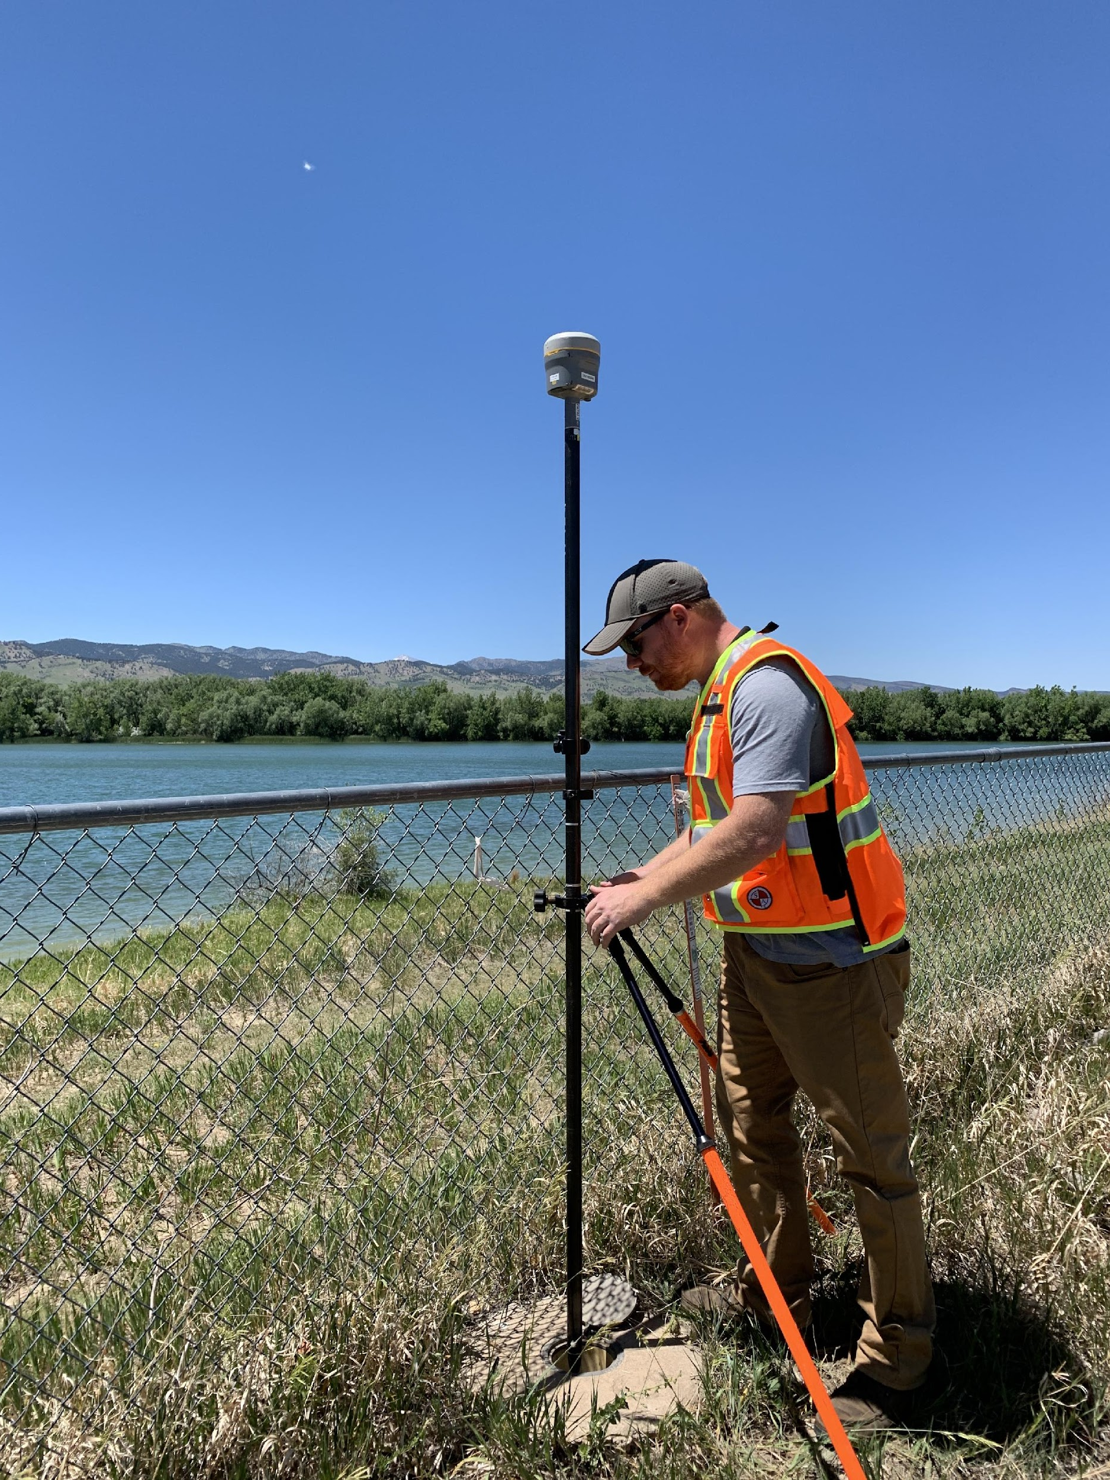
X 438 (LL1137)
Notes:
The station to the Northwest, X 438, has an adjusted NAD 83 (2011) position and ellipsoidal height as well as the 1st Order Class II NAVD 88 Orthometric height. This station is located at the local Municipal Airport, so some additional access permissions, safety, lighting and security was required.

Slide 13
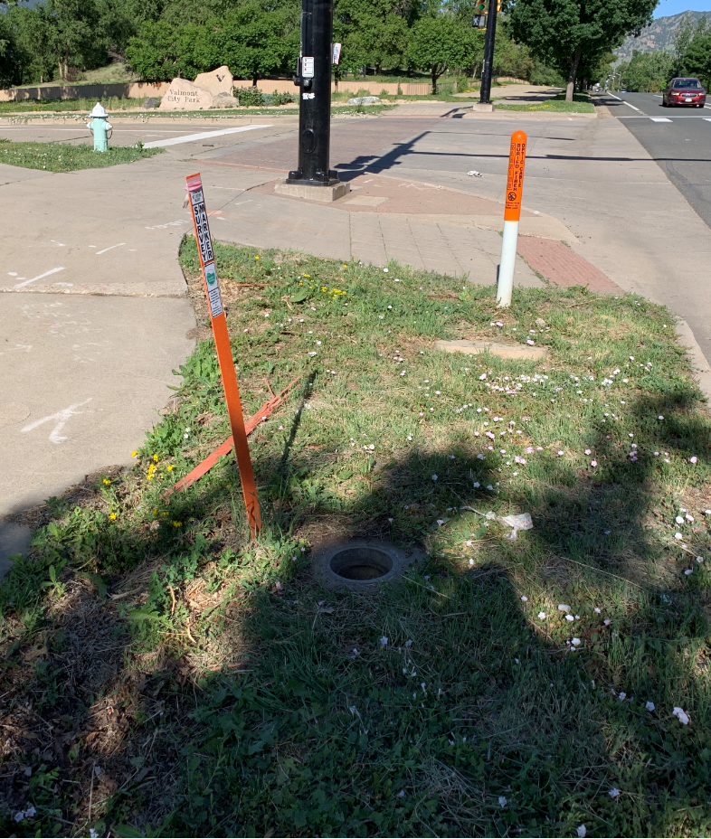
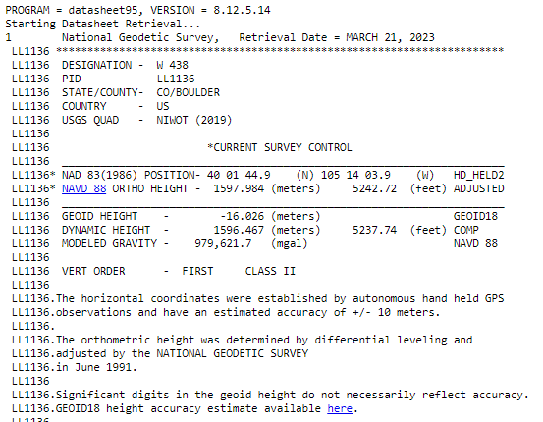
W 438 (LL1136)
Notes:
W 438 is a 1st Order Vertical control monument. The horizontal position was from a hand-held device and not used for any horizontal check. The location of this mark is between a busy road and well-trafficked sidewalk, so while useful, could have been risky for a longer static GNSS occupation.

Slide 14
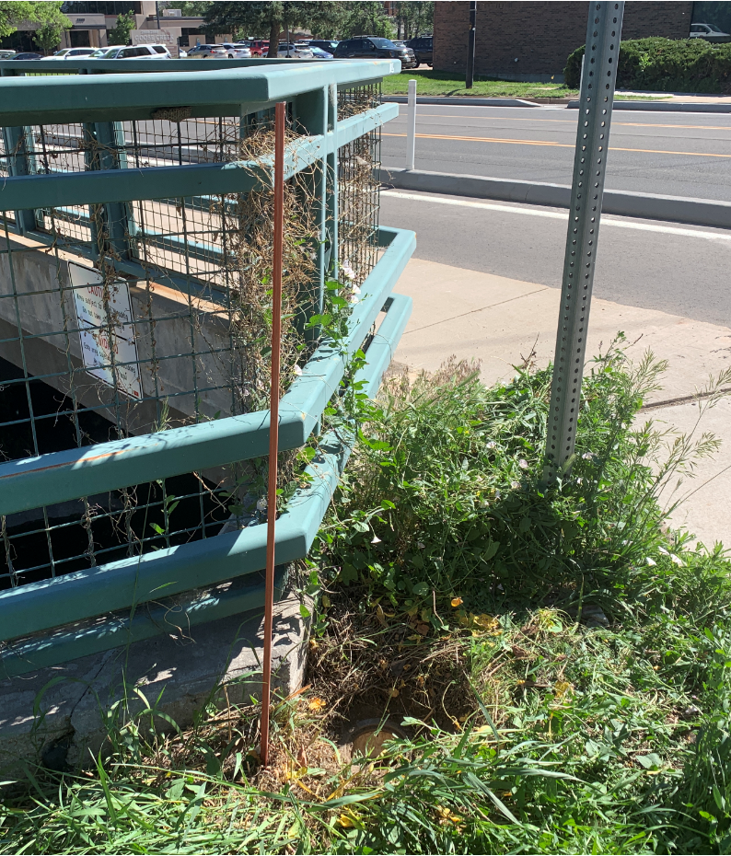
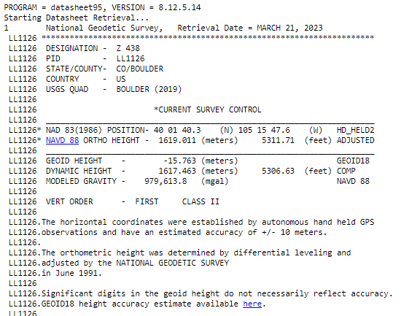
Z 438 (LL1126)
Notes:
Similarly, Z 438 is a First Order Vertical control monument with hand-held position. This mark is the furthest from our base at about 3.2 KM. Again, next to a highly trafficked road, bike lanes and pedestrian walkway. A traditional tripod setup at this location may have been a bit tricky.

Slide 15
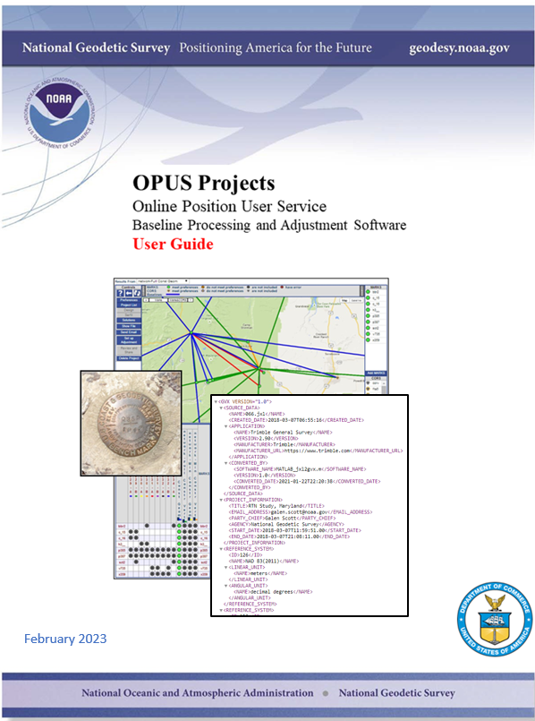
Observation Requirements
Static – Minimum two 2-hour
RTK – Minimum three 5-min observations
Notes:
Without going into too much detail about OPUS 5 and GVX vectors, I should mention some of the minimum requirements for using Static and RTK data in OPUS 5. First, is that static GPS is an initial requirement whether it is from an RTK base or an RTN base station. A minimum of two 2-hour sessions are required. For our project, we achieved almost three 24-hour sessions.
For the RTK vectors to have the best sampling of data, a minimum of Three 5-minute occupations taken at different times of day are recommended. For our project, we had between 4 and 5 independent RTK sessions.

Slide 16
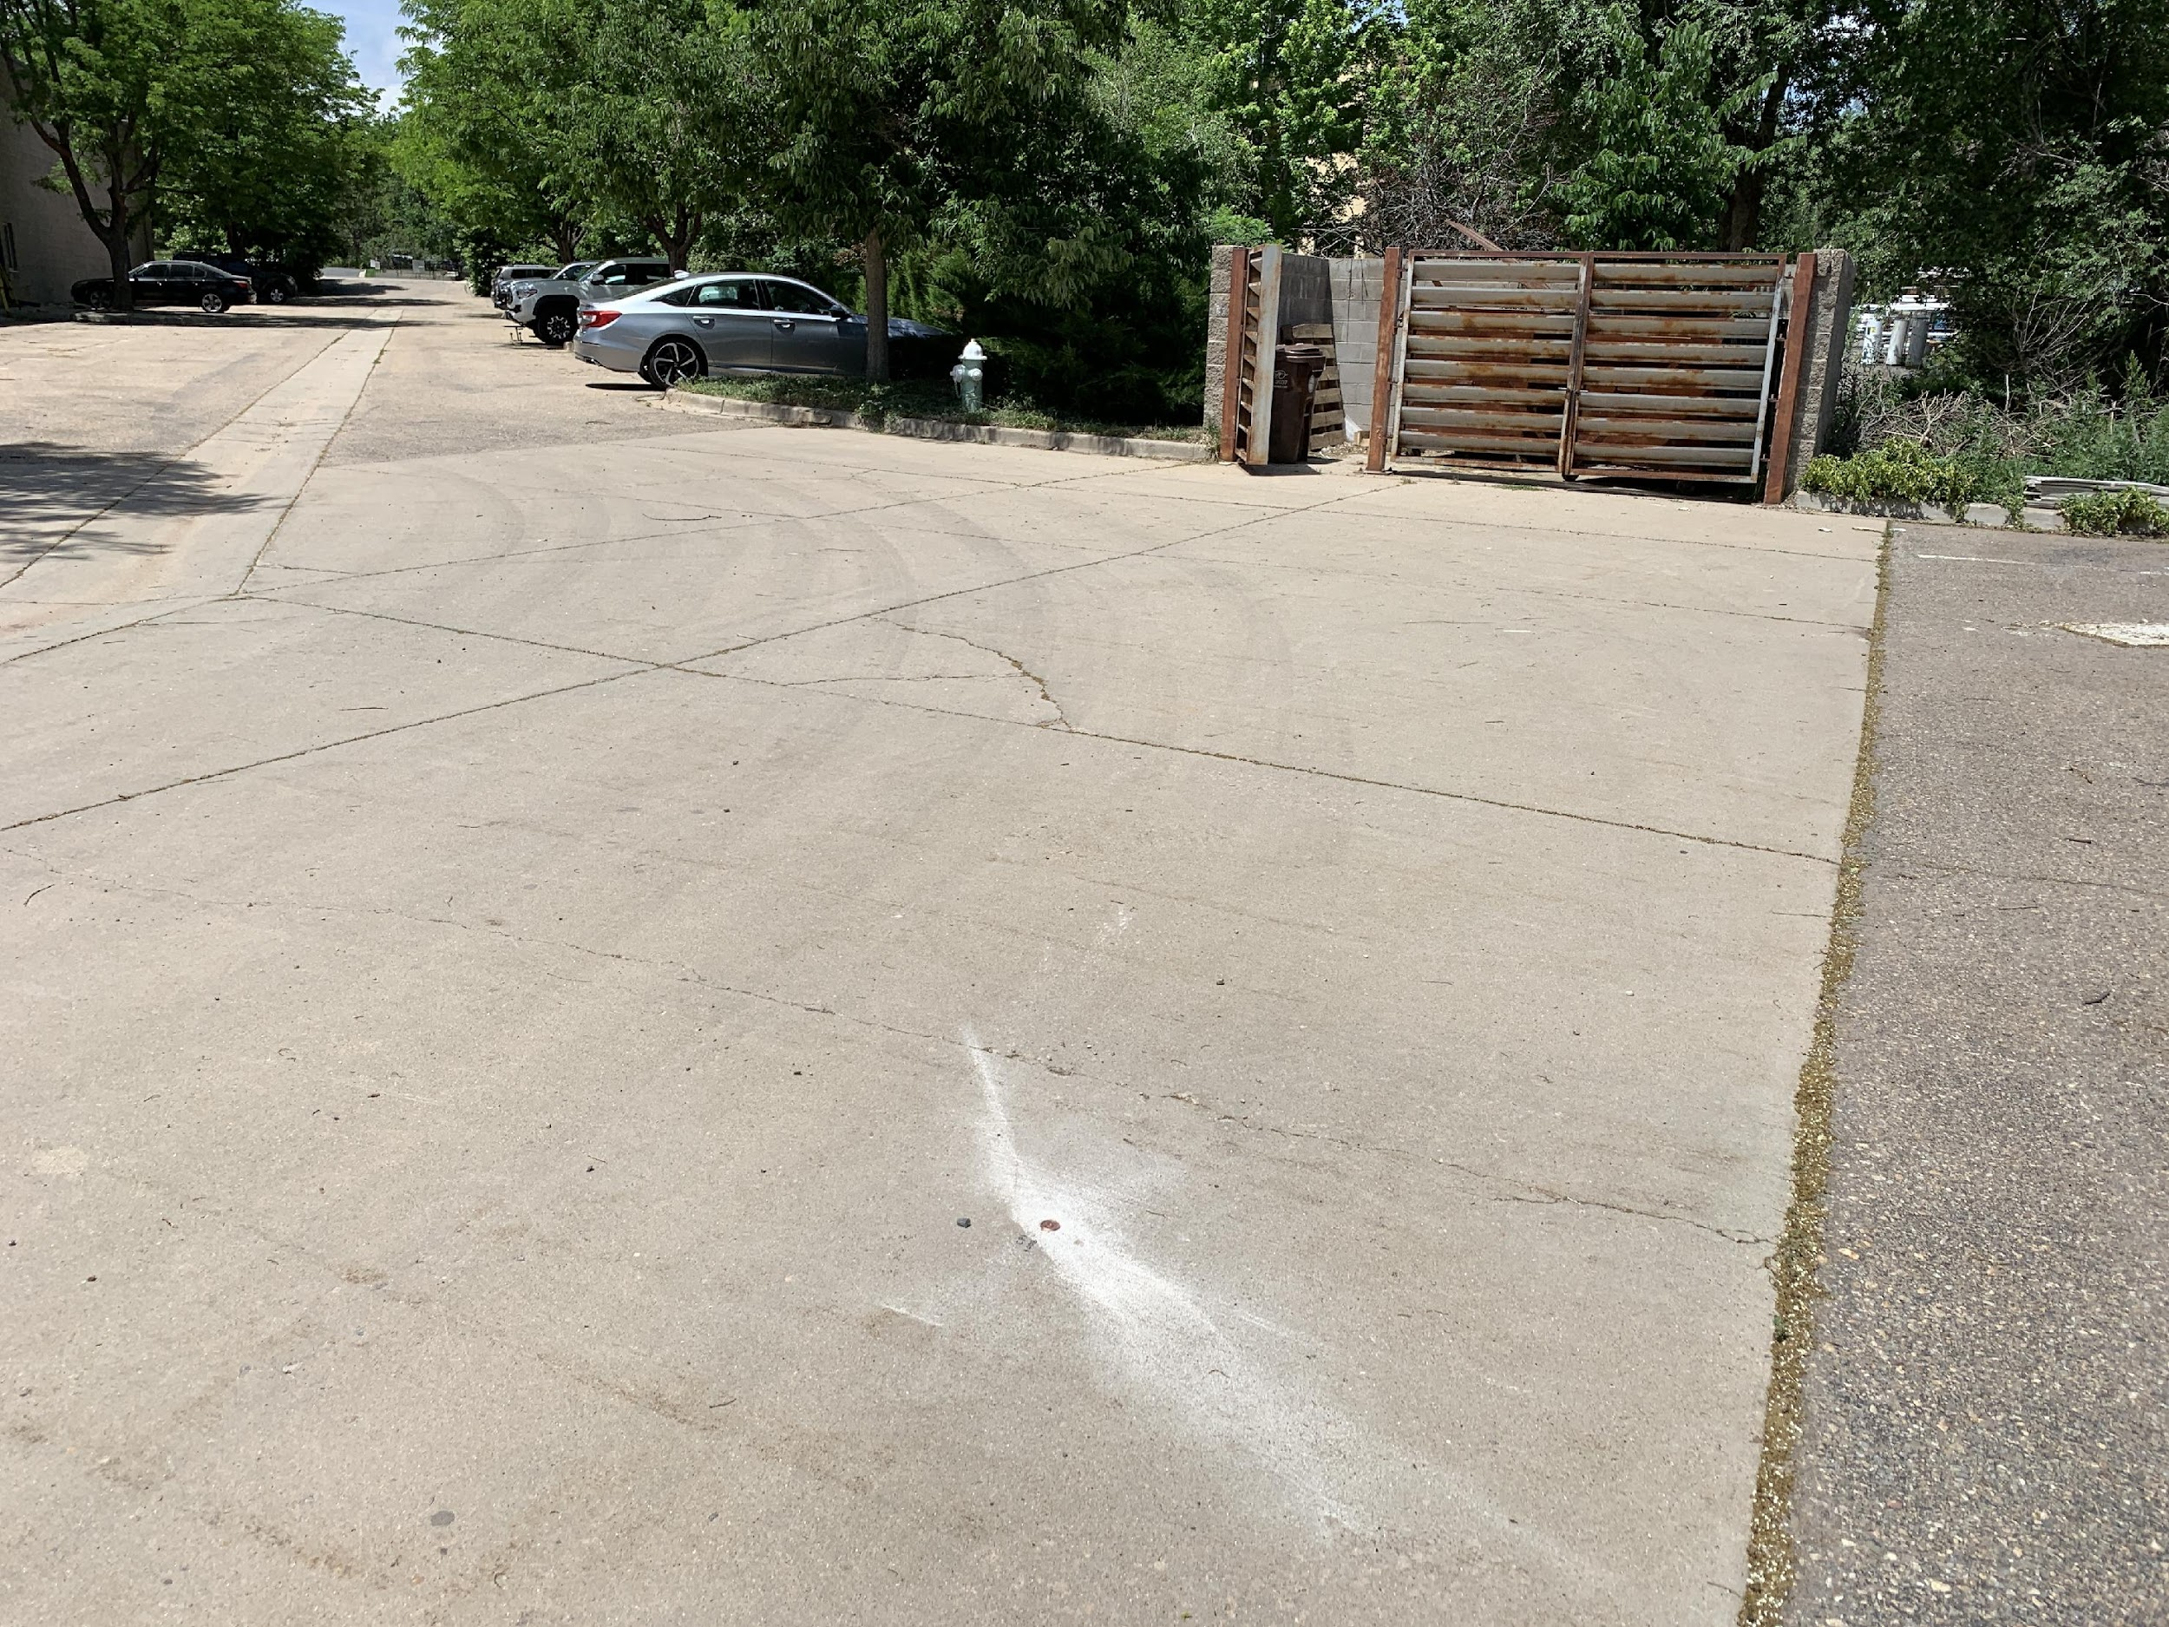
Exterior
CP2
CP1
Notes:
A separate terrestrial survey using an assumed coordinate starting point was also performed. A closed traverse loop starting at CP1 with a backsight to CP2 enabled us to begin our traverse into the building.

Slide 17
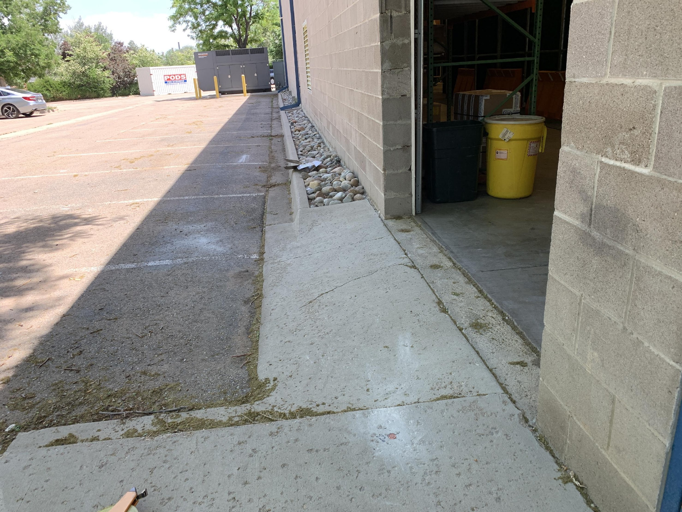
Exterior - Interior
CP1
CP2
CP3
Notes:
From a different perspective with CP1 in the background, the backsight was CP2 and the foresight was CP3. Traverse to CP3, backsight CP1 and we’re off into the building.

Slide 18
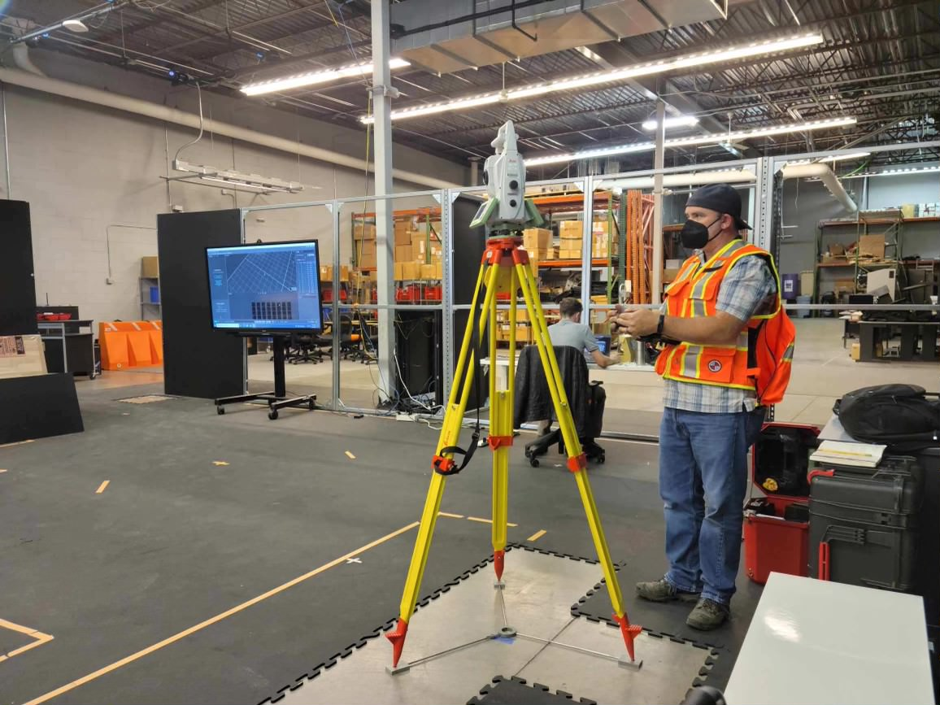
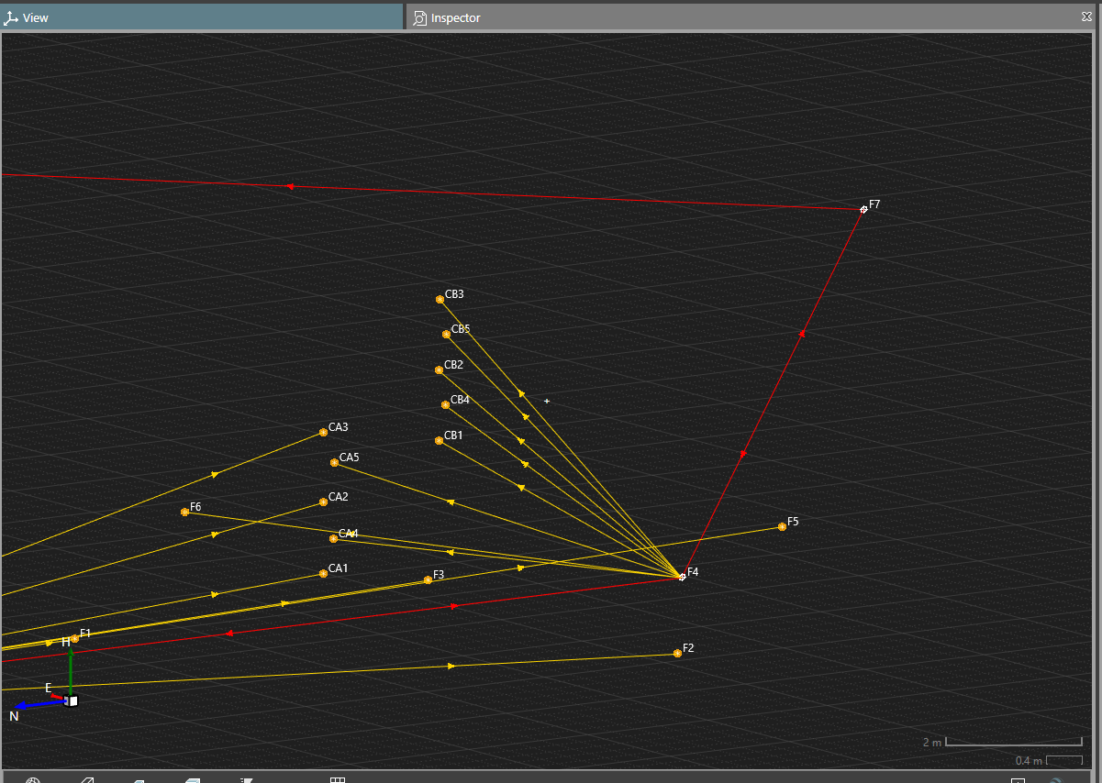
Interior
CP1
Notes:
A turning point, F4 was established for the next set of observations. Additional floor monuments were installed as well as reflective adhesive targets on the vertical columns. Once the indoor targets were observed, a final monument was set…shown as F7 in the plan view, then through another Bay Loading Door, the traverse was closed back on CP1.

Slide 19
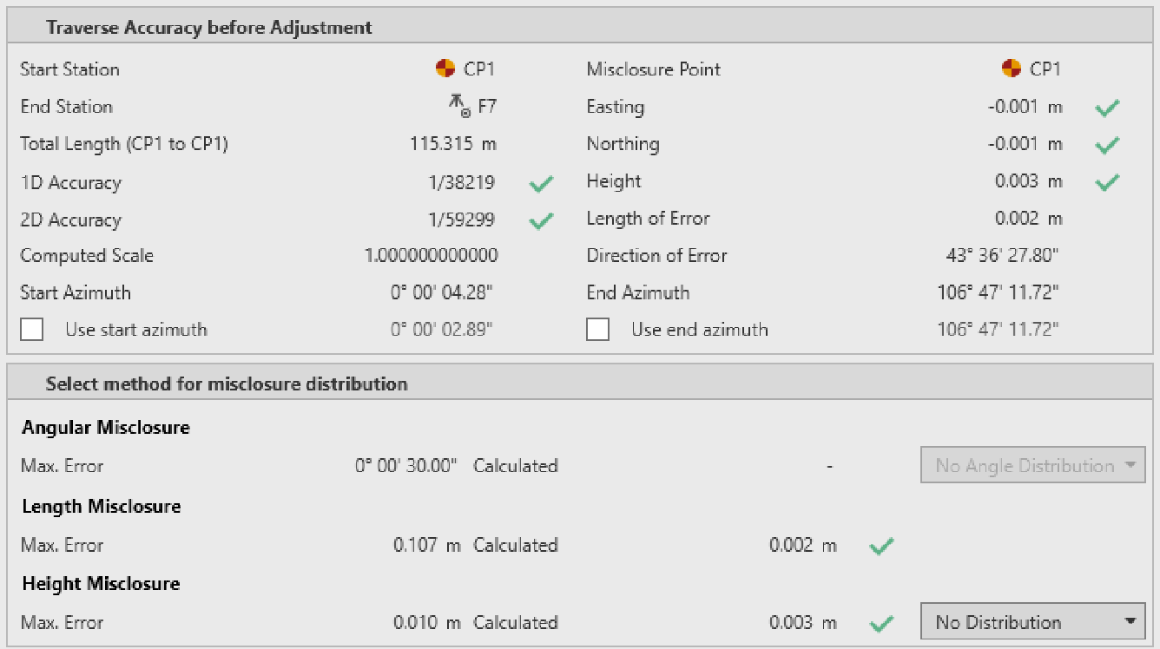
Office Processing
Notes:
Vendor software was used to verify the traverse loop closure met tolerance. The maximum distance misclosure was 2 millimeters while the height misclosure was 3 millimeters.

Slide 20
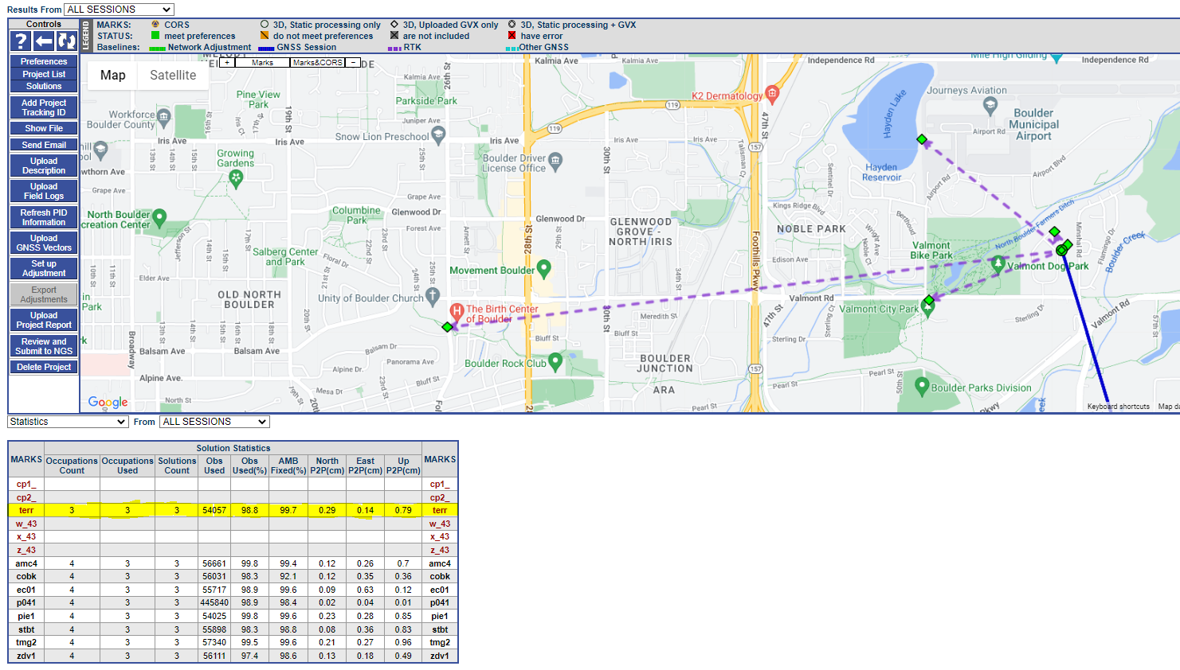
Office Processing
Notes:
In OPUS Projects, through baseline GPS Processing of our base station on the Terrace, the maximum peak-to-peak differences for the three sessions was less than 1 cm in North, East and Up comparable to the NOAA CORS solution statistics.
What you’re not yet seeing on this page are the solution statistics for the RTK observations.

Slide 21
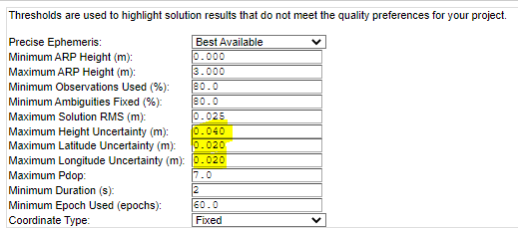
Office Processing
Notes:
Those can be found in the GVX file page. By default, OPUS Projects will flag any uncertainties that exceed more than 2 cm Horizontal and 4 cm in Height. If there were a problem with any one of these vectors not meeting preferences, the user has a capability of excluding them from the adjustment.

Slide 22
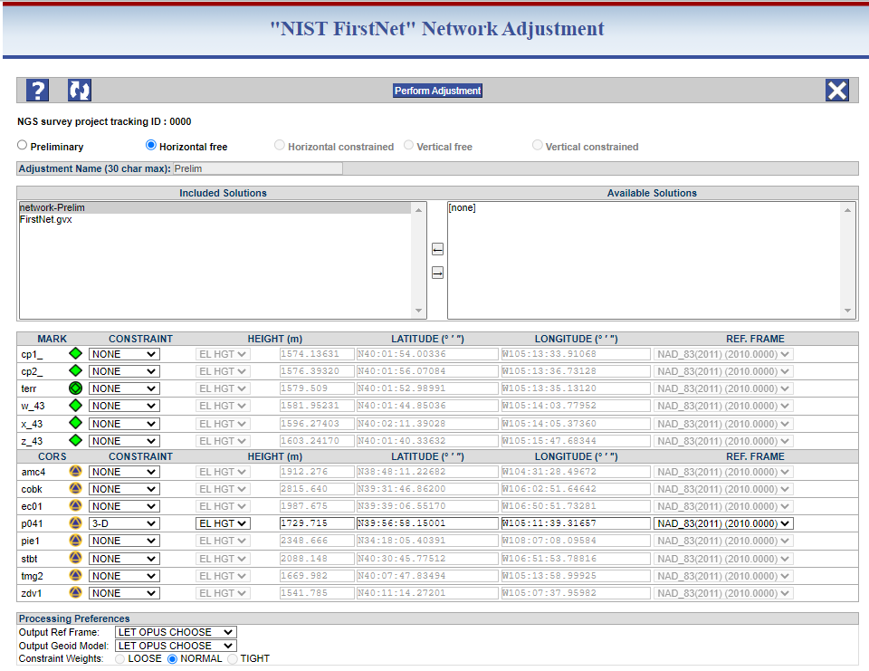
Office Processing
Notes:
The adjustment process to align the survey to the NSRS is fairly straightforward so long as the user has an understanding the quality of the CORS and the observations going in are reflected in the results that come out. There are 5 steps in the adjustment sequence to align the survey to NAD 83 and NAVD 88. Following the first “preliminary” adjustment, the user is directed to perform a minimally constrained horizontal adjustment (or FREE Adjustment) holding the nearest NCN CORS as the 3 Dimensional fix in Latitude/Longitude and Ellipsoidal Height.
In the above example, you will also see the RTK vectors are also included in this adjustment.

Slide 23
Office Processing
Notes:
The following Adjustment allows the user to constrain the NCN CORS as well as any Passive NSRS Control. In this example, we can see that one of our RTK observed stations is selected to be constrained in 3D. This adjustment will provide a result of how well our RTK Rover observation of this mark compares to the Published NSRS Position.

Slide 24
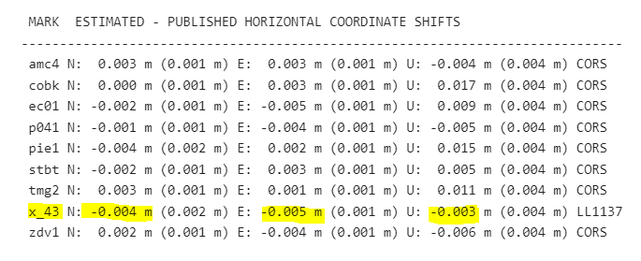
Office Processing
Notes:
The result of the Horizontal Constrained Adjustment show good agreement between the Observed to Published NAD 83 coordinates including our RTK observation of X 438.

Slide 25
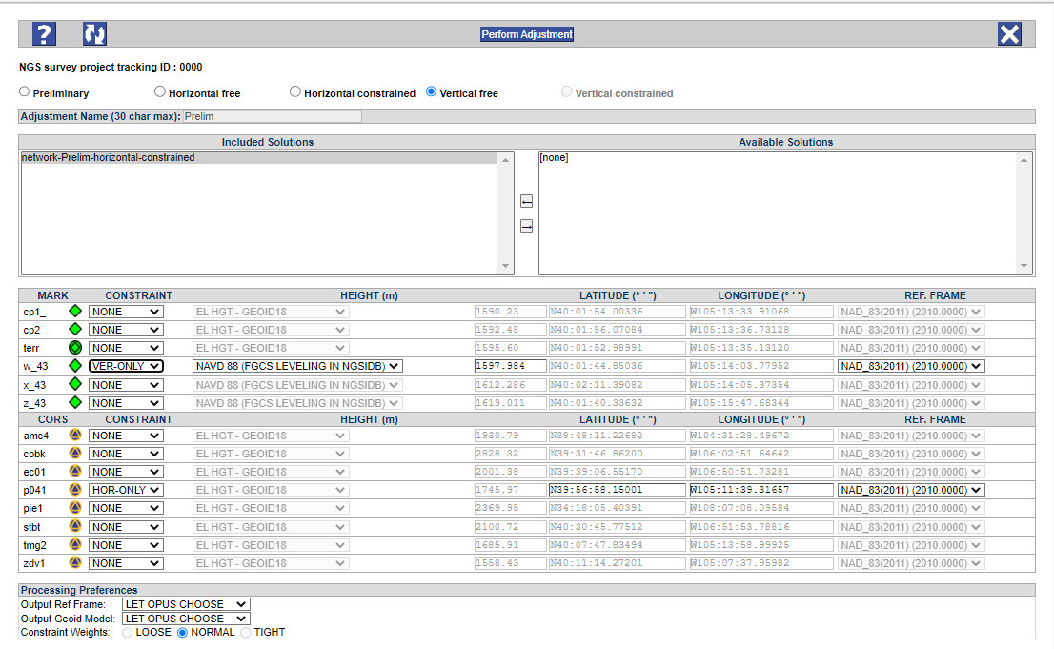
Office Processing
Notes:
Our Vertical Free Adjustment comes next, holding a single NAVD 88 1st Order, Class II bench mark. This mark was collected using RTK.
Only a single CORS is used for the Horizontal Constraint.

Slide 26
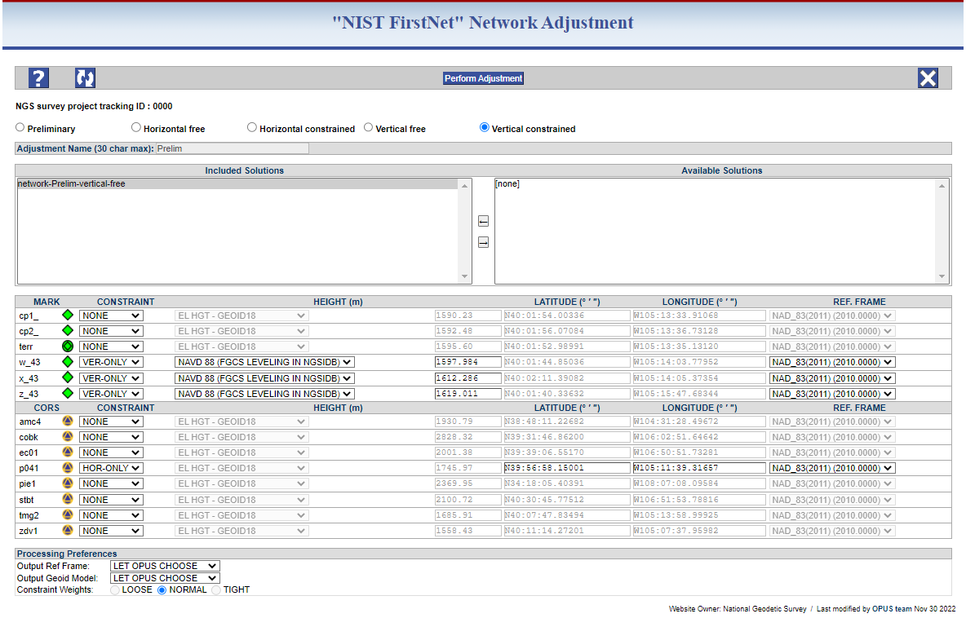
Office Processing
Notes:
Our Final Adjustment is the Vertical Constrained Adjustment where we constrain the 3 NAVD 88 Bench Marks as well as the Horizontal Only position of the single CORS.

Slide 27
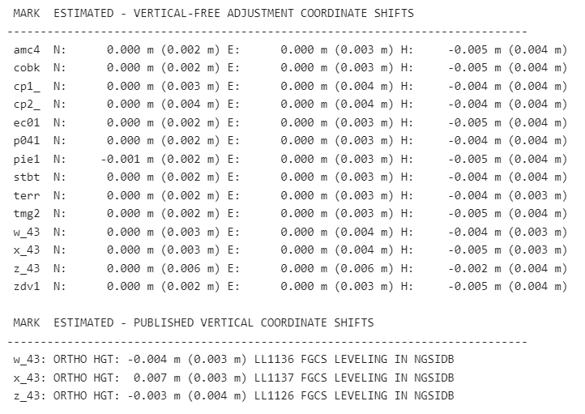
Office Processing
Notes:
The Vertical Constrained adjustment output shows that there were minimal shifts from the Free to Constrained adjustments. The information at the bottom provides an adjusted to published comparison result. If there were a problem at one of these marks, we could go back to the constraints and choose to unconstrain one of them. In this case, we had very good agreement, so all of the NAVD 88 ties will be used.

Slide 28
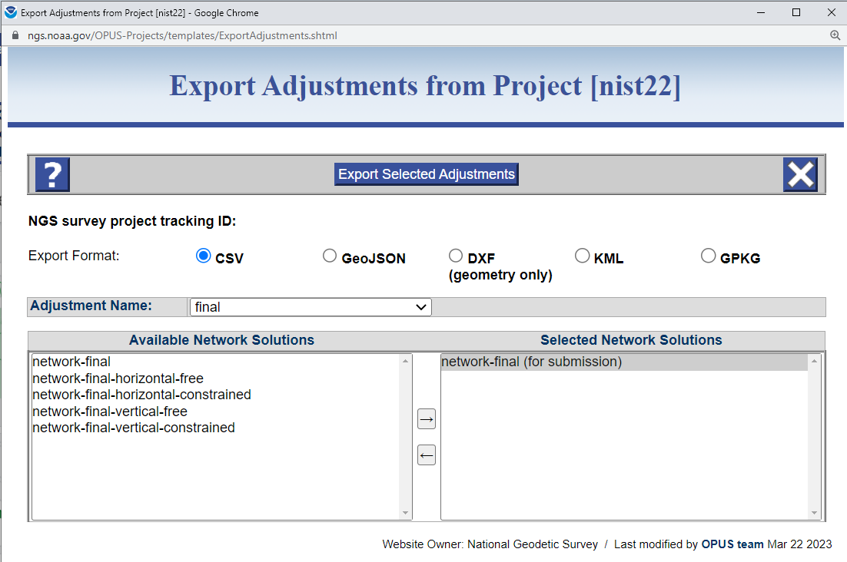
Office Processing
Notes:
Finally, the final coordinates in State Plane zone CO N-0501 and Orthometric heights were exported from OPUS Projects were imported into Leica Infinity to transform the control points to the final NSRS Adjusted values.

Slide 29
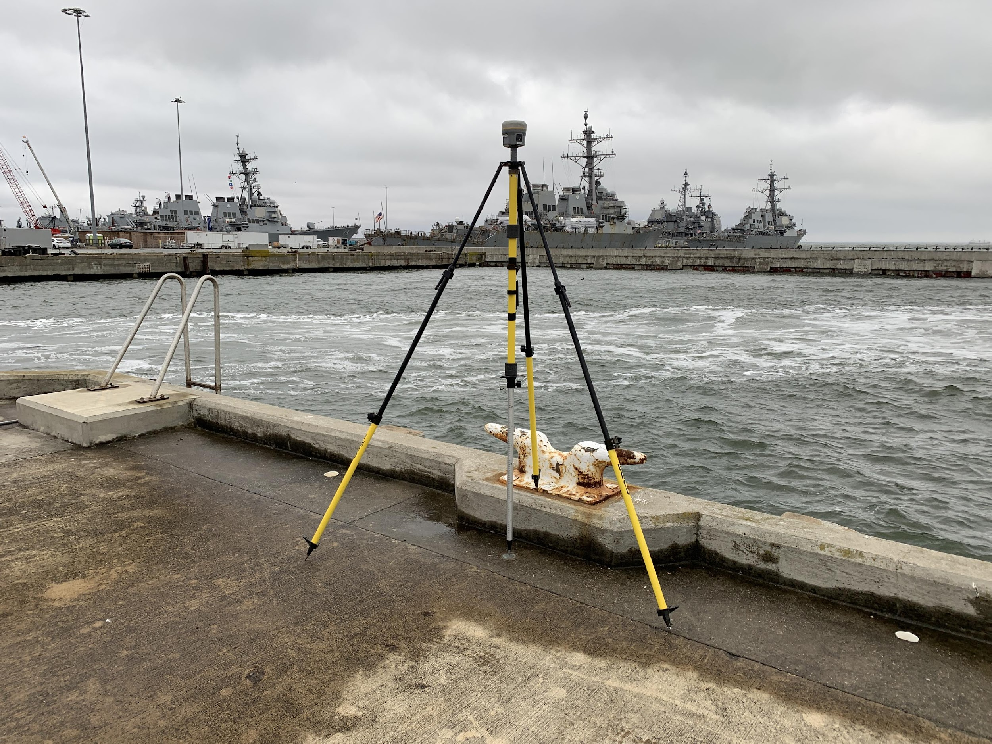
Thank You!
Notes:
On a final note; The continued testing and analysis of RTK/RTN capabilities and align these surveys to the NSRS has many rewards, but to just name a few; Increased efficiency, a post-NSRS Modernization Workflow, and real-life examples that we can use to help advise our constituents to better align their projects to the NSRS.

