Slide 1
The NOAA CORS Network (NCN) Services
John Galetzka
Geodetic Infrastructure Branch Chief
National Geodetic Survey
FIG 2023 Working Week
Orlando, Florida, USA
Notes:
--Promise the audience that they will learn something about the NOAA CORS Network, or NCN for short.
--Acknowledge the CORS team, original and new members
--the CORS contributors,
--and the many behind-the-scenes people NGS who support CORS such as PAGES team, Field Operations Branch, admin, front office
--Share biography?

Slide 2
Notes:
--This is the network at the end of 1994
--The Cooperative International GPS Network was established in 1989 and later turned into the International GNSS Service

Slide 3
Notes:
--Today the NOAA CORS Network has more than 1800 stations throughout the United States, its territories and a number of other countries
--The network is an important part of the National Geodetic Survey and its mission to establish and maintain the NSRS
--More than 200 contributors ranging from government, academia and the commercial sector.
--Spacing

Slide 4
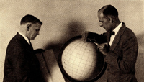
Well I’ll be!
There is a CORS in Barrow, Alaska!
Notes:
OUR GUIDELINES
--Operators are expected to share data, keep NGS informed about any planned outages, changes in equipment/firmware/physical space surrounding antenna;
--siting
--construction
--maintenance
--uptime
PRODUCTS, SERVICES AND ACCESS
--Free to public since Feb 09, 1994, including:
--GPS/GNSS observation in the form of RINEX files
--Daily broadcast ephemerides
--Station logs
--Official coordinates and velocities with respect to the ITRF and NSRS derived from IGS ”repros” our own Multi-Year CORS Solutions (explain...)
--OPUS support (explain...)
--WE DON’T PROVIDE RTK CORRECTIONS, BUT WE DO INTEND TO WORK ON PROVIDING REAL TIME DATA STREAMS TO THE IGS TO SUPPORT ULTRA RAPID ORBITS, CLOCKS, ETC.
THE FUTURE
--Troposheric and roducts to support Meteorology
--Additional data to support GNSS Reflectometry for water level, snow accumulation and soil moisture monitoring
--Ultra-rapid orbits to contribute to the IGS
SEGWAY TO THE NEXT SLIDE ABOUT FCORS...

Slide 5
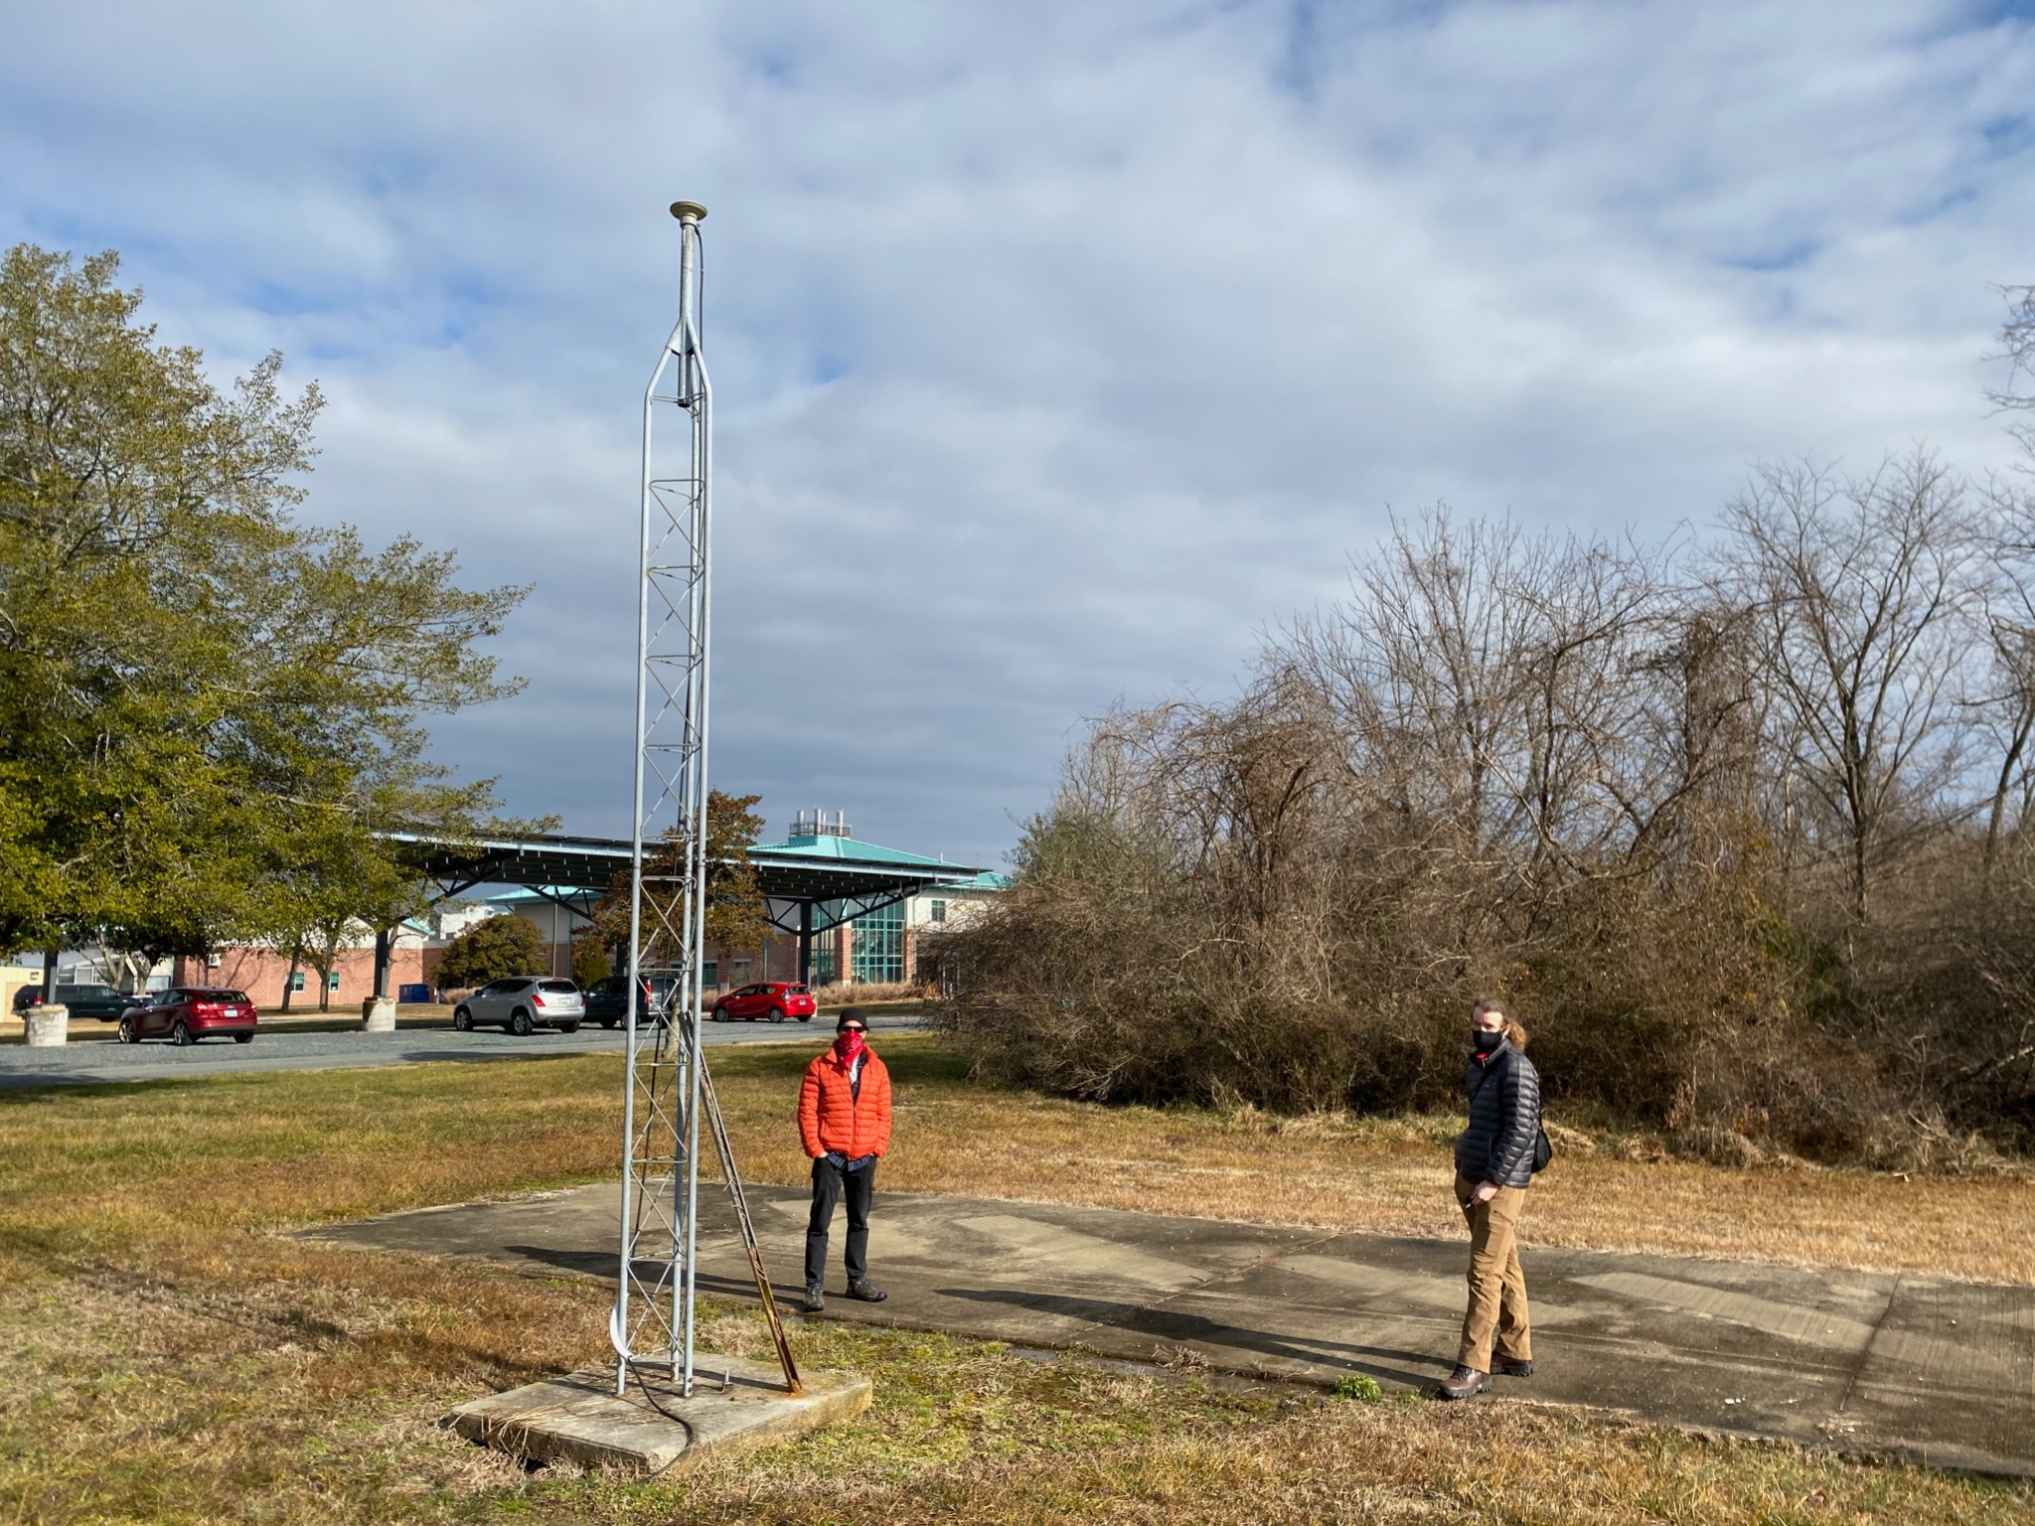
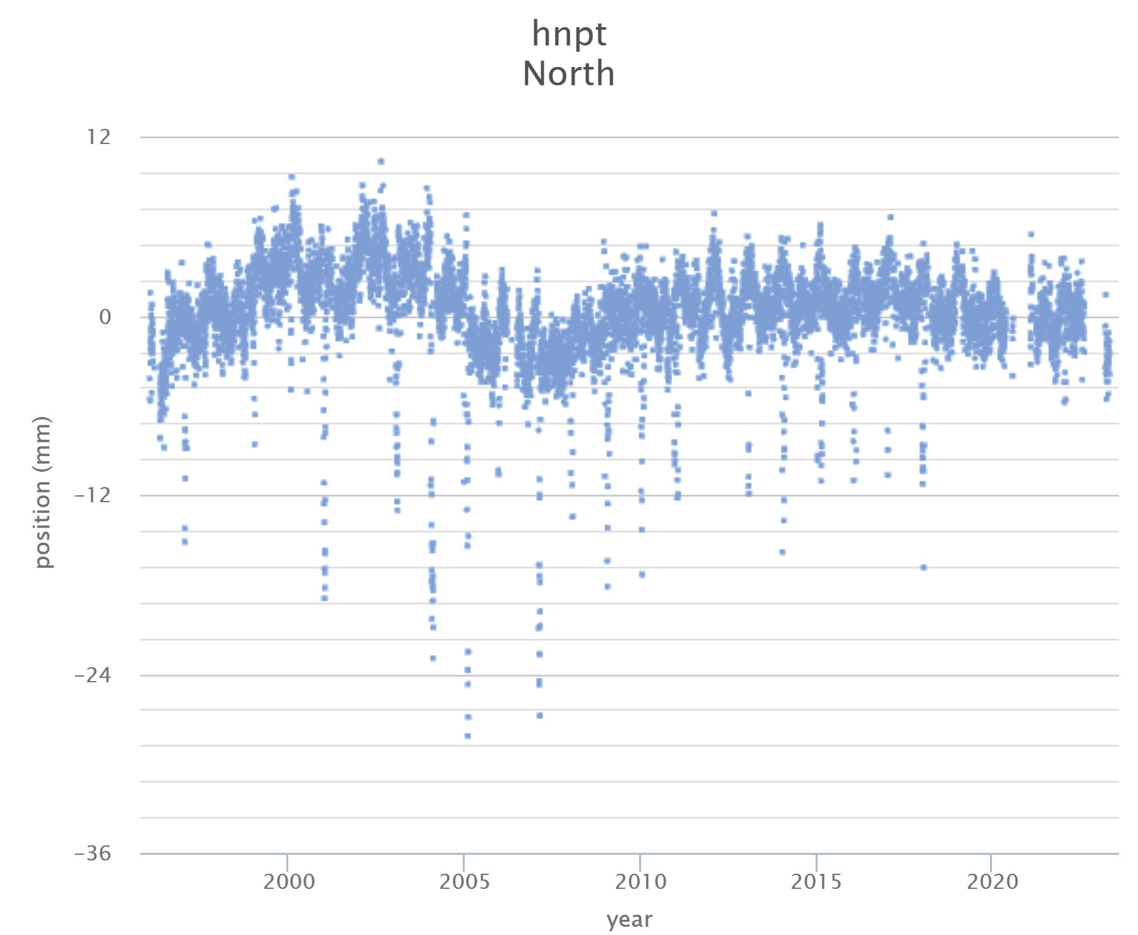
SOPAC MGVIZ online visualization tool http://mgviz.ucsd.edu/?mission=ESESES#

Slide 6
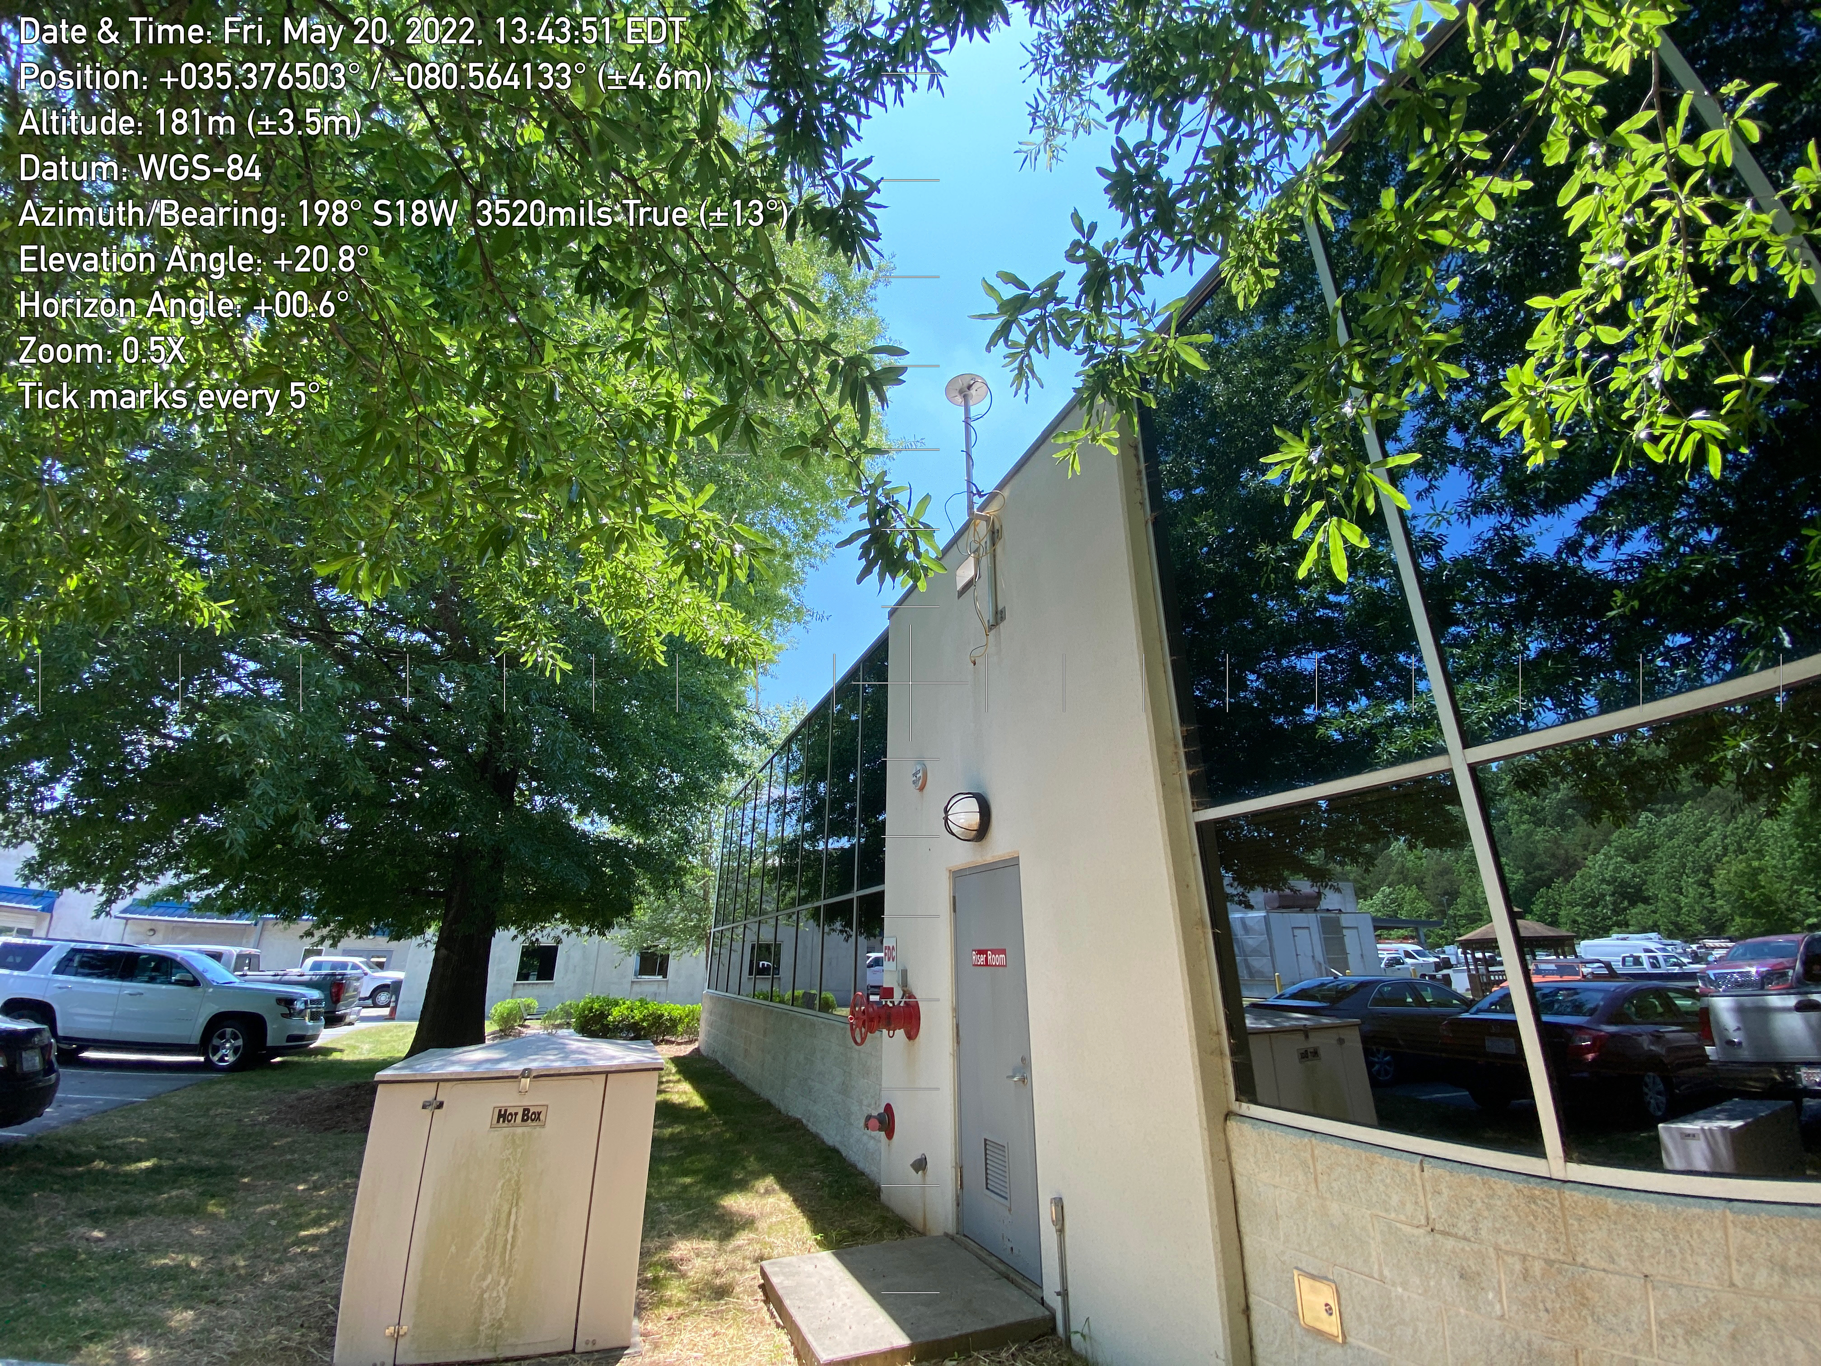

Slide 7
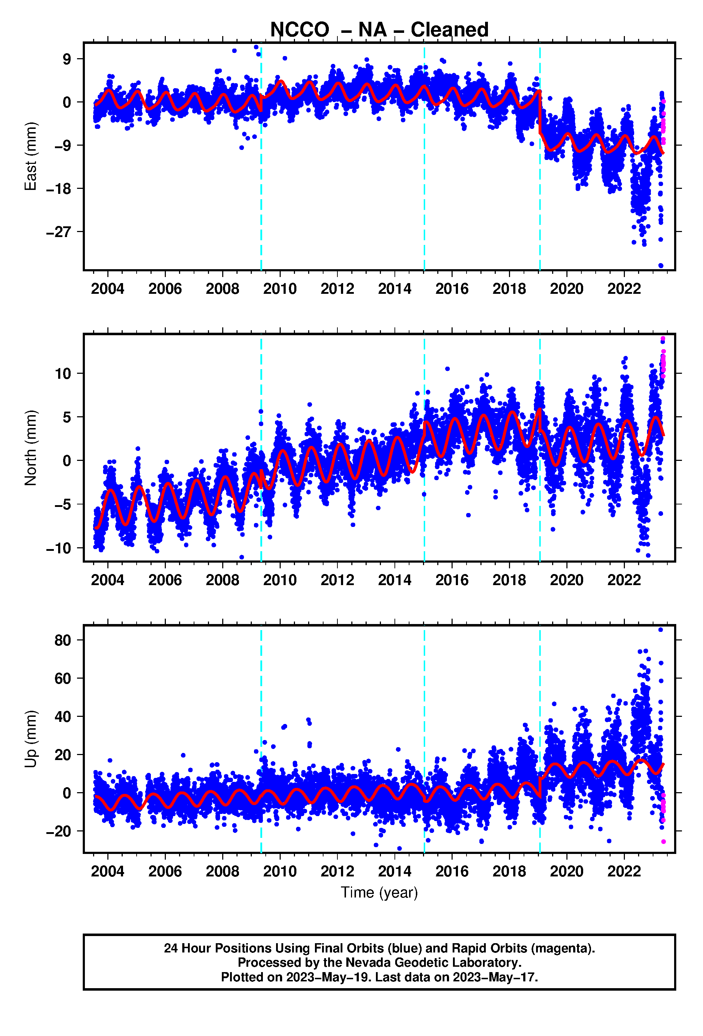
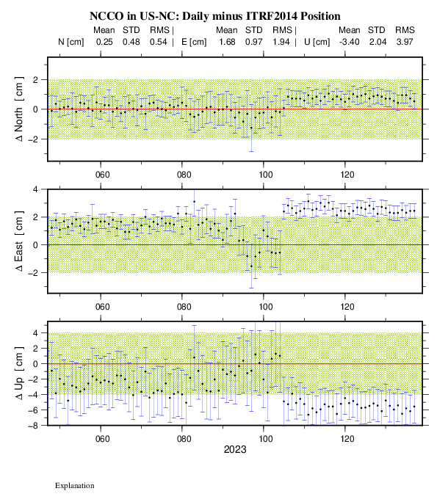
Nevada Geodetic Laboratory
http://geodesy.unr.edu/NGLStationPages/stations/NCCO.sta
Notes:
--1800 operational vs 2800 total.
--NCCO is an example of a station that did not end up in the decommissioned CORS graveyard

Slide 8
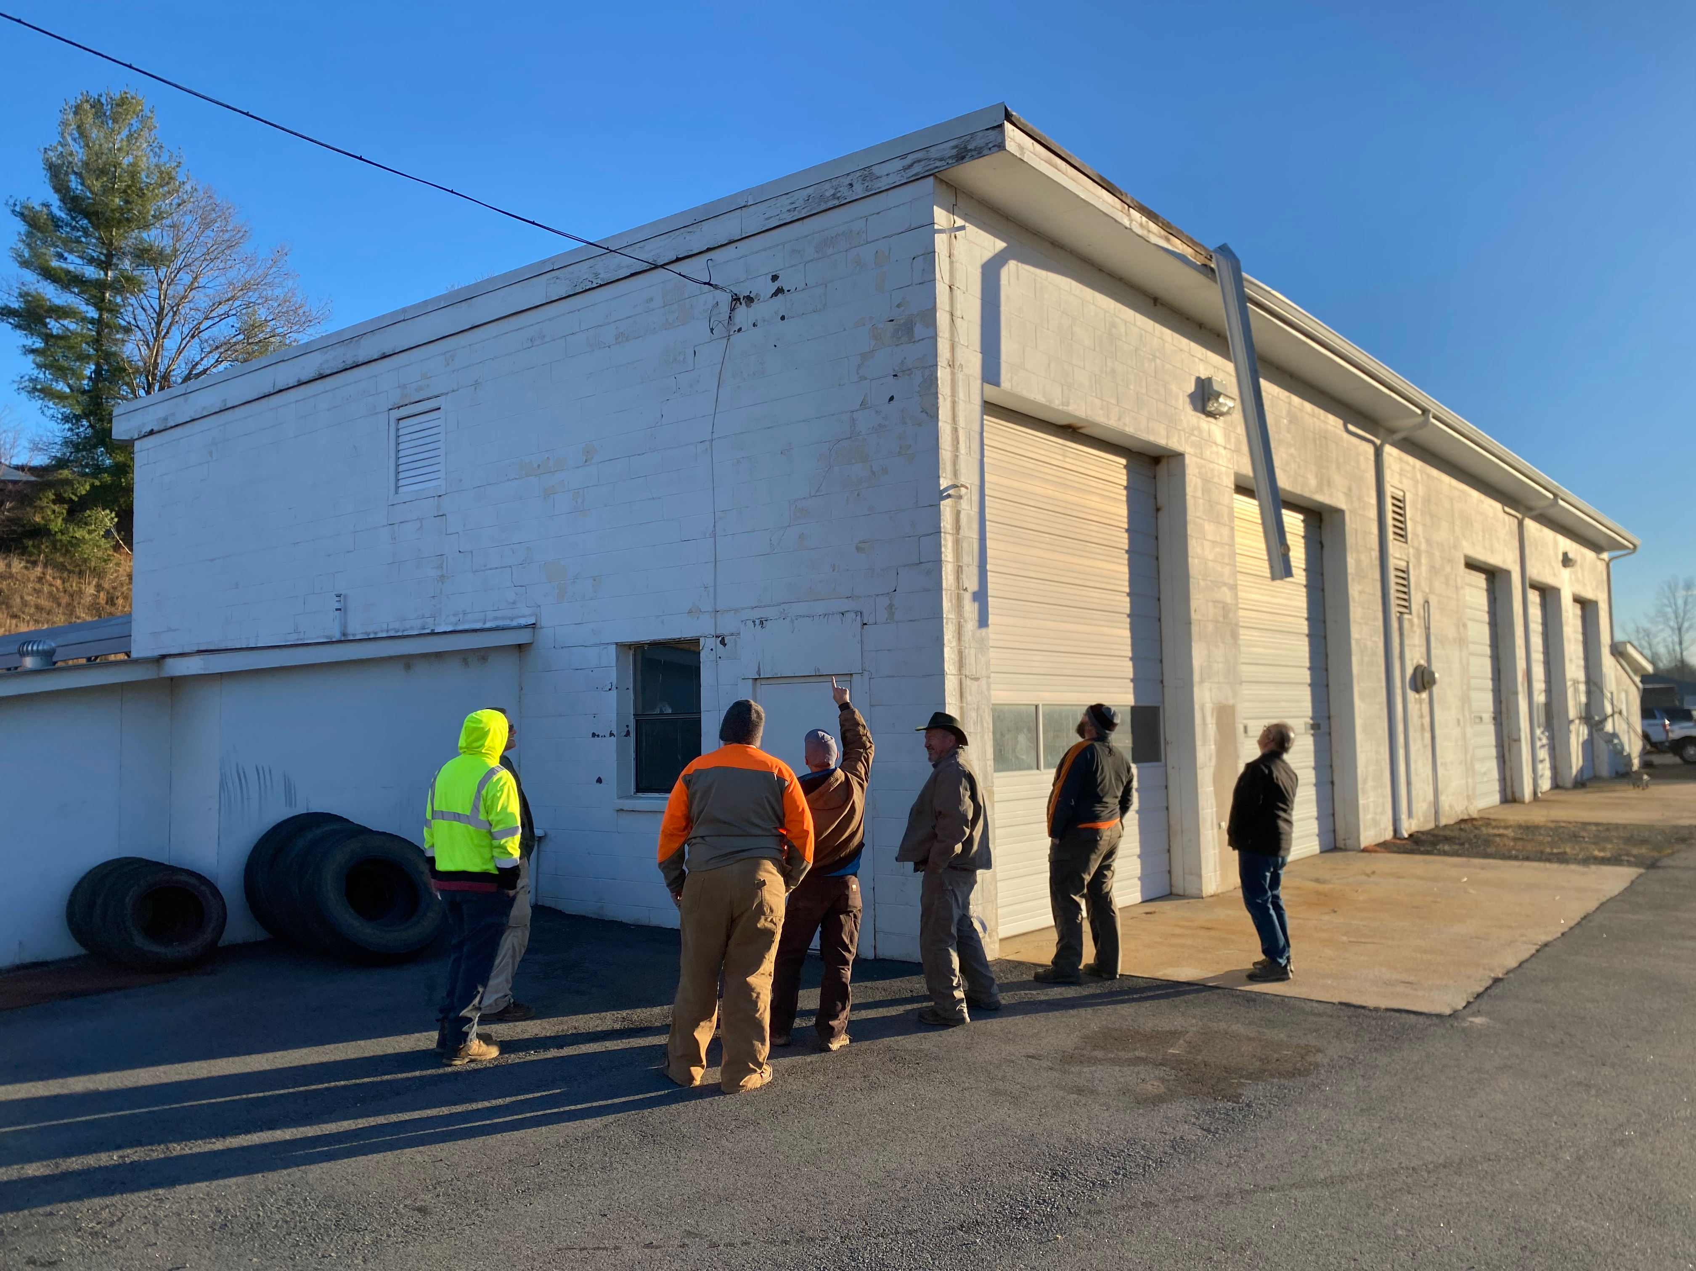
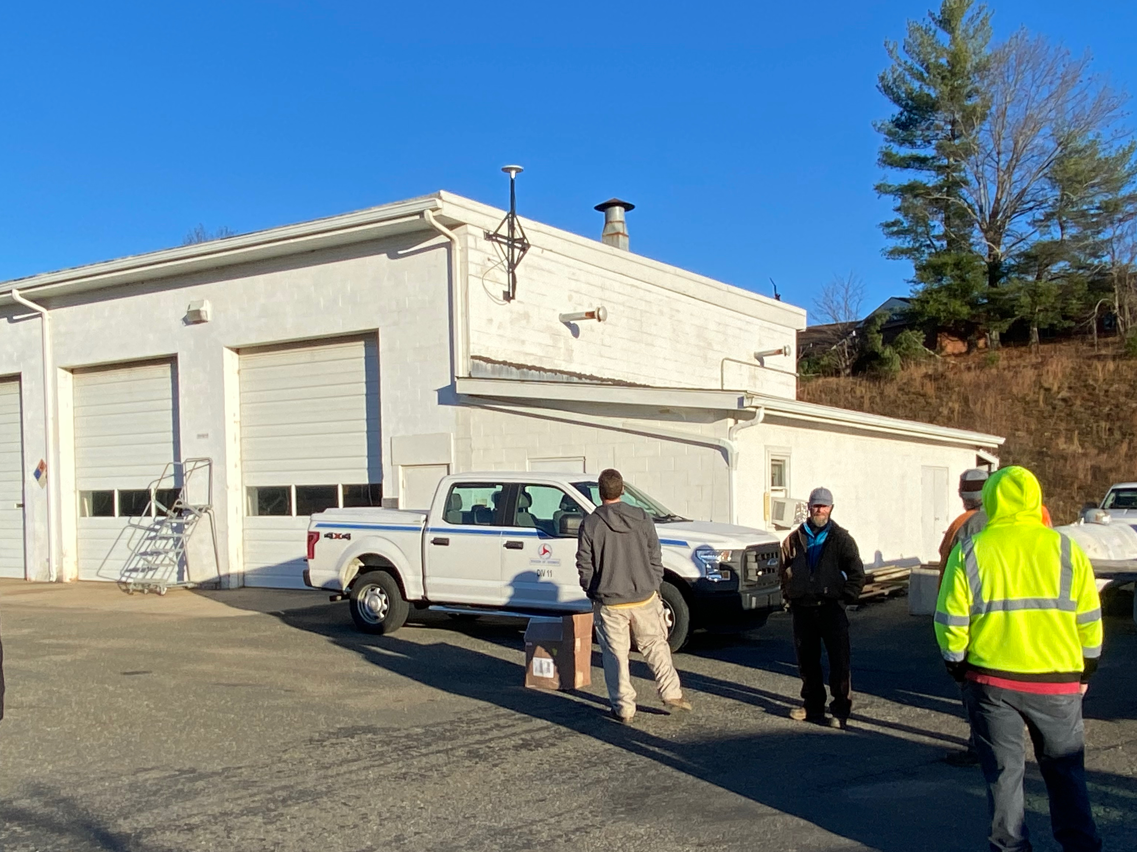

Slide 9
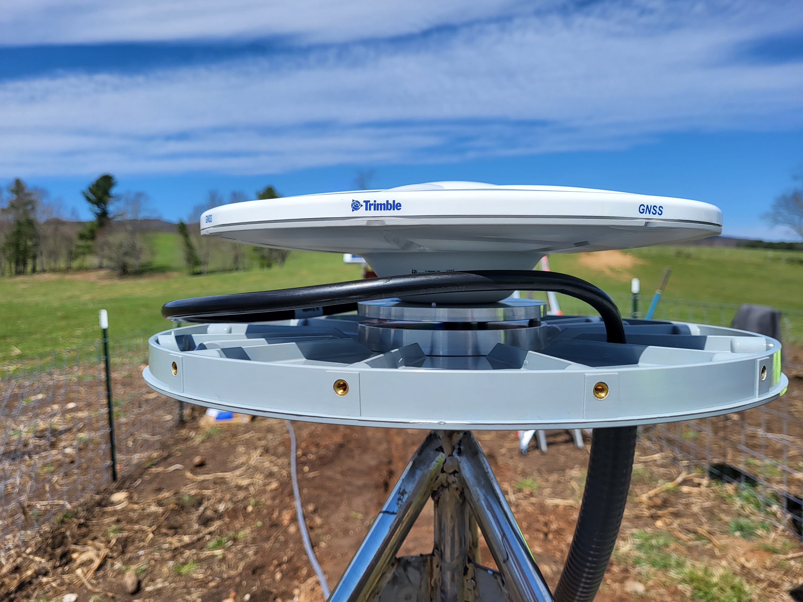
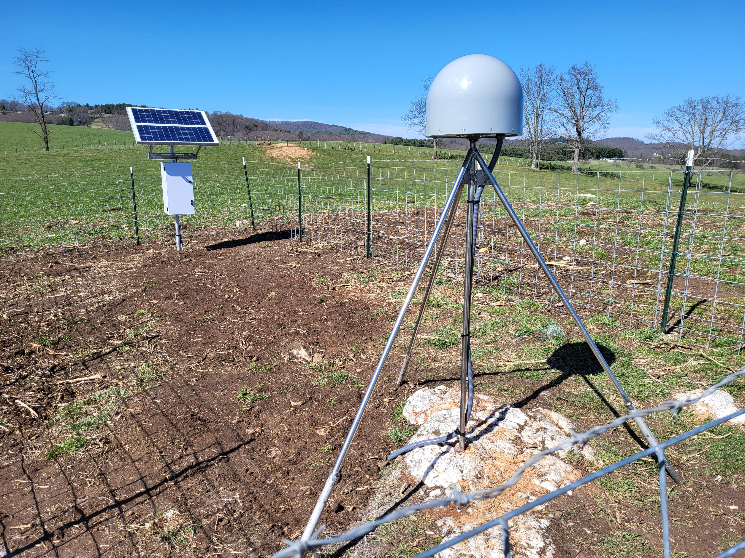
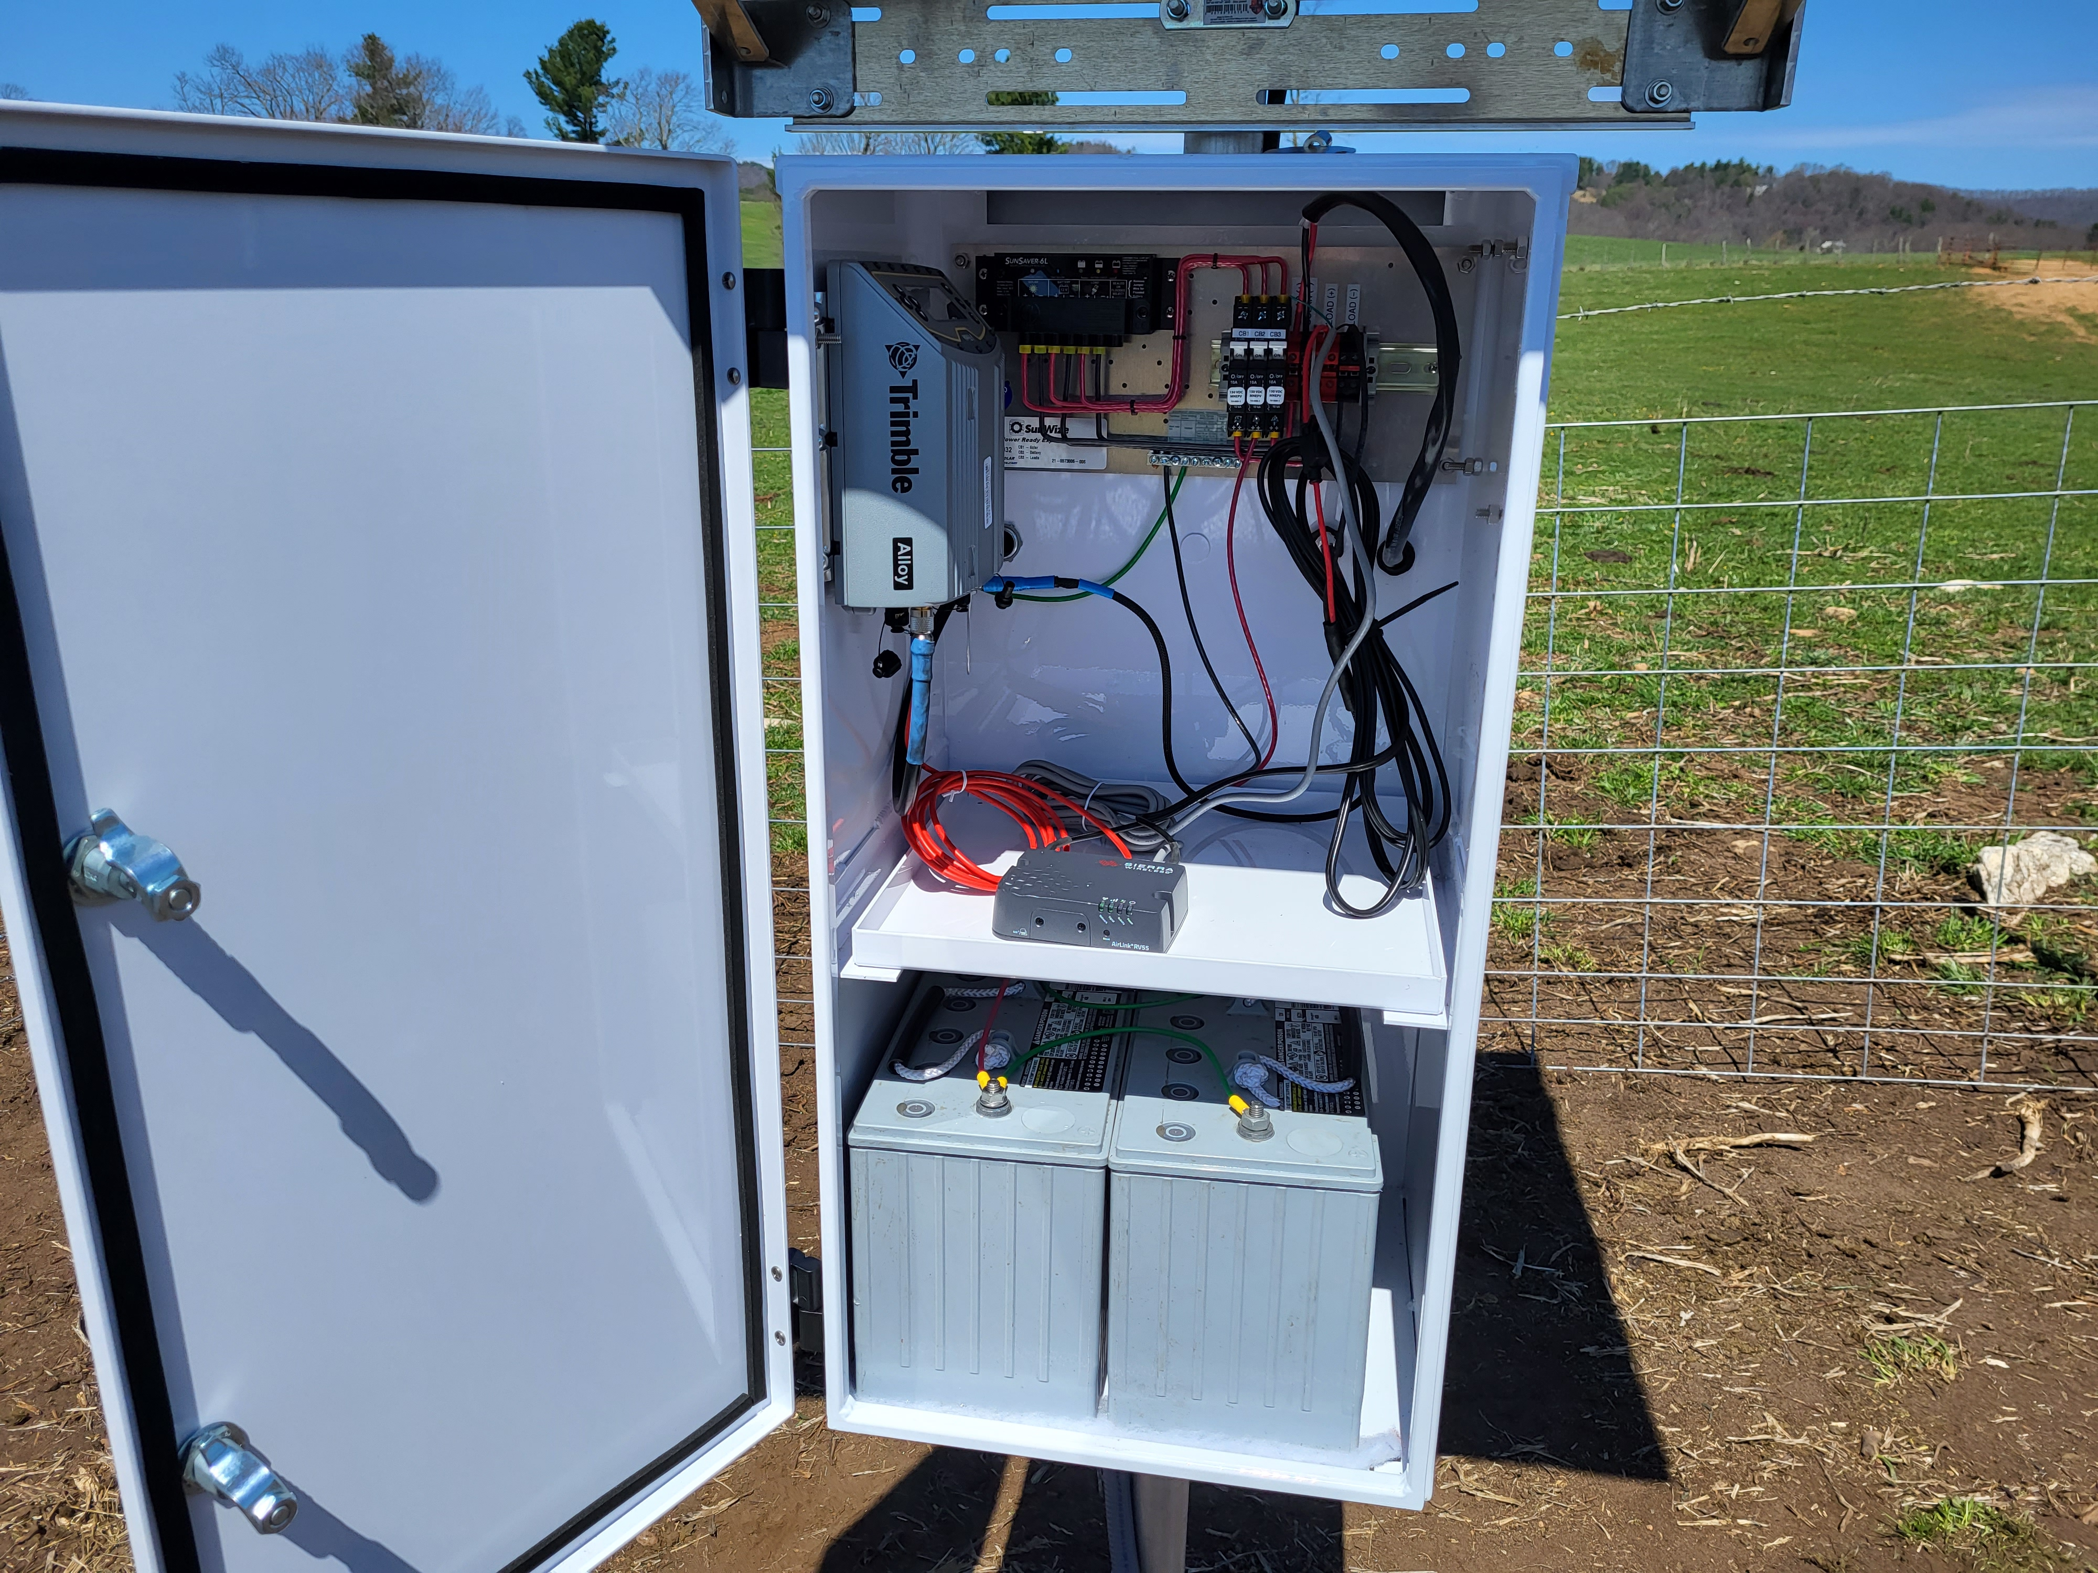
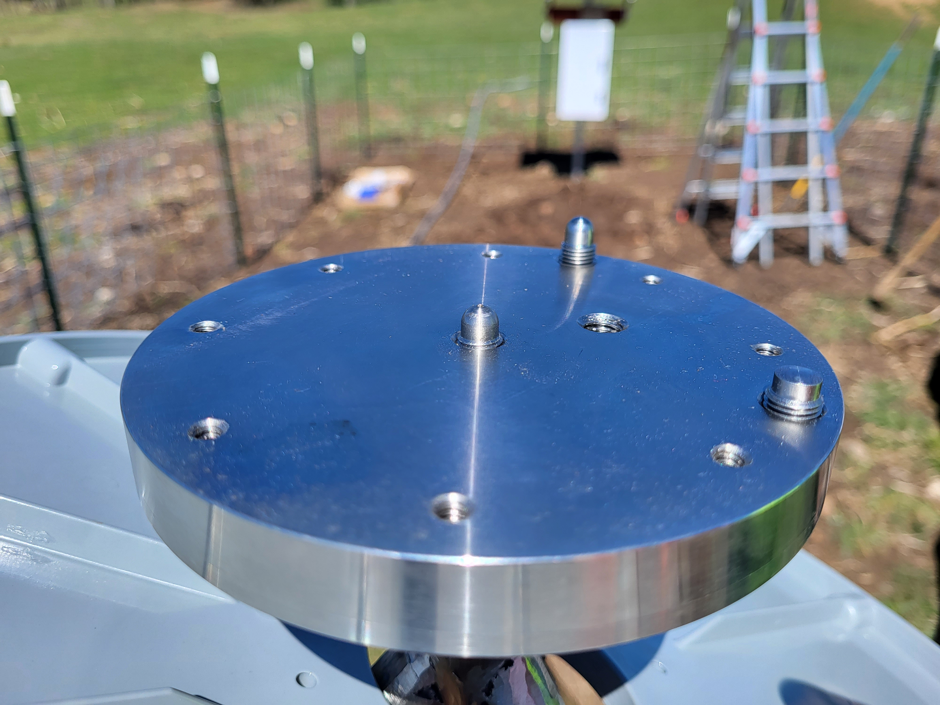

Slide 10
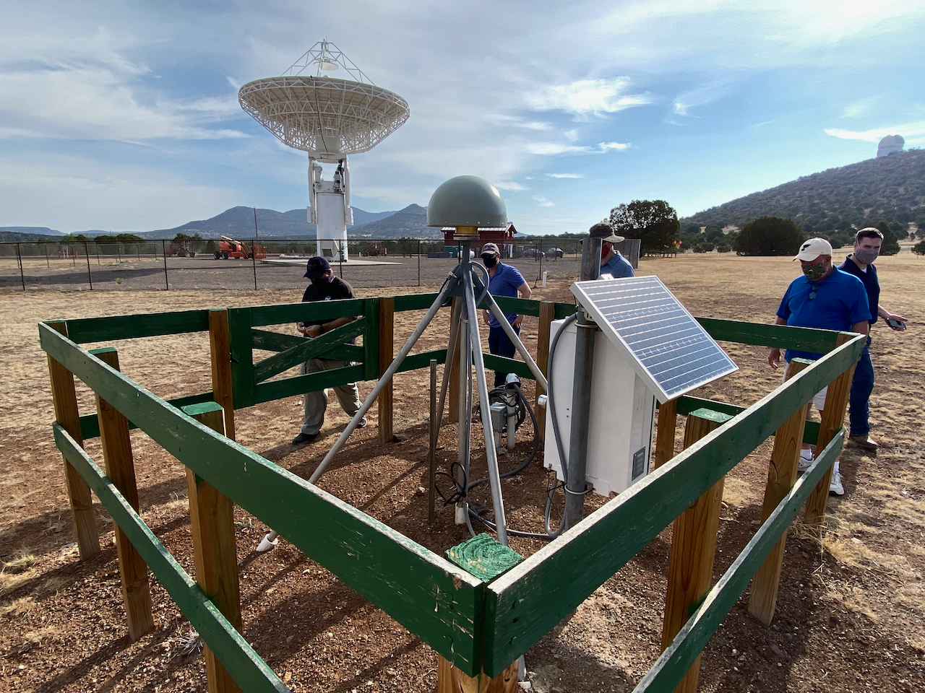
Notes:
FOUNDATION CORS
--A federally controlled network
--Provide support for the ITRF through ties to the three other space geodetic techniques, determining poles and rates of rotation for North American, Pacific, Caribbean and Mariana tectonic plates; and filling in large geographic gaps
--Operational Time:
Network availability >90% at all times;
Individual station down time < 14 days;
--In 2022, NGS received enough funding from BIL to install high quality NGS’s owned stations.

Slide 11
Summary

Slide 13
Target 20 slides - More pictures
The Theme for this Working Week is "Protecting Our World, Conquering New Frontiers." To achieve this, geospatial data from many different sources must be interoperable and defined within a modern, accurate, inclusive reference frame. The National Oceanic and Atmospheric Administration’s (NOAA) mission to understand and predict changes in climate, weather, ocean and coasts also includes a mandate to define, maintain and provide access to the National Spatial Reference System (NSRS). Tracing roots back to the first federal scientific agency in the United States, NOAA's National Geodetic Survey (NGS) enables mapping and charting and provides the framework for positioning in the U.S. through the NSRS. The NSRS modernization, underway for a decade and nearly complete, will align the critical U.S. geospatial data assets within global data inventories and enable improved analysis and modeling of climate changes and impacts to society and the environment. The modernized NSRS enables data integration of new and old technologies, adopts modern standards and empowers growth in new fields and applications.

Slide 14
Outline
Historical Context
DOC/NOAA Strategic plans
But things have Changed- GGRF and ITRS
GDA - Must Use New Standards and Norms
FGDC - All Govt agencies with Geospatial Data
OMB Circular A16 - All agencies must use NSRS
We must migrate in a way that is consistent with the needs of our customers - NSRS Modernization
How NGS@FIG Day will address how we plan to do this
Direct of Indirect business with the government also requires following these rules
Geospatial Knowledge Infrastructure - Who does it impact - Not just the Gov agencies
We are making tools to enable customers to get the level of accuracy needed cost effectively
NGS Data Offereings

Slide 15
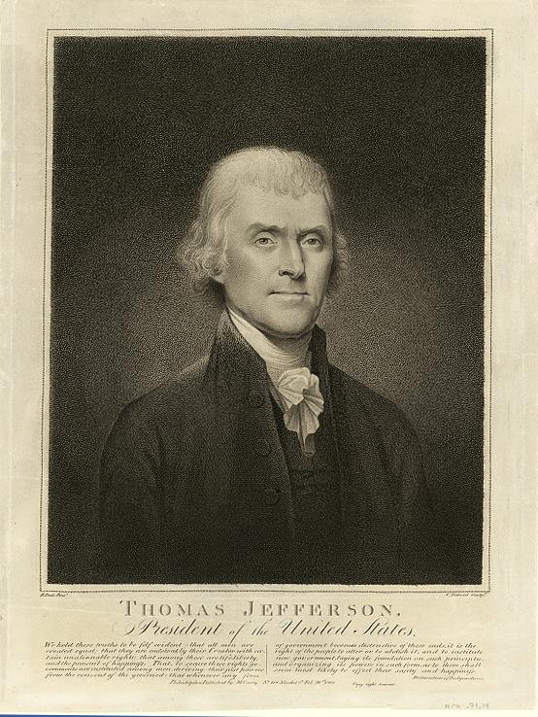
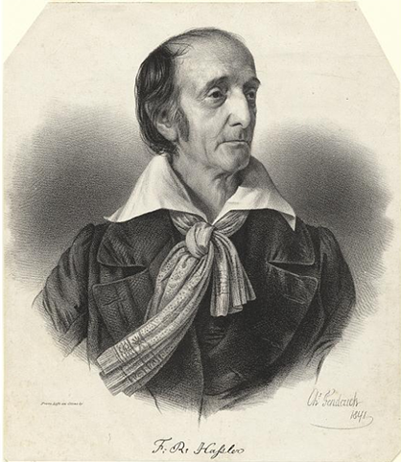
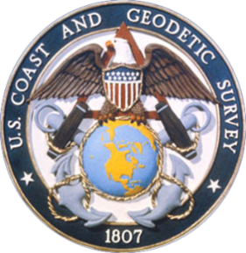
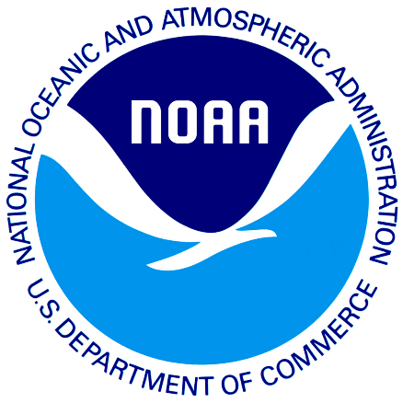
NOAA and NGS
Our Nation’s First Civilian Science Agency
1807
Thomas Jefferson
Survey of the Coast
1811
Ferdinand Hassler
Superintendent
1836
U.S. Coast
Survey
1878
U.S. Coast and
Geodetic Survey
1970
NOAA is established
Notes:
NGS has been around a long time. For more than 200 years, NGS and its predecessor agencies have collaborated with public and private organizations to establish reference stations at precisely determined locations.
We began on a mission established by Thomas Jefferson in 1807 to conduct a “Survey of the Coast” (as the United States Coast Survey).
(Pictured are Thomas Jefferson and Ferdinand Hassler, the first Superintendent of the Coast Survey). We were renamed the U.S. Coast and Geodetic Survey in 1878. NOAA was established in 1970.
Traditionally, precise positioning locations have been identified by setting a survey mark—usually a brass, bronze, or aluminum disk. Locations might also be identified by a deeply driven rod, or a prominent object, such as a water tower or church spire.

Slide 16
NGS@FIG Day Agenda
11:30 - 13:00- Practical implications of National Spatial Reference System (NSRS) Modernization
Practical impacts of the modernized NSRS
Canada’s implementation of the modernized frames
Changes Afoot: State Plane 2022 and Retirement of the U.S. Survey Foot
Preparing for the Modernization of the NSRS
Q&A
14:30 - 16:00- Update on the NOAA CORS Network and OPUS
The NOAA CORS Network (NCN) Services
Updating OPUS-S to Support Multi-GNSS
OPUS-Projects 5: Supporting RTK for Establishment of Geodetic Control
OPUS-Projects for Manager’s Training - Transitioning from Instructor-led to Online, Self-paced instruction
Augmenting Data exchange formats for OPUS of the future
Q&A
16:30 - 18:00- Case studies of Surveys NGS does now and how they will change
Implementing NGS OPUS Projects’ GVX feature to align RTK vectors to the NSRS to establish Geodetic Control for FirstNet Indoor Mapping.
IGLD: A case study for leveraging digital tools to enhance QA/QC on large scale static GNSS observation campaigns
Geodetic Leveling in the Modernized NSRS
NGS Field Operations: Modernizing in Many Ways
Q&A
Closing Remarks by Director of National Geodetic Survey

