Slide 1
Geodetic Leveling in the Modernized National Spatial Reference System
Ben Erickson
May 31, 2023

Slide 2
Differential leveling
Setup of Leveling, Δh = B – F
Rod 1
Rod 2
Backsight
Foresight
B
F
Δh
S_{B}
S_{F}
S

Slide 3
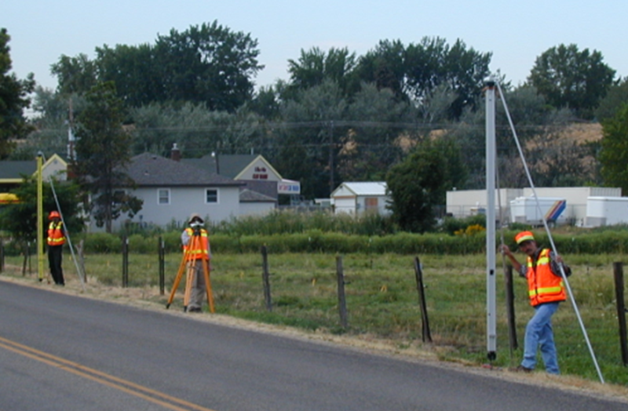
Differential leveling
B
Topography
A
C
Notes:
Leveling is a very “simple” survey practice - determining elevation differences through use of conventional leveling procedures – through backsight minus foresight measurements between points A to B and B to C.
Differential leveling surveys, being a “piecewise” metric measurement technique, accumulate local height differences (dh).
But, being a piecewise metric measurement system, we must also be aware and account for factors affecting our understanding and use of height interpretations.
Traditionally, orthometric heights can be considered as a distance (elevation difference) above a reference surface or datum.

Slide 4
Differential leveling
Very accurate differential heights. Precision < 1 mm.
Time consuming, expensive.
For absolute positioning, starting heights must be known.
Current method:
Start from passive bench marks with heights published in NGS’s vertical datum, NAVD88.
Establish heights on new marks via leveling.
Notes:
Knowledge of precise heights is important for understanding water flow, alignment tasks, construction.

Slide 5
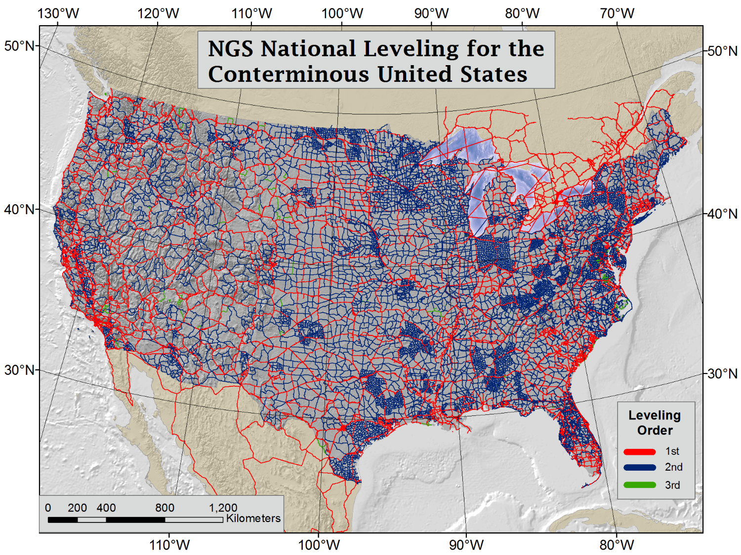
Credit: Brian Shaw

Slide 6
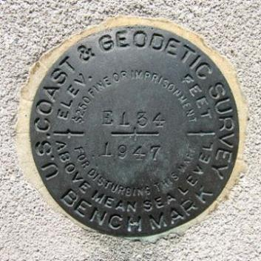
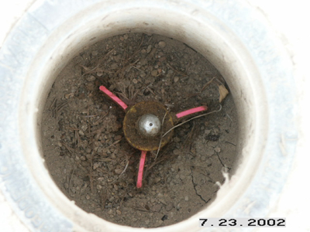
Ties to Existing Vertical Control
A
B
2 Mark Tie
1
2
3
4
Existing BM
New BM
Single Run Leveling
Double Run Leveling
5
6
R
S
2 Mark Tie
Notes:
Must tie into existing control. The existing control must be validated. If not, go further out and find additional marks.
The classification of your work is dependent on the classification of the marks you tie into.
This image: 2nd Order, Class I. 2 mark tie and each end.
Tie points should be 0.5 km apart to mitigate susceptibility to local disturbances.

Slide 7
Leveling today: assumptions
Published marks are available near the project area.
Historic level lines must have been previously run.
Mark still exists and is recoverable.
Marks are often lost or destroyed without being replaced.
Mark has not moved.
Stability of setting, damage, subsidence, uplift.
Published coordinates are accurate & consistent.
Coordinates may be “stale”.

Slide 8
Leveling in the modernized NSRS
Starting heights need not come from historic level lines.
Most reliable source will be from new GNSS occupations of primary control marks included in the level survey.
Static, RTK, RTN.
Obtain orthometric heights from GNSS ellipsoid height and high-resolution geoid model.

Slide 9
GNSS-derived orthometric heights
H ≈ h - N
H_{NAPGD2022}(t) = h_{NATRF2022}(t) – N_{GEOID2022}(t)
h
H
Ellipsoid
N
Geoid
Ocean
Credit: Dan Gillins
Notes:
Note the time-dependency!

Slide 10
Primary control marks
3 marks minimum.
Provide access to NAPGD2022 orthometric heights.
30 km max distance.
GNSS occupations to obtain coordinates at an epoch representative of the survey (e.g., the midpoint date).
2 occupations minimum at the beginning of leveling.
2 occupations minimum at the end of leveling.
For projects over 6 months, 2 occupations near the middle of leveling.
Notes:
(GNSS specs based on NOAA Technical Memo NOS NGS 92.)

Slide 11
Additional marks for leveling
Leveling-only secondary marks are set as needed for the project.
Nominal spacing of 1-3 km for level lines.
Double-run leveling (forward/backward) connects the primary marks to the other marks.

Slide 12
GNSS and leveling
GNSS-derived orthometric heights
Leveling marks
Double-run leveling
Credit: Dan Gillins

Slide 13
Establishing heights
At the primary control marks:
GNSS occupations are processed into NATRF2022 coordinates at the survey epoch.
Coordinates combined with GEOID2022 to produce orthometric heights at the survey epoch.
Orthometric heights used as vertical control for adjustment of the leveling data.

Slide 14
Establishing heights
Uncertainties will be propagated through the processing sequence. Sources include:
$σ_{h}$ from GNSS observations (cm level).
$σ_{N}$ from GEOID2022 model (cm level).
$σ_{∆H}$ from leveling observations (mm level).
In the adjustment, the controlling orthometric heights will float according to their uncertainties (held as stochastic constraints).

Slide 15
Establishing heights
Per the weighting scheme…
Absolute accuracy is determined by the GNSS (network accuracy).
Relative precision of the leveling is maintained (local accuracy).
Corrections are applied to leveling for systematic effects.
Astronomic, orthometric, gravity, atmosphere, instrument calibration.
End result: adjusted orthometric heights for all points in the project at the survey epoch.

Slide 16
GNSS and leveling adjustment
ΔH
ΔH
H₂
H₁
Geoid
Credit: Dan Gillins

Slide 17
GNSS and leveling adjustment
ΔH
H₂
ΔH
H₁
Geoid
Credit: Dan Gillins

Slide 18
GNSS and leveling adjustment
ΔH_{adj}
H_{2,adj}
ΔH_{adj}
H_{f}
H_{d}
H_{e}
H_{1,adj}
H_{b}
H_{c}
H_{a}
Geoid
Credit: Dan Gillins

Slide 19
Conclusions
In the modernized NSRS:
Leveling will remain the premier technique for obtaining accurate differential heights.
Users will longer have to rely on historic passive control with coordinates that may be unsuitable.
Users can establish new marks and starting coordinates tied to NAPGD2022 via GNSS wherever they like.

Slide 20
Conclusions
In the modernized NSRS:
High-precision leveling can extend vertical control throughout the project area.
NGS tools will process and adjust the data, providing orthometric heights, along with estimates of uncertainty.

Slide 21
Under development
Software and tools for data processing.
Integrating functionality into the OPUS software suite.
Making adjacent projects at different epochs consistent.
Updating formal documentation on leveling methodologies and GNSS control.

Slide 22
Thank you.
Notes:
Good Afternoon everyone. I was hoping to take some time today to show off FOB’s use of RTK for Past, Present and Future surveys while leveraging the capabilities of OPUS Projects 5.
Who has experience using RTK or RTN technology?
Who has accessed the NSRS via OPUS or OPUS Projects?

