Slide 1
Preparing for the Modernization of the NSRS: NGS Regional Activity
FIG Working Week 2023, Sponsored by
The International Federation of Surveyors and the NSPS
May 28- June 1/ Orlando, FL
Lynda Bell, SW Regional Advisor (AZ, NM, UT)
NOAA’s National Geodetic Survey

Slide 2
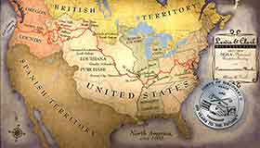
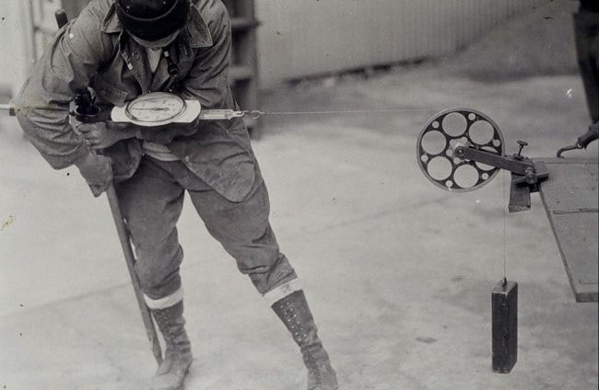
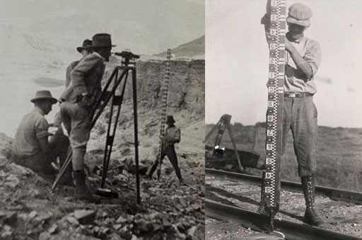
NOAA and the National Geodetic Survey
Our Nation’s First Civilian Science Agency
For more than 200 years, NGS and its predecessor agencies have collaborated with public and private organizations to establish reference stations at precisely determined locations.
Notes:
NGS has been around a long time. For more than 200 years, NGS and its predecessor agencies have collaborated with public and private organizations to establish reference stations at precisely determined locations.
We began on a mission established by Thomas Jefferson in 1807 to conduct a “Survey of the Coast” (as the United States Coast Survey).
(Pictured are Thomas Jefferson and Ferdinand Hassler, the first Superintendent of the Coast Survey). We were renamed the U.S. Coast and Geodetic Survey in 1878. NOAA was established in 1970.
Traditionally, precise positioning locations have been identified by setting a survey mark—usually a brass, bronze, or aluminum disk. Locations might also be identified by a deeply driven rod, or a prominent object, such as a water tower or church spire.

Slide 3
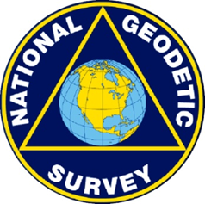
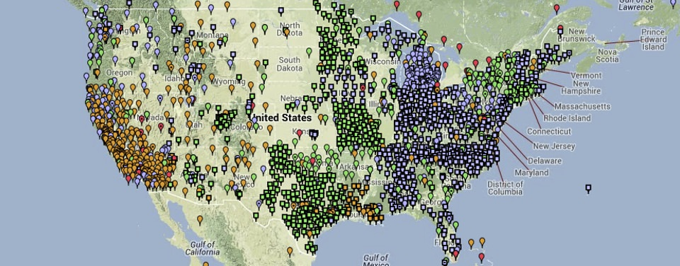
NGS Mission
Define, maintain, and provide access to the
National Spatial Reference System (NSRS)
“The NSRS is a consistent coordinate system that defines latitude, longitude, height, scale, gravity, orientation, and shoreline throughout the U.S.”

Slide 4
What is NSRS Modernization?
Improving the National Spatial Reference System
The National Geodetic Survey has been working over the last ten plus years to remove inaccuracies in the existing datums of the United States.
By tracking the dynamic nature of the Earth, and giving users tools to account for it, NGS will provide a new National Spatial Reference System that is semi-dynamic.
“By fully embracing the benefits of GNSS as the positioning tool of today, and of the future, NGS will effectively link the replacements for NAD 83 and NAVD 88 through a geocentric reference frame and gravimetric geoid model”
-Dr. Dru Smith, Chief Geodesist, National Geodetic Survey, 2010

Slide 5
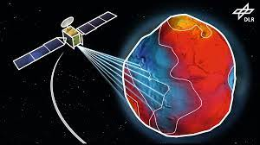
Setting a Geodetic Standard
For 200 years, NGS and its predecessor agencies have collaborated with public and private organizations to establish reference stations at precisely determined locations.
More recently, NGS has fostered a network of continuously operating reference stations (CORS) where each CORS includes a highly accurate receiver that continuously collects radio signals broadcast by Global Navigation Satellite System (GNSS) satellites forming a network used to accurately position other points of interest.

Slide 6
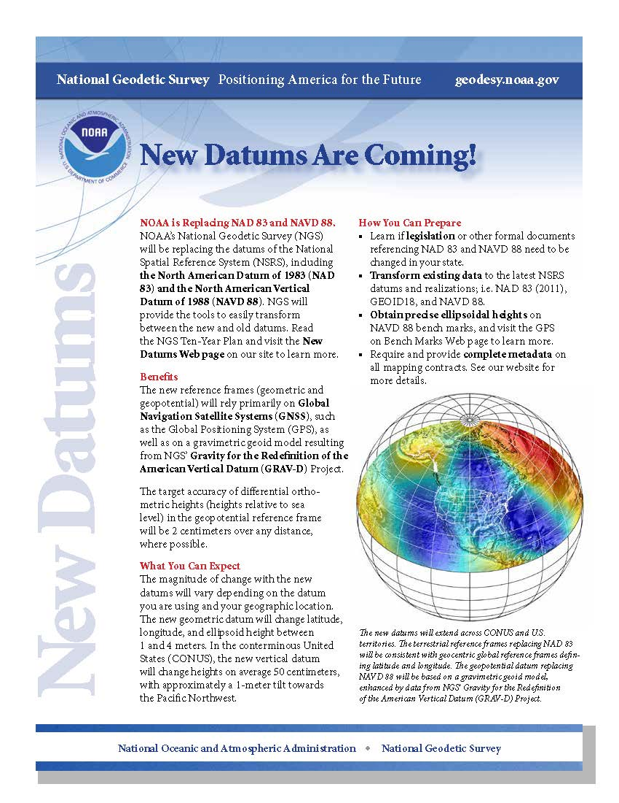
How You Can Prepare for the Modernization of the National Spatial Reference Frame
Transform your coordinates using NGS Coordinate and Transformation Tool (NCAT)
Record your metadata by knowing the datums and epochs of your geospatial files
Perform GPS on Bench Marks Operations.
Review State Plane Coordinate System of 2022 requirements
Prepare to update legislation, as needed

Slide 7
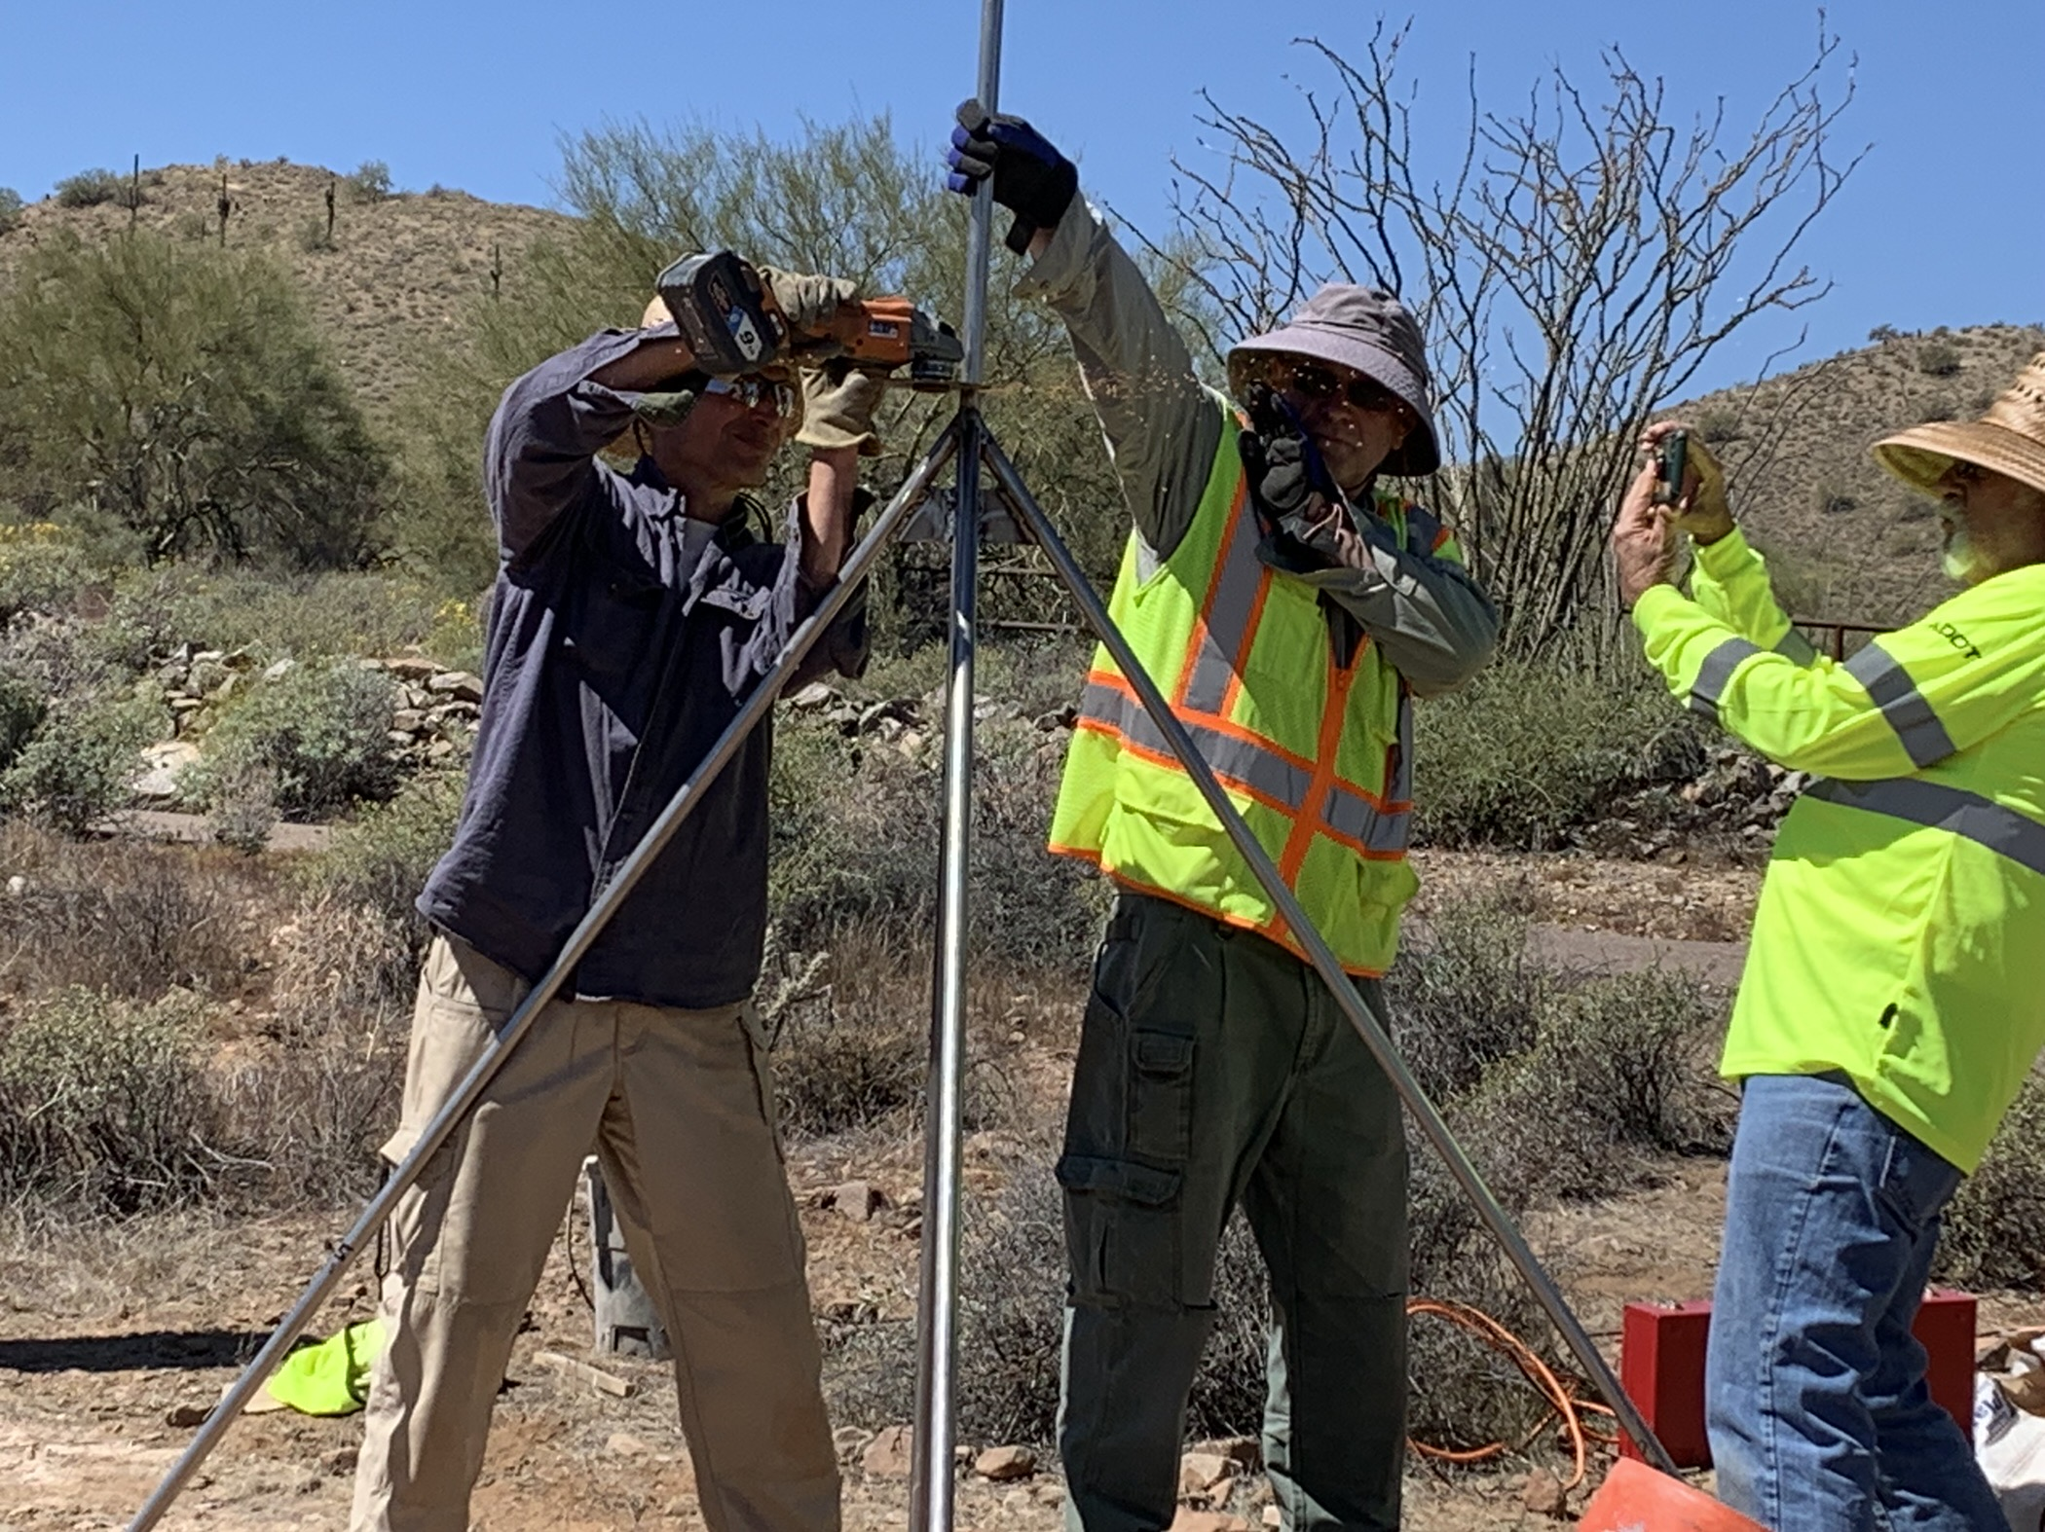
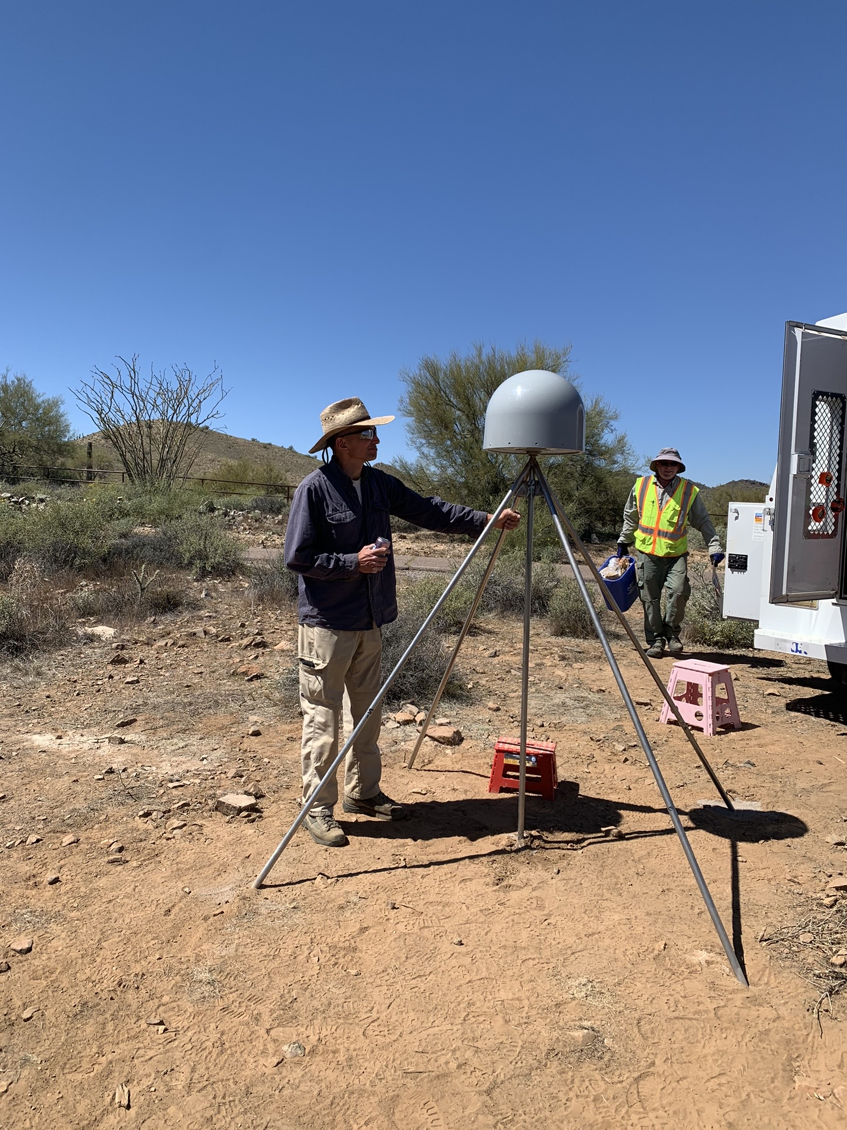
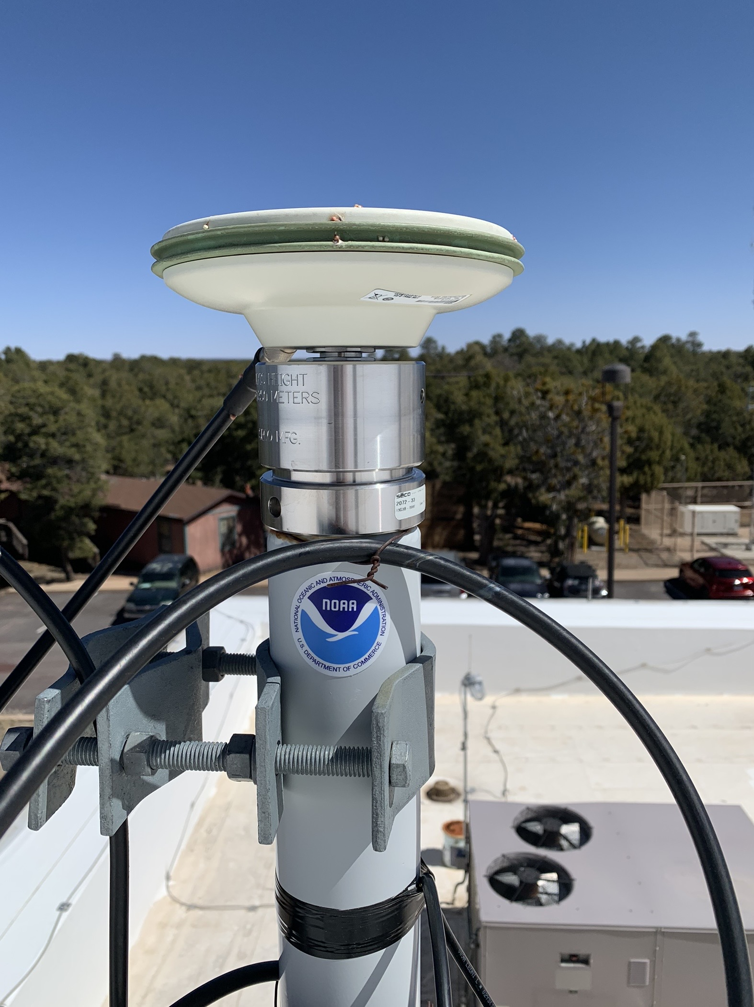
NSRS Modernization : Regional Preparation
New CORS Sub-Committees
Braced Monument Workshops
CORS Station Improvements
GPS on Benchmarks
OPUS Training
Water Management
Subsidence Monitoring
Control Densification
Partnership Work
Foundation CORS

Slide 8
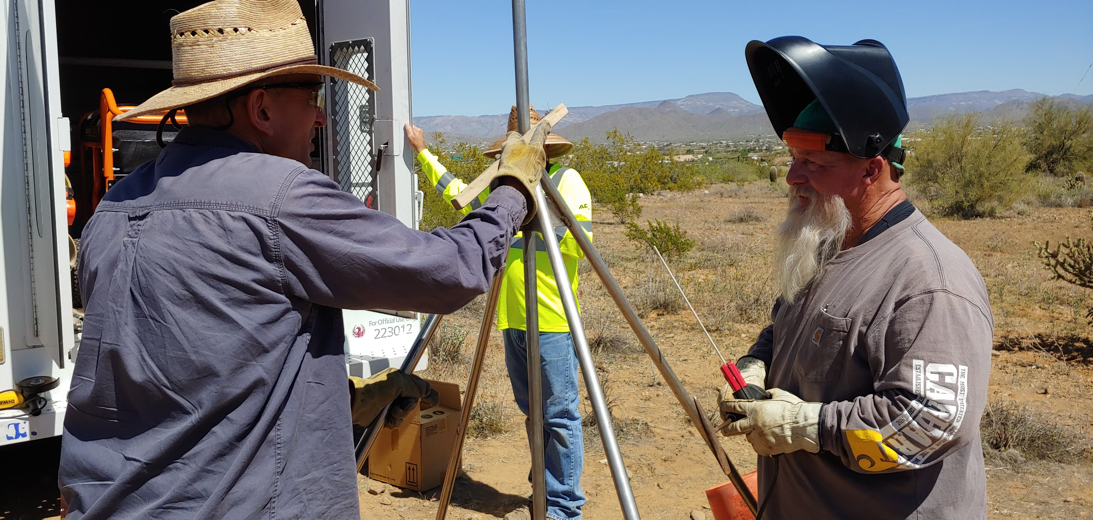
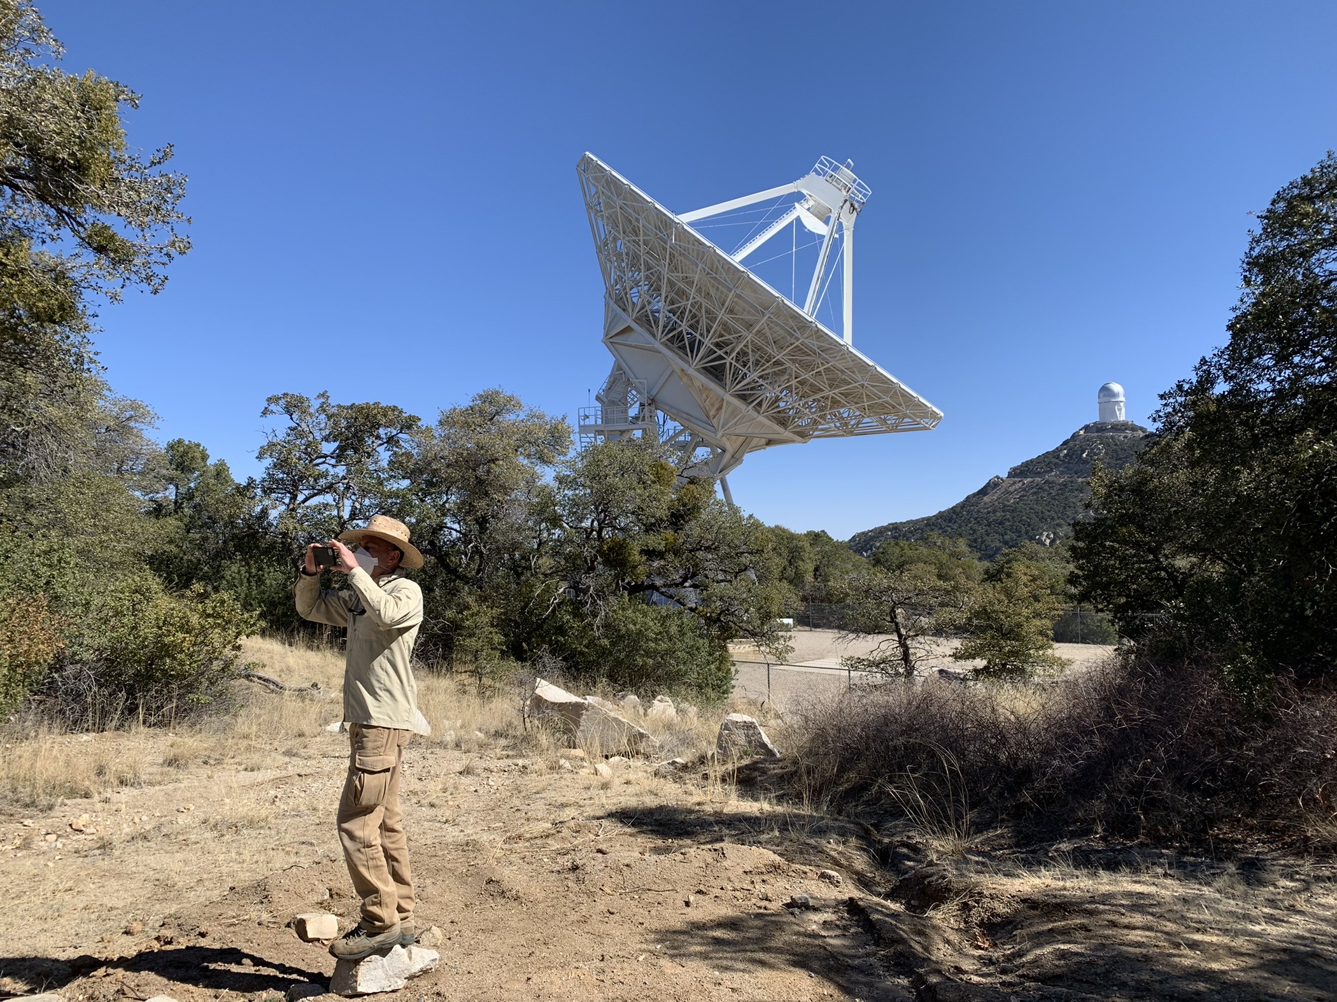
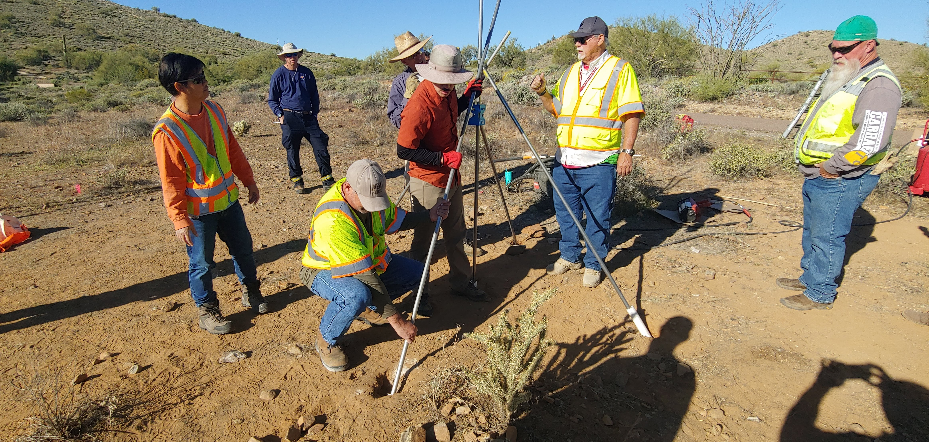
Enhancing Geodetic Control to Improve Positioning Data and Imagery
Bringing downed NOAA CORS Network sites back online – six sites currently
Building new CORS stations with improved stability and monumentation – Shallow and Deep Braced Monuments
Building a new Foundation CORS array at VLBA’s in NM and AZ
NGS/City of Phoenix Braced Monument Workshop
Partnership Work!
NGS siting new GNSS array at Kitt Peak National Observatory, AZ

Slide 9
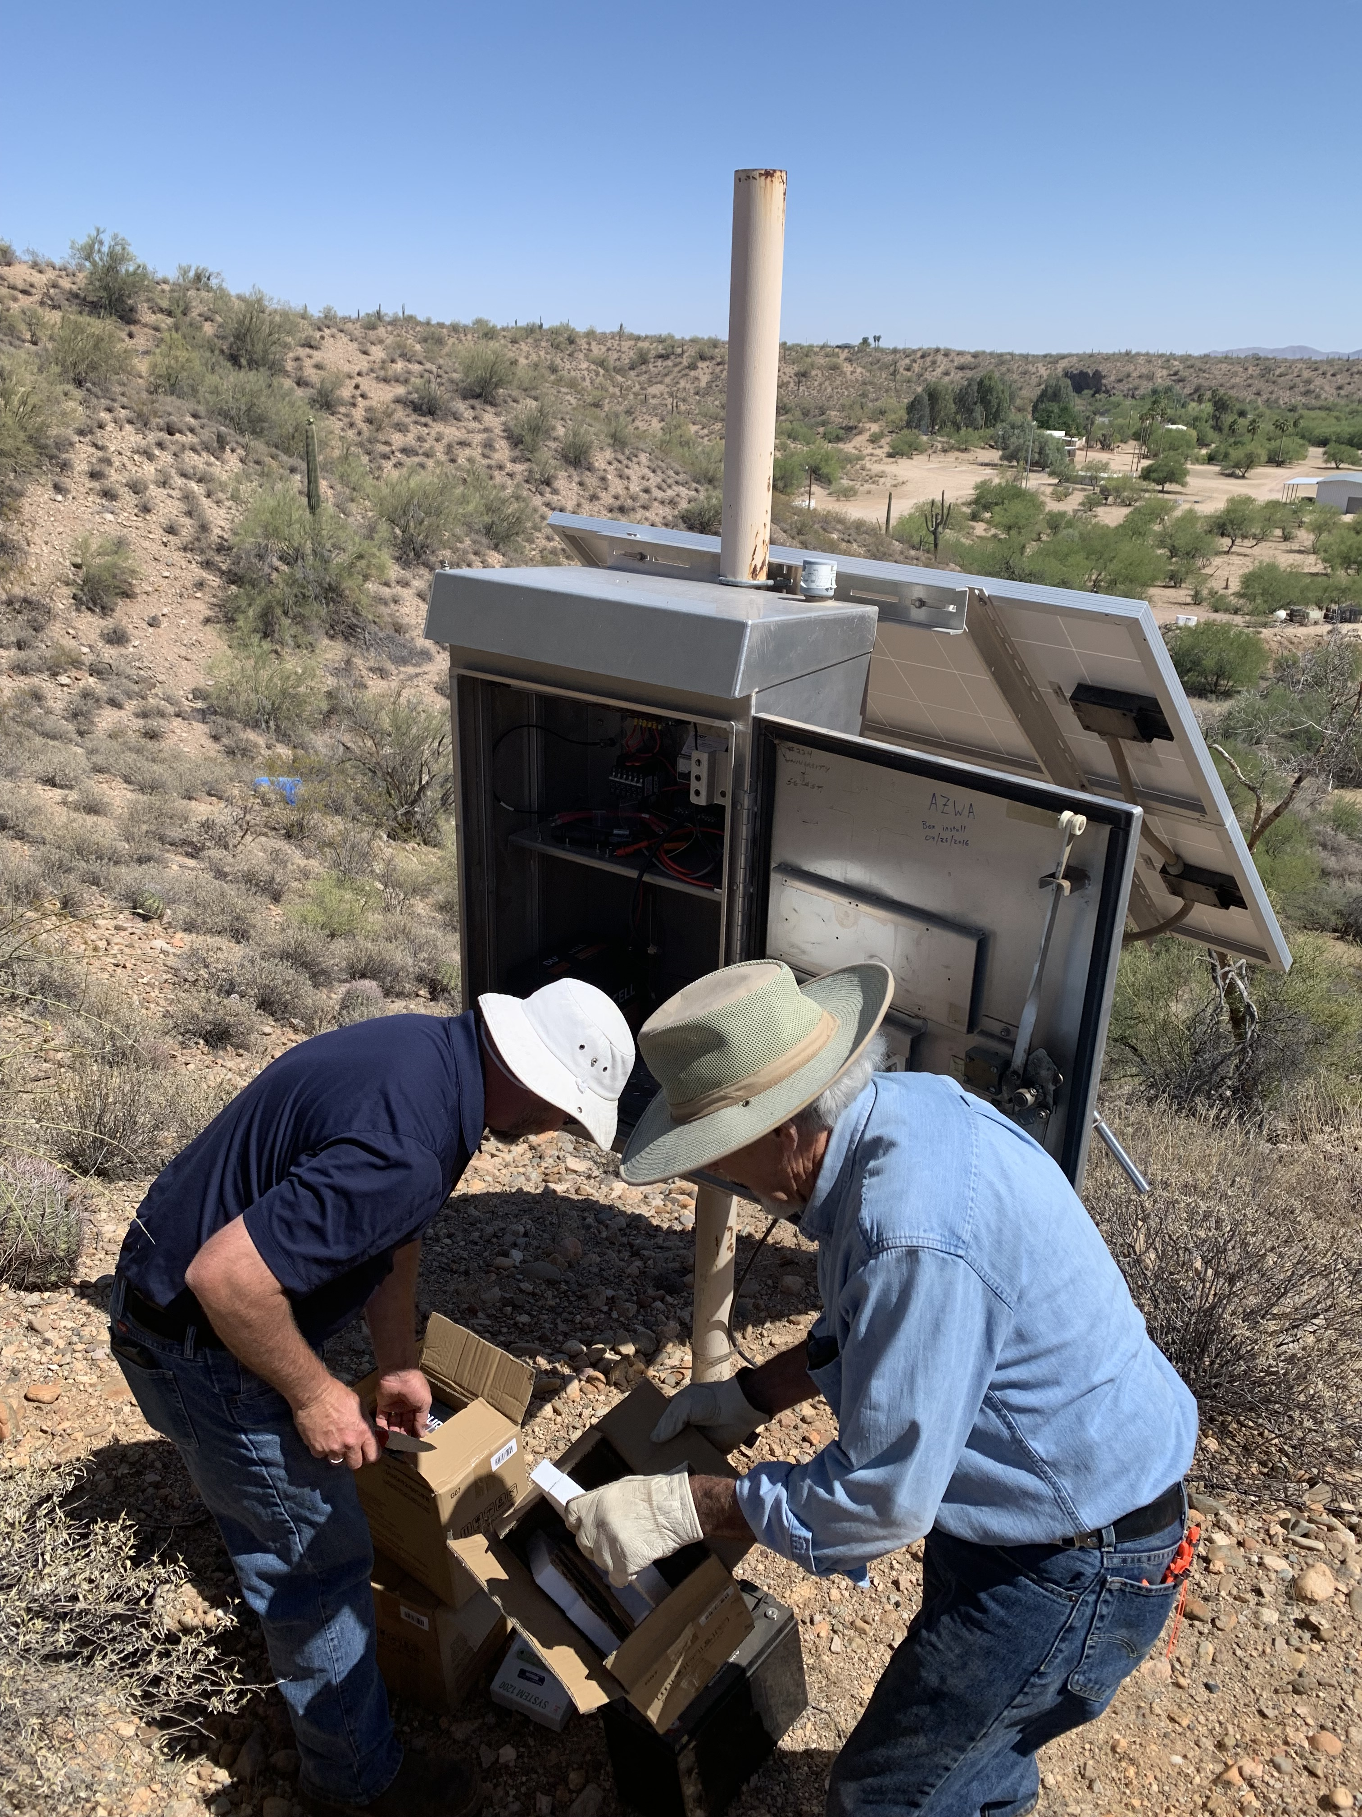
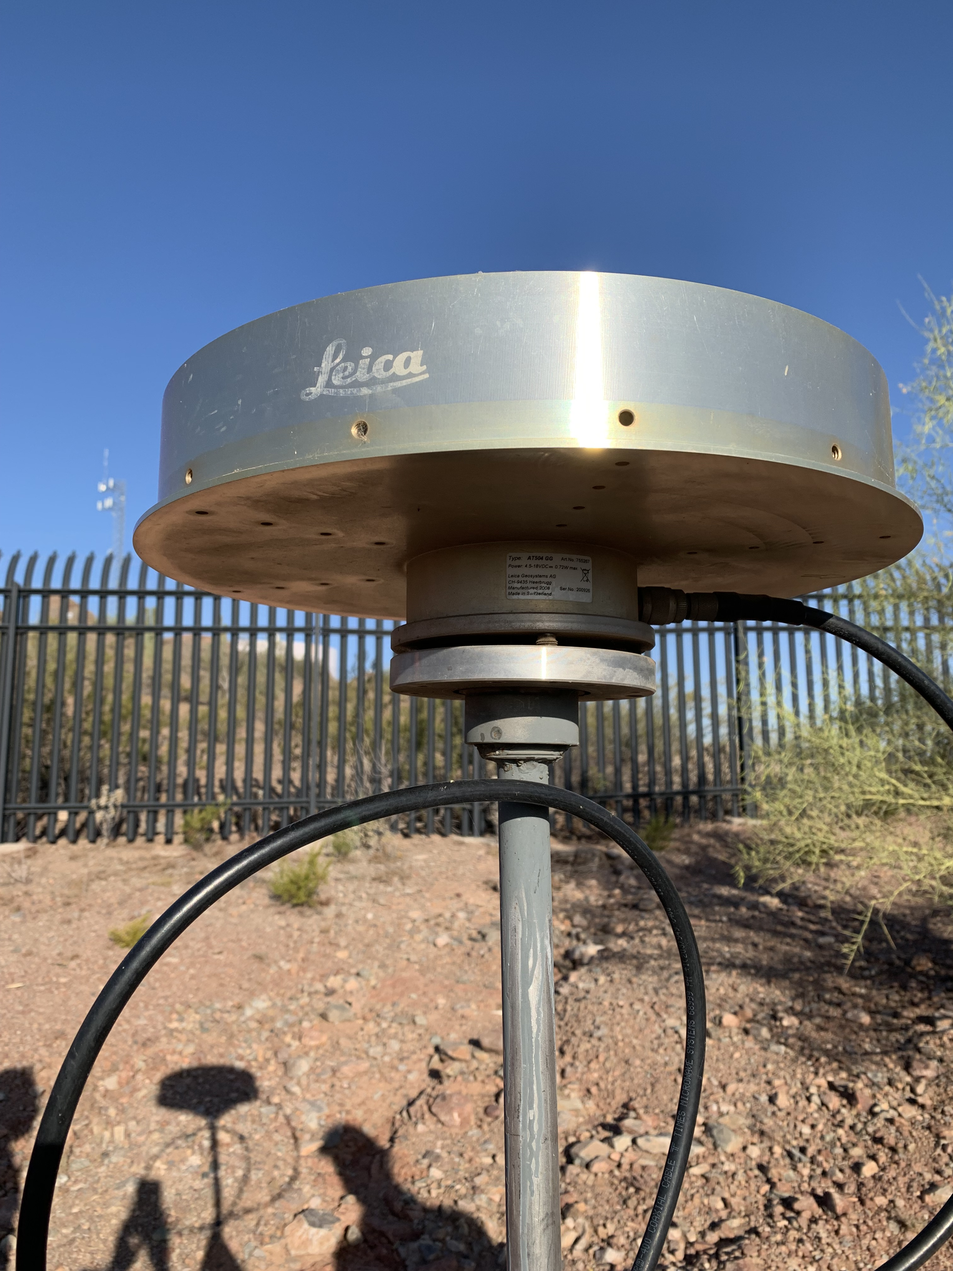
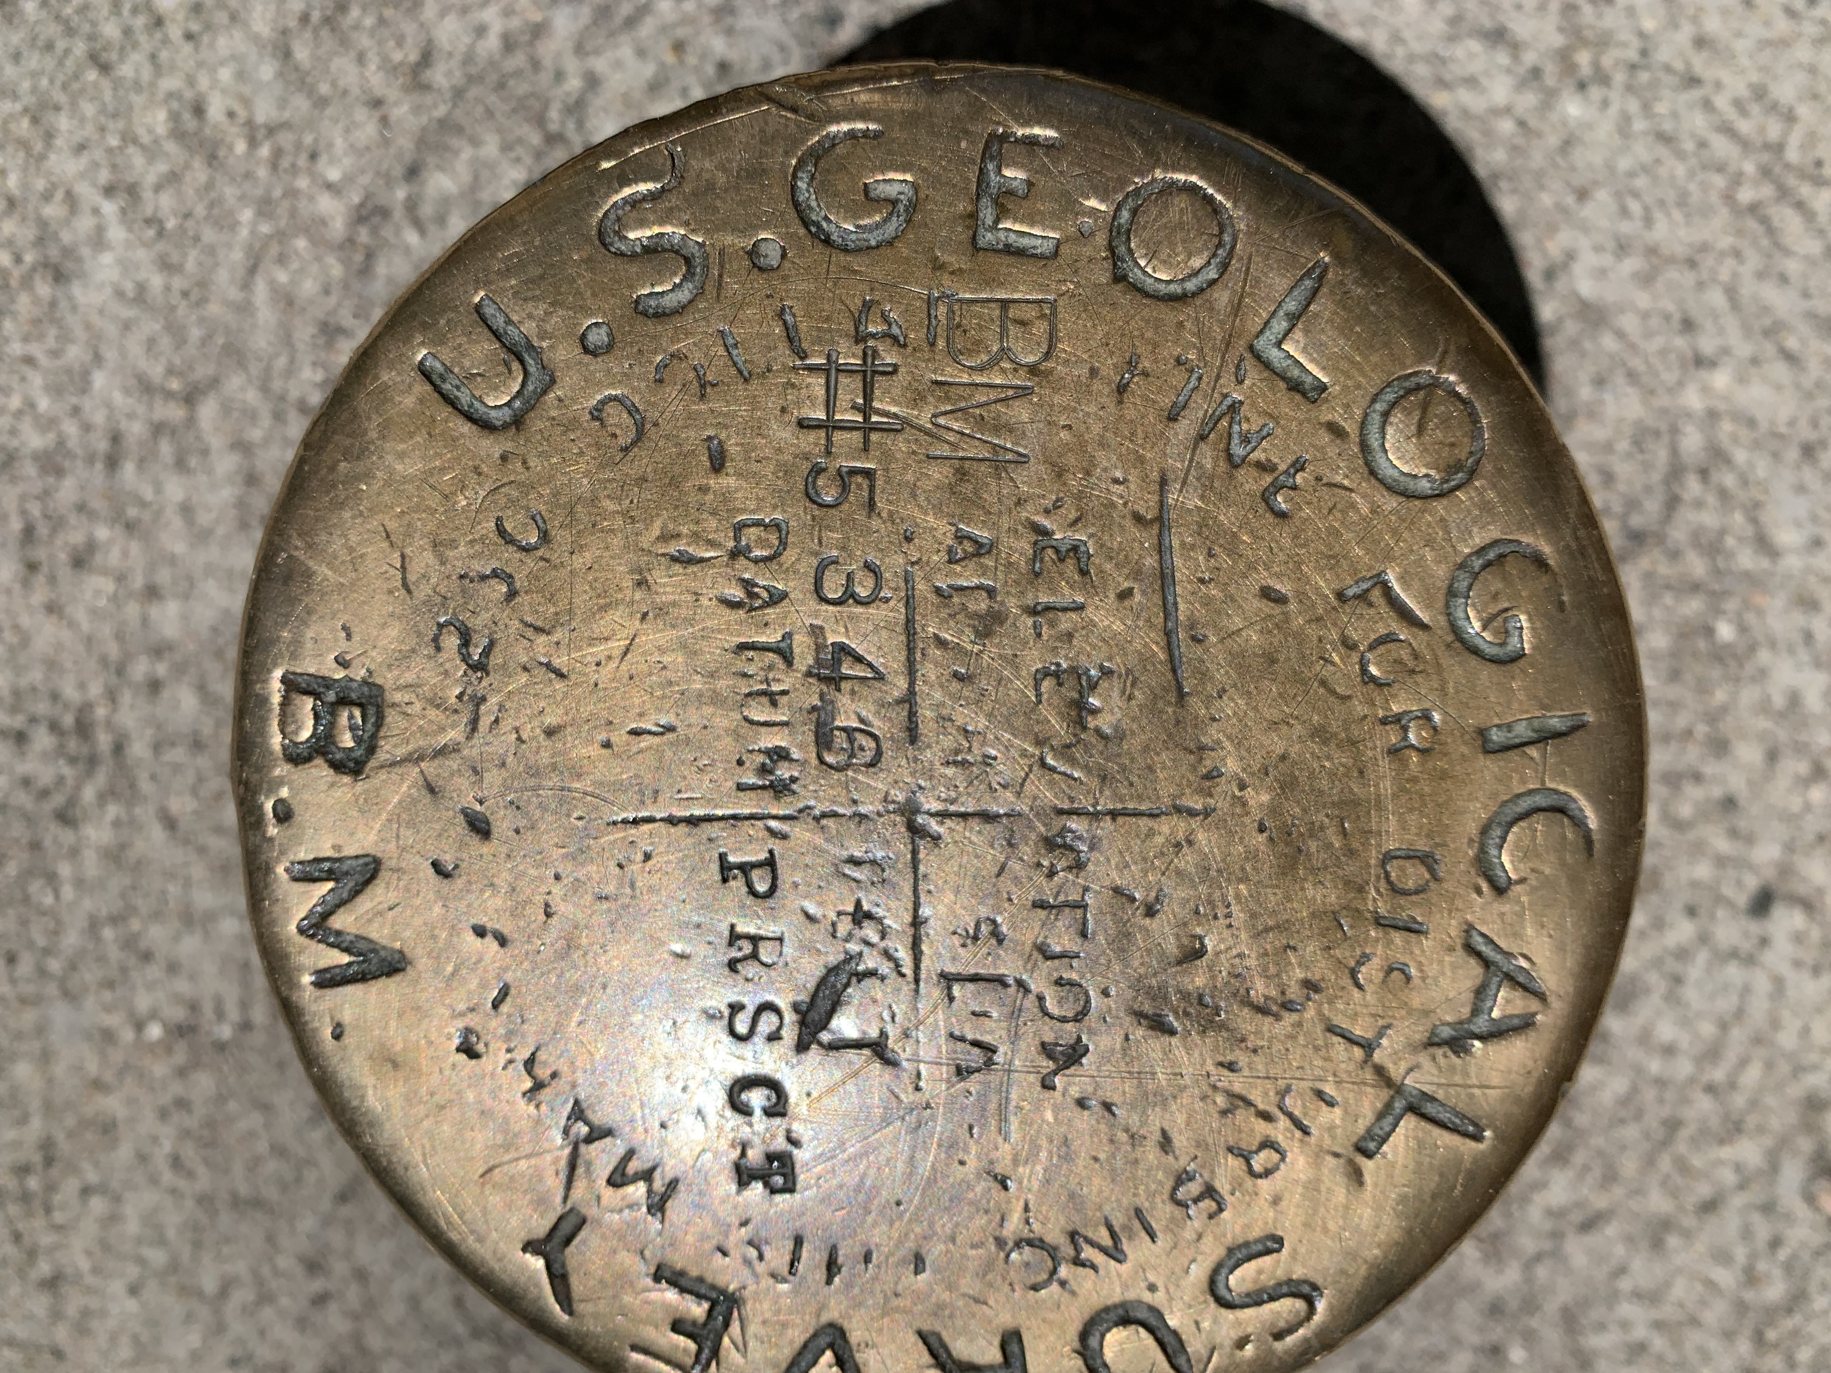
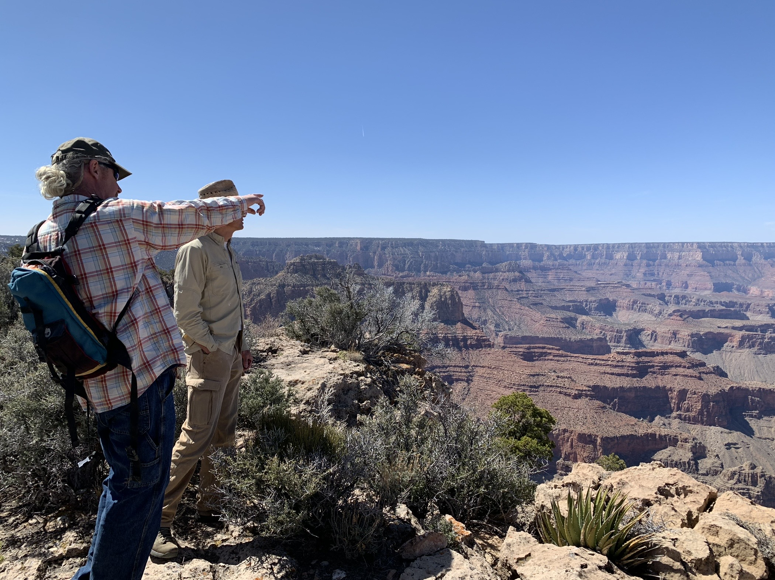
Densification of Survey Control through Partnerships
Positioning – improvements in both vertical and horizontal positioning
Ground truthing – improve base station positions for LIDAR, aerial, drone, photogrammetric, altimetric data
Datum consistency -throughout multiple data sets used for digital elevation modeling

Slide 10
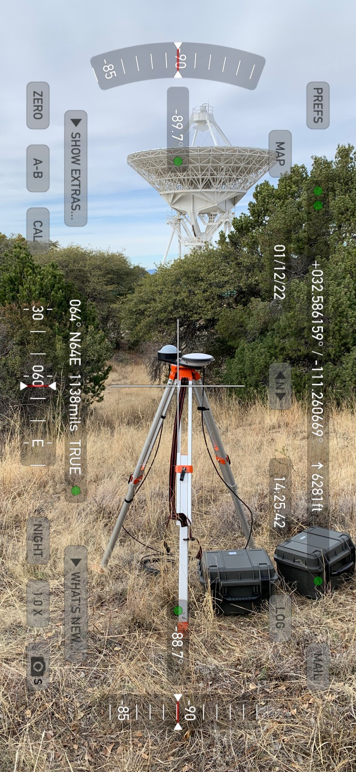
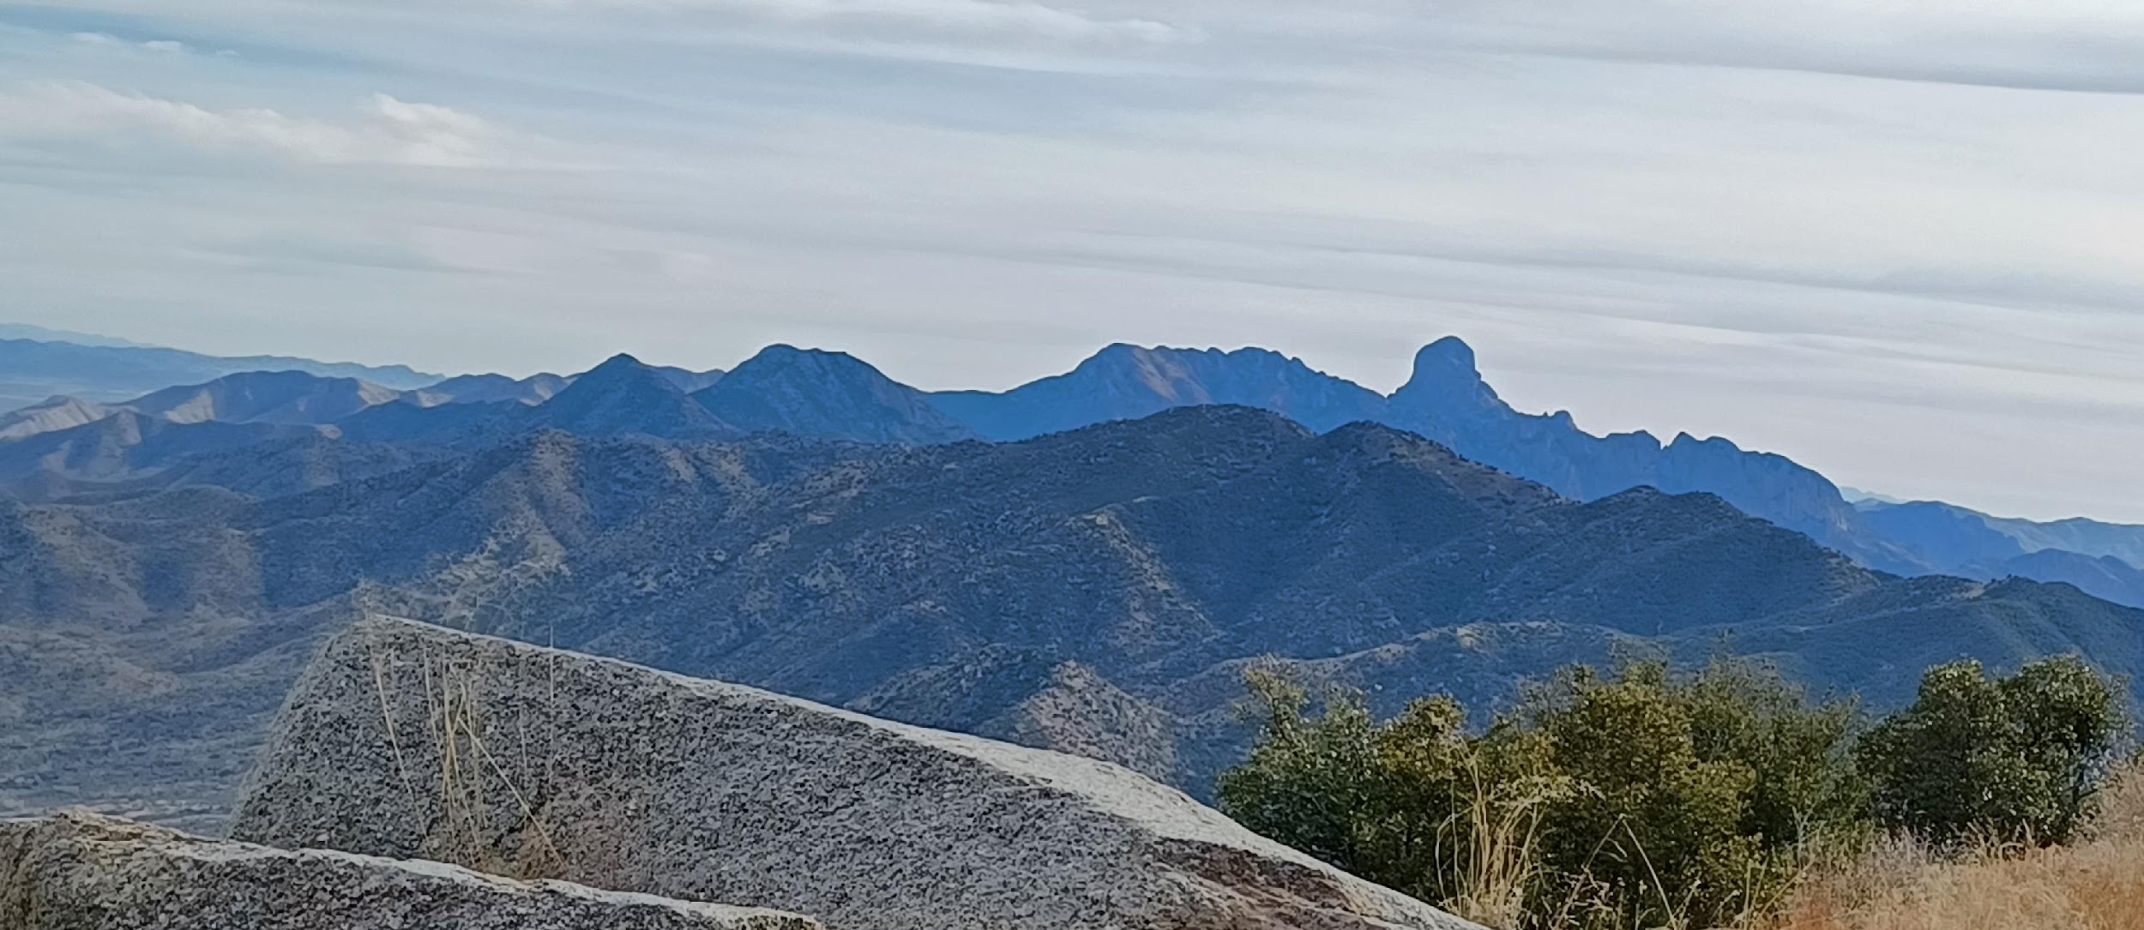
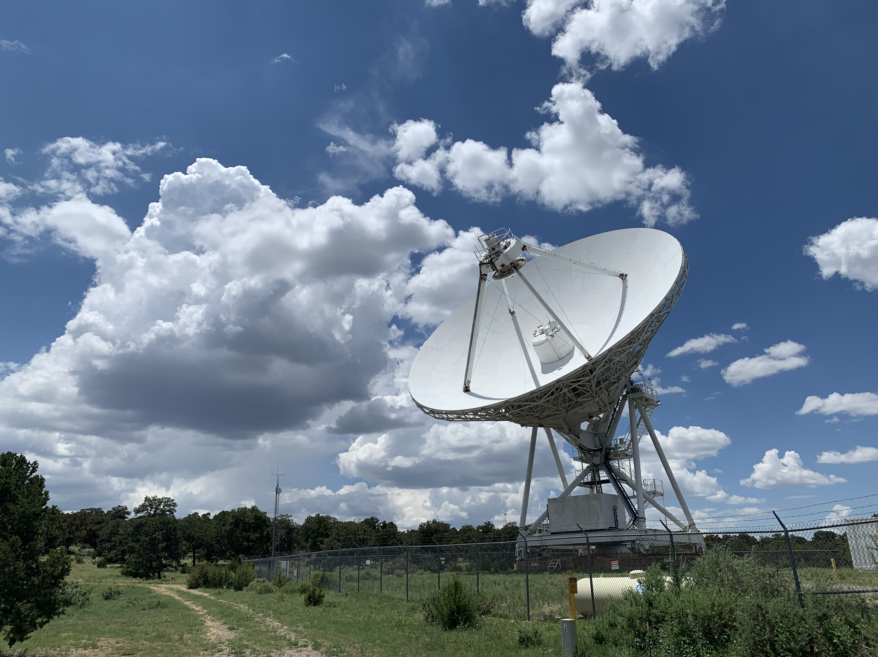
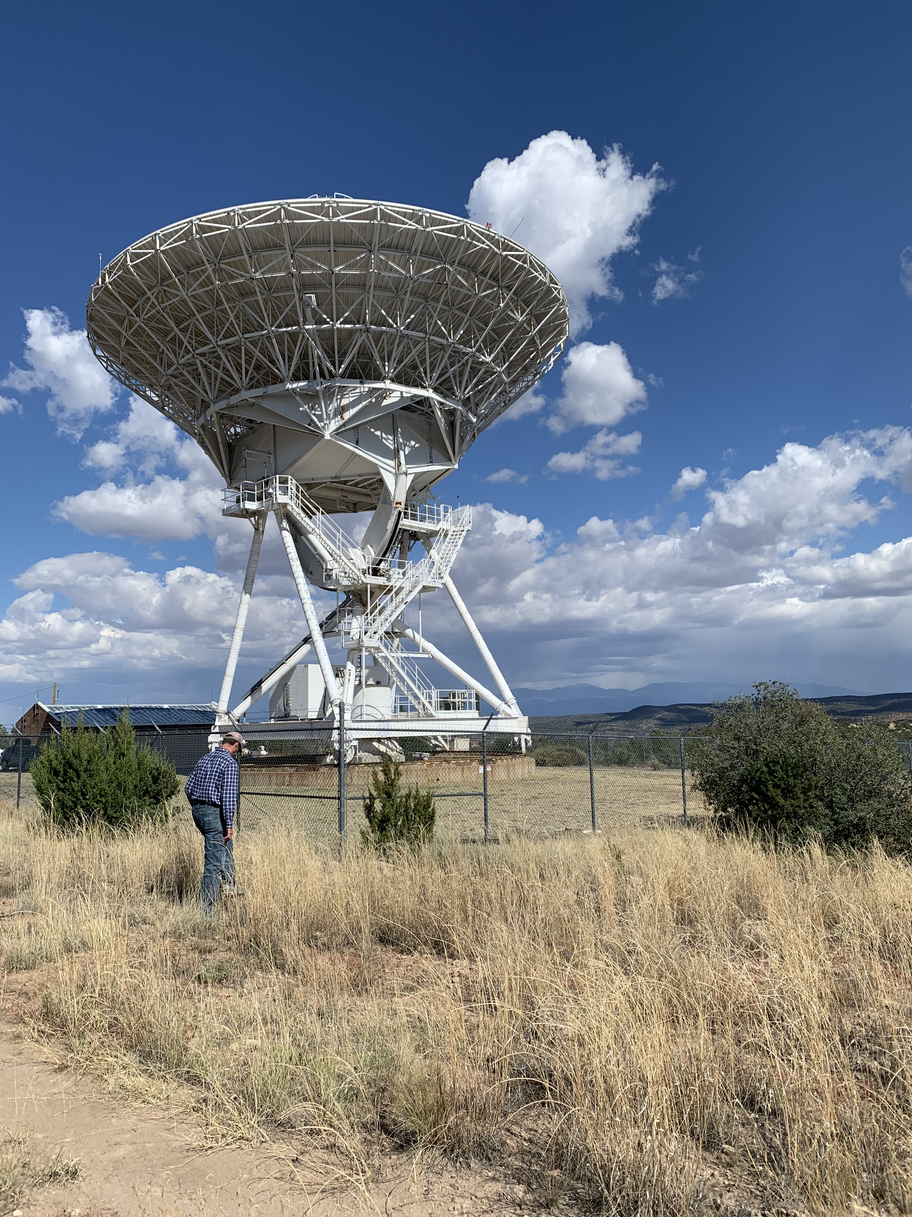
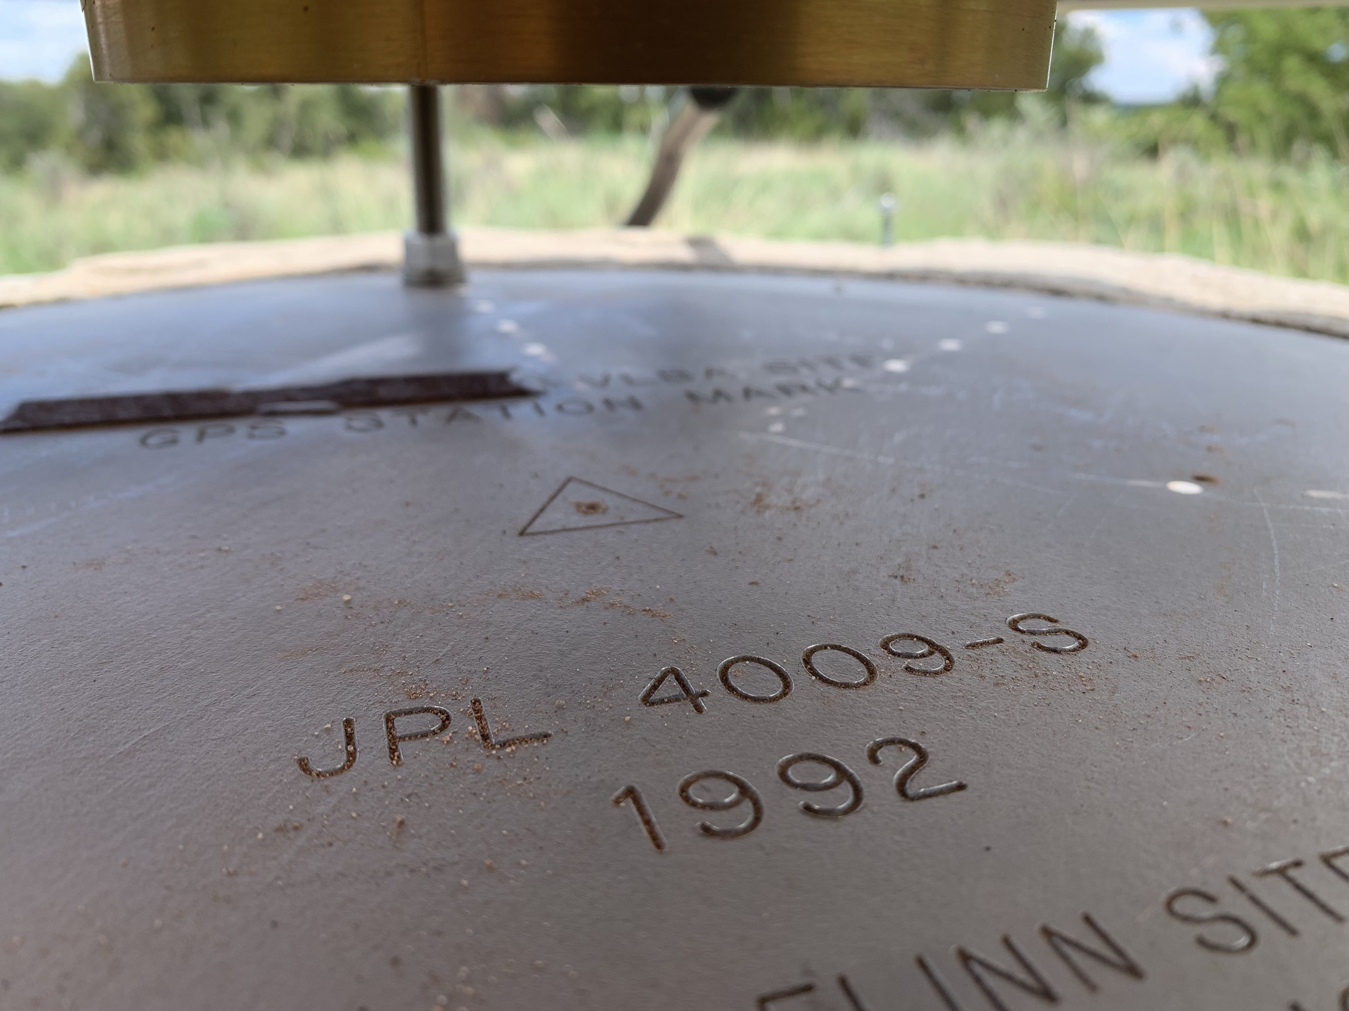
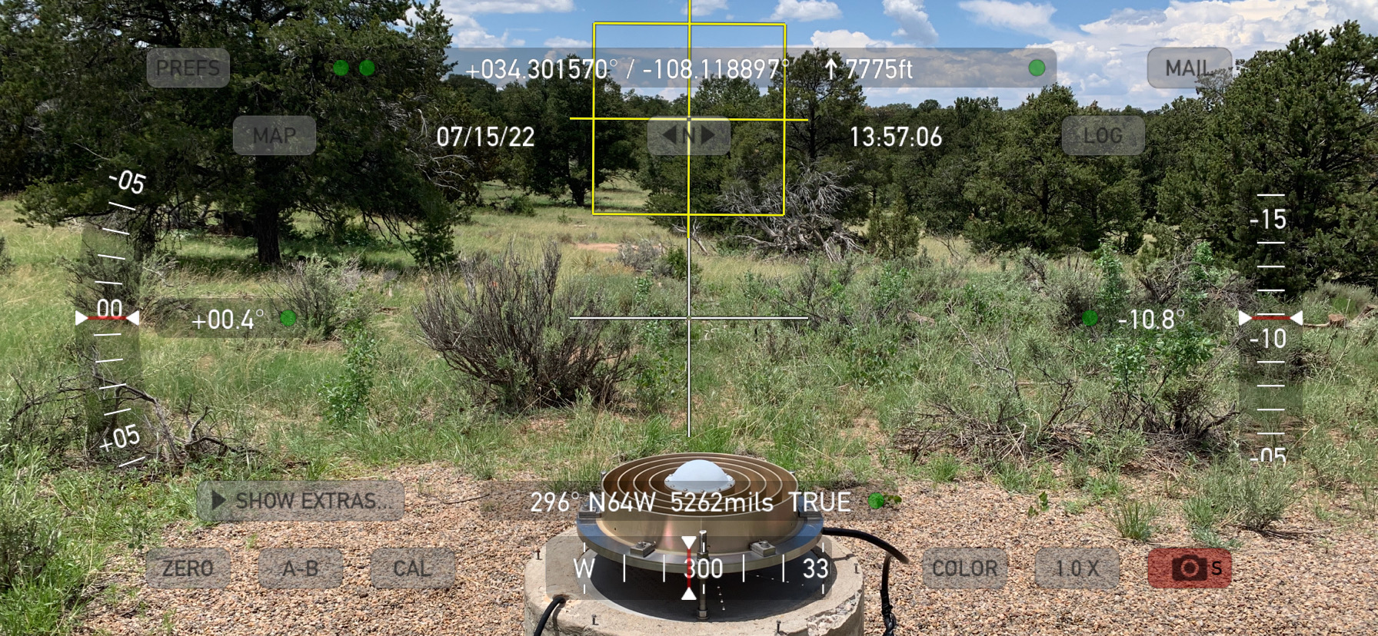
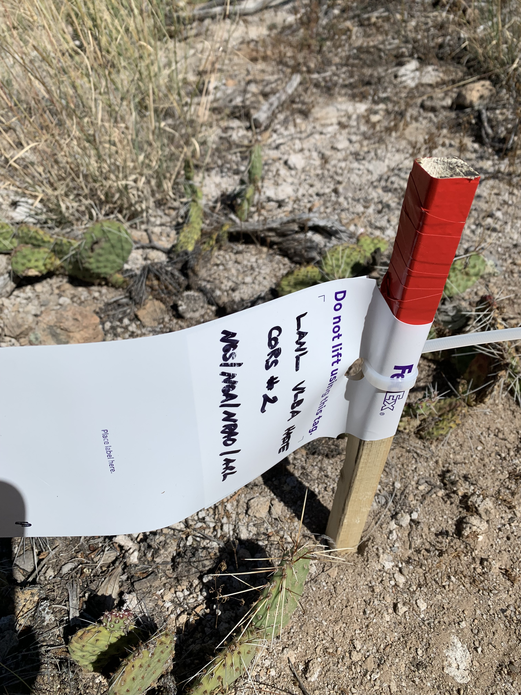
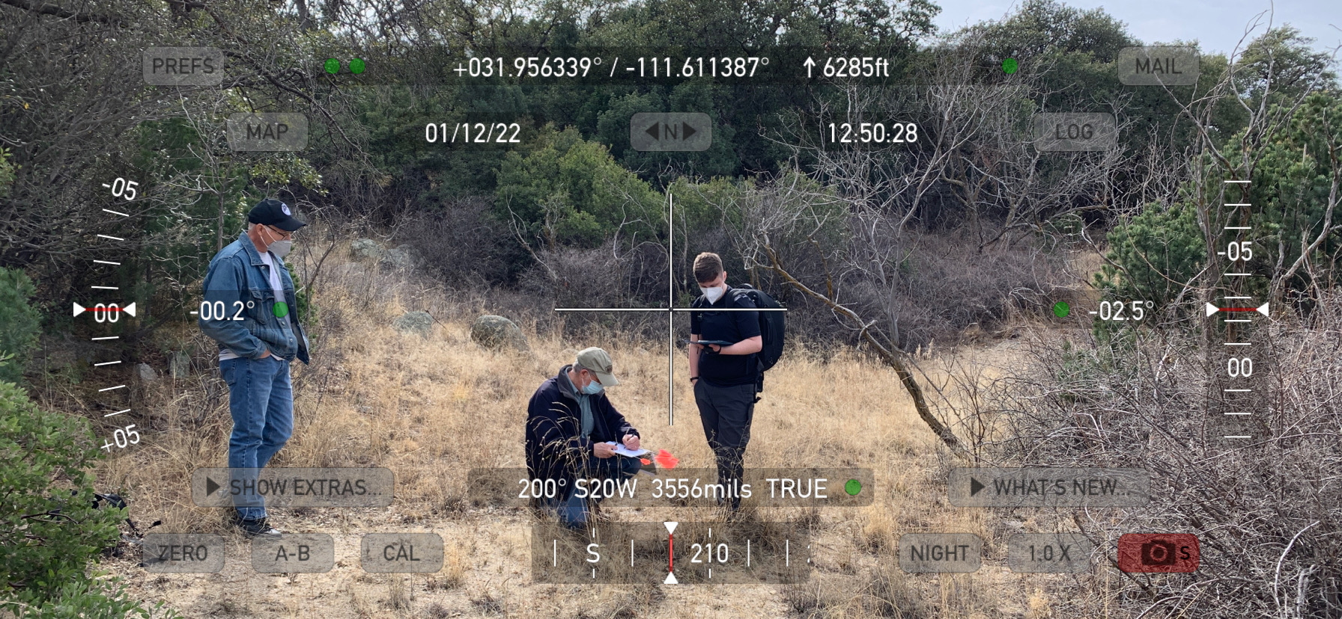
Foundation CORS/HASTE Project Reconnaissance 2022 Kitt Peak, AZ; Pietown, NM; Los Alamos, NM at U.S. Space Geodetic Observatories with NGS/NRAO/NGA/NSF/ARL

Slide 11
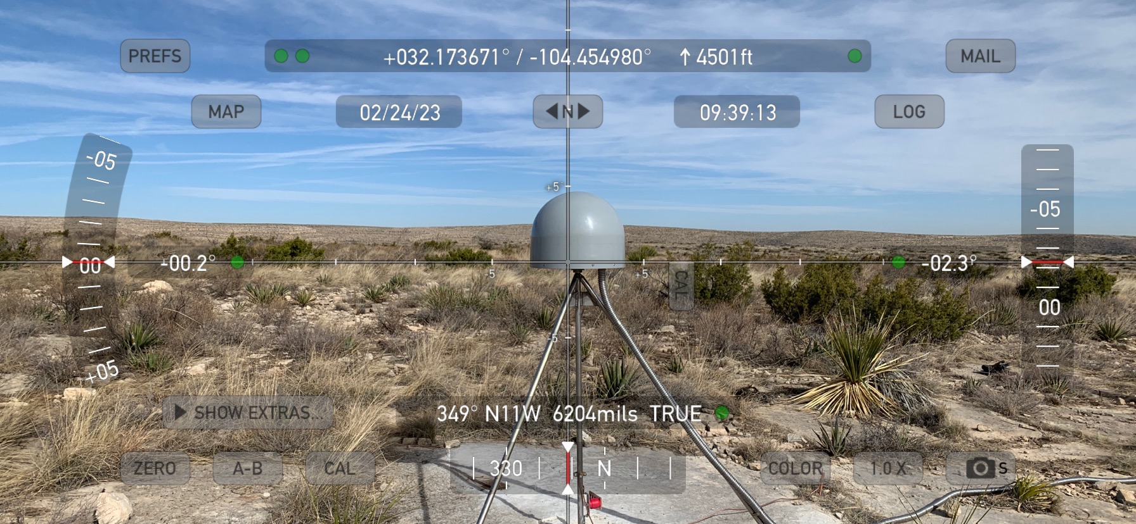
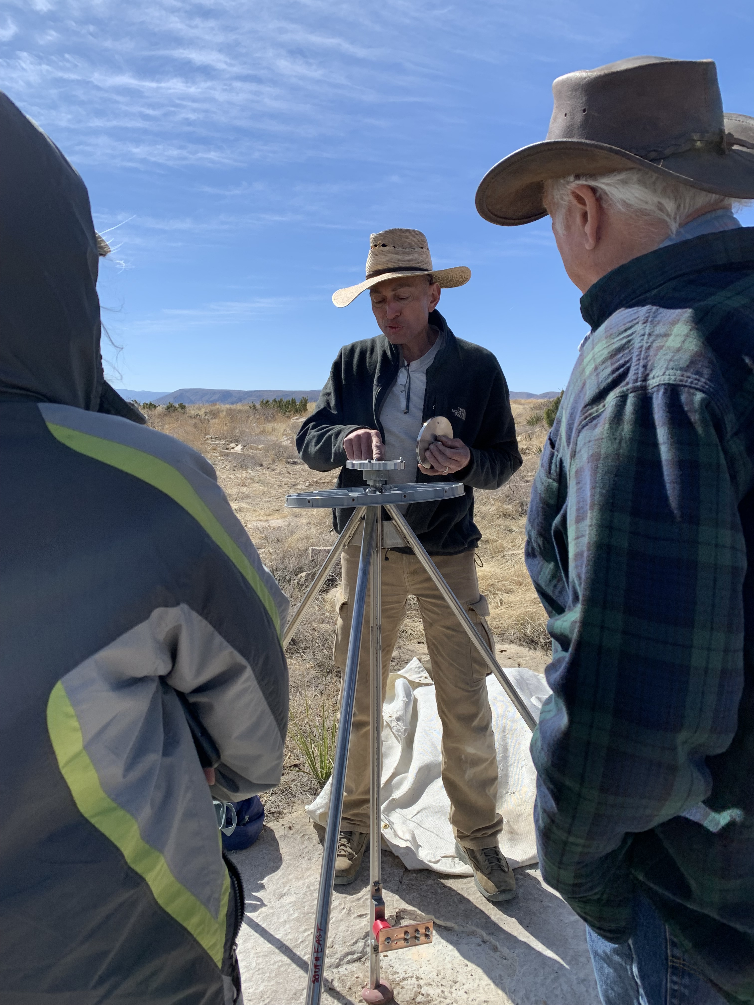
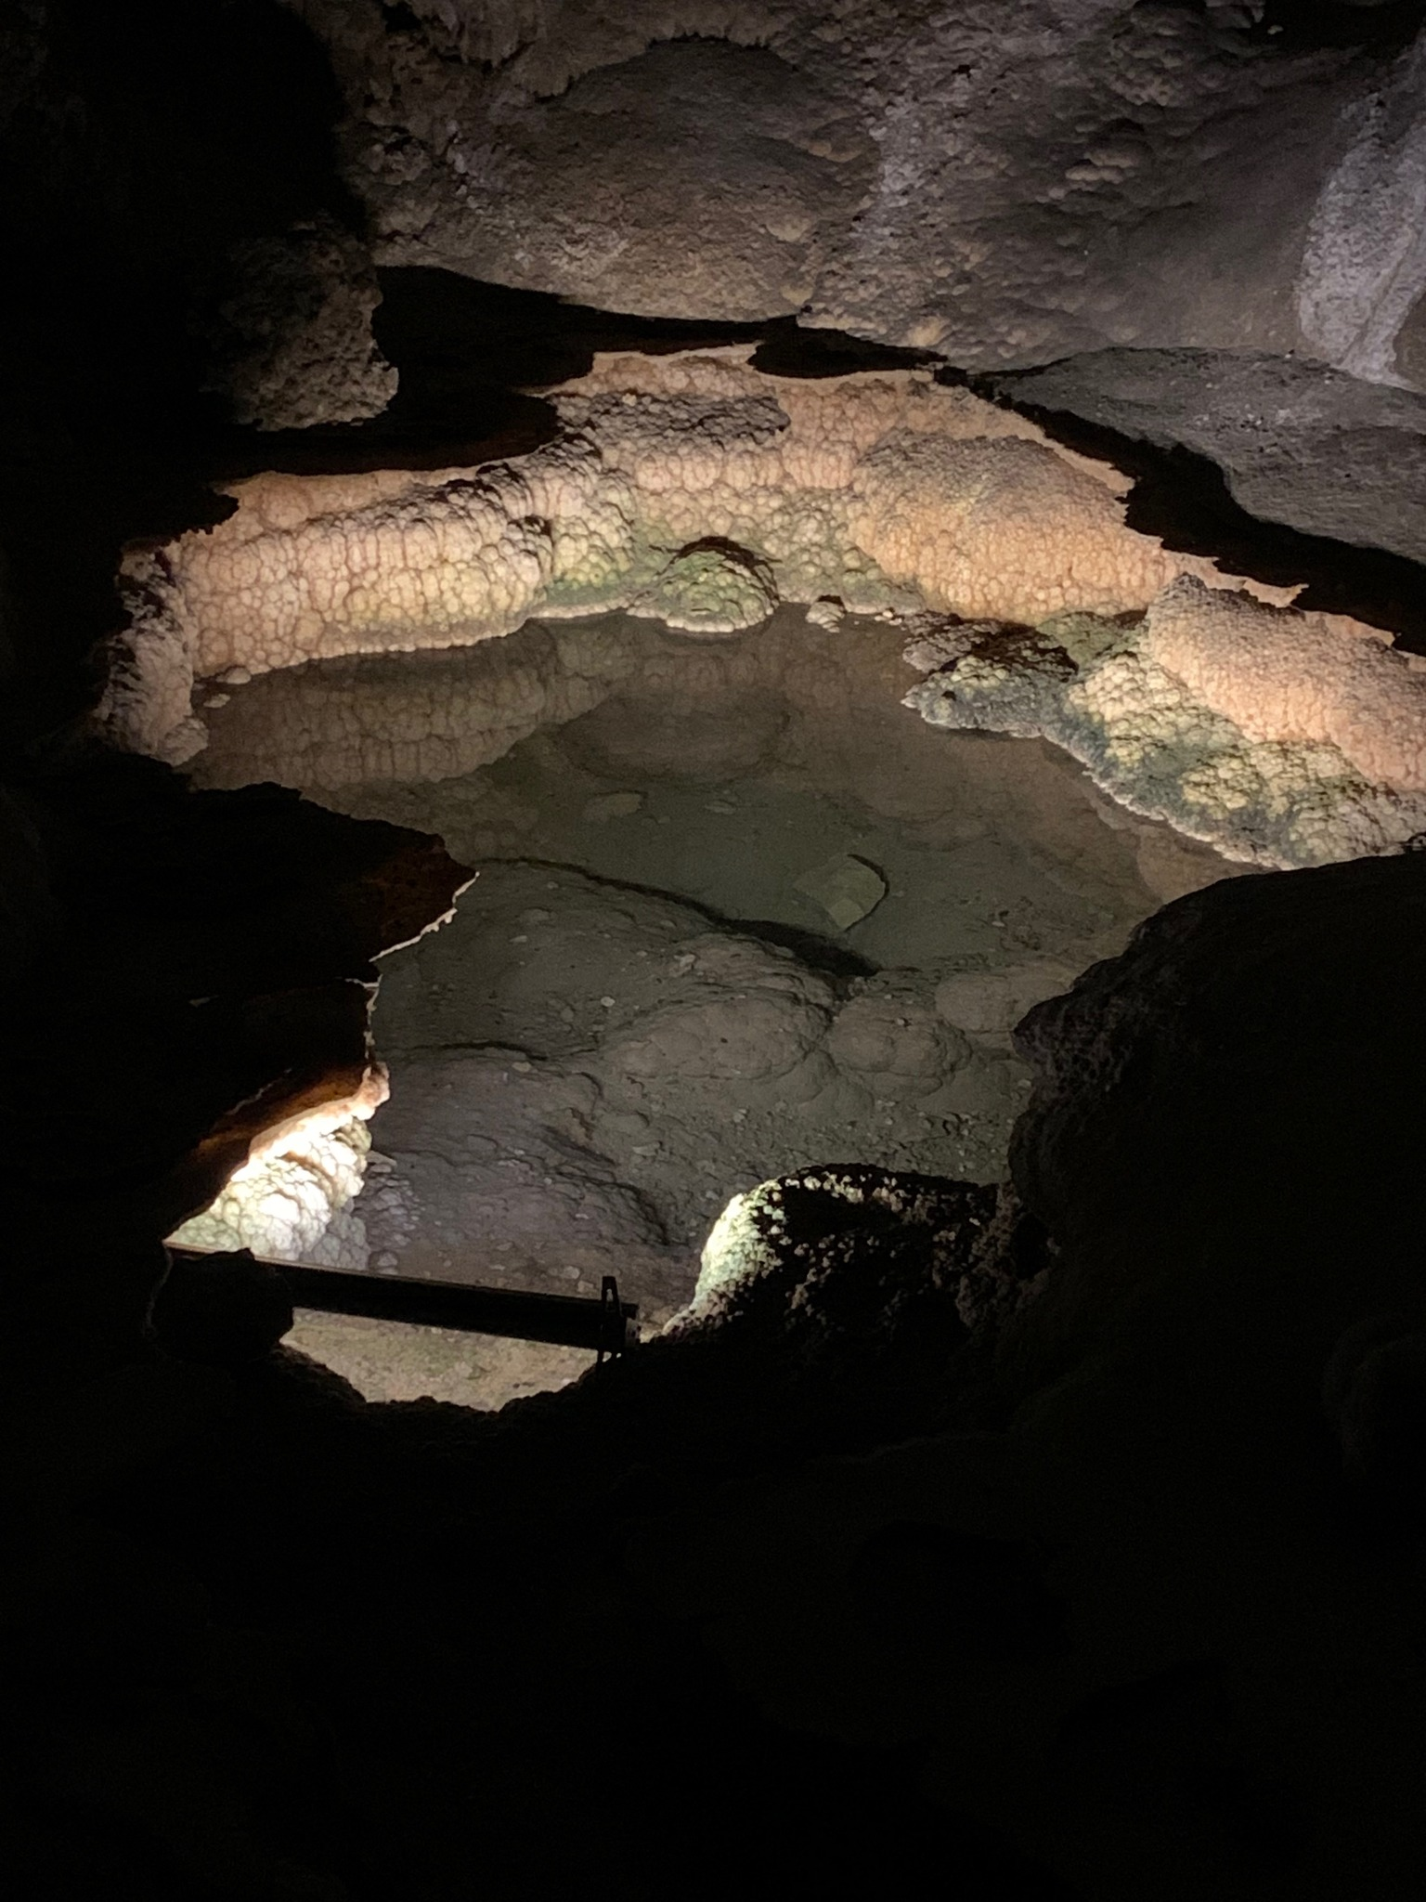
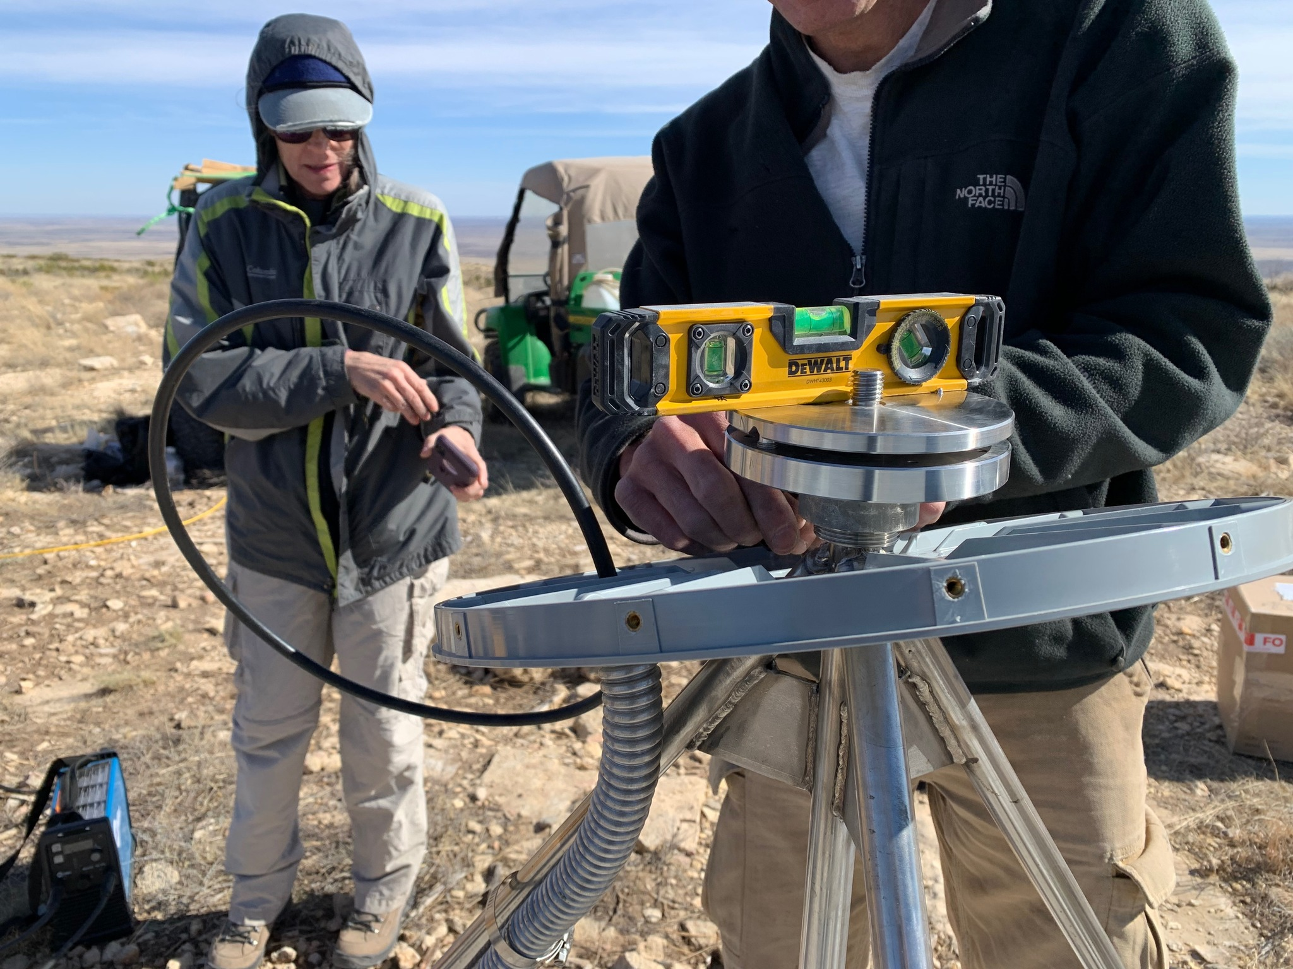
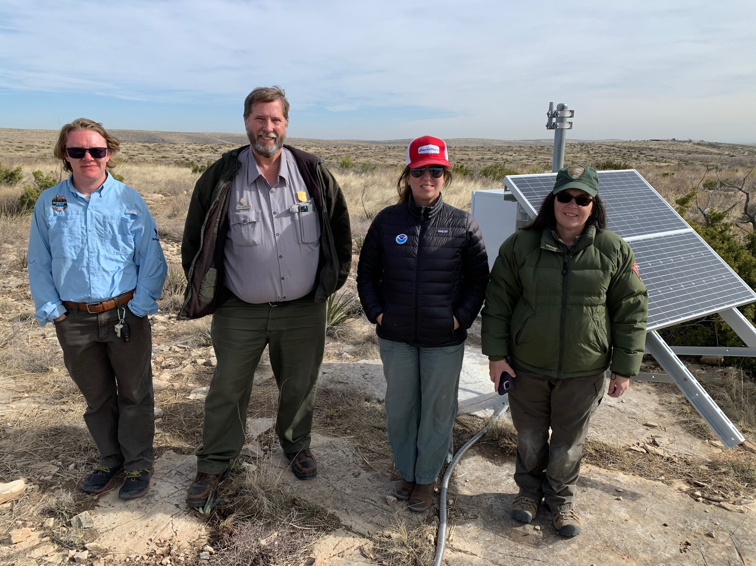
2023 NGS/NPS Carlsbad Caverns National Park: Welcomes ‘CAVE’ to the NOAA CORS Network!

Slide 12
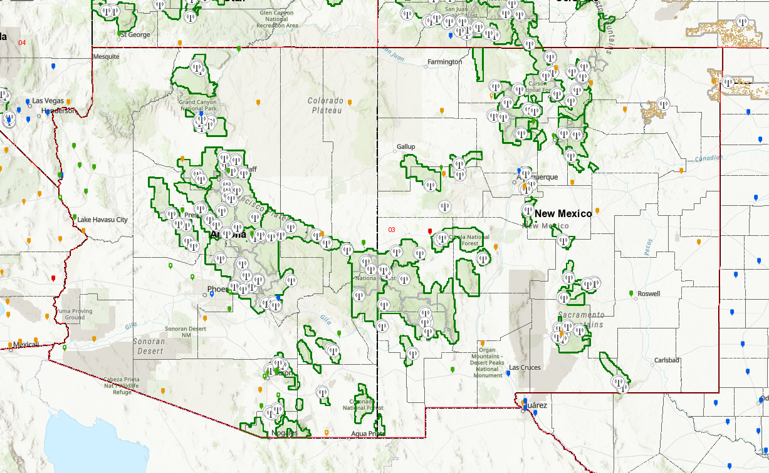
2023 National Forest Service/ NGS Partnership
National Forest Service is working with NOAA’s NGS to enhance CORS network coverage in remote Forest Service regions in NM and AZ
Enhance Cell Coverage and Provide Accurate Positioning Data in Gap Areas

Slide 13
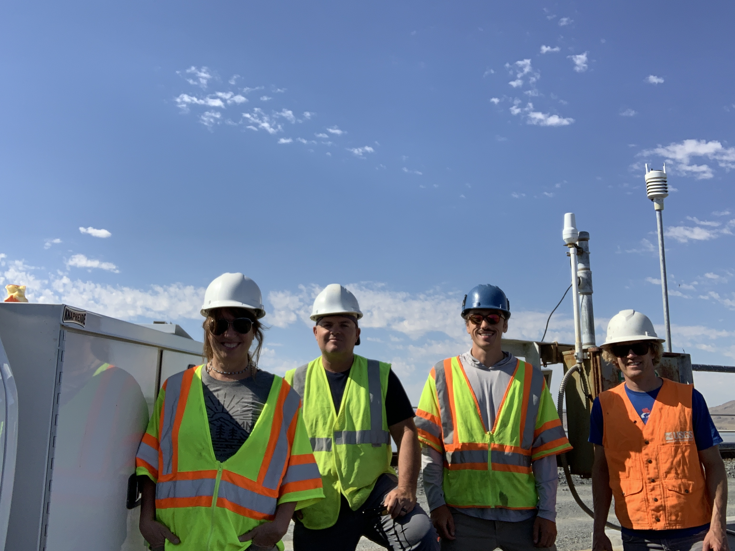
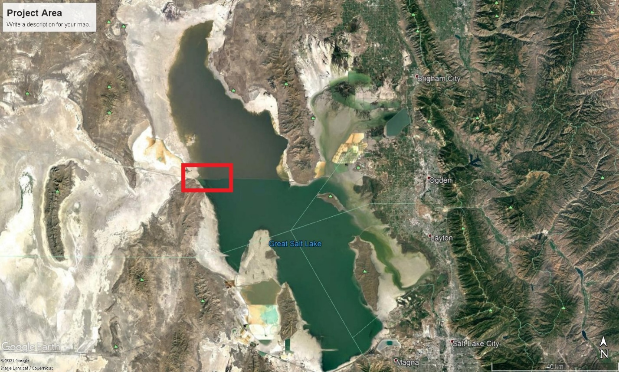
USGS Great Salt Lake Hydrologic Survey: USGS/NOAA-NGS/UGRC Partnership
In 2016 a breach in the causeway was created to allow exchange of water from south to north
The USGS has established a gauging station at the breach that monitors lake water surface elevation and salinity
It is critical to report highly accurate lake elevations using a meaningful datum that can be related to other lake gauges at the far south end of the lake (Saltair)
Project Plan:
Improve Geodetic Control for USGS Lake Gauges at the Causeway and the Saltair Marina:
Utah Geospatial Resource Center (UGRC) Partners with the USGS

Slide 14
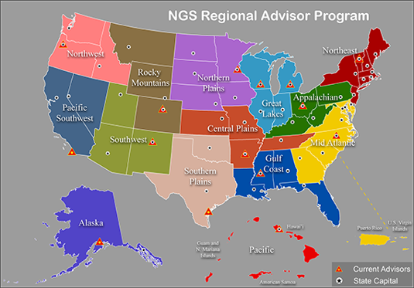
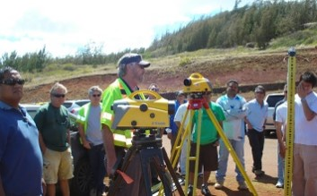
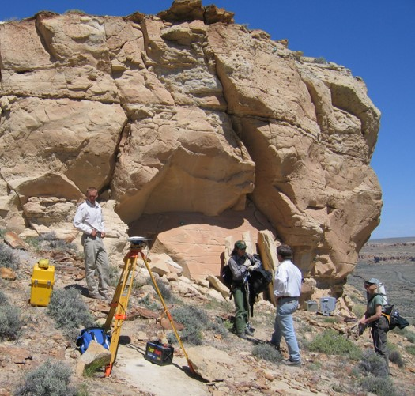
The Regional Geodetic Advisor Program
The Regional Geodetic Advisor is a federal employee of NOAA’s National Geodetic Survey serving as a liaison between NGS and its public, academic, and private sector constituents who are managing the geodetic component of geospatial activities tied to the National Spatial Reference System (NSRS) in their region. Assistance in management of CORS stations in an advisor’s region is an integral part of supporting the NSRS.

Slide 15
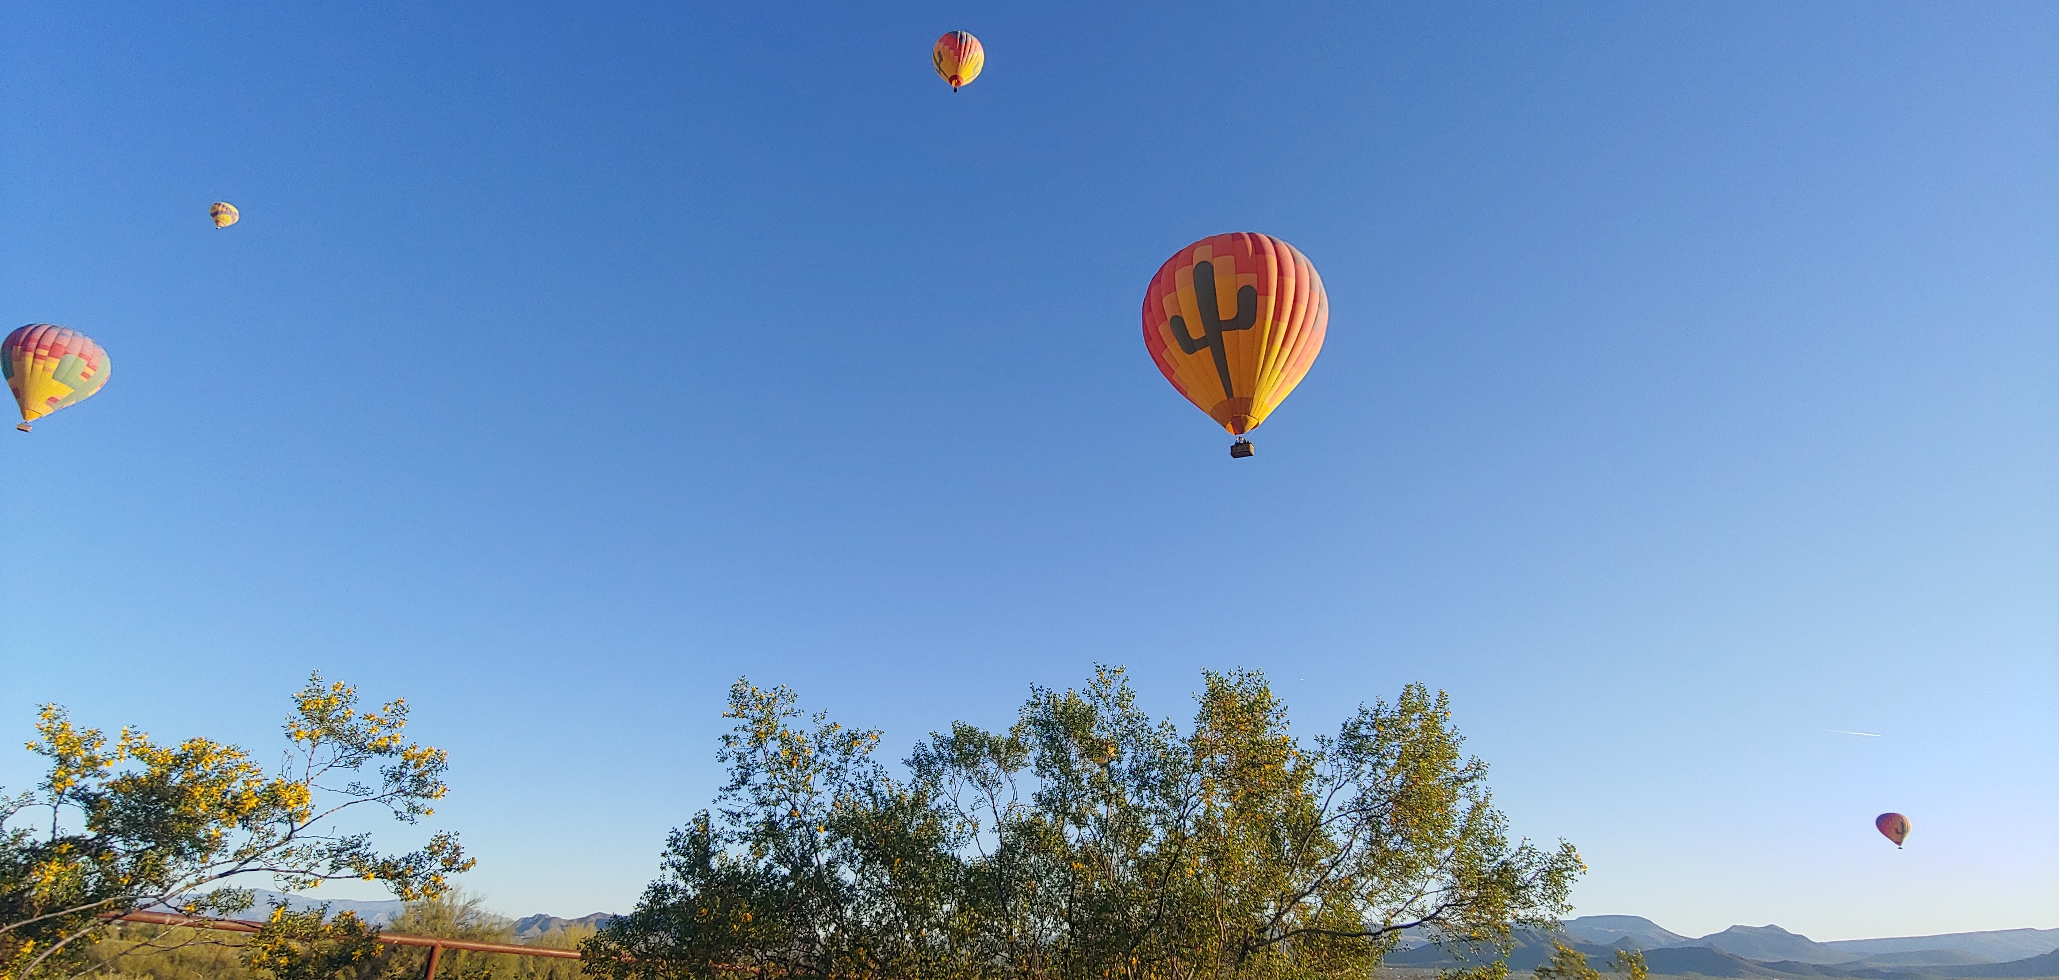
As always, we want to thank you for supporting the NSRS and encourage you to reach out to us so we can support you in preparing for Modernization!
https://geodesy.noaa.gov

Slide 16
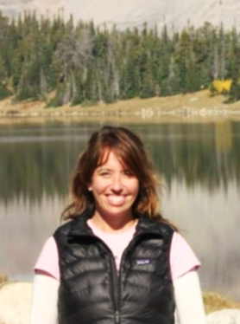
About
I am currently a full time civil servant for the Department of Commerce, serving as the Southwest Regional Geodetic Advisor for NOAA's National Geodetic Survey (NGS). I am serving as a liaison between NGS and its public, academic, and private sector customers within my region (Arizona, New Mexico, and Utah), providing guidance and assistance on geospatial activities that are tied to the National Spatial Reference System. My current duty station is located at the USGS Science Center Campus in Flagstaff, AZ.
I have also had the great privilege to serve several other federal agencies in the geospatial community, working as a Geophysicist and Senior Scientist at NASA’s Goddard Space Flight Center in Greenbelt, MD and as a Sea Level Specialist at the National Park Service Headquarters in Fort Collins, CO.
Lynda Bell
NGS SW Regional Advisor
(AZ,NM,UT)
lynda.bell@noaa.gov
240-988-5919

