Slide 1

NGS Overview and New Datums
WVSPS Annual Convention
February 2020
Jeff Jalbrzikowski, P.S., GISP, CFS
Appalachian Regional Geodetic Advisor
jeff.jalbrzikowski@noaa.gov
240-988-5486

Slide 2
My Background
Licensed Surveyor in OH, PA, and WV (PS)
Certified GIS Professional (GISP)
Certified Floodplain Surveyor (CFS)
BS in Surveying & Mapping, Univ. of Akron
Came to NGS from USACE Pittsburgh District
primary experience is engineering surveys, including structural deformation, hydrographic/bathymetric, terrestrial lidar, GNSS control, local/legacy datum resolution

Slide 3
So… NAD83 and NAVD88 are scheduled to be replaced
Who’s nervous?
Who’s ready?
Who’s already working in ITRF?

Slide 4



Organizational Structure
-Department of Commerce (DoC)
(~47,000 employees)
-National Oceanic and Atmospheric Administration (NOAA)
-National Ocean Service (NOS)
-National Geodetic Survey (NGS)
(~175 employees)

Slide 5


Organizational Structure
We’re not USGS, we’re NGS
-Department of Commerce (DoC)
(~47,000 employees)
-National Oceanic and Atmospheric Administration (NOAA)
-National Ocean Service (NOS)
-National Geodetic Survey (NGS)
(~175 employees)
≠

Slide 6
NGS Mission
To define, maintain and provide access to the National Spatial Reference System (NSRS) to meet our Nation’s economic, social, and environmental needs.

Slide 7
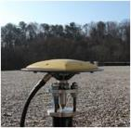
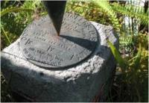

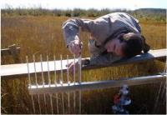
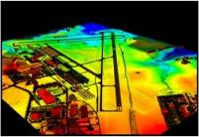
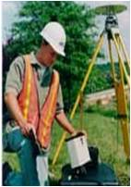
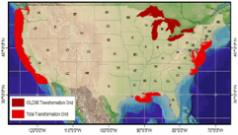
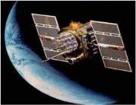
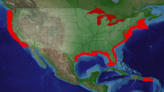
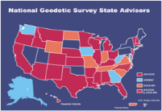
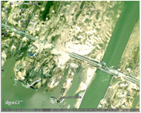
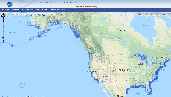
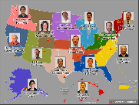
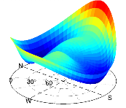
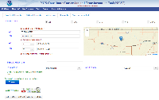
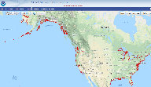
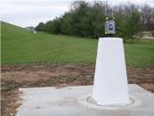
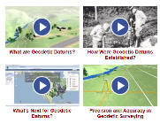
NGS Overview
Modernizing the NSRS
CORS
NHMP
GRAV-D
ECO
NGS Products and Services
ASP
OPUS
VDatum
Orbit Data
National Shoreline
Geodetic Advisors
ERI
Antenna Calibrations
NCAT
CUSP
CBL
Outreach

Slide 8
NGS Overview
Modernizing the NSRS
CORS
NHMP
GRAV-D
ECO
NGS Products and Services
ASP
OPUS
VDatum
Orbit Data
National Shoreline
Geodetic Advisors
ERI
Antenna Calibrations
NCAT
CUSP
CBL
Outreach

Slide 9
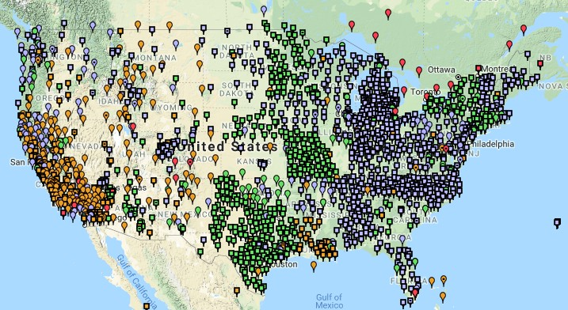
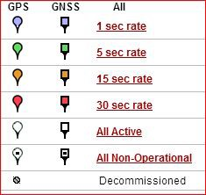
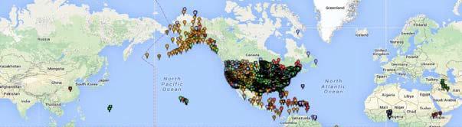
Continuously Operating Reference Station (CORS)
2000+ sites
~225 organizations

Slide 10
NOAA CORS Network (NCN)
2000+ sites
~225 organizations

Slide 11
NGS Overview
Modernizing the NSRS
CORS
NHMP
GRAV-D
ECO
NGS Products and Services
ASP
OPUS
VDatum
Orbit Data
National Shoreline
Geodetic Advisors
ERI
Antenna Calibrations
NCAT
CUSP
CBL
Outreach

Slide 12
National Height Modernization Program
“…the establishment of accurate, reliable heights using GNSS technology in conjunction with traditional leveling, gravity, and modern remote sensing information…”
propagation and long-term monitoring of control thru static GPS campaigns, GPS on BMs, and digital leveling
combined with gravity and lidar data

Slide 13
National Height Modernization Program
Funded partners
States engaged in HM without Federal funding
Spatial Reference Centers
Regional Leaders
Other funded partners

Slide 14
National Height Modernization Program
supports various Federal Programs
FEMA: Flood Hazard Mapping Program (FIRM, etc.)
USACE: Levee & Dam Safety Programs, etc.
USGS: National Geospatial Program (3DEP, NHD+, etc.)
and countless non-Federal programs
still an active program but there have not been any grants in many years

Slide 15
NGS Overview
Modernizing the NSRS
CORS
NHMP
GRAV-D
ECO
NGS Products and Services
ASP
OPUS
VDatum
Orbit Data
National Shoreline
Geodetic Advisors
ERI
Antenna Calibrations
NCAT
CUSP
CBL
Outreach

Slide 16
Gravity for the Redefinition of the American Vertical Datum
Two major campaigns within GRAV-D
High-resolution snapshot of gravity
airborne observations of relative gravity
collected in as short of a timespan as is realistic
full coverage
Low-resolution “movie” of gravity changes
on-the-ground observations of absolute gravity
periodic or episodic; repeat every ___ years
large spacing, a few per state

Slide 17
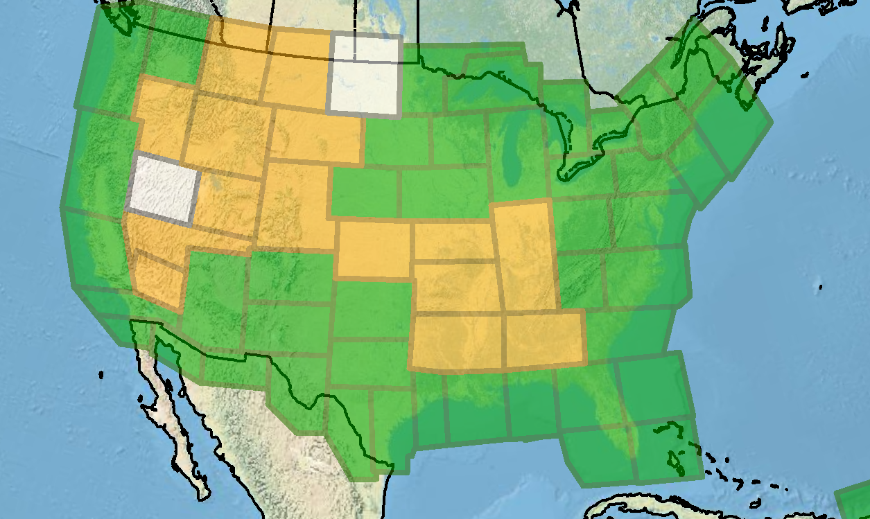
Gravity for the Redefinition of the American Vertical Datum
Green = Complete
Blue = In Processing
Yellow = Underway
White = Planned
10 km data lines
70 km cross lines
20,000 ft altitude
230 kt flight speed
As of DEC2019:
81% complete

Slide 18
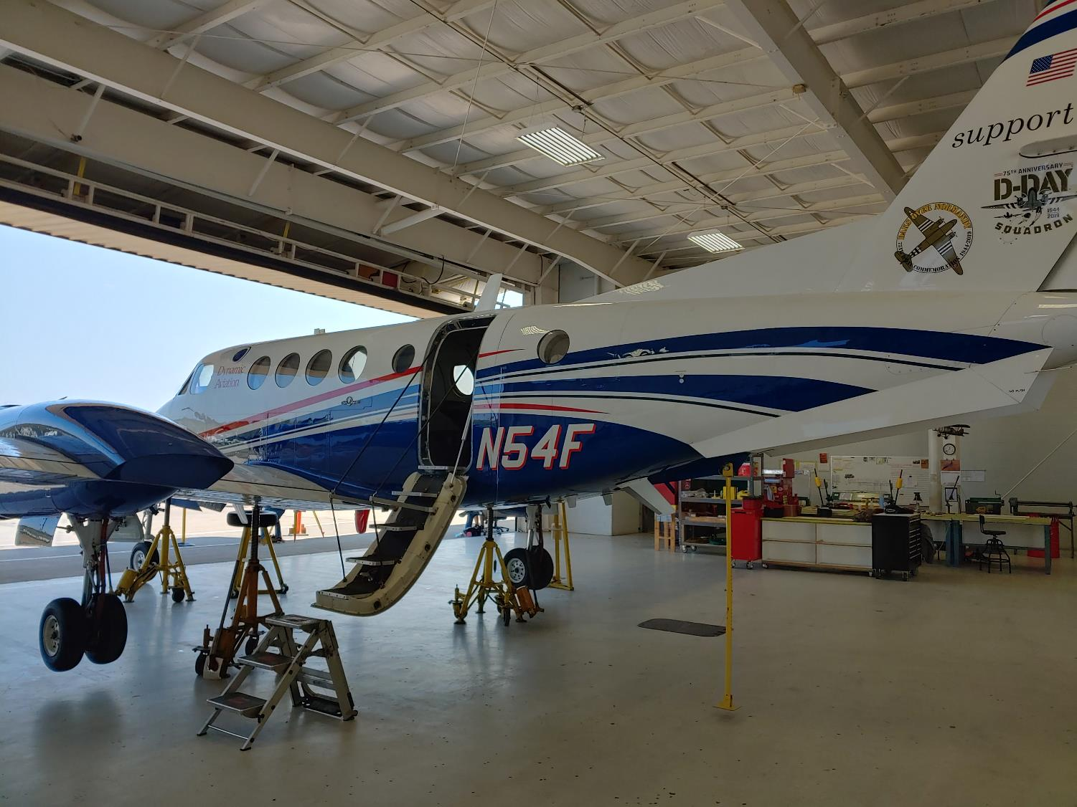
Dynamic Aviation’s King Air 200T

Slide 19

NOAA’s Gulfstream IV-SP

Slide 20
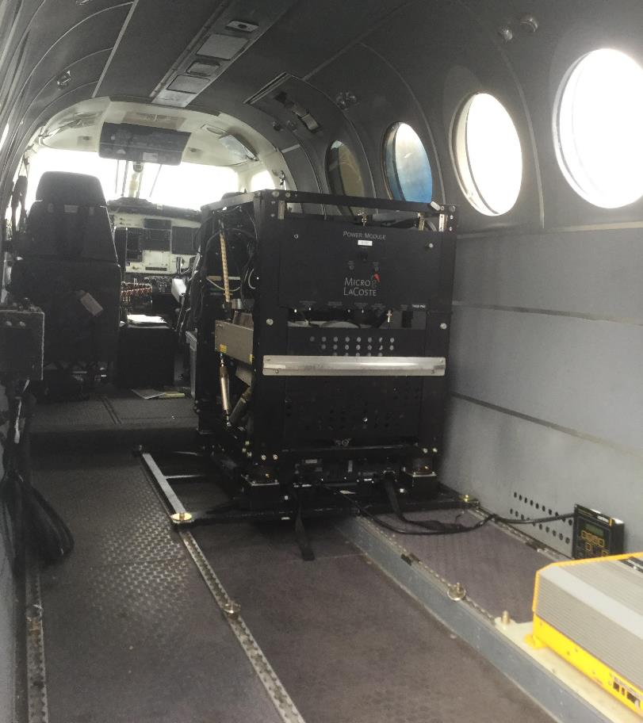
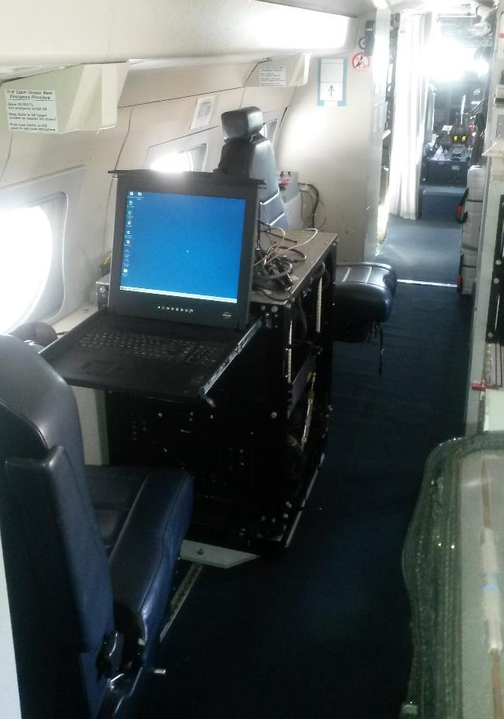
Gravimeters in the Aircraft
in the King Air
in the Gulfstream IV

Slide 21
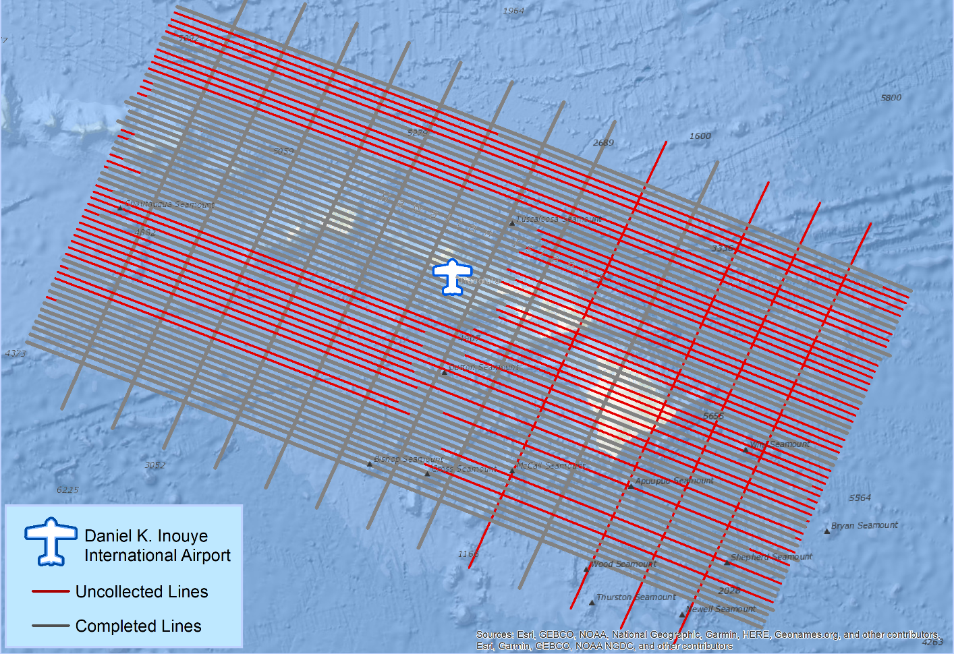
What does a flight plan look like?

Slide 22
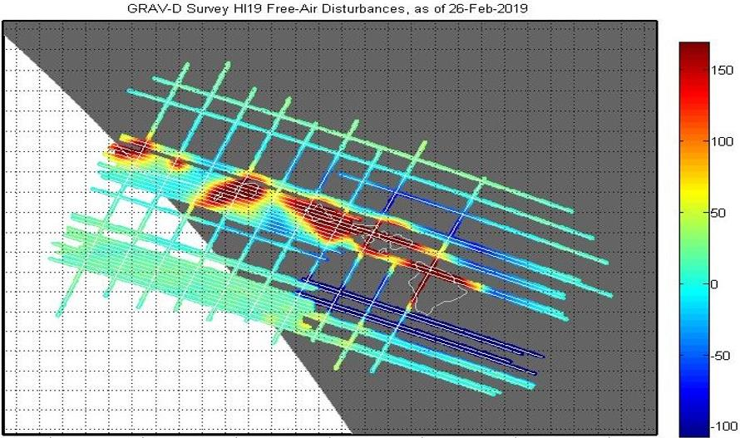
What does processed data look like?
mGal
mGal = milligal

Slide 23
NGS Overview
Modernizing the NSRS
CORS
NHMP
GRAV-D
ECO
NGS Products and Services
ASP
OPUS
VDatum
Orbit Data
National Shoreline
Geodetic Advisors
ERI
Antenna Calibrations
NCAT
CUSP
CBL
Outreach

Slide 24
Online Positioning User Service
OPUS Rapid Static (OPUS-RS)
dual frequency receiver data
static sessions only
30 seconds epoch rate (aka recording interval)
15 minutes to 2 hours of GPS data
OPUS Static (OPUS-S)
same requirements as above
2 to 48 hours of GPS data
OPUS Projects (OP)
adds session processing and network adjustment
training by NGS required; typically 12 hours
upload to OPUS with a “Project ID” keyed in Options

Slide 25
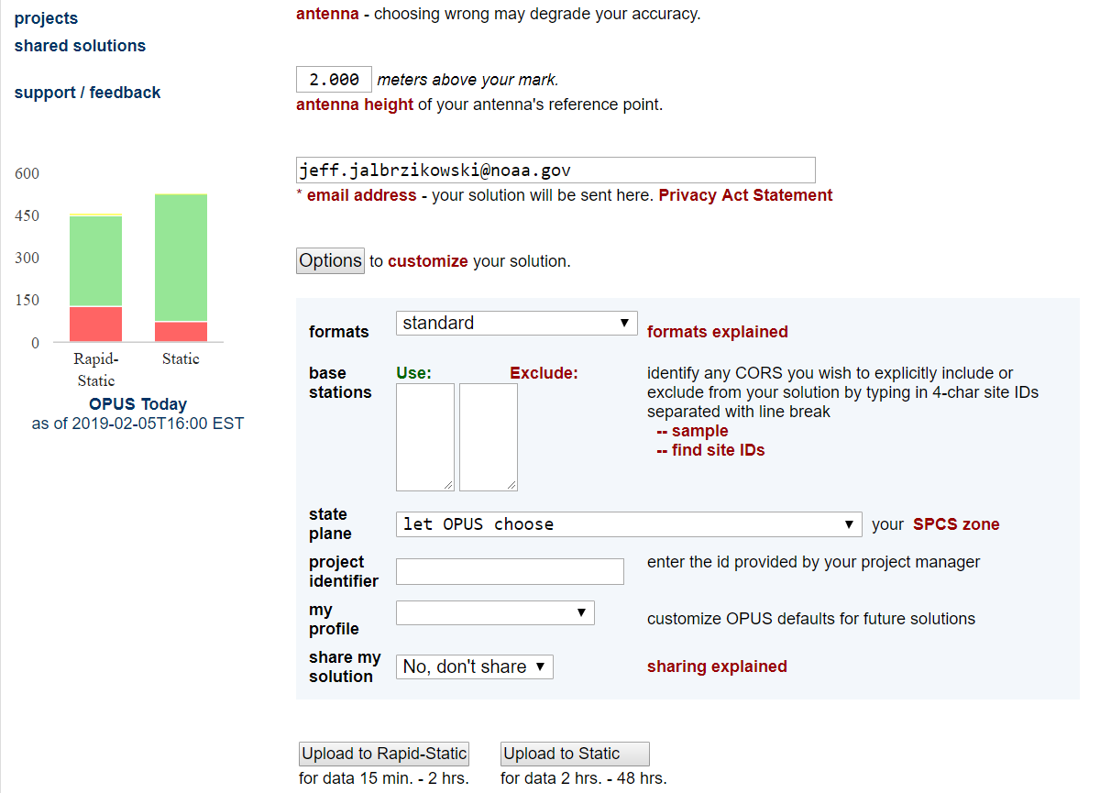
a note on OPUS “my profile”
be careful!

Slide 26
NGS Overview
Modernizing the NSRS
CORS
NHMP
GRAV-D
ECO
NGS Products and Services
ASP
OPUS
VDatum
Orbit Data
National Shoreline
Geodetic Advisors
ERI
Antenna Calibrations
NCAT
CUSP
CBL
Outreach

Slide 27
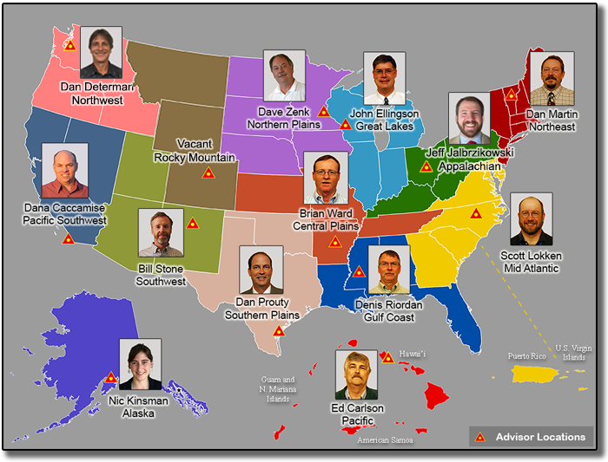
https://www.ngs.noaa.gov/ADVISORS/

Slide 28

Regional Geodetic Advisor Program
www.ngs.noaa.gov/ADVISORS/
query any major search engine: “ngs advisors”

Slide 29
State Geodetic Coordinators
Not an NGS employee, rather:
State/Commonwealth government
RTN manager
DOT survey lead
Geospatial Information Officer
Academia
Professor or Program Director
Professional society representative
Serves as a liaison between the State’s geospatial community and the NGS

Slide 30
NGS Overview
Modernizing the NSRS
CORS
NHMP
GRAV-D
ECO
NGS Products and Services
ASP
OPUS
VDatum
Orbit Data
National Shoreline
Geodetic Advisors
ERI
Antenna Calibrations
NCAT
CUSP
CBL
Outreach

Slide 31
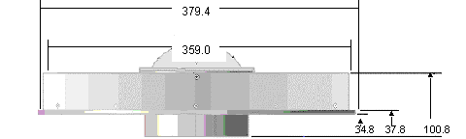
Phase Center Offset - conceptual
Orange dot = mean point of signal reception
Blue dot = Antenna Reference Point (ARP)
Red line = Phase Center Offset (PCO)

Slide 32
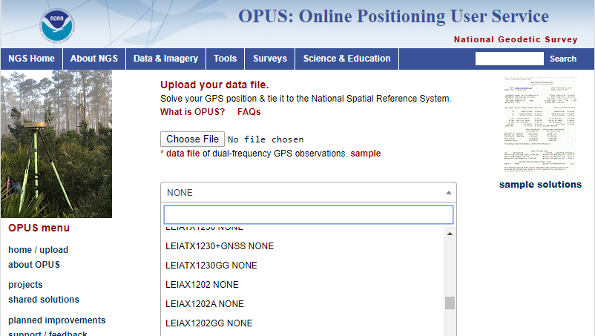
Phase Center Offset
The PCO is one reason it is important to select the correct antenna for OPUS upload!
choose
carefully!
if you have questions… drop me a line

Slide 33
NGS Overview
Modernizing the NSRS
CORS
NHMP
GRAV-D
ECO
NGS Products and Services
ASP
OPUS
VDatum
Orbit Data
National Shoreline
Geodetic Advisors
ERI
Antenna Calibrations
NCAT
CUSP
CBL
Outreach

Slide 34
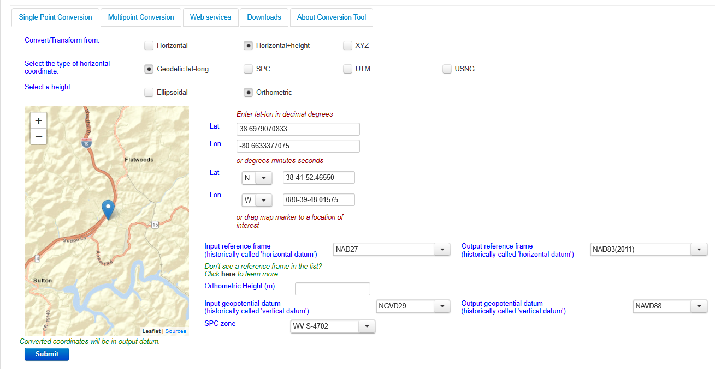
NGS Coordinate Conversion And Transformation Tool (NCAT)

Slide 35
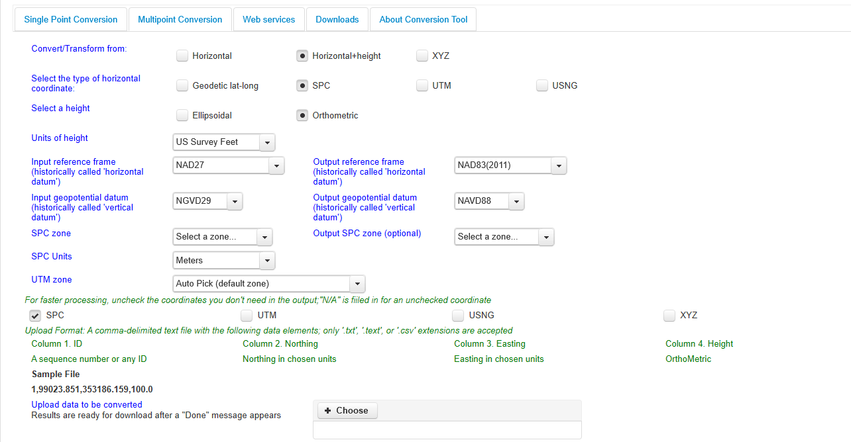
NGS Coordinate Conversion And Transformation Tool (NCAT)

Slide 36
NGS Overview
Modernizing the NSRS
CORS
NHMP
GRAV-D
ECO
NGS Products and Services
ASP
OPUS
VDatum
Orbit Data
National Shoreline
Geodetic Advisors
ERI
Antenna Calibrations
NCAT
CUSP
CBL
Outreach

Slide 37
Calibration Base Lines - CBL
Three types of CBL defined by NGS
Primary CBL (PCBL): in Woodford, VA at NGS TTC; it is open for use to organizations like the PLSO
Federal CBL (FCBL): established with EDM checked at the NGS PCBL and IAW NOAA TM NGS-8
2 in West Virginia: Marshall County Airport, Byrd L&D
Cooperative CBL (CCBL): established with EDM checked on an FCBL and IAW that same NGS-8 manual

Slide 38
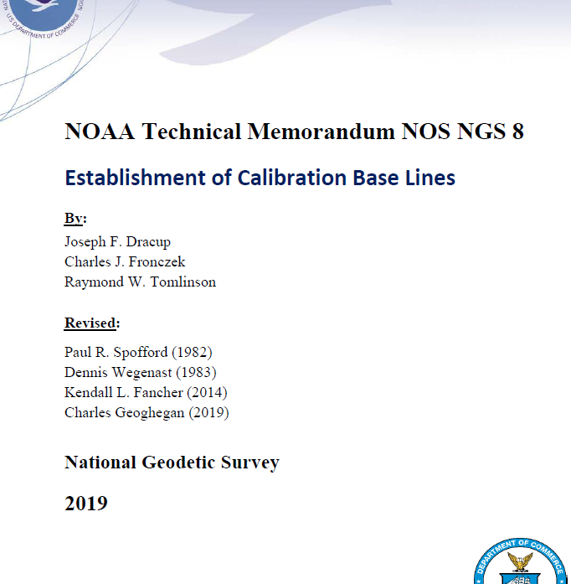
Calibration Base Lines - CBL
NGS commitment to the CBL Program:
A minimum of one FCBL per State
Establishment procedures document
Public access to the CBL database
Software to process your observations
Verification and re-measurement data review
Technical support (Advisors or other personnel)
https://www.ngs.noaa.gov/CBLINES/

Slide 39
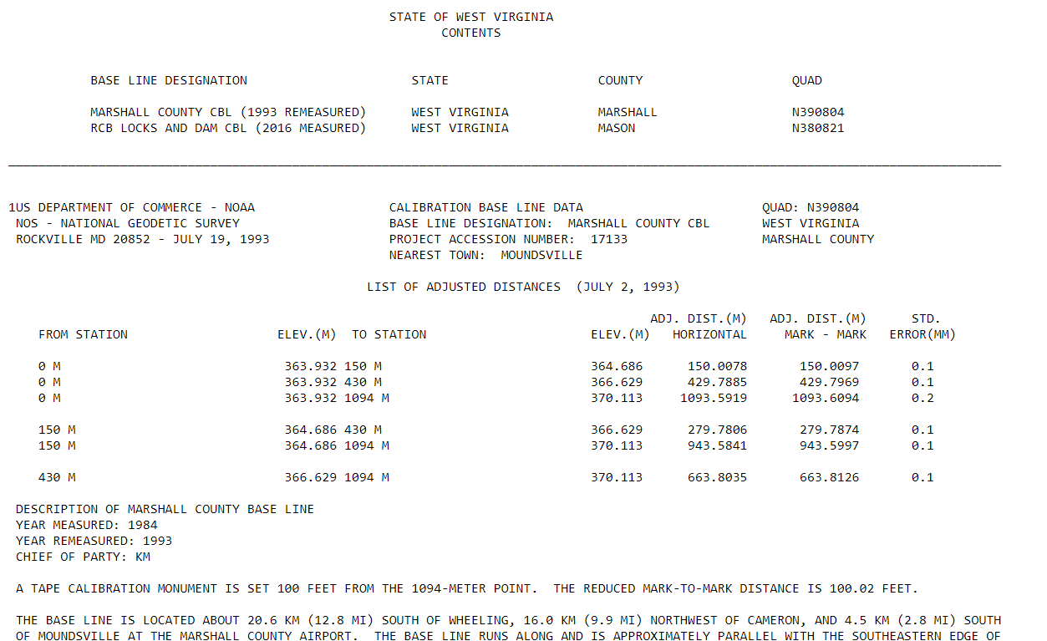
CBL Datasheets

Slide 40
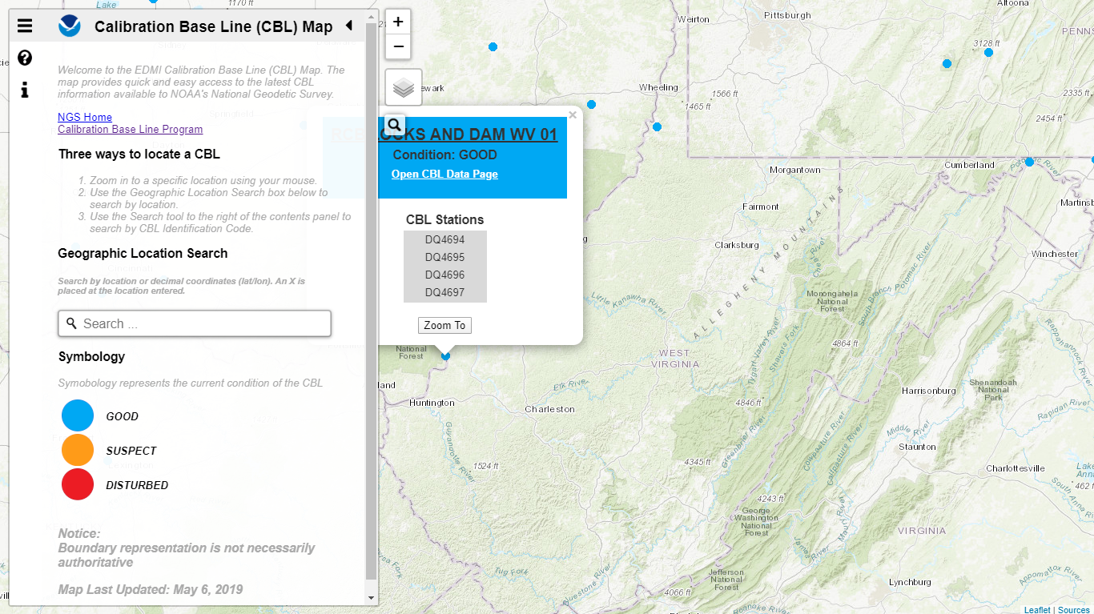
Beta CBL Map Viewer
https://www.ngs.noaa.gov/CBLINES/

Slide 41
NGS Overview
Modernizing the NSRS
CORS
NHMP
GRAV-D
ECO
NGS Products and Services
ASP
OPUS
VDatum
Orbit Data
National Shoreline
Geodetic Advisors
ERI
Antenna Calibrations
NCAT
CUSP
CBL
Outreach

Slide 42
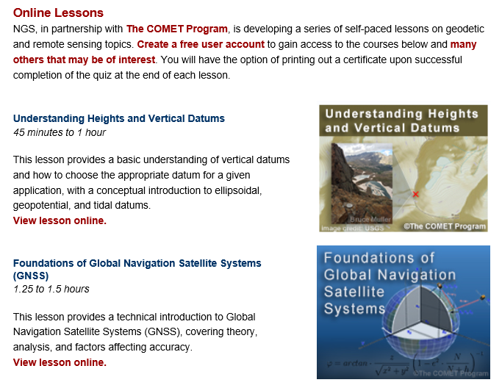
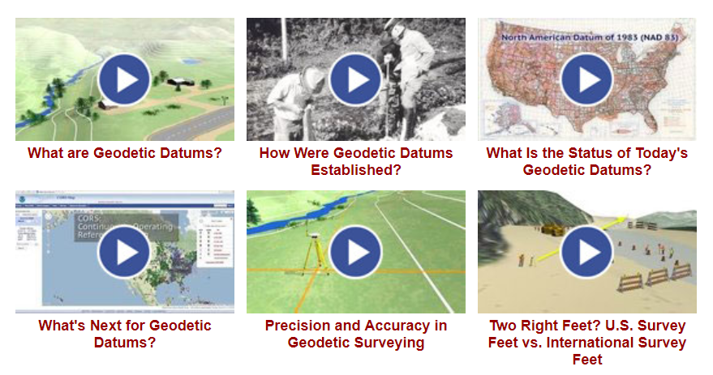
Outreach & Educational Resources

Slide 43
NGS Mission
To define, maintain and provide access to the National Spatial Reference System (NSRS) to meet our Nation’s economic, social, and environmental needs.

Slide 44
National Spatial Reference System (NSRS)
A consistent coordinate system that defines
latitude
longitude
height
scale
orientation
gravity
throughout the United States.
…and their time variants

Slide 45
National Spatial Reference System (NSRS)
These items ARE part of the NSRS
Horizontal Datums (aka Geometric Reference Frames) | Vertical Datums | Great Lakes Datums | Geoid Models | Transformations and Conversions
NAD83 | NAVD88 | IGLD85 | GEOID18 | NADCON
NAD27 | NGVD29 | IGLD55 | GEOID12B | VERTCON
USSD | VIVD09 |  | GEOID09
 | GUVD04 |  | GEOID06 | SPCS83
 | NMVD03 |  | GEOID03 | SPCS27
 | ASVD02 |  | GEOID99
 | PRVD02 |  | GEOID96
 |  |  | ALASKA94
 |  |  | GEOID93
 |  |  | GEOID90

Slide 46
National Spatial Reference System (NSRS)
These items are NOT part of the NSRS
Horizontal Datums (aka Geometric Reference Frames) | Vertical Datums | Geoid Models | Transformations and Conversions
WGS84 | IHRS (by IAG) | OSU91A | CORPSCON
WGS72 |  | EGM96 | Appendix B.6 of DMA TR 8350.2 (WGS 84)
ITRF (Intl. Terrestrial Reference Frame by IERS) |  | EGM2008 | Oregon Coordinate Reference System (ORCS)
IGS (Intl. GNSS Service reference frame) |  |  | The Kansas Regional Coordinate System
Hyperlink to ITRF station map

Slide 47
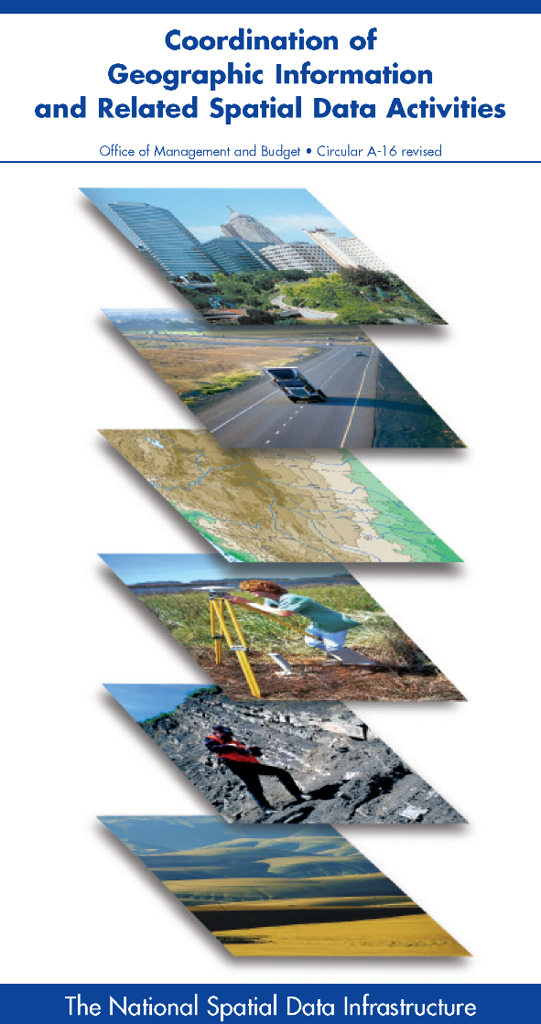



NSRS … do I have to use it?
OMB Circular A-16
requires all Federal civilian agencies to utilize geodetic control for their geospatial activities
places NOAA in responsible charge of that control
NGS has defined that control as the NSRS
FGCS has issued requirements, via FRNs, to reference data to the most recent components of the NSRS
1989 FRN designated NAD 83
1993 FRN designated NAVD 88
Hyperlink to NAVD88 FRN
Hyperlink to NAD83 FRN

Slide 48
NSRS … do I have to use it?
Not necessarily, but it’s a great idea!
States may mandate use (does West Virginia?)
All Federal spatial data and GIS activities financed directly or indirectly, in whole or in part, by Federal funds are required to be tied to the NSRS
If you want to get involved in survey contracting with the Federal Government it’s a necessity

Slide 49
Not just new datums…
NSRS Modernization
Replace NAD83
Replace NAVD88
Re-invent Bluebooking
Improve Geodetic Toolkit
Better Surveying Methods
Blueprint for 2022, Part 1
Blueprint for 2022, Part 2
Blueprint for 2022, Part 3

Slide 50
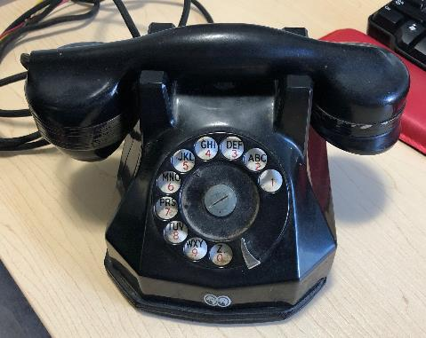
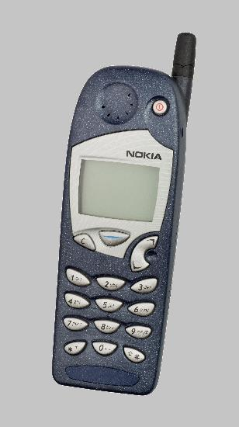
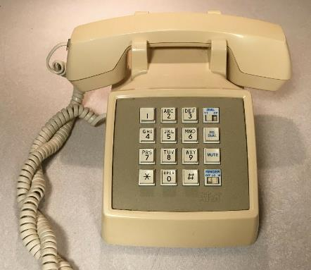
Evolution of the NSRS
NAD27
NAD83 (1986)
NAD83 (2011)

Slide 51

Modernized NSRS is our “smartphone”
You resisted it for a while…
It was a little cumbersome to get used to…
But soon you were hooked!

Slide 52
Two Major Components of
Modernized NSRS
Geometric (LLh)
Latitude, Longitude, Ellipsoid Height
Geopotential (H)
Orthometric Height

Slide 53
North American Datum
of 1983
NAD83
will be replaced by

Slide 54
North American Terrestrial Reference Frame of 2022
NATRF2022
(pronounced: nat-ref)

Slide 55
Reference Frame ≈ Datum
Reference Frame is a more scientifically appropriate way of saying “datum”
could be debated that “datum” was misused in NAD83(2011)
you will continue to see NGS use the phrase “New Datums” for 2022

Slide 56
Datum Defined
The adopted standard latitude and longitude of a given station, together with the adopted standard azimuth of a line from that station.
e.g. Meade’s Ranch and it’s azimuth mark, Waldo
Source: Proceedings of the 14th General Conference of the International Geodetic Association (IAG) - ”Report on Geodetic Operations in the United States”, O.H. Tittmann, Superintendent of the USC&GS

Slide 57
Reference Frame Defined
A point of view or a ‘frame of reference’.
If your reference frame is North America, you are standing somewhere within North America, seeing how other places move from your point of view.

Slide 58
Why replace NAD83?
Main driver: Global Navigation Satellite System (GNSS)
ACCESS
GNSS equipment is fast, inexpensive, reliable
Reduces reliance on physical control marks
ACCURACY
Insensitive to distance-dependent errors
Immune to instability; active control via CORS
CONSISTENCY
Eliminates systematic errors in current datums
Aligned with global reference frame

Slide 59
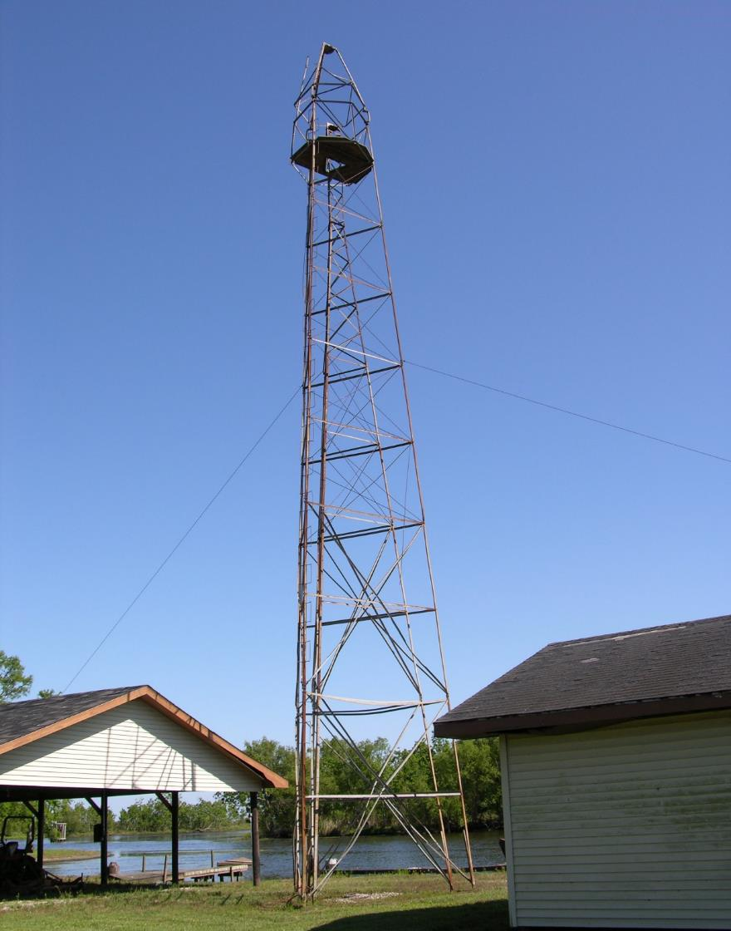
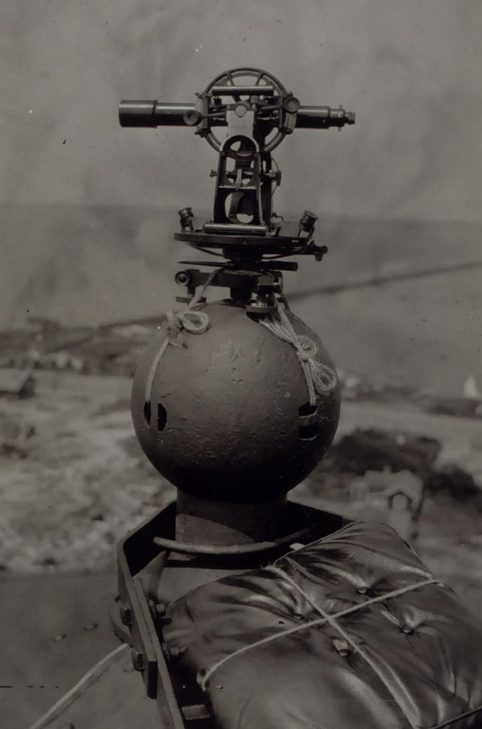
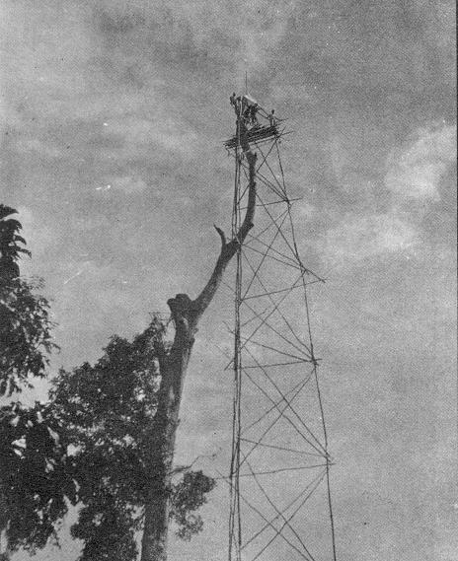
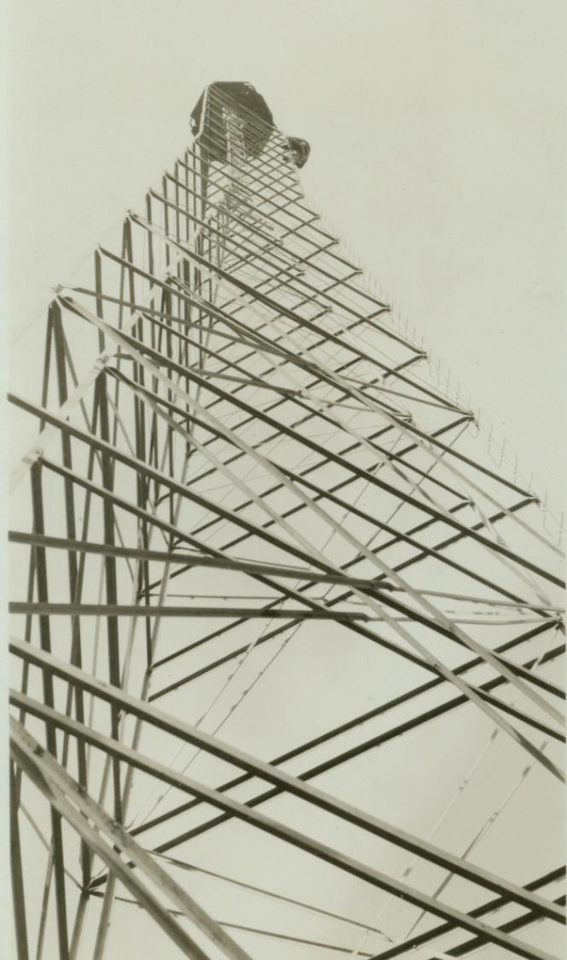
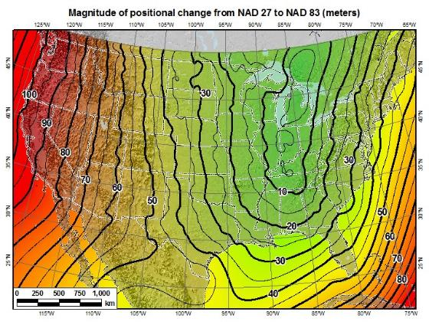
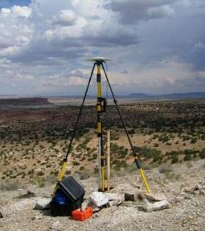
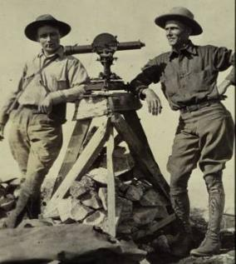
A very brief history of U.S. horizontal & geometric datums
GNSS
triangulation
NAD83(HARN/199#)
US Standard Datum
NAD83(HARN/199#)
NAD83(2007)
NATRF2022
NAD83(1986)
NAD83(2011)
NAD27
+
+
+
+
+
+
+
time
tens of meters
few 0.1m
few 0.01m
few 0.01m
<10 m
~2m
shift

Slide 60


Slide 61
Replacing NAD83
develop four "plate-fixed" reference frames
remove non-geocentricity of NAD83
align to ITRF2014 at epoch 2020.00
remove most of tectonic plate rotation from ITRF2014 via Euler Pole Parameters
Shift and Drift…

Slide 62
Replacing NAD83
develop four "plate-fixed" reference frames
remove non-geocentricity of NAD83
align to ITRF2014 at epoch 2020.00
remove most of tectonic plate rotation from ITRF2014 via Euler Pole Parameters
Shift and Drift…

Slide 63
Four “Plate-Fixed” Reference Frames
North American Terrestrial Reference Frame of 2022
(NATRF2022)
Pacific Terrestrial Reference Frame of 2022
(PATRF2022)
Caribbean Terrestrial Reference Frame of 2022
(CATRF2022)
Mariana Terrestrial Reference Frame of 2022
(MATRF2022)

Slide 64
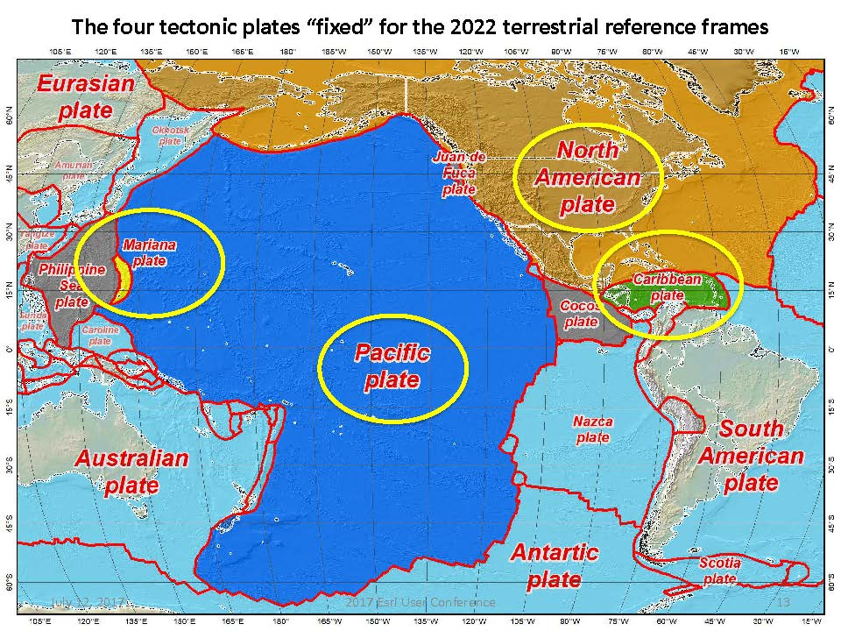


Slide 65
Four “Plate-Fixed” Reference Frames
North American Terrestrial Reference Frame of 2022
(NATRF2022)
Pacific Terrestrial Reference Frame of 2022
(PATRF2022)
Caribbean Terrestrial Reference Frame of 2022
(CATRF2022)
Mariana Terrestrial Reference Frame of 2022
(MATRF2022)

Slide 66
Replacing NAD83
develop four "plate-fixed" reference frames
remove non-geocentricity of NAD83
align to ITRF2014 at epoch 2020.00
remove most of tectonic plate rotation from ITRF2014 via Euler Pole Parameters
Shift and Drift…

Slide 67
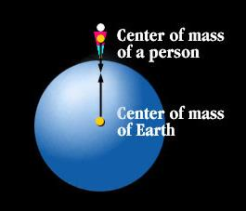
Non-geocentricity?
Geocentric:
relating to, measured from, or as if observed from the earth's center of mass
The goal was to accomplish that… but didn’t.

Slide 68

Non-geocentricity of NAD83
ITRF2014
GRS80 ellipsoid
NAD83
GRS = Geodetic Reference System

Slide 69
Non-geocentricity of NAD83
ITRF2014
GRS80 ellipsoid
NAD83

Slide 70
Non-geocentricity of NAD83
Earth’s
Surface
h₁₄
h₈₃
NAD83
origin
ITRF2014
origin
~2.2 meters
GRS80
ellipsoid

Slide 71
Non-geocentricity of NAD83
Earth’s
Surface
h₂₂
NAD83
ITRF2014
NATRF2022
GRS80
ellipsoid
Shift…

Slide 72


Geometric change due to ellipsoid non-geocentricity
Horizontal (Lat, Lon)
Ellipsoidal (h)
Shift…

Slide 73
Replacing NAD83
develop four "plate-fixed" reference frames
remove non-geocentricity of NAD83
align to ITRF2014 at epoch 2020.00
remove most of tectonic plate rotation from ITRF2014 via Euler Pole Parameters
Shift and Drift…

Slide 74


International Terrestrial Reference Frame
(ITRF)
International Earth Rotation and Reference Systems Service (IERS)
International Union of Geodesy and Geophysics (IUGG)

Slide 75
International Terrestrial Reference Frame
The stable coordinate system that allows us to measure change over space, time and evolving technologies.
An accurate, stable set of station positions and velocities.
Network measurements interconnected by co-location of different space geodetic techniques.
“Approximately represents the motions of the tectonic plates with respect to the Earth's deep interior”… huh?

Slide 76

ITRF concept
Watch the grid!
Drift…

Slide 77

Epoch?
eh-puck? ee-pock? … to-may-to, to-mah-to
an instant of time or a date selected as a point of reference

Slide 78
Replacing NAD83
develop four "plate-fixed" reference frames
remove non-geocentricity of NAD83
align to ITRF2014 at epoch 2020.00
remove most of tectonic plate rotation from ITRF2014 via Euler Pole Parameters
(pronounced: “oiler”)
Shift and Drift…

Slide 79
The wrong question, circa 2022:
“What’s the position of that point?”
The right question, circa 2022:
“What’s the position of that point, on some specific date?”
Drift…

Slide 80
Two types of drift
Tectonic Plate Rotation
horizontal
Everything Else
residual motions left after rotation
regional linear motions
localized subsidence or uplift
simple to model
complex

Slide 81
Tectonic Plate Rotation
horizontal
simple to model

Slide 82
Euler Pole Parameters
of 2022
EPP2022

Slide 83

Plate Rotation visualized
Drift…

Slide 84

Euler Poles and “Plate-Fixed”
In the ITRF, many tectonic plates have a dominant motion: rotation
Euler Pole - point about which a plate rotates (yellow star)
NATRF2022 Euler Pole

Slide 85
Euler Poles and “Plate-Fixed”
ITRF
Frame = constant
NA Plate = rotating
NATRF
Frame = rotating
NA Plate = constant

Slide 86
Euler Poles and “Plate-Fixed”
ITRF
Frame = constant
NA Plate = rotating
NATRF
Frame = rotating
(relative to ITRF)
NA Plate = constant
(relative to NATRF2022)

Slide 87

ITRF – constant frame, rotating plate

Slide 88
“Plate-Fixed”
NATRF – rotating frame, constant with plate

Slide 89
ITRF or NATRF – your choice, just use EPP

Slide 90
EPP – Euler Pole Parameters
Latitude
Longitude
Rotation Speed
yellow star off west coast of S. America

Slide 91
CORS Velocities in ITRF2014
Drift…

Slide 92

CORS Velocities in NATRF2022
Think of this map as ITRF2014 + EPP2022
Still SomeDrift…

Slide 93
ITRF2014 + EPP2022 = --TRF2022
Rotation of the
North American Plate
NATRF2022
CATRF2022
PATRF2022
MATRF2022
Rotation of the
Caribbean Plate
ITRF2014
Rotation of the
Pacific Plate
Rotation of the
Mariana Plate
EPP2022

Slide 94
ITRF2014 + EPP2022 = --TRF2022
Rotation of the
North American Plate
NATRF2022
EPP2022
ITRF2014

Slide 95
Two types of drift
Tectonic Plate Rotation
horizontal
Everything Else
residual motions left after rotation
regional linear motions
localized subsidence or uplift
simple to model
complex

Slide 96
Everything Else
residual motions left after rotation
regional linear motions
localized subsidence or uplift
Still SomeDrift…
complex

Slide 97
Intra-Frame Velocity Model of 2022
IFVM2022

Slide 98
Concept of goal of IFVM
Longitude (Easting) History of DI4044
Trend: -1.7 mm / year
RED IS NATRF2022
COORDINATE
Still Some Drift…
Trend: -14.3 mm / year
BLUE IS ITRF COORDINATE
2004 2006 2008 2010 2012 2014 2016 2018

Slide 99
CORS Velocities in NATRF2022
Think of this map as ITRF2014 + EPP2022
Still SomeDrift…

Slide 100

IFVM goal = model all velocities
Think of this map as ITRF2014 + EPP2022 + IFVM2022

Slide 101
Still Some Drift…
Everything in the world moves
Coordinates will be associated with the actual date when the data was collected!
Velocities at all marks can be estimated using this Intra-Frame Velocity Model
IFVM goal being to move collected data thru time to Reference Epochs for coordinate comparisons/analysis

Slide 102
Intra-Frame Velocity Model
A model of all residual velocities, after removal of tectonic rotation via EPP:
Horizontal residual motion
Total vertical motion (ellipsoid heights)
Replaces / Improves upon HTDP
Given t₁ and t₂, compute Δλ, Δϕ, Δh at any point, accounting for all motions
Likely be built upon CORS data, geodynamic models and InSAR, but not yet finalized

Slide 103
EPP2022 – Euler Pole Parameters – Simple Rotation
Three parameters: lat, lon, rotation speed
Horizontal only: just latitude and longitude
Changes the frame: ITRF2014 + EPP2022 = NATRF2022
Does not change the epoch
IFVM2022 – Intra-Frame Velocity Model - Complex
Complex set of parameters
Residual horizontal motion: all the motion leftover after Euler Pole rotation
All vertical motion: localized subsidence or uplift
Changes the epoch
Does not change the frame: “intra” = on the inside; within

Slide 104
EPP2022 IFVM2022
Two new tools that will make time dependent geodetic control practical
They work together to account for the Drift…

Slide 105
Example of application of EPP and IFVM
It’s 2039 and you are working in San Diego using NATRF2022
And you want to compare your work to another survey from 2028
Important: This slide only covers geometric coordinates.
…the catch is, that survey was done in PATRF2022
PATRF2022
ep. 2028.048
EPP2022
(PA)
ITRF2014
ep. 2028.048
EPP2022
(NA)
NATRF2022
ep. 2028.048
IFVM2022
(PA)
IFVM2022
(NA)
PATRF2022
ep. 2039.704
EPP2022
(PA)
ITRF2014
ep. 2039.704
EPP2022
(NA)
NATRF2022
ep. 2039.704

Slide 106
Alright Jeff... enough jibba-jabba, what’s the impact?

Slide 107


Slide 108

What’s that going to look like?
PHOTO = NAD83
RED = NAD83 shoreline data
GREEN = shoreline transformed to NATRF2022

Slide 109

If you’re only working in this region…
North American Terrestrial Reference Frame of 2022
(NATRF2022)

Slide 110
Two Major Components of
Modernized NSRS
Geometric (LLh)
Latitude, Longitude, Ellipsoid Height
Geopotential (H)
Orthometric Height

Slide 111
North American Vertical Datum
of 1988
NAVD88
will be replaced by

Slide 112
North American-Pacific Geopotential Datum of 2022
NAPGD2022
(pronounced: nap-jee-dee)

Slide 113
A brief history of (the most prevalent) U.S. vertical datums

Slide 114

NGVD29
Referenced to 26 tide gauges in the US and Canada

Slide 115
NGVD29 – based on 26 tide gauges
Concept

Slide 116

Referenced to a single tide gauge in Canada
Why one gage fixed this time?
removed local sea level variation problem of NGVD29
But it did introduce possibility of cross-continent error build-up…
Father Point Lighthouse, Quebec

Slide 117

NAVD88 – based on single tide gauge
Concept

Slide 118

Approximate Error in NAVD88 "zero elevation” (H=0)
Map is the H=0 surface overlaid onto satellite gravity data

Slide 119


Why Replace NAVD88?
tilt in the "zero surface” (intended to be flat)
subsidence, uplift, freeze & thaw of BMs
limited availability of undisturbed marks
Approximate Error in NAVD88 "zero surface”

Slide 120

Passive marks may lie still… but they still may lie! (small instability x long time = large inaccuracy)

Slide 121
Replacing NAVD88
primary access via GNSS and geoid (think OPUS)
accurate continental gravimetric geoid (1-2 cm)
aligned with:
NATRF2022 (or CATRF, PATRF, MATRF)
global mean sea level (GMSL)
monitor time-varying nature of gravity (NGS Geoid Monitoring Service GeMS)

Slide 122
Two types of geoid models…
Gravimetric
Hybrid

Slide 123
Gravimetric → Hybrid
Gravimetric geoid is created from “scratch” with various types of gravity data
USGG2003, USGG2009, USGG2012, xGEOID19
Hybrid geoid is simply a gravimetric geoid warped to fit some vertical datum… like NAVD88
GEOID03, GEOID09, GEOID12B, GEOID18

Slide 124
Gravimetric → Hybrid
USGG2003, USGG2009, USGG2012, xGEOID19
GEOID03, GEOID09, GEOID12B, GEOID18
best fit to NAVD88
best fit to NAVD88
best fit to NAVD88
best fit to NAVD88

Slide 125


Slide 126

Calculating N_{g} is not easy!
First you need a gravity field
data collected from different distances away from Earth
Next calculate gravity anomaly, or ∆g
Then, just solve Stokes’ integral!
R is the mean radius of the earth
ɣ0 is mean surface gravity on ellipsoid
S is a geometric function of position
…there’s a catch
Need to know ∆g over entire surface of the earth

Slide 127
Calculating N_{g} is not easy!
First you need a gravity field
data collected from different distances away from Earth
Next calculate gravity anomaly, or ∆g
Then, just solve Stokes’ integral!
R is the mean radius of the earth
ɣ0 is mean surface gravity on ellipsoid
S is a geometric function of position
…there’s a catch
Need to know ∆g over entire surface of the earth

Slide 128







Building a Gravity Field Model
Long Wavelengths (> 250 km)
GRACE/GOCE/Satellite Altimetry
+
Intermediate Wavelengths (20km to 300 km)
Airborne Observations
+
Short Wavelengths (< 100 km)
Terrestrial/Surface Observations and Predicted Gravity from Topography

Slide 129

GRACE - 2 Satellites measuring separation

Slide 130

GRAV-D – airborne relative gravimeters

Slide 131

Terrestrial Gravimeter - Relative

Slide 132

Terrestrial Gravimeter - Relative

Slide 133

Terrestrial Gravimeter - Absolute

Slide 134

Terrestrial Gravimeters - Absolute and Relative

Slide 135
Individual Components of NAPGD2022
Global Model of the geopotential field
GM2022
Geoid undulation models by region
GEOID2022 aka “0 elevation”
Deflection of the Vertical (DoV) models by region
DEFLEC2022
Surface Gravity models by region
GRAV2022

Slide 136


Slide 137

Sea Level Change and the Geoid

Slide 138

Sea Level Change and the Geoid

Slide 139

Sea Level Change and the Geoid

Slide 140

Estimated change in orthometric heights from NAVD88 to NAPGD2022
(NAPGD2022 approximated using xGEOID16B)

Slide 141


Estimated change in orthometric heights from NAVD88 to NAPGD2022
(NAPGD2022 approximated using xGEOID16B)
Vertical change of about -0.6 to -2.0 feet

Slide 142

North American-Pacific Geopotential Datum of 2022
(NAPGD2022)

Slide 143
How can I prepare? Where did this all start? What’s the benefit to me? How is all this possible?
Well, besides learning a whole new set of terminology and methods…

Slide 144
How can surveyors prepare?
Get familiar with terms, ask now, be ready
Set/occupy RTN Validation Stations (OPUS)
Research your published control
pre-1995 will NOT get new coordinates (GPS only)
Use OPUS Projects to re-observe/process

Slide 145

What’s the benefit?
Reduce all definitional & access-related errors in geometric reference frame to 1 cm when using 15 min of GNSS data
aka “Replace NAD83”
Reduce all definitional & access-related errors in orthometric heights in geopotential datum to
2 cm when using 15 min of GNSS data
aka “Replace NAVD88”
https://geodesy.noaa.gov/web/about_ngs/info/tenyearfinal.shtml

Slide 146

How is all this possible?
CORS
Co-location of space geodetic instruments worldwide that feed into ITRF development
Teamwork with other geodetic organizations
Research and Development
Testing
Science, dude!

Slide 147





Co-location Site
NASA Goddard Space Flight Center, Greenbelt MD, USA
GNSS, SLR, VLBI, DORIS

Slide 148

Co-location Site
NASA Goddard Space Flight Center, Greenbelt MD, USA
GNSS, SLR, VLBI, DORIS

Slide 149
Co-location Site
NASA Goddard Space Flight Center, Greenbelt MD, USA
GNSS, SLR, VLBI, DORIS

Slide 150
SLR
Satellite Laser Ranging

Slide 151


Slide 152
Co-location Site
NASA Goddard Space Flight Center, Greenbelt MD, USA
GNSS, SLR, VLBI, DORIS

Slide 153
VLBI
Very Long Baseline Interferometry

Slide 154

VLBI

Slide 155

VLBI

Slide 156
Co-location Site
NASA Goddard Space Flight Center, Greenbelt MD, USA
GNSS, SLR, VLBI, DORIS

Slide 157
DORIS
Doppler Orbitography and Radiopositioning Integrated by Satellite

Slide 158

Doppler Orbitography and Radiopositioning Integrated by Satellite

Slide 159

Space Geodesy Co-location Diagram
Generic concept of “co-location survey”, typically more complex.

Slide 160


Altogether now!
All these techniques work together to create a well-defined, robust reference frame that improves positioning for users globally.

Slide 161
Not just new datums…
NSRS Modernization
-OPUS enhancements/additions
-new types of coordinates
-new methods for establishing control
-streamlined Bluebooking
-retire the US Survey Foot

Slide 162

Blueprint for 2022, Part 3

Slide 163
Let’s look at some new terminology

Slide 164
NOAA CORS Network (NCN)
As of 2019, this is the official name of the national network of CORS whose data are managed by NGS
Historically referred to as “CORS” or “the CORS”
Remember, not all CORS are in the NCN
For example: the WVDOH CORS Network, not all of those Stations are in the NCN
CORS = Continuously Operating Reference Station

Slide 165

NOAA CORS Network (NCN)

Slide 166

WVDOH CORS Network

Slide 167
GPS Month
A span of four consecutive GPS weeks, where the first GPS week in the GPS month is an integer multiple of 4
GPS Month 0 = GPS Weeks 0, 1, 2 and 3
GPS Month 1 = GPS Weeks 4, 5, 6 and 7
GPS Month 2 = GPS Weeks 8, 9, 10, and 11
GPS Month 3 = GPS Weeks 12, 13, 14, and 15
You get the idea…

Slide 168
New Types of Coordinates

Slide 169
Five types of coordinates in Modernized NSRS
Name | Generally on… | Description
Reported | Passive | “Quick and Dirty”. Smartphone accuracy.
Preliminary | Passive | Computed by you with OPUS using your data. Unchecked by NGS.
Final Discrete | Passive | Most accurate. Time-dependent. Computed by NGS every four weeks.
Final Running | CORS | Continuous time-dependent CORS coordinates. Checked by NGS every day.
Reference Epoch | Passive and CORS | Modeled from Final Discrete, Final Running, IFVM2022 and GeMS. Computed by NGS every five years.

Slide 170
Reported Coordinates
These are from any source in which the coordinate is directly reported to NGS without the data necessary for NGS to replicate the coordinate.
Compares to:
SCALED – like on a datasheet
HD_HELD – like on a datasheet
Smartphone/Device GNSS
From NCAT or VDatum
Coordinates from and RTK/RTN rover without data files

Slide 171


Reported Coordinates

Slide 172
Preliminary Coordinates
These are coordinates at survey epoch that have been computed from OPUS, but not yet quality checked and loaded into the National Spatial Reference System Database (NSRS DB).
Compares to:
OPUS Solution Report – NGS does not QC these
OPUS-Projects results – only QC’d if submitted
Note:
These are the only coordinates a user will get directly from OPUS

Slide 173
Final Discrete Coordinates
These are coordinates computed by NGS using submitted data and metadata, checked, adjusted, and referenced to a single survey epoch for loading into the NSRS DB.
Represent the best estimate of the time-dependent coordinates at any given mark
What will the Survey Epochs be?
GNSS: GPS Month
Stand-alone occupations, RTK/RTN, Campaigns, etc.
Leveling: Calendar Year; Annually
Will be adjusted to GNSS-based orthometric heights

Slide 174
Final Running Coordinates
These are the only type which will have a published coordinate at any epoch.
Generally will only be available at CORSs
Will be generated by a “fit” to daily processed data
Another new term!
We’ll refer to these as the Coordinate Function

Slide 175
Daily Epochs?!?
It seems unlikely that the majority of surveyors will embrace these (e.g. 2028.048, 2039.074 from last slide)
To mitigate that, NGS will issue “snapshots” of the NSRS every five years
We’re calling these Reference Epochs
These will be estimates of coordinates at specific 5 year intervals - based on historic coordinates and the IFVM2022
Beginning with 2020.00
Each “snapshot” will be published 2-3 years after the reference epoch, so the 2020.00 Reference Epoch Coordinates get published by the end of calendar year 2022… thus the name/date of 2022

Slide 176
Reference Epoch Coordinates
These are coordinates which have been estimated by NGS based on time-dependent (final discrete and final running) coordinates, at an Official NSRS Reference Epoch (ONRE).
Compares to:
NAD 83(2011) epoch 2010.00 on a Datasheet
When will NGS compute these?
Every 5 years, on a timeline of 2-3 years post-date
2020.00 coordinates will be computed in 2022
2025.00 coordinates will be computed in 2027

Slide 177
Let’s visualize some of these new things.

Slide 178
Assume “h” was determined four different times:
1990: 2.100
1994: 2.110
2002: 2.190
2009: 2.180
h
2.250
2.200
2.150
2.100
2.050
2.000
1990
‘95
‘00
‘05
‘10
‘15
‘20
‘25
‘30
time

Slide 179
h
In today’s NSRS, a height is held fixed until replaced. So plotting the height of these coordinates as seen on an NGS Datasheet over time would look like this:
2.250
2.200
2.150
2.100
2.050
2.000
1990
‘95
‘00
‘05
‘10
‘15
‘20
‘25
‘30
time

Slide 180
All measurements have error. Shown here are the same
Values of “h”, but with their error estimates.
1990: 2.100 +/- 0.0375 (3.75 cm)
1994: 2.110 +/- 0.0250 (2.50 cm)
2002: 2.190 +/- 0.0200 (2.00 cm)
2009: 2.180 +/- 0.0250 (2.50 cm)
h
2.250
2.200
2.150
In the Modernized NSRS these time-dependent
coordinates, estimated at the actual date when
the surveys took place, will be called
Final Discrete Coordinates
2.100
2.050
2.000
1990
‘95
‘00
‘05
‘10
‘15
‘20
‘25
‘30
time

Slide 181
The IFVM2022 will (statistically)
align to these Reference Epoch Coordinates.
In the Modernized NSRS we will also have an estimate of
crustal motion from IFVM2022
h
2.250
2.200
2.150
2.100
Combining Final Discrete Coordinates
with IFVM2022 allows NGS to estimate Reference Epoch Coordinates
2.050
2.000
1990
‘95
‘00
‘05
‘10
‘15
‘20
‘25
‘30
time

Slide 182
h
2.250
2.200
2.150
2.100
2.050
In the absence of new survey data, error estimates will
grow through time.
2.000
1990
‘95
‘00
‘05
‘10
‘15
‘20
‘25
‘30
time

Slide 183
The (in)ability of current approach to
properly inform users of the height of
this mark can be seen in blue.
2.250
2.200
2.150
2.100
2.050
2.000
1990
‘95
‘00
‘05
‘10
‘15
‘20
‘25
‘30

Slide 184
State Plane Coordinate System of 2022
SPCS2022

Slide 185

Bumper Stickers I’ll be selling in Booth #22 tomorrow afternoon ☺

Slide 186
SPCS2022 stakeholders
State groups that formally interface with NGS
Departments of transportation
Cartographer/GIS office
Professional surveying, engineering, GIS societies
Colleges/universities with geospatial curriculum
Can submit requests and proposals for designs
Requests are for designs by NGS
Proposals are designs by stakeholders
Stakeholder input must be unanimous

Slide 187
General SPCS2022 characteristics
Distortion design requirements
Linear distortion minimized at topographic surface (not at ellipsoid surface)
Purpose: to reduce difference between projected “grid” and actual “ground” distances
Other characteristics
Default designs (if no consensus stakeholder input)
Statewide and “layered” zones
Positive east longitudes
Low-distortion projections (LDPs)
“Special use” zones

Slide 188


Linear distortion with respect to ellipsoid
Projection axis
Projection surface (secant)
Ellipsoid distance
Grid distance > ellipsoid distance
Ellipsoid distance
Ellipsoid surface
This design approach used for SPCS 27 and 83 (minimizes distortion with respect to ellipsoid)
Grid distance < ellipsoid distance

Slide 189










Changing projection axis to reduce distortion variation
Topographic surface
Grid distance = ground distance at many points
Projection axis
Ellipsoid height of surface not constant:
h₁ ≠ h₂
h₂
h₁
Only way to reduce variation in distortion is to change projection axis location.
IMPORTANT: For large areas, there is no single defining ellipsoid height, h, for scaling the projection.
Ellipsoid surface
This design approach is being used for SPCS2022 (minimizes distortion with respect to topography)

Slide 190



“Non-intersecting” conformal map projection
Topographic surface
Grid distance = ground distance at a point
Grid distance = ground distance at a point
Projection axis
Non-intersecting
Grid distance ≈ ground distance over finite distance
Purpose is to reduce linear distortion at “ground” (topographic surface).
But distortion can vary considerably across area of interest.
Ellipsoid surface

Slide 191
Default SPCS2022 zones
To ensure all states and U.S. territories covered
For complete system if no consensus stakeholder input
Nearly same as SPCS83 but with some changes
Almost all zone projection types and extents the same
Modify existing zones to meet SPCS2022 policy
Scale redefined with respect to topographic surface
Minor changes to parameters to meet requirements
NGS will create a statewide zone for all states

Slide 192
Zone “layers” and LDPs
Each state may have max of THREE zone “layers”
One layer must be statewide zone (designed by NGS)
Other layers have two or more zones (“multi-zone”)
Only one layer can have discontinuous coverage
Multi-zone layer can consist of LDPs
Designed by stakeholder “contributing partners”
Minimum zone width 50 km (if height range < 250 m)
OR 10 km (if height range > 250 m)
LDP coverage can be discontinuous

Slide 193

Alaska statewide “base” layer
Alaska zone layers
1. Statewide layer

Slide 194

Alaska complete “intermediate” layer
Alaska zone layers
1. Statewide layer
2. “Intermediate” layer (complete state coverage)
194

Slide 195


Alaska with THREE SPCS2022 layers
Alaska zone layers
1. Statewide layer
2. “Intermediate” layer (complete state coverage)
3. LDP layer (partial state coverage)
195

Slide 196
SPCS2022 deadlines
Consensus input per SPCS2022 procedures
Requests for designs done by NGS
Proposals for designs by contributing partners
Submittal of approved designs
Proposal must first be approved by NGS
Designs must be complete for NGS to review
Later requests will be for changes to SPCS2022
by March 31, 2020 for requests and proposals
by March 31, 2021 for submittal of approved designs

Slide 197
SPCS2022 in West Virginia
We have received no requests from WV
Regardless, NGS will design a single statewide Zone that covers the entire State
This will enable State agencies, etc., to maintain all GIS data within one zone
Is there a need for the two North and South Zones?
If the performance of the single zone is better than the existing N-S Zones… why have both?

Slide 198

US Survey Foot
and
International Foot
…or Feets Don’t Fail Me Now

Slide 199
The problem
Two versions of same unit in current use
“New” international foot and “old” U.S. survey foot
“New” shorter than “old” by 2 ppm (0.01 ft per mile)
A real problem with real costs
What’s in a name?
“U.S. survey” versus “international”
Who is using U.S. survey feet?
Surveyors exclusively, in most (not all) states
But it impacts everyone

Slide 200

2 parts per million (ppm)
1,000,000.00 sft = 999,998.00 ift
10,000,000.00 sft = 9,999,980.00 ift
International → 1 ft = .3048 m
US → 1 ft = .30480061 m (approx.)
frequently calculated by $\frac{1200}{3937}$

Slide 201
What’s impacted?
When does this matter?
Not typically in lengths/distances
But in published planar coordinate systems
Like what?
SPCS and UTM are very popular and both fall victim to mix-ups
Why?
Large false eastings and northings

Slide 202




Who is responsible for standards?
National Institute of Standards and Technology

Slide 203
Adopted International Foot in 1959
1 foot = 0.3048 meter exactly (1 yard = 0.9144 m)
New foot definition adopted by NASA predecessor
National Bureau of Standards created
Adopted as “new” foot for entire U.S.
1901
1933
1952
1954
1959
With one little exception…
New foot definition adopted by ANSI predecessor
International nautical mile
1,852 m exact

Slide 204
With one little exception…
“Any data expressed in feet derived from and published as a result of geodetic surveys within the United States will continue to bear the following relationship as defined in 1893: 1 foot = 1200/3937 meter
The foot unit defined by this equation shall be referred to as the U.S. Survey Foot and it shall continue to be used, for the purpose given herein, until such a time as it becomes desirable and expedient to readjust the basic geodetic survey networks in the United States, after which the ratio of a yard, equal to 0.9144 meter, shall apply.”

Slide 205
More Federal Register Notices
Surveying and mapping only (pending analysis, never resolved)
Proposed permanent use of U.S. Survey Foot
Restatement that metric used for U.S.
International vs. U.S. Survey Foot
1975
1977
1988
1989
1990
NGS goes entirely metric (for NAD 83)
NAD 83 announced
International foot used for “engineering”
U.S. survey foot used for “mapping and land measurement”
We readjusted the basic geodetic network!

Slide 206

Out of order, chaos
A foot still in limbo
2008 - NIST “Guide to the Use of the SI”
U.S. survey foot still used
but never officially permanently adopted
Repeats 1975 FRN ideas about the two feet:
International ft used for engineering
U.S. ft used for surveying & mapping
At odds with very idea of “standards”

Slide 207

Oops!
Problem created and perpetuated by NGS
In 1959. Then in 1986. And again in 2016…

Slide 208
What are the choices?
Do nothing (i.e., NGS stays “metric” only)
States choose whatever foot they want
Both feet will creep back into NGS products & services
Officially adopt U.S. survey foot for specific things
U.S. survey foot for surveying and mapping
International foot for engineering (and everything else)
Use international foot for everything
Support only foot = 0.3048 meter after 2022
Use U.S. survey foot for everything (highly unlikely)
Go entirely metric (ideal situation, but also unlikely)

Slide 209
NGS proposal
Only one foot after 2022 (1 foot = 0.3048 meter)
Make official through NIST
NO option for U.S. survey foot in NATRF/SPCS2022
NGS will help with the transition
Will fully support backward compatibility
Use “correct” foot for SPCS83 and SPCS27
Automatically done by NGS products and services
Guiding ideas
Of all changes in 2022, this is the least significant
About the future, not the past

Slide 210
Putting our best “foot” forward…
NGS created problem, will help fix it
Fully support backward compatibility (NAD83, NAD27)
Unit change minor compared to other 2022 changes
Contact us at NGS.Feedback@noaa.gov
Federal Register Notice – 17 October 2019
Deprecate US Survey Foot on 31 December 2022
After, use International conversion (1 ft = 0.3048 m)
Drop “International” refer to unit simply as “foot”
Comment period open thru 02 December 2019
Follow-up webinar was 12 December - recorded

Slide 211
Using the modernized NSRS
OPUS
Guidance (such as pre-selected CORSs and assistance in locating marks in project areas)
Users will decide what control to hold fixed and what epochs they wish to set for the adjustment
“Preliminary coordinates”
If submitted to NGS (aka “Shared”), we will harvest your raw GNSS data and use it to compute Final Discrete coordinates

Slide 212
Using the modernized NSRS
GNSS is the only entry for now
Leveling and Total Station surveys will need some GNSS if you wish to submit your survey to NGS for inclusion in the NSRS database
Some GNSS is fine; e.g. RTK or RTN
No decision yet on whether OPUS Projects will operate if with no GNSS in a project

Slide 213
So much more to NSRS Modernization!
New version of PAGES
Multi-Constellation → GPS, Galileo, GLONASS, Beidou, etc.
Target: 15 minute occupations
OPUS expansion plan
RTK/RTN: 2020 rollout, see demo tomorrow
Leveling, Classical (Total Station), Gravity: 2020-2025
Ease of submission to NGS for inclusion in the NSRS
New Mark Recovery Tool
current draft version in Beta
Fully integrate conversions and transformations
NCAT and VDatum

Slide 214
What new tools are already live?
VERTCON 3.0 – functionality now in NCAT
Mark Recovery – mobile browser compatible
VDatum 4.0.1 – released in October
GEOID18 – latest, greatest, and last hybrid
GPSonBM – updated tracking map (AGOL)
for NAVD88→NAPGD2022 transformation

Slide 215

Mark Recovery – mobile browser compatible
use your smartphone to submit recovery
Any major search engine:
“NGS survey mark recovery”
beta.ngs.noaa.gov/cgi-bin/recvy_entry_www.prl
Try it out! Give us feedback!
NGS.Feedback@noaa.gov

Slide 216


Mark Recovery – mobile browser compatible

Slide 217
https://www.ngs.noaa.gov/ADVISORS/
-use any major search engine: “NGS advisors”
Jeff Jalbrzikowski, P.S., GISP, CFS
Appalachian Regional Geodetic Advisor
jeff.jalbrzikowski@noaa.gov
240-988-5486

Slide 218


