Slide 1
Absolute Gravimetry in NGS: Instrumentation and Applications
by Daniel Winester, NOAA-NGS-OAD
Table Mountain Geophysical Observatory
17 September 2012

Slide 2
Overview of talk
Acknowledgements to colleagues
Historic gravity work in US C&GS and NOAA
Instrumentation used
NOAA AG sites and their research
GRAV-D
GSVS-11 in Texas
SAVSARP in Arizona
AG site reconnaissance
2

Slide 3
Other NGS-ers doing Absolute Gravity Observations since 1986
LT Brent Bernard
Knute Berstis
David Conner
Greg DeAngelo
Mark Eckl
Jack Fried
Lt JG John Griffin
Fred Klopping
Dave McAdoo
George Peters
Glenn Sasagawa
David Schmerge
Timothy Wilkins
JD Williams
3

Slide 4
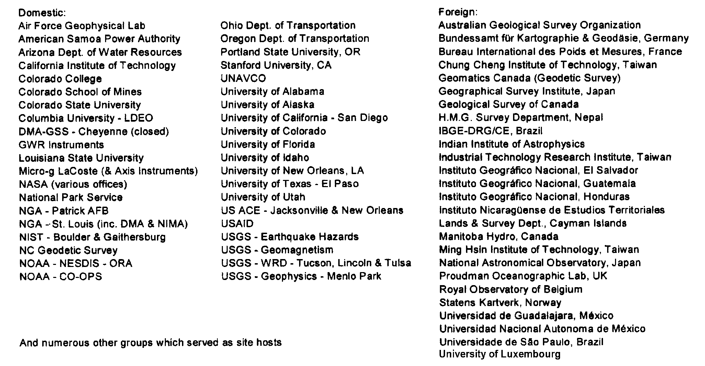
Cooperators with NGS & OES Absolute Gravimetry Program
4

Slide 5
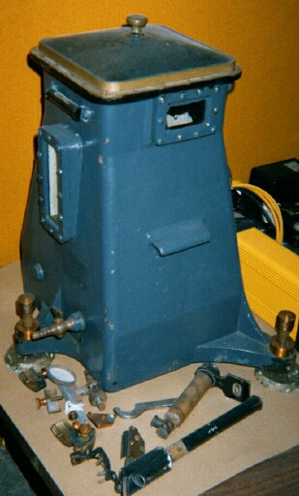
Gravimeters over the decades
Mendenhall pendulum gravimeter
Accuracy: ±1 to 5 mGals
Used from 1891 to ~1930 for geoid and base stations control (predecessors used from 1871 to 1891)
5

Slide 6
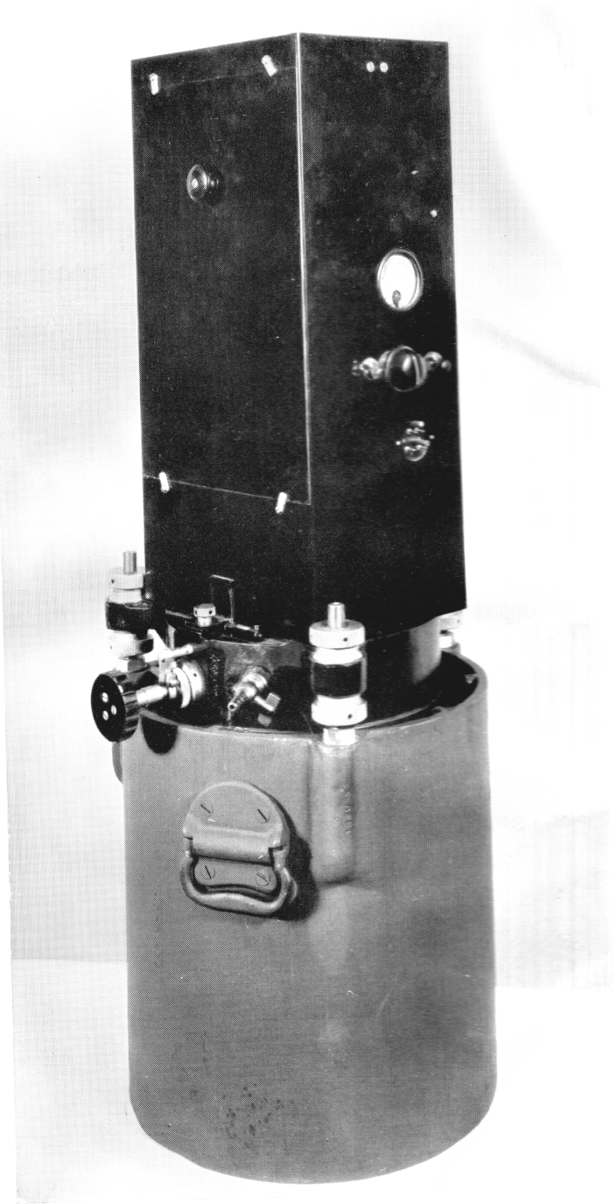
Brown pendulum gravimeter
Accuracy: ±0.6 to 2 mGals
Used from 1931 to ~1960 for geoid and base stations control
6

Slide 7
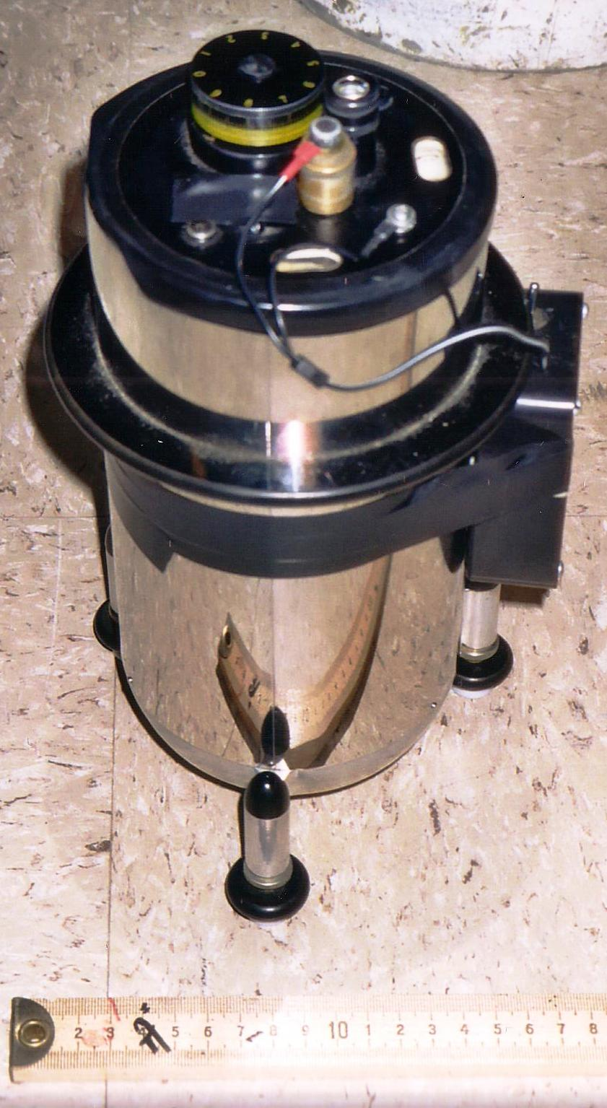
Spring-based relative gravimeters
Worden and LaCoste & Romberg land meters
7

Slide 8
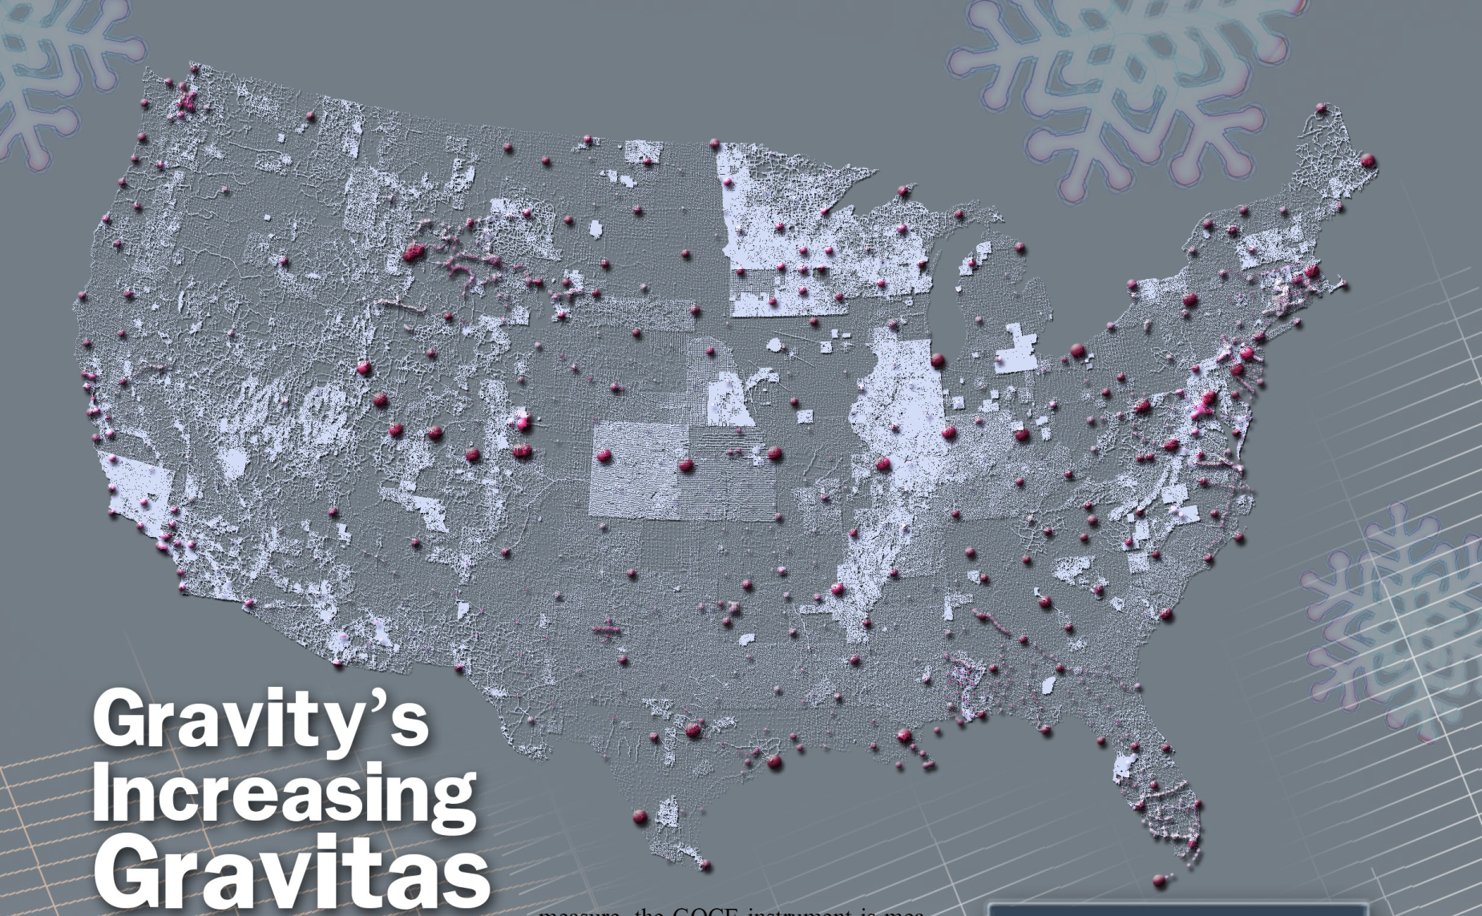
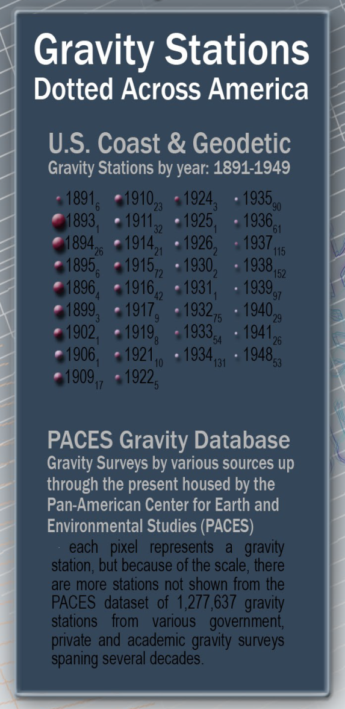
Courtesy of V. Kelly Bellis, PLS, copyrighted material used with permission.
8

Slide 9
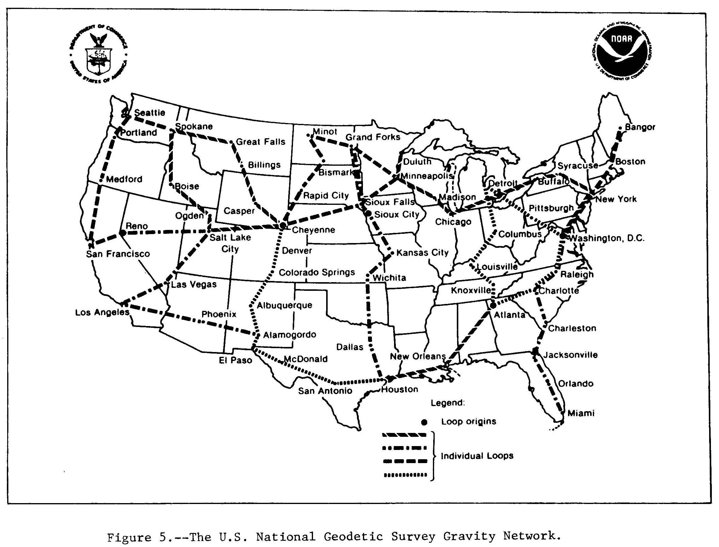
NGS Gravity Network (1986)
9

Slide 10
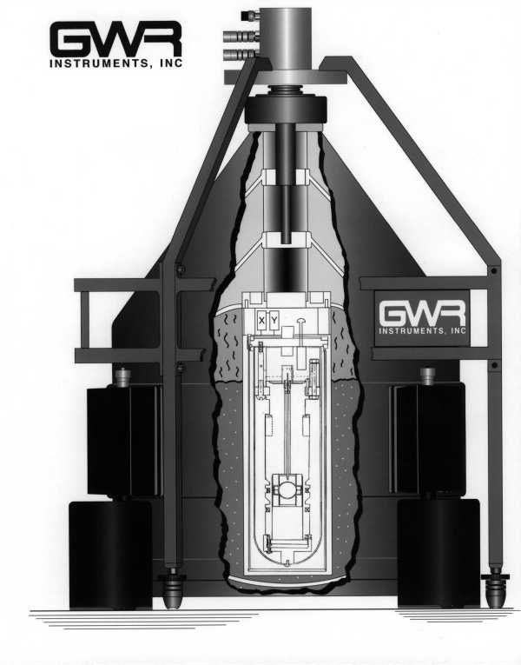
GWR Cryogenic meter
Cryogenic (superconducting) gravimeter – one at TMGO since 1995
10

Slide 11
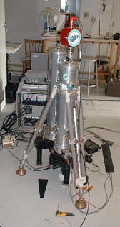
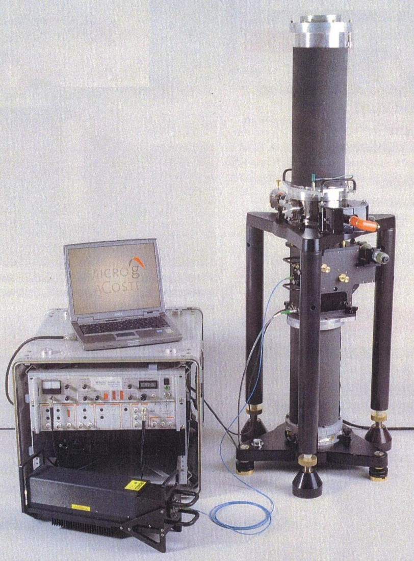
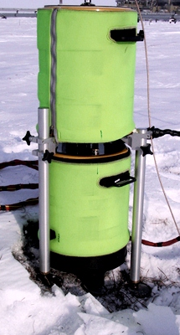
Absolute gravimeters
JILAg-4 FG5-102 A10-025
None of pictured meters match serial numbers above.
11

Slide 12
Absolute gravity research programs by area
Plate & local tectonics: Alaska, Chesapeake Bay, Los Angeles basin & other California, Mississippi River embayment, Oregon, Utah, Walker Lane (NV), Himalayas (Nepal & India), Japan, Mexican trench (Mexico & Central America) , Taiwan, Pacific NW
Volcanism: Yellowstone, Hawaii, Central America, Pacific NW
Post-glacial rebound: Fennoscandia, mid-continent & eastern U.S. & Canada, Alaska
Glacial ice mass: Greenland, Antarctica
Sea level change: coastal CONUS, Hawaii, Fennoscandia, Bermuda
Gravity base stations, Geoid & Height Modernization: Central America, Brazil, American Samoa, various CONUS, New Zealand, Nepal, Alaska
Metrology, intercomparisons & calibration lines: CA, CO, MD, NC, VA, eastern U.S, Rocky Mtn. front, France, Germany, Japan, Taiwan
Ground water: Arizona, Florida, Nebraska, Texas
VLBI & SLR overlap: AK, CA , FL, HI, IA, MD, MA, OK, TX, Bermuda, British Columbia, Brazil, Germany, Japan
12

Slide 13
Worldwide Absolute Gravity Sites in NOAA database
NOAA sites
Others agencies’ sites in USA
13

Slide 14
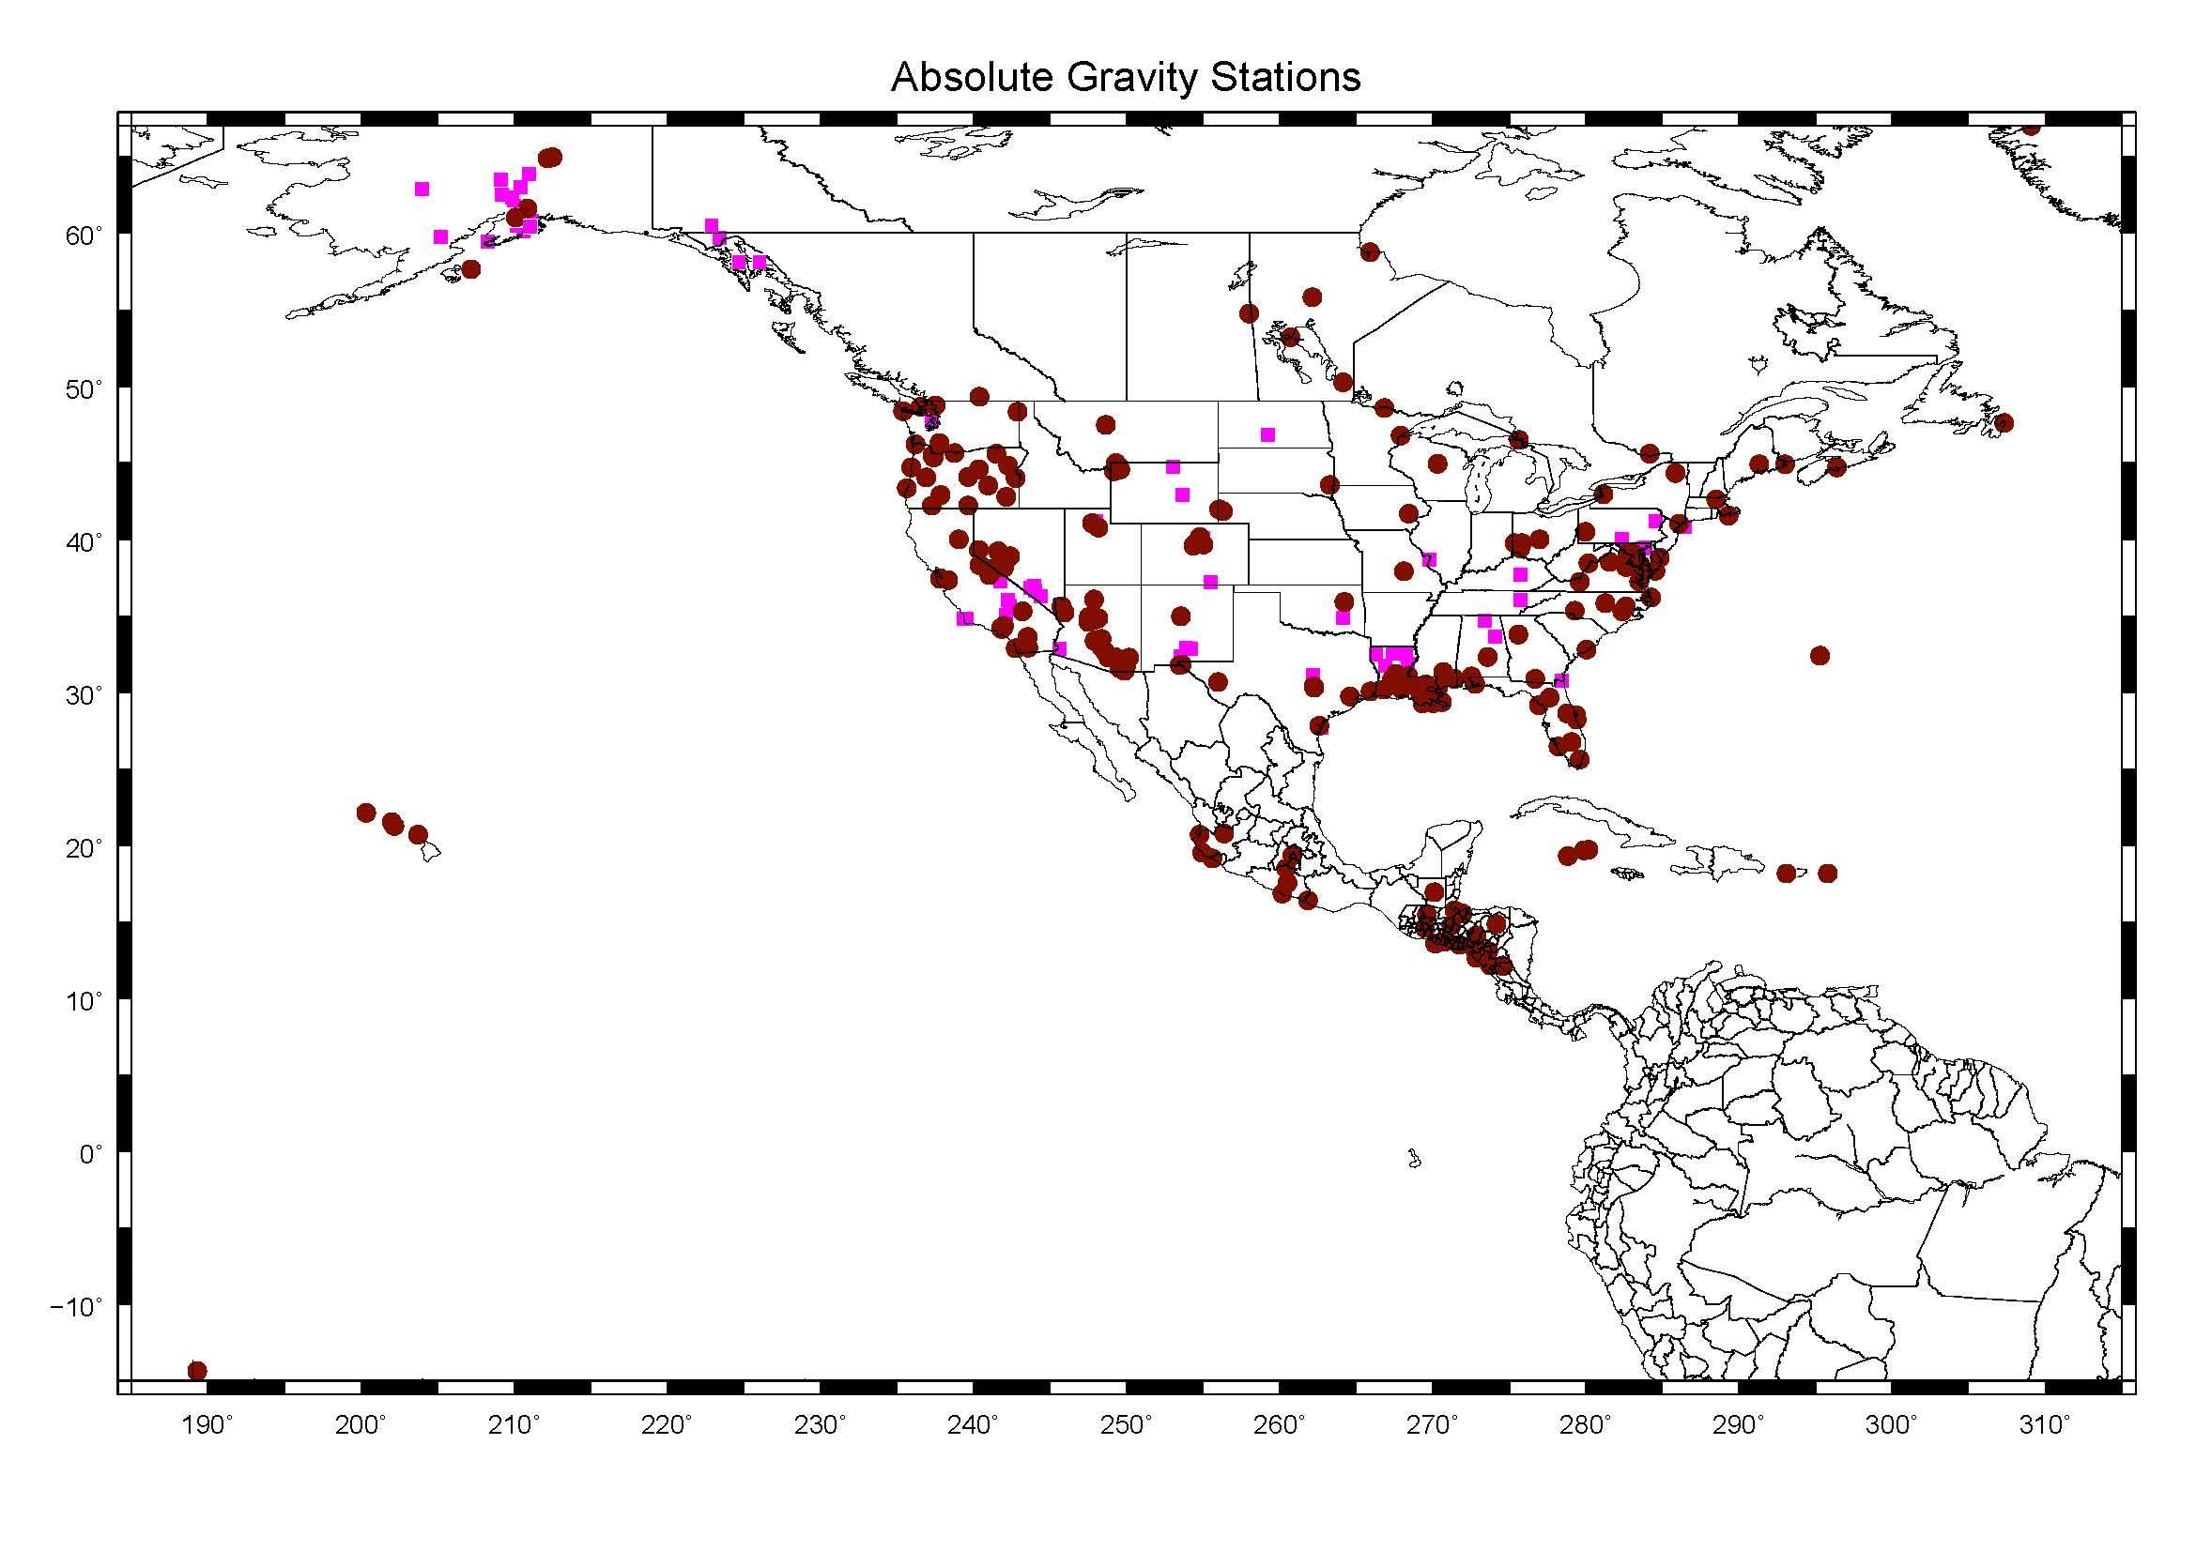
North American Absolute Gravity Sites
NOAA sites
Others agencies sites
14

Slide 15
PACES GRAVMAG Website
http://gis.utep.edu
Data Catalog
http://gis.utep.edu/index.php?option=com_content&view=article&id=45&Itemid=54
Gravity Base Station for the United States
http://gis.utep.edu/index.php?option=com_content&view=article&id=157%3Agravity-base-stations&catid=50%3Agravity-base-stations&Itemid=54
Pick a State; Pick a Station
15

Slide 16
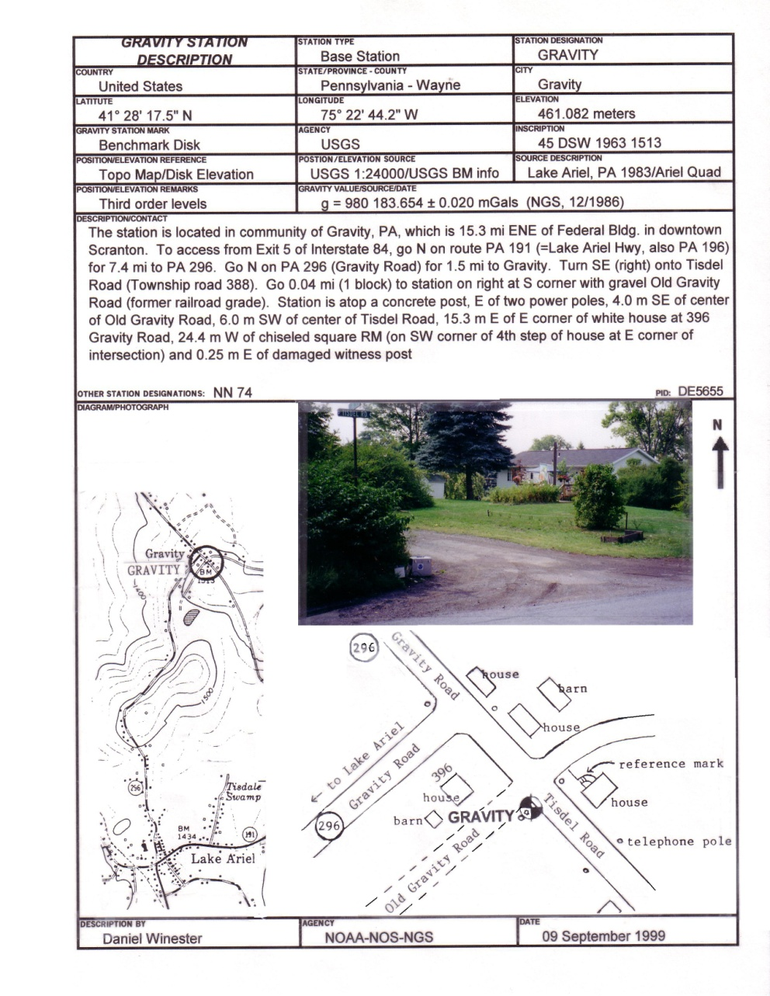
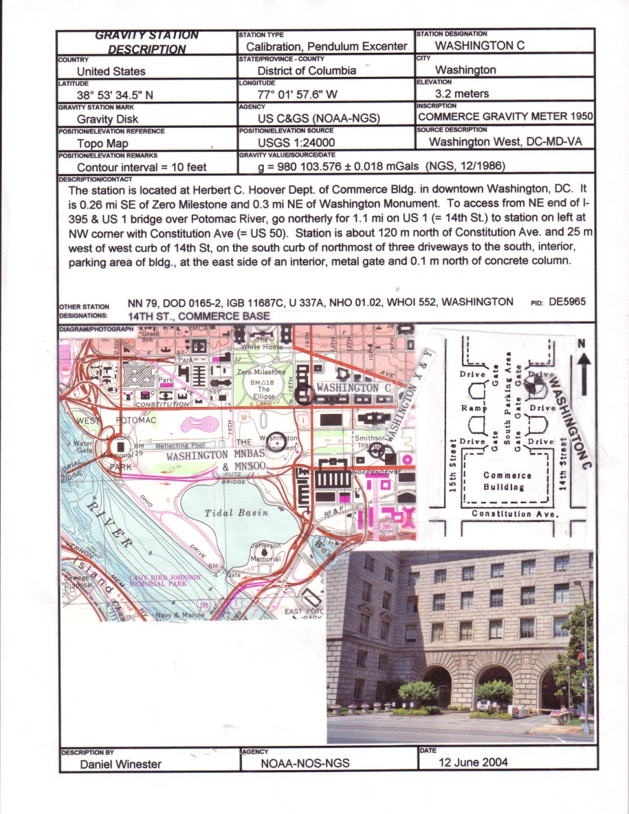
16

Slide 17
Richmond soil moisture
, FL
(Miami suburb)
5
17

Slide 18
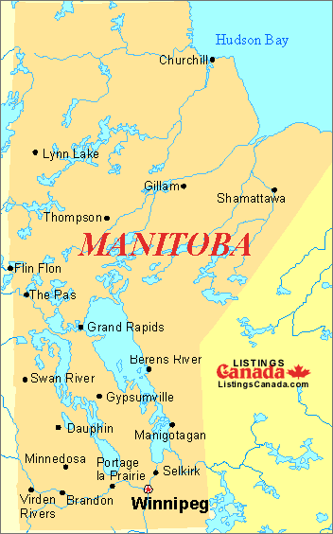
Manitoba
Hudson Bay
Manitoba absolute gravity stations ( ) and inferred uplift rates (mm/year)
11
Churchill River
Nelson River
Note: Drainage is to the north. Lake Winnipeg will tilt southward; affecting flooding in Selkirk area and Manitoba Hydro’s hydroelectric dams
8
Lake Winnipeg
Lake Winnipegosis
Lake Manitoba
Pinawa
5
Lake of the Woods
18
3
International Falls
5

Slide 19
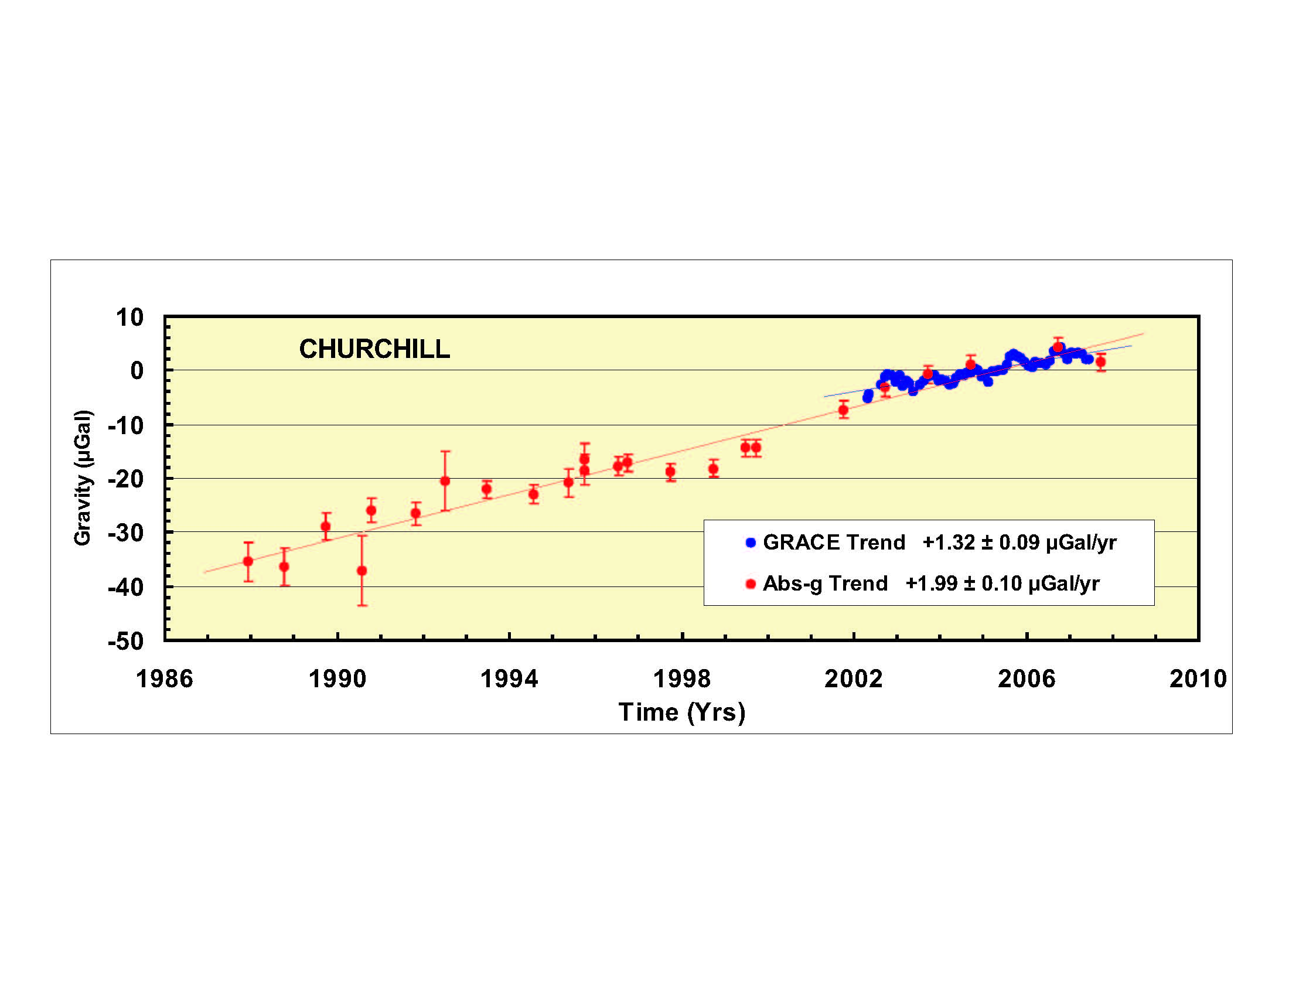
Churchill
Gravity changes at Churchill, MB (south side of Hudson Bay)
Gravity actually deceases and plot is inverted to accommodate GRACE data. Elevation is increasing 9 to11 mm/year.
2 cm uplift
Slide courtesy of Joe Henton, GSC
19

Slide 20
New Orleans
NEW ORLEANS AA, LA
g – 979 317 000 μGals
2 cm subsidence
Observed trend corresponds to 10 mm/year of subsidence
20

Slide 21
GRAV-D Program Gravity for the Redefinition of the American Vertical Datum
The specific goal of GRAV-D is to model and monitor Earth’s geoid to serve as a zero reference surface for all heights in the nation (or North America) accurate to one cm. This should allow for orthometric heights coming from GPS to be accurate to two cm.
Geoid: The equipotential surface of the Earth's gravity field which best fits, in a least squares sense, global mean sea level.
Current geoid model is a hybrid of terrestrial gravity data and leveling data. NAVD-88 H=0 is not the geoid; and it has a half meter bias and one meter tilt across CONUS. And is worse in Alaska.
21

Slide 22
GRAV-D Program Gravity for the Redefinition of the American Vertical Datum
Part 1: Link precise satellite gravity data via new airborne gravity data to legacy terrestrial data. This will allow for a computation of purely gravimetric geoid.
NGS has two TAGS (airborne) meters.
Will fly USA (inc. territories) at 10 km flight spacing. Will take about 15 years to complete.
TAGS measurements tied to AG observations
22

Slide 23
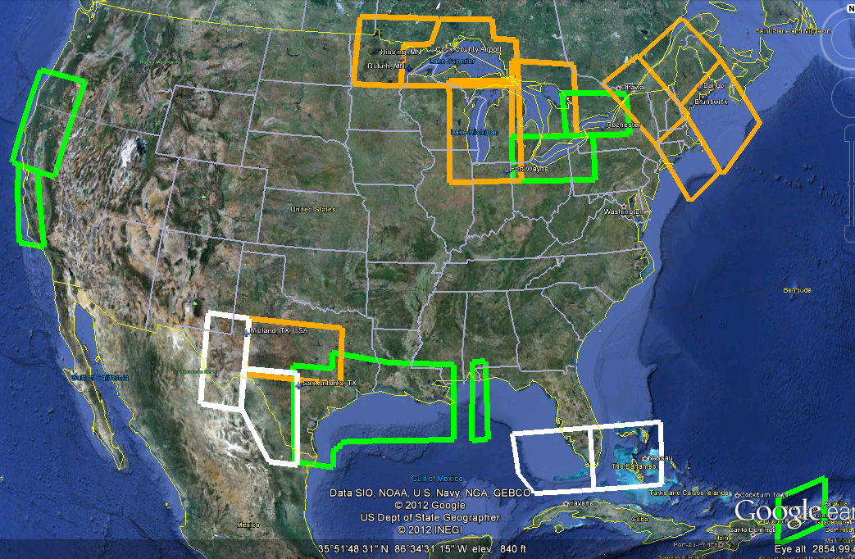
GRAV-D in the Continental US
Complete
In FY13
Complete
In FY13
White = FY13
Orange = FY12
Green = FY11 and earlier
23

Slide 24
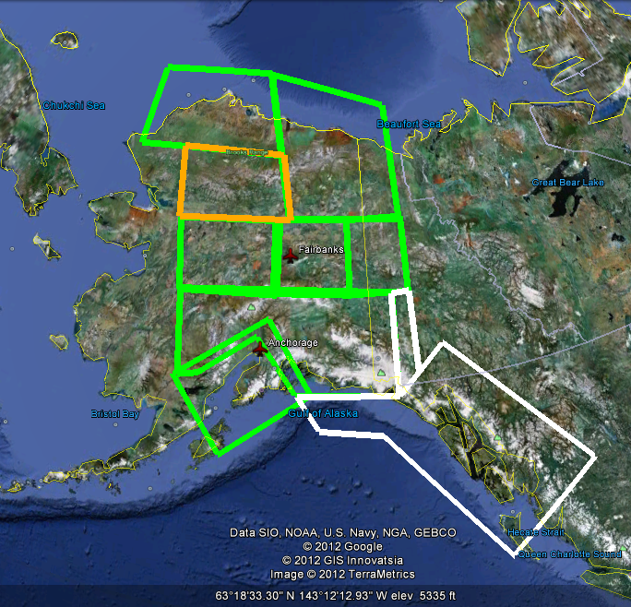
GRAV-D in Alaska
White = FY13
Orange = FY12-13
Green = FY11 and earlier
24

Slide 25
GRAV-D Program Gravity for the Redefinition of the American Vertical Datum
Part 2: Monitor geoid changes over decadal time scales.
Ideally this would be done with satellites. However, with uncertainties in satellite programs (budgets, satellite longevity, replacement satellites etc.), a network of FG5 absolute gravity stations is envisioned to do temporal gravity monitoring, which can be modelled into geoid change.
25

Slide 26
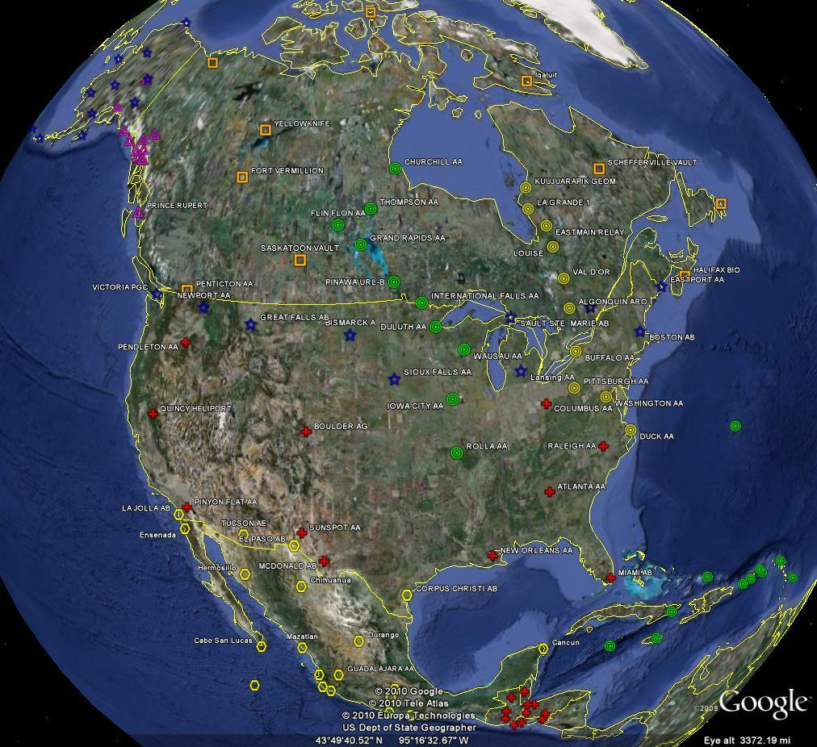
26

Slide 27
Geoid Slope Validation Survey of 2011
Objective: to see if GRAV-D can hope to achieve 1 to 2 cm geoid accuracies
Observe geoid shape (slope) using multiple independent terrestrial survey methods
  GPS + Leveling
  Deflections of the Vertical
Compare observed slopes (from terrestrial surveys) to modeled slopes (from gravimetry or satellites)
  With / Without new GRAV-D airborne gravity
Notes:
Although a geoid slope validation survey won’t validate the absolute accuracy of the geoid model, it will help point out weakness in data and theory. The accuracy of the terrestrial surveys will be best achievable, and formal accuracy estimates will be used to bound allowable disagreements with modeled geoid slopes.

Slide 28
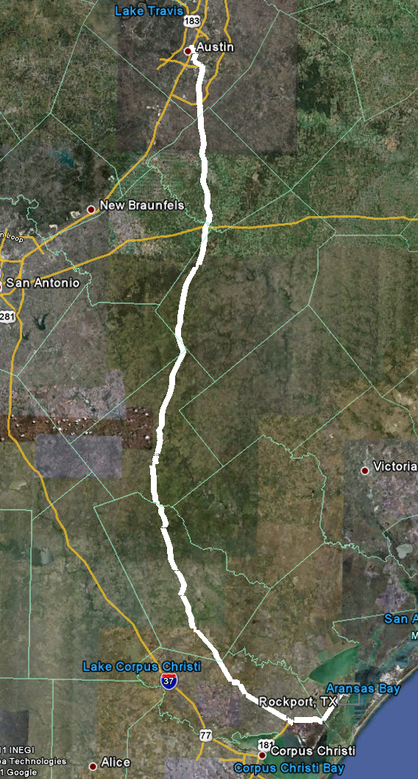
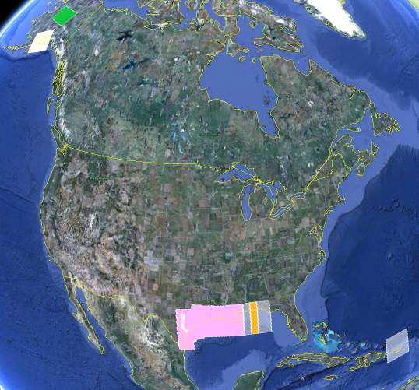
325 km
218 points
1.5 km spacing
28

Slide 29
Geoid Slope Validation Survey of 2011
GPS: 20 identical. units, 10/day leapfrog, 40 hrs ea.
Leveling: 1st order, class II, digital barcode leveling
Gravity: FG-5 and A-10 anchors, 4 L/R in 2 teams
DoV: ETH Zurich DIADEM GPS & camera system
LIDAR: Riegl Q680i-D, 2 pt/m² spacing, 0.5 km width
Imagery: Applanix 439 RGB DualCam, 5000’ AGL
Other: RTN, short-session GPS, extra AG around Austin, gravity gradients
29

Slide 30
High Resolution Geoids
(vs GPS / Leveling; cm)
Bins of d_{ij}, km | h/H error budget | USGG2009 (1’x1’) | EGM2008 (5’x5’) | USGG2012x01 (1’x1’) New software | USGG2012x02 (1’x1’) New software + Airborne data
0.4 - 15 | 0.0 ± 0.4 | 0.0 ± 1.0 | -0.0+/-1.0 | -0.0+/-1.0 | -0.0+/-0.9
15-30 | 0.0 ± 0.5 | 0.0 ± 1.0 | 0.0+/-1.3 | -0.0+/-1.4 | -0.0+/-1.1
30-46 | 0.0 ± 0.6 | -0.1 ± 1.5 | 0.0+/-1.7 | -0.2+/-1.8 | -0.2+/-1.1
46-63 | 0.0 ± 0.6 | -0.3 ± 1.7 | -0.1+/-2.0 | -0.4+/-2.1 | -0.3+/-1.2
63-81 | 0.0 ± 0.7 | -0.4 ± 2.0 | -0.2+/-2.1 | -0.6+/-2.5 | -0.3+/-1.3
81-101 | 0.0 ± 0.8 | -0.6 ± 2.3 | -0.4+/-2.2 | -0.7+/-2.8 | -0.4+/-1.4
101-122 | 0.0 ± 0.8 | -0.7 ± 2.6 | -0.6+/-2.3 | -0.8+/-3.0 | -0.4+/-1.4
122-145 | 0.0 ± 0.9 | -0.9 ± 2.7 | -0.8+/-2.4 | -0.7+/-2.9 | -0.3+/-1.3
145-172 | 0.0 ± 1.0 | -1.0 ± 2.8 | -1.0+/-2.6 | -0.6+/-2.6 | -0.1+/-1.0
172-204 | 0.0 ± 1.0 | -1.2 ± 2.7 | -1.2+/-2.5 | -0.9+/-2.1 | -0.2+/-1.0
204-247 | 0.0 ± 1.1 | -1.4 ± 2.4 | -1.3+/-2.7 | -1.7+/-1.4 | -0.7+/-1.0
247-325 | 0.0 ± 1.4 | -1.0 ± 1.6 | -0.2+/-2.3 | -1.9+/-1.4 | -1.3+/-1.0
All separation distances
show improvement
with GSVS11 survey when
airborne gravity are
introduced.
New software shows modest
improvement at medium wavelengths
30
Notes:
This chart speaks to the ability of a gravimetric geoid model to be as accurate over distances as GPS and leveling combined. The basic messages here are that currently, gravimetric geoids aren’t as accurate as GPS and leveling, but they aren’t bad either. They are certainly cheaper than leveling! Furthermore, it shows that for this survey, at least, USGG2009 has some improvements to make to beat EGM2008. As such, NGS embarked on a rigorous re-examination of their geoid modeling methods. The new software will likely be complete later in 2012. But some new experimental geoids with the new software show an improvement over USGG2009, but still not quite as good as EGM2008. The real story of columns 3/4/5 can be summarized as follows: “No matter what software is used, massaging the same old, uncorrected terrestrial gravity data isn’t going to yield
However, when adding in airborne gravity from GRAV-D, these new geoids blow everything else away.

Slide 31
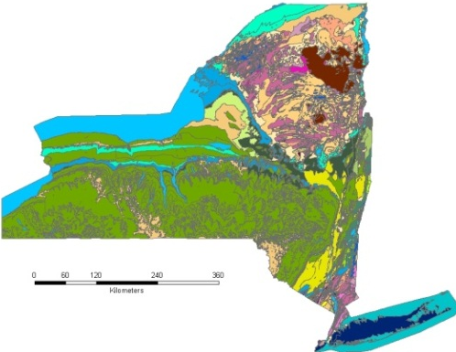
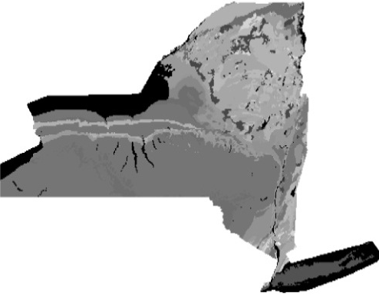
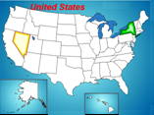
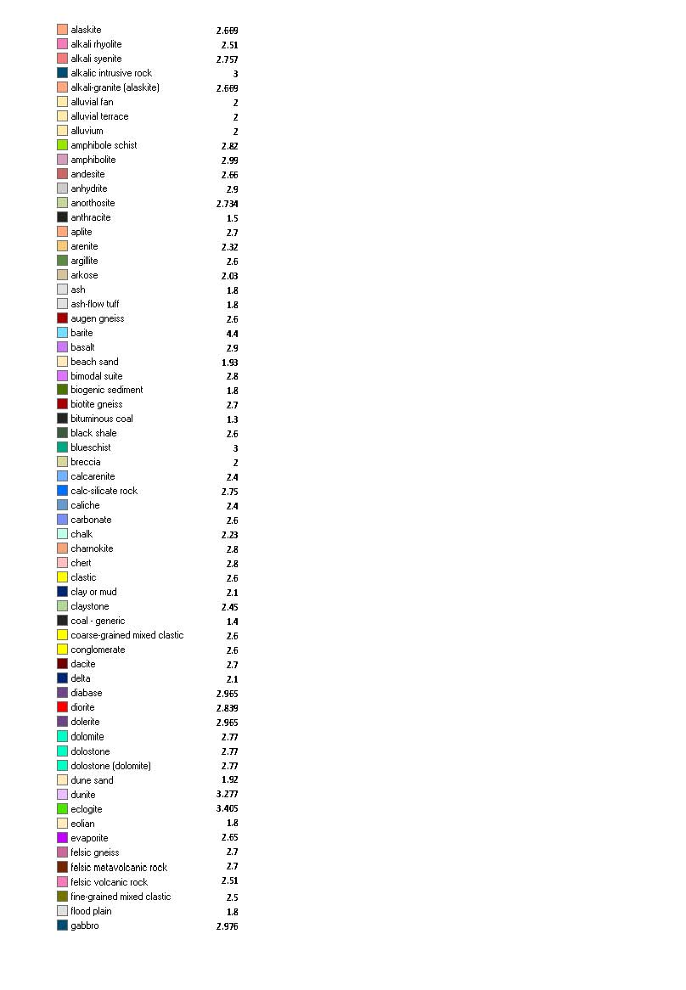
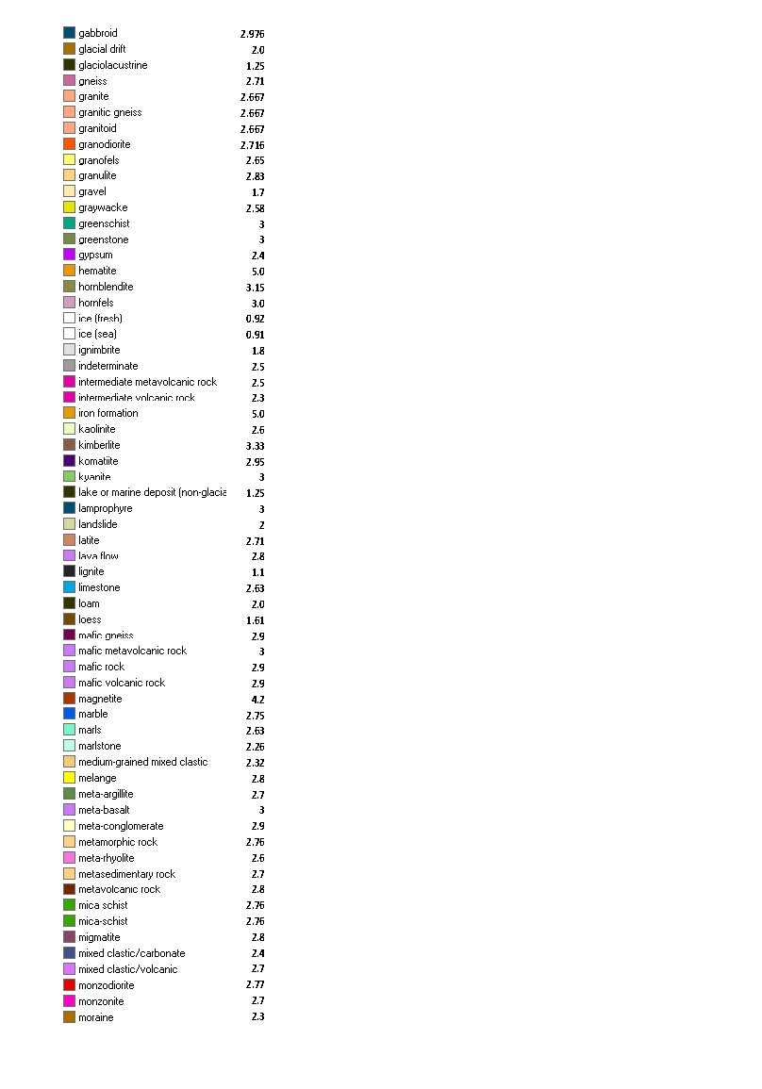
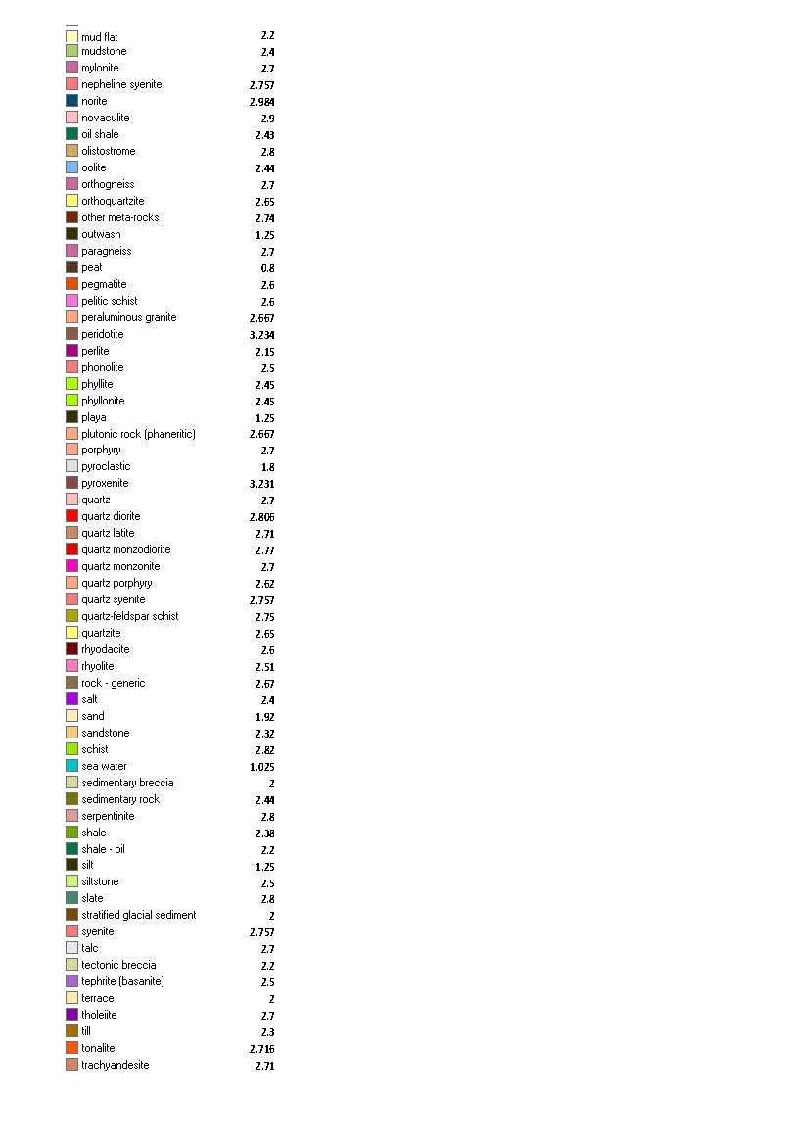
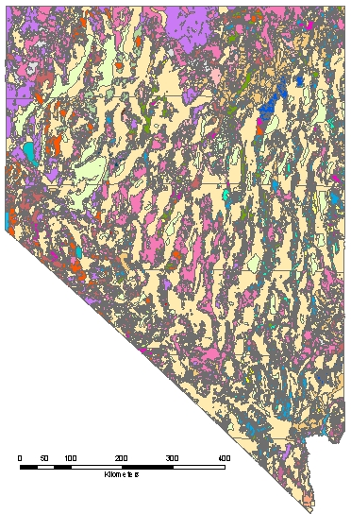
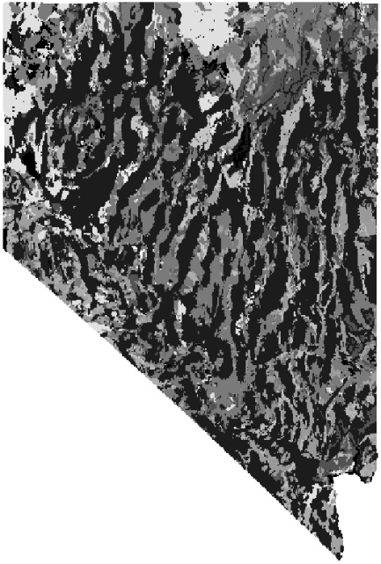
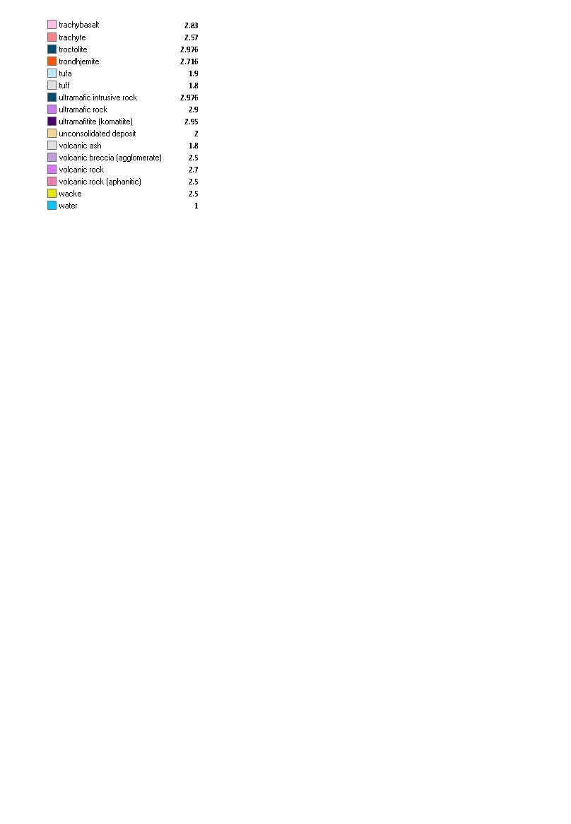
National Density Map
Map Colors, Lithologies, and Densities (g/cm³) for all mapped units in CONUS
New York
Geologic maps Density maps (denser =lighter color)
Nevada
Convert GIS lithologies into density map at one arc-minute scale
31

Slide 32
Southern Avra Valley Storage and Recovery Project (SAVSARP), west of Tucson, AZ
Joint project between University of Arizona – Hydrology Dept., USGS Water Resources Dept., GWR Instruments, GeoForschungsZentrum-Potsdam and NOAA-NGS
Study the direct effect on gravity due to the recharge and withdrawal of ground water in managed situation.
32

Slide 33
Southern Avra Valley Storage and Recovery Project (SAVSARP), west of Tucson, AZ
Basins filled with known volume of water and time
Water removed (pumped) at known time, volume, locations and depths
SG (iGrav), tidal (g-phone), AG (FG5 and A10) and GPS observations at bldgs. A-10 and relative grav. observations at well heads
About a one year expt. (on going)
33

Slide 34
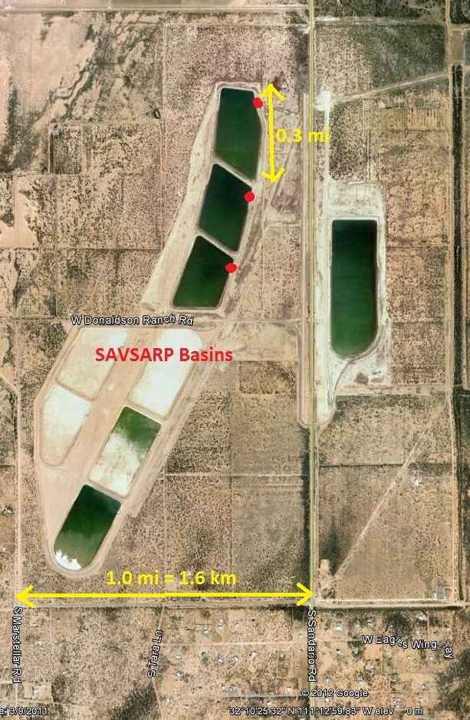
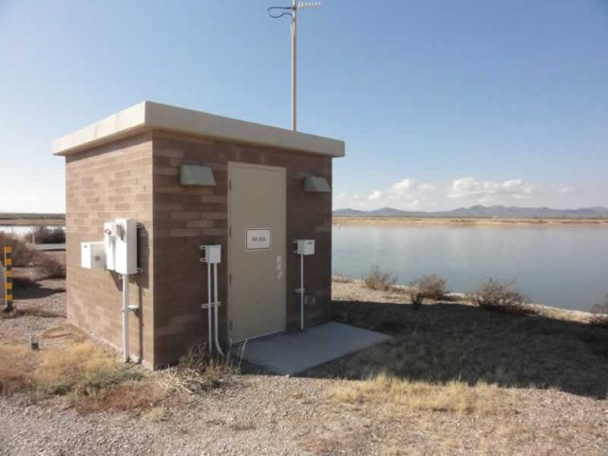
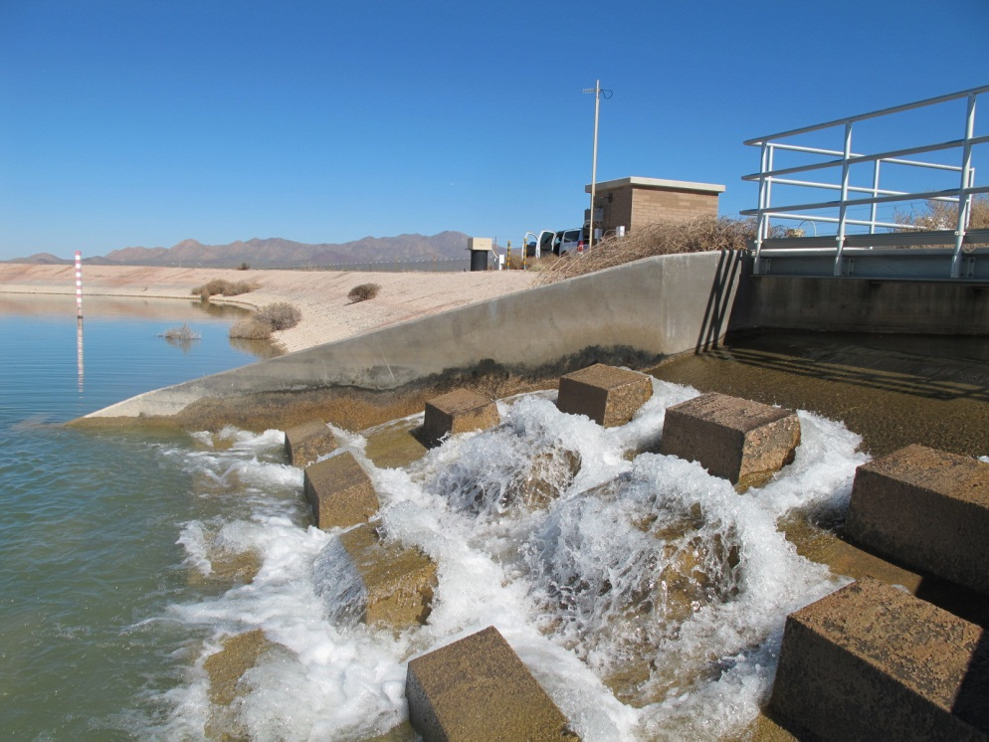
207
206
205

Slide 35
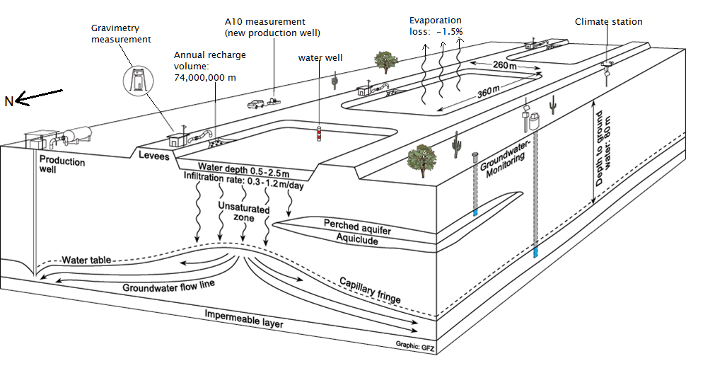
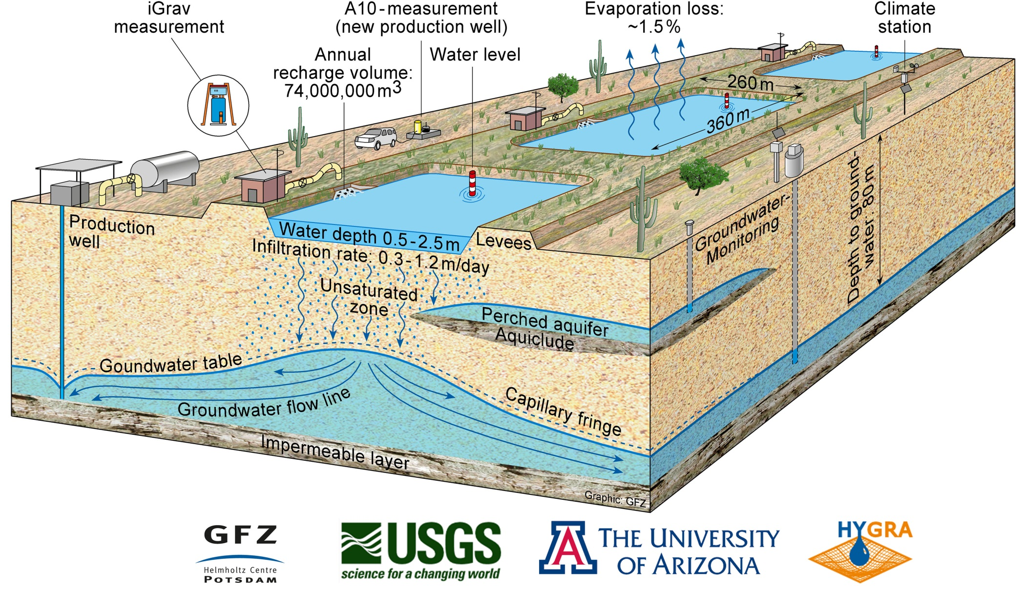
SAVSARP Recharge Facilities
iGrav & FG5
N
Slide courtesy of Jeff Kennedy, USGS and Benjamin Creutzfeldt, GFZ
34
35
Notes:
Unconfined conditions
Recharge is primarily downward - perching layers appear to be minimal.
Lateral extent of groundwater mound is small.
Recharge rates vary from pond to pond

Slide 36
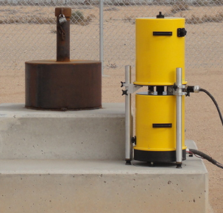
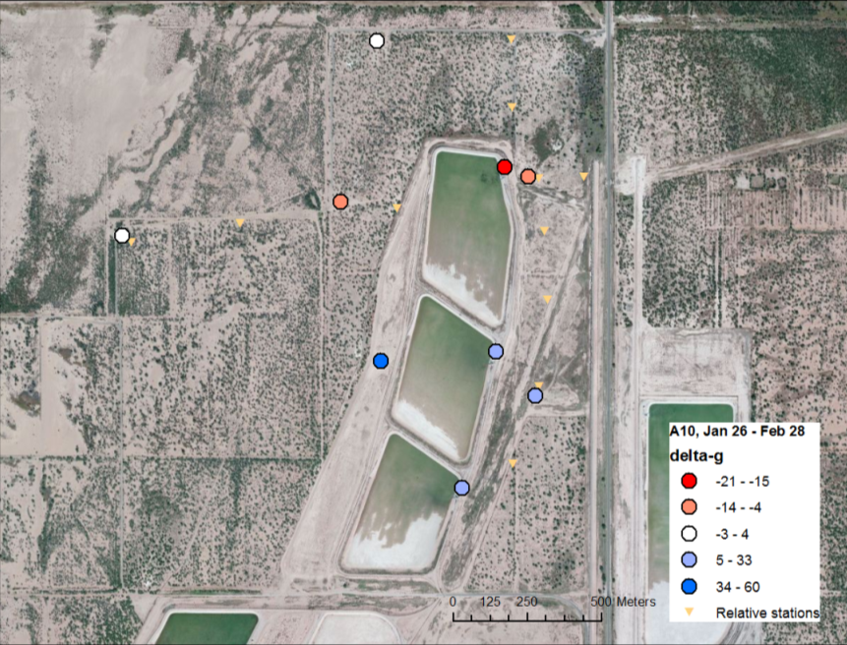
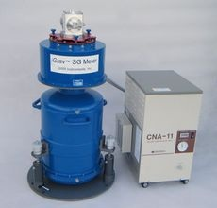
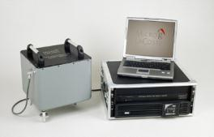
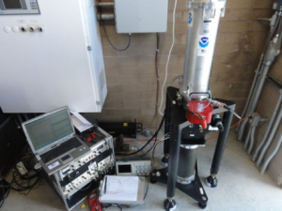
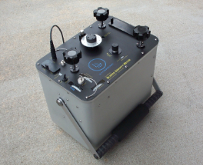
How can different gravimeters be used together?
Slide courtesy of Jeff Kennedy, USGS
36

Slide 37
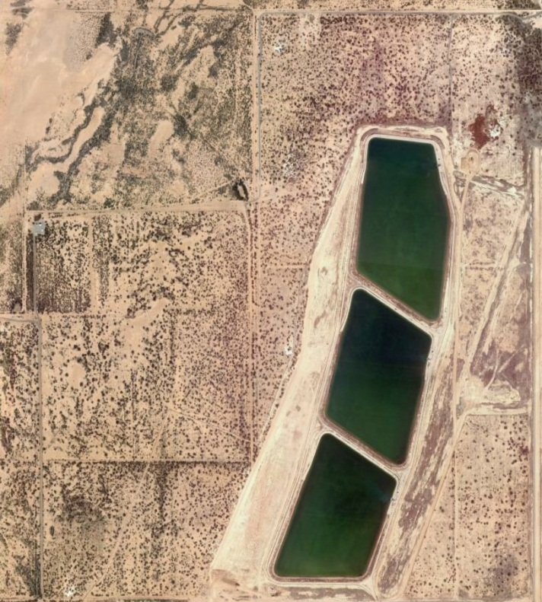
A10 data
Recharge starts
Slide courtesy of Jeff Kennedy, USGS
37

Slide 38
Absolute Site Reconnaissance
Meets project needs (e.g. station spacing, geologic setting or other geodetic control)
Site permanence for re-observations: Gov’t bldg., interested host, historic bldg.
Micro-seismic noise: Bedrock = good, Soil = mediocre, Swamp/Beach = poor.
Hammer test
Others: power, control, space, temp control…
38

Slide 39
Site Monumentation
Flat disk: harder to level to, but is easier to transfer height to AG; older AG have alcohol bottle on ground.
Indoors: Host may prefer unobtrusive mark; e.g 2 cm plug. Others may want ‘trophy disk.’
Monument should be sized to handle different types of g-meters; as well as GPS or levels
39

Slide 40
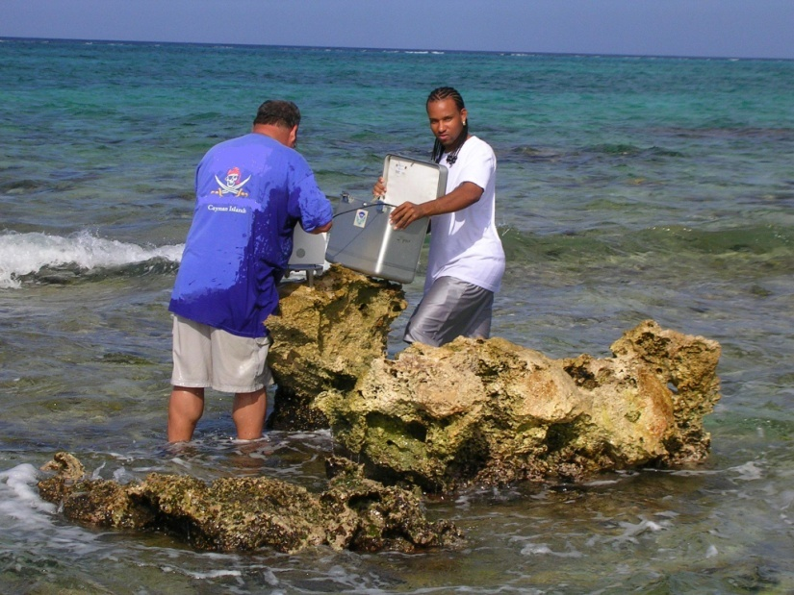
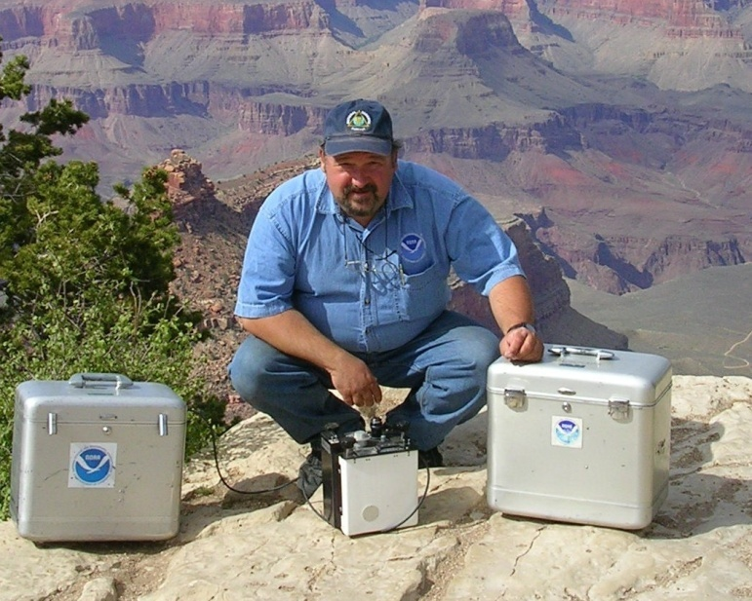
Dat’s all folks…
I will now fend off questions

Slide 41
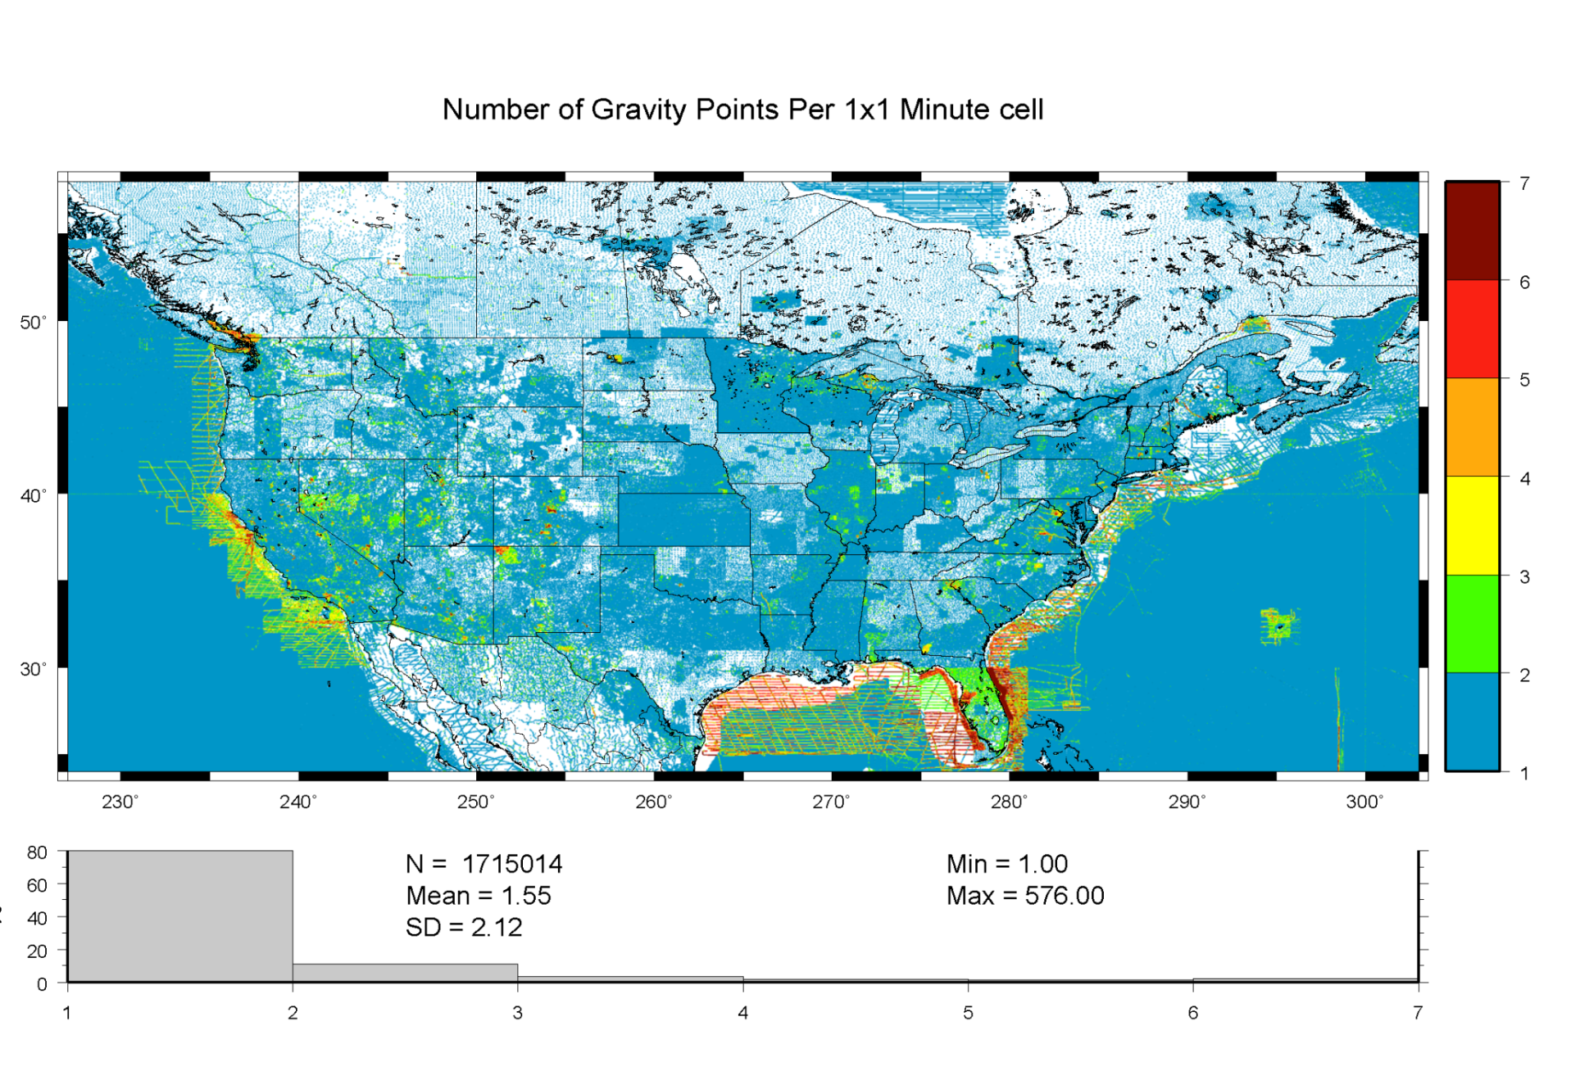
Notes:
41
This shows the extent of the gravity data that went info the USGG2009
Terrestrial data onshore; shipborne and altimetric data offshore.
Note the disparity in coverage. This is further reason for GRAV-D.

Slide 42
How to read the next chart
Pick any 2 (of the 218) points (P_{i} and P_{j}) separated by a distance “d_{ij}”
  23,871 possible (i,j) pairs of points
  0.4km < d_{ij} < 325km
Compute residuals: Δ(h-H-N) over distance:
  Δ(h-H-N) = (h_{i}-H_{i})-(h_{j}-H_{j}) – (N_{i}-N_{j})
Accumulate statistics on residuals for all (i,j) pairs in a bin
Each d_{ij} bin contains ~2000 pairs of points

Slide 43
High Resolution Geoids
(vs GPS / Leveling; cm)
Bins of d_{ij}, km | h/H error budget | USGG2009 (1’x1’) | EGM2008 (5’x5’) | USGG2012x01 (1’x1’) New software | USGG2012x02 (1’x1’) New software + Airborne data
0.4 - 15 | 0.0 ± 0.4 | 0.0 ± 1.0 | -0.0+/-1.0 | -0.0+/-1.0 | -0.0+/-0.9
15-30 | 0.0 ± 0.5 | 0.0 ± 1.0 | 0.0+/-1.3 | -0.0+/-1.4 | -0.0+/-1.1
30-46 | 0.0 ± 0.6 | -0.1 ± 1.5 | 0.0+/-1.7 | -0.2+/-1.8 | -0.2+/-1.1
46-63 | 0.0 ± 0.6 | -0.3 ± 1.7 | -0.1+/-2.0 | -0.4+/-2.1 | -0.3+/-1.2
63-81 | 0.0 ± 0.7 | -0.4 ± 2.0 | -0.2+/-2.1 | -0.6+/-2.5 | -0.3+/-1.3
81-101 | 0.0 ± 0.8 | -0.6 ± 2.3 | -0.4+/-2.2 | -0.7+/-2.8 | -0.4+/-1.4
101-122 | 0.0 ± 0.8 | -0.7 ± 2.6 | -0.6+/-2.3 | -0.8+/-3.0 | -0.4+/-1.4
122-145 | 0.0 ± 0.9 | -0.9 ± 2.7 | -0.8+/-2.4 | -0.7+/-2.9 | -0.3+/-1.3
145-172 | 0.0 ± 1.0 | -1.0 ± 2.8 | -1.0+/-2.6 | -0.6+/-2.6 | -0.1+/-1.0
172-204 | 0.0 ± 1.0 | -1.2 ± 2.7 | -1.2+/-2.5 | -0.9+/-2.1 | -0.2+/-1.0
204-247 | 0.0 ± 1.1 | -1.4 ± 2.4 | -1.3+/-2.7 | -1.7+/-1.4 | -0.7+/-1.0
247-325 | 0.0 ± 1.4 | -1.0 ± 1.6 | -0.2+/-2.3 | -1.9+/-1.4 | -1.3+/-1.0
All separation distances
show improvement
with GSVS11 survey when
airborne gravity are
introduced.
New software shows modest improvement
at medium wavelengths
Notes:
This chart speaks to the ability of a gravimetric geoid model to be as accurate over distances as GPS and leveling combined. The basic messages here are that currently, gravimetric geoids aren’t as accurate as GPS and leveling, but they aren’t bad either. They are certainly cheaper than leveling! Furthermore, it shows that for this survey, at least, USGG2009 has some improvements to make to beat EGM2008. As such, NGS embarked on a rigorous re-examination of their geoid modeling methods. The new software will likely be complete later in 2012. But some new experimental geoids with the new software show an improvement over USGG2009, but still not quite as good as EGM2008. The real story of columns 3/4/5 can be summarized as follows: “No matter what software is used, massaging the same old, uncorrected terrestrial gravity data isn’t going to yield
However, when adding in airborne gravity from GRAV-D, these new geoids blow everything else away.

Slide 44
Notes:
This slide shows to RMS error (disagreement) between h, H and N for various geoid models as compared to the best GPS and leveling on GSVS11. Note first the black bars, which are the allowable h and H error build up over further distances. Compare these to the total error of the h-H-N values. USGG2009 and EGM2008 have similar patterns, with EGM2008 being slightly better behaved. The new model, USGG2012x01 has patterns of improvement and degradation relative to EGM2008 and USGG2009, showing the need to keep working on theory and software. However, the geoid model with airborne data, USGG2012x02 shows clear improvement over all models, and even begins to approach the level of accuracy of h-H at medium wavelengths.

Slide 45
The “1 cm geoid”
Notes:
This slide is a companion to the previous one, but the h-H errors have been removed, in an RMS sense, from the total h-H-N errors, leaving, ostensibly, gravimetric geoid errors only. As seen previously, the airborne geoid is the best performer, by far. In fact, as a general statement, it could be said that USGG2012x02, an airborne gravity data enhanced geoid model, is effectively at the 1 cm differential geoid undulation accuracy level across all distances, in the region of GSVS11.

