Slide 1




The first realization of NAPGD2022: GEOID2022 and its accuracy estimation
YM Wang, X Li, K Ahlgren, R Hardy, J Krcmaric
National Geodetic Survey, U.S.A.
J Huang, I Foroughi, M Véronneau
Canadian Geodetic Survey, Canada
D Avalos-Naranjo, Raúl Muñoz-Abundes
National Institute of Statistics and Geography, Mexico
GGHS2024
Thessaloniki, Greece | September 4 - 6, 2024

Slide 2
Outline
From the old datums to the North American-Pacific
Geopotential Datum of 2022 (NAPGD2022)
Definition and parameters of NAPGD2022
Gravity for the Redefinition of the American Vertical Datum (GRAV-D)
Preliminary GEOID2022 models and evaluation results
Future work
PID: EZ0840

Slide 3
From the old datums to NAPGD2022
  The Old:
  NAVD 88
  PRVD 02
  VIVD09
  ASVD02
  NMVD03
  GUVD04
  IGLD 85
  IGSN71
  The New:
  The North American-Pacific
  Geopotential Datum of 2022
  (NAPGD2022)
  - Will include GEOID2022
  - DEFLEC2022, GRAV2022, etc.
Orthometric
Heights
Normal
Orthometric
Heights
Dynamic
Heights

Slide 4
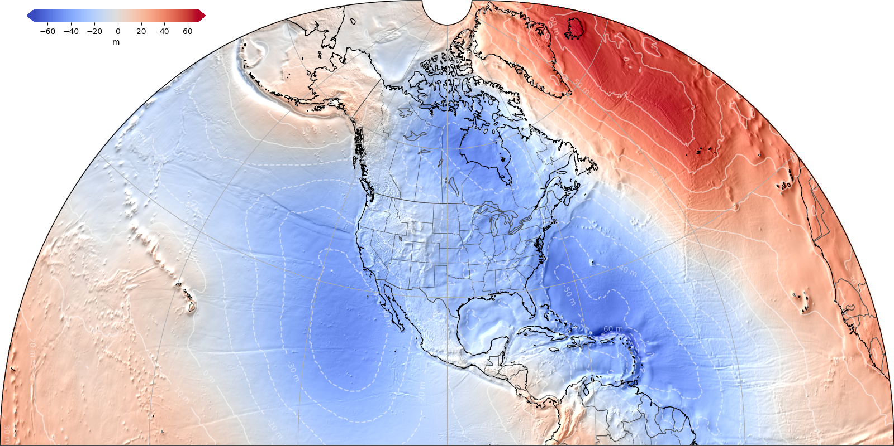
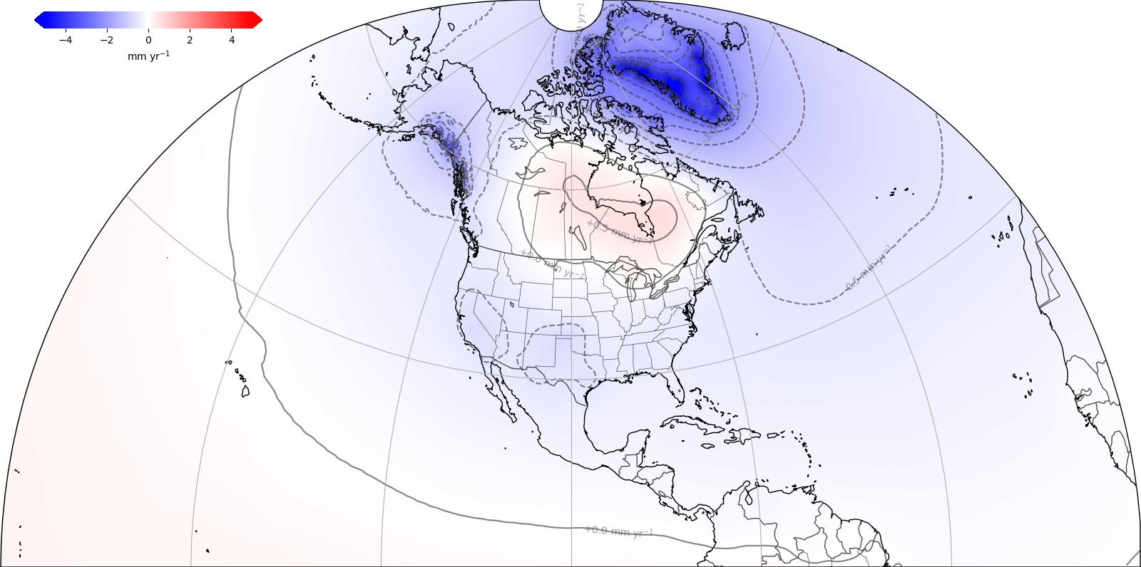
North American-Pacific Geopotential Datum 2022
Models include:
      Geopotential
      Deflection
      Gravity
      Geoid
GEOID2022: Static Component Dynamic Component
¼ Earth’s Surface

Slide 5
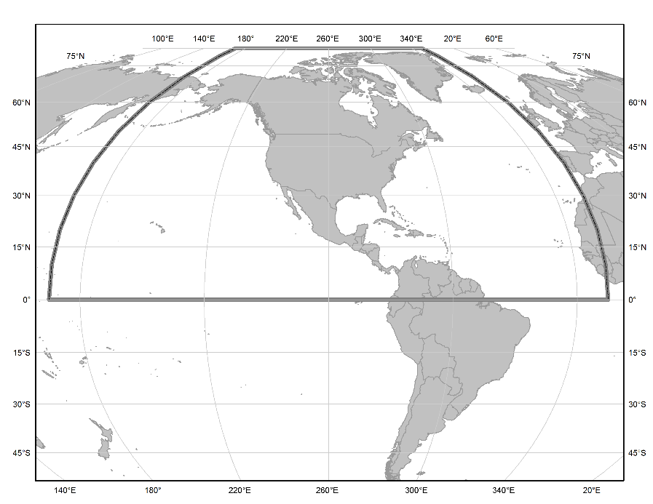
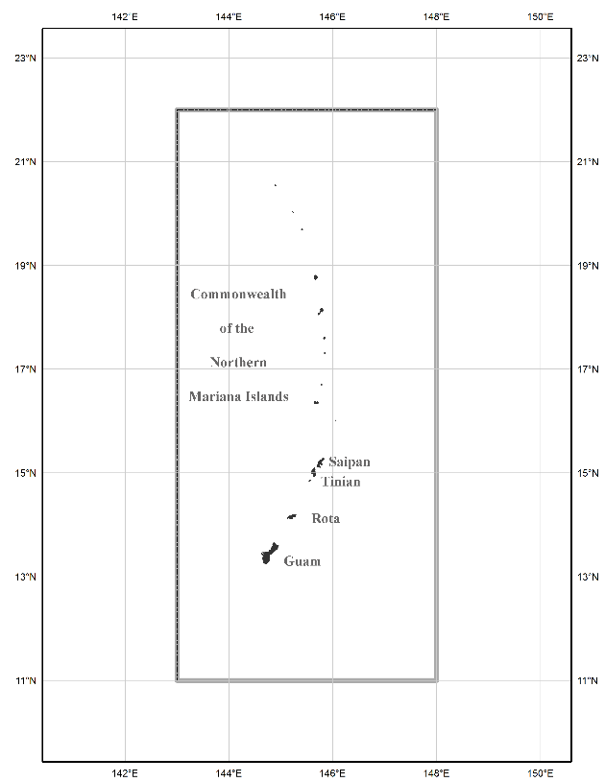
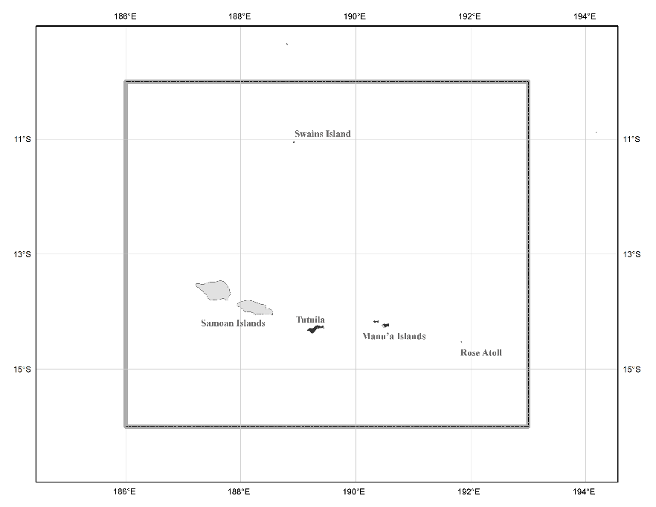
Three Gridded Regions
“North American region”
¼ of the Earth

Slide 6
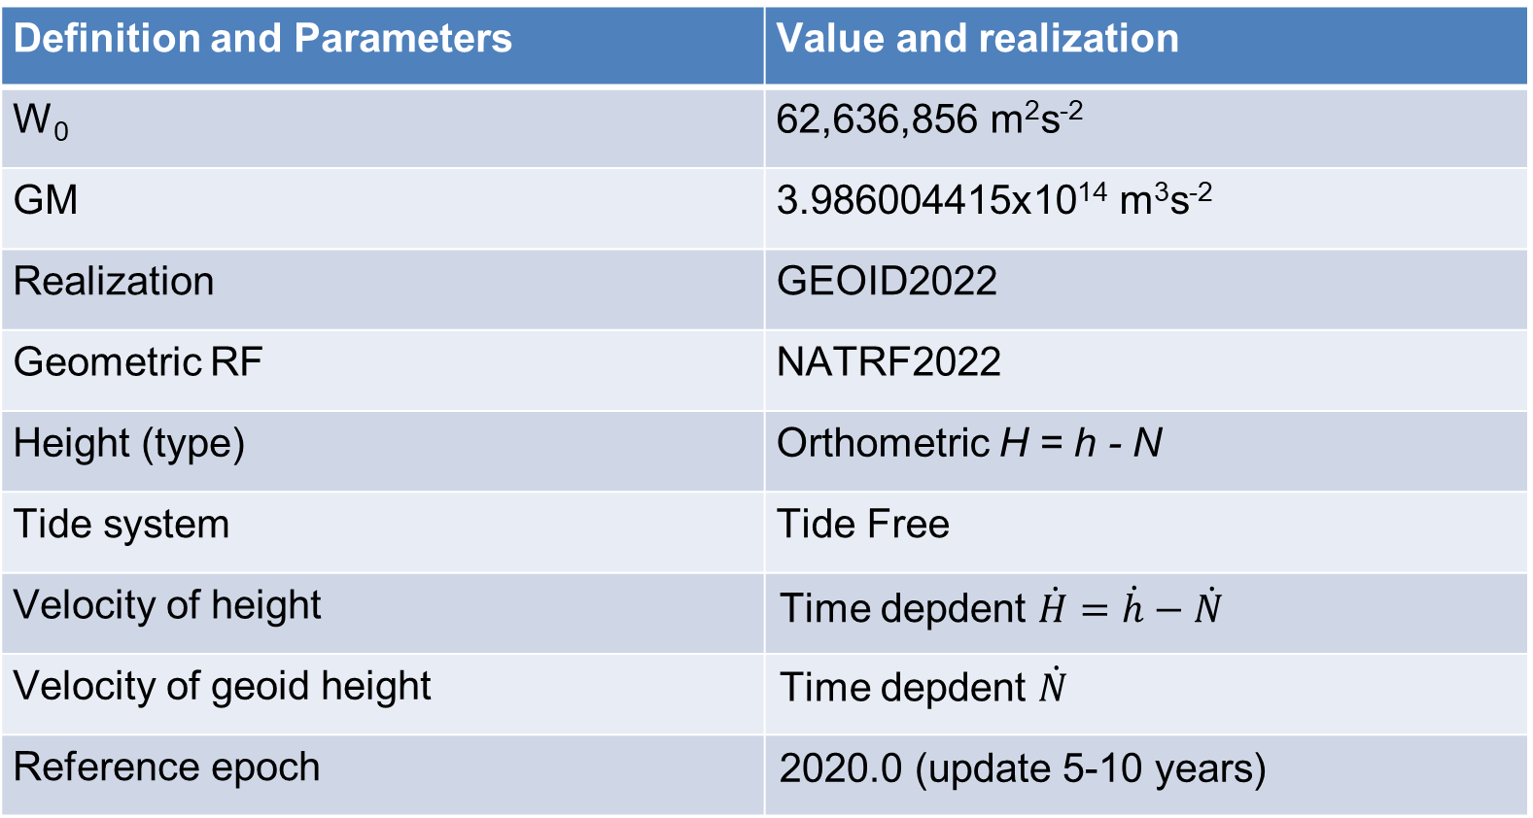
Definition and parameters of NAPGD2022
Definition and Parameters | Value and realization
W₀ | 62,636,856 m²s⁻²
GM | 3.986004415x10¹⁴ m³s⁻²
Realization | GEOID2022
Geometric RF | NATRF2022
Height (type) | Orthometric H = h - N
Tide system | Tide Free
Velocity of height | Time depdent $\dot{H}=\dot{h}−\dot{N}$
Velocity of geoid height | Time depdent $\dot{N}$
Reference epoch | 2020.0 (update 5-10 years)

Slide 7
Data used in GEOID2022 computation
Terrestrial gravity data (2.1 million points contributed by NGA, NGS, CGS, and INEGI databases)
Altimetric gravity (DTU21) in 1’x1’ grid
DEM2022 (3′′, a combination of TanDEM-X, NED, and MERIT)
ArcGPv2020 in 3’x3’ grids from NGA
Ice thickness data sets over Greenland
Airborne gravity data (GRAV-D)

Slide 8
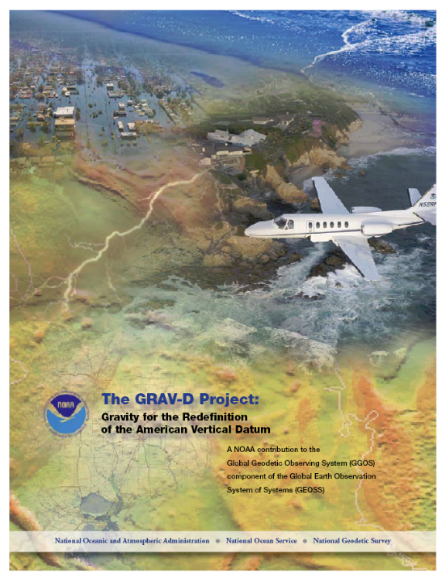
GRAV-D - Gravity for the Redefinition of the American Vertical Datum
Started in 2008, finished in 2023, a 16 years project
The GRAV-D data was collected 100% in 2023
Data was re-processed in February, 2024
The data is used to refine the global gravity coefficient model, which is used as the reference model for geoid computations

Slide 9
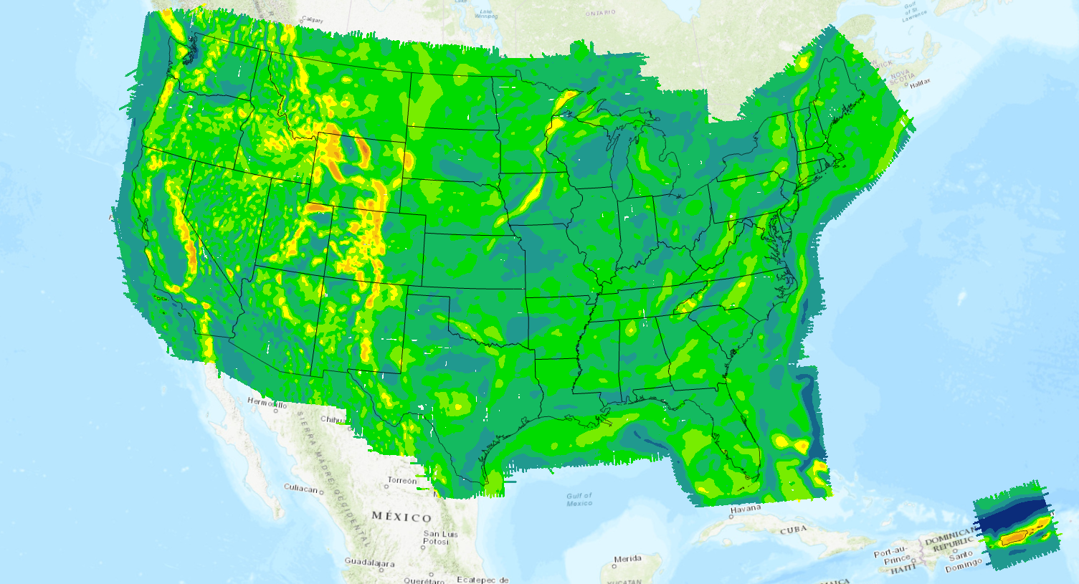
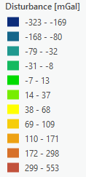
CONUS and PR/VI
Notes:
Gravity disturbance collected from the GRAV-D airborne project gridded at the flight altitude.

Slide 10
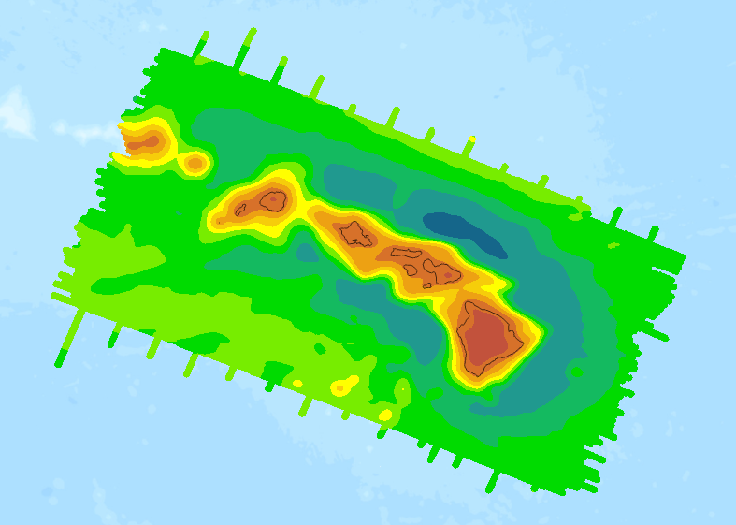
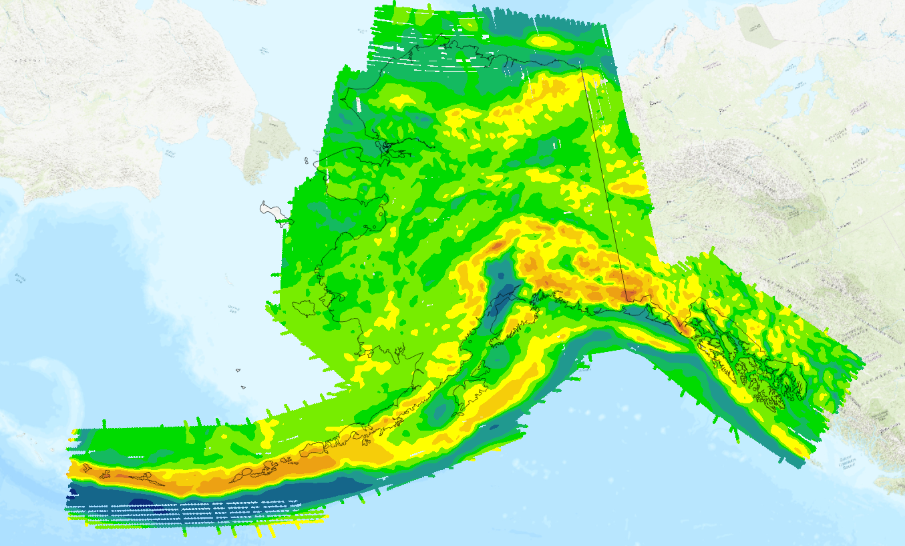
Hawaii
Alaska

Slide 11
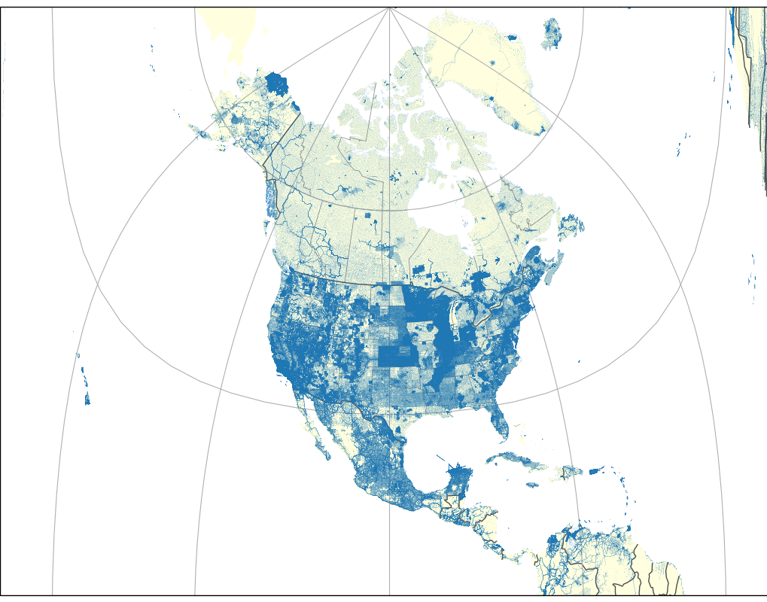
Density of terrestrial gravity data
2,100,000 gravity observations throughout North America
Data included from Canada, Mexico, and USA
  Various other regions
Quality is variable – most data were from many decades ago
Spacing is variable
Density of terrestrial gravity

Slide 12
NGS and CGS geoid computation scheme
Approach | CGS models | NGS models
GBVP type | Stokes-Helmert | Molodensky
Remove-Compute-Restore | Yes | Yes
Kernel Modification | Two kernel modifications: L= 220, 670 | L=330,1800
Topo-correction | Direct and Indirect effects | Geoid-quasigeoid separation
Gravity Data Interpolation | Complete Bouguer Anomalies | Complete Bouguer Anomalies
Glacial Ice Correction over Greenland | Yes | Yes
Constant density assumption | Yes | Yes

Slide 13
Geoid model evaluation
  Two preliminary combination models CGS11NGSBA, CGS11NGSV8, together with the reference model GM22 and G22Alpha are evaluated using the following independent data sets:
  Historical GPS/leveling data (state bias removed)
  GPS/leveling of three GSVS lines (GSVS11, 14 and 17)
  Mean height of Great Lakes from altimetric data
  Great Lakes water gauge data (to be complete)
  Oceanic dynamic topography over selected areas (to be complete)

Slide 14
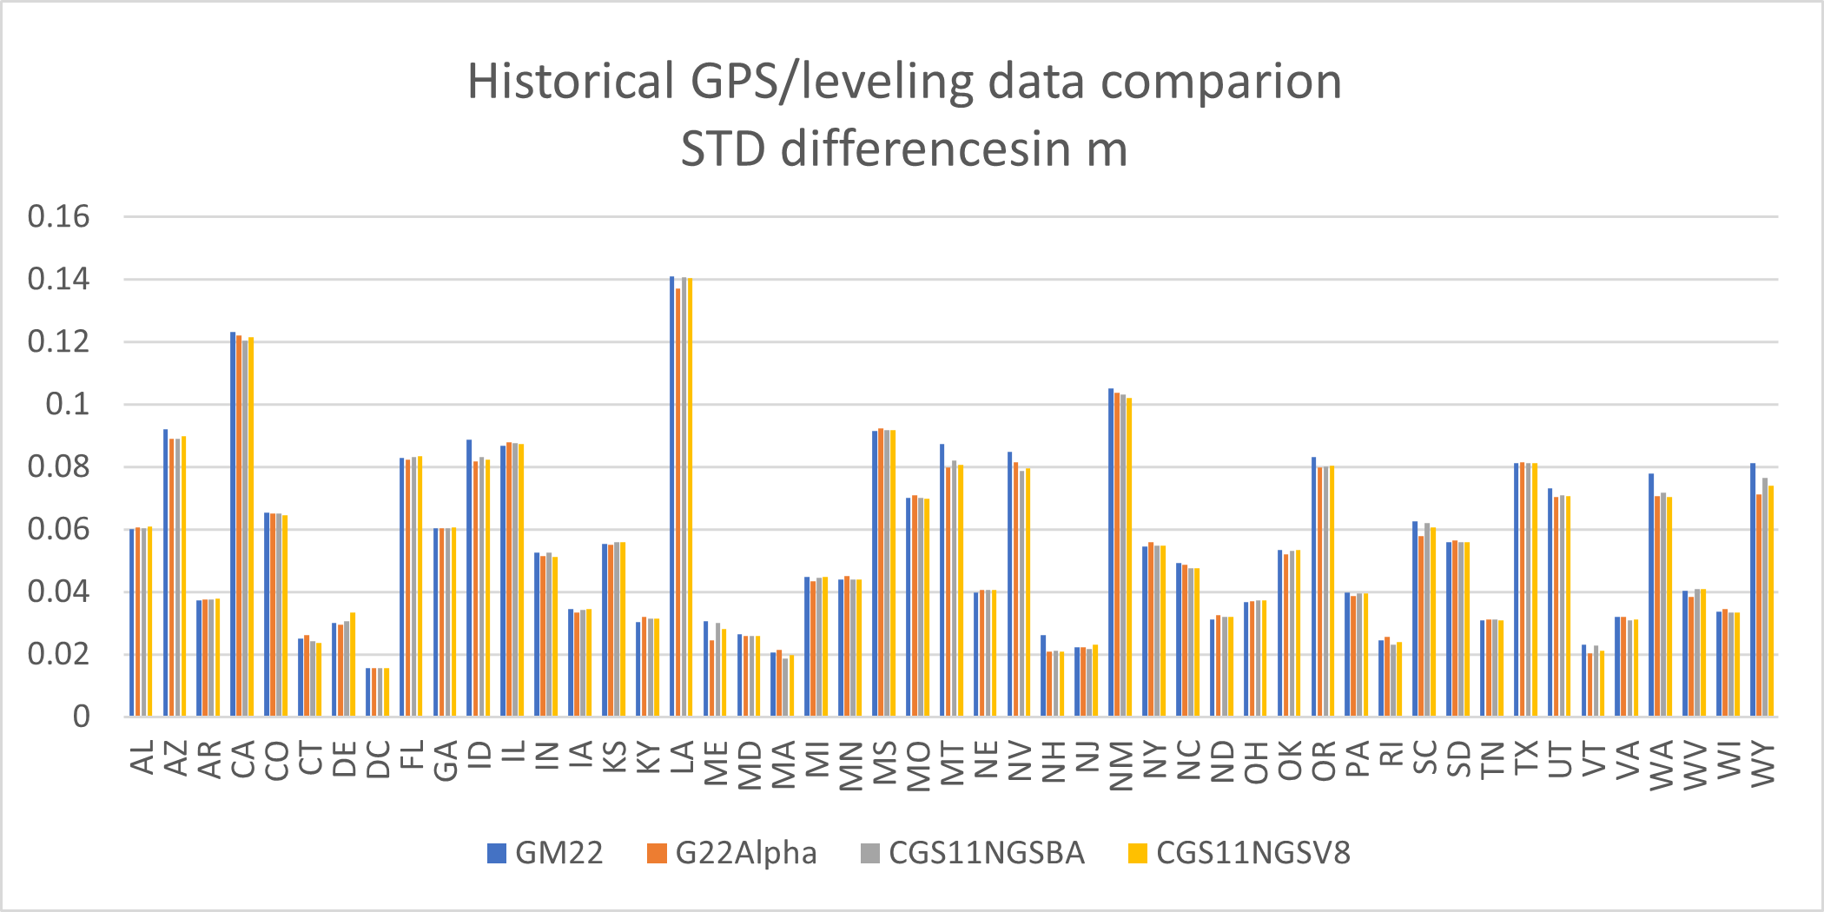

Slide 15
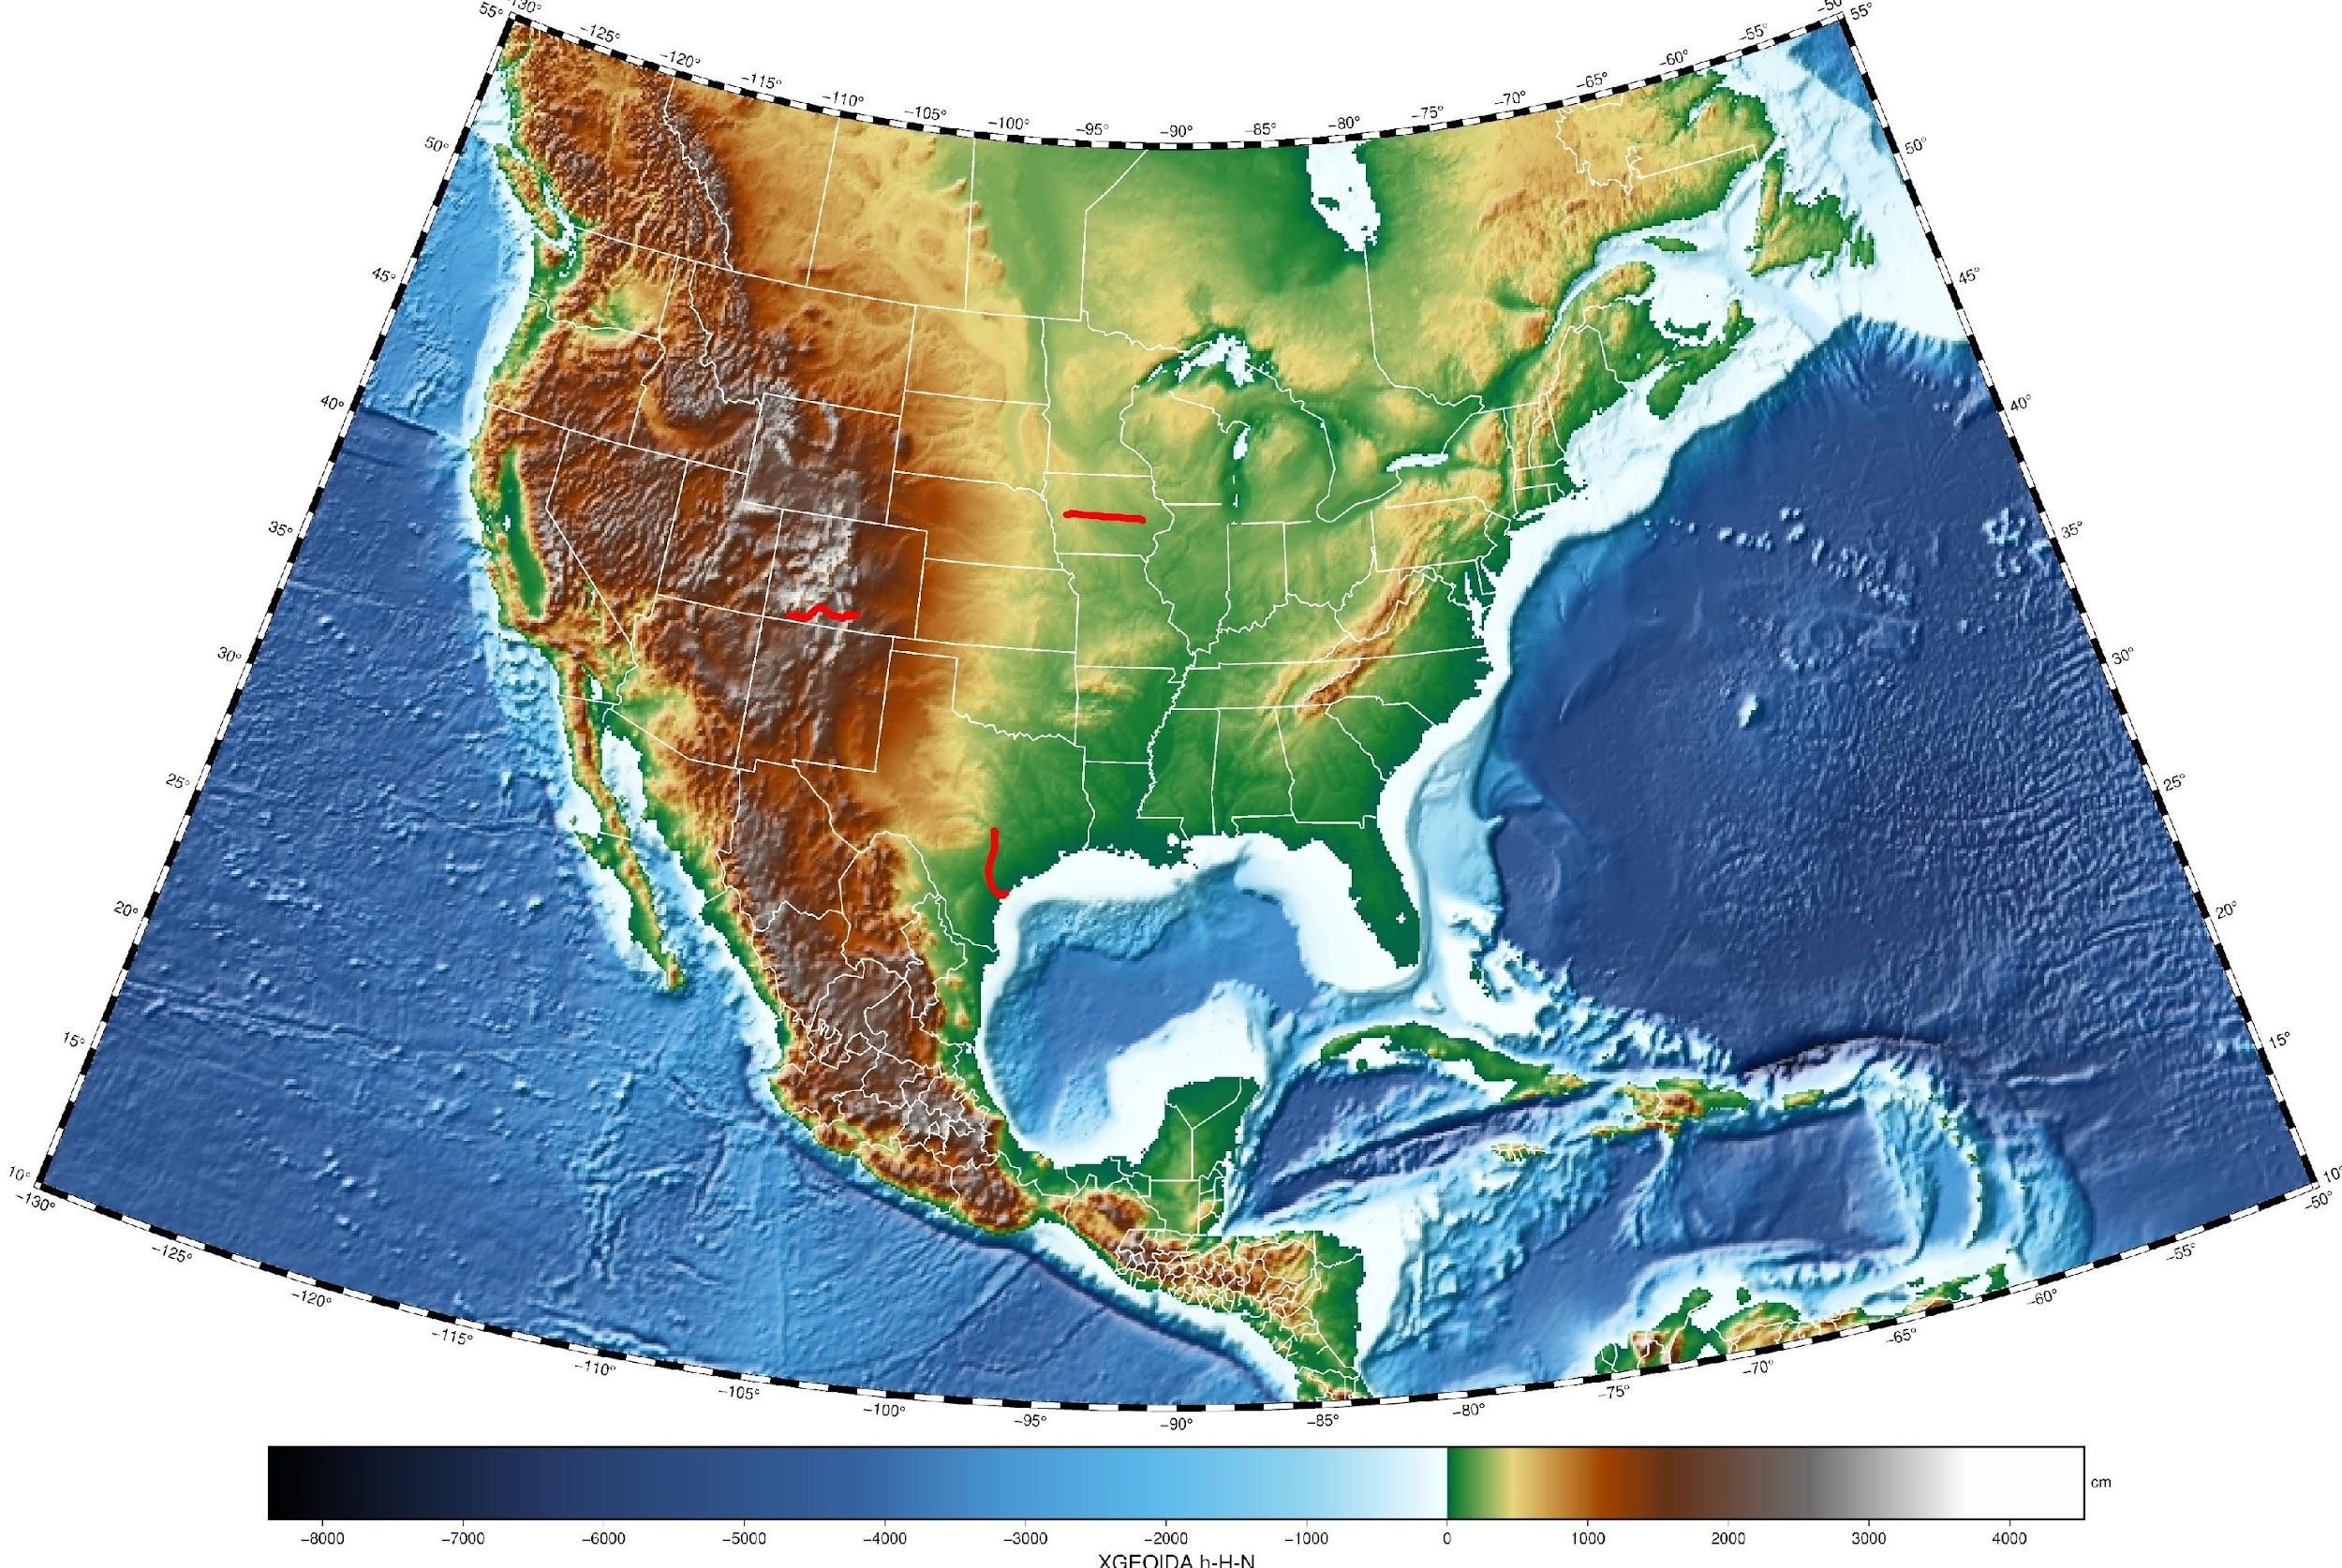
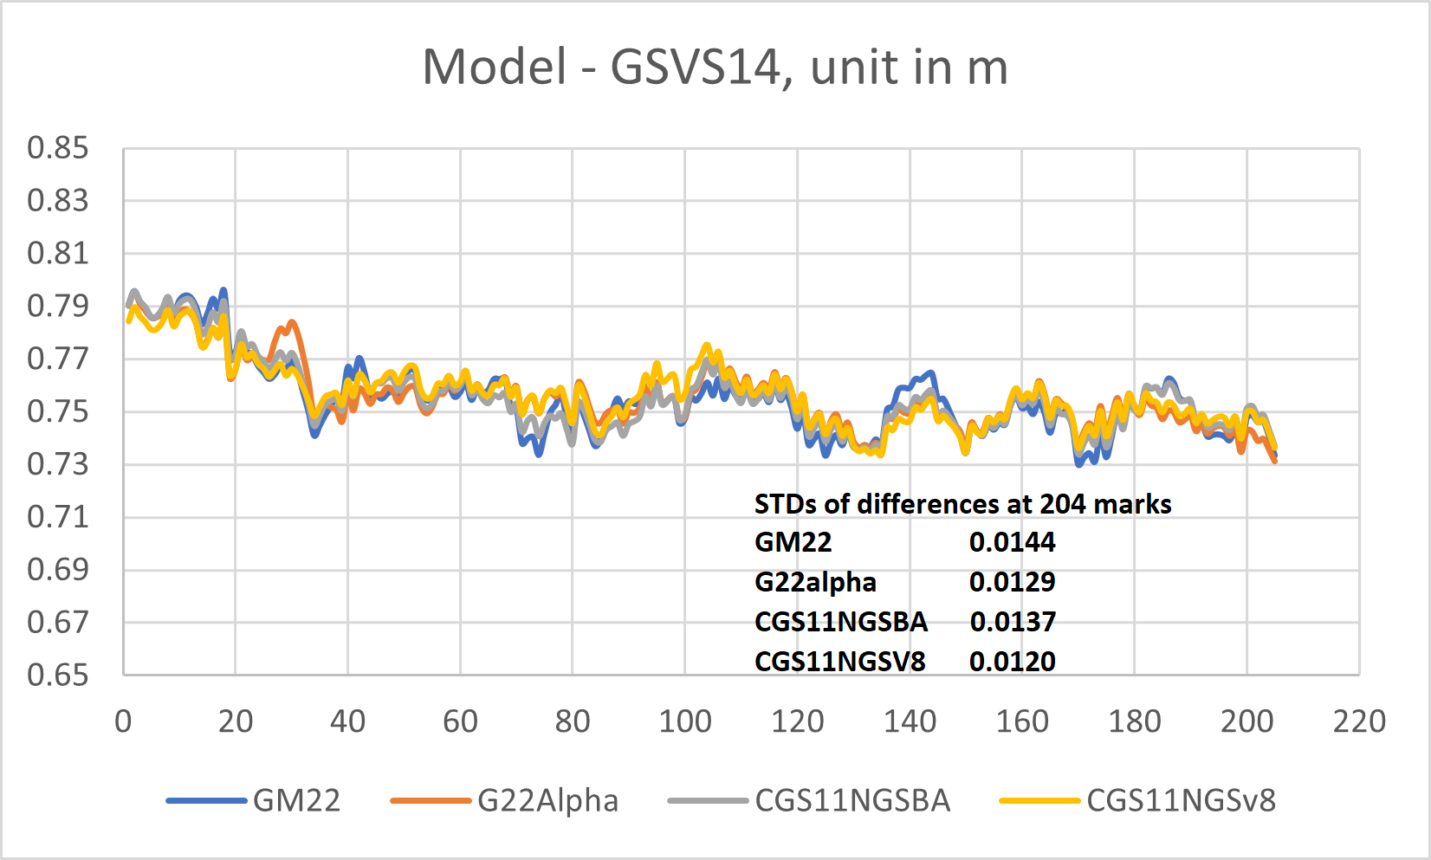
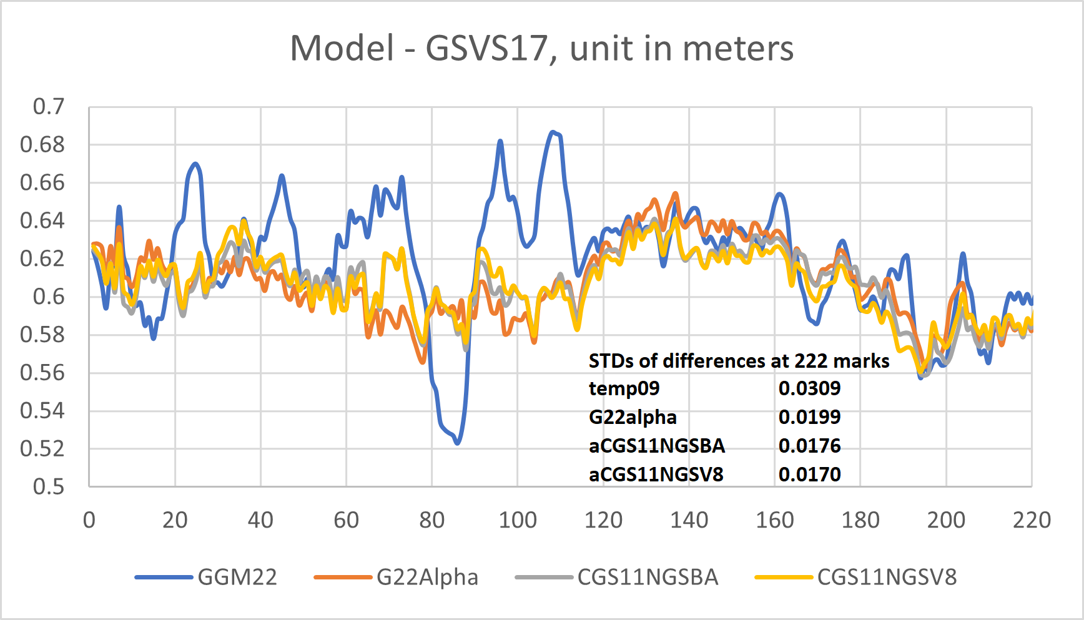
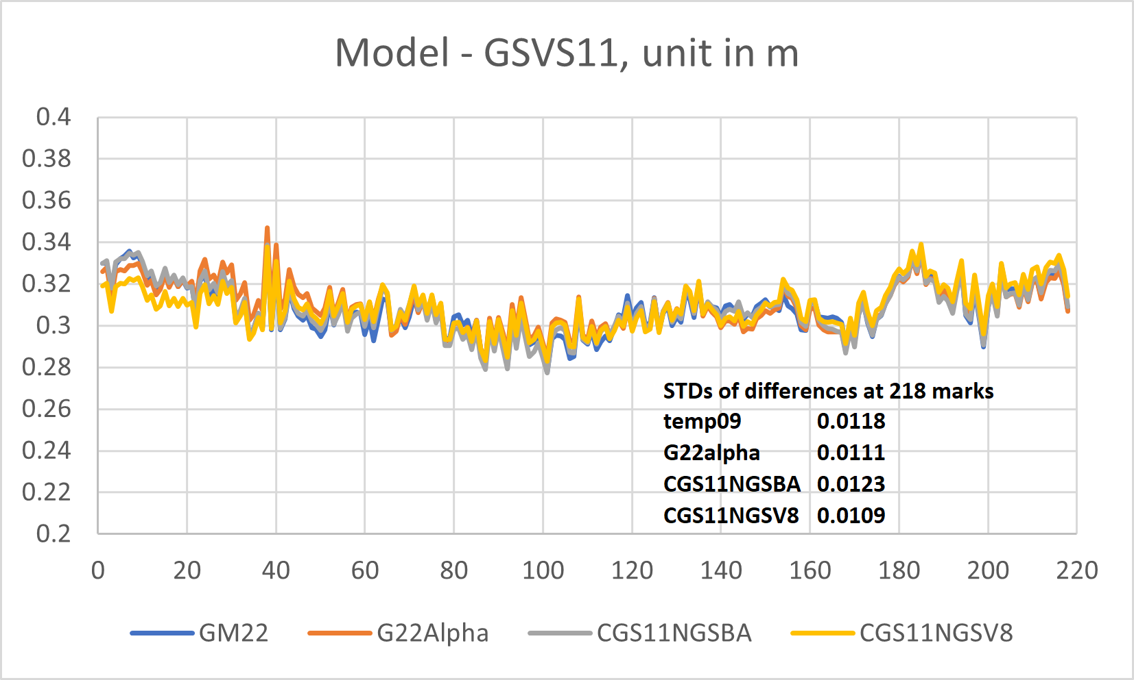
Geoid Slope Validation Surveys (GSVS) comparisons

Slide 16
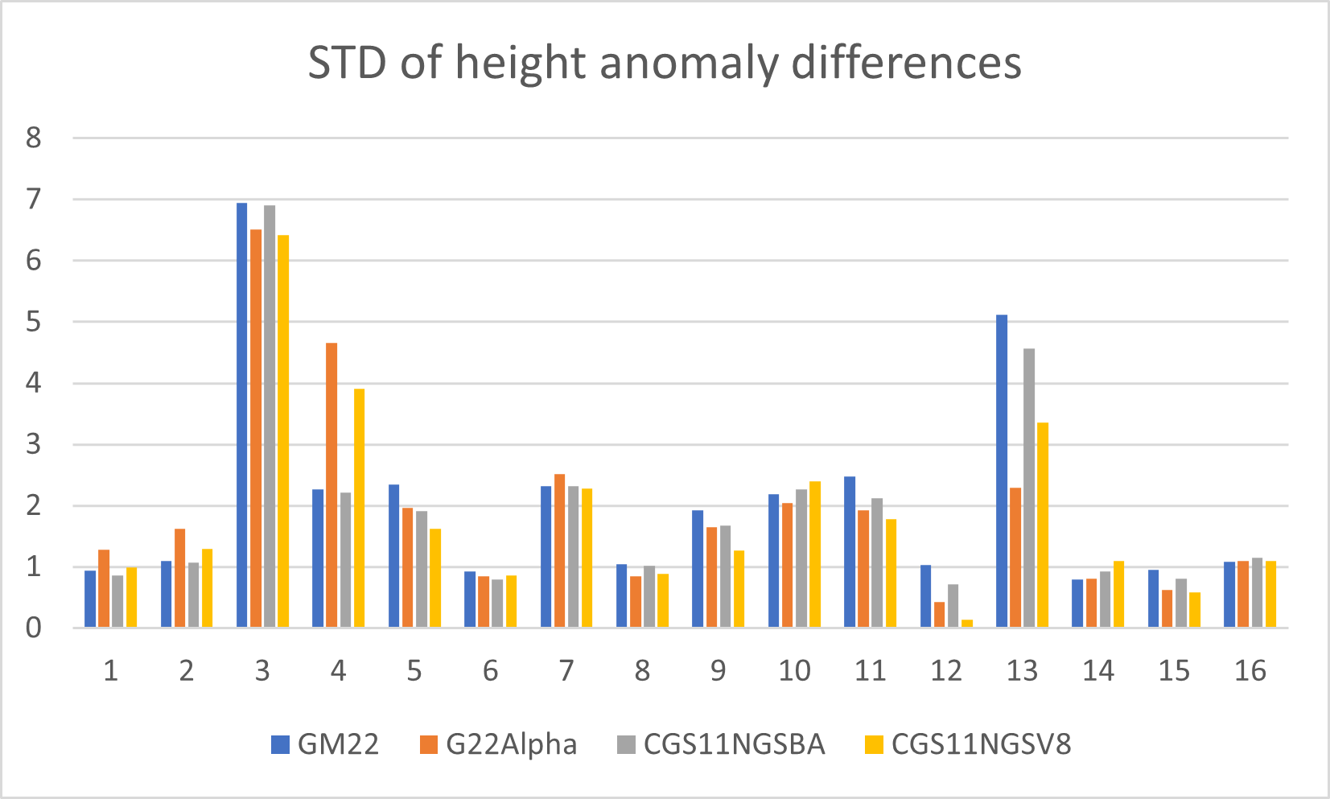
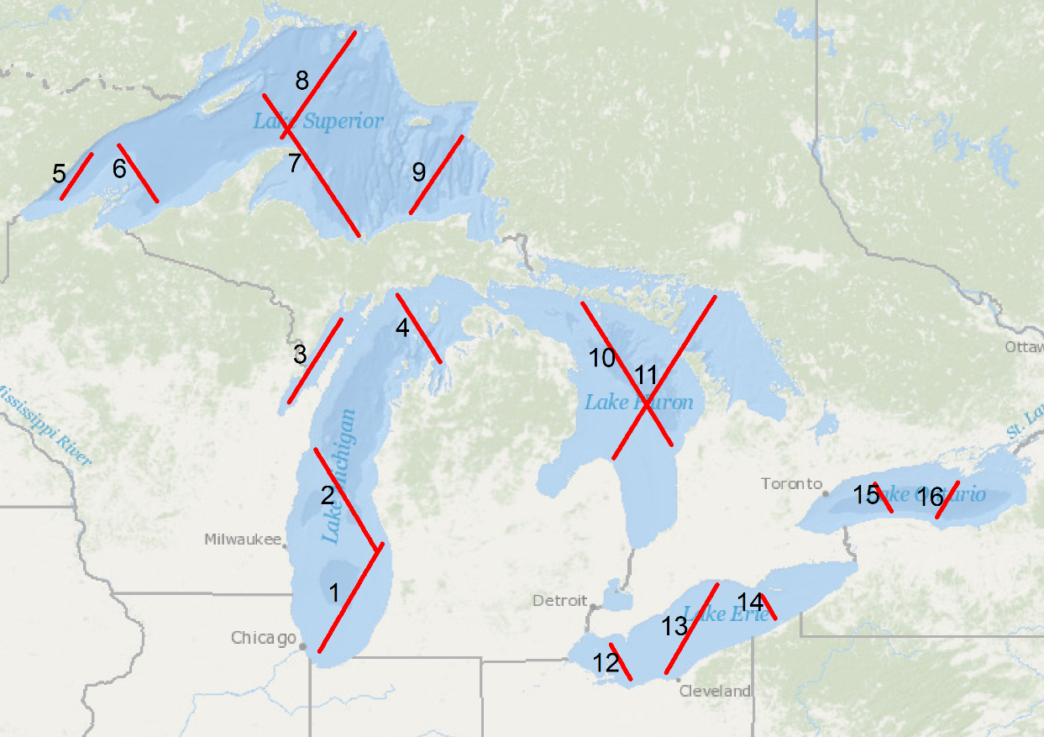
  Great Lakes altimetry comparisons, in cm
TOPEX/Poseidon ground track over the Great Lakes

Slide 17
  Conclusions
  NGS and CGS models provide very similar results, with differences only at the millimeter level. The Mexican model agrees well with NGS and CGS models.
  Differences between the models are noted in areas lacking gravity data or where data is sparse. This is due to different computational schemes used.
  Residual geoid models make significant contributions in mountainous regions. For instance, they improve agreement with the GSVS17 model from 3 cm to about 1.7 cm.
  Geoid models agree with 31,514 historical GPS/leveling points with STDs of around 6 cm. These differences are largely due to errors in the GPS/leveling data.
  The STD of geoid differences between the models and GSVS lines are below 2 cm, indicating the high quality of the geoid models and GSVS data.

Slide 18
  What is coming next
  GEOID2022 will be finalized in coming months. The model is expected to be public available in 2025.
  The following products will be available
  - Static and dynamic geoid models with accuracy grids (1’x1’)
  - Deflection of vertical with accuracy grids (1’x1’)
  - Gravity interpolation
  - GM2022 is available in spherical harmonic coefficients to d/o 2190

