Slide 1

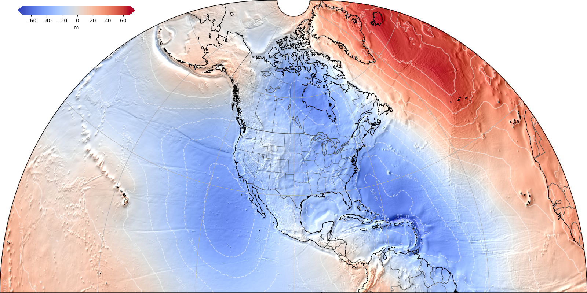
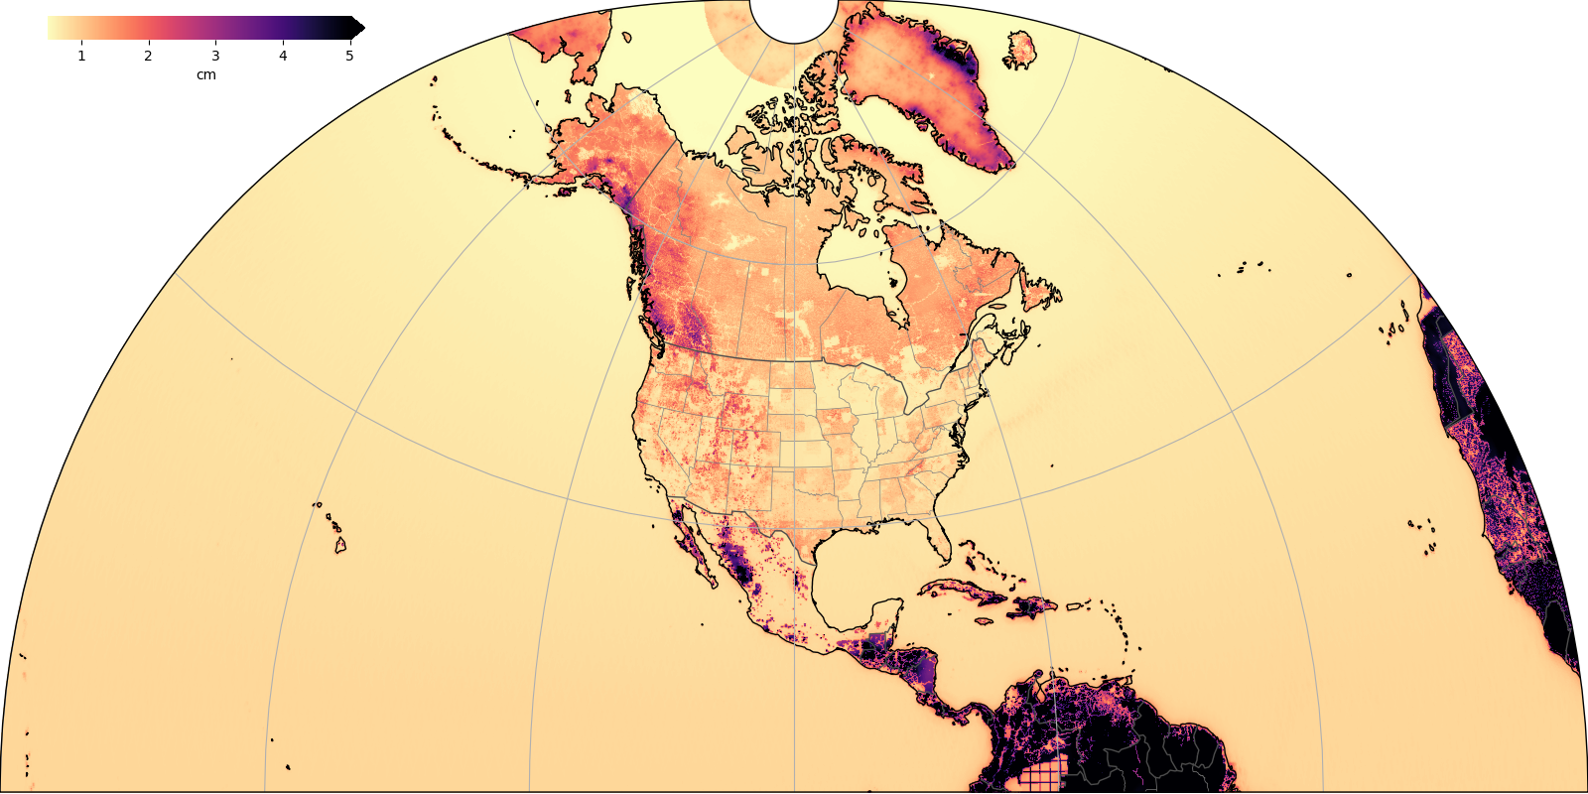
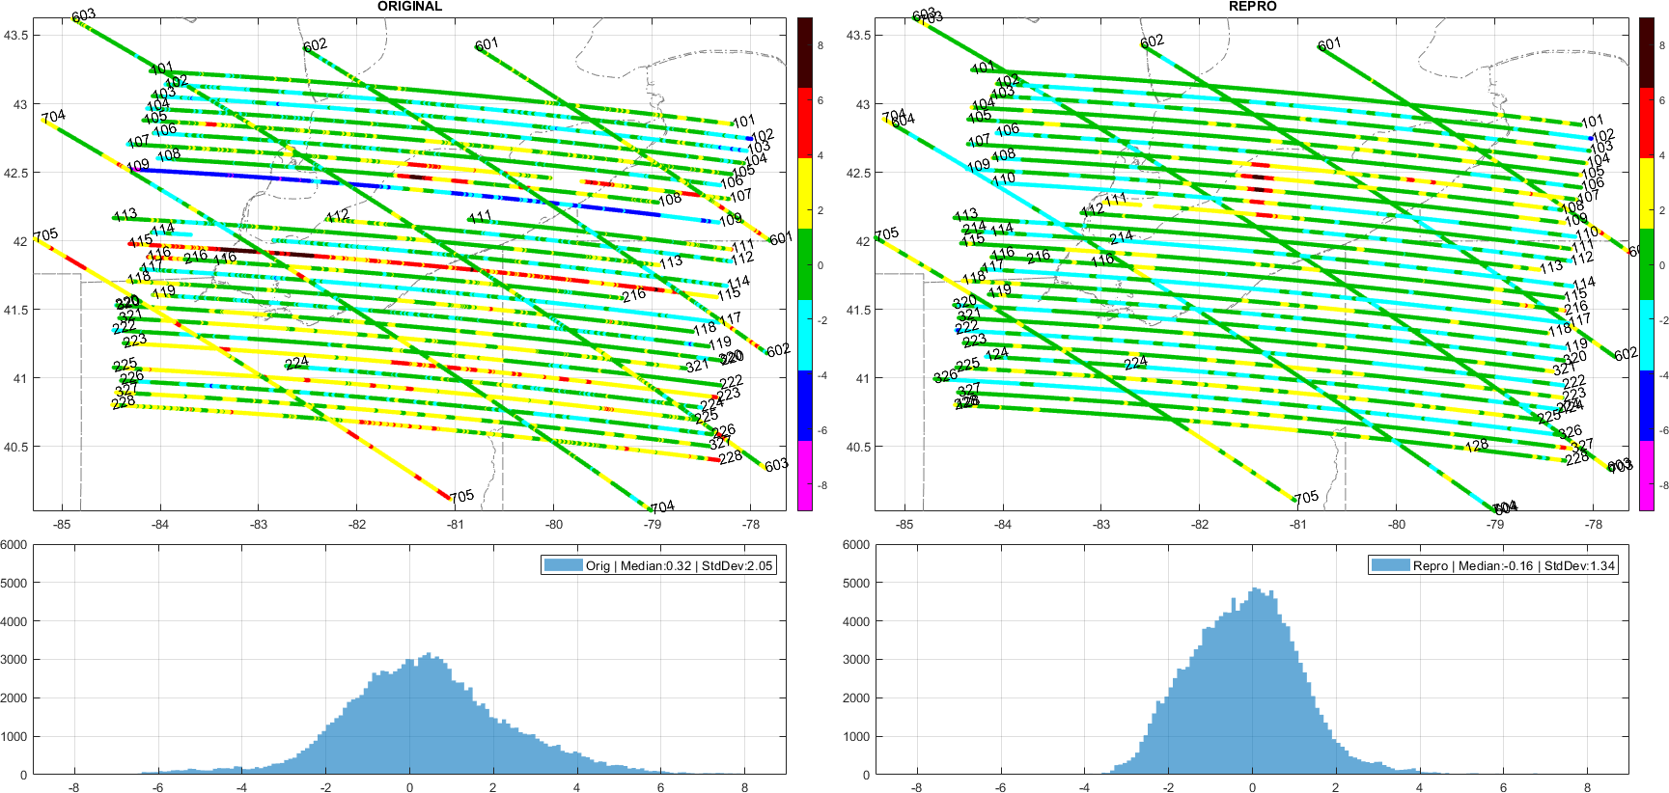
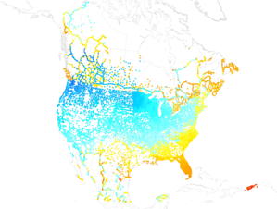
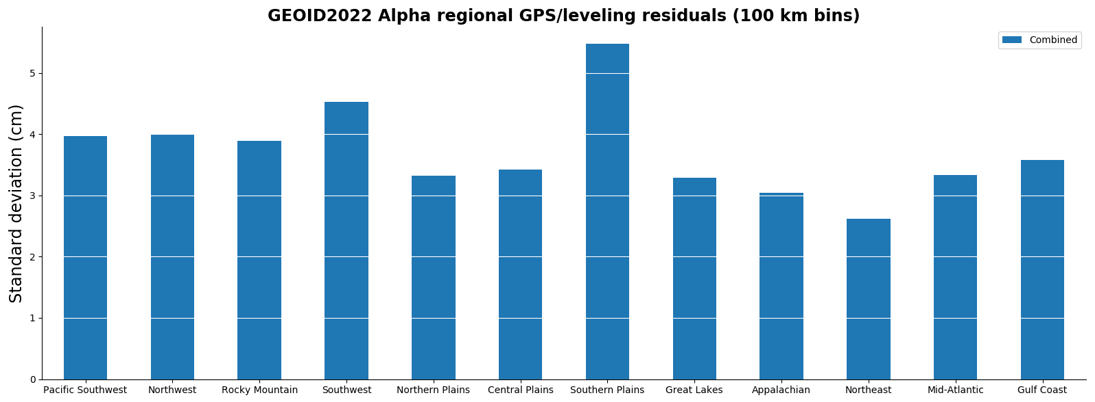
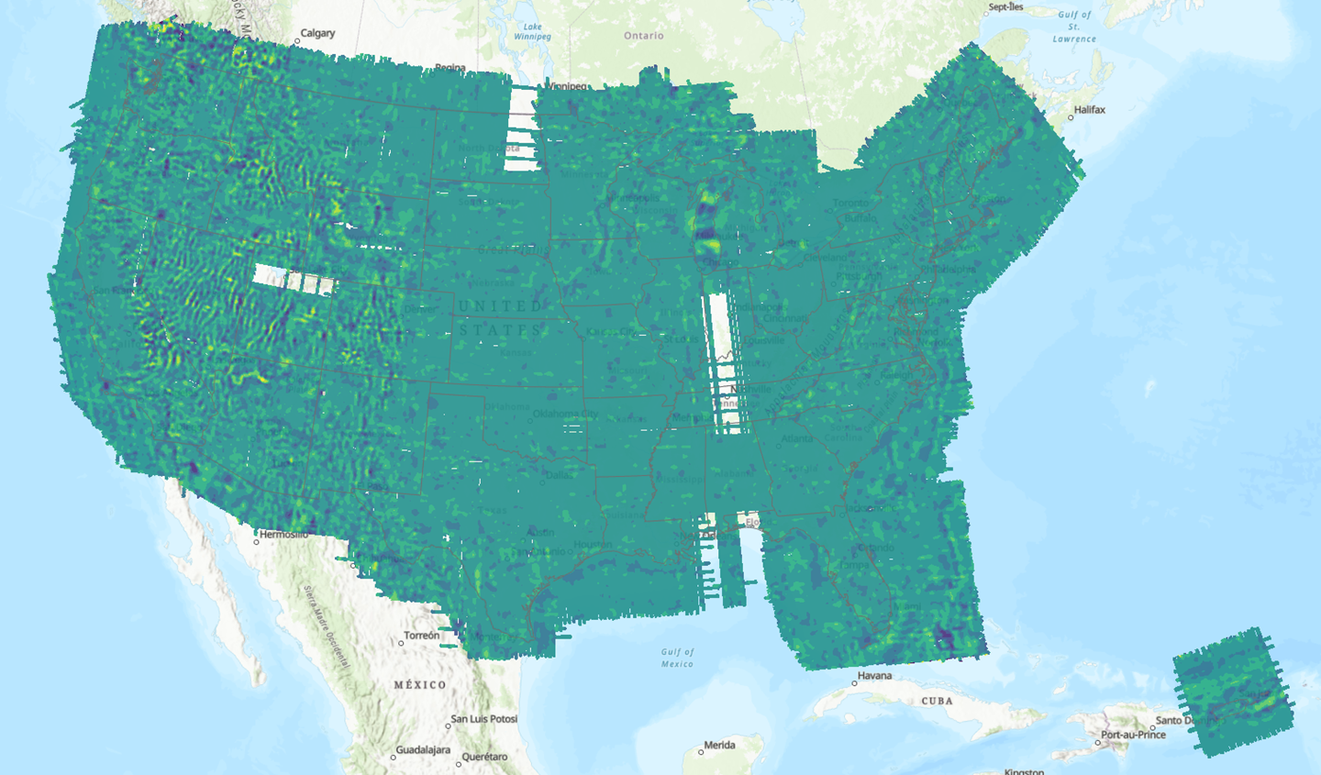
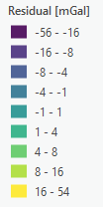
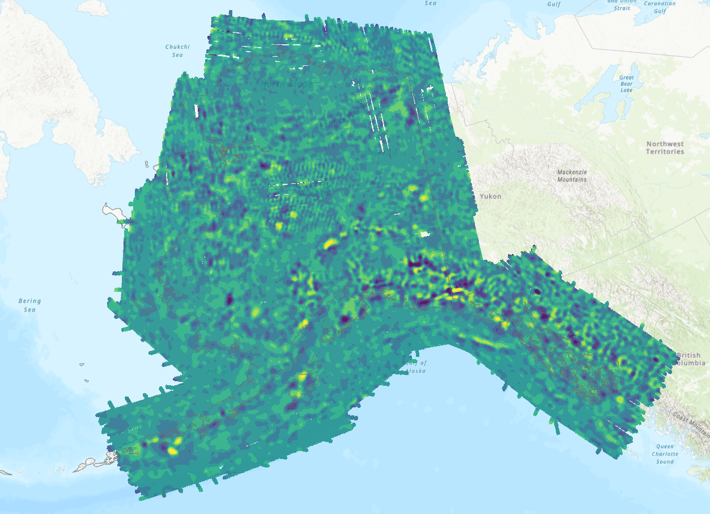
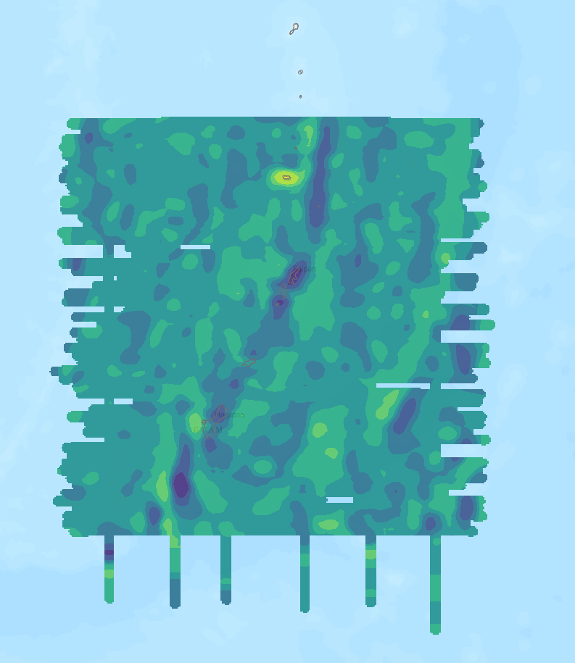
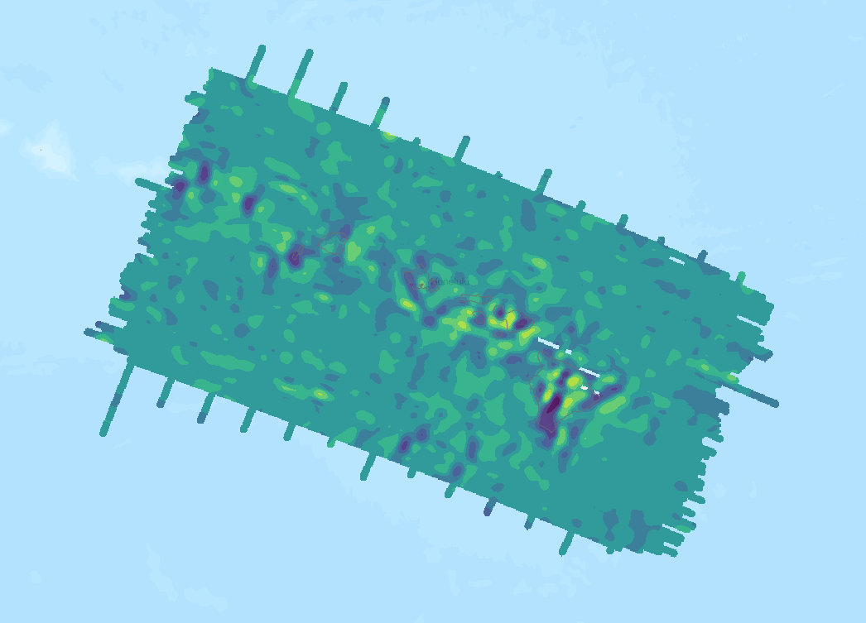
GEOID2022 Alpha*, a prototype geoid for NAPGD2022 G33A-0529
Wang YM, Li X, Ahlgren K, Hardy R, Krcmaric J
National Geodetic Survey, U.S.A
* GEOID2022 Beta v01 is now GEOID2022 Alpha
Huang J, Foroughi I, Véronneau M, Crowley J
Canadian Geodetic Survey, Canada
Avalos-Naranjo D
National Inst of Statistics and Geography of Mexico
Abstract
GEOID2022 will be a realization of a geoid model for the North American-Pacific Geopotential Datum of 2022 (NAPGD2022). This presentation focuses on a prototype of the geoid model developed jointly by three agencies of the U.S.A., Canada and Mexico, NGS, CGS and INEGI. We will present computation procedures and methods by each agency, data compilation (terrestrial, GRAV-D airborne gravity, satellite altimetric and shipborne gravity, icesheet data, and the digital elevation model), development of the reference Earth's Gravitational Model (EGM), weighting strategy toward a single geoid model, and results of evaluation against independent data sets.
Data used
The following data sets are used for geoid computation:
GOCO06S satellite gravity model (Kvas et al., 2021)
Terrestrial gravity:
National Geospatial-Intelligence Agency (NGA) data covers the area -5 ̊ ≤ latitude ≤ 85 ̊; 170 ̊ ≤ longitude ≤ 350 ̊.
National Geodetic Survey (NGS) data provides supplemental coverage to the NGA data
Canadian Geodetic Survey (CGS) data covers Canada lands.
INEGI data provides supplemental coverage to NGA data in Mexico
Reprocessed GRAV-D airborne gravity data (96% completion)
Arctic Gravity Project (ArcGP) data provided by NGA in a 3-arcmin. grid covering 60 ̊ ≤ latitude ≤ 90 ̊; 0 ̊ ≤ longitude ≤ 360 ̊
DTU21, a 30-arcsec. grid of marine gravity anomalies derived from satellite altimetry data (Andersen personal communication)
DEM2022, a 3-arcsec. digital elevation model (Krcmaric and Li., 2023)
BedMachine Greenland ice thickness grid (Morlighem M. et al., 2017)).
Goddard Space Flight Center L1B GRACE/GRACE-FO mascon trend solutions (dynamic component)
GRAV-D airborne gravity data reprocessing
GRAV-D residual gravity disturbances after reprocessing
Computation methods
NGS: Height anomalies are computed with the g1 term in 1’x1’ grid, then converted into the geoid using the complete geoid-quasigeoid separation term. Constant density assumed, ice data used in Greenland.
CGS: The geoid is computed using the Stokes-Helmert scheme in 1’x1’ grid. Constant density assumed.
GEOID2022 Alpha
GEOID2022 Alpha: simple arithmetic average of NGS and CGS models
Geoid grids covers: North America-Pacific
Guam and Northern Mariana Islands
American Samoa
Approach | NGS | CGS
GBVP type | Molodensky | Stokes – Helmert
Remove-Compute-Restore | Yes | Yes
Data combination | > 40 km (EGM including GRAV-D), < 40 km (Terr) | >180 km (Sat) , 55 - 180 (GRAV-D), < 55 km (Terr)
Geoid-to-Quasigeoid separation correction | Yes | No
Gravity Data Interpolation | Residual Free-air Anomalies/Bouguer anomalies | Complete Bouguer Anomalies
Glacial Ice Correction | Yes | No
GEOID2022 Alpha evaluation
Error estimation of GEOID2022 Alpha
Historical GNSS/leveling Comparison in cm
96% of survey blocks are reprocessed using updated software
Off-level correction: proper alignment with the gravity vector
Filtering free-air disturbances: instead of full-field gravity
Absolute gravity ties: all reprocessed and checked
Trims and Edits: performed as consistently as possible
ITRF2020: reference frame
 | CA #2451 | USA #31514 | MX #2641
Mean | -15 | -56 | -40
STD | 14 | 6 | 18
Historical GNSS/leveling comparison by region, USA in cm
Residual gravity disturbances with respect to EGM2008 over Lake Erie EN02 [mGal] . The left panel is the original/published data, SD=2.05, and the right is the reprocessed data, SD=1.34.
Conclusions and future work
The GEOID2022 Alpha agrees with the GSVS lines over 300 km within 1-2 cm (1σ) with no noticeable slopes. There are 6 cm discrepancies over 50 km at west side of the GSVS14 line. GSVS17 is in Colorado where elevation ranges from 1900 to 3300 meters.
After removing the biases of each 1º by 1º block, standard deviations of GNSS/leveling comparisons are better than 5 cm (1σ) for all US states. The differences are slightly larger for individual Canadian provinces without removing the bias and tilt in GPS/leveling data.
Geoid errors are estimated based on gravity data accuracies and data distribution. .
Model will be published early 2024.
GEOID2022 Schedule
2023
- GEOID2022 Alpha to be computed
- GRAV-D to be completed 100% and processed
2024
- GEOID2022 to be computed and validated. It will be ready for release with its
time varying components, deflections of the vertical and their accuracy
estimation. A EGM enhanced by GRAV-D to degree and order 2160 will be part
of the release.
2025
- NAPGD2022 to be released with the North America Terrestrial Reference Frame
NATRF2022
Comparisons with the geoid Slope validation surveys in cm
GRAV-D goes to shelf break
Alaska
 | GSVS11 #218 | GSVS14 #204 | GSVS17 #222
Mean | 31.0 | 75.6 | 60.8
STD | 1.1 | 1.3 | 2.0
Min | 28.4 | 73.1 | 56.3
Max | 34.7 | 79.5 | 65.5
Guam and CNMI
Hawaii

