Slide 1
Progress of GEOID2022 beta v01
YM Wang, X Li, K Ahlgren, R Hardy, J Krcmaric
National Geodetic Survey, U.S.A.
J Huang, I Foroughi, M Veronneau
Canadian Geodetic Survey, Canada
D Avalos-Naranjo
National Institute of Statistics and
Geography, Mexico
IUGG2023 Berlin, Germany | July 10 - 20, 2023

Slide 2

Outline
Geoid teams (NGS, CGS and INEGI)
Parameters used for GEOID2022 (a realization of NAPGP2022)
Datasets used for GEOID2022 beta v01
GRAV-D reprocessing
Development of the reference coefficient model
The experiment geoid xGEOID2020
Schedule of North American-Pacific Geopotential Datum of 2022 (NAPGD2022)

Slide 3
US National Geodetic Survey
Yan Ming Wang, lead
Xiaopeng Li
Kevin Alhgren
Jordan Krcmaric
Ryan Hardy
Canadian Geodetic Survey
Jianliang Huang, lead
Marc Véronneau
John Crowley
Ismael Foroughi
National Institute of Statistics and Geography
David Naranjo Avalos, lead
Marco A. Mendoza-Martinez
Raul Munoz-Abundes
T
E
A
M
S

Slide 4
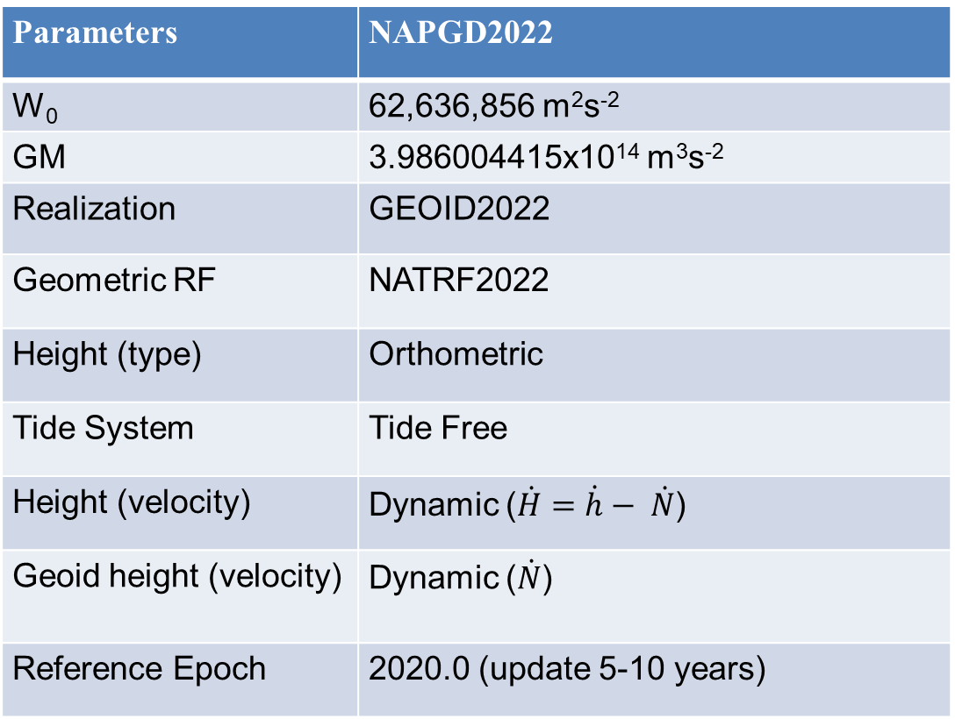
Parameters used for NAPGD2022
Parameters | NAPGD2022
W₀ | 62,636,856 m²s⁻²
GM | 3.986004415x10¹⁴ m³s⁻²
Realization | GEOID2022
Geometric RF | NATRF2022
Height (type) | Orthometric H = h - N
Tide system | Tide Free
Velocity of height
Velocity of geoid height
Reference epoch | 2020.0 (update 5-10 years)

Slide 5
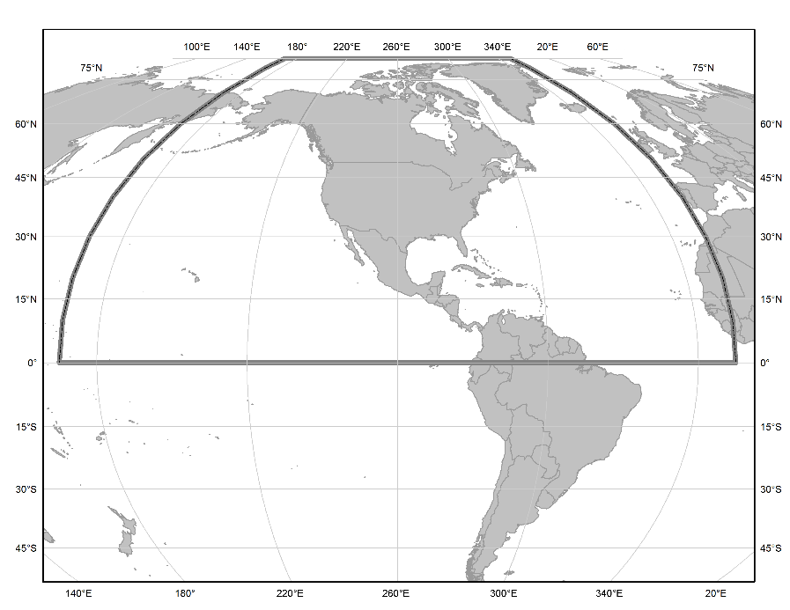
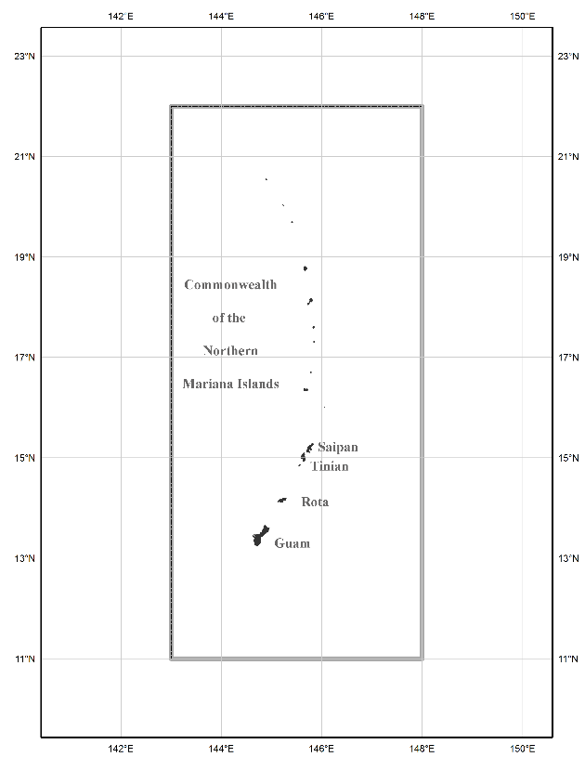
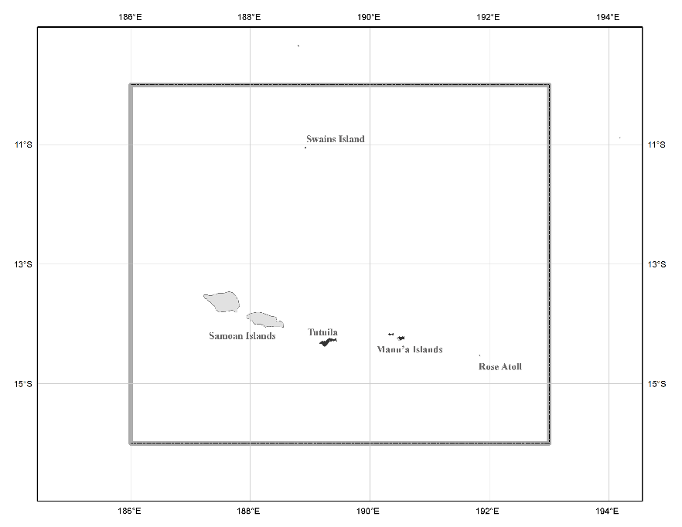
GEOID2022 coverage (1’x1’)
North American region
¼ of the Earth
American Samoa
Guam

Slide 6
Data used (common data sets)
NGS, CGS, INEGI and NGA terrestrial gravity data (~ 1.9 million pts.)
Repro GRAV-D airborne gravity data (U.S. Territories)
DEM2022 at a 3″ spatial resolution
Marine gravity data: DTU21 (Andersen personal Comm., 2022) and shipboard gravity
ArcGPv2020 (Beale personal comm., 2020)
Ice thickness (Greenland)
For validation: 3 Geoid slope validation surveys, ~40,000 GPS/GNSS, TOPEX/POSEIDON over Great Lakes, water gauge data

Slide 7
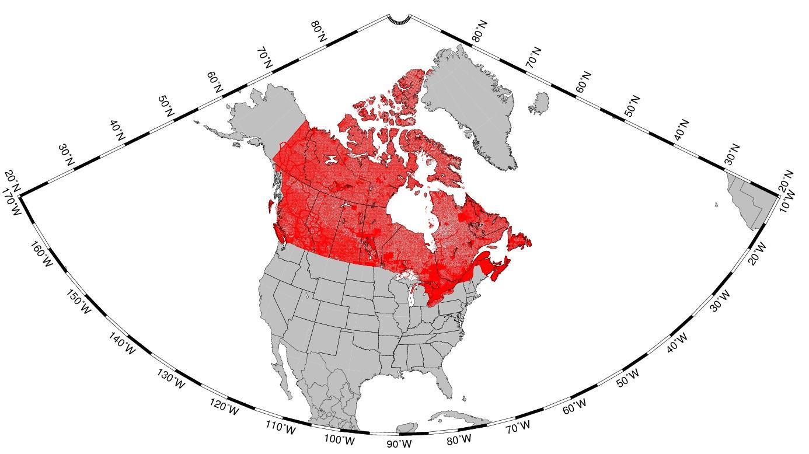
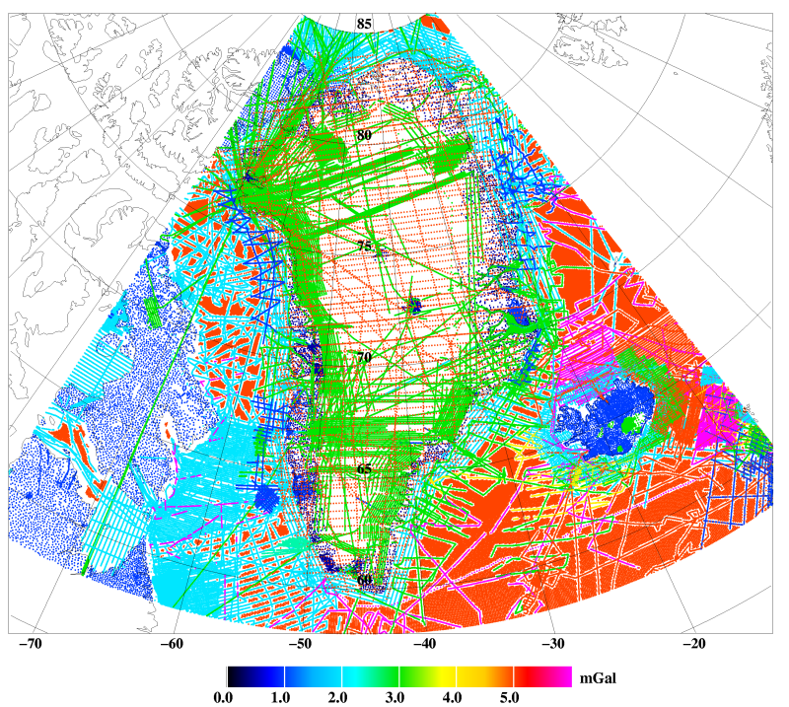
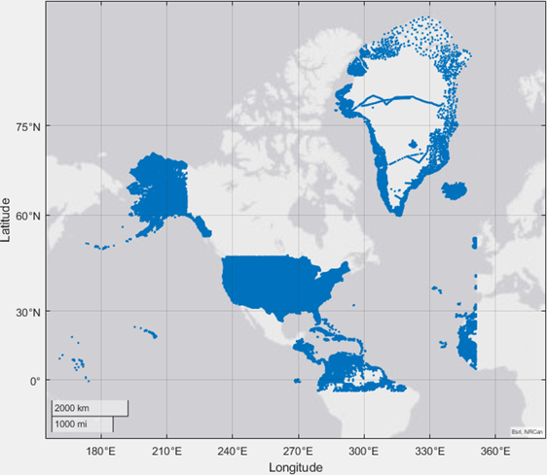
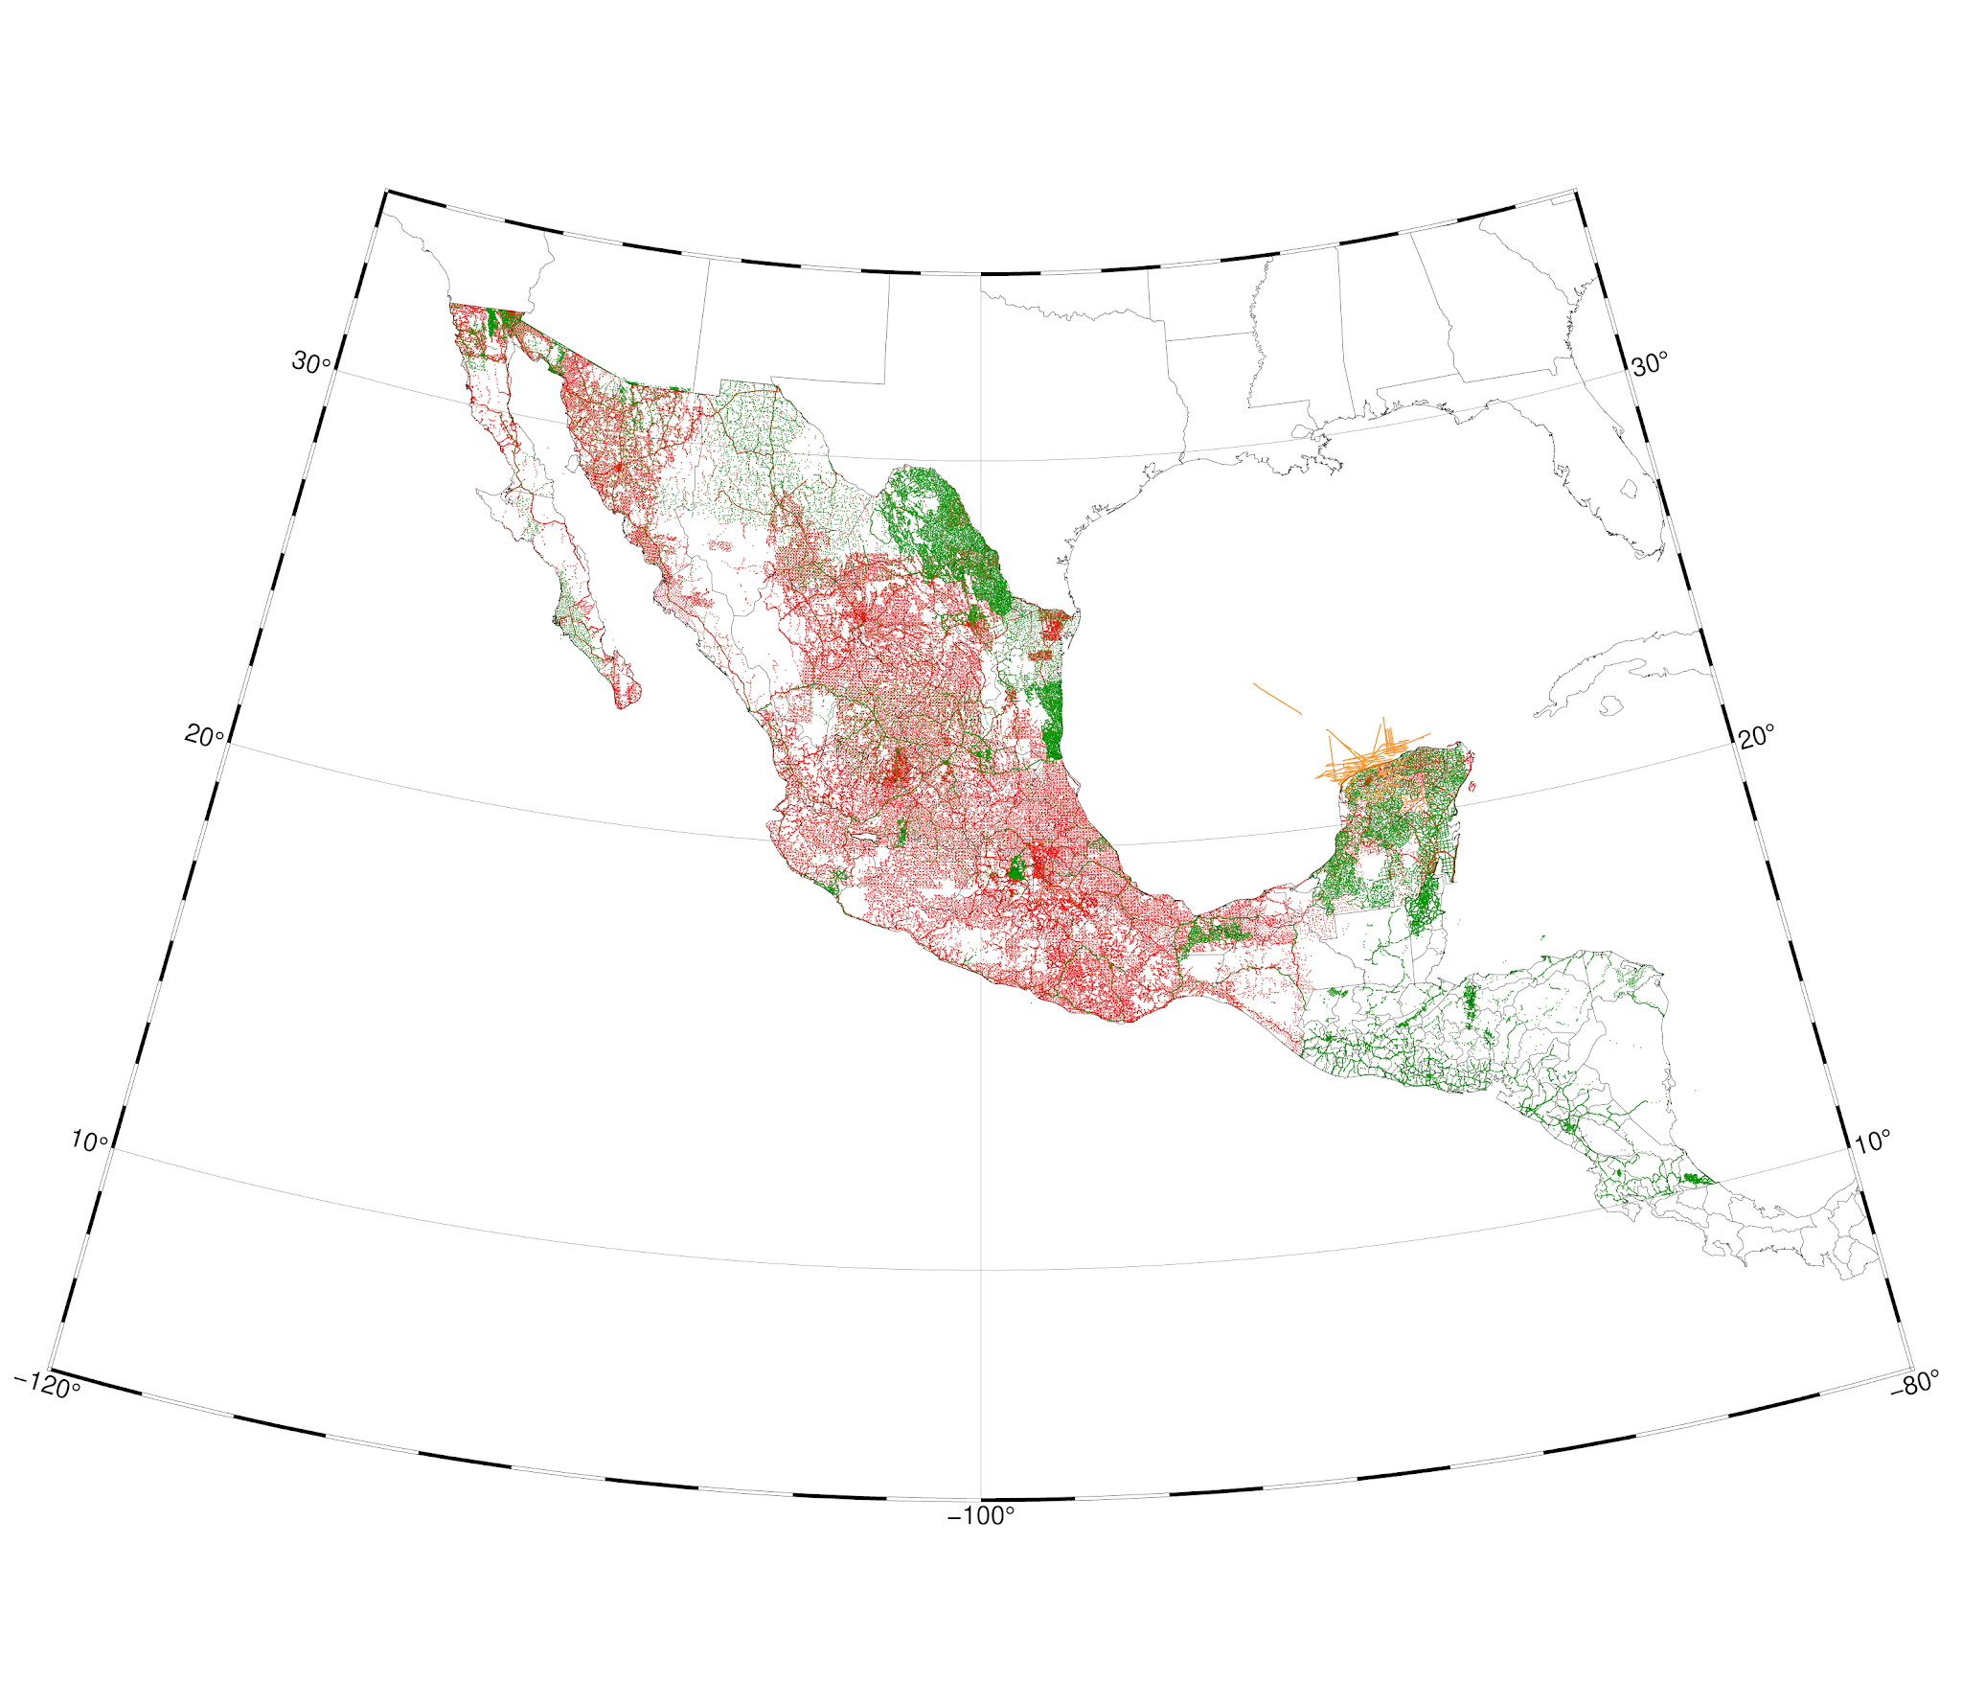
Data used (common data sets)
Canada
~255 k pts
NGA/NGS
~1.5 M pts
ARCGP20
Mexico ~110 k pts

Slide 8
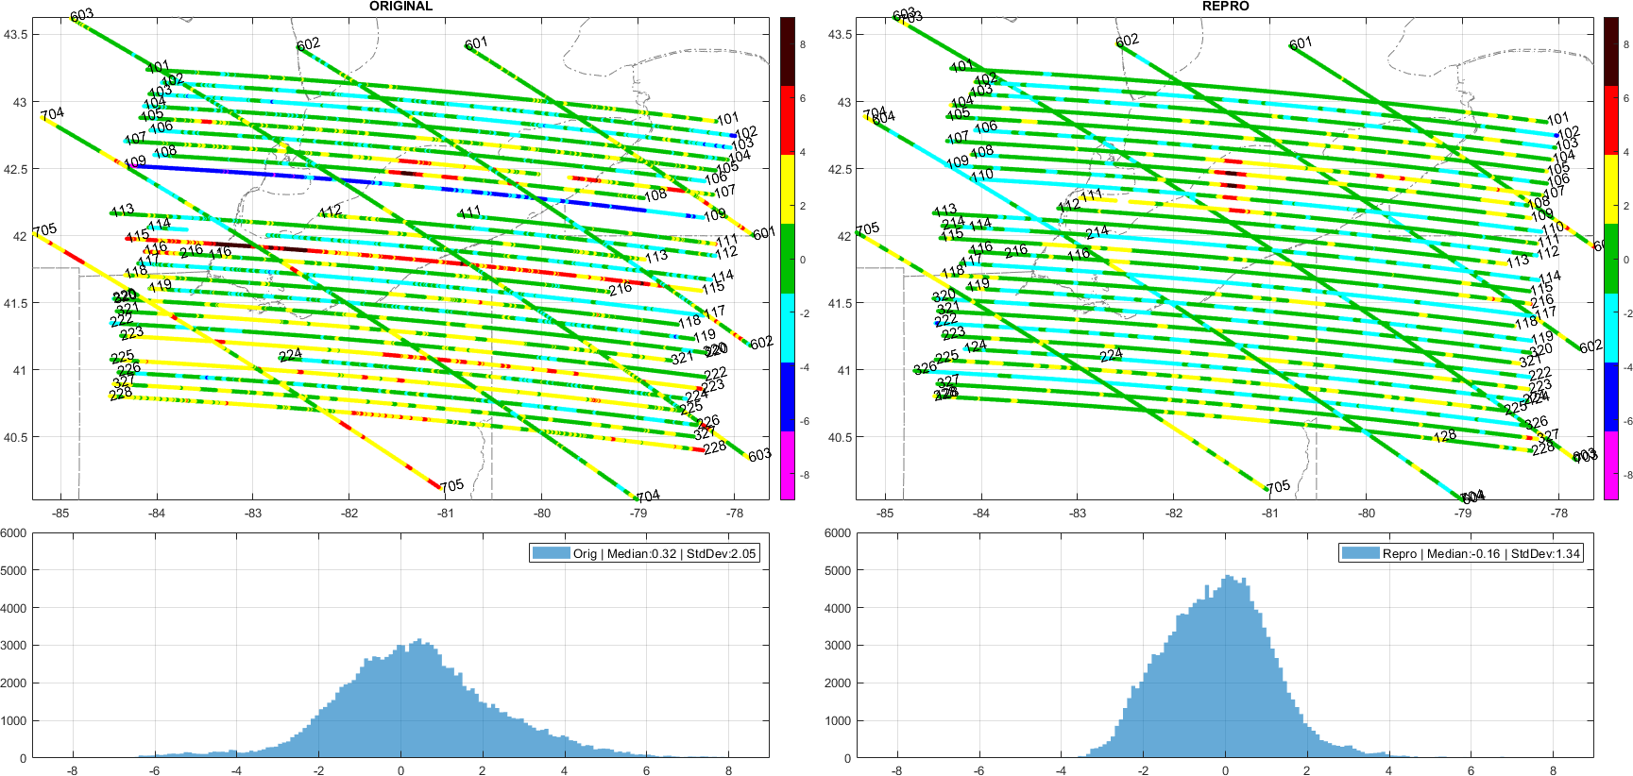
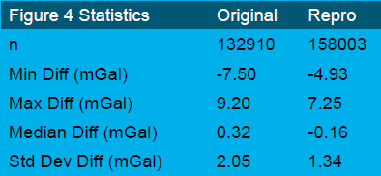
GRAV-D reprocessing
What’s NEW?
Off-level correction: proper alignment with the gravity vector
Filtering free-air disturbances: instead of full-field gravity
Absolute gravity ties: all reprocessed and checked
Trims and Edits: performed as consistently as possible
ITRF2020 reference frame
Lake Erie
Lake Erie
GRAV-D observations minus EGM2008 predictions [mGal]. The left panel is the original/published data, and the right is the reprocessed data.

Slide 9
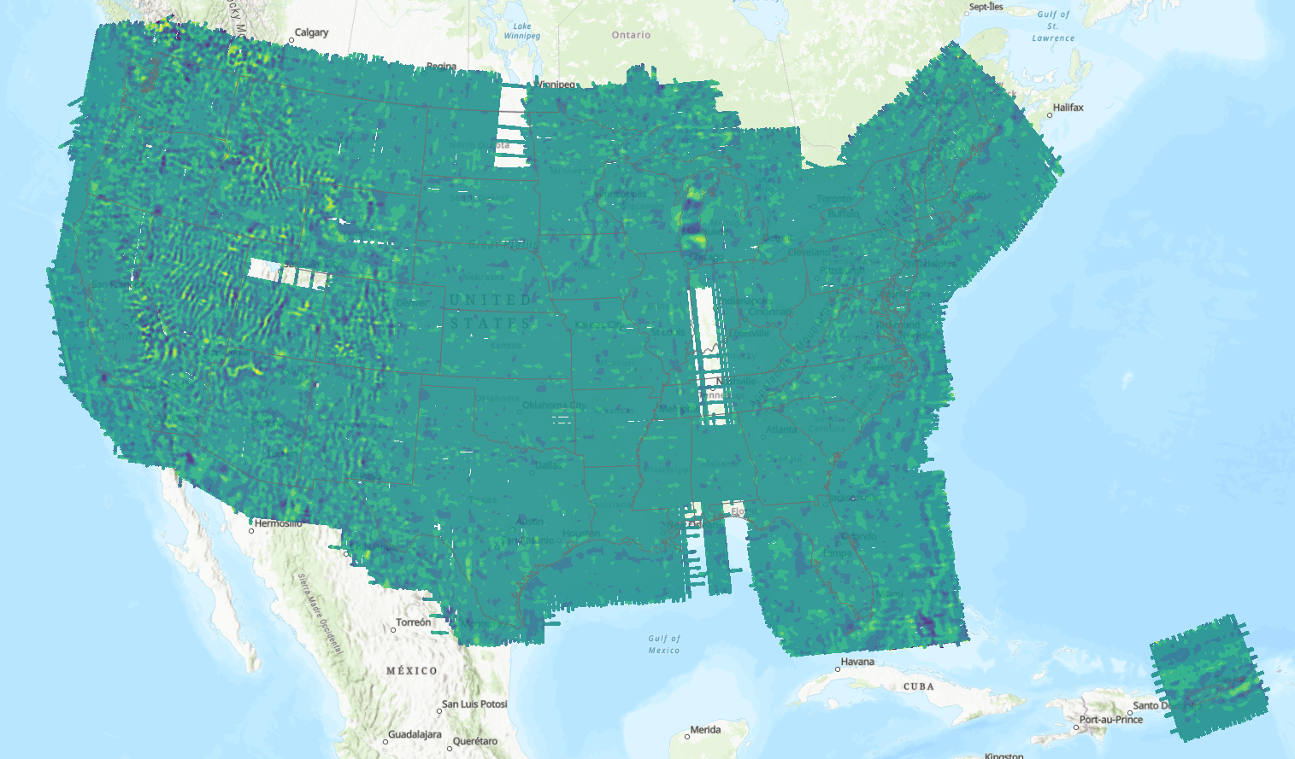
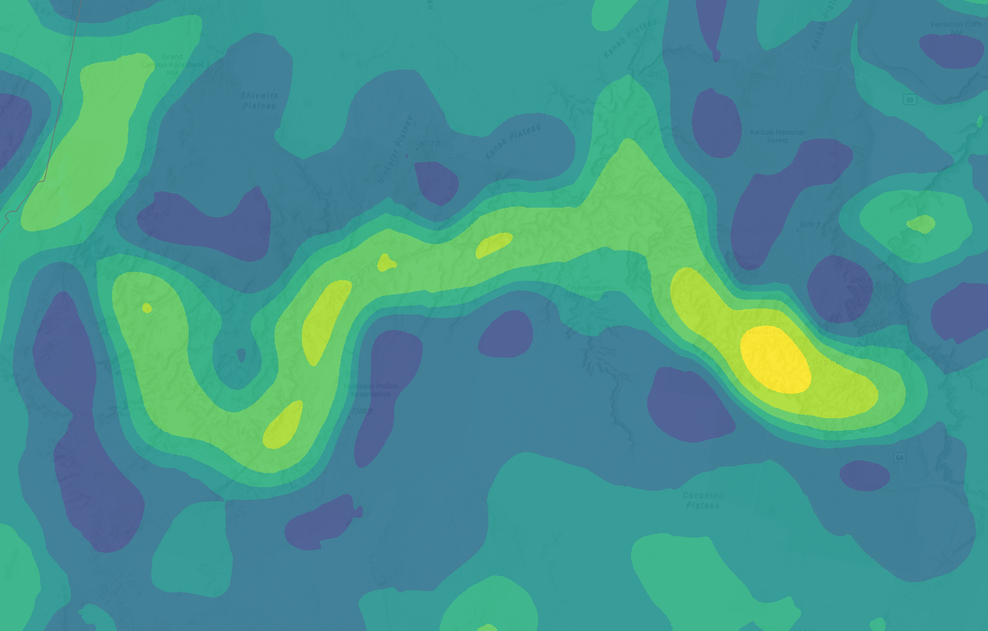
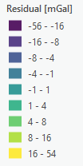
CONUS and PR/VI

Slide 10
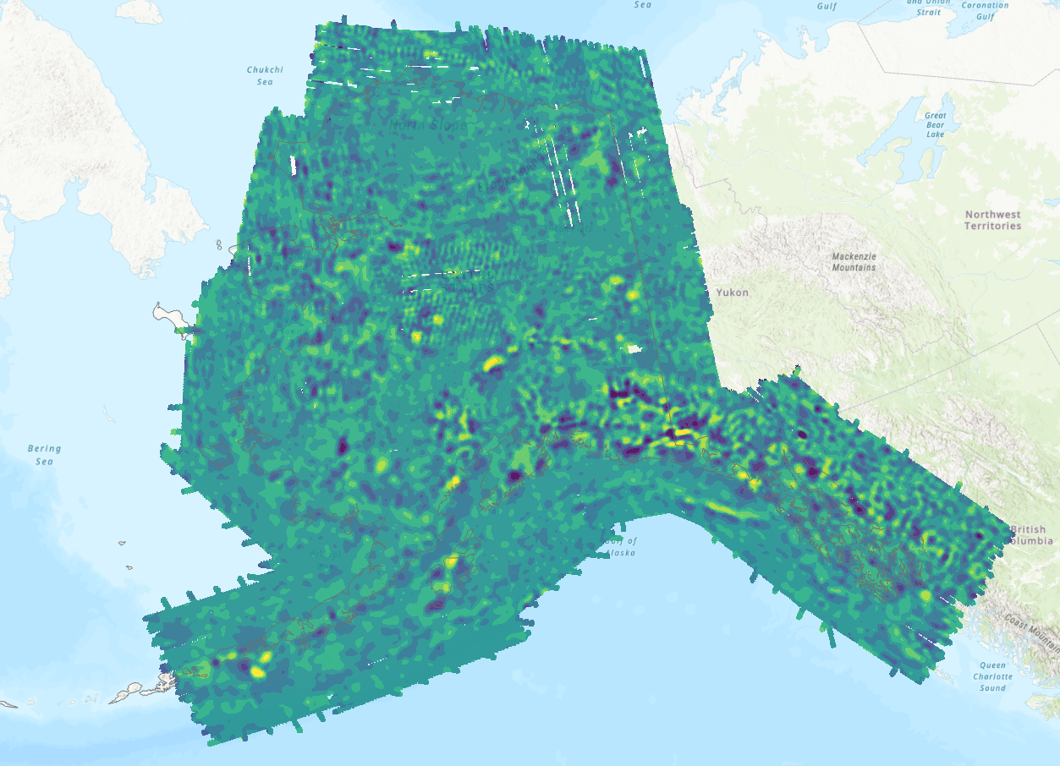
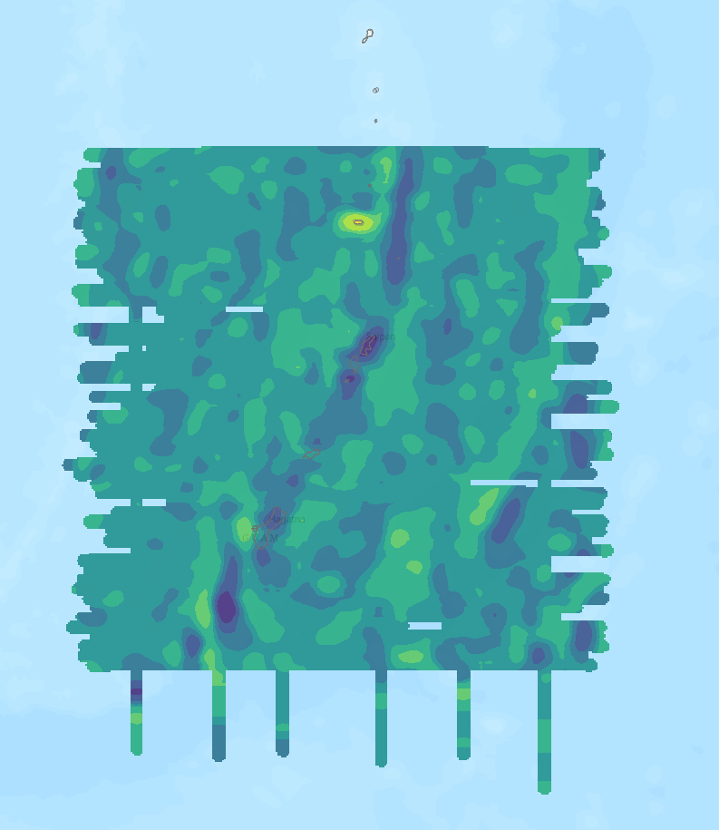
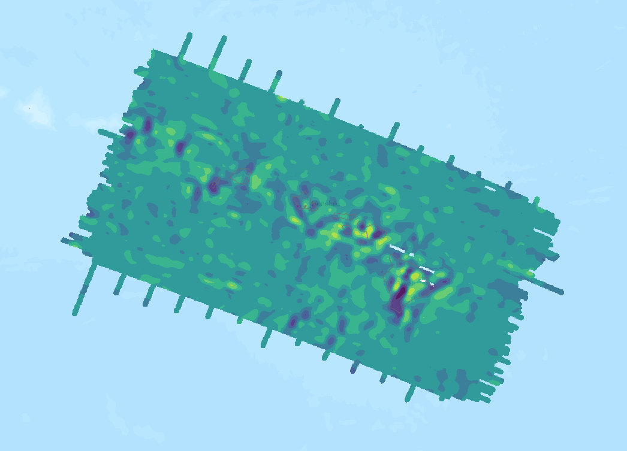
Alaska
Guam and CNMI
Hawaii

Slide 11
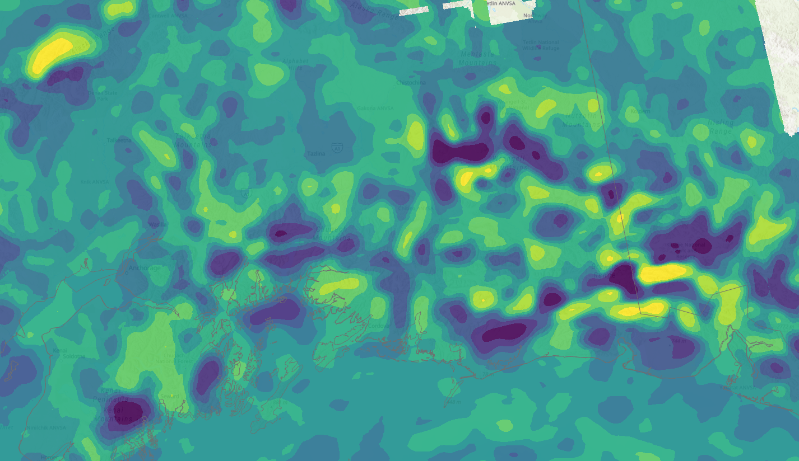
Alaska

Slide 12
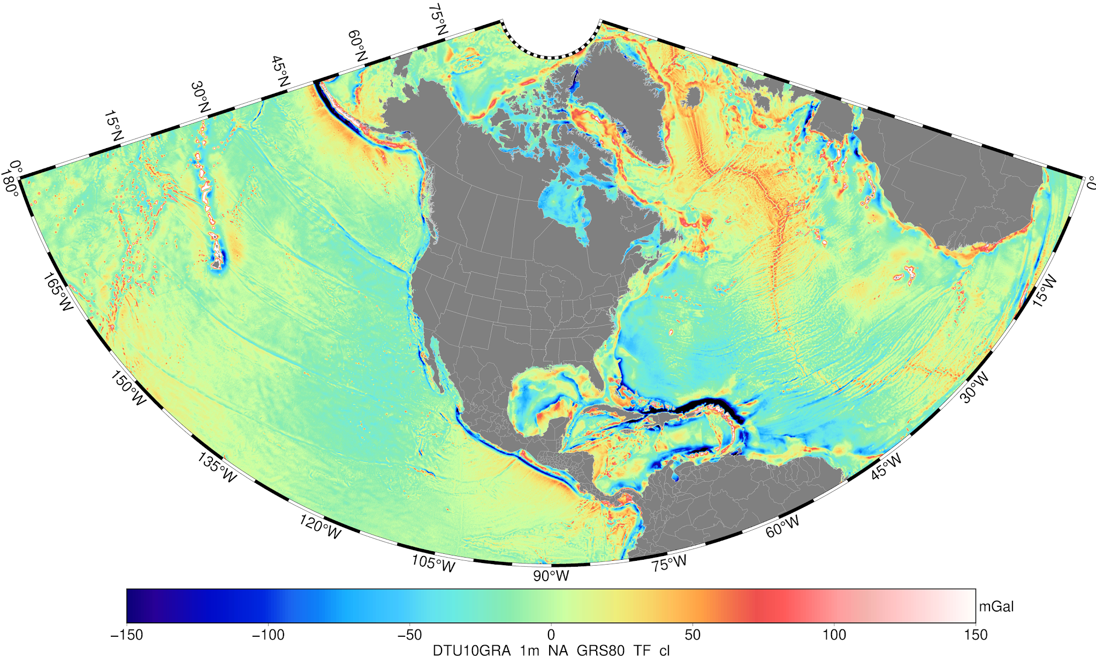
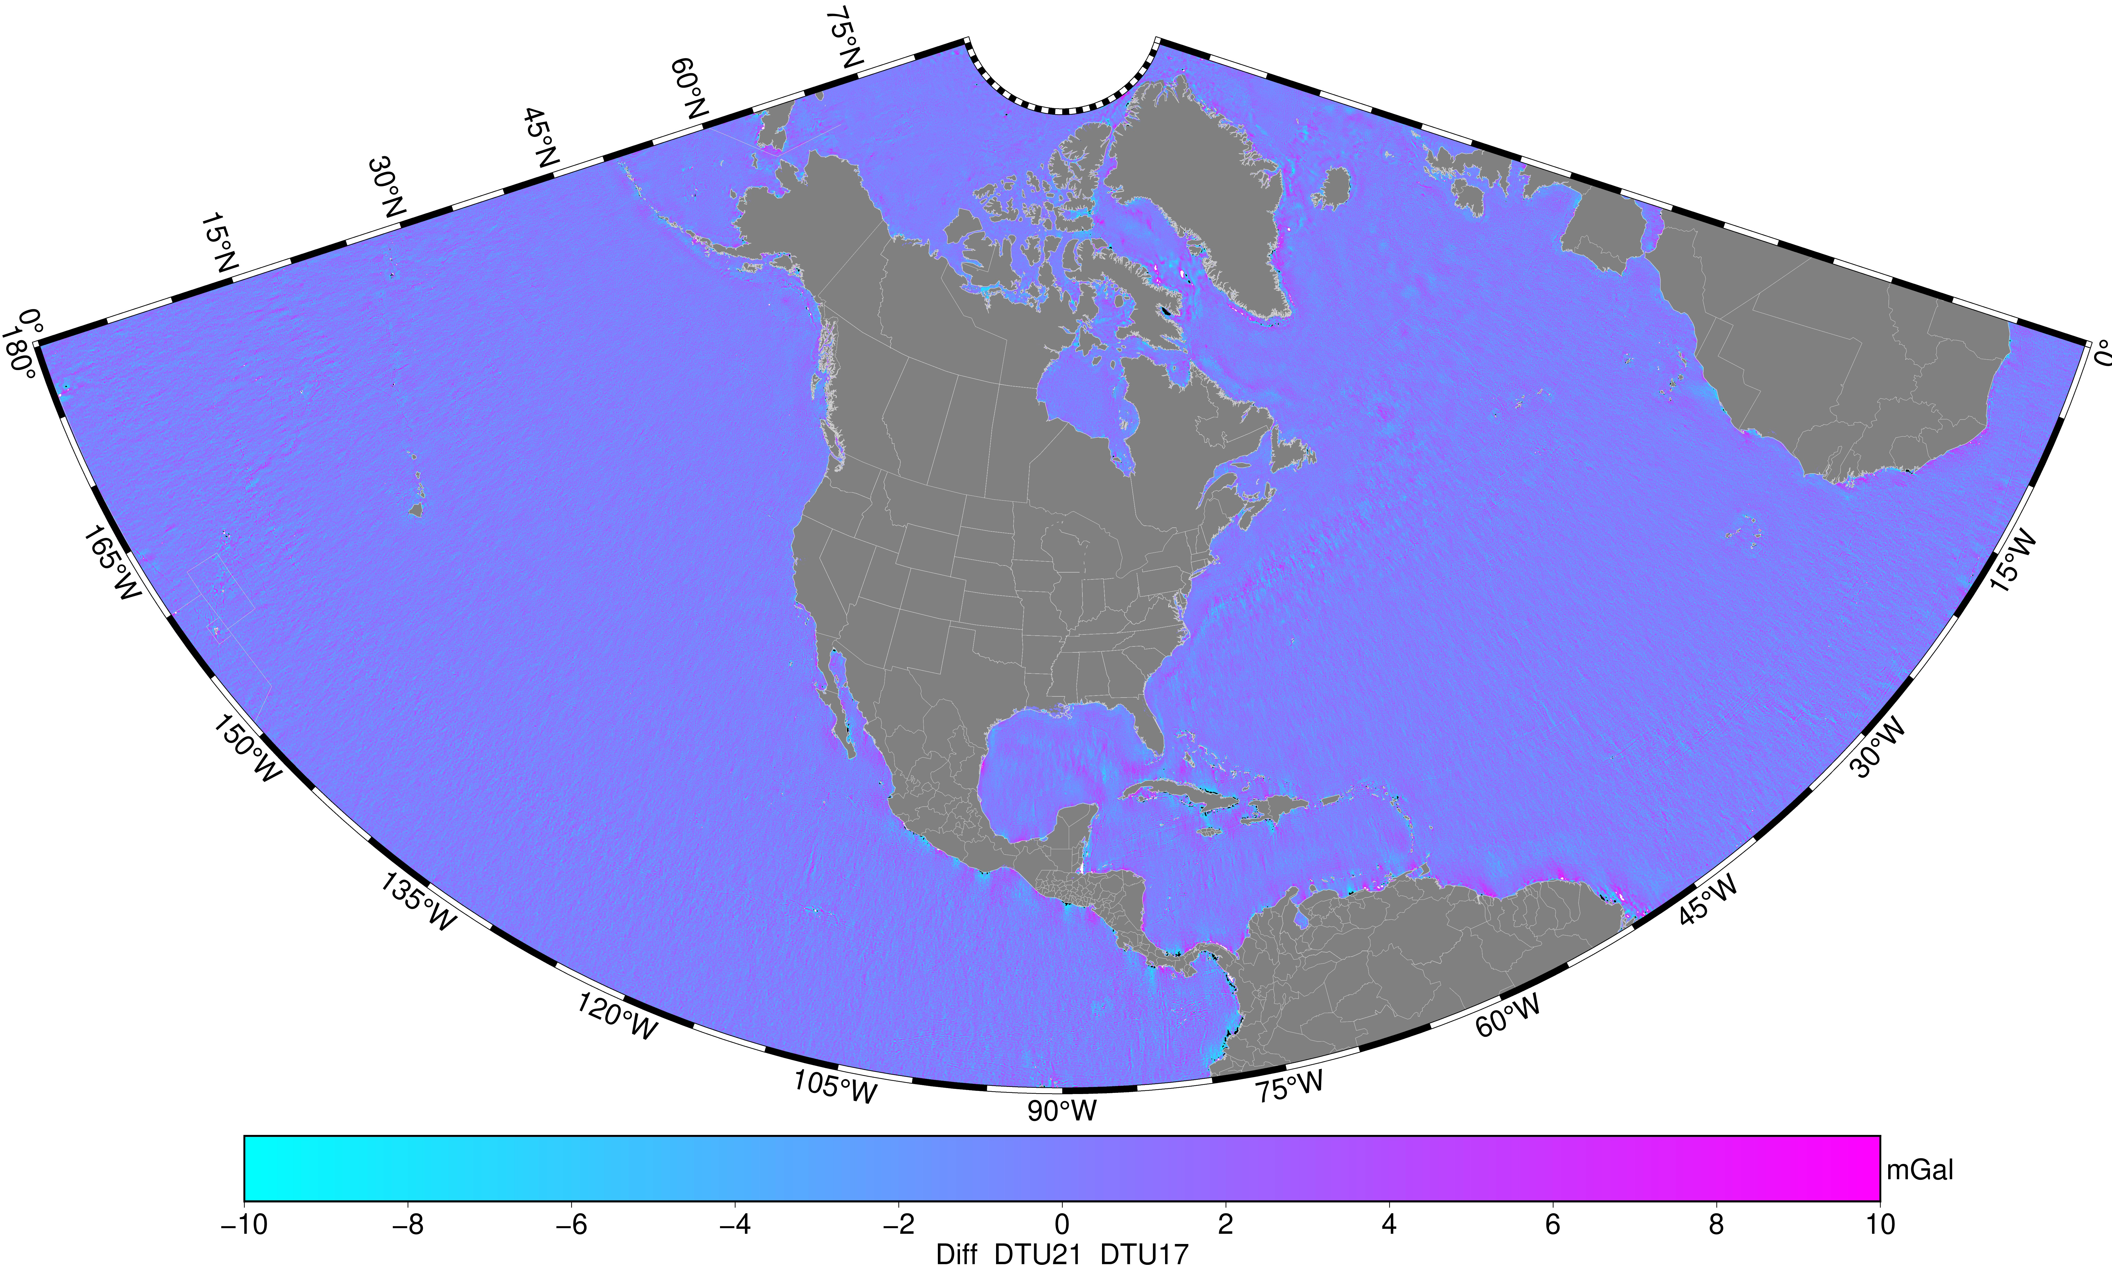
Altimetric gravity anomalies (DTU21) used
DTU17 1 arcmin used in xGEOID2020
DTU21 – DTU17

Slide 13
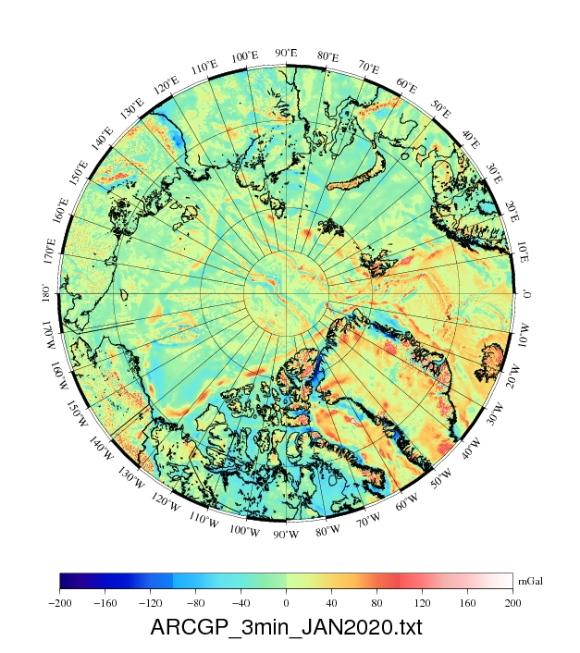
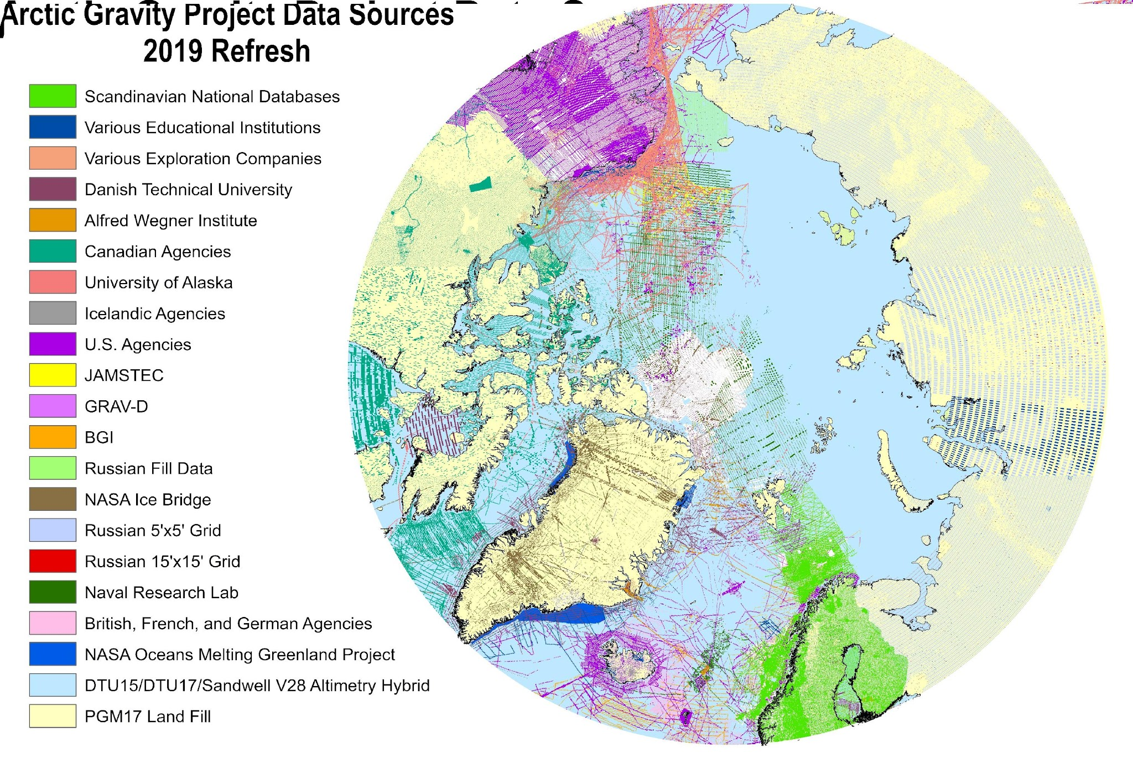
ARCGP20 from NGA

Slide 14
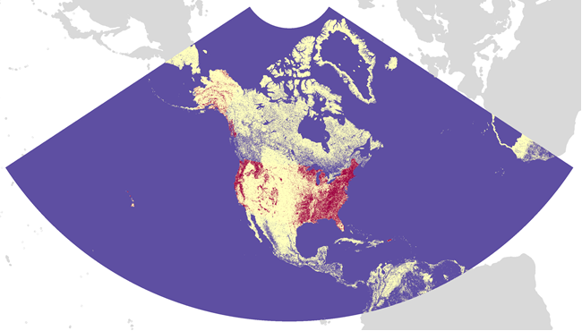
DEM2022 and distribution of GNSS/leveling data
Resolution: 3″, or ~90 m
#GPS points over Canada: 4308
Mean: -2.1 m (xG20DEM)
RMSE: 6.9 m (xG20DEM)
# GPS on BMs over USA : 31851
Mean: -0.3 m (xG20DEM)
RMSE: 2.1 m (xG20DEM)

Slide 15
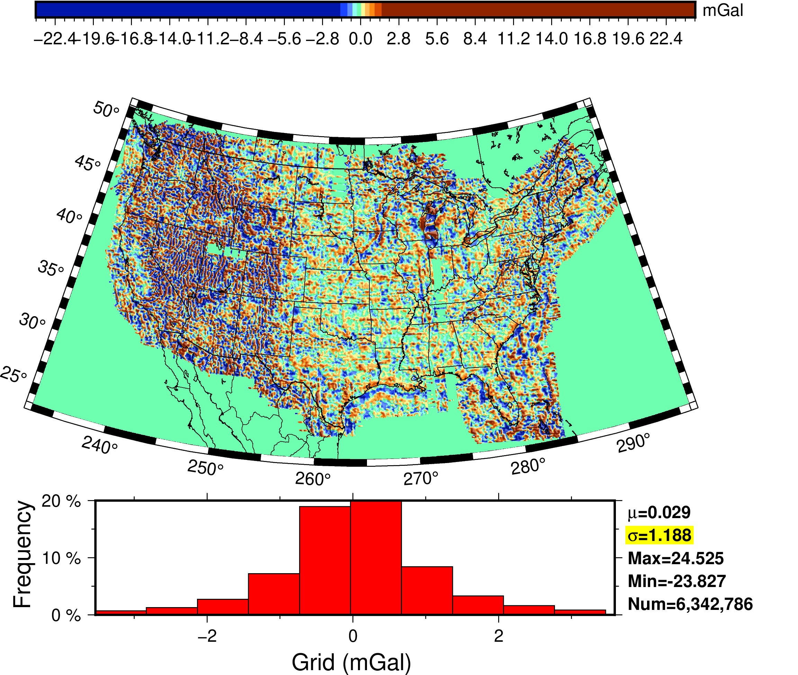
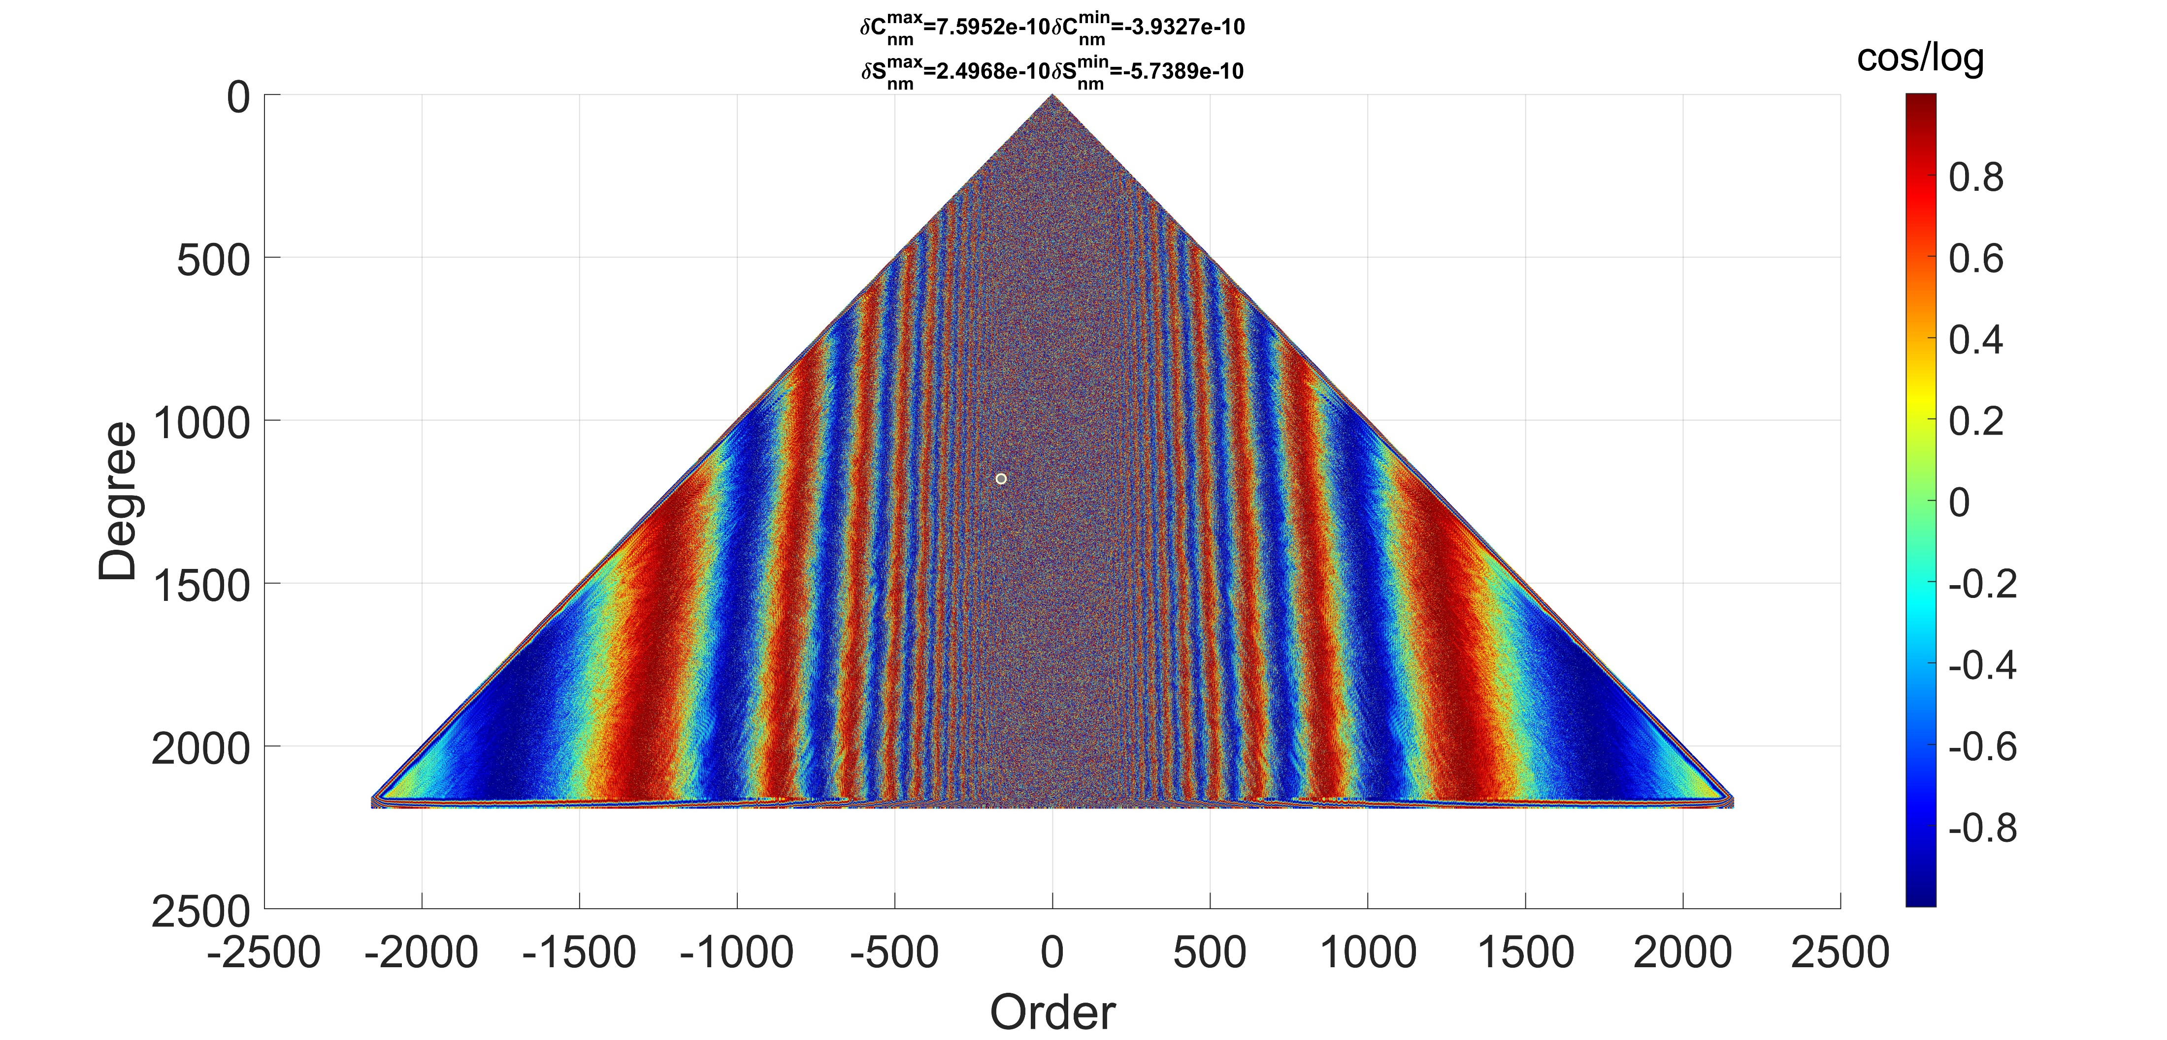
Reference model: “Adding” GRAV-D to refA
Fourier Legendre transformation
For more details: G02p-030-IUGG23-2975July162023-1700-1830

Slide 16
NGS CGS/INEGI computation schemes
Approach | CGS | NGS
GBVP type | Stokes – Helmert | Molodensky
Remove-Compute-Restore | Yes | Yes
Data combination | >180 km (Sat) , 55 - 180 (GRAV-D), < 55 km (Terr) | > 40 km (EGM including GRAV-D), < 40 km (Terr)
Geoid-to-Quasigeoid separation correction | No | Yes
Gravity Data Interpolation | Complete Bouguer Anomalies | Residual Free-air Anomalies/Bouguer anomalies
Glacial Ice Correction | Yes (over Greenland) | Yes (over Greenland)
Topo Mass Density Effect | No

Slide 17
Experimental geoid xGEOID2020A/B
NGS and CGS computed geoid models independently in 1’×1’ spatial resolution
The combined models include the common area of the NGS and CGS models (N0°/N85°/E180°/E350°)
xGEOID20 A and B were computed using the simple arithmetic mean between CGS’s and NGS’s Models A and B, respectively.

Slide 18
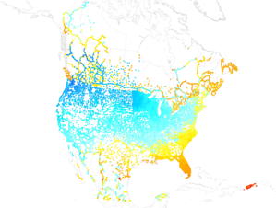
Historical GNSS/leveling Comparison in cm
 | CA #2451 A/B | USA #32276 A/B | MX #2641 A/B
Mean | -15/-15 | -56/-56 | -40/-40
STD | 14/14 | 30/30 | 18/18
Min | -68/-68 | -125/-125 | -116/-113
Max | 39/39 | 54/57 | 78/78
Range | 107/107 | 178/182 | 194/191

Slide 19
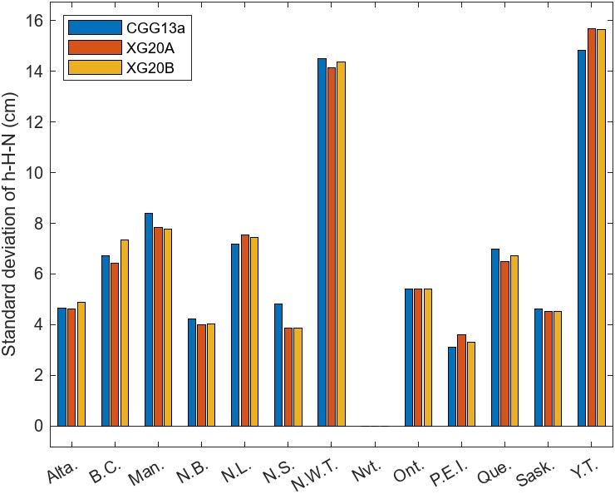
Historical GNSS/leveling comparison by province Canada in cm

Slide 20
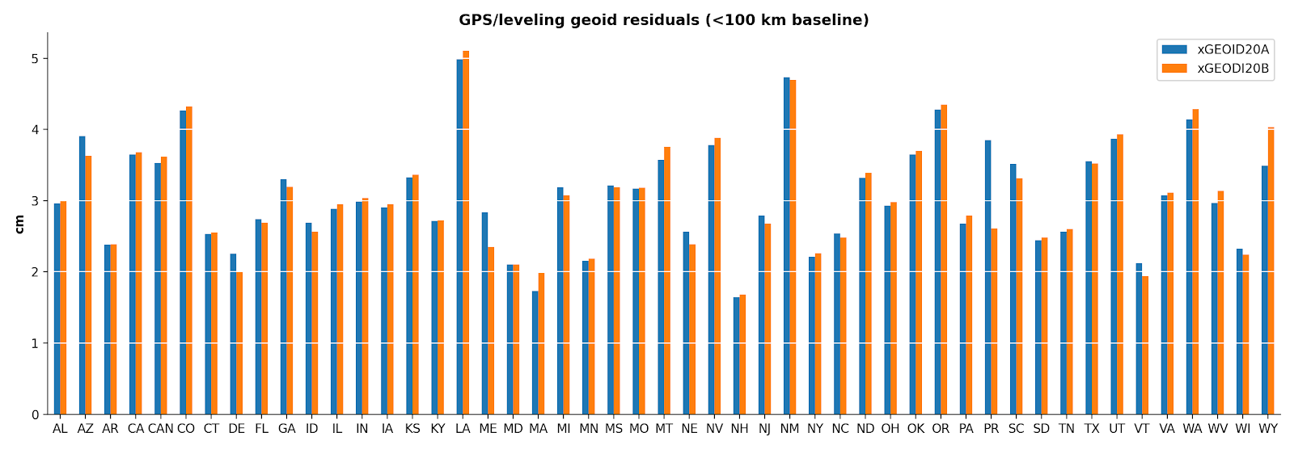
Historical GNSS/leveling comparison by state, USA in cm

Slide 21
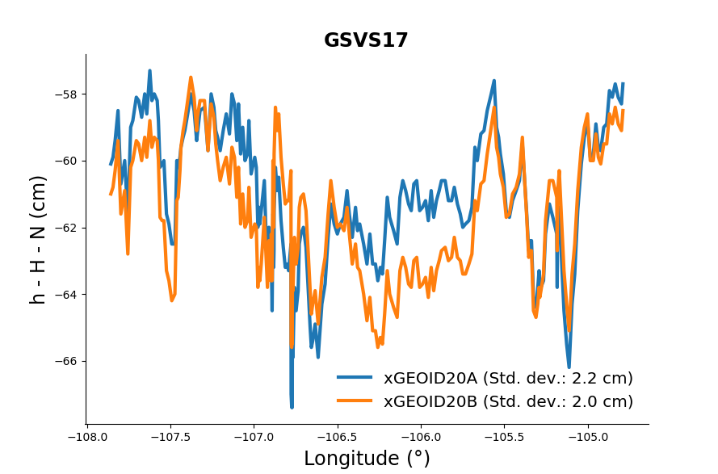
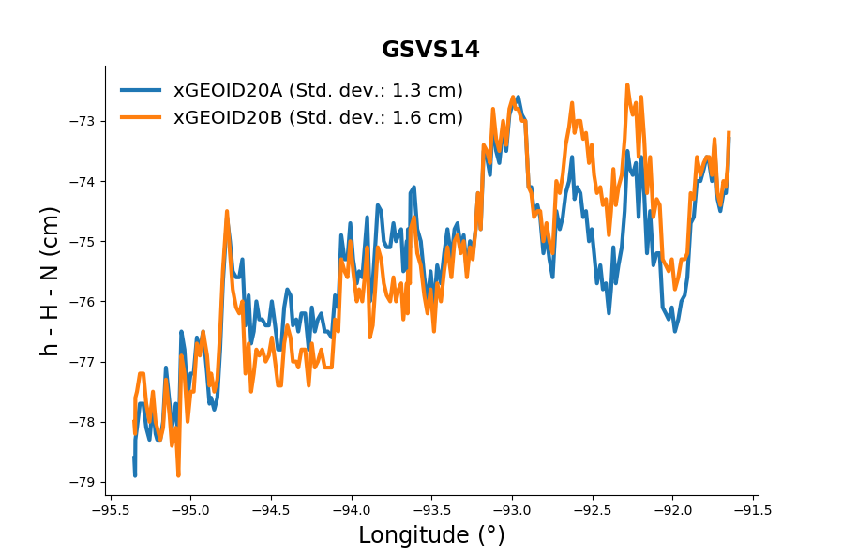
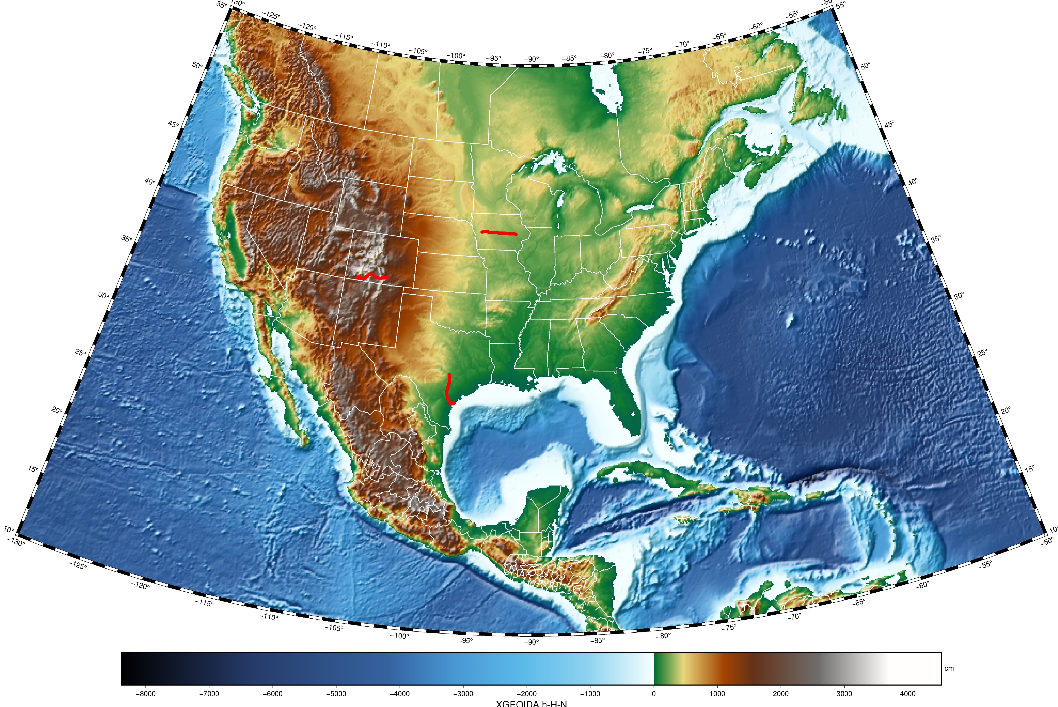
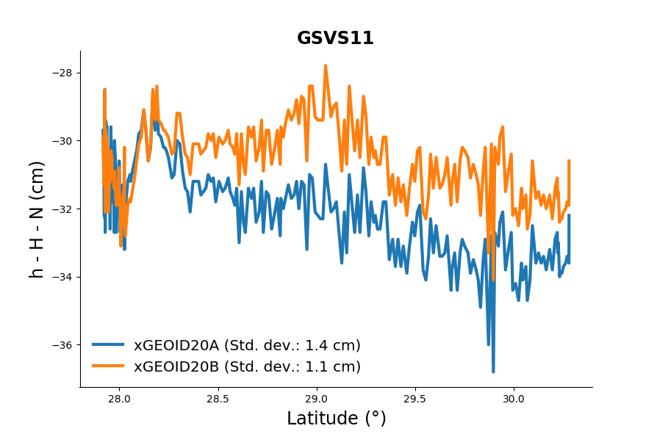
Residual geoid along three GSVS lines

Slide 22
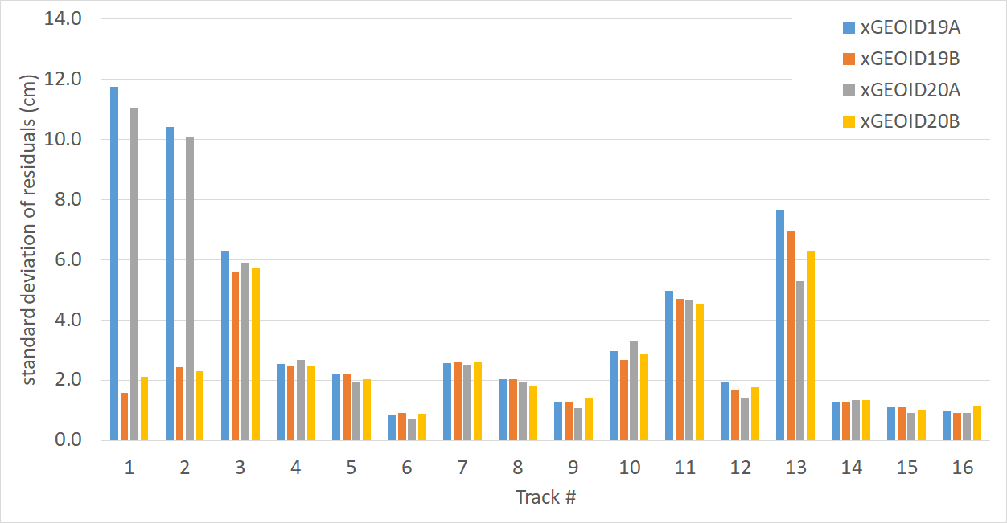
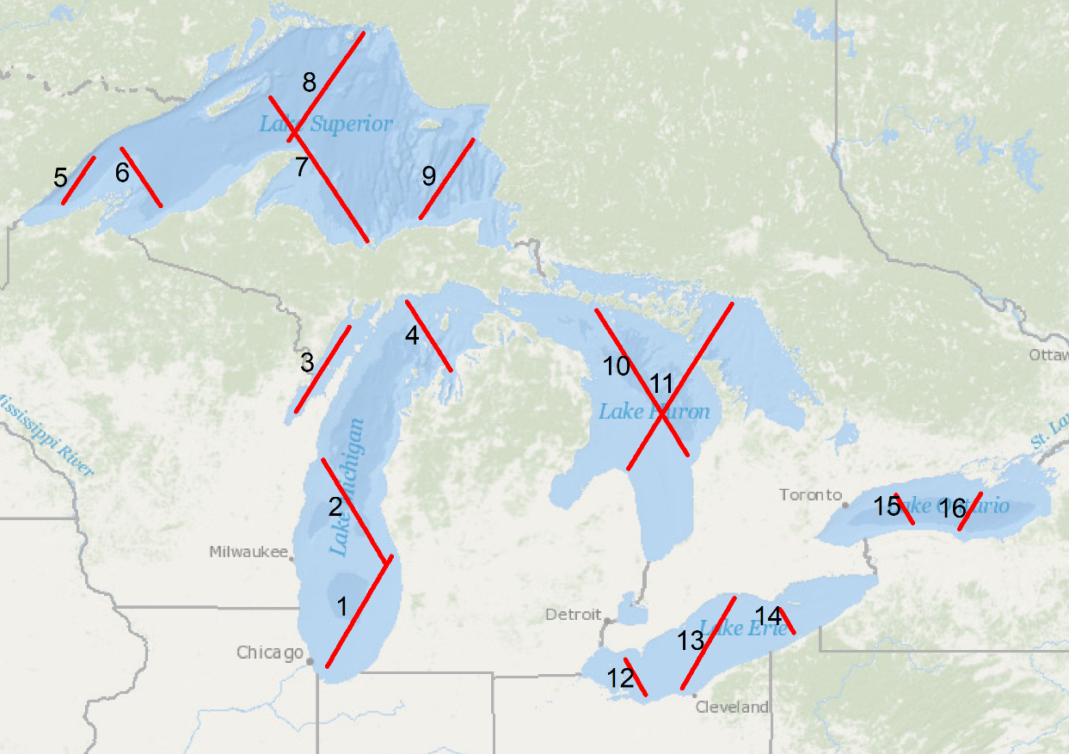
TOPEX/Poseidon ground track over the Great Lakes

Slide 23
Summery and conclusions
After removing the biases of each 1º by 1º block, standard deviations of GNSS/leveling comparisons are better than 5 cm (1σ) for all US states. The differences are slightly larger for individual Canadian provinces.
The Great Lakes satellite altimetry comparisons show 1-2 cm agreement on most tracks, but differences are larger on track 3 (Green Bay), 11 (Lake Huron), and 13 (Lake Erie).
The xGEOID20 agrees with the GSVS lines over 300 km within 1-2 cm (1σ) with no noticeable slopes, except on GSVS14.

Slide 24
GEOID2022 schedule
2023
- beta version of GEOID2022 to be computed
- GRAV-D to be completed 100% and processed
2024
GEOID2022 to be computed and validated. It will be ready for
release with its time varying components, deflections of the
vertical and their accuracy estimation. A EGM enhanced by
GRAV-D to degree and order 2160 will be part of the release.
2025
NAPGD2022 to be released with the North America Terrestrial
Reference Frame NATRF2022

