Slide 1

GNSS Best Practices
VSLS Winter Webinar
December 13, 2024
Dan Martin
Northeast Regional Geodetic Advisor
Dan.martin@noaa.gov
240-676-4762

Slide 2
The use of GNSS technology has become common within the surveying profession. This is especially true when it comes to the use of real-time techniques (Real-Time Kinematic) and Real-Time Networks (RTN). These techniques offer methods that significantly increase productivity, with little degradation of accuracy. But a tool by itself does not produce accuracy or confidence. The procedures used, and attention to detail by the user is what helps to ensure you achieve the results you are aiming for. In this workshop, we will discuss the GNSS tools and techniques that are available, their adequacy for common survey tasks, and take an in-depth look at “best practices” that have been developed by practitioners that are designed to catch blunders, eliminate common systematic errors, and increase confidence in survey results. We will also look at the newly released NGS Standards and Specifications, which include the use of Real-Time techniques, and provide research showing why certain specifications or techniques are required.

Slide 3

View from the field – Boone Meeden
Matching the tech to the task
  Intended use, accuracy, resources
Best practices (general)
Best practices
  Equip. maint., Errors, Redundancy, Validation
NOAA Technical Memorandum NOS NGS 92

Slide 4
Techniques we will cover
Static (OPUS) (H&V)
Real-Time Network (RTN) (H&V)
Differential Leveling (V)
OPUS-Projects (H&V)

Slide 5
Technique used…which one?
Technique is determined by a number of factors
  What is the intended outcome, i.e., what activity is the positioning supporting?
  What is the intended accuracy or precision?
  What resources are available?
  How long do the coordinates need to be maintained/used/checked

Slide 6
Intended Use/Activity
Position relative to a datum (NAD 83 and/or NAVD 88)
  All Techniques suitable
  What is the intended accuracy relative to the datum?
    Do you have the resources to utilize the technique to achieve that accuracy?
    Will these coordinates need to be maintained?

Slide 7

Planning Your Project
Exploring the requirements for planning a successful GNSS project for submission to NGS for publication……….Or ANY GNSS project for that matter!!
What survey marks will I use as control?
What new marks do I need?
How accurate does my survey need to be?
What survey method is most efficient?
What is the project’s objective?
Notes:
Geometric coordinates are always considered a triplet: Lat, Lon, EH. So height accuracy always plays into the equation, regardless of whether or not you want NAVD 88.

Slide 8
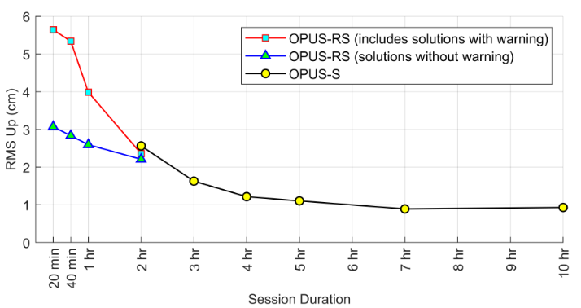
OPUS Accuracy (Datum)
Approximately 3 cm and 5 cm at 95% for 2 hours and four hours respectively

Slide 9
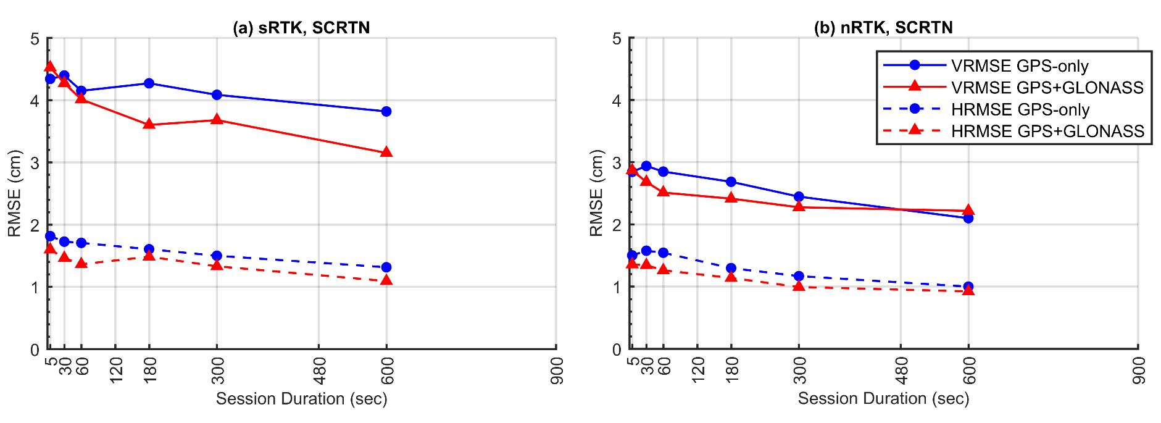
RTN Accuracy (Datum)
95% Confidence
± 5.0 cm, vertical
± 2.5 cm, horizontal
Or similar to accuracy of a 2-h OPUS-S solution!

Slide 10
Summary on the Accuracy RTK
RTNs in Oregon and South Carolina produced similar results
NRTK is more accurate than SRTK, especially vertically
  HRMSE = 1.0 to 1.8 cm for both NRTK and SRTK
  VRMSE = 3.1 to 4.7 cm for SRTK
  VRMSE = 2.0 to 2.7 cm for NRTK
    VRMSE @ 95% = 3.9 to 5.3 cm
GPS+GLONASS is slightly more accurate than GPS-only
Accuracy hardly improves with session duration, especially after 5 minutes
  T = 3 to 5 minutes appears optimal
Notes:
It seems that in real-time, it is readily possible to measure an ellipsoid height to less than 5 cm at 95% confidence using NRTK. This error could be further reduced by taking multiple repeat NRTK observations on the same mark.

Slide 11
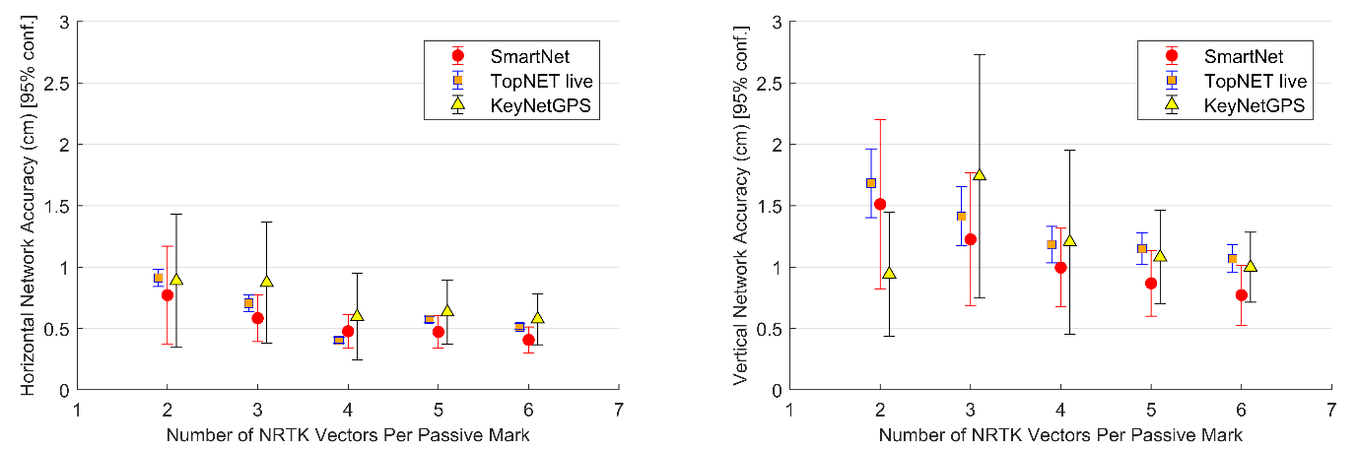
Repeat Occupations
Accuracy improves even more by making repeat occupations on marks
[Gillins et al. 2019]
Notes:
Based on testing of 9 bench marks in Maryland

Slide 12
Differential Leveling Accuracy (Datum)
Capable of mm level precision/accuracy
Ultimately depends on the equipment and specifications being used, and the accuracy of the existing benchmarks
Are there any existing benchmarks reasonably nearby?

Slide 13
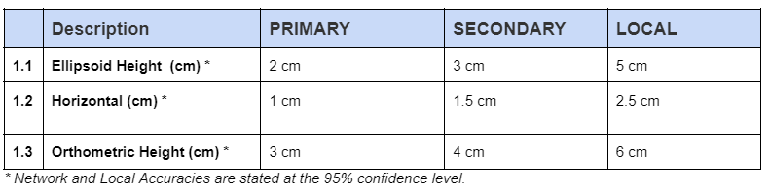
OPUS-Projects Accuracy (Datum)

Slide 14
Intended Use/Activity
Relative height difference between points(NAVD 88)
  All Techniques suitable**
  What is the intended accuracy of relative height difference?
    Do you have the resources to achieve that accuracy?
    Will this height need to be maintained?
**OPUS and RTN ‘suitable’ but no direct connection, no way to compute a relative accuracy

Slide 15
Relative Height Accuracy 95%
OPUS (4-6 cm)
RTN (4-6 cm one obs 2-4 cm 6 obs)
Leveling (mm to cm – distance dependent)
OPUS-Projects
  2-5 cm ellipsoid
  3-6 cm Orthometric
Static or RTN depending on observation requirements

Slide 16
Relative Horizonta Accuracy 95%
OPUS (2-4 cm)
RTN (2-4 cm one obs)
OPUS-Projects 1-2 cm
Static or RTN depending on observation requirements

Slide 17
OPUS, RTN, RTK
OPUS
Session
Adjustment
CORS3
CORS5
CORS2
CORS1
CORS4
solution HATFIELD
solution MCCOY

Slide 18
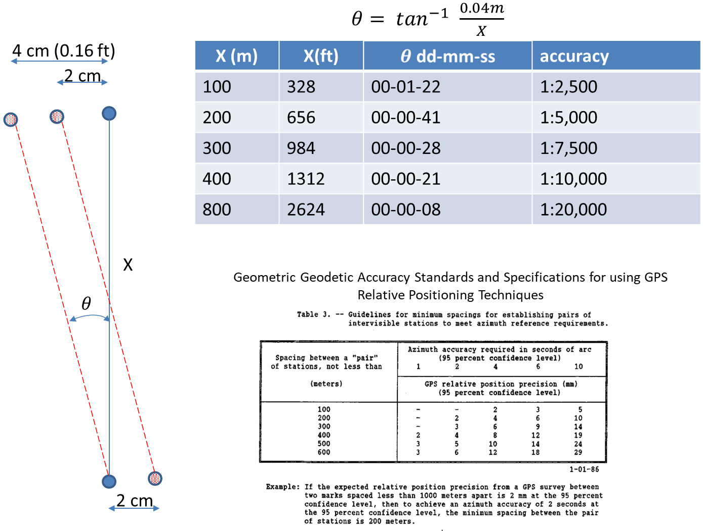
Azimuth??

Slide 19
OPUS Projects
OPUS
Session
Adjustment
CORS3
CORS5
CORS2
CORS1
CORS4
solution HATFIELD
solution MCCOY
session 001

Slide 20
Maintenance Needs of Coordinates?
Is this a control point that should be maintained when the Reference Frames are released?
One time use?
Set for others to use, check into?

Slide 21


Accuracy vs. Cost
Accuracy
Cost
Geodetic Leveling (other than localized)
Set a continuous GNSS reference station (i.e., CORS)
  Permanent or semi-permanent base station
Campaign-style static survey campaign with multiple receivers
  Develop survey network for adjustment
  OPUS-Projects
Static GNSS survey session with one receiver (i.e., OPUS-S)
Rapid-static GNSS survey session with one receiver (i.e., OPUS-RS)
Real-time network (RTN) observation

Slide 22
Law of the Instrument
“Maslow’s hammer”
  If all you have is a hammer, then everything looks like a nail
  AND similarly………..

Slide 23
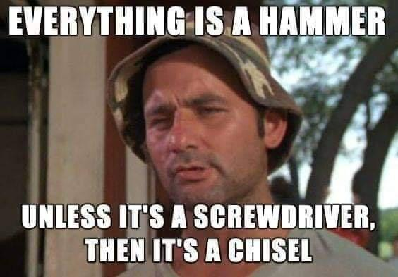
If everything looks like a nail….then all you need is a hammer! And Remember….

Slide 24
But…..
It is not JUST the instrument, tool, or even technique that defines the accuracy or success of a survey.
Procedures and specifications that are designed to produce certain results and to detect and eliminate errors must be included in the process.

Slide 25
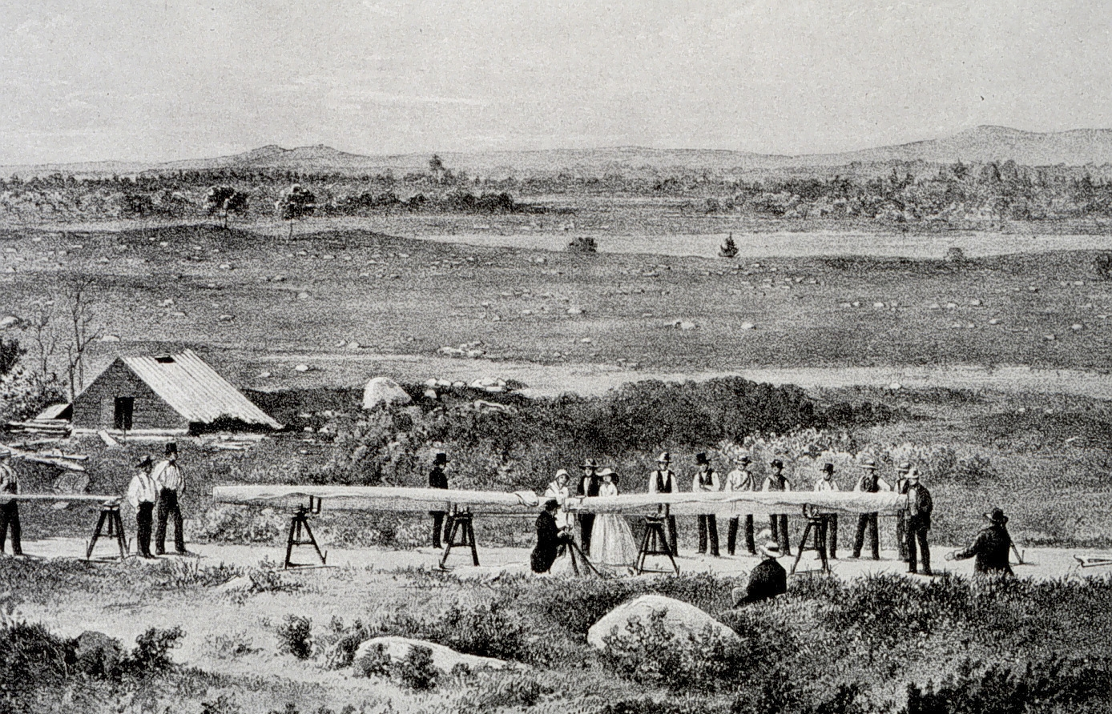
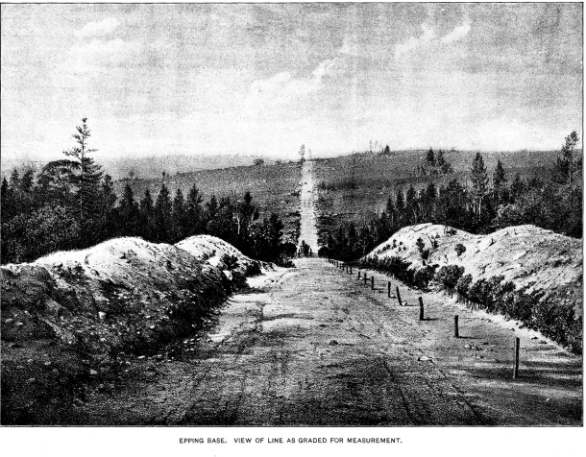
It is not just the Measuring Stick
Epping BL (1857)
  8715.9422m (5.4 mi) +/- (0.0158m) (1.8 ppm)

Slide 26
RTK/RTN Best Practices
General Thoughts
  Multi-constellation makes a big difference
  Observations in canopy? Not recommended, but it seems the needle is moving a bit on this.
  Obstructions and Multipath (Avoid)
  Space Weather (Check NOAA Forecast)

Slide 27
RTK/RTN Best Practices
Establish a point (or points) at or very near your office that can be used for validation.
  Use OPUS, OPUS Projects to establish marks
  Best if one mark is an existing NAVD 88 BM

Slide 28
RTK/RTN Best Practices
Equipment Check
  Cables, batteries, Cell or UHF antenna
  Cell or UHF device (if separate)
  Legs tight
  Bubbles check
  Tripod/bipod tips tight
  Tripod/bipod height validated recently

Slide 29
RTK/RTN Best Practices
Sanity Check (Validation)
  Check to make sure RTN is up and running
  Do a check obs on your validation station(s)
    Checks rover receiver equip/config, functionality
    Checks DC settings
  Base/Rover – set base on one, check other
    Checks Base/rover receiver equip/config, functionality
    Checks DC settings

Slide 30
RTK/RTN Best Practices
Initialization
  Always initialize in the open
  Should take only 10-15 seconds max
    If it is taking too long float > fix, quit and start over
  RMS should drop rapidly and stabilize at sub-cm
    If rms remains high, or takes a while to come down, quit and start over

Slide 31
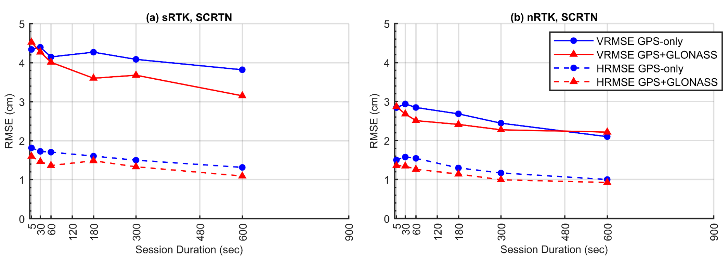
RTK/RTN Best Practices
Observations
Observation Time
  1-5 min
Redundancy
  2 (ideally 3) (different init.)
  Separate start times by 3 hrs
  Different day (recommended)
95% Confidence
± 5.0 cm, vertical
± 2.5 cm, horizontal

Slide 32

New Standards
Quick Facts
Designed for OPUS Projects, and Bluebooking, but specifications valid on their own
OPUS PP (Post Processed)
GNSS Vector Exchange Format
  Post Processed (vendor software)
  RTN
  RTK

Slide 33
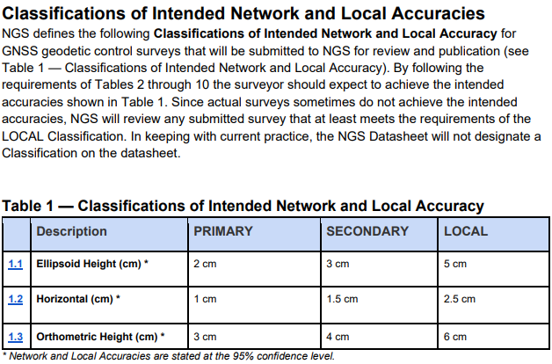
NGS 92

Slide 34
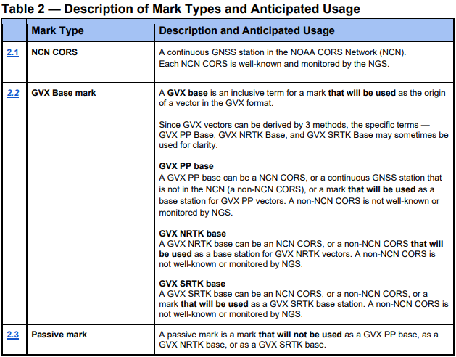
NGS 92

Slide 35
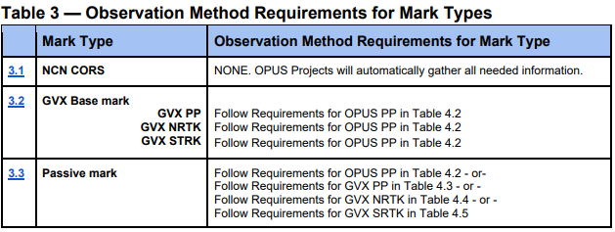
NGS 92

Slide 36
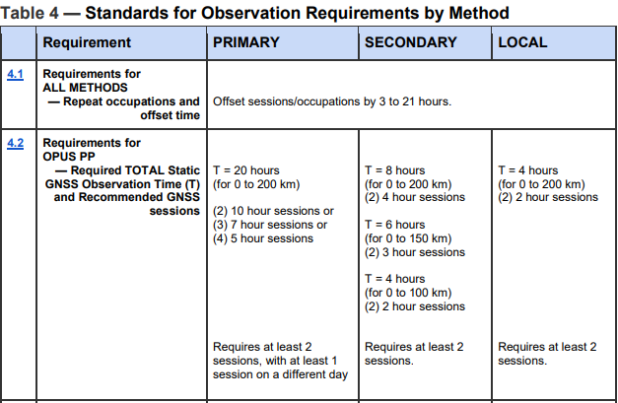
NGS 92

Slide 37
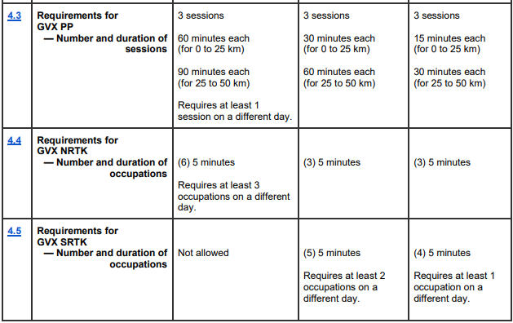
NGS 92

Slide 38
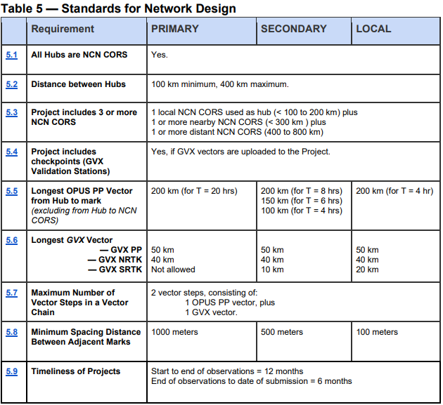
NGS 92

Slide 39
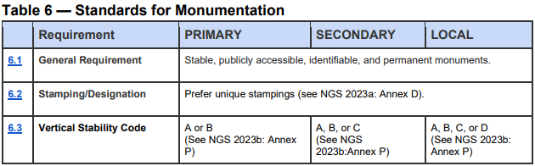
NGS 92

Slide 40
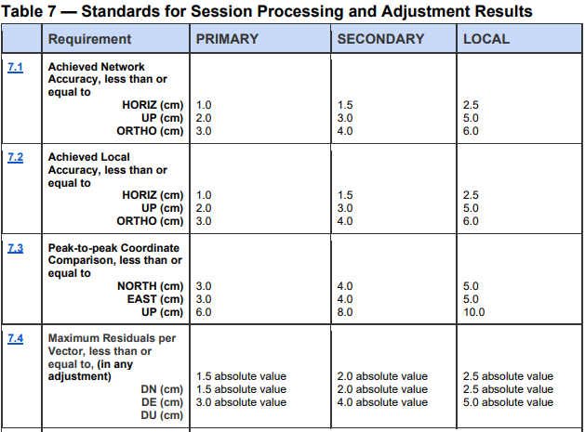
NGS 92

Slide 41
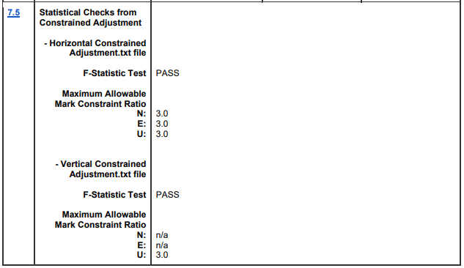
NGS 92

Slide 42
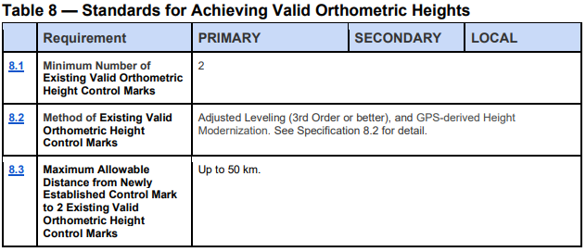
NGS 92

Slide 43
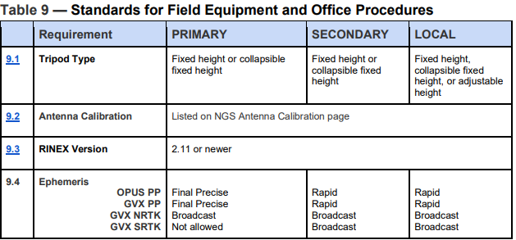
NGS 92

Slide 44
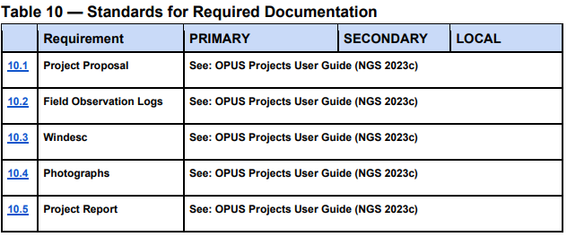
NGS 92

Slide 45
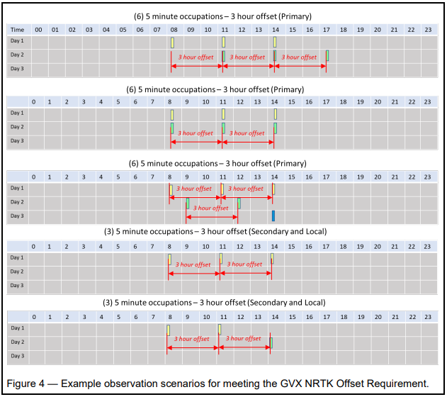
NGS 92

Slide 46
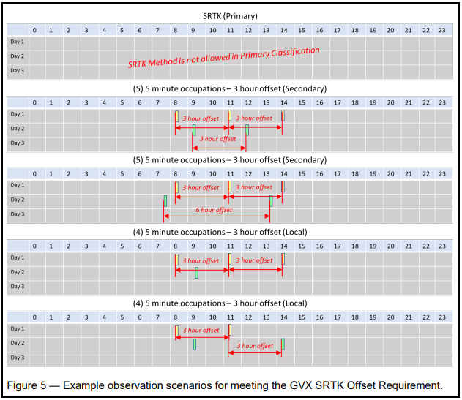
NGS 92

Slide 47
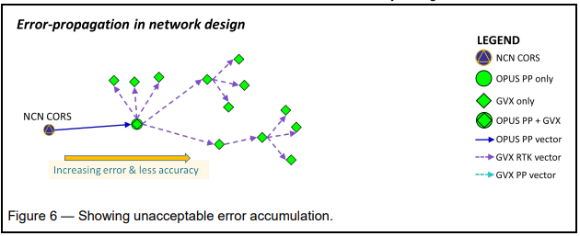
NGS 92

Slide 48
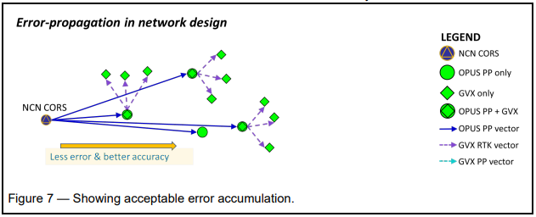
NGS 92

Slide 49
Questions?
Presentation will be available at:
https://www.ngs.noaa.gov/web/science_edu/presentations_library/
Dan Martin
Northeast Regional Geodetic Advisor
ME, NH, VT, MA, CT, RI, NY, NJ
Dan.martin@noaa.gov
240-676-4762

