Slide 1
Using the Vermont CORS to Access the National Spatial Reference System
Webinar hosted by the Vermont Center for Geographic Information
Wednesday January 26, 2011
Dan Martin
National Geodetic Survey
VT State Advisor

Slide 2
What is VECTOR?? Vermont Enhanced CORS & Transmission Of Real-time data
Network of Continuously Operating GNSS Reference Stations.
Provides access to the National Spatial Reference System (NSRS)
Access available for post processing (Static) and Real-time (single base RTK).

Slide 3
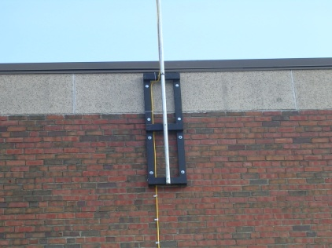
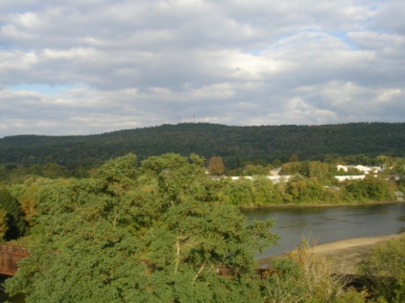
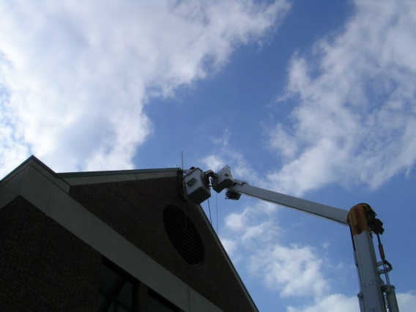
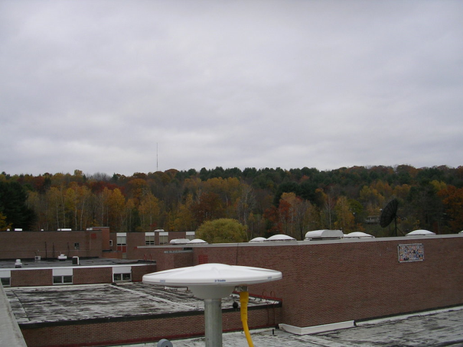
VECTOR Site Criteria
50 km spacing along Interstate
Masonry building <= 2 story
Secure location
State owned
Clear view to sky
Stable/dedicated power source
High speed internet connection
Antenna location < 100 meters from receiver location

Slide 4
VECTOR Expansion
1996 - VCAP
2004 - VTUV
2006 – VTD2, VTSP, VTWR, VTOX, VTD7, VTD9, VTC1, VTSA, VTRU, (VCAP Upgrade)
2008 – VTBE, VTDA, VTMI, VTIP
2010 - VTHA
Three stations will be added in 2011 to complete the network - Dover, Richmond, and Eden

Slide 5
Current Features and Capabilities
Dual frequency GPS and GLONASS
All stations except VTRU and VTUV
Ready to receive modernized signals
24-7-365 availability
1 and 15 second raw data for post-processing on-line for 45 days (VT server) (forever from NGS web)
Single-based Real-time data
Direct access to the NSRS

Slide 6
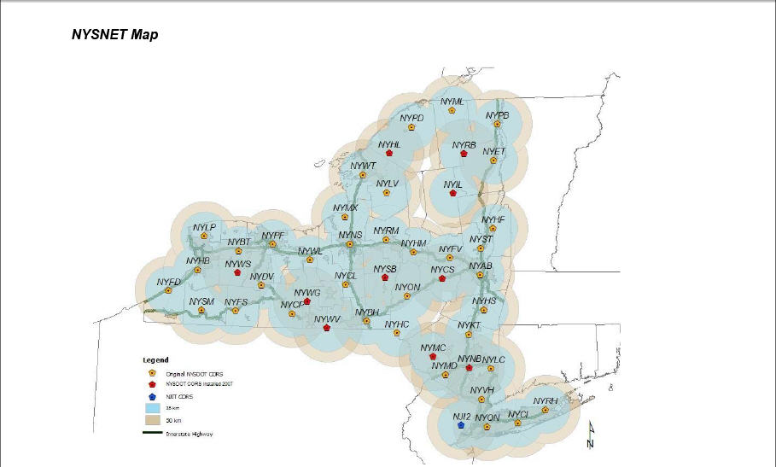
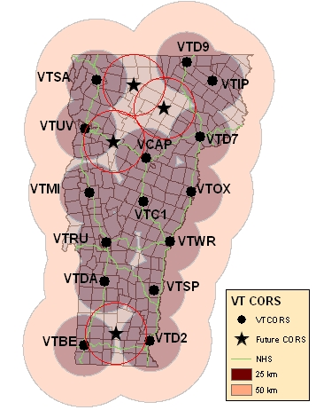
Real Time Networks

Slide 7
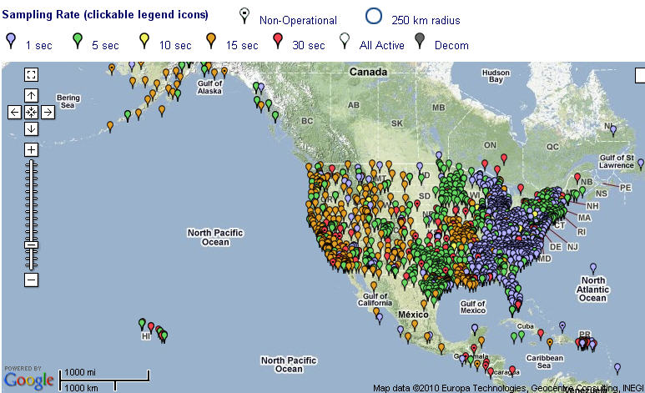
1599 National CORS As of 01/07/11

Slide 8
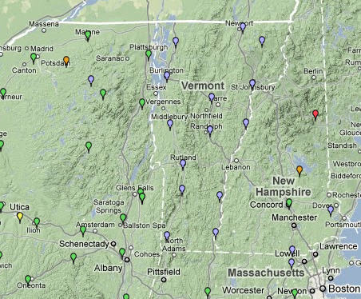
National CORS in our Area

Slide 9
So What??
What is the benefit to having these stations out there?
Are they being used?
How are they being used?
Who is using them?
How are they being accessed?
How much are they being accessed?

Slide 10
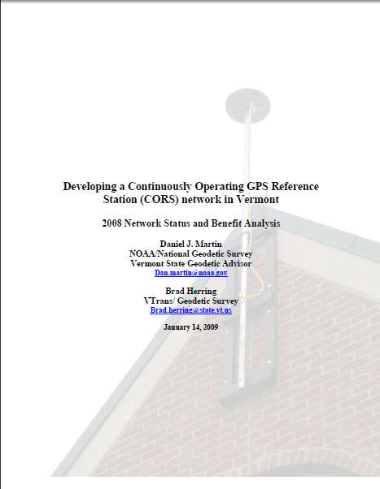

Slide 11
How are they being used?
Highway Surveys
Collection of inventory and resource data
Culvert inventory, Rest Area re-design, and ITS elements such as RWIS, PCMS/VMS, and WIMS location and planning
Control surveys for photography and LiDAR
Topo
Boundary
Flood Plane mapping
Wetland Surveys
Precision Agriculture
Construction stakeout
Geodetic and Geophysical applications
Ionospheric modeling
Plate tectonics
Precipitable Water Vapor modeling (weather forecasting)

Slide 12
Who is using them
VTrans
Land Surveyors
Engineering firms
GIS Professionals
Foresters
Other State Agencies Such as Agency of Natural Resources and Department of Agriculture
Other non-VT State Agencies
Federal and International Agencies and educational institutions
National Weather Service
National Geodetic Survey
US Geological Survey
Geodetic Survey Canada
International GNSS Service
UVM, UNH, UMaine, Lyndon and Johnson State, Norwich University

Slide 13
How are the VT CORS being Accessed?
Raw Data (post processing)
VTGS Web
VTGS and NGS FTP
NGS Web (UFCORS)
Derived Products
OPUS_S
OPUS_RS
OPUS_DB
RTK Corrections
Incorporated into other networks (NYSNet, Keynet, Bunce)

Slide 14
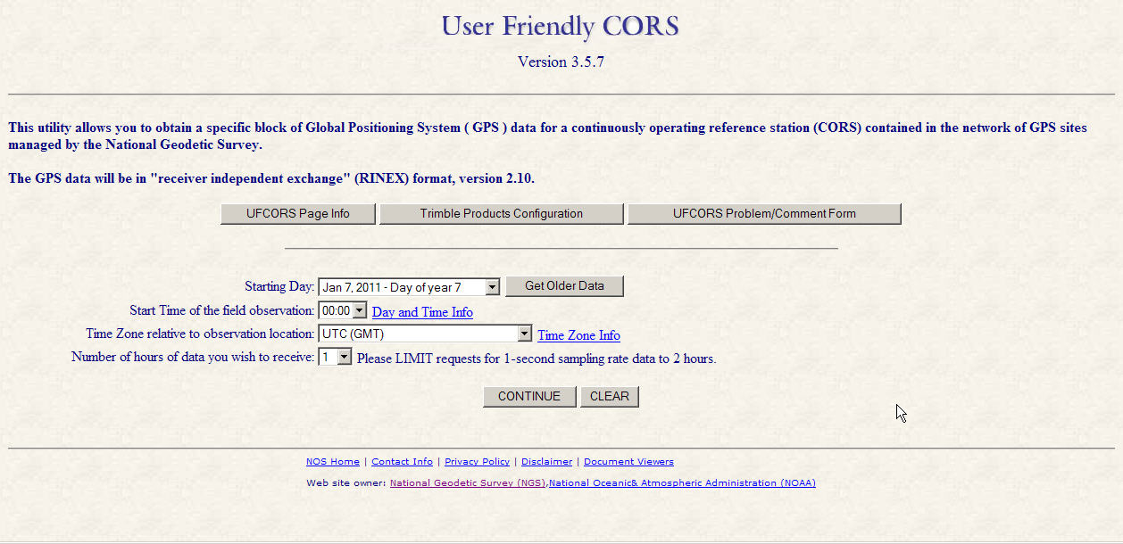
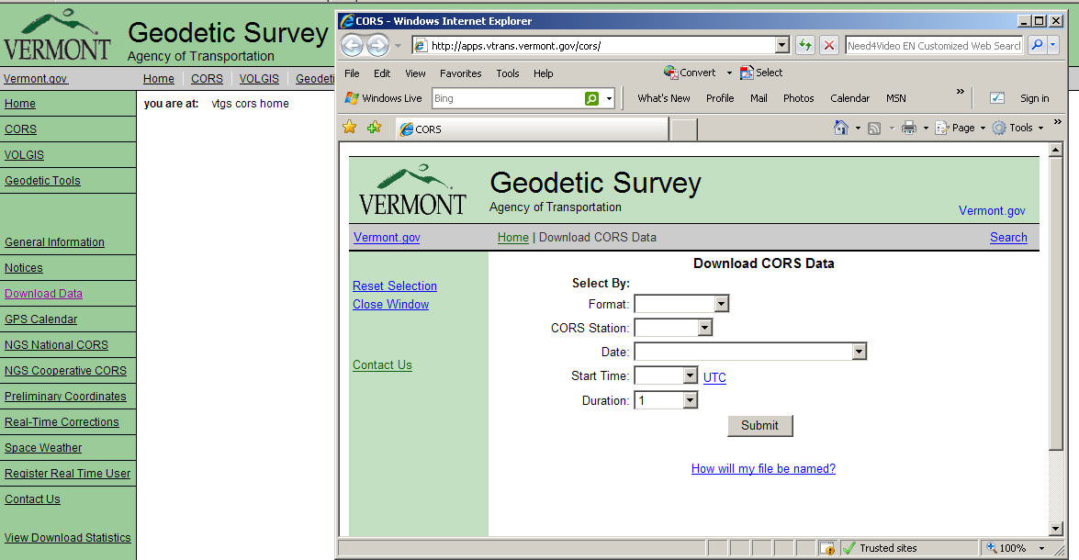
Raw Data (NGS and VT)

Slide 15
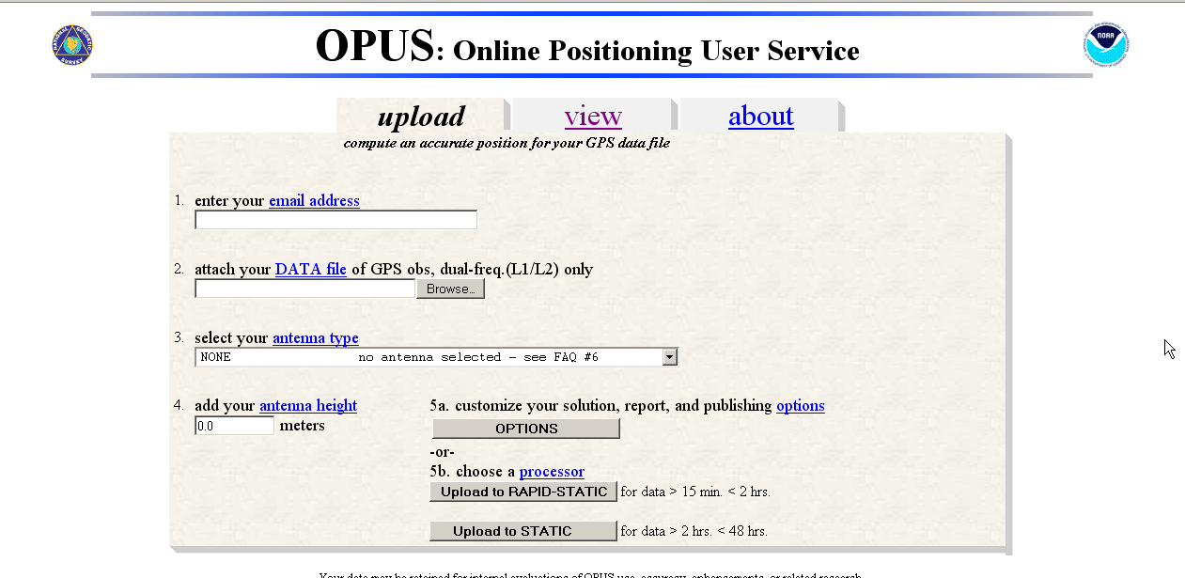
Derived Product

Slide 16
OPUS-S & OPUS-RS
OPUS-S
Minimum of 2 hours of data max of 48 hours
Process against 3 National CORS
Solution is average of three processed vectors
Results returned in minutes via e-mail
OPUS-RS
Minimum of 15 minutes of data max of 2 hours
Processes against up to 9 National CORS
Solution is least squares adjustment of all vectors
Results returned in minutes via e-mail

Slide 17
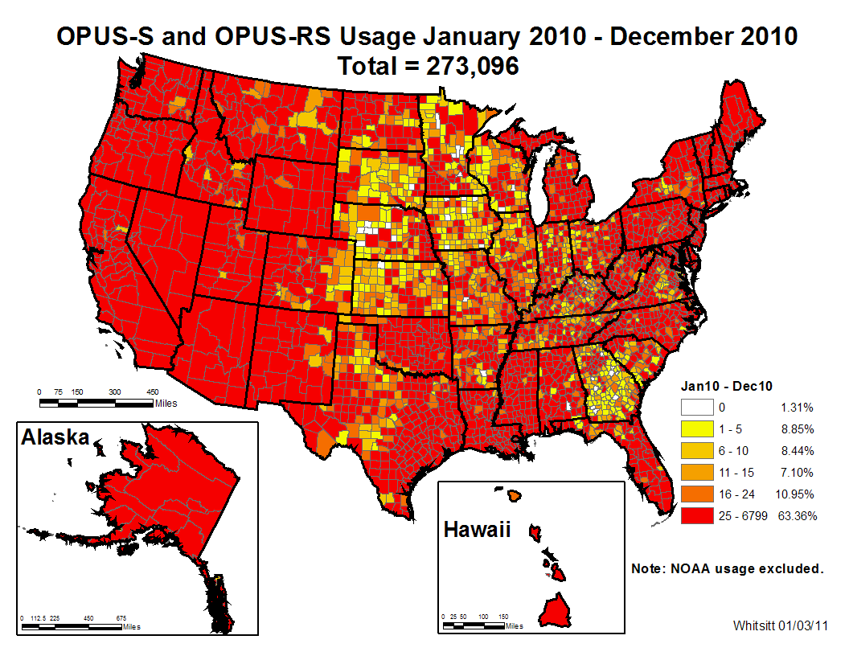

Slide 18
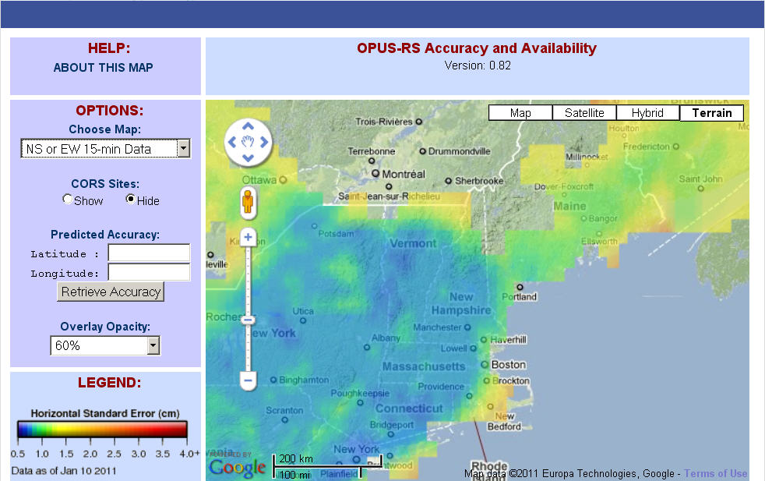

Slide 19
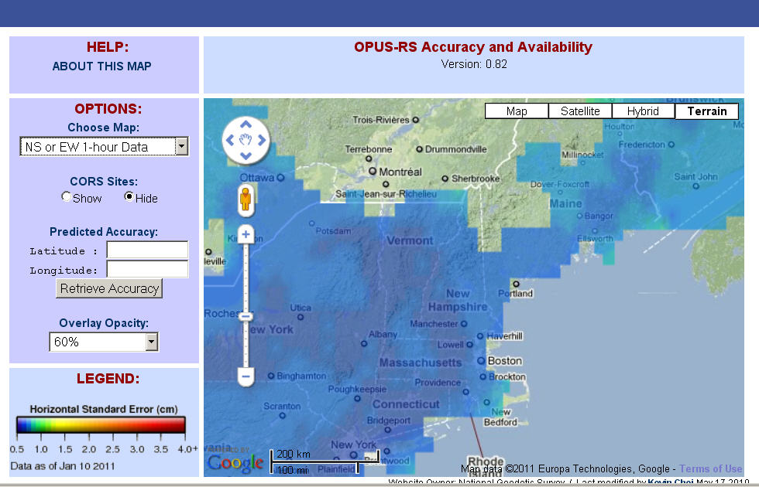

Slide 20
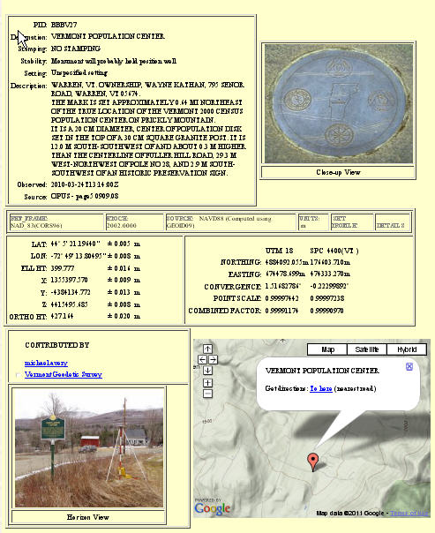
Publish/Share your Data

Slide 21
Derived Product (RTK)

Slide 22
2009-2010 LiDAR QA

Slide 23
Interstate Small Culvert Inventory 2007-2008
I89
≈4000 Culverts
≈2800 DI’s
≈10,800 Total Shots
I91 (first 95 miles)
≈2700 Culverts
???? DI’s
≈5400 Total Shots+DI’s
59 crew weeks
≈ $60k savings

Slide 24
Small Culvert Inventory

Slide 27
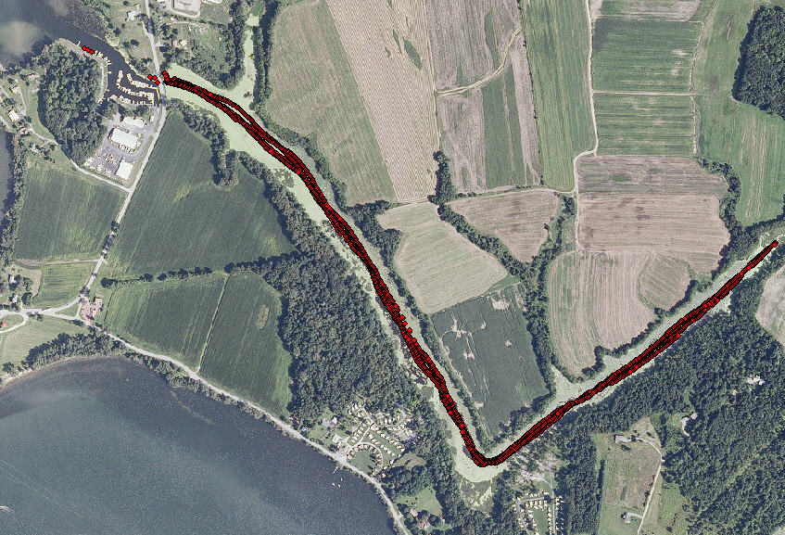
Hospital Creek surface profile

Slide 29
2010 VT CORS Statistics
Product | 2010 Usage
UFCORS Downloads | 2753 2-hr files (ave)
VT Web Download (VTDL) | 4308 1-hr files
VT FTP Download | 8987 1-hr files
OPUS_S | 983 Solutions
OPUS_RS | 758 Solutions
OPUS_DB | 112 Submissions
RTK | 1432 Hours (41 Unique Users)

Slide 30
Benefit for VT CORS Products
Product | User Benefit
UFCORS | $200/download
VT Web Download (VTDL) | $100/1-hour file
VT FTP Download | $50/1-hour file
OPUS_S | $600/solution
OPUS_RS | $600/solution
OPUS_DB | $400/submission
RTK | $100/hour

Slide 32
Future Trends for Accessing the NSRS
OPUS-Projects
Observers (crew members) submit data
Process between local stations
Manage project
OPUS-Net
New OPUS processing engine
Ties to ITRS
Submit data, let OPUS choose processor
Optimized based on your data

Slide 33
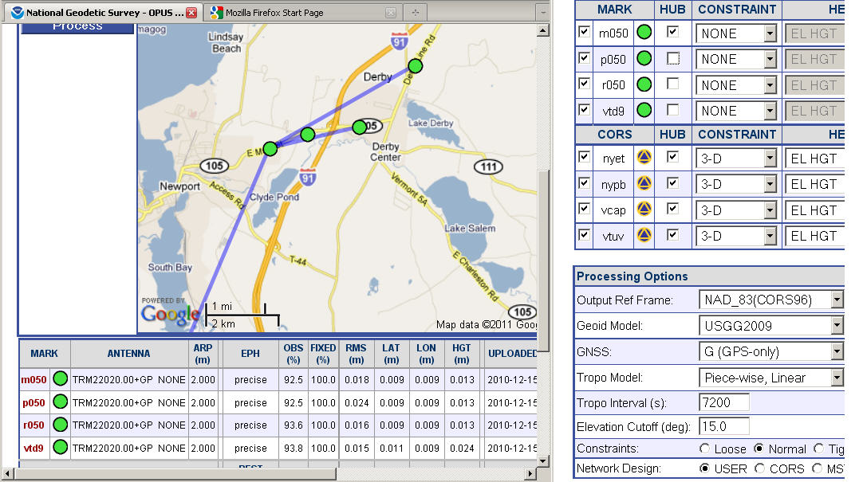
OPUS-Projects

Slide 34
VT CORS Summary
The VT CORS Network has provided significant benefit to VTrans and the taxpayers of VT
It supports a wide variety of different applications from a diverse user community
It provides a direct tie to the NSRS

Slide 35
Recommendations
Continue with expansion of network to provide state-wide coverage
Work to get as many stations into the National Network as possible
Work to increase the use of the network inside VTrans
Continue to promote the network outside of VTrans

