Slide 1
New Developments for OPUS
Dr. Mark Schenewerk
Mark.Schenewerk@noaa.gov
913-481-9998

Slide 2
Who is this guy?
I am Mark Schenewerk with National Geodetic Survey (NGS).
B.S. from the University of Missouri at Rolla.
Ph.D. from the University of Illinois at Champaign-Urbana.
The NGS calls me a geodesist, but I’m actually an astronomer who happens to do things that look like geodesy.
I am the “father” of the PAGES processing software.
I’ve been (very) indirectly involved in OPUS since its inception and directly involved in some of the new development for the last two years.
2010-Jul-22
2

Slide 3
Workshop Outline
What is OPUS? (≈1.5 hr)
An overview of OPUS in which I’ll “pull back the curtain” a bit and let you see what’s going on behind the web pages.
BREAK
New Developments for OPUS (≈0.5 hr)
A summary of pending enhancements and new capabilities.
BREAK
OPUS-Projects (≈1 hr)
On-line access to project organization and processing tools.
2010-Jul-22
3

Slide 4
Workshop Outline
I’m an informal speaker, so feel free to ask questions.
I will show examples of the web pages for completeness, but I am assuming a basic familiarity with the existing OPUS web sites. If you find any discussion about a web page too terse, ask for clarification.
2010-Jul-22
4

Slide 5
What is OPUS?
To better understand where OPUS is going, let’s begin by reviewing the who, what, when, where and why of OPUS
as it is today.
2010-Jul-22
5

Slide 6
What is OPUS?
OPUS, the On-line Positioning User Service, is a growing set of applications offering web-based access to the tools and resources provided by the NGS.
Currently, OPUS is composed of:
OPUS-S . . . . . . . static processing
OPUS-RS. . . . . . rapid-static processing
OPUS-DB. . . . . . data base and publishing
Reviewing each of these individually…
2010-Jul-22
6

Slide 7
OPUS-S . . . . . . . static processing
A Little OPUS-S History.
The OPUS-S Interface.
How Good Can I Do With OPUS-S?
A Quick Example.
The Extended Report.
Back To Our Quick Example.
How Does OPUS-S Work?
OPUS-S Uploads By Month.
2010-Jul-22
7

Slide 8
A Little OPUS-S History.
In the late 1990’s, a growing number of organizations were making their Continuously Operating Reference Station (CORS) data publically available with a short latency.
Supporting products such as precise ephemerides were improving and also becoming available with a short latency.
Many organizations recognized that the time seemed ripe for some sort of on-line, processing service.
2010-Jul-22
8

Slide 9
A Little OPUS-S History.
In the NGS, Gerry Mader started promoting the idea of a processing service.
Specifically he envisioned a web-based service that was as simple as possible without significantly sacrificing accuracy thereby creating a tool useful to the largest possible group of potential users.
The NGS recognized that such a service could also be an effective tool to disseminate the National Spatial Reference System (NSRS).
2010-Jul-22
9

Slide 10
A Little OPUS-S History.
Mader and Weston (NGS) cloistered themselves and, with the help others too numerous to be mentioned here, created OPUS, now called OPUS-S, essentially as it exists today.
After an extended trial period, OPUS was formally made available to the public in 2002.
2010-Jul-22
10

Slide 11
The OPUS-S Interface.
Beautiful in its simplicity, the user need only provide:
Their email address.
The antenna type.
The offset to the antenna reference point (ARP).
2- to 48-hours of GPS L1 + L2 data.
In turn, the user receives:
Coordinates accurate to a few centimeters.
2010-Jul-22
11

Slide 12
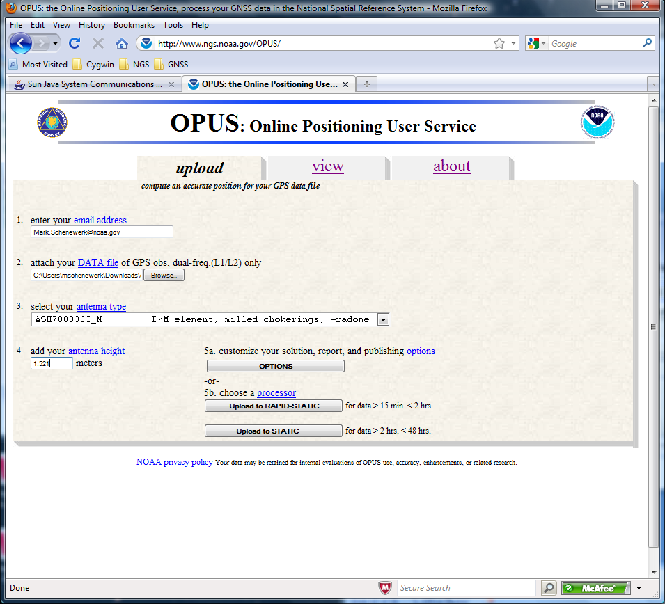
The OPUS-S Interface.
http://www.ngs.noaa.gov/OPUS/
This is the OPUS home page used to submit data to
the OPUS processing queues. To use OPUS-S, complete the four fields, then click the “Upload to STATIC” button. In a few minutes, an email arrives with the results.
2010-Jul-22
12

Slide 13
How Good Can I Do With OPUS-S?
OPUS-S reliably addresses the more historically conventional requirements for GPS data processing. It typically yields accuracies of:
1 – 2 cm horizontally
2 – 4 cm vertically.
However, there is no guarantee that this stated accuracy will result from any given data set. Confirming the quality of the OPUS solution remains the user’s responsibility. That’s the “price” for automated processing.
2010-Jul-22
13

Slide 14
How Good Can I Do With OPUS-S?
As a quality test, 2-hour data sets from more than 200 CORS were submitted to OPUS-S and the results compared to the accepted coordinates.
Mean: <0.1 cm
N-S RMS: 0.8 cm
E-W RMS: 1.4 cm
Weston, N. “OPUS: Online Positioning User Service”, CGSIC USSLS MEETING, 2008-07-08, NEW ORLEANS, LA.
2010-Jul-22
14

Slide 15
How Good Can I Do With OPUS-S?
Same data sets.
Same analysis but for the vertical.
The vertical is always a little more interesting.
Mean: <0.1 cm
U-D RMS: 1.9 cm
Weston, “OPUS: Online Positioning User Service”, CGSIC USSLS MEETING,
2008-07-08, NEW ORLEANS, LA
2010-Jul-22
15

Slide 16
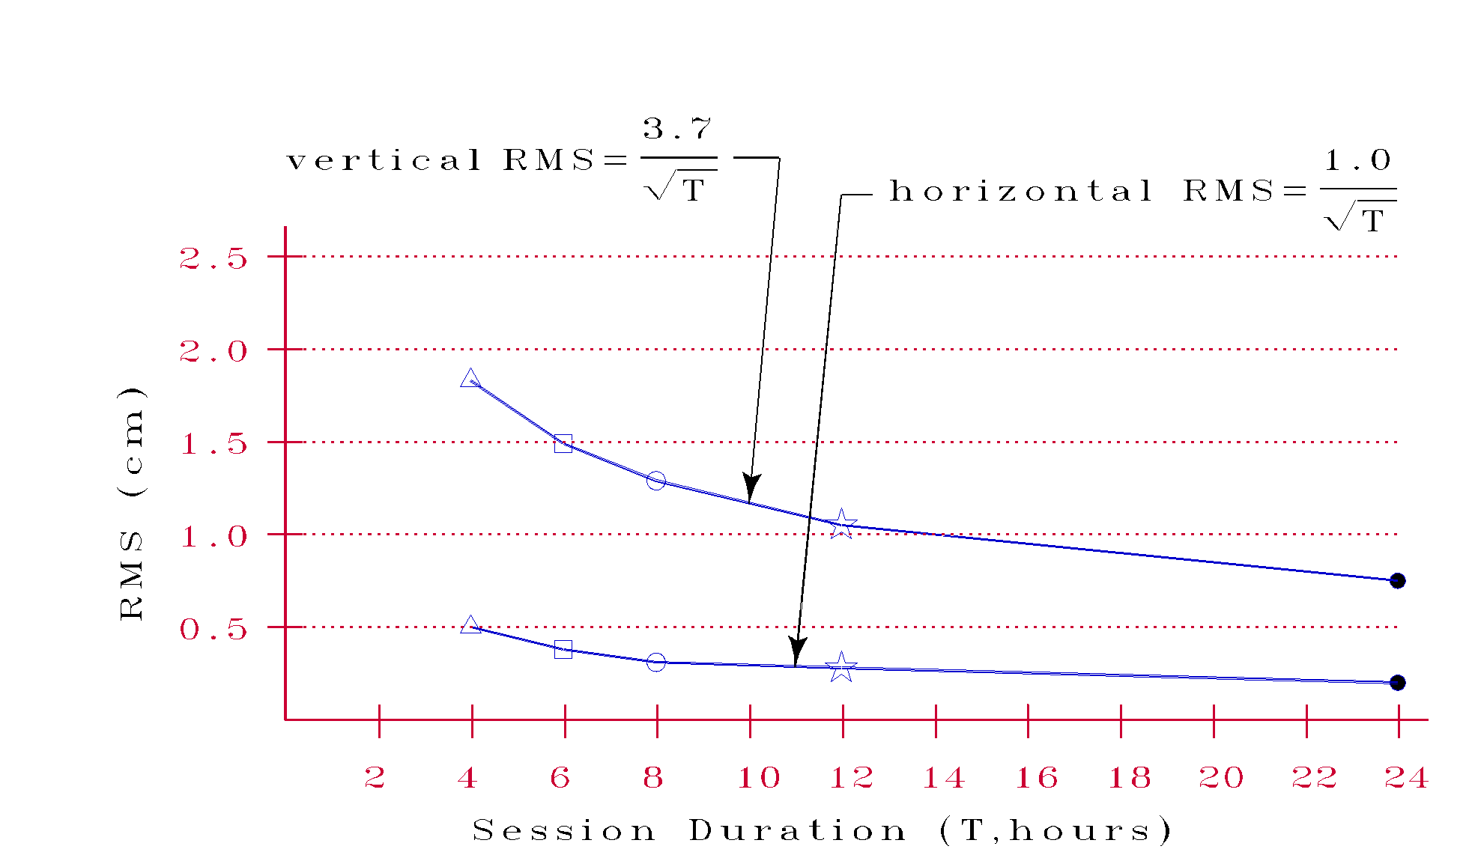
How Good Can I Do With OPUS-S?
More generally, Eckl et al. (NGS) preformed a similar but more extensive test using the same software but outside OPUS.
Eckl et al., 2001, “Accuracy of GPS-derived relative positions as a function of interstation distance and observing-session duration”, J. of Geod. 75, 633-640).
Their results provide a good “rule of thumb” for accuracy versus session duration when using OPUS-S and in many other applications.
2010-Jul-22
16

Slide 17
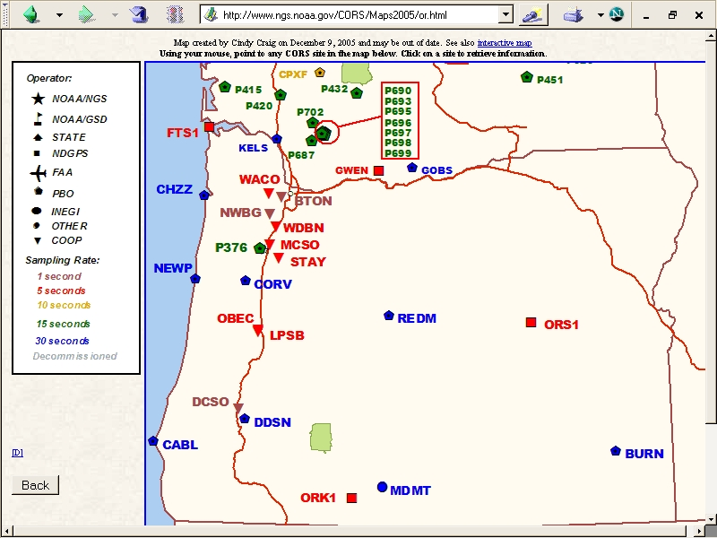
A Quick Example.
As an example,
2-hours of
2009-059 data
from CORV, a PBO CORS in Oregon were submitted to OPUS-S.
2010-Jul-22
17

Slide 18
A Quick Example.
Here is part of the report for this submission.
FYI, these results differ 2.1 cm horizontally and 1.6 cm vertically from the accepted position projected to the epoch of the data.
USER: mark.schenewerk@noaa.gov DATE: March 31, 2010
RINEX FILE: corv059f.09o TIME: 19:43:42 UTC
SOFTWARE: page5 0909.08 master40.pl 081023 START: 2009/02/28 05:00:00
EPHEMERIS: igs15206.eph [precise] STOP: 2009/02/28 06:59:00
NAV FILE: brdc0590.09n OBS USED: 5984 / 6181 : 97%
ANT NAME: ASH700936C_M NONE # FIXED AMB: 31 / 31 : 100%
ARP HEIGHT: 1.521 OVERALL RMS: 0.009(m)
REF FRAME: NAD_83(CORS96)(EPOCH:2002.0000) ITRF00 (EPOCH:2009.1596)
X: -2498422.603(m) 0.011(m) -2498423.344(m) 0.011(m)
Y: -3802821.159(m) 0.007(m) -3802819.941(m) 0.007(m)
Z: 4454736.661(m) 0.021(m) 4454736.734(m) 0.021(m)
LAT: 44 35 7.91060 0.016(m) 44 35 7.92618 0.016(m)
E LON: 236 41 43.48046 0.013(m) 236 41 43.42207 0.013(m)
W LON: 123 18 16.51954 0.013(m) 123 18 16.57793 0.013(m)
EL HGT: 106.011(m) 0.014(m) 105.627(m) 0.014(m)
ORTHO HGT: 128.542(m) 0.020(m) [NAVD88 (Computed using GEOID09)]
UTM COORDINATES STATE PLANE COORDINATES
UTM (Zone 10) SPC (3601 OR N)
Northing (Y) [meters] 4936954.909 105971.559
Easting (X) [meters] 475821.304 2277335.367
Convergence [degrees] -0.21381419 -1.98897513
Point Scale 0.99960719 0.99994603
Combined Factor 0.99959057 0.99992941
US NATIONAL GRID DESIGNATOR: 10TDQ7582136954(NAD 83)
BASE STATIONS USED
PID DESIGNATION LATITUDE LONGITUDE DISTANCE(m)
DH4503 P376 EOLARESVR_OR2004 CORS ARP N445628.313 W1230608.100 42648.2
DE6258 MCSO MARION CNTY COOP CORS ARP N445825.701 W1225720.639 51226.8
DG5352 STAY STAYTON COOP CORS ARP N444950.530 W1224915.036 47030.9
2010-Jul-22
18

Slide 19
A Quick Example.
Again, I’m assuming familiarity with the report, but …
… at the risk of stating the obvious, there are a few items I want to draw attention to.
USER: mark.schenewerk@noaa.gov DATE: March 31, 2010
RINEX FILE: corv059f.09o TIME: 19:43:42 UTC
SOFTWARE: page5 0909.08 master40.pl 081023 START: 2009/02/28 05:00:00
EPHEMERIS: igs15206.eph [precise] STOP: 2009/02/28 06:59:00
NAV FILE: brdc0590.09n OBS USED: 5984 / 6181 : 97%
ANT NAME: ASH700936C_M NONE # FIXED AMB: 31 / 31 : 100%
ARP HEIGHT: 1.521 OVERALL RMS: 0.009(m)
REF FRAME: NAD_83(CORS96)(EPOCH:2002.0000) ITRF00 (EPOCH:2009.1596)
X: -2498422.603(m) 0.011(m) -2498423.344(m) 0.011(m)
Y: -3802821.159(m) 0.007(m) -3802819.941(m) 0.007(m)
Z: 4454736.661(m) 0.021(m) 4454736.734(m) 0.021(m)
LAT: 44 35 7.91060 0.016(m) 44 35 7.92618 0.016(m)
E LON: 236 41 43.48046 0.013(m) 236 41 43.42207 0.013(m)
W LON: 123 18 16.51954 0.013(m) 123 18 16.57793 0.013(m)
EL HGT: 106.011(m) 0.014(m) 105.627(m) 0.014(m)
ORTHO HGT: 128.542(m) 0.020(m) [NAVD88 (Computed using GEOID09)]
UTM COORDINATES STATE PLANE COORDINATES
UTM (Zone 10) SPC (3601 OR N)
Northing (Y) [meters] 4936954.909 105971.559
Easting (X) [meters] 475821.304 2277335.367
Convergence [degrees] -0.21381419 -1.98897513
Point Scale 0.99960719 0.99994603
Combined Factor 0.99959057 0.99992941
US NATIONAL GRID DESIGNATOR: 10TDQ7582136954(NAD 83)
BASE STATIONS USED
PID DESIGNATION LATITUDE LONGITUDE DISTANCE(m)
DH4503 P376 EOLARESVR_OR2004 CORS ARP N445628.313 W1230608.100 42648.2
DE6258 MCSO MARION CNTY COOP CORS ARP N445825.701 W1225720.639 51226.8
DG5352 STAY STAYTON COOP CORS ARP N444950.530 W1224915.036 47030.9
2010-Jul-22
19

Slide 20
A Quick Example.
I apologize for stating the obvious, but …
When reviewing your OPUS solution, double check that the information you provided is correct.
USER: mark.schenewerk@noaa.gov DATE: March 31, 2010
RINEX FILE: corv059f.09o TIME: 19:43:42 UTC
SOFTWARE: page5 0909.08 master40.pl 081023 START: 2009/02/28 05:00:00
EPHEMERIS: igs15206.eph [precise] STOP: 2009/02/28 06:59:00
NAV FILE: brdc0590.09n OBS USED: 5984 / 6181 : 97%
ANT NAME: ASH700936C_M NONE # FIXED AMB: 31 / 31 : 100%
ARP HEIGHT: 1.521 OVERALL RMS: 0.009(m)
REF FRAME: NAD_83(CORS96)(EPOCH:2002.0000) ITRF00 (EPOCH:2009.1596)
X: -2498422.603(m) 0.011(m) -2498423.344(m) 0.011(m)
Y: -3802821.159(m) 0.007(m) -3802819.941(m) 0.007(m)
Z: 4454736.661(m) 0.021(m) 4454736.734(m) 0.021(m)
LAT: 44 35 7.91060 0.016(m) 44 35 7.92618 0.016(m)
E LON: 236 41 43.48046 0.013(m) 236 41 43.42207 0.013(m)
W LON: 123 18 16.51954 0.013(m) 123 18 16.57793 0.013(m)
EL HGT: 106.011(m) 0.014(m) 105.627(m) 0.014(m)
ORTHO HGT: 128.542(m) 0.020(m) [NAVD88 (Computed using GEOID09)]
UTM COORDINATES STATE PLANE COORDINATES
UTM (Zone 10) SPC (3601 OR N)
Northing (Y) [meters] 4936954.909 105971.559
Easting (X) [meters] 475821.304 2277335.367
Convergence [degrees] -0.21381419 -1.98897513
Point Scale 0.99960719 0.99994603
Combined Factor 0.99959057 0.99992941
US NATIONAL GRID DESIGNATOR: 10TDQ7582136954(NAD 83)
BASE STATIONS USED
PID DESIGNATION LATITUDE LONGITUDE DISTANCE(m)
DH4503 P376 EOLARESVR_OR2004 CORS ARP N445628.313 W1230608.100 42648.2
DE6258 MCSO MARION CNTY COOP CORS ARP N445825.701 W1225720.639 51226.8
DG5352 STAY STAYTON COOP CORS ARP N444950.530 W1224915.036 47030.9
RINEX FILE: corv059f.09o
START: 2009/02/28 05:00:00
STOP: 2009/02/28 06:59:00
ANT NAME: ASH700936C_M NONE
ARP HEIGHT: 1.521
2010-Jul-22
20

Slide 21

A Quick Example.
I apologize for stating the obvious, but …
Check the quality control measures provided:
OBS USED > 90%
# FIXED AMB > 50%
OVERALL RMS < 3 cm
peak-to-peak < 5 cm
In this example, we have a .
USER: mark.schenewerk@noaa.gov DATE: March 31, 2010
RINEX FILE: corv059f.09o TIME: 19:43:42 UTC
SOFTWARE: page5 0909.08 master40.pl 081023 START: 2009/02/28 05:00:00
EPHEMERIS: igs15206.eph [precise] STOP: 2009/02/28 06:59:00
NAV FILE: brdc0590.09n OBS USED: 5984 / 6181 : 97%
ANT NAME: ASH700936C_M NONE # FIXED AMB: 31 / 31 : 100%
ARP HEIGHT: 1.521 OVERALL RMS: 0.009(m)
REF FRAME: NAD_83(CORS96)(EPOCH:2002.0000) ITRF00 (EPOCH:2009.1596)
X: -2498422.603(m) 0.011(m) -2498423.344(m) 0.011(m)
Y: -3802821.159(m) 0.007(m) -3802819.941(m) 0.007(m)
Z: 4454736.661(m) 0.021(m) 4454736.734(m) 0.021(m)
LAT: 44 35 7.91060 0.016(m) 44 35 7.92618 0.016(m)
E LON: 236 41 43.48046 0.013(m) 236 41 43.42207 0.013(m)
W LON: 123 18 16.51954 0.013(m) 123 18 16.57793 0.013(m)
EL HGT: 106.011(m) 0.014(m) 105.627(m) 0.014(m)
ORTHO HGT: 128.542(m) 0.020(m) [NAVD88 (Computed using GEOID09)]
UTM COORDINATES STATE PLANE COORDINATES
UTM (Zone 10) SPC (3601 OR N)
Northing (Y) [meters] 4936954.909 105971.559
Easting (X) [meters] 475821.304 2277335.367
Convergence [degrees] -0.21381419 -1.98897513
Point Scale 0.99960719 0.99994603
Combined Factor 0.99959057 0.99992941
US NATIONAL GRID DESIGNATOR: 10TDQ7582136954(NAD 83)
BASE STATIONS USED
PID DESIGNATION LATITUDE LONGITUDE DISTANCE(m)
DH4503 P376 EOLARESVR_OR2004 CORS ARP N445628.313 W1230608.100 42648.2
DE6258 MCSO MARION CNTY COOP CORS ARP N445825.701 W1225720.639 51226.8
DG5352 STAY STAYTON COOP CORS ARP N444950.530 W1224915.036 47030.9
OBS USED: 5984 / 6181 : 97%
# FIXED AMB: 31 / 31 : 100%
OVERALL RMS: 0.009(m)
0.011(m)
0.007(m)
0.021(m)
2010-Jul-22
21

Slide 22
The Extended Report.
If the extended report option was selected, next you’ll see the BASE STATION section.
Here, the components contributing to the base stations’ coordinates of the data are shown in detail. These and the following information are expressed in the ITRF currently in use.
BASE STATION INFORMATION
STATION NAME: p376 a 2 (EOLARESVR_OR2004; Salem, OR United States)
MONUMENT: NO DOMES NUMBER
XYZ -2469806.7634 -3788348.6049 4482853.4377 MON @ 1997.0000 (M)
XYZ -0.0141 0.0030 -0.0043 VEL (M/YR)
NEU -0.0000 0.0000 0.0083 MON TO ARP (M)
NEU 0.0009 0.0009 0.1068 ARP TO L1 PHASE CENTER (M)
NEU 0.0002 0.0017 0.1251 ARP TO L2 PHASE CENTER (M)
XYZ -0.1715 0.0365 -0.0523 VEL TIMES 12.1597 YRS
XYZ -0.0032 -0.0049 0.0059 MON TO ARP
XYZ -0.0402 -0.0633 0.0761 ARP TO L1 PHASE CENTER
XYZ -2469806.9782 -3788348.6366 4482853.4674 L1 PHS CEN @ 2009.1596
XYZ 0.0000 0.0000 0.0000 + XYZ ADJUSTMENTS
XYZ -2469806.9782 -3788348.6366 4482853.4674 NEW L1 PHS CEN @ 2009.1596
XYZ -2469806.9381 -3788348.5733 4482853.3913 NEW ARP @ 2009.1596
XYZ -2469806.9348 -3788348.5684 4482853.3855 NEW MON @ 2009.1596
LLH 44 56 28.32921 236 53 51.83975 180.9607 NEW L1 PHS CEN @ 2009.1596
LLH 44 56 28.32918 236 53 51.83971 180.8539 NEW ARP @ 2009.1596
LLH 44 56 28.32918 236 53 51.83971 180.8456 NEW MON @ 2009.1596
STATION NAME: mcso a 1 (MARION CNTY COOP; Salem, Oregon, U.S.A.)
MONUMENT: NO DOMES NUMBER
XYZ -2458668.9460 -3792427.4770 4485327.2930 MON @ 1997.0000 (M)
XYZ -0.0131 0.0018 -0.0047 VEL (M/YR)
NEU 0.0000 0.0000 0.0000 MON TO ARP (M)
NEU 0.0025 0.0013 0.1065 ARP TO L1 PHASE CENTER (M)
NEU -0.0007 0.0013 0.1254 ARP TO L2 PHASE CENTER (M)
XYZ -0.1593 0.0219 -0.0572 VEL TIMES 12.1597 YRS
XYZ 0.0000 0.0000 0.0000 MON TO ARP
XYZ -0.0389 -0.0624 0.0770 ARP TO L1 PHASE CENTER
XYZ -2458669.1442 -3792427.5176 4485327.3129 L1 PHS CEN @ 2009.1596
XYZ -0.0000 -0.0000 -0.0000 + XYZ ADJUSTMENTS
XYZ -2458669.1442 -3792427.5176 4485327.3129 NEW L1 PHS CEN @ 2009.1596
XYZ -2458669.1053 -3792427.4551 4485327.2358 NEW ARP @ 2009.1596
XYZ -2458669.1053 -3792427.4551 4485327.2358 NEW MON @ 2009.1596
LLH 44 58 25.71729 237 2 39.30118 52.9227 NEW L1 PHS CEN @ 2009.1596
LLH 44 58 25.71721 237 2 39.30112 52.8162 NEW ARP @ 2009.1596
LLH 44 58 25.71721 237 2 39.30112 52.8162 NEW MON @ 2009.1596
2010-Jul-22
22

Slide 23
The Extended Report.
This section includes
a priori information.
BASE STATION INFORMATION
STATION NAME: p376 a 2 (EOLARESVR_OR2004; Salem, OR United States)
MONUMENT: NO DOMES NUMBER
XYZ -2469806.7634 -3788348.6049 4482853.4377 MON @ 1997.0000 (M)
XYZ -0.0141 0.0030 -0.0043 VEL (M/YR)
NEU -0.0000 0.0000 0.0083 MON TO ARP (M)
NEU 0.0009 0.0009 0.1068 ARP TO L1 PHASE CENTER (M)
NEU 0.0002 0.0017 0.1251 ARP TO L2 PHASE CENTER (M)
XYZ -0.1715 0.0365 -0.0523 VEL TIMES 12.1597 YRS
XYZ -0.0032 -0.0049 0.0059 MON TO ARP
XYZ -0.0402 -0.0633 0.0761 ARP TO L1 PHASE CENTER
XYZ -2469806.9782 -3788348.6366 4482853.4674 L1 PHS CEN @ 2009.1596
XYZ 0.0000 0.0000 0.0000 + XYZ ADJUSTMENTS
XYZ -2469806.9782 -3788348.6366 4482853.4674 NEW L1 PHS CEN @ 2009.1596
XYZ -2469806.9381 -3788348.5733 4482853.3913 NEW ARP @ 2009.1596
XYZ -2469806.9348 -3788348.5684 4482853.3855 NEW MON @ 2009.1596
LLH 44 56 28.32921 236 53 51.83975 180.9607 NEW L1 PHS CEN @ 2009.1596
LLH 44 56 28.32918 236 53 51.83971 180.8539 NEW ARP @ 2009.1596
LLH 44 56 28.32918 236 53 51.83971 180.8456 NEW MON @ 2009.1596
STATION NAME: mcso a 1 (MARION CNTY COOP; Salem, Oregon, U.S.A.)
MONUMENT: NO DOMES NUMBER
XYZ -2458668.9460 -3792427.4770 4485327.2930 MON @ 1997.0000 (M)
XYZ -0.0131 0.0018 -0.0047 VEL (M/YR)
NEU 0.0000 0.0000 0.0000 MON TO ARP (M)
NEU 0.0025 0.0013 0.1065 ARP TO L1 PHASE CENTER (M)
NEU -0.0007 0.0013 0.1254 ARP TO L2 PHASE CENTER (M)
XYZ -0.1593 0.0219 -0.0572 VEL TIMES 12.1597 YRS
XYZ 0.0000 0.0000 0.0000 MON TO ARP
XYZ -0.0389 -0.0624 0.0770 ARP TO L1 PHASE CENTER
XYZ -2458669.1442 -3792427.5176 4485327.3129 L1 PHS CEN @ 2009.1596
XYZ -0.0000 -0.0000 -0.0000 + XYZ ADJUSTMENTS
XYZ -2458669.1442 -3792427.5176 4485327.3129 NEW L1 PHS CEN @ 2009.1596
XYZ -2458669.1053 -3792427.4551 4485327.2358 NEW ARP @ 2009.1596
XYZ -2458669.1053 -3792427.4551 4485327.2358 NEW MON @ 2009.1596
LLH 44 58 25.71729 237 2 39.30118 52.9227 NEW L1 PHS CEN @ 2009.1596
LLH 44 58 25.71721 237 2 39.30112 52.8162 NEW ARP @ 2009.1596
LLH 44 58 25.71721 237 2 39.30112 52.8162 NEW MON @ 2009.1596
STATION NAME: p376 a 2 (EOLARESVR_OR2004; Salem, OR United States)
MONUMENT: NO DOMES NUMBER
XYZ -2469806.7634 -3788348.6049 4482853.4377 MON @ 1997.0000 (M)
XYZ -0.0141 0.0030 -0.0043 VEL (M/YR)
NEU -0.0000 0.0000 0.0083 MON TO ARP (M)
NEU 0.0009 0.0009 0.1068 ARP TO L1 PHASE CENTER (M)
NEU 0.0002 0.0017 0.1251 ARP TO L2 PHASE CENTER (M)
2010-Jul-22
23

Slide 24
The Extended Report.
Computation of the coordinates at the mean epoch of the data.
BASE STATION INFORMATION
STATION NAME: p376 a 2 (EOLARESVR_OR2004; Salem, OR United States)
MONUMENT: NO DOMES NUMBER
XYZ -2469806.7634 -3788348.6049 4482853.4377 MON @ 1997.0000 (M)
XYZ -0.0141 0.0030 -0.0043 VEL (M/YR)
NEU -0.0000 0.0000 0.0083 MON TO ARP (M)
NEU 0.0009 0.0009 0.1068 ARP TO L1 PHASE CENTER (M)
NEU 0.0002 0.0017 0.1251 ARP TO L2 PHASE CENTER (M)
XYZ -0.1715 0.0365 -0.0523 VEL TIMES 12.1597 YRS
XYZ -0.0032 -0.0049 0.0059 MON TO ARP
XYZ -0.0402 -0.0633 0.0761 ARP TO L1 PHASE CENTER
XYZ -2469806.9782 -3788348.6366 4482853.4674 L1 PHS CEN @ 2009.1596
XYZ 0.0000 0.0000 0.0000 + XYZ ADJUSTMENTS
XYZ -2469806.9782 -3788348.6366 4482853.4674 NEW L1 PHS CEN @ 2009.1596
XYZ -2469806.9381 -3788348.5733 4482853.3913 NEW ARP @ 2009.1596
XYZ -2469806.9348 -3788348.5684 4482853.3855 NEW MON @ 2009.1596
LLH 44 56 28.32921 236 53 51.83975 180.9607 NEW L1 PHS CEN @ 2009.1596
LLH 44 56 28.32918 236 53 51.83971 180.8539 NEW ARP @ 2009.1596
LLH 44 56 28.32918 236 53 51.83971 180.8456 NEW MON @ 2009.1596
STATION NAME: mcso a 1 (MARION CNTY COOP; Salem, Oregon, U.S.A.)
MONUMENT: NO DOMES NUMBER
XYZ -2458668.9460 -3792427.4770 4485327.2930 MON @ 1997.0000 (M)
XYZ -0.0131 0.0018 -0.0047 VEL (M/YR)
NEU 0.0000 0.0000 0.0000 MON TO ARP (M)
NEU 0.0025 0.0013 0.1065 ARP TO L1 PHASE CENTER (M)
NEU -0.0007 0.0013 0.1254 ARP TO L2 PHASE CENTER (M)
XYZ -0.1593 0.0219 -0.0572 VEL TIMES 12.1597 YRS
XYZ 0.0000 0.0000 0.0000 MON TO ARP
XYZ -0.0389 -0.0624 0.0770 ARP TO L1 PHASE CENTER
XYZ -2458669.1442 -3792427.5176 4485327.3129 L1 PHS CEN @ 2009.1596
XYZ -0.0000 -0.0000 -0.0000 + XYZ ADJUSTMENTS
XYZ -2458669.1442 -3792427.5176 4485327.3129 NEW L1 PHS CEN @ 2009.1596
XYZ -2458669.1053 -3792427.4551 4485327.2358 NEW ARP @ 2009.1596
XYZ -2458669.1053 -3792427.4551 4485327.2358 NEW MON @ 2009.1596
LLH 44 58 25.71729 237 2 39.30118 52.9227 NEW L1 PHS CEN @ 2009.1596
LLH 44 58 25.71721 237 2 39.30112 52.8162 NEW ARP @ 2009.1596
LLH 44 58 25.71721 237 2 39.30112 52.8162 NEW MON @ 2009.1596
XYZ -0.1715 0.0365 -0.0523 VEL TIMES 12.1597 YRS
XYZ -0.0032 -0.0049 0.0059 MON TO ARP
XYZ -0.0402 -0.0633 0.0761 ARP TO L1 PHASE CENTER
XYZ -2469806.9782 -3788348.6366 4482853.4674 L1 PHS CEN @ 2009.1596
2010-Jul-22
24

Slide 25
The Extended Report.
And the coordinates at the mean epoch of the data.
BASE STATION INFORMATION
STATION NAME: p376 a 2 (EOLARESVR_OR2004; Salem, OR United States)
MONUMENT: NO DOMES NUMBER
XYZ -2469806.7634 -3788348.6049 4482853.4377 MON @ 1997.0000 (M)
XYZ -0.0141 0.0030 -0.0043 VEL (M/YR)
NEU -0.0000 0.0000 0.0083 MON TO ARP (M)
NEU 0.0009 0.0009 0.1068 ARP TO L1 PHASE CENTER (M)
NEU 0.0002 0.0017 0.1251 ARP TO L2 PHASE CENTER (M)
XYZ -0.1715 0.0365 -0.0523 VEL TIMES 12.1597 YRS
XYZ -0.0032 -0.0049 0.0059 MON TO ARP
XYZ -0.0402 -0.0633 0.0761 ARP TO L1 PHASE CENTER
XYZ -2469806.9782 -3788348.6366 4482853.4674 L1 PHS CEN @ 2009.1596
XYZ 0.0000 0.0000 0.0000 + XYZ ADJUSTMENTS
XYZ -2469806.9782 -3788348.6366 4482853.4674 NEW L1 PHS CEN @ 2009.1596
XYZ -2469806.9381 -3788348.5733 4482853.3913 NEW ARP @ 2009.1596
XYZ -2469806.9348 -3788348.5684 4482853.3855 NEW MON @ 2009.1596
LLH 44 56 28.32921 236 53 51.83975 180.9607 NEW L1 PHS CEN @ 2009.1596
LLH 44 56 28.32918 236 53 51.83971 180.8539 NEW ARP @ 2009.1596
LLH 44 56 28.32918 236 53 51.83971 180.8456 NEW MON @ 2009.1596
STATION NAME: mcso a 1 (MARION CNTY COOP; Salem, Oregon, U.S.A.)
MONUMENT: NO DOMES NUMBER
XYZ -2458668.9460 -3792427.4770 4485327.2930 MON @ 1997.0000 (M)
XYZ -0.0131 0.0018 -0.0047 VEL (M/YR)
NEU 0.0000 0.0000 0.0000 MON TO ARP (M)
NEU 0.0025 0.0013 0.1065 ARP TO L1 PHASE CENTER (M)
NEU -0.0007 0.0013 0.1254 ARP TO L2 PHASE CENTER (M)
XYZ -0.1593 0.0219 -0.0572 VEL TIMES 12.1597 YRS
XYZ 0.0000 0.0000 0.0000 MON TO ARP
XYZ -0.0389 -0.0624 0.0770 ARP TO L1 PHASE CENTER
XYZ -2458669.1442 -3792427.5176 4485327.3129 L1 PHS CEN @ 2009.1596
XYZ -0.0000 -0.0000 -0.0000 + XYZ ADJUSTMENTS
XYZ -2458669.1442 -3792427.5176 4485327.3129 NEW L1 PHS CEN @ 2009.1596
XYZ -2458669.1053 -3792427.4551 4485327.2358 NEW ARP @ 2009.1596
XYZ -2458669.1053 -3792427.4551 4485327.2358 NEW MON @ 2009.1596
LLH 44 58 25.71729 237 2 39.30118 52.9227 NEW L1 PHS CEN @ 2009.1596
LLH 44 58 25.71721 237 2 39.30112 52.8162 NEW ARP @ 2009.1596
LLH 44 58 25.71721 237 2 39.30112 52.8162 NEW MON @ 2009.1596
XYZ -2469806.9782 -3788348.6366 4482853.4674 NEW L1 PHS CEN @ 2009.1596
XYZ -2469806.9381 -3788348.5733 4482853.3913 NEW ARP @ 2009.1596
XYZ -2469806.9348 -3788348.5684 4482853.3855 NEW MON @ 2009.1596
LLH 44 56 28.32921 236 53 51.83975 180.9607 NEW L1 PHS CEN @ 2009.1596
LLH 44 56 28.32918 236 53 51.83971 180.8539 NEW ARP @ 2009.1596
LLH 44 56 28.32918 236 53 51.83971 180.8456 NEW MON @ 2009.1596
2010-Jul-22
25

Slide 26
The Extended Report.
So, if you add the
the a priori coordinates
+ ARP TO L1,
+ MON TO ARP
+ VEL offsets,
you will get the coordinates at the mean epoch of the data, shown here highlighted in yellow, used in the processing.
BASE STATION INFORMATION
STATION NAME: p376 a 2 (EOLARESVR_OR2004; Salem, OR United States)
MONUMENT: NO DOMES NUMBER
XYZ -2469806.7634 -3788348.6049 4482853.4377 MON @ 1997.0000 (M)
XYZ -0.0141 0.0030 -0.0043 VEL (M/YR)
NEU -0.0000 0.0000 0.0083 MON TO ARP (M)
NEU 0.0009 0.0009 0.1068 ARP TO L1 PHASE CENTER (M)
NEU 0.0002 0.0017 0.1251 ARP TO L2 PHASE CENTER (M)
XYZ -0.1715 0.0365 -0.0523 VEL TIMES 12.1597 YRS
XYZ -0.0032 -0.0049 0.0059 MON TO ARP
XYZ -0.0402 -0.0633 0.0761 ARP TO L1 PHASE CENTER
XYZ -2469806.9782 -3788348.6366 4482853.4674 L1 PHS CEN @ 2009.1596
XYZ 0.0000 0.0000 0.0000 + XYZ ADJUSTMENTS
XYZ -2469806.9782 -3788348.6366 4482853.4674 NEW L1 PHS CEN @ 2009.1596
XYZ -2469806.9381 -3788348.5733 4482853.3913 NEW ARP @ 2009.1596
XYZ -2469806.9348 -3788348.5684 4482853.3855 NEW MON @ 2009.1596
LLH 44 56 28.32921 236 53 51.83975 180.9607 NEW L1 PHS CEN @ 2009.1596
LLH 44 56 28.32918 236 53 51.83971 180.8539 NEW ARP @ 2009.1596
LLH 44 56 28.32918 236 53 51.83971 180.8456 NEW MON @ 2009.1596
STATION NAME: mcso a 1 (MARION CNTY COOP; Salem, Oregon, U.S.A.)
MONUMENT: NO DOMES NUMBER
XYZ -2458668.9460 -3792427.4770 4485327.2930 MON @ 1997.0000 (M)
XYZ -0.0131 0.0018 -0.0047 VEL (M/YR)
NEU 0.0000 0.0000 0.0000 MON TO ARP (M)
NEU 0.0025 0.0013 0.1065 ARP TO L1 PHASE CENTER (M)
NEU -0.0007 0.0013 0.1254 ARP TO L2 PHASE CENTER (M)
XYZ -0.1593 0.0219 -0.0572 VEL TIMES 12.1597 YRS
XYZ 0.0000 0.0000 0.0000 MON TO ARP
XYZ -0.0389 -0.0624 0.0770 ARP TO L1 PHASE CENTER
XYZ -2458669.1442 -3792427.5176 4485327.3129 L1 PHS CEN @ 2009.1596
XYZ -0.0000 -0.0000 -0.0000 + XYZ ADJUSTMENTS
XYZ -2458669.1442 -3792427.5176 4485327.3129 NEW L1 PHS CEN @ 2009.1596
XYZ -2458669.1053 -3792427.4551 4485327.2358 NEW ARP @ 2009.1596
XYZ -2458669.1053 -3792427.4551 4485327.2358 NEW MON @ 2009.1596
LLH 44 58 25.71729 237 2 39.30118 52.9227 NEW L1 PHS CEN @ 2009.1596
LLH 44 58 25.71721 237 2 39.30112 52.8162 NEW ARP @ 2009.1596
LLH 44 58 25.71721 237 2 39.30112 52.8162 NEW MON @ 2009.1596
XYZ -2469806.7634 -3788348.6049 4482853.4377 MON @ 1997.0000 (M)
XYZ -0.1715 0.0365 -0.0523 VEL TIMES 12.1597 YRS
XYZ -0.0032 -0.0049 0.0059 MON TO ARP
XYZ -0.0402 -0.0633 0.0761 ARP TO L1 PHASE CENTER
XYZ -2469806.9782 -3788348.6366 4482853.4674 L1 PHS CEN @ 2009.1596
2010-Jul-22
26

Slide 27
The Extended Report.
Computation of the coordinates at the mean epoch of the data.
The a priori coordinates
+ ARP TO L1,
+ MON TO ARP
+ VEL offsets,
you will give the
L1 PHS CEN coordinates at the mean epoch of the data used in the processing.
BASE STATION INFORMATION
STATION NAME: p376 a 2 (EOLARESVR_OR2004; Salem, OR United States)
MONUMENT: NO DOMES NUMBER
XYZ -2469806.7634 -3788348.6049 4482853.4377 MON @ 1997.0000 (M)
XYZ -0.0141 0.0030 -0.0043 VEL (M/YR)
NEU -0.0000 0.0000 0.0083 MON TO ARP (M)
NEU 0.0009 0.0009 0.1068 ARP TO L1 PHASE CENTER (M)
NEU 0.0002 0.0017 0.1251 ARP TO L2 PHASE CENTER (M)
XYZ -0.1715 0.0365 -0.0523 VEL TIMES 12.1597 YRS
XYZ -0.0032 -0.0049 0.0059 MON TO ARP
XYZ -0.0402 -0.0633 0.0761 ARP TO L1 PHASE CENTER
XYZ -2469806.9782 -3788348.6366 4482853.4674 L1 PHS CEN @ 2009.1596
XYZ 0.0000 0.0000 0.0000 + XYZ ADJUSTMENTS
XYZ -2469806.9782 -3788348.6366 4482853.4674 NEW L1 PHS CEN @ 2009.1596
XYZ -2469806.9381 -3788348.5733 4482853.3913 NEW ARP @ 2009.1596
XYZ -2469806.9348 -3788348.5684 4482853.3855 NEW MON @ 2009.1596
LLH 44 56 28.32921 236 53 51.83975 180.9607 NEW L1 PHS CEN @ 2009.1596
LLH 44 56 28.32918 236 53 51.83971 180.8539 NEW ARP @ 2009.1596
LLH 44 56 28.32918 236 53 51.83971 180.8456 NEW MON @ 2009.1596
STATION NAME: mcso a 1 (MARION CNTY COOP; Salem, Oregon, U.S.A.)
MONUMENT: NO DOMES NUMBER
XYZ -2458668.9460 -3792427.4770 4485327.2930 MON @ 1997.0000 (M)
XYZ -0.0131 0.0018 -0.0047 VEL (M/YR)
NEU 0.0000 0.0000 0.0000 MON TO ARP (M)
NEU 0.0025 0.0013 0.1065 ARP TO L1 PHASE CENTER (M)
NEU -0.0007 0.0013 0.1254 ARP TO L2 PHASE CENTER (M)
XYZ -0.1593 0.0219 -0.0572 VEL TIMES 12.1597 YRS
XYZ 0.0000 0.0000 0.0000 MON TO ARP
XYZ -0.0389 -0.0624 0.0770 ARP TO L1 PHASE CENTER
XYZ -2458669.1442 -3792427.5176 4485327.3129 L1 PHS CEN @ 2009.1596
XYZ -0.0000 -0.0000 -0.0000 + XYZ ADJUSTMENTS
XYZ -2458669.1442 -3792427.5176 4485327.3129 NEW L1 PHS CEN @ 2009.1596
XYZ -2458669.1053 -3792427.4551 4485327.2358 NEW ARP @ 2009.1596
XYZ -2458669.1053 -3792427.4551 4485327.2358 NEW MON @ 2009.1596
LLH 44 58 25.71729 237 2 39.30118 52.9227 NEW L1 PHS CEN @ 2009.1596
LLH 44 58 25.71721 237 2 39.30112 52.8162 NEW ARP @ 2009.1596
LLH 44 58 25.71721 237 2 39.30112 52.8162 NEW MON @ 2009.1596
XYZ -2469806.7634 -3788348.6049 4482853.4377 MON @ 1997.0000 (M)
XYZ -0.1715 0.0365 -0.0523 VEL TIMES 12.1597 YRS
XYZ -0.0032 -0.0049 0.0059 MON TO ARP
XYZ -0.0402 -0.0633 0.0761 ARP TO L1 PHASE CENTER
XYZ -2469806.9782 -3788348.6366 4482853.4674 L1 PHS CEN @ 2009.1596
2010-Jul-22
27

Slide 28
The Extended Report.
Next are summaries of the solutions relative to each base station.
We’ll discuss this a few minutes, but, for now, simply be aware that OPUS “solves” each baseline separately, then compares and averages these results to create the report.
REMOTE STATION INFORMATION
STATION NAME: corv 1
MONUMENT: NO DOMES NUMBER
XYZ -2498423.7849 -3802820.9571 4454737.7025 MON @ 2009.1595 (M)
NEU -0.0014 0.0010 1.5210 MON TO ARP (M)
NEU 0.0014 -0.0010 0.1089 ARP TO L1 PHASE CENTER (M)
NEU 0.0010 0.0005 0.1274 ARP TO L2 PHASE CENTER (M)
XYZ -0.5945 -0.9067 1.0667 MON TO ARP
XYZ -0.0429 -0.0635 0.0774 ARP TO L1 PHASE CENTER
XYZ -2498424.4223 -3802821.9273 4454738.8466 L1 PHS CEN @ 2009.1596
BASELINE NAME: p376 corv
XYZ 0.4450 1.0132 -0.9754 + XYZ ADJUSTMENTS
XYZ -2498423.9773 -3802820.9141 4454737.8713 NEW L1 PHS CEN @ 2009.1596
XYZ -2498423.9344 -3802820.8506 4454737.7938 NEW ARP @ 2009.1596
XYZ -2498423.3399 -3802819.9439 4454736.7271 NEW MON @ 2009.1596
LLH 44 35 7.92601 236 41 43.42229 107.2518 NEW L1 PHS CEN @ 2009.1596
LLH 44 35 7.92597 236 41 43.42234 107.1429 NEW ARP @ 2009.1596
LLH 44 35 7.92601 236 41 43.42229 105.6219 NEW MON @ 2009.1596
BASELINE NAME: mcso corv
XYZ 0.4343 1.0202 -0.9746 + XYZ ADJUSTMENTS
XYZ -2498423.9880 -3802820.9071 4454737.8721 NEW L1 PHS CEN @ 2009.1596
XYZ -2498423.9451 -3802820.8436 4454737.7946 NEW ARP @ 2009.1596
XYZ -2498423.3506 -3802819.9369 4454736.7279 NEW MON @ 2009.1596
LLH 44 35 7.92603 236 41 43.42171 107.2523 NEW L1 PHS CEN @ 2009.1596
LLH 44 35 7.92599 236 41 43.42176 107.1434 NEW ARP @ 2009.1596
LLH 44 35 7.92603 236 41 43.42171 105.6224 NEW MON @ 2009.1596
BASELINE NAME: stay corv
XYZ 0.4437 1.0153 -0.9543 + XYZ ADJUSTMENTS
XYZ -2498423.9786 -3802820.9120 4454737.8923 NEW L1 PHS CEN @ 2009.1596
XYZ -2498423.9357 -3802820.8485 4454737.8149 NEW ARP @ 2009.1596
XYZ -2498423.3412 -3802819.9418 4454736.7482 NEW MON @ 2009.1596
LLH 44 35 7.92653 236 41 43.42219 107.2658 NEW L1 PHS CEN @ 2009.1596
LLH 44 35 7.92648 236 41 43.42224 107.1569 NEW ARP @ 2009.1596
LLH 44 35 7.92653 236 41 43.42219 105.6359 NEW MON @ 2009.1596
2010-Jul-22
28

Slide 29
The Extended Report.
Here we see the best guess for the site’s a priori information based upon the information I provided when I submitted the data file to OPUS-S and a crude point position solution. Remember that these are also “in” the ITRF.
REMOTE STATION INFORMATION
STATION NAME: corv 1
MONUMENT: NO DOMES NUMBER
XYZ -2498423.7849 -3802820.9571 4454737.7025 MON @ 2009.1595 (M)
NEU -0.0014 0.0010 1.5210 MON TO ARP (M)
NEU 0.0014 -0.0010 0.1089 ARP TO L1 PHASE CENTER (M)
NEU 0.0010 0.0005 0.1274 ARP TO L2 PHASE CENTER (M)
XYZ -0.5945 -0.9067 1.0667 MON TO ARP
XYZ -0.0429 -0.0635 0.0774 ARP TO L1 PHASE CENTER
XYZ -2498424.4223 -3802821.9273 4454738.8466 L1 PHS CEN @ 2009.1596
BASELINE NAME: p376 corv
XYZ 0.4450 1.0132 -0.9754 + XYZ ADJUSTMENTS
XYZ -2498423.9773 -3802820.9141 4454737.8713 NEW L1 PHS CEN @ 2009.1596
XYZ -2498423.9344 -3802820.8506 4454737.7938 NEW ARP @ 2009.1596
XYZ -2498423.3399 -3802819.9439 4454736.7271 NEW MON @ 2009.1596
LLH 44 35 7.92601 236 41 43.42229 107.2518 NEW L1 PHS CEN @ 2009.1596
LLH 44 35 7.92597 236 41 43.42234 107.1429 NEW ARP @ 2009.1596
LLH 44 35 7.92601 236 41 43.42229 105.6219 NEW MON @ 2009.1596
BASELINE NAME: mcso corv
XYZ 0.4343 1.0202 -0.9746 + XYZ ADJUSTMENTS
XYZ -2498423.9880 -3802820.9071 4454737.8721 NEW L1 PHS CEN @ 2009.1596
XYZ -2498423.9451 -3802820.8436 4454737.7946 NEW ARP @ 2009.1596
XYZ -2498423.3506 -3802819.9369 4454736.7279 NEW MON @ 2009.1596
LLH 44 35 7.92603 236 41 43.42171 107.2523 NEW L1 PHS CEN @ 2009.1596
LLH 44 35 7.92599 236 41 43.42176 107.1434 NEW ARP @ 2009.1596
LLH 44 35 7.92603 236 41 43.42171 105.6224 NEW MON @ 2009.1596
BASELINE NAME: stay corv
XYZ 0.4437 1.0153 -0.9543 + XYZ ADJUSTMENTS
XYZ -2498423.9786 -3802820.9120 4454737.8923 NEW L1 PHS CEN @ 2009.1596
XYZ -2498423.9357 -3802820.8485 4454737.8149 NEW ARP @ 2009.1596
XYZ -2498423.3412 -3802819.9418 4454736.7482 NEW MON @ 2009.1596
LLH 44 35 7.92653 236 41 43.42219 107.2658 NEW L1 PHS CEN @ 2009.1596
LLH 44 35 7.92648 236 41 43.42224 107.1569 NEW ARP @ 2009.1596
LLH 44 35 7.92653 236 41 43.42219 105.6359 NEW MON @ 2009.1596
STATION NAME: corv 1
MONUMENT: NO DOMES NUMBER
XYZ -2498423.7849 -3802820.9571 4454737.7025 MON @ 2009.1595 (M)
NEU -0.0014 0.0010 1.5210 MON TO ARP (M)
NEU 0.0014 -0.0010 0.1089 ARP TO L1 PHASE CENTER (M)
NEU 0.0010 0.0005 0.1274 ARP TO L2 PHASE CENTER (M)
XYZ -0.5945 -0.9067 1.0667 MON TO ARP
XYZ -0.0429 -0.0635 0.0774 ARP TO L1 PHASE CENTER
XYZ -2498424.4223 -3802821.9273 4454738.8466 L1 PHS CEN @ 2009.1596
2010-Jul-22
29

Slide 30
The Extended Report.
In the associated “blocks”, the estimated adjustment and resulting coordinates from each baseline solution are shown.
REMOTE STATION INFORMATION
STATION NAME: corv 1
MONUMENT: NO DOMES NUMBER
XYZ -2498423.7849 -3802820.9571 4454737.7025 MON @ 2009.1595 (M)
NEU -0.0014 0.0010 1.5210 MON TO ARP (M)
NEU 0.0014 -0.0010 0.1089 ARP TO L1 PHASE CENTER (M)
NEU 0.0010 0.0005 0.1274 ARP TO L2 PHASE CENTER (M)
XYZ -0.5945 -0.9067 1.0667 MON TO ARP
XYZ -0.0429 -0.0635 0.0774 ARP TO L1 PHASE CENTER
XYZ -2498424.4223 -3802821.9273 4454738.8466 L1 PHS CEN @ 2009.1596
BASELINE NAME: p376 corv
XYZ 0.4450 1.0132 -0.9754 + XYZ ADJUSTMENTS
XYZ -2498423.9773 -3802820.9141 4454737.8713 NEW L1 PHS CEN @ 2009.1596
XYZ -2498423.9344 -3802820.8506 4454737.7938 NEW ARP @ 2009.1596
XYZ -2498423.3399 -3802819.9439 4454736.7271 NEW MON @ 2009.1596
LLH 44 35 7.92601 236 41 43.42229 107.2518 NEW L1 PHS CEN @ 2009.1596
LLH 44 35 7.92597 236 41 43.42234 107.1429 NEW ARP @ 2009.1596
LLH 44 35 7.92601 236 41 43.42229 105.6219 NEW MON @ 2009.1596
BASELINE NAME: mcso corv
XYZ 0.4343 1.0202 -0.9746 + XYZ ADJUSTMENTS
XYZ -2498423.9880 -3802820.9071 4454737.8721 NEW L1 PHS CEN @ 2009.1596
XYZ -2498423.9451 -3802820.8436 4454737.7946 NEW ARP @ 2009.1596
XYZ -2498423.3506 -3802819.9369 4454736.7279 NEW MON @ 2009.1596
LLH 44 35 7.92603 236 41 43.42171 107.2523 NEW L1 PHS CEN @ 2009.1596
LLH 44 35 7.92599 236 41 43.42176 107.1434 NEW ARP @ 2009.1596
LLH 44 35 7.92603 236 41 43.42171 105.6224 NEW MON @ 2009.1596
BASELINE NAME: stay corv
XYZ 0.4437 1.0153 -0.9543 + XYZ ADJUSTMENTS
XYZ -2498423.9786 -3802820.9120 4454737.8923 NEW L1 PHS CEN @ 2009.1596
XYZ -2498423.9357 -3802820.8485 4454737.8149 NEW ARP @ 2009.1596
XYZ -2498423.3412 -3802819.9418 4454736.7482 NEW MON @ 2009.1596
LLH 44 35 7.92653 236 41 43.42219 107.2658 NEW L1 PHS CEN @ 2009.1596
LLH 44 35 7.92648 236 41 43.42224 107.1569 NEW ARP @ 2009.1596
LLH 44 35 7.92653 236 41 43.42219 105.6359 NEW MON @ 2009.1596
BASELINE NAME: p376 corv
XYZ 0.4450 1.0132 -0.9754 + XYZ ADJUSTMENTS
XYZ -2498423.9773 -3802820.9141 4454737.8713 NEW L1 PHS CEN @ 2009.1596
XYZ -2498423.9344 -3802820.8506 4454737.7938 NEW ARP @ 2009.1596
XYZ -2498423.3399 -3802819.9439 4454736.7271 NEW MON @ 2009.1596
LLH 44 35 7.92601 236 41 43.42229 107.2518 NEW L1 PHS CEN @ 2009.1596
LLH 44 35 7.92597 236 41 43.42234 107.1429 NEW ARP @ 2009.1596
LLH 44 35 7.92601 236 41 43.42229 105.6219 NEW MON @ 2009.1596
2010-Jul-22
30

Slide 31
The Extended Report.
Here, again, you can see the pieces need to compute each mean value (above/blue)
and its corresponding statistics (below/green).
REMOTE STATION INFORMATION
STATION NAME: corv 1
MONUMENT: NO DOMES NUMBER
XYZ -2498423.7849 -3802820.9571 4454737.7025 MON @ 2009.1595 (M)
NEU -0.0014 0.0010 1.5210 MON TO ARP (M)
NEU 0.0014 -0.0010 0.1089 ARP TO L1 PHASE CENTER (M)
NEU 0.0010 0.0005 0.1274 ARP TO L2 PHASE CENTER (M)
XYZ -0.5945 -0.9067 1.0667 MON TO ARP
XYZ -0.0429 -0.0635 0.0774 ARP TO L1 PHASE CENTER
XYZ -2498424.4223 -3802821.9273 4454738.8466 L1 PHS CEN @ 2009.1596
BASELINE NAME: p376 corv
XYZ 0.4450 1.0132 -0.9754 + XYZ ADJUSTMENTS
XYZ -2498423.9773 -3802820.9141 4454737.8713 NEW L1 PHS CEN @ 2009.1596
XYZ -2498423.9344 -3802820.8506 4454737.7938 NEW ARP @ 2009.1596
XYZ -2498423.3399 -3802819.9439 4454736.7271 NEW MON @ 2009.1596
LLH 44 35 7.92601 236 41 43.42229 107.2518 NEW L1 PHS CEN @ 2009.1596
LLH 44 35 7.92597 236 41 43.42234 107.1429 NEW ARP @ 2009.1596
LLH 44 35 7.92601 236 41 43.42229 105.6219 NEW MON @ 2009.1596
BASELINE NAME: mcso corv
XYZ 0.4343 1.0202 -0.9746 + XYZ ADJUSTMENTS
XYZ -2498423.9880 -3802820.9071 4454737.8721 NEW L1 PHS CEN @ 2009.1596
XYZ -2498423.9451 -3802820.8436 4454737.7946 NEW ARP @ 2009.1596
XYZ -2498423.3506 -3802819.9369 4454736.7279 NEW MON @ 2009.1596
LLH 44 35 7.92603 236 41 43.42171 107.2523 NEW L1 PHS CEN @ 2009.1596
LLH 44 35 7.92599 236 41 43.42176 107.1434 NEW ARP @ 2009.1596
LLH 44 35 7.92603 236 41 43.42171 105.6224 NEW MON @ 2009.1596
BASELINE NAME: stay corv
XYZ 0.4437 1.0153 -0.9543 + XYZ ADJUSTMENTS
XYZ -2498423.9786 -3802820.9120 4454737.8923 NEW L1 PHS CEN @ 2009.1596
XYZ -2498423.9357 -3802820.8485 4454737.8149 NEW ARP @ 2009.1596
XYZ -2498423.3412 -3802819.9418 4454736.7482 NEW MON @ 2009.1596
LLH 44 35 7.92653 236 41 43.42219 107.2658 NEW L1 PHS CEN @ 2009.1596
LLH 44 35 7.92648 236 41 43.42224 107.1569 NEW ARP @ 2009.1596
LLH 44 35 7.92653 236 41 43.42219 105.6359 NEW MON @ 2009.1596
XYZ -2498424.4223 -3802821.9273 4454738.8466 L1 PHS CEN @ 2009.1596
XYZ 0.4450 1.0132 -0.9754 + XYZ ADJUSTMENTS
XYZ -2498423.9773 -3802820.9141 4454737.8713 NEW L1 PHS CEN @ 2009.1596
XYZ -2498423.3399 -3802819.9439 4454736.7271 NEW MON @ 2009.1596
XYZ -2498423.3506 -3802819.9369 4454736.7279 NEW MON @ 2009.1596
XYZ -2498423.3412 -3802819.9418 4454736.7482 NEW MON @ 2009.1596
2010-Jul-22
31

Slide 32
The Extended Report.
Following the baseline information are some Bluebook records…
G-FILES
Axx2009 228 9 228
B2009 228 5 0 9 228 659 1 page5 v0909.08IGS 226 1 2 27NGS 2010 7 9IFDDFX
Iant_info.003 NGS 20100616
C00090001 286164051 30 144713755 32 281166583 28 X0599ACORVX0599AP376
D 1 2 9032521 1 3 -2281991 2 3 -5618980
Axx2009 228 9 228
B2009 228 5 0 9 228 659 1 page5 v0909.08IGS 226 1 2 27NGS 2010 7 9IFDDFX
Iant_info.003 NGS 20100616
C00090002 397542453 32 103924818 30 305905079 27 X0599ACORVX0599AMCSO
D 1 2 8318045 1 3 -1709106 2 3 -6334467
Axx2009 228 9 228
B2009 228 5 0 9 228 659 1 page5 v0909.08IGS 226 1 2 27NGS 2010 7 9IFDDFX
Iant_info.003 NGS 20100616
C00090003 425824609 35 -48539879 22 193670380 18 X0599ACORVX0599ASTAY
D 1 2 6847311 1 3 -1553171 2 3 -7047523
2010-Jul-22
32

Slide 33
The Extended Report.
Solution statistics and observation counts in tabular form ordered by satellite (rows) and baseline (columns)…
POST-FIT RMS BY SATELLITE VS. BASELINE
OVERALL 03 06 07 08 10 13 16 19
p376-corv| 0.009 0.010 0.016 ... 0.007 0.014 0.005 0.015 0.009
20 23 25 27 28
p376-corv| ... 0.008 0.005 ... 0.010
OVERALL 03 06 07 08 10 13 16 19
mcso-corv| 0.009 0.010 0.014 ... 0.010 0.011 0.006 0.015 0.012
20 23 25 27 28
mcso-corv| ... 0.008 0.005 ... 0.010
OVERALL 03 06 07 08 10 13 16 19
stay-corv| 0.010 0.014 0.016 ... 0.009 0.014 0.006 0.013 0.012
20 23 25 27 28
stay-corv| ... 0.011 0.005 ... 0.012
OBS BY SATELLITE VS. BASELINE
OVERALL 03 06 07 08 10 13 16 19
p376-corv| 2000 238 237 ... 238 169 238 99 187
20 23 25 27 28
p376-corv| ... 227 238 ... 129
OVERALL 03 06 07 08 10 13 16 19
mcso-corv| 1973 238 234 ... 238 169 238 93 185
20 23 25 27 28
mcso-corv| ... 211 238 ... 129
OVERALL 03 06 07 08 10 13 16 19
stay-corv| 2011 238 238 ... 238 169 238 99 199
20 23 25 27 28
stay-corv| ... 229 238 ... 125
2010-Jul-22
33

Slide 34
The Extended Report.
These tables can be a challenge to read, especially for longer data spans, because the lines wrap in the standard 80-column format. Here’s the same table without line-wrapping and with the extra header lines removed.
POST-FIT RMS BY SATELLITE VS. BASELINE
OVERALL 03 06 07 08 10 13 16 19 20 23 25 27 28
p376-corv| 0.009 0.010 0.016 ... 0.007 0.014 0.005 0.015 0.009 ... 0.008 0.005 ... 0.010
mcso-corv| 0.009 0.010 0.014 ... 0.010 0.011 0.006 0.015 0.012 ... 0.008 0.005 ... 0.010
stay-corv| 0.010 0.014 0.016 ... 0.009 0.014 0.006 0.013 0.01 ... 0.011 0.005 ... 0.012
OBS BY SATELLITE VS. BASELINE
OVERALL 03 06 07 08 10 13 16 19 20 23 25 27 28
p376-corv| 2000 238 237 ... 238 169 238 99 187 ... 227 238 ... 129
mcso-corv| 1973 238 234 ... 238 169 238 93 185 ... 211 238 ... 129
stay-corv| 2011 238 238 ... 238 169 238 99 199 ... 229 238 ... 125
2010-Jul-22
34

Slide 35
The Extended Report.
Covariance Matrix for the xyz OPUS Position (meters^2).
0.0000069978 0.0000004873 -0.0000000972
0.0000004873 0.0000053511 -0.0000002879
-0.0000000972 -0.0000002879 0.0000040822
Covariance Matrix for the enu OPUS Position (meters^2).
0.0000060540 0.0000007189 -0.0000006244
0.0000007189 0.0000048712 -0.0000010998
-0.0000006244 -0.0000010998 0.0000055059
Horizontal network accuracy = 0.00573 meters.
Vertical network accuracy = 0.00460 meters.
Next are covariance
matrices for the XYZ
and NEU vectors, and
the network horizontal
and vertical accuracy…
The network horizontal and vertical accuracies are a relatively new addition and will become the standard in the future.
Because of the way OPUS-S works (now), these values are derived from empirically determined relationships in the CORS network plus statistics from the individual baseline solutions.
2010-Jul-22
35

Slide 36
The Extended Report.
Derivation of NAD 83 vector components
Position of reference station ARP in NAD_83(CORS96)(EPOCH:2002.0000).
Xa(m) Ya(m) Za(m)
P376 -2469806.16816 -3788349.79220 4482853.31622 2002.00
MCSO -2458668.34414 -3792428.66602 4485327.16392 2002.00
STAY -2455840.11392 -3807675.15002 4474103.71103 2002.00
Position of reference station monument in NAD_83(CORS96)(EPOCH:2002.0000).
Xr(m) Yr(m) Zr(m)
P376 -2469806.16496 -3788349.78730 4482853.31032 2002.00
MCSO -2458668.34414 -3792428.66602 4485327.16392 2002.00
STAY -2455840.11392 -3807675.15002 4474103.71103 2002.00
Velocity of reference station monument in NAD_83(CORS96)(EPOCH:2002.0000).
Vx (m/yr) Vy (m/yr) Vz (m/yr)
P376 0.00440 0.00380 0.00560
MCSO 0.00550 0.00260 0.00520
STAY 0.00460 0.00290 0.00490
Vectors from unknown station monument to reference station monument
in NAD_83(CORS96)(EPOCH:2002.0000).
Xr-X= DX(m) Yr-Y= DY(m) Zr-Z= DZ(m)
P376 28616.43804 14471.37170 28116.64932 2002.00
MCSO 39754.25886 10392.49298 30590.50292 2002.00
STAY 42582.48908 -4853.99102 19367.05003 2002.00
Additional information
related to the derivation
of NAD_83(CORS96)
vector components…
You’ll see four “blocks”:
the reference sites’ ARP
and MON coordinates,
their velocities and the
solution vector
components all expressed in the NAD 83 frame.
2010-Jul-22
36

Slide 37
The Extended Report.
The state plane coordinates expressed using the international foot rather than meters …
STATE PLANE COORDINATES - International Foot
SPC (3601 OR N)
Northing (Y) [feet] 347675.719
Easting (X) [feet] 7471572.725
Convergence [degrees] -1.98897513
Point Scale 0.99994603
Combined Factor 0.99992941
2010-Jul-22
37

Slide 38
The Extended Report.
STATE PLANE COORDINATES - International Foot
SPC (3601 OR N)
Northing (Y) [feet] 347675.719
Easting (X) [feet] 7471572.725
Convergence [degrees] -1.98897513
Point Scale 0.99994603
Combined Factor 0.99992941
And, finally, the ortho-
metric height derived
using the USGG2009
geoid model. The USGG2009 is a “true” geoid model based upon satellite and other space geodesy techniques. This will become the standard in the future.
For more information, visit the USGG2009 home page at http://www.ngs.noaa.gov/GEOID/USGG2009/.
2010-Jul-22
38

Slide 39
Back To Our Quick Example.
If you’re uncomfortable with your results (we’re not, but speaking hypothetically), check your data first.
Your hardware manufacturer may provide software.
  Use third-party software such as TEQC.
  Estes and Meertens, “TEQC: The Multi-Purpose Toolkit for GPS/GLONASS Data”, 1999, GPS Solutions, 3, 1, 42-49.
Resubmit requesting the extended report.
If you’re still uncomfortable, consider checking the CORS used in the OPUS processing. The performance of the CORS is reflected in your results.
2010-Jul-22
39

Slide 40
Back To Our Quick Example.
The CORS selected as reference sites are listed towards the bottom of the standard report.
OPUS examined the available sites and selected P376, MCSO and STAY.
USER: mark.schenewerk@noaa.gov DATE: March 31, 2010
RINEX FILE: corv059f.09o TIME: 19:43:42 UTC
SOFTWARE: page5 0909.08 master40.pl 081023 START: 2009/02/28 05:00:00
EPHEMERIS: igs15206.eph [precise] STOP: 2009/02/28 06:59:00
NAV FILE: brdc0590.09n OBS USED: 5984 / 6181 : 97%
ANT NAME: ASH700936C_M NONE # FIXED AMB: 31 / 31 : 100%
ARP HEIGHT: 1.521 OVERALL RMS: 0.009(m)
REF FRAME: NAD_83(CORS96)(EPOCH:2002.0000) ITRF00 (EPOCH:2009.1596)
X: -2498422.603(m) 0.011(m) -2498423.344(m) 0.011(m)
Y: -3802821.159(m) 0.007(m) -3802819.941(m) 0.007(m)
Z: 4454736.661(m) 0.021(m) 4454736.734(m) 0.021(m)
LAT: 44 35 7.91060 0.016(m) 44 35 7.92618 0.016(m)
E LON: 236 41 43.48046 0.013(m) 236 41 43.42207 0.013(m)
W LON: 123 18 16.51954 0.013(m) 123 18 16.57793 0.013(m)
EL HGT: 106.011(m) 0.014(m) 105.627(m) 0.014(m)
ORTHO HGT: 128.542(m) 0.020(m) [NAVD88 (Computed using GEOID09)]
UTM COORDINATES STATE PLANE COORDINATES
UTM (Zone 10) SPC (3601 OR N)
Northing (Y) [meters] 4936954.909 105971.559
Easting (X) [meters] 475821.304 2277335.367
Convergence [degrees] -0.21381419 -1.98897513
Point Scale 0.99960719 0.99994603
Combined Factor 0.99959057 0.99992941
US NATIONAL GRID DESIGNATOR: 10TDQ7582136954(NAD 83)
BASE STATIONS USED
PID DESIGNATION LATITUDE LONGITUDE DISTANCE(m)
DH4503 P376 EOLARESVR_OR2004 CORS ARP N445628.313 W1230608.100 42648.2
DE6258 MCSO MARION CNTY COOP CORS ARP N445825.701 W1225720.639 51226.8
DG5352 STAY STAYTON COOP CORS ARP N444950.530 W1224915.036 47030.9
BASE STATIONS USED
PID DESIGNATION LATITUDE LONGITUDE DISTANCE(m)
DH4503 P376 EOLARESVR_OR2004 CORS ARP N445628.313 W1230608.100 42648.2
DE6258 MCSO MARION CNTY COOP CORS ARP N445825.701 W1225720.639 51226.8
DG5352 STAY STAYTON COOP CORS ARP N444950.530 W1224915.036 47030.9
2010-Jul-22
40

Slide 41
Back To Our Quick Example.
Shown are the positions of P376, MCSO and STAY relative to our “test” site, CORV.
A similar, interactive map (without the baselines) can be
found under the CORS link at the NGS web site.
http://www.ngs.noaa.gov/CORS/
2010-Jul-22
41

Slide 42
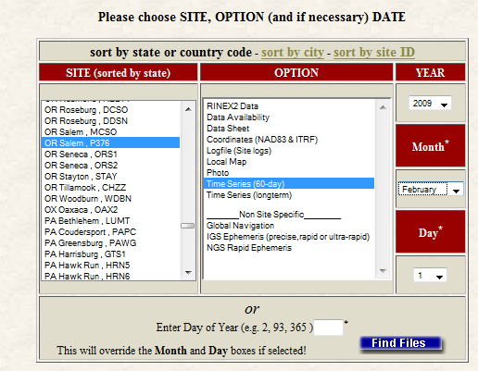
Back To Our Quick Example.
The NGS monitors the CORS data daily and provides summaries of those results.
Site logs and coordinate time series for the CORS can be accessed through
the Logfiles option under
the CORS Site Metadata.
http://www.ngs.noaa.gov/CORS/logfiles/
2010-Jul-22
42

Slide 43
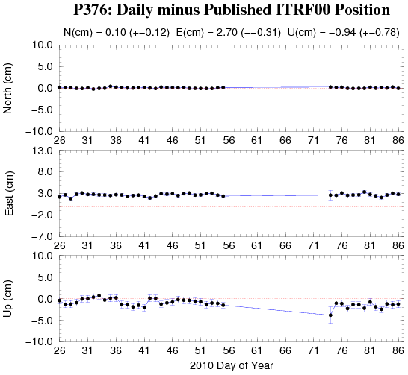
Back To Our Quick Example.
Looking at the 60-day time-series around 2009-056 for P376, we discover that the P376 data for the this day happens to be the last before an extended gap.
2010-Jul-22
43

Slide 44
Back To Our Quick Example.
Although this site and the results appears fine otherwise, we may want to consider digging a little deeper.
Possible next steps in evaluating this CORS are:
Resubmit requesting the extended report.
Review the P376 site log.
Resubmit excluding P376.
2010-Jul-22
44

Slide 45
How Does OPUS-S Work?
The primary steps of OPUS-S processing are:
Prepare and quality control the submitted data.
Estimate a crude point-position using TEQC.
Compute distances to every available CORS.
Select the three “best” CORS based upon:
    Being closest to the user’s site.
    Having common satellite visibility with the user data.
    Having more than 80% of the possible data available.
    Having low multipath measures.
  Complete the single-baseline processing using PAGES.
  Check the solution quality and replace a CORS if needed.
  Generate and email the report to the user.
2010-Jul-22
45

Slide 46
How Does OPUS-S Work?
OPUS-S uses PAGES for data processing.
PAGES is a state-of-the-art processing engine developed by the NGS.
Besides OPUS-S, PAGES is used for orbit production, reference frame definition, network monitoring and many
other GPS data processing tasks.
http://www.ngs.noaa.gov/GRD/GPS/DOC/toc.html
http://igscb.jpl.nasa.gov/igscb/center/analysis/noaa.acn
2010-Jul-22
46

Slide 47
How Does OPUS-S Work?
OPUS-S modeling highlights:
Satellite coordinates from the International GNSS Service (IGS) precise ephemerides.
http://igscb.jpl.nasa.gov/components/usage.html.
CORS coordinates and hardware histories from the NGS site information data base.
Receiver antenna phase center offsets and variations from the NGS relative antenna model data base.
http://www.ngs.noaa.gov/ANTCAL/.
International Earth Rotation Service (IERS) 2003 solid Earth tide model.
http://www.iers.org/nn_11216/IERS/EN/Publications/TechnicalNotes/tn32.html.
Surface met from a climatological model.
Boehm et al., “Short Note: A global model of pressure and temperature for geodetic applications”, J. Geod., 2007.
2010-Jul-22
47

Slide 48
How Does OPUS-S Work?
OPUS-S processing highlights:
Everything is “done” in the International Terrestrial Reference Frame (ITRF).
SV coordinates are held rigidly fixed.
CORS coordinates are heavily constrained.
Neutral atmosphere (tropo) dry component modeled.
Neutral atmosphere (tropo) wet component estimated.
Double-differenced, ion-free carrier phase observable.
Carrier phase ambiguities are fixed to their integer values where possible; float ambiguities are estimated otherwise.
Individual baselines are processed and the results combined generating mean coordinates and peak-to-peak uncertainties.
2010-Jul-22
48

Slide 49
How Does OPUS-S Work?
Some thoughts on phase ambiguity integer fixing.
The ambiguities, (charged and neutral) atmosphere delays and station heights strongly alias into each other.
There are really only two ways to “break” this aliasing:
Introduce more data.
Introduce additional information.
2010-Jul-22
49

Slide 50
How Does OPUS-S Work?
OPUS-S uses the former strategy.
Depending upon the circumstances, 1- to 2-hours of observations are sufficient to decorrelate the ambiguities, atmosphere and heights allowing reliable estimation of all. Thus the requirement for a minimum of 2-hours in OPUS-S.
As an aside, be aware that while simply having more data helps, it is actually the change in orientation of the satellites over the data span that forces the decorrelation.
2010-Jul-22
50

Slide 51
OPUS-S Uploads By Month.
Shown here are the monthly upload counts to OPUS-S.
Submissions to OPUS-S comprise a
non-trivial percentage of all “hits” on the NGS web sites.
Valid as of 2010-03-30. Values before January, 2005 are approximate.
2010-Jul-22
51

Slide 52
OPUS-RS. . . . . . . rapid-static processing
A Little OPUS-RS History.
The OPUS-RS Interface.
How Good Can I Do With OPUS-RS?
A Quick Example (cont.).
The Extended Report (cont.).
How Does OPUS-RS Work?
OPUS-S and OPUS-RS Uploads By Month.
2010-Jul-22
52

Slide 53
A Little OPUS-RS History
Although successful, OPUS obviously does not satisfy the needs of all users. For this reason, discussions with the user community about future development began almost immediately after OPUS was made public.
These early discussions clearly indicated that the most desired enhancement would be a tool capable of producing a similar quality result from a shorter data span.
2010-Jul-22
53

Slide 54
A Little OPUS-RS History
Work by several groups demonstrated that reliably producing results of similar quality to OPUS from shorter data spans was possible.
Collaboration between the NGS and the Satellite Positioning and Inertial Navigation (SPIN) group at The Ohio State University enabled Schwarz (DST) to implement a new processing engine capable of generating those results.
In early 2007, OPUS-RS was made publically available after its own trial period. To better delineate uses, the original OPUS processing stream was renamed OPUS-S.
2010-Jul-22
54

Slide 55
The OPUS-RS Interface.
With OPUS-RS, the beautiful simplicity remained. In fact the entry form is the same as for OPUS-S. The user provides:
Their email address.
An antenna type.
The vertical offset to the ARP.
15-minutes to 2-hours of GPS L1 + L2 data.
The user receives:
Coordinates accurate to a few centimeters.
2010-Jul-22
55

Slide 56
The OPUS-RS Interface.
http://www.ngs.noaa.gov/OPUS/
http://www.ngs.noaa.gov/OPUS/
The same interface is used except one clicks the “Upload to RAPID-STATIC” button instead.
2010-Jul-22
56

Slide 57
A Quick Example. (cont.)
Shown here is part of the OPUS-RS report for the same CORV data discussed earlier.
The results differ by
2.4 cm horizontally and 0.2 cm vertically from the accepted position projected to the epoch of the data.
USER: mark.schenewerk@noaa.gov DATE: April 01, 2010
RINEX FILE: corv059f.09o TIME: 16:17:51 UTC
SOFTWARE: rsgps 1.35 RS11.prl 1.57 START: 2009/02/28 05:00:00
EPHEMERIS: igs15206.eph [precise] STOP: 2009/02/28 06:59:30
NAV FILE: brdc0590.09n OBS USED: 5652 / 11169 : 51%
ANT NAME: ASH700936C_M QUALITY IND. 48.23/108.85
ARP HEIGHT: 1.521 NORMALIZED RMS: 0.280
REF FRAME: NAD_83(CORS96)(EPOCH:2002.0000) ITRF00 (EPOCH:2009.15959)
X: -2498422.589(m) 0.015(m) -2498423.330(m) 0.015(m)
Y: -3802821.147(m) 0.012(m) -3802819.929(m) 0.012(m)
Z: 4454736.644(m) 0.021(m) 4454736.717(m) 0.021(m)
LAT: 44 35 7.91061 0.004(m) 44 35 7.92619 0.004(m)
E LON: 236 41 43.48069 0.011(m) 236 41 43.42230 0.011(m)
W LON: 123 18 16.51931 0.011(m) 123 18 16.57770 0.011(m)
EL HGT: 105.986(m) 0.026(m) 105.602(m) 0.026(m)
ORTHO HGT: 128.517(m) 0.030(m) [NAVD88 (Computed using GEOID09)]
UTM COORDINATES STATE PLANE COORDINATES
UTM (Zone 10) SPC (3601 OR N)
Northing (Y) [meters] 4936954.909 105971.559
Easting (X) [meters] 475821.309 2277335.372
Convergence [degrees] -0.21381414 -1.98897509
Point Scale 0.99960719 0.99994603
Combined Factor 0.99959058 0.99992942
US NATIONAL GRID DESIGNATOR: 10TDQ7582136954(NAD 83)
BASE STATIONS USED
PID DESIGNATION LATITUDE LONGITUDE DISTANCE(m)
DH4503 P376 EOLARESVR_OR2004 CORS ARP N445628.313 W1230608.100 42648.2
DG5352 STAY STAYTON COOP CORS ARP N444950.530 W1224915.036 47030.9
DE6258 MCSO MARION CNTY COOP CORS ARP N445825.701 W1225720.639 51226.8
DI7529 P367 NEWPRTAIR_OR2007 CORS ARP N443506.870 W1240341.598 60113.5
⁞
2010-Jul-22
57

Slide 58
A Quick Example. (cont.)
Note that the solution quality measures are slightly different.
OBS USED > 50%
QUALITY IND. > 3
NORM. RMS ≈ 1
uncertainties < 5 cm
The uncertainties are standard deviations
from the solution, not
the peak-to-peak values reported by OPUS-S.
USER: mark.schenewerk@noaa.gov DATE: April 01, 2010
RINEX FILE: corv059f.09o TIME: 16:17:51 UTC
SOFTWARE: rsgps 1.35 RS11.prl 1.57 START: 2009/02/28 05:00:00
EPHEMERIS: igs15206.eph [precise] STOP: 2009/02/28 06:59:30
NAV FILE: brdc0590.09n OBS USED: 5652 / 11169 : 51%
ANT NAME: ASH700936C_M QUALITY IND. 48.23/108.85
ARP HEIGHT: 1.521 NORMALIZED RMS: 0.280
REF FRAME: NAD_83(CORS96)(EPOCH:2002.0000) ITRF00 (EPOCH:2009.15959)
X: -2498422.589(m) 0.015(m) -2498423.330(m) 0.015(m)
Y: -3802821.147(m) 0.012(m) -3802819.929(m) 0.012(m)
Z: 4454736.644(m) 0.021(m) 4454736.717(m) 0.021(m)
LAT: 44 35 7.91061 0.004(m) 44 35 7.92619 0.004(m)
E LON: 236 41 43.48069 0.011(m) 236 41 43.42230 0.011(m)
W LON: 123 18 16.51931 0.011(m) 123 18 16.57770 0.011(m)
EL HGT: 105.986(m) 0.026(m) 105.602(m) 0.026(m)
ORTHO HGT: 128.517(m) 0.030(m) [NAVD88 (Computed using GEOID09)]
UTM COORDINATES STATE PLANE COORDINATES
UTM (Zone 10) SPC (3601 OR N)
Northing (Y) [meters] 4936954.909 105971.559
Easting (X) [meters] 475821.309 2277335.372
Convergence [degrees] -0.21381414 -1.98897509
Point Scale 0.99960719 0.99994603
Combined Factor 0.99959058 0.99992942
US NATIONAL GRID DESIGNATOR: 10TDQ7582136954(NAD 83)
BASE STATIONS USED
PID DESIGNATION LATITUDE LONGITUDE DISTANCE(m)
DH4503 P376 EOLARESVR_OR2004 CORS ARP N445628.313 W1230608.100 42648.2
DG5352 STAY STAYTON COOP CORS ARP N444950.530 W1224915.036 47030.9
DE6258 MCSO MARION CNTY COOP CORS ARP N445825.701 W1225720.639 51226.8
DI7529 P367 NEWPRTAIR_OR2007 CORS ARP N443506.870 W1240341.598 60113.5
⁞
OBS USED: 5652 / 11169 : 51%
QUALITY IND. 48.23/108.85
NORMALIZED RMS: 0.280
2010-Jul-22
58

Slide 59

A Quick Example. (cont.)
Although the quality indices, normalized RMS and uncertainties are OK, the percentage of observations used gives this solution a .
If you are uncomfortable with your solution, the same diagnostic steps discussed for OPUS-S can be applied here too.
USER: mark.schenewerk@noaa.gov DATE: April 01, 2010
RINEX FILE: corv059f.09o TIME: 16:17:51 UTC
SOFTWARE: rsgps 1.35 RS11.prl 1.57 START: 2009/02/28 05:00:00
EPHEMERIS: igs15206.eph [precise] STOP: 2009/02/28 06:59:30
NAV FILE: brdc0590.09n OBS USED: 5652 / 11169 : 51%
ANT NAME: ASH700936C_M QUALITY IND. 48.23/108.85
ARP HEIGHT: 1.521 NORMALIZED RMS: 0.280
REF FRAME: NAD_83(CORS96)(EPOCH:2002.0000) ITRF00 (EPOCH:2009.15959)
X: -2498422.589(m) 0.015(m) -2498423.330(m) 0.015(m)
Y: -3802821.147(m) 0.012(m) -3802819.929(m) 0.012(m)
Z: 4454736.644(m) 0.021(m) 4454736.717(m) 0.021(m)
LAT: 44 35 7.91061 0.004(m) 44 35 7.92619 0.004(m)
E LON: 236 41 43.48069 0.011(m) 236 41 43.42230 0.011(m)
W LON: 123 18 16.51931 0.011(m) 123 18 16.57770 0.011(m)
EL HGT: 105.986(m) 0.026(m) 105.602(m) 0.026(m)
ORTHO HGT: 128.517(m) 0.030(m) [NAVD88 (Computed using GEOID09)]
UTM COORDINATES STATE PLANE COORDINATES
UTM (Zone 10) SPC (3601 OR N)
Northing (Y) [meters] 4936954.909 105971.559
Easting (X) [meters] 475821.309 2277335.372
Convergence [degrees] -0.21381414 -1.98897509
Point Scale 0.99960719 0.99994603
Combined Factor 0.99959058 0.99992942
US NATIONAL GRID DESIGNATOR: 10TDQ7582136954(NAD 83)
BASE STATIONS USED
PID DESIGNATION LATITUDE LONGITUDE DISTANCE(m)
DH4503 P376 EOLARESVR_OR2004 CORS ARP N445628.313 W1230608.100 42648.2
DG5352 STAY STAYTON COOP CORS ARP N444950.530 W1224915.036 47030.9
DE6258 MCSO MARION CNTY COOP CORS ARP N445825.701 W1225720.639 51226.8
DI7529 P367 NEWPRTAIR_OR2007 CORS ARP N443506.870 W1240341.598 60113.5
⁞
2010-Jul-22
59

Slide 60
The Extended Report . (cont.)
Of necessity, the OPUS-RS extended report is larger than the corresponding OPUS-S solution. Too large to be conveniently shown here. But while seemingly intimidating, the OPUS-RS extended report sections are basically the same as those in the OPUS-S extended report.
Some additional sections include:
A covariance matrix for the reference-station-only solution.
A correlation as well as a covariance matrix.
Various Dilutions Of Precision (DOPs).
2010-Jul-22
60

Slide 61
How Good Can I Do With OPUS-RS?
OPUS-RS can produce quality results from more challenging “short” data sets, but it is slightly more restrictive in the data sets allowed. Because of the restrictions, which will be discussed later, the NGS recently made available the
“OPUS-RS Accuracy and Availability” tool (Choi, NGS).
Typical estimated and empirical accuracies within the continental U.S. are comparable to OPUS-S.
Remember that the estimated accuracies suggested by this tool are just that - estimates. Confirming the quality of the OPUS solution remains the user’s responsibility.
2010-Jul-22
61

Slide 62
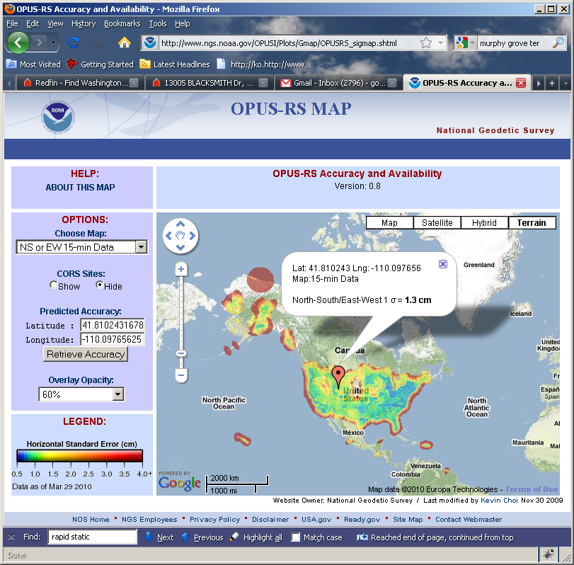
How Good Can I Do With OPUS-RS?
The OPUS-RS Accuracy and Availability Tool.
http://www.ngs.noaa.gov/OPUSI/Plots/Gmap/OPUSRS_sigmap.shtml
2010-Jul-22
62

Slide 63
How Good Can I Do With OPUS-RS?
1 σ for each 0.2 degree grid.
Horizontal and vertical standard
errors for 15 minutes and
1-hour length data.
Inverse Distance Weighting
method to interpolate the sigmas.
Areas outside the color overlay
are where there are less than
three active CORS sites within
250 km range. OPUS-RS will
usually fail at these locations.
Automated Weekly update
  Use updated CORS list and observation data availability
Global coverage including non-US territories.
2010-Jul-22
63

Slide 64
How Does OPUS-RS Work?
OPUS-RS uses the RSGPS program which was developed specifically for this purpose.
Like OPUS-S, OPUS-RS uses state-of-the-art models, but the strategy to fix phase ambiguities to their integer values differs.
To fix integers, OPUS-RS introduces more information:
Pseudorange and carrier phase.
More reference stations if possible.
2010-Jul-22
64

Slide 65
How Does OPUS-RS Work?
OPUS-RS selects three to nine “best” CORS based upon:
    Having common satellite visibility with the user data.
    Having distances from the user’s site <250 km.
This is shown here graphically.
The star represents the user’s
site. The triangles are CORS.
No CORS farther than 250 km
from the user’s site will be
included.
The three CORS minimum is shown.
No more than nine are used.
s
>250km
250km
Choi, 2010, personal communication.
2010-Jul-22
65

Slide 66
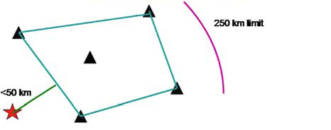
How Does OPUS-RS Work?
In addition, user’s site must be no more than 50 km from the (convex) polygon created by the selected CORS.
Again in this figure, the star represents the user’s site; the
triangles are CORS. Five CORS and their resulting polygon are shown in this example.
If the user’s site, the star, is
more than 50 km outside
this polygon, alternate
CORS will be considered.
If none can be found,
the processing will abort.
Schwarz et al., “Accuracy assessment of the National Geodetic Survey's OPUS-RS utility”, 2009, GPS Solutions, 13(2), 119-132.
2010-Jul-22
66

Slide 67
How Does OPUS-RS Work?
OPUS-RS uses no less than 1-hour of CORS data and no more than the submitted data’s span plus 15-minutes before and after.
The CORS data are used to estimate the atmospheric delays at each CORS and predict them at the user’s site.
OPUS-RS then processes each baseline to the user’s site individually to produce a improved a priori position.
Switching modes, the previously determined values and all data are used in an “integer-fixed” solution for the user’s site.
Schwarz et al., “Accuracy assessment of the National Geodetic Survey's OPUS-RS utility”, 2009, GPS Solutions, 13(2), 119-132.
2010-Jul-22
67

Slide 68
OPUS-S And OPUS-RS Uploads By Month.
Upload rates to OPUS-S and OPUS-RS appear to have leveled off at approximately 15,000 per month for each.
Valid as of 2010-03-30.
2010-Jul-22
68

Slide 69
OPUS-DB. . . . . . data base and publishing
A Little OPUS-DB History.
The OPUS-DB Interface.
How Does OPUS-DB Work?
OPUS-DB Uploads By Month.
2010-Jul-22
69

Slide 70
A Little OPUS-DB History.
With the release of OPUS-RS, the comments about OPUS began to focus on a new issue. Users wanted an equally simple way to share their OPUS results with the community.
2010-Jul-22
70

Slide 71
A Little OPUS-DB History.
Historically, when in collaboration with or publishing through the NGS, one submitted results to the Integrated Data Base (IDB) and, in this manner, contributed to the NSRS.
Before submitted results could be entered into the IDB, the submissions had to meet a well-defined set of requirements and quality controls.
Reconciling the “open” input philosophy represented by OPUS with the “controlled” input philosophy represented by IDB is a tremendous challenge.
2010-Jul-22
71

Slide 72
A Little OPUS-DB History.
A significant step in reconciliation came in 2009 with the release of OPUS-DB.
OPUS-DB allows users to publish their OPUS result in an
on-line data base if minimum requirements for quality are
met and the associated meta-data, such as photos and descriptions, are provided.
2010-Jul-22
72

Slide 73
A Little OPUS-DB History.
For now, OPUS-DB and the IDB exist as two separate tools.
As the NGS begins to more fully understand the characteristics of the OPUS-DB, the OPUS-DB and the IDB will be more fully reconciled.
In the meantime, a submission to the OPUS-DB may be eligible for, but not guaranteed to be included in the IDB.
2010-Jul-22
73

Slide 74
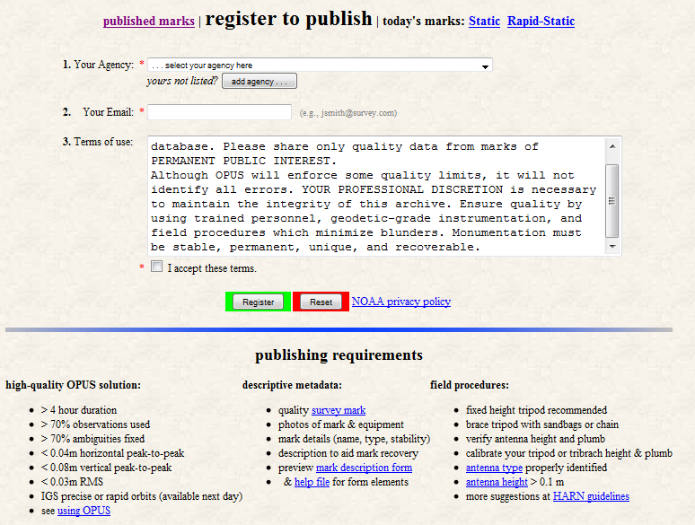
OPUS-DB Interface.
Before publishing to OPUS-DB, one must first register.
That form is found at the bottom of the “view” tab on the OPUS home page.
http://www.ngs.noaa.gov/OPUS/view.jsp
2010-Jul-22
74

Slide 75
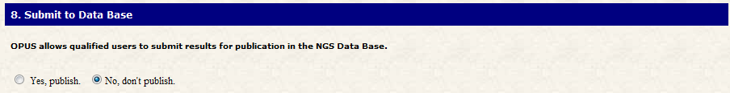
OPUS-DB Interface.
The first step in publishing to OPUS-DB is to submit data to OPUS.
The user completes the OPUS form normally, but must explicitly designate that the results should be published.
This is done through the Options.
The “Submit to Data Base”, i.e. publish, option is near the bottom of the Options list.
2010-Jul-22
75

Slide 76
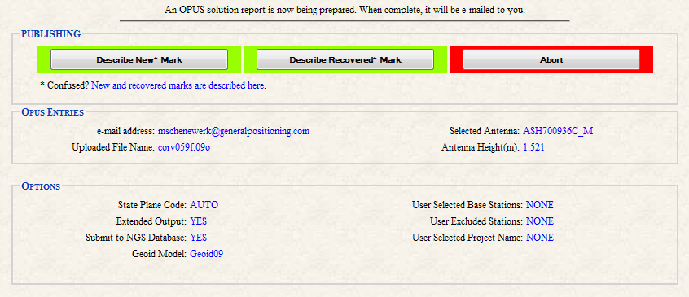
OPUS-DB Interface.
The user is taken to a new page where they designate the mark associated with their data as “new” or “recovered”.
2010-Jul-22
76

Slide 77
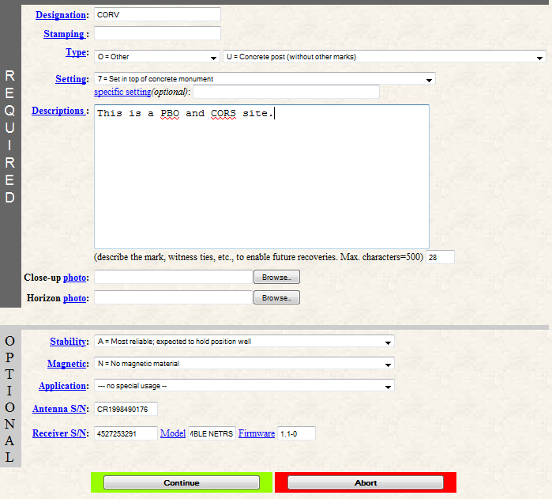
OPUS-DB Interface.
After making that selection, the user is offered the appropriate form for entering the meta-data.
In this example, we’re following the “new” mark designation.
2010-Jul-22
77

Slide 78
OPUS-DB Interface.
Many of you will recognize these fields as a subset of the information required to “blue book” a mark.
2010-Jul-22
78

Slide 79
OPUS-DB Interface.
This is not blue booking per se.
The process is streamlined. This is possible, in part, because some information is provided by the data processing itself.
2010-Jul-22
79

Slide 80
OPUS-DB Interface.
As a last step, the user given a chance to review the submission in the form of a mock-up of the datasheet for their submission.
If the meta-data is complete, the quality control restrictions are met and the user gives the “OK”, the submission is entered into the data base.
2010-Jul-22
80

Slide 81
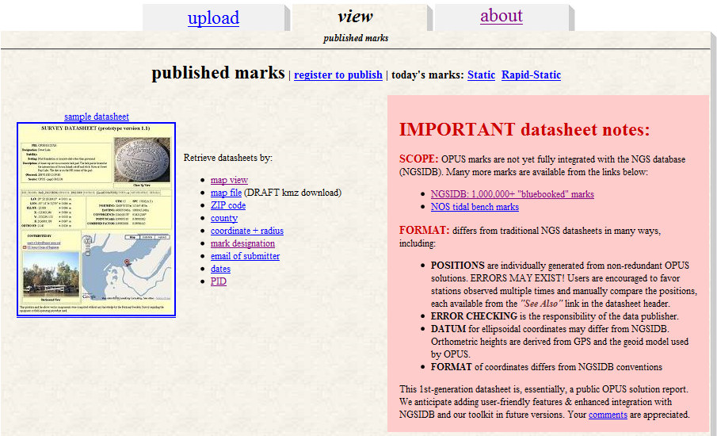
OPUS-DB Interface.
The “view” tab on the OPUS home page provides access to the results stored in the data base.
http://www.ngs.noaa.gov/OPUS/view.jsp
81
2010-Jul-22

Slide 82
OPUS-DB Interface.
The notes in the red box on the right side summarize the characteristics of the OPUS data base and its differences to the IDB.
http://www.ngs.noaa.gov/OPUS/view.jsp
82
2010-Jul-22

Slide 83
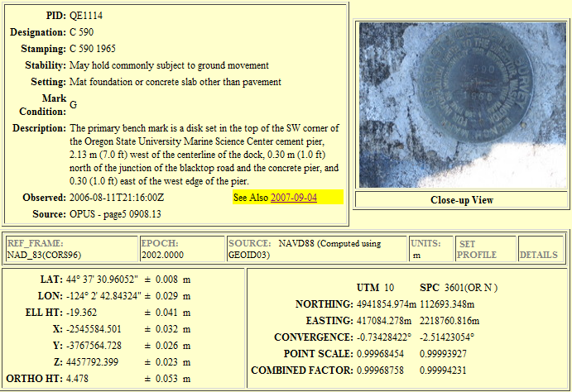
OPUS-DB Interface.
This is part of an OPUS-DB
data sheet.
Note the “See Also” highlight.
Note the “See Also” highlight. This provides access to other data base and IDB entries for this mark.
2010-Jul-22
83

Slide 84
How Does OPUS-DB Work?
OPUS-DB is a data base in the sense that we think of electronic, software-driven data bases today.
This implies that entries in the data base can be sorted and sampled by any of the individual data elements provided with each submission.
For example, users normally search the data base by PID, descriptor or location, but, of course, one could search for all the marks in by county or zip code.
2010-Jul-22
84

Slide 85
How Does OPUS-DB Work?
The OPUS-DB interface has started as a small, logical extension of the IDB interface, but, in a sense, OPUS-DB is a “blank sheet”.
Given a fully functional data base with graphical user interface, it’s not clear how OPUS-DB will evolve in the future.
2010-Jul-22
85

Slide 86
How Does OPUS-DB Work?
For this reason, note the “comments” link on the “view” page. This and similar links on other pages are sincere requests for your help in guiding future development.
http://www.ngs.noaa.gov/OPUS/view.jsp
86
2010-Jul-22

Slide 87
OPUS-DB Marks Published.
OPUS-DB
is showing steady growth in registered users and published marks.
2010-Jul-22
Evjen, “OPUS at 1000 published marks”, “Brown bag” presentation 2009-08-06.
87

Slide 88
New Developments for OPUS.
Lots of things are in the works for OPUS. Here is a sample.
New Look And Feel.
OPUS-Net.
OPUS-Mapper.
Other GNSS.
BREAK
OPUS-Projects.
2010-Jul-22
88

Slide 89
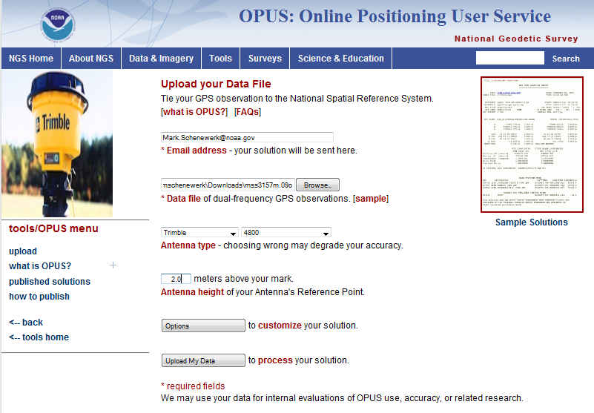
New Look And Feel.
The National Oceanic and Atmospheric Administration, the parent of the NGS, has asked
all offices to implement a common “look and feel”
to their web pages. This will soon be reflected in
the OPUS pages too.
2010-Jul-22
89

Slide 90
New Look And Feel.
The exact content isn’t set so I won’t show the page clearly; however, the web page will have several ease-of-use enhancements.
2010-Jul-22
90

Slide 91
New Look And Feel.
The enhancements include:
Simplified antenna selection.
More direct access to the options.
Consistent navigation.
2010-Jul-22
91

Slide 92
OPUS-Net.
Weston and Ray (NGS) have found that by more fully implementing the available processing models in conjunction with changing the CORS selection criteria, at a minimum, the scatter in the north and east components can be significantly reduced with no degradation in the scatter in the height produced by OPUS-S.
Moreover, the resulting coordinates agree better with other sources such as the IGS weekly combinations.
Weston and Ray, “Test of the Use of Regional Networks for OPUS Processing”, 2010, EGU General Assembly 2010,
Geophysical Research Abstracts.
2010-Jul-22
92

Slide 93
OPUS-Net.
Implemented in an OPUS-like application, called OPUS-Net during its testing phase, it includes
An ocean-tide loading (OTL) model.
Absolute antenna phase correction models.
A combination of near-by and more-distant CORS.
Let’s look at these individually.
2010-Jul-22
93

Slide 94
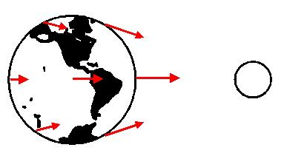
OPUS-Net.
What is OTL?
Subtle differences in the gravitational force of the Moon and Sun cause the Earth to deform. Most commonly seen as ocean tides, it also affects the solid Earth and atmosphere.
Schenewerk, “Physical Models Used (and Not Used) in the PAGES Software Suite”, 2008, private communication.
2010-Jul-22
94

Slide 95
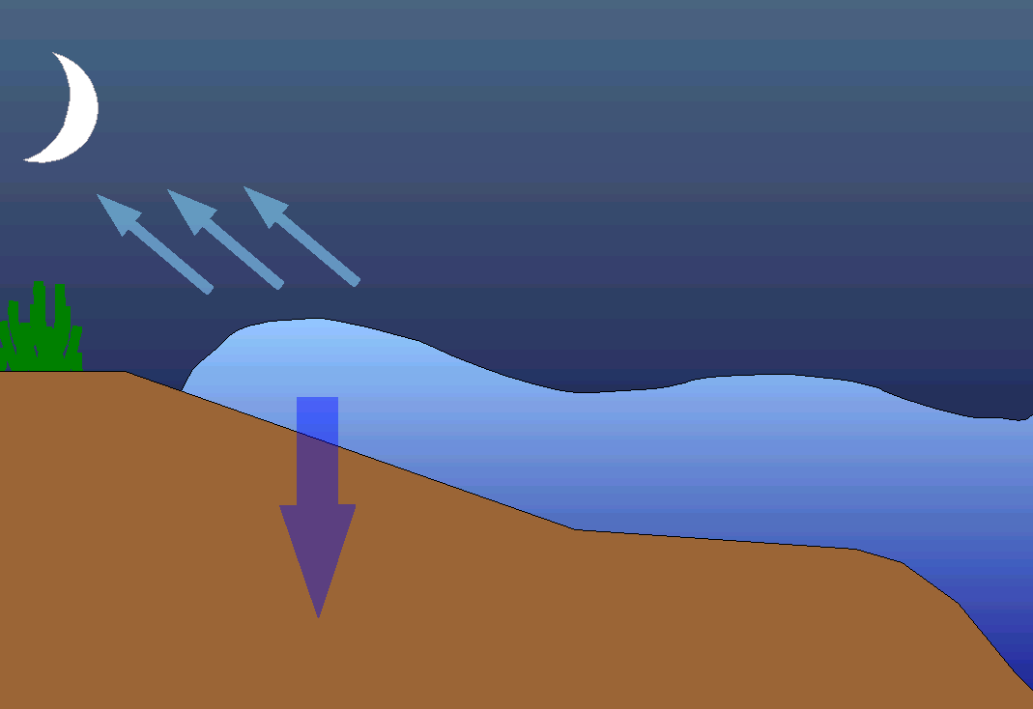
OPUS-Net.
Focusing on ocean tides, as the tide swells and ebbs, the changing weight of water presses on the Earth’s crust causing it to deform with the same period as the tide.
2010-Jul-22
95

Slide 96
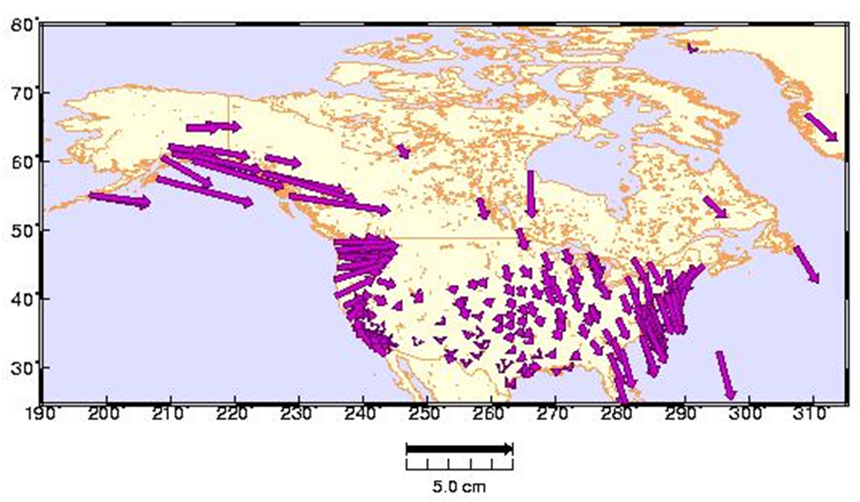
OPUS-Net.
The magnitude of the deformation depends upon the shape of the coastline and topography of the ocean floor. 1 – 3 cm vertical deformation is common along the continental U.S. coasts; larger on the Gulf of Alaska.
Schenewerk et al., "Vertical Ocean Loading Deformations Derived from a Global GPS Network", 2001, J. of the Geod. Soc. Of Japan, 47, 1, 237-242.
2010-Jul-22
96

Slide 97
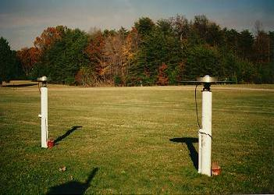
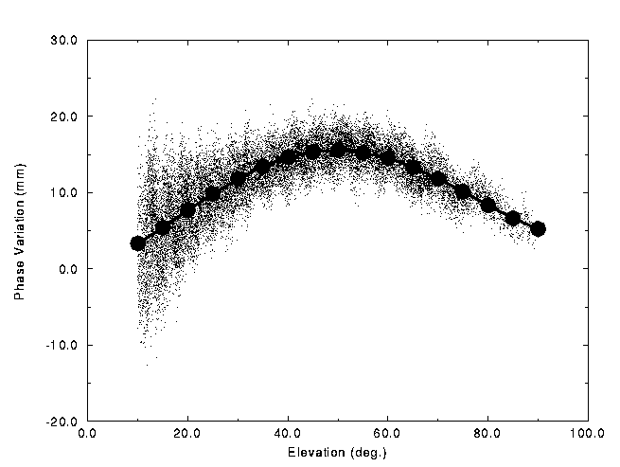
OPUS-Net.
What are absolute antenna phase
correction models?
No antenna is physically or electro-
magnetically perfect.
For about two decades, some sort
of antenna correction has been
applied as part of processing.
Historically, these corrections
have been relative to a specific
antenna type.
The NGS antenna test range and a sample relative correction
pattern are shown. http://www.ngs.noaa.gov/ANTCAL/
2010-Jul-22
97

Slide 98
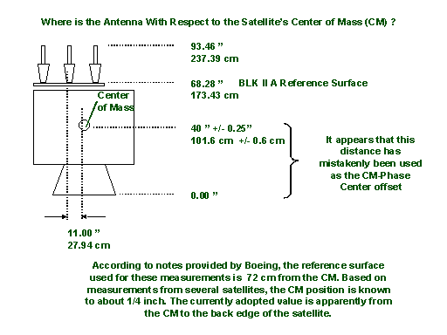
OPUS-Net.
The “relative” antenna
corrections work well,
particularly if the
antennas are close
together.
But, as data processing
has improved, the
limitations of relative
antenna corrections
have become increas-
ingly evident. One example: satellite antenna corrections can not be fully applied when using a relative model.
http://www.ngs.noaa.gov/ANTCAL/
2010-Jul-22
98

Slide 99
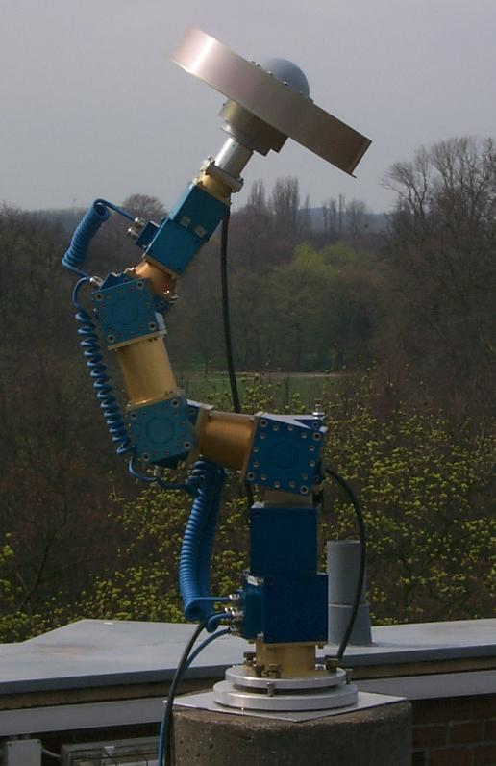
OPUS-Net.
By using data from a spatially large network
with diverse equipment, and by including data
from new tools such as robotic arms which
shift the orientation of the antenna being
tested on demand, “absolute” antenna phase
patterns can be produced.
Absolute antenna corrections:
More fully implement the corrections.
Help minimize the effects of baseline lengths.
Help minimize hardware changes.
http://www.geopp.de/
2010-Jul-22
99

Slide 100
OPUS-Net.
Why use near-by and more-distant CORS?
Although it may seem counter-intuitive, using a combination
of near and distant CORS has a number of advantages.
Site “quality” can be emphasized as well as data quantity.
Longer baselines enable better atmosphere corrections.
More CORS minimizes the effects of missing data and changes.
2010-Jul-22
100

Slide 101
OPUS-Mapper.
Traditionally, NGS products have supported higher-accuracy uses. While the NGS and its products have supported uses such as GIS, kinematic and hand-held tracking, to list a few, OPUS seems an appropriate gateway to supporting at least some activities more directly.
But, do we need another flavor of OPUS?
The answer is probably yes. A limited accuracy application fits into the NGS’s plans and the needs large user community.
2010-Jul-22
101

Slide 102
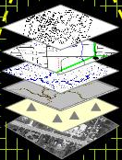
OPUS-Mapper.
# of People Who Care
NGS Works Here
GIS Works Here
mm
cm
dm
m
dam
hm
km
Position Accuracy
Mader and Weston, “An On-Line Positioning User Service For Geographic Information Systems”, 2007, 2007 ESRI Survey & Engineering GIS Summit.
2010-Jul-22
102

Slide 103
OPUS-Mapper.
What does OPUS-Mapper offer?
Accepts single- and dual-frequency data.
Accepts kinematic data.
Differential pseudorange solution to CORS.
Kinematic trajectory report.
Static occupation report.
Shape files are coming.
2010-Jul-22
103

Slide 104
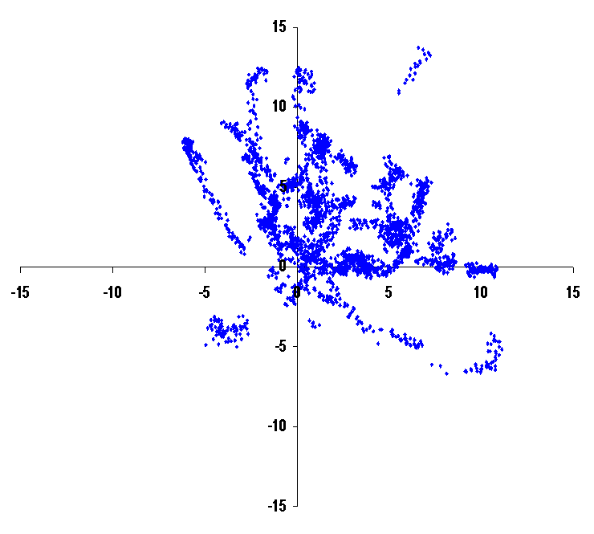
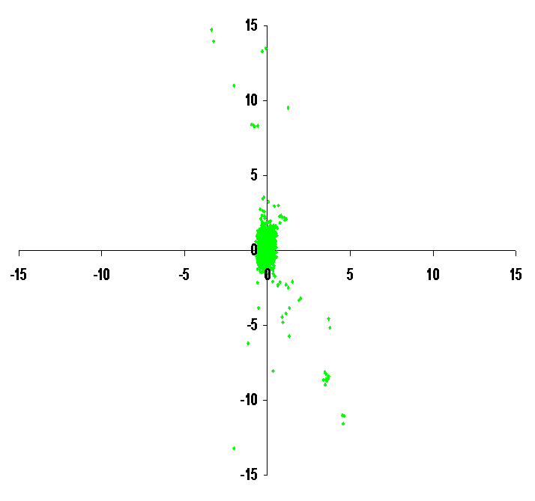
OPUS-Mapper.
Why opt for differential over point positioning?
N
N
W
E
W
E
S
S
Point Positioning
Differential Positioning
2010-Jul-22
104

Slide 105
OPUS-Mapper.
Although some trials were completed, there is no active web interface for OPUS-Mapper at this time. This is because:
Often, results like these are only part of a more comprehensive data set. It was realized that a
means for “connecting” user-supplied data and
meta-data needed to be developed.
Sometimes the developer needs a “kick in the pants.”
2010-Jul-22
105

Slide 106
OPUS-Mapper.
OPUS–Mapper Kinematic Trajectory Report
2005/12/ 3 17: 1:31.0 2.9 1.160 954480.027 -5680360.821 2729931.909 1.056 2.848 1.418 25.5077314 -80.4616043 -27.099 0.913 1.239 2.977
2005/12/ 3 17: 1:32.0 3.2 1.236 954481.086 -5680362.067 2729932.279 1.441 3.341 1.528 25.5077290 -80.4615959 -25.672 1.070 1.474 3.500
2005/12/ 3 17: 1:33.0 3.2 1.222 954481.036 -5680362.056 2729932.286 1.426 3.303 1.511 25.5077291 -80.4615964 -25.687 1.059 1.458 3.461
2005/12/ 3 17: 1:34.0 3.2 1.083 954481.059 -5680362.424 2729932.291 1.263 2.926 1.338 25.5077277 -80.4615968 -25.353 0.938 1.292 3.066
2005/12/ 3 17: 1:35.0 3.2 1.067 954480.952 -5680362.523 2729932.256 1.245 2.881 1.318 25.5077271 -80.4615980 -25.297 0.924 1.272 3.018
2005/12/ 3 17: 1:36.0 2.9 1.072 954480.179 -5680361.378 2729932.061 0.975 2.626 1.307 25.5077304 -80.4616037 -26.515 0.844 1.143 2.746
2005/12/ 3 17: 1:37.0 2.9 1.007 954480.317 -5680361.418 2729932.122 0.916 2.467 1.228 25.5077307 -80.4616024 -26.432 0.793 1.074 2.579
2005/12/ 3 17: 1:38.0 2.9 0.926 954480.509 -5680361.612 2729932.255 0.843 2.268 1.129 25.5077309 -80.4616009 -26.174 0.729 0.987 2.370
2005/12/ 3 17: 1:39.0 2.9 0.852 954480.740 -5680361.761 2729932.392 0.776 2.088 1.040 25.5077313 -80.4615988 -25.947 0.671 0.909 2.183
2005/12/ 3 17: 1:40.0 2.9 0.772 954480.960 -5680361.889 2729932.507 0.703 1.891 0.941 25.5077316 -80.4615969 -25.752 0.608 0.824 1.977
2005/12/ 3 17: 1:41.0 2.9 0.751 954481.064 -5680362.026 2729932.598 0.683 1.838 0.915 25.5077317 -80.4615961 -25.575 0.591 0.801 1.921
2005/12/ 3 17: 1:42.0 2.9 0.732 954481.140 -5680362.105 2729932.554 0.666 1.790 0.891 25.5077310 -80.4615955 -25.512 0.576 0.780 1.871
2005/12/ 3 17: 1:43.0 3.2 0.970 954481.362 -5680362.468 2729932.576 1.132 2.613 1.196 25.5077297 -80.4615939 -25.146 0.841 1.157 2.738
2005/12/ 3 17: 1:44.0 2.9 0.671 954481.325 -5680362.341 2729932.577 0.611 1.641 0.818 25.5077302 -80.4615941 -25.264 0.528 0.716 1.716
2005/12/ 3 17: 1:45.0 2.9 0.639 954481.429 -5680362.449 2729932.646 0.582 1.563 0.779 25.5077303 -80.4615932 -25.123 0.504 0.682 1.634
2005/12/ 3 17: 1:46.0 2.9 0.625 954481.526 -5680362.463 2729932.677 0.569 1.528 0.761 25.5077304 -80.4615923 -25.083 0.493 0.666 1.598
2005/12/ 3 17: 1:47.0 2.9 0.621 954481.582 -5680362.499 2729932.724 0.566 1.518 0.756 25.5077306 -80.4615918 -25.022 0.490 0.662 1.587
GPST Date & Time
XYZ
XYZ RMS
LAT, LON, EL HGT
NEU RMS
RDOP
RMS
2010-Jul-22
106

Slide 107
OPUS-Mapper.
OPUS–Mapper Static Occupation Report
Station #: 1 File: zzyy337r.05o
2005/12/ 3 17: 1:31 954482.055 0.566 25 1 27.8497 0.603
2005/12/ 3 17: 3:14 -5680362.733 0.590 -80 27 41.7152 0.487
#sec: 103 #pts: 104 2729933.535 0.812 -24.3934 0.855
Station #: 2 File: zzyy337r.05o
2005/12/ 3 17: 4:41 955062.476 0.248 25 4 23.5041 0.268
2005/12/ 3 17: 7:23 -5680325.193 0.257 -80 27 20.9951 0.250
#sec: 162 #pts: 163 2729813.609 0.339 -22.6164 0.330
Station #: 3 File: zzyy337r.05o
2005/12/ 3 17: 9:56 955528.756 0.327 25 9 57.3369 0.179
2005/12/ 3 17:12:31 -5680598.380 0.312 -80 27 6.1520 0.280
#sec: 155 #pts: 156 2729086.863 0.359 -22.5733 0.472
Station #: 4 File: zzyy337r.05o
2005/12/ 3 17:14:13 956928.191 2.125 25 14 57.7295 0.045
2005/12/ 3 17:14:23 -5680357.338 0.525 -80 26 15.3043 2.181
#sec: 10 #pts: 11 2729097.676 0.128 -22.7844 0.206
2010-Jul-22
107

Slide 108
Other GNSS.
Other Global Navigation Satellite System, GNSS, are or will be operational in the future.
GLONASS is operational now.
Galileo is in testing and preparing for deployment.
COMPASS is in planning.
Like you, the NGS wants to make use of these systems.
2010-Jul-22
108

Slide 109
Other GNSS.
Unfortunately, the infrastructure must also be in place before new GNSS can be incorporated into OPUS.
Precise ephemerides must be available in a timely manner.
A robust and comprehensive CORS network is needed.
Antenna models and other information must be available.
Software must be ready and proven robust.
The community must feel a sufficient level of comfort
which is gained by reliably producing quality products.
2010-Jul-22
109

Slide 110
Other GNSS.
Looking at these point for GLONASS specifically:
Precise ephemerides are available no sooner than two-weeks and there is limited global support for this product.
The number of GLONASS enable CORS is limited but growing (approximately 12% in the U.S. as of 2010-Apr).
Antenna models and other information are being produced.
Software development is underway at the NGS.
The NGS has begun activities which will help develop a solid foundation for using GLONASS.
2010-Jul-22
110

Slide 111
Other GNSS.
What’s happening now?
Schenewerk is extending the PAGES suite to handle GLONASS and other GNSS.
GLONASS PAGES will be able to process integer-fixed or float GPS and float GLONASS separately or together.
The software is literally an extension of PAGES which has been proven in a variety of operational tasks.
2010-Jul-22
111

Slide 112
Other GNSS.
The GLONASS PAGES programming is largely complete.
Orbit production trials should be underway by June, 2010.
Contribution to the IGS GLONASS precise ephemeris combinations is planned by the end of the year.
Recall that the precise ephemerides have a two-week latency, so the viability of a GLONASS rapid product
(one day latency or less) will be investigated.
2010-Jul-22
112

Slide 113
Other GNSS.
But GLONASS PAGES is just a transitional tool:
It provides useful products in the short-term.
Its products will be regularly compared with similar products from the international community.
It can provide experience with other GNSS.
It can provide a way to experiment with other GNSS.
It is a “benchmark” for the next-generation software.
2010-Jul-22
113

Slide 114
Other GNSS.
At the same time, Choi et al. are building the next generation software.
Software requirements:
  Ability to process single- or multi-frequency data.
  Ability to process single- or multi-constellation data.
  Ability to process other many observables.
  Ability to fix integers.
2010-Jul-22
114

Slide 115
Other GNSS.
At the same time, Choi et al. are building the next generation software.
Technical aspects:
  Object oriented programming.
  C++ or Java.
  Unified formats and a robust interface which supports backward- and forward-compatibility.
2010-Jul-22
115

Slide 116
Other GNSS.
Challenges in building the next-generation software.
  Understanding the biases within and between GNSS.
      Receiver clock biases.
      Inter-channel biases:
      hardware dependent for each frequency.
      Other system biases.
  The classic double-difference approach won’t work.
      Different receiver clock estimates for each GNSS.
      Mixing different frequencies.
      Inter-channel biases.
      Integer ambiguity fixing.
2010-Jul-22
116

Slide 117
OPUS-Projects
A Little OPUS-Projects History.
What Is OPUS-Projects?
The OPUS-Projects Interface.
How Good Can I Do With OPUS-Projects?
2010-Jul-22
117

Slide 118
A Little OPUS-Projects History.
The success of OPUS clearly demonstrated the value of
web-based tools for some activities. This begged the question, could a web-based utility be made for a more complex task such as an airport or height modernization survey?
In these cases, one or more survey crews would be occupying one or more marks over several hours or days in a manner consistent with predefined project specifications.
2010-Jul-22
118

Slide 119
A Little OPUS-Projects History.
The “wish list” for such a web-based utility included:
Visualize and organize multiple, related data submissions.
Process all or subsets of the data according to user-required specifications.
Offer the results in useful forms and formats.
Do all this as simply as possible.
2010-Jul-22
119

Slide 120
A Little OPUS-Projects History.
But do we really need another OPUS flavor?
The practical answer is probably yes.
The NGS and other groups have a history of project’s whose specifications can’t be entirely supported by OPUS.
The academic answer is probably yes.
As good as OPUS does, and that is very good, sacrificing simplicity for flexibility can improve results, at least in some cases.
2010-Jul-22
120

Slide 121
A Little OPUS-Projects History.
In 2005, Weston and Gwinn began initial development on OPUS-Projects.
In 2006, several “proof of concept” tests were completed including one that involved hundreds of occupations spanning several weeks. Many “pros and cons” resulted, but the overall impression was positive.
2010-Jul-22
121

Slide 122
A Little OPUS-Projects History.
After a hiatus, Schenewerk began development again in 2007, in part, thanks to some financial support from the FAA.
Prusky and Schenewerk oversaw a second, more focus test in 2009. Again, many “pros and cons” in the original design were revealed, but a better defined set of desirable capabilities resulted.
2010-Jul-22
122

Slide 123
A Little OPUS-Projects History.
Today, OPUS-Projects BETA is being built incorporating the desired capabilities identified in the earlier tests.
Later in 2010, a third test is planned.
2010-Jul-22
123

Slide 124
What Is OPUS-Projects?
OPUS-Projects gives users web-based access to simple visualization, management and processing tools for multiple sites and multiple occupations.
These tools include:
The advantages of data submission through OPUS.
Data visualization and management aids.
Enhanced data processing using the PAGES suite.
Solution visualization aids.
Seamless connectivity with other OPUS tools.
2010-Jul-22
124

Slide 125
What Is OPUS-Projects?
OPUS-Projects exists in a hierarchical structure
Create . . . . . . . . . . . . . . . . creates a project.
Submit . . . . . . . . . . . . . . . . data submission.
Process . . . . . . . . . . . . . . . session solutions.
Manage . . . . . . . . . . . . . . . network solutions.
OPUS-Projects czar for general support.
2010-Jul-22
125

Slide 126
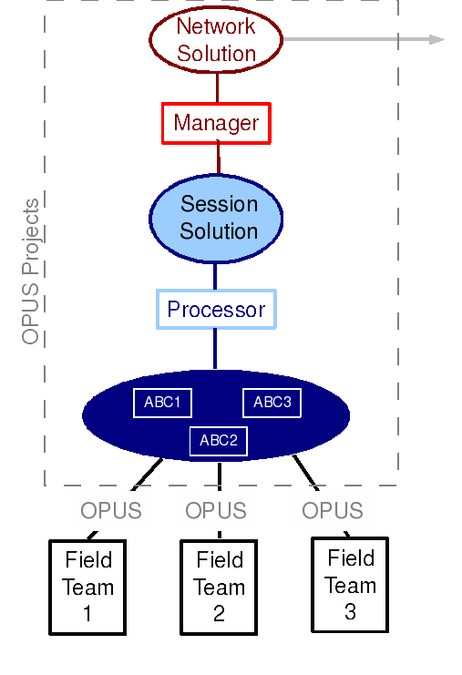
What Is OPUS-Projects?
Graphically, this looks like:
2010-Jul-22
126

Slide 127
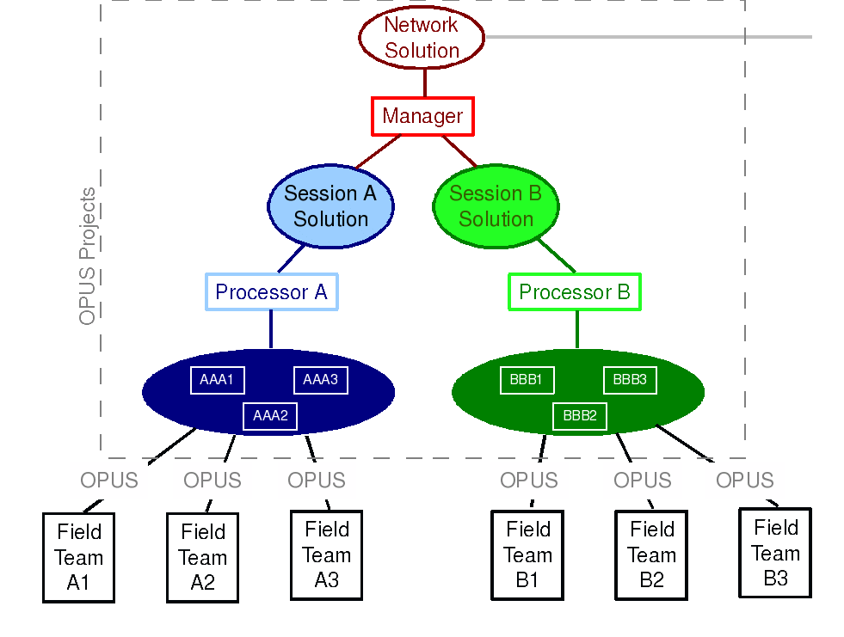
What Is OPUS-Projects?
2010-Jul-22
127

Slide 128
The OPUS-Projects Interface.
It’s probably easier to show the interface than describe it, so let’s walk through some of the basic steps in creating and reviewing a project.
Please be aware …
OPUS-Projects is actively being developed. The information shown here reflects many, but not all of the recent and pending changes.
2010-Jul-22
128

Slide 129
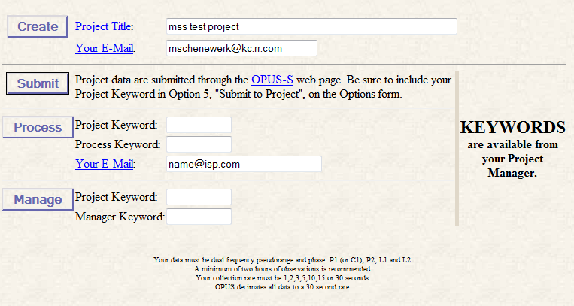
The first step is to “Create” a project. This allocates on-line storage for the project’s data and generates project keywords.
Although it’s not always necessary, we’ll begin the description of this and each major step at the OPUS-Projects home page.
2010-Jul-22
129

Slide 130
Enter a project title and the project manager’s (your) email address, then click the “Create” button.
Don’t worry, these can be changed later.
2010-Jul-22
130

Slide 131
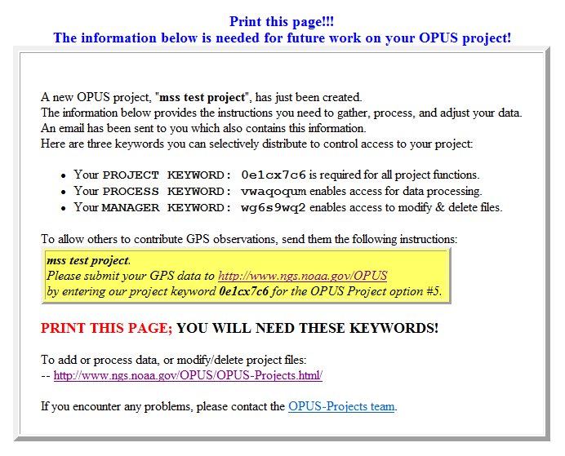
Within moments, project keywords are generated and storage space assigned. An email is sent to the project manager and a
confirmation page displayed.
2010-Jul-22
131

Slide 132
The second step is to “Submit” data files to your project.
At this time, this is done through OPUS-S implying the same restrictions:
Your data must be dual frequency pseudorange and phase P1 (or C1), P2, L1 and L2.
A minimum 2-hours data span for each submission.
A collection rate of 1, 2, 3, 5, 10, 15 or 30 seconds.
2010-Jul-22
132

Slide 133
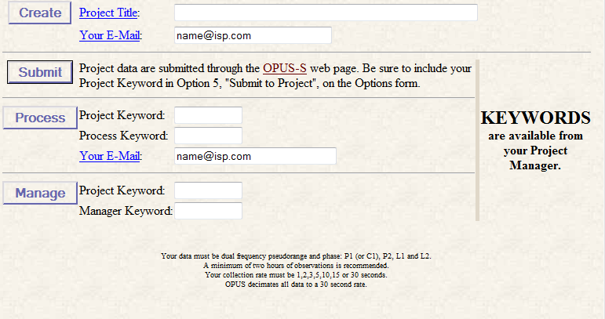
The Opus-Projects web page provides a convenient link to the OPUS page, but it’s OK to skip this and start at the OPUS page.
2010-Jul-22
133

Slide 134
Once at the OPUS “upload page, complete the entry fields normally …
2010-Jul-22
134

Slide 135
… but be sure to follow the “OPTIONS” link to specify that your data be stored with its project.
2010-Jul-22
135

Slide 136
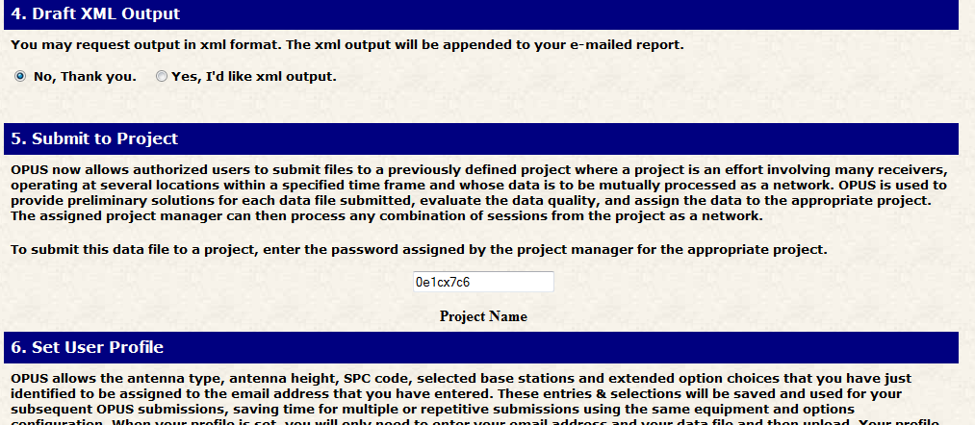
Complete the other option fields as needed, but be certain to insert your project’s keyword.
If you have many data files, consider taking advantage of the “Set User Profile” option, at the bottom of this page.
2010-Jul-22
136

Slide 137
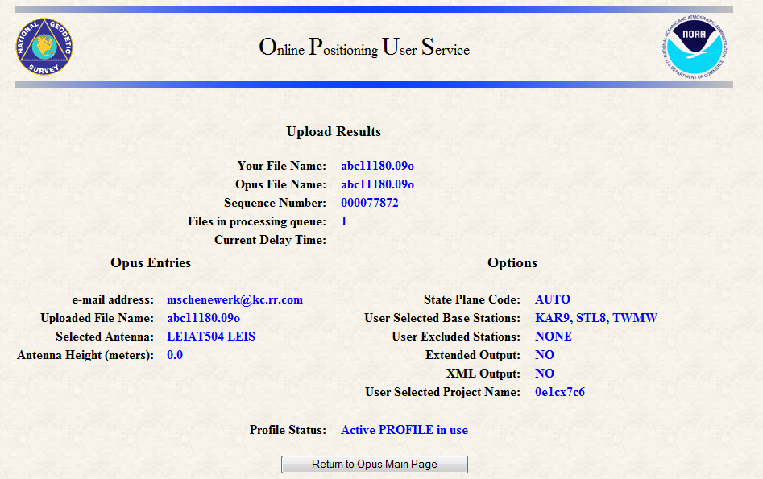
Once uploaded, OPUS-S will remind you that this data will be associated with your project.
2010-Jul-22
137

Slide 138
When data are submitted to a project, the OPUS-S results are “quality controlled” using thresholds specified by the project manager.
If the results from a data file exceed any of the thresholds, a warning message is sent to the email address entered when the data were submitted.
Receiving a warning message does not mean the data
will be excluded from your project. That is the project’s decision. However, the data are flagged for easy identification by the project.
2010-Jul-22
138

Slide 139
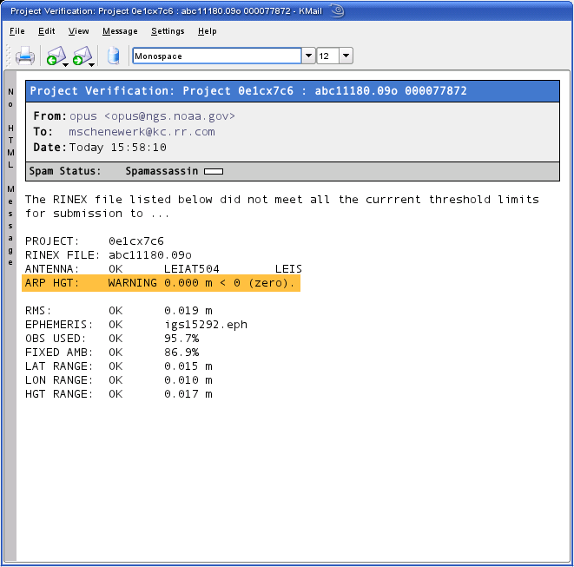
The highlight is mine.
2010-Jul-22
139

Slide 140
OPUS-Projects groups the data into sessions.
Sessions are groups of site occupations that overlap significantly in time. Note that
a site may appear in more than one session.
as new data are submitted, the definitions of the sessions may change.
Now that some data has been submitted to the project, processing can begin.
2010-Jul-22
140

Slide 141
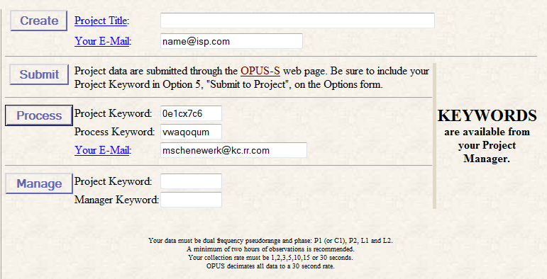
To review or process a session, enter the project and process keywords, and your email address, then click the “Process” button on the OPUS-Projects home page.
OPUS-Projects will display your page after a brief pause.
2010-Jul-22
141

Slide 142
Let’s switch to a project already loaded with data.
The project title is:
“mss test project 1”
The project keywords are:
PROJECT : 6vlap35e
MANAGER : hrpyi51d
PROCESS : vdblq8ye
Please note that this is a project used for testing and, so, may not always be in this exact state. Nevertheless, feel free to visit and look around.
http://www.ngs.noaa.gov/OPUSI/OPUS-Projects.html
2010-Jul-22
142

Slide 143
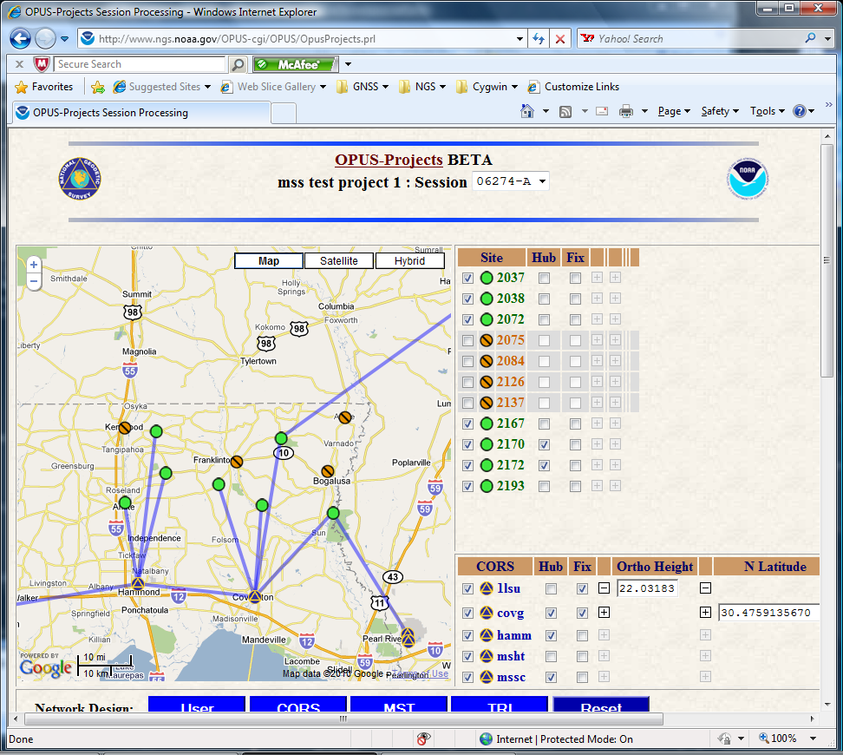
2010-Jul-22
143

Slide 144
This is the page for session 06274-A of “mss test project 1”. The components of this page are:
The banner shows the project’s title and session. The session ID can be used to select another session to review/work with.
2010-Jul-22
144

Slide 145
The map shows the relative positions of the sites in this session. The positions of the included CORS sites are indicated too.
2010-Jul-22
145

Slide 146
The map sidebar’s upper table lists the user’s sites and controls.
2010-Jul-22
146

Slide 147
These are sites whose data met the project’s quality control thresholds.
2010-Jul-22
147

Slide 148
These are sites whose data did not meet the project’s quality control thresholds.
2010-Jul-22
148

Slide 149
The CORS are segregated from the user’s sites in the lower table and identified by a special symbol.
2010-Jul-22
149

Slide 150
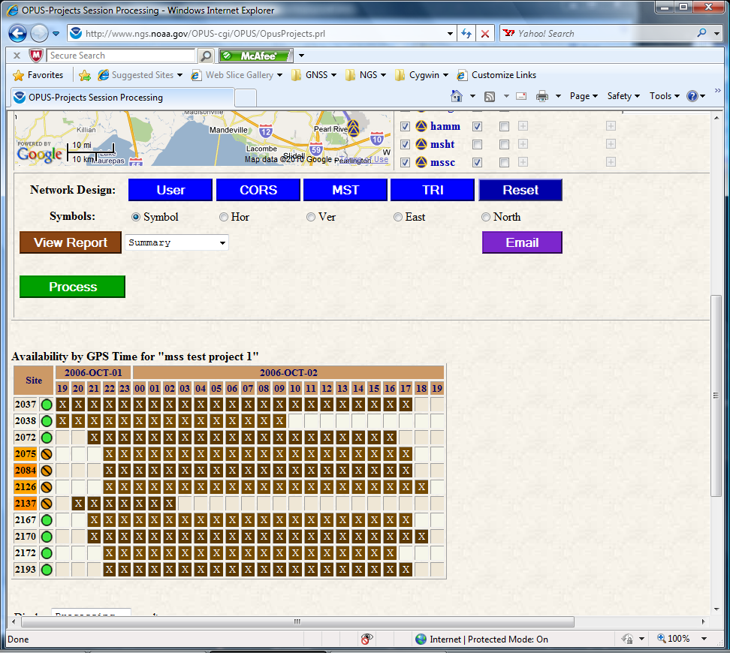
Scrolling down the web page …
Next, you’ll find the display, access and processing controls.
2010-Jul-22
150

Slide 151
Below the processing controls is a table representing the Data Availability for each site in this session.
2010-Jul-22
151

Slide 152
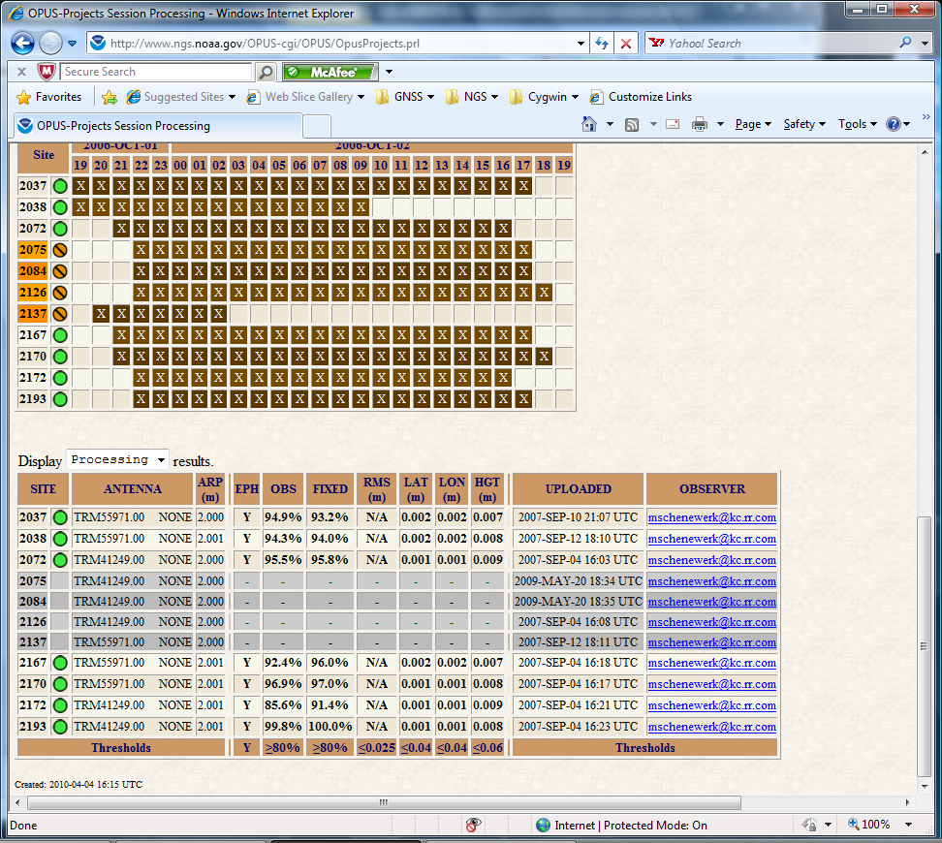
Scrolling one last time …
At the bottom of the page, a table summarizes the most pertinent information about each site including results from OPUS-S or OPUS-Projects.
2010-Jul-22
152

Slide 153
Let’s scroll back to the top of the page and look at some of the controls in a little more detail. First, on the map …
2010-Jul-22
153

Slide 154
If processing has occurred, as is the case here, the baselines selected in that processing are indicated.
2010-Jul-22
154

Slide 155
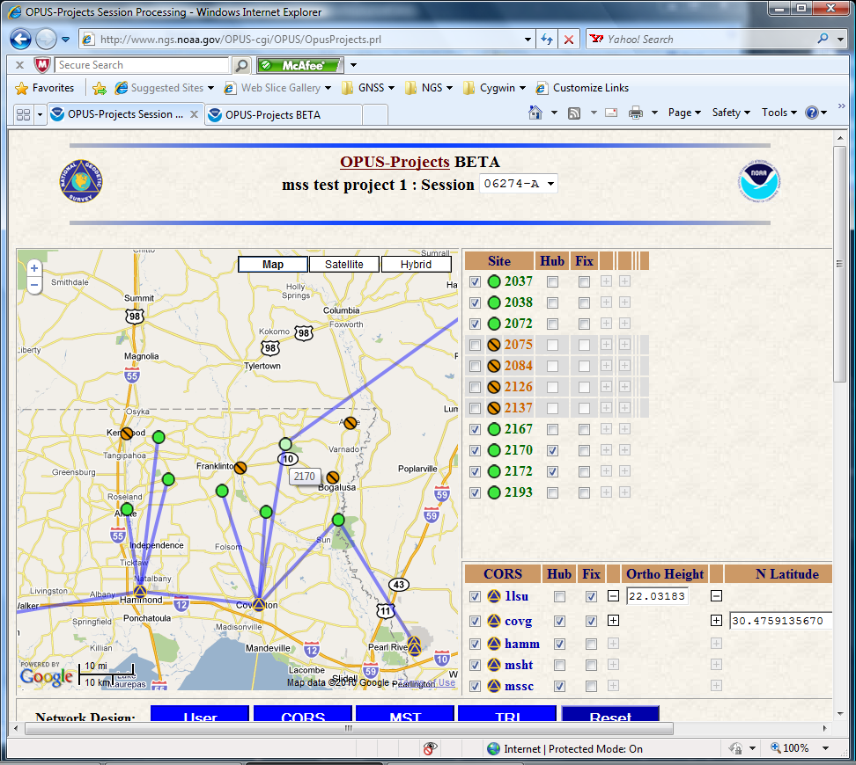
Before leaving the map, notice that if you let the reticule (cursor) hover over a map symbol, the site’s four character identifier appears.

Slide 156
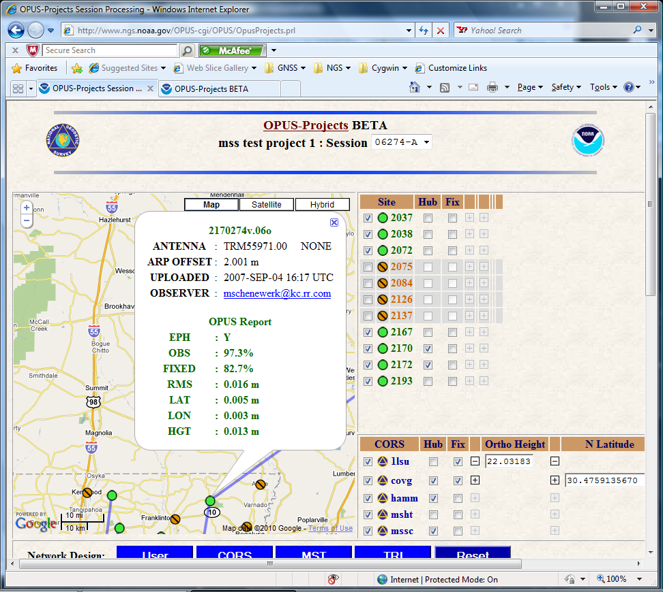
Clicking on a map symbol “pops” a window holding the site summary table’s information for that site.

Slide 157
Turning to the controls, placing the reticule over a sidebar table entry causes the corresponding symbol to “highlight”. Unfortunately, this can not be displayed meaningfully here.
2010-Jul-22
157

Slide 158
The first checkbox on each line signals that the site will or will not be included in the processing.
2010-Jul-22
158

Slide 159
The second checkbox designates sites to be used as “hub” sites.
By hub sites we mean sites that are preferentially selected when baselines are automatically chosen.
2010-Jul-22
159

Slide 160
The third checkbox designates sites that will be fixed, i.e. constrained, in the processing.
2010-Jul-22
160

Slide 161
Moreover, once a site has been designated as a fixed site, clicking the expansion button, the small with a “+” or “-” symbol, reveals fields where the user can enter the values to be used in the constraint.
Here, I’ve specified an orthometric height for 1lsu and horizontal coordinates for covg.
2010-Jul-22
161

Slide 162
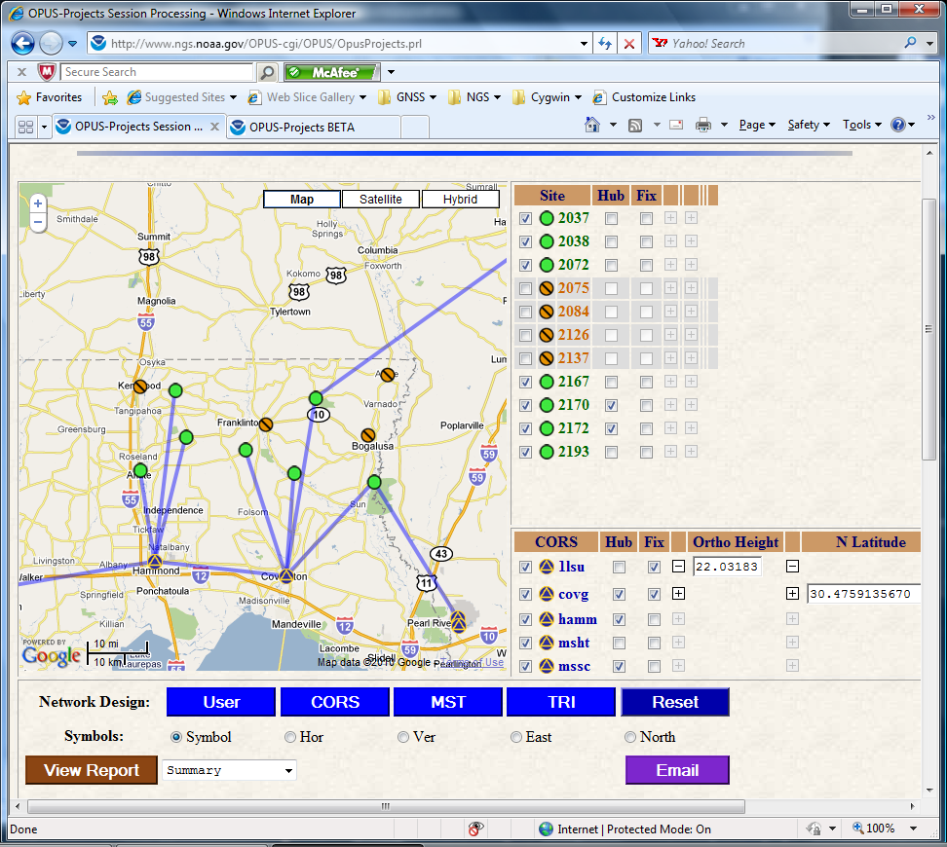
Moving our attention to the controls below the map and sidebar, the first row, labeled “Network Design”, controls the baseline selection.
Note that these controls may change the hub designations but not which sites are included or fixed.
2010-Jul-22
162

Slide 163
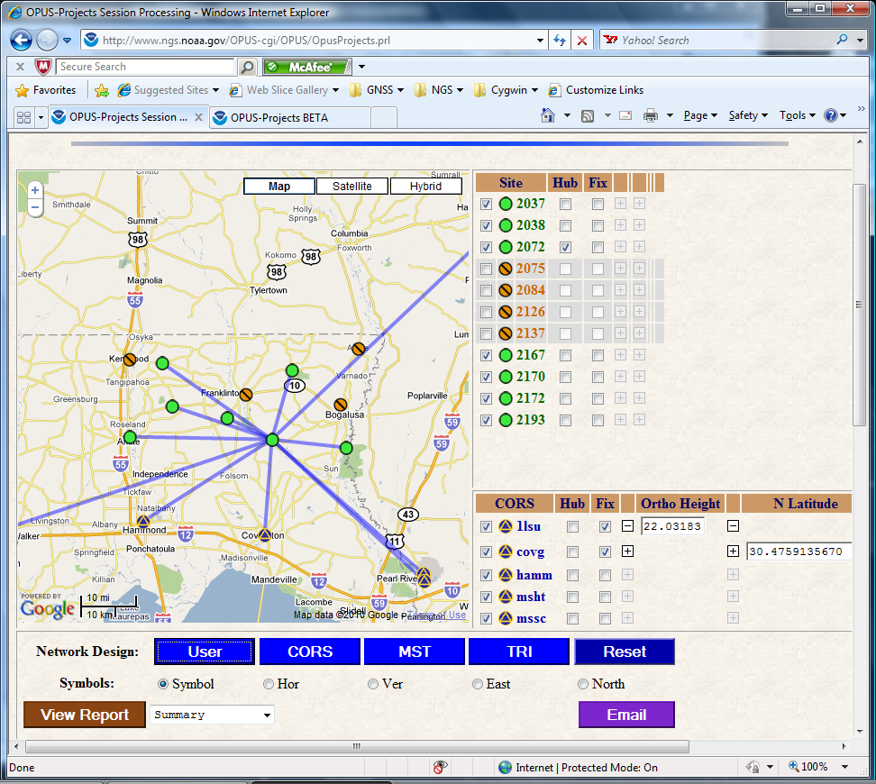
The first button causes baselines to be selected solely based upon user included and hub site selections. Here, I selected only one site to be a hub creating a “radial” design.
Note that the sites selected for omission or constraint are retained. The constraint values are also preserved.
2010-Jul-22
163

Slide 164
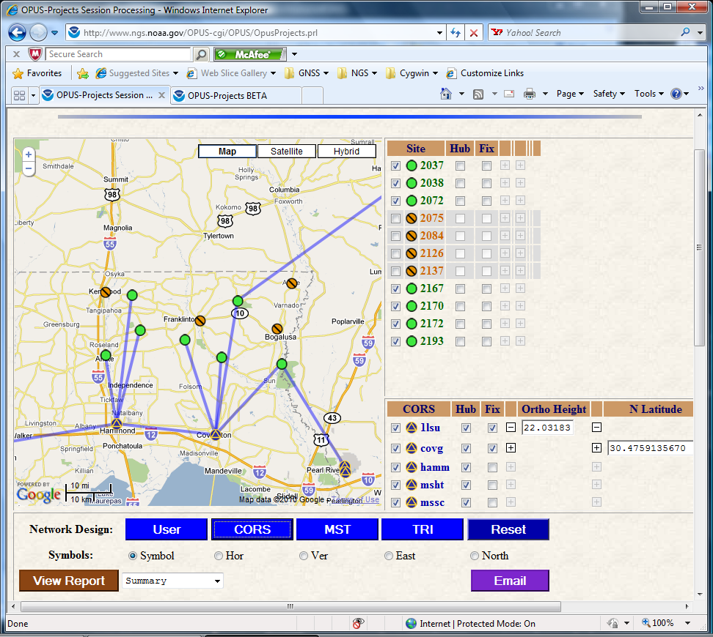
The CORS button forces all included CORS to be hub sites.
2010-Jul-22
164

Slide 165
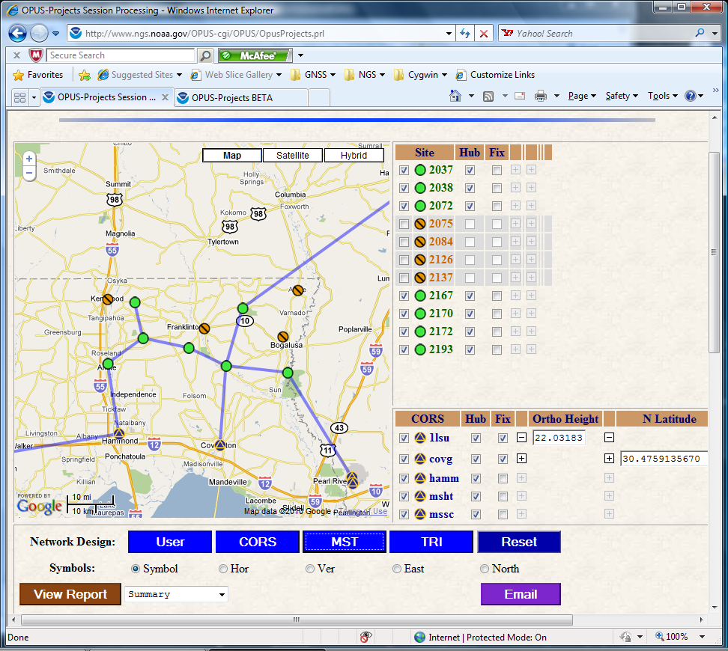
MST causes all included sites to be selected as hub sites resulting in a minimal-spanning tree.
2010-Jul-22
165

Slide 166
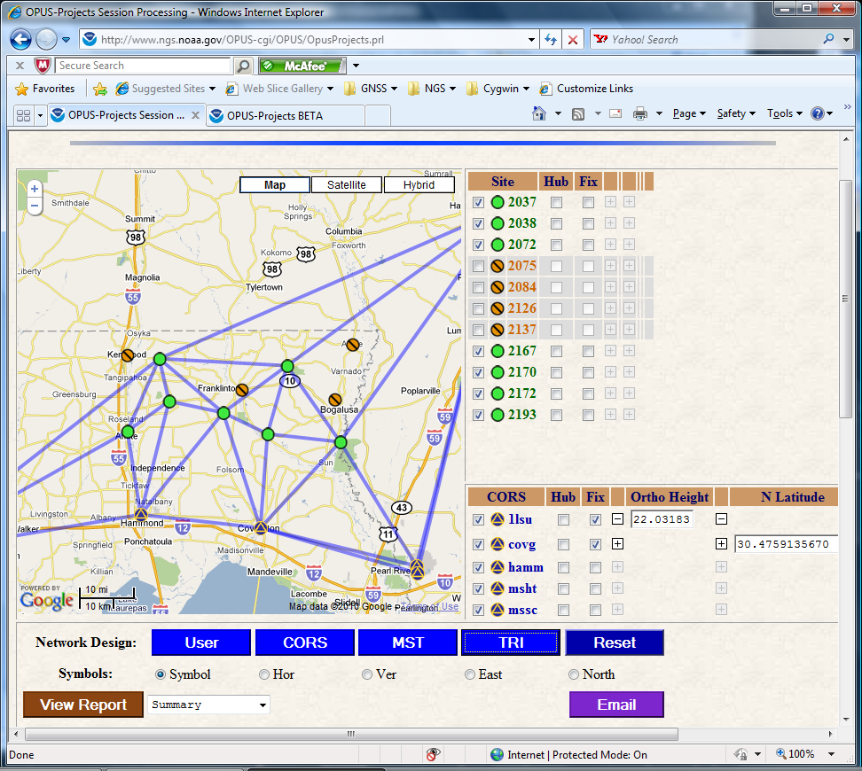
The TRI button creates “closed loop” as specified by a variant of the Delaunay triangulation method.
2010-Jul-22
166

Slide 167

Reset returns all selections to those used when the page is first displayed.
2010-Jul-22
167

Slide 168
Once the included, hub and fixed sites are selected and the network designed, the user only needs to click the “Process” button to submit their request to the processing queue.
OPUS-Projects reviews the selections before the request is inserted in the queue. If any inconsistencies or errors are found, these are reported immediately and the request is not submitted.
2010-Jul-22
168

Slide 169
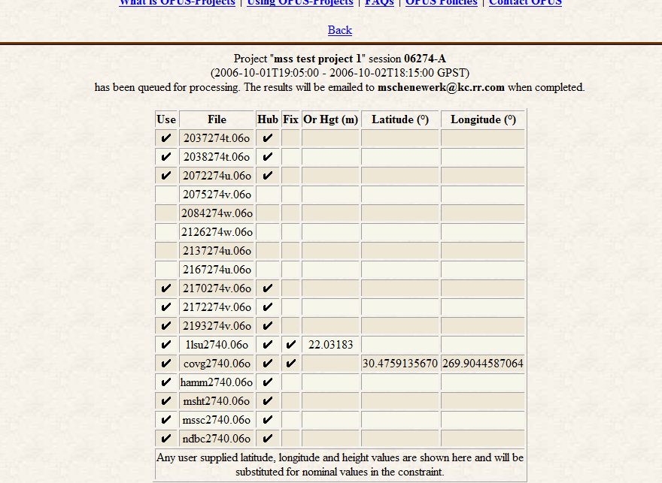
If the request is appears feasible, it is submitted to the queue and the selections summarized for the user’s records.
2010-Jul-22
169

Slide 170
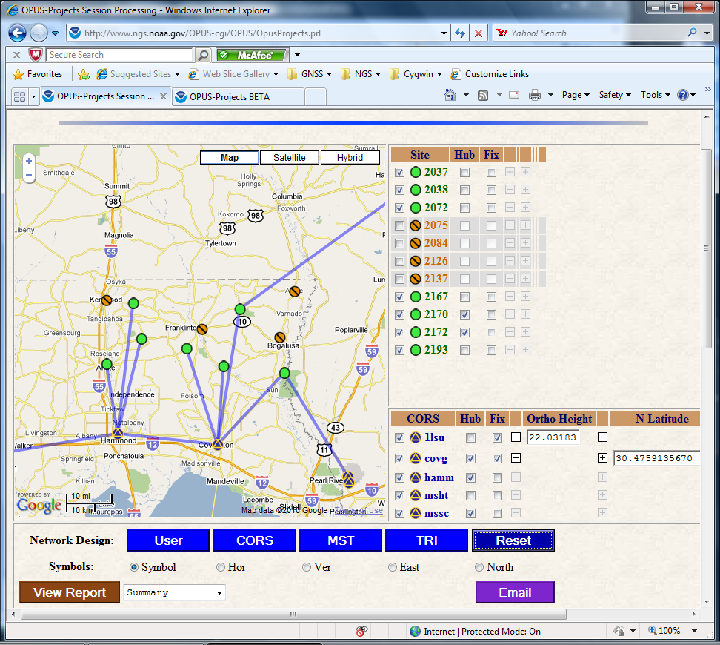
The next row of controls select the site symbols displayed on the map. The default is simple “dots.” A green/open circle indicates that a site has met all the projects thresholds; an orange/barred circle indicates it did not.
2010-Jul-22
170

Slide 171
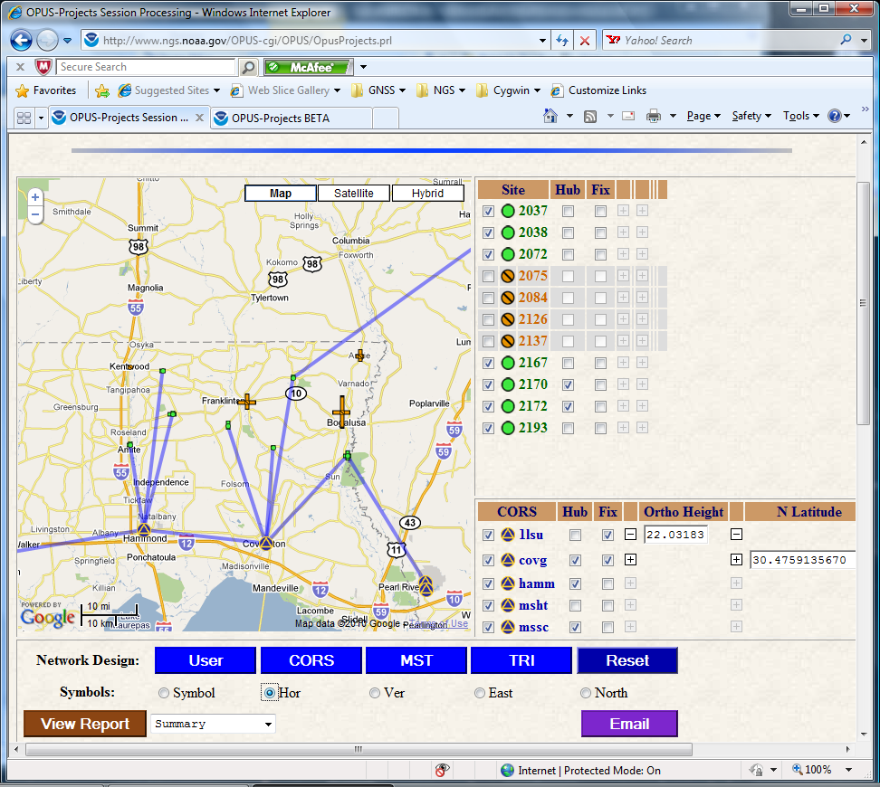
Checking “Hor” displays the north and east horizontal uncertainties for each site.
The threshold color coding is retained.
The East and North uncertainties can be shown separately using the checkboxes at far right.
2010-Jul-22
171

Slide 172
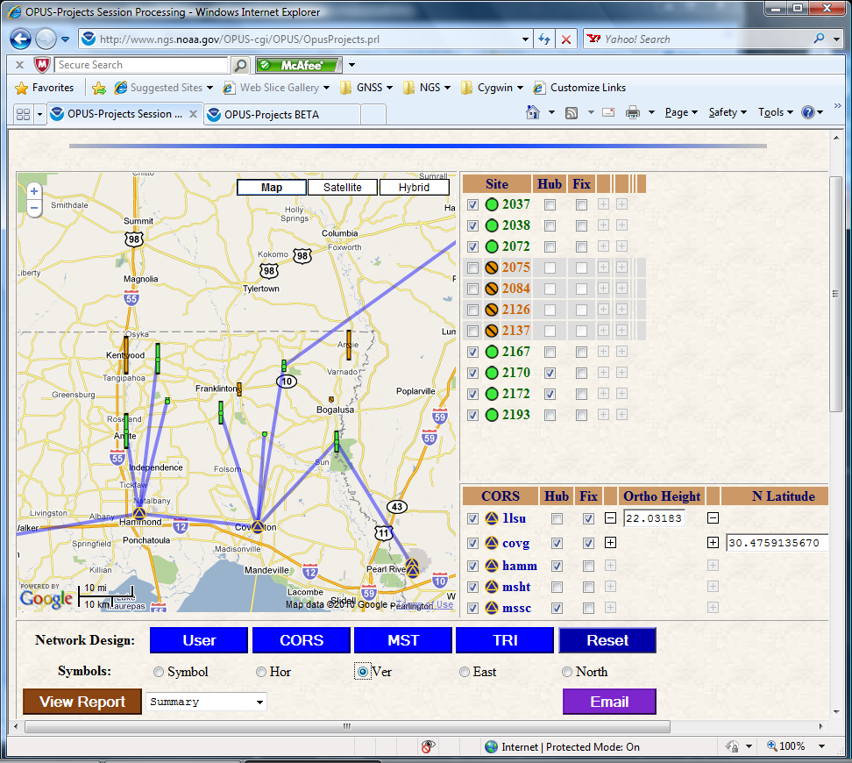
Similarly, the vertical uncertainties are represented when “Ver” is checked.
2010-Jul-22
172

Slide 173
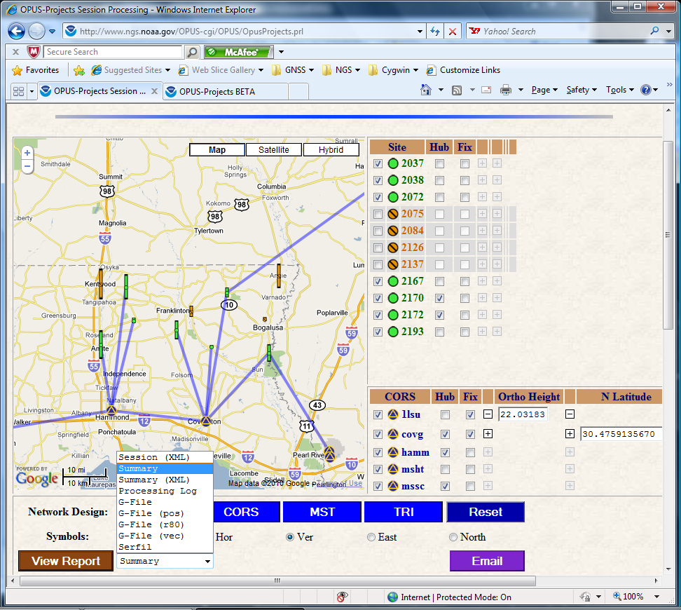
OPUS-Projects automatically generates a variety of reports. “View Report” displays the selected report on the screen. These reports include:
A session summary in XML format.
The processing summary in text and XML formats.
The log from the processing engine.
A variety of G-file components.
As an example, sections of the processing summary are shown in the next slides.
2010-Jul-22
173

Slide 174
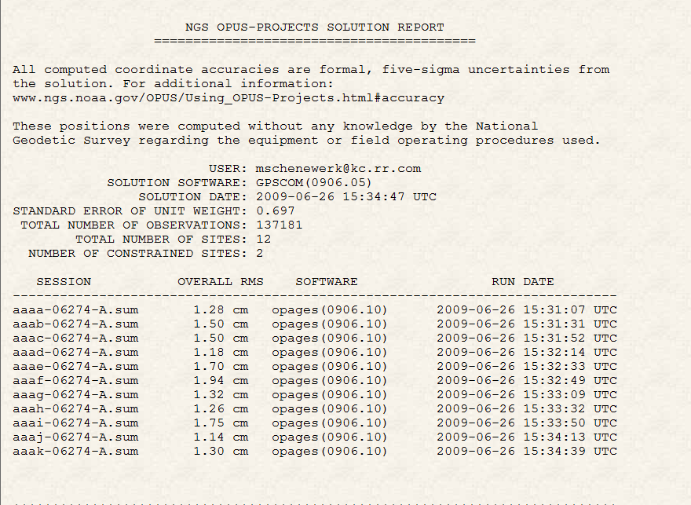
The processing summary reports the most pertinent information and overall statistics at the top.
2010-Jul-22
174

Slide 175
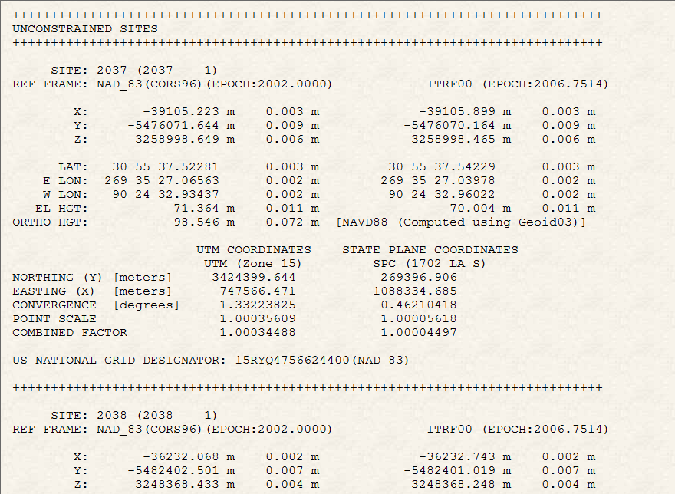
Site-by-site solution information follows in an OPUS-like format.
2010-Jul-22
175

Slide 176

These reports are emailed to the user after processing is complete; however, they can be re-sent or sent to others using the Email tool.
2010-Jul-22
176

Slide 177
At any time during its lifetime, the manager can review the project’s status and modify details. Once again we’ll use the more interesting project,
“mss test project 1”
whose keywords are:
PROJECT : 6vlap35e
MANAGER : hrpyi51d
PROCESS : vdblq8ye
Recall that this is an active test project and, so, may not always be in this exact state
2010-Jul-22
177

Slide 178

The manager’s tasks are sufficiently numerous and varied to warrant a separate login.
To begin, enter the project and manager keyword, then click the “Manage” button.
2010-Jul-22
178

Slide 179

The layout of the “Manage” page is typical of OPUS-Projects: a map showing the relative positions of all sites with sidebar tables on the right side listing the sites.
2010-Jul-22
179

Slide 180
Controls on the left are for managing the project and processing.
2010-Jul-22
180

Slide 181
The manager will be able to access on-line help and tutorials.
2010-Jul-22
181

Slide 182
Send email to the other participants in the project or the OPUS-Project czar.
2010-Jul-22
182

Slide 183
Review processing reports, process sessions or the entire network.
2010-Jul-22
183

Slide 184
Review and modify the thresholds used in quality controlling the data.
2010-Jul-22
184

Slide 185
Change site names, antenna types and ARP offsets.
2010-Jul-22
185

Slide 186
Manage the bureaucratic details of the project.
2010-Jul-22
186

Slide 187
Request the project be deleted.
2010-Jul-22
187

Slide 188

At the bottom of the page is a summary table showing the sites and their quality control status.
The table is organized by site (left) and the sessions in which they’re included (top).
The site and session identifiers are convenient links which take the manager to the indicated site or session (Process) summary page.
2010-Jul-22
188

Slide 189
Work has begun on the individual site summary pages. Hopefully, these pages will address at least some of the concerns voiced about quality controlling the solutions.
Each page will contain pertinent information about each site:
  Data file names.
  Associated antenna types and offsets.
  Plots summarizing the OPUS, session and network solutions
  Tables summarizing those solutions.
  Other information from OPUS-DB or the IDB.
2010-Jul-22
189

Slide 190

These are examples of two plots-types that can already be displayed for the sites.
The project thresholds are indicated in orange, the OPUS solutions as gray circles, session solutions as blue diamonds, a network solution (not available here) as a green square.
The user will be able to turn on/off each symbol type.
2010-Jul-22
190

Slide 191
Eventually, OPUS-Projects will be integrated with the other aspects of OPUS; most notably OPUS-DB.
With that, in addition to a working tool, the site summaries will seem to be a preview of the publication to the data base.
The manager will be able to review and modify the sites’ meta-data, then publish entire projects (or as much as he/she chooses) with the click of a button.
2010-Jul-22
191

Slide 192

How Good Can I Do With OPUS-Projects?
Schenewerk submitted several
3-hour CORS data sets to
OPUS and OPUS-Projects.
A representative east versus north
plot for anp5 is shown.
The white box represents ±2 cm,
centered on the ITRF2000 coordinates
projected to the mean epoch of these data.
OPUS results are gray circles with their peak-to-peak uncertainties.
OPUS-Projects solutions for individual occupations are blue diamonds with formal 5σ uncertainties.
The OPUS-Projects solution for all occupations is the green square also with 5σ uncertainties.
2010-Jul-22
192

Slide 193

How Good Can I Do With OPUS-Projects?
Here is the related plot showing
the ellipsoid height estimates
relative to the accepted value
projected to the mean epoch
of these data.
The white box now represents
±4 cm. The meaning of all other
symbols remains the same.
In all cases examined, OPUS performed very well, but OPUS-Projects performed slightly better with minimal additional effort.
2010-Jul-22
193

Slide 194
New Developments for OPUS
Dr. Mark Schenewerk
Mark.Schenewerk@noaa.gov
913-481-9998

