Slide 1
Update to the UN Subcommittee on Geodesy 4th Plenary Session
Daniel Roman, Bureau Member to SCGeodesy / Chair, FIG Americas CDN
Sergio Cimbaro, Member IAC-UN-GGCE / Bureau Member SCGeodesy UN-GGIM
Gustavo Caubarrere, Chair, UN-GGIM: Americas WG GRFA/President, SIRGAS
Dana J Caccamise II, Rep., UN-GGIM ANA/US Rep., SIRGAS
Notes:
Speaker: Sergio
Talking Points: Introduce co-authors

Slide 2
History of UN-GGIM: Americas
Resolution No. 3 of the Sixth Regional Cartographic Conference of the United Nations for the Americas (UNRCC-Americas) 1997
Established the Permanent Committee for Geospatial Data Infrastructure of the Americas (PC-GDIA)
UN Secretariat report established UN-GGIM in 2011
PC-GDIA became the UN-GGIM: Americas in 2014
It was reorganized recently into four WG’s – with the most recent being the Geodetic Reference Frame for the Americas (GRFA)
Notes:
Speaker: Dan
Talking Points: A brief history of the evolution of the RC for the Americas

Slide 3
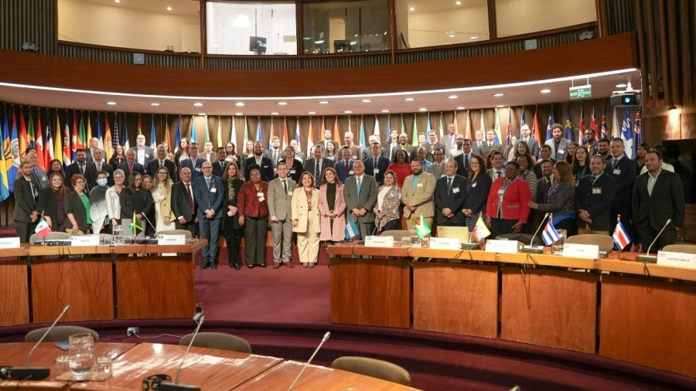
Structure of UN-GGIM: Americas
Leadership
Working Groups and Networks
President: Sofía Nilo Crisóstomo
Vice-President: Leonardo Scharth Loureiro
Executive Secretary: Pamela Castillo
Board Members (Vocales)
Gabriela García Seco, North America
Isis Tejada, Central América
Simone Lloyd, Caribbean
Marcelo Emery, South America
Working Groups
Integration of Statistical and Geospatial Information
Disasters
Geodesy (GRFA)
Integrated Geospatial Information Framework
Land Administration (in process of implementation)
Networks
ANA - Rosario Casanova
Private Sector – Valrie Grant
Notes:
Speaker: Dan
Talking Points: RC Leadership and general structure
GRFA - Geodetic Reference Frame for the Americas
Note that GRFA implmenets the GGRF for the Americas

Slide 4
Geodetic Reference Frame for the
Americas (GRFA)
Projects (CARIGEO … )
UN-GGIM: Americas
ANA
Private Sector
Working Group inside of UN-GGIM-Americas
Implements the GGRF for the Americas
Equivalent to the UN SCoG for the Americas
Membership is identical to the Directing Council of SIRGAS (Responsible for Geodesy in member countries)
This simplifies the connection between science and policy
Recent Resolution supported Americas Nations adopting GGRF
SIRGAS: Sistema de Referencia Geodésico para las Américas
In English: Geodetic Reference System for the Americas
SIRGAS has roots in both the International Association of Geodesy (IAG) and the Pan American Institute of Geography and History (PAIGH)
SIRGAS is IAG 1.3b but is separately an NGO for the Americas
Three WG’s inside SIRGAS
WG1 – Reference System: combines IAG 1.3b, 1.3c (SIRGAS and NAREF)
WG2 - SIRGAS at national level: National implementation of SIRGAS
WG3 – Vertical Datum: combines IAG 2.4b and 2.4c (GG in SA and GG NCA)
ISGI
GRFA
Disasters
IGIF Americas
SIRGAS Directing Council
Notes:
Speaker: Gustavo
Talking Points: Note that the GRFA members are intended to be identical to the SIRGAS Directing Council
Cover the internal organization of SIRGAS

Slide 5
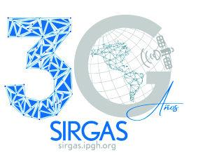
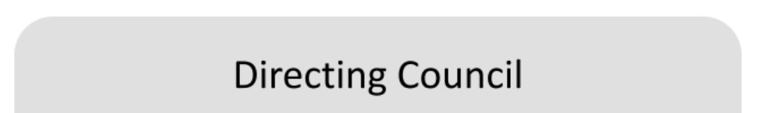
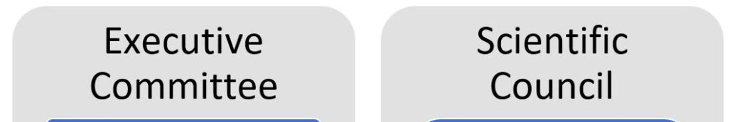
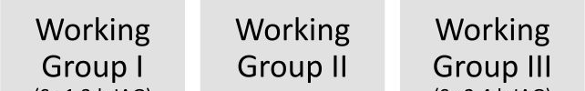
SIRGAS Structure
IAG, PAIGH, reps from 22 member states, observers
EC - Pres., VP, WG Chairs
SC - DC votes on members
WG1 - Geometric TRF
WG2 - National Networks
WG3 - Geopotential RF
(DC)
(EC)
(SC)
(WG1)
(WG2)
(WG3)
Notes:
Speaker - Gustavo
Talking Points: Function of different elements of SIRGAS
SIRGAS DC membership is only for 22 of the 37 Nations in the Americas
Hence, there is not yet parity between the GRFA and SIRGAS
Additional member states, especially from the Caribbean region (e.g., Jamaica), are being invited to join
Note the three WG’s inside SIRGAS that address the scientific needs of Member States
Will now discuss the three Working Groups in further detail

Slide 6
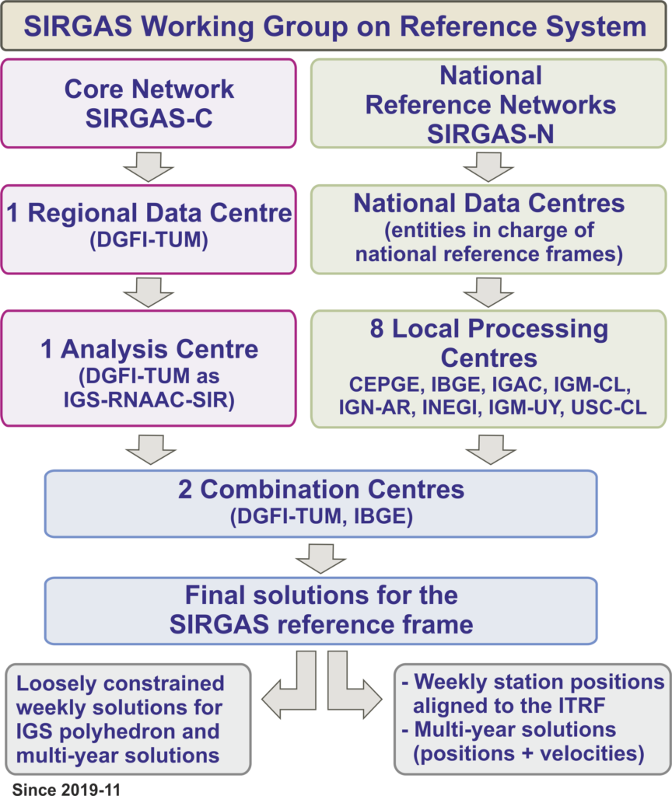
SIRGAS WG 1 IAG 1.3b
Regional Analysis Center of Associates of the IGS Network for SIRGAS (IGS, RNAAC, & SIRGAS)
11 SIRGAS Processing Centres (Local) in the Americas Nations
One Analysis Centre dedicated to the Neutral Atmosphere
Two SIRGAS Combination Centres
VLBI Analysis Center of IVS
SLR processing Center in progress
Notes:
Speaker: Gustavo
Talking Points: SIRGAS originally focused on South and Central America, which is covered by IAG 1.3b
Much of the structure is organized to support that

Slide 7
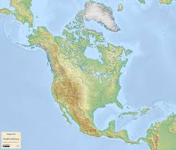
SIRGAS WG 1 - cont IAG 1.3c
IGS Analysis Centers, six
Global Network Associate Analysis Centers, one
Regional Network Associate Analysis Centers, two
Notes:
Speaker - Dan
Talking Points: Separately, NAREF (IAG 1.3c) has been developing their own processing centers
The merging of the processing centers for all the Americas is a work in progress

Slide 8
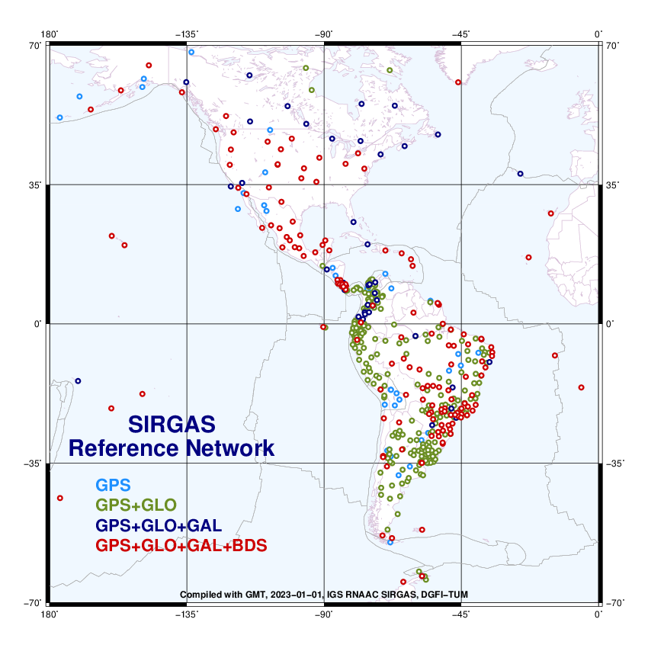
SIRGAS WG 1 IAG 1.3b and IAG 1.3c
SIRGAS Stations
Multi-GNSS predominant
Distribution is for SIRGAS-N (all stations now in SIRGAS)
Future inclusion of some North America stations
Training
2023 - 8th SIRGAS School on Reference System – Heredia and San José, Costa Rica
July 3 to 7, 2023, 55 assistants from Chile, Colombia, Costa Rica, Ecuador, Brazil, Mexico, Panama and Republica Dominicana.
Notes:
Speaker - Dan
Talking Points: Merging of the stations is much further along
There is a plan for including further information inthe North America region
There have been recent training opportunities and these will occur again in the future in some form

Slide 9
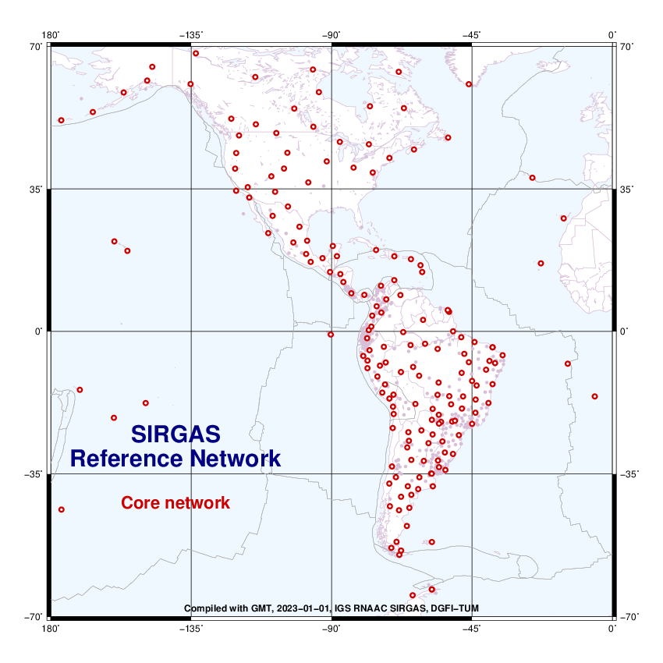
SIRGAS WG 1 - cont IAG 1.3b and IAG 1.3c
SIRGAS-C core network
Primary densification of ITRF
Americas and the Caribbean
Good continental coverage
Stable site locations ensure long-term stability
Combines IAG 1.3b & 1.3c
Select stations used in IGS solutions for ITRF
Notes:
Speaker - Gustavo
Talking Points: These are the core stations representing all the Americas IAG 1.3b + IAG 1.3c)
These stations are available for inclusion in future IGS/ITRF modeling

Slide 10
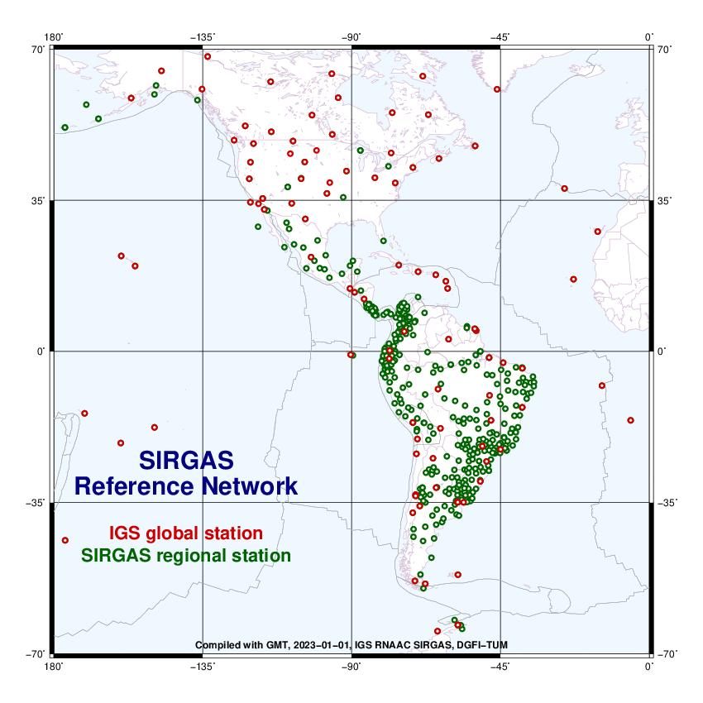
SIRGAS WG 1 - cont IAG 1.3b and IAG 1.3c
SIRGAS-N - National reference network
Improves the densification of the core network
Provides national and local access to the reference frame
Both, SIRGAS-C and SIRGAS-N satisfy the same characteristics and quality
Each station is processed by three analysis centres.
Notes:
Speaker - Gustavo
Talking Points: Incorporating the national densifications provides a more robust, extended network

Slide 11
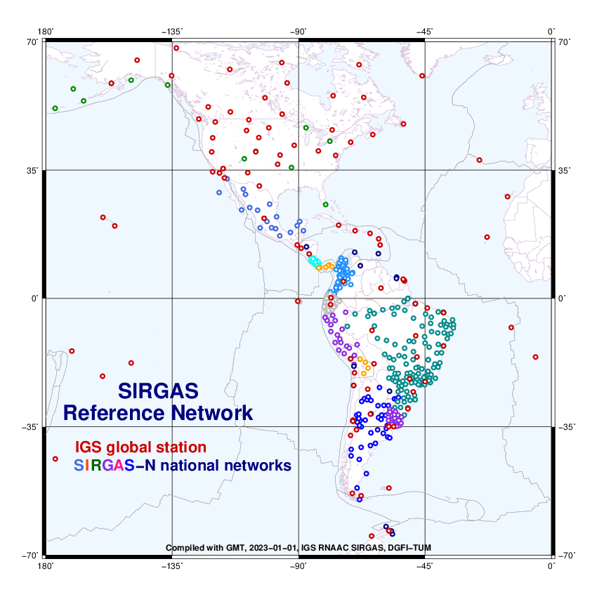
SIRGAS WG 2
. Almost all countries in the Americas are aligned with the GGRF.
. We are working to incorporate all countries, particularly those in the Caribbean.
Notes:
Speaker - Gustavo
Talking Points: Still working to include more Nations particularly from the Caribbean
WG2 works with members to align their national systems to SIRGAS
These national densifications fit the respective national datums but can be related back to SIRGAS and the ITRS

Slide 12
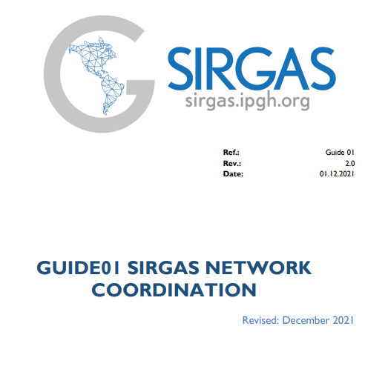
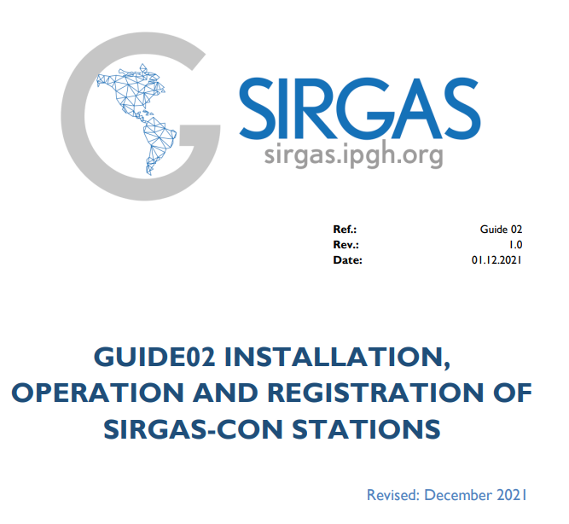
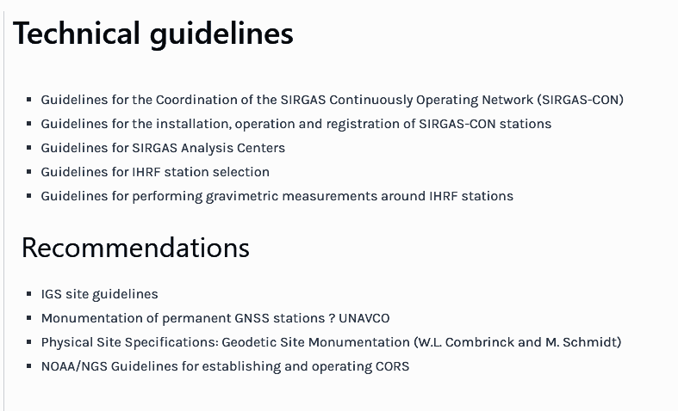
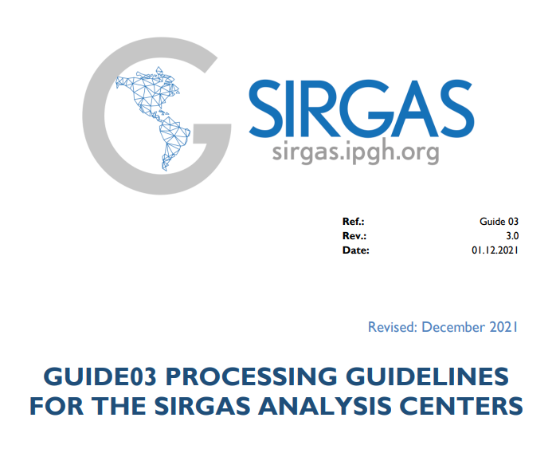
SIRGAS WG 2
Notes:
Speaker - Gustavo
Talking Points: WG 2 has documented guidance to aide new accessions into SIRGAS

Slide 13
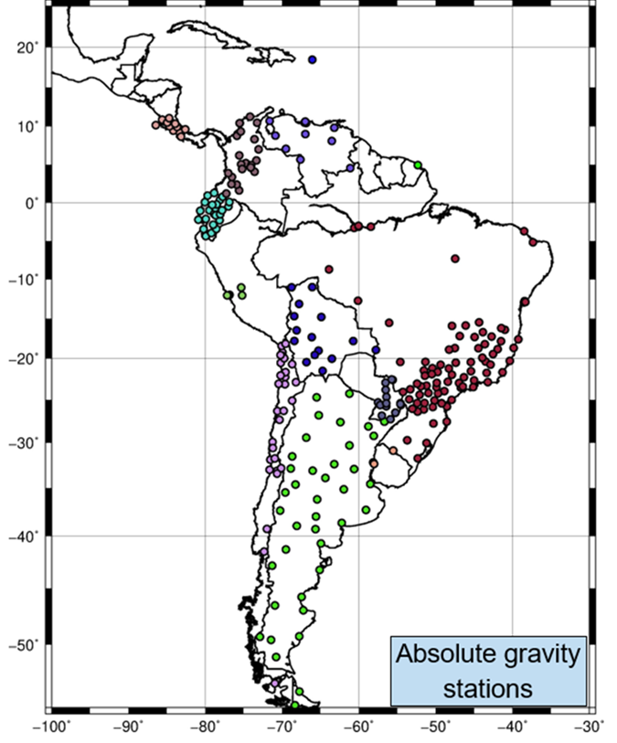
SIRGAS WG 3 IAG 2.4b
SIRGAS works together with universities and geographic institutes to determine absolute gravity stations in the region.
SIRGAS encourages countries to keep data open and share gravity information in the AGrav (Absolute Gravity Database) repository of the International Gravity Field Service (IGFS) (agrav.bkg.bund.de).
Notes:
Speaker - Dan
Talking Points: Absolute gravity stations provide the unification for relative gravity throughout the Americas
We also aim to support making all data available following F.A.I.R principals

Slide 14
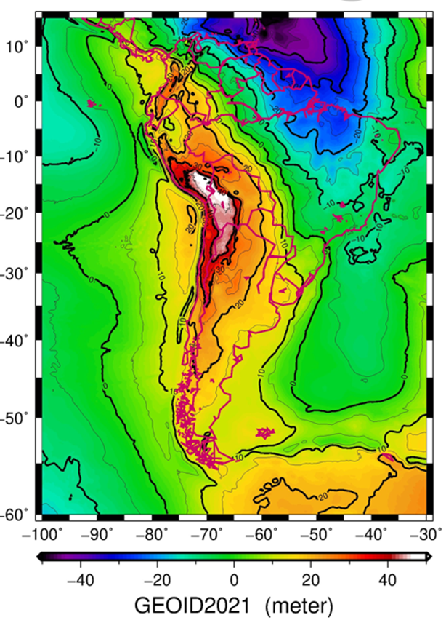
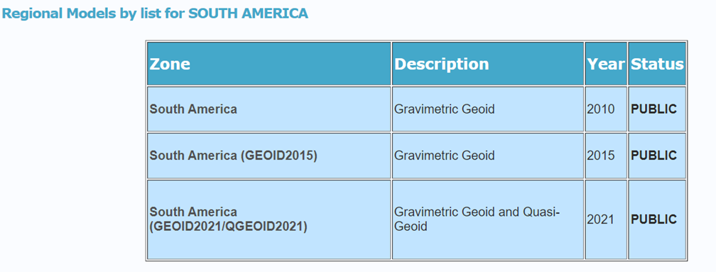
SIRGAS WG 3 - cont IAG 2.4b
SIRGAS makes geoid models available for the South American community. The models are available for download on the International Geoid Service (ISG) page of the International Geodesy Association.
Notes:
Speaker - Dan
Talking Points: The gravity data are then manipulated to produce a geoid model to serve as a vertical datum for South America (IAG 2.4b)

Slide 15
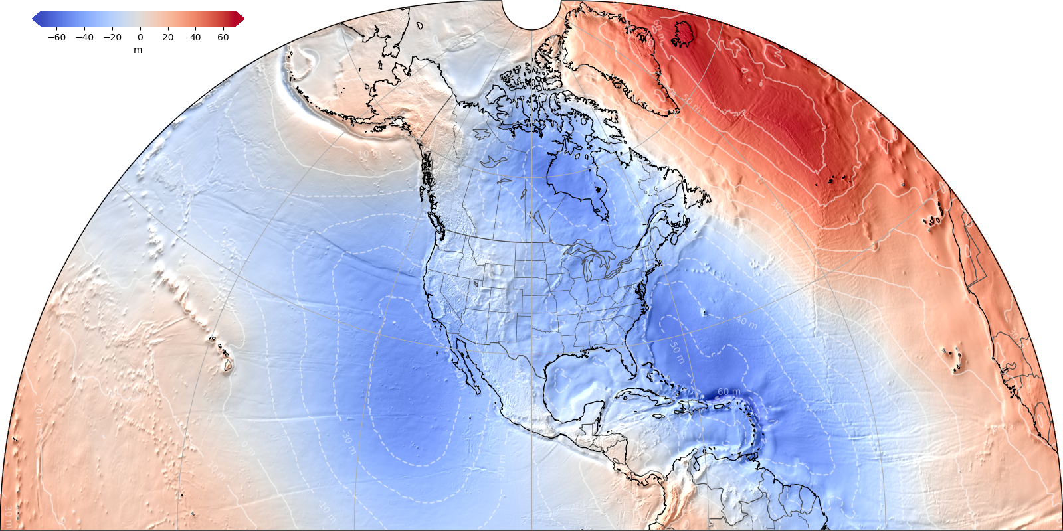
SIRGAS WG3 - NAGPD2022 (Alpha)
IAG 2.4c
Joint US-Canada Geopotential Datum
Use by Mexico
¼ Earth Surface
W₀ (IAU) = 62,636,856.0 m²s²
Estimated from over 200 TBMs
Notes:
Speaker - Dan
Talking Points: The North and Central America Gravity and Geoid (IAG 2.4c) that is nearly complete
This datum is actually a geopotential datum covering the entire region. It contains models of geoid height, gravity and deflections of the vertical. It can be used to produce normal, orthomertric and dynamic heights.
So merging the efforts betweeen North and South have not yet begun, but there is signficant overlap between the two

Slide 16
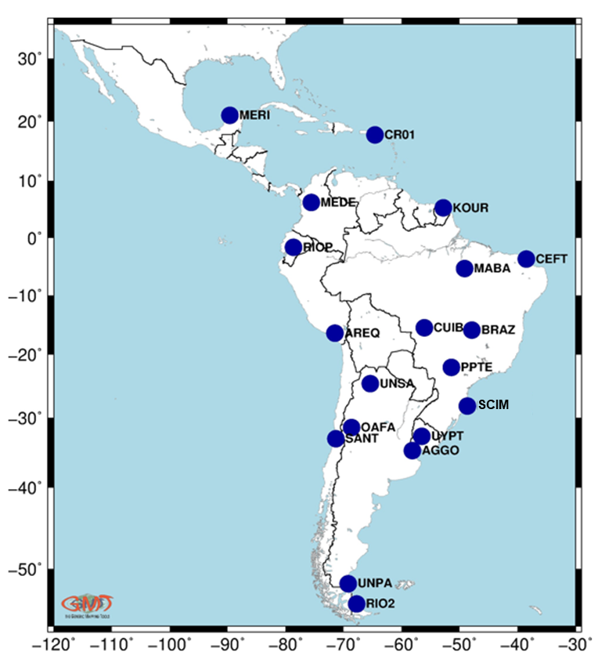
SIRGAS WG 3 - cont IAG 2.4b
SIRGAS is involved in the activities for the realization of the International Height Reference Frame. In Latin America 19 stations make up the global network.
The members of GT-III have collaborated in the calculation of gravity potential values for the stations in the region.
Notes:
Speaker - Dan
Talking Points: Additionally, there has been a great deal of effort to determine geopotential surfaces surrounding select sites to enhance production of a global model

Slide 17
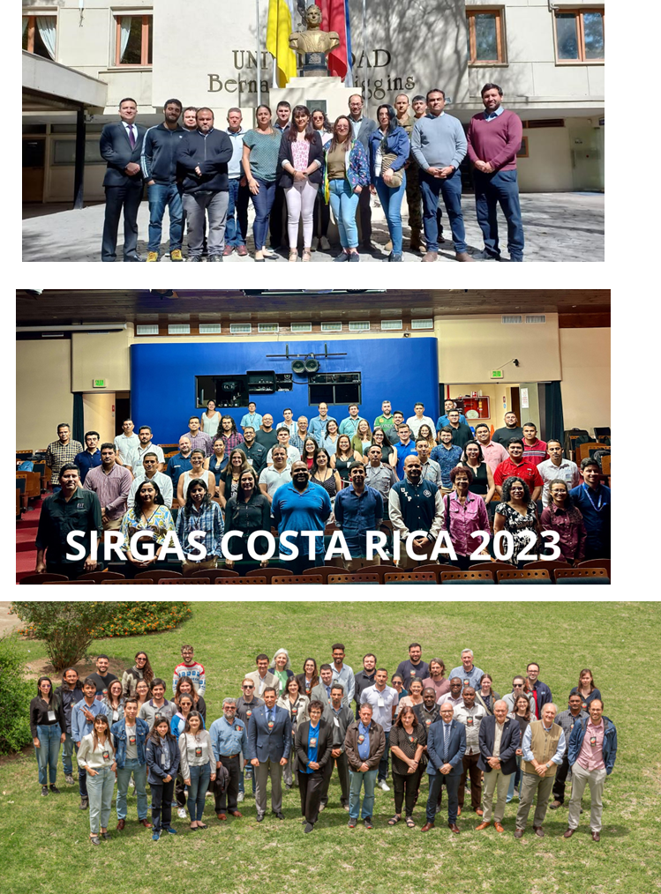
SIRGAS WG 3 -
Training activities
2022 - Workshop "Vertical Reference Systems“ – Santiago, Chile
November 2 to 4. 14 assistants from 6 countries.
2023 - 14th International School on “The Determination and Use of the Geoid” – Buenos Aires, Argentina
November 13 to 17. The school was held in cooperation with the International Service for the Geoid from the International Association of Geodesy. 40 assistants from 14 countries.
2024 - SIRGAS Symposium
November TBD. To train scientists, professionals and technicians from national mapping agencies, universities and research centers in the most modern geodetic techniques linked to the geocentric, altimetric and gravimetric reference frameworks.
Notes:
Speaker - Gustavo
Talking Points: WG3 has also helpd training and has an upcoming Symposium

Slide 18
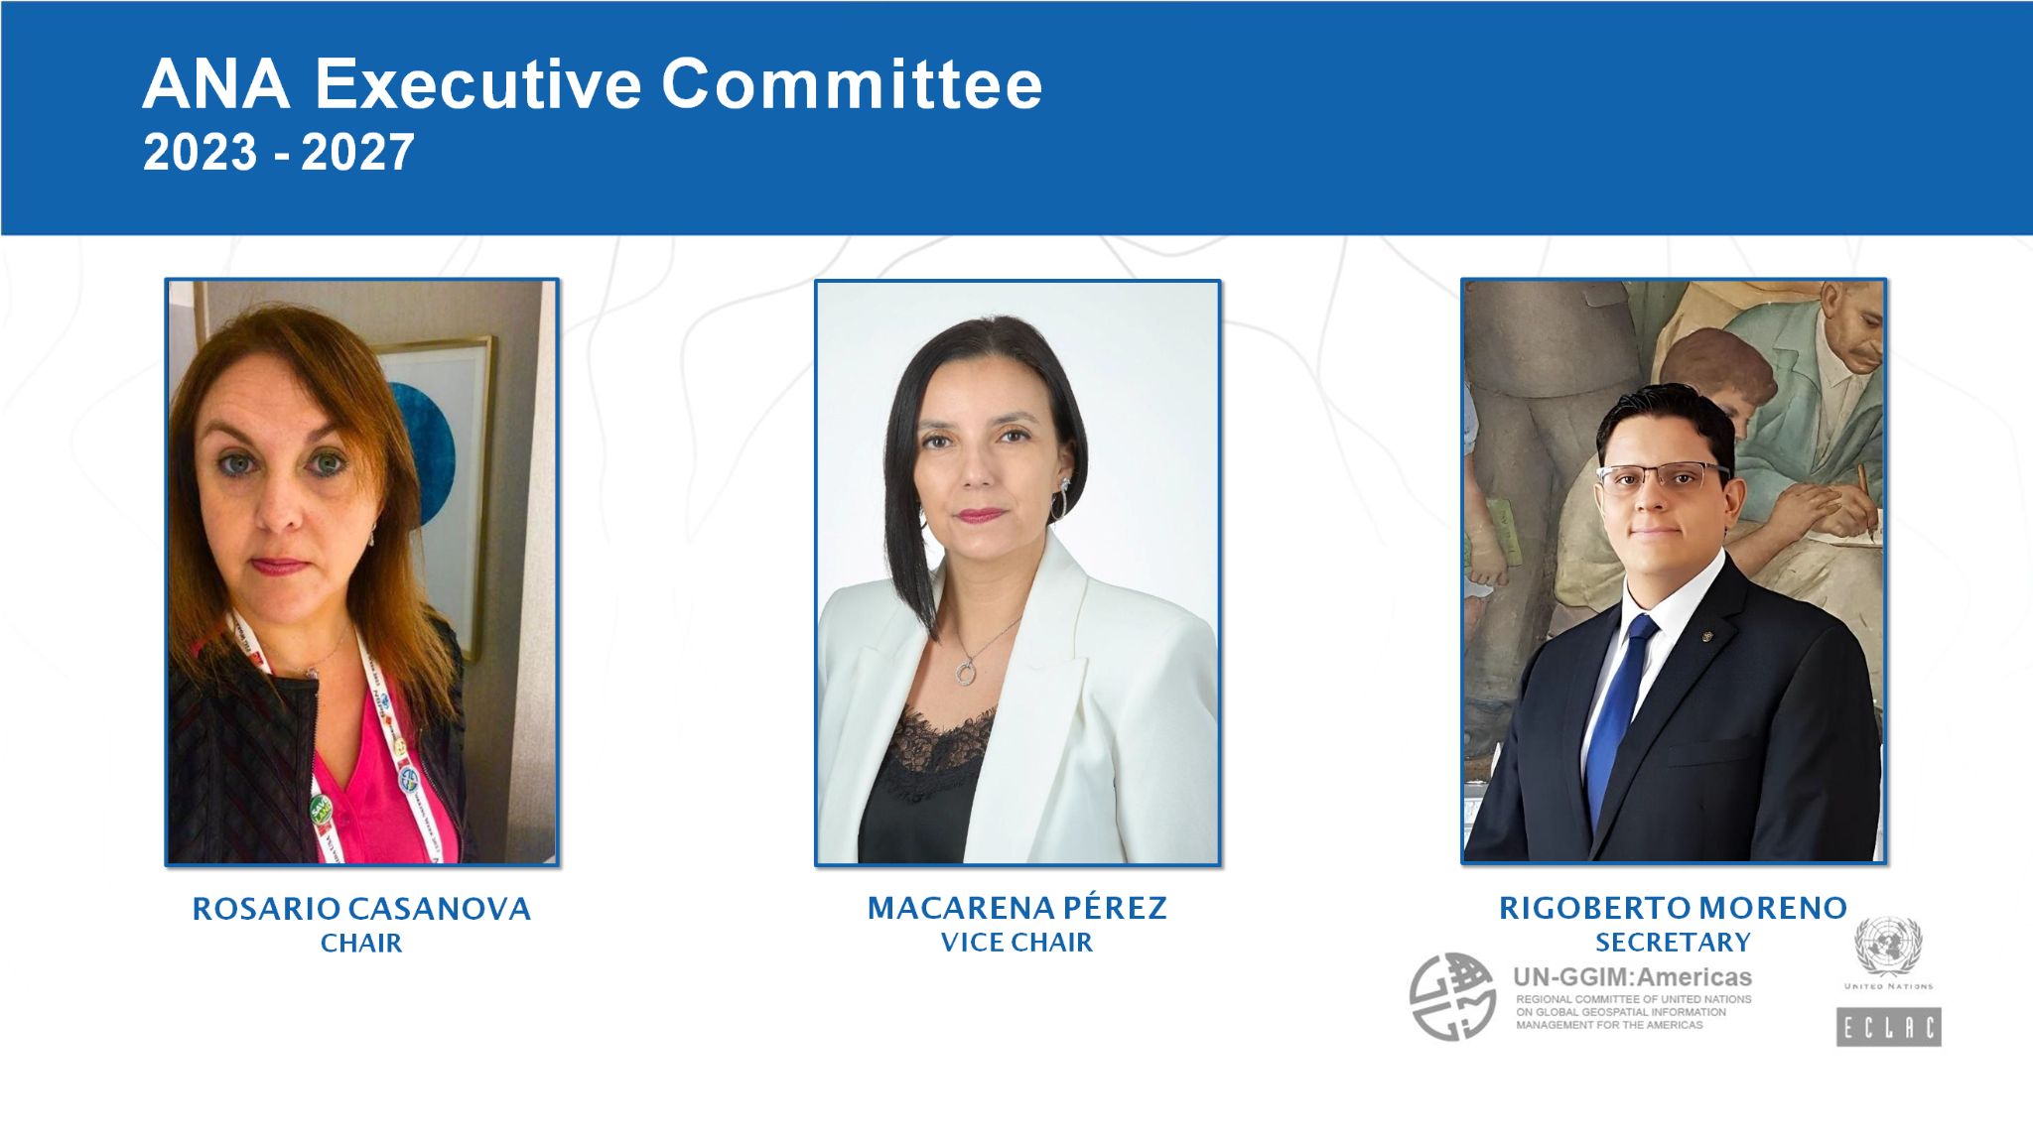
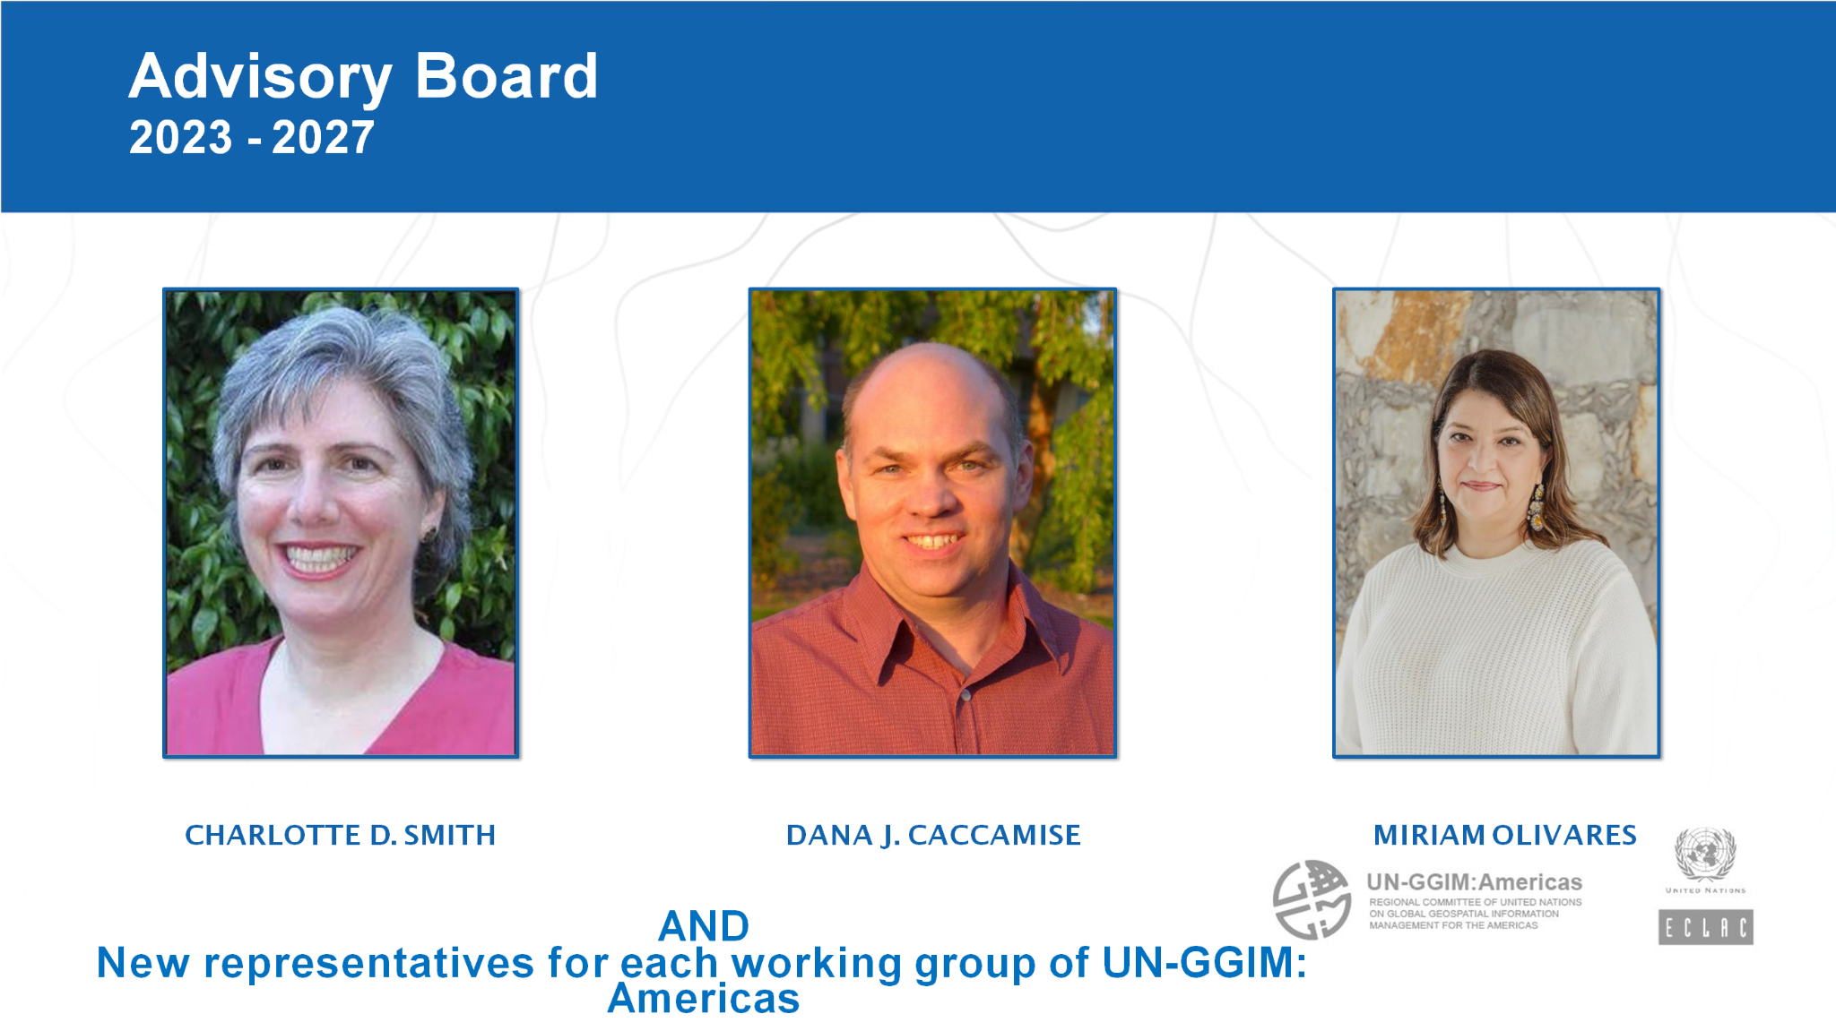
ACADEMIC NETWORK
UN-GGIM: AMERICAS
Collaboration working groups
Aguascalientes Declaration
Capacity Development WG
Education/webinars
As part of the activities of UN-GGIM: Americas
Diffusion of other educational activities from partners
Geo-Ethics
Include SDG in Academic Curr.
Ethical use of Geospatial Data
Inventory of courses related to Geospatial Data
Notes:
Speaker - Dan
Talking Points: The Academic Network of the Americas (ANA) has focused on training specific to geospatial professionals
It is developing an inventory of available, pertinent training resources

Slide 19
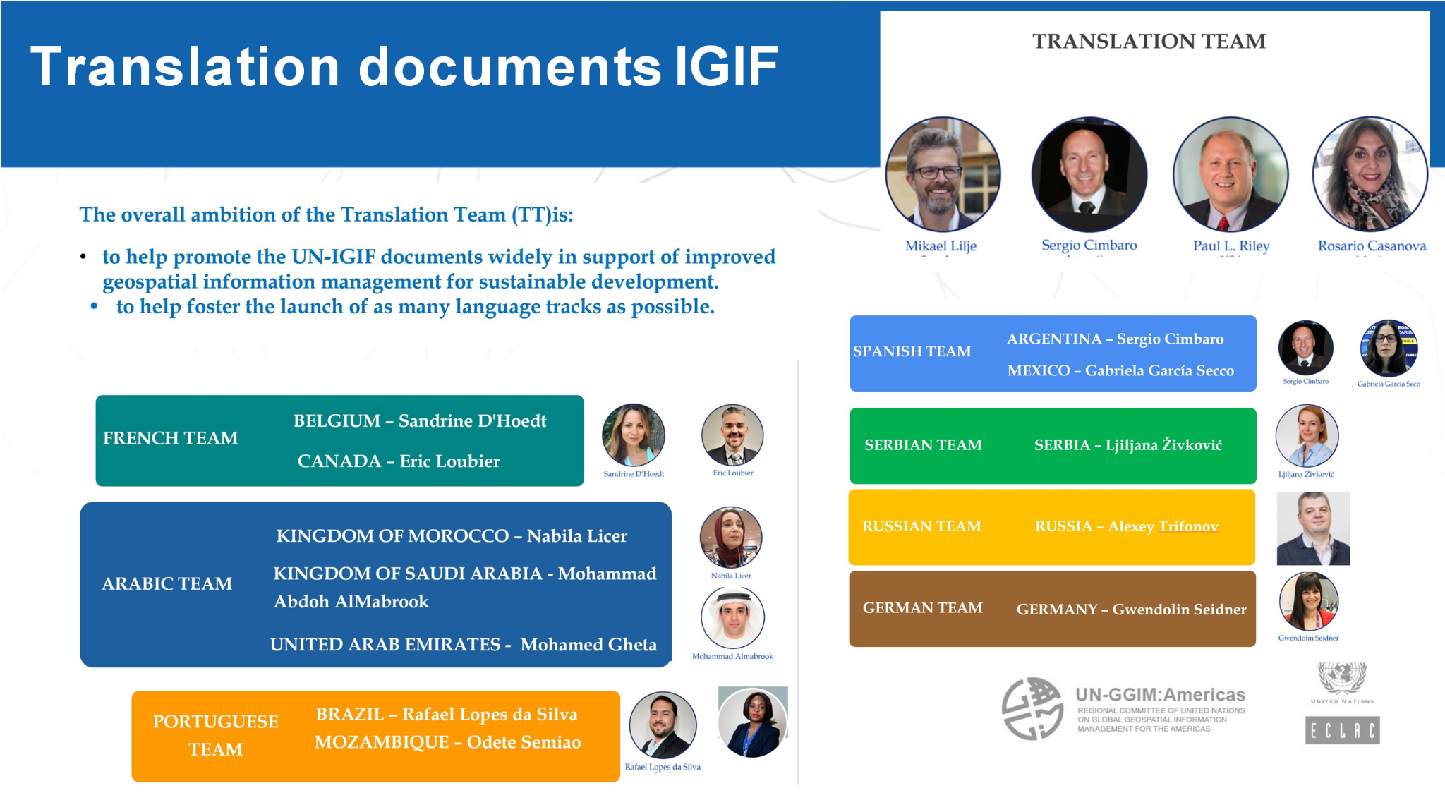
Notes:
Speaker - Dan
Talking Points: Additionally, they have been heavily engaged in translation of IGIF documents into multiple languages

Slide 20
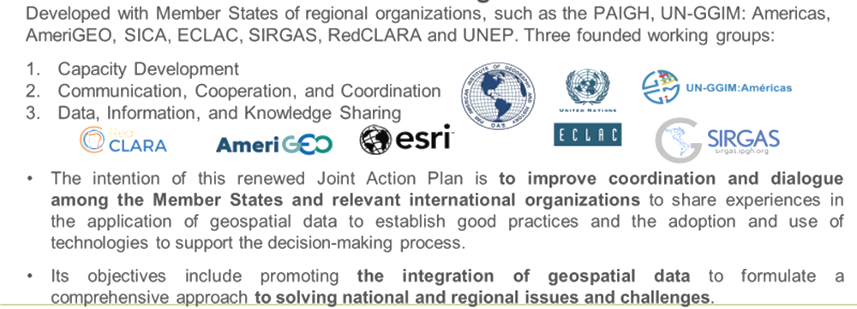
Joint Action Plan:
Outcomes of the Aguascalientes Declaration
Notes:
Speaker - Dan
Talking Points: Note that a Joint Action Plan that includes geodetic components already exists for the Americas
While it has not been very active, it does provide an agreed upon plan and path forward

Slide 21
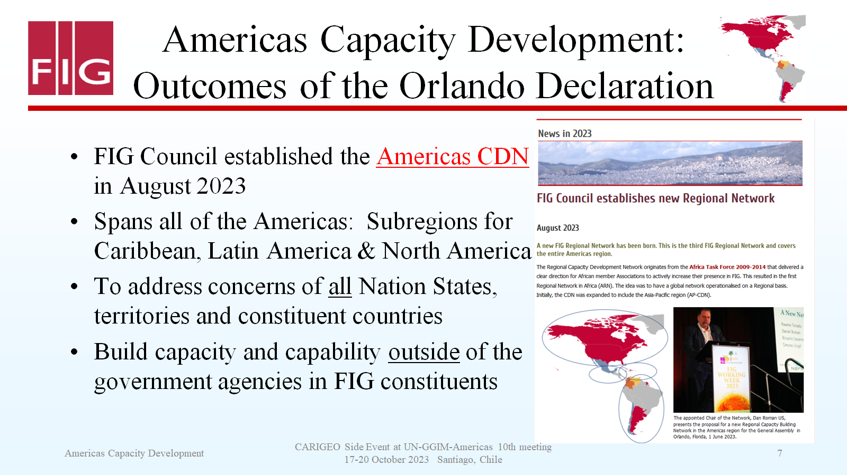
FIG Americas CDN
Notes:
Speaker - Dan
Talking Points: FIG Americas Capacity Development Network focuses on the transition of capacity building to the private sector
A great deal of effort for other groups focuses on capacity building in the governments
AN effort must be made to bridge this capacity building and education to the private sector to better enable the UN SDGs

Slide 22
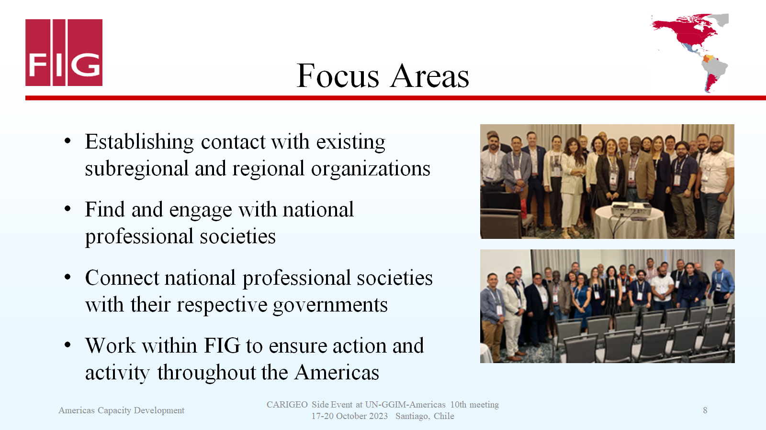
Notes:
Speaker - Dan
Talking Points: talk to pointsd liste

Slide 23
Summary
UN-GGIM: Americas is central IGO for Americas Geospatial Data
GRFA WG implements the GGRF in the Americas
Makes recommendation to the Americas RC
GRFA membership is identical to SIRGAS DC
SIRGAS WG’s all contribute to education, capacity building and training opportunities primarily in the Americas
WG1 provides a regional densification of the ITRF2020 for the Americas
GRFA recommended resolution to adopt SIRGAS - approved October 2023
WG2 builds links to Member Nations Reference Systems
WG3 develop a regional geopotential model
ANA leverages academic contacts to for outreach and education
FIG Americas CDN bridges gap between governments and private sector professional organizations
Notes:
Speaker - Dan
Talking Points: speak to listed points

Slide 24


https://geo.cepal.org/en/inicio.html
Notes:
Dan

