Slide 1
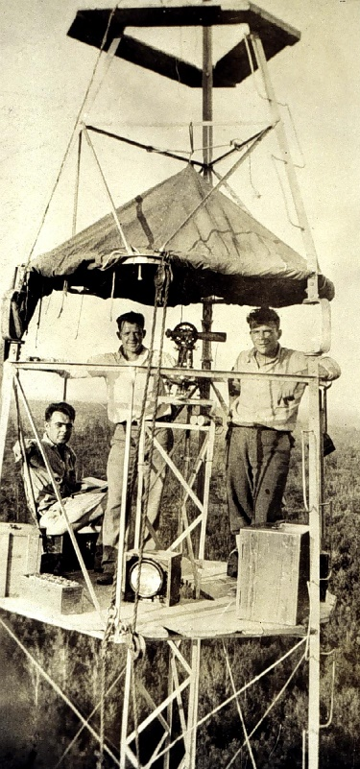
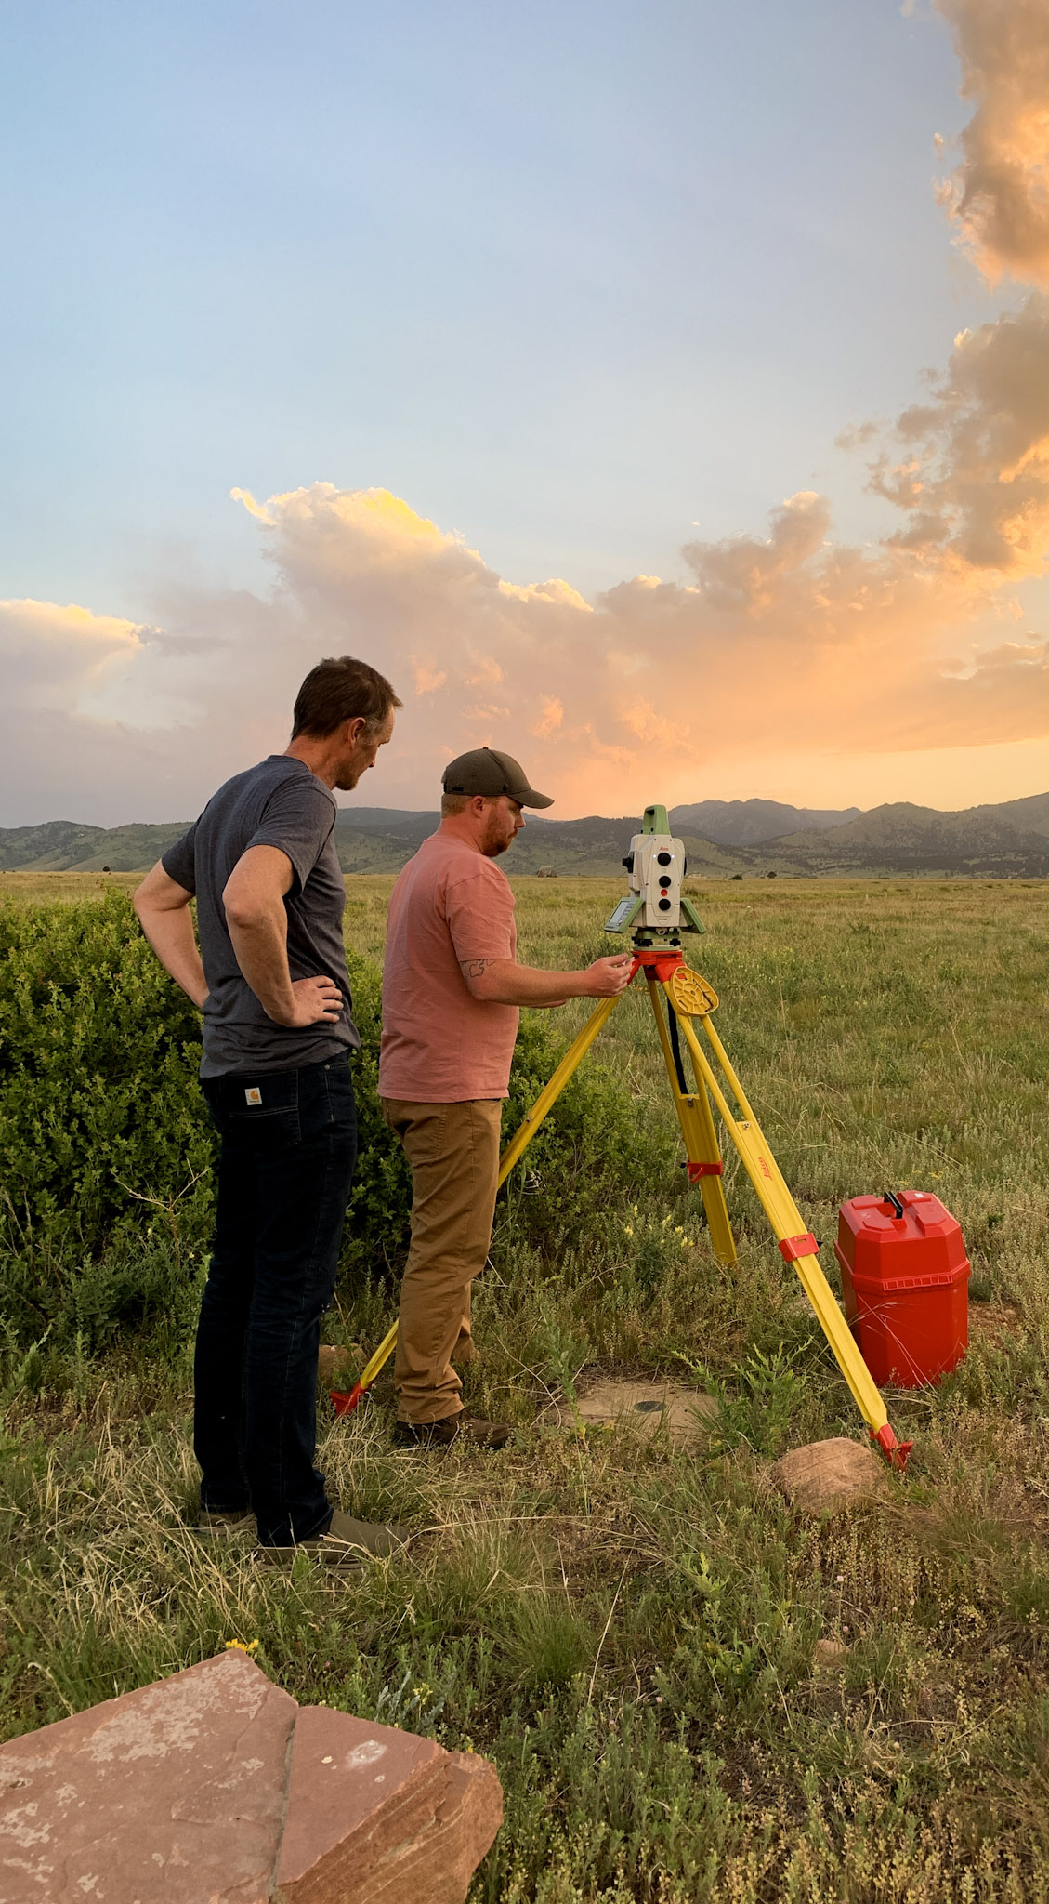
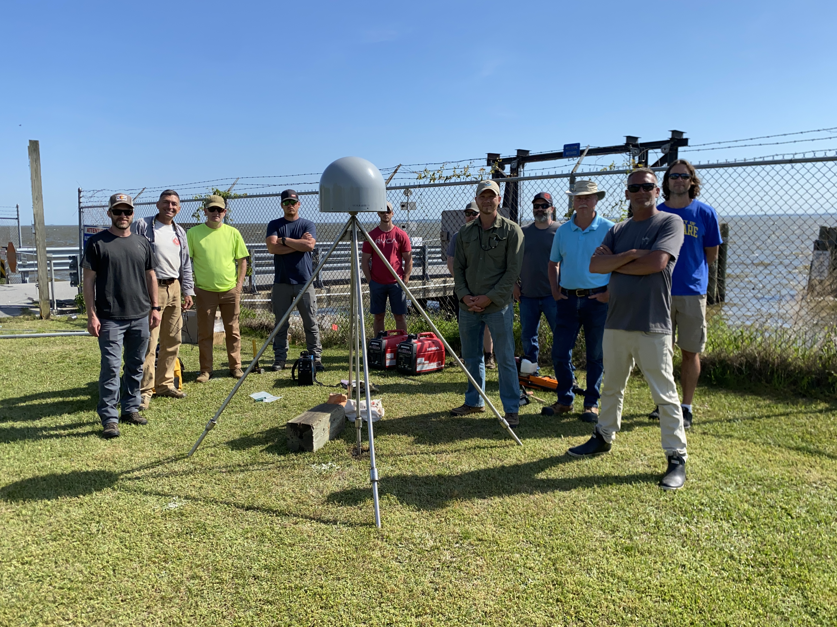
"Tying" It All Together:
NGS Field Operations
NGS Webinar Series
March 21, 2024
Ryan Hippenstiel, PLS
NGS Field Ops Branch Chief

Slide 2
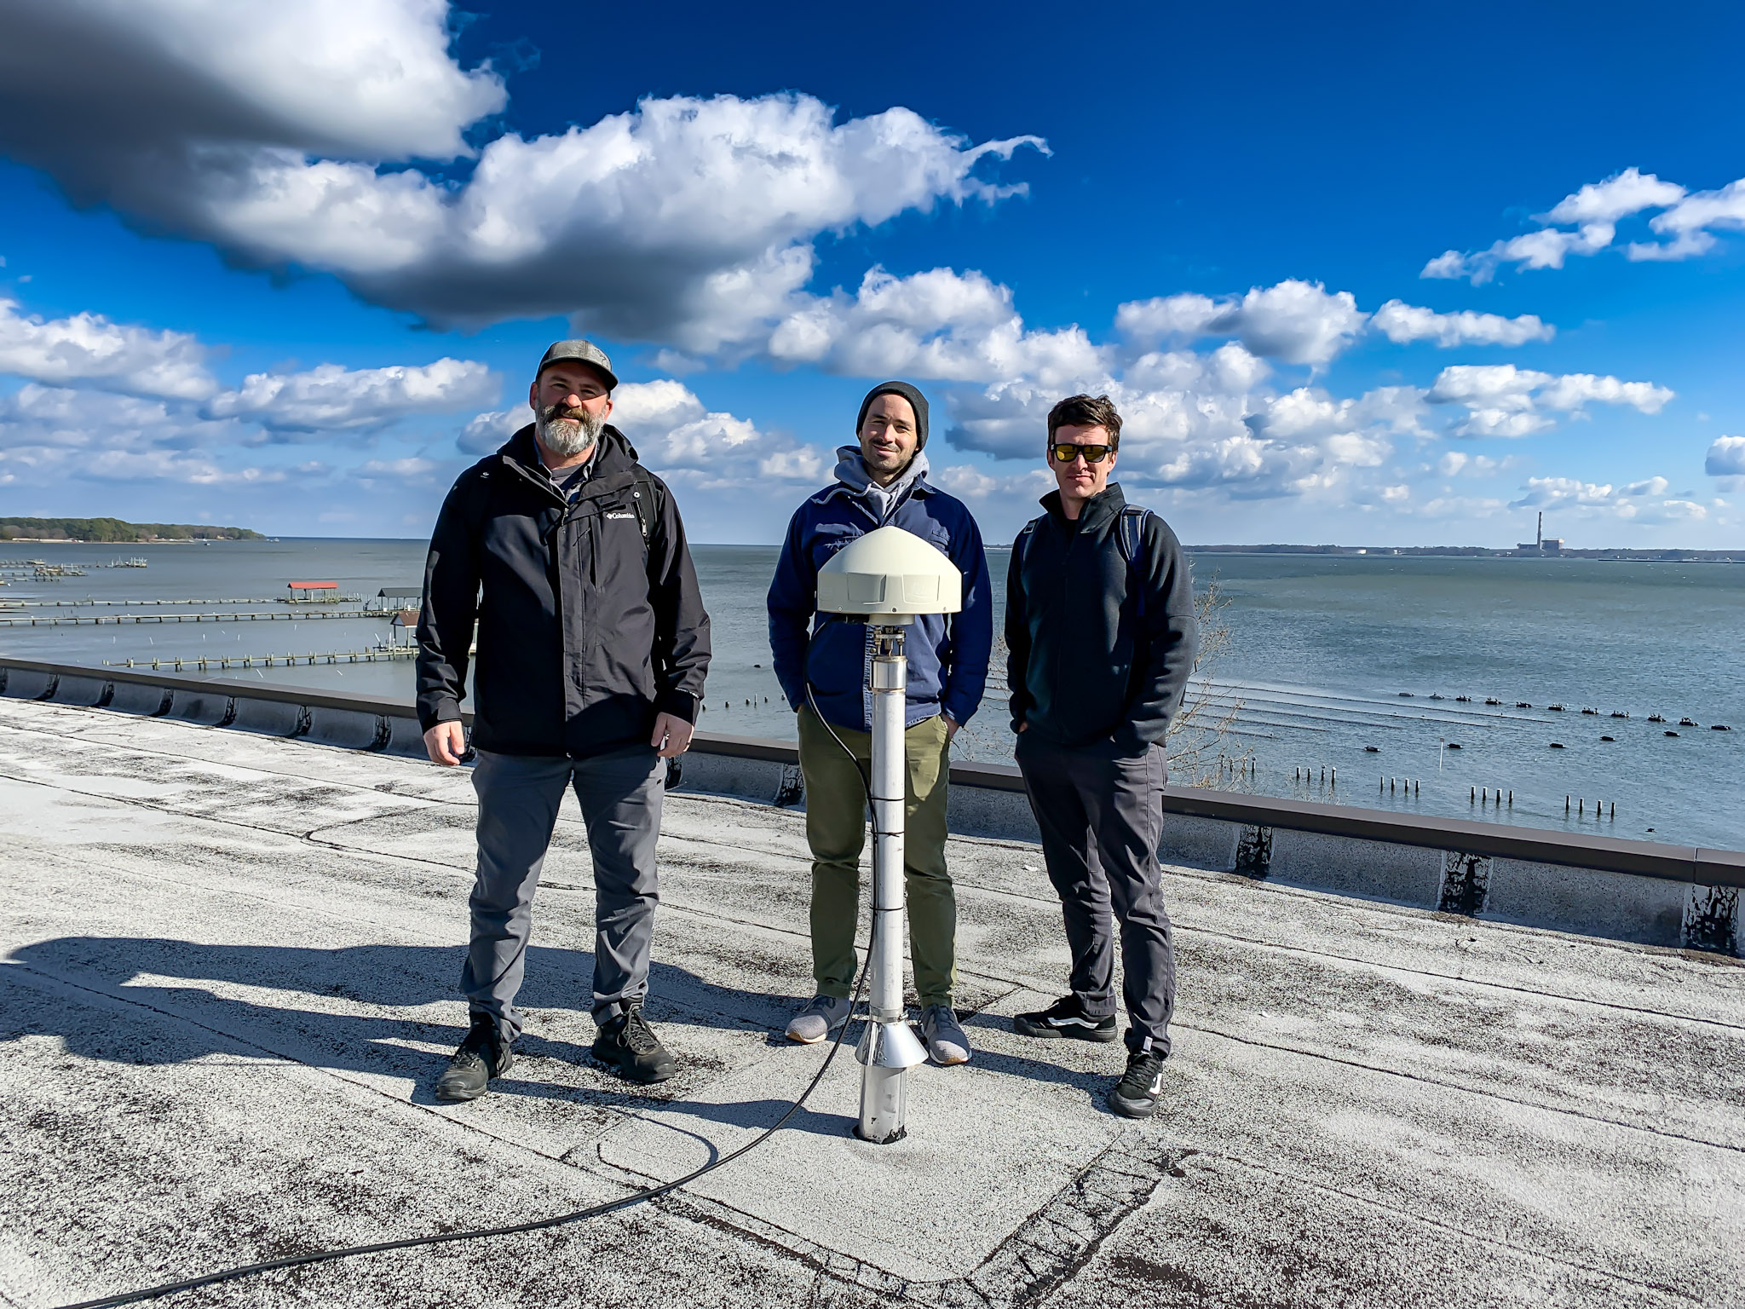
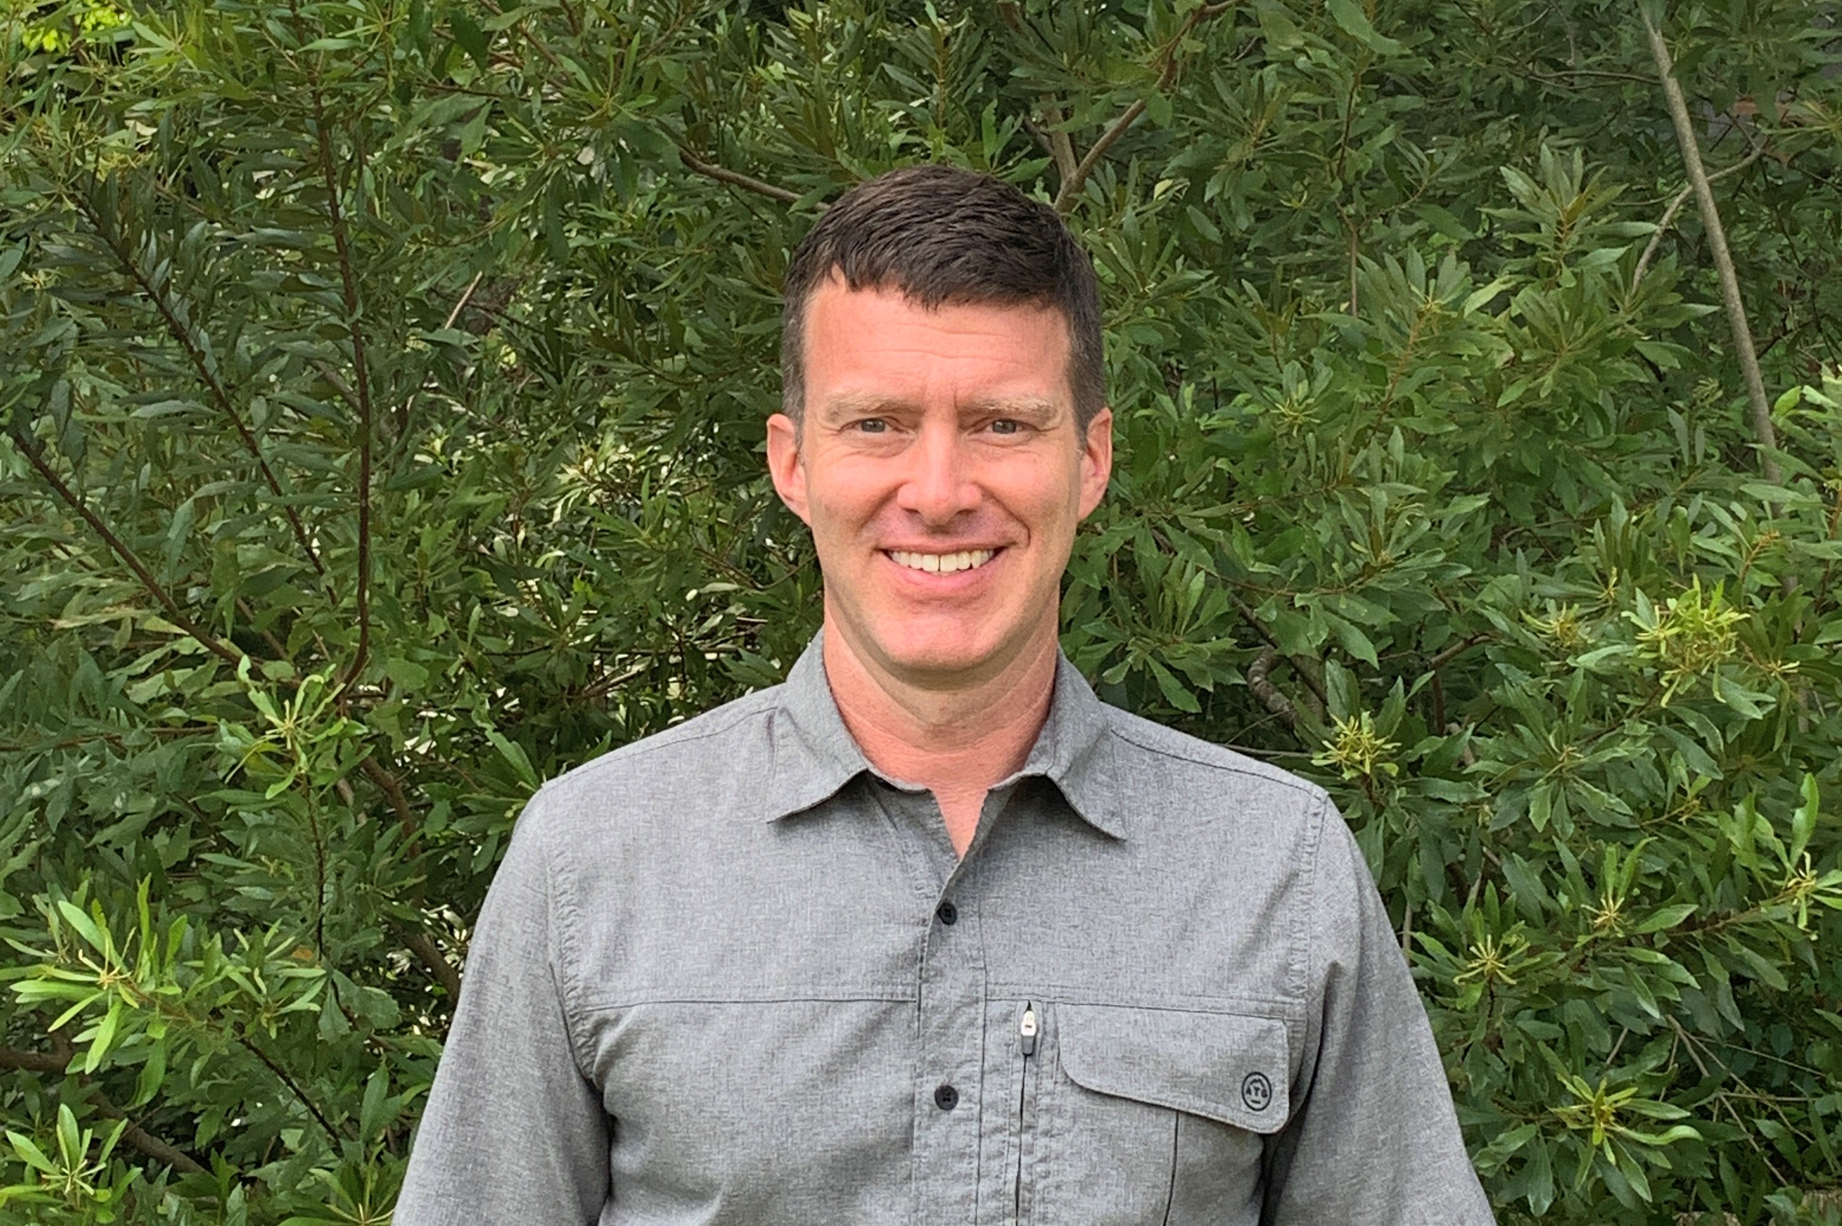
Who?
Professional Land Surveyor
Penn State graduate
Started career in US Forest Service
Worked in Private Sector (A&E, infrastructure)
Closing in on 8 years at NGS as Field Operations Branch Chief
Co-Chair of IAG/IERS Joint Working Group (Metrology of Space Geodetic Infrastructure)

Slide 3
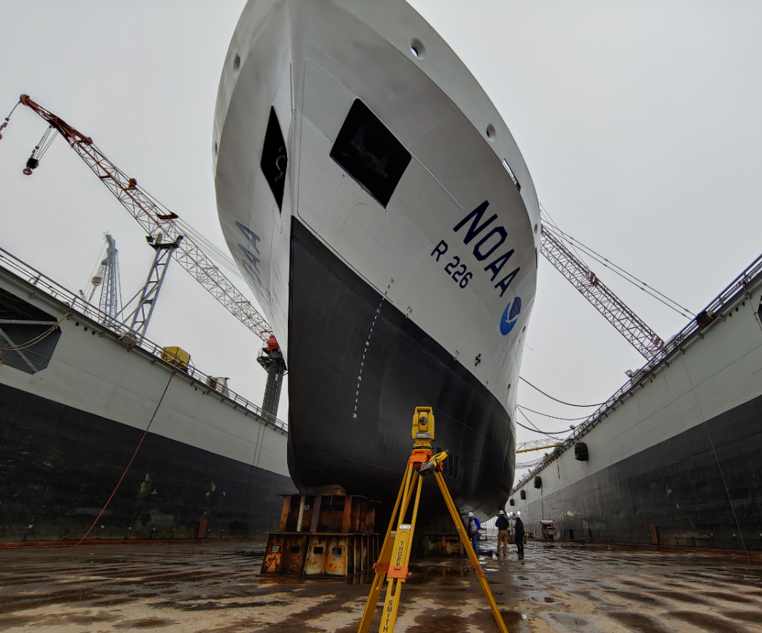
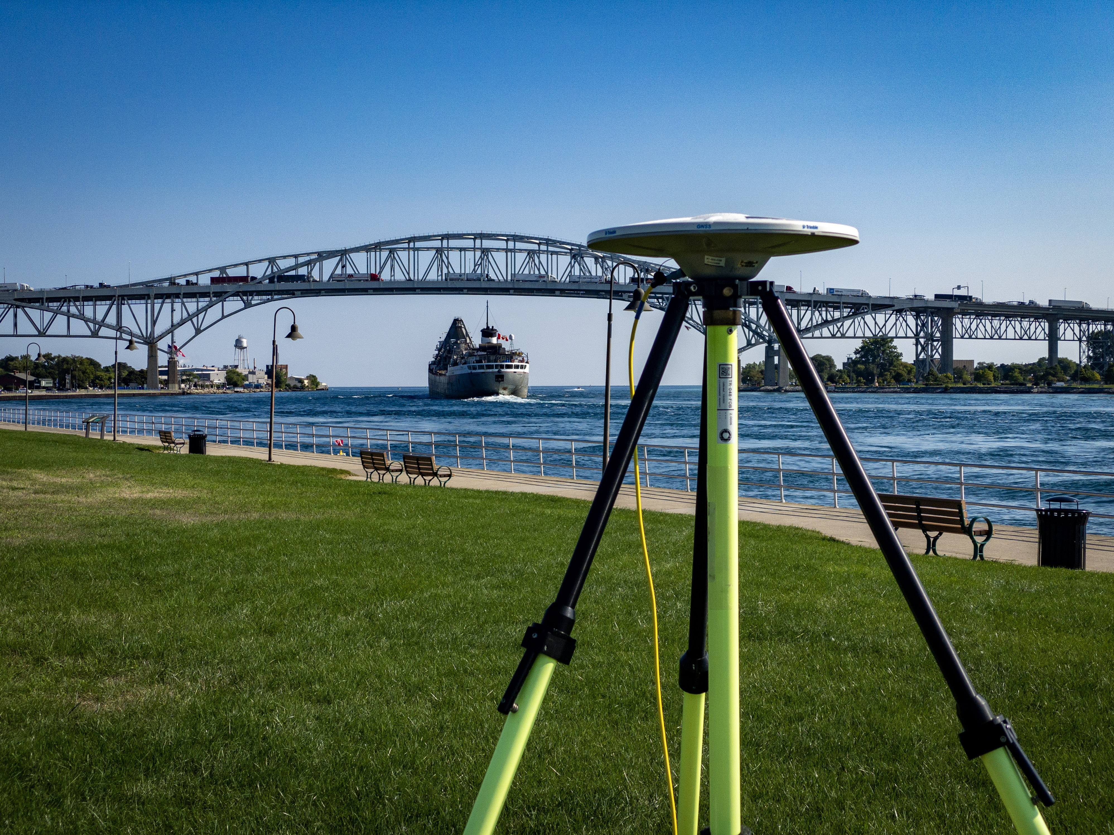
Standard Work
Responsible for the collection and processing of surveying data for various NOAA missions:
IERS/Foundation CORS local tie surveys
GNSS observations to support VDATUM
Coastal Mapping Program ground support
“Campaign” Surveys (IGLD, American Samoa, Ches Bay)
Maintain NOAA CORS Network
Subsidence & Vertical Land Motion support
Grav-D and NOAA Vessel Support
Support of technical manuals and survey protocols
FAA/ASP Survey Plan and Data reviews
National Geodetic Survey

Slide 4
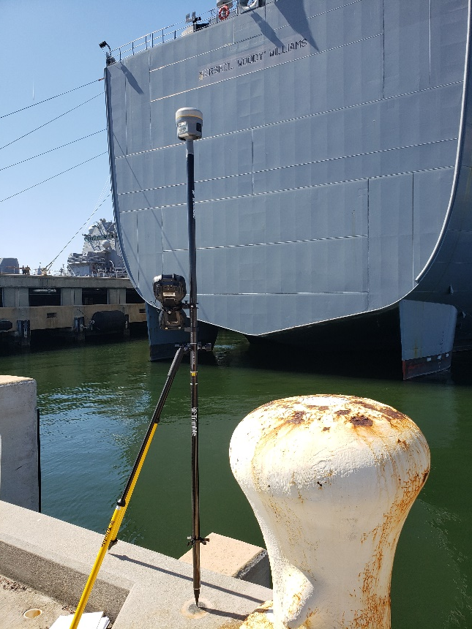
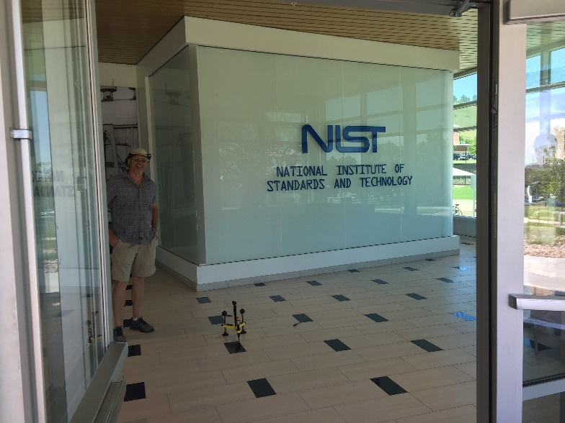
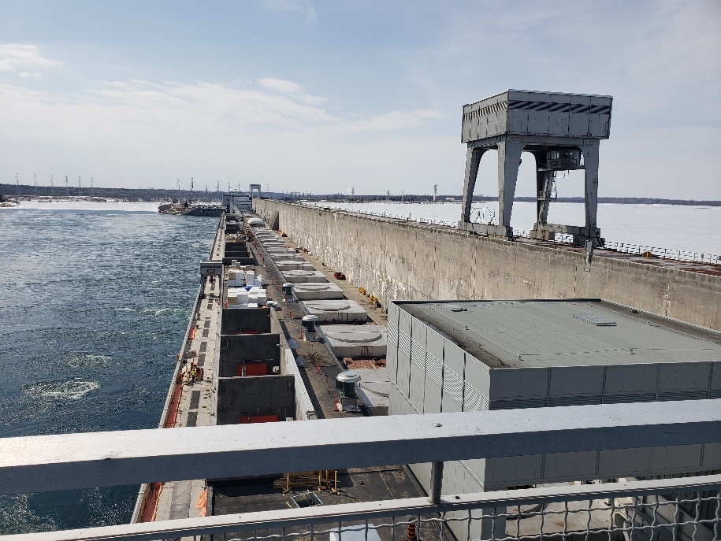
Layered Technology
Regular use of static & real-time GNSS and high accuracy terrestrial equipment allows for tailored projects.
NIST – Boulder for First Responder dataset research
Geodetic Leveling at the Moses-Saunders Hydro Plant
Multiple projects in Chesapeake Bay region to support coastal resilience, vertical land motion, and sea level rise research
ational Geodetic Survey

Slide 5
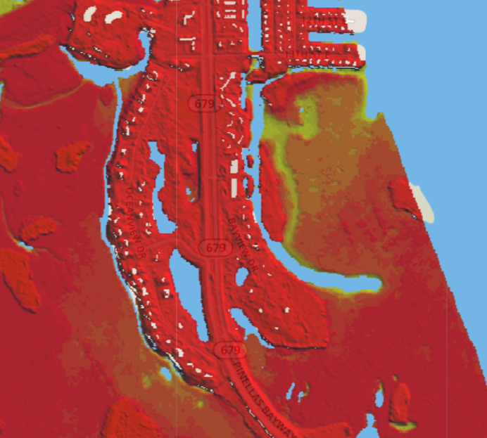
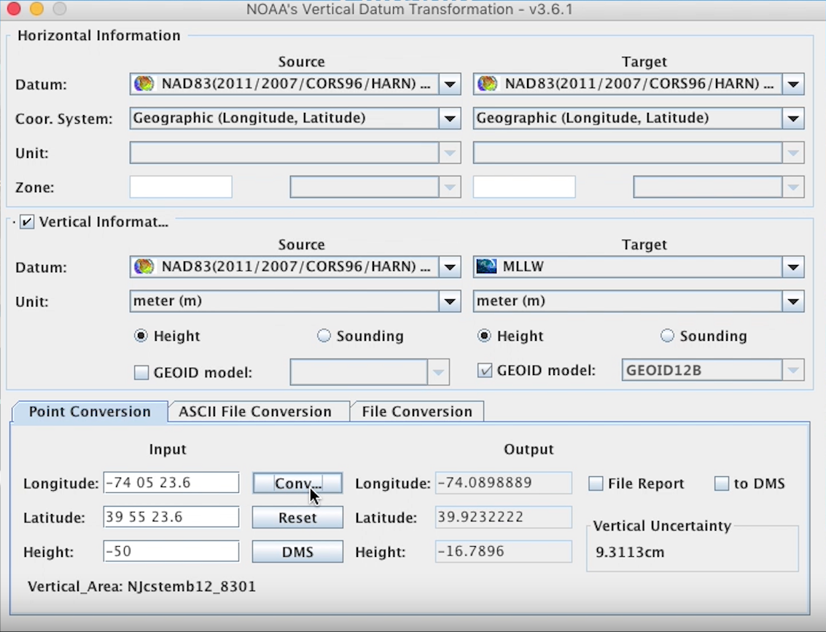
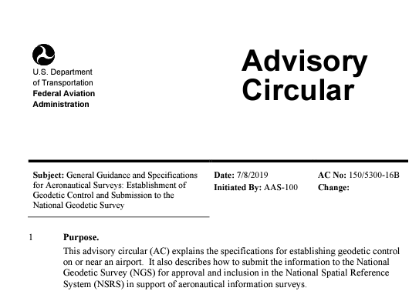
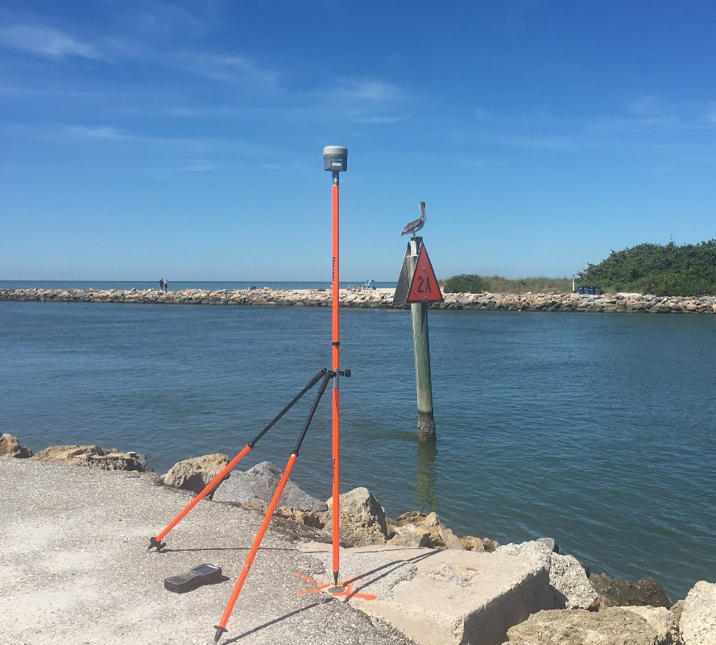
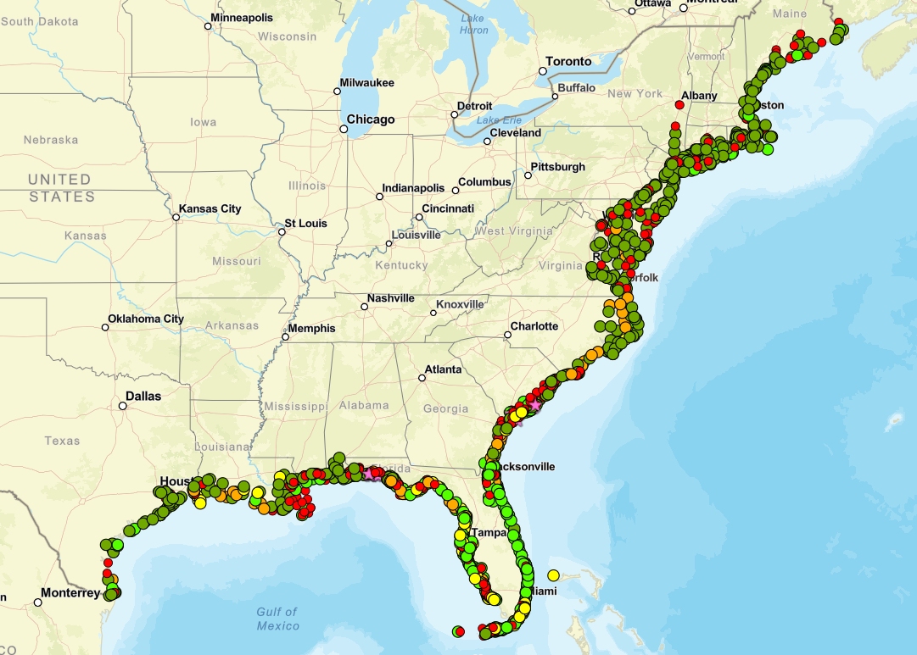
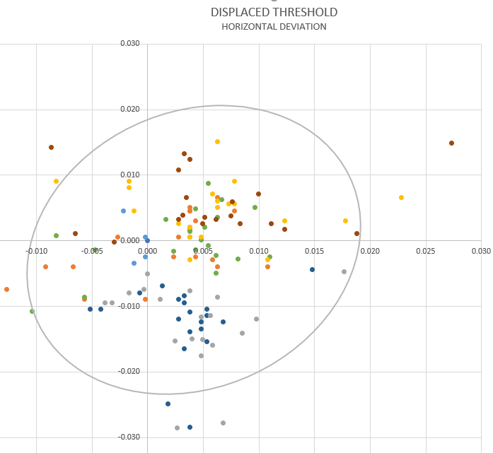
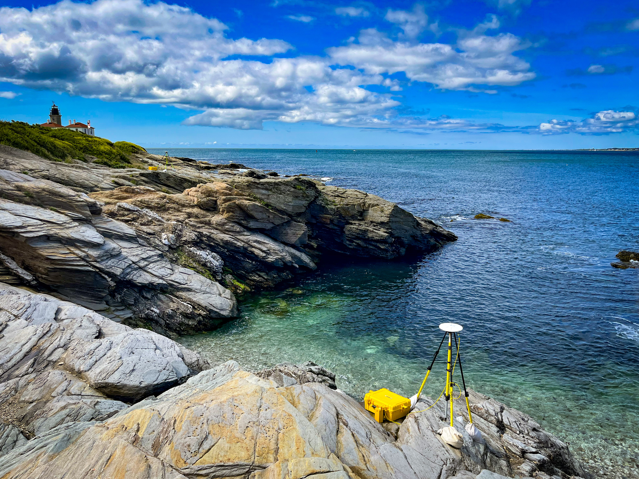
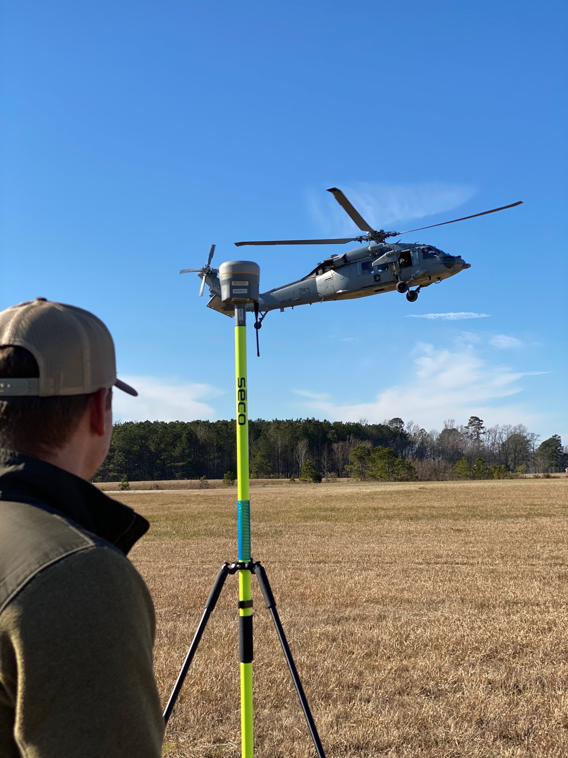
You may already use…
Remotely Sensed Data
Transformation Tools
FAA Guidance

Slide 6
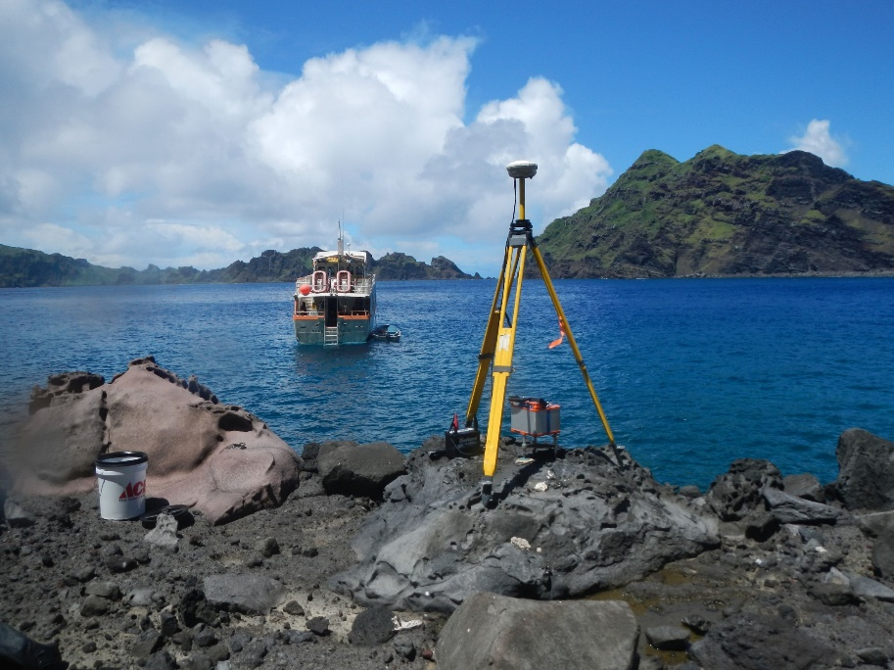
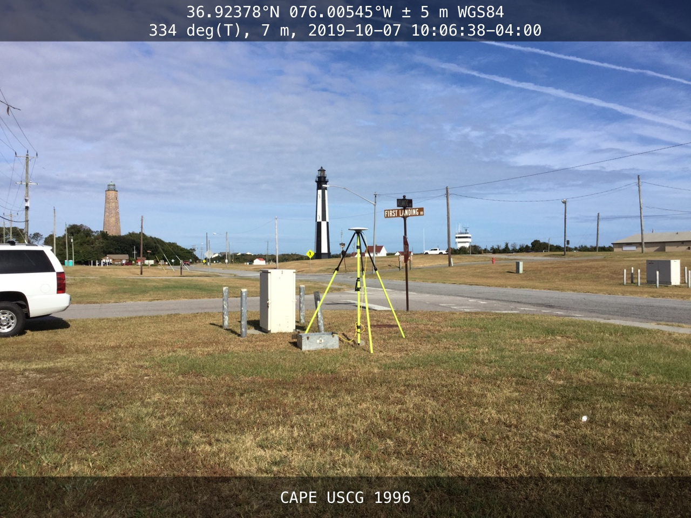
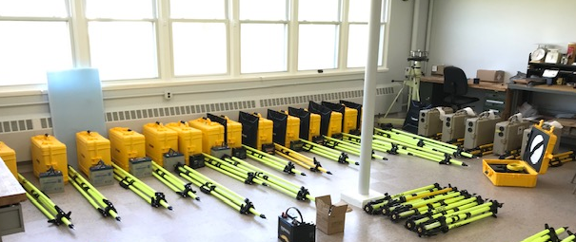
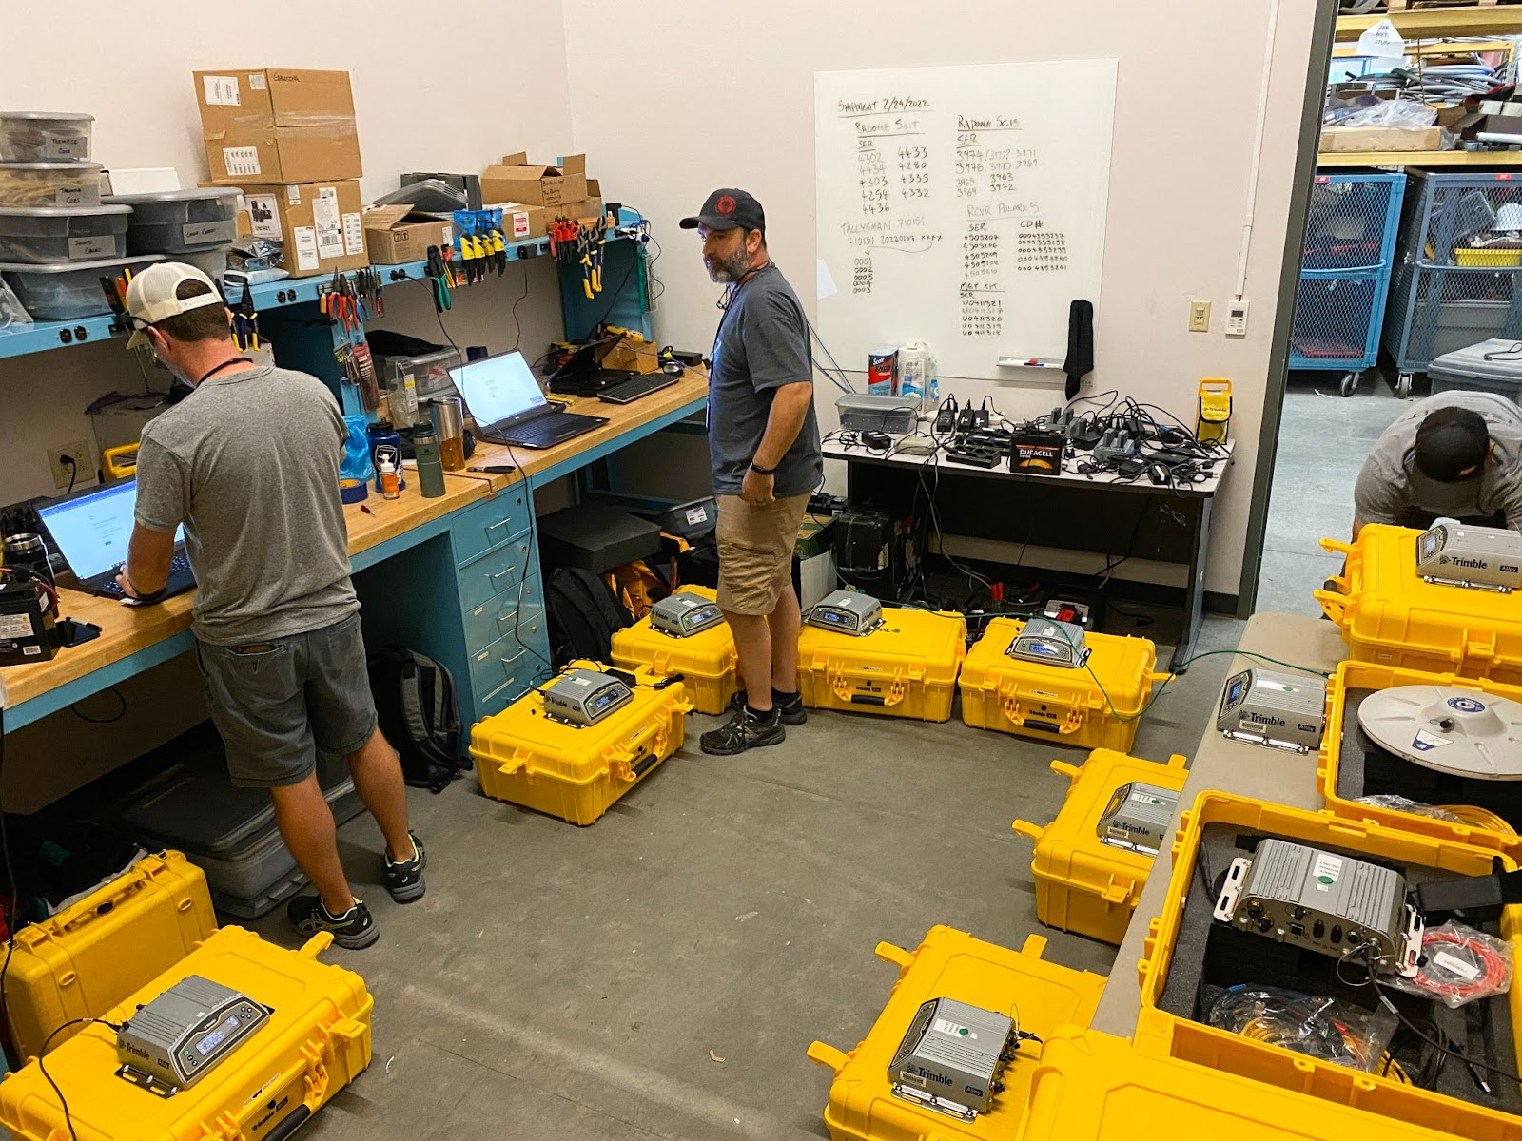
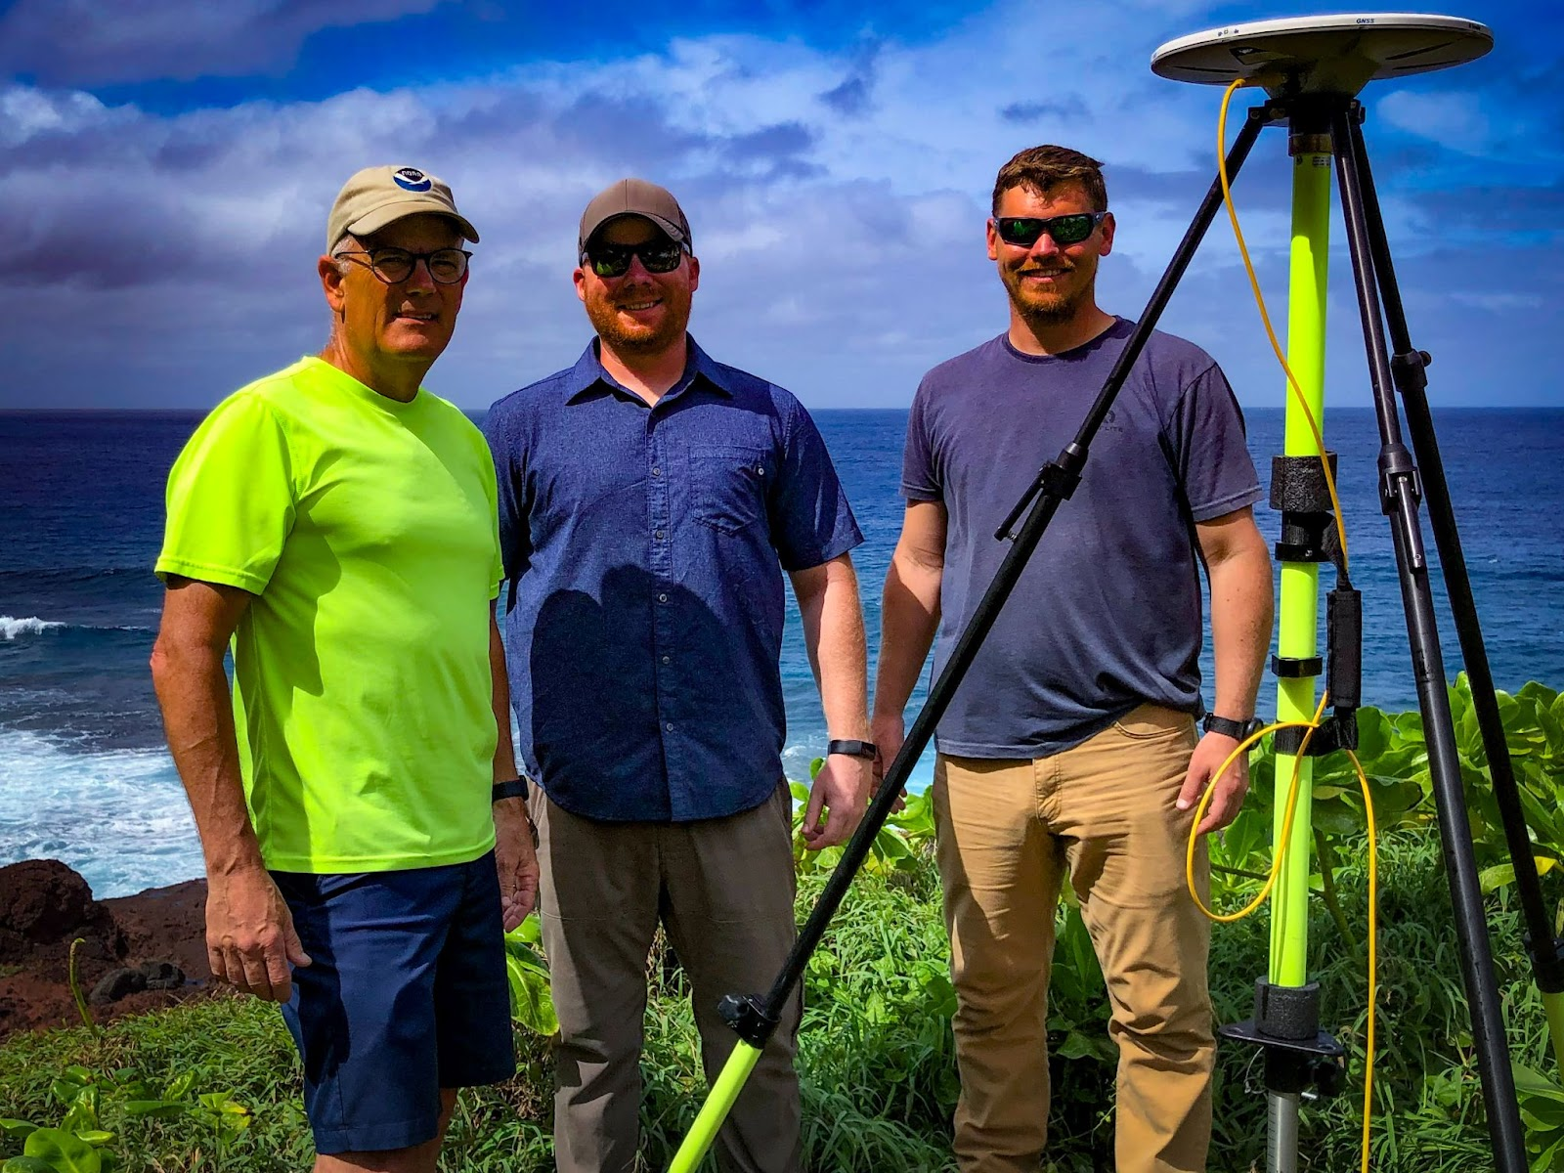
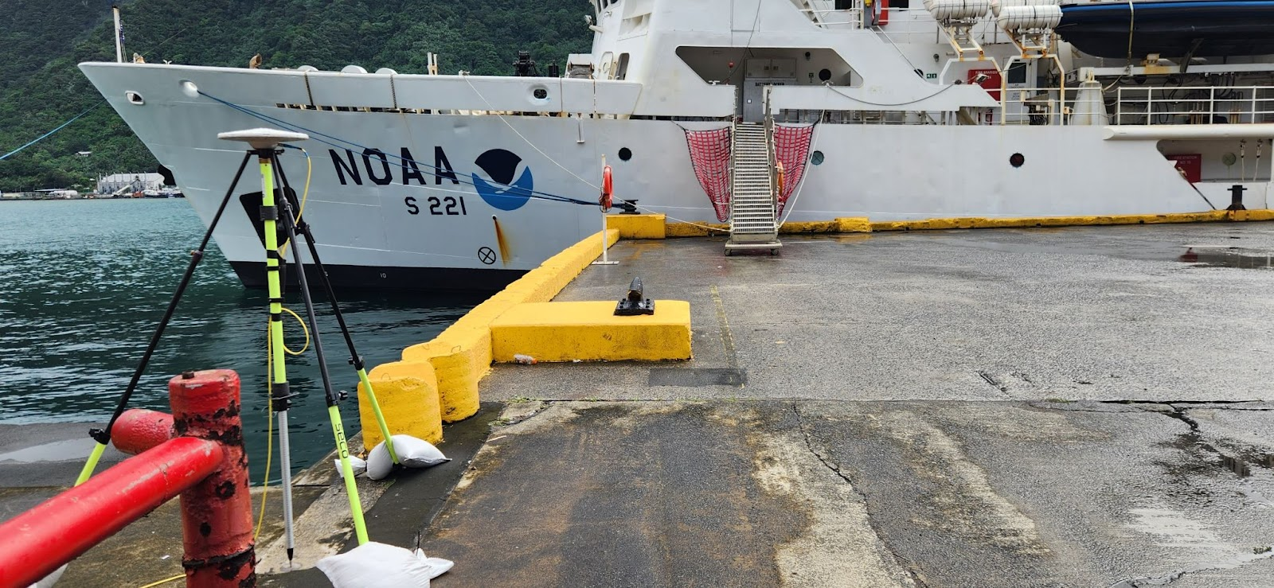
Campaigns
Projects tailored specifically to answer a certain question or collect a certain dataset.

Slide 7
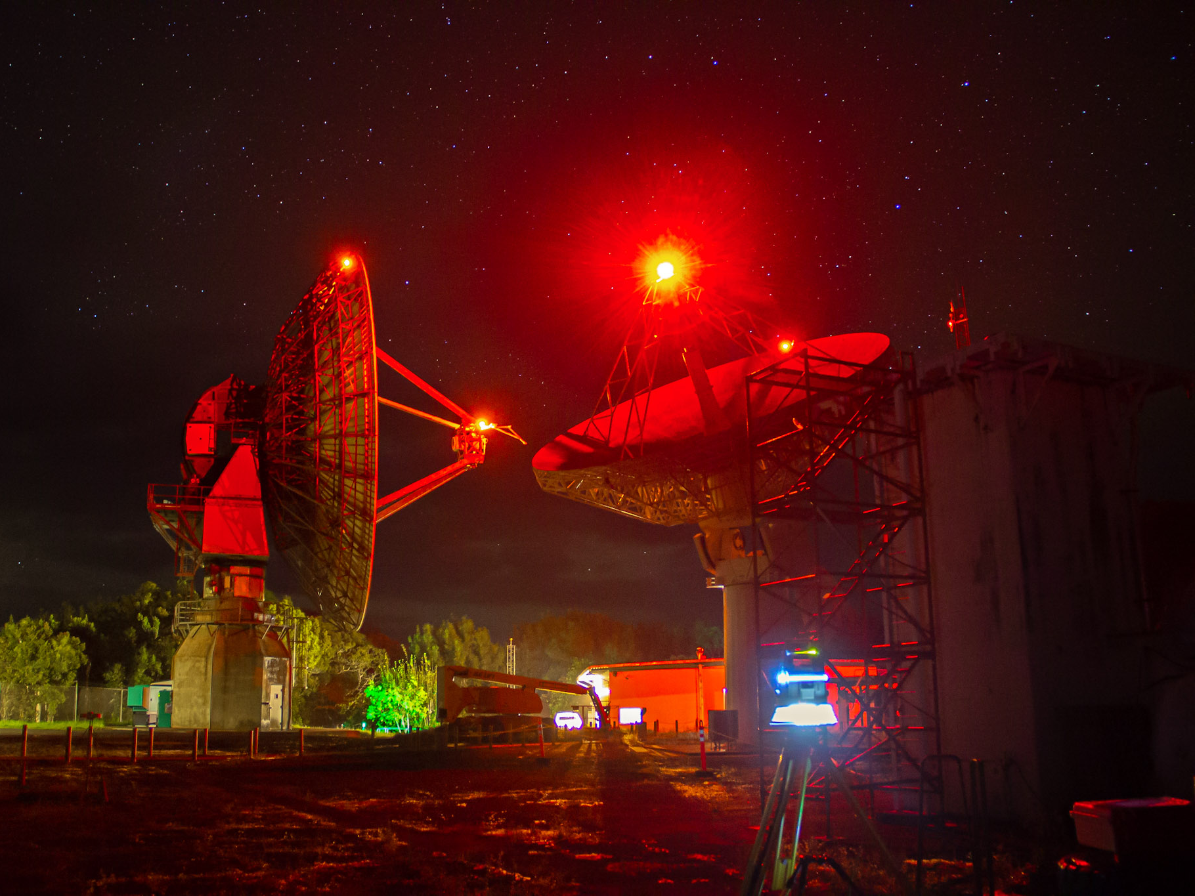
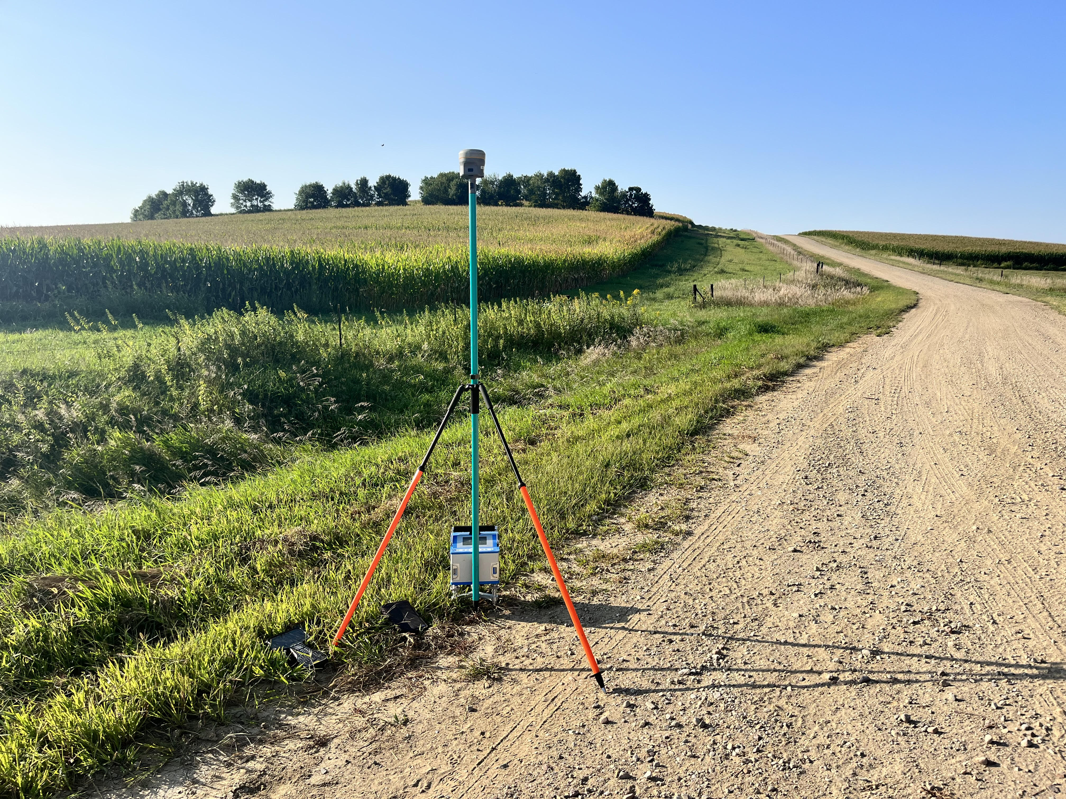
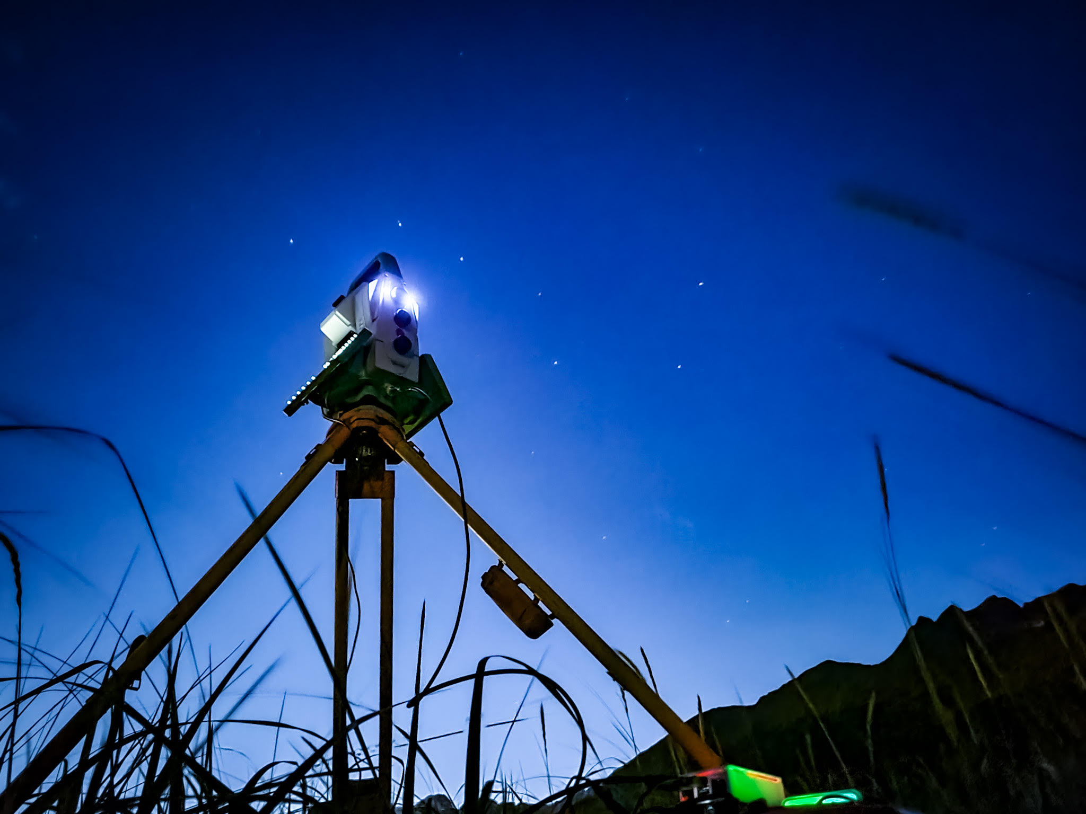
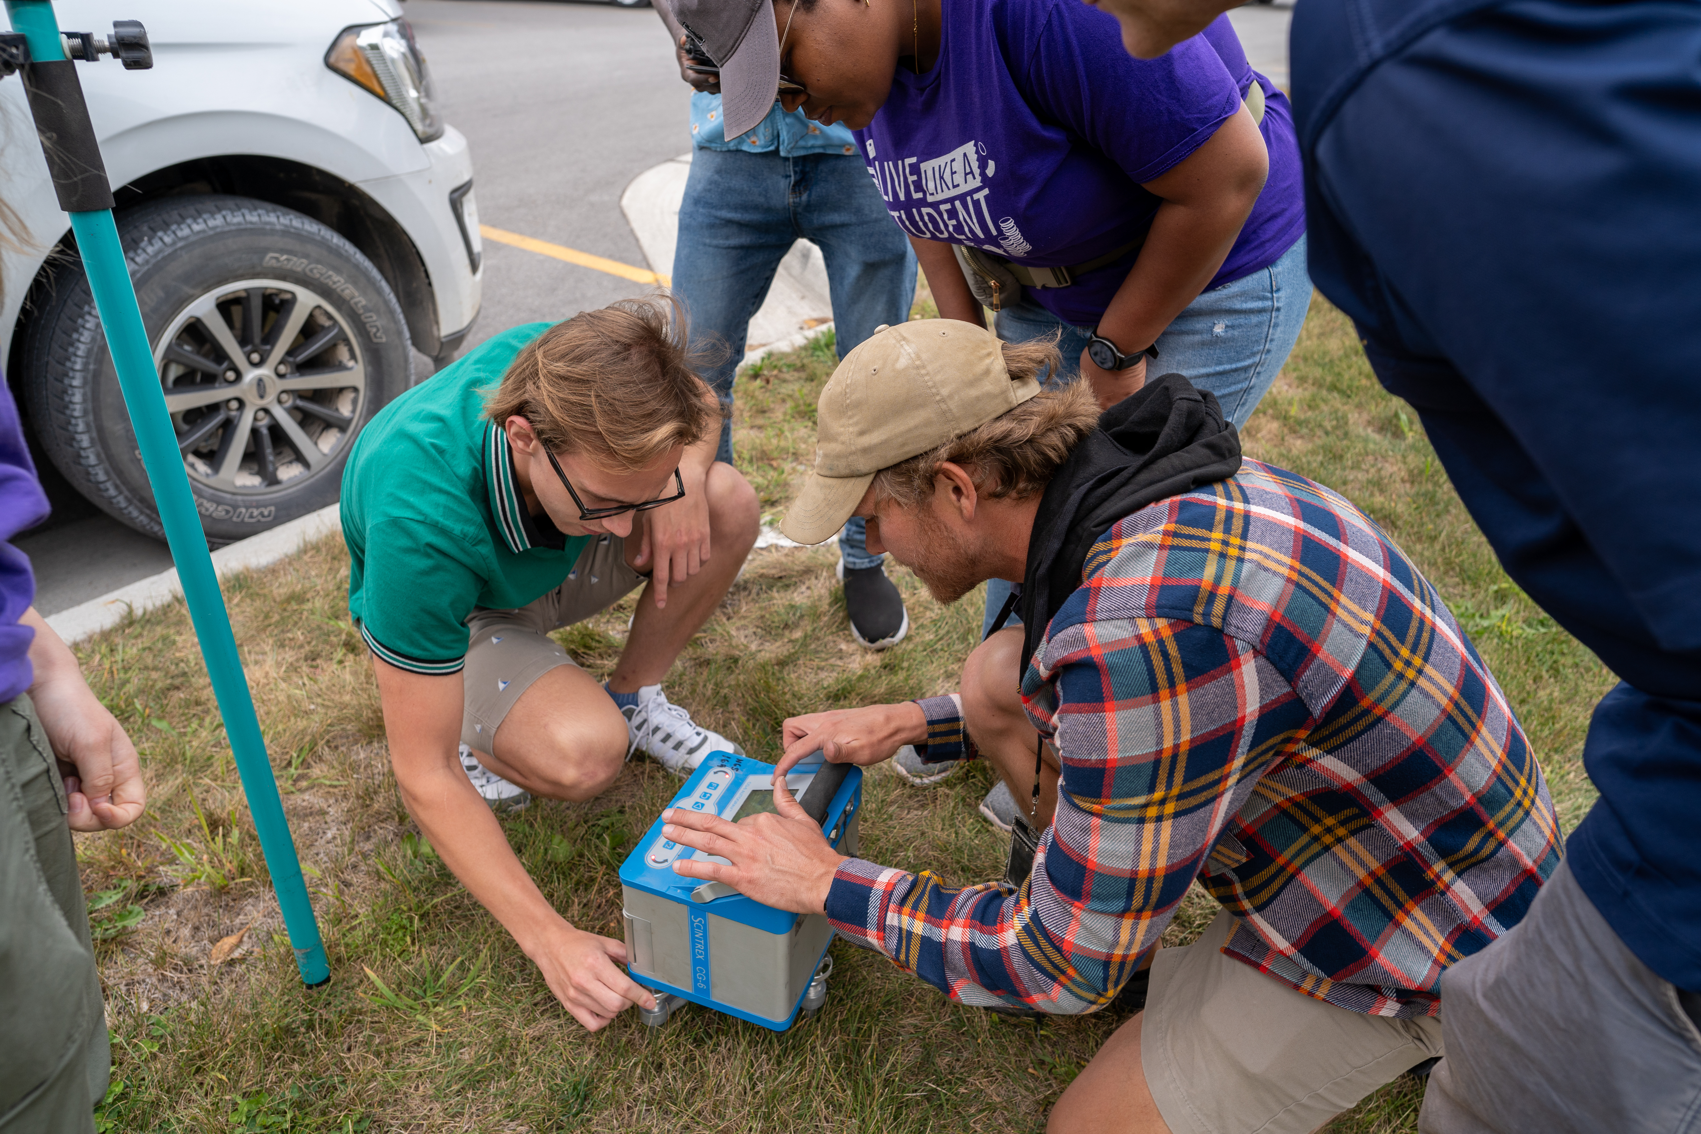
Emerging
RTK/N for Control
Deflection of Vertical
Astronomic Azimuths
Relative Gravity
Support of clock research
Progressing protocols, data types, and technology to advance science, inform Modernization standards, and share knowledge with the community.

Slide 8
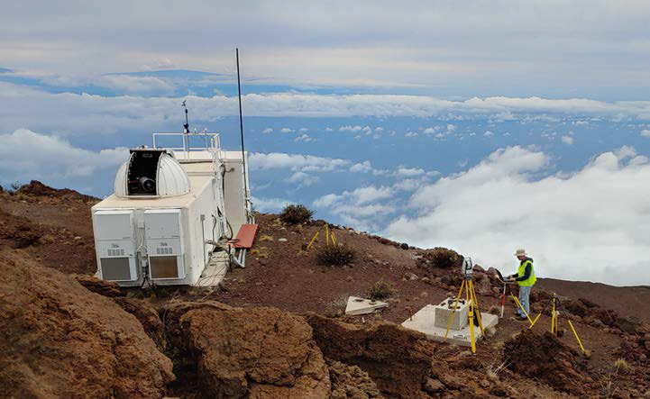
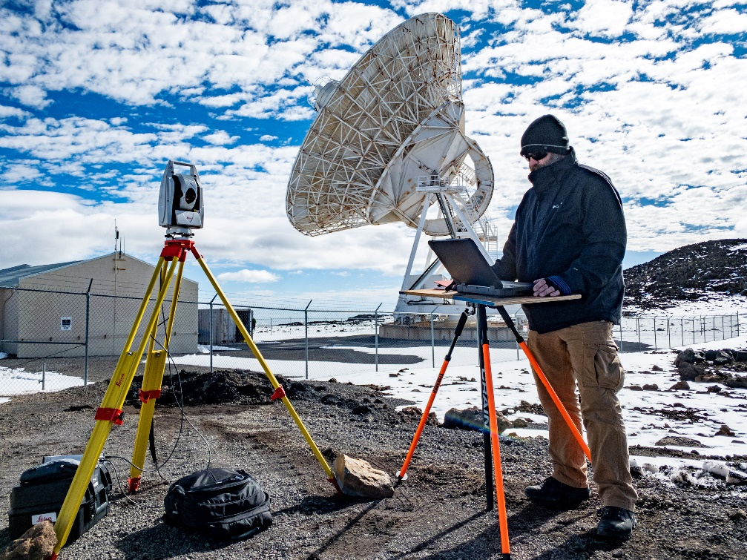
Tie Surveys & Co-location
ITRF realizations are the combination of the four space geodetic techniques
Co-locating these techniques allows for their combination
Individual techniques are asking for millimeter precision
History of NGS local tie surveys:
Supporting early mobile space technique programs, evolving into….
Supporting IERS by completing annual surveys at co-location sites

Slide 9
Four Major Space Geodetic Techniques
GNSS
Global Navigation Satellite System
Think satellites broadcast DOWN to receivers
DORIS
Doppler Orbitography and Radiopositioning Integrated by Satellite
Think radio UP to satellites
SLR
Satellite Laser Ranging
Think lasers UP and DOWN to satellites
*ILRS also includes LLR (lunar laser ranging)
VLBI/A
Very-long-baseline interferometry
Think listening to objects in space
No matter how accurate the individual techniques are, a ground survey ties them together.

Slide 10
Tie Surveys & Co-location
Each technique center submits their own data and models of the international reference frame.
This is ultimately combined to produce the ITRF.
As everyone here knows, the new NSRS will be aligned to the ITRF.

Slide 11
Tie Surveys & Co-location
Each technique center submits their own data and models of the international reference frame.
This is ultimately combined to produce the ITRF.
As everyone here knows, the new NSRS will be aligned to the ITRF.

Slide 12
Tie Surveys & Co-location
Each technique center submits their own data and models of the international reference frame.
This is ultimately combined to produce the ITRF.
As everyone here knows, the new NSRS will be aligned to the ITRF.

Slide 13
Tie Surveys & Co-location
Each technique center submits their own data and models of the international reference frame.
This is ultimately combined to produce the ITRF.
As everyone here knows, the new NSRS will be aligned to the ITRF.

Slide 14
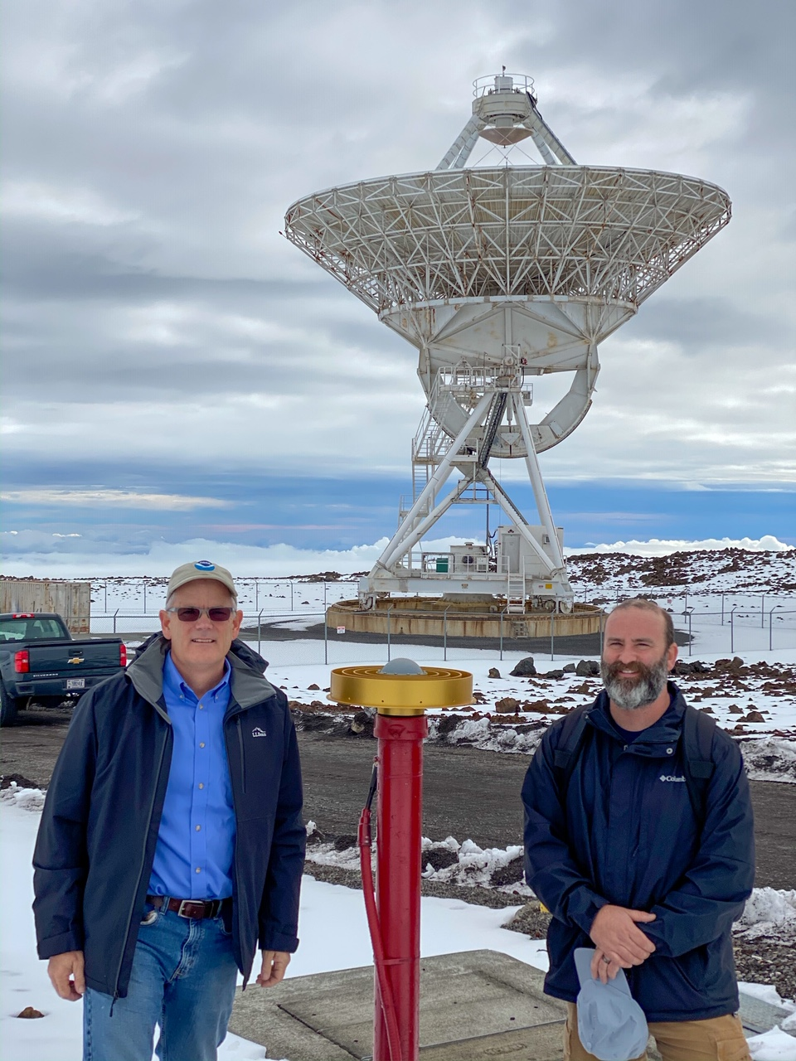
IERS/ITRF Work
There was an increase in tie surveys vectors from GNSS to DORIS, SLR, VBLI between 2014 to 2020 (Altamimi 2022)
Total vectors from 212 to 253
Vectors with discrepancy <5mm from 64 to 96
Recent Activities
Maui, HI (GNSS/SLR)
Westford, MA (GNSS/VLBI)
Stafford, VA (GNSS/SLR)
Table Mountain, CO (GNSS/Gravity)
Mauna Kea, HI (VLBI/GNSS)
Greenbelt/Goddard (All)
Kokee (VLBI/GNSS)

Slide 15
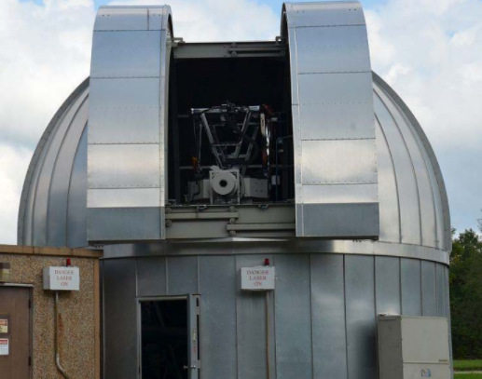
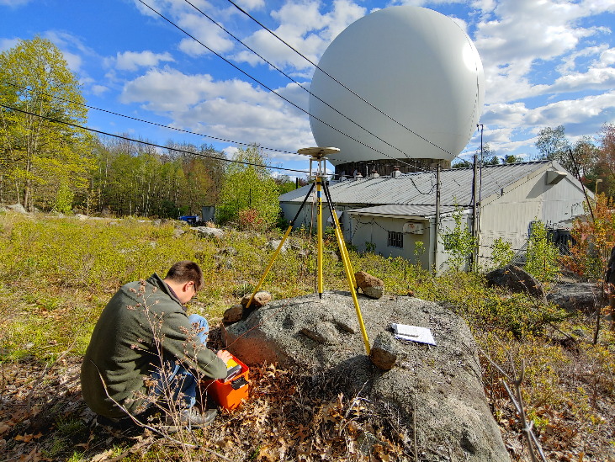
So why else do we do it?
Enhanced partnerships due to Foundation CORS development has increased need and number of partners
Growing interest in water levels and coastal resilience has increased the desire and need for tie surveys and layered data
Researchers and scientists are striving for (and reporting in) mm’s, so the continued need for robust field surveying protocols is only growing

Slide 16
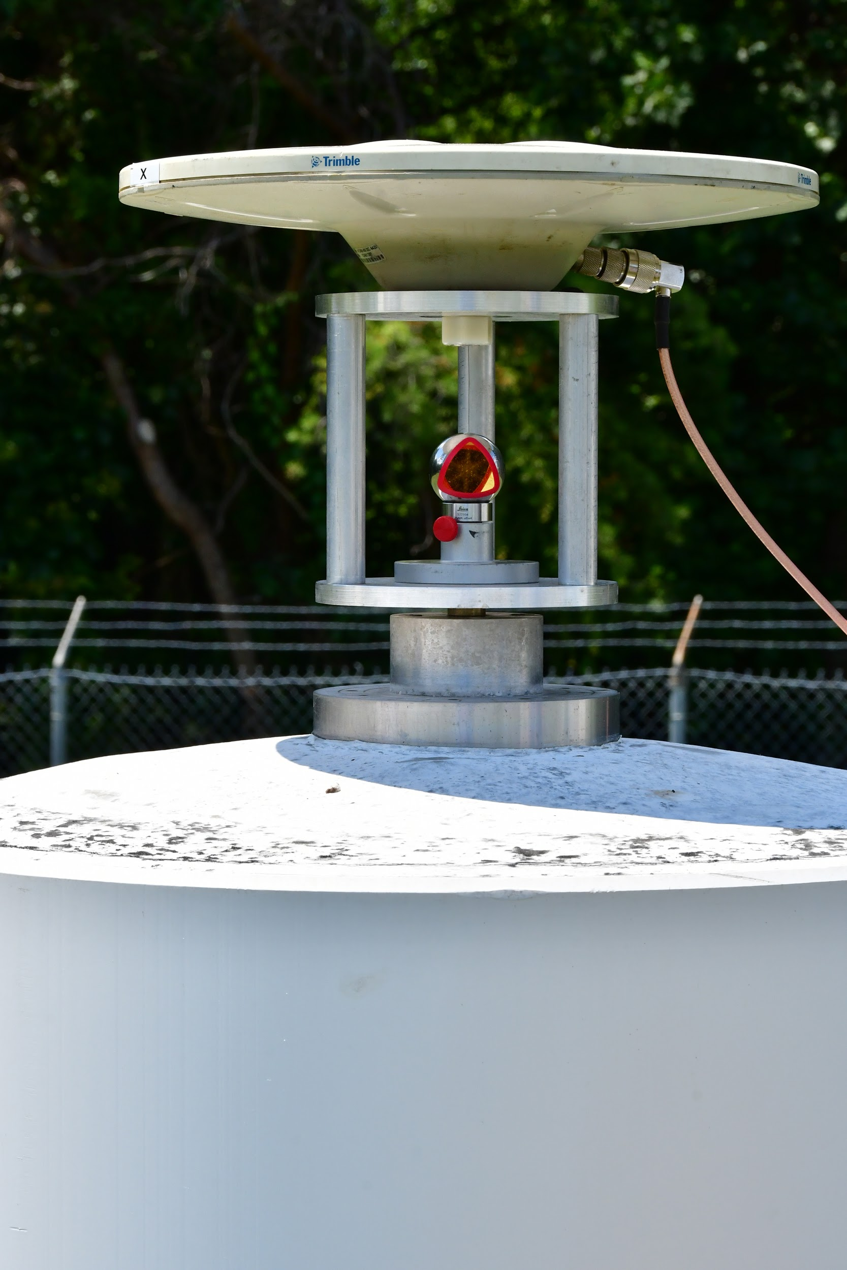
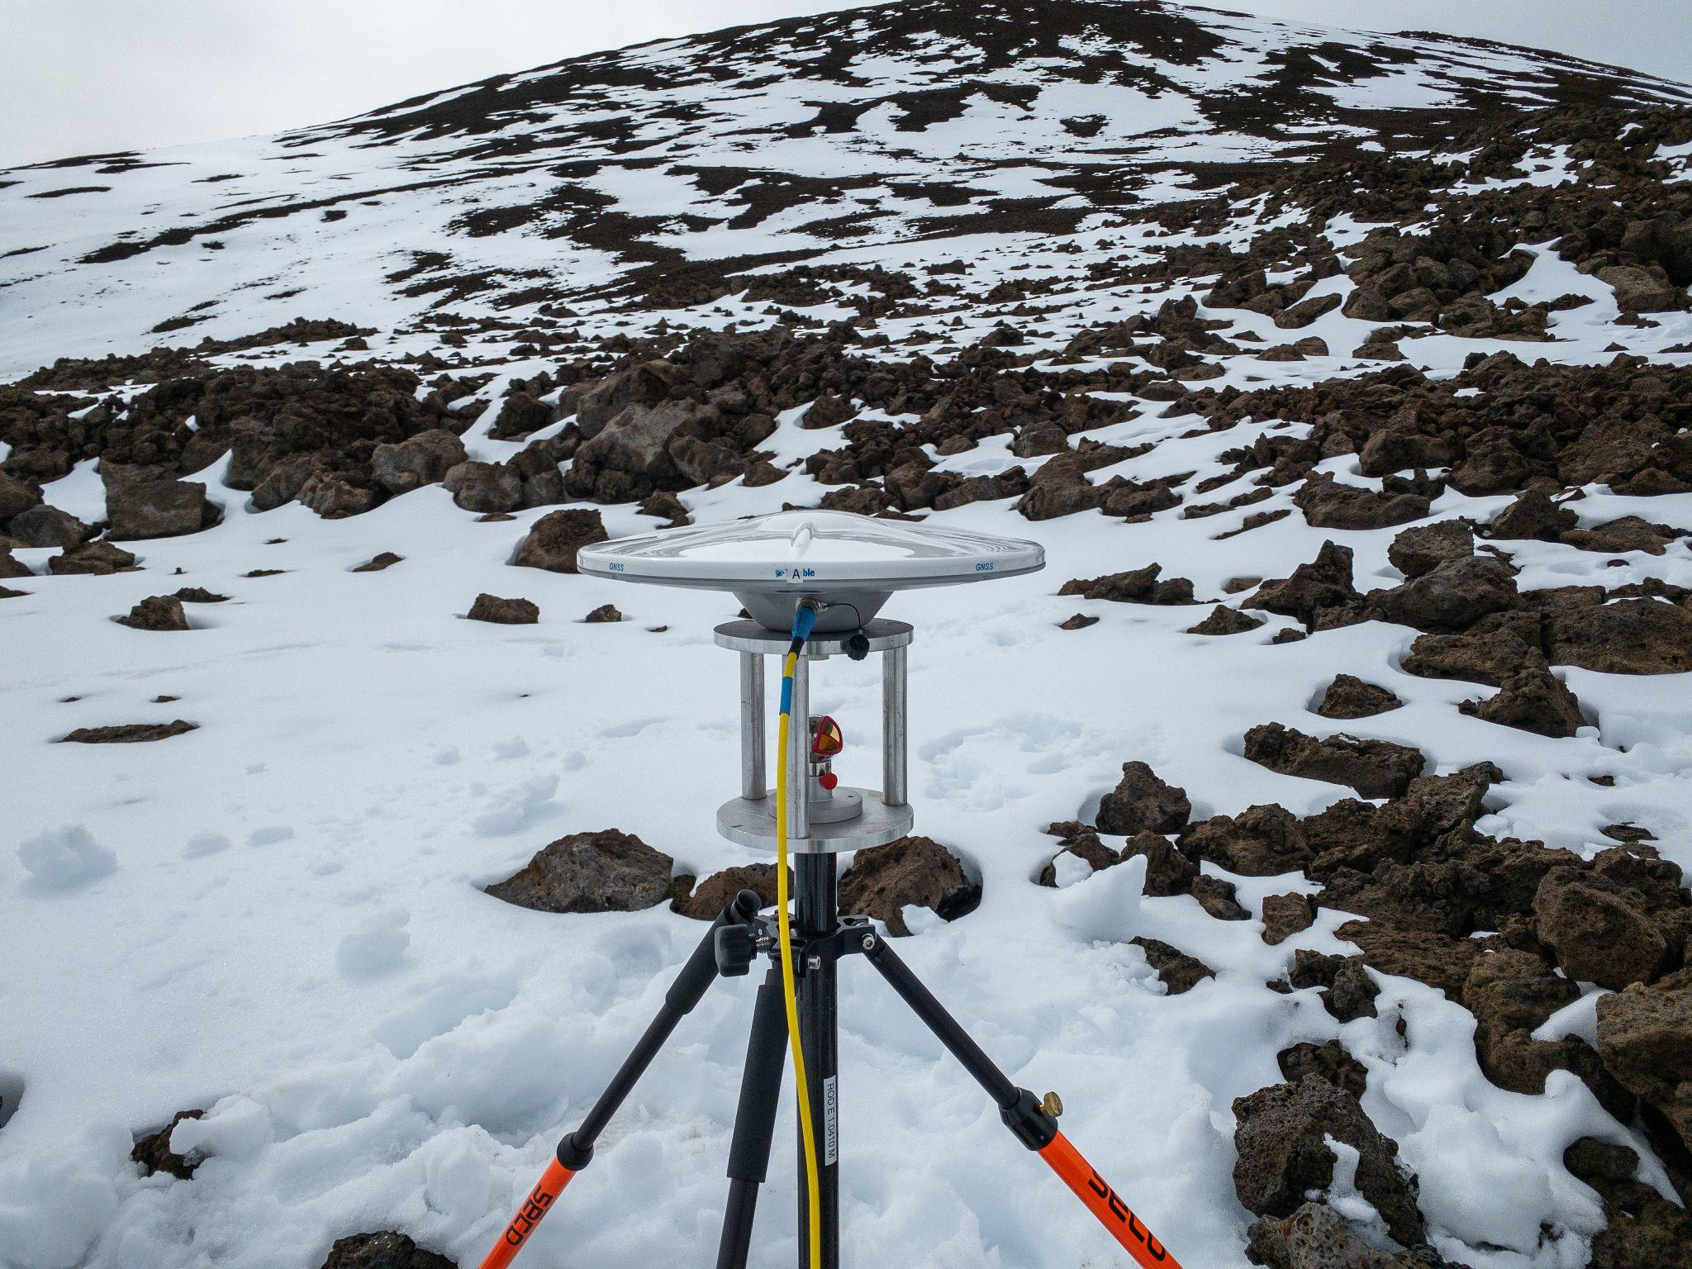
So how do we do it?
Using passive marks as our fabric, we measure ties with terrestrial observations and align with GNSS…..for now
Data goes through rigorous analysis and processing and is submitted to IERS via a SINEX file for incorporation in ITRF development

Slide 17
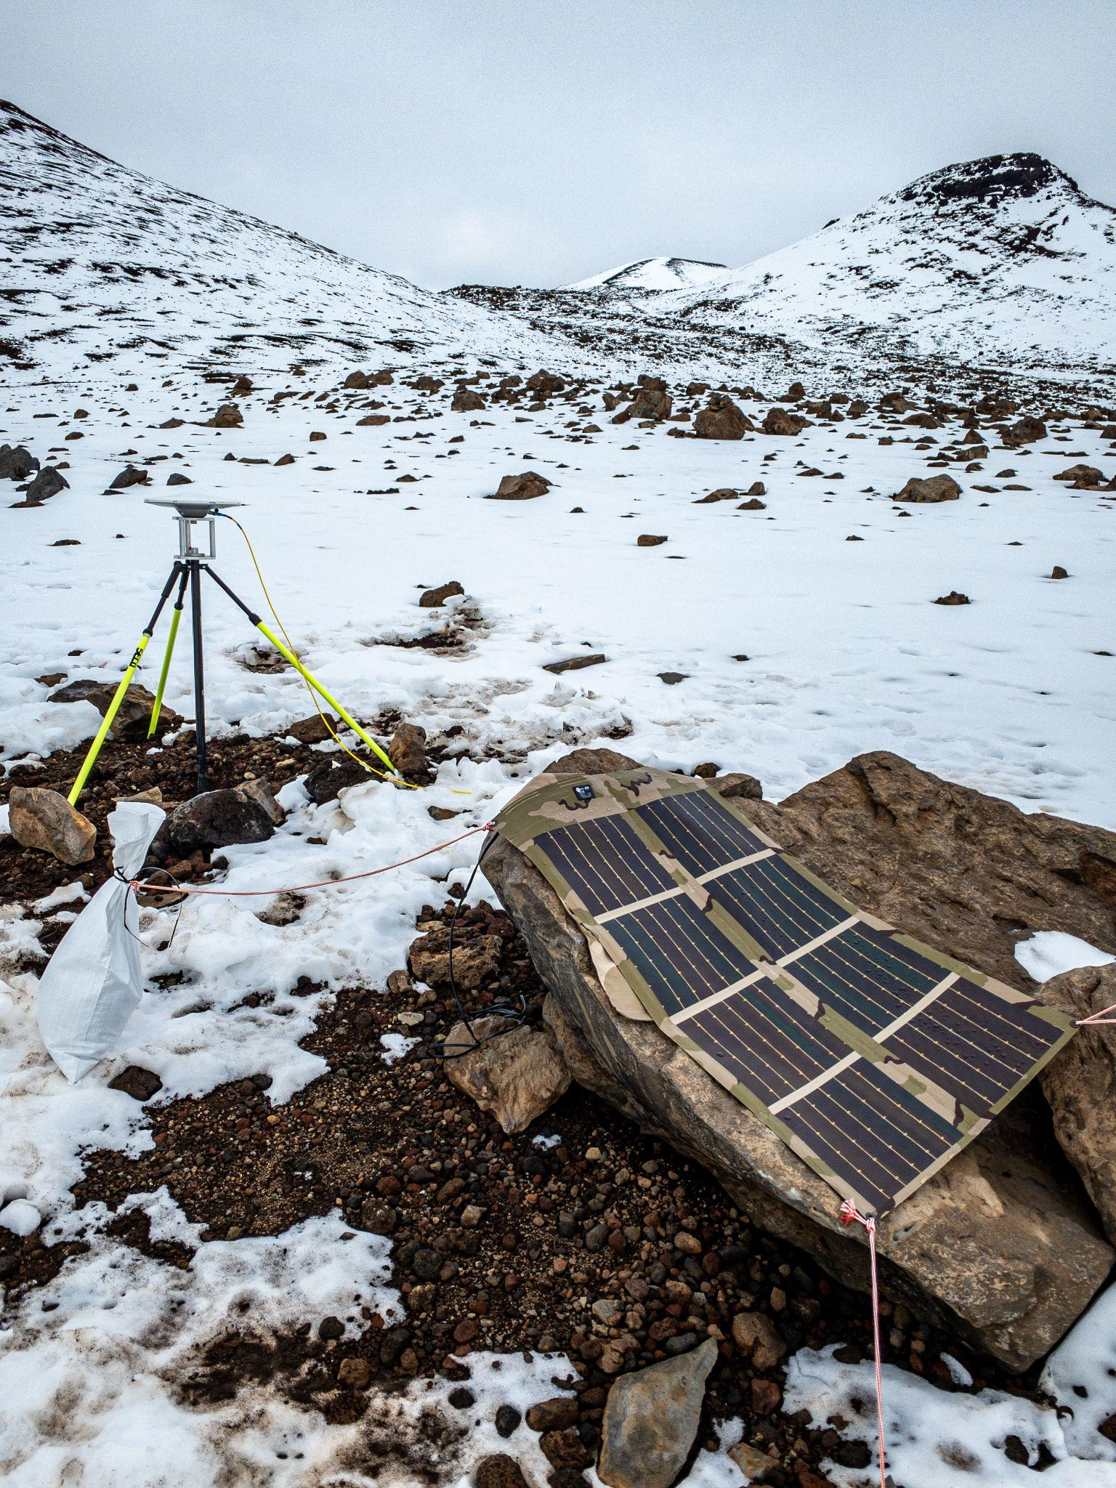
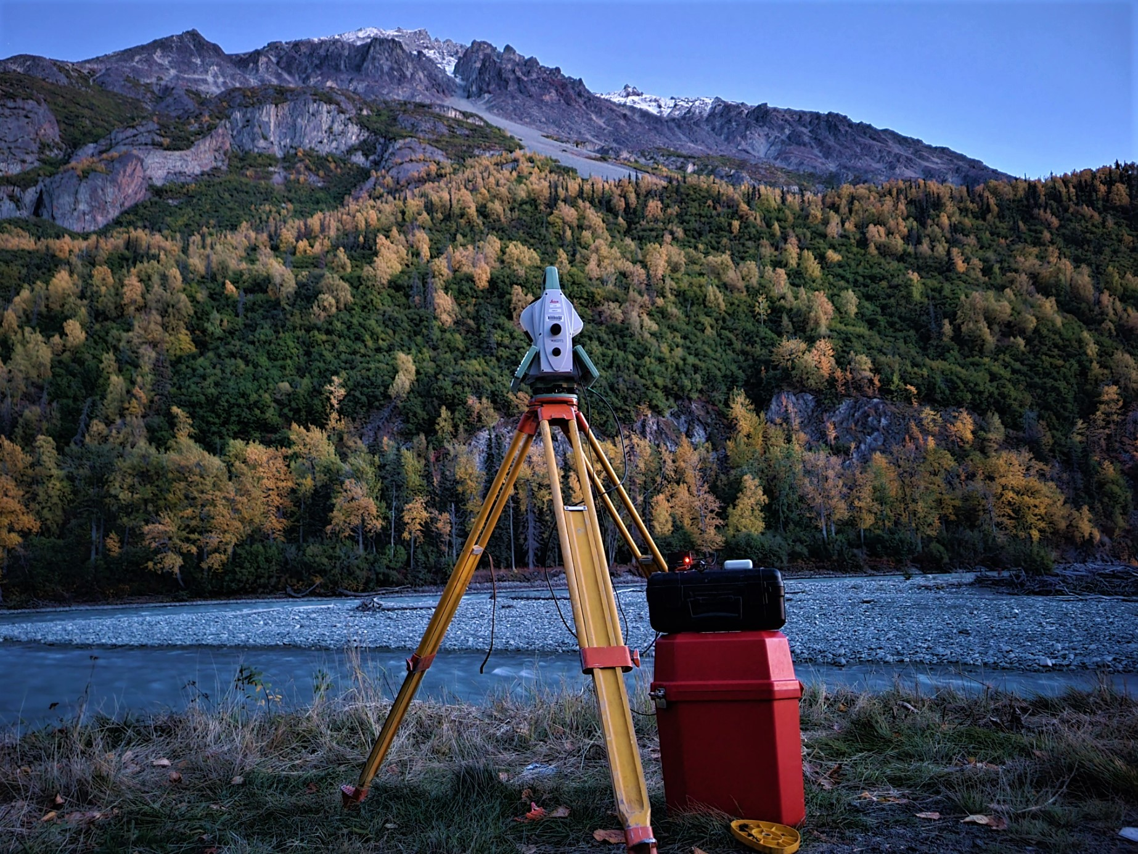
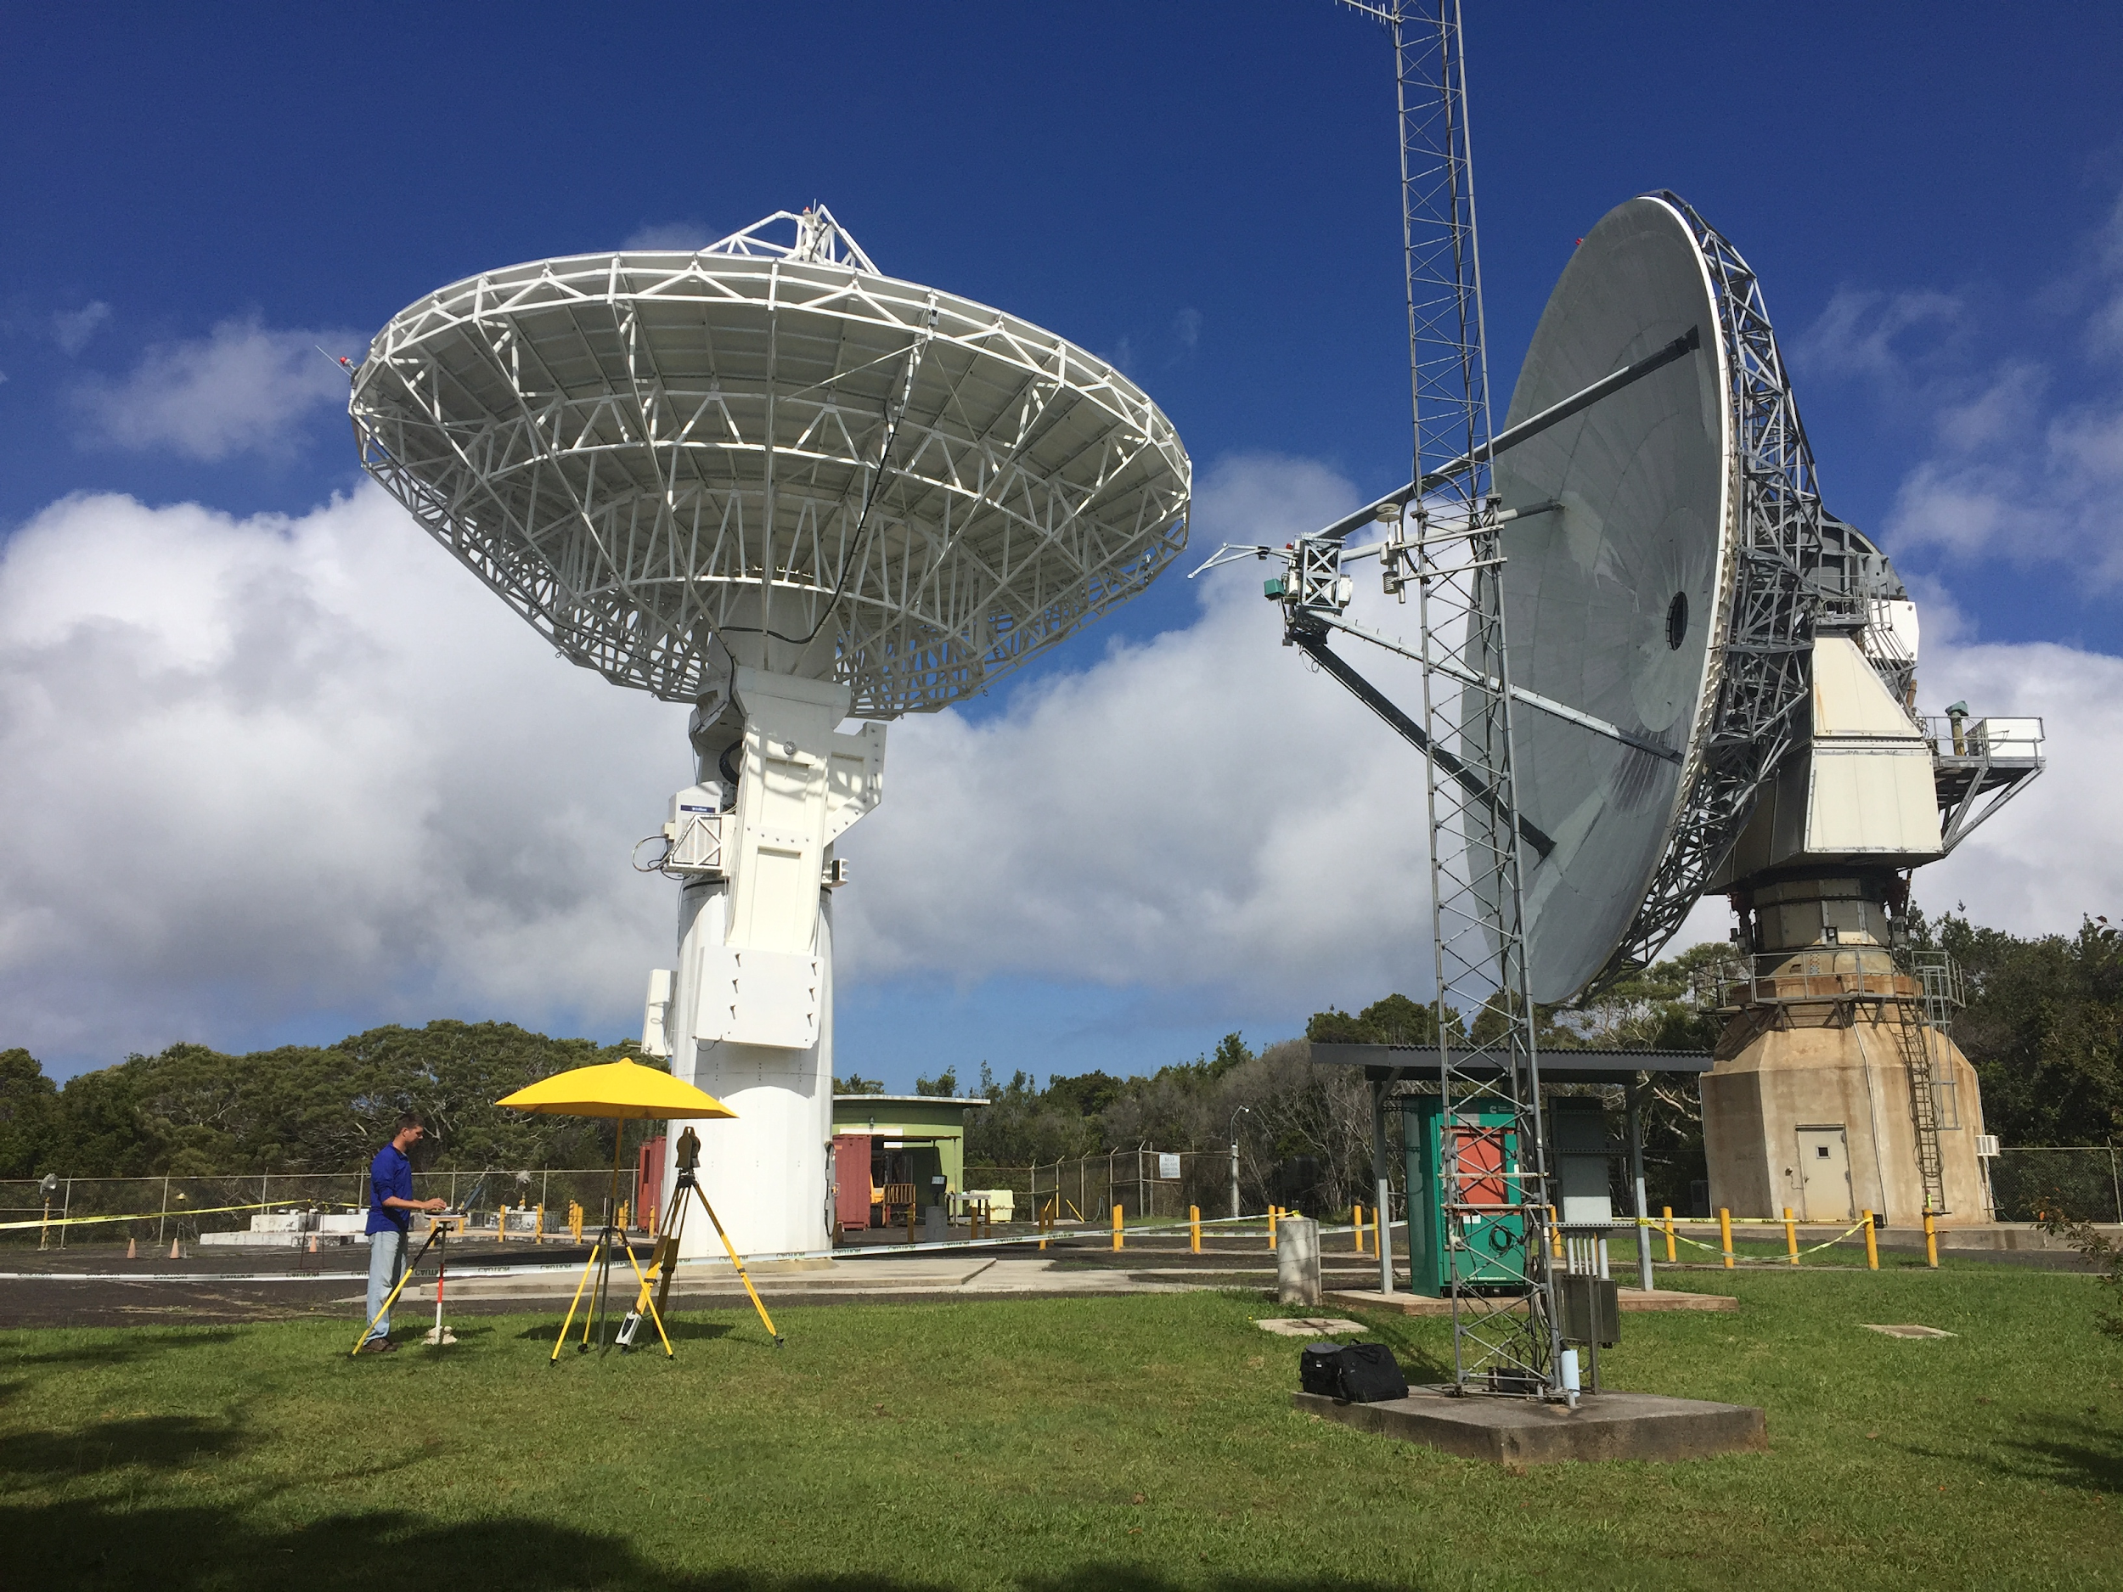
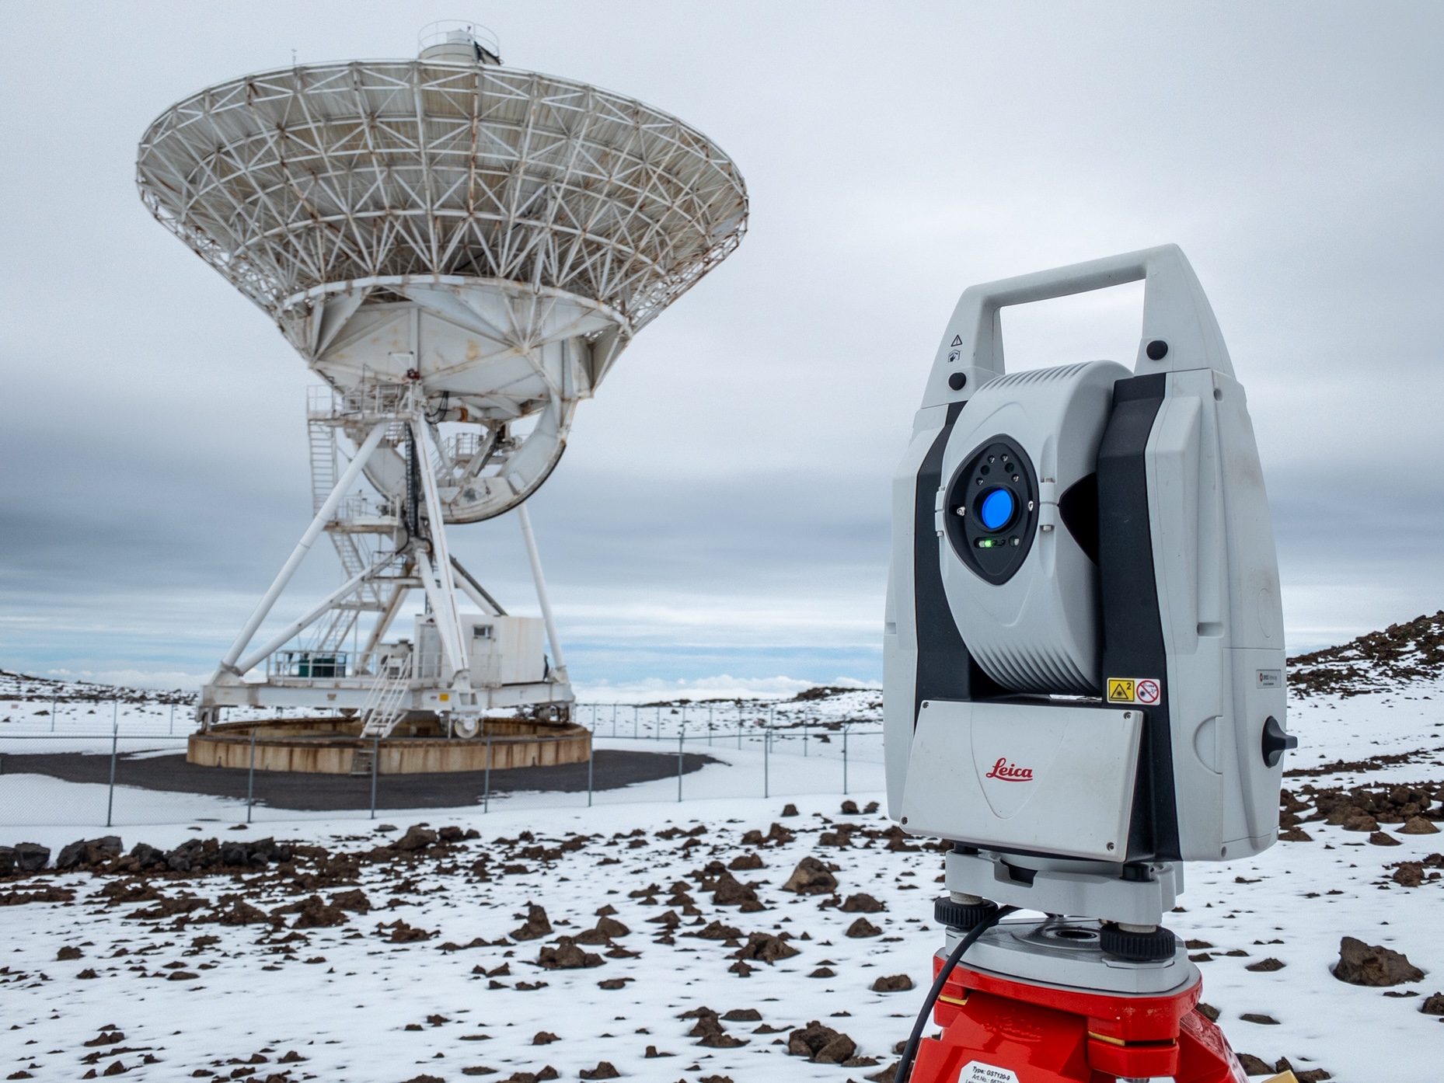
Instrumentation
Multi-purpose Tripod Adapter (MTA)
Allows for simultaneous GNSS and terrestrial data collection

Slide 18
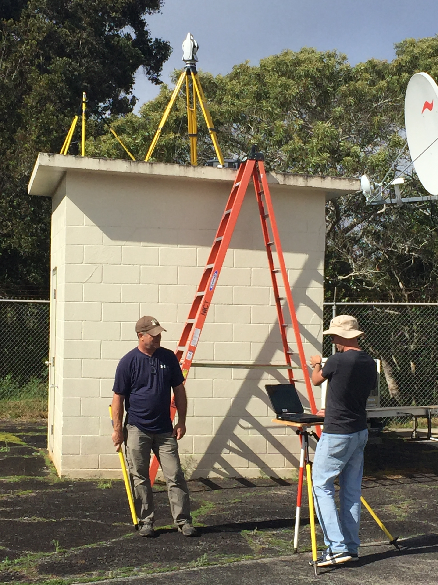
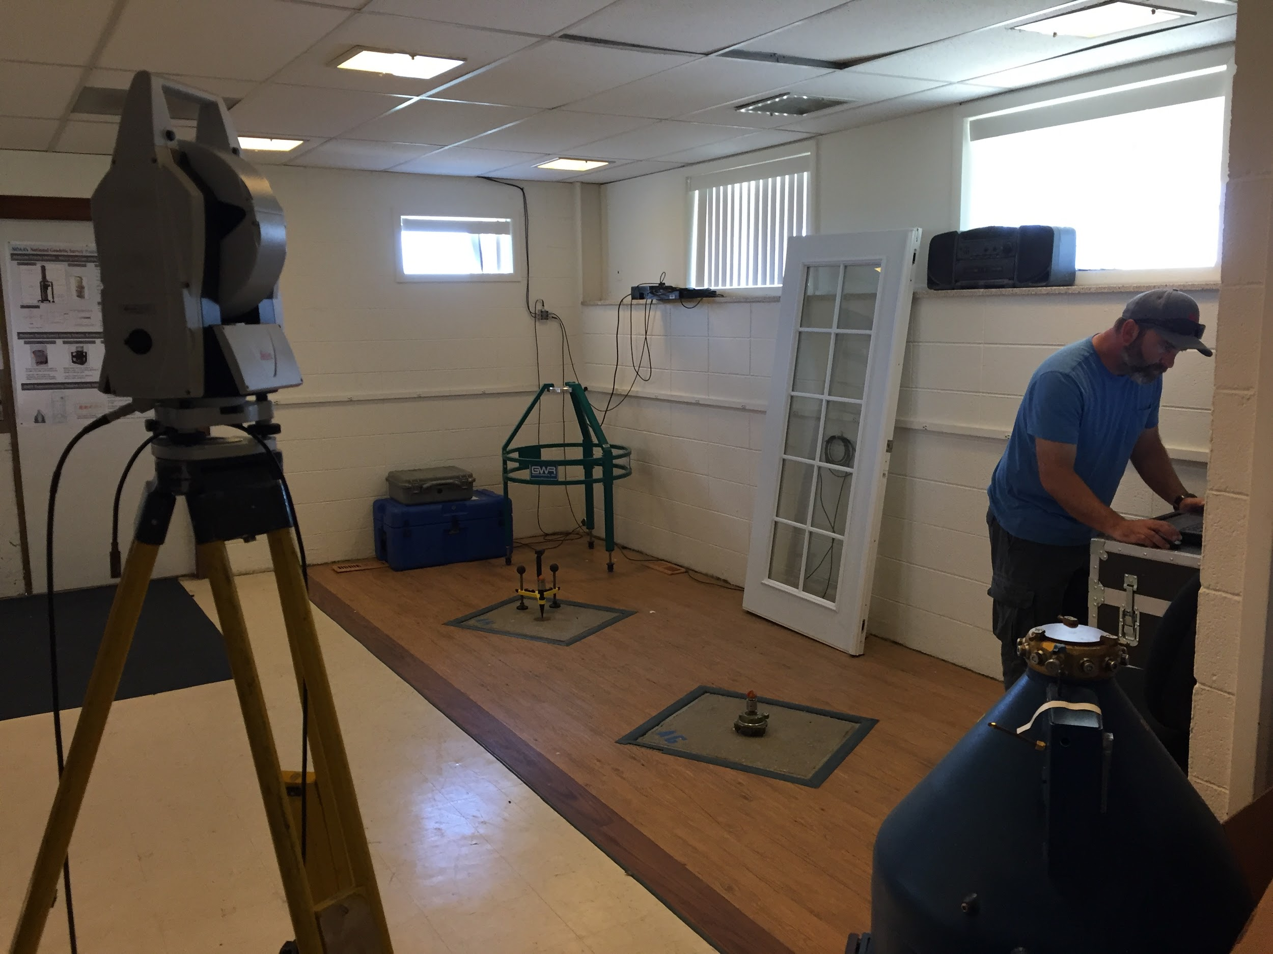
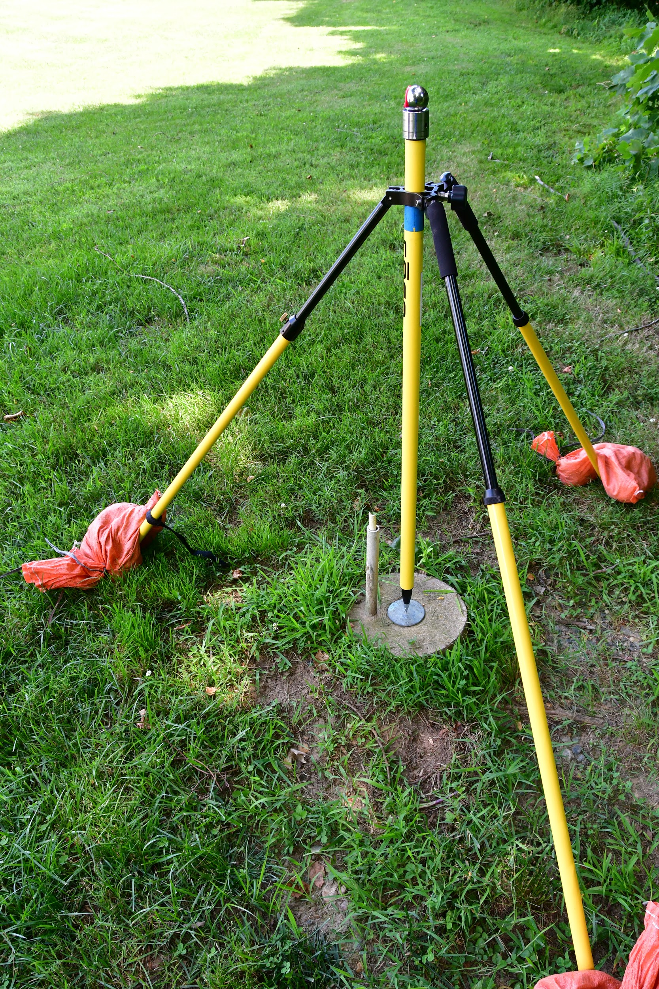
Absolute laser tracker
0.5 second angular accuracy
7 microns distance accuracy
Fully robotic
Atmospheric corrections applied real-time to each measurement
Associated data collection software allows for real-time circle-fitting
Modular targeting setups
for limited centering errors and easier portability

Slide 19
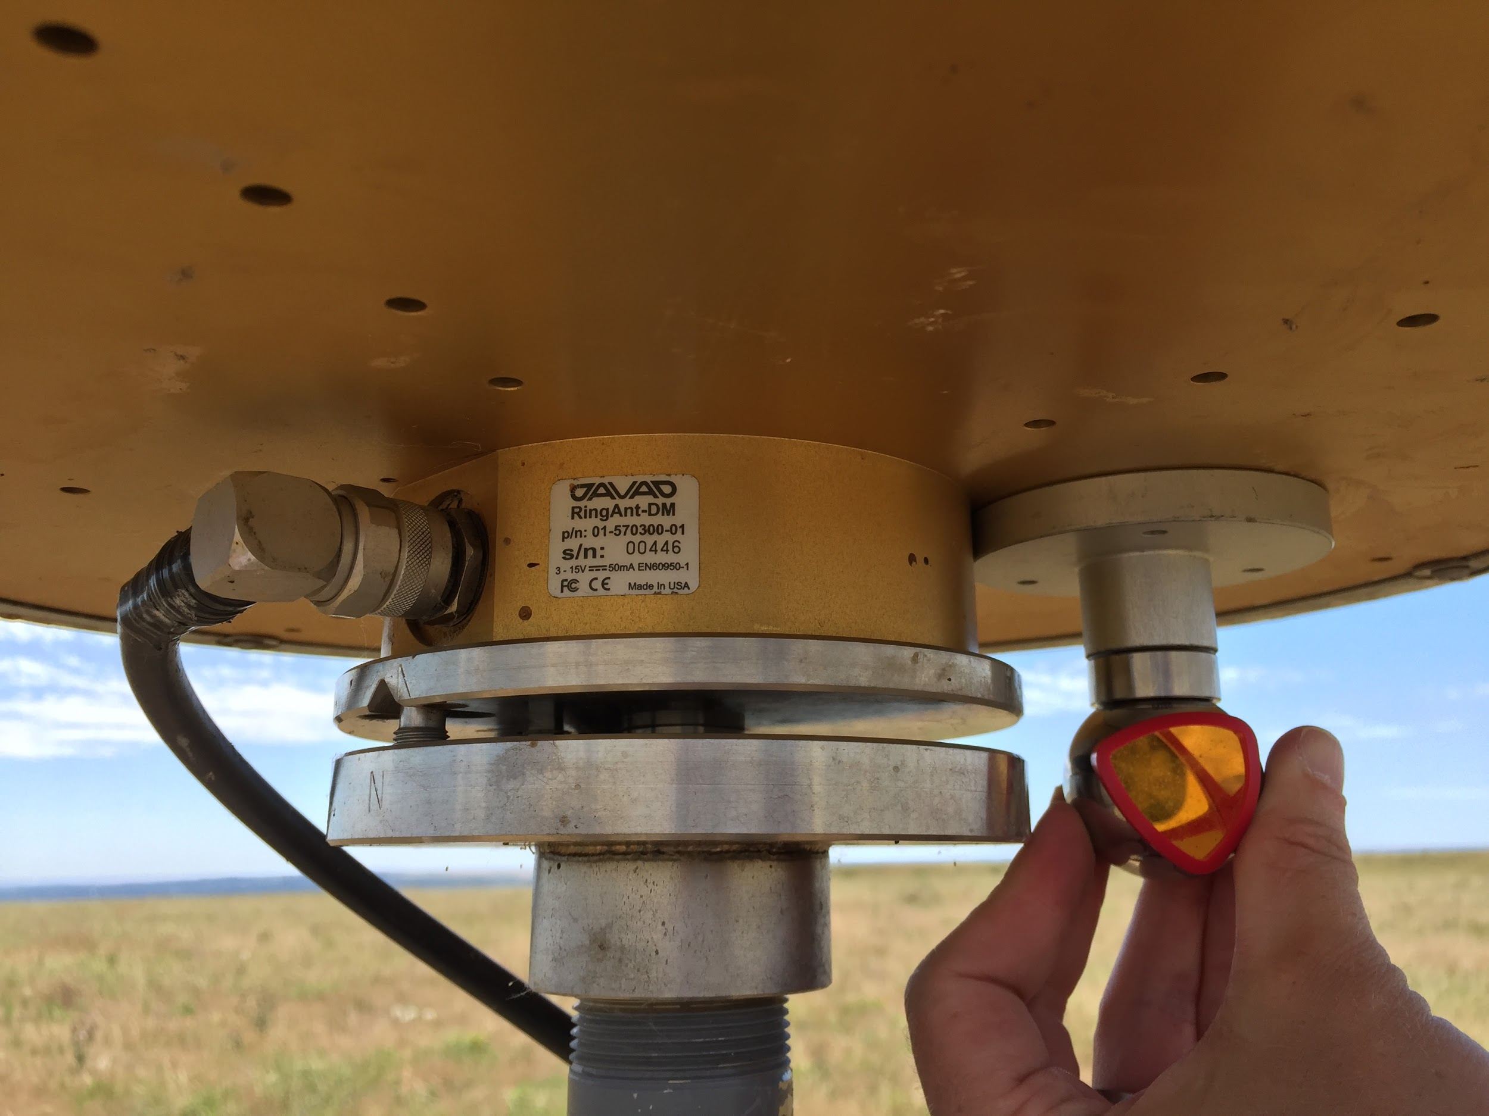
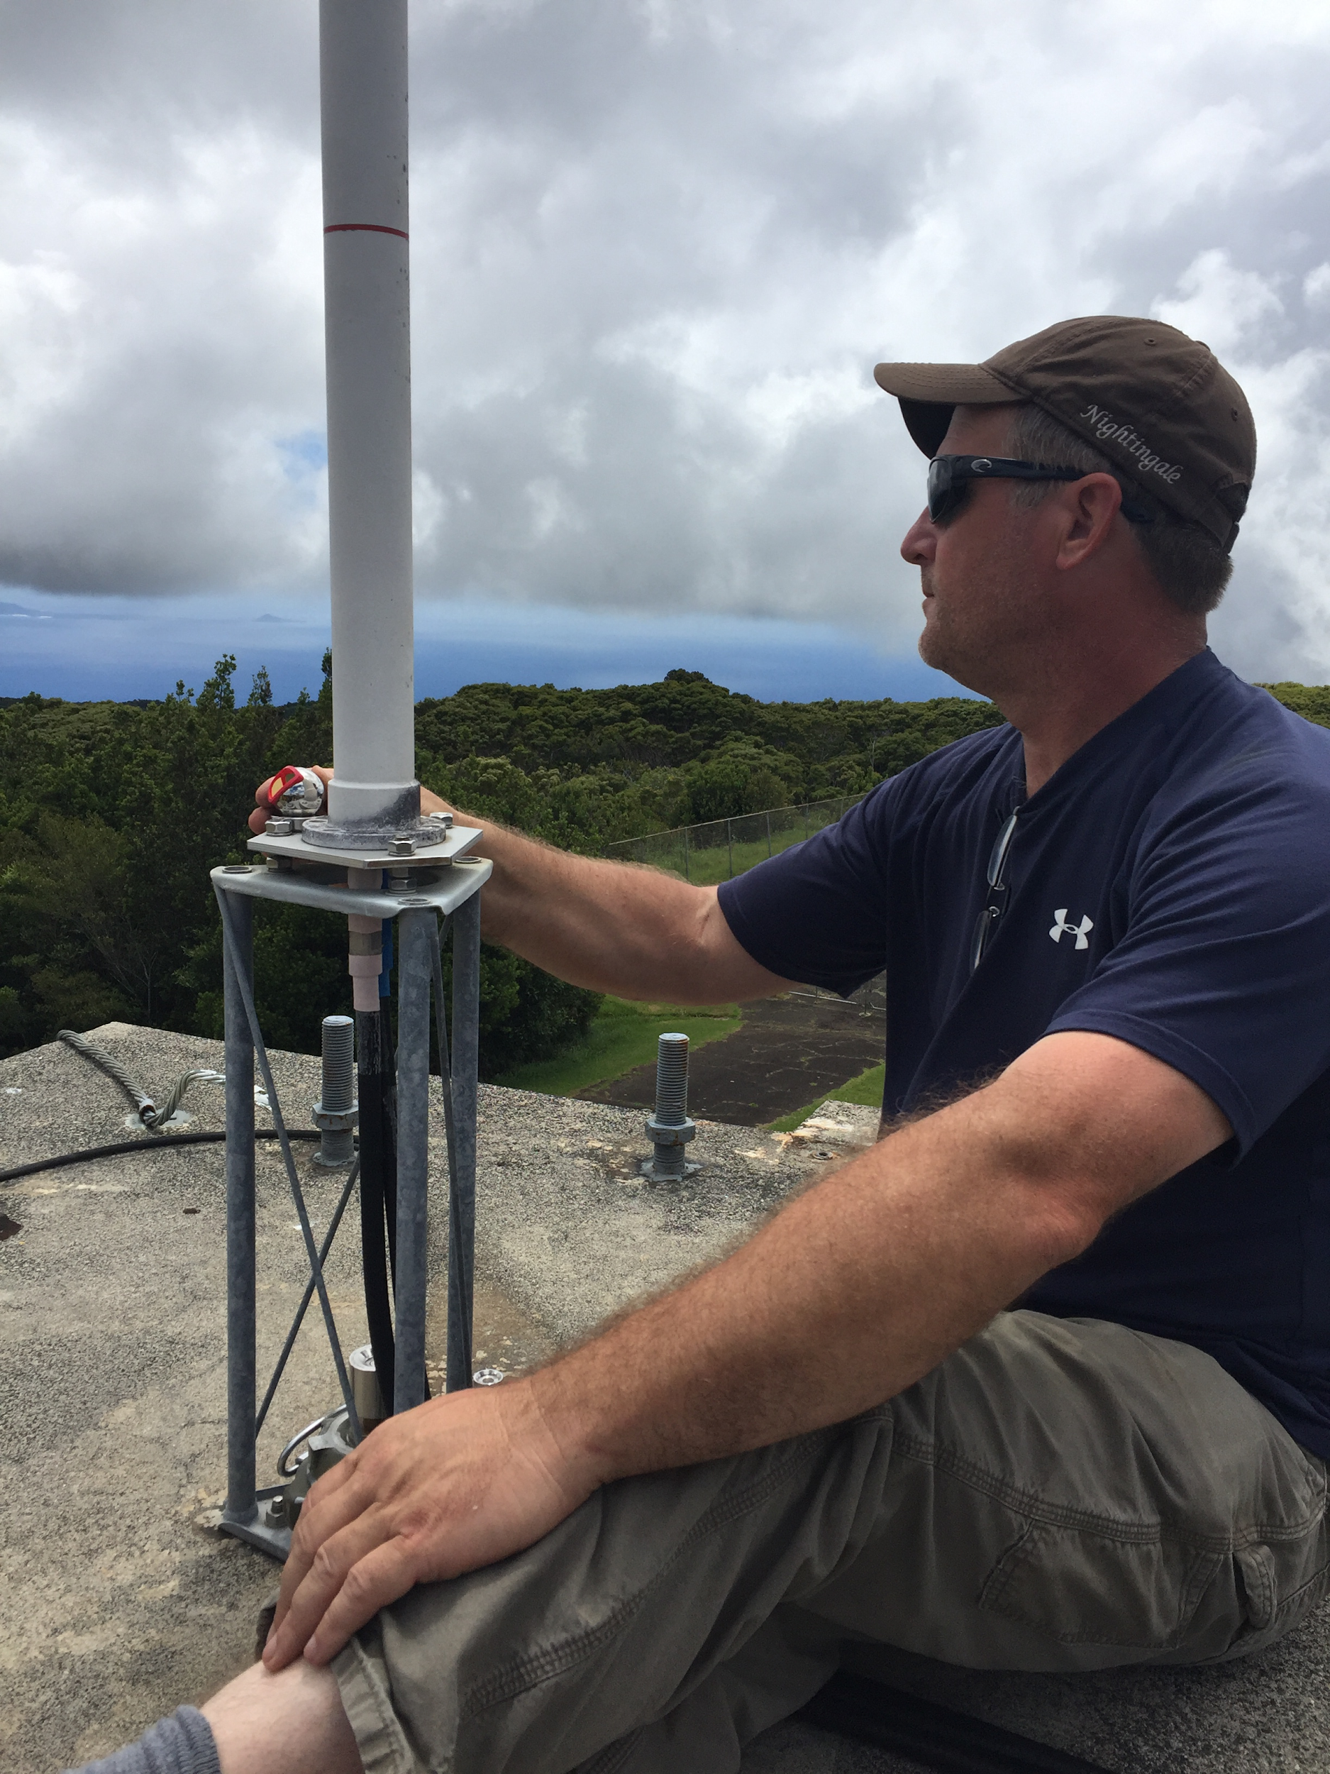
GNSS/DORIS antenna circle-fitting routine
Series of observations is taken around the physical structure and manufacturer’s specs are used for offsets.

Slide 20
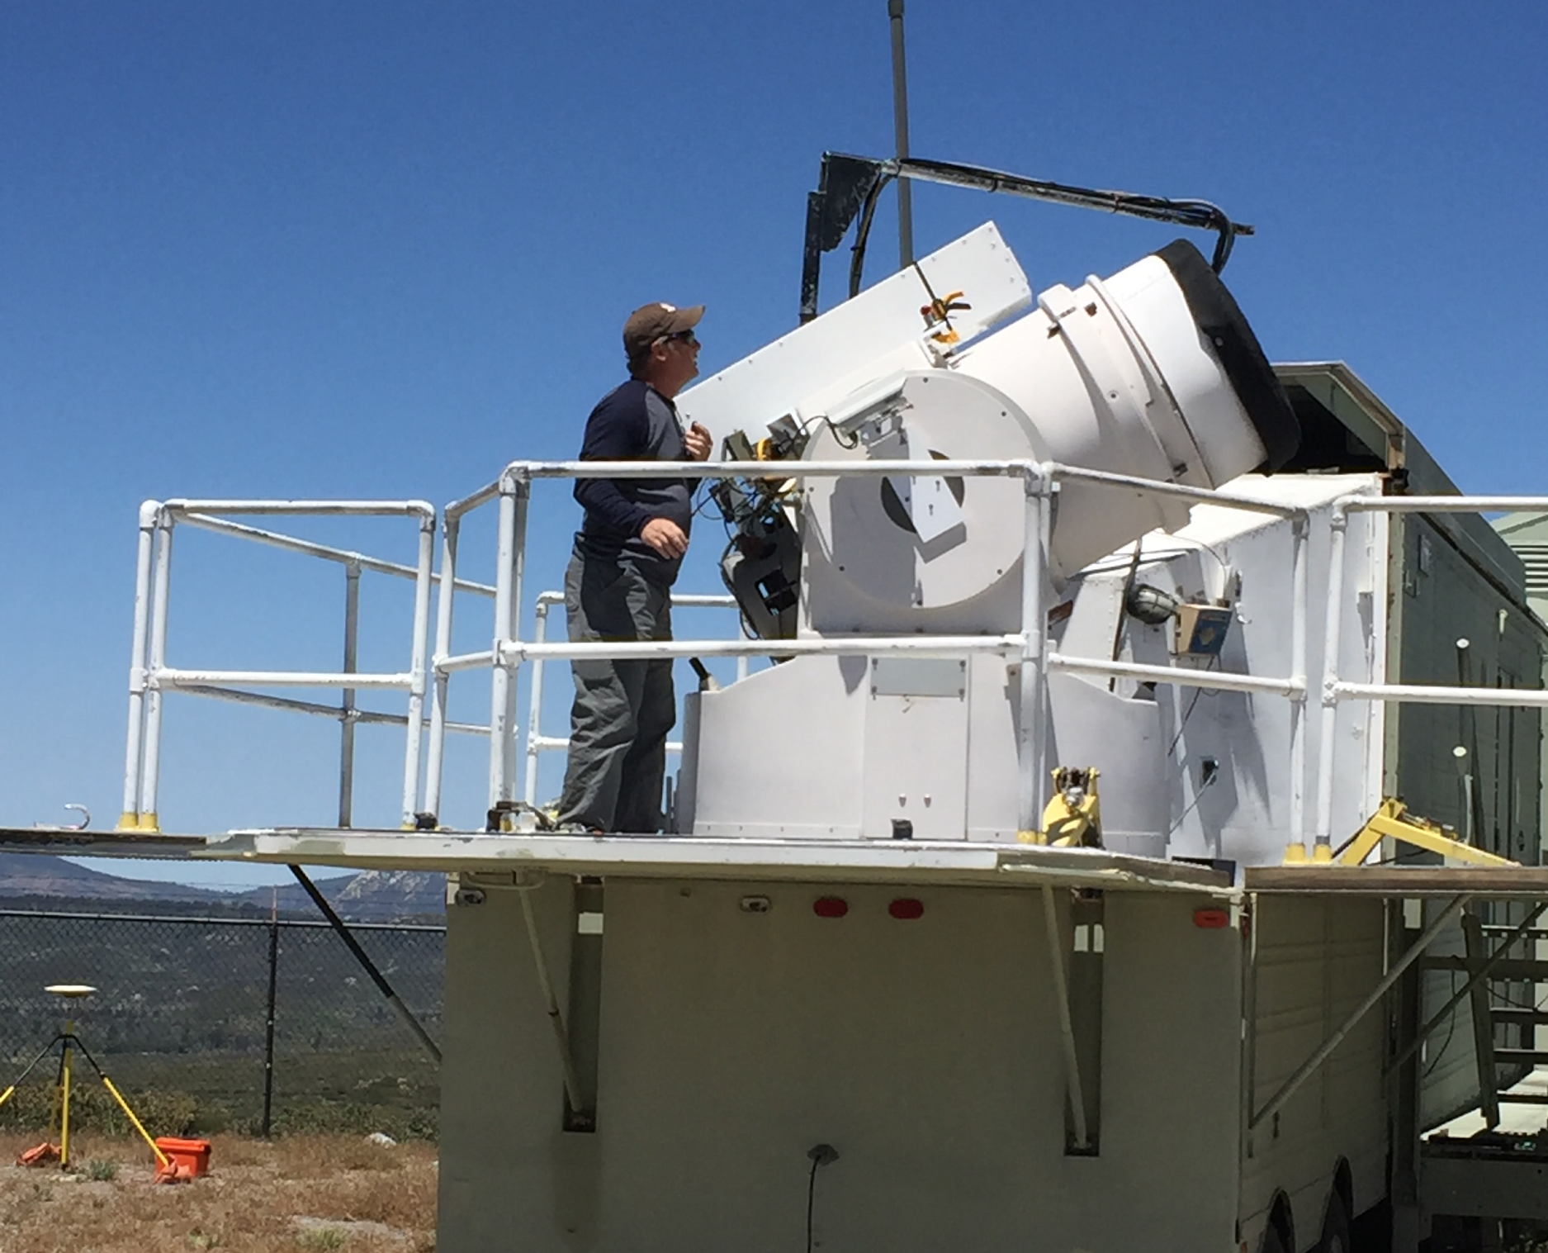
VLBI/SLR circle-fitting routine
Each site is again unique but the routine is modified to deal with multiple axes. Normally one axis is locked out and a circle is scribed for the other. Then we switch and lock out the other axis.

Slide 21
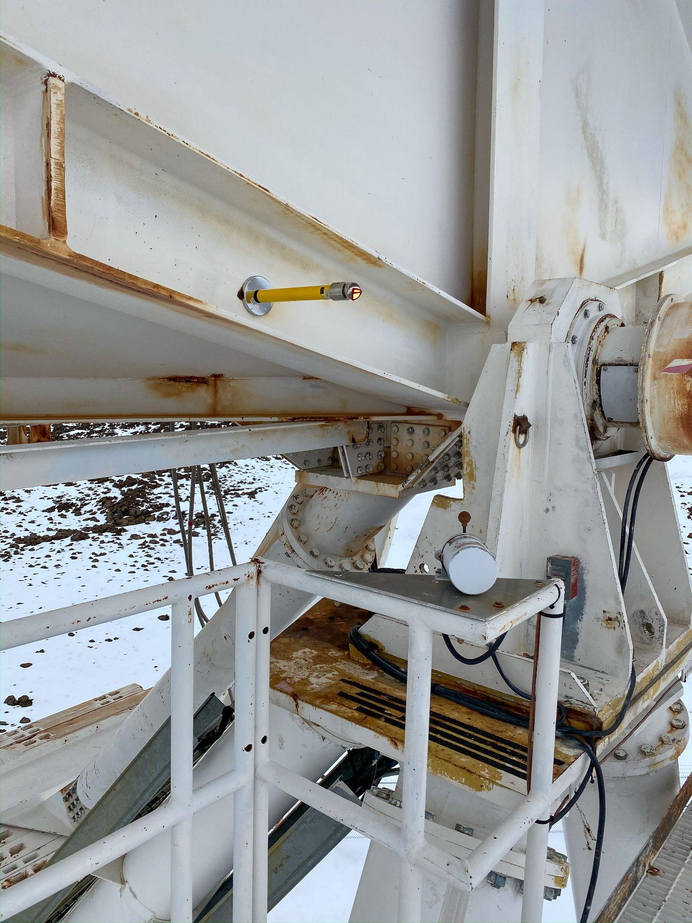
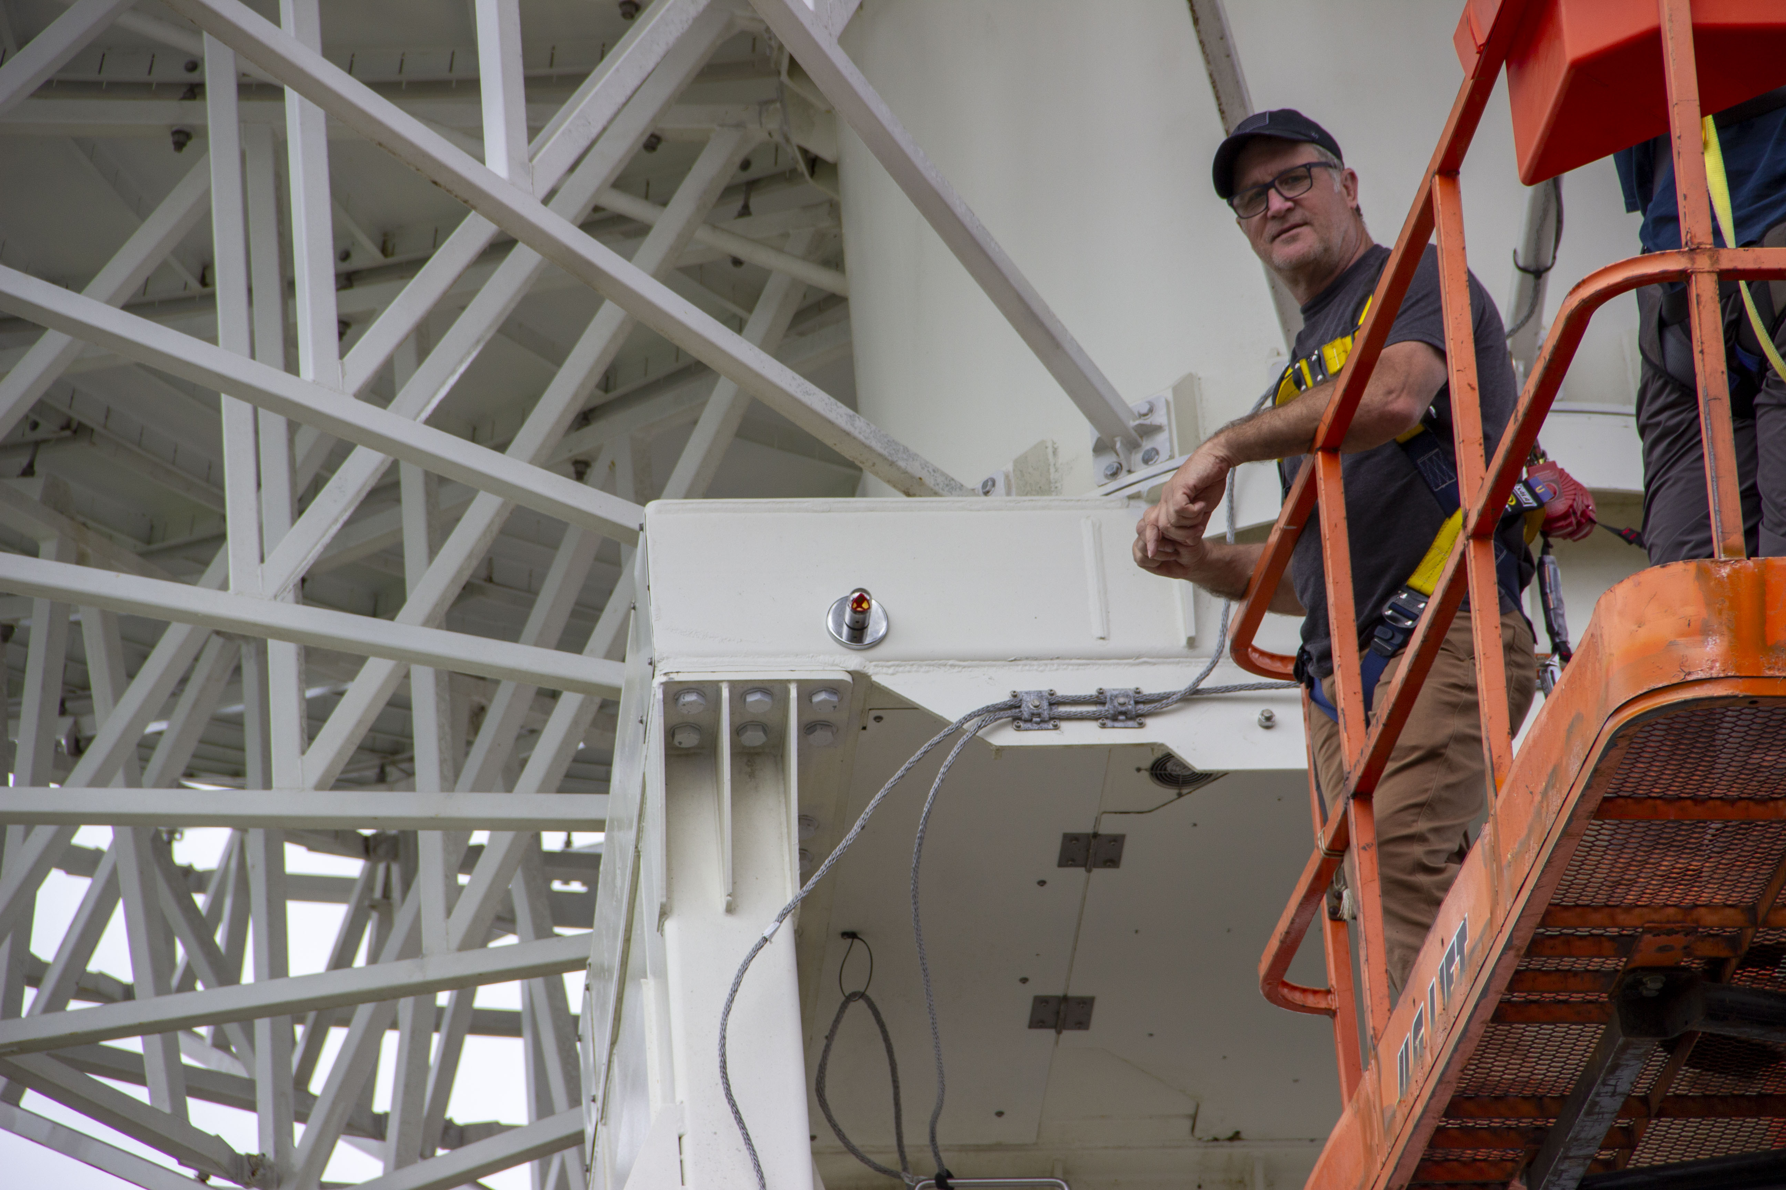
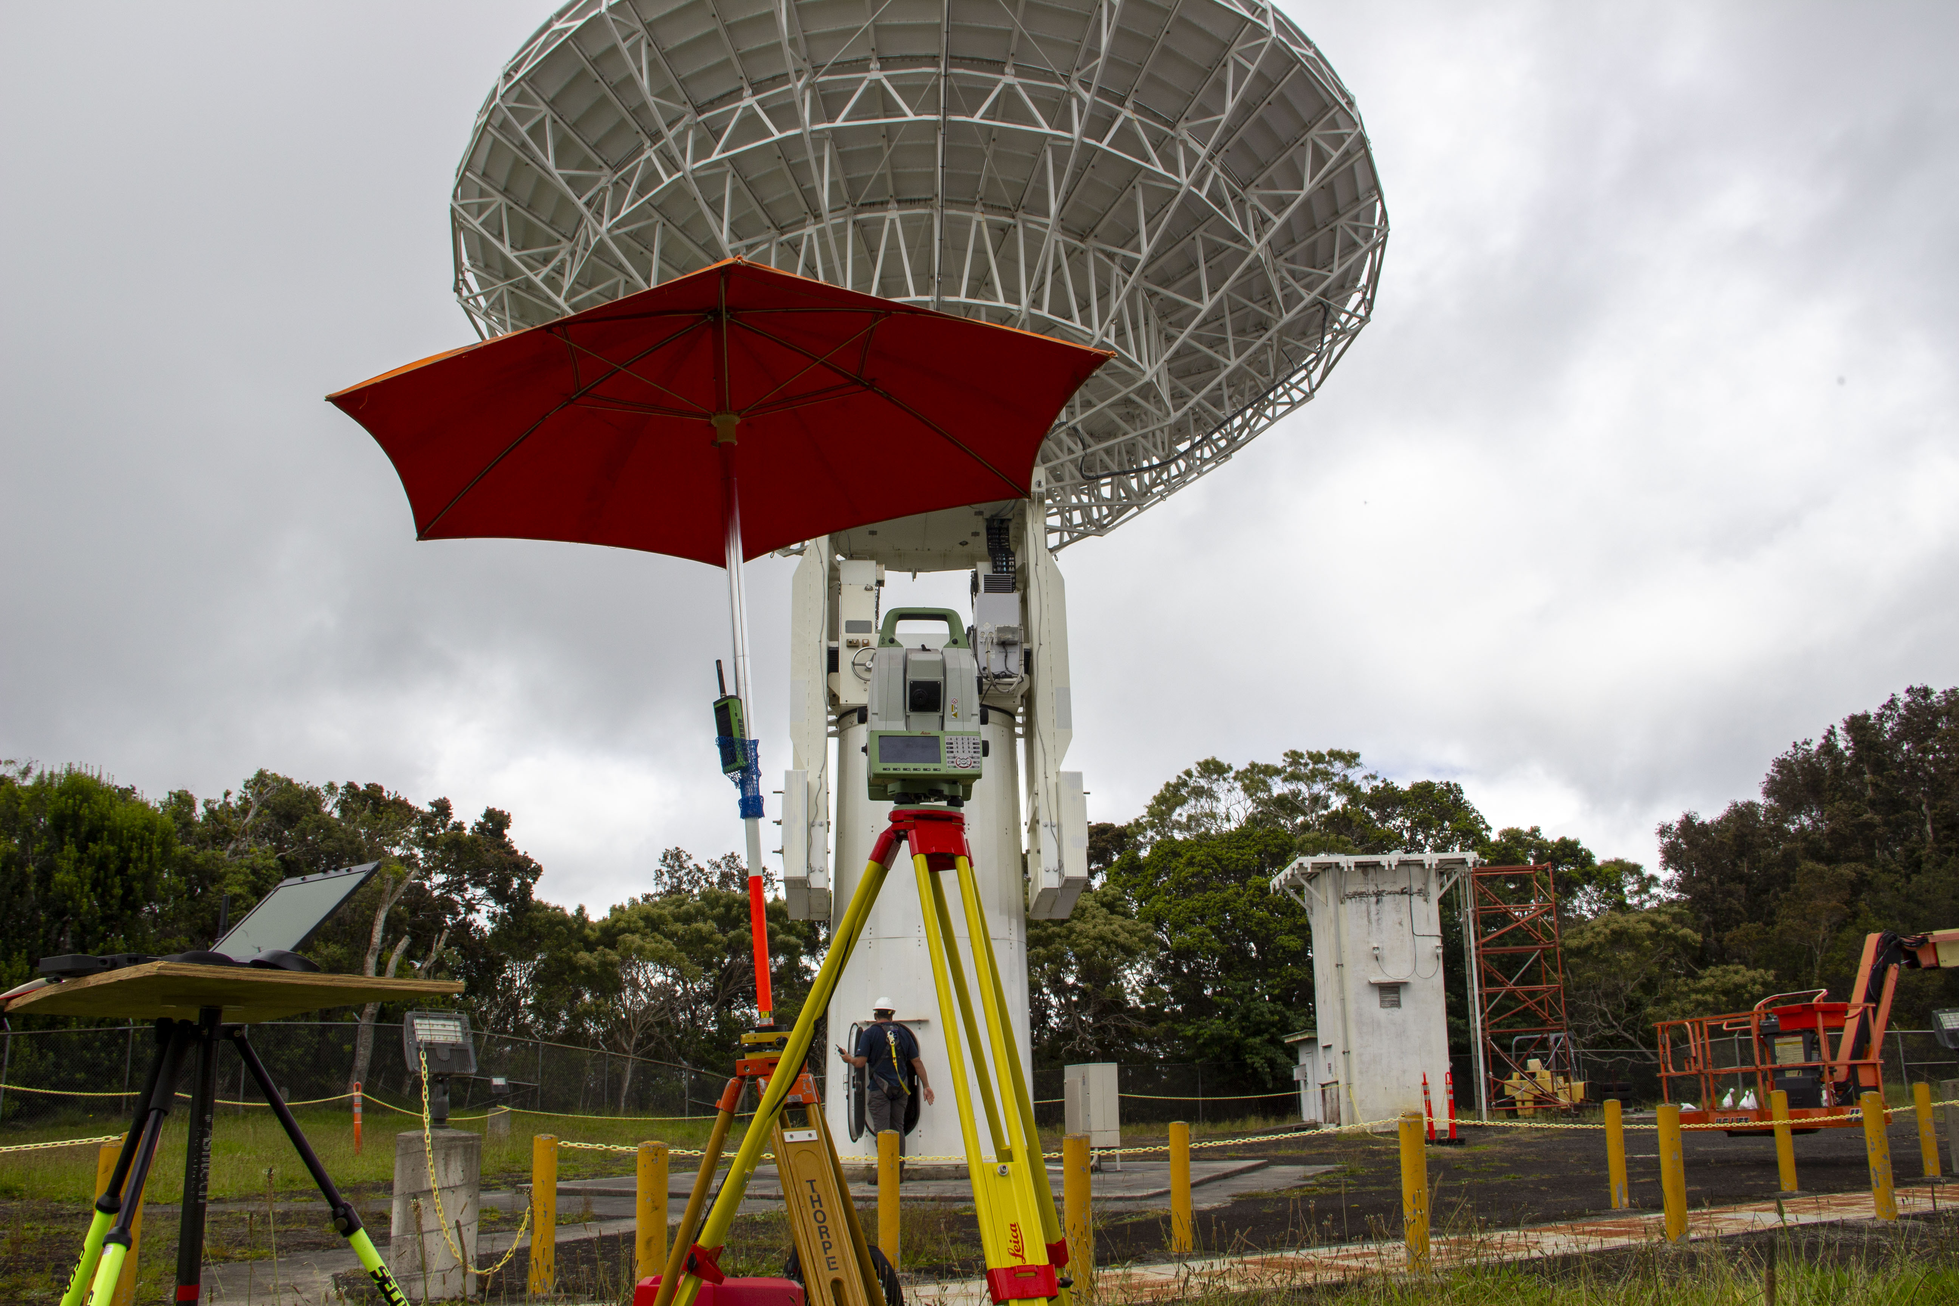

Slide 22
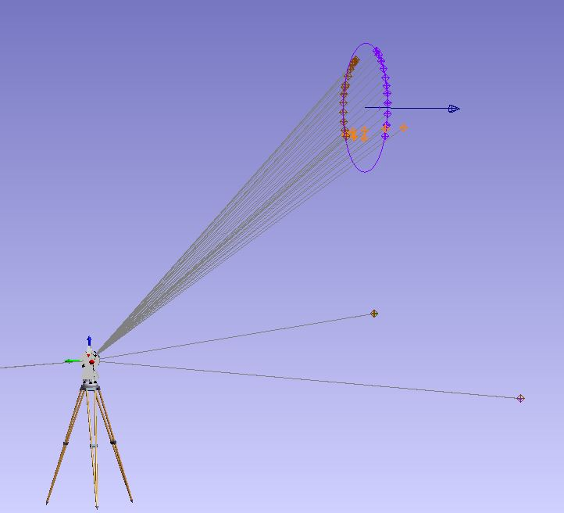
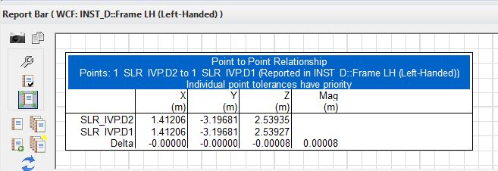
Construct Line then Intersect
Construct Lines and Points at Intersecting Axes

Slide 23
Terrestrial Observations & Sample Site Diagram

Slide 24
Data Processing
Measurements are independent
Survey Frames use instrument as the origin
Established routines are necessary to convert X,Y,Z to Distance, Direction and Elevation
Data is exported for further processing

Slide 25
Data Reduction/Analysis Workflow
OPUS Projects
Reduce GNSS Data to IGS RF epoch date of survey
Spatial Analyzer
Reduce Angular and Distance measurements
PPM Corrections
Circle Fitting
StarNet
Combine LSA of Terrestrial Measurements and GNSS vectors
Create full variance-covariance
matrix of adjusted and aligned
project measurements
Align to IGS RF epoch date of survey
AXIS
Output Coordinates
Creation of SINEX file

Slide 26
Sinex
Star*Net Adjustments
Terrestrial Obs File
Setup File (Provisional Coordinates)
Instrument Parameters
Site parameters (SPC Zone/Geoid)
GNSS Vector File*

Slide 27
Final Report

Slide 28
Co-location Research & Applications
On-going development in field protocols and research topics are developed based on field discoveries, operator requests, and site-specific challenges
Current topics are VLBI antenna deformation, automated site monitoring, and the inclusion of additional sensors (InSAR, water levels, etc.)
The value of these surveys to the overall community is immense and co-locating of sensors continues to be a growing area of expertise
These protocols can be fit to InSAR reflectors, water level stations, and multi-sensor systems with limited protocol development
National Geodetic Survey

Slide 29
NGS Field Support
Surveying
Conduct or provide input on campaign surveys utilizing long-duration static GNSS
Measure local ties at co-location sites (observatories, water level stations, VLM)
Geodetic Expertise
We will answer questions, provide feedback on survey plans, or potentially operationalize for those that have challenges requiring field work
Equipment
Consistently working with CORSs, GNSS, robotic total stations, leveling procedures, etc. to determine best course forward for geodetic-quality work
Training
Videos or job aids available from various projects that describe tripod calibration, receiver configuration, and best practices
Established training courses available
Lessons learned in the field

Slide 30
Thank You
Ryan Hippenstiel, PLS
Chief, Field Operations Branch
NOAA's National Geodetic Survey
https://www.ngs.noaa.gov/
ryan.hippenstiel@noaa.gov

