Slide 1

NGS Coordinate Conversion and Transformation Tool (NCAT)
Krishna Tadepalli
05/07/2019

Slide 2

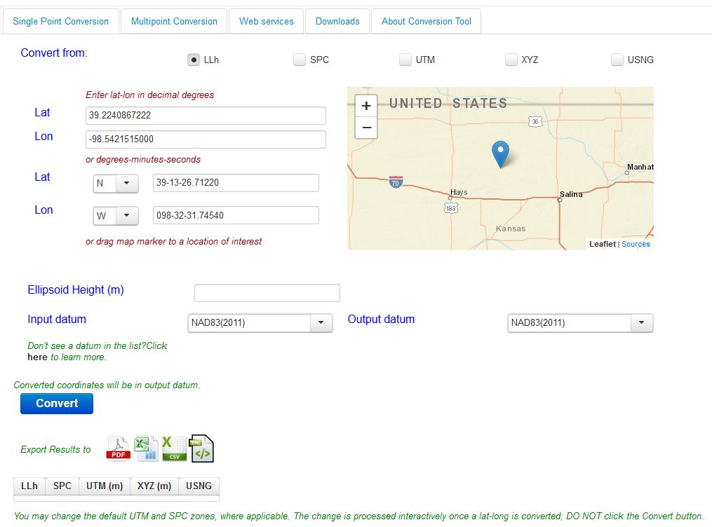

Slide 3
NCAT Roadmap
2/2018 – NCAT went live
  -Conversions between LLh, SPC, UTM, XYZ, USNG and Nadcon transformation integrated into NCAT
6/2019 – Vertcon
2019-20 – Deflection models
2020 – Geoid models

Slide 4
NCAT Roadmap…
2020-21 – Helmert Transformations
2022-23 – IFVM epoch (2020) in Nadcon and Vertcon; 5-year update cycle,**TRF,NAPGD Transformations
2023-25 – Dynamic Heights
Shared code base ensures consistent results between NCAT and VDatum

Slide 5
Changes to NCAT
No significant changes to UI through Vertcon
Major changes to UI with integration of
deflection and geoid models
Web services (API) will be backward compatible, new services added
Metadata for API

Slide 6
Changes to NCAT…
Minor changes to upload formats, new formats added
Variable output results

