Slide 1

Online Positioning User Service (OPUS) Improvements - Part 1
A look into recent upgrades and the near future of OPUS
Presenting: Jeff Jalbrzikowski
Supporting SMEs: Heather Nicholson, Ryan White, Jaya Neti
Notes:
Hello, I’m going to talk a little bit about , well, what it says on your screen there: some recent upgrades to OPUS and a look into the future
-quick shout out to the supporting Subject Matter Experts here who are online ready to assist with any questions, and also Dru of course leading the charge to make all this happen

Slide 2

NGS Products and Services
Not just OPUS
All exist in three environments:
  Development (DEV) - internal testing and development
    same as when you hear a company talk about an “Alpha” product
  Beta - continued internal testing, open for public testing
    key features have already been vetted/tested
  Production - final product, open to public use
    this is what you see first when navigating our website
Notes:
I’ll be talking about OPUS today, but I need to clarify one of our processes for this to all be clear. I will also mention that this is a new-ish workflow for NGS, began in the past 8 or so years.
So all NGS Products & Services go thru this process as they are created, tested internally, open for testing by you our constituents, and then rolled out as final products.
CLICK
There’s three environments that products will exist in, listed here in the order they occur
First, a tool will be created on the “DEV” servers for internal NGS-only development, testing, and otherwise “working the bugs out”
→this is the same phase as when you hear a software company or video game maker talk about their alpha products
CLICK
Next, after some level of confidence in the product is gained, it will be migrated to the Beta servers, thereby open to the public for their own testing
→it’s important to note that when a product is available via our Beta page, when you use it you are indeed now a “beta tester”
key features will have already been tested in the Development environment, but it is still a beta, so as a beta tester please let us know if you have issues/complications/struggles or the like
CLICK
At some point, when all I’s are dotted and T’s crossed, the thing will be moved to the Production environment.
→ by then, the tool is integrated into others, has been vetted with 2 testing phases and functions as expected, but may still continue to receive version updates by repeating this process

Slide 3
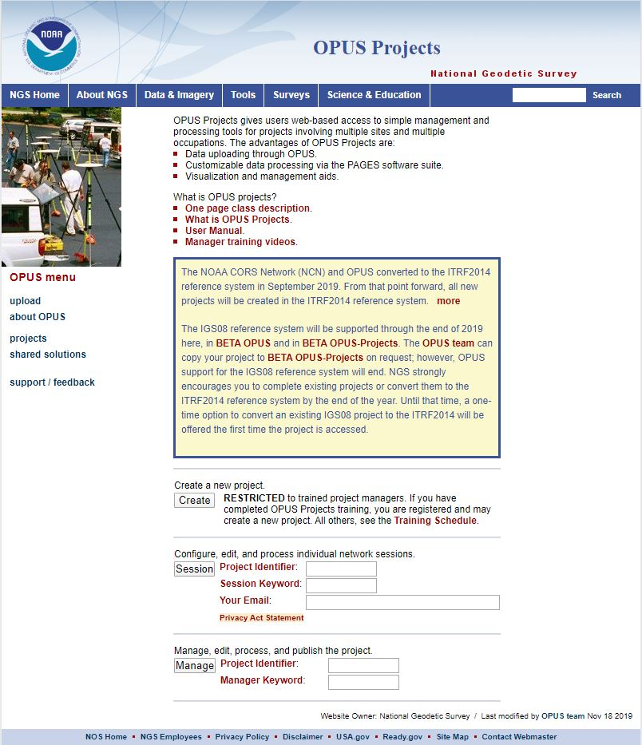
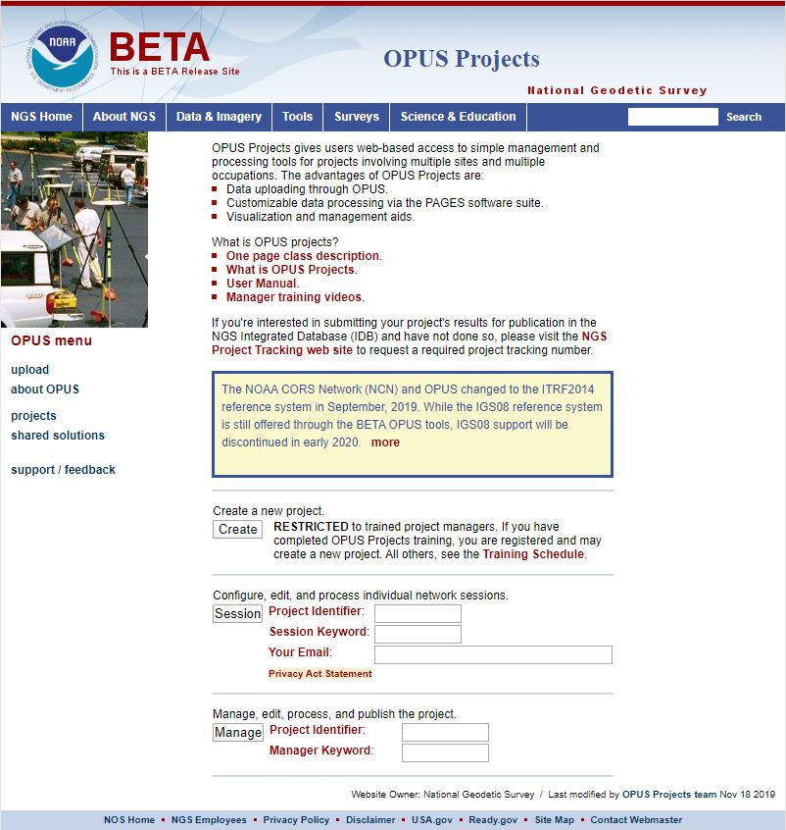
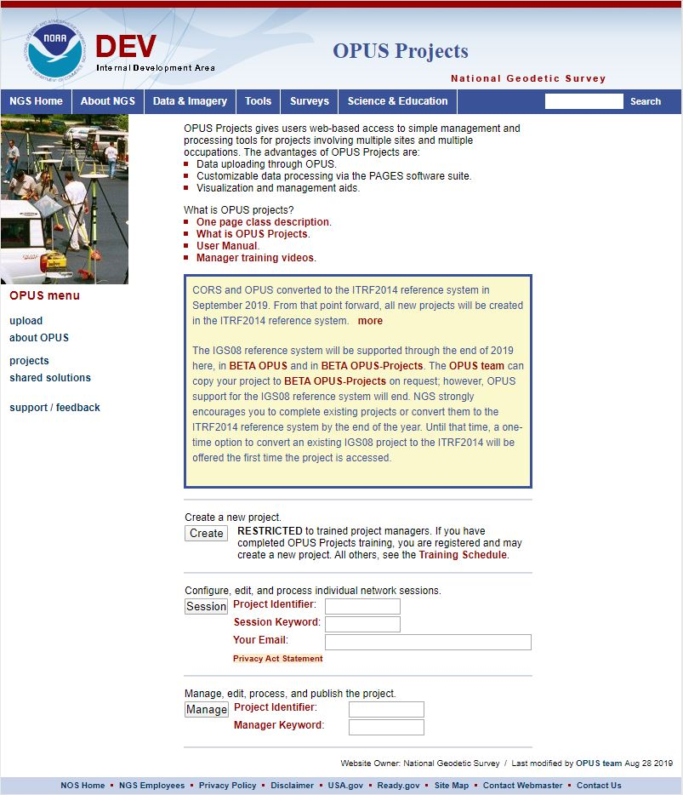
www.ngs.noaa.gov
beta.ngs.noaa.gov
Remember, you won’t see the DEV environment…
Notes:
So here we have 3 screenshots, first here showing the Production OPUS Projects gateway page
CLICK
Second is the Beta page, with the text here showing the URL for our Beta homepage
-How do you find that beta page? substitute “beta” for “www”
-or most tools that have a beta will have a link to that beta platform
CLICK
Last is the Development or DEV example, which again you will not see unless via a demo from NGS personnel

Slide 4
Aside from environments, we have versions
Just like any software
Right now:
  OP 4.0 – currently in transition from Beta to Production
  OP 5.0 – similarly, moving from Development to Beta
Notes:
Of course, aside from the 3 environments, we also have different versions of our products, just like anyone else.
CLICK
Right now:
OPUS Projects version 4.0 is currently in transition from Beta to Production
OP 5.0 – likewise, moving from the Development servers to fill the gap in Beta left by OP 4.0 migration

Slide 5
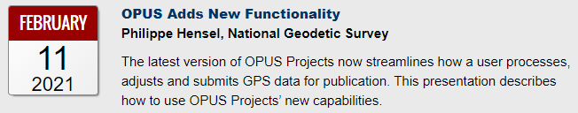
OP 4.0
What does this version add?
  Allows you to submit campaign style GPS survey to NGS for inclusion in the IDB (Integrated DataBase)
    Upload GPS data to OPUS-S
    Upload mark descriptions and photos
    Process simultaneous/overlapping sessions
    Run network adjustment (using GPSCOM and ADJUST)
    Click the “Submit” button to send to NGS!
(must be created using WinDesc)
Notes:
OP 4.0, our recent improvement allows users to submit campaign-style GPS surveys for inclusion into the NGS Integrated Database
→if you haven’t heard the phrase IDB before, that’s the database that holds the coordinates that you get on a Datasheet
So with version 4.0 you can
CLICK
Upload GPS data to OPUS-S
CLICK
Upload mark descriptions and photos … I do want to point out that descriptions and photos must be created/formatted with another tool we provide called WinDesc
CLICK
Process simultaneous/overlapping sessions
CLICK
Run least squares adjustment on the resulting network
CLICK
Then when you’re ready to submit just click the “Submit” button to send to us!
CLICK
For full details see our Webinar Series, recorded on 11 February 2021

Slide 6
OP 5.0
What will this future version add?
  Allows you to upload your own GNSS vectors
    Pre-processed vectors uploaded directly to a user project
      pre-processed? → RTK, RTN, PPK, even Static from other software
    Upload via the GVX file format
      GNSS Vector eXchange: developed by NGS; .xml based format
  Recommendations and Station Selection Criteria
v5.1 will bring M-PAGES → multi-constellation processing
Huge advantage…
submit your RTK/RTN data to us!
Notes:
This version, 5.0, will add functionality that allows upload and therefore submission of pre-processed GNSS vectors,
CLICK
such as from real-time networks, your RTK base-rover setups, any PPK you might still use when you radio or cell data is not an option, and even static commercially available GNSS processing software
How will you get that data into OP?
CLICK
Upload via the GVX file format
GNSS Vector eXchange: developed by NGS; an .xml based file format that we hope will catch on with various software developers … idea being your software will give you the option to export a GVX which you can then carry over to OP
CLICK
It’s also at this phase that Recommendations and Station Selection Criteria will enter the picture
CLICK
then a big milestone is planned to roll out with version 5.1 … multi-constellation processing that Andria told us about yesterday (if you missed her presentation, don’t worry the recordings will be up soon after the summit concludes)
So what’s the big deal with this?
CLICK
remember that with version 4.0 came online-based or digital submission of data, so this is a big step to be able to submit your RTK/RTN data to us for potential inclusion in the IDB

Slide 7
OPUS 6.0
What will this future version add?
  Integration with other NGS tools
  Ability to upload non-GNSS data
    Leveling, Gravity, Classical (total station)
  More of a web-based interaction/interface
    Solutions delivered right in the browser
will not be in Production until the Modernized NSRS is rolled out
Notes:
Eventually, OPUS will be completely overhauled … NOTE at this point I’ve ditched the moniker of OPUS Projects and I’m just saying “OPUS”. That’s a part of the major changes, a rename to just “OPUS”
What will this future version add?
Integration with other NGS tools such as Mark Recovery, Map Searching, NCAT, etc.
Ability to upload non-GNSS data
Leveling, Gravity, Classical total station observations
We plan to move to a more web-based interaction/interface
Currently → Solution Reports via email
Future → solutions delivered right in the web browser
CLICK
-it’s important for me to point out that although OPUS 6.0 will not migrate to the Production environment until the Modernized NSRS is rolled out… facets of it will become available in Beta by way of new buttons/options to get you comfortable with the idea of uploading Leveling and other data to OPUS.
So this version will sit over in Beta for a while, where you are invited and welcome to come take a look, try it out, and provide us any feedback

Slide 8
What does the future hold?
OPUS will expand to more than just GNSS
Beta environment will continue to be your first option to try out new features and functionality
  Remember: Development → Beta → Production
  How to find the Beta?
    check the regular Production NGS website for links to different Beta tools
    instead of www.ngs.noaa.gov → beta.ngs.noaa.gov
Notes:
OP will expand to far more than just GNSS, it will be the tool NGS provides for processing all types of survey data
Beta environment will continue to be your first option to try out new features and functionality
Remember: Development → Beta → Production
How to find the Beta?
check the regular Production NGS website for links to different Beta tools
instead of www.ngs.noaa.gov, use beta.ngs.noaa.gov

Slide 9
Questions
OPUS?
M-PAGES?
GVX?
RTN?
IDB?
RINEX?
BETA?

