Slide 1
State Plane 2022
The Shape of Things to Come
Michael L. Dennis, PhD, RLS, PE
SPCS2022 Project Manager
June 11, 2020

Slide 2


The shape of things to come…

Slide 3

The shape of things to come…
A “history” of the future through 2106… published in 1933

Slide 4
Previous State Plane webinars
The State Plane Coordinate System: History, Policy, Future Directions (March 8, 2018)
Building a State Plane Coordinate System for the Future (April 12, 2018)
State Plane Coordinate System Update (March 7, 2019)
The State Plane Coordinate System of 2022: Making It Your Way (May 6, 2019, at Geospatial Summit)
Be a Part of the Change: A Guide to Customizing State Plane for 2022 (October 10, 2019)

Slide 5
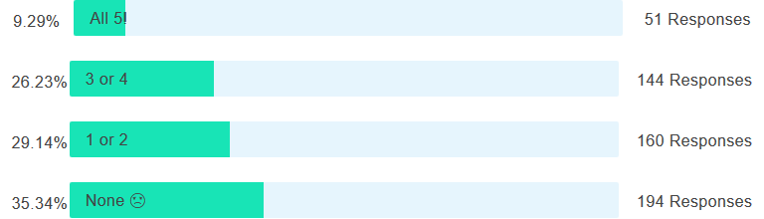
Poll Question
Did you attend or view any of the previous five State Plane webinars (Mar & Apr 2018; Mar, May & Oct 2019)?
549 responses total

Slide 6
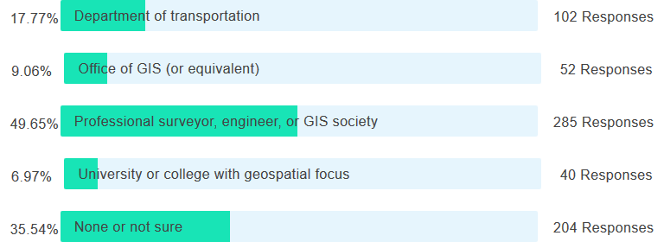
Poll Question
Are you associated with state stakeholder groups that provided SPCS2022 input to NGS? (select all that apply)
574 responses total

Slide 7
Discussion items
Discussion items
SPCS2022 overview
SPCS2022 requests and proposals
Status of zone layout and designs
Exceptions and special use zones
Zone design distortion maps and datasets
Finalizing SPCS2022 designs
Footnote

Slide 8
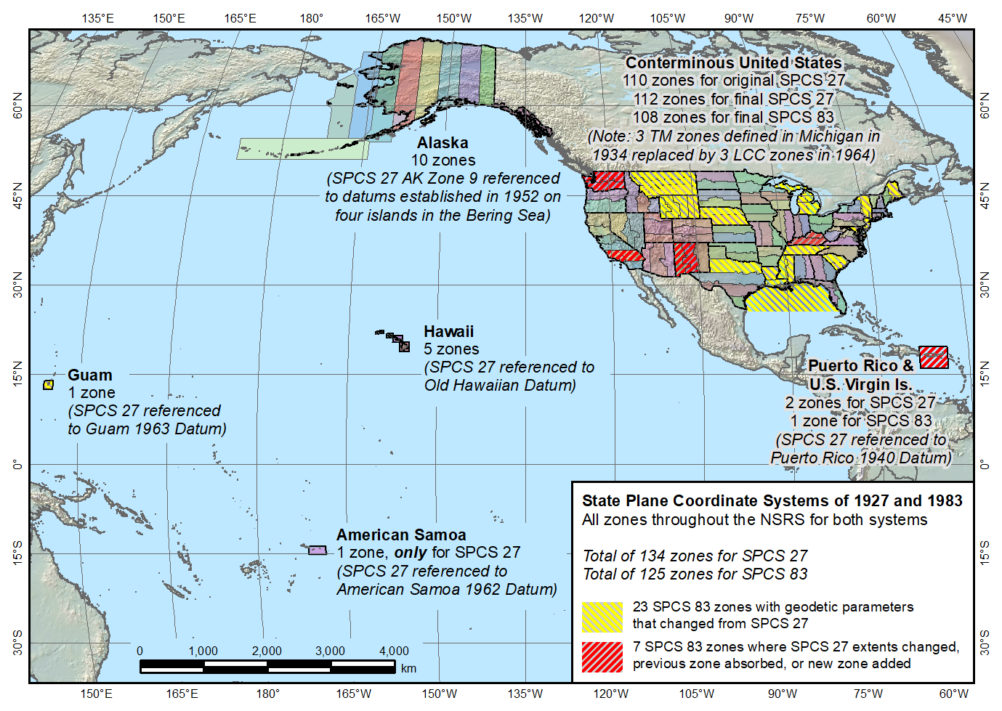
SPCS 83 and 27
State Plane Coordinate Systems of 1927 (134 zones) and 1983 (125 zones)
The shape of things to come for SPCS2022
?

Slide 9
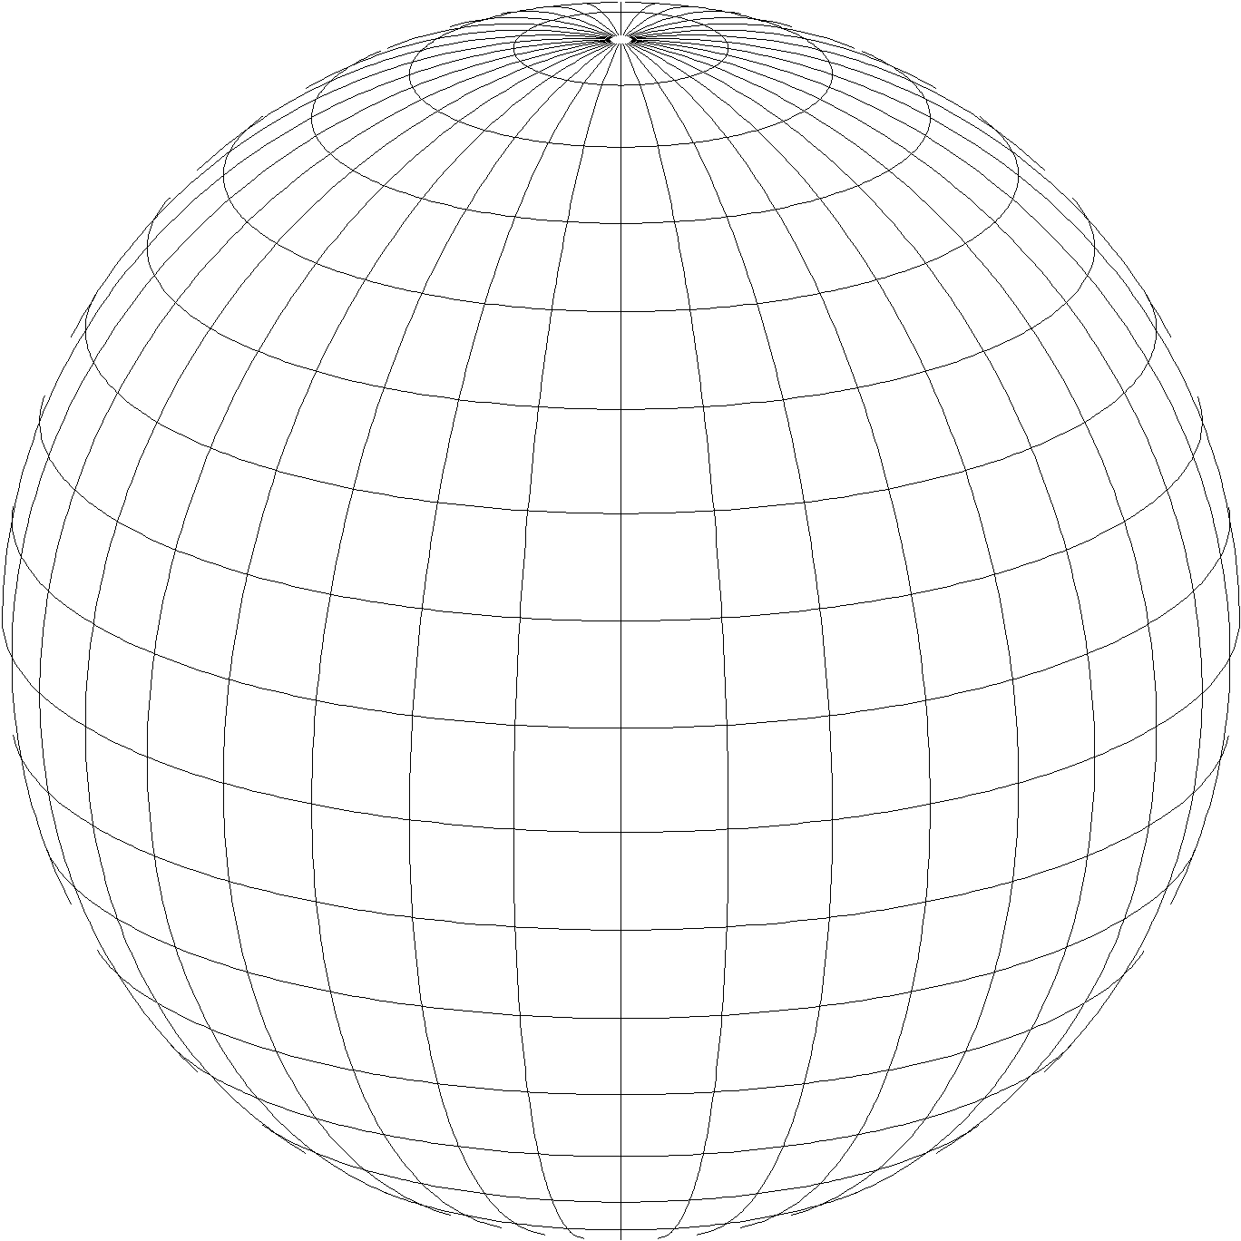
A New State Plane for 2022
State Plane Coordinate System of 2022 (SPCS2022)
  Referenced to 2022 Terrestrial Reference Frames (TRFs)
  Based on same reference ellipsoid as SPCS 83 (GRS 80)
  Same 3 conformal projection types as SPCS 83 and 27:
Lambert Conformal Conic (LCC)
Transverse Mercator (TM)
Oblique Mercator (OM)

Slide 10
We projected coordinate systems
SPCS2022
Making the Earth flat again
…one zone at a time

Slide 11
Overall SPCS2022 characteristics
Minimize distortion at topo surface, not ellipsoid
Max of up to 3 zone “layers” allowed
  1 statewide plus 0, 1, or 2 multiple-zone layers
  Most states will have total of 2 layers
Many states made requests and proposals
  Proposals are for zones designed by the states
  Can include “low-distortion projections” (LDPs)
NGS will design:
  Statewide zone for every state
  Default zones if no input from stakeholders (most with same zone extents and projection type as SPCS 83)
  Zones formally requested by states

Slide 12
Discussion items
Discussion items
SPCS2022 overview
SPCS2022 requests and proposals
Status of zone layout and designs
Exceptions and special use zones
Zone design distortion maps and datasets
Finalizing SPCS2022 designs
Footnote

Slide 13
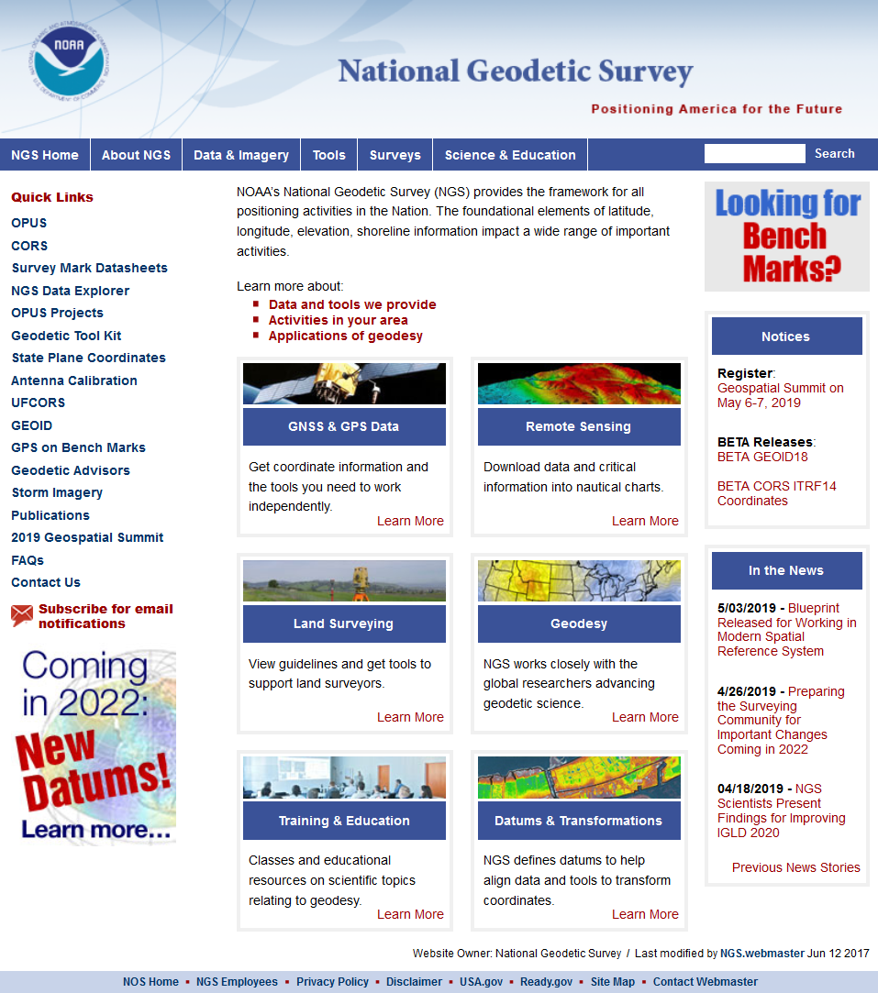
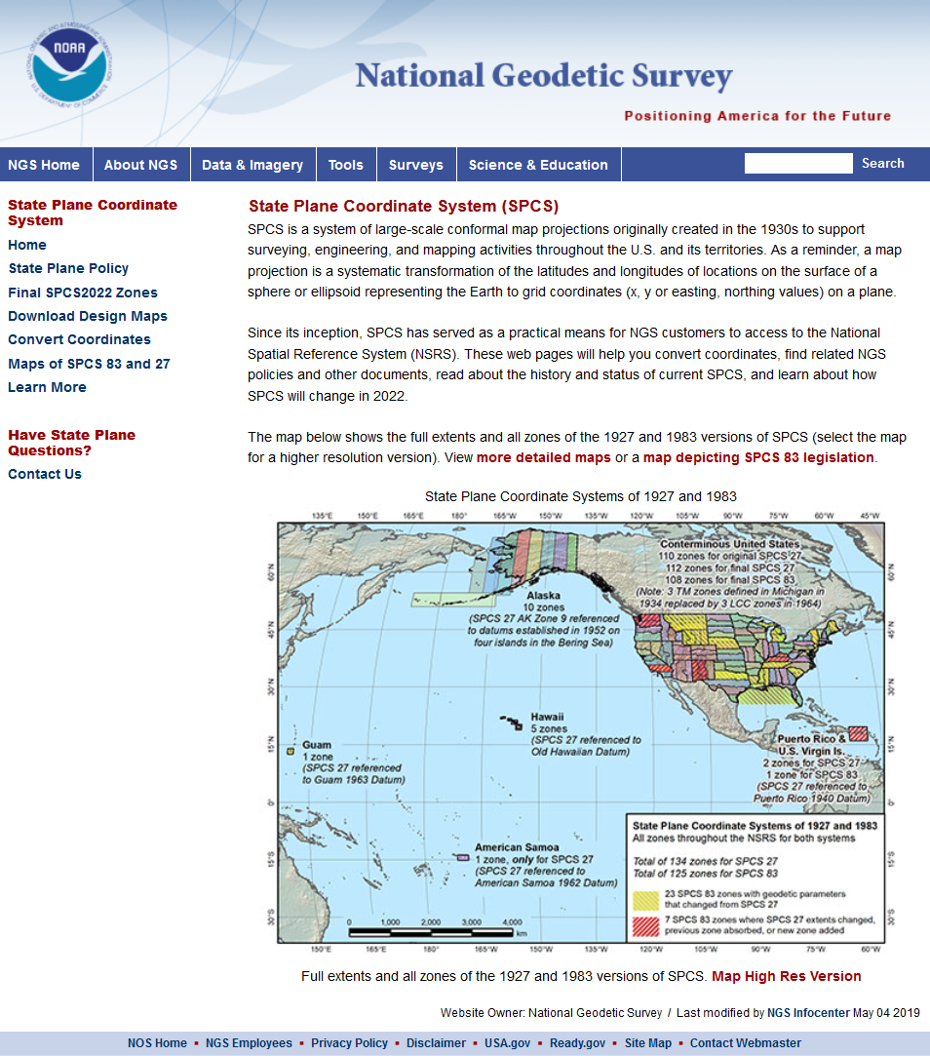
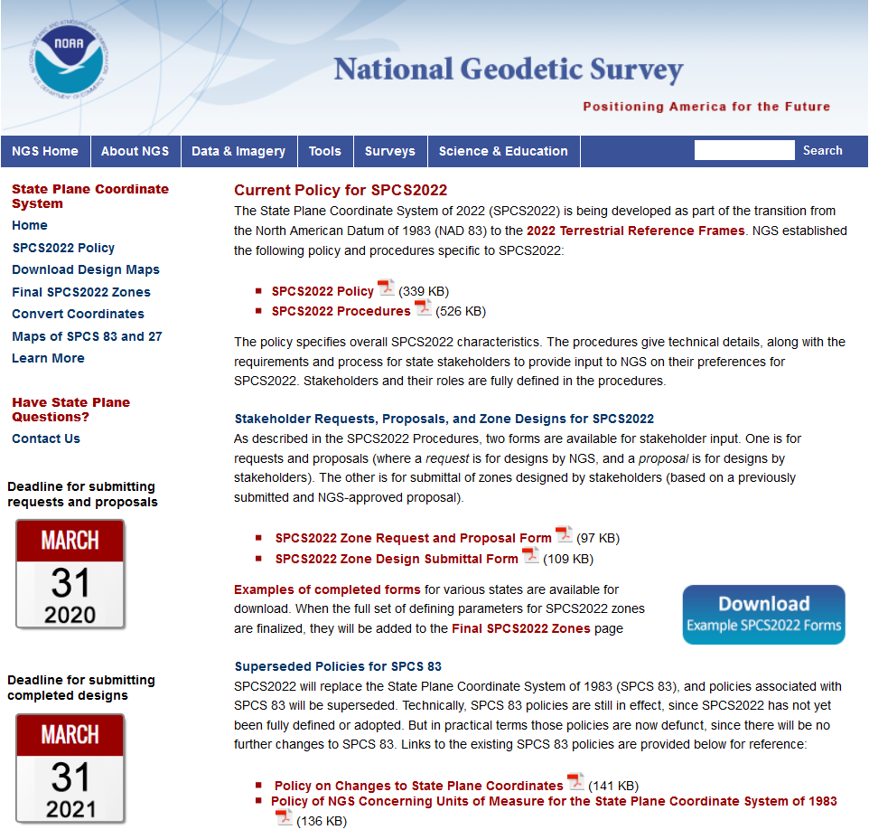

geodesy.noaa.gov

Slide 14
SPCS2022 requests and proposals
Deadline was 3/31/2020
  67 forms received from 41 states
  Plus 2 complete design submittals (KY and IA)
36 requests (designs by NGS)
  23 for statewide zone layers
  13 for multiple-zone layers (9 with new layout)
31 proposals (designs by stakeholders)
  17 with complete state coverage
  14 with partial state coverage
  Deadline for designs: 3/31/2021

Slide 15
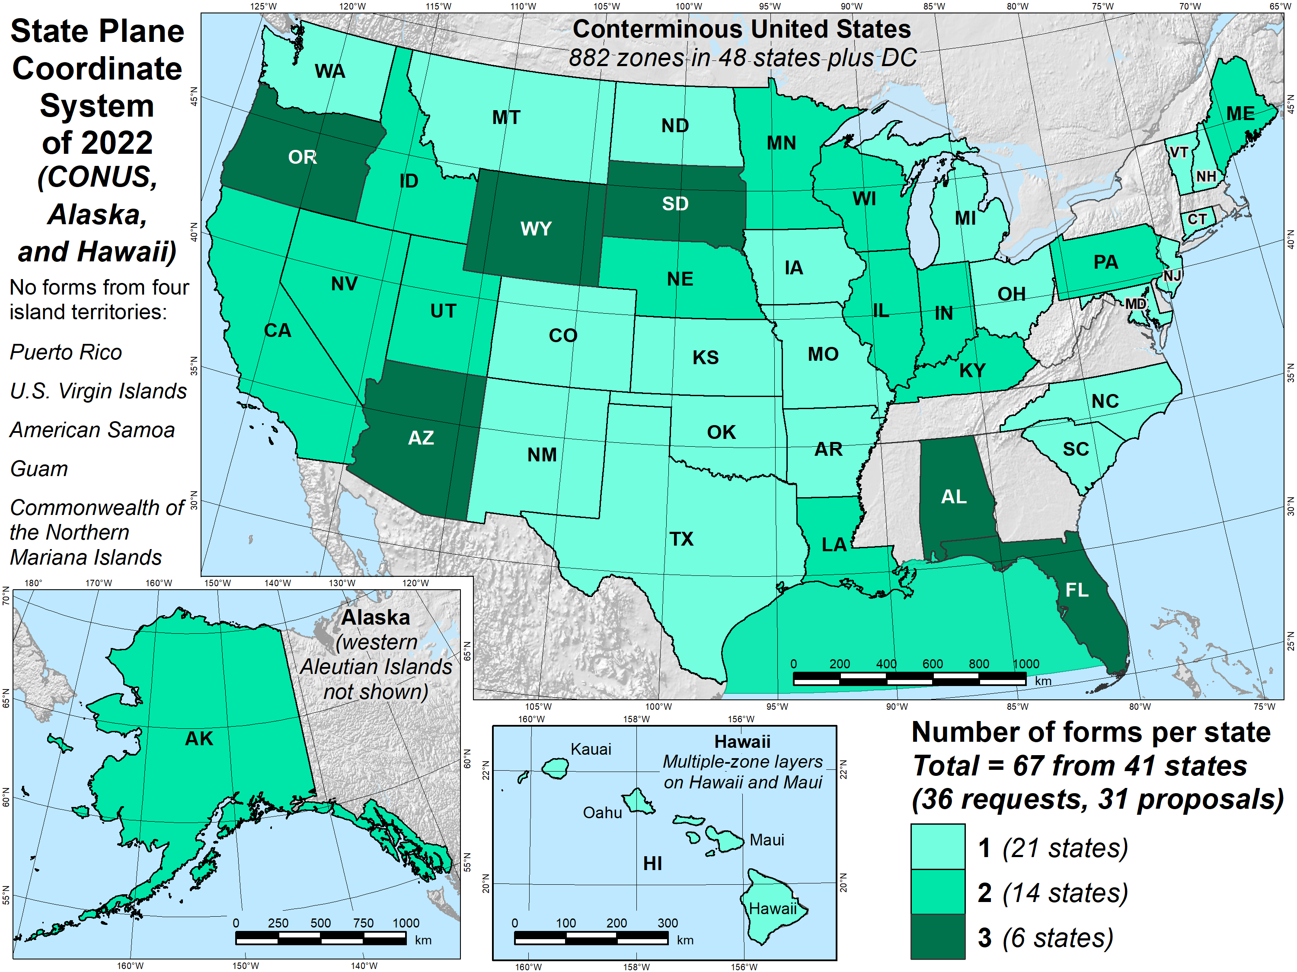
Maps of requests, proposals

Slide 16
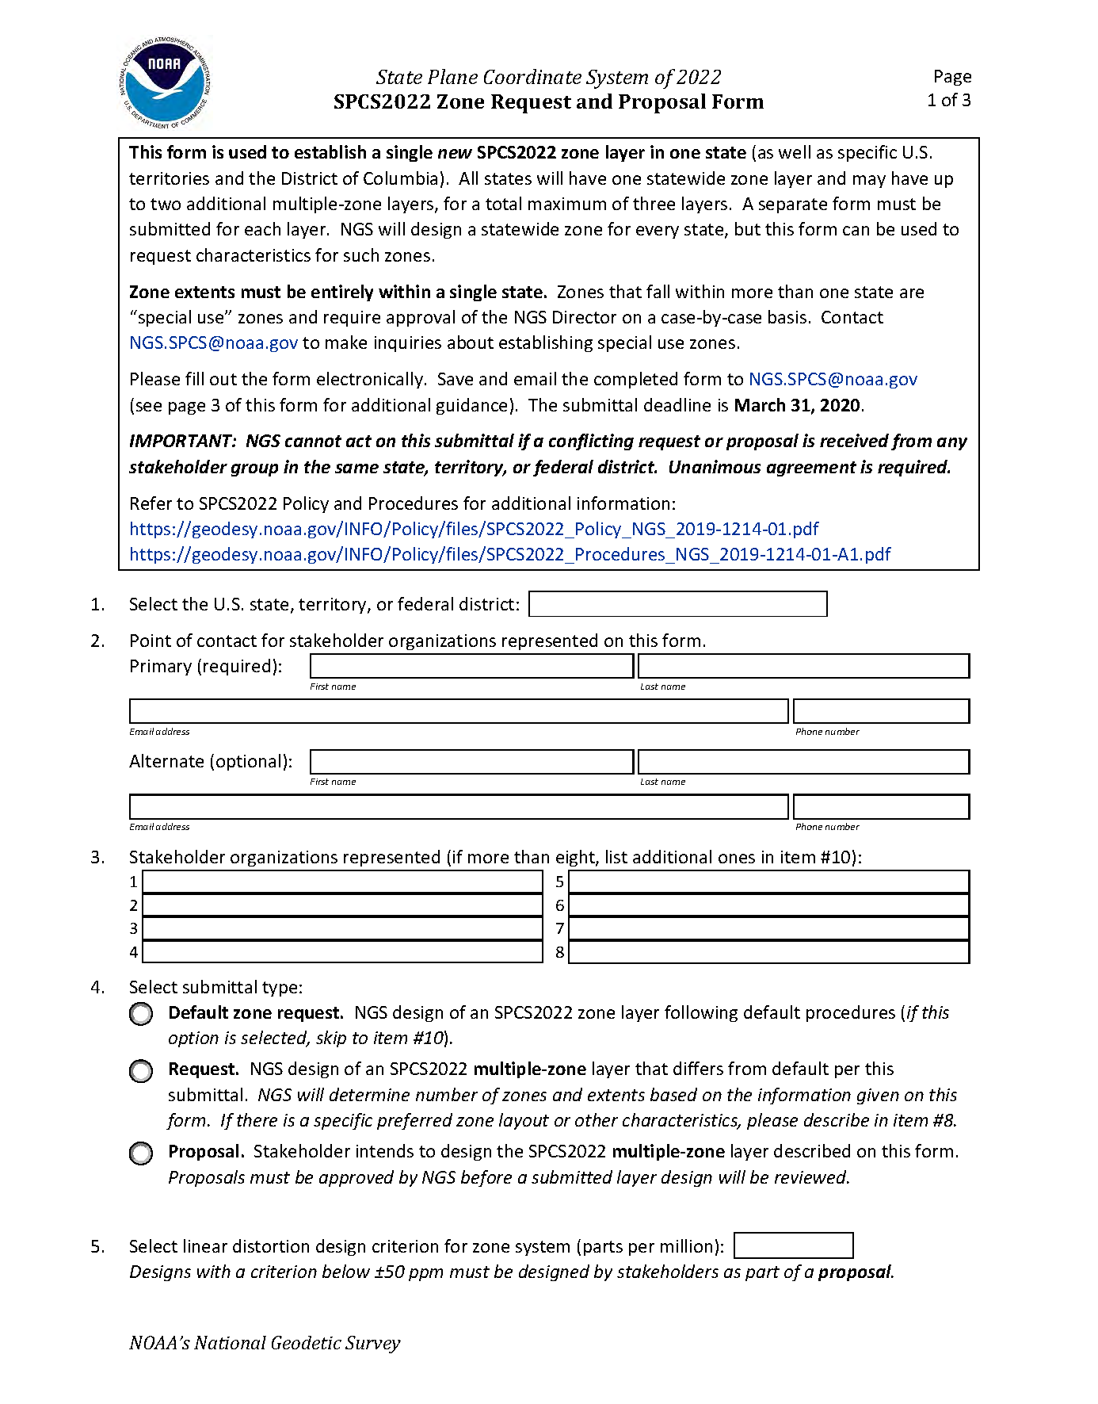
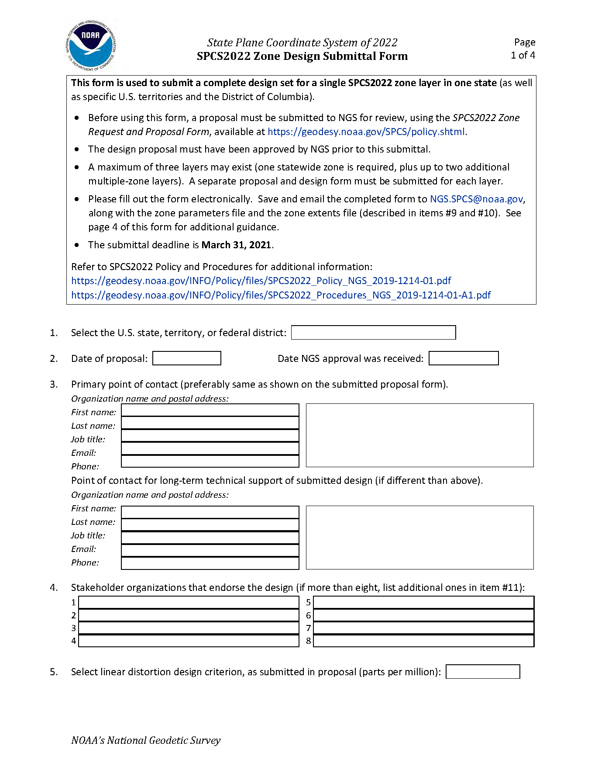
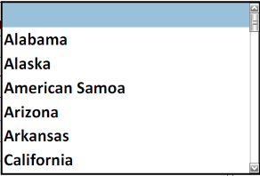
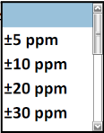
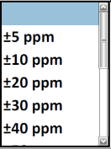
Request/Proposal Form
Design Submittal Form
DONE
Deadline:
March 31, 2020
Deadline:
March 31, 2021
NGS-approved proposal required

Slide 17
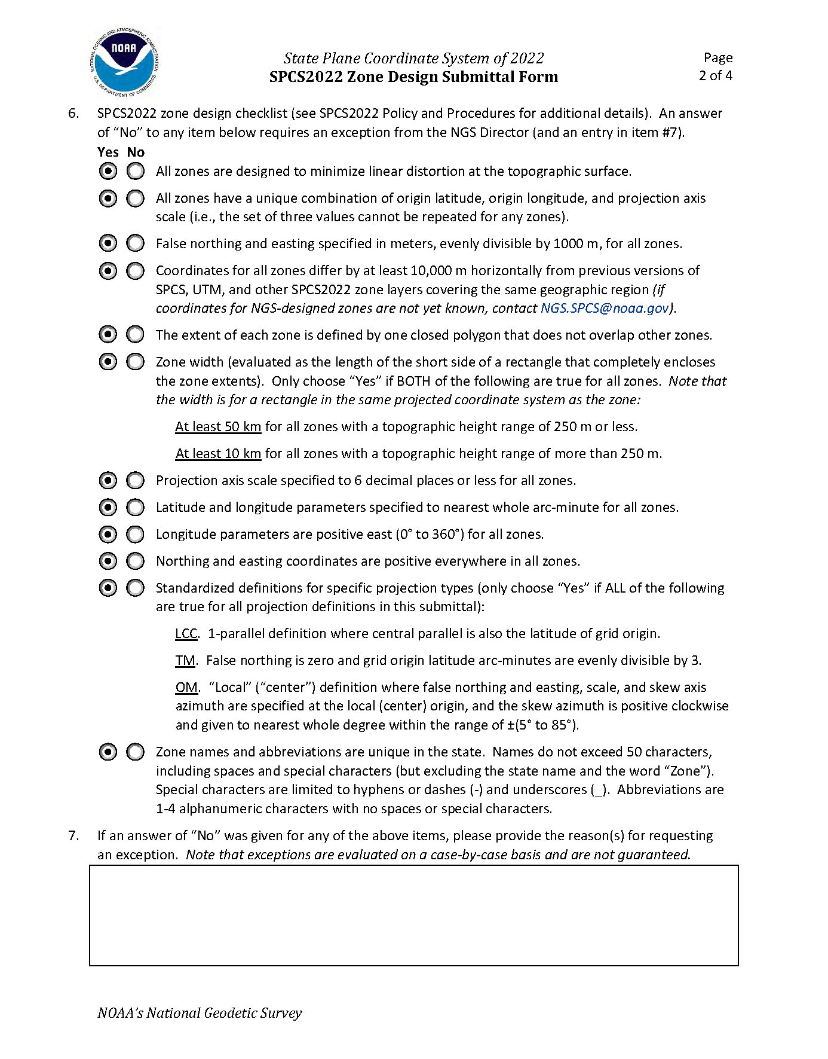
Use as policy & procedures checklist

Slide 18
Discussion items
Discussion items
SPCS2022 overview
SPCS2022 requests and proposals
Status of zone layout and designs
Exceptions and special use zones
Zone design distortion maps and datasets
Finalizing SPCS2022 designs
Footnote

Slide 19
Status of zone layout and designs
One layer (statewide): 16 states and territories
  Includes combined territories sharing 1 zone
    Puerto Rico and U.S. Virgin Islands
    Guam and Commonwealth Northern Mariana Islands
Two zone layers: 26 states
Three zone layers: 12 states

Slide 20
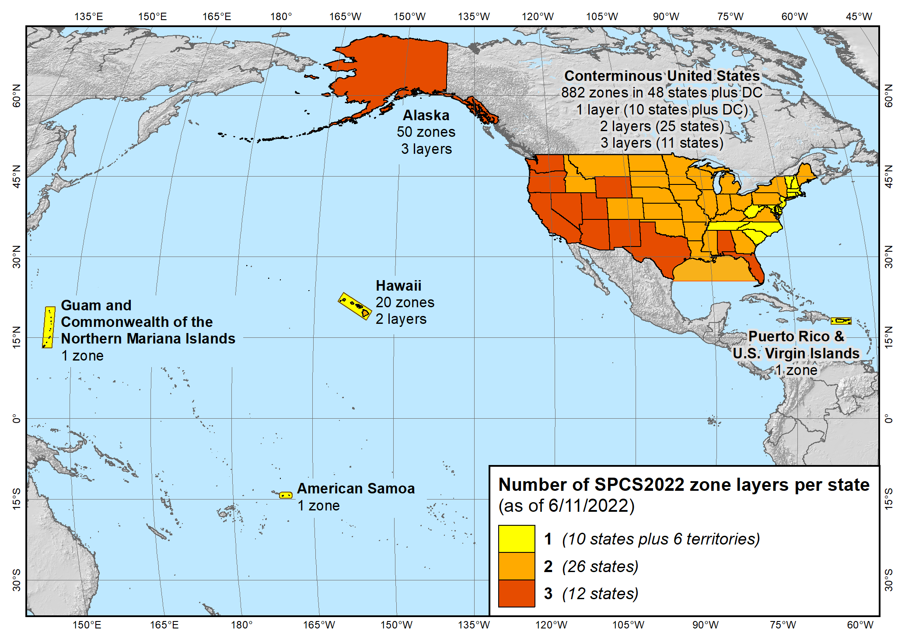
Maps of all SPCS2022 layers
State Plane Coordinate System of 2022 (955 zones in 56 states and territories)

Slide 21
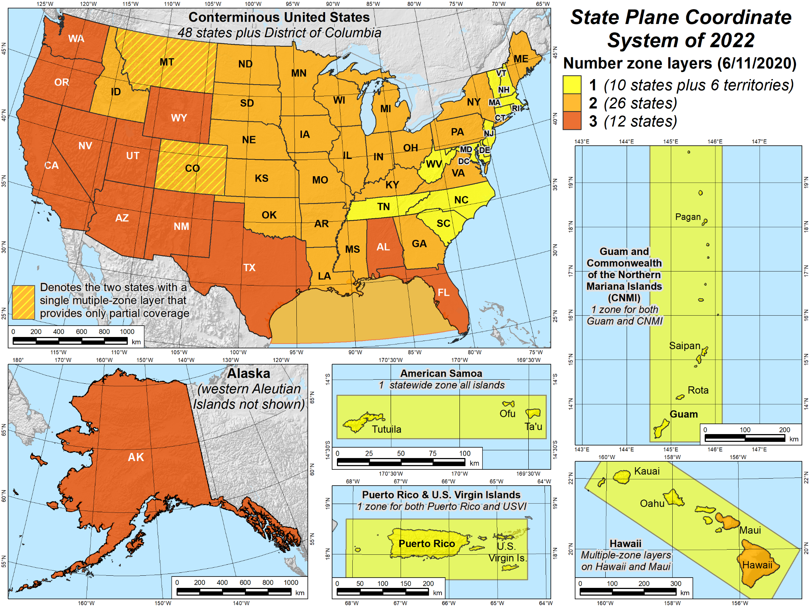
Maps of number of layers

Slide 22
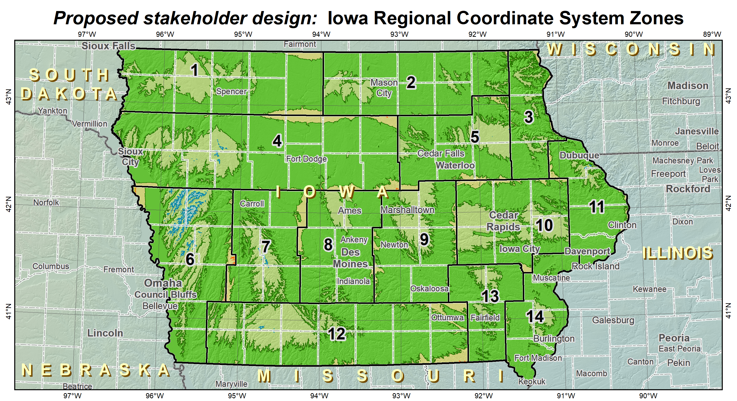
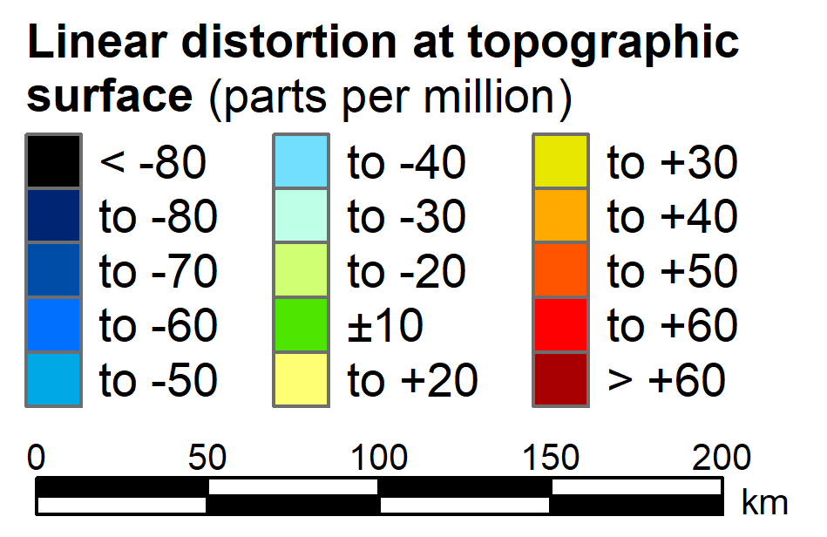
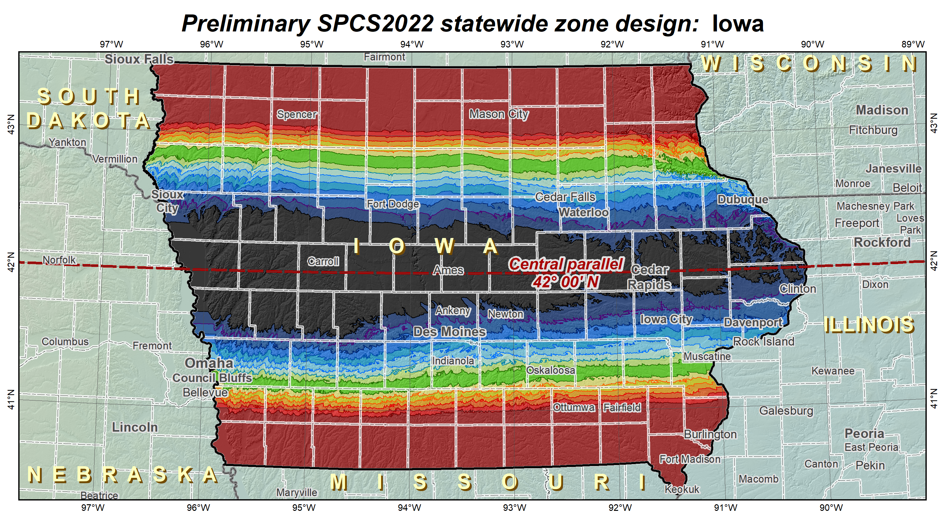
Example of 2 zone layers: Iowa
Multiple-zone layer
(complete state coverage)
Statewide layer for EVERY state

Slide 23
Status of zone layout and designs
955 zones (approx) for 56 states and territories

Slide 24
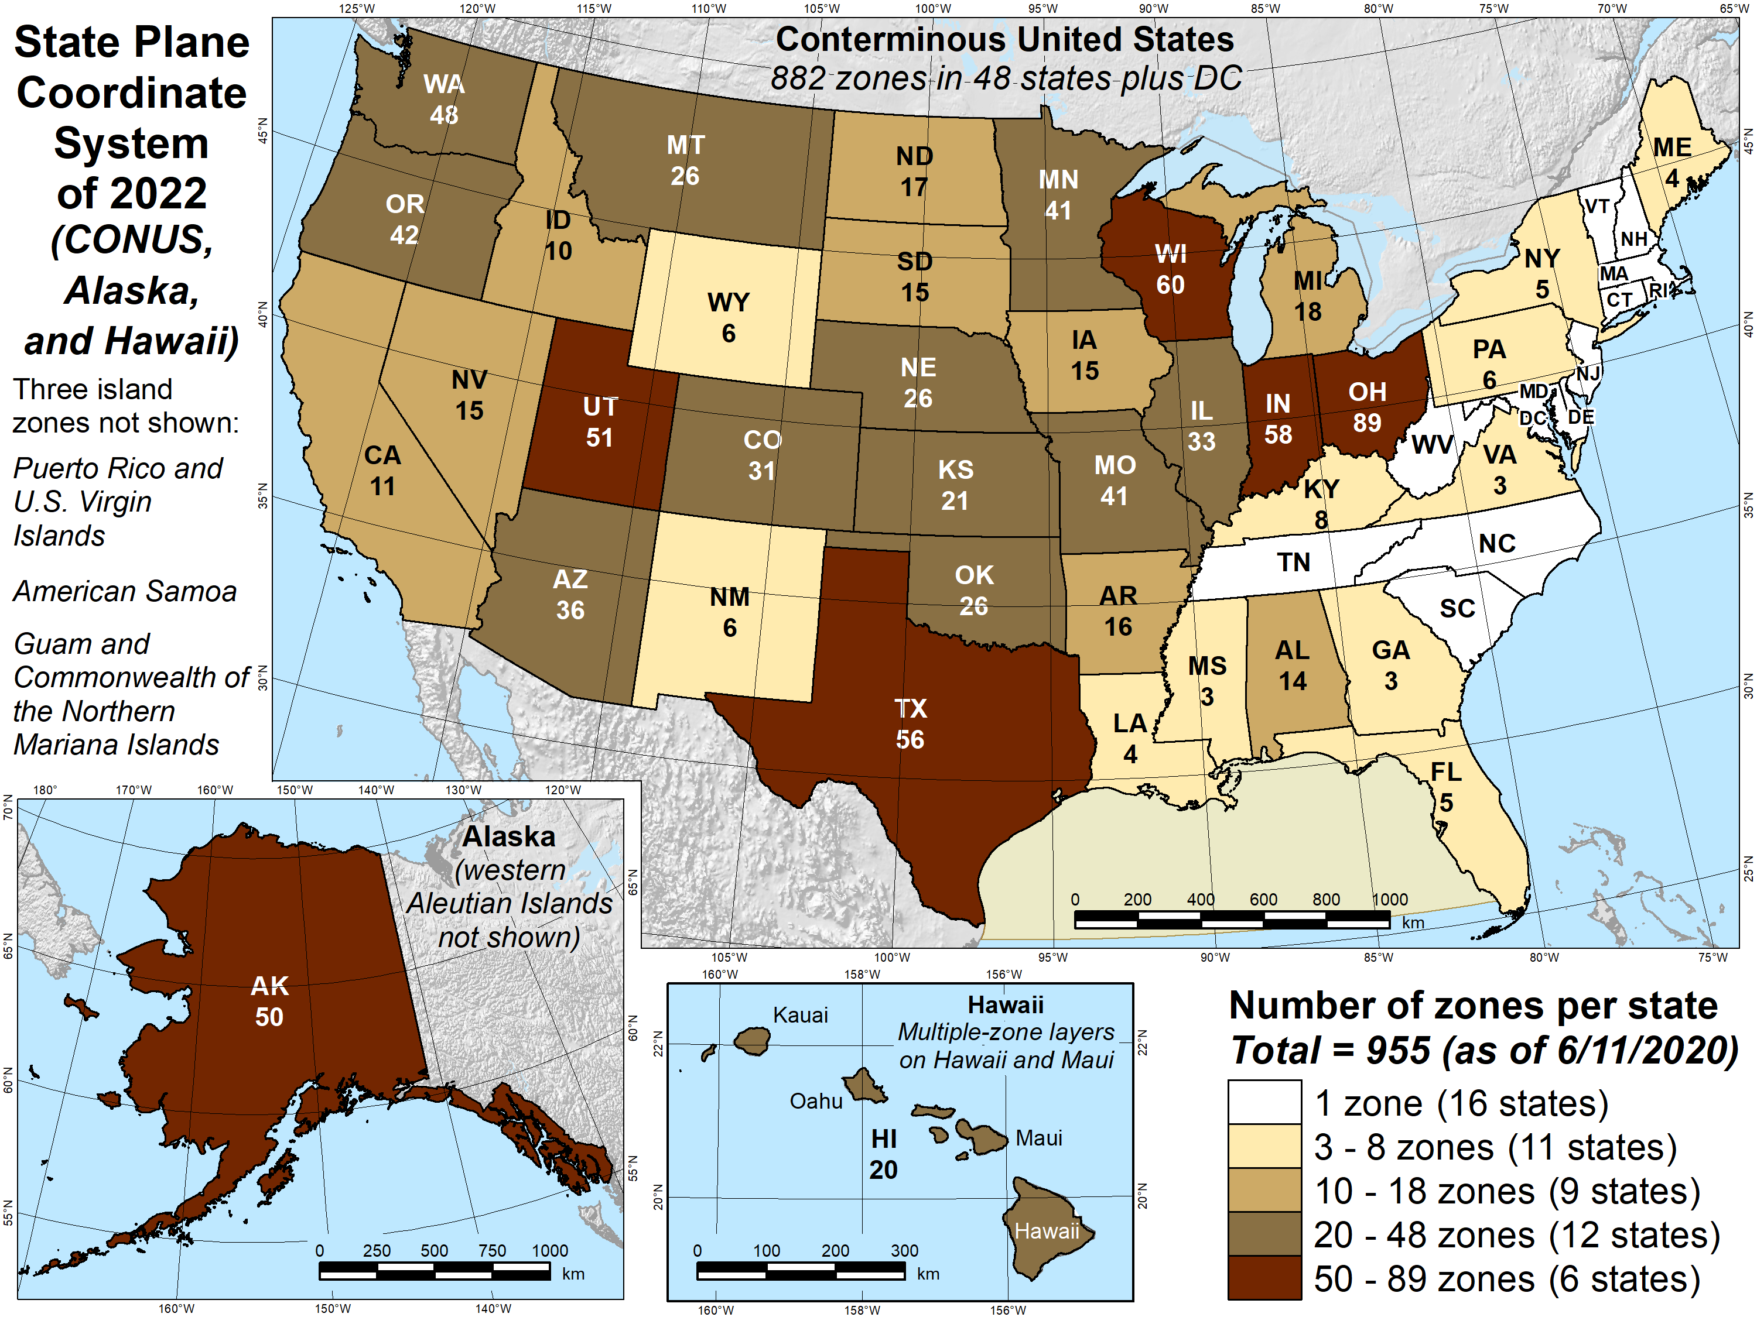
Map number of zones

Slide 25
Status of zone layout and designs
955 zones (approx) for 56 states and territories
Designs by NGS
  161 zones (approx), including statewide zones
  Range from 1 to 20 zones (Alaska and Hawaii)
  About 120 done (preliminary)
  Statewide zones done for nearly all states

Slide 26
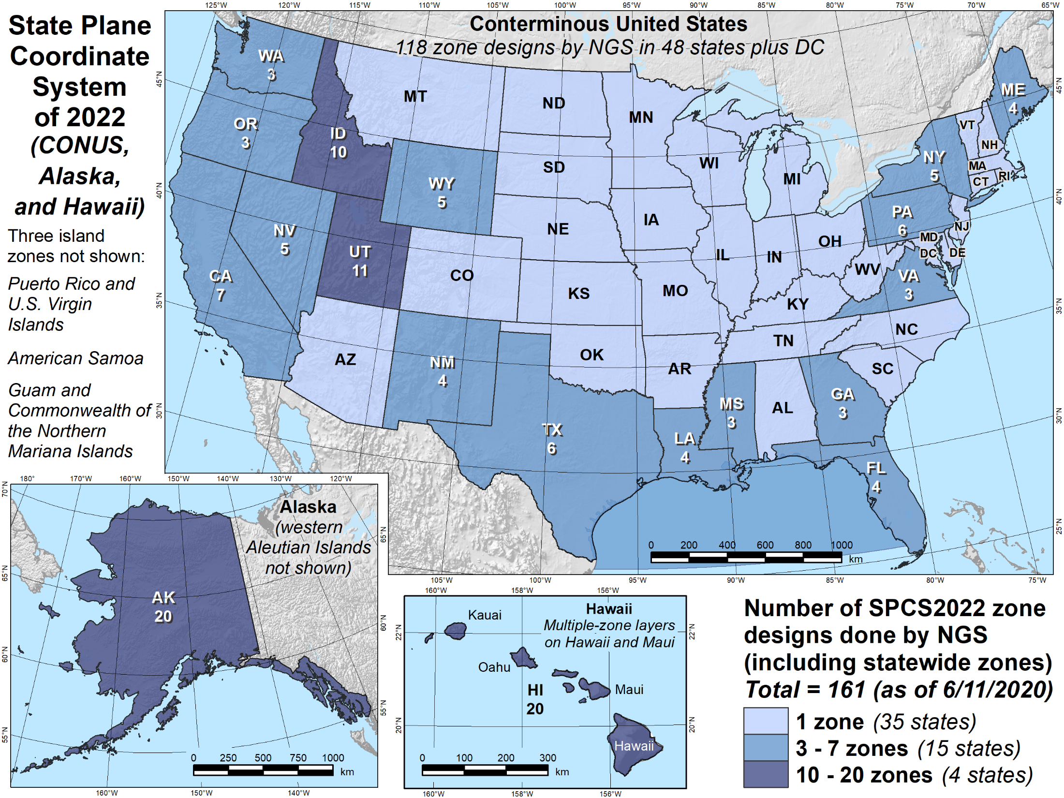
Map of NGS designs

Slide 27
Status of zone layout and designs
955 zones (approx) for 56 states and territories
Designs by NGS
  161 zones (approx), including statewide zones
  Range from 1 to 20 zones (Alaska and Hawaii)
  About 120 done (preliminary)
  Statewide zones done for nearly all states
Designs by state stakeholders
  794 zones (approx) in 29 states
  Range from 1 to 88 zones (Ohio)
  Essentially all are LDPs (distortion < ±50 ppm)

Slide 28
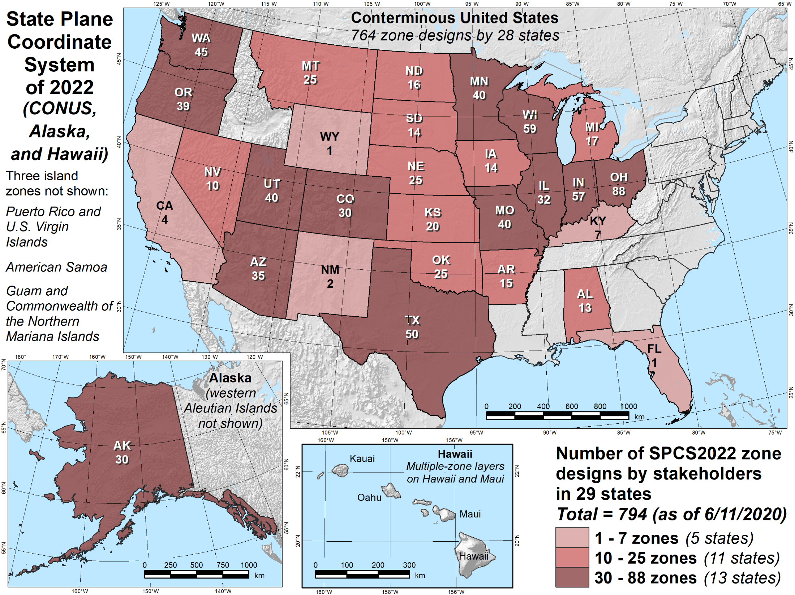
Map of state designs

Slide 29
Discussion items
Discussion items
SPCS2022 overview
SPCS2022 requests and proposals
Status of zone layout and designs
Exceptions and special use zones
Zone design distortion maps and datasets
Finalizing SPCS2022 designs
Footnote

Slide 30
Exception requests
Total of 3 states requested exceptions
  Wisconsin (59 zones for 72 counties): APPROVED
  Indiana (57 zones for 92 counties): PENDING
  Ohio (88 zones, one per county): PENDING
Must be approved by NGS Director
  Indiana and Ohio requests were expected
  No “surprise” requests received
  May be a few requests during state design efforts

Slide 31
Special use zones
Zones that are in more than one state
Total of 2 requests for 4 special use zones
  Navajo Nation (AZ, NM, UT, plus CO)
  Lower Colorado River (AZ, CA, NV)
  Glen Canyon National Recreation Area (AZ, UT)
  Flaming Gorge / Dinosaur Nat’l Mon (CO, UT, WY)
Must be approved by NGS Director

Slide 32
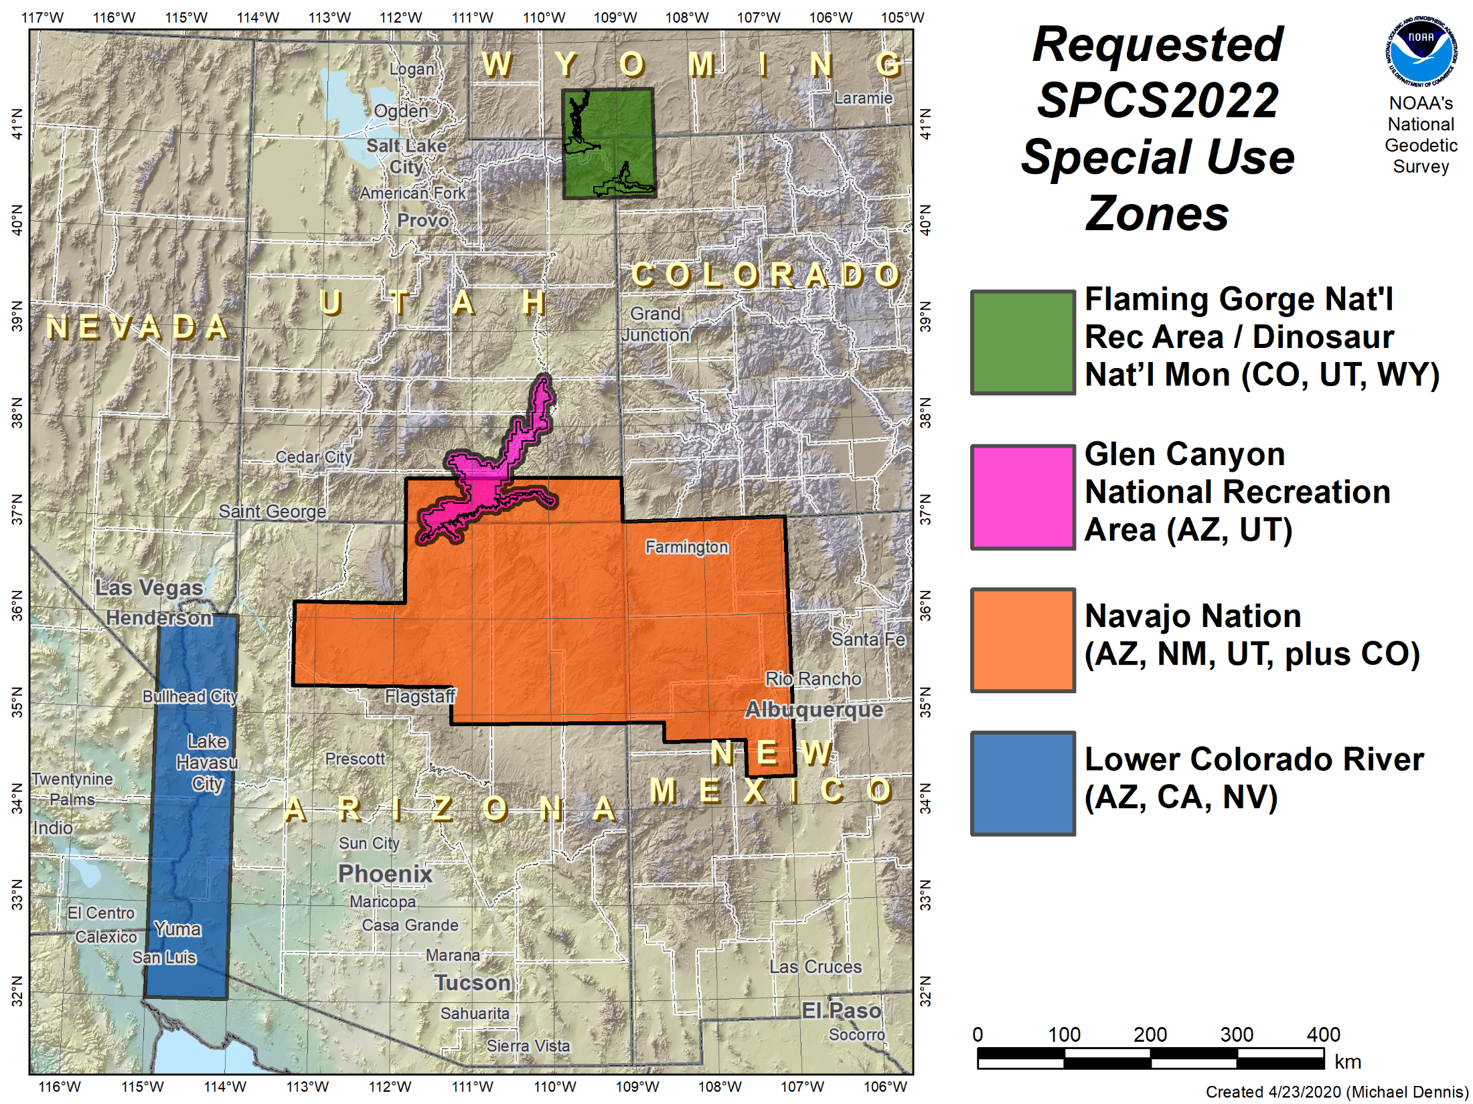
Map of special use zones

Slide 33
Special use zones
Zones that are in more than one state
Total of 2 requests for 4 special use zones
  Navajo Nation (AZ, NM, UT, plus CO)
  Lower Colorado River (AZ, CA, NV)
  Glen Canyon National Recreation Area (AZ, UT)
  Flaming Gorge / Dinosaur Nat’l Mon (CO, UT, WY)
Must be approved by NGS Director
Make Louisiana Offshore zone special use?

Slide 34
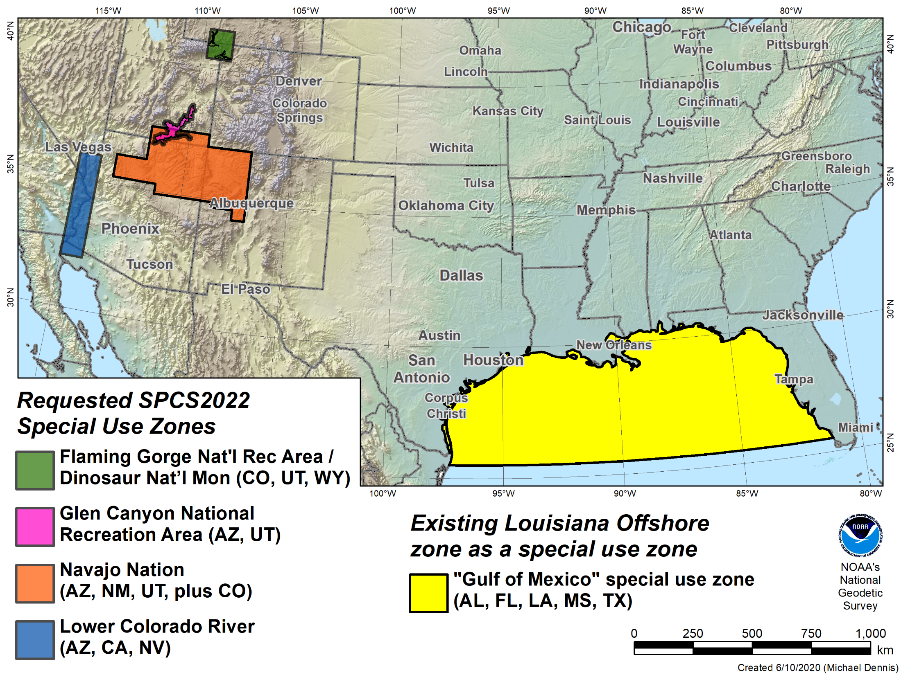
Existing “special use” zone
Louisiana “offshore” zone

Slide 35
Discussion items
Discussion items
SPCS2022 overview
SPCS2022 requests and proposals
Status of zone layout and designs
Exceptions and special use zones
Zone design distortion maps and datasets
Finalizing SPCS2022 designs
Footnote

Slide 36
Current distortion design maps
Over 200 distortion design maps created
  NONE give all design parameters
About 120 SPCS2022 designs in most states
  About 45 multiple-zone maps (~60 zones total)
  About 75 statewide zone maps
About 90 maps for existing NAD 83 zones
  ~50 SPCS 83 existing zone maps
  ~40 UTM 83 or existing statewide zones
Distortion data provided for many states

Slide 37
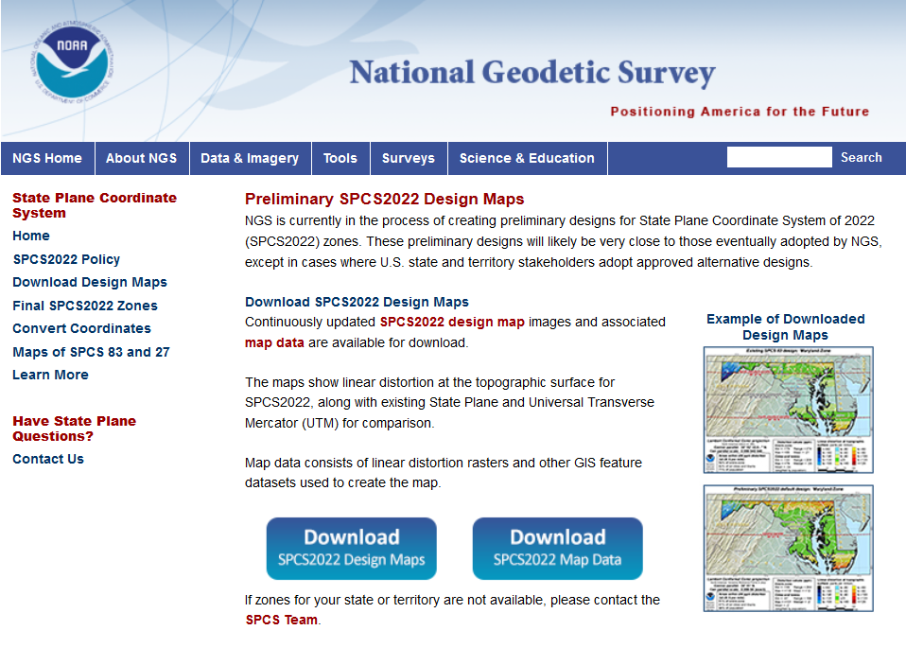
geodesy.noaa.gov

Slide 38
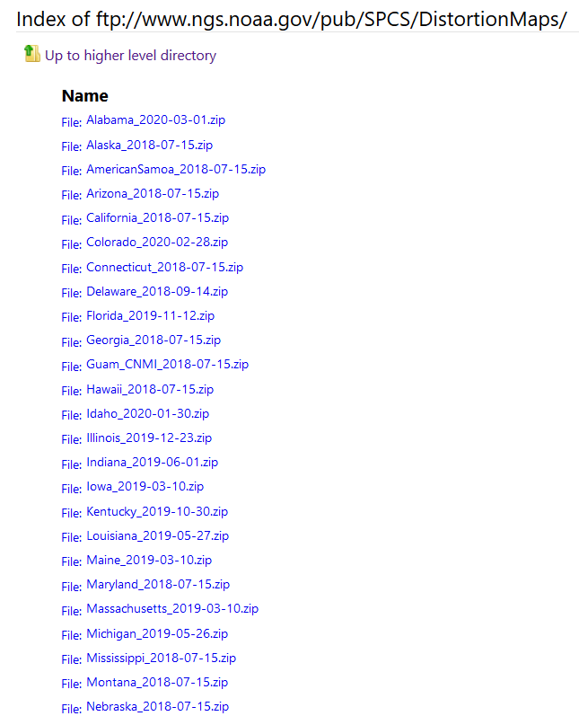
geodesy.noaa.gov

Slide 39
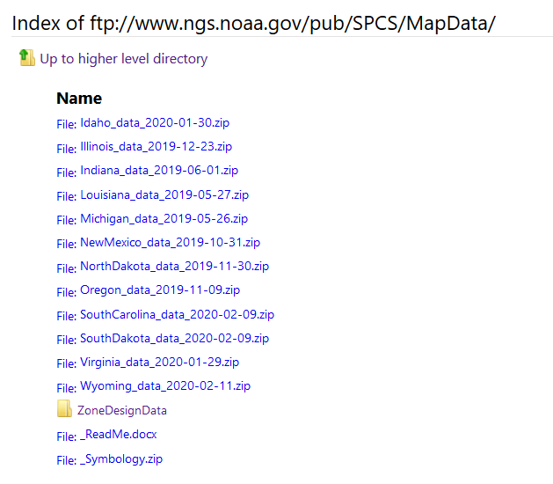
geodesy.noaa.gov

Slide 40
Zone design maps and data
How best to proceed?
  New maps with all parameters via FTP?
  Create an SPCS2022 “atlas”?

Slide 41
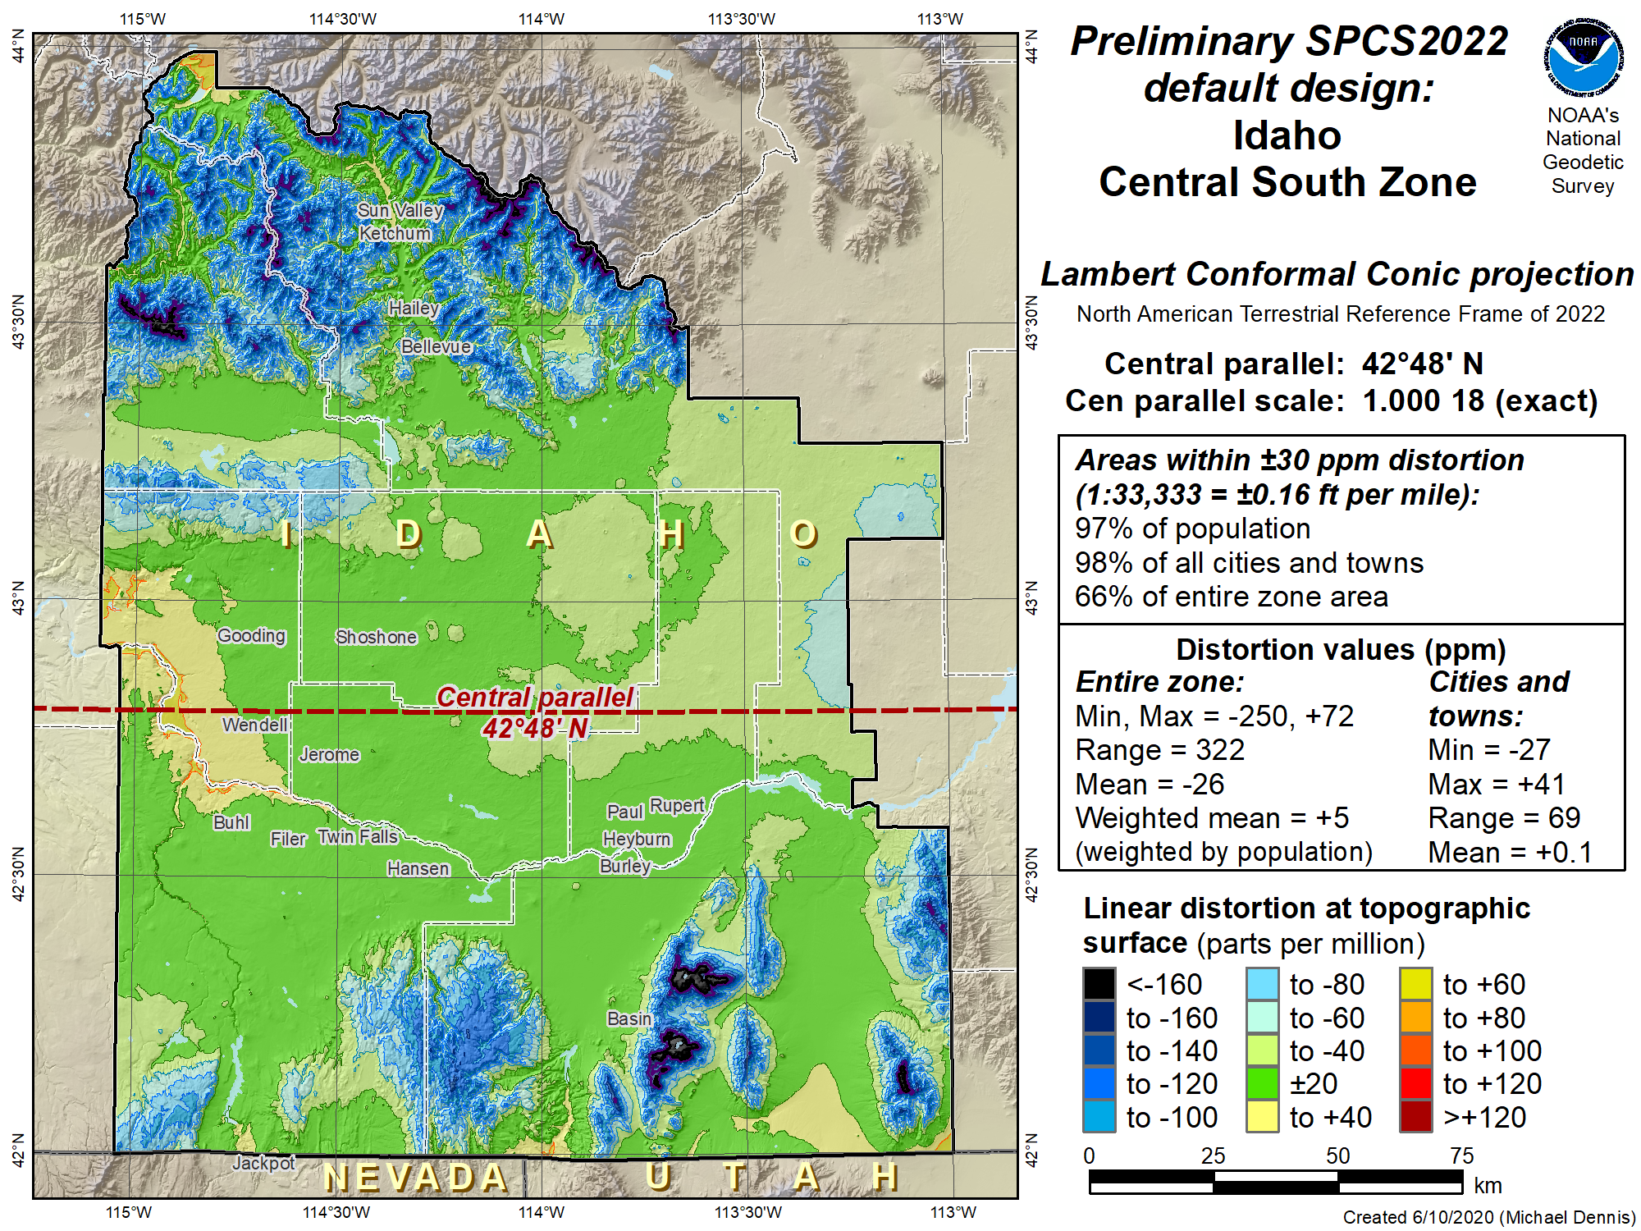
Example map partial

Slide 42
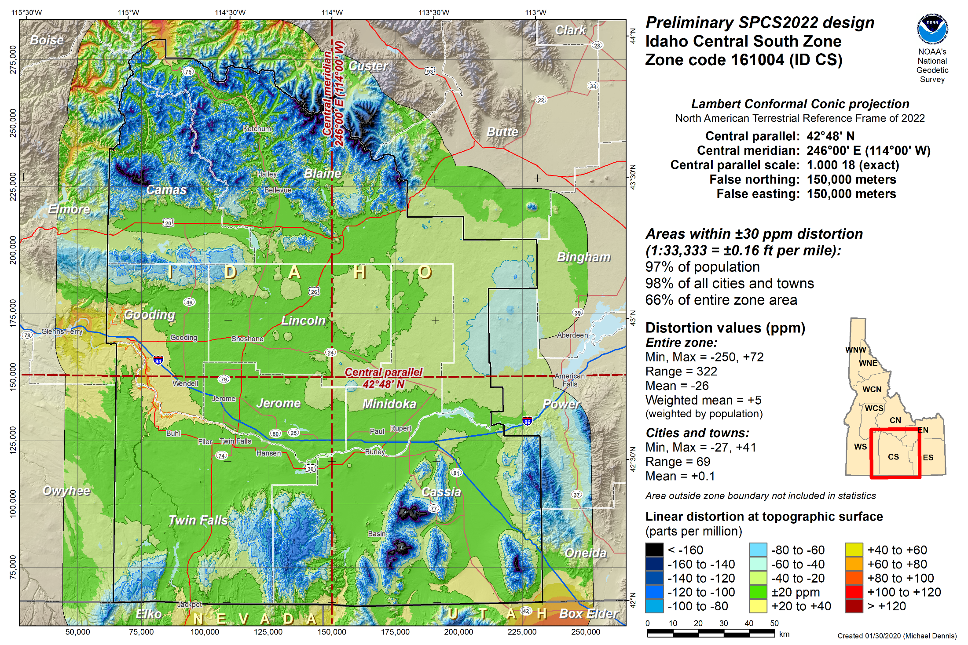
Example map complete

Slide 43
New distortion design maps
How best to proceed?
  New maps with all parameters via FTP?
  Create an SPCS2022 “atlas”?
  Create interactive online maps and dashboards?
  Provide distortion rasters? Via FTP or web?
  Provide parameters separate from maps?

Slide 44
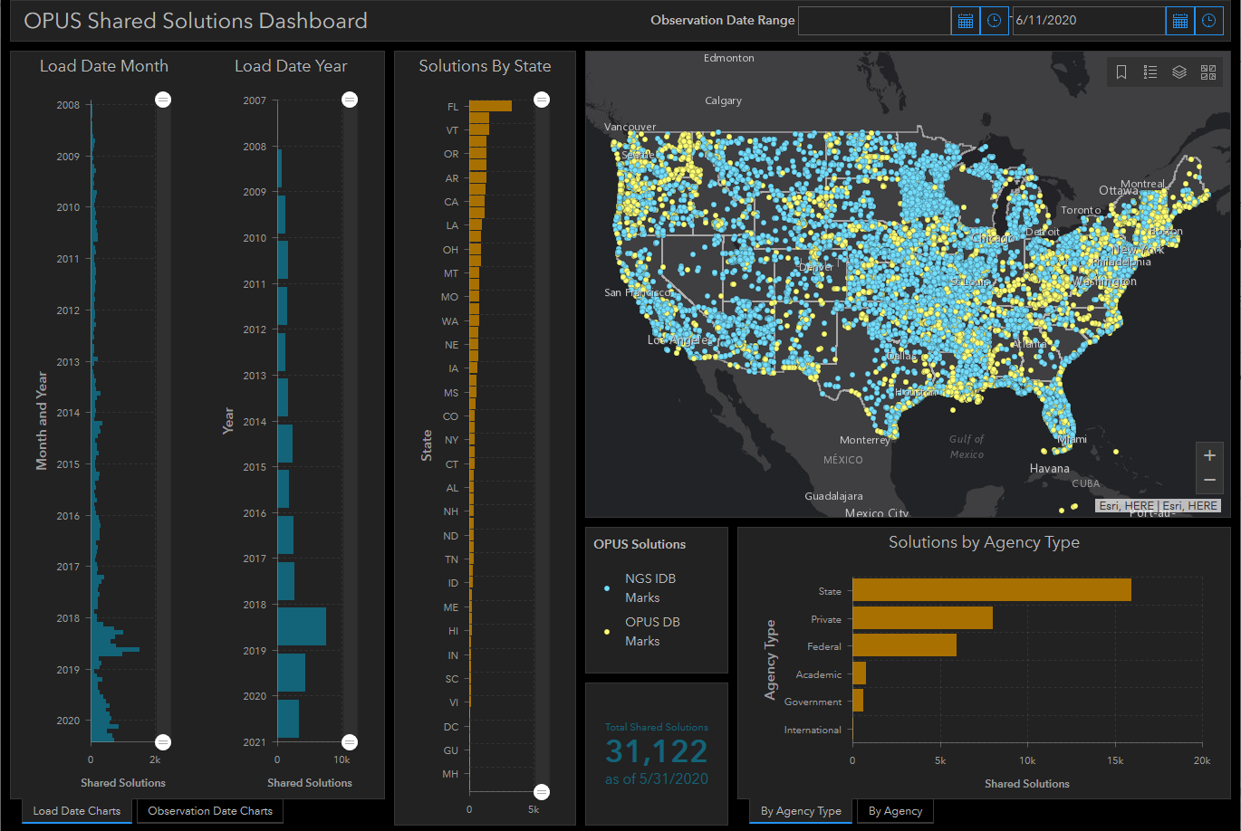
Example interactive online maps and dashboard

Slide 45
SPCS2022 zone documentation
Complete zone parameters
Performance statistics
Bounding coordinates and convergence angles
Test point coordinates, distortion, convergence
Comparison to existing SPCS 83, SPCS 27, UTM
Comparison to overlapping SPCS2022 zones

Slide 46
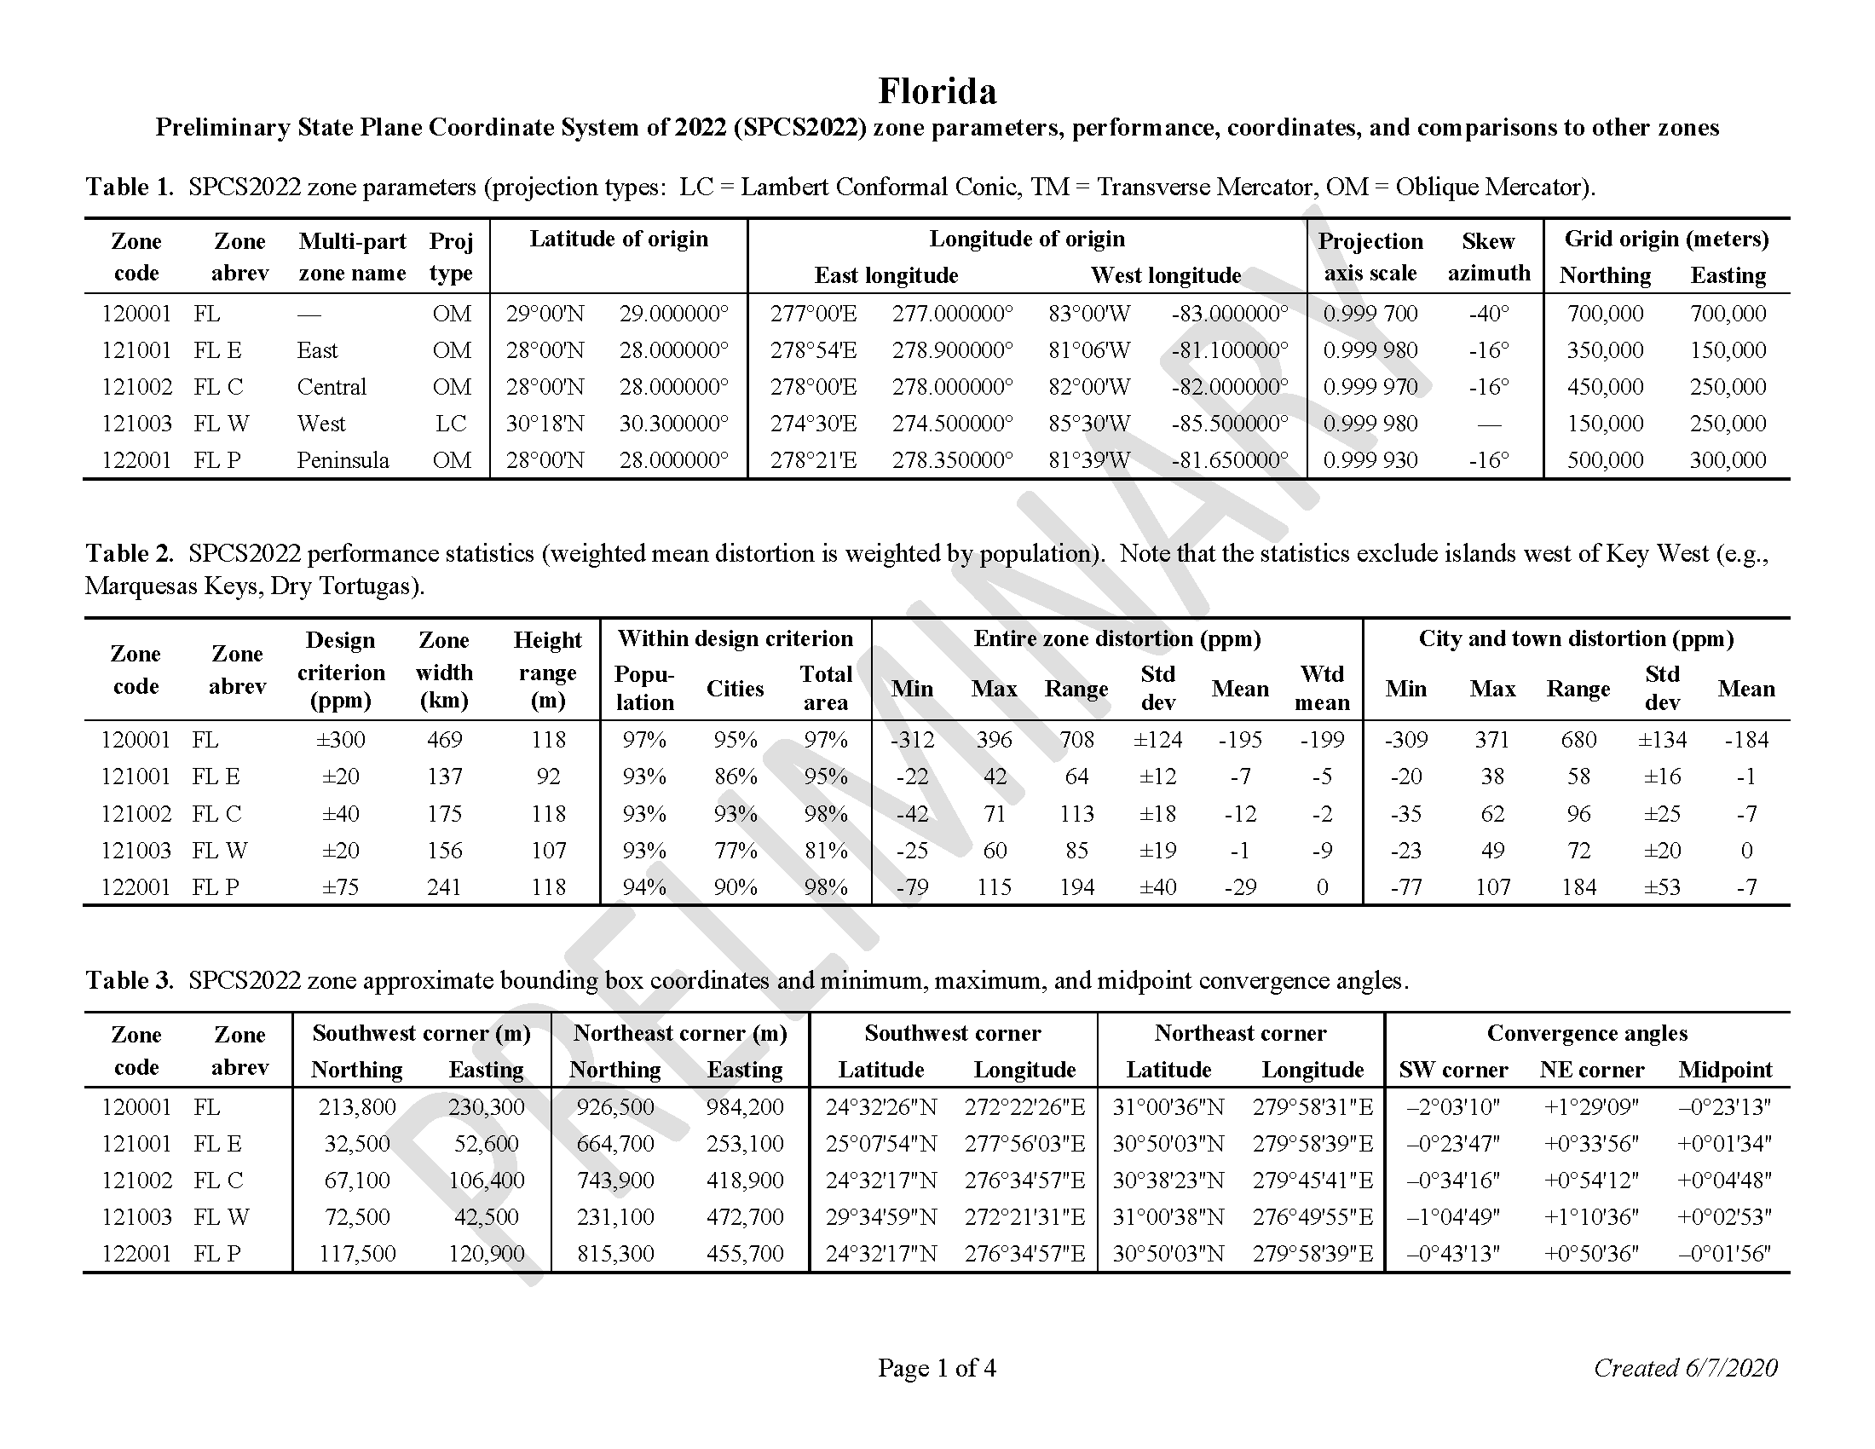
SPCS2022 zone documentation

Slide 47
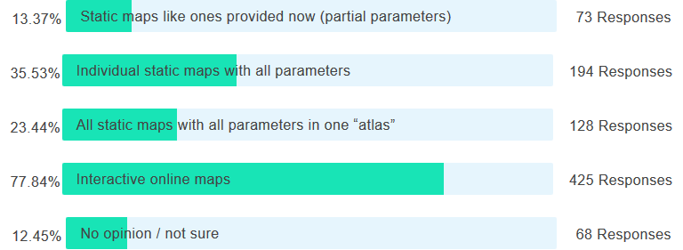
Poll Question
Which TWO of the SPCS2022 distortion map types would be MOST useful for you? (select one or two)
546 responses total

Slide 48
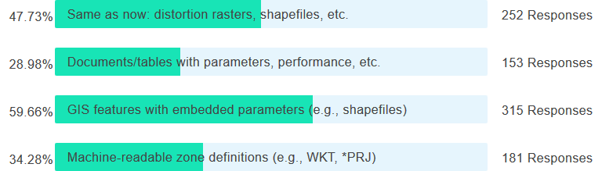
Poll Question
Which TWO supporting SPCS2022 datasets would be MOST useful to you? (select one or two)
528 responses total
WKT = “Well Known Text” format (machine and human readable)
PRJ = “Projection file” format (Esri version of WKT)

Slide 49
Discussion items
Discussion items
SPCS2022 overview
SPCS2022 requests and proposals
Status of zone layout and designs
Exceptions and special use zones
Zone design distortion maps and datasets
Finalizing SPCS2022 designs
Footnote

Slide 50
SPCS2022 zone designs
All designs so far are PRELIMARY
Begin finalizing designs NOW
  Compile and compare all designs
  Ensure consistent and correct
Get stakeholder input before finalizing
  Solicit input from stakeholders mid-2021
  Finalize after stakeholder input
  Provide preliminary complete parameters now

Slide 51
About the timing of it all…
Stakeholder designs due by 3/31/2021
  Finalize all designs by late 2021
Official release with all of NSRS modernization
  Cannot release prior to NSRS 2022 TRFs
  But complete definitions available sooner
Other things (by end of 2021…?)
  Machine-readable definitions (e.g., WKT 2)
  SPCS2022 report
  Modify NGS algorithms (e.g., 1-parallel Lambert)
  Check NGS algorithms (refine after 2021…?)

Slide 52
Discussion items
Discussion items
SPCS2022 overview
SPCS2022 requests and proposals
Status of zone layout and designs
Exceptions and special use zones
Zone design distortion maps and datasets
Finalizing SPCS2022 designs
Footnote

Slide 53
U.S. survey foot and state legislation
SPCS2022 parameter definitions metric
  Output coordinates in feet → international feet
  Can use name “foot” or “international foot”
  1 foot = 0.3048 meter (exact)
U.S. survey foot deprecated after Dec 31, 2022
  Will not be used for SPCS2022
  But legacy applications supported (e.g., SPCS 83)
NSRS legislation with international foot
  Two states done: Kentucky and Washington

Slide 54
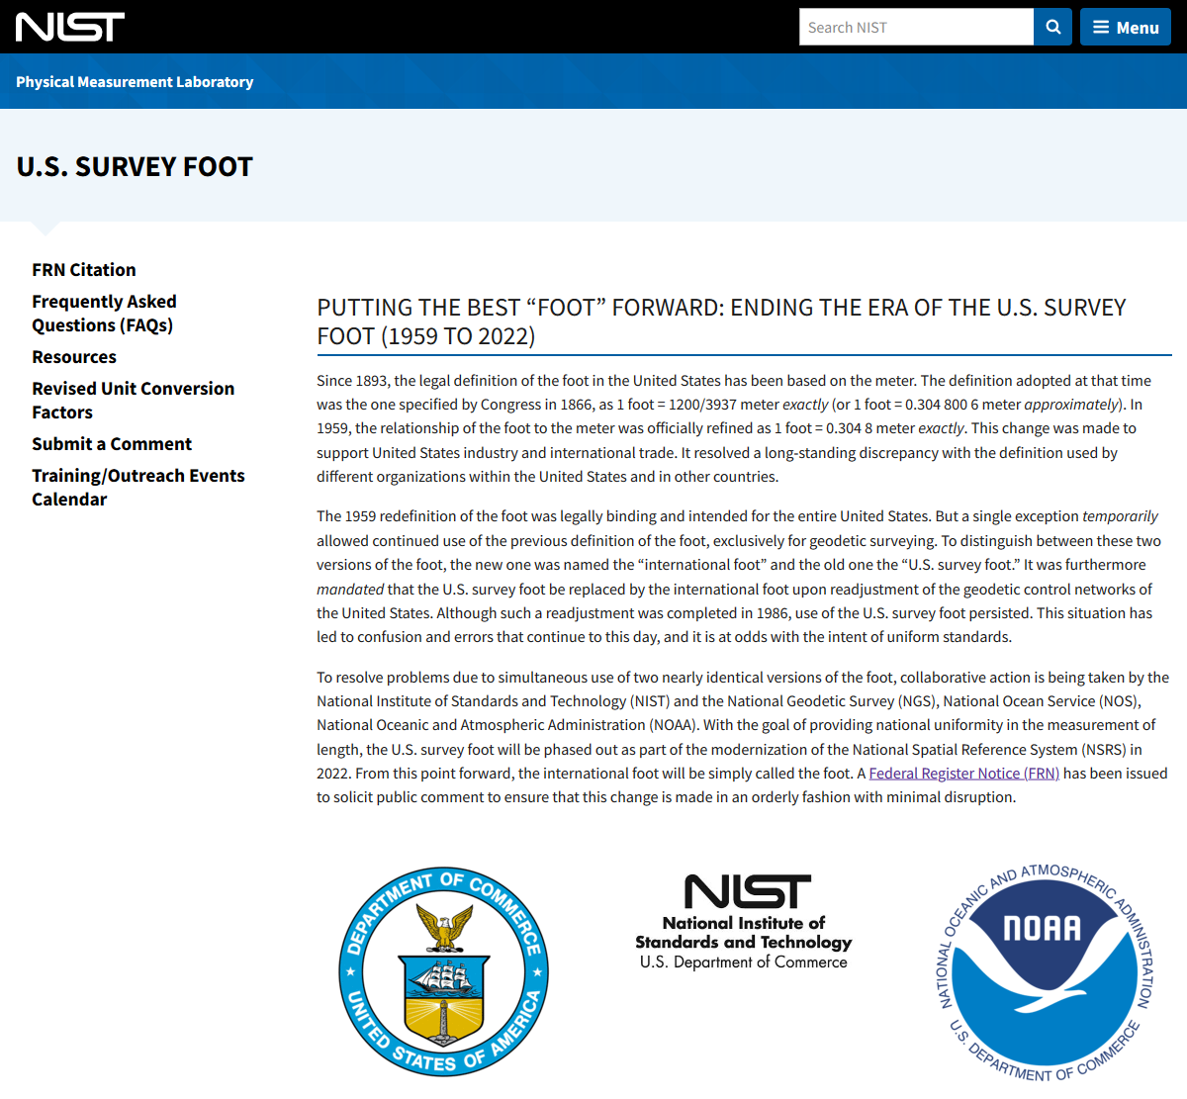
www.nist.gov/pml/us-surveyfoot

Slide 55
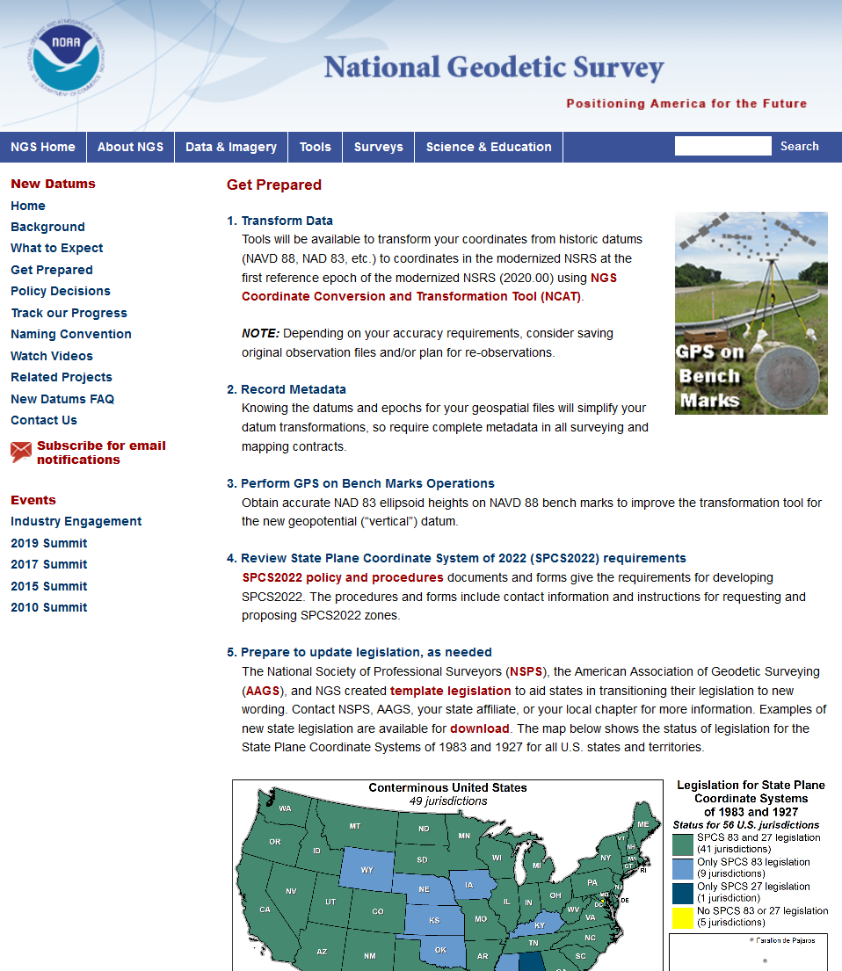
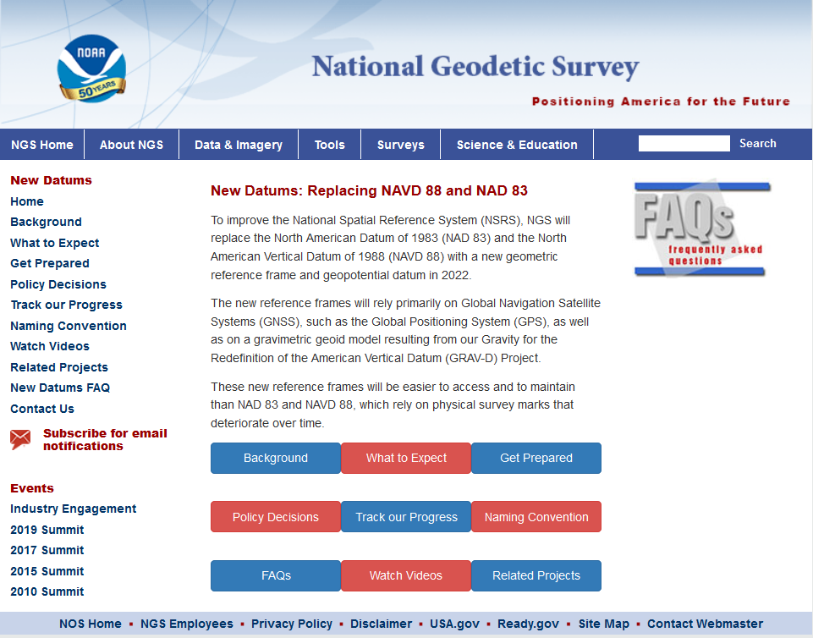
geodesy.noaa.gov

Slide 56
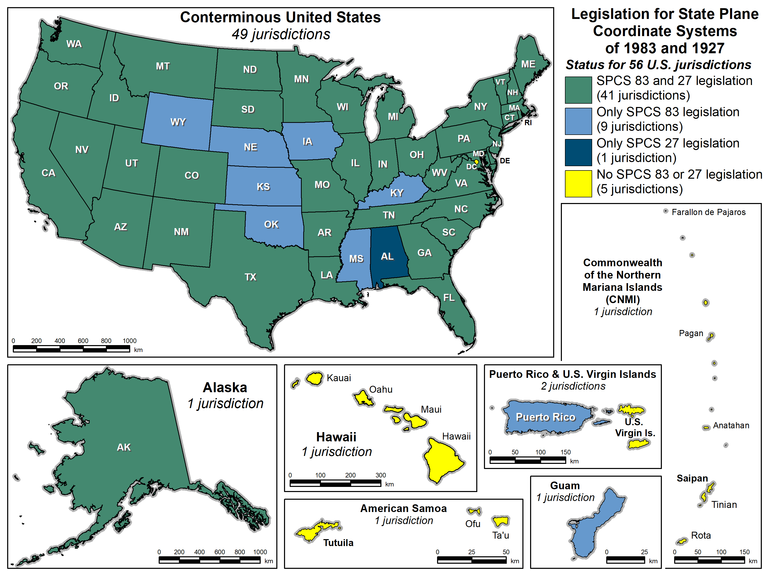
SPCS legislation

Slide 57
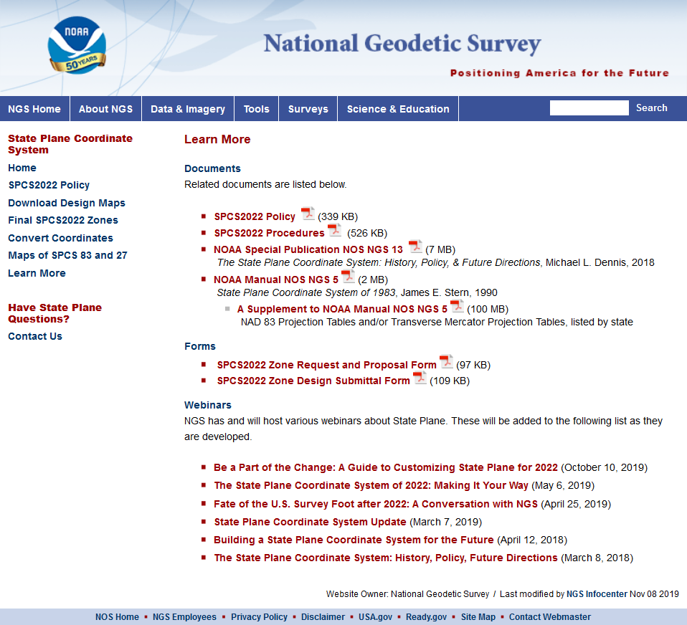
geodesy.noaa.gov
Questions?

Slide 58
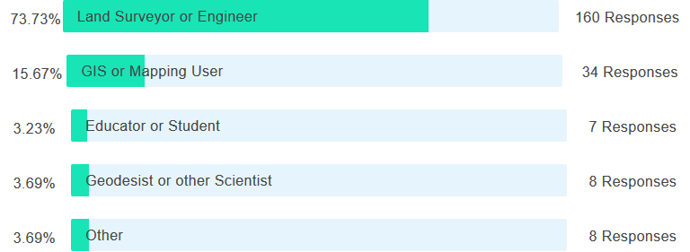
Poll Question
What is your profession?

