Slide 1

The State Plane Coordinate System
History, Policy, and Future Directions
Michael L. Dennis
SPCS2022 Project Manager
March 8, 2018

Slide 2
A Tale of Two Webinars on the State Plane Coordinate System (SPCS)
First webinar today (March 8)
  History and status of SPCS 27 and SPCS 83
  Map projection concepts
  Introduction to SPCS2022
Next webinar on April 12
  Greater detail on SPCS2022 policy and procedures
  Additional technical information
  More SPCS2022 zone design examples
Your questions today will help with April webinar!

Slide 3
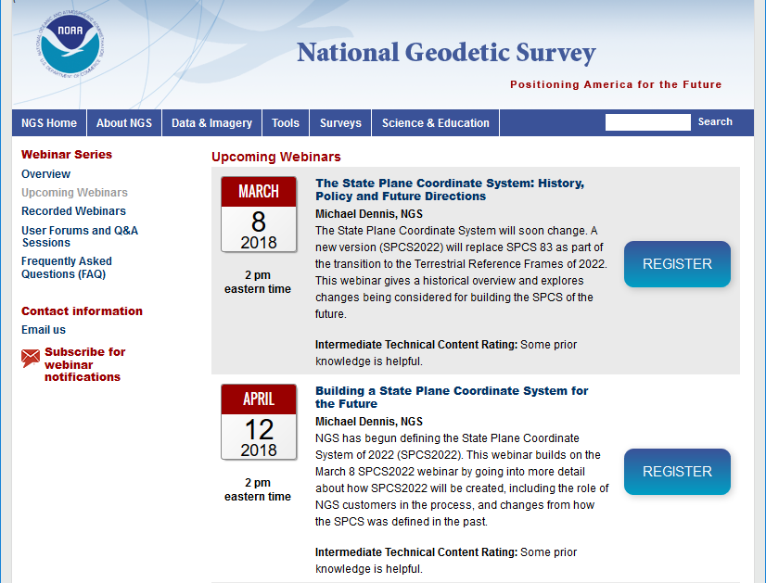

Slide 4
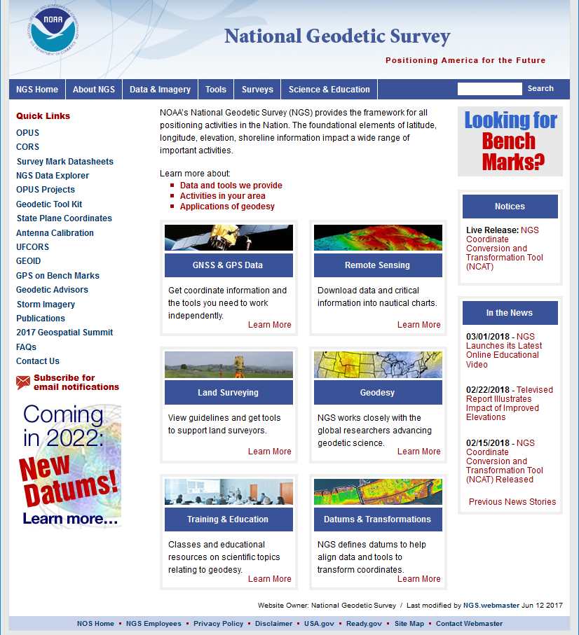
Why a new State Plane system?
geodesy.noaa.gov

Slide 5
New State Plane Coordinate System
State Plane Coordinate System of 2022 (SPCS2022)
  Referenced to new 2022 Terrestrial Reference Frames (TRFs)
  Based on same reference ellipsoid (GRS 80)
  Same 3 conformal projection types
    Lambert Conformal Conic (LCC)
    Transverse Mercator (TM)
    Oblique Mercator (OM)
NGS in process of specifying SPCS2022 characteristics
  Draft policy and procedures for public comment
  Federal Register Notice (FRN) on policy and procedures
  New report on State Plane history, policy, and future (done!)
NOTE: SPCS2022 policy, procedures, and FRN currently in review
  Approved version may differ from what is presented here but should be finalized before April 12 webinar

Slide 6
When feedback is needed (draft)
SPCS2022 Federal Register Notice
August 31, 2018 for public comment on draft policy & procedures
Includes “special purpose” zones
SPCS2022 procedures
December 31, 2019 for SPCS2022 zone requests and proposals
  Requests are for zone designs by NGS
  Proposals are for zone designs by others
December 31, 2020 for submittal of approved designs by others
  Proposal must first be approved by NGS
  Designs must be complete before NGS review
After deadlines, requests will be for changes to SPCS2022
More details will be provided in April 12 webinar

Slide 7
History and Future of State Plane
SPCS created 85 years ago
  SPCS 27: 1933 – 1986 (53 years, with some changes)
  SPCS 83: 1986 – 2022 (36 years, with some changes)
  SPCS2022: 2022 – ? (at least a few decades…)
SPCS2022 will likely be around for a long time
  Honor the history and legacy of SPCS…
  …while building a system for the future
High visibility and big impact
  SPCS used by many in US geospatial community
  NGS already contacted by 16 states about SPCS2022

Slide 8
SPCS Special Publication
History of NGS projections (1853 to present)
SPCS policies and legislation
Departures from policy and convention
Recent developments in projected coordinate systems
Appendices
  Defining parameters for ALL zones of ALL versions of SPCS, plus additional information
  Status of SPCS 83 legislation and foot conversions
https://geodesy.noaa.gov/library/pdfs/ NOAA_SP_NOS_NGS_0013_v01_2018-03-06.pdf

Slide 9
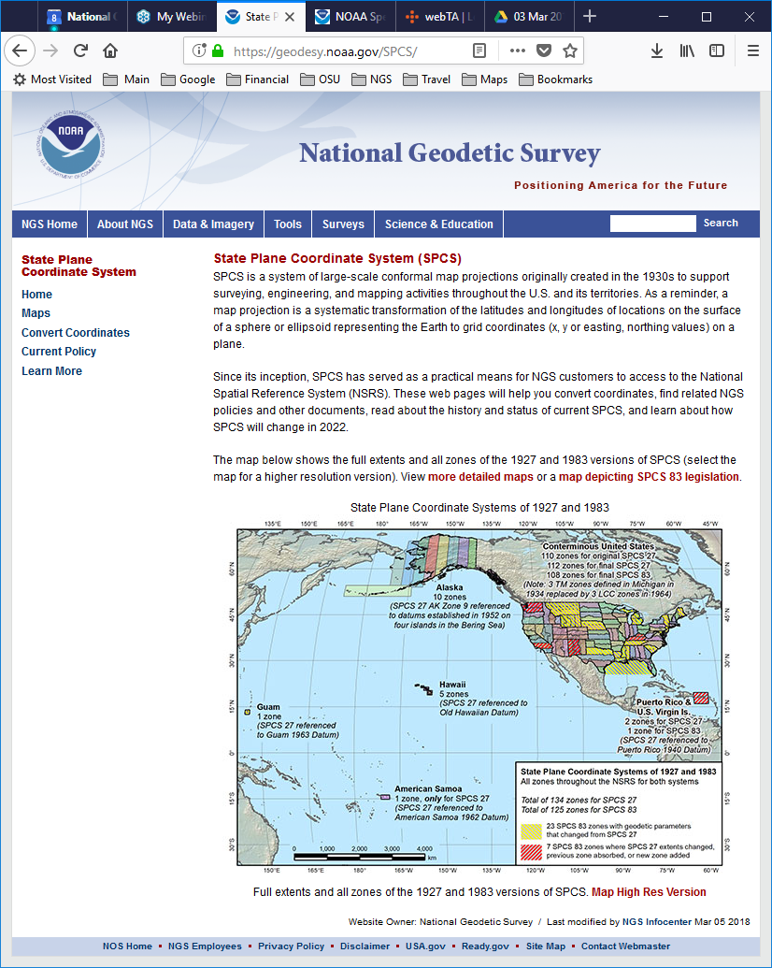
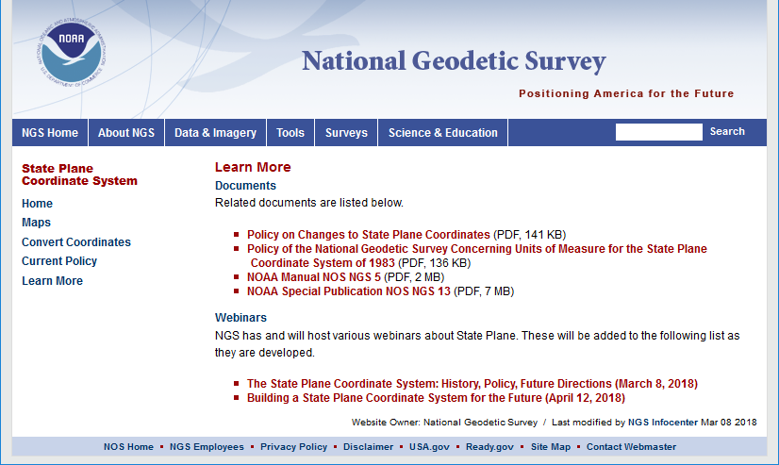
geodesy.noaa.gov/SPCS/
On “Learn More” page will soon add:
Spreadsheets with complete definitions for all SPCS 27 and
SPCS 83 zones
Shapefiles of all SPCS 27 and SPCS 83 zones with parameters as attributes

Slide 10
An interesting and varied history
Initially created for North Carolina at customer request
  Gave practical access to National Spatial Reference System (NSRS)
  SPCS 27 started in 1933, completed in 1934(!)
Changes from SPCS 27 to SPCS 83:
  Multi-zone to single-zone for some states (SC, NE, MT)
  Change in grid origin and units (US feet to meters)
  American Samoa has no SPCS 83 zone
Departures from policy and convention:
  Guam used non-conformal projection for SPCS 27
  Michigan used “scaled” ellipsoid for SPCS 27 (after 1963)
  California added small Los Angeles County zone for SPCS 27
  Kentucky has “layered” (overlapping) SPCS 83 zones
  Montana single SPCS 83 zone greatly exceeds 1:10,000 scale error

Slide 11
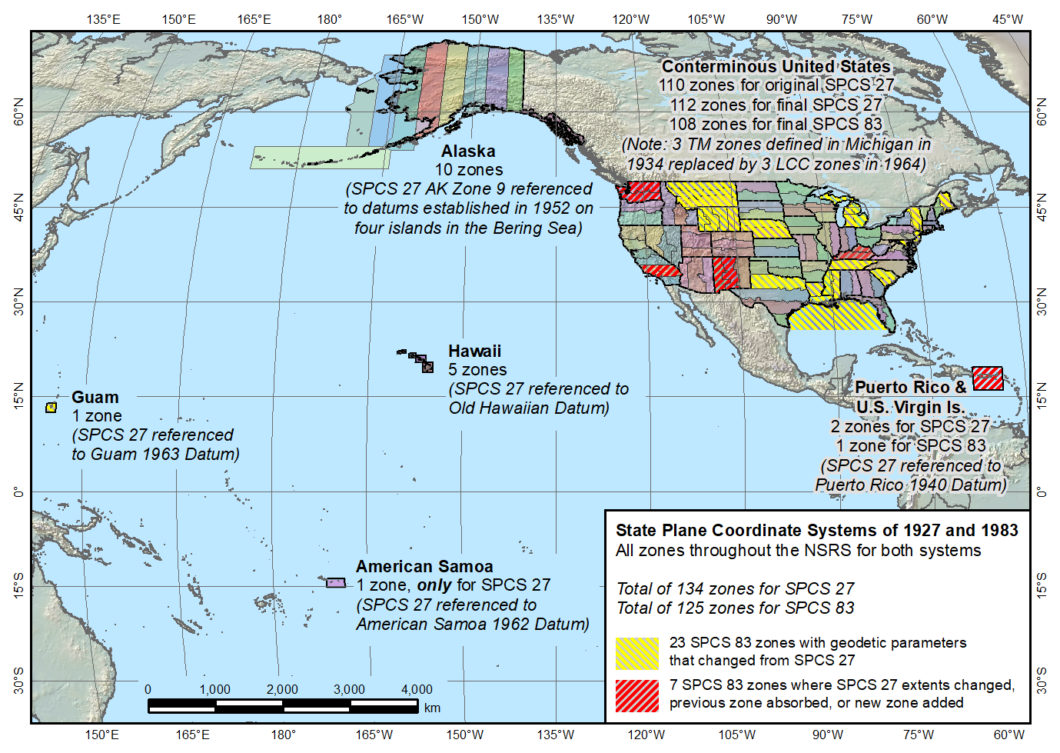
State Plane Coordinate Systems of 1927 (134 zones) and 1983 (125 zones)
Guam SPCS 83 zone added in 1995
Guam SPCS 27 zone a non-conformal projection
Two zones in SPCS 27, one in SPCS 83
American Samoa only in SPCS 27, not SPCS 83

Slide 12
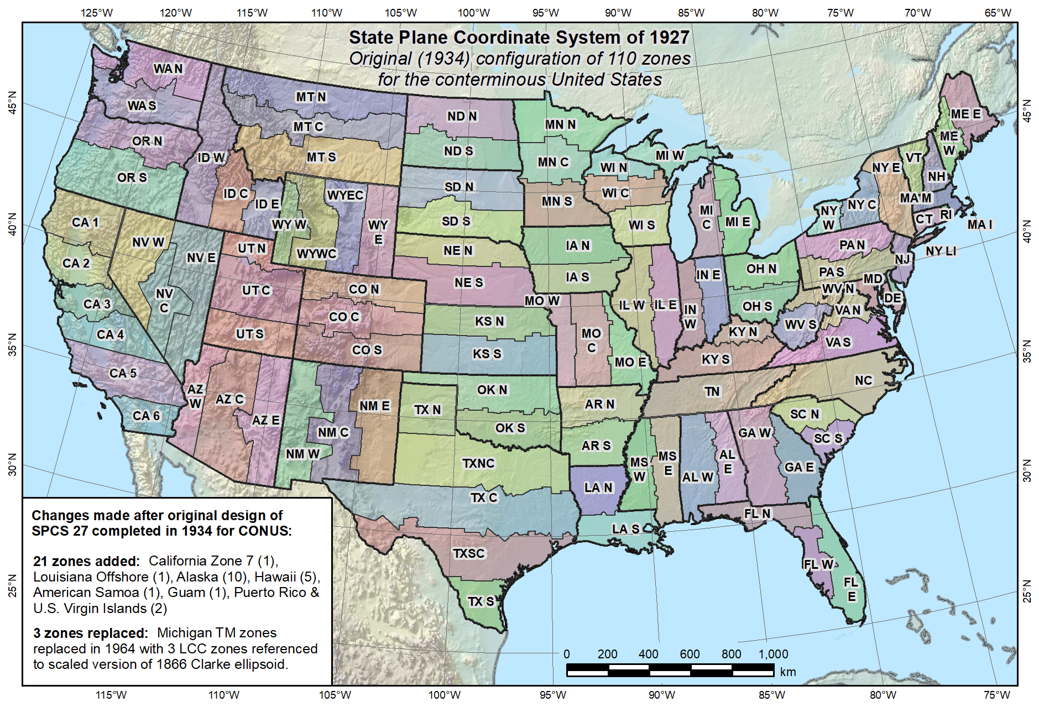
Original SPCS 27, as of 1934 (110 zones total)

Slide 13
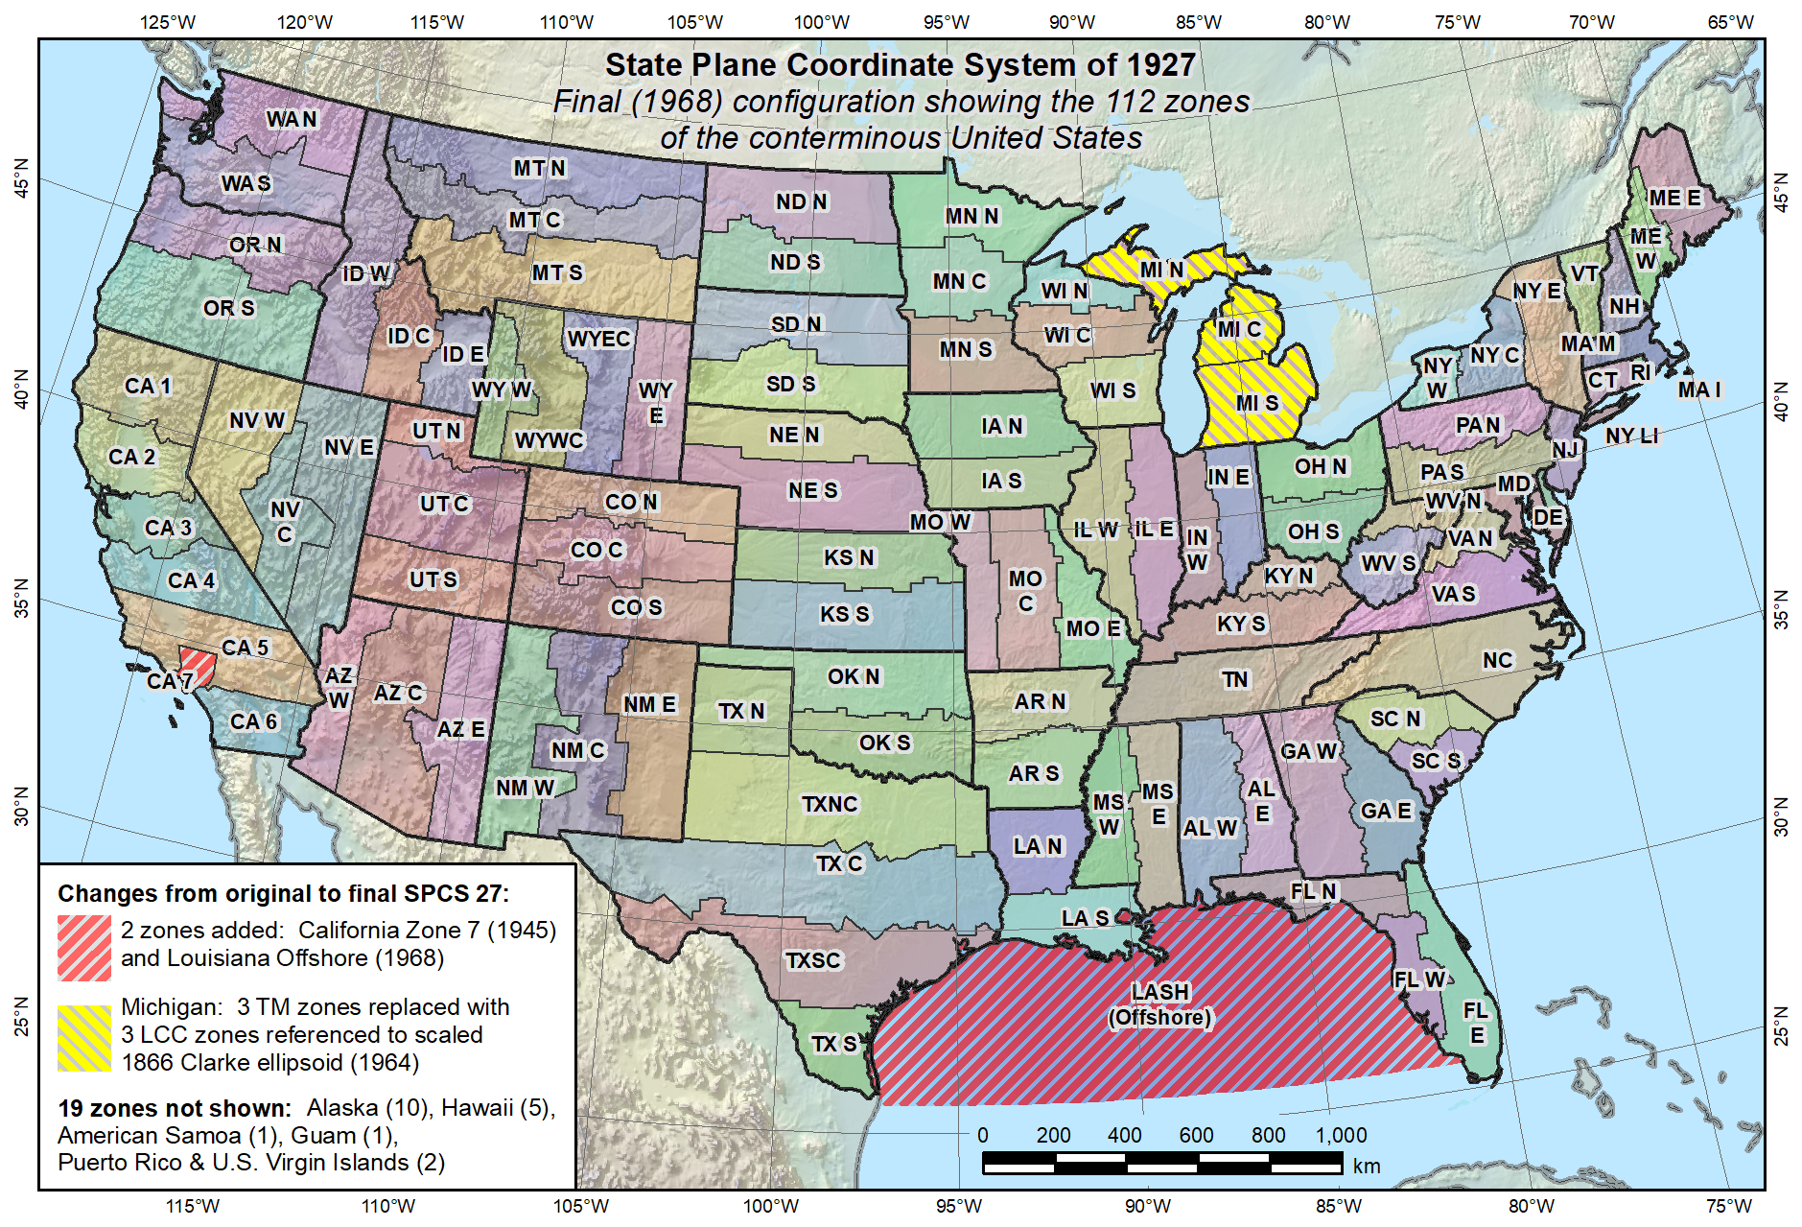
Final SPCS 27, as of 1968 (112 zones in CONUS, 131 zones total)
Reduced distortion zones added: CA 7 (1945)
MI (1964)

Slide 14
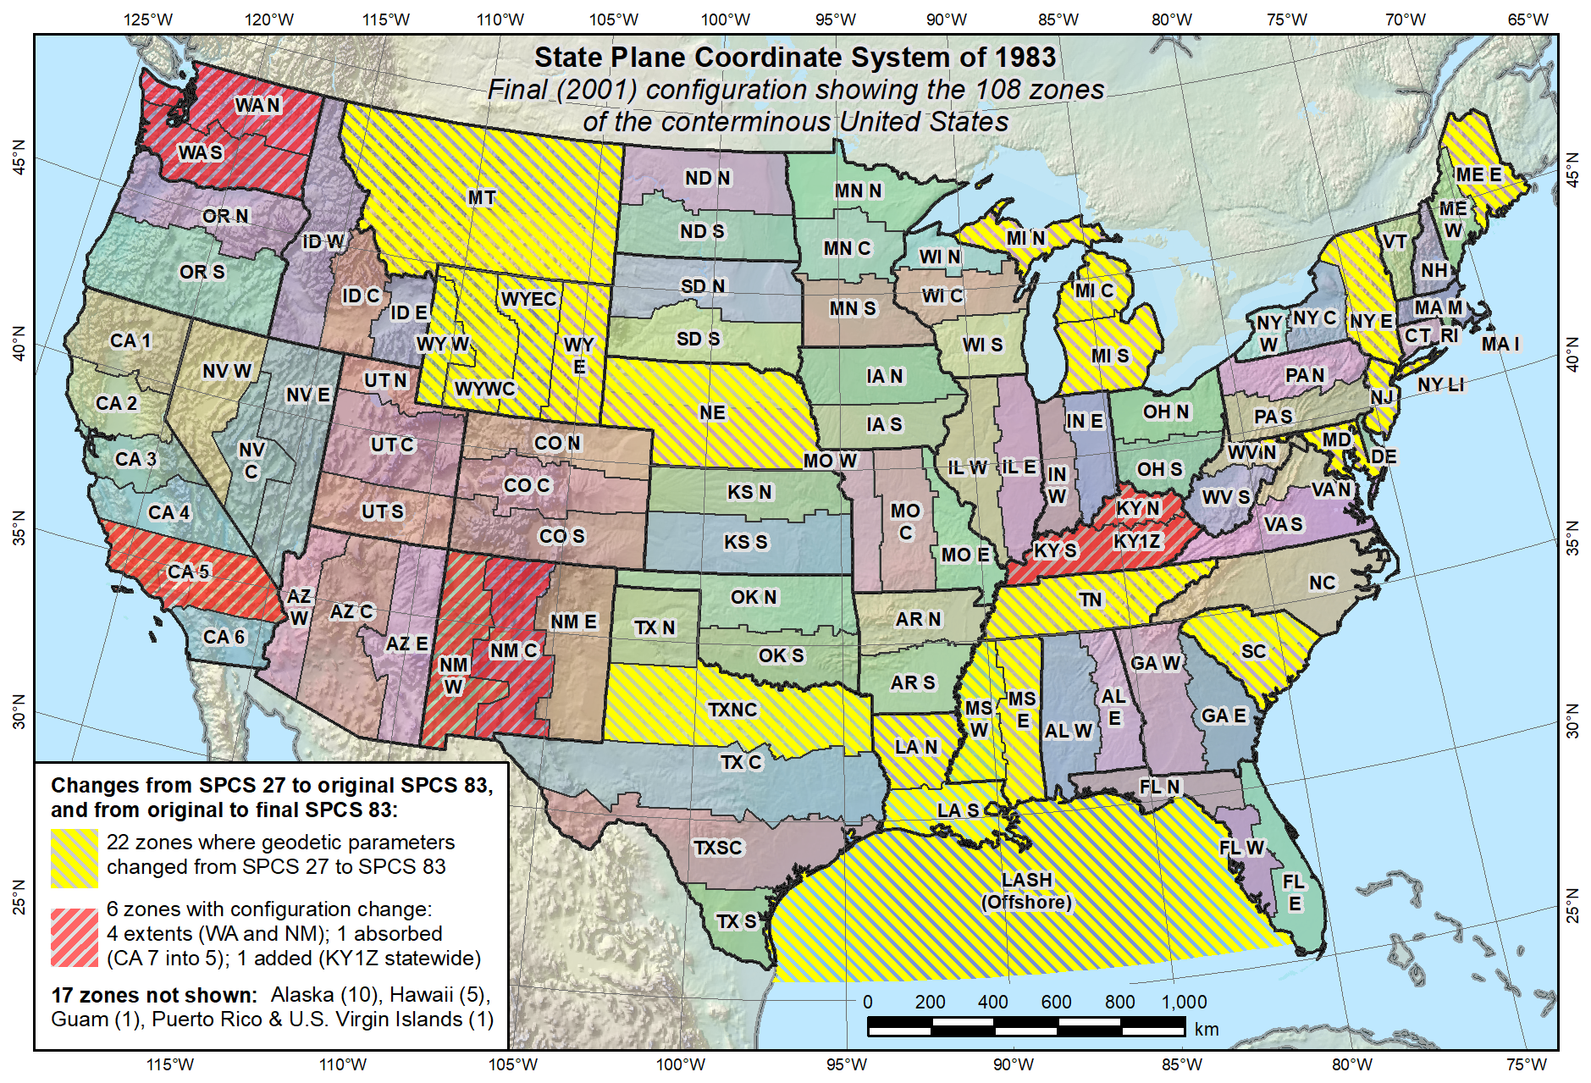
Final SPCS 83, as of 2001 (108 zones in CONUS, 125 zones total)
KY statewide zone added in 2001

Slide 15
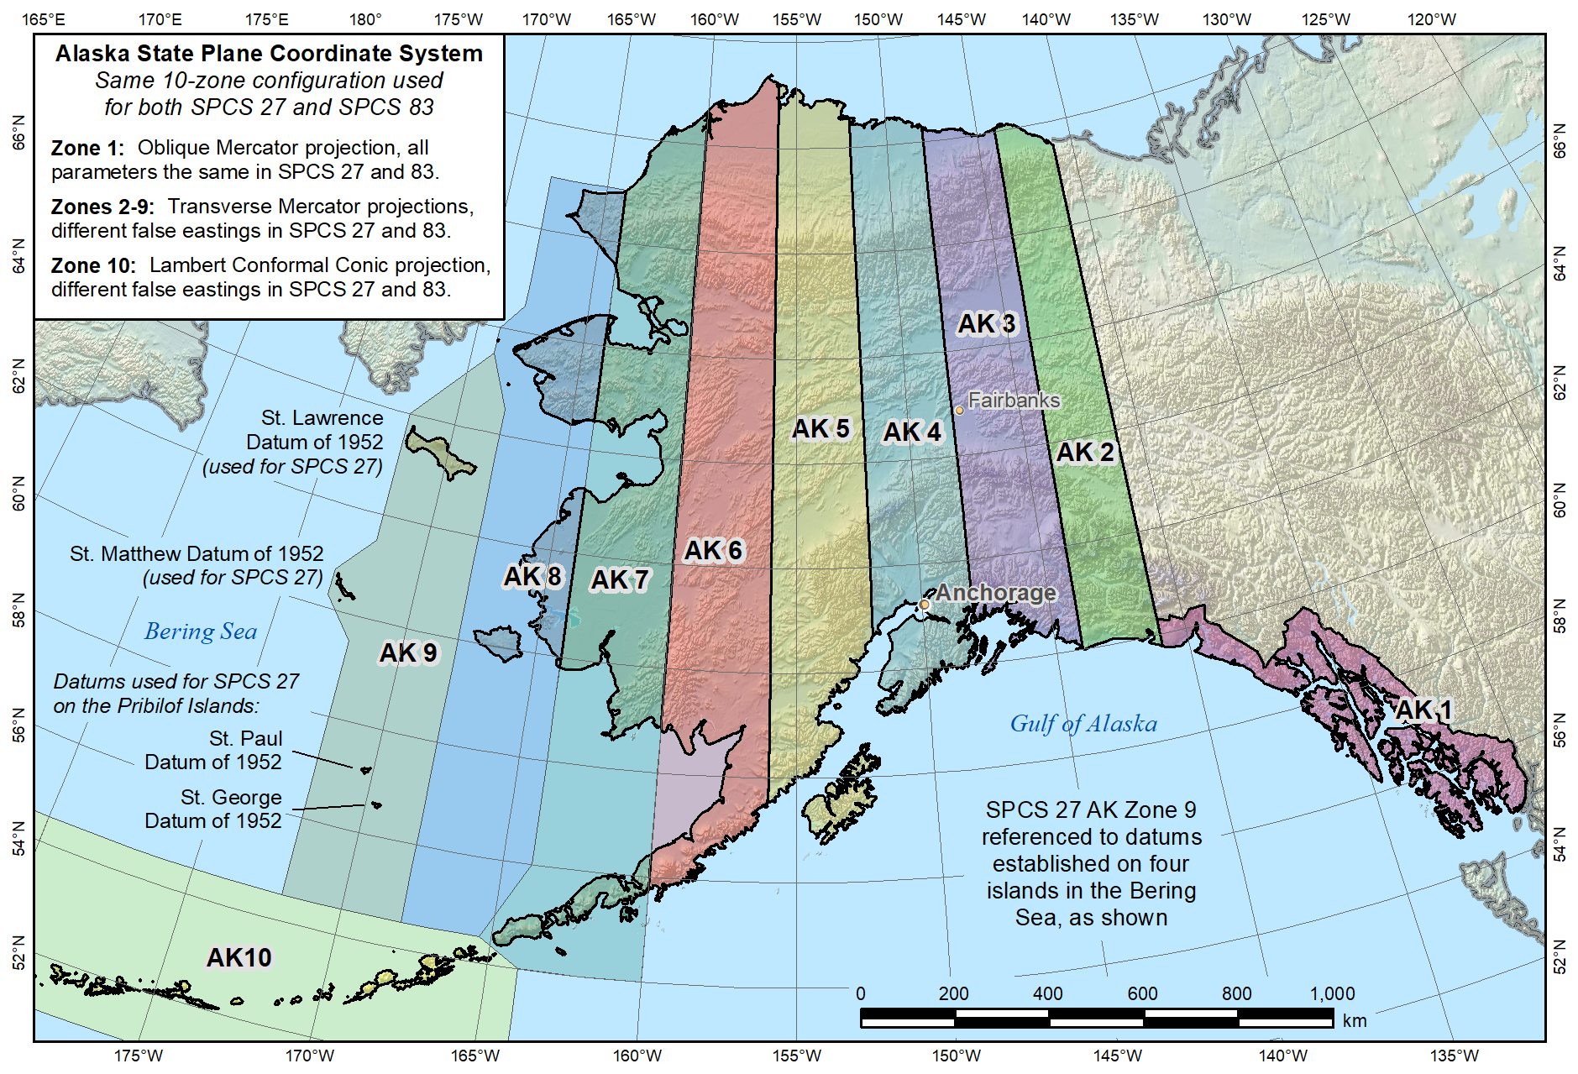
Alaska State Plane Coordinate Systems of 1927 and 1983 (10 zones)
Islands in Zone 9 are referenced to local datums other than NAD 27

Slide 16
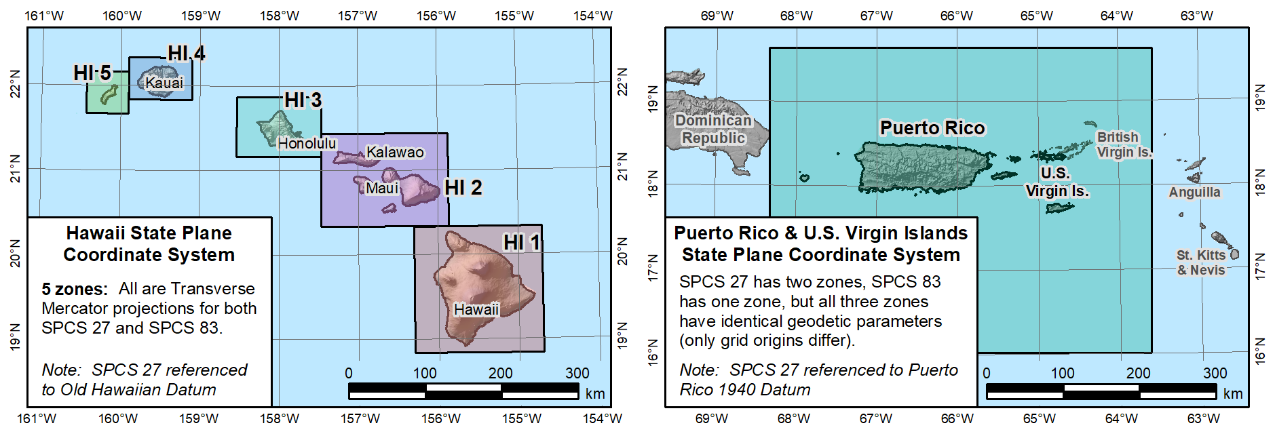
Hawaii State Plane
Coordinate Systems
of 1927 and 1983 (5 zones)
“SPCS 27” version referenced to
Old Hawaiian Datum
Puerto Rico and U.S. Virgin Islands
State Plane Coordinate Systems
of 1927 (2 zones) and 1983 (1 zone)
“SPCS 27” version referenced to
Puerto Rico 1940 Datum

Slide 17
Issues with SPCS 83
Incomplete NGS documentation (until now)
Inconsistent zone definitions
  Highly variable linear distortion
  “Layered” zones exist (Kentucky)
  Inconsistent specification of grid origins
  Scale explicitly defined for some zones, implicitly for others
  Incomplete coverage of U.S. territories
Note common usage of SPCS “at ground”
  Many surveyors & engineers scale SPCS to topo surface
  NGS used to give workshops on this methodology
  Process incorporated in most surveying software
  Shows desire to work “at ground”

Slide 18
Map projection concepts
Linear distortion (“scale error”)
  Amount map projection “grid” distance differs from true (curved) horizontal distance
    Usually at topographic surface (“grid” vs. “ground” distance)
    Can also be at ellipsoid surface (“grid” vs. ellipsoid distance)
Conformal map projection
  Linear distortion unique at a point (same in every direction)
  Simple relationship between grid and geodetic azimuth
  SPCS2022 zones will use following conformal projections:
    Lambert Conformal Conic (LCC)
    Transverse Mercator (TM)
    Oblique Mercator (OM)

Slide 19
SPCS2022 characteristics (draft)
Technical requirements
  Linear distortion design criterion at topographic surface (not at ellipsoid surface)
    Difference in distance between “grid” and “ground”
  Use 1-parallel definition for LCC projections
Other characteristics
  Default designs (if no consensus stakeholder input)
  “Layered” zones
  Low-distortion projections (LDPs)
  “Special purpose” zones

Slide 20
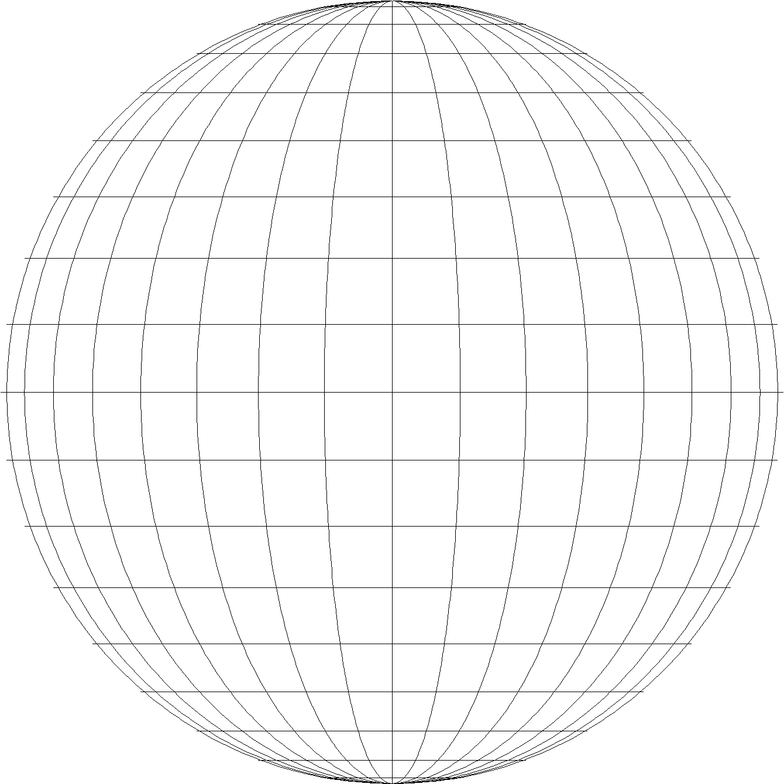
Can think of projection as “light rays” projecting onto surface
Projection surface
Projection surface
Projection surface
Ray source at center of Earth
Ray source at opposite side of Earth
Ray source
at infinity
Gnomonic projection
(non-conformal)
Stereographic projection
(conformal)
Orthographic projection
(non-conformal)
However, this only works for a few sphere-based projections

Slide 21
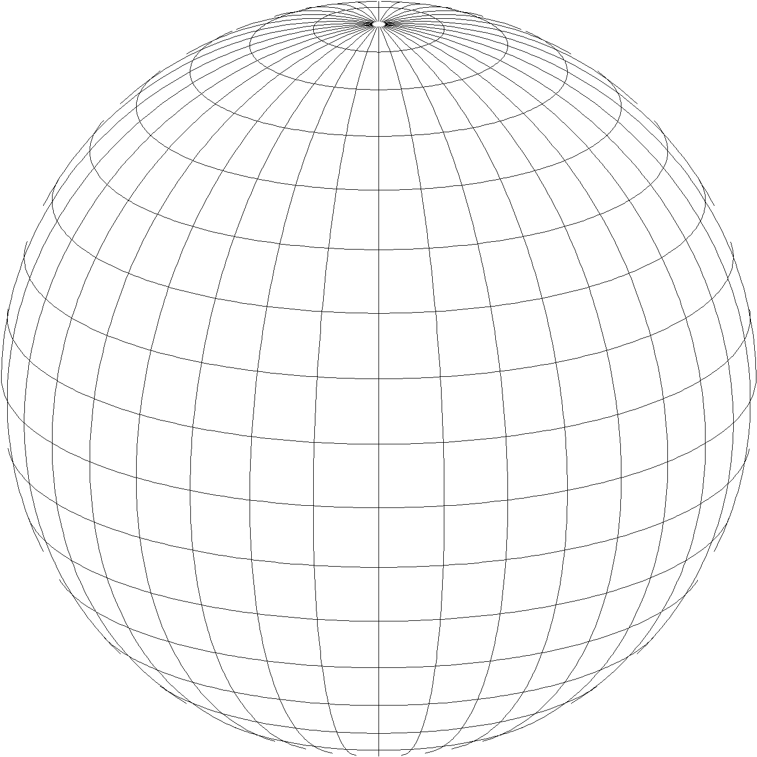
Developable surfaces: Planes and cones
Planar (azimuthal) projections
Conic projections
Polar aspect
Standard parallel
Standard parallels
Origin
Central parallel
Oblique aspect
One-parallel (tangent)
Two-parallel (secant)
e.g., stereographic (not used for SPCS)
e.g., Lambert conformal conic
(used for SPCS)
Examples given are CONFORMAL projections

Slide 22
Developable surfaces: Cylinders
Cylindrical projections
“Regular” aspect
Transverse aspect
Oblique aspect
Equator
Central meridian
Skew axis
e.g., Mercator
(not used for SPCS)
e.g., transverse Mercator
(used for SPCS)
e.g., oblique Mercator
(used for SPCS)
Examples given are CONFORMAL projections

Slide 23
Linear distortion with respect to ellipsoid
Projection
axis
Ellipsoid surface
Ellipsoid distance
Projection surface (secant)
Grid distance > ellipsoid distance
This design approach
used for SPCS 27 and 83 (minimizes distortion with respect to ellipsoid)
Ellipsoid distance
Grid distance <
ellipsoid distance

Slide 24
Linear distortion with respect to topographic surface
Horizontal ground distance
> ellipsoid distance
and
> grid distance
Topographic surface
Projection
axis
Ellipsoid surface
Ellipsoid distance
Projection surface (secant)
Grid distance
> ellipsoid distance
< ground distance
This design approach
used for SPCS 27 and 83 (minimizes distortion with respect to ellipsoid)
Ellipsoid distance
Grid distance
< ellipsoid distance
< ground distance

Slide 25
Linear distortion with respect to topographic surface
Horizontal ground distance
> ellipsoid distance
and
> grid distance
Topographic surface
Projection
axis
Ellipsoid surface
Ellipsoid distance
Grid distance
> ellipsoid distance
≈ ground distance
Projection surface (non-intersecting)
This design approach
will be used for SPCS2022 (minimizes distortion with respect to topography)

Slide 26
Linear distortion magnitudes ppm = parts per million (mm/km)
±20 ppm = 2 cm/km = 0.1 ft/mile = 1 : 50,000
  Often used as “low distortion” design criterion (at ground)
±50 ppm = 5 cm/km = 0.3 ft/mile = 1 : 20,000
  Minimum design criterion for SPCS2022 designs by NGS (at ground)
±100 ppm = 10 cm/km = 0.5 ft/mile = 1 : 10,000
  “Nominal” maximum State Plane value (on ellipsoid)
  Can be much greater at topo surface
±400 ppm = 40 cm/km = 2.1 ft/mile = 1 : 2,500
  Maximum design criterion for SPCS2022 zones (at ground)
  Maximum UTM value (on ellipsoid)
Nominal distortion criterion (on ellipsoid) for SPCS 27 and 83 zones (although greatly exceeded for some zones in SPCS 83).

Slide 27
Linear distortion magnitudes ppm = parts per million (mm/km)
±20 ppm = 2 cm/km = 0.1 ft/mile = 1 : 50,000
  Often used as “low distortion” design criterion (at ground)
±50 ppm = 5 cm/km = 0.3 ft/mile = 1 : 20,000
  Minimum design criterion for SPCS2022 designs by NGS (at ground)
±100 ppm = 10 cm/km = 0.5 ft/mile = 1 : 10,000
  “Nominal” maximum State Plane value (on ellipsoid)
  Can be much greater at topo surface
±400 ppm = 40 cm/km = 2.1 ft/mile = 1 : 2,500
  Maximum design criterion for SPCS2022 zones (at ground)
  Maximum UTM value (on ellipsoid)
Distortion range (at ground) for zones designed by NGS, as proposed in draft SPCS2022 policy and procedures.

Slide 28
Linear distortion magnitudes ppm = parts per million (mm/km)
±20 ppm = 2 cm/km = 0.1 ft/mile = 1 : 50,000
  Often used as “low distortion” design criterion (at ground)
±50 ppm = 5 cm/km = 0.3 ft/mile = 1 : 20,000
  Minimum design criterion for SPCS2022 designs by NGS (at ground)
±100 ppm = 10 cm/km = 0.5 ft/mile = 1 : 10,000
  “Nominal” maximum State Plane value (on ellipsoid)
  Can be much greater at topo surface
±400 ppm = 40 cm/km = 2.1 ft/mile = 1 : 2,500
  Maximum design criterion for SPCS2022 zones (at ground)
  Maximum UTM value (on ellipsoid)
Distortion criterion (at ground) often used for “low distortion projection” (LDPs); designed by others for SPCS2022 (not by NGS)

Slide 29
SPCS2022 characteristics (draft)
Technical requirements
  Linear distortion design criterion at topographic surface (not at ellipsoid surface)
    Difference in distance between “grid” and “ground”
  Use 1-parallel definition for LCC projections
Other characteristics
  Default designs (if no consensus stakeholder input)
  “Layered” zones
  Low-distortion projections (LDPs)
  “Special purpose” zones

Slide 30
Lambert Conformal Conic projection
Conical developable surface
Used for many State Plane zones
Can define scale two different ways:
  Define scale explicitly on central standard parallel
  Compute scale implicitly
    From separation between two “standard” parallels
    Scale (at ellipsoid) is exactly 1 for standard parallels
The two types are mathematically identical!
  “Projection axis” for both is central standard parallel

Slide 31
Why only a 1-parallel LCC?
Consistency
  Explicitly define projection scale (same as TM and OM)
  Can use same number of parameters as TM
  Applicable to both “secant” and “non-intersecting” cases
Simplicity
  Easier to design with respect to topography
  Scale due to separation of 2 standard parallels not obvious
  Can more readily use “clean” values for parallels
Mathematically identical to 2-parallel
  Any 2-parallel LCC can be recast as 1-parallel that behaves exactly the same

Slide 32
Consider North Carolina SPCS 83 Zone
Secant Lambert Conformal Conic projection, 2-parallel definition:
Standard parallels
North = 36°10’N (exact)
South = 34°20’N (exact)
It is EXACTLY the same as this 1-parallel definition:
Central standard parallel
35°15’06.33096…”N
Scale = 0.9998 7259…
Ellipsoid
Scale = 1
North standard parallel
Scale =
0.9998 7259…
Central “standard” parallel
(projection axis)
(1:7849)
Scale = 1
South standard parallel
An LCC projection is defined by its projection axis, which is ALWAYS the central standard parallel

Slide 33
SPCS2022 characteristics (draft)
Technical requirements
  Linear distortion design criterion at topographic surface (not at ellipsoid surface)
    Difference in distance between “grid” and “ground”
  Use 1-parallel definition for LCC projections
Other characteristics
  Default designs (if no consensus stakeholder input)
  “Layered” zones
  Low-distortion projections (LDPs)
  “Special purpose” zones

Slide 34
Default SPCS2022 designs (draft)
Default needed in absence of stakeholder input
Same projections and zones for most SPCS 83 zones
Performance and coverage very similar to SPCS 83
Characteristics that differ from SPCS 83:
  Projection scale modified to minimize distortion at ground
  Lambert Conformal Conic converted to one-parallel type
  Most geodetic origins with arc-minutes evenly divisible by 3
  A few zones with different projection & zone extents

Slide 35
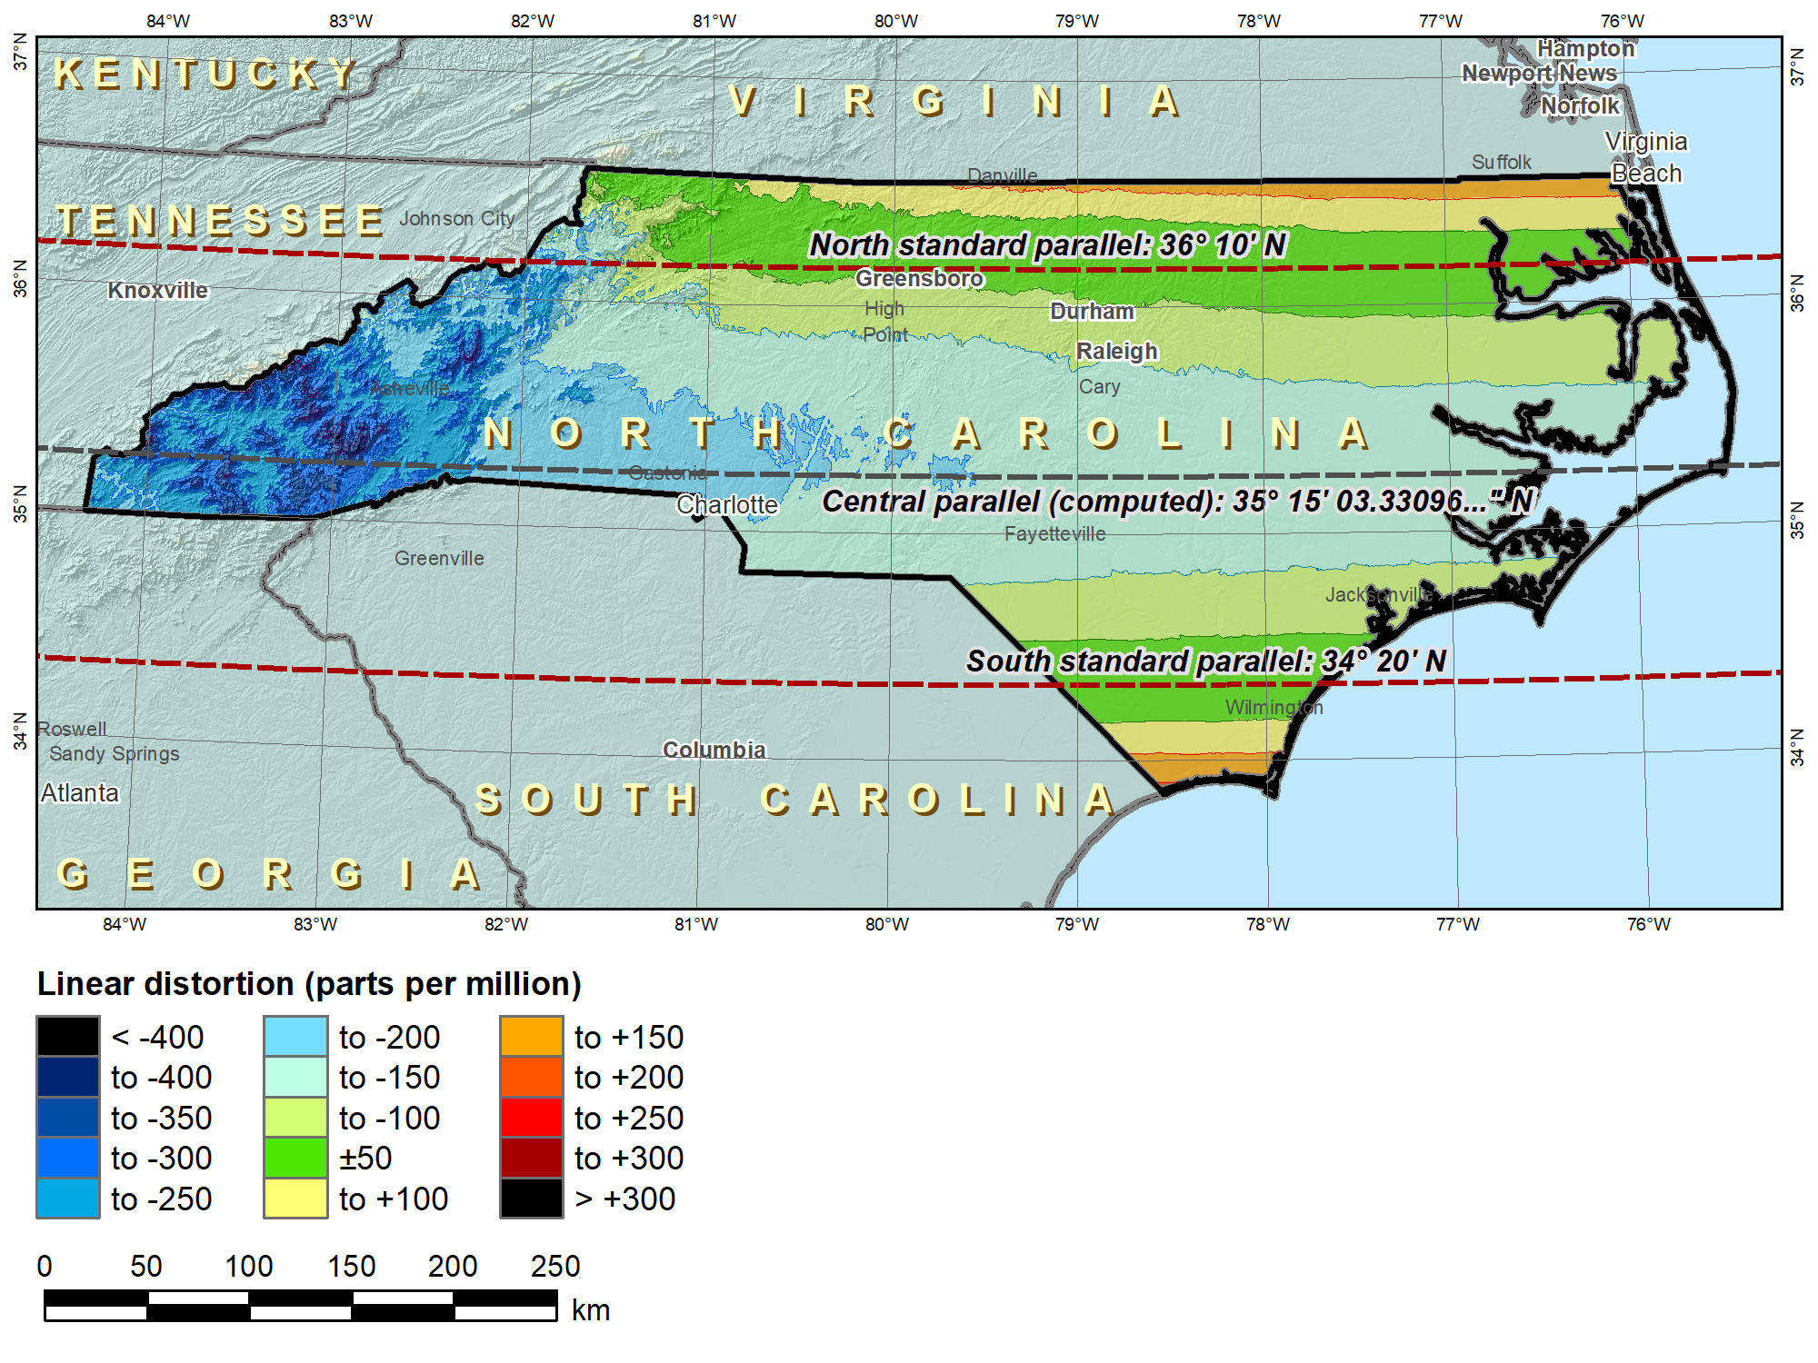
SPCS 83 North Carolina (Lambert Conformal Conic 2-parallel)
 |  | SPCS 83 NC
Central parallel |  | 35°15’06.33…”N
Cen parallel scale |  | 0.9998 7259…
 | Height (m) | Distortion (ppm)
Min | -41 | -413
Max | 1939 | +176
Mean | 197 | -93

Slide 36
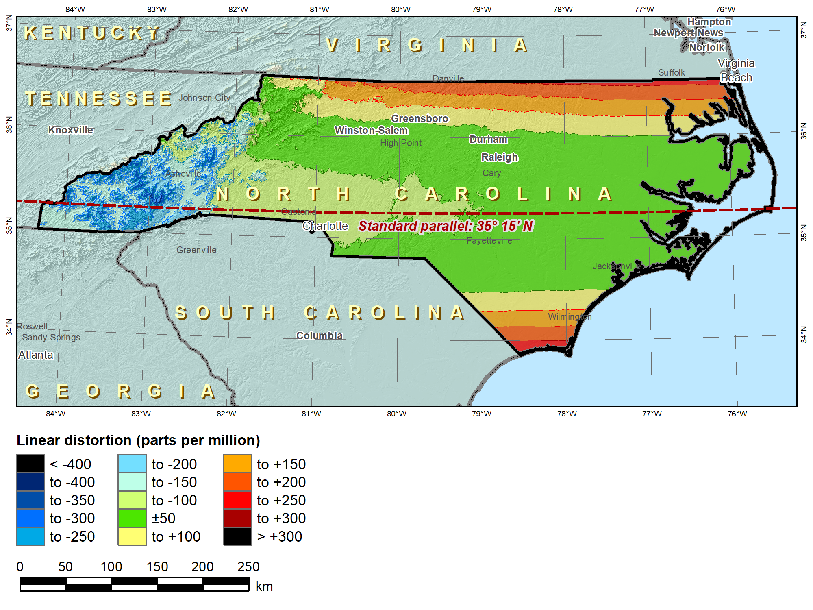
SPCS2022 “default” NC (Lambert Conformal Conic 1-parallel)
No change in projection type or zone extents
 |  | SPCS 83 NC | SPCS2022
Central parallel |  | 35°15’06.33…”N | 35°15’N
Cen parallel scale |  | 0.9998 7259… | 0.99996
 | Height (m) | Distortion (ppm)
Min | -41 | -413 | -325
Max | 1939 | +176 | +263
Mean | 197 | -93 | -5

Slide 37
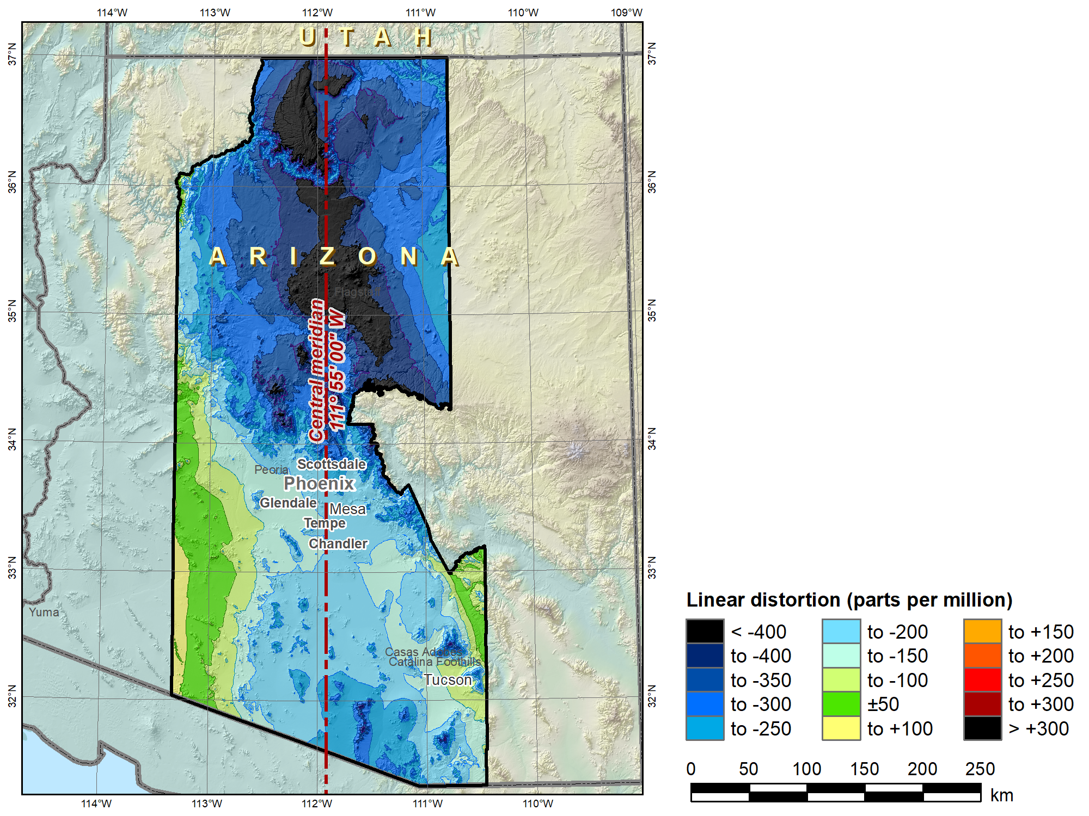
SPCS 83
Arizona Central Zone (Transverse Mercator)
 | Height (m)
Min | 96
Max | 3607
Mean | 1177
 |  | SPCS 83 AZ C
C.M. |  | 111°55’W
Scale |  | 0.9999
 |  | Distortion (ppm)
Min |  | -660
Max |  | +102
Mean |  | -224

Slide 38
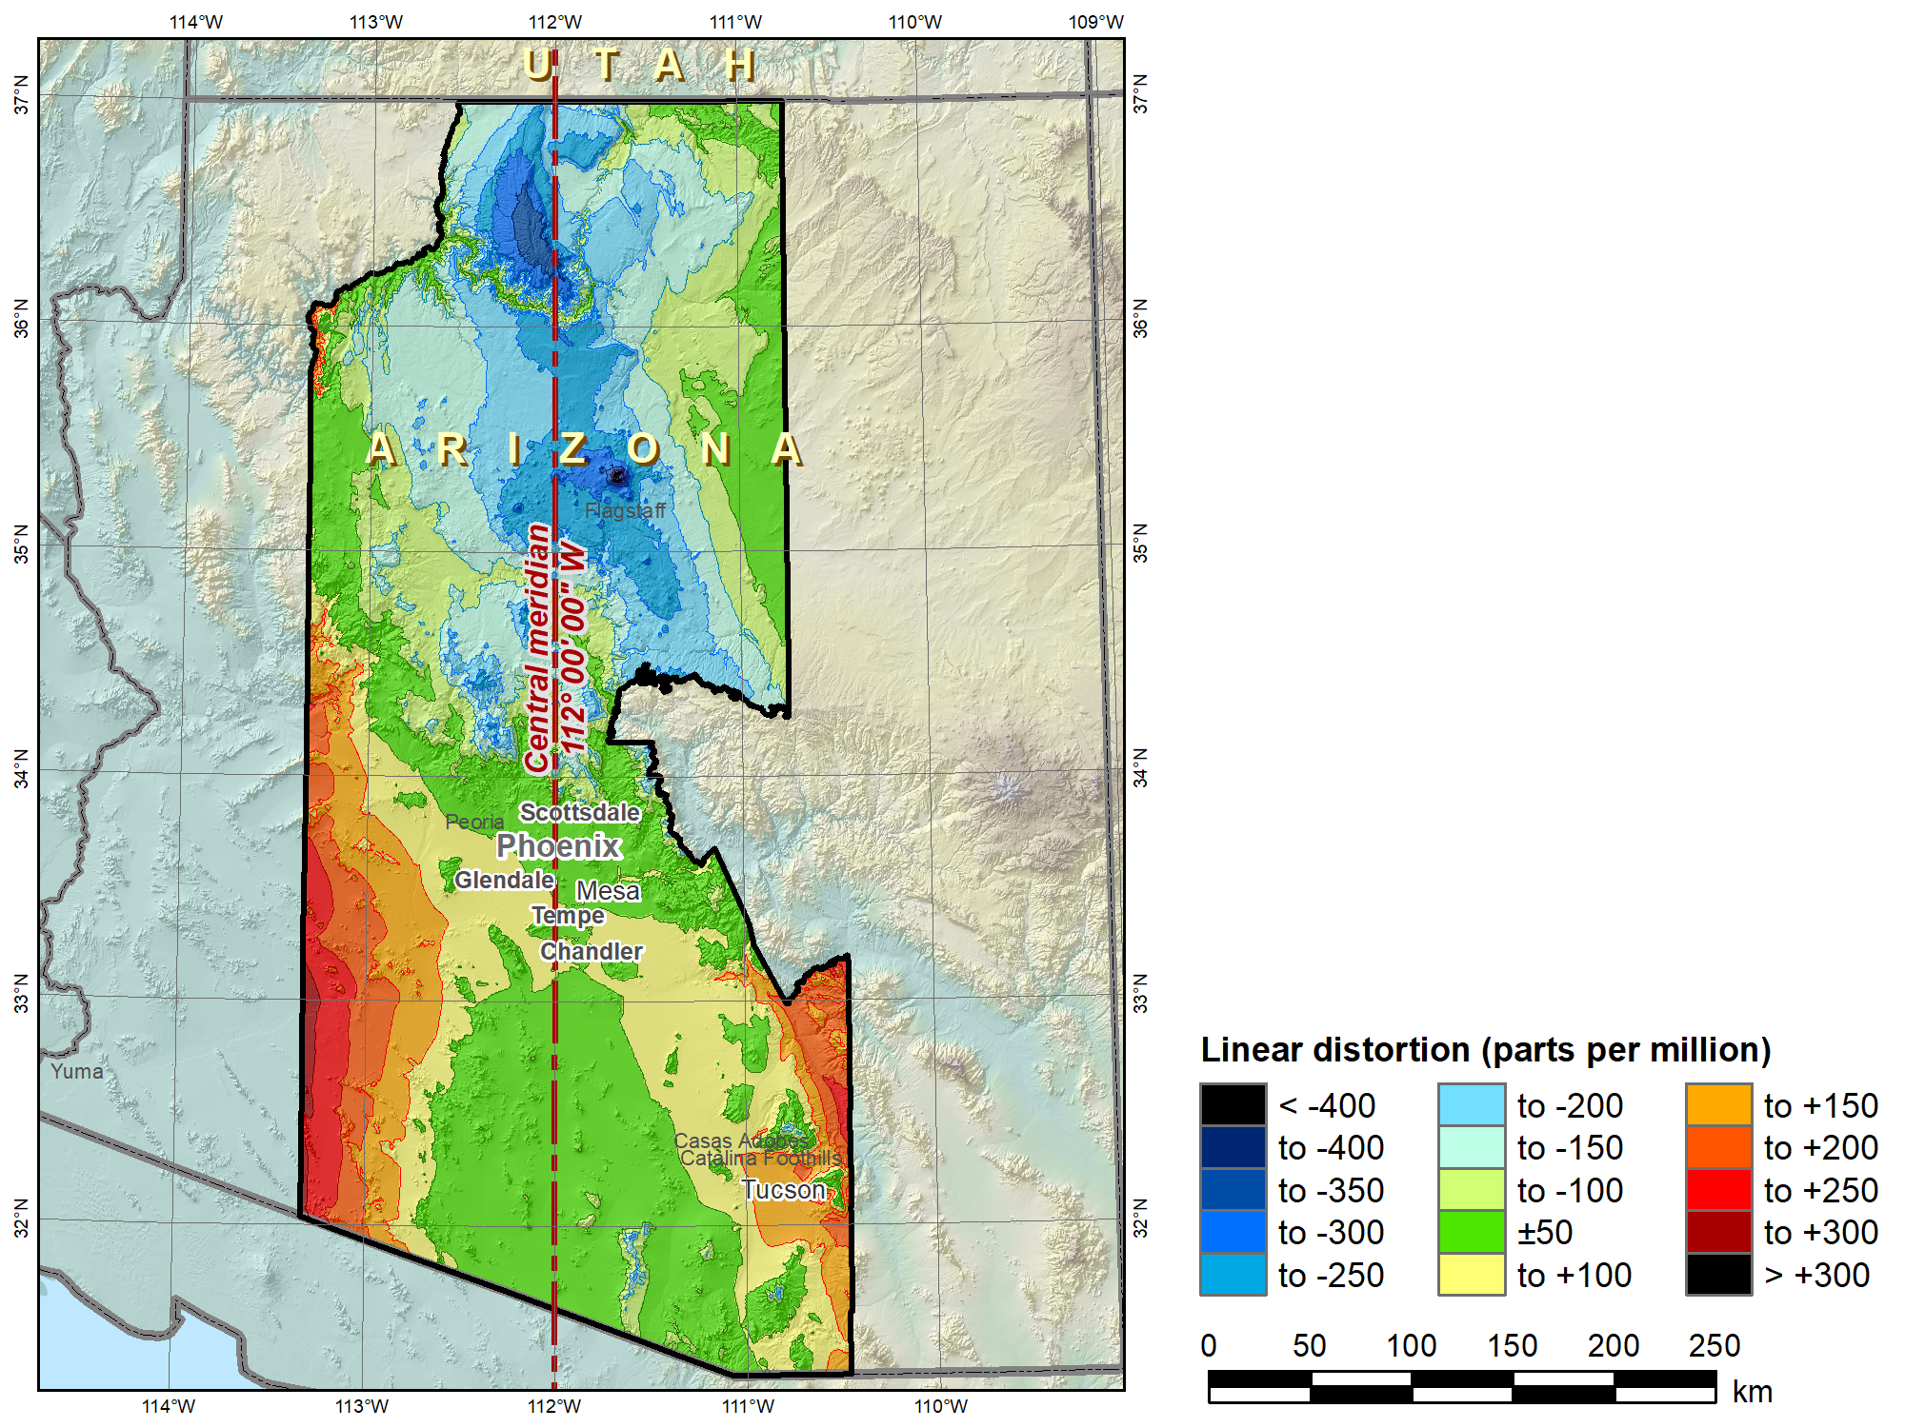
SPCS2022 “default” Arizona Central Zone (Transverse Mercator)
No change in projection type or zone extents
 | Height (m)
Min | 96
Max | 3607
Mean | 1177
 |  | SPCS 83 AZ C | SPCS2022
C.M. |  | 111°55’W | 112°W
Scale |  | 0.9999 | 1.0001
 |  | Distortion (ppm)
Min |  | -660 | -455
Max |  | +102 | +277
Mean |  | -224 | -24

Slide 39
“Layered” zones (draft)
Limitations
  Max of TWO layers: Statewide and sub-zones
  If two layers, one MUST be statewide
  Minimum sub-zone dimension > 50 km
States often want statewide and small zones
  Statewide: Single geometry required for state GIS
  Sub-zones: Lower distortion for surveying/engineering
Accommodates state needs, but with restrictions
  Prevent poor design choices for statewide zones
  One already exists in SPCS 83…

Slide 40
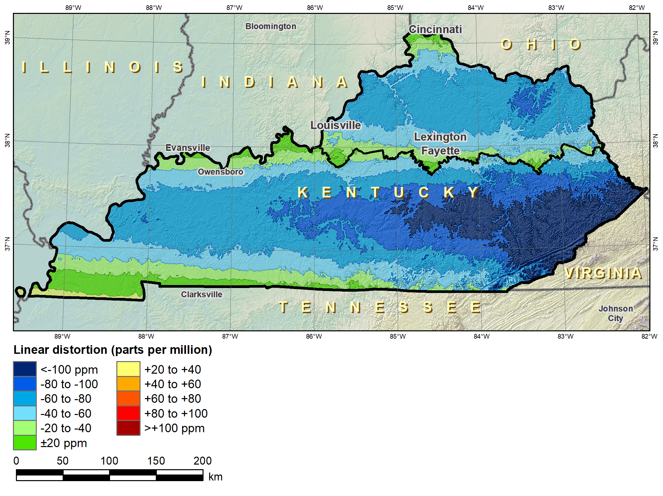
Kentucky layered zones
“Layered” zones
SPCS 83 Kentucky N and S zones (Lambert Conformal Conic)
 |  | North | South
N parallel |  | 38°58’N | 37°56’N
S parallel |  | 37°58’N | 36°44’N
 |  | Distortion (ppm)
Min |  | -93 | -211
Max |  | +17 | +42
Mean |  | -56 | -67

Slide 41
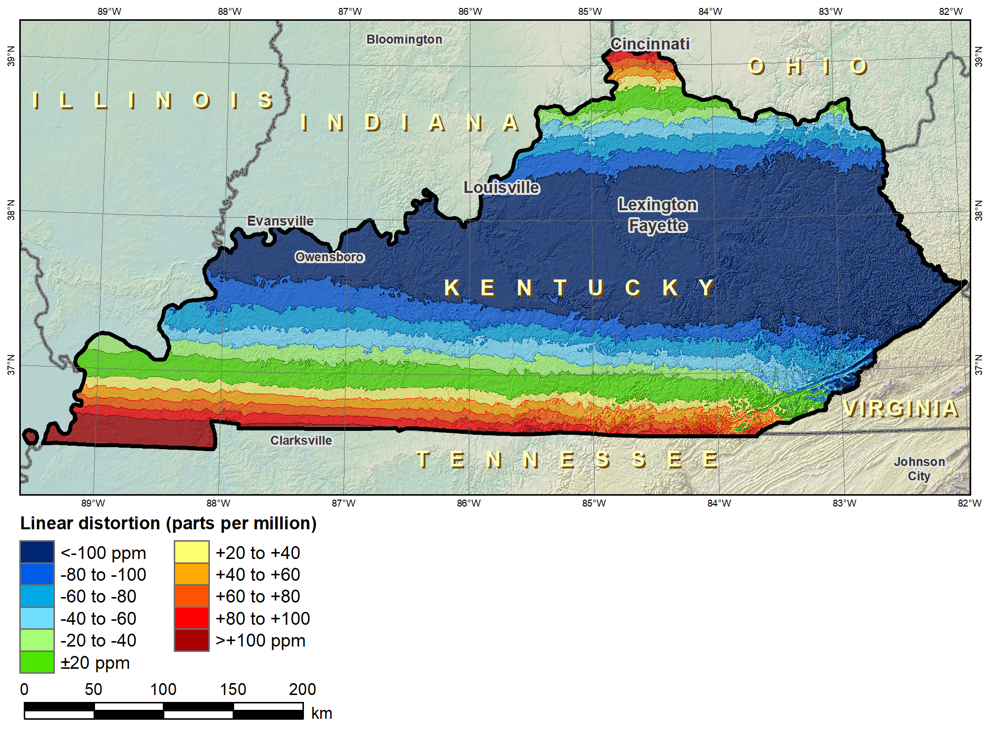
Kentucky layered zones
“Layered” zones
SPCS 83 Kentucky statewide zone (Lambert Conformal Conic)
 |  | North | South | Statewide
N parallel |  | 38°58’N | 37°56’N | 38°40’N
S parallel |  | 37°58’N | 36°44’N | 37°05’N
 |  | Distortion (ppm)
Min |  | -93 | -211 | -166
Max |  | +17 | +42 | +181
Mean |  | -56 | -67 | -58

Slide 42
Linear distortion design criteria (draft)
NGS design of zones requested by stakeholders
  Limited to zones with 50-400 ppm distortion criterion
    50 ppm = 5 cm/km = 0.3 ft/mi = 1:20,000
    400 ppm = 40 cm/km = 2.1 ft/mi = 1:2,500
Design criterion < 50 ppm (“low distortion”)
  Min criterion 20 ppm = 2 cm/km = 0.1 ft/mi = 1:50,000
  Must be designed by others (not by NGS)
  Proposed and final design reviewed by NGS
What is the current situation with “low distortion” projected coordinate systems?

Slide 43
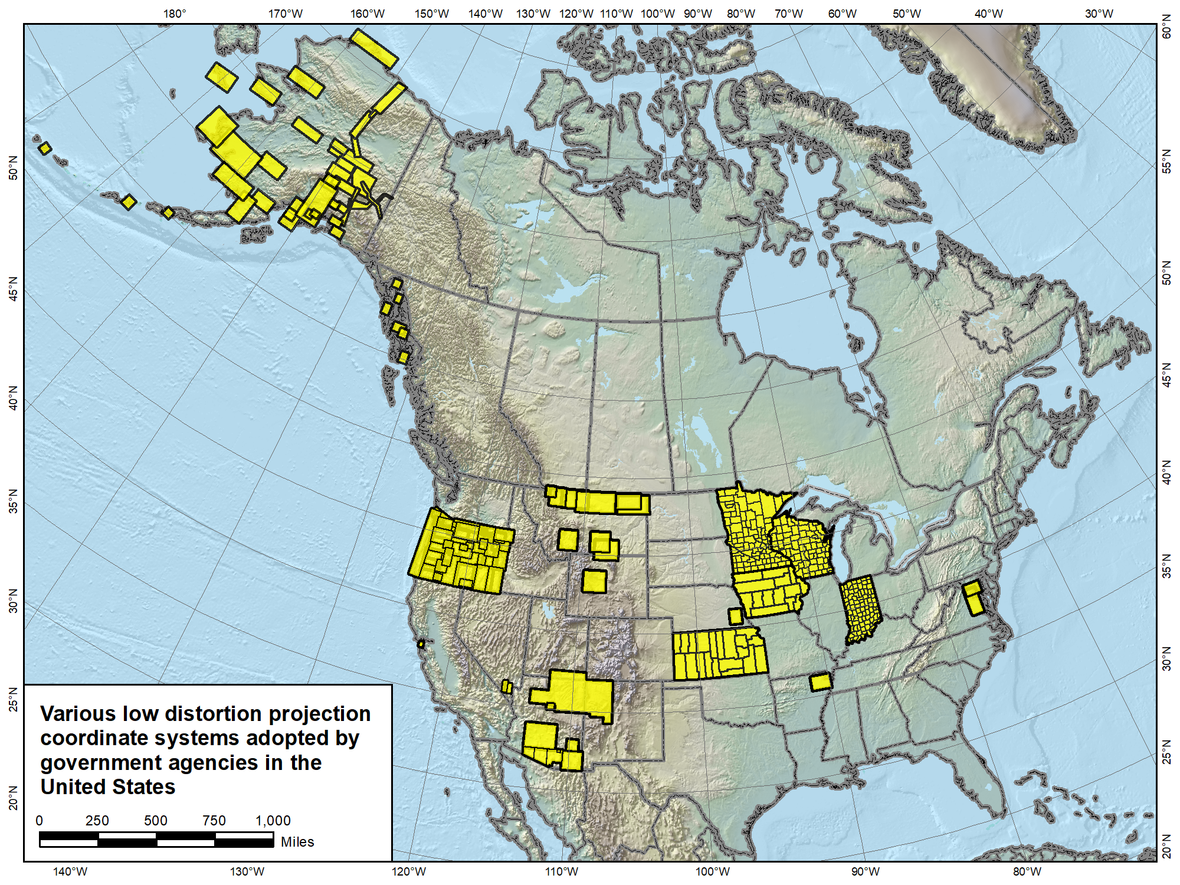

Slide 44
“Special purpose” zones (FRN)
For areas with inadequate SPCS zone coverage
  Usually areas that are in more than one zone
Categories:
  Major urban areas (e.g., New York, Chicago, St. Louis)
  Large Indian reservations (e.g., Navajo Nation)
  Federal applications covering large areas (e.g., coastal mapping of Atlantic Coast; Grand Canyon)
Permitted for metro areas in 1977 policy (but never used)
Only in FRN, not in draft policy & procedures
  Intent is to get input on concept first

Slide 45
Wrap-up
State Plane has a long and varied history
Main characteristics of SPCS2022 (draft)
  Designed with respect to “ground”
  Use 1-parallel definitions for LCCs
  Default designs similar to existing State Plane
  Can include a statewide zone plus a sub-zone layer
  LDPs can be used but must be designed by others
Stakeholder input on zones for their states
Next State Plane webinar on April 12 – register at:
  https://geodesy.noaa.gov/web/science_edu/webinar_series/Webinars.shtml
NOTE: SPCS2022 policy, procedures, and FRN currently in review
  Approved version may differ from what is presented here but should be finalized before April 12 webinar

