Slide 1

A New State Plane
Coordinate System for 2022
Federal Geodetic Control Subcommittee Meeting
Silver Spring, Maryland
February 20, 2018
Michael Dennis, RLS, PE
Geodesist
michael.dennis@noaa.gov

Slide 2
New State Plane Coordinate System
State Plane Coordinate System of 2022 (SPCS2022)
  Referenced to new 2022 Terrestrial Reference Frames (TRFs)
  Based on same reference ellipsoid (GRS 80)
  Same 3 conformal projection types
    Lambert Conformal Conic (LCC)
    Transverse Mercator (TM)
    Oblique Mercator (OM)
NGS in process of specifying SPCS2022 characteristics
  Draft policy and procedures for public comment
  Federal Register Notice (FRN) on policy and procedures
  New report on State Plane history, policy, and future
NOTE: SPCS2022 characteristics currently in review
  Approved version may differ from what is presented here

Slide 3
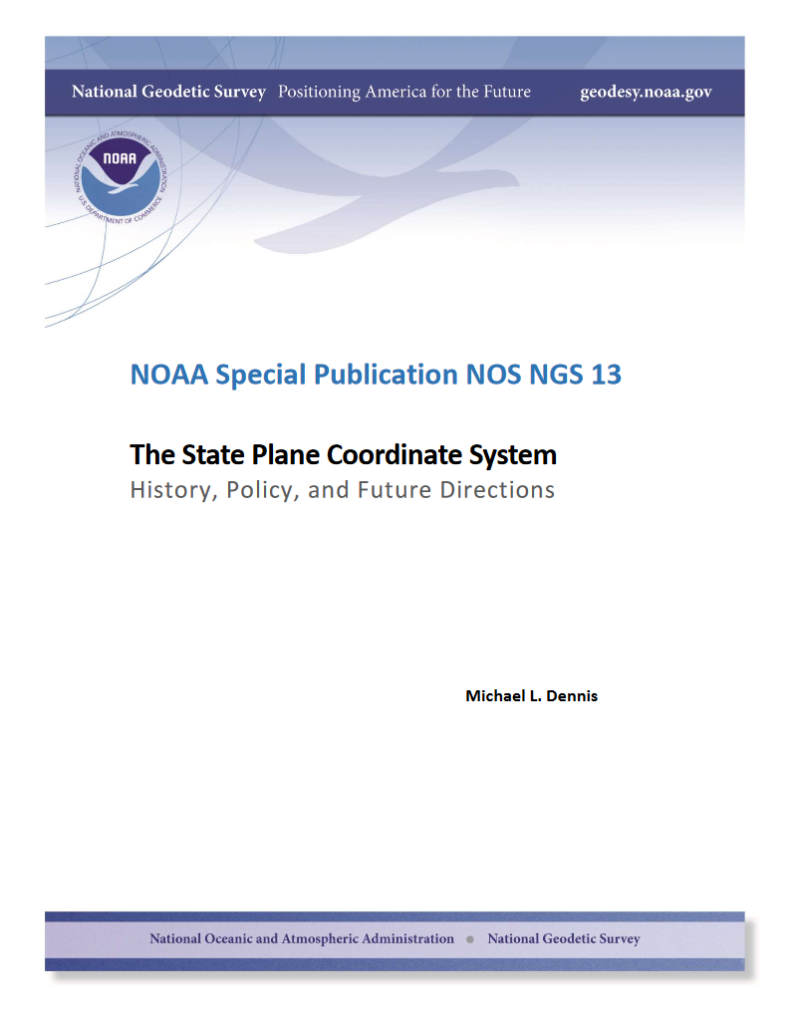
SPCS Special Publication
History of NGS projections (1853 to present)
SPCS policies and legislation
Departures from policy and convention
Recent developments in projected coordinate systems
Appendices
  Defining parameters for ALL zones of ALL versions of SPCS, plus additional information
  Status of SPCS 83 legislation and foot conversions

Slide 4
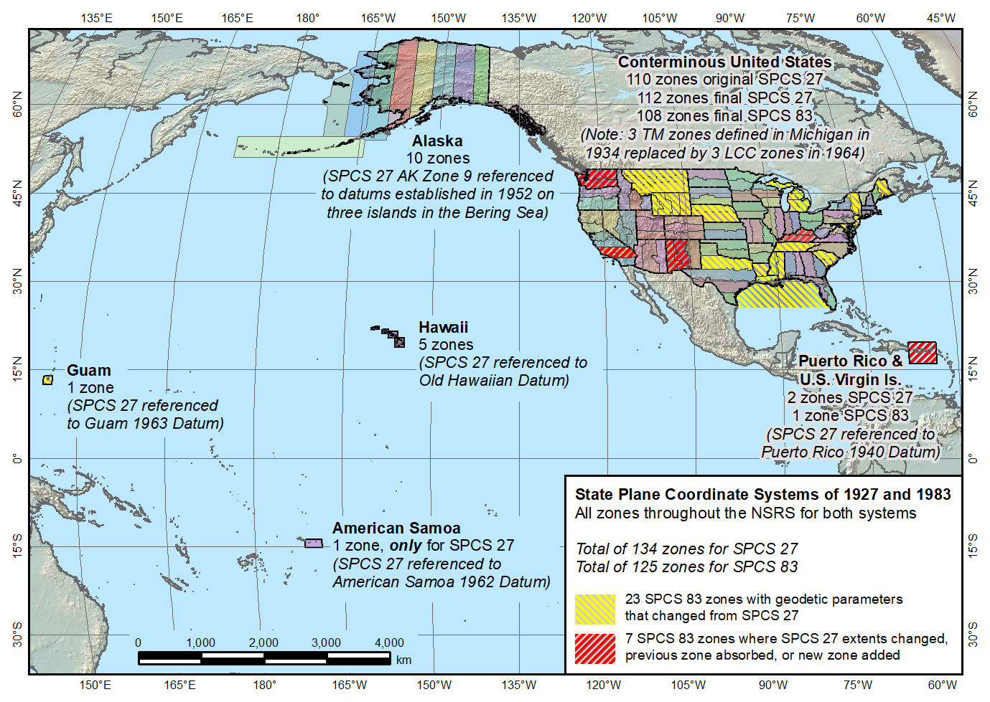
State Plane Coordinate Systems of 1927 (134 zones) and 1983 (125 zones)

Slide 5
Draft SPCS2022 Policy & Procedures
Release for public comment period (FRN)
  Deadline for comment: July 31, 2018
Stakeholder input from states for their zones
  DOTs, GIS offices, professional societies, universities
  Deadlines:
    Dec 31, 2019 for requests and proposals
    Dec 31, 2020 for submitted designs
  Consensus input REQUIRED
Federal agency input through FGCS
  But input for specific zones is from state stakeholders
  Can coordinate with state stakeholders

Slide 6
SPCS2022 characteristics (draft)
Technical requirements
  Linear distortion design criterion at topographic surface (not at ellipsoid surface)
    Difference in distance between “ground” and “grid”
  Use 1-parallel definition for LCC projections
Other characteristics
  Default designs (if no consensus stakeholder input)
  “Layered” zones
  Low-distortion projections (LDPs)
  “Special purpose” zones

Slide 7
Linear distortion magnitudes ppm = parts per million (mm/km)
δ = ±20 ppm = 2 cm/km = 0.1 ft/mile = 1 : 50,000
  Often used as “low distortion” design criterion (at ground)
δ = ±50 ppm = 5 cm/km = 0.3 ft/mile = 1 : 20,000
  Minimum design criterion for SPCS2022 designs by NGS (at ground)
δ = ±100 ppm = 10 cm/km = 0.5 ft/mile = 1 : 10,000
  “Nominal” maximum State Plane value (on ellipsoid)
  Can be much greater at topo surface
δ = ±400 ppm = 40 cm/km = 2.1 ft/mile = 1 : 2,500
  Maximum design criterion for SPCS2022 zones (at ground)
  Maximum UTM value (on ellipsoid)
This is distortion range (at ground) for zones designed by NGS, as proposed in SPCS2022 policy and procedures.

Slide 8
Default SPCS2022 designs (draft)
Default needed in absence of stakeholder input
Same projections and zones for most SPCS 83 zones
Performance and coverage very similar to SPCS 83
Characteristics that differ from SPCS 83:
  Projection scale modified to minimize distortion at ground
  Lambert Conformal Conic converted to one-parallel type
  Most geodetic origins with arc-minutes evenly divisible by 3
  A few zones with different projection & zone extents

Slide 9
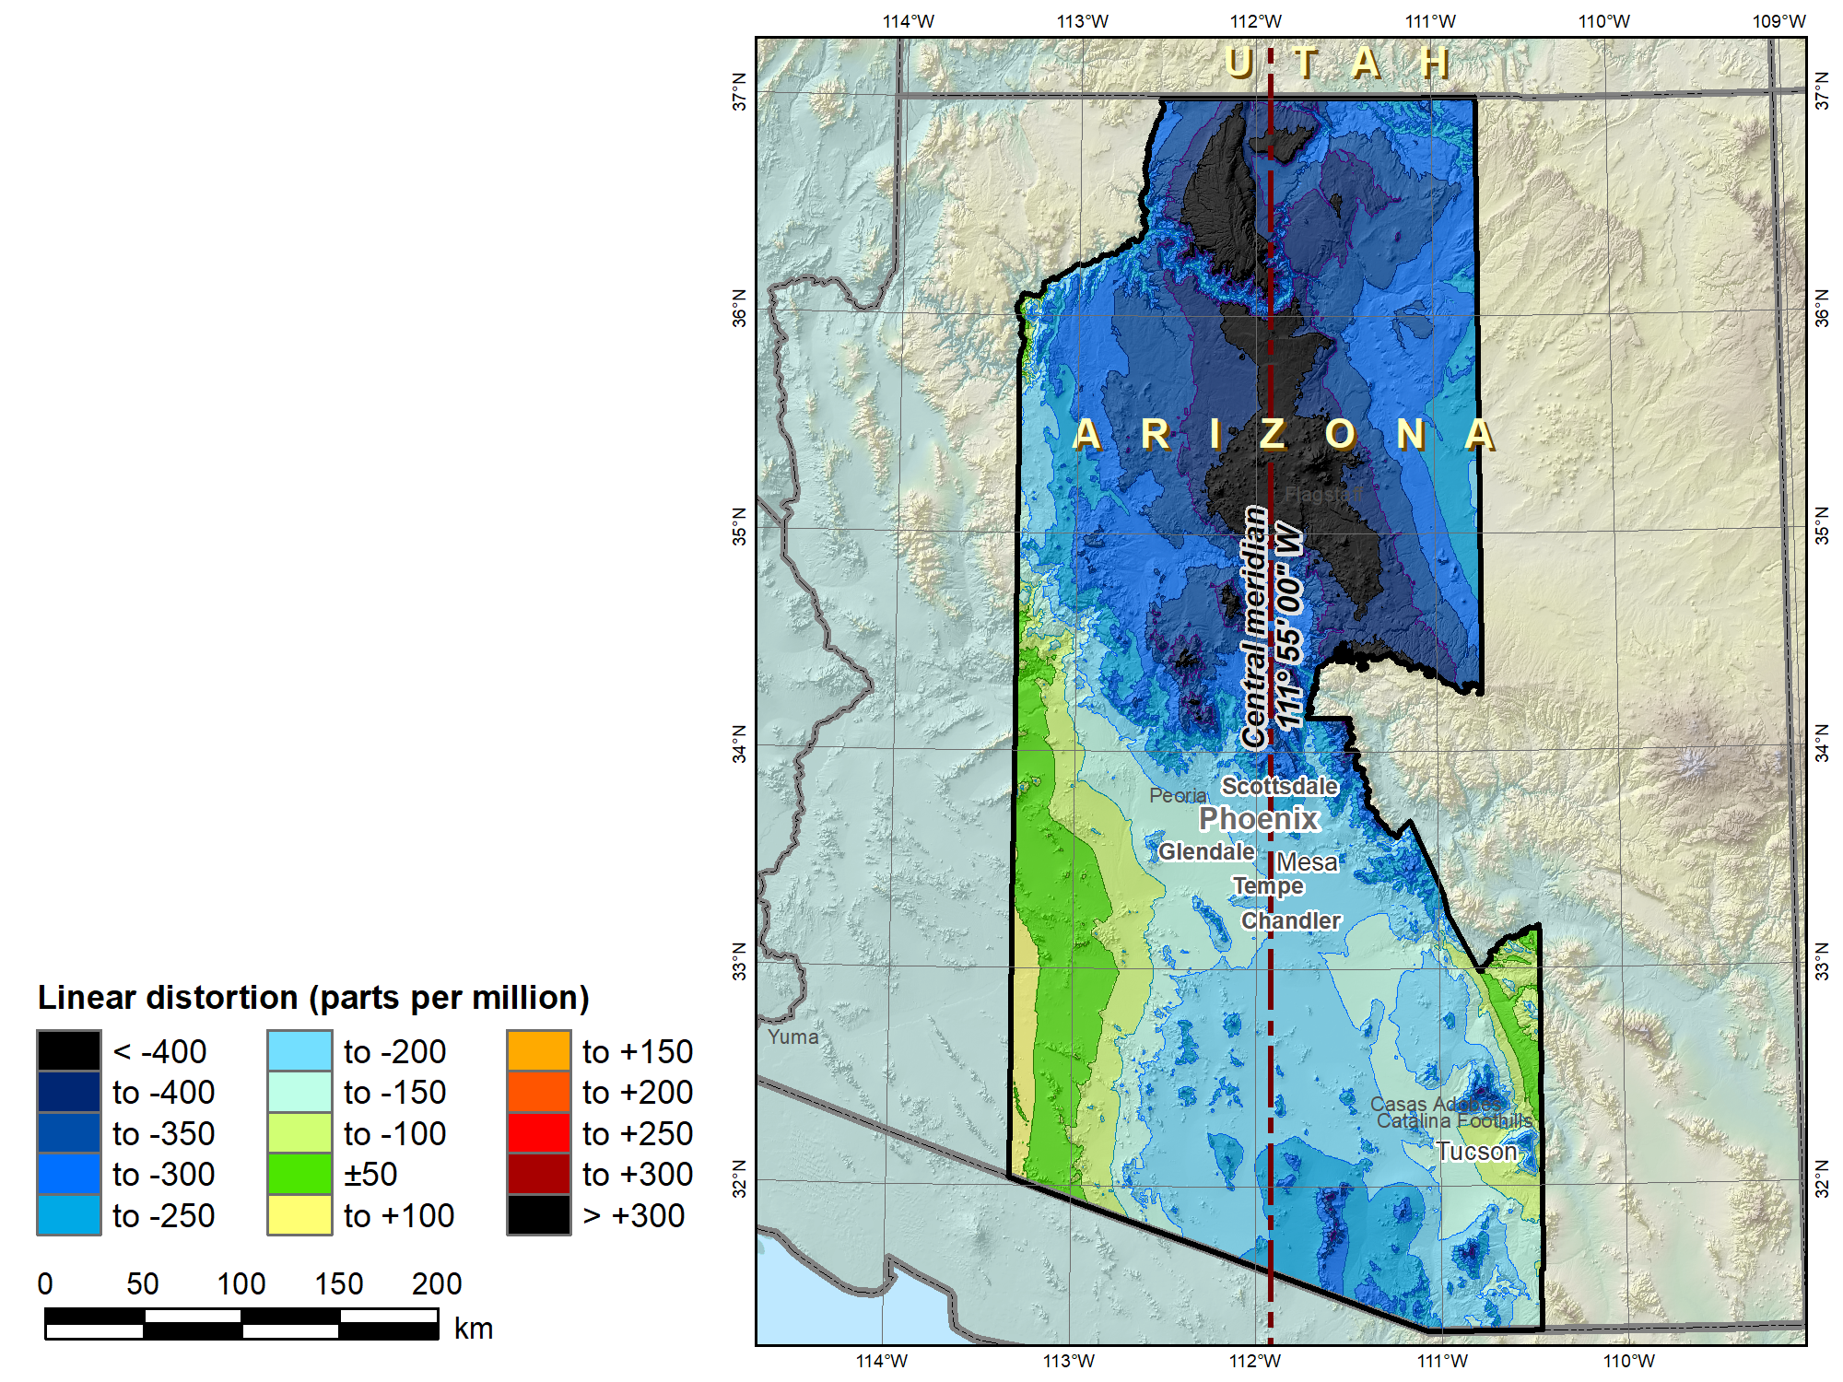
SPCS 83
Arizona Central Zone (Transverse Mercator)
 | Height (m)
Min | 96
Max | 3607
Mean | 1177
 |  | SPCS 83 AZ C
C.M. |  | 111°55’W
Scale |  | 0.9999
 |  | Distortion (ppm)
Min |  | -660
Max |  | +102
Mean |  | -224

Slide 10
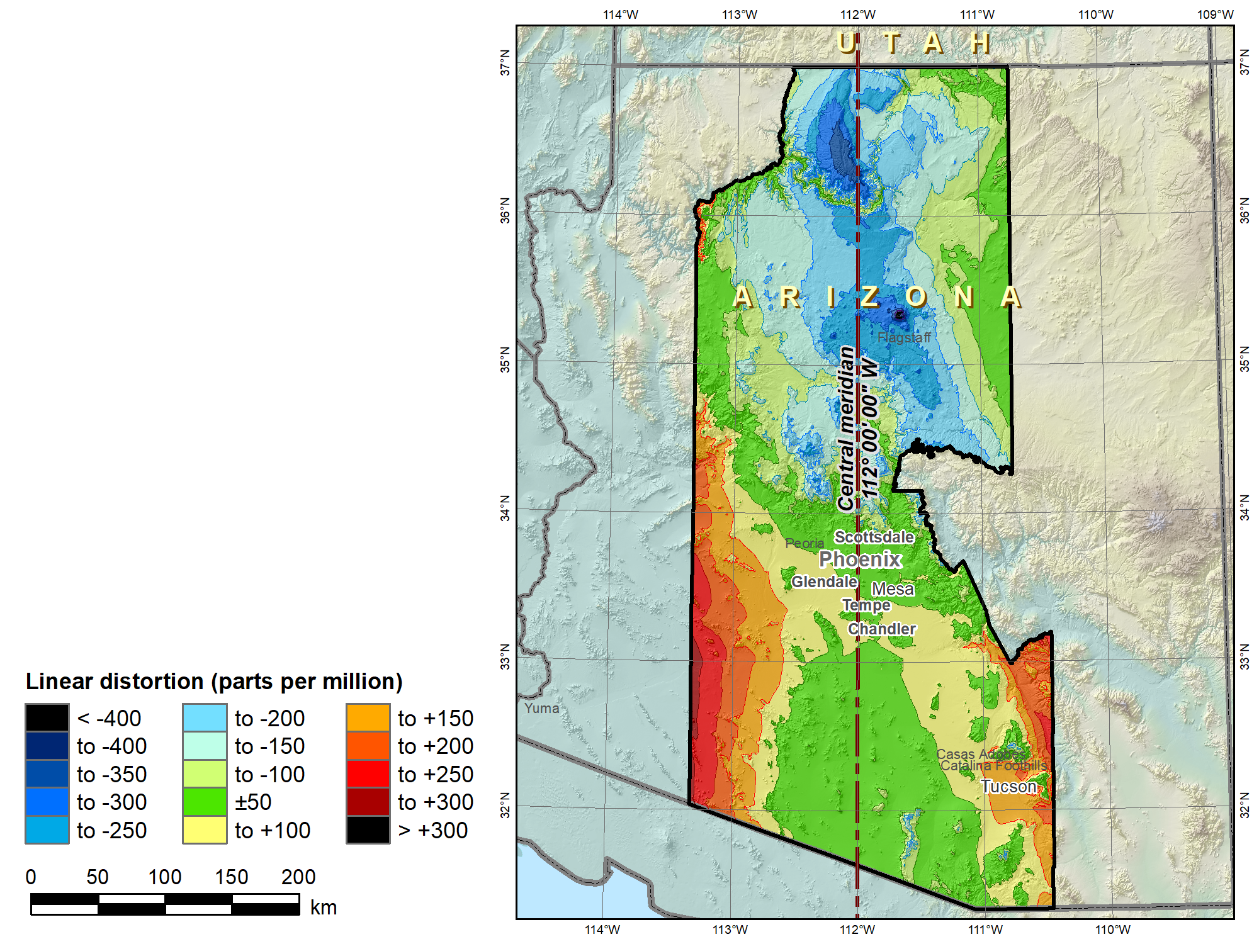
SPCS2022 “default” Arizona Central Zone (Transverse Mercator)
No change in projection type or zone extents
 | Height (m)
Min | 96
Max | 3607
Mean | 1177
 |  | SPCS 83 AZ C | SPCS2022
C.M. |  | 111°55’W | 112°W
Scale |  | 0.9999 | 1.0001
 |  | Distortion (ppm)
Min |  | -660 | -455
Max |  | +102 | +277
Mean |  | -224 | -24

Slide 11
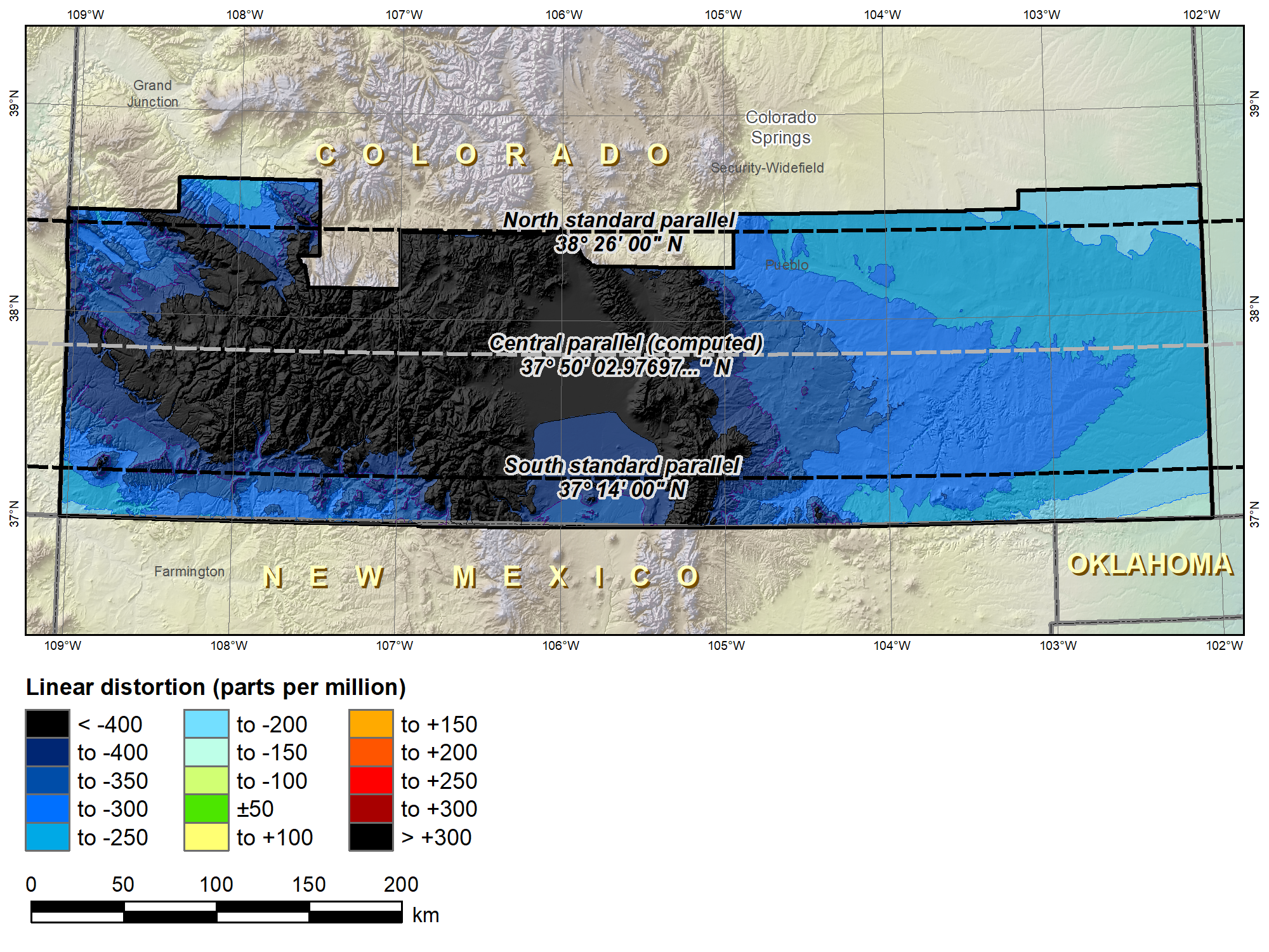
SPCS 83 Colorado South (Lambert Conformal Conic 2-parallel)
 |  | SPCS 83 CO S
Central parallel |  | 37°50’02.98…”N
Cen parallel scale |  | 0.9999453985…
 | Height (m) | Distortion (ppm)
Min | 998 | -697
Max | 4106 | -117
Mean | 2091 | -352

Slide 12
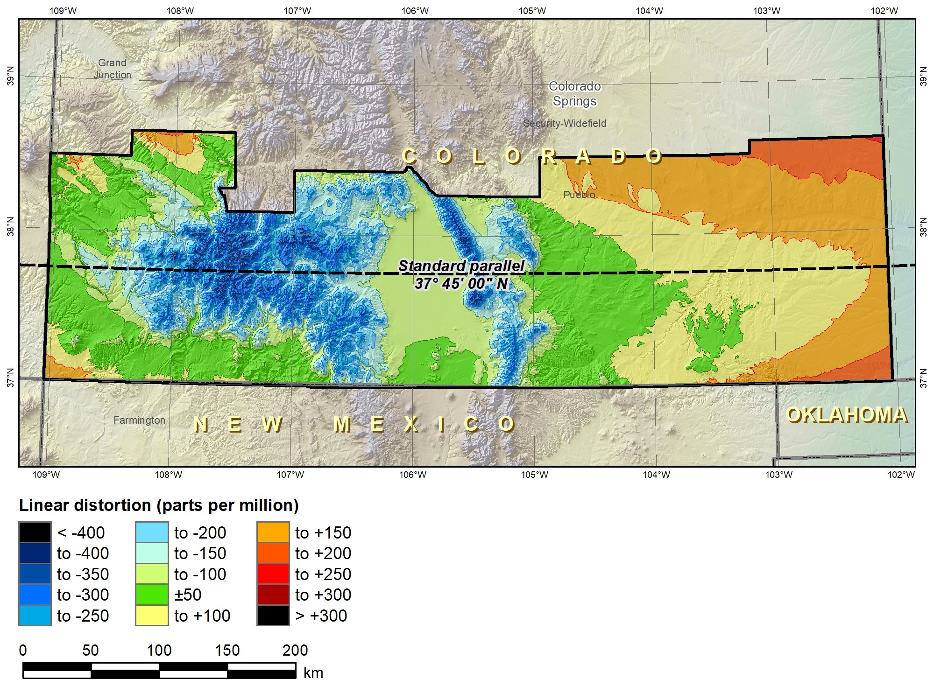
SPCS2022 “default” CO S (Lambert Conformal Conic 1-parallel)
No change in projection type or zone extents
 |  | SPCS 83 CO S | SPCS2022
Central parallel |  | 37°50’02.98…”N | 37°45’N
Cen parallel scale |  | 0.9999453985… | 1.00028
 | Height (m) | Distortion (ppm)
Min | 998 | -697 | -360
Max | 4106 | -117 | +209
Mean | 2091 | -352 | -19

Slide 13
“Layered” zones (draft)
Limitations
  Max of TWO layers: Statewide and sub-zones
  If two layers, one MUST be statewide
  Minimum sub-zone dimension > 50 km
States often want statewide and small zones
  Statewide: Single geometry required for state GIS
  Sub-zones: Lower distortion for surveying/engineering
Accommodates state needs, but with restrictions
  Prevent poor design choices for statewide zones
  One already exists in SPCS 83…

Slide 14
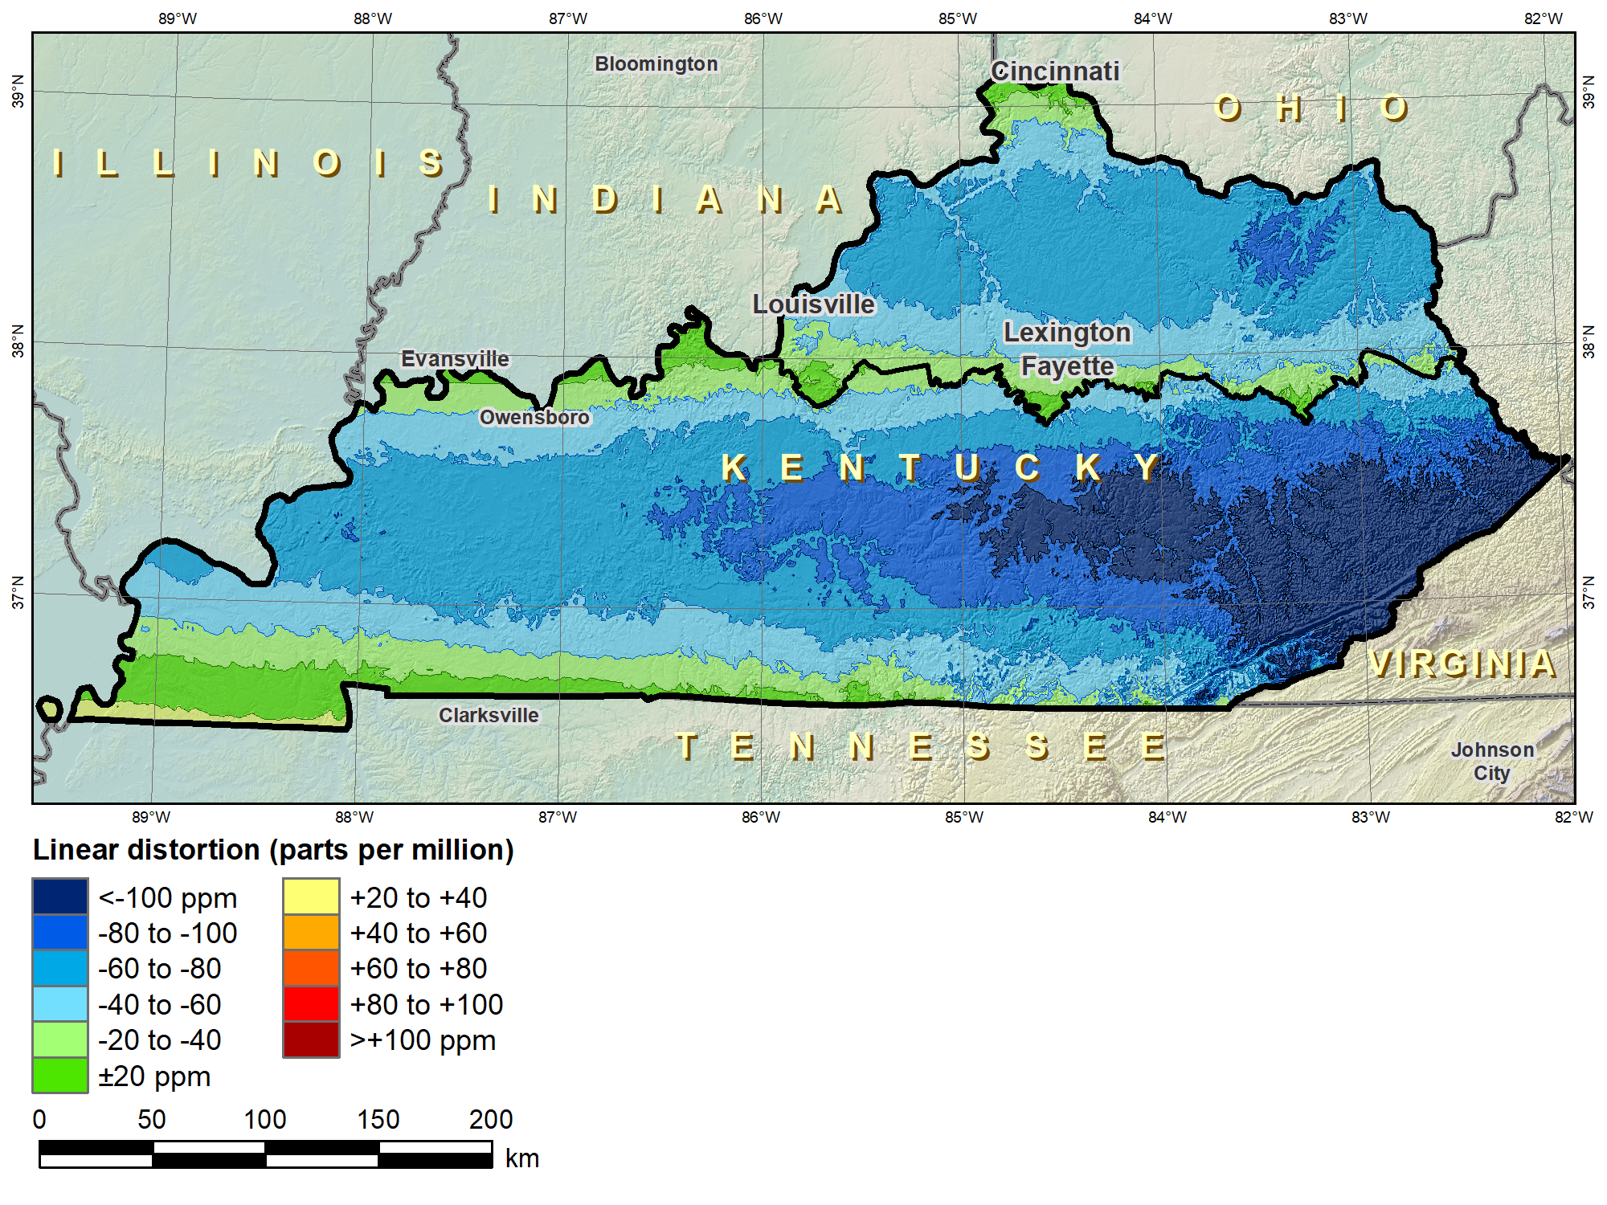
Kentucky layered zones
“Layered” zones
SPCS 83 Kentucky N and S zones (Lambert Conformal Conic)
 |  | North | South
N parallel |  | 38°58’N | 37°56’N
S parallel |  | 37°58’N | 36°44’N
 |  | Distortion (ppm)
Min |  | -93 | -211
Max |  | +17 | +42
Mean |  | -56 | -67

Slide 15
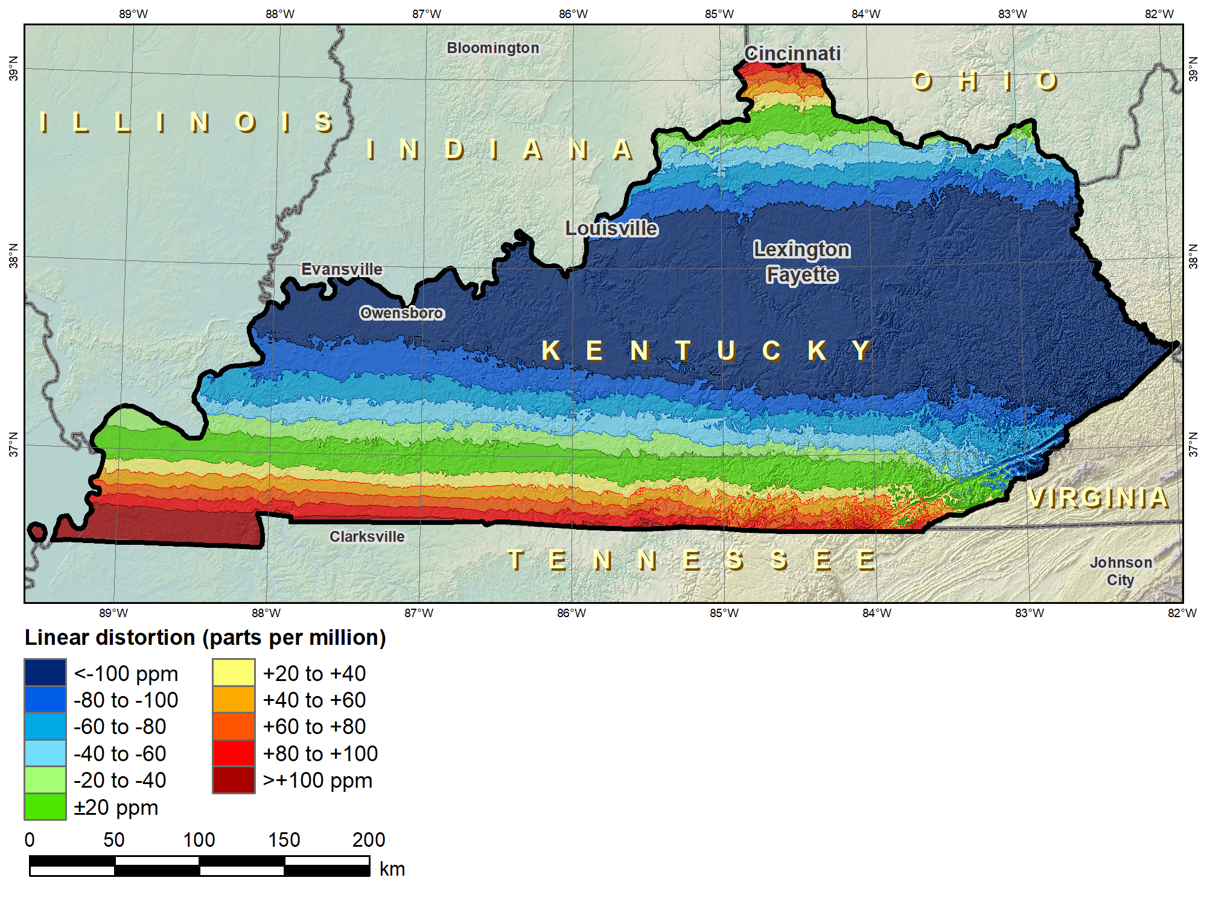
Kentucky layered zones
“Layered” zones
SPCS 83 Kentucky statewide zone (Lambert Conformal Conic)
 |  | North | South | Statewide
N parallel |  | 38°58’N | 37°56’N | 38°40’N
S parallel |  | 37°58’N | 36°44’N | 37°05’N
 |  | Distortion (ppm)
Min |  | -93 | -211 | -166
Max |  | +17 | +42 | +181
Mean |  | -56 | -67 | -58

Slide 16
Linear distortion design criteria (draft)
NGS design of zones requested by stakeholders
  Limited to zones with 50-400 ppm distortion criterion
    50 ppm = 5 cm/km = 0.3 ft/mi = 1:20,000
    400 ppm = 40 cm/km = 2.1 ft/mi = 1:2,500
Design criterion < 50 ppm (“low distortion”)
  Min criterion 20 ppm = 2 cm/km = 0.1 ft/mi = 1:50,000
  Must be designed by others (not by NGS)
  Proposed and final design reviewed by NGS
What is the current situation with “low distortion” projected coordinate systems?

Slide 17
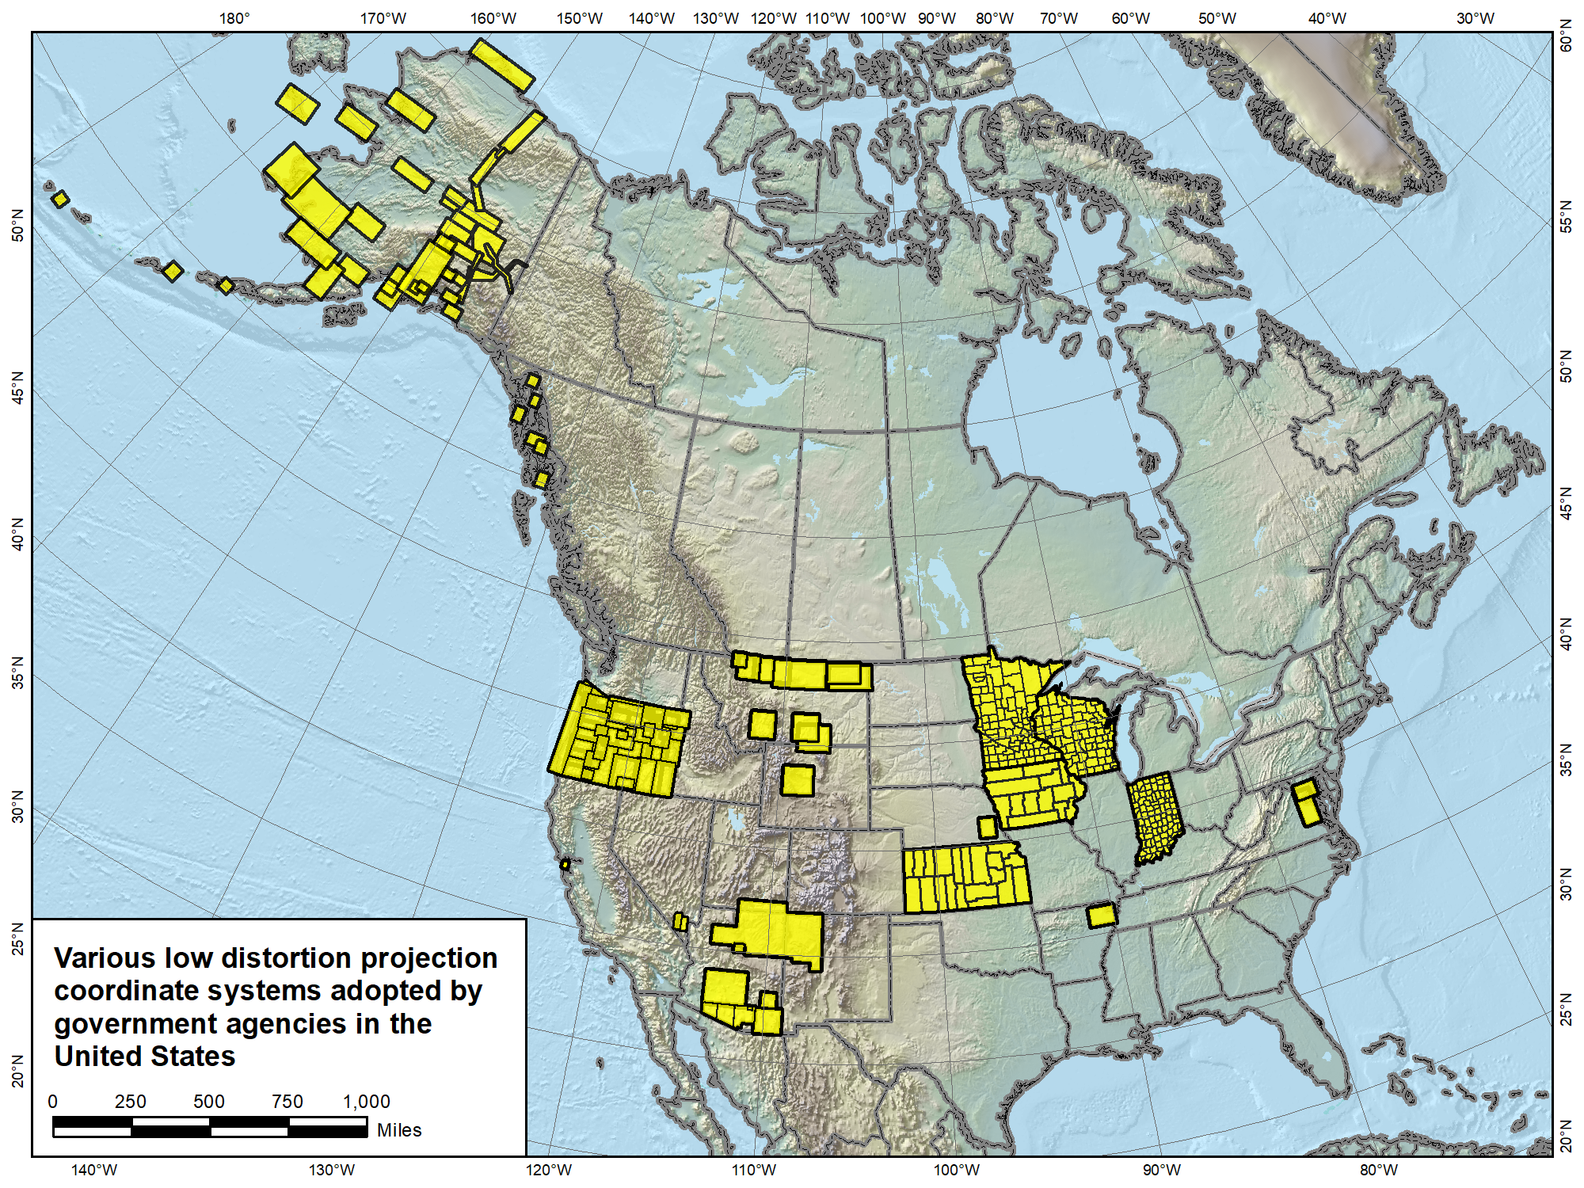

Slide 18
“Special purpose” zones
For areas with inadequate SPCS zone coverage
  Usually areas that are in more than one zone
Categories:
  Major urban areas (e.g., New York, Chicago, St. Louis)
  Large Indian reservations (e.g., Navajo Nation)
  Federal applications covering large areas (e.g., coastal mapping of Atlantic Coast; Grand Canyon)
Permitted for metro areas in 1977 policy (but never used)
Only in FRN, not in draft policy & procedures
  Intent is to get input on concept first

Slide 19
SPCS2022 Summary
Main characteristics
  Designed with respect to “ground”
  Default designs similar to existing State Plane
  Can include a statewide zone plus a sub-zone layer
  LDPs can be used but must be designed by others
Stakeholder input on zones for their states
  REQUIRES consensus input
Federal agency input through FGCS
  Can coordinate with states stakeholders
NGS webinars on March 8 and April 12 – register at:
  https://geodesy.noaa.gov/web/science_edu/webinar_series/Webinars.shtml
NOTE: SPCS2022 policy and procedures currently in review, not yet finalized

