Slide 1

National Spatial Reference System (NSRS)
Modernization Industry Workshop
Preparing for a New State Plane
Coordinate System in 2022
Michael L. Dennis
SPCS2022 Project Manager
NOAA Science Center
1301 East West Highway
Silver Spring, MD 20910
May 7-8, 2018

Slide 2
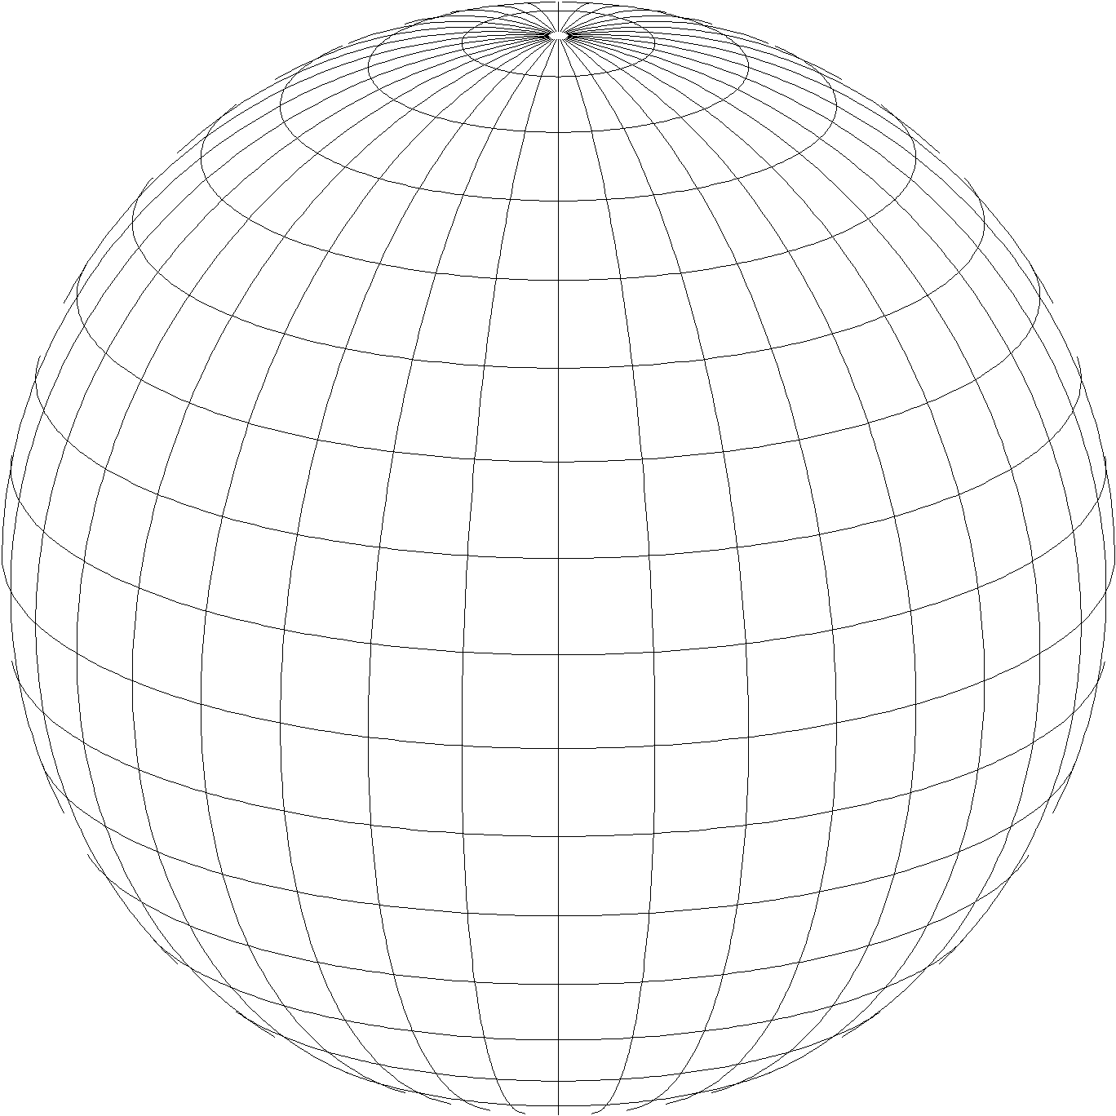
A New State Plane Coordinate System
State Plane Coordinate System of 2022 (SPCS2022)
  Referenced to 2022 Terrestrial Reference Frames (TRFs)
  Based on same reference ellipsoid as SPCS 83 (GRS 80)
  Same 3 conformal projection types as SPCS 83 and 27:
Lambert Conformal Conic (LCC)
Transverse Mercator (TM)
Oblique Mercator (OM)

Slide 3
Recent activity at NGS on State Plane
New report on State Plane history, policy, and future
  NOAA Special Publication NOS NGS 13
Draft SPCS2022 policy and procedures
  Define characteristics and requirements for SPCS2022
  Instructions for state requests and proposals
Federal Register Notice (FRN) published April 18, 2018
  Requests public comment on policy and procedures
  Includes “special purpose” zones
State Plane NGS Webinar Series (March 8 and April 12)
  Recordings, slides, and Q&A documents available

Slide 4
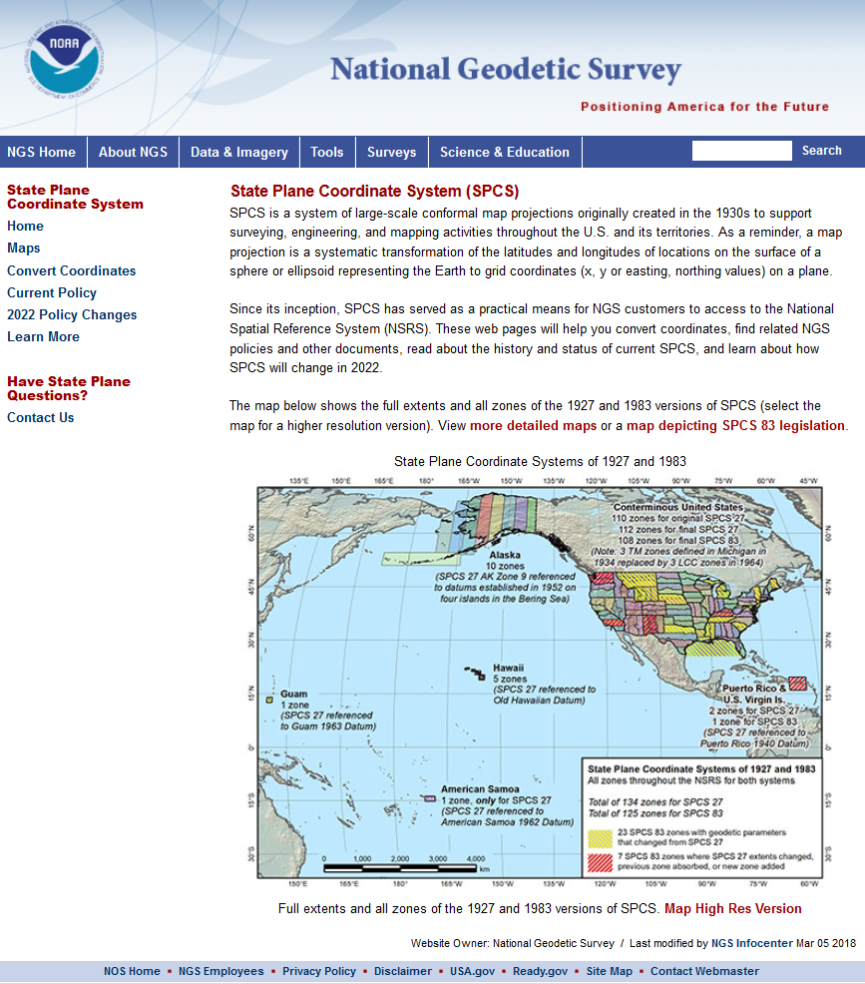
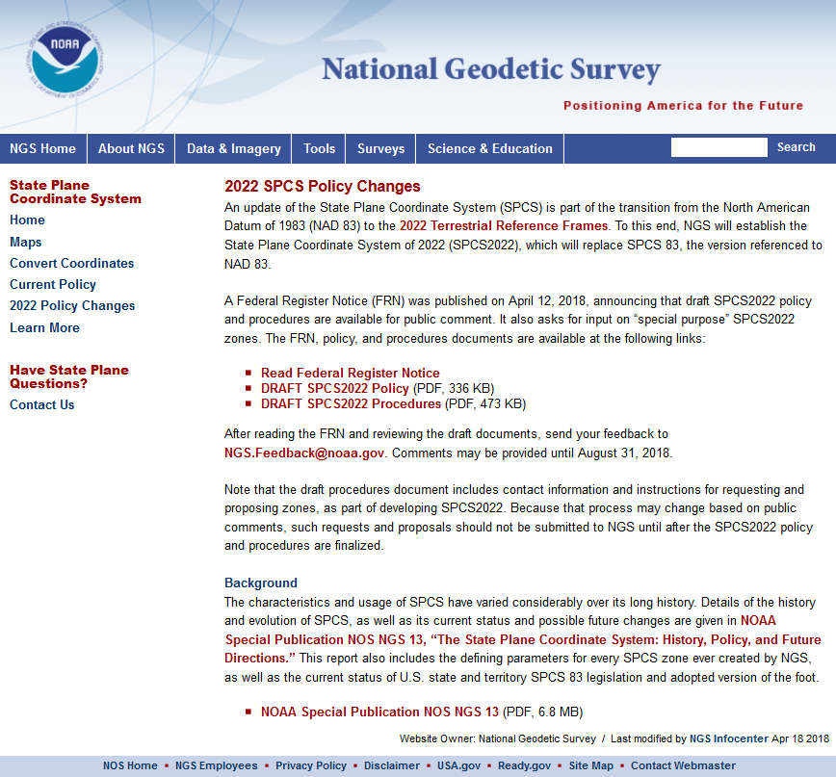
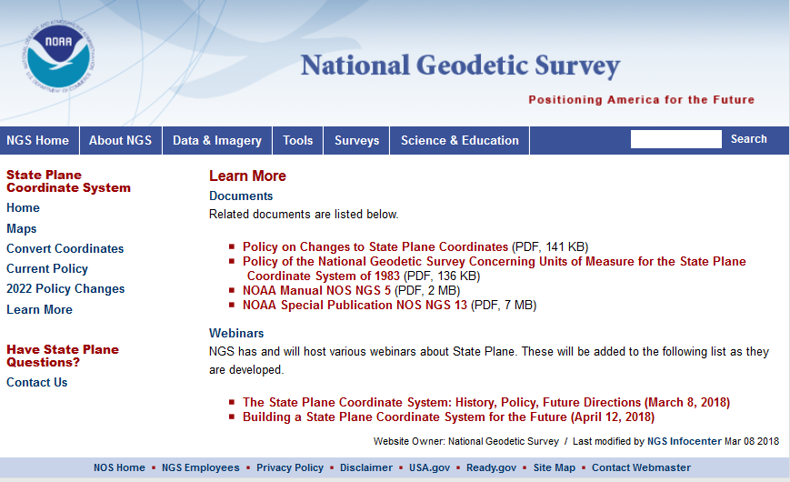
geodesy.noaa.gov/SPCS/

Slide 5
Overview: Policy, Procedures, and FRN
Linear distortion at topographic surface
Default SPCS2022 zone designs
Statewide and “layered” zones
Linear distortion design criteria
  Maximum and minimum distortion and zone size
  Allow “low distortion projections” (LDPs)
“Special purpose” zones (in FRN only)
SPCS2022 parameters and computations

Slide 6
Linear distortion with respect to ellipsoid
Projection
axis
Ellipsoid surface
Ellipsoid distance
Projection surface (secant)
Grid distance > ellipsoid distance
This design approach
used for SPCS 27 and 83 (minimizes distortion with respect to ellipsoid)
Ellipsoid distance
Grid distance <
ellipsoid distance

Slide 7
Linear distortion with respect to topographic surface
Horizontal ground distance
> ellipsoid distance
and
> grid distance
Topographic surface
Projection
axis
Ellipsoid surface
Ellipsoid distance
Projection surface (secant)
Grid distance
> ellipsoid distance
< ground distance
This design approach
used for SPCS 27 and 83 (minimizes distortion with respect to ellipsoid)
Ellipsoid distance
Grid distance
< ellipsoid distance
< ground distance

Slide 8
Linear distortion with respect to topographic surface
Horizontal ground distance
> ellipsoid distance
and
> grid distance
Topographic surface
Projection
axis
Ellipsoid surface
Ellipsoid distance
Grid distance
> ellipsoid distance
≈ ground distance
Projection surface (non-intersecting)
This design approach
will be used for SPCS2022 (minimizes distortion with respect to topography)

Slide 9
Overview: Policy, Procedures, and FRN
Linear distortion at topographic surface
Default SPCS2022 zone designs
Statewide and “layered” zones
Linear distortion design criteria
  Maximum and minimum distortion and zone size
  Allow “low distortion projections” (LDPs)
“Special purpose” zones (in FRN only)
SPCS2022 parameters and computations

Slide 10
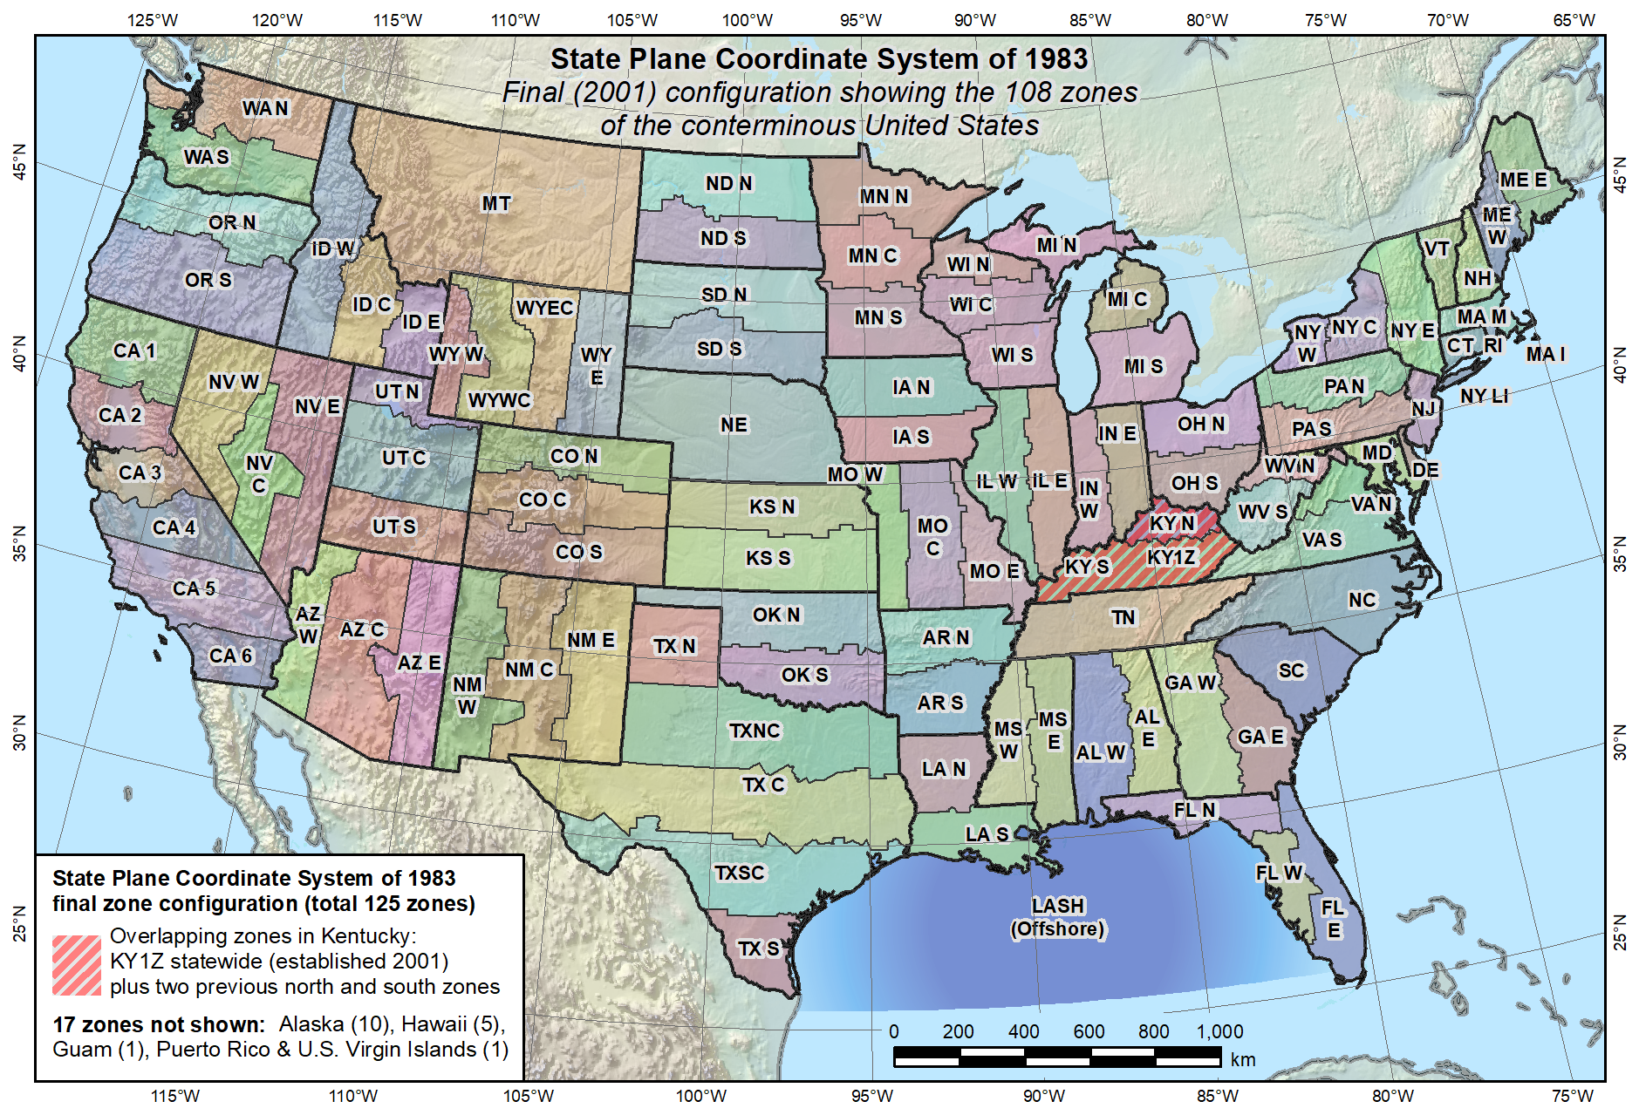
Default SPCS2022 would look a lot like SPCS 83…

Slide 11
Overview: Policy, Procedures, and FRN
Linear distortion at topographic surface
Default SPCS2022 zone designs
Statewide and “layered” zones
Linear distortion design criteria
  Maximum and minimum distortion and zone size
  Allow “low distortion projections” (LDPs)
“Special purpose” zones (in FRN only)
SPCS2022 parameters and computations

Slide 12
Statewide and “layered” zones
States often want statewide and small zones
  Statewide: Single geometry required for state GIS
  Subzones: Lower distortion for surveying/engineering
Limitations
  Max of TWO layers: Statewide and subzones
  If two layers, one MUST be statewide
  Minimum subzone dimension > 50 km
One already exists in SPCS 83…

Slide 13
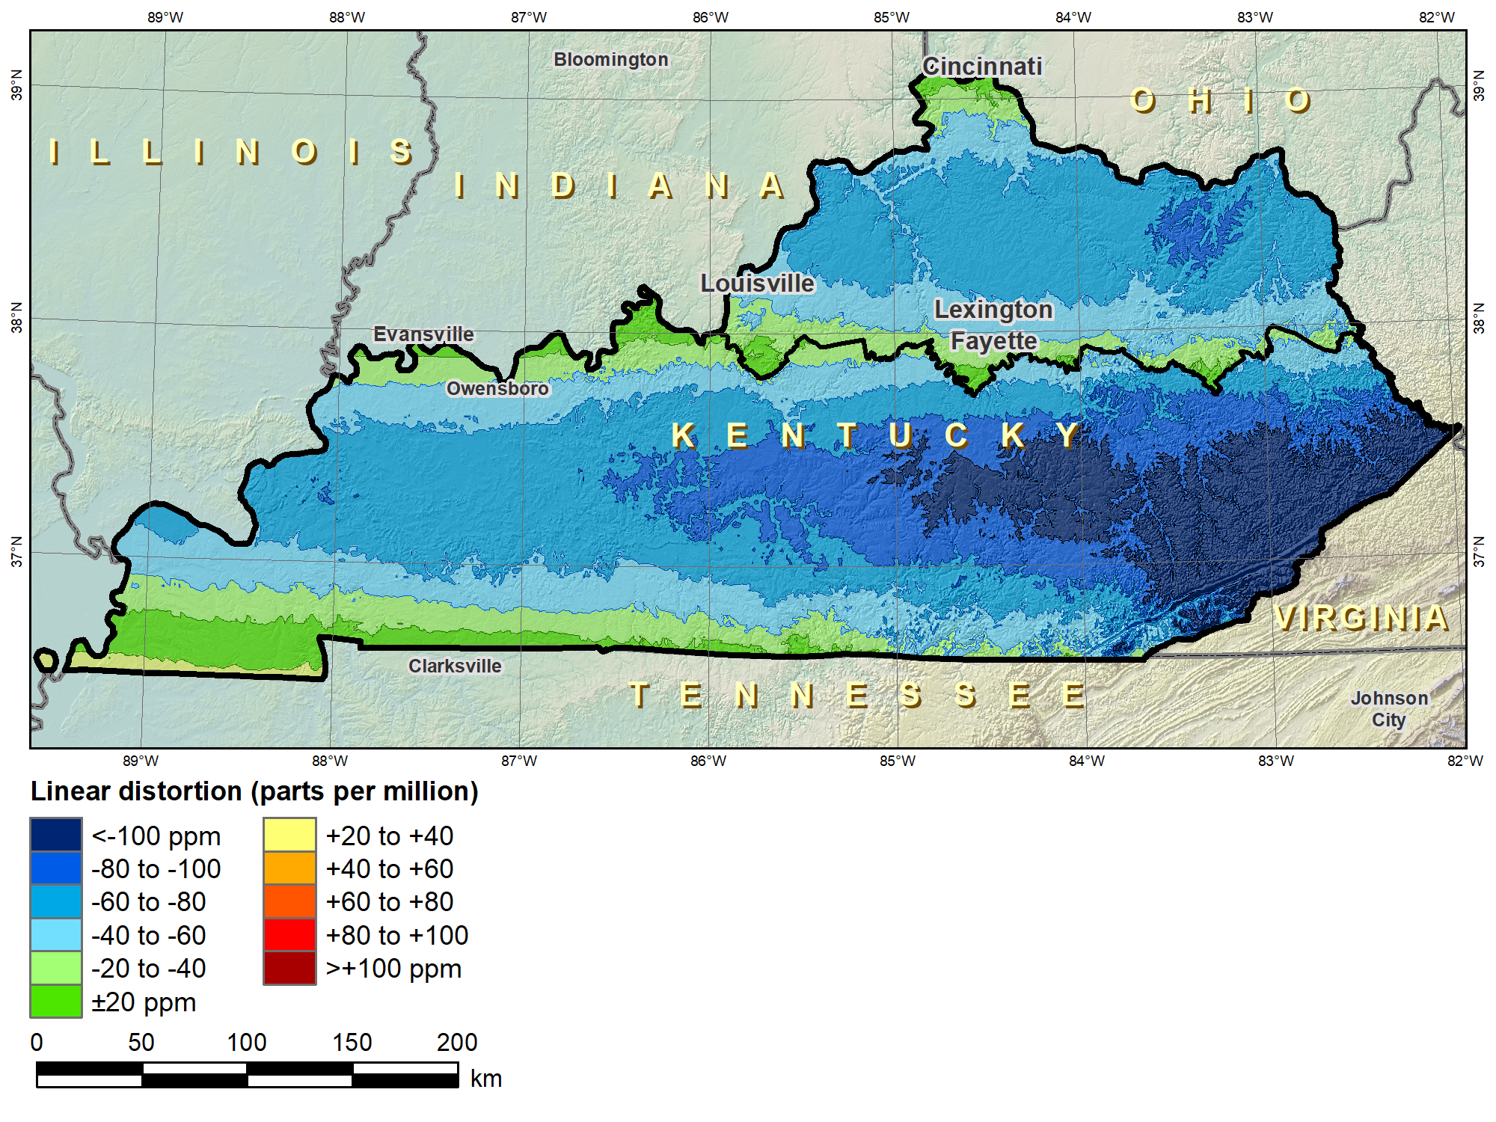
Kentucky layered zones
“Layered” zones
SPCS 83 Kentucky N and S zones (Lambert Conformal Conic)
 |  | North | South
N parallel |  | 38°58’N | 37°56’N
S parallel |  | 37°58’N | 36°44’N
 |  | Distortion (ppm)
Min |  | -93 | -211
Max |  | +17 | +42
Mean |  | -56 | -67

Slide 14
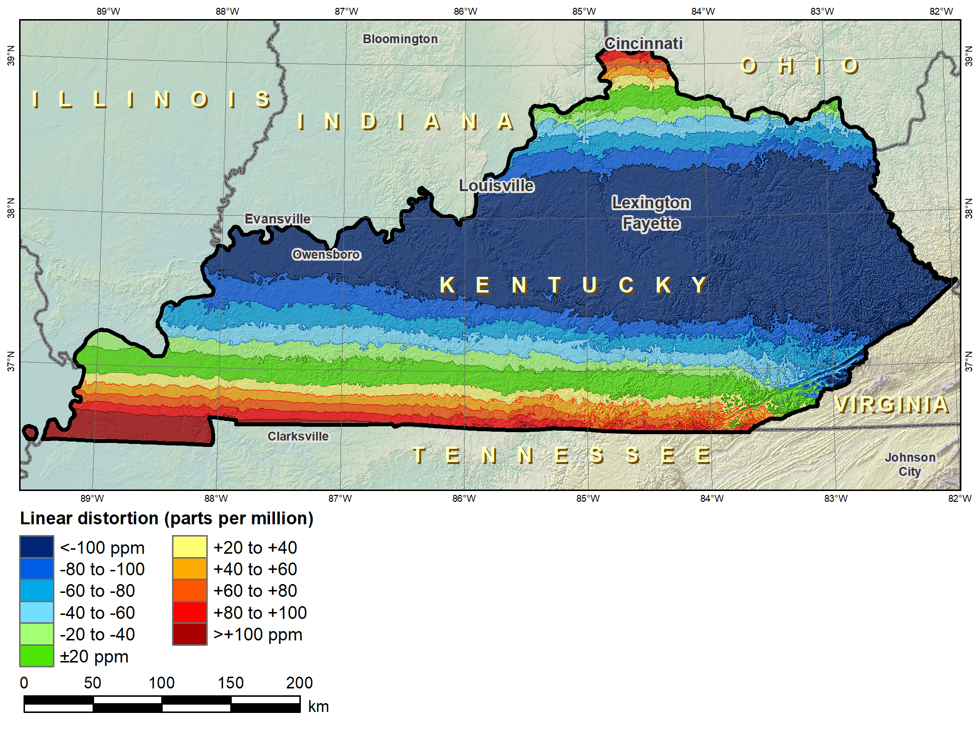
Kentucky layered zones
“Layered” zones
SPCS 83 Kentucky statewide zone (Lambert Conformal Conic)
 |  | North | South | Statewide
N parallel |  | 38°58’N | 37°56’N | 38°40’N
S parallel |  | 37°58’N | 36°44’N | 37°05’N
 |  | Distortion (ppm)
Min |  | -93 | -211 | -166
Max |  | +17 | +42 | +181
Mean |  | -56 | -67 | -58

Slide 15
Overview: Policy, Procedures, and FRN
Linear distortion at topographic surface
Default SPCS2022 zone designs
Statewide and “layered” zones
Linear distortion design criteria
  Maximum and minimum distortion and zone size
  Allow “low distortion projections” (LDPs)
“Special purpose” zones (in FRN only)
SPCS2022 parameters and computations

Slide 16
Linear distortion design criteria
NGS design of zones requested by stakeholders
  Minimum: 50 ppm = 5 cm/km = 0.3 ft/mi = 1:20,000
  Maximum: 400 ppm = 40 cm/km = 2.1 ft/mi = 1:2,500
Design criterion < 50 ppm (“low distortion”)
  Minimum distortion criterion 20 ppm (0.1 ft/mi)
  Minimum zone width 50 km (31 miles)
  Must be designed by others (not by NGS)
  Proposed and final design reviewed by NGS

Slide 17
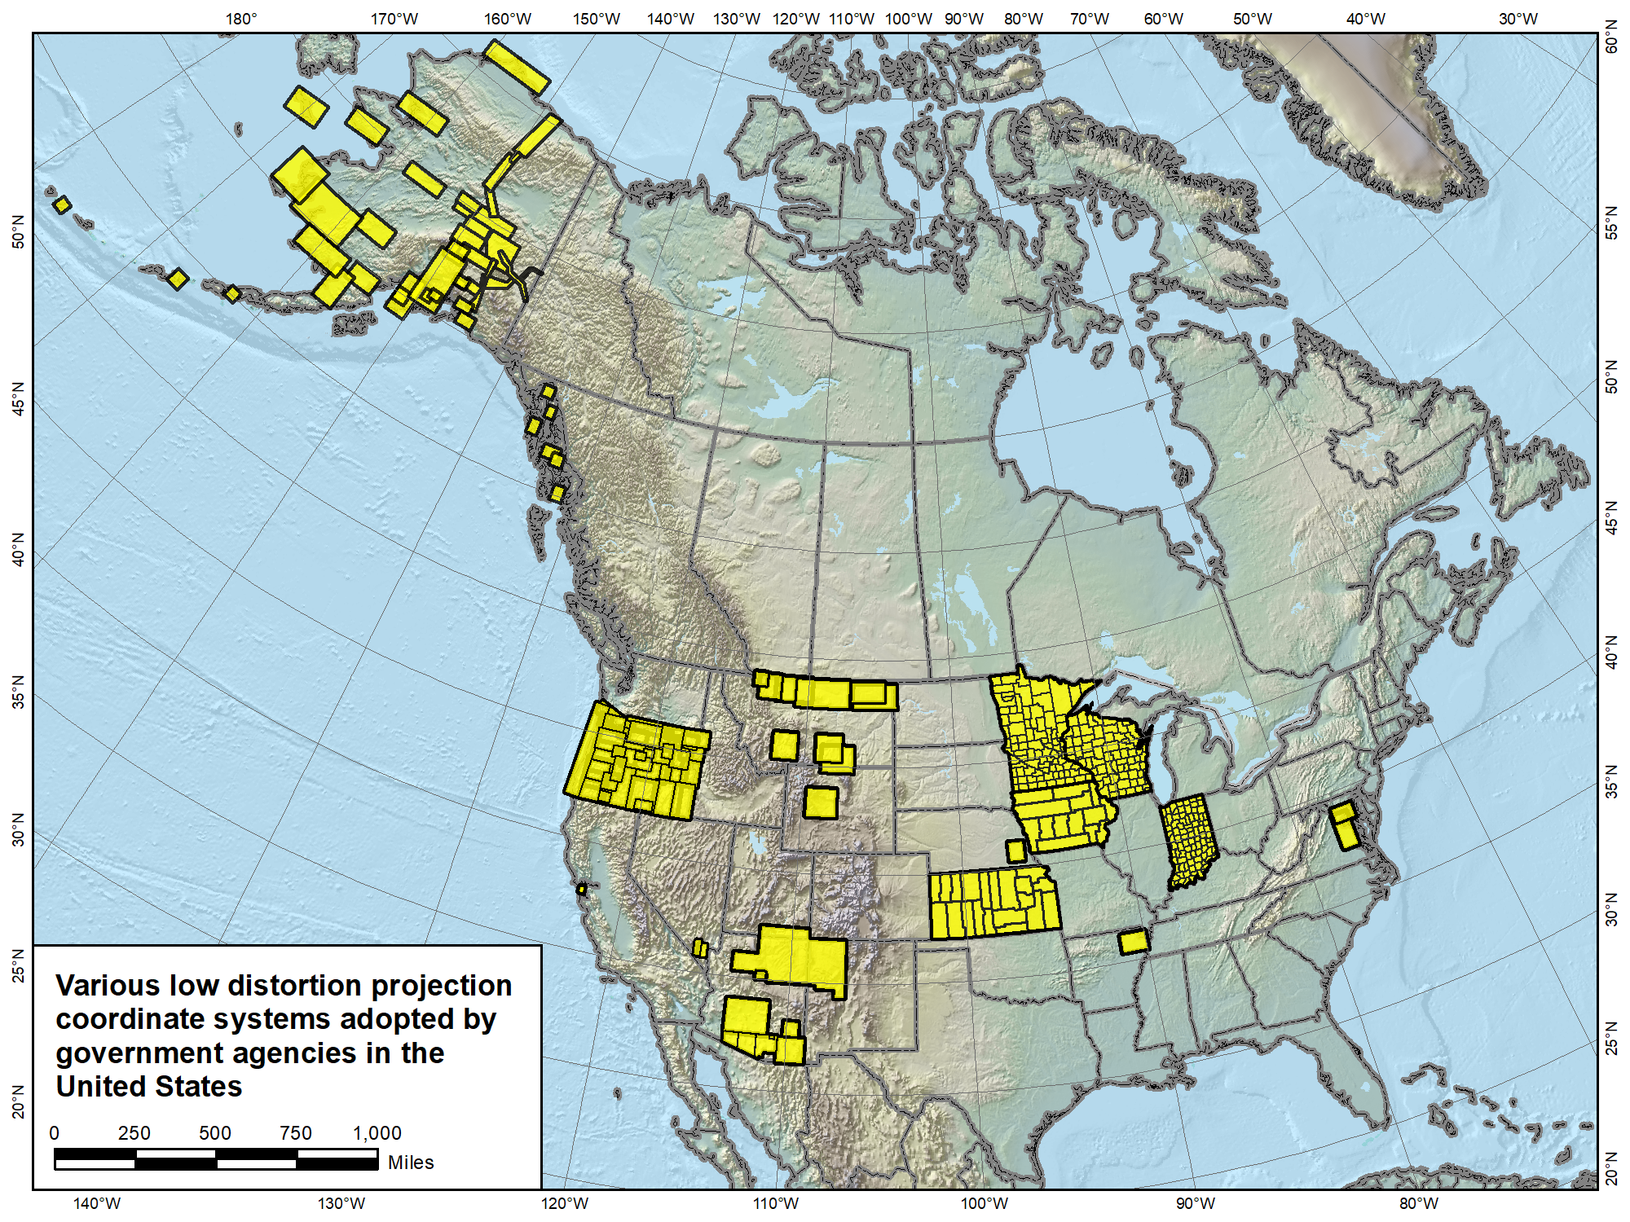

Slide 18
Overview: Policy, Procedures, and FRN
Linear distortion at topographic surface
Default SPCS2022 zone designs
Statewide and “layered” zones
Linear distortion design criteria
  Maximum and minimum distortion and zone size
  Allow “low distortion projections” (LDPs)
“Special purpose” zones (in FRN only)
SPCS2022 parameters and computations

Slide 19
“Special purpose” zones
For areas with inadequate SPCS zone coverage
  Usually areas in more than one zone
Categories:
  Major urban areas (e.g., New York, Chicago, St. Louis)
  Large Indian reservations (e.g., Navajo Nation)
  Federal applications covering large areas (e.g., coastal mapping of Atlantic Coast; Grand Canyon National Park)
Only in FRN, not in draft policy & procedures
  Intent is to get input on concept first
  If used in SPCS2022, will NOT count as a subzone layer

Slide 20
Overview: Policy, Procedures, and FRN
Linear distortion at topographic surface
Default SPCS2022 zone designs
Statewide and “layered” zones
Linear distortion design criteria
  Maximum and minimum distortion and zone size
  Allow “low distortion projections” (LDPs)
“Special purpose” zones (in FRN only)
SPCS2022 parameters and computations

Slide 21
Providing SPCS2022 Parameters
Standardized projection definitions (metric)
  Parameters: 5 for LCC and TM, and 6 for OM
    LCC: One-parallel with latitude of origin on central parallel
    OM: Rectified Hotine using local (centered) definition
  Ellipsoid inverse flattening to 9 decimal places
Ways to provide definitions
  Well-Known Text (WKT) format…?
  Geography Markup Language (GML) format…?
  Use standardized database or registry?
    E.g., EPSG Geodetic Parameter Registry

Slide 22
SPCS2022 Computations
Computational accuracy goals (within zone)
  Coordinates to ±0.01 mm
  Convergence angles to ±0.001 arc-second
  Grid point scale factor to 10 decimal places
Related calculations
  Height (“elevation”) factor based on ellipsoid height
  Compute using geometric mean radius of curvature
Existing NGS algorithms will be evaluated
  May require changes to meet accuracy goals
  Will endeavor to use existing accepted methods

Slide 23
Deadlines for SPCS2022 input
NGS.Feedback@noaa.gov by August 31, 2018
Anyone can comment!
Federal Register Notice (FRN)
Announcement and public comments
  On draft SPCS2022 policy & procedures
  On “special purpose” zones
SPCS2022 Procedures (draft)
Consensus input per SPCS2022 procedures
  Requests for designs done by NGS
  Proposals for designs by contributing partners
Submittal of approved designs
  Proposal must first be approved by NGS
  Designs must be complete for NGS to review
Later requests will be for changes to SPCS2022
NGS.SPCS@noaa.gov
by December 31, 2019 for requests and proposals
by December 31, 2020 for submittal of approved designs
State stakeholders only!

Slide 24
Summary
Draft SPCS2022 policy and procedures
  Designed with respect to “ground”
  Default designs similar to existing SPCS 83
  Can include a statewide zone plus one subzone layer
  LDPs can be used but must be designed by others
Federal Register Notice (FRN)
  Public comment on policy & procedures
  Input on “special purpose” zones
Standardized definitions and computations
Consensus state stakeholder input required for SPCS2022 zone requests, proposals, and designs

