Slide 1
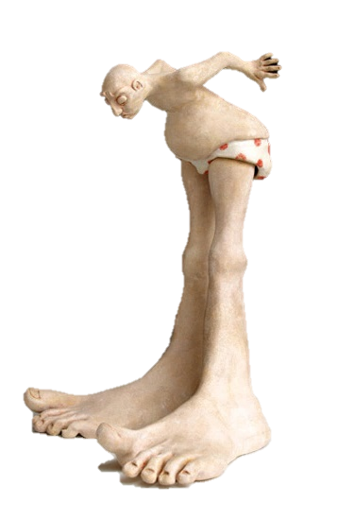
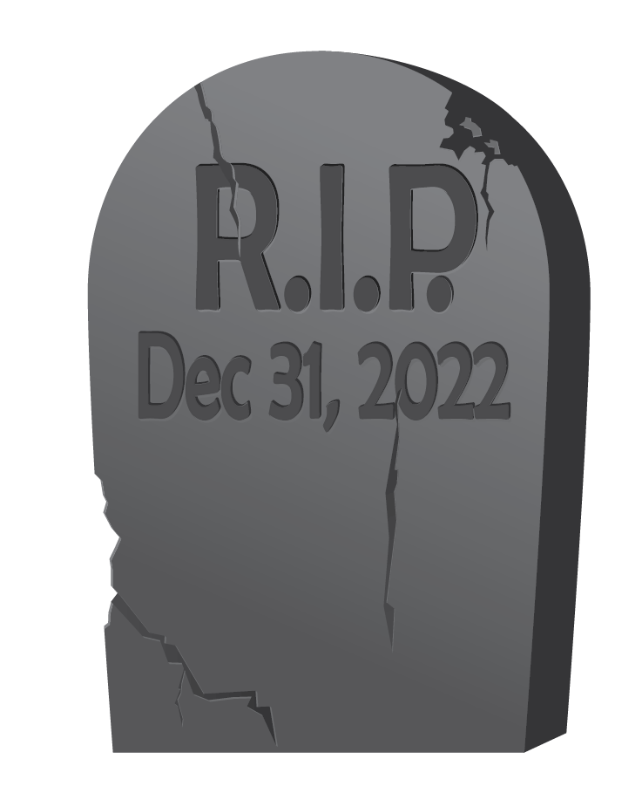
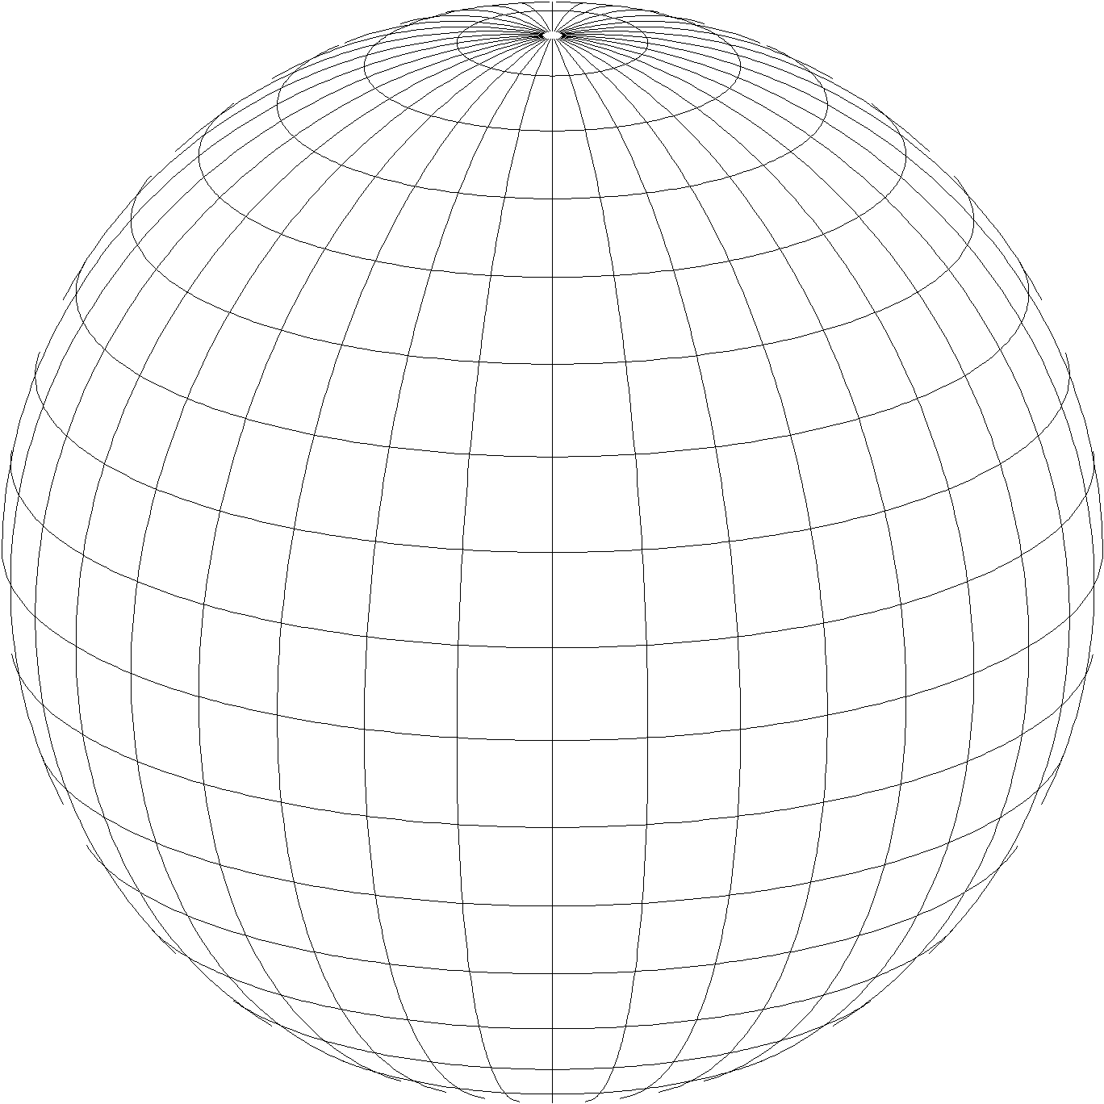
Changes Afoot After 2022
State Plane and the Death of the U.S. Survey Foot
NGS Webinar Series
November 10, 2022
Michael L. Dennis, PhD, PE, PLS
SPCS2022 Project Manager

Slide 2
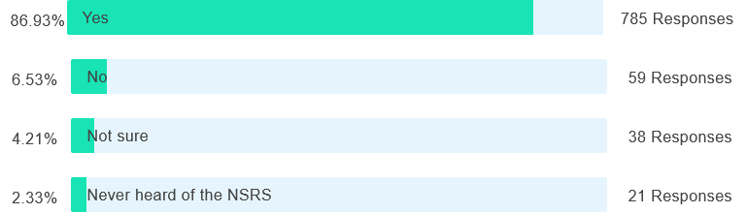
Poll question
Are you aware that NGS is in the process of modernizing the National Spatial Reference System (NSRS)?

Slide 3
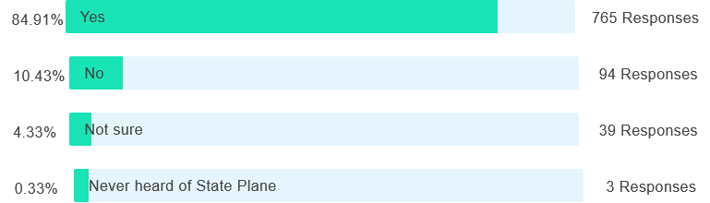
Poll question
Did you know that existing State Plane will be replaced by a new version as part of modernizing the NSRS?

Slide 4
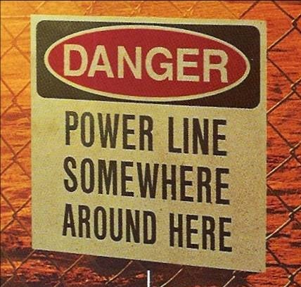
Why should you care about modernizing the NSRS?
Geodesy: the science of where things are

Slide 5
“Modernizing” the NSRS means:
Updating all NSRS coordinates
  Replace existing datums with new datums
  Replacing existing State Plane with new State Plane
  Accounting for coordinates changing with time
Improving NGS products and services
Simplifying customer contributions
Making the NSRS:
  More accurate
  More accessible
  More efficient
Rollout in
2025

Slide 6
The plan for today’s webinar
State Plane Coordinate System of 2022 (SPCS2022)
  Design philosophy
  Understanding linear distortion (with a wee bit of math)
  Status and timing of completion
U.S. survey and international foot
  Some background information
  “Deprecating” the U.S. survey foot
Adopting the modernized NSRS in state legislation
  History and status of existing legislation
  Recommendations on new legislation
  Dealing with the “foot” in statute

Slide 7
Surveyors (and engineers) projected
coordinate systems
(geodesists, not so much)
SPCS2022
Making the Earth flat again
…one zone at a time

Slide 8

How surveyors and engineers see the Earth…

Slide 9
A “flat” Earth for the future
State Plane Coordinate System of 2022 (SPCS2022)
Similar to existing State Plane…
  Same 3 map projection types
  Same ellipsoid (GRS 80)
But different…
  Based on new datums instead of NAD 83
  Designed to reduce difference between “grid” and “ground”
  Many more “zones”
  Zones “layers” will exist in most states
Lambert Conformal Conic (LCC)
Transverse Mercator (TM)
Oblique Mercator (OM)

Slide 10
Getting acquainted with SPCS2022
Overall distortion design philosophy
  Linear distortion minimized (or “optimized”) at topographic surface
  (not at ellipsoid surface)
  Purpose: reduce difference between projected “grid” and actual “ground” distances
What is linear distortion?
  Defined at a point (infinitesimal distances)
  Unique (i.e., same in every direction) only for conformal projections
  Given here in parts per million (ppm) = mm per km
Linear distortion | = | δ | = | Projected minus actual distance
 |  |  |  | Actual distance

Slide 11
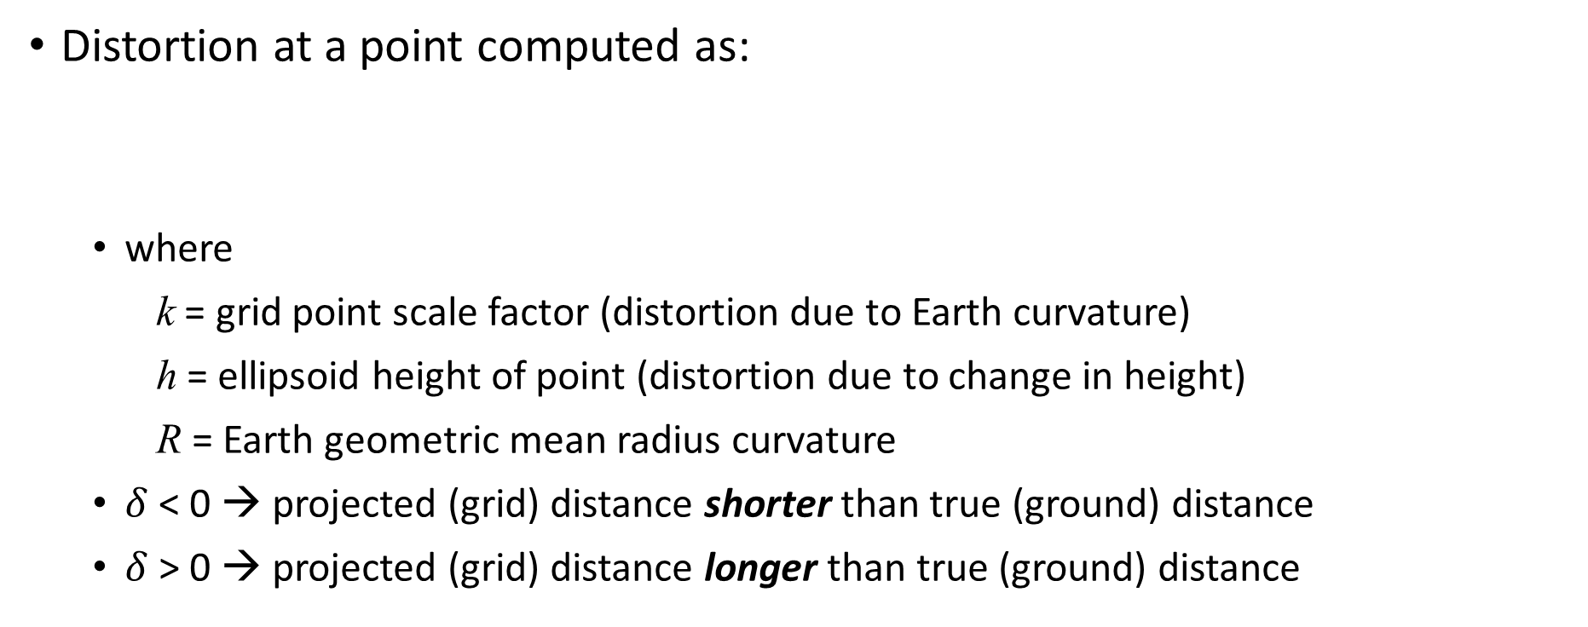
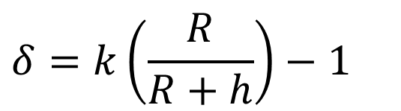
Map projection linear distortion
Distortion at a point computed as:
  where
    k = grid point scale factor (distortion due to Earth curvature)
    h = ellipsoid height of point (distortion due to change in height)
    R = Earth geometric mean radius curvature
  $δ$ < 0 → projected (grid) distance shorter than true (ground) distance
  $δ$ > 0 → projected (grid) distance longer than true (ground) distance
Combined factor
Grid point scale factor
$$δ=k\left(\frac{R}{R+h}\right)−1$$
Height (“elevation”) factor

Slide 12

Linear distortion with respect to ellipsoid surface
Projection
axis
(k₀ < 1)
Topographic surface
Horizontal ground distance
> ellipsoid distance
and
> grid distance
k₀ = scale on projection axis
LCC: central parallel
TM: central meridian
OM: skew axis
Ellipsoid distance
Grid distance
> ellipsoid distance
< ground distance
(k > 1 and δ < 0)
Projection surface (secant)
Ellipsoid distance
Ellipsoid surface
This design approach
used for SPCS 27 and 83 (minimizes distortion with respect to ellipsoid)
Grid distance
< ellipsoid distance
< ground distance
(k < 1 and δ < 0)
$$δ=k −1$$
12

Slide 13
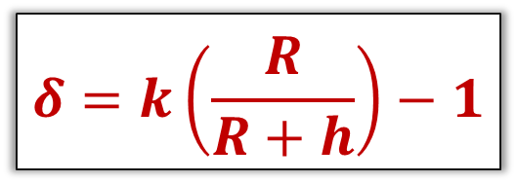
Linear distortion with respect to topographic surface
Projection
axis
(k₀ > 1)
Horizontal ground distance
> ellipsoid distance
and
> grid distance
Topographic surface
Projection surface (non-intersecting)
h
Ellipsoid distance
Grid distance
> ellipsoid distance
≈ ground distance
(k > 1 and δ ≈ 0)
Ellipsoid surface
$$δ=k\left(\frac{R}{R+h}\right)−1$$
R
13

Slide 14
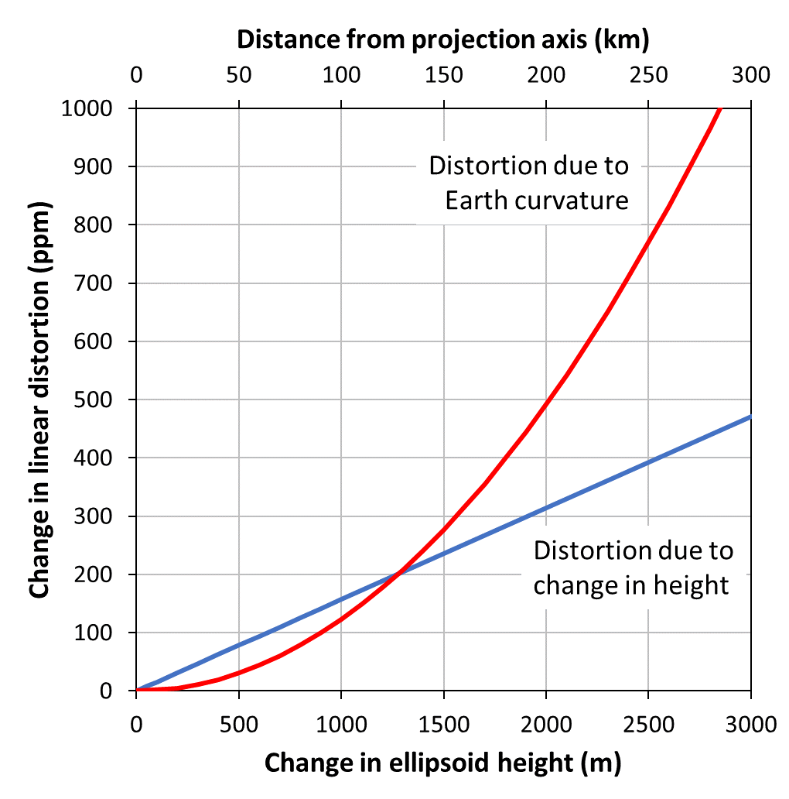
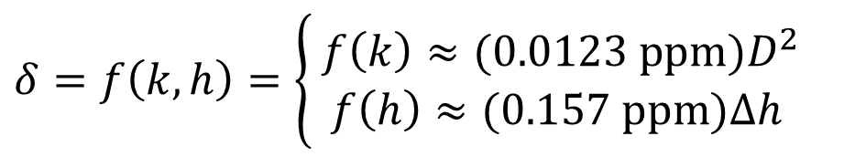
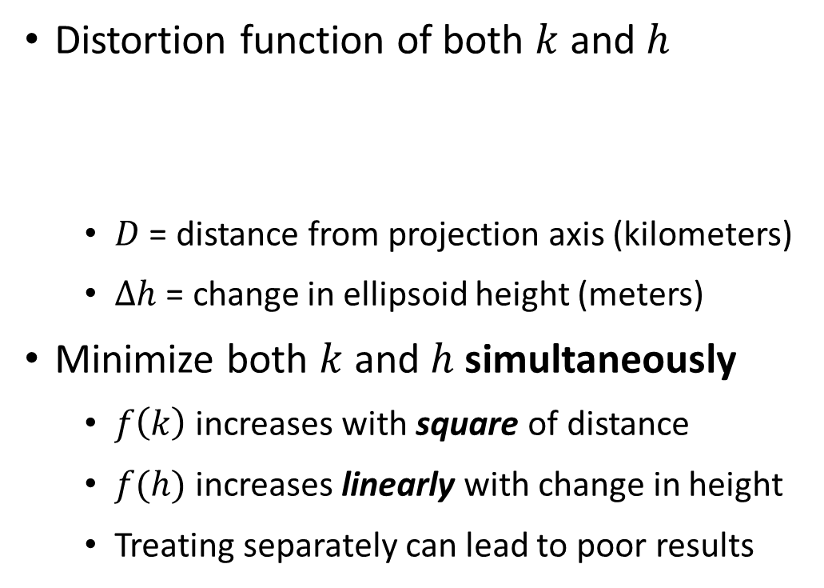
Minimizing linear distortion
Distortion function of both $k$ and $h$
  $D$ = distance from projection axis (kilometers)
  $∆h$ = change in ellipsoid height (meters)
Minimize both $k$ and $h$ simultaneously
  $f\left(k\right)$ increases with square of distance
  $f(h)$ increases linearly with change in height
  Treating separately can lead to poor results
$$δ=f\left(k, h\right)=\left\{\begin{matrix} f\left(k\right)≈(0.0123 ppm)D^{2} \\ f\left(h\right)≈(0.157 ppm)∆h \end{matrix}\right.$$

Slide 15
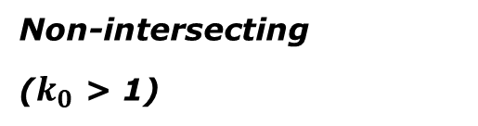
“Non-intersecting” conformal map projection
Topographic surface
Grid distance = ground distance at a point
Projection
axis
Grid distance = ground distance at a point
Non-intersecting
($k_{0}$ > 1)
Grid distance ≈ ground distance over finite distance
Purpose is to reduce linear distortion at “ground” (topographic surface).
But distortion can vary considerably across area of interest.
Ellipsoid surface
15

Slide 16
“Non-intersecting” conformal map projection
Topographic surface
Projection
axis
Non-intersecting
($k_{0}$ > 1)
Ellipsoid surface
16

Slide 17
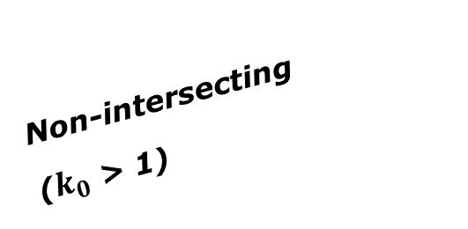

Changing projection axis to reduce distortion variation
This design approach
used for SPCS2022 (minimizes distortion with respect to topography)
Topographic surface
Grid distance = ground distance at many points
Projection
axis
Ellipsoid height of surface not constant:
h₁ ≠ h₂
h₂
Non-intersecting
($k_{0}$ > 1)
h₁
ONLY way to reduce variation in distortion is to change projection axis location (or change projection).
Ellipsoid surface
Projection axis scale can be less than 1 for steeply sloping areas even if heights are large.
IMPORANT: For large areas, there is no single defining ellipsoid height for scaling the projection.
$$δ=k\left(\frac{R}{R+h}\right)−1$$
R₂
R₁
17

Slide 18
NOT changing projection axis to reduce distortion variation
Topographic surface
Grid distance = ground distance at a point
Projection
axis
Grid distance = ground distance at a point
Non-intersecting
($k_{0}$ > 1)
h₂
Ellipsoid height of surface not constant:
h₁ ≠ h₂
h₁
Ellipsoid surface
IMPORANT: For large areas, there is no single defining ellipsoid height for scaling the projection – even if there is no attempt to account for topographic slope.
18

Slide 19
Linear distortion magnitudes
Parts per million | Centimeters per kilometer | Feet per mile | Dimensionless ratio
20 ppm | 2 cm/km | 0.1 ft/mile | 1:50,000
50 ppm | 5 cm/km | 0.3 ft/mile | 1:20,000
100 ppm | 10 cm/km | 0.5 ft/mile | 1:10,000
400 ppm | 40 cm/km | 2.1 ft/mile | 1:2,500

Slide 20
Status of zone layout and designs
Designs by NGS
  159 zones (including 54 statewide)
  Plus 3 “special use zones” (in more than one state)
Designs by state stakeholders
  806 zones in 28 states
  Most are “low-distortion projections” (LDPs)
Total = 968 zones for 56 states and territories
  Number will likely decrease slightly
Compare to 125 zones in existing State Plane

Slide 21
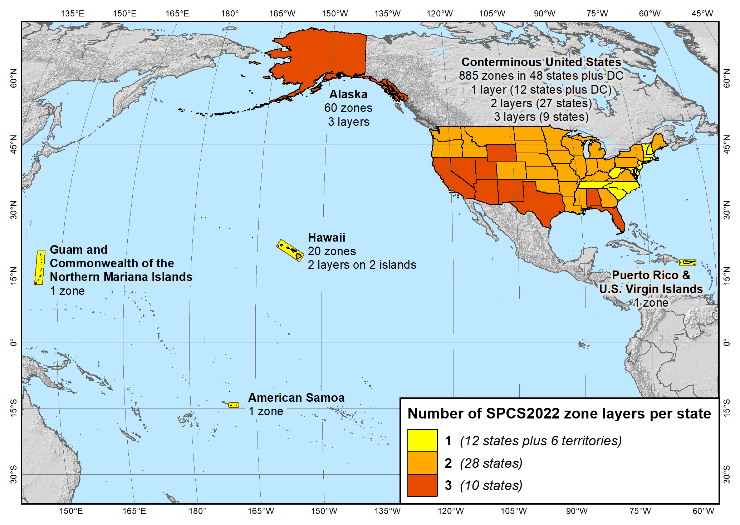
SPCS2022 zone layers
1 layer: 12 states plus 6 territories
2 layers: 28 states
3 layers: 10 states

Slide 22
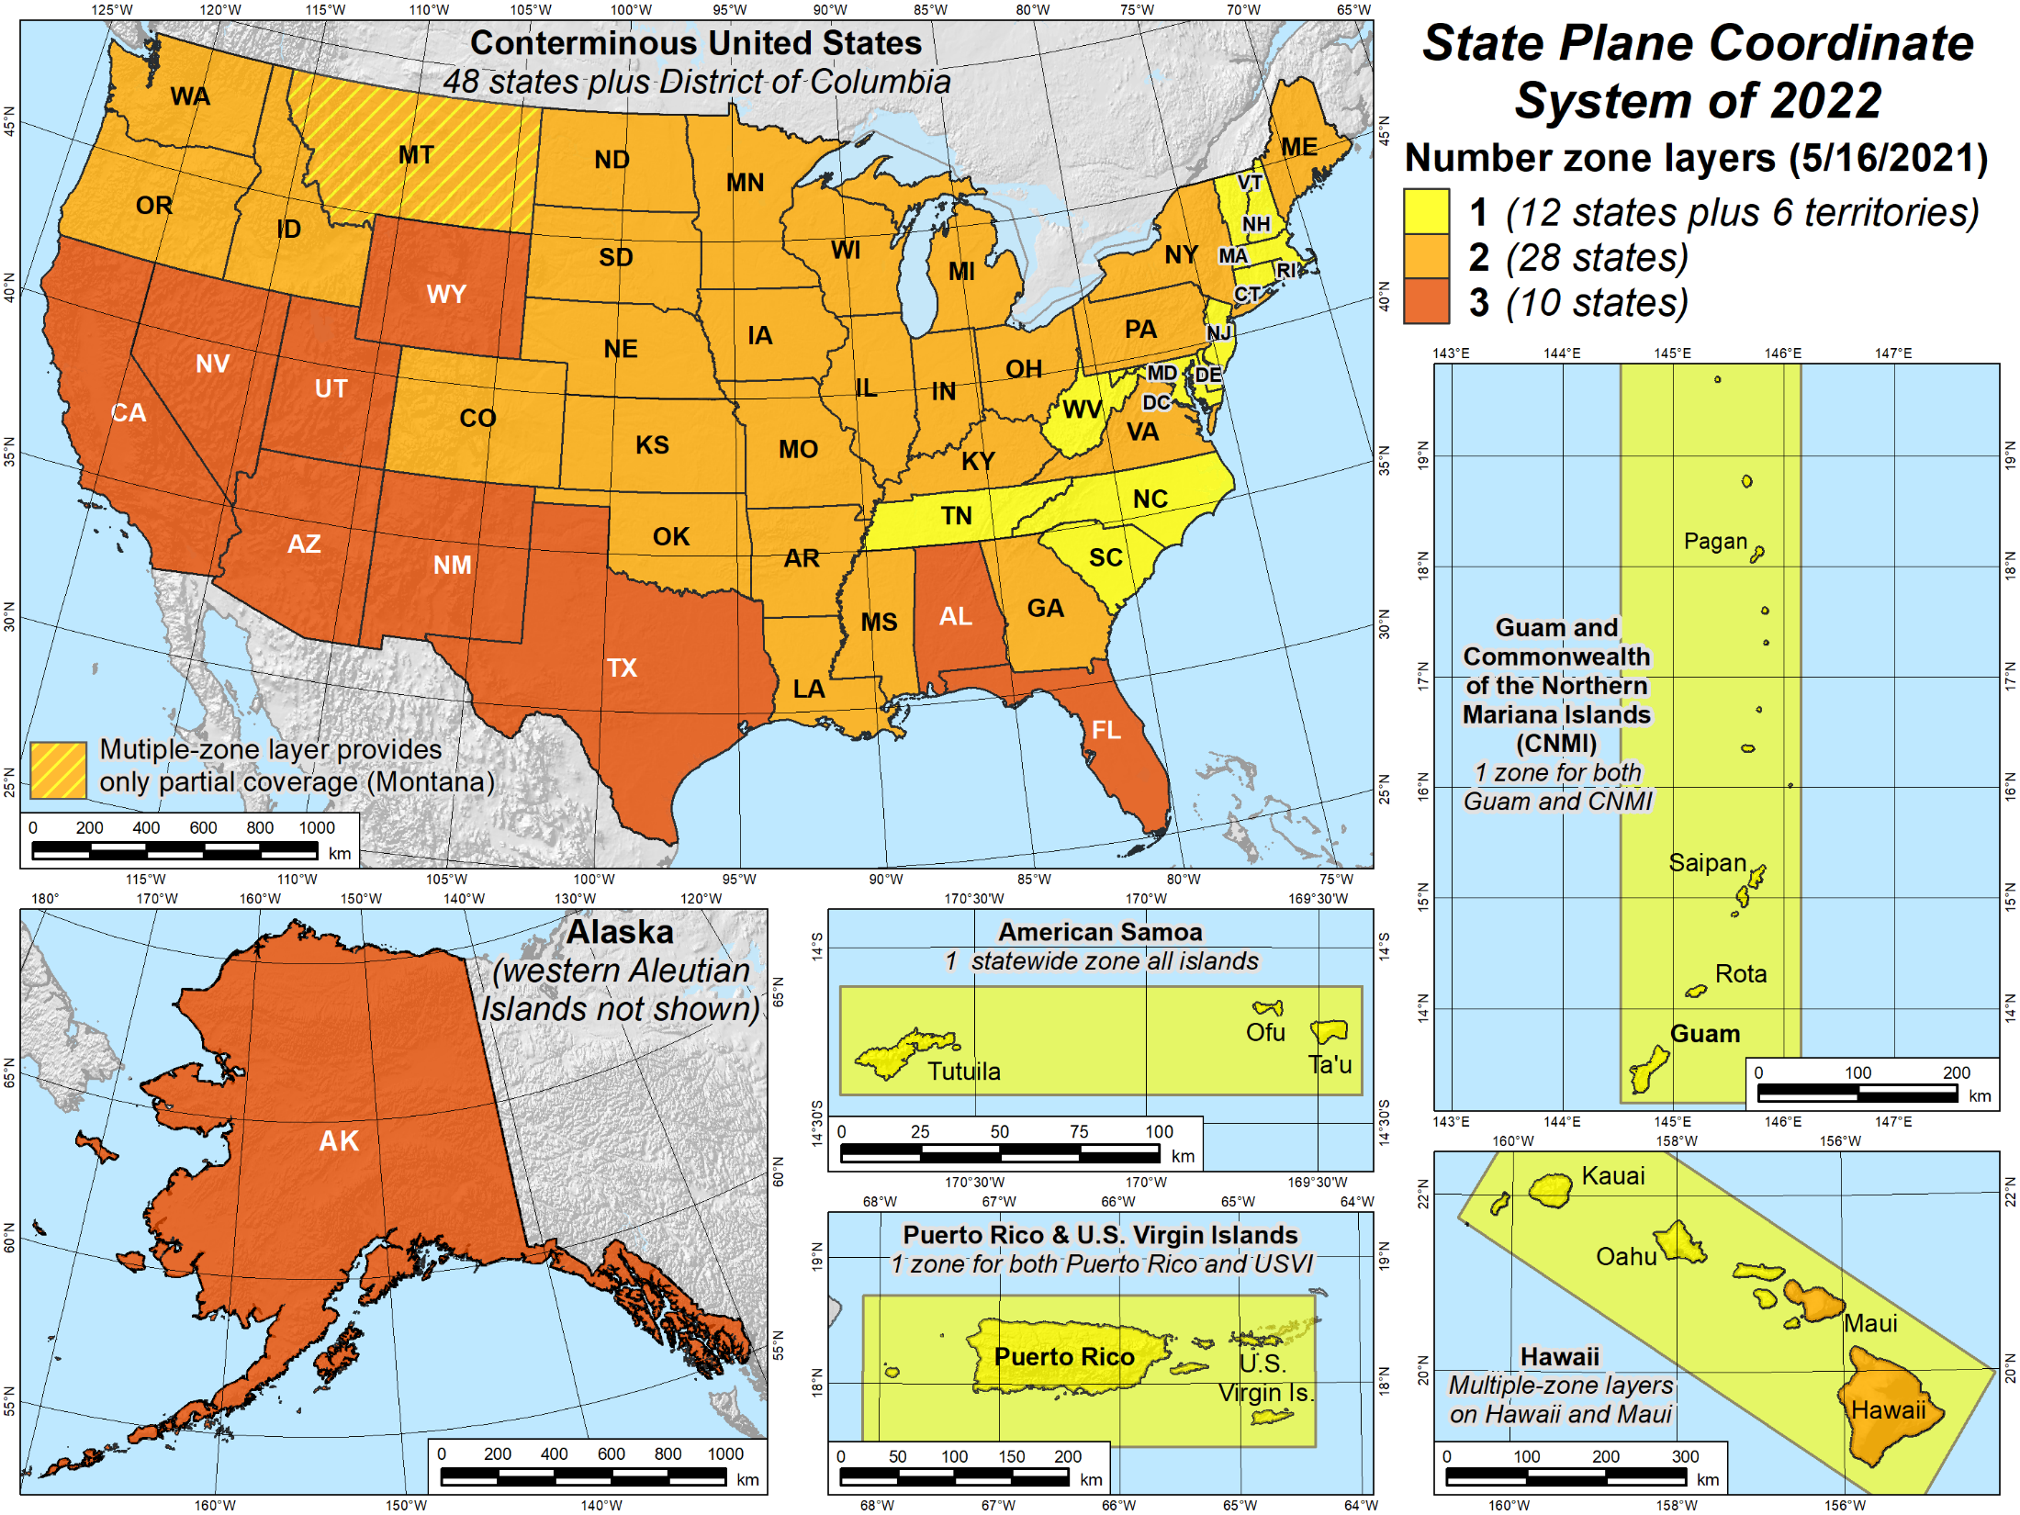
SPCS2022 zone layers
1 layer: 12 states plus 6 territories
2 layers: 28 states
3 layers: 10 states

Slide 23
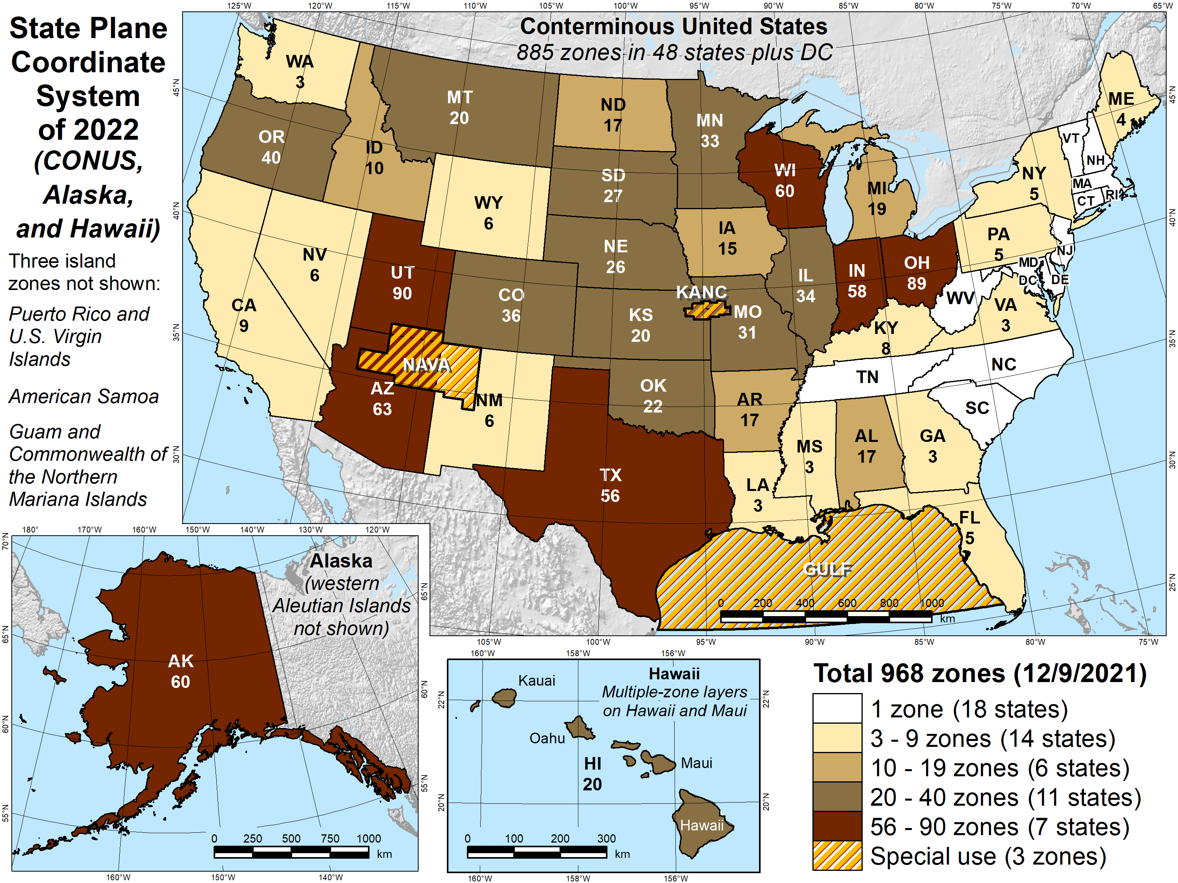
Number of SPCS2022 zones (preliminary)
CONUS, Alaska, and Hawaii
Three island zones not shown:
Puerto Rico and U.S. Virgins Islands
American Samoa
Guam and the Commonwealth of the Northern Mariana Islands

Slide 24
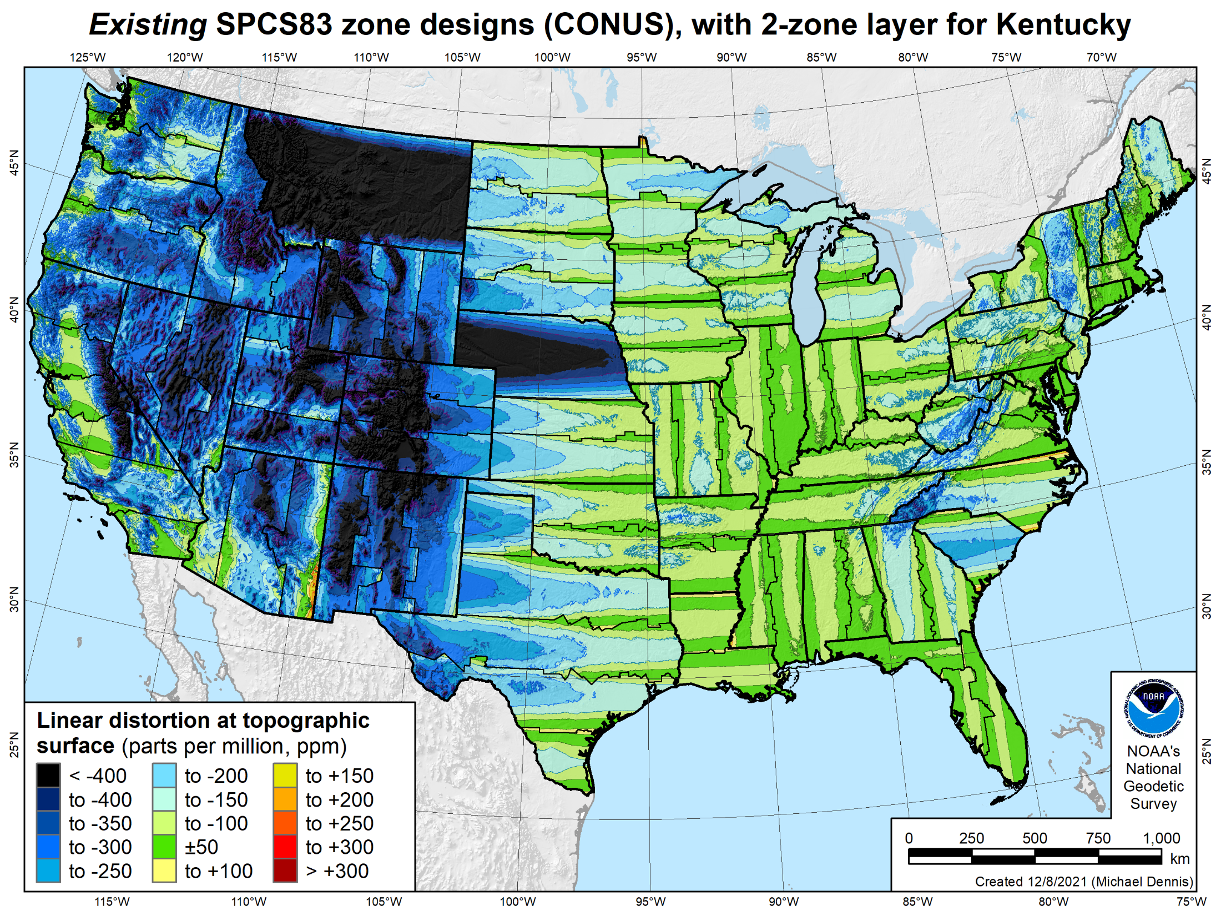
Existing SPCS 83 linear distortion
106 zones (CONUS)
Percent within distortion (ppm):
Distor | Pop | Cities | Area
±20 | 17% | 11% | 6%
±50 | 40% | 30% | 17%
±100 | 74% | 68% | 41%
±400 | 99% | 98% | 91%
City and area statistics (ppm):
 | Min | -913 | -1038
 | Max | +206 | +223
 | Range | 1120 | 1261
 | Mean | -98 | -178
Mean weighted by pop = -75
24

Slide 25
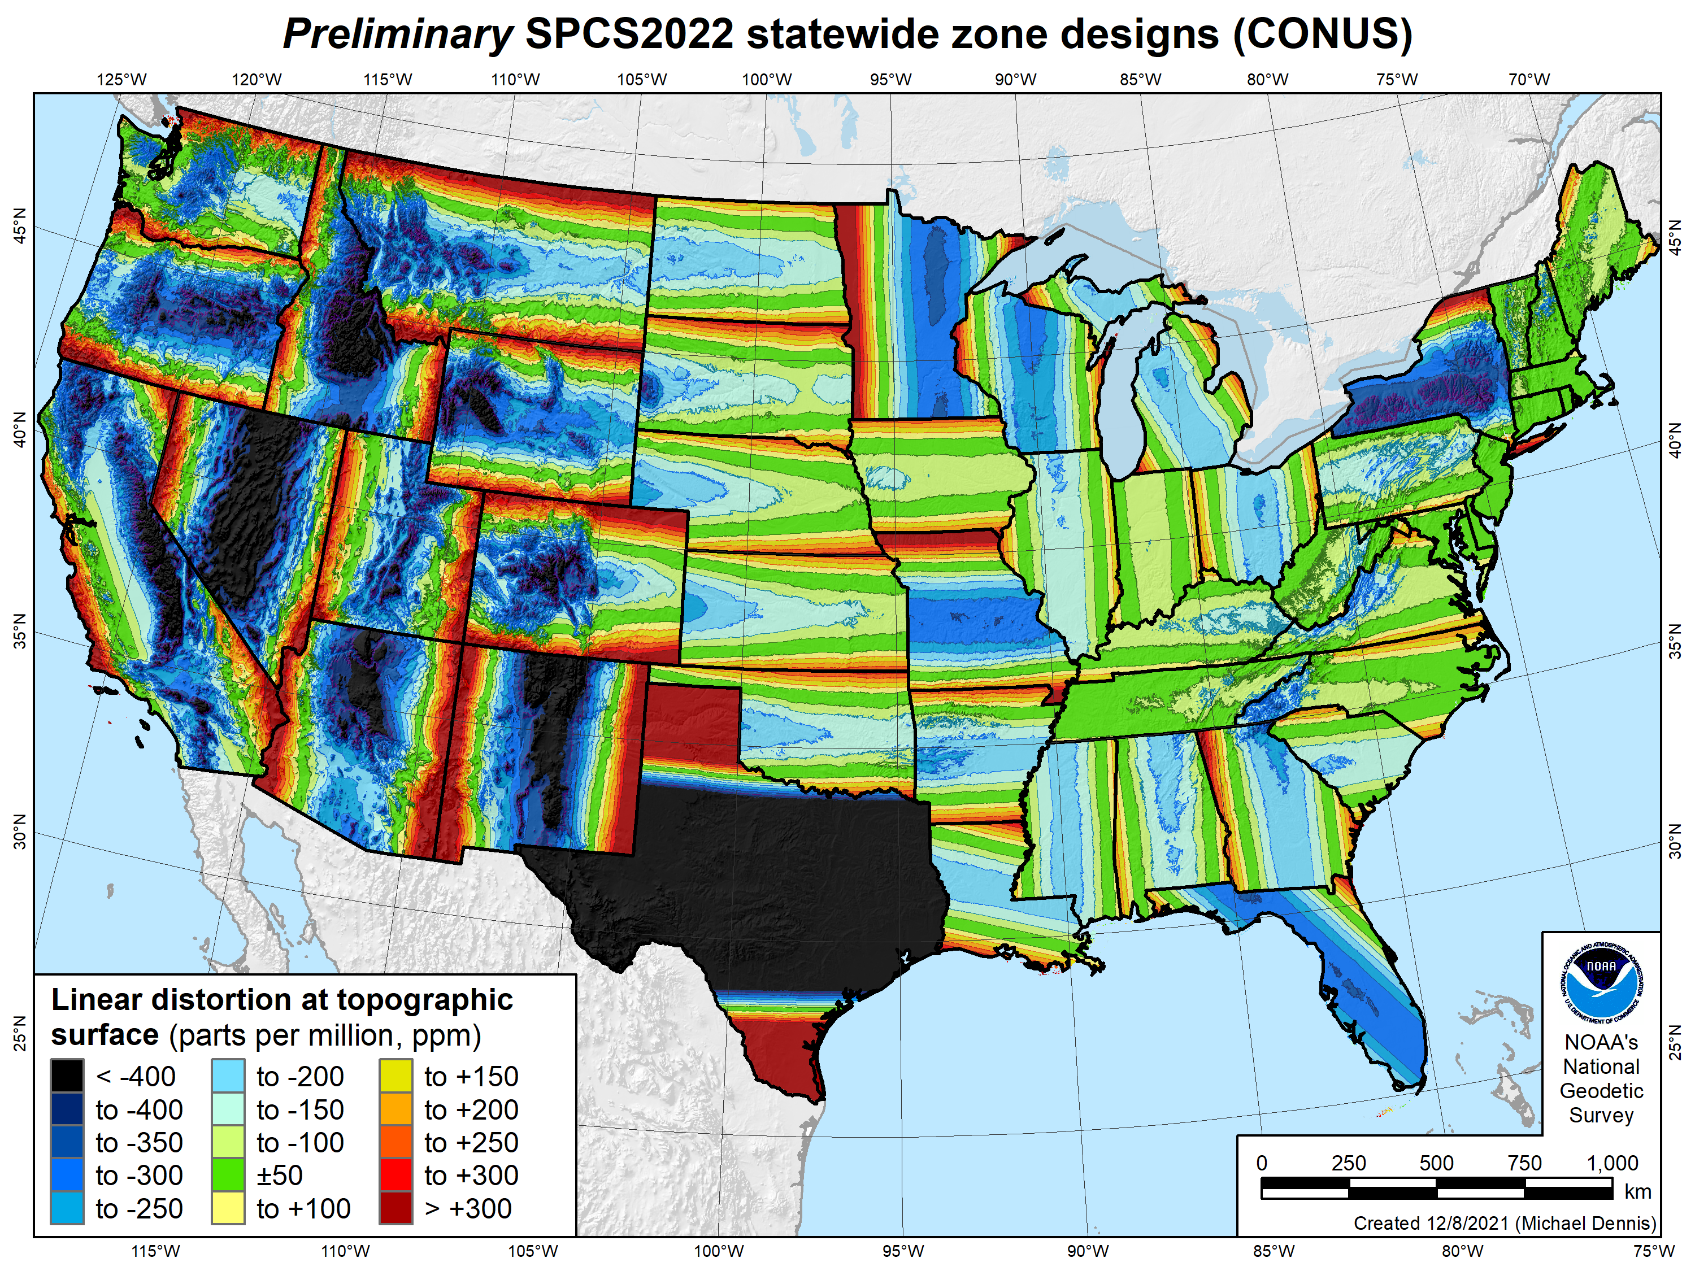
SPCS2022 linear distortion (prelim)
49 zones (CONUS)
Percent within distortion (ppm):
Distor | Pop | Cities | Area
±20 | 14% | 12% | 7%
±50 | 27% | 26% | 18%
±100 | 48% | 48% | 36%
±400 | 91% | 93% | 88%
City and area statistics (ppm):
 | Min | -1512 | -1627
 | Max | +2888 | +2987
 | Range | 4400 | 4614
 | Mean | -86 | -120
Mean weighted by pop = -100
25

Slide 26
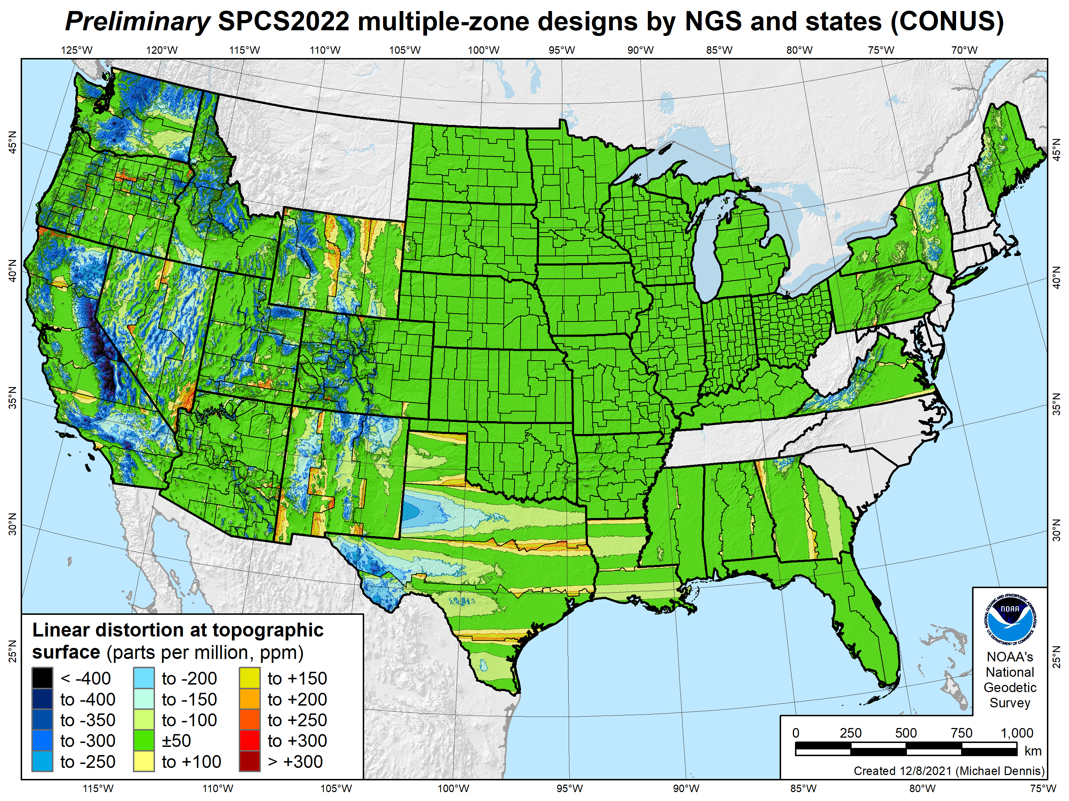
SPCS2022 linear distortion (prelim)
646 zones (35 states)
Percent within distortion (ppm):
Distor | Pop | Cities | Area
±20 | 76% | 70% | 54%
±50 | 92% | 88% | 73%
±100 | 98% | 97% | 89%
±400 | 100% | 100% | 99.9%
City and area statistics (ppm):
 | Min | -400 | -684
 | Max | +245 | +295
 | Range | 644 | 979
 | Mean | -5 | -23
Mean weighted by pop = -4
26

Slide 27
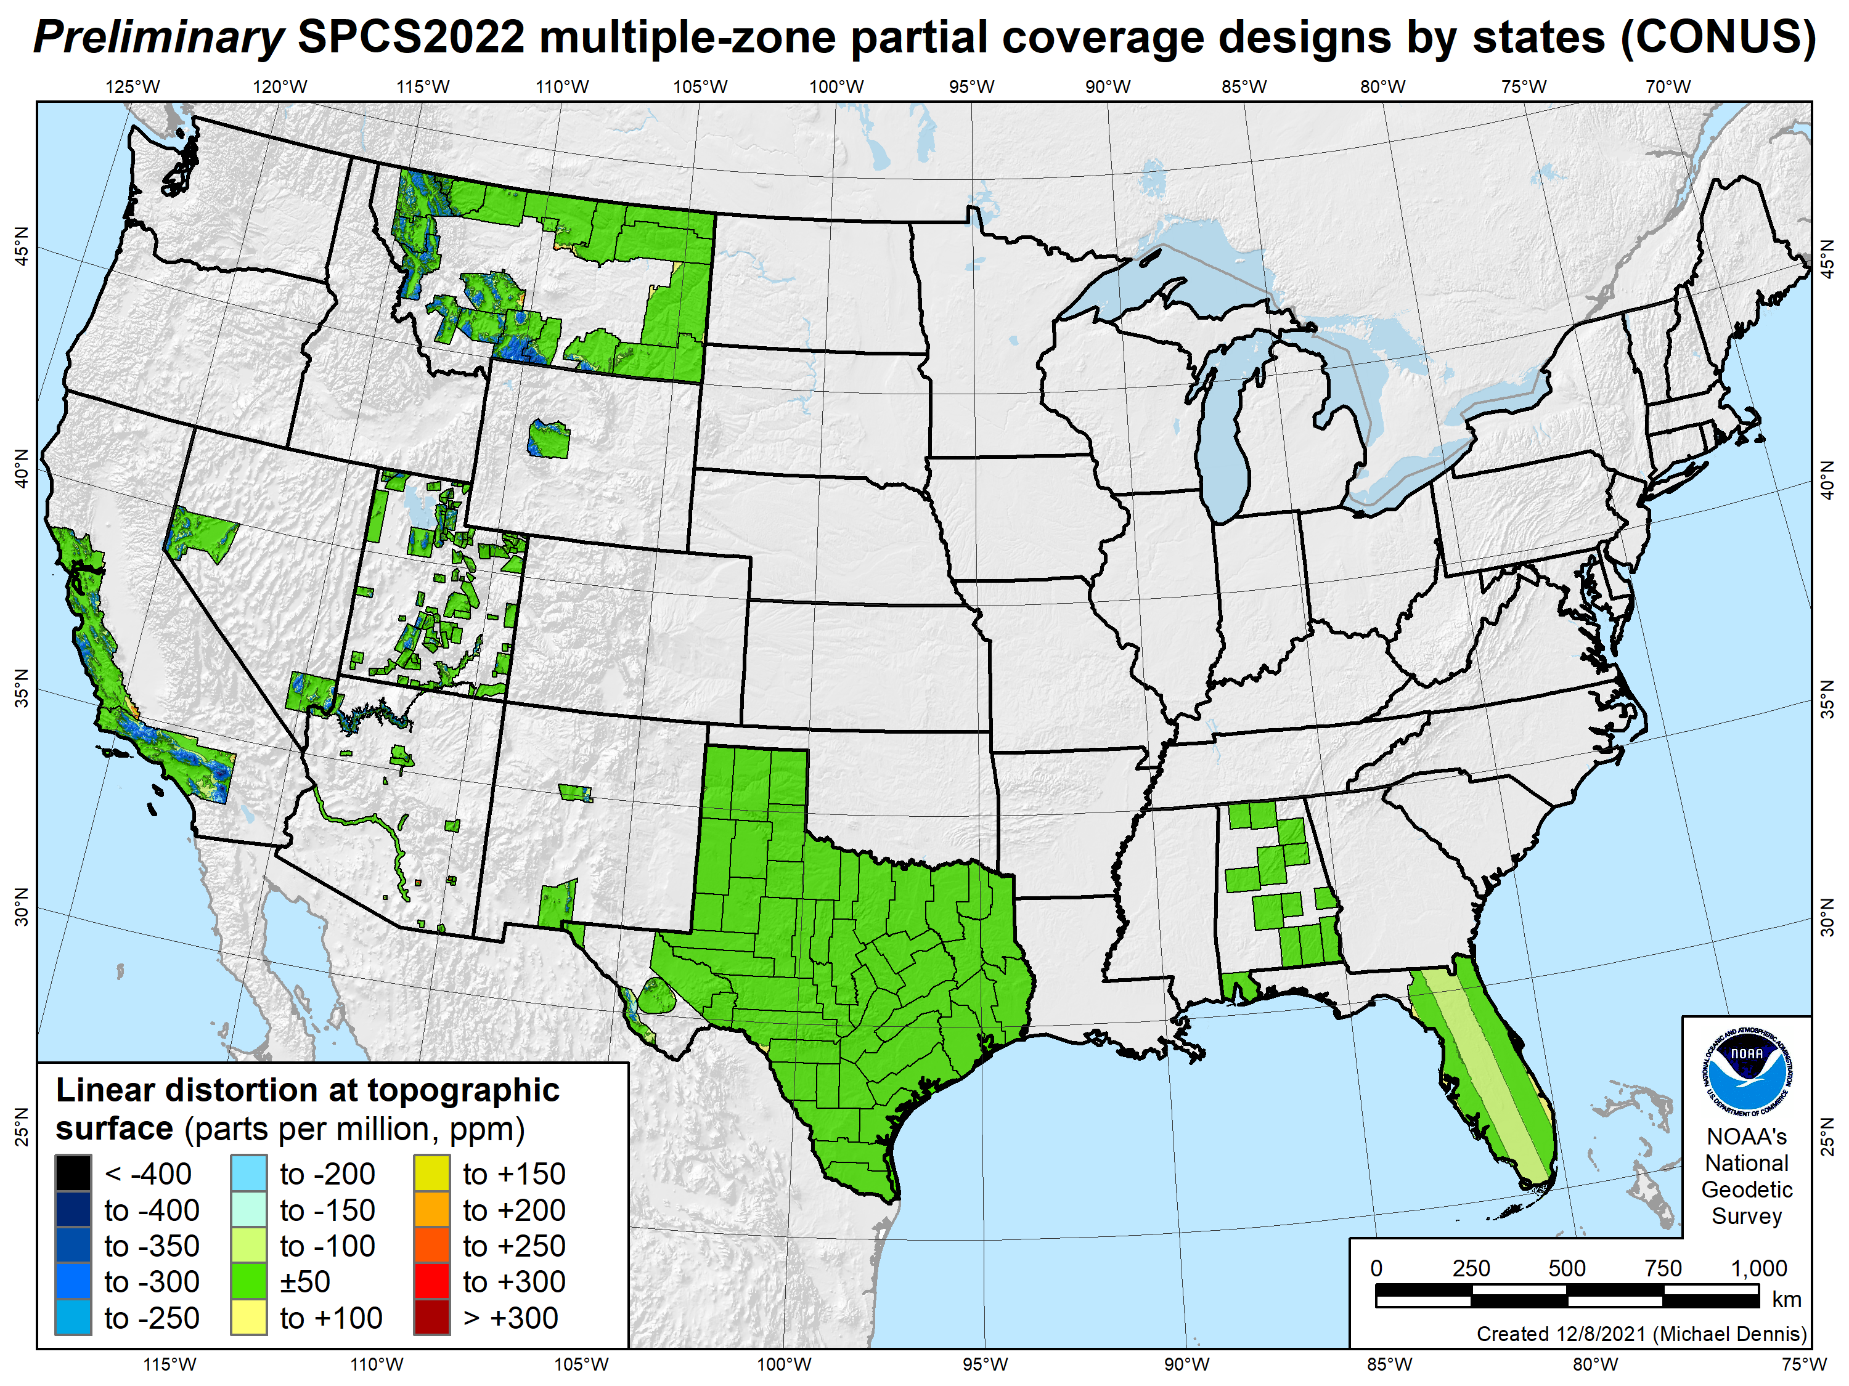
SPCS2022 linear distortion (prelim)
187 zones (10 states)
Percent within distortion (ppm):
Distor | Pop | Cities | Area
±20 | 78% | 78% | 73%
±50 | 91% | 90% | 88%
±100 | 99.8% | 99% | 97%
±400 | 100% | 100% | 100%
City and area statistics (ppm):
 | Min | -261 | -465
 | Max | +120 | +240
 | Range | 381 | 705
 | Mean | -3 | -12
Mean weighted by pop = -1
27

Slide 28
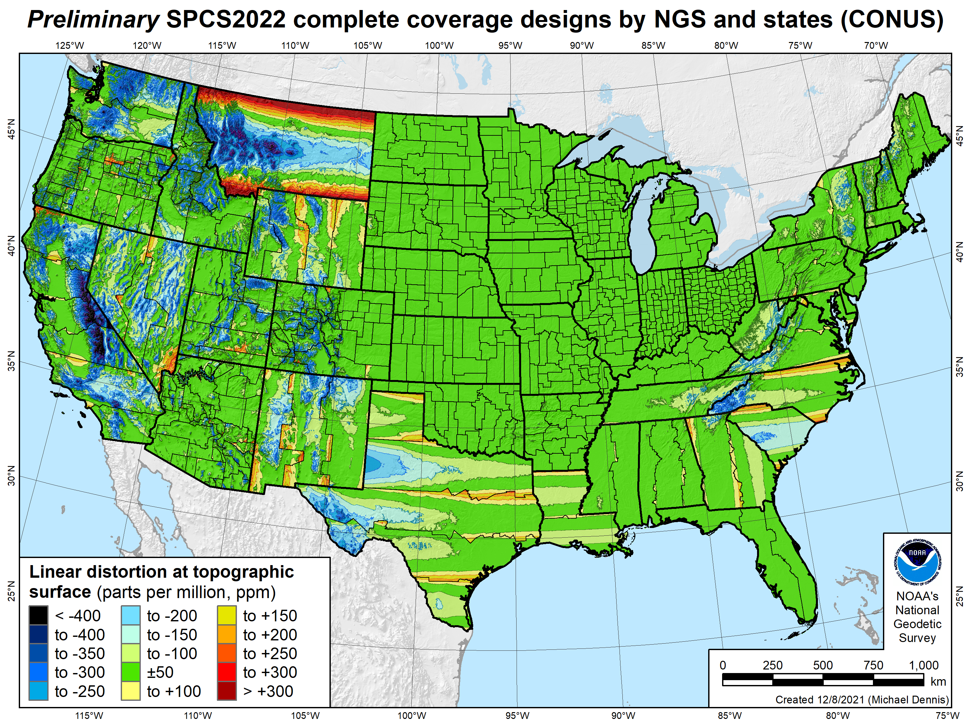
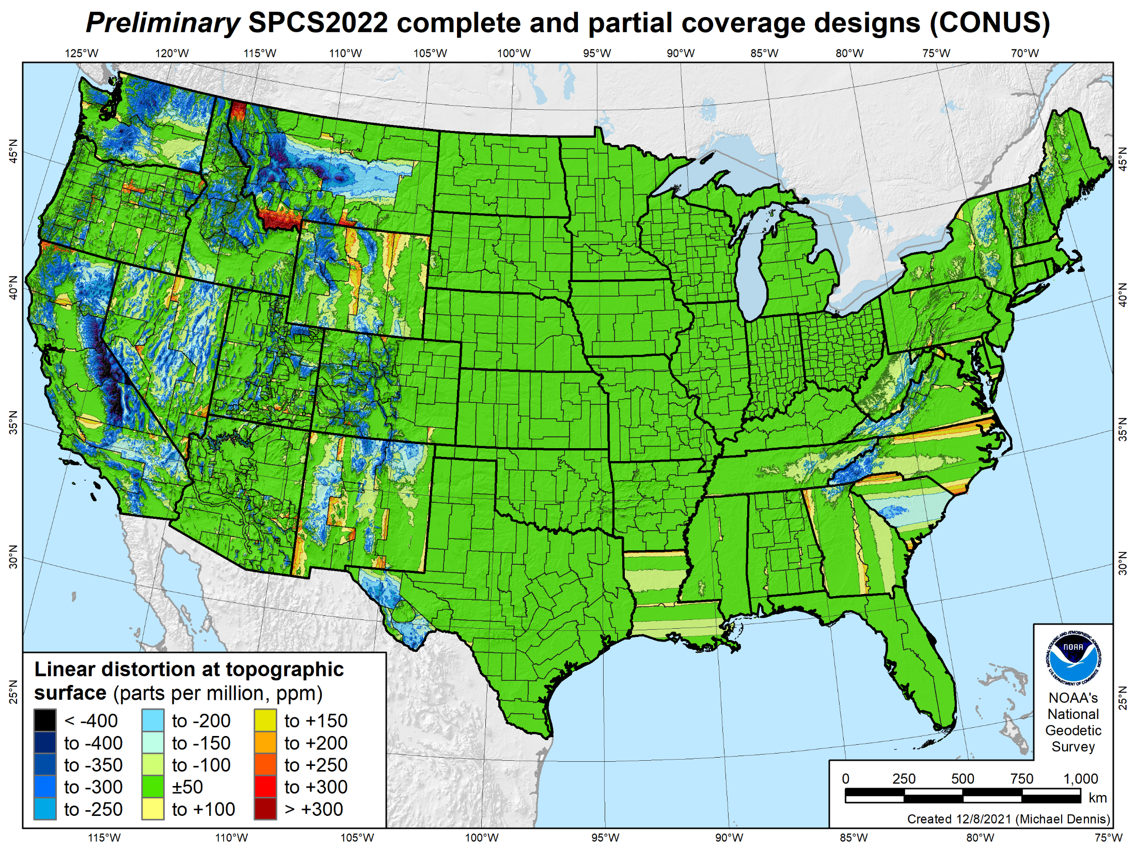
SPCS2022 linear distortion (prelim)
846 zones (CONUS)
Percent within distortion (ppm):
Distor | Pop | Cities | Area
±20 | 76% | 71% | 58%
±50 | 92% | 89% | 76%
±100 | 98% | 97% | 89%
±400 | 100% | 100% | 99.9%
City and area statistics (ppm):
 | Min | -407 | -1438
 | Max | +486 | +2624
 | Range | 893 | 4062
 | Mean | -6 | -23
Mean weighted by pop = -4

Slide 29
Existing SPCS 83 linear distortion
106 zones (CONUS)
Percent within distortion (ppm):
Distor | Pop | Cities | Area
±20 | 17% | 11% | 6%
±50 | 40% | 30% | 17%
±100 | 74% | 68% | 41%
±400 | 99% | 98% | 91%
City and area statistics (ppm):
 | Min | -913 | -1038
 | Max | +206 | +223
 | Range | 1120 | 1261
 | Mean | -98 | -178
Mean weighted by pop = -75
29

Slide 30
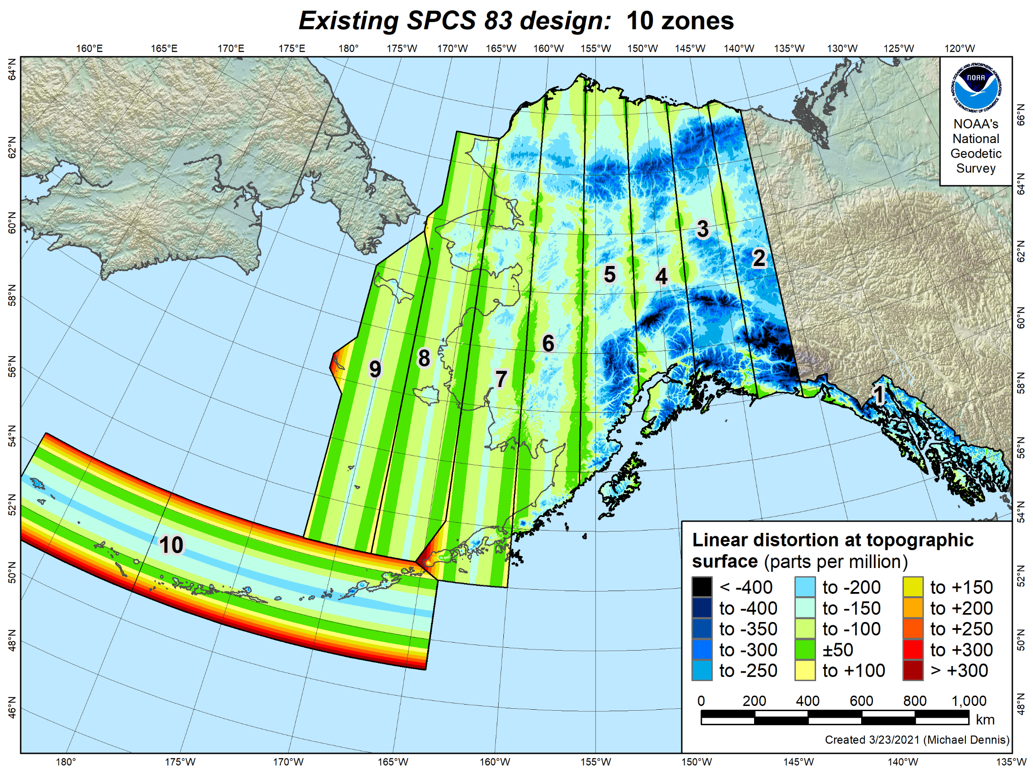
Existing SPCS 83 linear distortion
10 zones (Alaska)
Percent within distortion (ppm):
Distor | Pop | Cities | Area
±20 | 4% | 10% | 4%
±50 | 16% | 23% | 11%
±100 | 40% | 62% | 36%
±400 | 100% | 100% | 99.1%
City and area statistics (ppm):
 | Min | -263 | -967
 | Max | +86 | +342
 | Range | 349 | 1308
 | Mean | -83 | -135
Mean weighted by pop = -92
Statistics are for land areas only
30

Slide 31
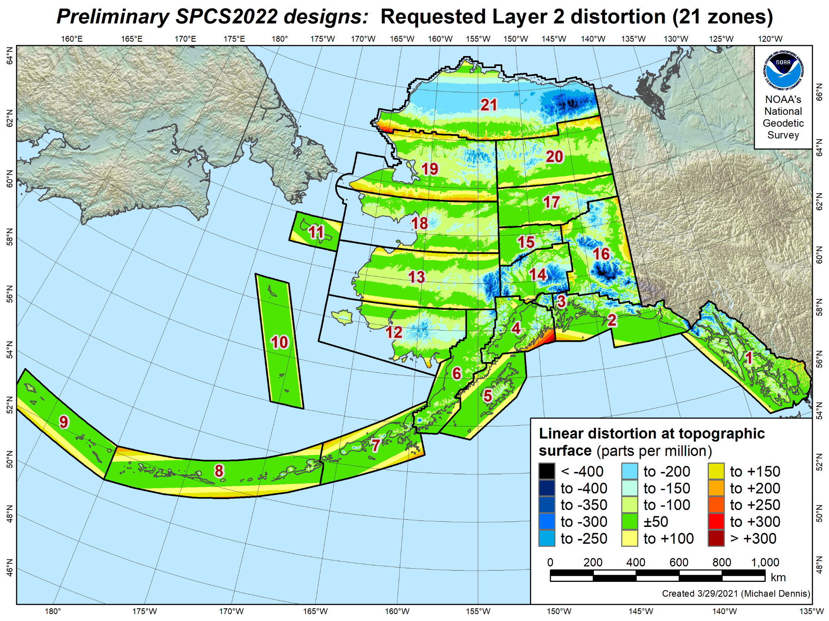
SPCS2022 linear distortion (prelim)
21 zones (Alaska)
Percent within distortion (ppm):
Distor | Pop | Cities | Area
±20 | 77% | 38% | 17%
±50 | 90% | 67% | 38%
±100 | 98% | 93% | 68%
±400 | 100% | 100% | 99.8%
City and area statistics (ppm):
 | Min | -177 | -794
 | Max | +321 | +331
 | Range | 498 | 1125
 | Mean | -7 | -53
Mean weighted by pop = -4
Statistics are for land areas only

Slide 32
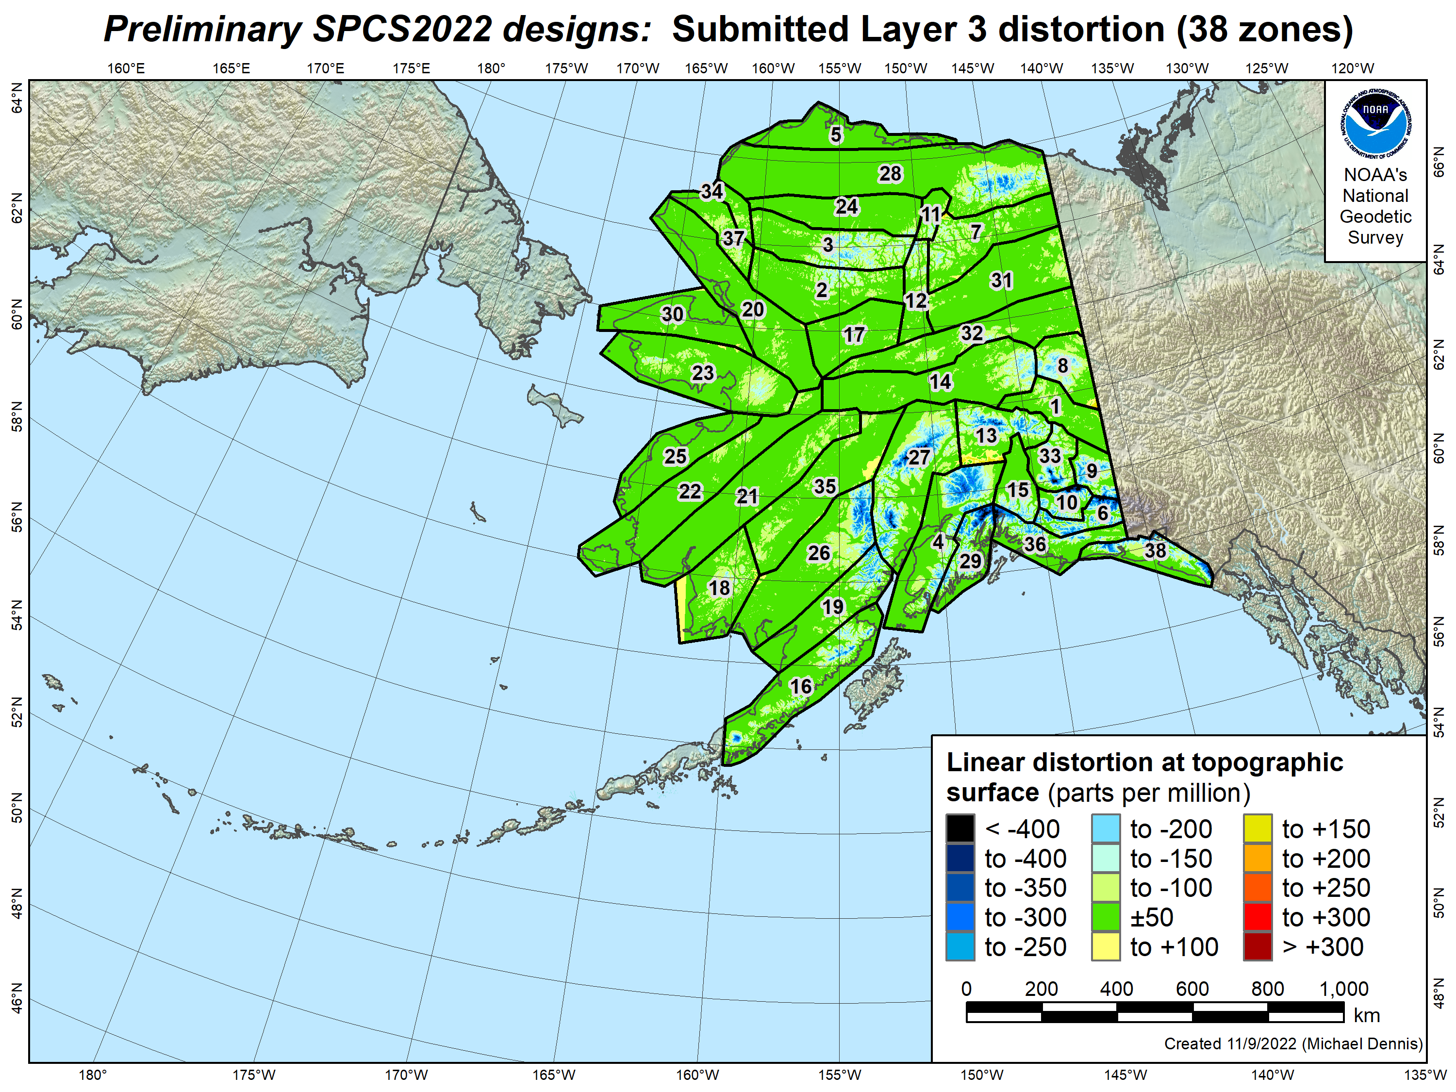
SPCS2022 linear distortion (prelim)
38 zones (Alaska)
Percent within distortion (ppm):
Distor | Pop | Cities | Area
±20 | 89% | 93% | 49%
±50 | 98% | 99.7% | 74%
±100 | 99.7% | 100% | 88%
±400 | 100% | 100% | 99.9%
City and area statistics (ppm):
 | Min | -59 | -937
 | Max | +49 | +190
 | Range | 108 | 1127
 | Mean | +0.4 | -34
Mean weighted by pop = -8
Statistics are for land areas only

Slide 33
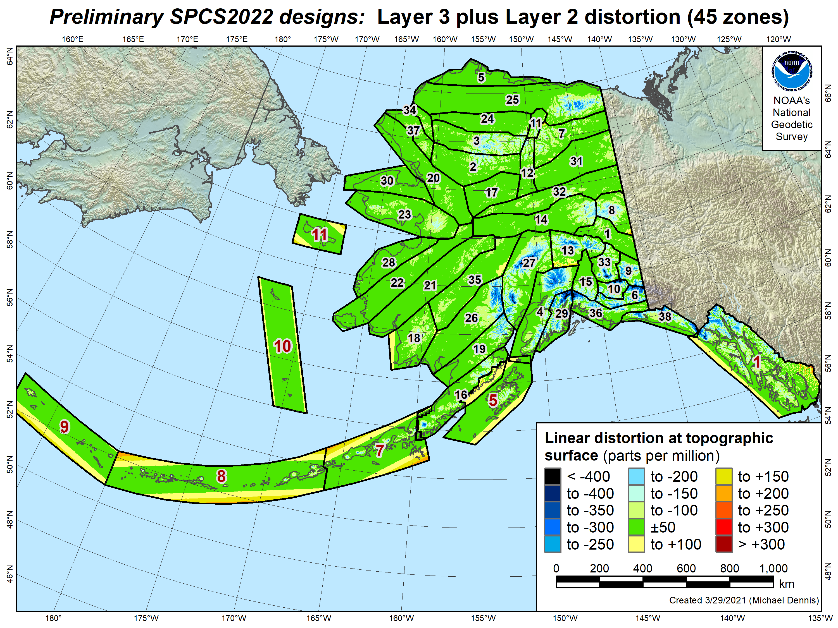
SPCS2022 linear distortion (prelim)
45 zones (Alaska)
Percent within distortion (ppm):
Distor | Pop | Cities | Area
±20 | 86% | 85% | 47%
±50 | 97% | 98% | 73%
±100 | 99.5% | 99.7% | 88%
±400 | 100% | 100% | 99.9%
City and area statistics (ppm):
 | Min | -60 | -937
 | Max | +321 | +335
 | Range | 380 | 1272
 | Mean | -3 | -35
Mean weighted by pop = -10
Statistics are for land areas only

Slide 34
Existing SPCS 83 linear distortion
10 zones (Alaska)
Percent within distortion (ppm):
Distor | Pop | Cities | Area
±20 | 4% | 10% | 4%
±50 | 16% | 23% | 11%
±100 | 40% | 62% | 36%
±400 | 100% | 100% | 99.1%
City and area statistics (ppm):
 | Min | -263 | -967
 | Max | +86 | +342
 | Range | 349 | 1308
 | Mean | -83 | -135
Mean weighted by pop = -92
Statistics are for land areas only
34

Slide 35
About the timing of it all…
Timeline
  Complete review of stakeholder submittals (DONE)
  Late 2022-Early 2023: Preliminary designs for stakeholder review
  Mid-2023: Finalize all zone designs
Other things in 2023
  Provide machine-readable definitions
  Modify NGS algorithms (e.g., 1-parallel Lambert)
  Document new projection algorithms
Release with rollout of modernized NSRS
  Final definitions available by late 2023
  Release with new “datums” in 2025
Rollout in
2025

Slide 36
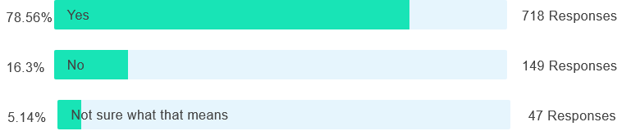
Poll question
Did you know that the U.S. survey foot will be retired (“deprecated”) on December 31, 2022?

Slide 37
A tale of two feet
Two versions of “foot” in current use:
“Old” U.S. survey foot
“New” international foot
‭1 ft = 1200/3937 m = 0.3048006096…‬ m
1 ft = 0.3048 m exactly
Differ by
2 parts per million (ppm) or ~0.01 ft (~1/8 inch) per mile
  A real problem with real costs

Slide 38
A tale of two feet
Who uses U.S. survey feet?
  Surveyors in most (not all) states
  But it impacts everyone
  It is a major issue for the
  National Spatial Reference System (NSRS),
  especially State Plane coordinates
  (and other projected coordinate systems)

Slide 39
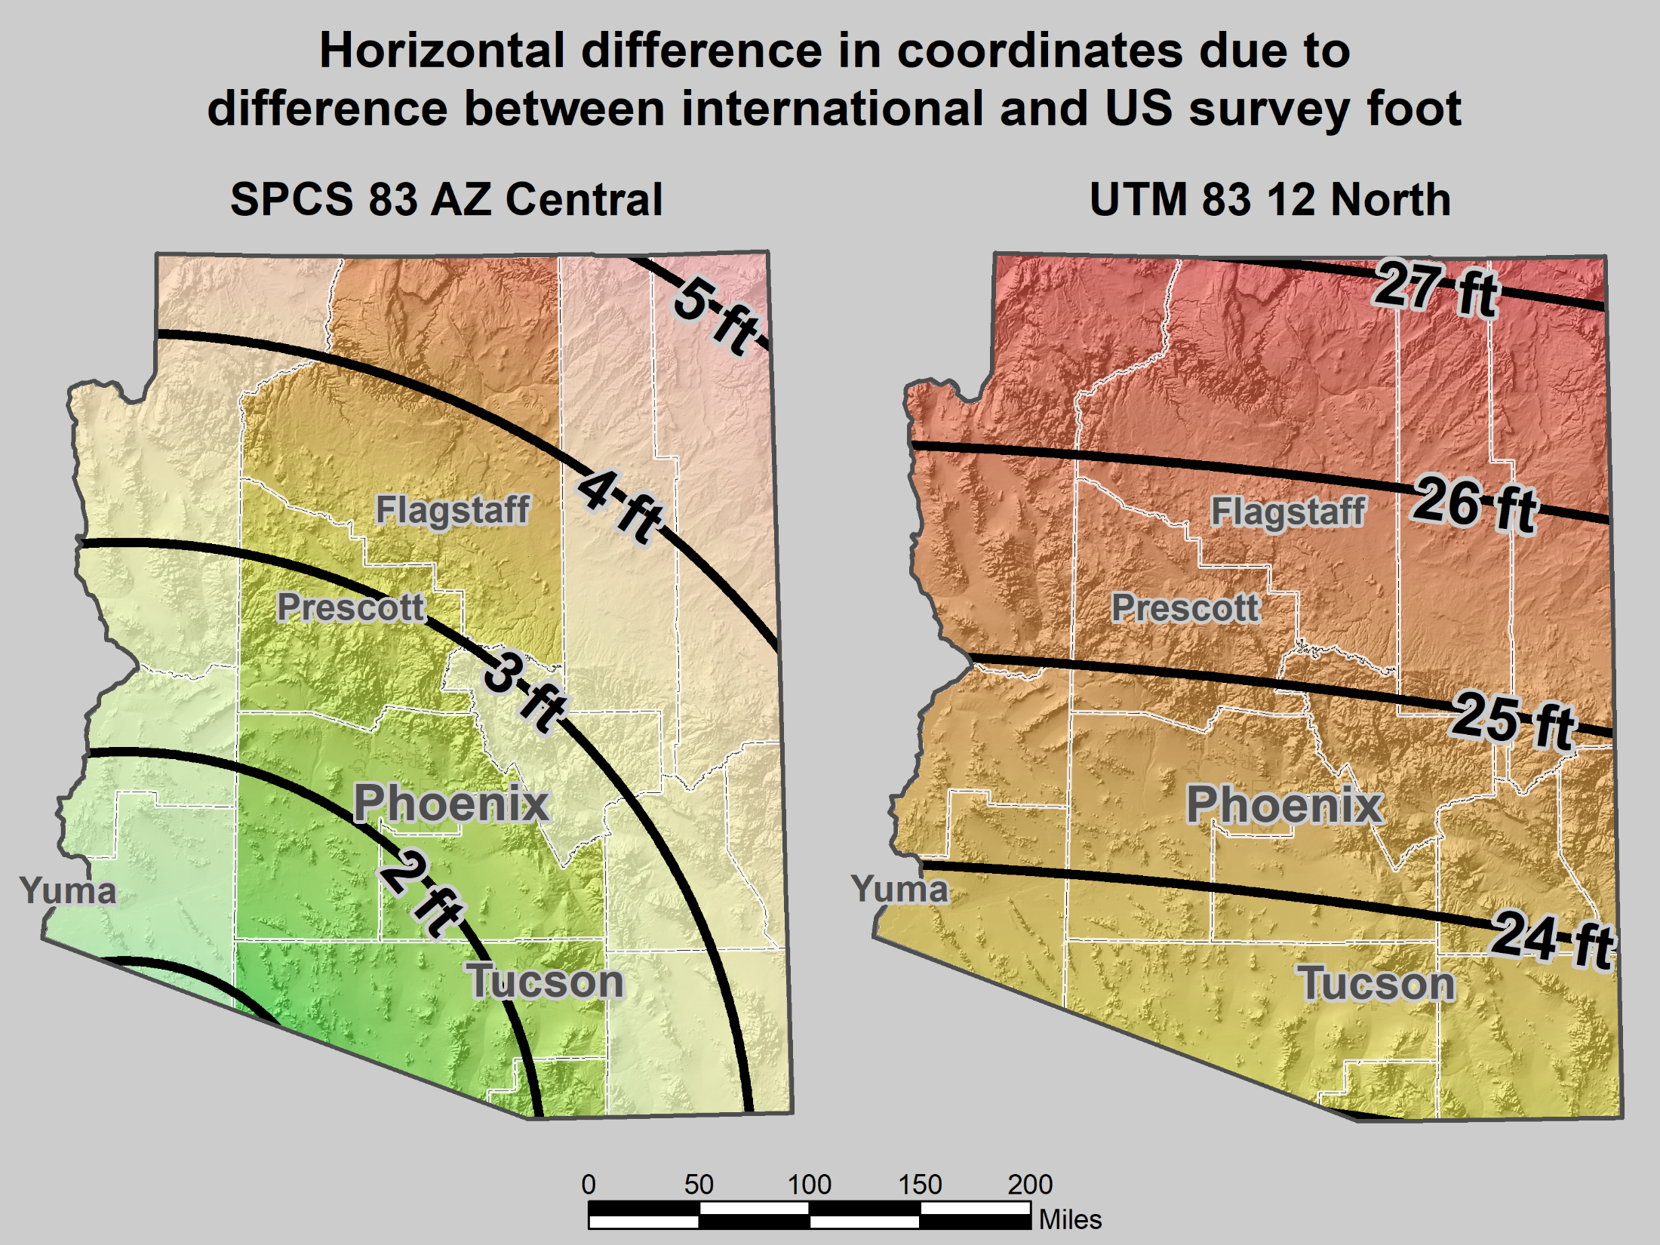
Horizontal error when mixing up feet
SPCS 83 AZ Central Zone
UTM 83 12 North Zone

Slide 40
Requiem for the U.S. survey foot
Will be “deprecated” on December 31, 2022
  Identified as being redundant or a source of confusion
  Deemed obsolete
  Its use should be avoided
After that date, international foot used for everything (sort of)
  Can call it “international foot” or just “foot”
  Use U.S. survey foot only for historical and legacy applications
December 31, 2022 is coming
  But NSRS modernization will occur in (mid) 2025
  What should you do between those dates?

Slide 41


The clock is ticking…
December 31, 2022 is almost here
Are you prepared?
DECEMBER
25
31
21
24
20
22
26
27
28
29
30
31
23
2022

Slide 42

To help get prepared, let’s talk about legislation

Slide 43
Why have State Plane legislation?
Proposed to state legislatures in 1945 by Council of State Governments to:
  Establish legal status
  Insure uniformity and definiteness in use
  Impose reasonable standards when coordinates become part of public record
Additional reasons:
  To make corners “indestructible”
  Save time and money by providing specifications on using State Plane
Other things:
  Use of system is permissive, not mandatory
  Uniformity of legislation is desirable
  Legislation not required to establish State Plane

Slide 44
History of State Plane in legislation
First nine states with State Plane laws:
  1935 (NJ), 1937 (PA), 1938 (NY), 1939 (MD, NC, GA), 1941 (MA), 1943 (TX), 1944 (LA)
Model act provided to state legislatures in 1945
  Included zone projection parameters
  Specified ½ mile max distance to 2nd order control (for public recording)
Some changes in model act for SPCS 83 (created 1977)
  Specified U.S. survey foot for SPCS 27; meter for SPCS 83 (but not U.S. survey foot)
  Max distance to 2nd order control changed from ½ mile to 1 km
  Interesting note at end of SPCS 83 model act (ca. 1989):
“In light of GPS technology, the 1 km limitation… should be reevaluated.”

Slide 45
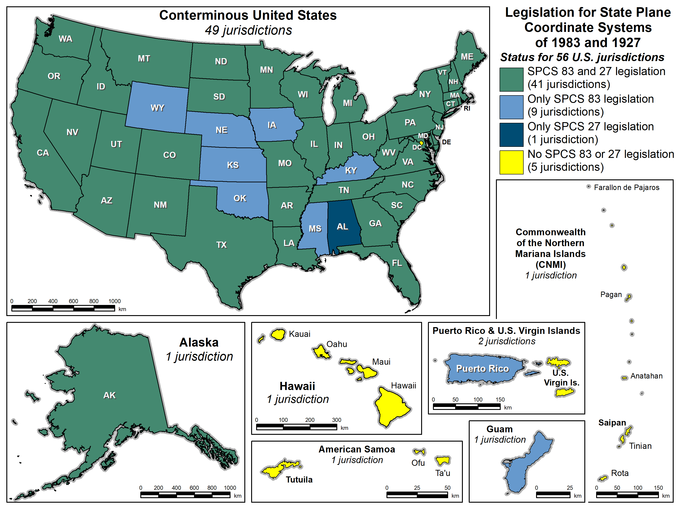
State Plane legislation for
SPCS 83 and 27
56 U.S. jurisdictions
  41 with SPCS 83 and 27
  9 with only SPCS 83
  1 with only SPCS 27
  5 with no legislation

Slide 46
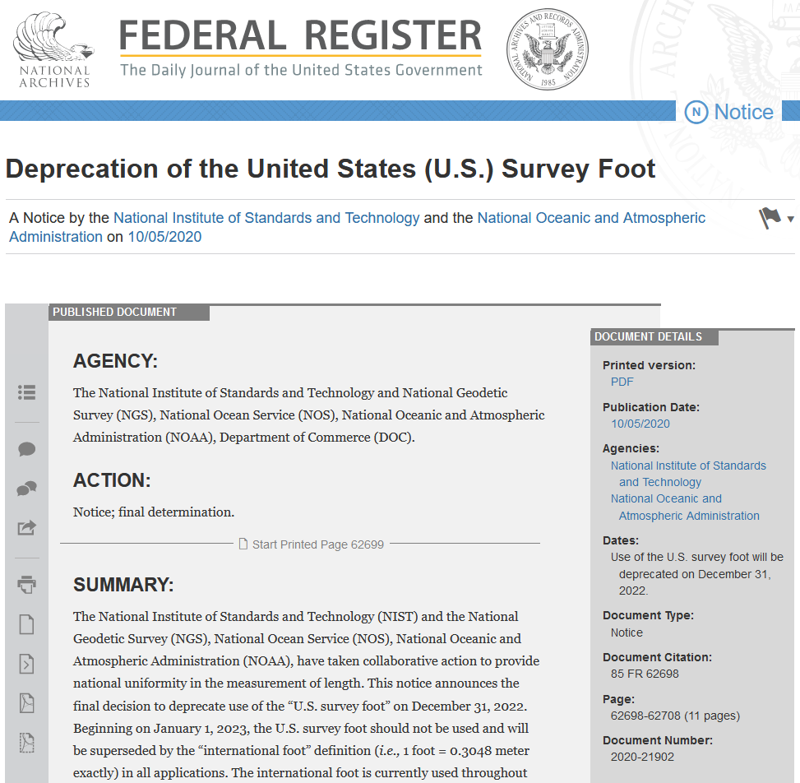
What about the U.S. survey foot?
Will be deprecated on Dec 31, 2022
  Per final determination Federal Register Notice issued on Oct 5, 2020
  Collaborative action by National Institute of Science and Technology (NIST) and NGS
  Describes public comments received, along with the plan, resources, training, and other information for an orderly transition with minimum disruption
(this image is hyperlinked to the Federal Register page)

Slide 47
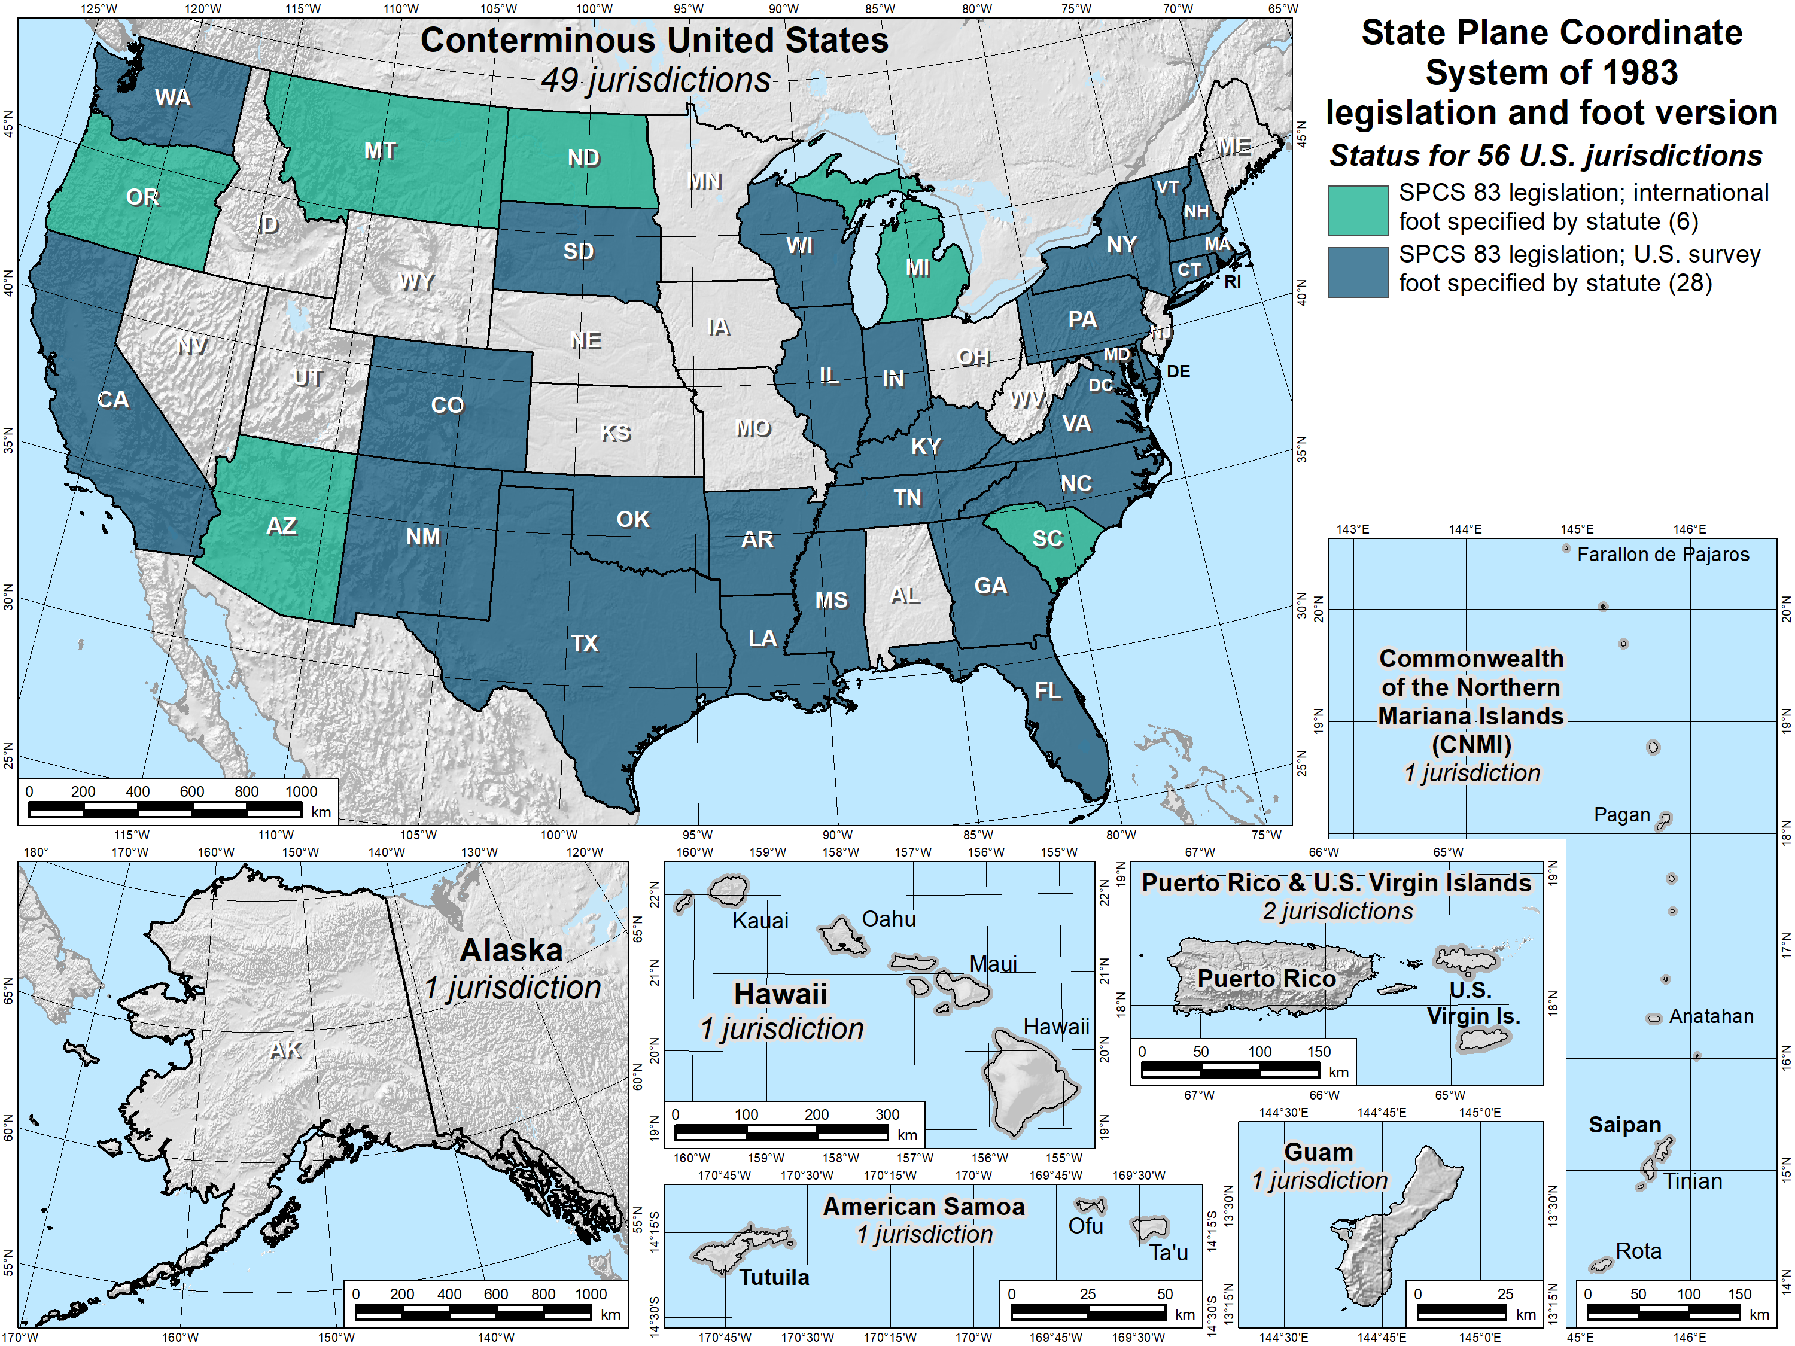
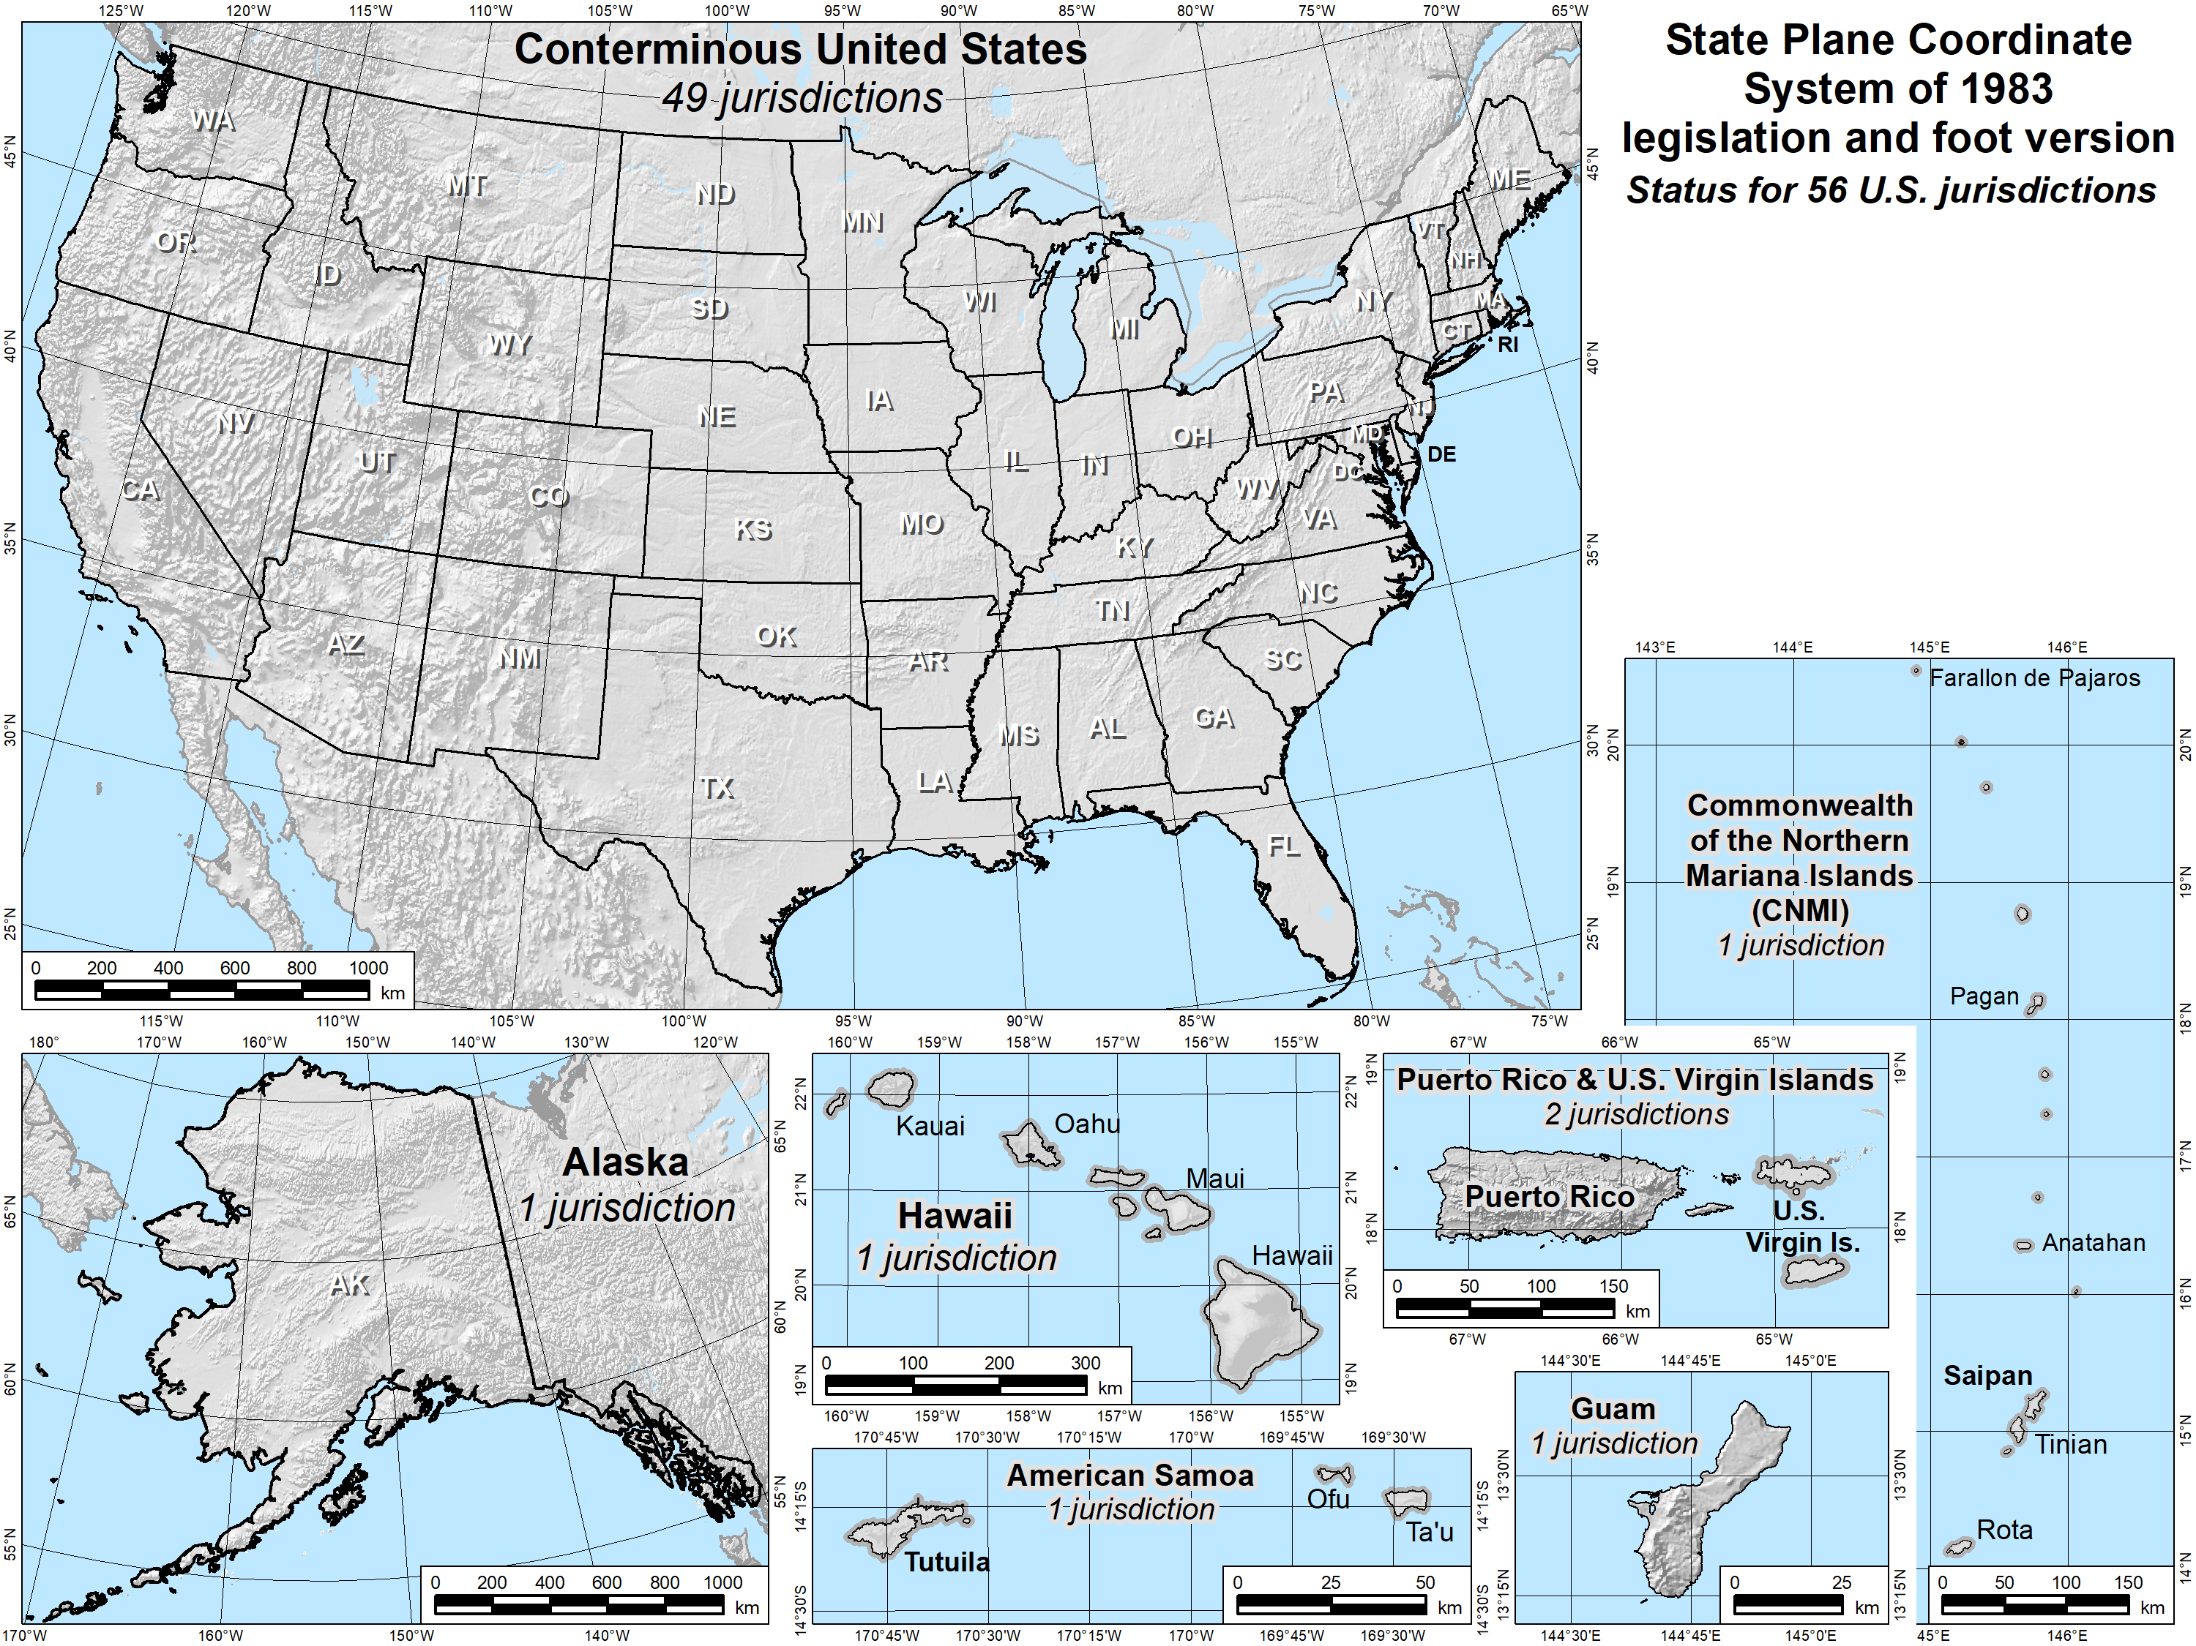
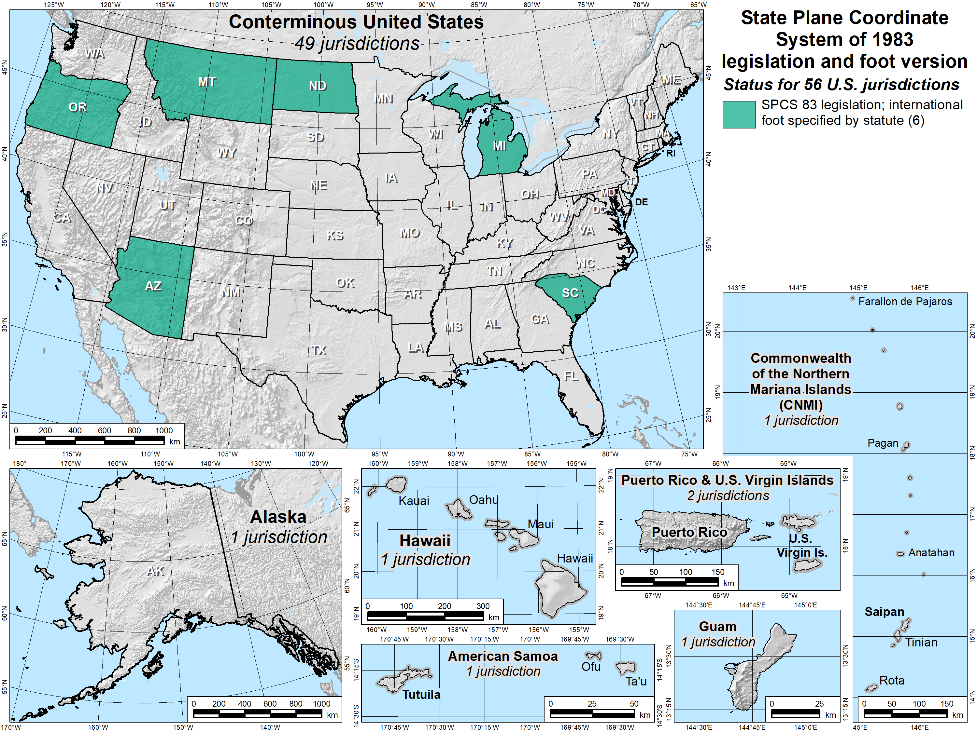
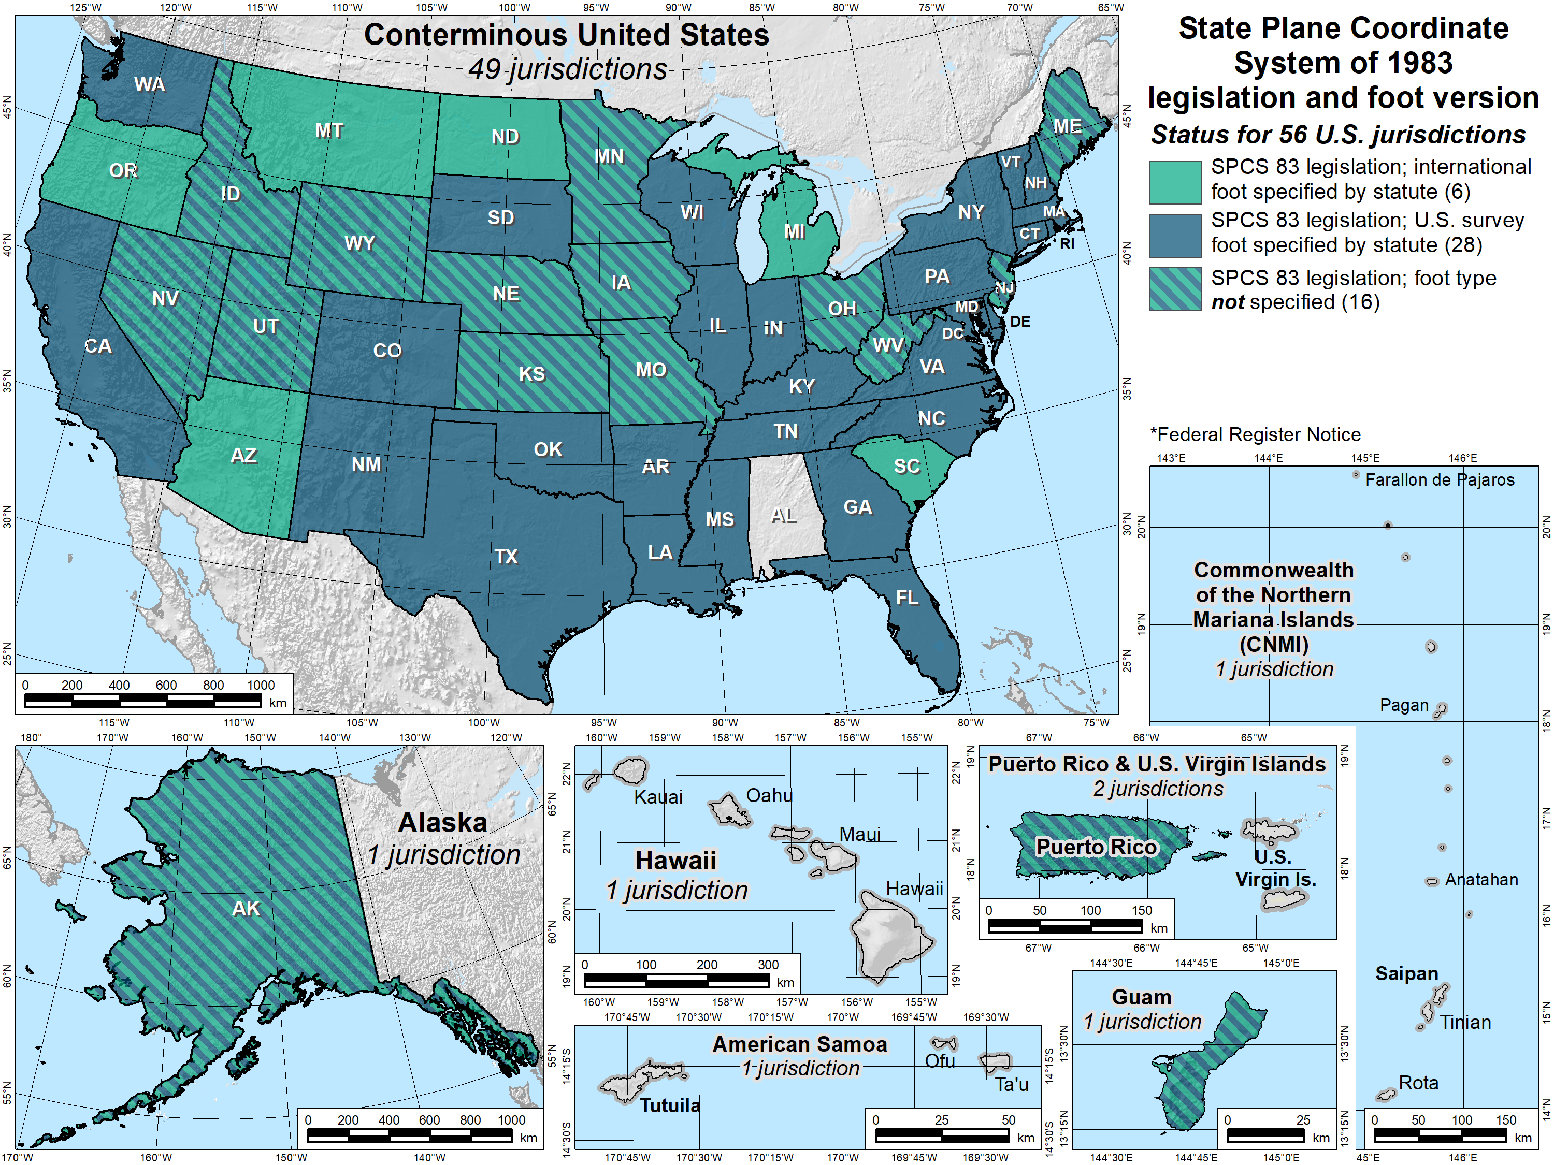
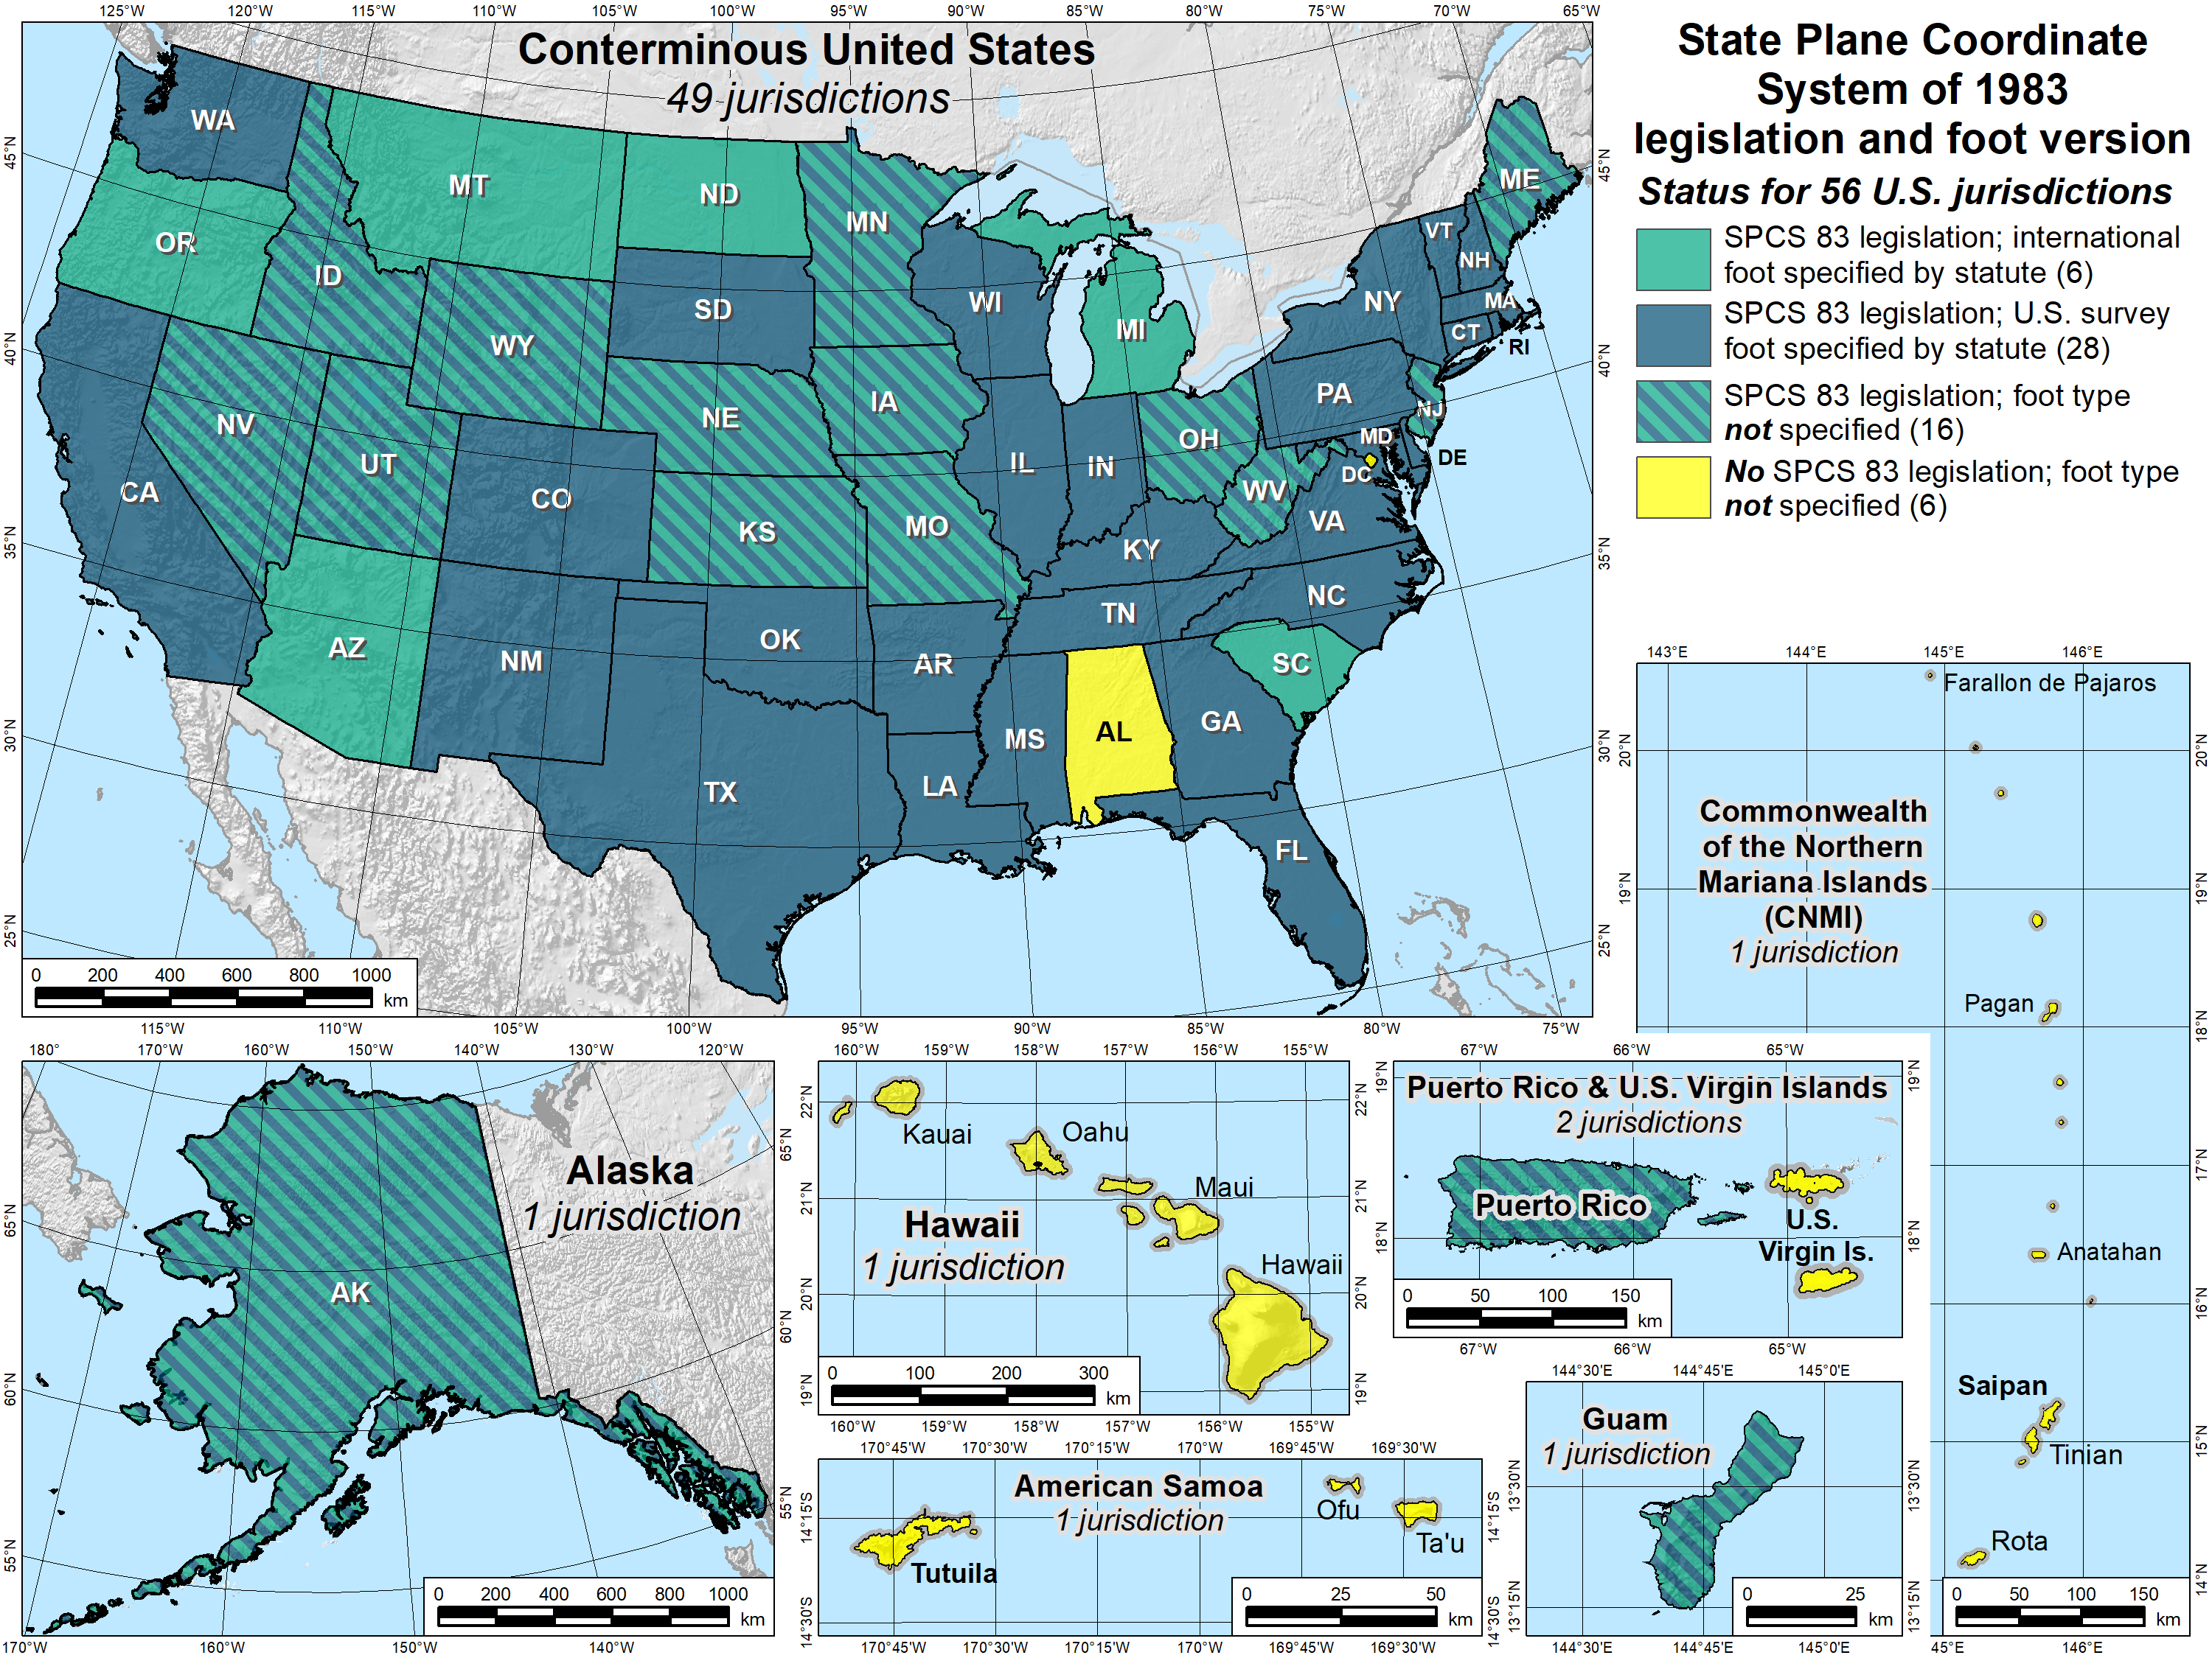
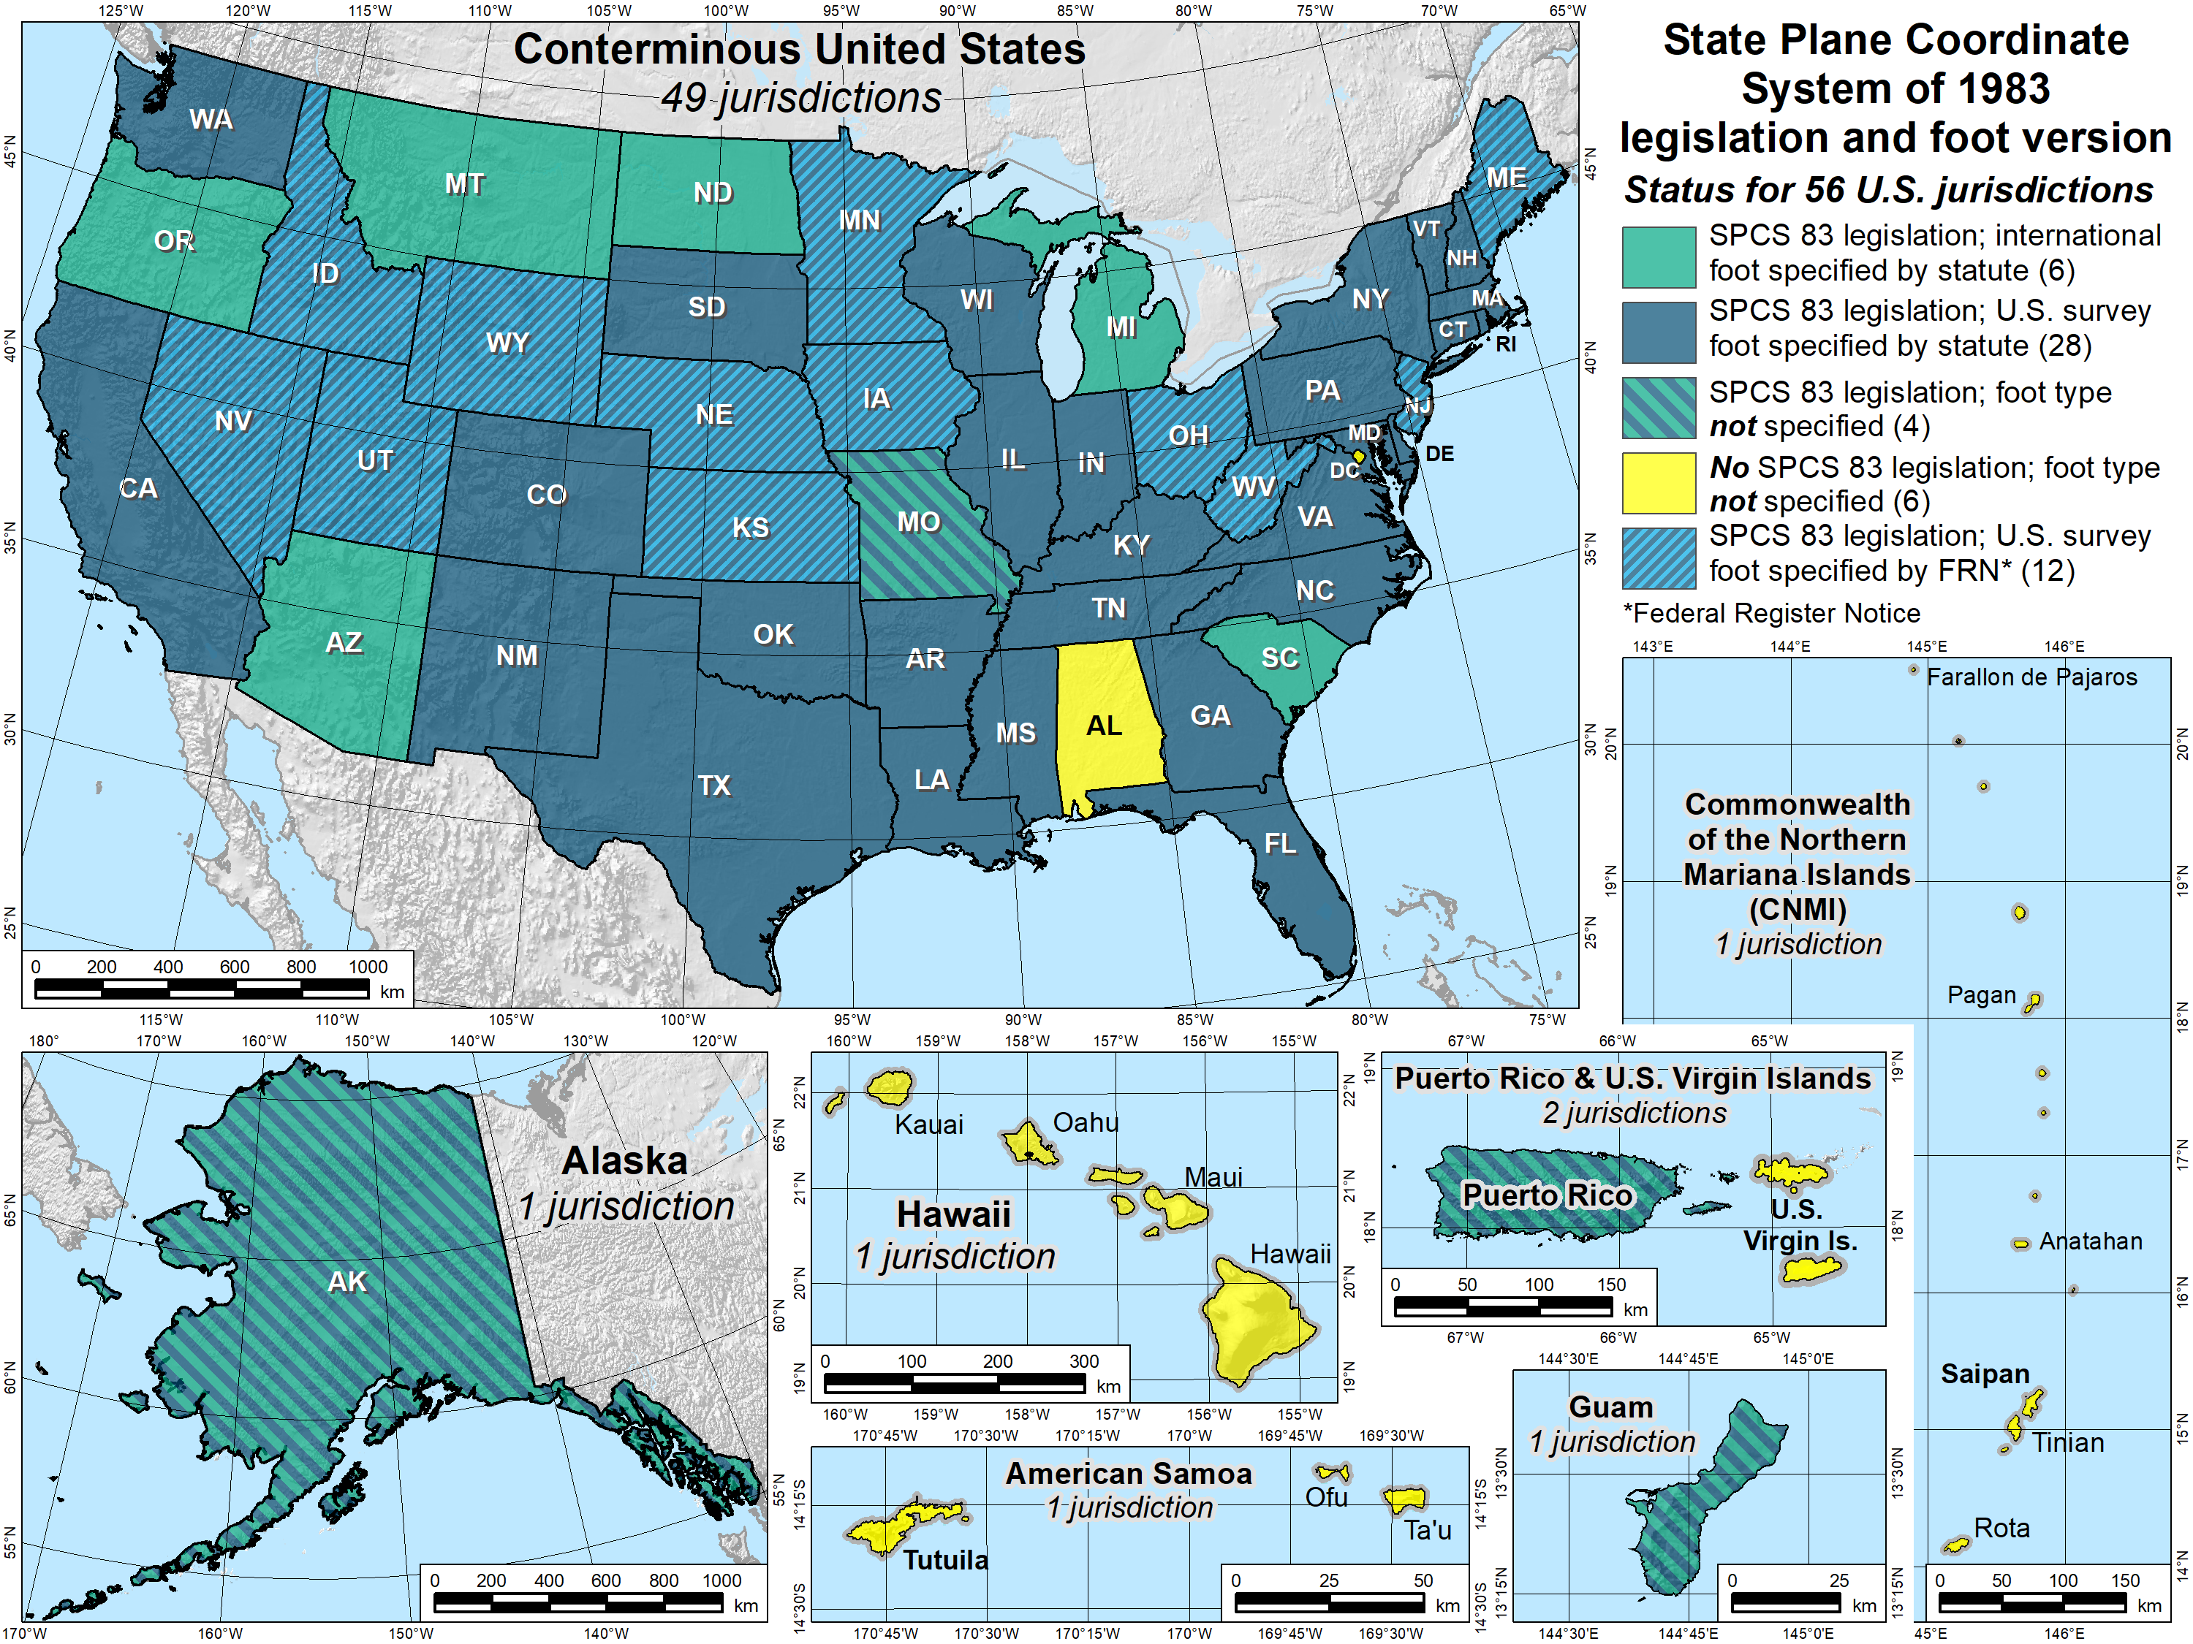
SPCS 83 legislation and foot version
56 U.S. jurisdictions
Legislation
  International foot: 6
  U.S. survey foot: 28
  Neither: 16
  No legislation at all: 6
Fed Register Notice
  U.S. survey foot: 12
  In lieu of legislation
  Done 2006-2009
47
47

Slide 48
Putting the “best” foot forward
U.S. survey foot will be retired
  Not supported for State Plane Coordinate System of 2022
  (or any part of modernized NSRS)
  Only international foot will be supported by NGS
In some states, law specifies U.S. survey foot for boundary surveys
  A separate issue since not part of NSRS (not dealt with here)
Effective December 31, 2022
  Independent of NSRS modernization
  U.S. survey foot will still be supported for legacy products
  (e.g., existing State Plane)…

Slide 49
Rumor of U.S. survey foot death greatly exaggerated
U.S. survey will be foot deprecated on December 31, 2022
But use can continue for SPCS 83 (and SPCS 27)
  The 40 states that “officially” use U.S. foot for SPCS 83
  All SPCS 27 zones
  NGS will support such “legacy” use forever
  But NOT supported for ANY zones in SPCS2022
Please repeat:
NGS will always support
U.S. survey foot for SPCS 83 and 27
Thank you.

Slide 50
Why allow U.S. survey foot after Dec 31, 2022?
Key idea: done in an “orderly fashion with minimum disruption”
  Sudden switch for existing coordinate system too disruptive
  Will give states more time to prepare
  U.S. survey foot usage will diminish over time (especially after 2025)
Recommend enabling in legislation
  Include SPCS 83 and SPCS 27 in statute as “legacy” systems
  Gives way to keep using U.S. survey foot after Dec 31, 2022
Better to have change occur with new State Plane
  Change in length of foot “hidden” in change of projection scale
  Projection scale change much greater than 2 ppm for most zones
NGS and NIST are not regulatory agencies, so can’t “enforce” change

Slide 51
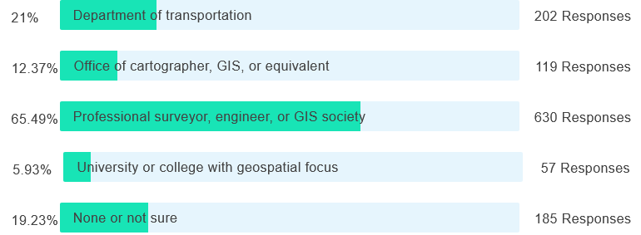
Poll question
Are you associated with any of the following SPCS2022 stakeholder groups in your state? (select all that apply)

Slide 52



Modernized NSRS in legislation
geodesy.noaa.gov
National Spatial Reference System will change in 2025
NGS recommends updating legislation for modernized NSRS
Template and example legislation available on NGS website

Slide 53
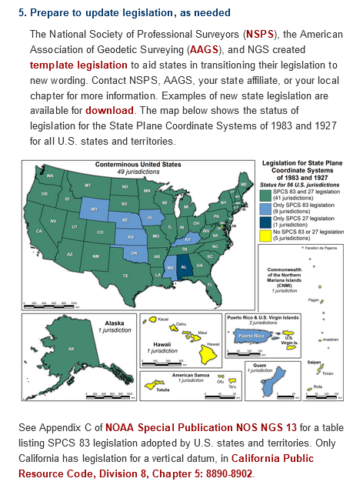
Template state legislation https://geodesy.noaa.gov/datums/newdatums/GetPrepared.shtml
Created by NSPS, AAGS, and NGS
  Intended to augment existing legislation
  Defined by NGS OR by state (not both)
Reduce need for later legislation updates
  Do not include specific names of datums, etc.
  Do not include zone projection parameters
Foot version
  Must be 1 ft = 0.3048 m for new State Plane
  Can be 1 ft = 1200/3937 m for previous
  State Plane

Slide 54
Example state legislation https://geodesy.noaa.gov/datums/newdatums/GetPrepared.shtml
Washington and South Dakota
  Uses “foot” definition 1 ft = 0.3048 m
  Nothing about previous State Plane
Kentucky
  Uses name “international foot”
  Refers to administrative regs for details
  Added SPCS 27 (not previously legislated)
Alaska
  “Alaska Coordinate System of 2022”
  Uses name “international foot”

Slide 55
Recommendations on NSRS legislation
Do not include specific technical information
  No zone parameters, accuracy, or performance specifications
Retain previous versions (SPCS 27 and SPCS 83)
  Provides mechanism for continuing to use U.S. survey foot for SPCS 83
Goal: “future-proof” legislation
  Create statute that will not require later updates
…and to just make life easier
  Much harder to change information in statute
  Less need to explain to legislators
  Some states will have a LOT of zones (e.g., 90 in Utah, 89 in Ohio, 63 in Arizona, etc.)
  Do you really want to put all of these zones into statute?

Slide 56
Do you really want stuff like this in statute?
Arizona Revised Statute, Title 33, Chapter 1, Article 3, Section 133:
B. For the purpose of more precisely defining the Arizona coordinate system, the following definitions of the national geodetic survey are adopted:
1. The Arizona coordinate system, 1983, west zone, is a transverse mercator projection of the North American datum, 1983, having a central meridian 113° 45' 00" west of Greenwich, on which meridian the scale is set one part in fifteen thousand too small. The origin of the coordinates is at the intersection of the meridian 113° 45' 00" west of Greenwich and the parallel of 31° 00' 00" north latitude. This origin is given the coordinates of "X" equals seven hundred thousand feet and "Y" equals zero feet.
Do you really want to explain this to legislators?
Do you want to repeat this 90 times (Utah), 89 times (Ohio),…?
What if you want or need to change something?
What if anything becomes obsolete?

Slide 57
Or this?
Arizona Revised Statute, Title 33, Chapter 1, Article 3, Section 137:
A. Extensions and densifications of the ground marking system of the Arizona coordinate system, 1983, shall be executed in conformity with the standards and specifications of the federal geodetic control committee for first order, second order class I and second order class II surveys and computed on the North American datum, 1983.
B. The results of these surveys shall be published by a competent department of the federal government, such as the national geodetic survey, or a surveyor qualified to practice in this state, in which case the survey results shall bear a certification to the effect that the specifications of the federal geodetic control committee have been followed.
C. Extensions and densifications of the ground marking system by first order, second order class I or second order class II methods only shall be used. Such extensions and densifications shall be integrated with previously established horizontal control stations of equal or higher order to form a matrix or network no part of which shall have positional errors exceeding those specified for class II second order. The spacing intervals shall not exceed three miles.
Obsolete
Remember prescient words about model act in 1989:
“In light of GPS technology, the 1 km limitation… should be reevaluated.”

Slide 58

Modernized NSRS in state legislation
Encouraged by NGS
  Part of NGS SPCS2022 Policy (§ III.C)
  But legislation not required to create SPCS
Please note:
  Cannot impose SPCS characteristics on NGS
  NGS has last word on SPCS
Keep in mind, NGS is a metric (SI) shop
  Have been since 1977
  We’d love it if you went metric, too!
  (and so would NIST)
(this image is hyperlinked to NGS policies page)

Slide 59
Summary
Long history of State Plane in legislation (since 1935!)
Make legislation “future proof”
  Do not include specific names for modernized NSRS
  No technical info (e.g., projection parameters, surveying specifications)
Legislation template and actual examples available
U.S. survey foot will not be supported in modernized NSRS
Legislation entirely up to states; NGS can only provide guidance
  NGS can’t make states do anything…
  …but states can’t make NGS do anything, either
An incentive to cooperate

Slide 60

So let there be questions,
or let there be none.

Slide 61
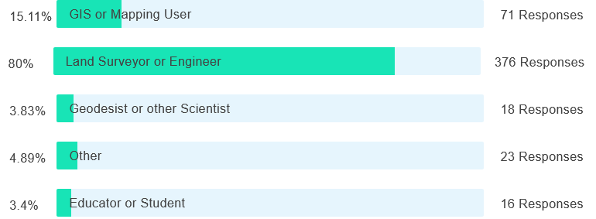
Post-webinar survey question
What is your profession?

