Slide 1

The Circle is Now Complete
nearly
Introducing the State Plane Coordinate System of 2022
UESI Surveying & Geomatics 2024 Conference
June 4, 2024
Michael L. Dennis, PhD, PE, PLS
SPCS2022 Project Manager

Slide 2
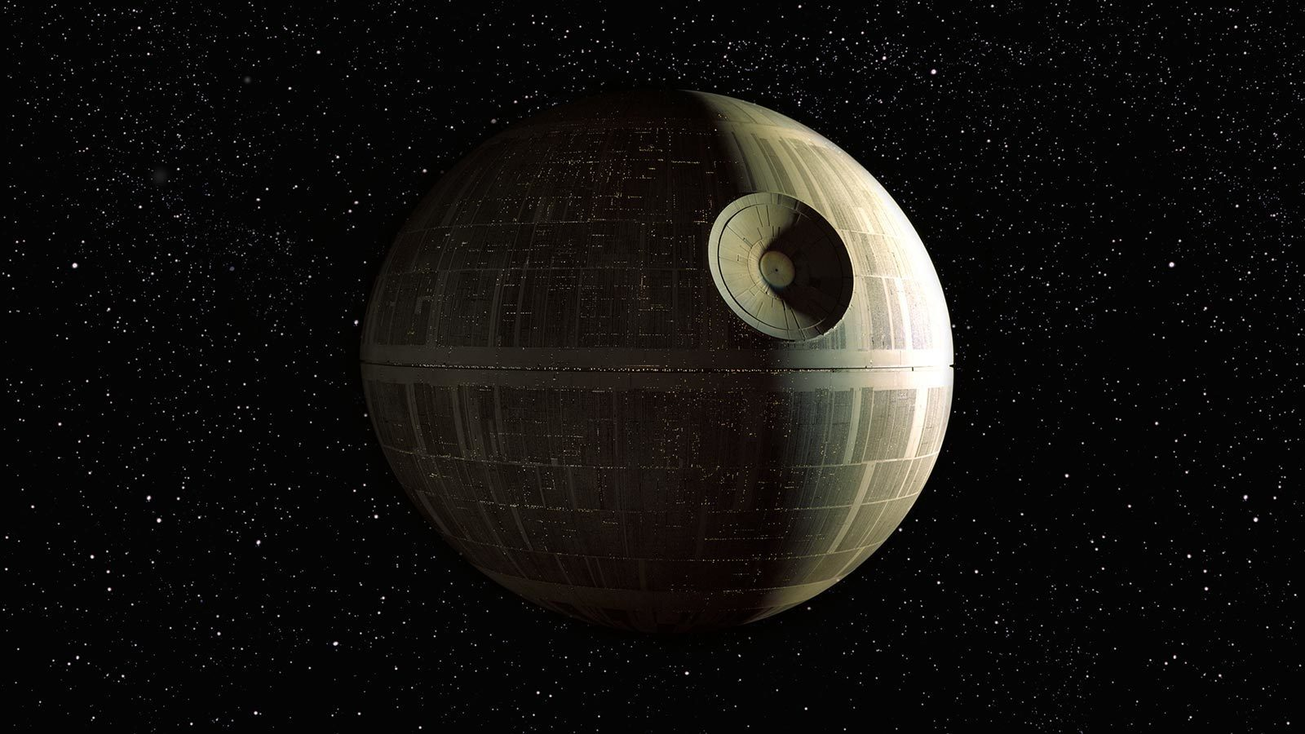
This is what we were hoping to show you today…

Slide 3
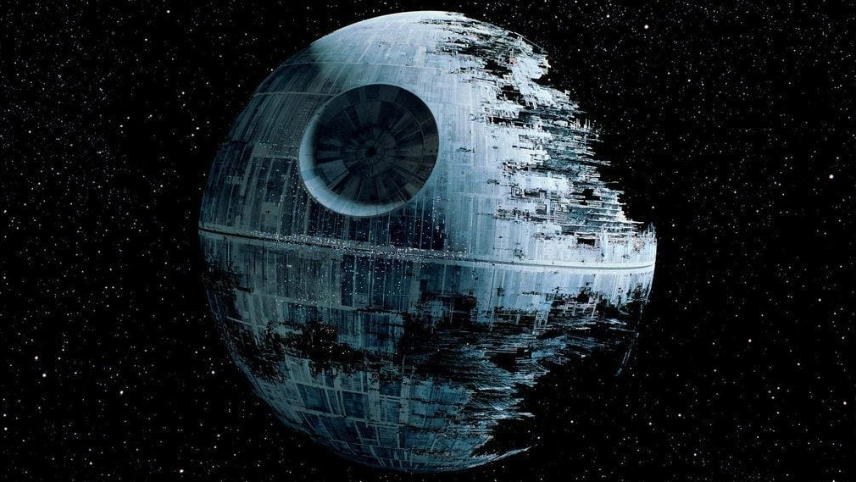
…but this is where we are (functional but still under construction)

Slide 4
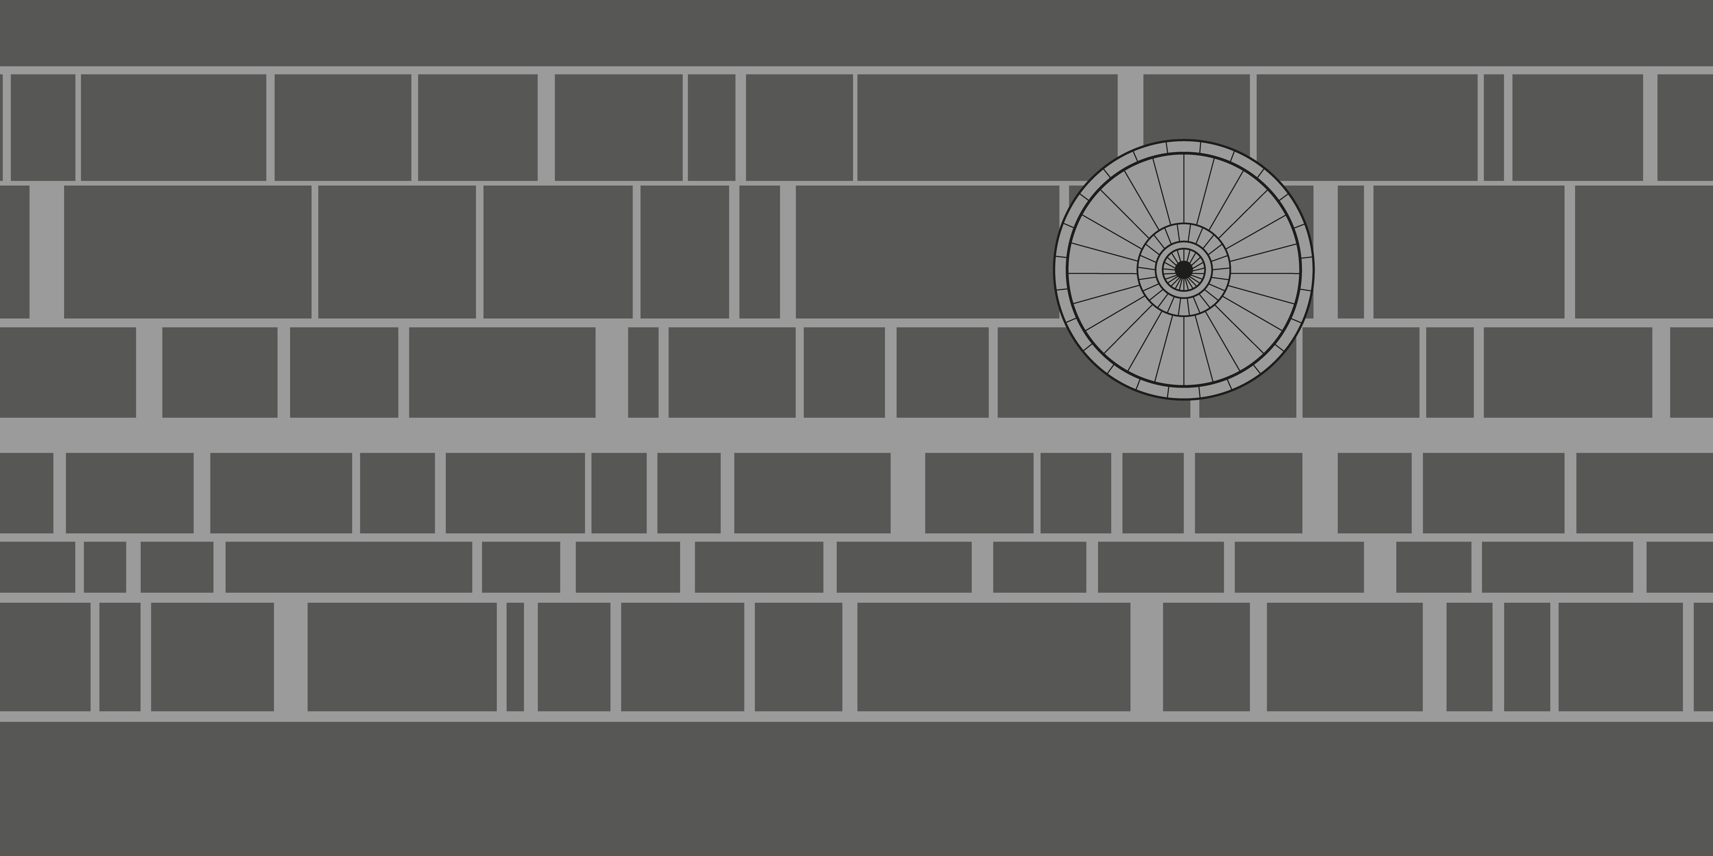
Perhaps “flatten” the Death Star with its own SPCS2022 zone?

Slide 5
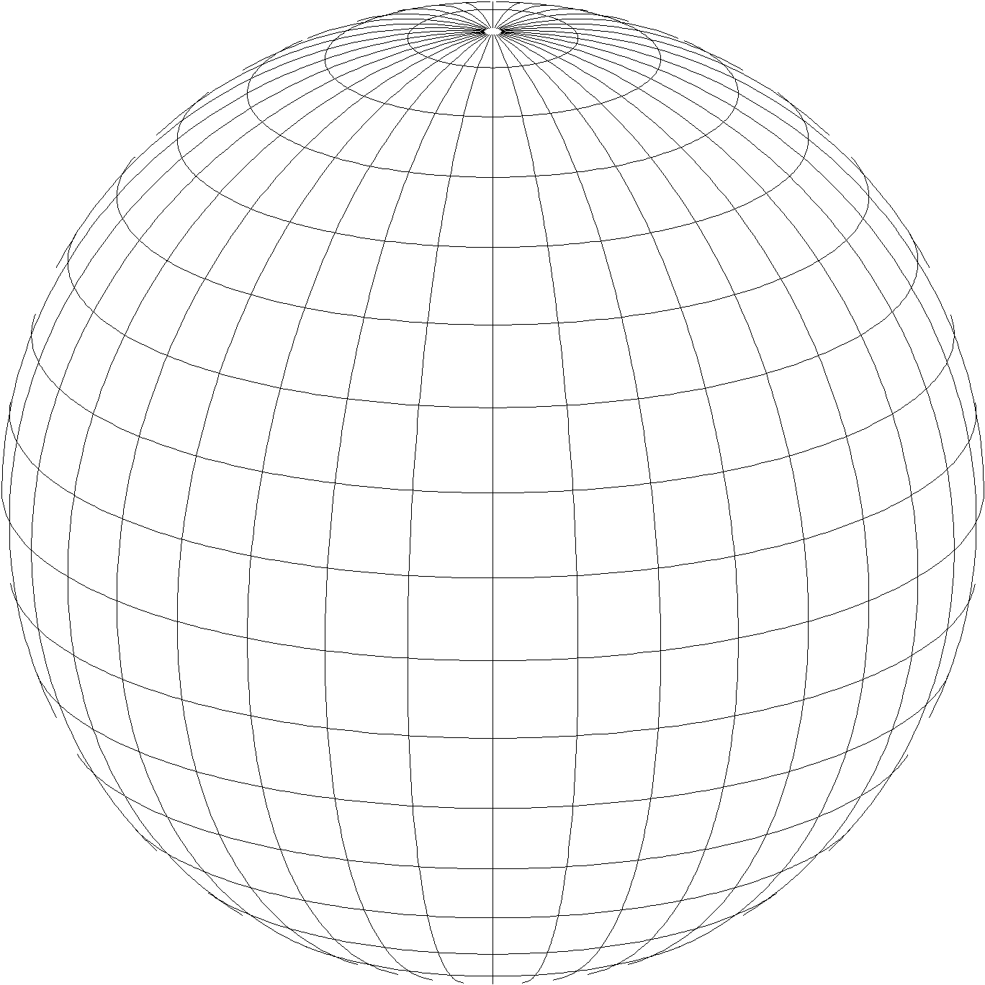
State Plane Coordinate System of 2022 (SPCS2022)
Part of modernizing the National Spatial Reference System (NSRS)
Third generation of State Plane
First in 1930s (SPCS 27), second in 1980s (SPCS 83)
Same 3 conformal map projection types
Same ellipsoid as SPCS 83 (GRS80)
Same as existing State Plane, but different…
Based on new terrestrial reference frames instead of NAD 83
More zones, most designed by state stakeholders
Designed to reduce linear distortion at topographic surface (i.e., reduce difference between “grid” and “ground” distances)
Design of all SPCS2022 zones (nearly) done!
Lambert Conformal Conic
Transverse Mercator
Hotine Oblique Mercator

Slide 6
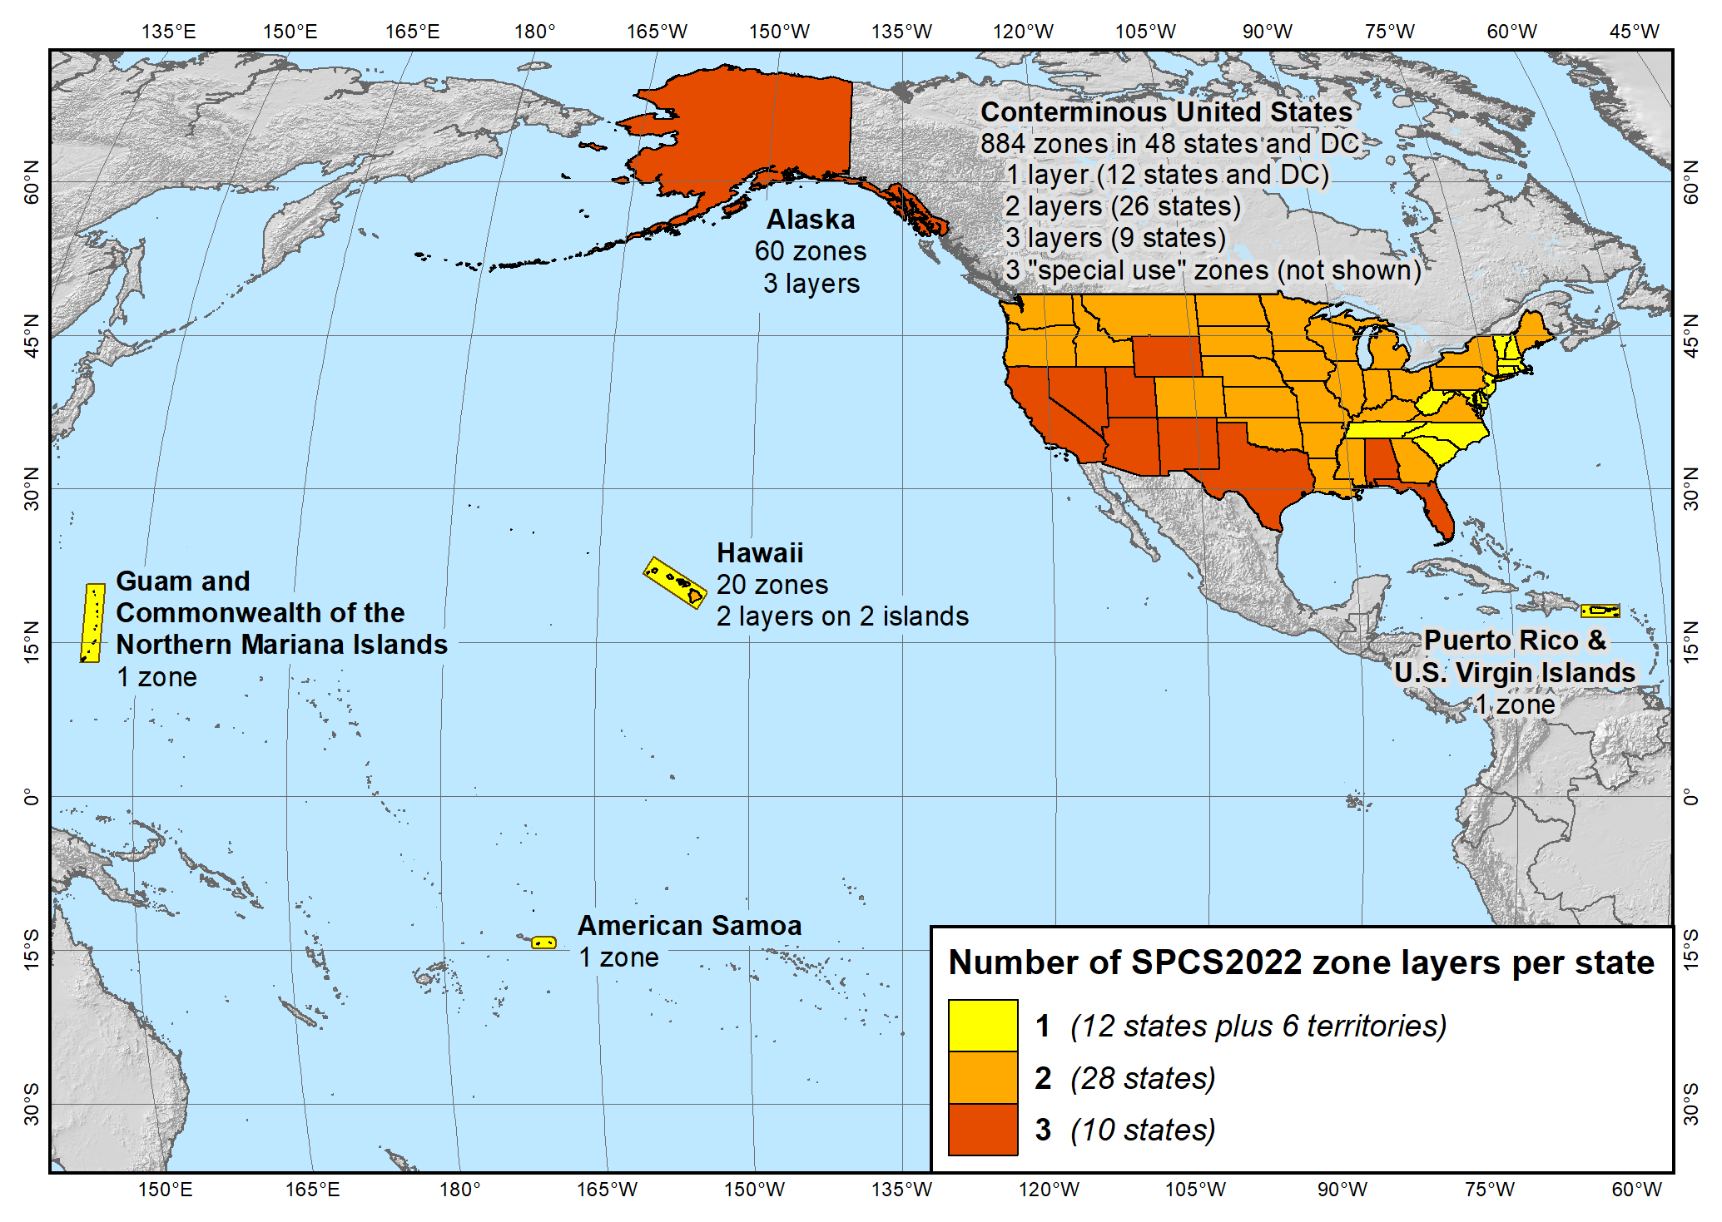
SPCS2022 zone layers
1 layer: 12 states plus 6 territories
2 layers: 28 states
3 layers: 10 states

Slide 7
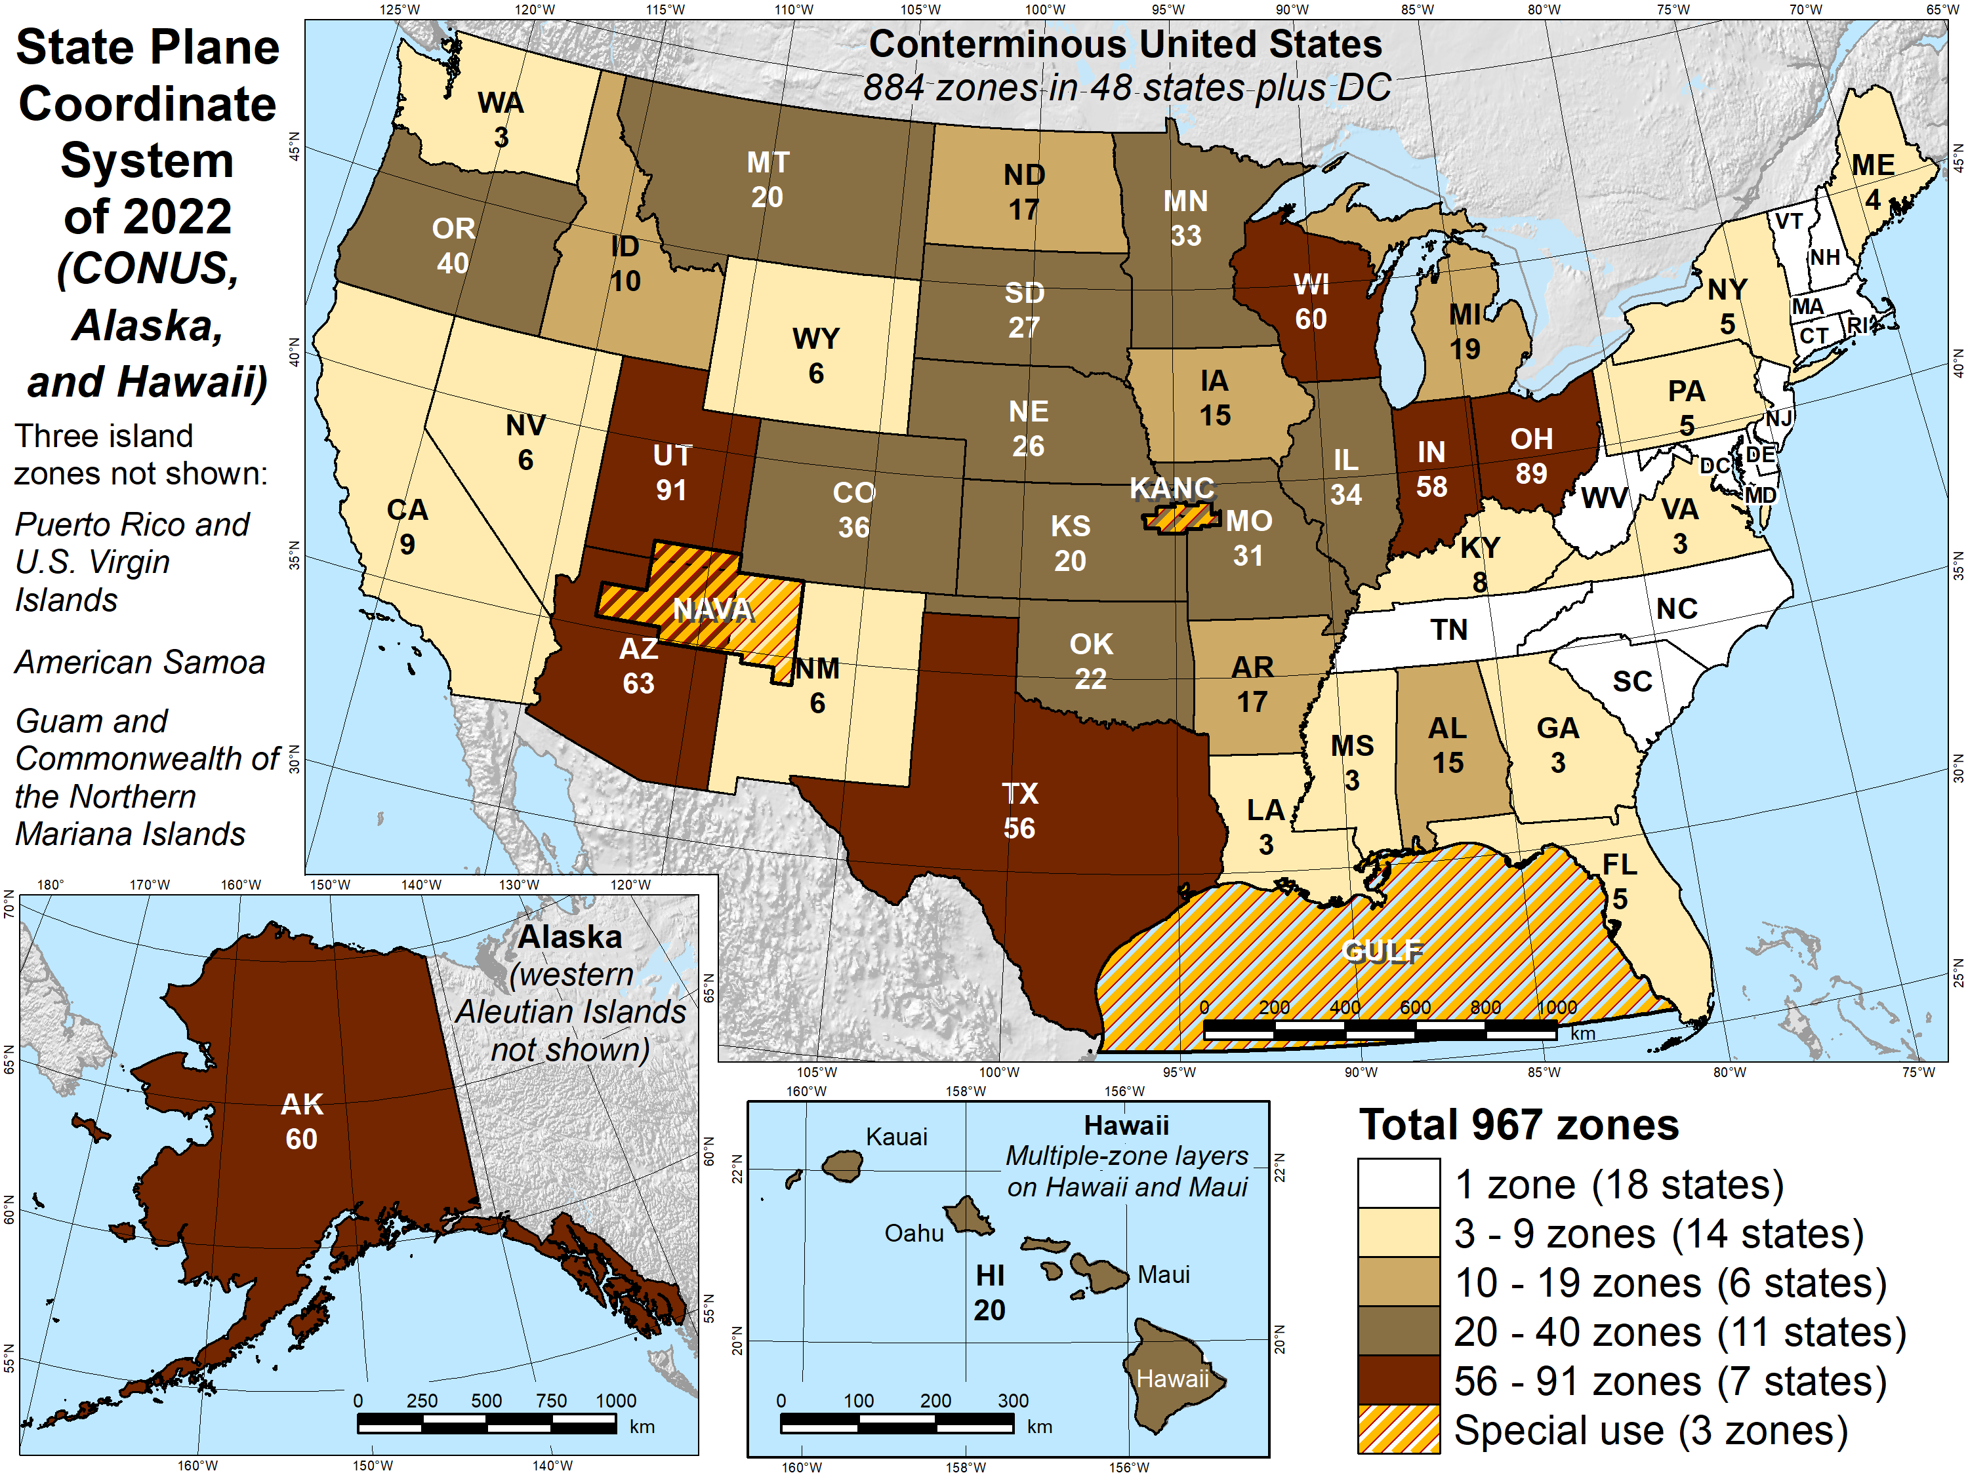
Number of SPCS2022 zones (preliminary)
Designs by NGS
165 zones
Includes 54 statewide zones…
…and 3 “special use” zones (in more than one state)
Designs by state stakeholders
802 zones in 28 states
Total = 967 zones for 56 states and territories
Compare to 125 zones in existing State Plane

Slide 8
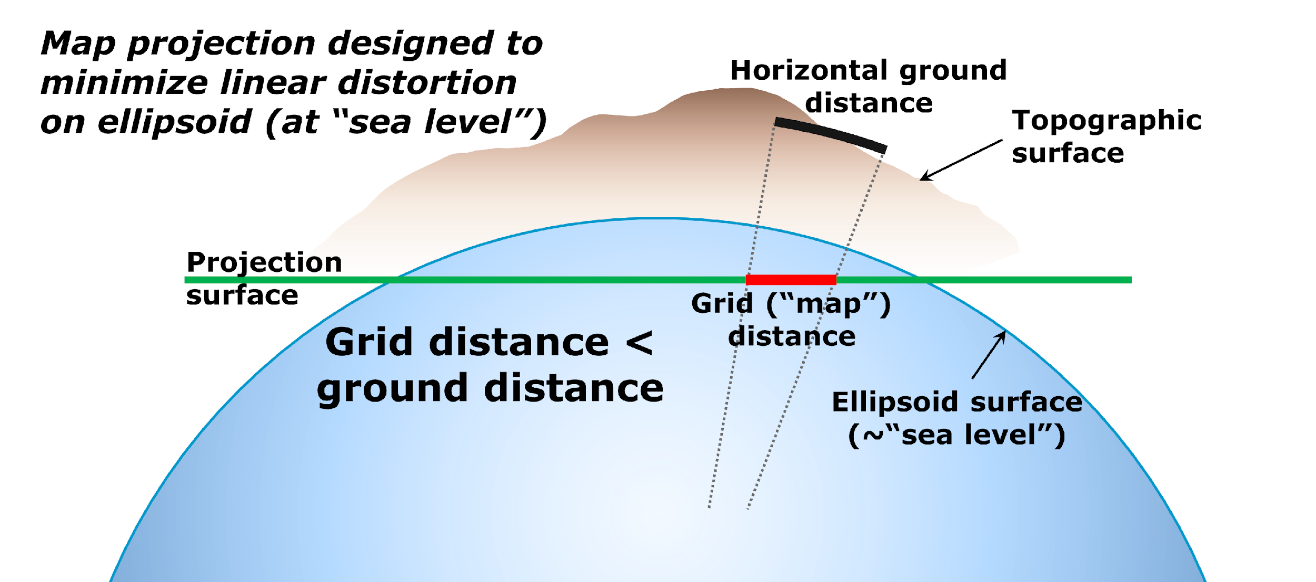
State Plane Coordinate Systems of 1983 and 1927

Slide 9
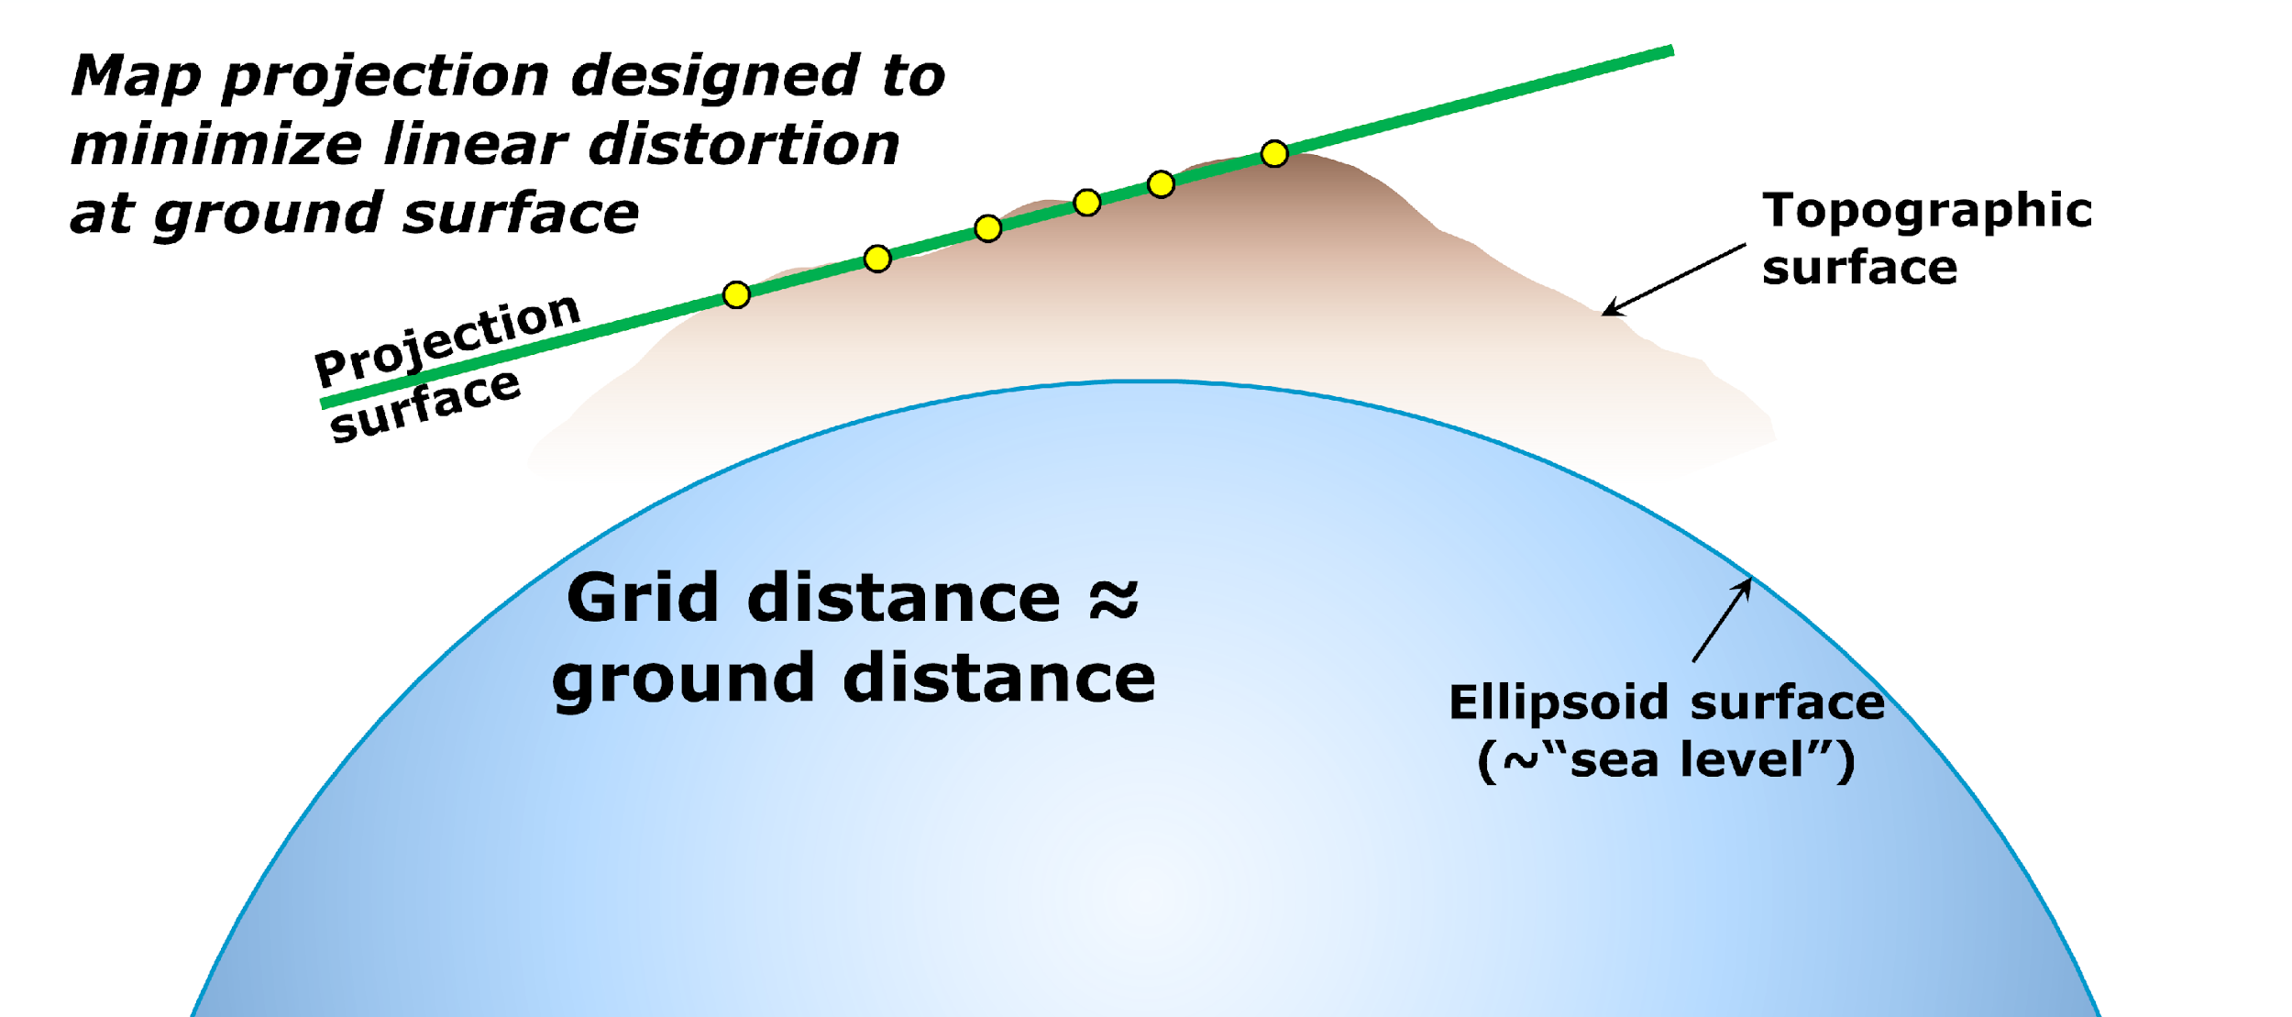
State Plane Coordinate System of 2022

Slide 10
SPCS2022 distortion design philosophy
Linear distortion minimized at topographic surface (not ellipsoid surface)
Purpose: reduce difference between projected “grid” and actual “ground” distances
Population distribution also taken into account in NGS designs
What is linear distortion?
Map projection “scale error” at topographic surface
Unique (i.e., same in every direction) only for conformal projections
Given here in parts per million (ppm) = mm of distortion per km
Linear distortion | = | Projected minus actual distance
 |  | Actual distance
= | Combined factor - 1

Slide 11
Linear distortion magnitudes
Parts per million | Centimeters per kilometer | Feet per mile | Dimensionless ratio | Examples
20 ppm | 2 cm/km | 0.11 ft/mile | 1:50,000 | Typical “low distortion projection” limit
50 ppm | 5 cm/km | 0.26 ft/mile | 1:20,000 | Minimum distortion for designs by NGS
100 ppm | 10 cm/km | 0.53 ft/mile | 1:10,000 | Historic State Plane distortion design limit
400 ppm | 40 cm/km | 2.11 ft/mile | 1:2,500 | UTM distortion design limit

Slide 12
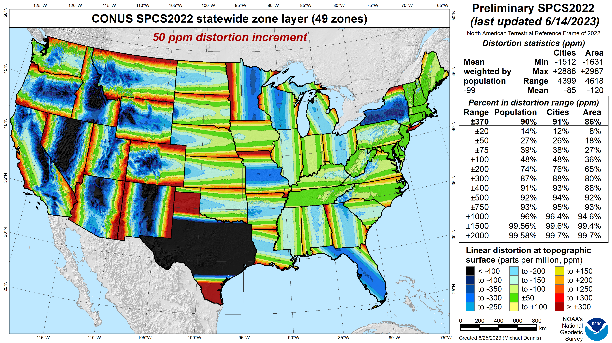
SPCS2022 linear distortion (preliminary)
Green is ±50 ppm (±0.26 ft/mile)
Distortion performance: ±370 ppm
Performance percentages:
90% population
91% cities & towns
86% total area
Mean weighted by population: -99 ppm
Grid versus ground distance
BLUE: grid SHORTER than ground
RED: grid LONGER than ground
GREEN: grid = ground (within ±50 ppm or ±0.26 ft/mile)

Slide 13
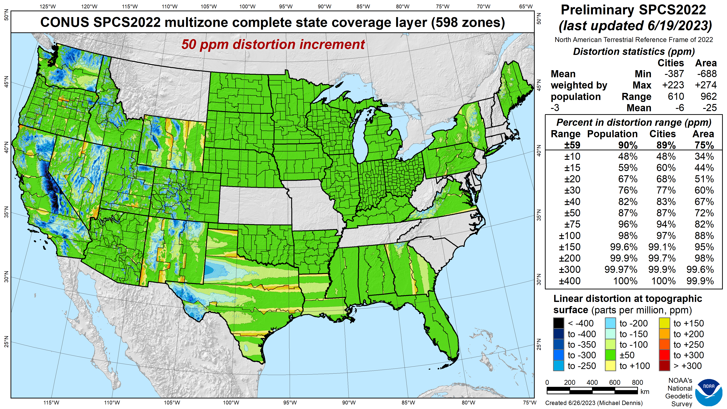
SPCS 83 linear distortion (existing)
Green is ±50 ppm (±0.26 ft/mile)

Slide 14
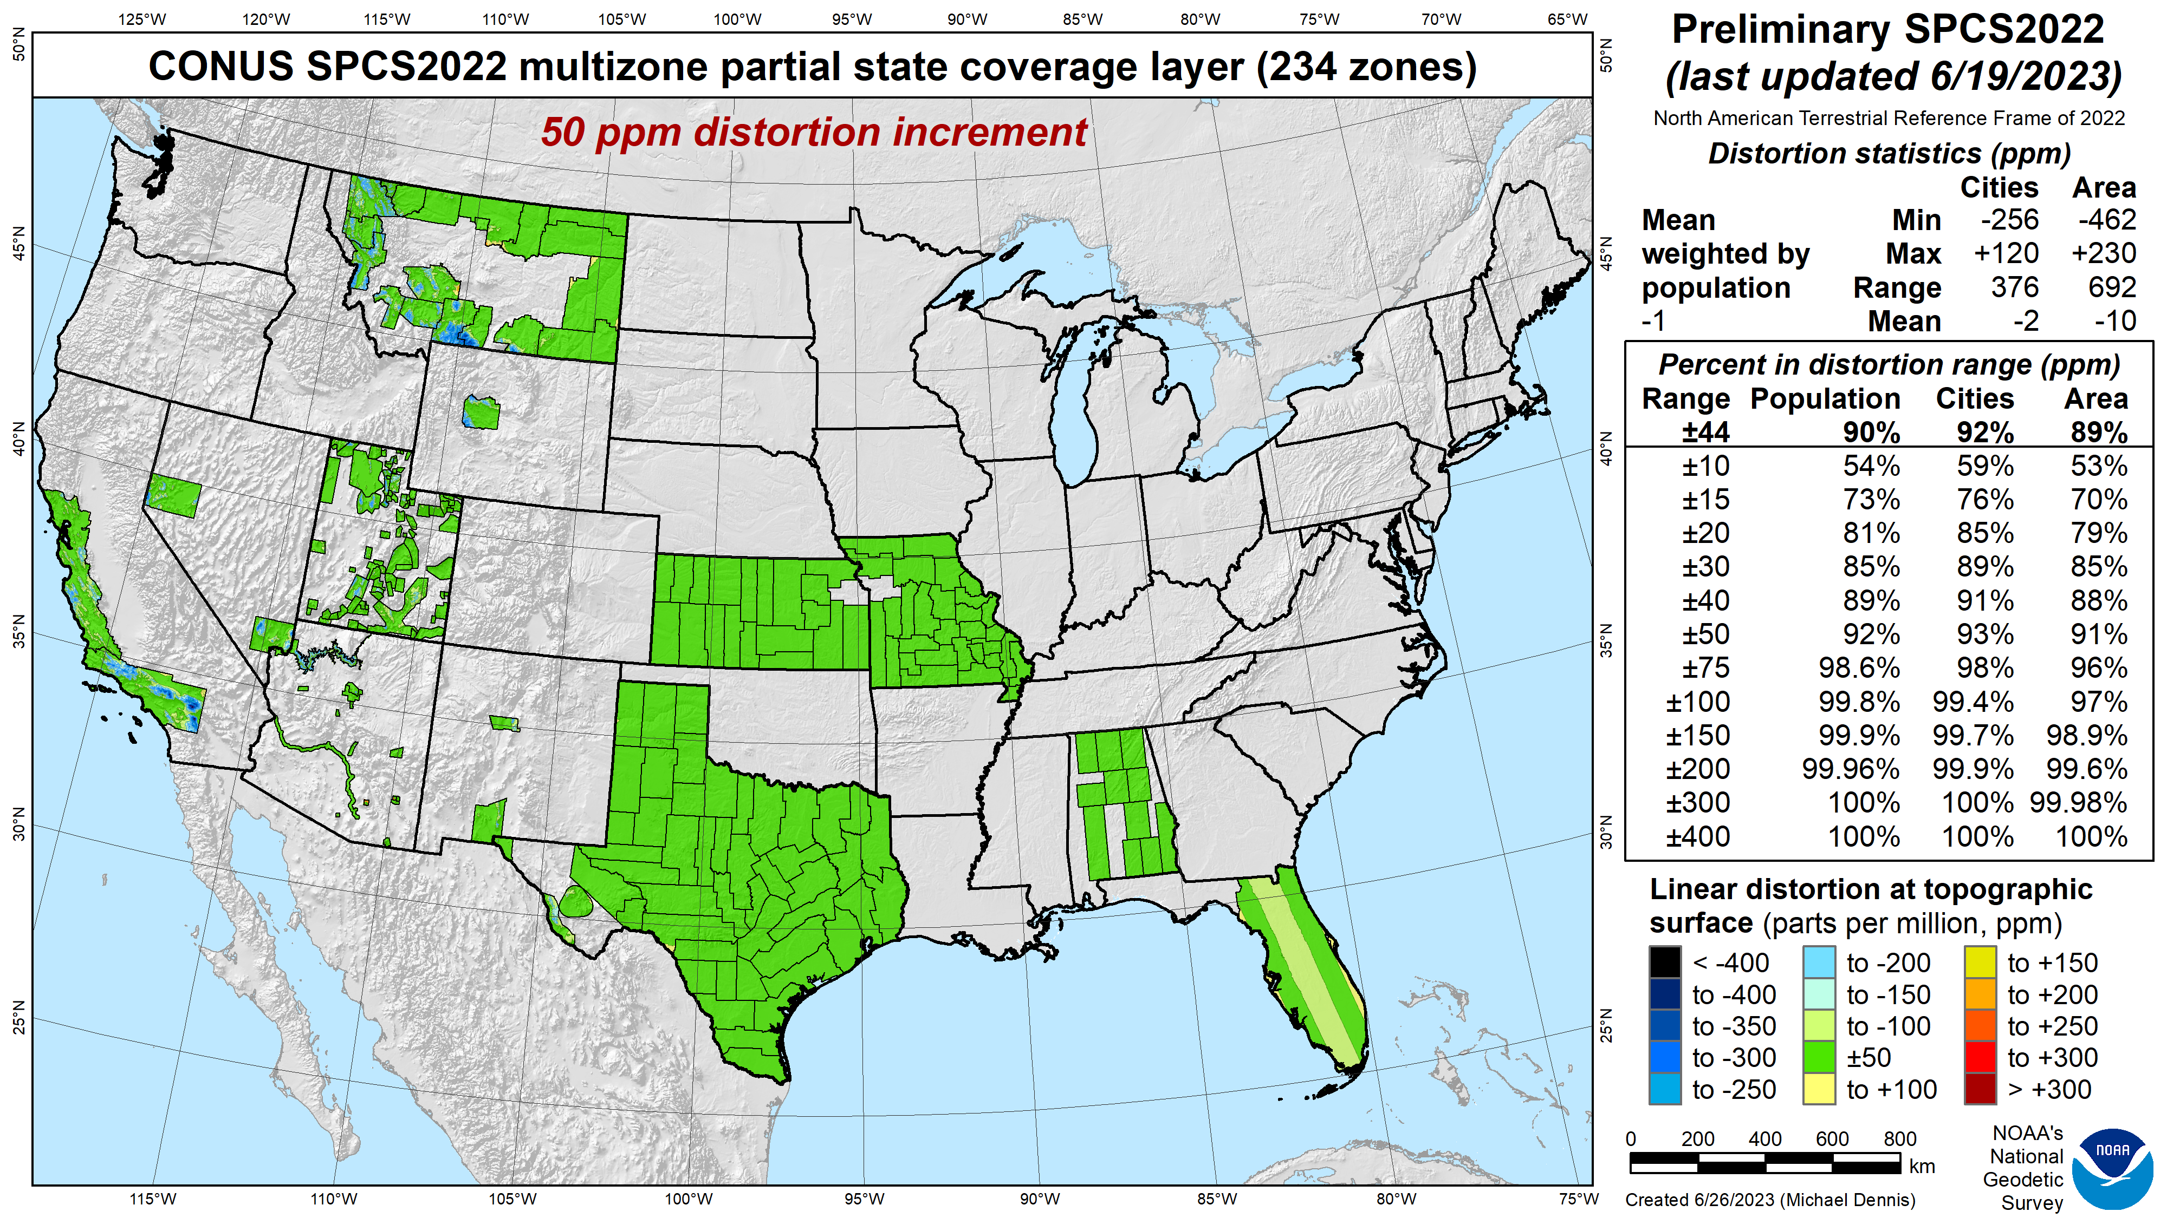
SPCS 83 linear distortion (existing)
Green is ±50 ppm (±0.26 ft/mile)
These 2 zones removed

Slide 15
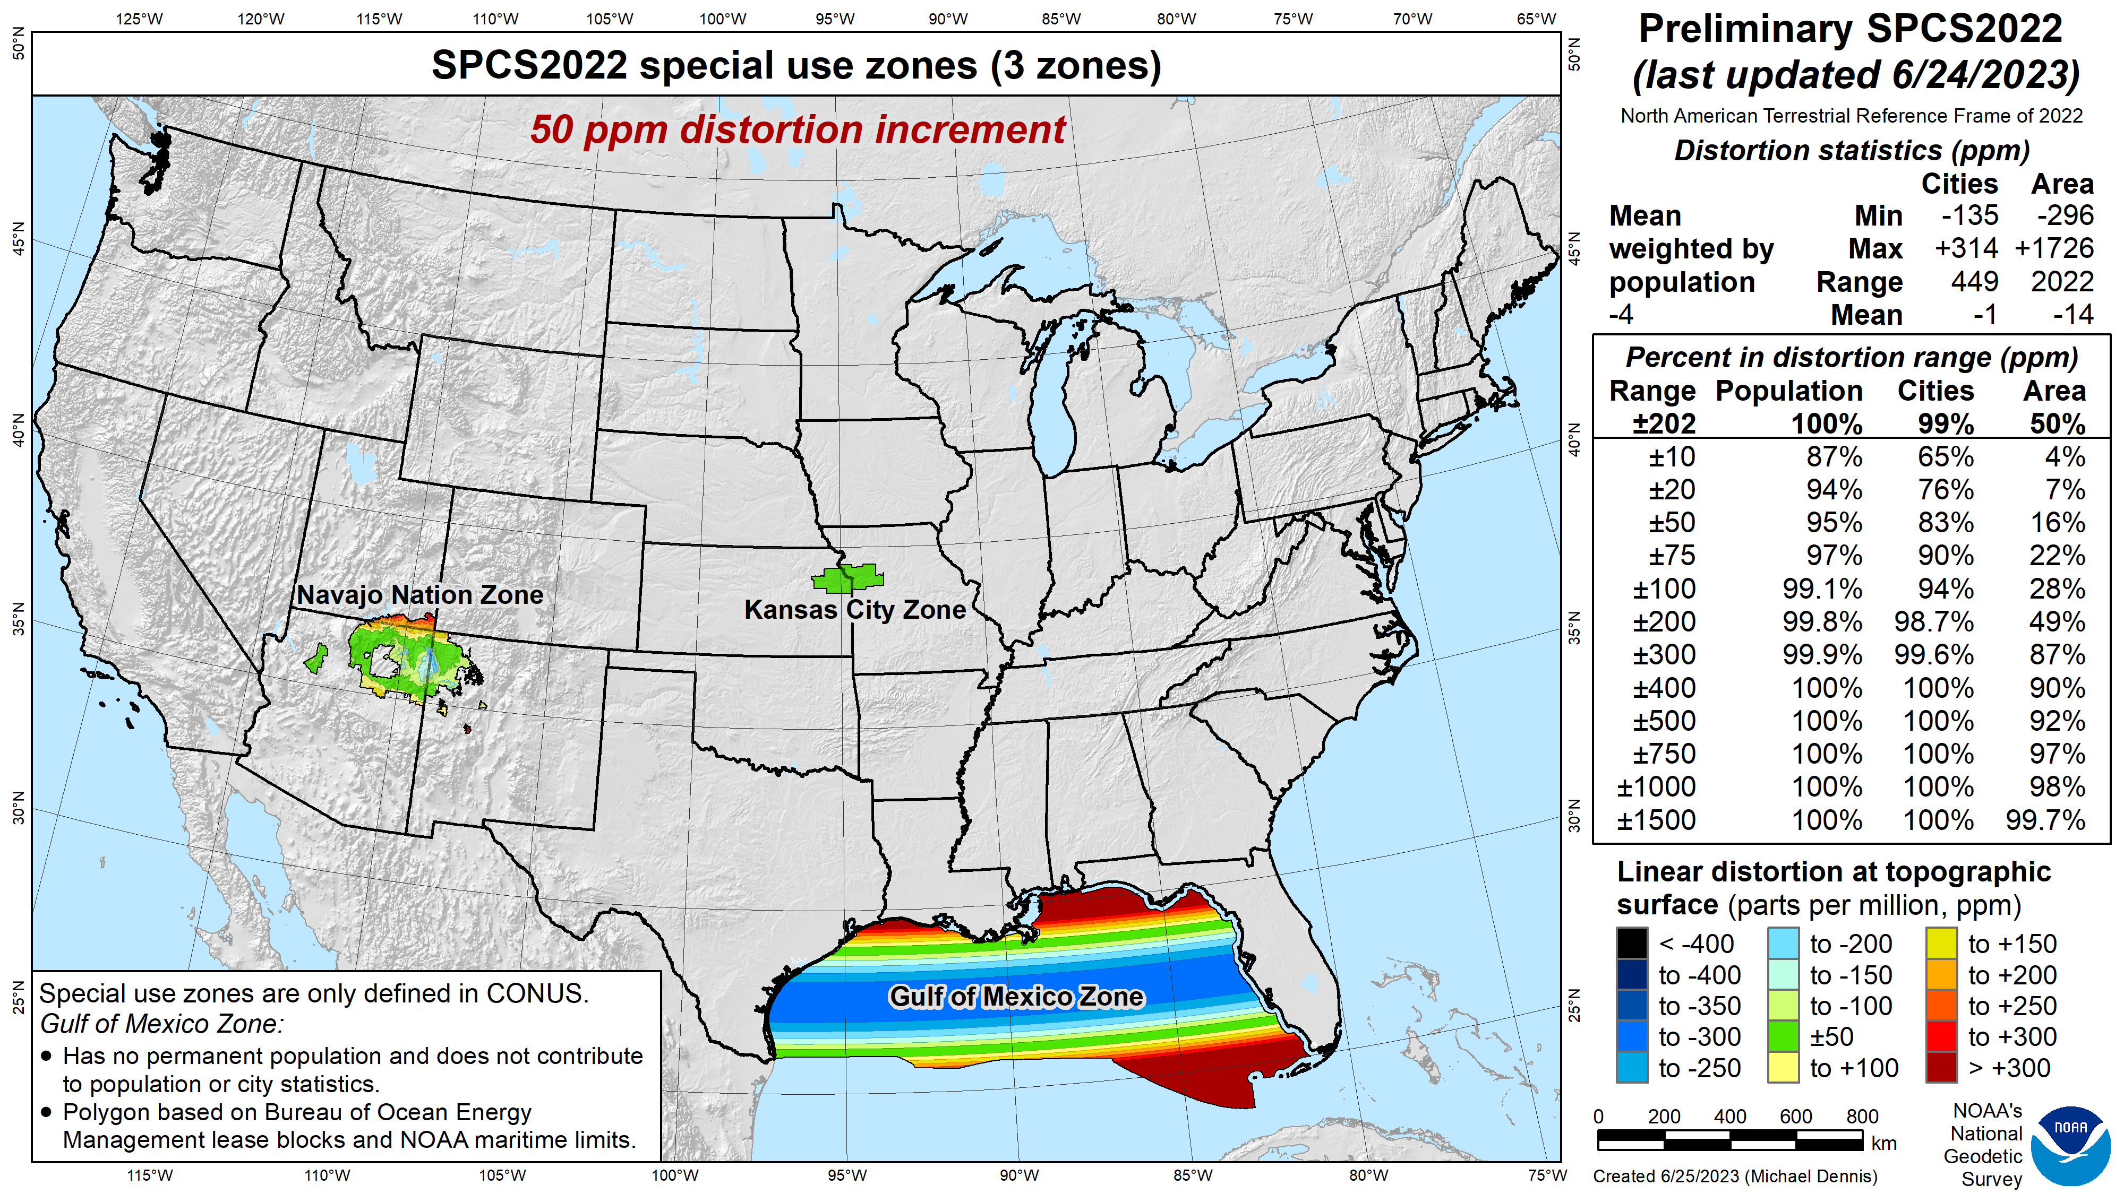
SPCS 83 linear distortion (existing)
Green is ±50 ppm (±0.26 ft/mile)
This zone changed, 7 zones added in multizone layer

Slide 16
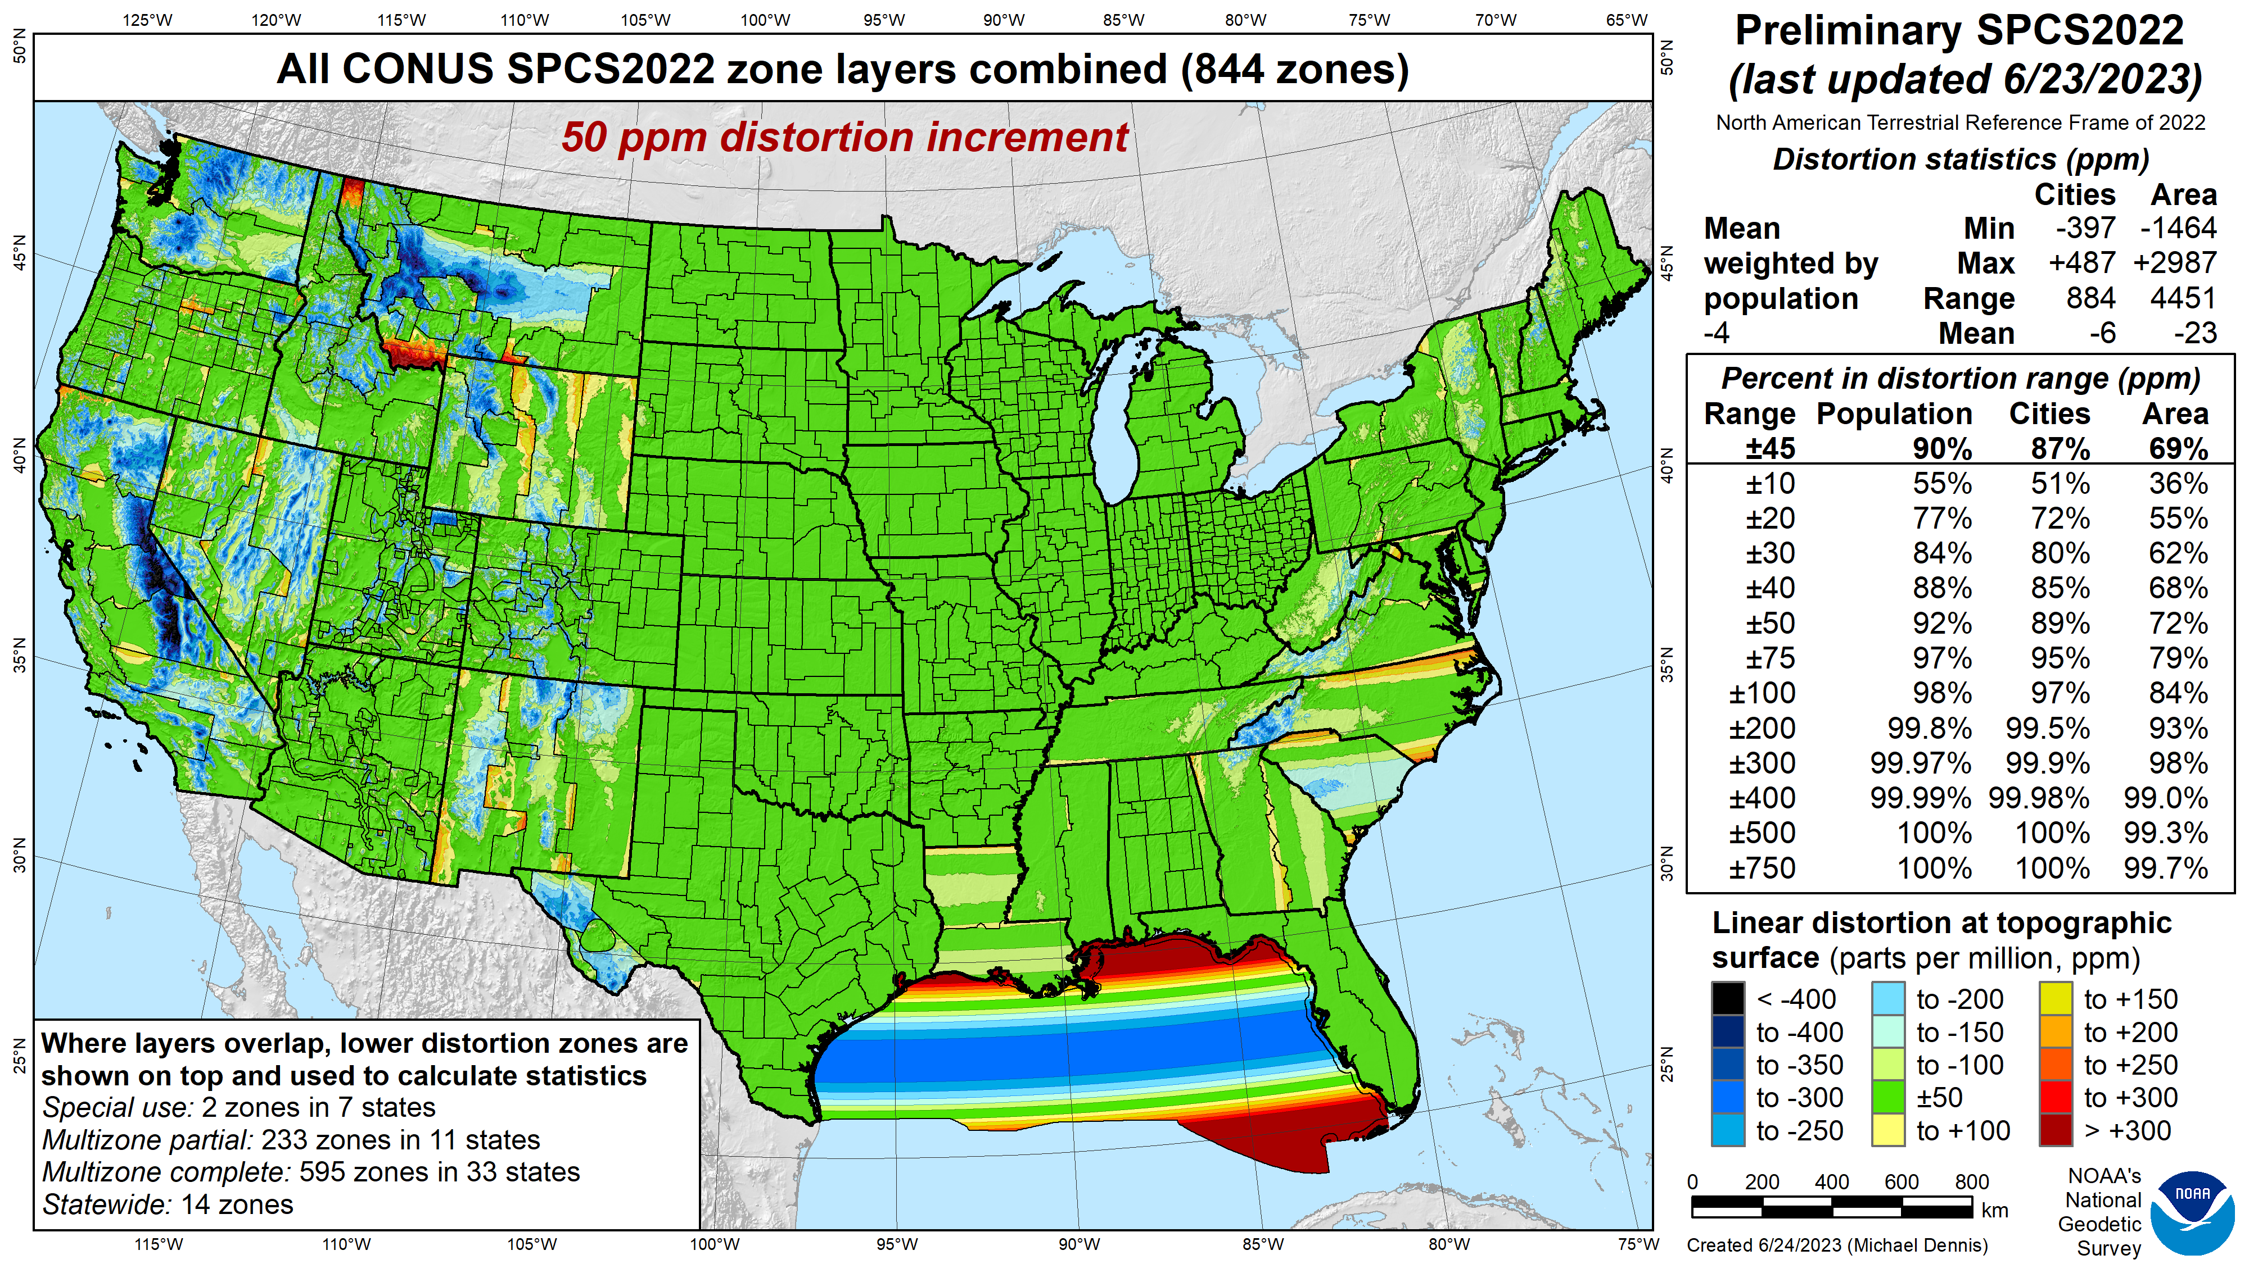
SPCS2022 linear distortion (preliminary)
Green is ±50 ppm (±0.26 ft/mile)
Distortion performance: ±45 ppm
Performance percentages:
90% population
87% cities & towns
69% total area
Mean weighted by population: -4 ppm

Slide 17
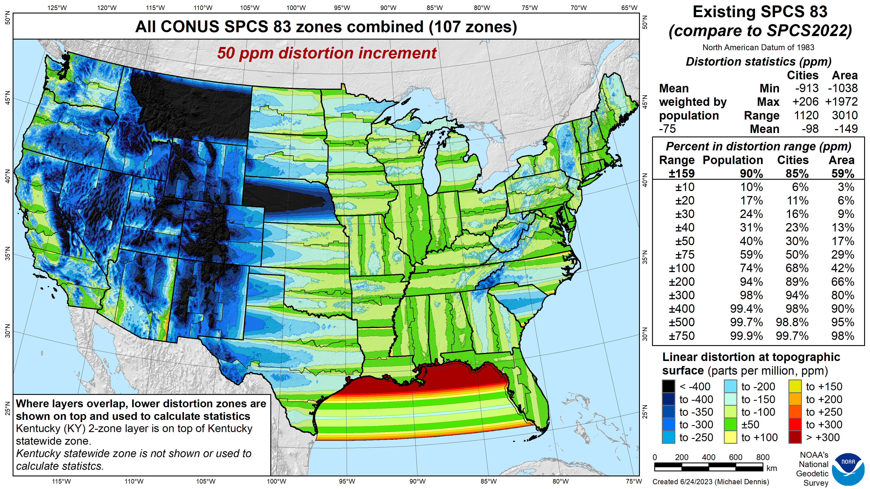
SPCS 83 linear distortion (existing)
Green is ±50 ppm (±0.26 ft/mile)
Distortion performance: ±159 ppm
Performance percentages:
90% population
85% cities & towns
59% total area
Mean weighted by population: -75 ppm

Slide 18
SPCS2022 linear distortion (preliminary)
Green is ±50 ppm (±0.26 ft/mile)
Distortion performance: ±45 ppm
Performance percentages:
90% population
87% cities & towns
69% total area
Mean weighted by population: -4 ppm

Slide 19

Burning questions about NSRS Modernization
When will it be done?
What will it consist of?
What formats will be used?
What will it look like?
Products on alpha will move to beta starting this year

Slide 20
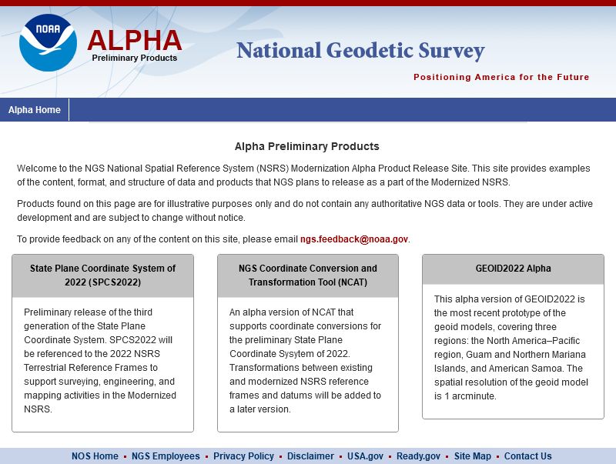


Alpha products are NOT final products!
https://alpha.ngs.noaa.gov/index.shtml
Preliminary
For illustrative purposes only
Not authoritative
Under active development
Subject to change without notice
Feedback to: ngs.feedback@noaa.gov

Slide 21
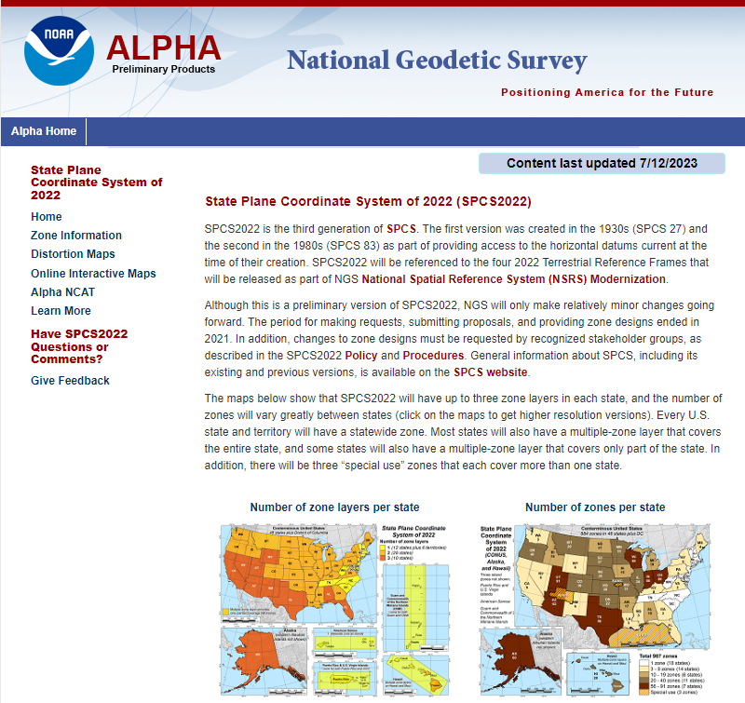

Alpha SPCS2022 Home
https://alpha.ngs.noaa.gov /SPCS/index.shtml
Gives date last updated
Links to other SPCS2022 pages in sidebar:
Zone information
Distortion maps
Online interactive maps (SPCS2022 Experience)
Alpha NCAT
Additional information
Feedback

Slide 22
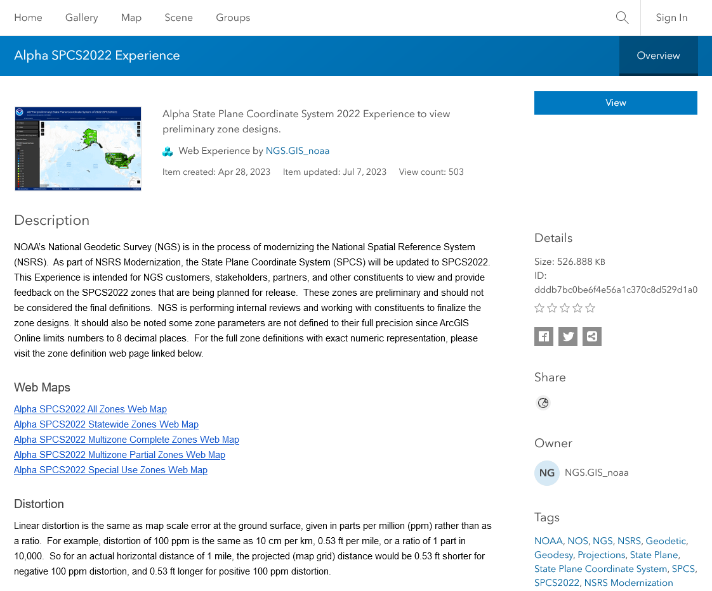

ArcGIS Online SPCS2022 Experience
Online interactive maps
Shows distortion and gives zone definitions
Being updated now
Accessible on mobile devices

Slide 23
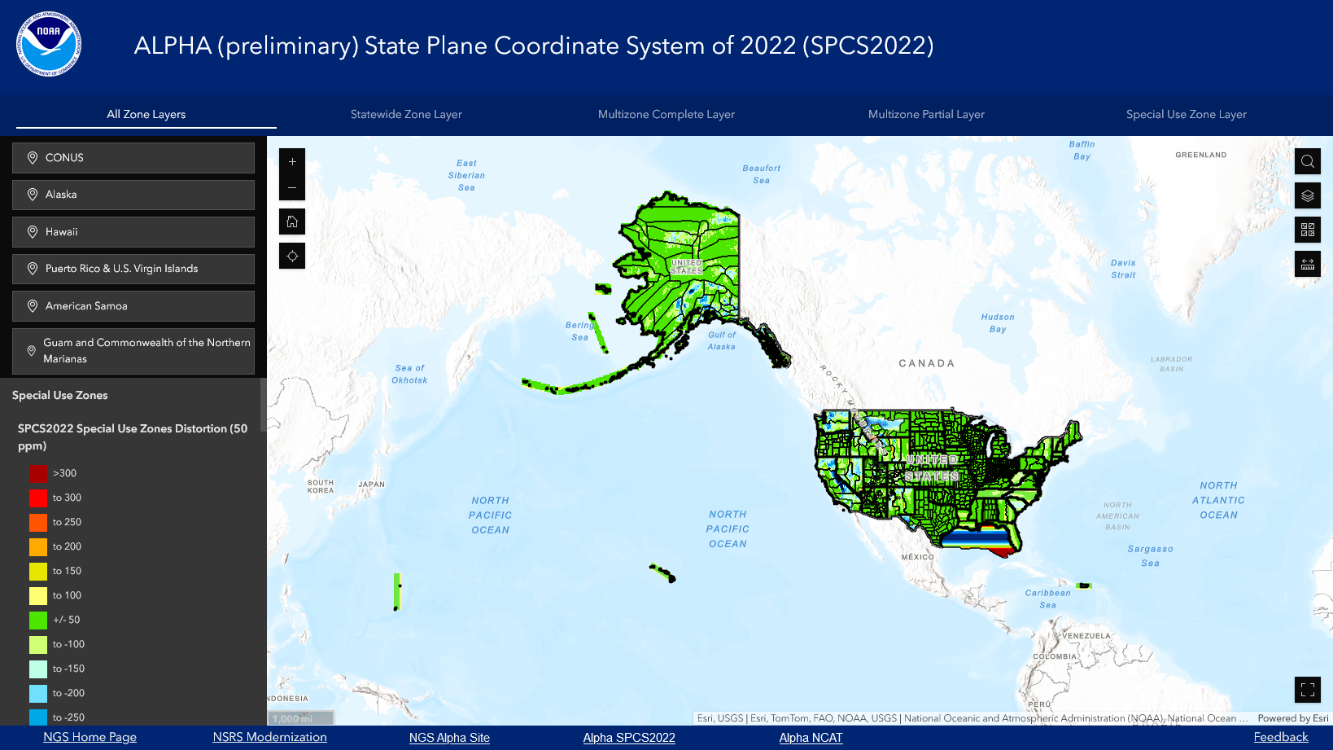
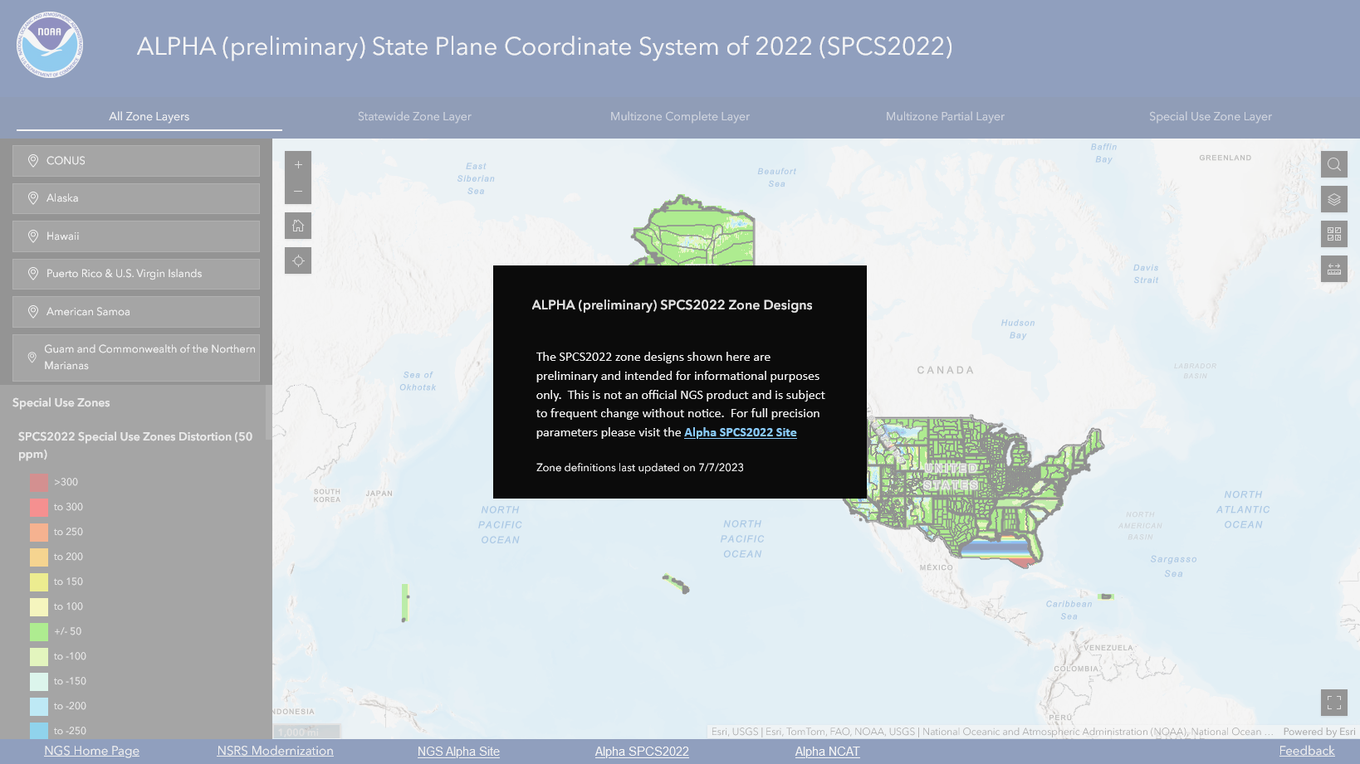


Slide 24
That’s great, but when will SPCS2022 be done?
SPCS2022 included with rollout of Modernized NSRS
Getting feedback from stakeholders and others NOW
In process of finalizing designs NOW
Zone designs done and shared with world by late 2024 or early 2025
Provide definitions directly usable by commercial partners
Definitions also in EPSG Geodetic Parameter Dataset and ISO Geodetic Registry
Modernized NSRS becomes official in 2026 (after beta)
SPCS2022 zones can then be added, removed, changed
Updated Policy and Procedures will describe the process

Slide 25
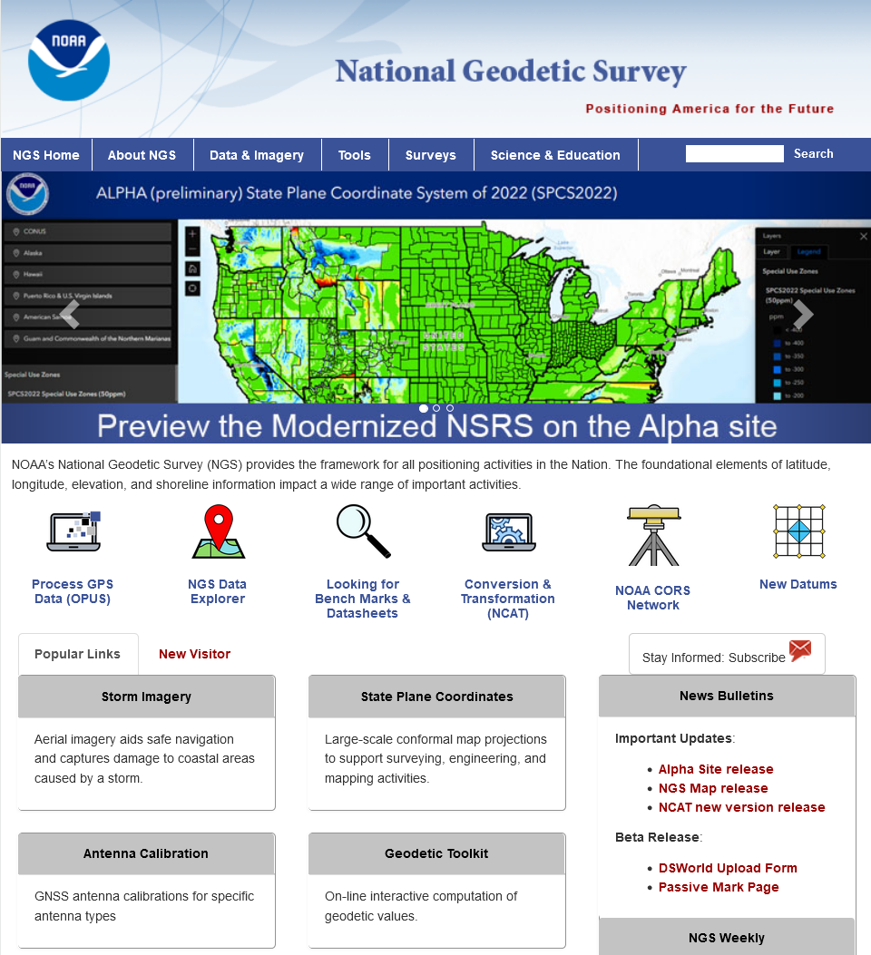

Where to learn more…
geodesy.noaa.gov
Thank you!

