Slide 1
Grids for the Future A New Approach for Designing State Plane Coordinate System Zones
Michael Dennis, PhD, PE, PLS, M.ASCE

Slide 2
Surveyors and engineers love projected coordinate systems
SPCS2022
Making the Earth flat again
…one zone at a time

Slide 3
How surveyors and engineers see the Earth…

Slide 4
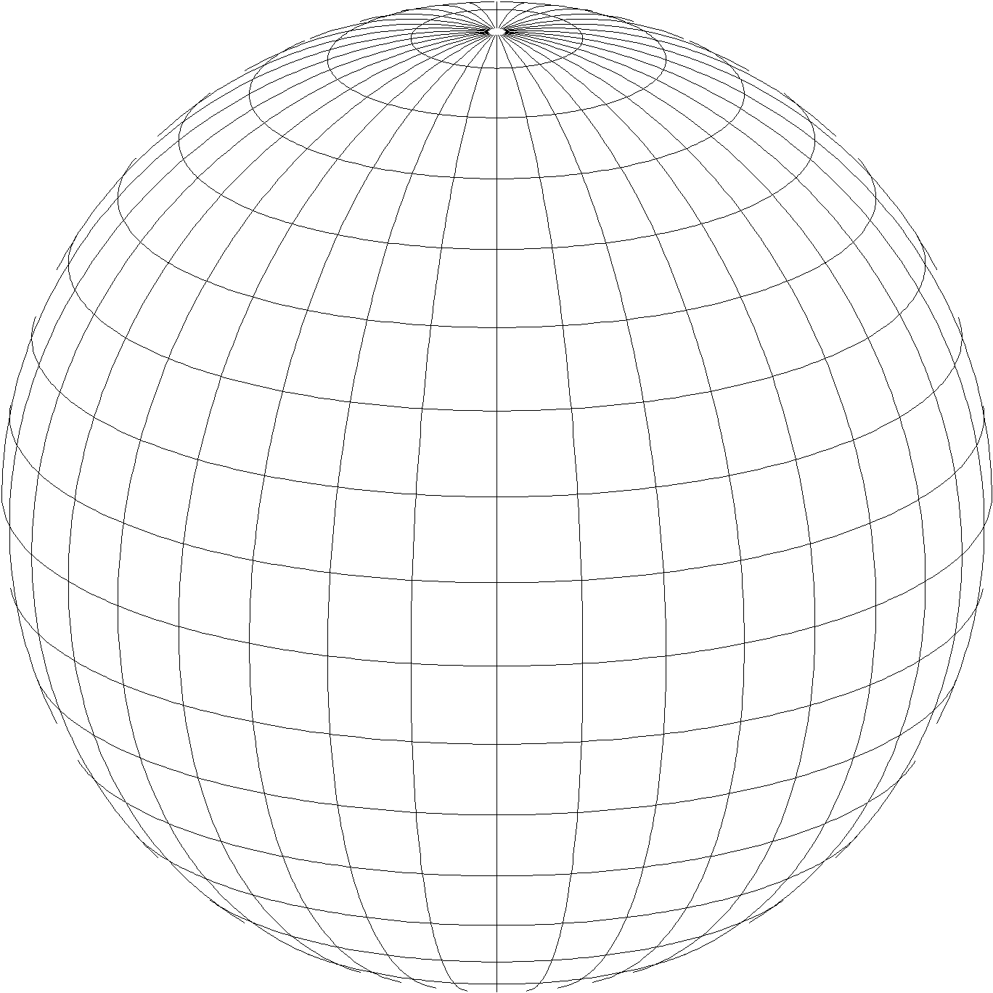
A “flat Earth” for the future
State Plane Coordinate System of 2022 (SPCS2022)
Similar to existing State Plane…
Same 3 map projection types
Same ellipsoid (GRS 80)
But different…
Based on new datums instead of NAD 83
Designed to reduce difference between “grid” and “ground”
Many more “zones”
Zones “layers” will exist in most states
Lambert Conformal Conic (LCC)
Transverse Mercator (TM)
Oblique Mercator (OM)

Slide 5
Getting acquainted with SPCS2022
Overall distortion design philosophy
Linear distortion minimized (or “optimized”) at topographic surface (not at ellipsoid surface)
Purpose: to reduce difference between and projected “grid” and actual “ground” distances in areas where people actually work
What is linear distortion?
Defined at a point (infinitesimal distances)
Unique (i.e., same in every direction) only for conformal projections
Given here in parts per million (ppm) = mm per km
Linear distortion | = | δ | = | Projected minus actual distance
 |  |  |  | Actual distance

Slide 6
Map projection linear distortion
Distortion at a point computed as:
where
k = grid point scale factor (distortion due to Earth curvature)
h = ellipsoid height of point (distortion due to change in height)
R = Earth geometric mean radius curvature
$δ$ < 0 → projected (grid) distance shorter than true (ground) distance
$δ$ > 0 → projected (grid) distance longer than true (ground) distance
Combined factor
Grid point scale factor
$$δ=k\left(\frac{R}{R+h}\right)−1$$
Height (“elevation”) factor

Slide 7
Linear distortion with respect to ellipsoid surface
k₀ = scale at projection axis
Projection axis (k₀ < 1)
Horizontal ground distance
> ellipsoid distance and > grid distance
Topographic surface
Ellipsoid surface
h
Projection surface (secant)
Ellipsoid distance
Grid distance > ellipsoid distance < ground distance (k > 1 and δ < 0)
Ellipsoid distance
This design approach used for SPCS 27 and 83 (minimizes distortion with respect to ellipsoid)
R
Grid distance < ellipsoid distance < ground distance (k < 1 and δ < 0)
$$δ=k −1$$
7

Slide 8
Linear distortion with respect to topographic surface
Projection axis (k₀ > 1)
Horizontal ground distance
> ellipsoid distance and > grid distance
Topographic surface
Ellipsoid surface
h
Projection surface (non-intersecting)
Ellipsoid distance
Grid distance > ellipsoid distance ≈ ground distance (k > 1 and δ ≈ 0)
$$δ=k\left(\frac{R}{R+h}\right)−1$$
R
8

Slide 9
Projection axis
Projection axis is line along which scale $k$ = $k_{0}$ is minimum and constant*
Projection axes for projections used in State Plane:
Lambert Conformal Conic (LCC): central parallel, $φ_{0}$
Transverse Mercator (TM): central meridian, $λ_{0}$
Oblique Mercator (OM): skew axis (“initial line”) with azimuth $α_{0}$ at origin $(φ_{0},λ_{0})$
Distortion a function of the following projection parameters:
LCC: $k_{0}$ and $φ_{0}$
TM: $k_{0}$ and $λ_{0}$
OM: $k_{0}$, $φ_{0}$, $λ_{0}$, and $α_{0}$
*Scale $k$ is not constant on OM skew axis (equals $k_{0}$ at origin and changes slowly with distance from origin)

Slide 10
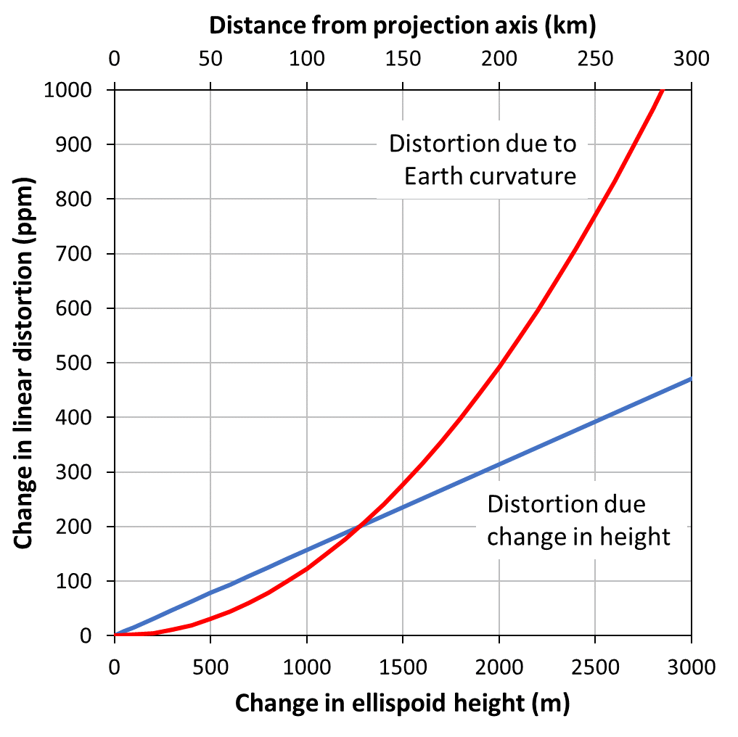
Minimizing linear distortion
Distortion function of both $k$ and $h$
$D$ = distance from projection axis (kilometers)
$∆h$ = change in ellipsoid height (meters)
Minimize both $k$ and $h$ simultaneously
$f\left(k\right)$ increases with square of distance
$f(h)$ increases linearly with change in height
Treating separately can lead to poor results
$$δ=f\left(k, h\right)=\left\{\begin{matrix} f\left(k\right)≈(0.0123 ppm)D^{2} \\ f\left(h\right)≈(0.157 ppm)∆h \end{matrix}\right.$$

Slide 11
“Non-intersecting” conformal map projection
Topographic surface
Grid distance = ground distance at a point
Projection axis
Grid distance = ground distance at a point
Non-intersecting
($k_{0}$ > 1)
Grid distance ≈ ground distance over finite distance
Purpose is to reduce linear distortion at “ground” (topographic surface).
But distortion can vary considerably across area of interest.
Ellipsoid surface
11

Slide 12
“Non-intersecting” conformal map projection
Topographic surface
Projection axis
Non-intersecting
($k_{0}$ > 1)
Ellipsoid surface
12

Slide 13
Changing projection axis to reduce distortion variation
This design approach used for SPCS2022 (minimizes distortion with respect to topography)
Topographic surface
Grid distance = ground distance at many points
Projection axis
Ellipsoid height of surface not constant:
h₁ ≠ h₂
h₂
Non-intersecting
($k_{0}$ > 1)
h₁
ONLY way to reduce variation in distortion is to change projection axis location (or change projection).
Projection axis scale can be less than 1 for steeply sloping areas even if heights are large.
Ellipsoid surface
IMPORANT: For large areas, there is no single defining ellipsoid height for scaling the projection.
13

Slide 14
NOT changing projection axis to reduce distortion variation
Topographic surface
Grid distance = ground distance at a point
Projection axis
Grid distance = ground distance at a point
Non-intersecting
($k_{0}$ > 1)
h₂
Ellipsoid height of surface not constant:
h₁ ≠ h₂
h₁
Ellipsoid surface
IMPORANT: For large areas, there is no single defining ellipsoid height for scaling the projection – even if there is no attempt to account for topographic slope.
14

Slide 15
Linear distortion design criterion
$$δ_{0}={±\left(\frac{w}{4k_{0}R}\right)}^{2}$$
Initial estimate of linear distortion design criterion as:
w = zone width (perpendicular to projection axis) in km
with following simplifying assumptions:
R = constant mean earth radius (6371 km)
$k_{0}$ = 1 (i.e., tangent to ellipsoid)
Constant topographic height
Following distortion range categories (in ppm) used in design:
Small “low distortion” zones: ±5, ±10, ±20, ±30, ±40 ppm
Typical SPCS zones: ±50, ±75, ±100, ±150, ±200, ±300, ±400, ±500 ppm
Very large zones: ±750, ±1000 , ±1500 , ±2000 , ±3000 , ±4000 , ±5000 ppm
$$≈±\left(0.00154 ppm\right)w^{2}$$

Slide 16
Linear distortion magnitudes
Parts per million | Centimeters per kilometer | Feet per mile | Dimensionless ratio
20 ppm | 2 cm/km | 0.1 ft/mile | 1:50,000
50 ppm | 5 cm/km | 0.3 ft/mile | 1:20,000
100 ppm | 10 cm/km | 0.5 ft/mile | 1:10,000
400 ppm | 40 cm/km | 2.1 ft/mile | 1:2,500

Slide 17
Four steps of overall design process
Select projection type and initial distortion design criterion, $δ_{0}$
Place projection axis in center of design area
Set axis scale $k_{0}$ to reasonable initial value (e.g., gives zero mean distortion)
OM projection origin location and skew axis azimuth requires special process
Initially determined using minimum bounding rectangle by width
Bounded polygon must be in projected coordinate system
Refined during design process to account for systematic topographic slope
Move projection axis to minimize range in distortion for entire zone
Also evaluate distortion range for cities and towns
Also balance positive distortion at zones edges

Slide 18
Four steps of overall design process (cont’d)
Modify axis scale such that all of the following are within $δ_{0}$:
≥ 90% of population
≥ 75% of all cities and towns (by location only)
≥ 50% of entire zone area
Evaluate and refine design
Mean for entire zone (arithmetic and weighted by population) and for all cities
Balance positive and negative distortion for entire zone area (and for cities)
Avoid positive distortion > 2 × negative distortion magnitude
60 – 80% of zone area with negative distortion (for zones with $δ_{0}≥$ ~50 ppm)
IMPORTANT: Create distortion map

Slide 19
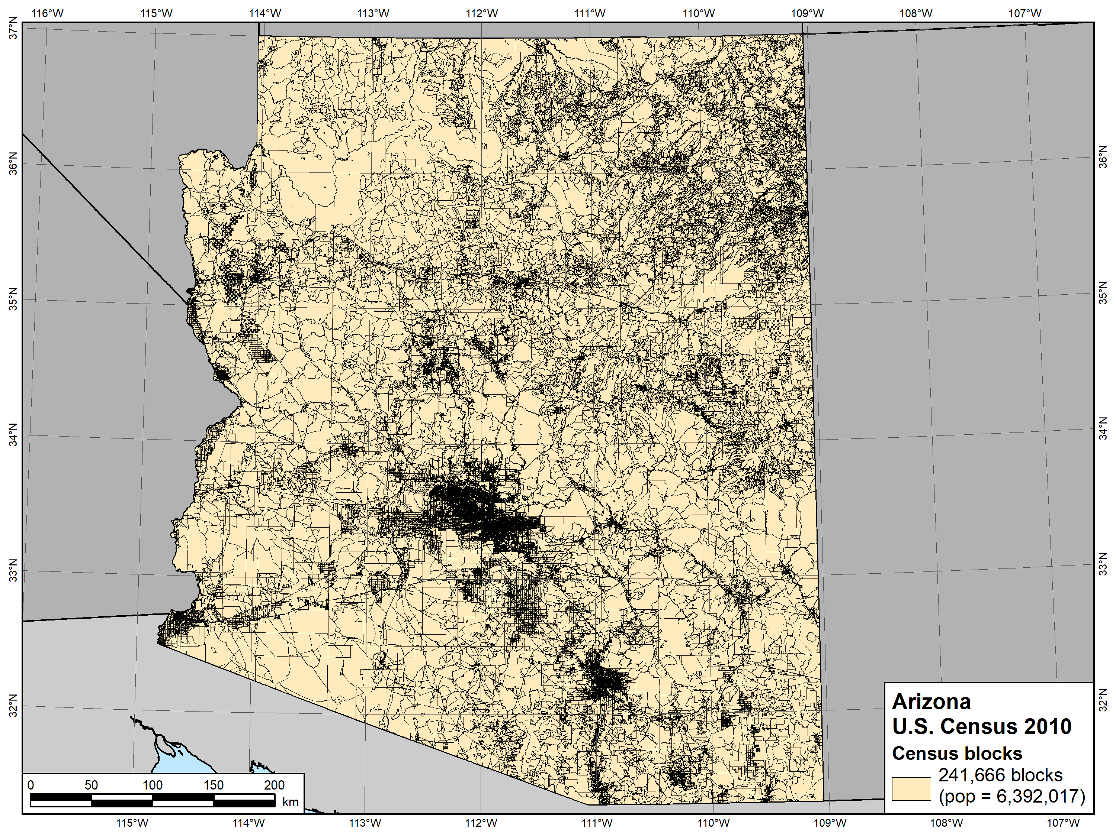
U.S. Census blocks
Used blocks from 2010 Census for SPCS2022 zone design

Slide 20
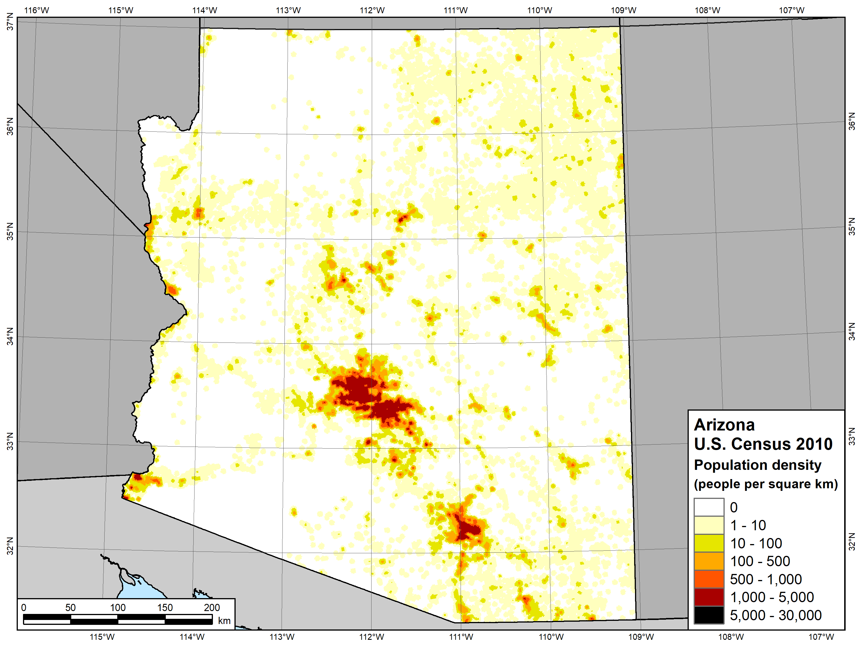
Population density
Created density raster from Census block data (done for visualization, not for design)

Slide 21
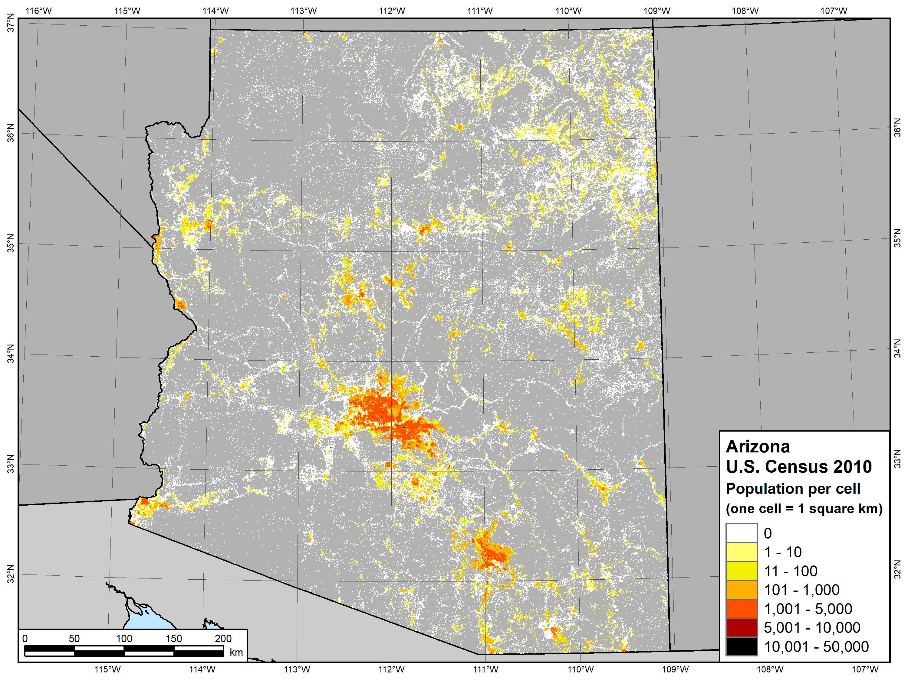
Population count
Equal area population count raster created from block data at 1 km resolution for design.
(note white cells with zero population)

Slide 22
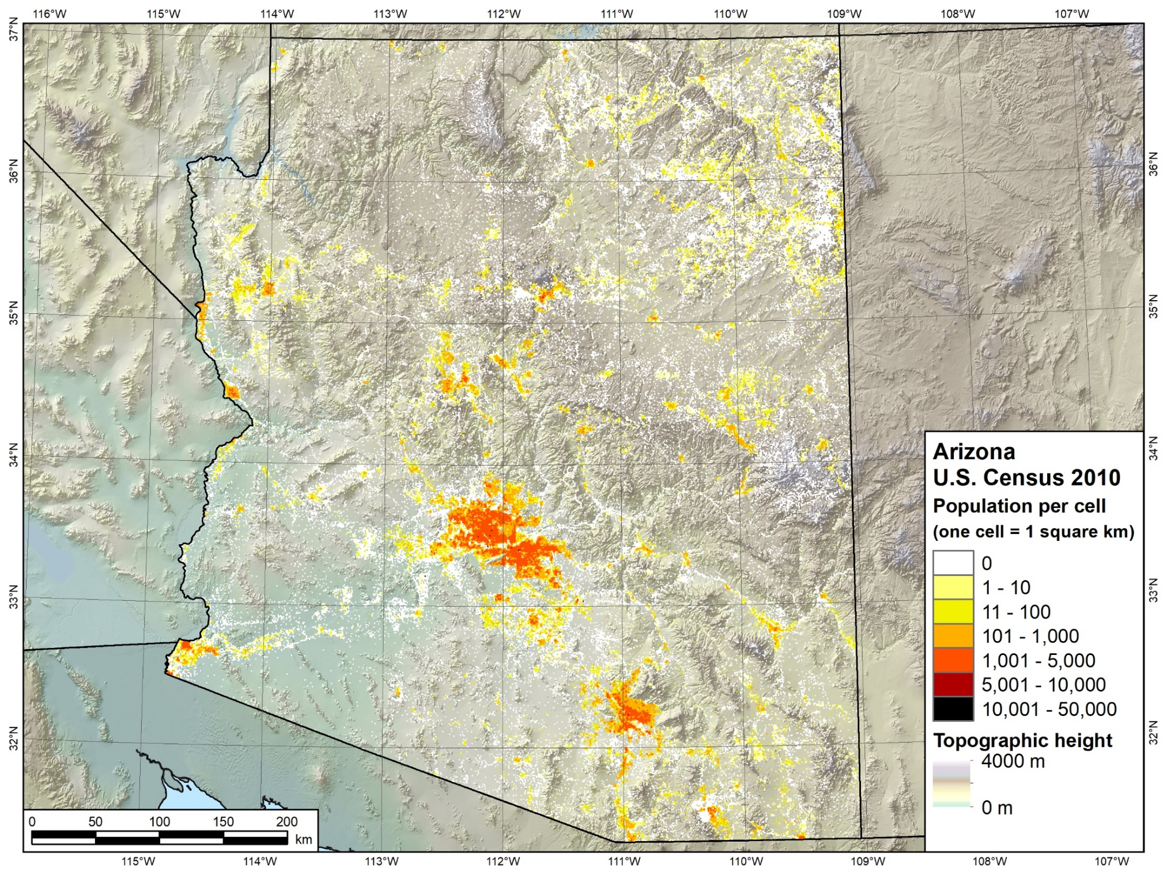
Topographic heights
Topographic ellipsoid heights added to population point data (computed from DEM and hybrid geoid model)

Slide 23
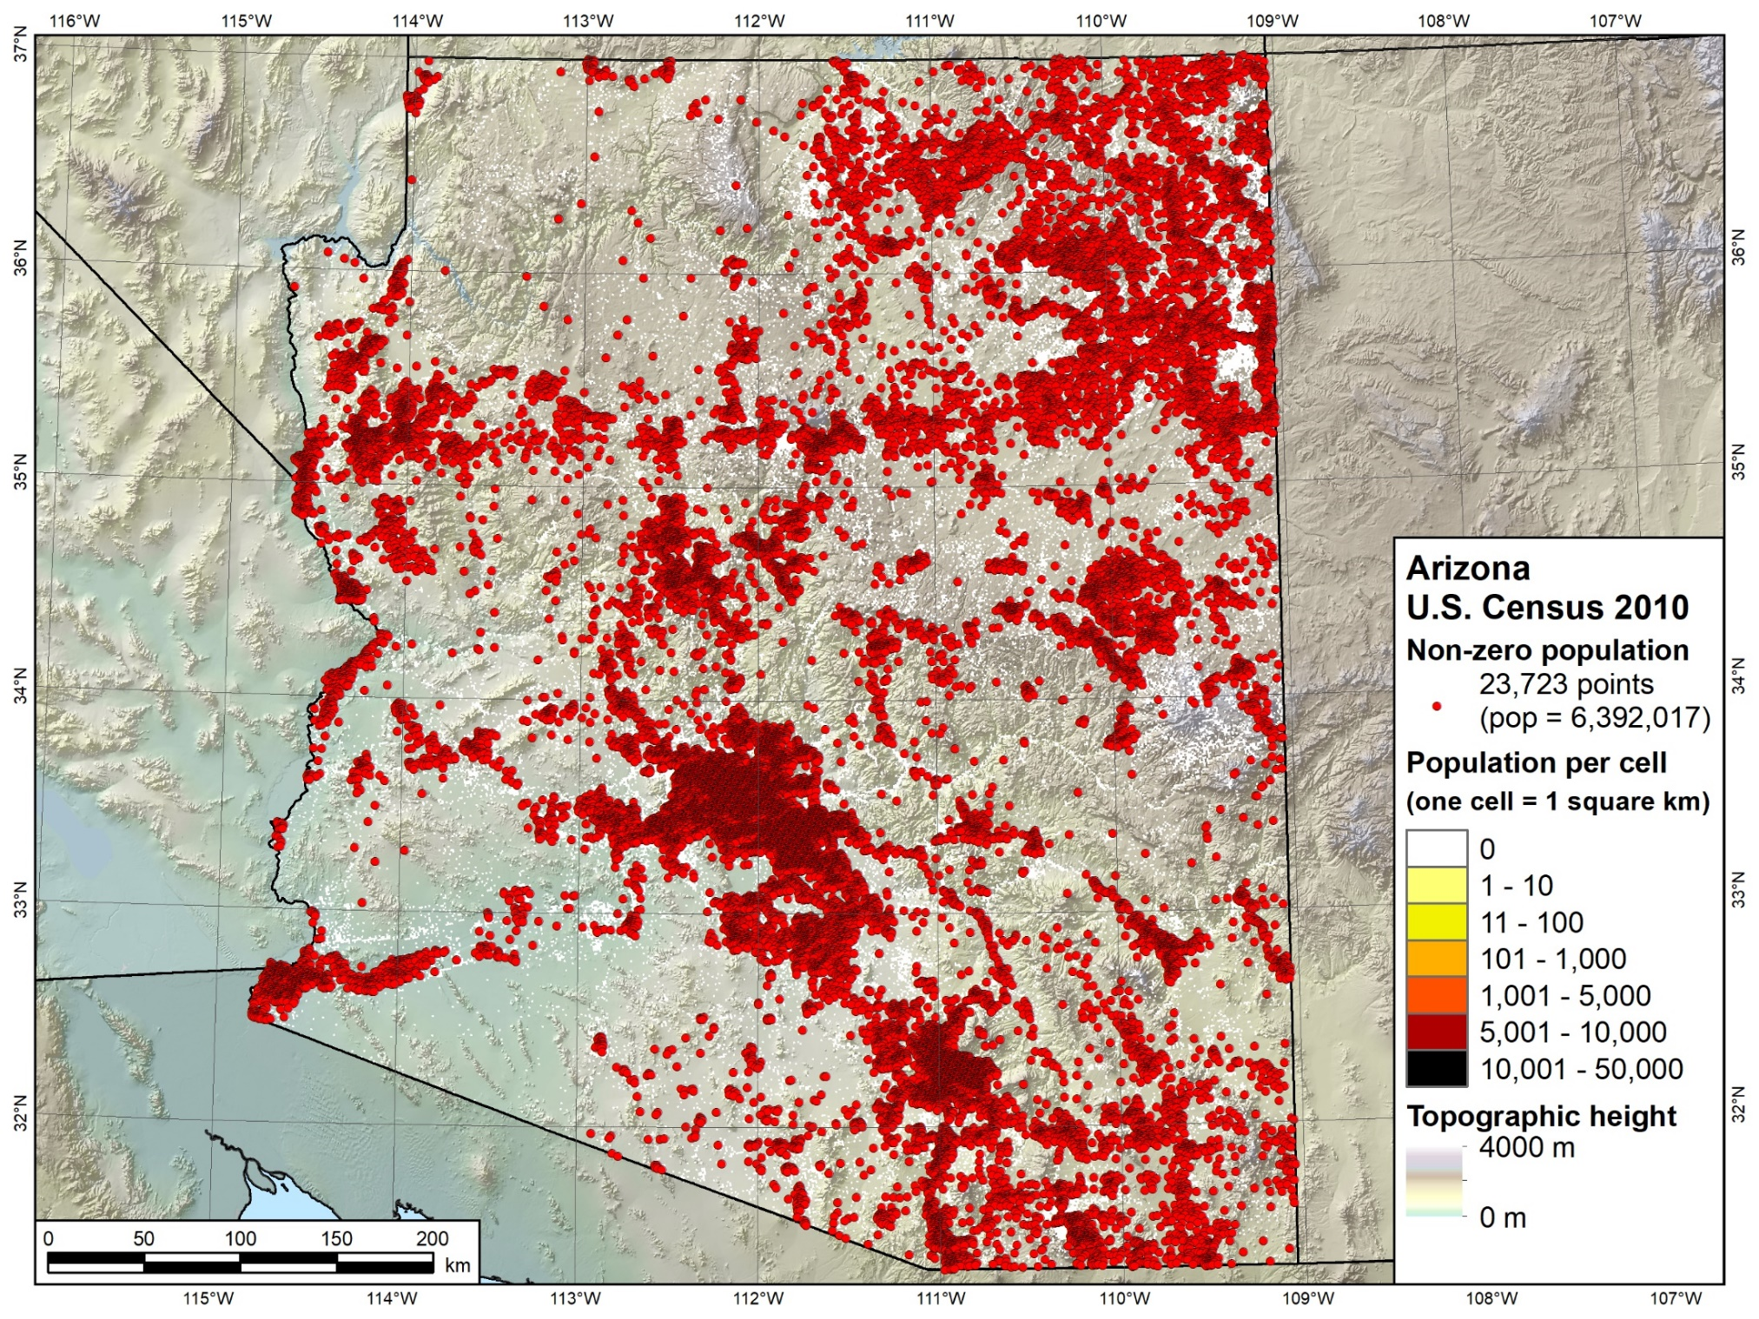
Final dataset for entire state
Equal area 1-km resolution point dataset with population, position, and height for SPCS2022 design
Range in ellipsoid height for population points = 3166 m (10,387 ft)

Slide 24
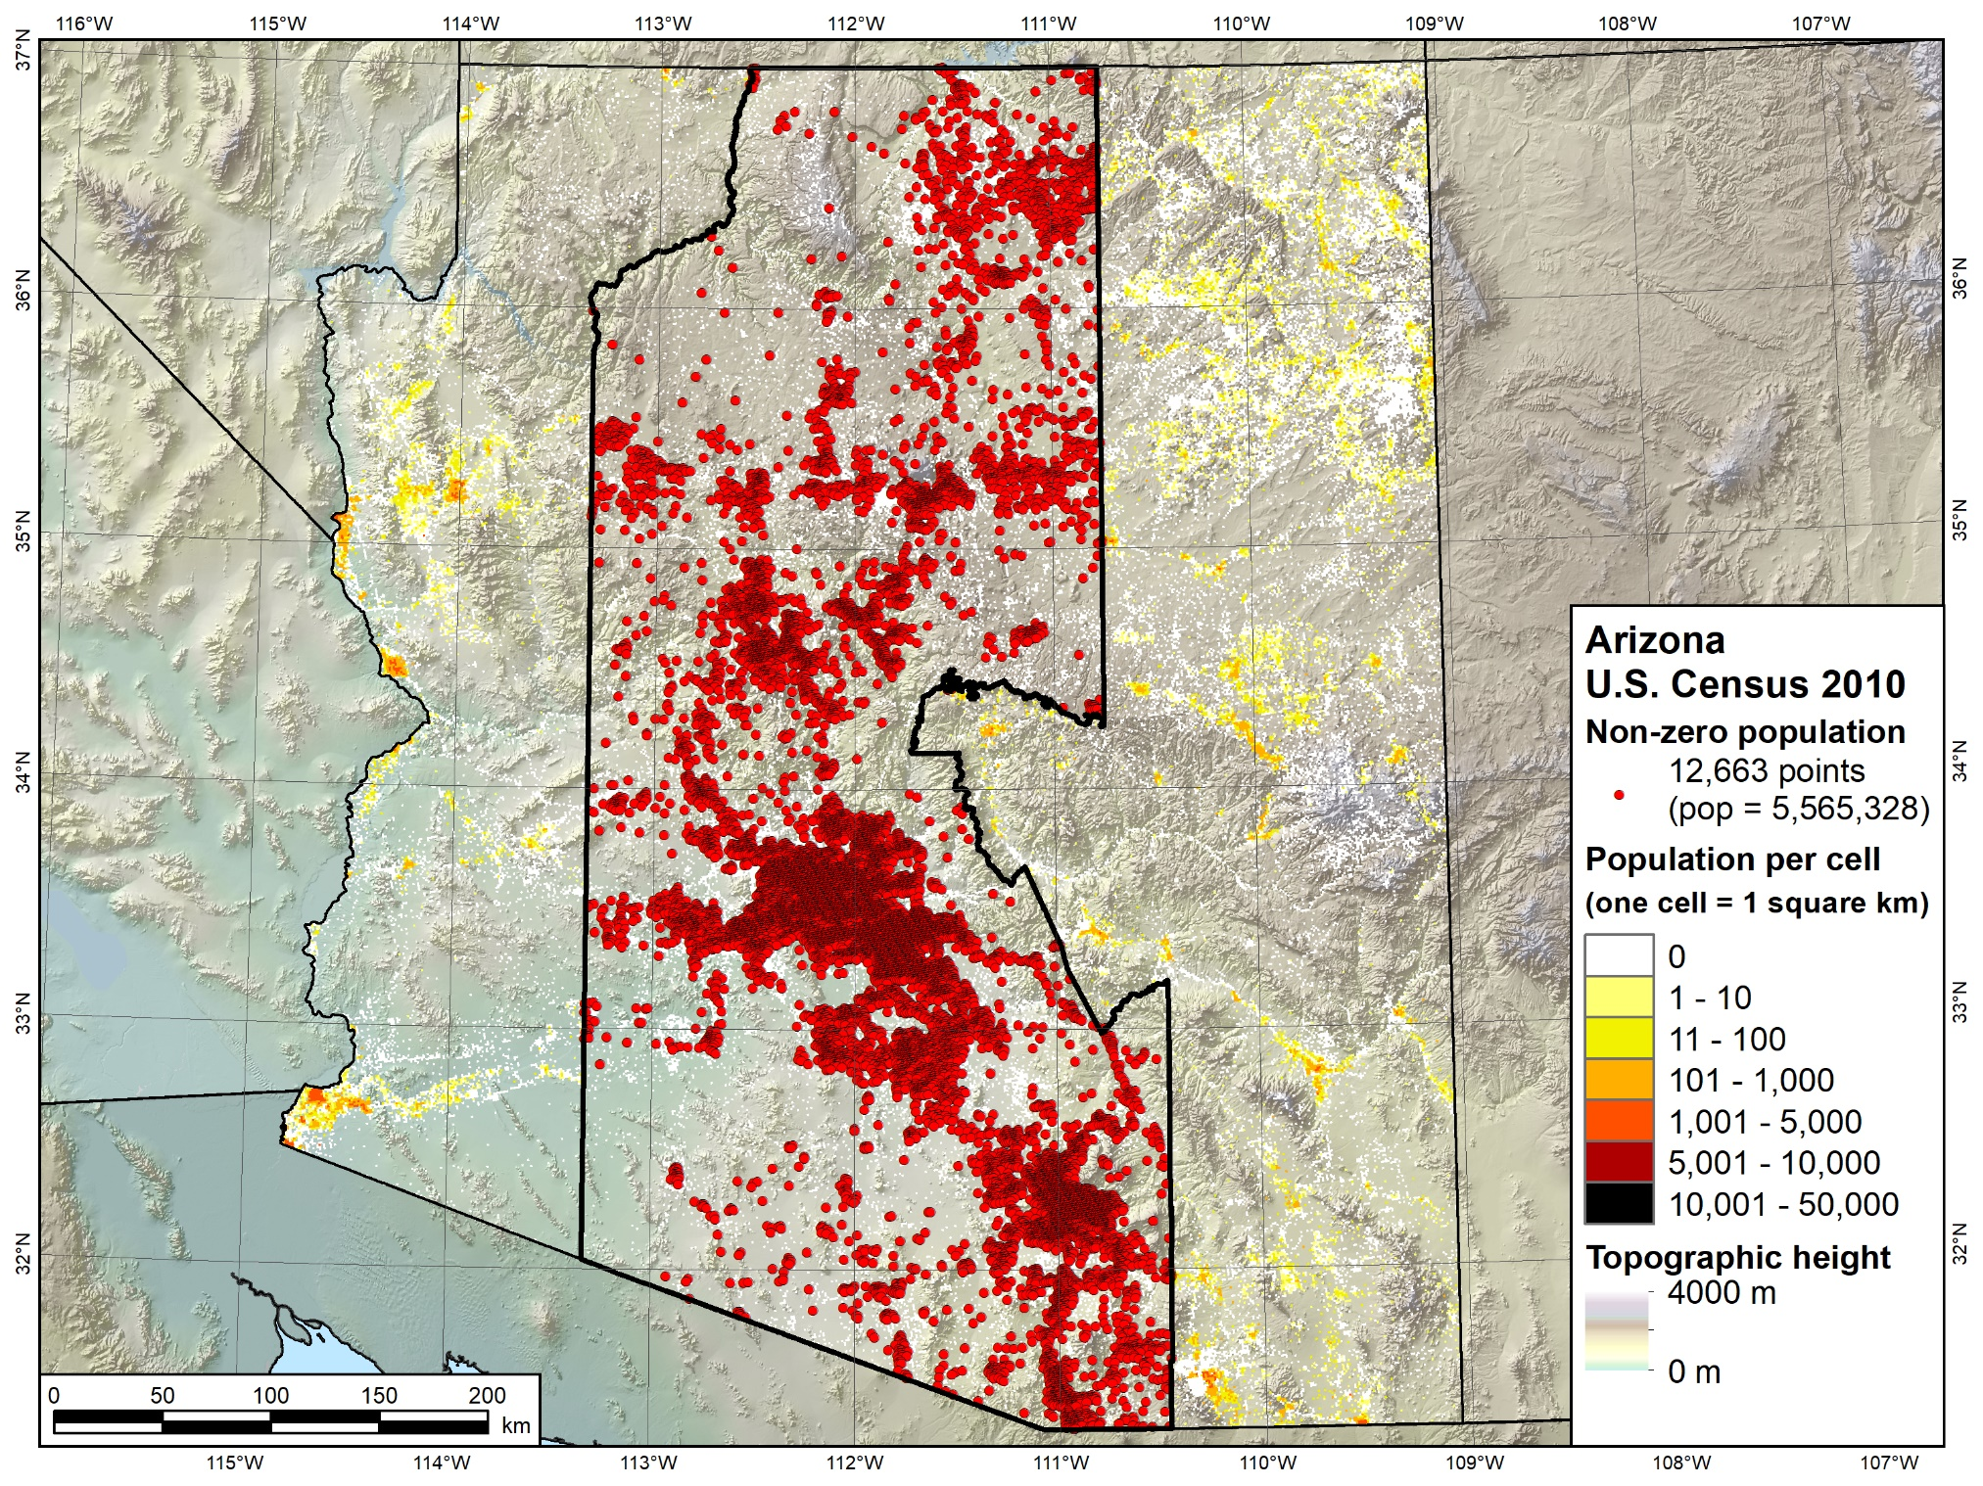
Dataset for zone design
Select subset of population points that are within polygon of zone being designed (Arizona Central Zone).
Range in ellipsoid height for population points = 3058 m (10,033 ft)

Slide 25
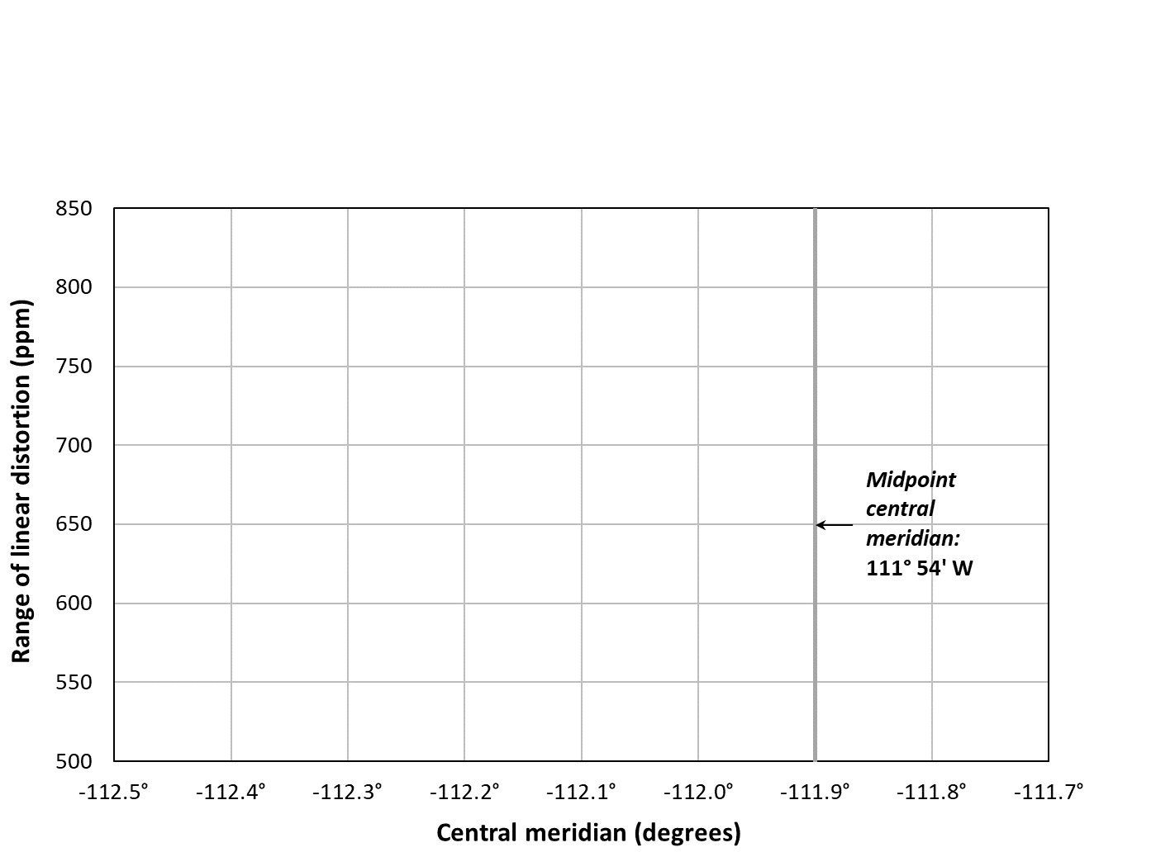
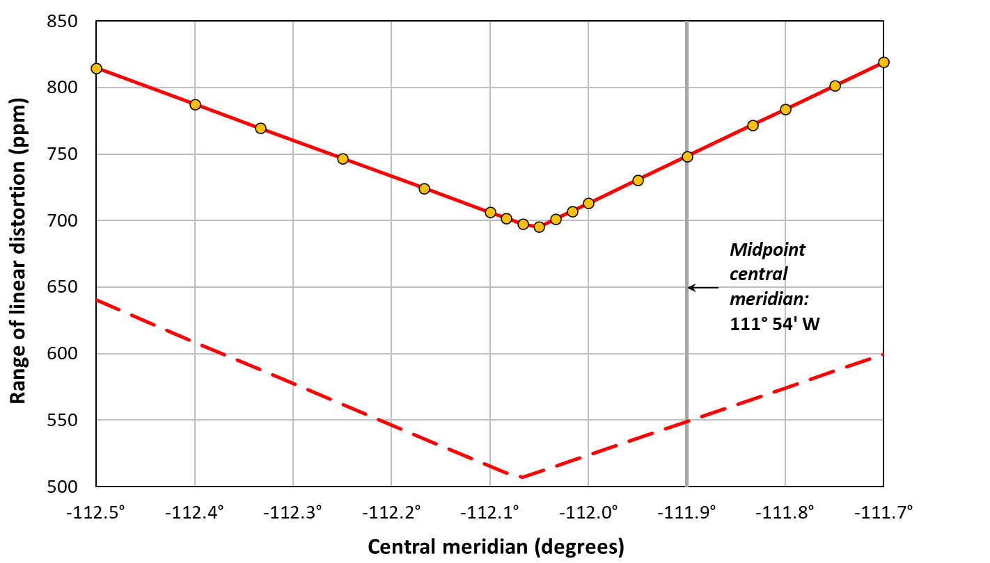
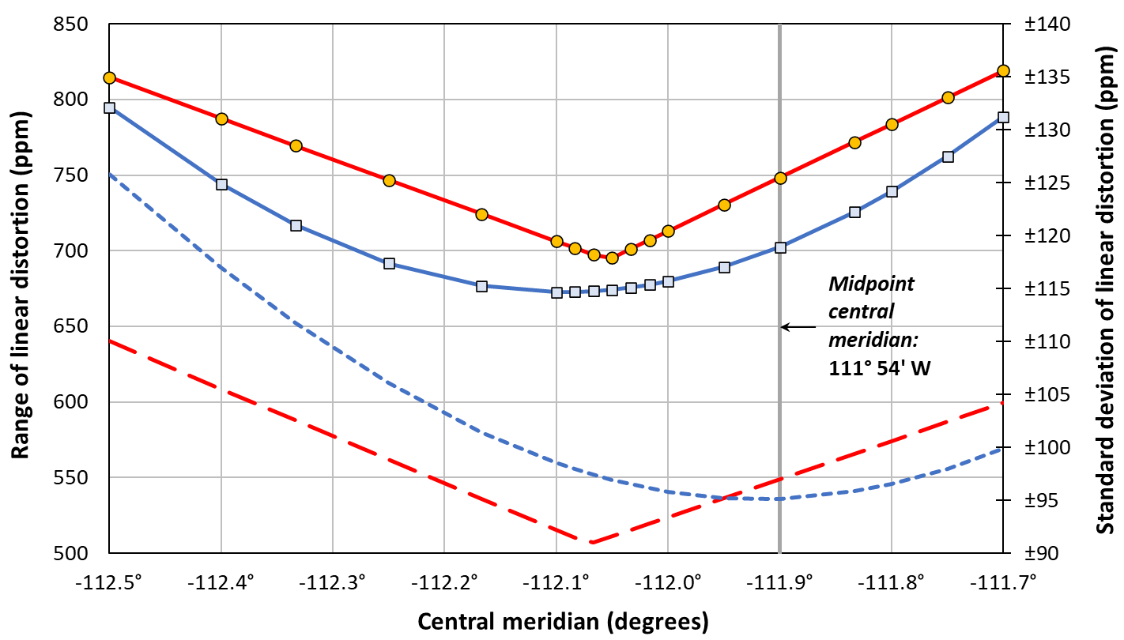
Design process
Projection type and distortion design criterion
TM (long north-south)
$δ0$ = ±114 ppm → ±100 ppm
Select 111°54’W (midpoint)
$k_{0}$ = 1.000 12 (zero mean)
Projection axis location
Minimize overall range
Minimize range for cities
Not same as min std dev
Select 112°03’W

Slide 26
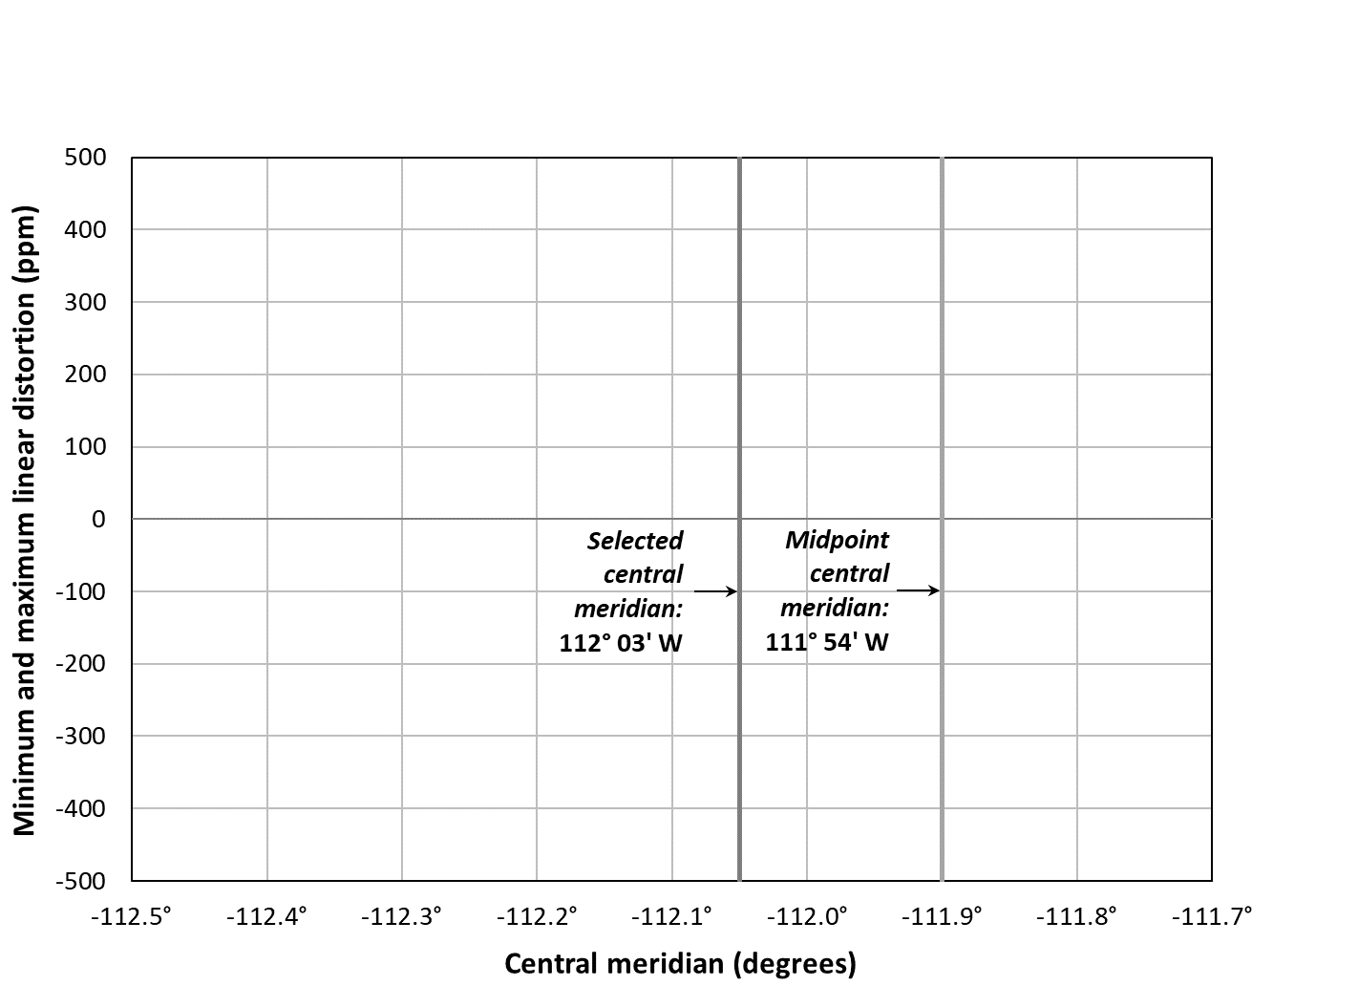
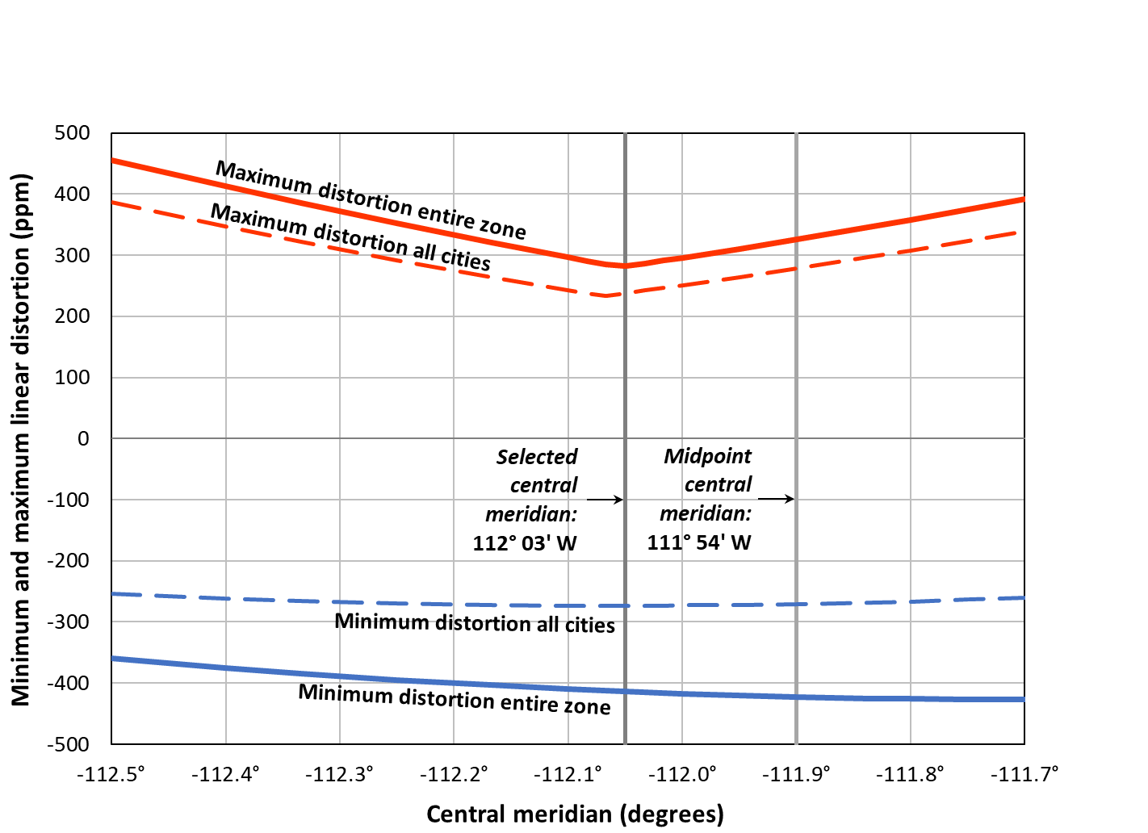
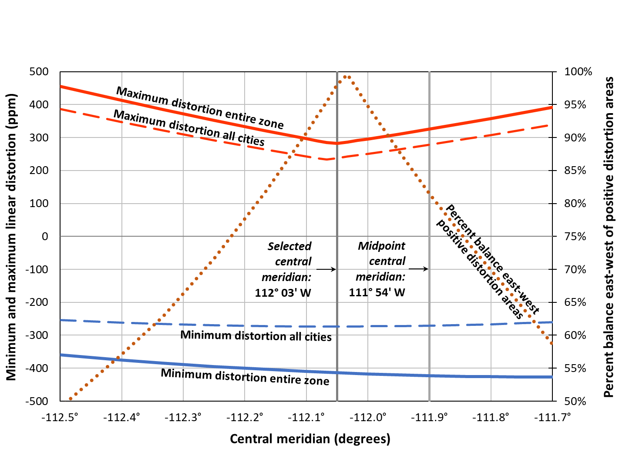
Design process
Projection type and distortion design criterion
TM (long north-south)
$δ0$ = ±114 ppm → ±100 ppm
Select 111°54’W (midpoint)
$k_{0}$ = 1.000 12 (zero mean)
Projection axis location
Minimize overall range
Minimize range for cities
Not same as min std dev
Select 112°03’W
Consider distortion extremes
Balance positive distortion

Slide 27
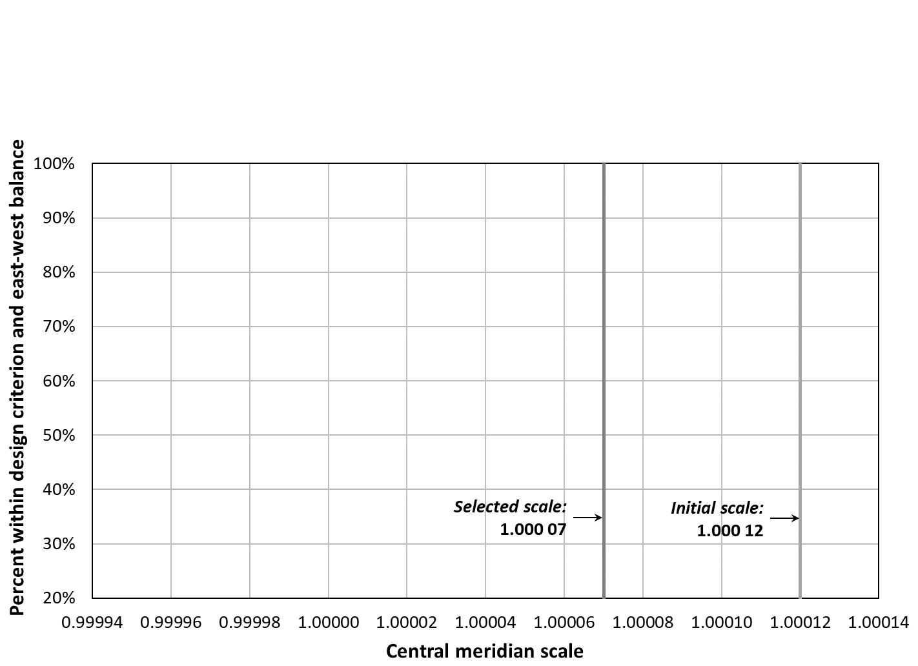
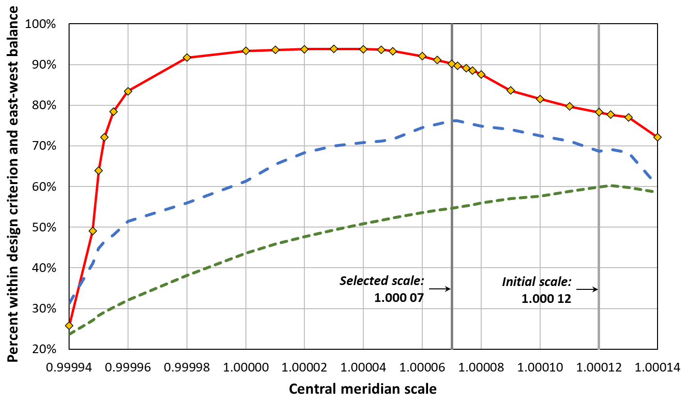
Design process
Modify axis scale based on design criterion of ±100 ppm
For $k_{0}$ = 1.000 07 have:
90% of population
76% of cities and towns
55% of total area
Evaluate and refine
Balance positive & negative

Slide 28
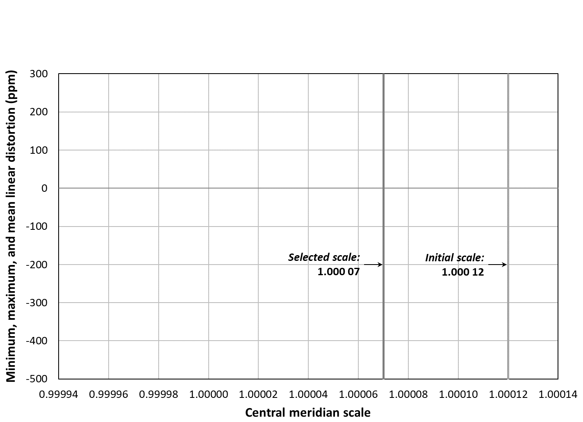
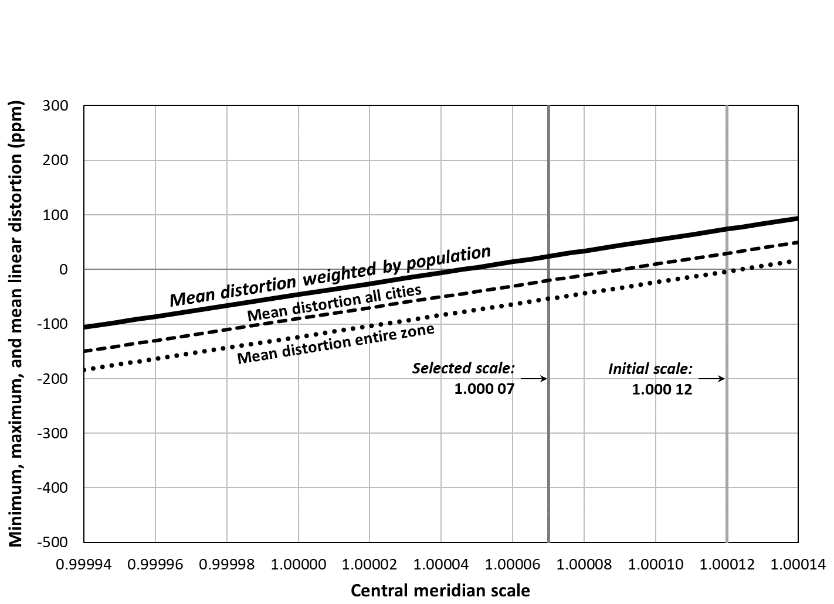
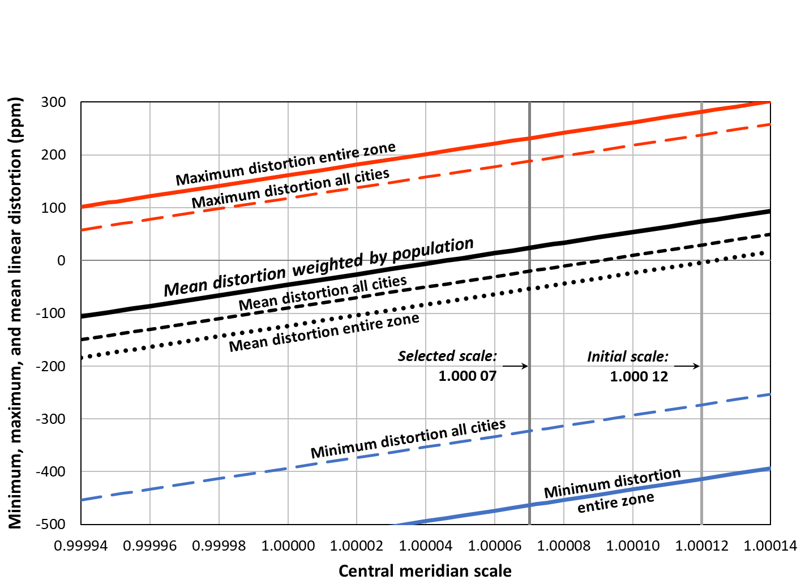
Design process
Modify axis scale based on design criterion of ±100 ppm
For $k_{0}$ = 1.000 07 have:
90% of population
76% of cities and towns
55% of total area
Evaluate and refine
Balance positive & negative
Weighted mean by population
Mean entire zone & all cities
Max and min entire zone
Max and min all cities
Create distortion map…

Slide 29
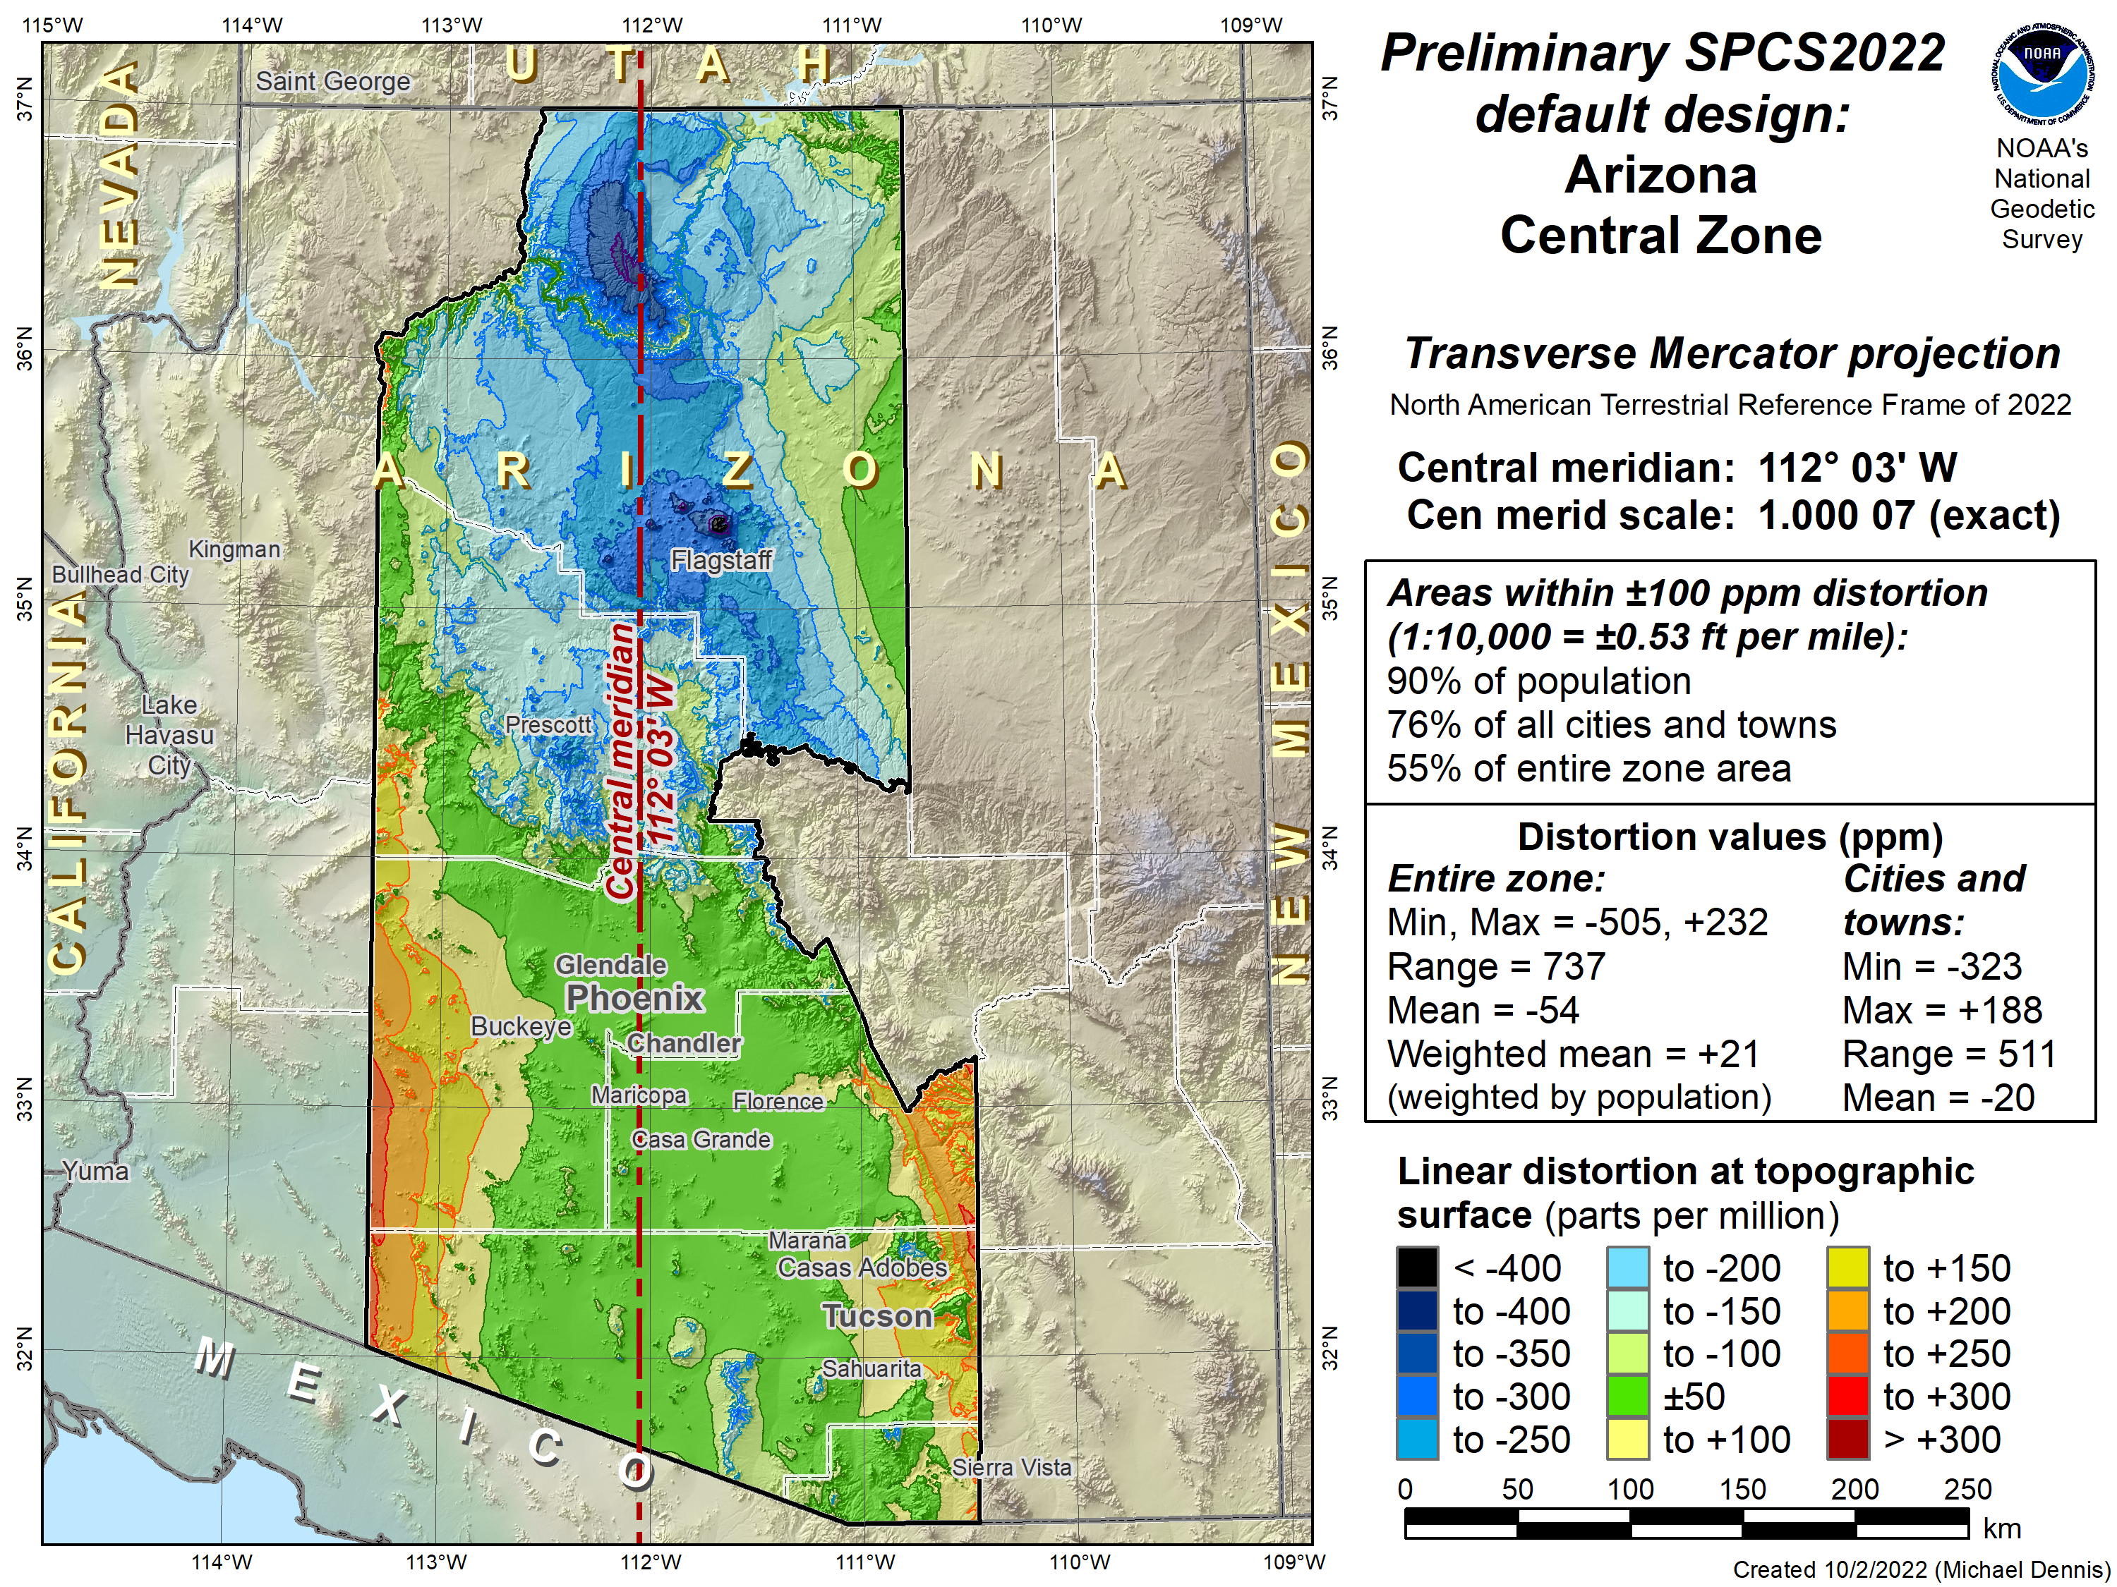
Linear distortion map SPCS2022
Arizona Central Zone
Percent within distortion (ppm):
Distor | Pop | Cities | Area
±50 | 76% | 49% | 34%
±75 | 81% | 61% | 45%
±100 | 90% | 76% | 55%
±150 | 96% | 88% | 74%
City and area statistics (ppm):
 | Min | -323 | -505
 | Max | +188 | +232
 | Range | 511 | 737
 | Mean | -20 | -54
Mean weighted by pop = +21

Slide 30
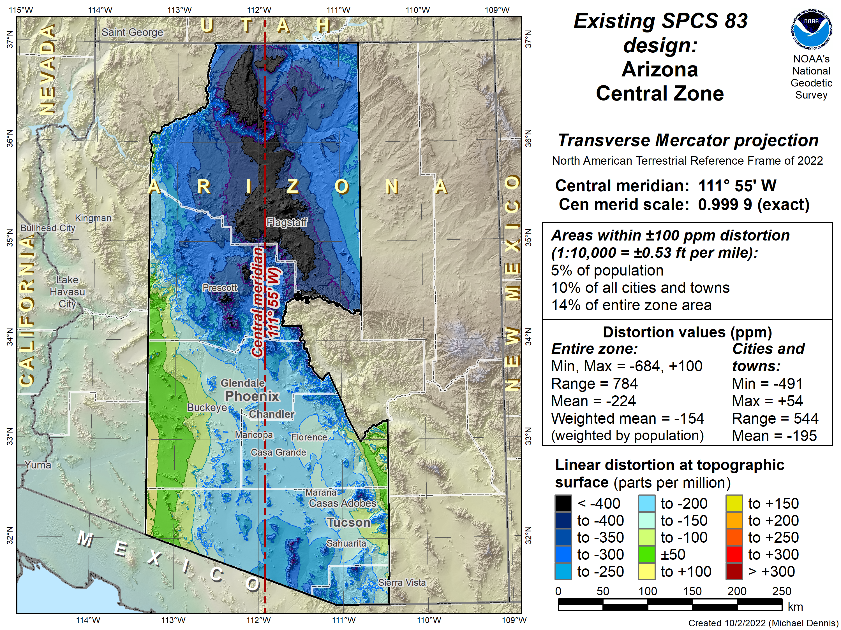
Linear distortion map SPCS 83
Arizona Central Zone
Percent within distortion (ppm):
Distor | Pop | Cities | Area
±50 | 0.1% | 3% | 6%
±75 | 0.5% | 7% | 10%
±100 | 5% | 10% | 14%
±150 | 48% | 36% | 25%
City and area statistics (ppm):
 | Min | -491 | -684
 | Max | +54 | +100
 | Range | 544 | 784
 | Mean | -195 | -224
Mean weighted by pop = -154

Slide 31
Status of zone layout and designs
Designs by NGS
159 zones (including 54 statewide)
Plus 3 “special use zones” (in more than one state)
Designs by state stakeholders
806 zones in 28 states
Most are “low-distortion projections” (LDPs)
Total = 968 zones for 56 states and territories
Number will likely decrease slightly
Compare to 125 zones in existing State Plane

Slide 32
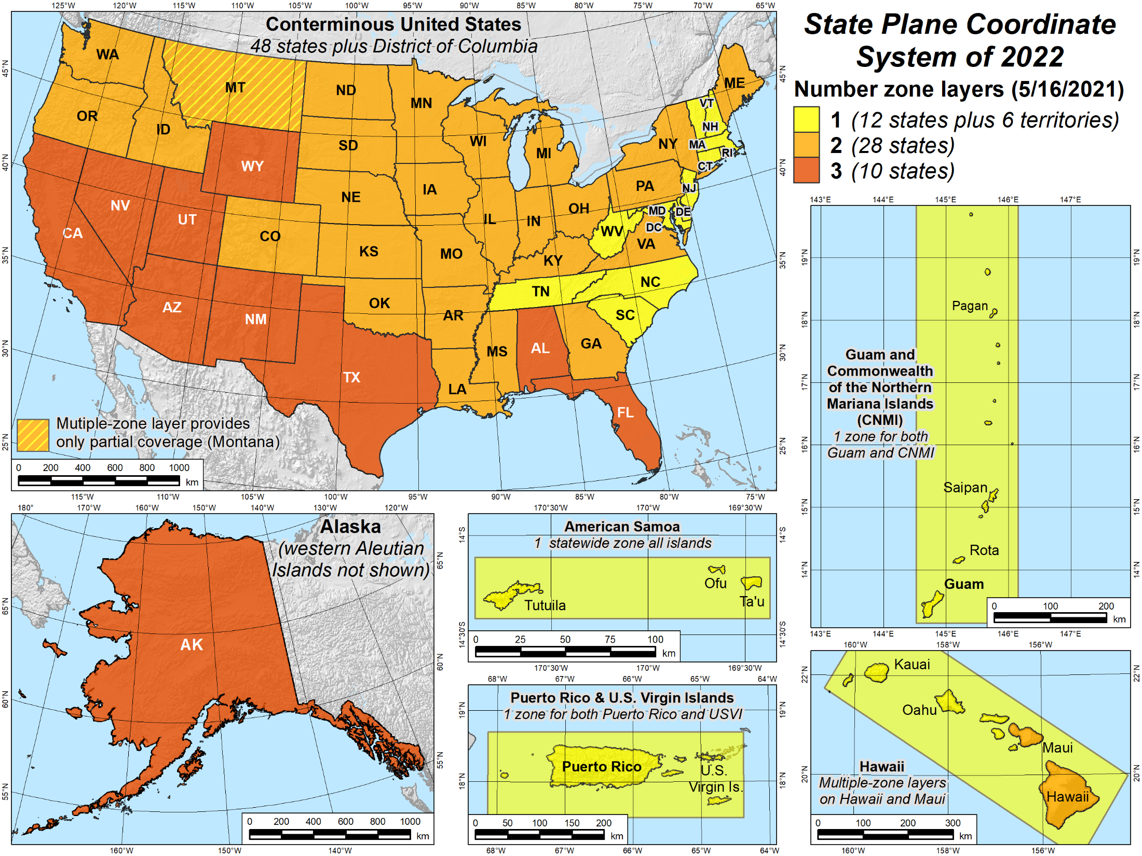
SPCS2022 zone layers (preliminary)
1 layer: 12 states plus 6 territories
2 layers: 28 states
3 layers: 10 states

Slide 33
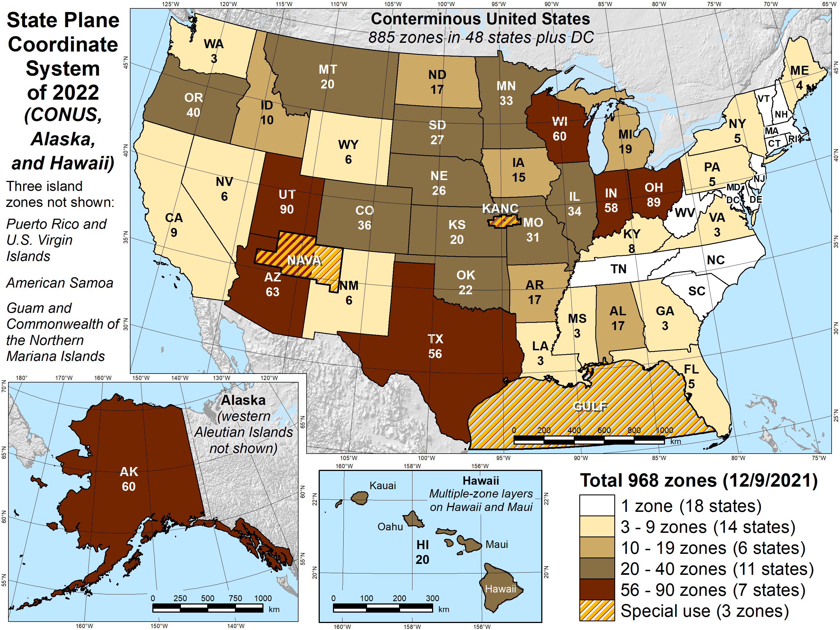
Number of SPCS2022 zones (preliminary)
CONUS, Alaska, and Hawaii
Three island zones not shown:
Puerto Rico and U.S. Virgins Islands
American Samoa
Guam and the Commonwealth of the Northern Mariana Islands

Slide 34
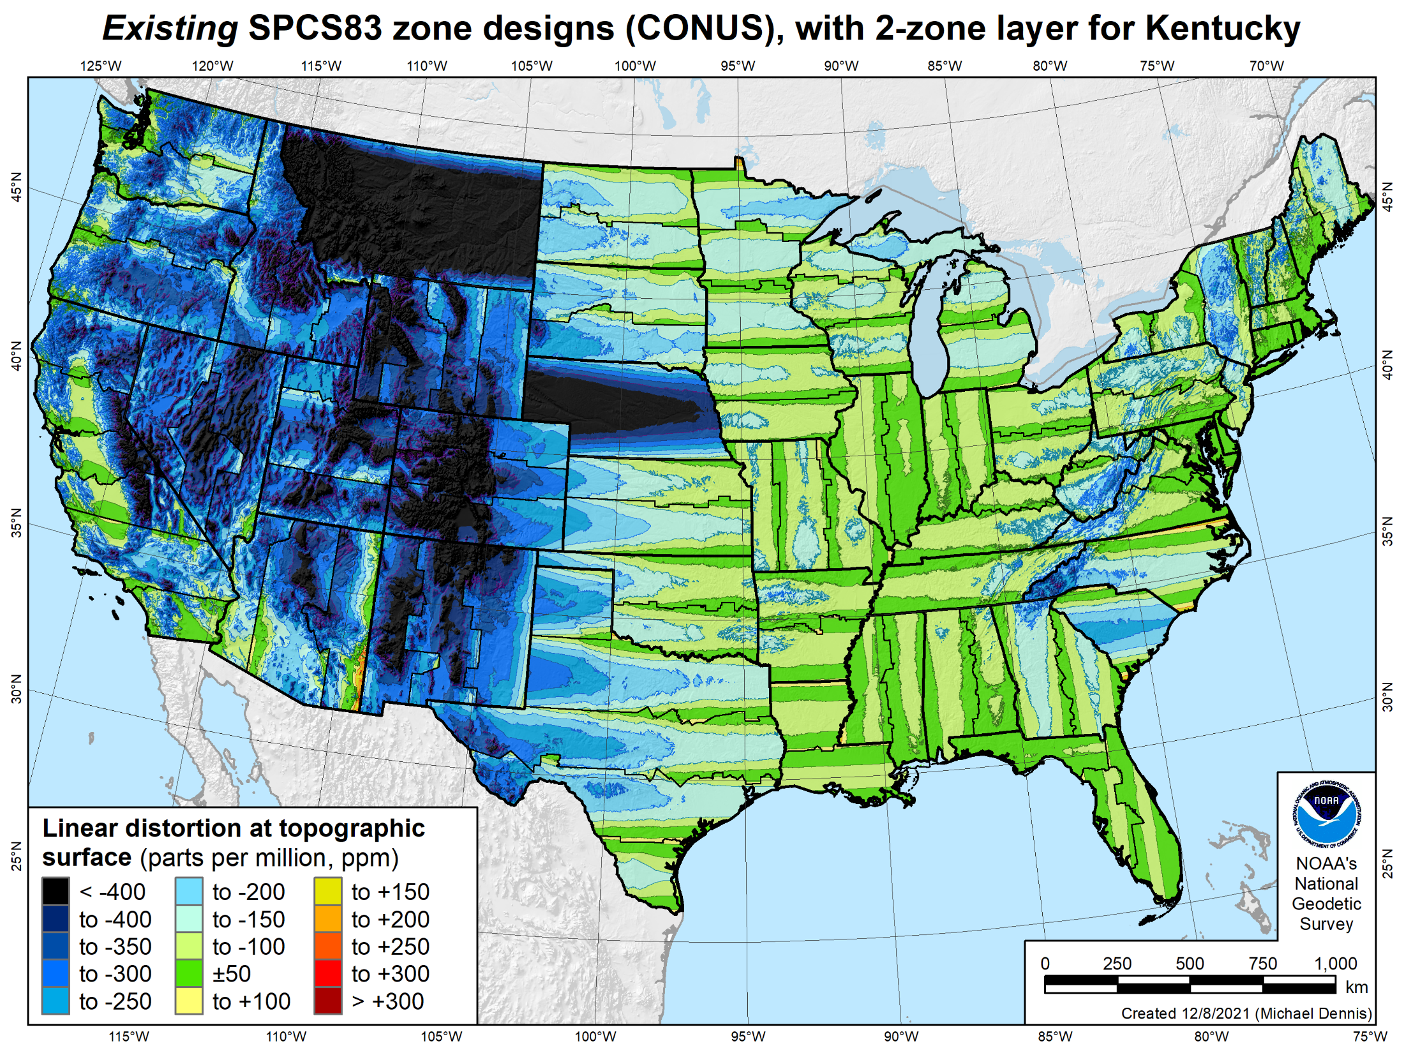
Existing SPCS 83 linear distortion
106 zones (CONUS)
Percent within distortion (ppm):
Distor | Pop | Cities | Area
±20 | 17% | 11% | 6%
±50 | 40% | 30% | 17%
±100 | 74% | 68% | 41%
±400 | 99% | 98% | 91%
City and area statistics (ppm):
 | Min | -913 | -1038
 | Max | +206 | +223
 | Range | 1120 | 1261
 | Mean | -98 | -178
Mean weighted by pop = -75

Slide 35
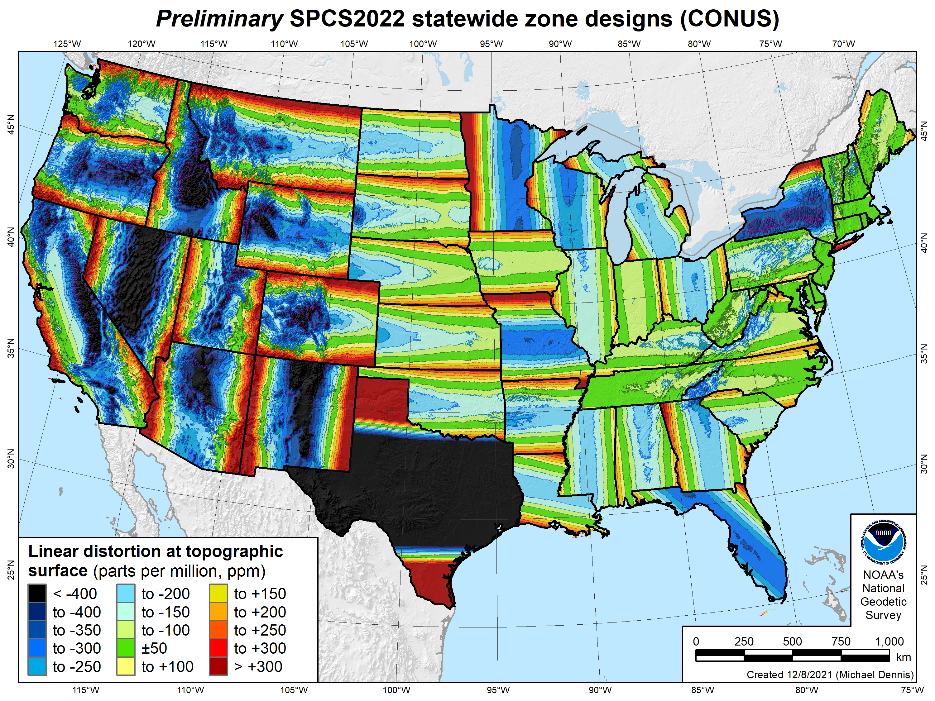
SPCS2022 linear distortion (prelim)
49 zones (CONUS)
Percent within distortion (ppm):
Distor | Pop | Cities | Area
±20 | 14% | 12% | 7%
±50 | 27% | 26% | 18%
±100 | 48% | 48% | 36%
±400 | 91% | 93% | 88%
City and area statistics (ppm):
 | Min | -1512 | -1627
 | Max | +2888 | +2987
 | Range | 4400 | 4614
 | Mean | -86 | -120
Mean weighted by pop = -100

Slide 36
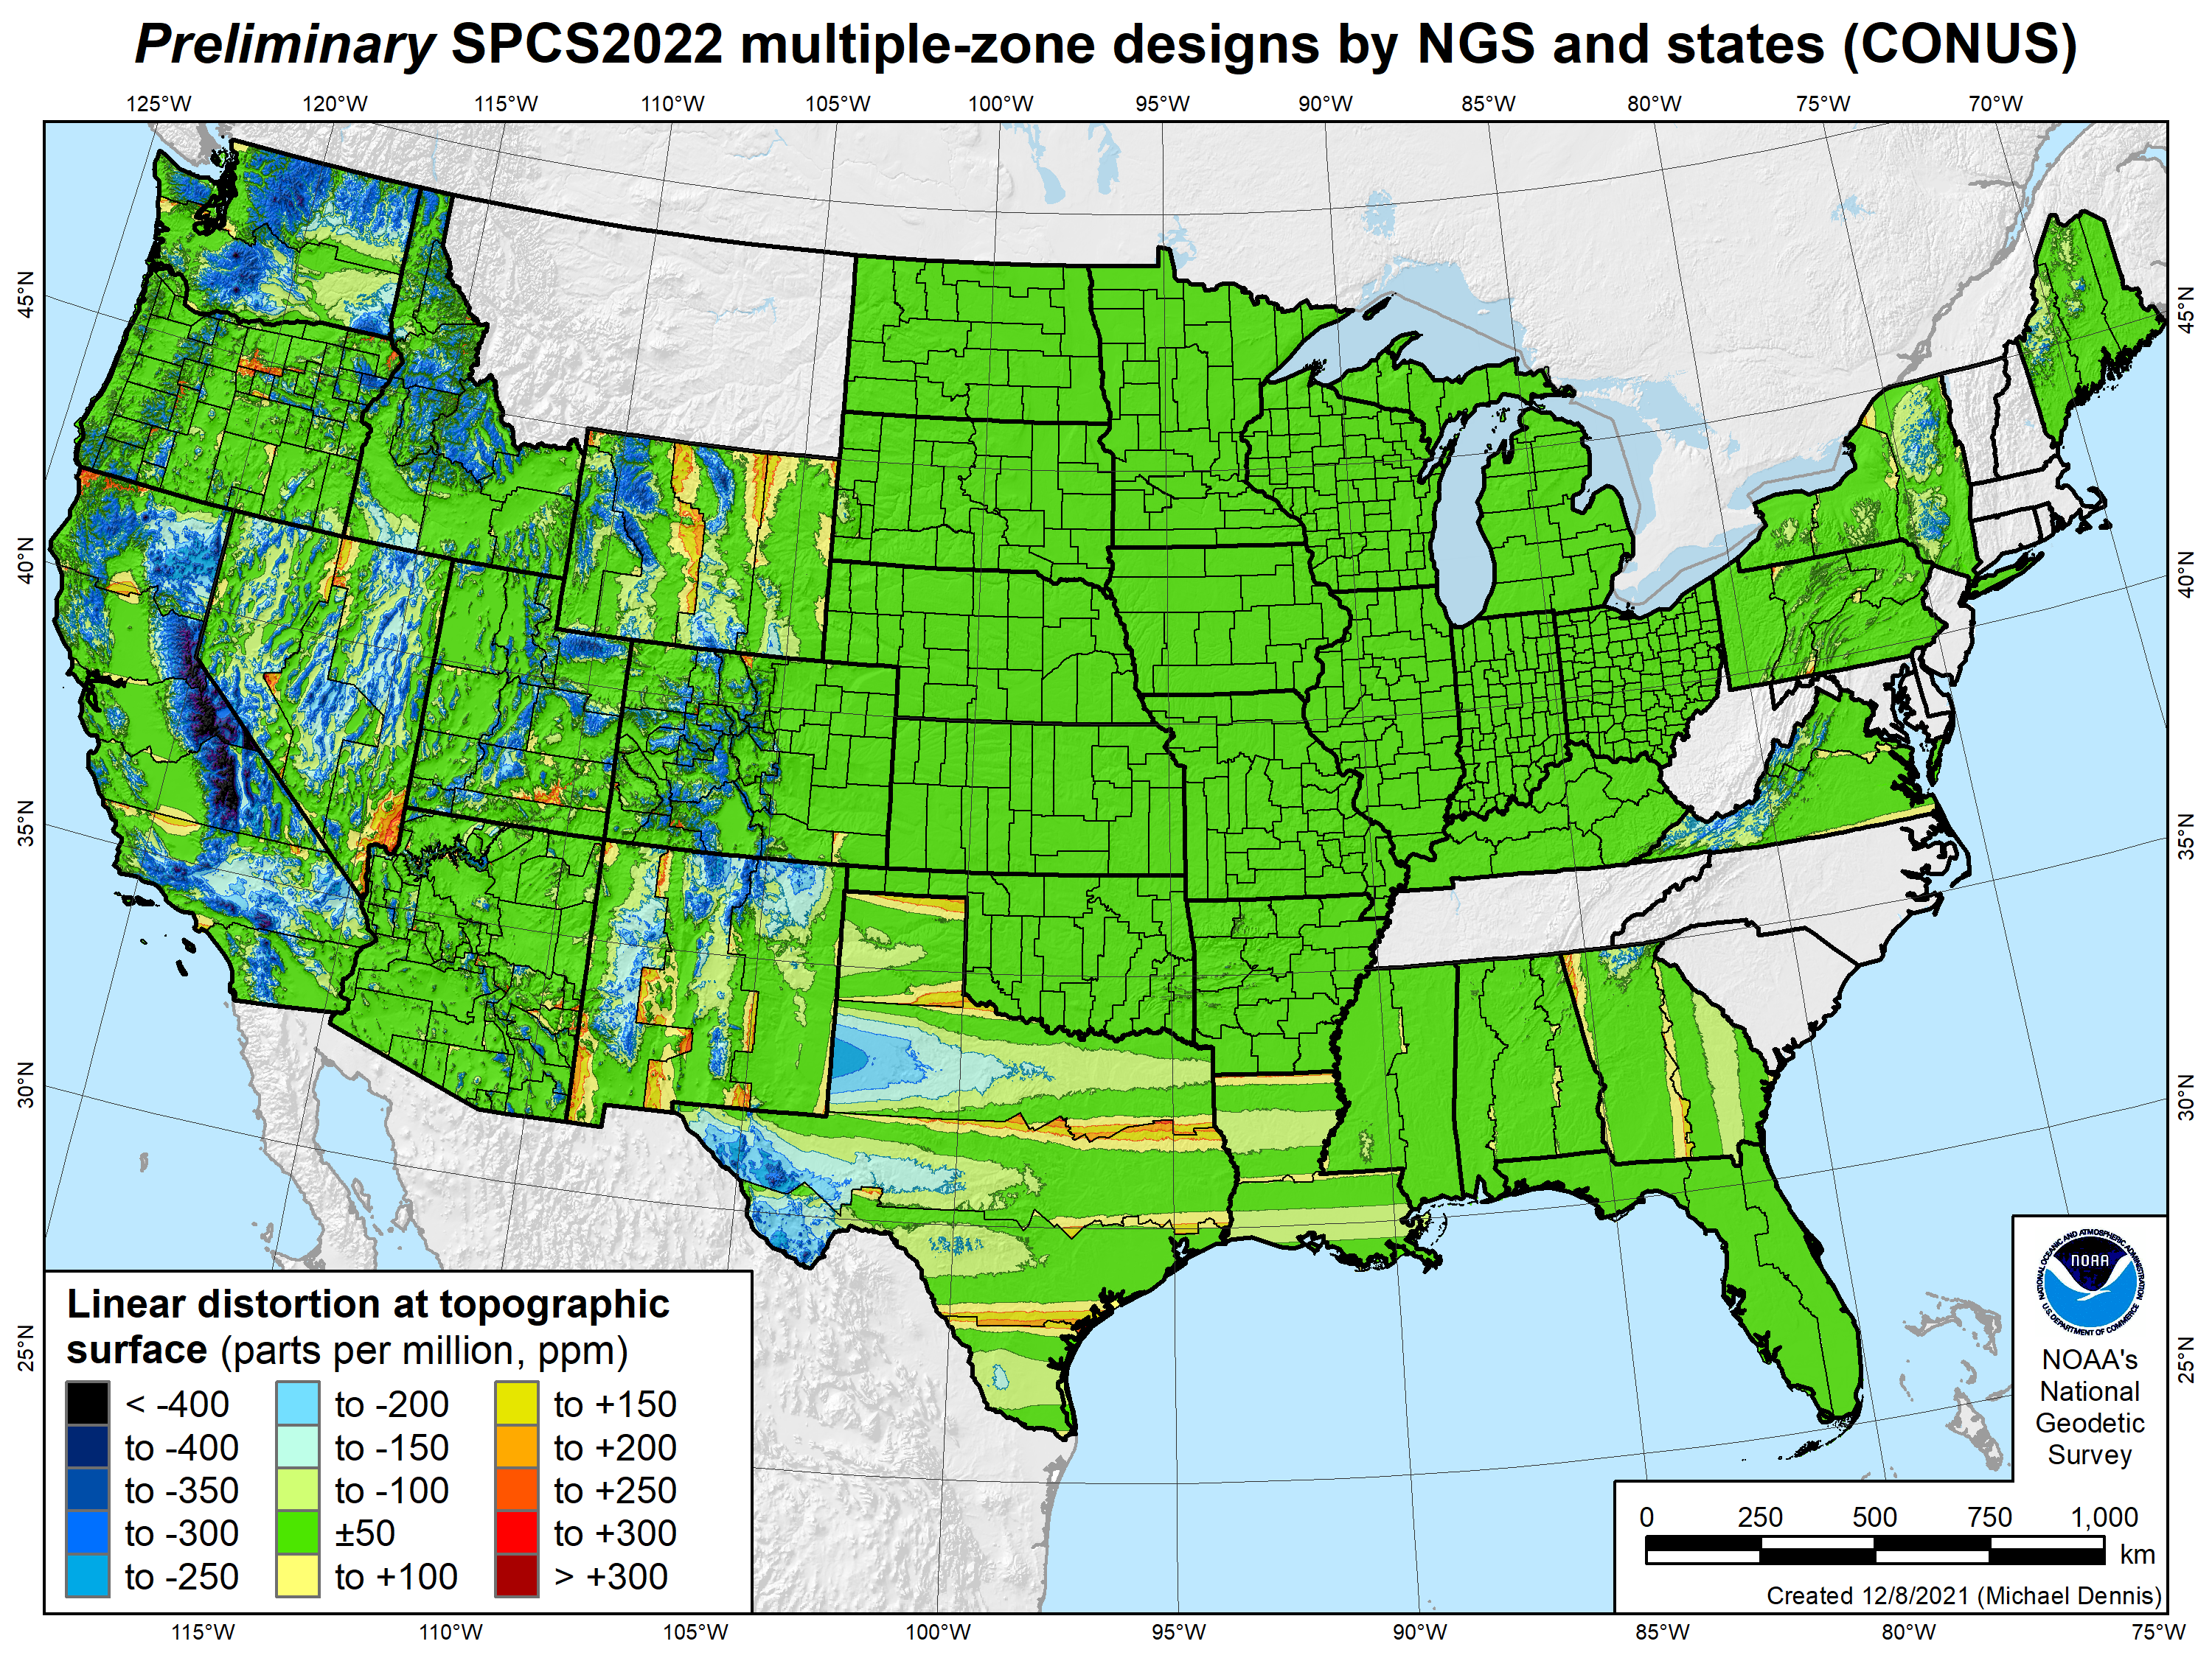
SPCS2022 linear distortion (prelim)
646 zones (35 states)
Percent within distortion (ppm):
Distor | Pop | Cities | Area
±20 | 76% | 70% | 54%
±50 | 92% | 88% | 73%
±100 | 98% | 97% | 89%
±400 | 100% | 100% | 99.9%
City and area statistics (ppm):
 | Min | -400 | -684
 | Max | +245 | +295
 | Range | 644 | 979
 | Mean | -5 | -23
Mean weighted by pop = -4

Slide 37
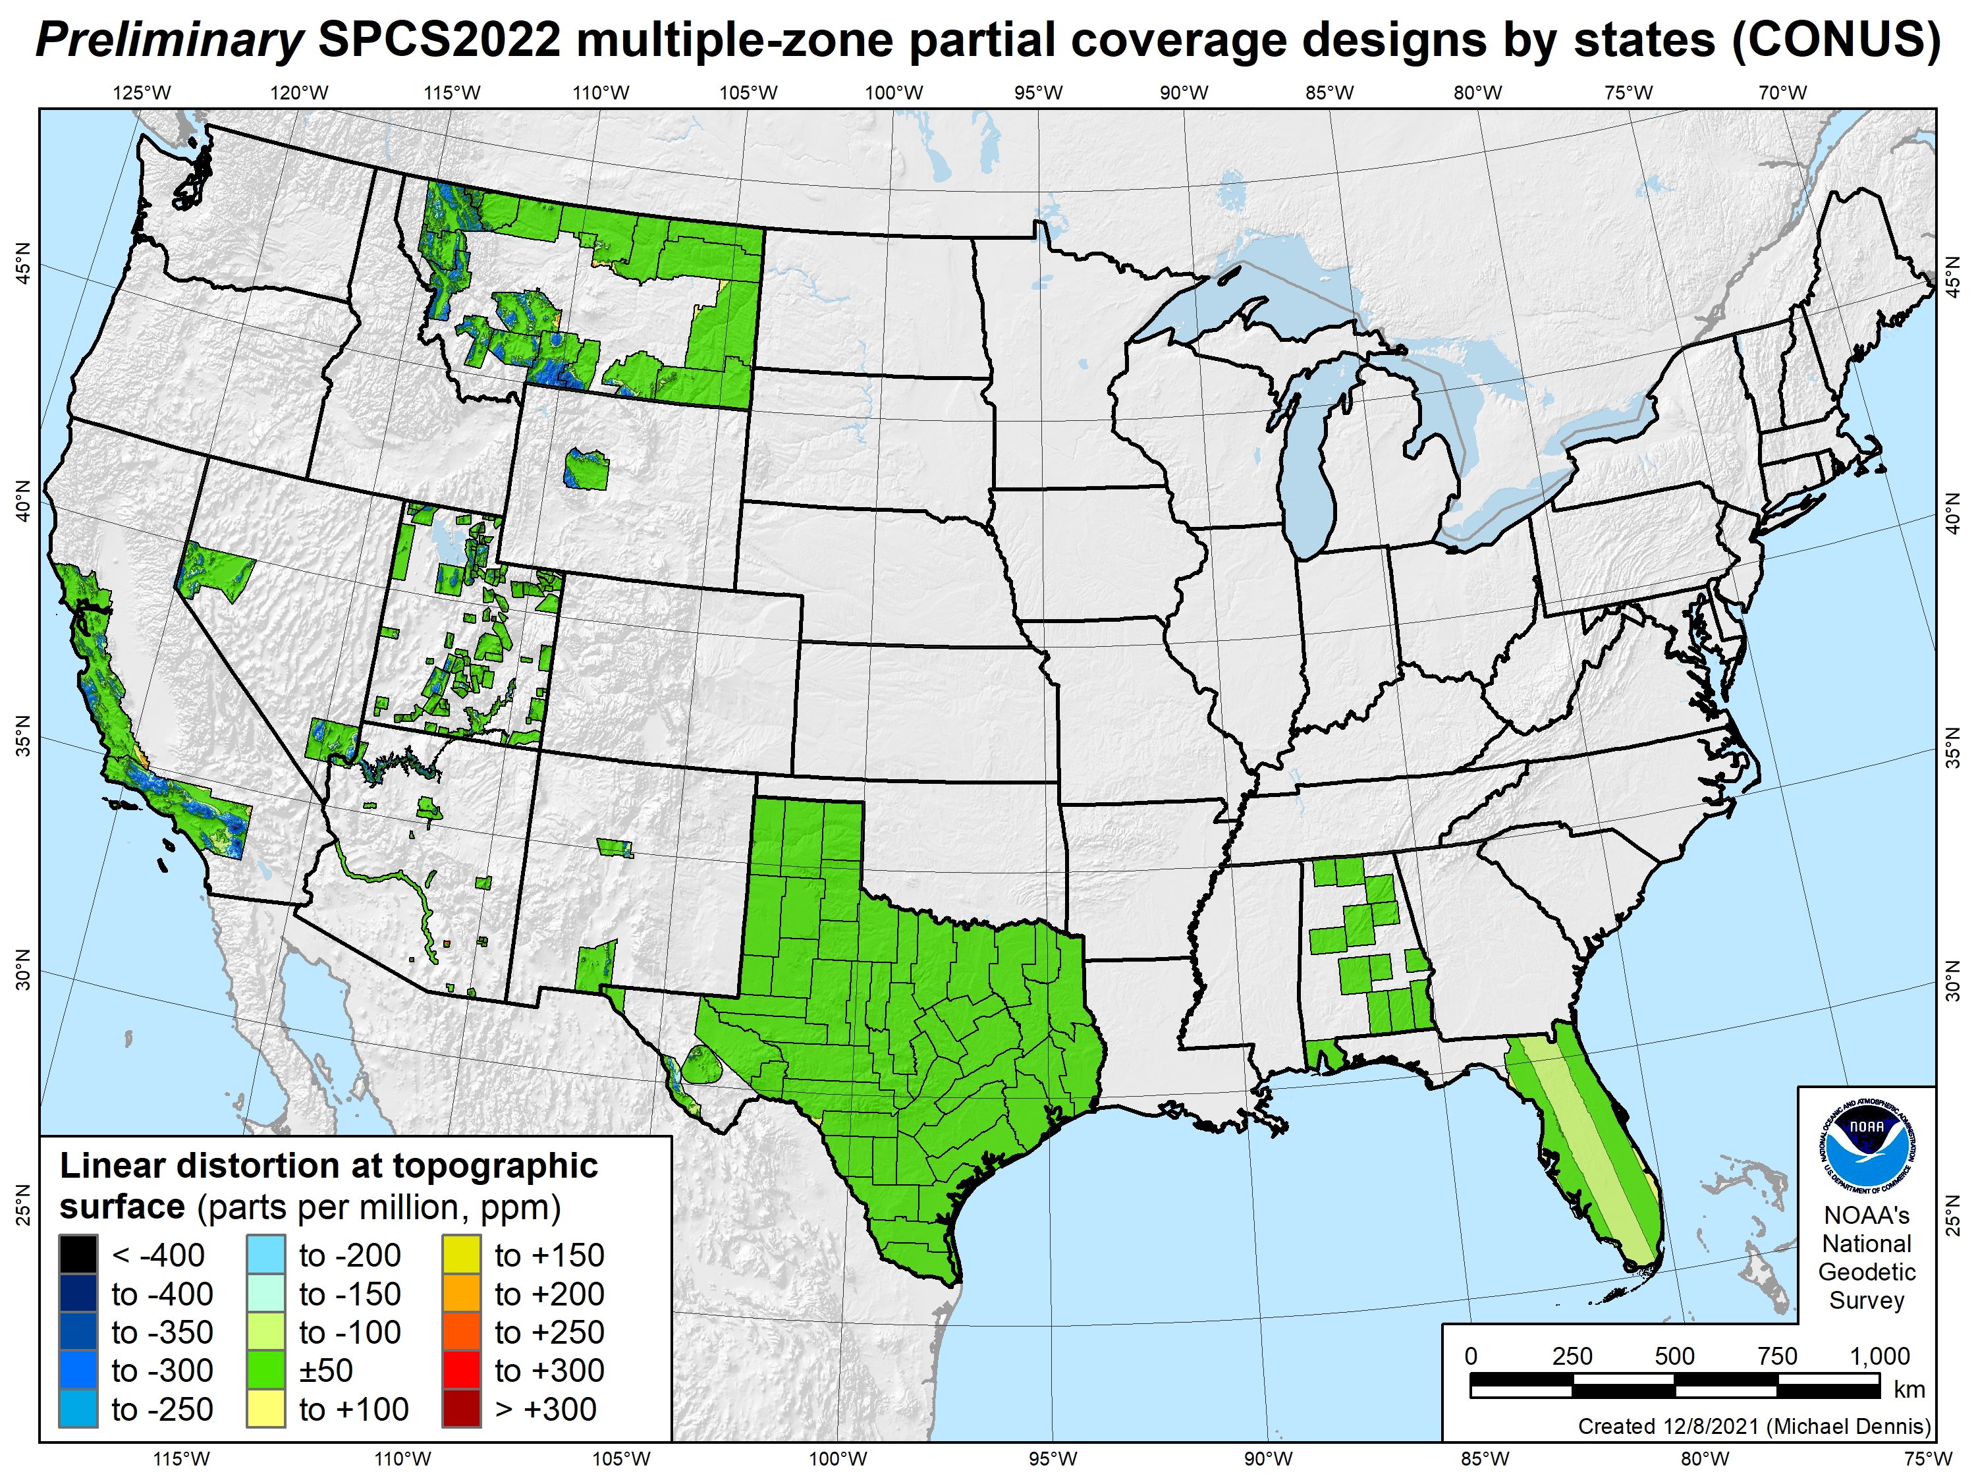
SPCS2022 linear distortion (prelim)
187 zones (10 states)
Percent within distortion (ppm):
Distor | Pop | Cities | Area
±20 | 78% | 78% | 73%
±50 | 91% | 90% | 88%
±100 | 99.8% | 99% | 97%
±400 | 100% | 100% | 100%
City and area statistics (ppm):
 | Min | -261 | -465
 | Max | +120 | +240
 | Range | 381 | 705
 | Mean | -3 | -12
Mean weighted by pop = -1

Slide 38
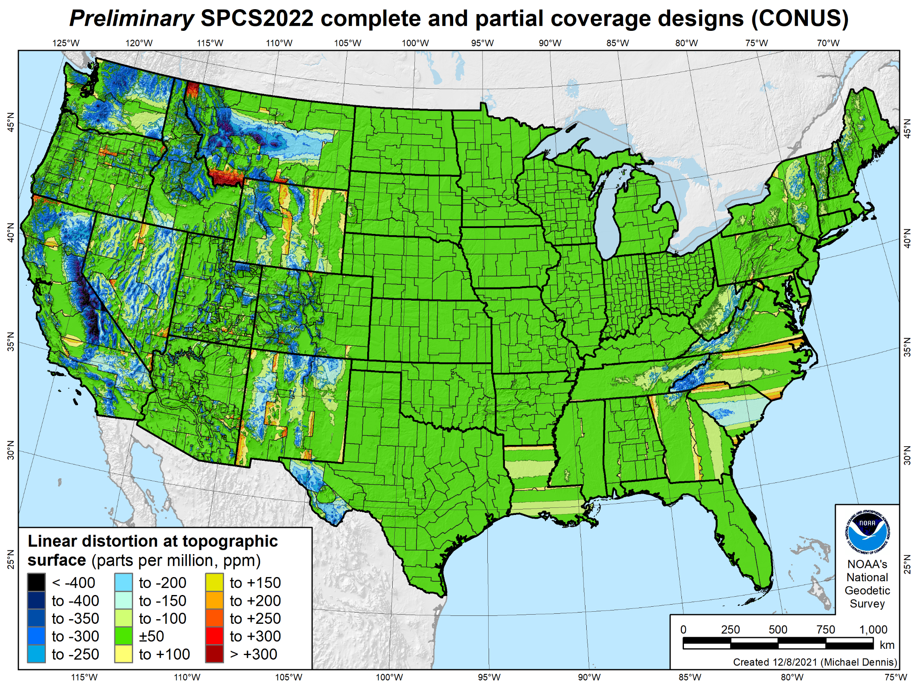
SPCS2022 linear distortion (prelim)
846 zones (CONUS)
Percent within distortion (ppm):
Distor | Pop | Cities | Area
±20 | 76% | 71% | 58%
±50 | 92% | 89% | 76%
±100 | 98% | 97% | 89%
±400 | 100% | 100% | 99.9%
City and area statistics (ppm):
 | Min | -407 | -1438
 | Max | +486 | +2624
 | Range | 893 | 4062
 | Mean | -6 | -23
Mean weighted by pop = -4

Slide 39
Existing SPCS 83 linear distortion
106 zones (CONUS)
Percent within distortion (ppm):
Distor | Pop | Cities | Area
±20 | 17% | 11% | 6%
±50 | 40% | 30% | 17%
±100 | 74% | 68% | 41%
±400 | 99% | 98% | 91%
City and area statistics (ppm):
 | Min | -913 | -1038
 | Max | +206 | +223
 | Range | 1120 | 1261
 | Mean | -98 | -178
Mean weighted by pop = -75

Slide 40
What to expect for SPCS2022
Coordinates will change by at least 10,000 m (~6 miles)
Less difference between “grid” and “ground”
More than one zone “layer” in most states
Zones will be similar to SPCS 83 in some states
Zones will be very different in most states
Every state will have a statewide zone layer
Rollout in 2025
Along with rest of modernized NSRS
Earlier usage with NAD 83 in some states
Questions?

