Slide 1

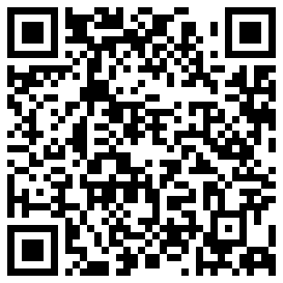
A New State Plane Coordinate System
for the Modernized National Spatial Reference System
of the United States
American Geophysical Union
2024 Annual Meeting
Washington DC, December 9-13
Michael L. Dennis, PhD, PE, PLS
SPCS2022 Project Manager
NGS Presentations Library

Slide 2
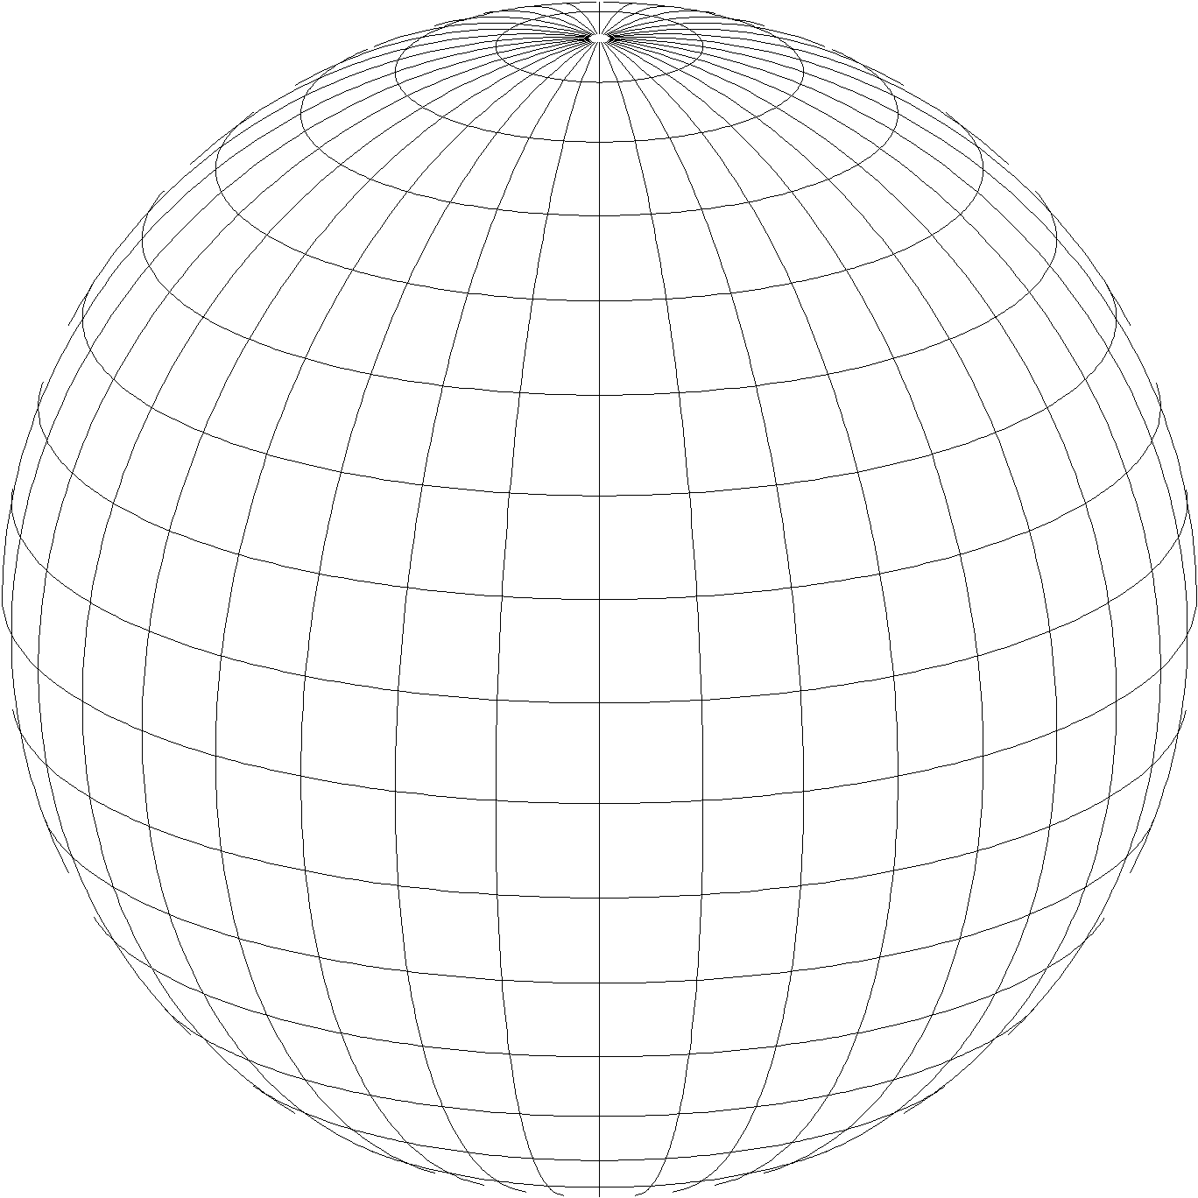
State Plane Coordinate System of 2022 (SPCS2022)
Part of modernizing the National Spatial Reference System (NSRS)
Third generation of State Plane
  First in 1930s (SPCS 27), second in 1980s (SPCS 83)
  Widely used in surveying, engineering, and GIS
  Same 3 conformal map projection types
  Same ellipsoid as SPCS 83 (GRS80)
Same as existing State Plane, but different…
  Based on new terrestrial reference frames instead of NAD 83
  More zones, most designed by state stakeholders
  Designed to reduce linear distortion at topographic surface
  (i.e., reduce difference between “grid” and “ground” distances)
Lambert Conformal Conic
Transverse Mercator
Hotine Oblique Mercator

Slide 3
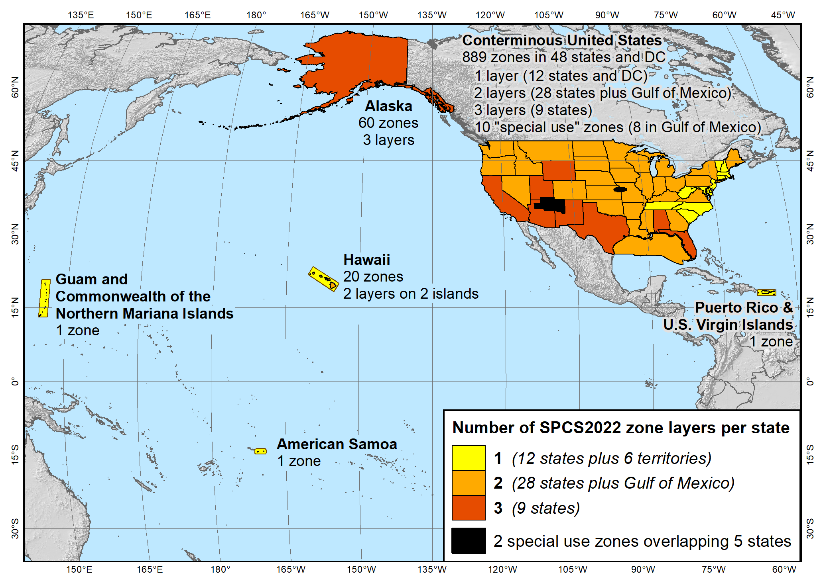
SPCS2022 zone layers
1 layer: 12 states plus 6 territories
2 layers: 28 states plus Gulf of Mexico
3 layers: 9 states
Plus 10 special use zones (2 zones overlap 5 states)
Every state and territory has a statewide zone layer

Slide 4
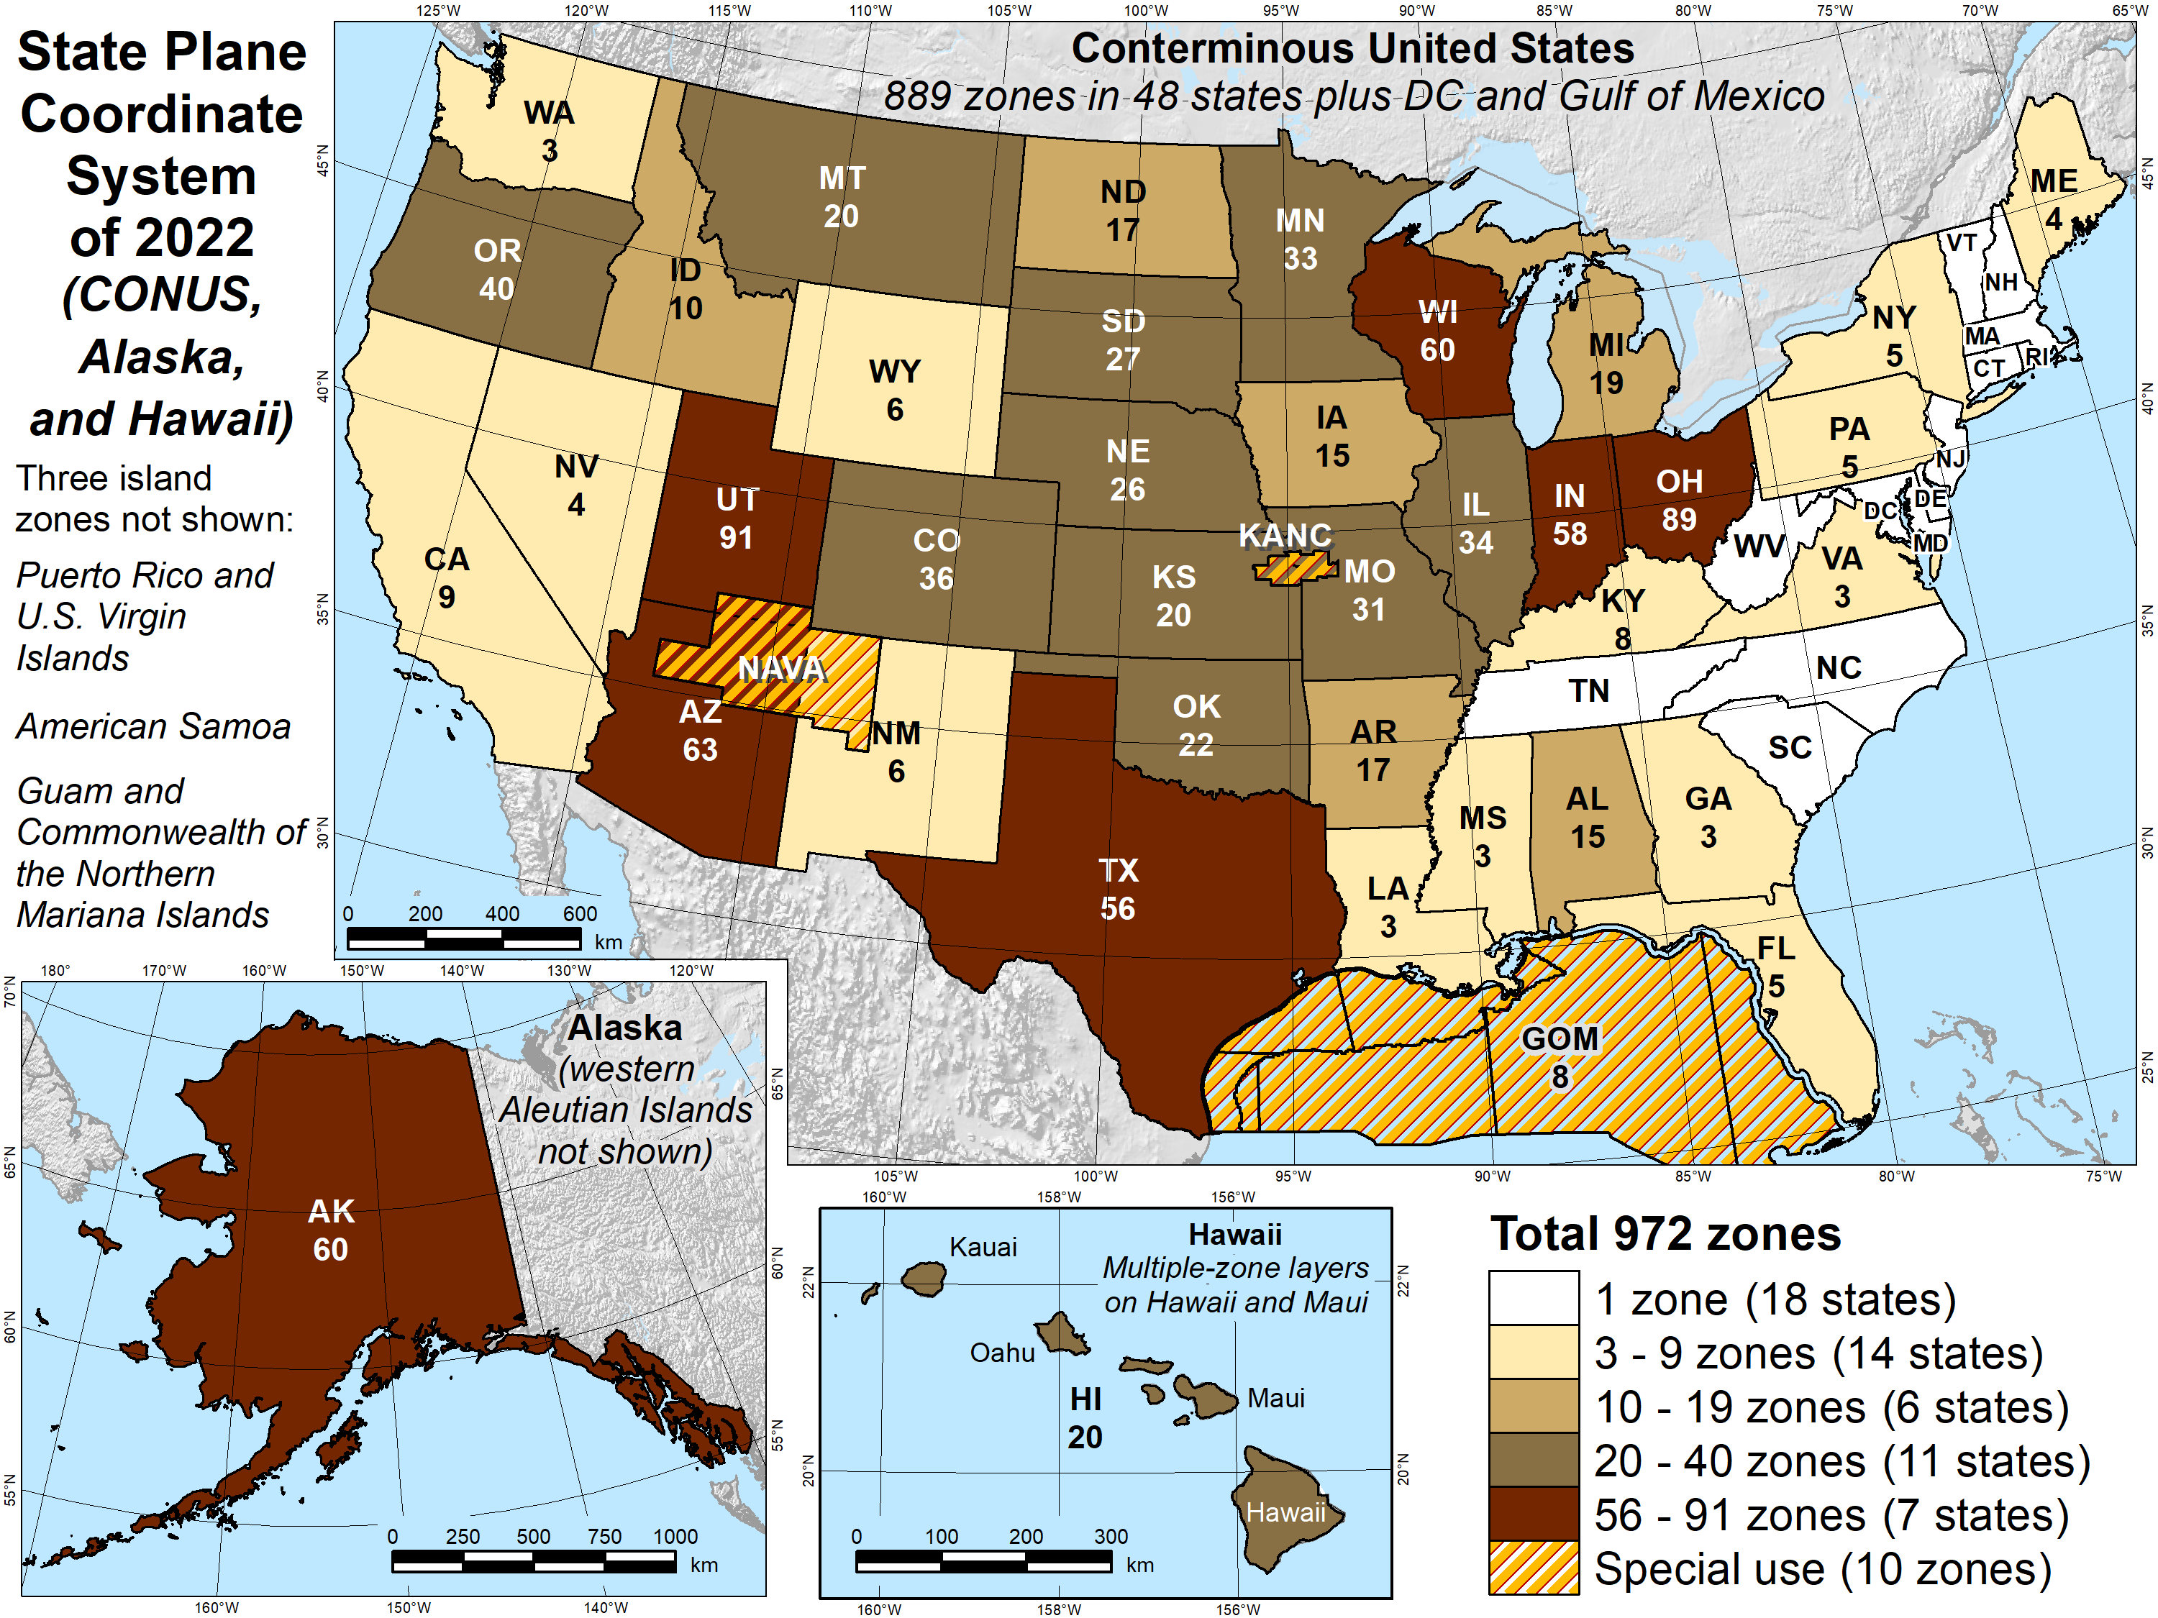
Number of SPCS2022 zones (preliminary)
Designs by NGS
  153 zones
  Includes 54 statewide zones…
  …and 10 “special use” zones
  (in more than one state or no state at all)
Designs by state stakeholders
  819 zones in 28 states
Total = 972 zones
for 56 states
and territories
Compare to 125
zones in existing
State Plane (SPCS 83)

Slide 5
SPCS2022 distortion design philosophy
Linear distortion minimized at topographic surface (not ellipsoid surface)
  Purpose: reduce difference between projected “grid” and actual “ground” distances
  Population distribution also taken into account in NGS designs
What is linear distortion?
  Map projection “scale error” at topographic surface
  Unique (i.e., same in every direction) only for conformal projections
  Given here in parts per million (ppm) = mm of distortion per km
Linear distortion | = | Projected minus actual distance
 |  | Actual distance
= | Combined factor - 1

Slide 6
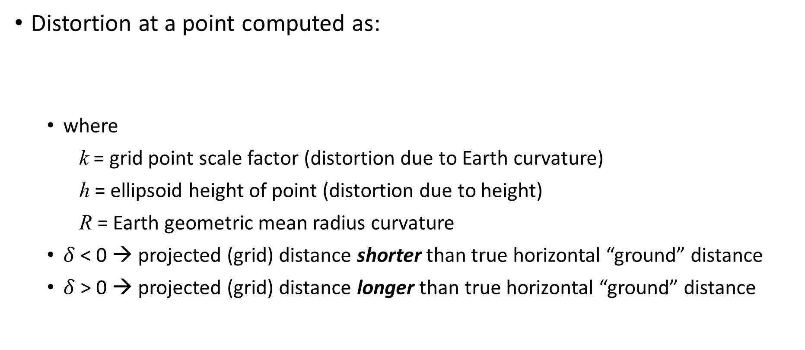
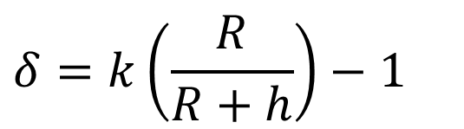
Map projection linear distortion
Distortion at a point computed as:
  where
    k = grid point scale factor (distortion due to Earth curvature)
    h = ellipsoid height of point (distortion due to height)
    R = Earth geometric mean radius curvature
  $δ$ < 0 → projected (grid) distance shorter than true horizontal “ground” distance
  $δ$ > 0 → projected (grid) distance longer than true horizontal “ground” distance
Combined factor
Grid point scale factor
$$δ=k\left(\frac{R}{R+h}\right)−1$$
Height (“elevation”) factor

Slide 7

Linear distortion with respect to ellipsoid surface
Projection
axis
(k₀ < 1)
Topographic surface
Horizontal ground distance
> ellipsoid distance
and
> grid distance
k₀ = scale on projection axis
LCC: central parallel
TM: central meridian
OM: skew axis
Ellipsoid distance
Grid distance
> ellipsoid distance
< ground distance
(k > 1 and δ < 0)
Projection surface (secant)
Ellipsoid distance
Ellipsoid surface
This design approach
used for SPCS 27 and 83 (minimizes distortion with respect to ellipsoid)
Grid distance
< ellipsoid distance
< ground distance
(k < 1 and δ < 0)
$$δ=k −1$$
7

Slide 8
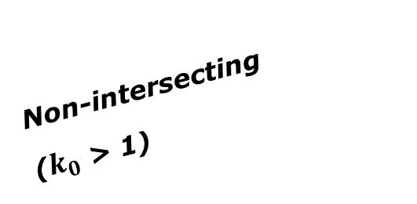
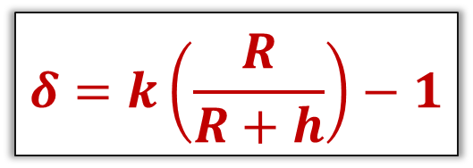
Changing projection axis to reduce distortion variation
This design approach
used for SPCS2022 (minimizes distortion with respect to topography)
Topographic surface
Grid distance = ground distance at many points
Projection
axis
Ellipsoid height of surface not constant:
h₁ ≠ h₂
h₂
Non-intersecting
($k_{0}$ > 1)
h₁
Ellipsoid surface
$$δ=k\left(\frac{R}{R+h}\right)−1$$
R₂
R₁
8

Slide 9
Linear distortion magnitudes
Parts per million | Centimeters per kilometer | Feet per mile | Dimensionless ratio | Examples
20 ppm | 2 cm/km | 0.11 ft/mile | 1:50,000 | Typical “low distortion projection” limit
50 ppm | 5 cm/km | 0.26 ft/mile | 1:20,000 | Minimum distortion for designs by NGS
100 ppm | 10 cm/km | 0.53 ft/mile | 1:10,000 | Historic State Plane distortion design limit
400 ppm | 40 cm/km | 2.11 ft/mile | 1:2,500 | UTM distortion design limit

Slide 10
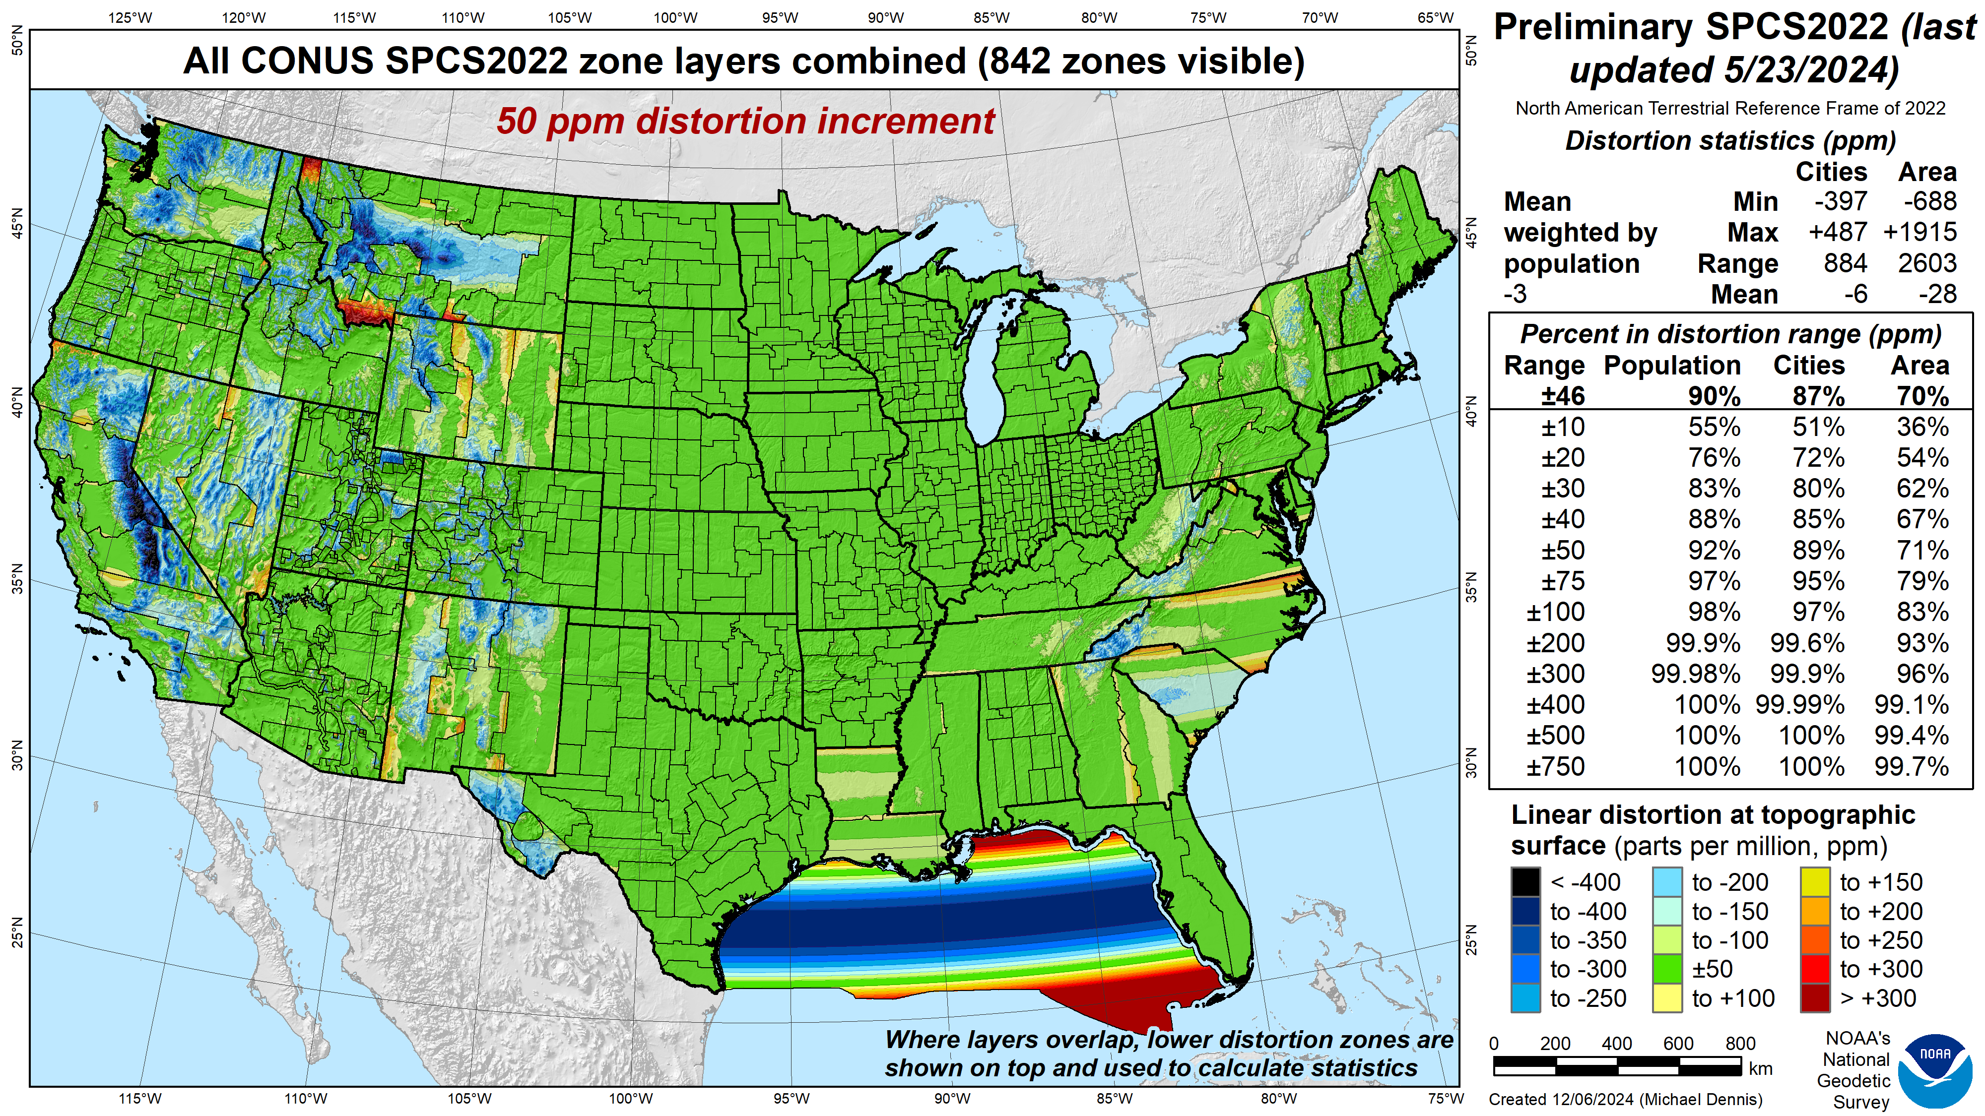
SPCS2022
linear distortion (preliminary)
Green is ±50 ppm (±0.26 ft/mile)
Distortion performance:
±46 ppm
Performance percentages:
90% population
87% cities & towns
70% total area
Mean weighted by population: -3 ppm
Performance must satisfy at least:
90%
75%
50%
Grid versus ground distance
BLUE: grid SHORTER than ground
RED: grid LONGER than ground
GREEN: grid = ground (within ±50 ppm)

Slide 11
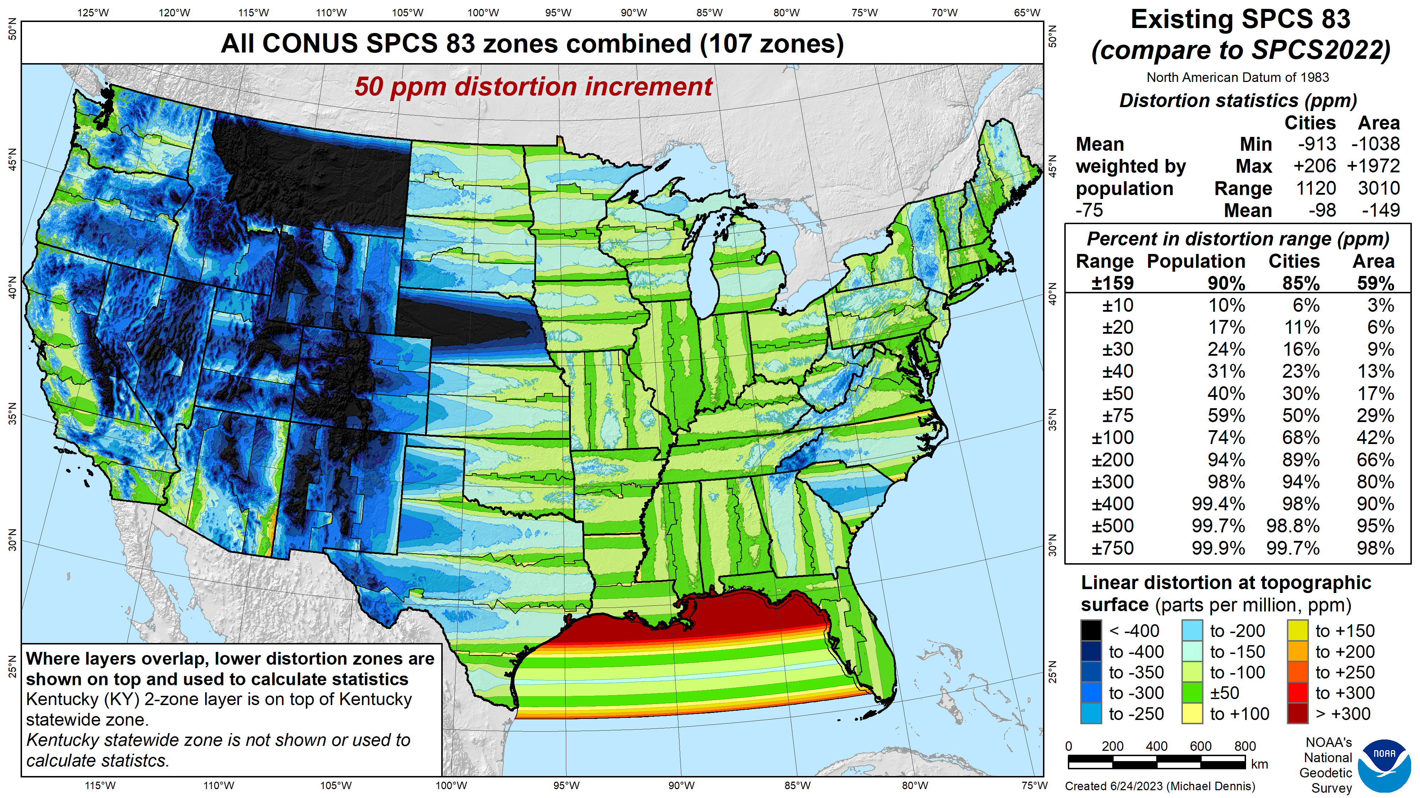
SPCS 83
linear distortion (existing)
Green is ±50 ppm (±0.26 ft/mile)
Distortion performance:
±159 ppm
Performance percentages:
90% population
85% cities & towns
59% total area
Mean weighted by population: -75 ppm

Slide 12

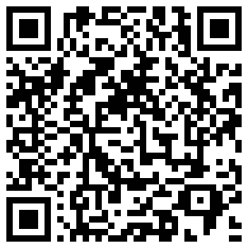
State Plane Coordinate System of 2022
NGS Presentations Library
Third generation of State Plane
  Likely most widely used projected coordinate system in United States
  SPCS2022 designed to minimize linear distortion at “ground”
  Supports use of NSRS in surveying and engineering
SPCS2022 will be released with rollout of Modernized NSRS
  Final definitions available in early 2025
  Release with “new datums” in 2026
  A truly customer-driven solution…
Online interactive SPCS2022 maps
GEODESY
for the
PEOPLE
Thank you!

