Slide 1

Blueprint for 2022, Part 3:
Working in the Modernized
National Spatial Reference System (NSRS)
Dru Smith
NSRS Modernization Manager
NOAA’s National Geodetic Survey

Slide 2
Outline
What is Blueprint for 2022, Part 3 (BP3)?
Terminology
New types of coordinates
New way of operating the NOAA CORS Network (NCN)
New way for USERS to process GNSS projects
New way of processing leveling projects
New way for NGS to process and store GNSS data
  Final Discrete Coordinates (FDCs)
New way for NGS to process and store GNSS data
  Reference Epoch Coordinates (RECs)
Miscellaneous / TBD

Slide 3
Acknowledgments
Blueprint for 2022, Part 3 is the result of significant TEAM efforts over 18 months
  GNSS Standard Operating Procedure (SOP) Team
    Choi, Roman, Jalbrzikowski, Sun, Dennis, Prusky, Gillins, W. Wang, Saleh, Yoon, Damiani, Kanazir, Evjen, Sellars, Schenewerk, Caccamise, Heck, Hilla, Bilich, McFarland
  Leveling Standard Operating Procedure (SOP) Team
    Zenk, Kanazir, Dennis, Breidenbach, Fancher, Hanson, Hensel, Paudel, Ward, Zilkoski, Gillins, Geoghegan
  BP3 Writing Team
    Kinsman, Kanazir, Hensel, Jordan, Stone, Vogel, Heck, Dennis, Fromhertz, Winester, Zenk, Silagi, Roman, Grosh, Ahlgren
It is a team document, with input from dozens of individuals around NGS

Slide 4
What is BP3?
BP3 is a companion to BP1 (geometric) and BP2 (geopotential), both released in 2017
  It is about “re-inventing bluebooking”
  It’s about how NGS will provide the frames/datum in the future
  It’s about how YOU will use the frames/datum in BP1 and BP2

Slide 5
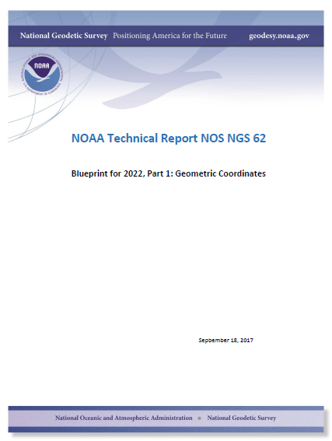
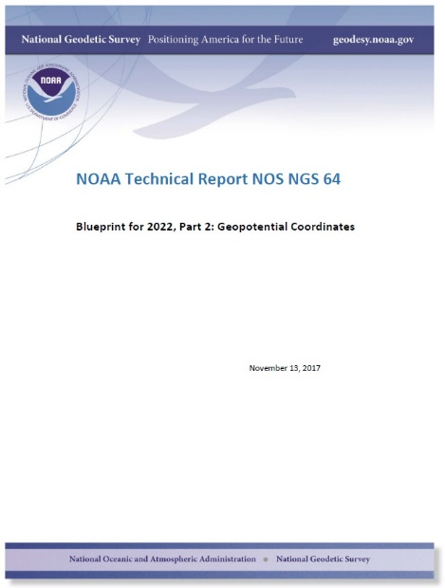
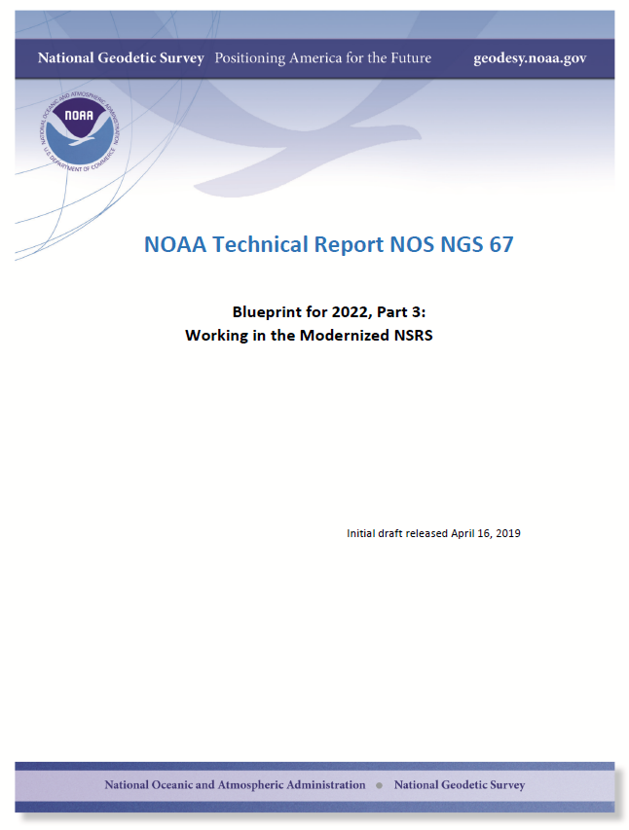
Modernizing the NSRS
The “blueprint” documents: Your best source for information
Geometric:
Sep 2017
Geopotential:
Nov 2017
Working in the
modernized NSRS:
April 2019

Slide 6
Terminology

Slide 7
Terminology
The following terms (and more) are defined meticulously in BP3 in a coordinated effort within NGS and with the IERS:
  Point, Mark, Station, Site, ARP, GRP, Site Marker, CORS, the NOAA CORS Network
    GRP = Geometric Reference Point – the official point on a station to which all coordinates refer
As a direct fallout: NGS will no longer provide CORS coordinates at an ARP, only to a GRP
  An antenna has an ARP.
    A CORS only sometimes has an antenna.
      Therefore a CORS only sometimes has an ARP.
      But it always has a GRP.
        The ARP and GRP are only sometimes coincident in space when the antenna is mounted at a CORS
  The GRP gets a Permanent Identifier (PID)

Slide 8
Terminology
“CORS” is an acronym
  It is singular (S means “Station”, not “Stations”)
  It will no longer be used to describe the network of all such stations
    That will, for now, be called the NOAA CORS Network, or NCN
      Which has a subset of stations called the NOAA Foundation CORS Network, or NFCN
  Its plural form is CORSs
    No apostrophe, No “es” and no skipping the “s”
    GODE is a CORS
      Not “a CORS site”
        And definitely NOT “a CORS Station”
          That’s like “an ATM machine”
    GODE and 1LSU are CORSs
    GODE and 1LSU belong to the NOAA CORS Network
    TMG2 is a NOAA Foundation CORS
    TMG2 and FLF1 are NOAA Foundation CORSs
    TMG2 and FLF1 belong to the NOAA Foundation CORS Network

Slide 9
Terminology
“OPUS”
  Online Positioning User Service
  Adopted as the general term for all of our online positioning software
    Rather than “-Projects” , “-S” , etc
    Basically “do it with OPUS” should be applicable to a wide variety of tasks
      Recon, Mark Recovery, GPS, Leveling, Gravity, Classical

Slide 10
Terminology
“GPS Month”
  A span of four consecutive GPS weeks, where the first GPS week in the GPS month is an integer multiple of 4
  GPS Month 0 = GPS weeks 0, 1, 2 and 3
  GPS Month 1 = GPS weeks 4, 5, 6 and 7
  Etc.

Slide 11
New Types of Coordinates

Slide 12
New Types of Coordinates
Reported
  “These are from any source where the coordinate is directly reported to NGS without the data necessary for NGS to replicate the coordinate.”
    Scaled
    From NCAT or Vdatum
      NGS Coordinate Conversion and Transformation Tool (NCAT)
    Hand Held / Smartphone
    Reported directly from an RTK rover without data files

Slide 13
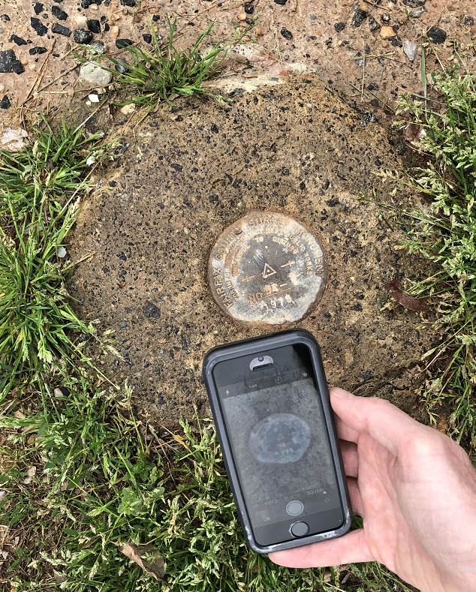
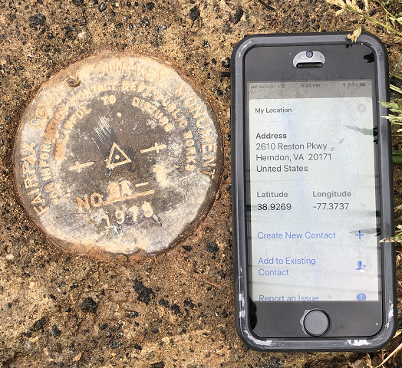
Reported Coordinates

Slide 14
New Types of Coordinates
Preliminary
  “These are coordinates at survey epoch that have been computed from OPUS, but not yet quality checked and loaded into the National Spatial Reference System Database (NSRS DB).”
    User-computed values, such as they might get today from either OPUS-S or OPUS-Projects
    “Preliminary” coordinates are the only coordinates a user will get directly from OPUS

Slide 15
New Types of Coordinates
Reference Epoch
  “These are coordinates which have been estimated by NGS, from time-dependent (final discrete and final running) coordinates, at an Official NSRS Reference Epoch (ONRE)”
    NAD 83(2011) epoch 2010.00 (sort of) would’ve fallen under this category
    These will be computed by NGS every 5 years
      On a schedule 2-3 years past ONRE
        2020.00 coordinates will be computed in CY 2022
        2025.00 coordinates will be computed in CY 2027

Slide 16
New Types of Coordinates
Final Discrete
  “These are coordinates computed by NGS using submitted data and metadata, checked and adjusted and referenced to one survey epoch.”
    These represent the best estimates NGS has of the time-dependent coordinates at any mark
    Could be a:
      Daily solution on one CORS
      The single adjusted value coming from one or more occupations on a passive mark within 1 GPS Month
*
*
More on that in a moment…

Slide 17
New Types of Coordinates
Final Running
  “Of all types of coordinates on a mark, these are the only ones which will have a coordinate at any time.”
    At a CORS GRP, they will be the coordinate function
      Which will be generated by a “fit” to regularly computed Final Discrete Coordinates (FDCs) on a TBD basis, perhaps daily, perhaps weekly
    On a passive mark, they will come from a mixture of Final Discrete Coordinates (FDCs) and the Intra-Frame Velocity Model (IFVM2022)
      And possibly the time-dependent geoid, DGEOID2022

Slide 18
New Way of Operating the NOAA CORS Network (NCN)

Slide 19
New Way of Operating the NOAA CORS Network (NCN)
Each CORS will get a coordinate function
  Actually three functions, X(t), Y(t), Z(t), in the ITRF2014 frame
  In the strict mathematical definition of “function”
    For any given “t”, there is one and only one X , Y and Z
    We actually do this today, just that the functions are piecewise linear
  We are NOT limiting our “modernized NSRS” discussions of CORS coordinate functions to linear functions only!
    But have made no further decisions yet

Slide 20
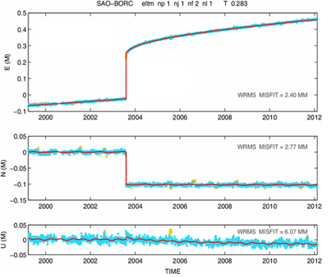
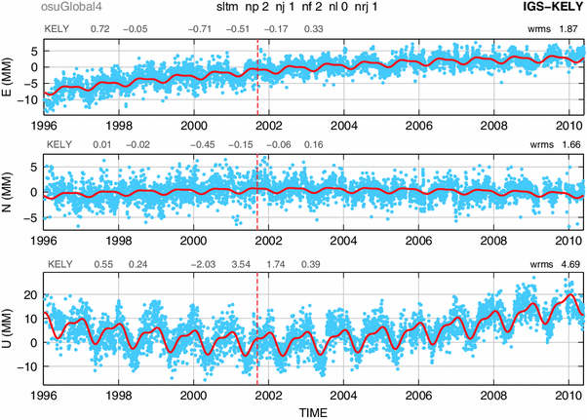
Examples of what non-linear CORS coordinate functions look like

Slide 21
New Way of Operating the NOAA CORS Network (NCN)
Philosophy:
  The NOAA CORS Network (NCN) will be self-consistent, meaning:
    The impact of a user’s CORS choices within their project will not exceed a small, statistically acceptable value:
      Horizontal < 5 mm, Vertical < 10 mm
  On a daily basis NGS must be able to detect, and react to, persistent disagreement between daily solutions and the current “coordinate function” assigned to any CORS in the NOAA CORS Network (NCN)

Slide 22
Persistent Disagreement
The point:
  It’s not enough to say “each CORS is good to 1 cm in ellipsoid height”.
    That phrase is vague, lacking what it means to be “good to 1 cm”.
  NGS will define and publish “persistent disagreement”
    Possible component: A persistent non-zero average disagreement
    Possible component: A persistently deviating disagreement
  And NGS will define what happens when a CORS exhibits “persistent disagreement”

Slide 23
New Way for USERS to Process GNSS Projects

Slide 24
GNSS: Time Span…
GNSS projects have no time limit.
  (Leveling does. More on that later)
  But they will be processed by NGS in GPS Months
*

Slide 25
GNSS: Processing by users in OPUS
GNSS projects, processed by users using OPUS, must always be processed by GPS month as a first step
  Multiple occupations on a point within a GPS month will be adjusted together
  Coordinate functions from the IGS network or the NOAA CORS Network are the only allowable control
  These are effectively the identical steps NGS will use in-house to compute Final Discrete Coordinates (FDCs) from your data
    Except NGS will merge your data with all other data in the nation during each GPS month
  This process will be built into OPUS as the default, making it easy for users to quickly perform the adjustment
  Afterwards, users may move on to a second step…
*

Slide 26
GNSS: Processing by users in OPUS
As a second step, a user may do many alternative things…
  Adjust to some epoch that is convenient to them…
  Hold any CORSs or passive control as constraints…
This two-step approach is a form of sequential adjustments and allows a win-win:
  NGS gets to see the user-computed time-dependent “preliminary” coordinates, which have been computed by GPS Month
    Which will be checked against “final discrete” coordinates computed by NGS
  The user gets whatever adjustment and/or coordinates fulfill their contractual needs
  Redundancy checks can occur both within a GPS month (at step 1, if multiple occupations occur in 1 GPS month) and across GPS months (at step 2, if occupations occur in different GPS months)

Slide 27
New Way of Processing Leveling Projects

Slide 28
Leveling: Time Span…
Leveling projects must not exceed 12 sequential months
  Longer projects must be broken into sub-projects each spanning less than 12 sequential months
A compromise between:
  Treating “1 GPS Month” as “simultaneous” in the GNSS arena, and
  Acknowledging that leveling surveys often take weeks to months to conduct
Mixed with the reality that:
  You can’t solve for time-dependent orthometric heights in most leveling projects

Slide 29
Leveling: GNSS required
For the immediate years following 2022, NGS will require that all leveling projects turned in have GNSS on primary control
  Minimum of 3 points
  Maximum spacing of 30 km
  At least two occupations:
    +/- 14 days of beginning of leveling
      But also within the same GPS month
    +/- 14 days of ending leveling
      But also within the same GPS month
  If leveling exceeds 6 months, must have a 3rd, middle occupation
A GNSS “occupation” can mean “RTK/N”!

Slide 30
Leveling: Step 1
Identify project marks

Slide 31
Leveling: Step 2
Identify primary control marks (PCM)
Each PCM is within 30 km of at least one other PCM
< 30 km
< 30 km
< 30 km
< 30 km

Slide 32
Leveling: Step 2
Identify primary control marks (PCM)
No point over 30 km from a PCM

Slide 33
Leveling: Step 3
Initial GNSS on all PCMs
All PCMs, required: within +/- 2 weeks of the start of leveling
Each PCM, required: 2+ occupations within the same GPS month
All PCMs, recommended: Use the same GPS month

Slide 34
Leveling: Step 4
Leveling
Finished in under 12 months
If greater than 6 months, need a mid-project GNSS set on PCMs

Slide 35
Leveling: Step 5 (if 6-12 months)
Mid-project GNSS on all PCMs
All PCMs, recommended: Near midpoint of project
Each PCM, required: 2+ occupations within the same GPS month
All PCMs, recommended: Use the same GPS month

Slide 36
Leveling: Step 6
Final GNSS on all PCMs
All PCMs, required: within +/- 2 weeks of the end of leveling
Each PCM, required: 2+ occupations within the same GPS month
All PCMs, recommended: Use the same GPS month

Slide 37
Leveling: Processing
All GNSS data processed into GPS months, as per normal processing
These are then adjusted to a mean epoch of the entire leveling survey to yield “representative” orthometric heights that serve as control over the entire leveling project
Stochastic but no time dependency

Slide 38
Leveling: Processing
The pre-computed GNSS-based orthometric heights are held as stochastic constraints in the adjustment of leveling data
Use math model from NOAA TM NOS NGS 74
Separates out errors in GNSS from Leveling:
  Absolute heights will have standard deviations that are “at GNSS accuracy levels”
  Differential heights will have standard deviations that are “at leveling accuracy levels”

Slide 39
Leveling: Absolute errors
Consider this quote from a concerned user:
  “In the old NSRS, I could pull the datasheet for a point in California and see that NGS trusted the NAVD 88 height to 1 millimeter. Now, you’re telling me to use RTN to establish orthometric heights in the same area, and I’m getting heights with 4 cm standard deviations! Why are your heights less accurate today than in the past?”

Slide 40
New Way for NGS to Process and store GNSS Data:
Final Discrete Coordinates (FDCs)

Slide 41
GNSS: Monthly workflow…
Every GPS month (say the first Monday of that GPS month), NGS will “process the GPS month of 12-16 weeks ago” by doing the following:
  Ensure that the “final” IGS orbits for the GPS month that spans 12-16 weeks prior are available
    If not, hold off on this until they are
  Create an in-house project named for that prior GPS month
  Farm all data (collected during that GPS month) from all projects submitted to NGS, and put them all into the in-house project

Slide 42
Processing by GPS Month…
GPS Month 587
GPS Month 588
GPS Month 589
GPS Month 590
GPS Month 591
GPS Month 592
GPS Month 593
GPS Month 594
All GNSS data collected in this
GPS month…
…are processed in this GPS month…
…to create Final Discrete coordinates for
this GPS month….
…which are loaded into the
NSRS database in this GPS month.

Slide 43
Processing by GPS Month…
GPS Month 587
GPS Month 588
GPS Month 589
GPS Month 590
GPS Month 591
GPS Month 592
GPS Month 593
GPS Month 594
All GNSS data collected in this
GPS month…
…are processed in this GPS month…
…to create Final Discrete coordinates for
this GPS month….
…which are loaded into the
NSRS database in this GPS month.

Slide 44
GNSS: Monthly workflow…
Adjust all that data together
Take the results of this adjustment and load them into the NSRS database as “final discrete” coordinates

Slide 45
GNSS: Monthly workflow…
Q: What about users’ projects that span more than 12-16 weeks?
A: NGS will provide a way for a user to “allow NGS to farm my data as it is loaded to my ongoing project”
  Thus NGS needn’t wait for them to finish their project and click “submit”.
  Will require some sort of metadata validity statement from the user for each data file uploaded

Slide 46
GNSS: Monthly workflow…
Q: What if a user turns in data more than 12-16 weeks after it was collected?
A: NGS will have a “holding bin” for such data. Occasionally, but not more than 1/year, NGS will sweep up all data in the holding bin, and put that data into the proper in-house GPS-month-based projects, depending on the GPS month of that data.
  Since those in-house projects have already been adjusted once before using data that WAS submitted within the 12-16 week limit, and “final discrete” coordinates were computed on those early-submitted data, NGS will hold the “final discrete” coordinates on that early-submitted data as “fixed”, and adjust the later-submitted data only.

Slide 47
New Way for NGS to Process and store GNSS Data:
Reference Epoch Coordinates (RECs)

Slide 48
GNSS: Every five years…
Official NSRS Reference Epochs (ONREs) will happen every five years, beginning with 2020.00.
Every ONRE will have a project associated with it
  To estimate the Reference Epoch Coordinates (RECs) at each ONRE
  That project will begin 2 years after the ONRE and will end 3 years after it
    Thus the project to create 2020.00 RECs will run January 1-December 31, 2022
    Using data collected through the end of 2021
Error estimates in RECs will grow larger every five years for those points which are not regularly observed
Once computed, the REC at an ONRE for a point will stand forever, unless corrected for a blunder

Slide 49
Miscellaneous

Slide 50
Miscellaneous
OPUS-RS will be modified to work in the modernized NSRS online, but will not be used to populate the NSRS Database
  To use the new terminology: it will provide preliminary coordinates
  To acknowledge the problems with integrating this software with any other version of OPUS
  In preparation for its eventual mothballing / replacement by the new multi-GNSS PAGES

Slide 51
Future Discussions/Decisions:
What will be the nature of the coordinate functions at each CORS?
How will those functions be used to detect, and correct, persistent disagreement between daily solutions and the coordinate functions?

Slide 52
Future discussions:
What will be the nature of the “coordinate functions” at each CORS?
How will those functions be used to detect, and correct, persistent disagreement between daily(?) final discrete coordinates and the coordinate functions?

Slide 53
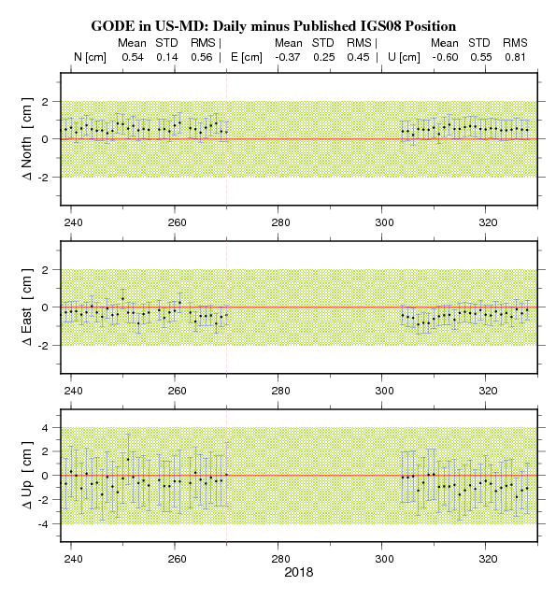
CORS Processing
This is from the most recent
“short term” plots of GODE
Note, what could be called a “persistent
non-zero average disagreement” between
daily solutions and the assigned coordinate
function (about 5 mm in North, for example)
Not “persistently growing disagreement”, as
the average disagreement isn’t getting
worse.

Slide 54
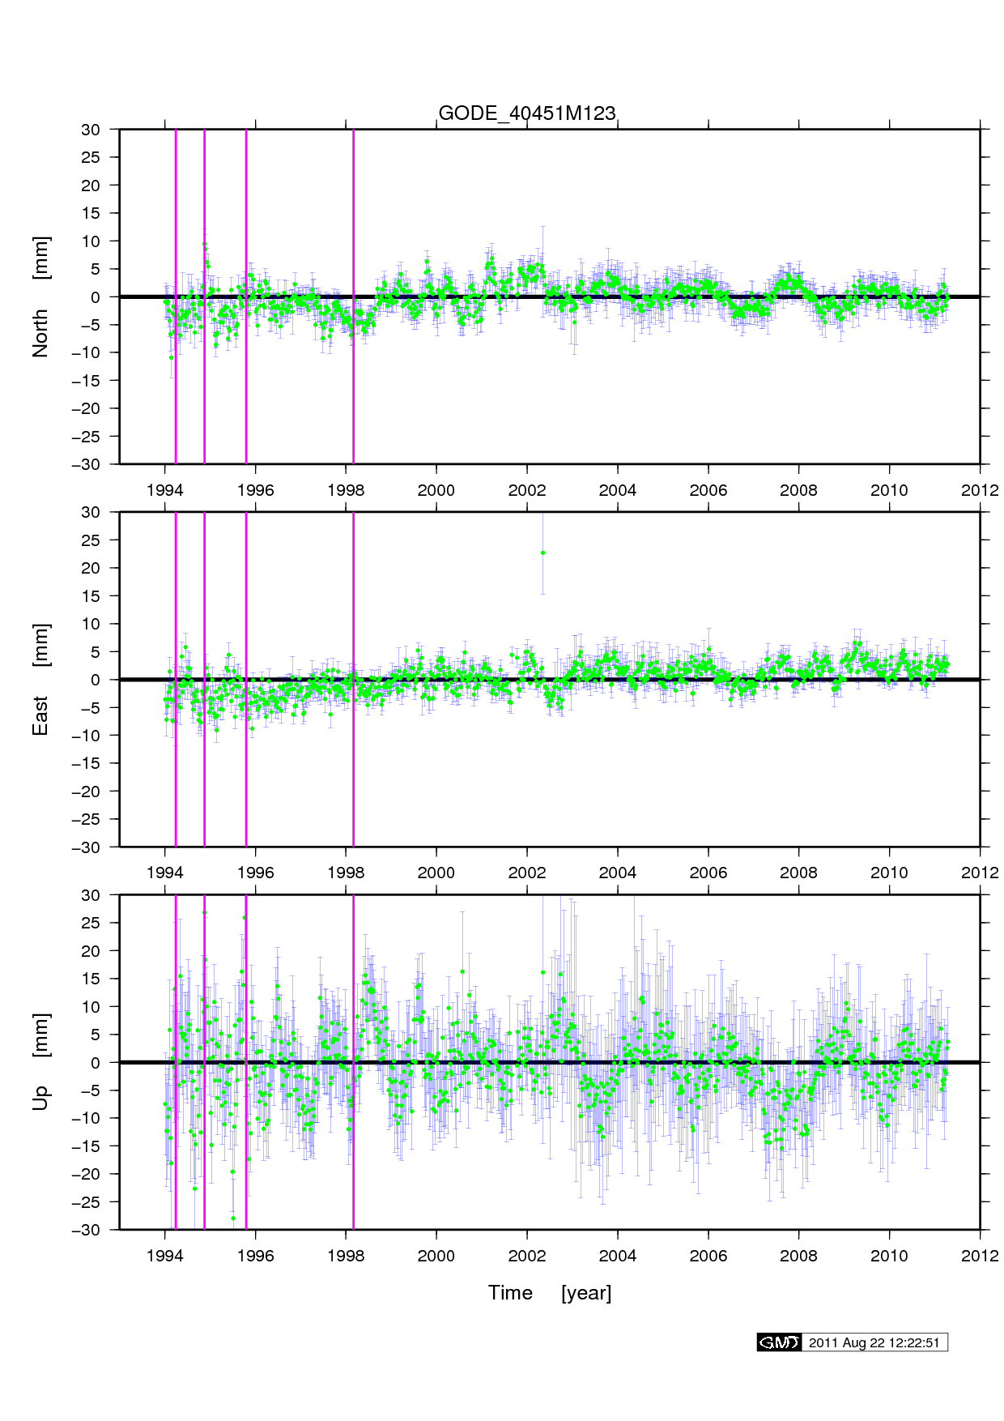
CORS Processing
This is from the most recent
“long term” plots of GODE

Slide 55
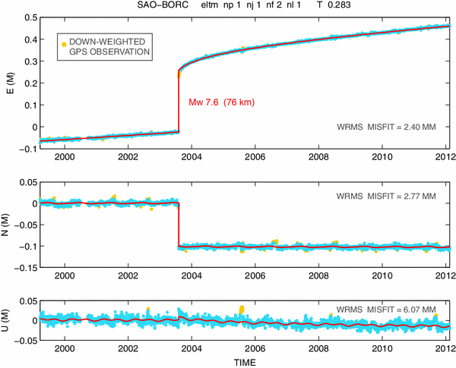
CORS Processing
An example of
how OSU processes
daily data (blue) into
“coordinate functions”
(red).
Coordinate functions
contain:
Linear terms
Polynomials (to 4)
Annual/Semi-Annual
Exponentials
Discontinuities

Slide 56
CORS Processing
An example of
how OSU processes
daily data (blue) into
“coordinate functions”
(red).

Slide 57
Thank you!

Slide 58
Questions?

Slide 59
Extra Slides

Slide 60
Why “1 GPS Month”?
The NSRS should be more accurate than everything built upon it
Has everything to do with systematic movement of passive marks, not random error in GPS
In order to properly adopt time-dependent coordinates, NGS must pick some time span that we call “simultaneous”
During that time span, the mark must not move systematically (in the ITRF2014 frame) by more than some set threshold

Slide 61
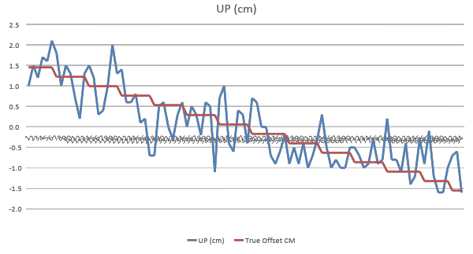
Why “1 GPS Month”?
What threshold to pick?
  Do NOT confuse random errors with systematic movement
To the left is a daily
set of GPS-derived heights (blue) collected from an antenna which was systematically lowered by 1 mm every week over 14 weeks.
Random error: +/- 0.5 cm (OP)
See that the “mm/week” trend is definitely manifest in the blue curve, despite the “half cm of noise”!

Slide 62
Why “1 GPS Month”?
What threshold to pick?
  Because we are an agency that has long cared about millimeters…
    See, for example, leveling accuracy. See, for example, XYZ coordinates of all CORSs.
  Because one half millimeter is the most systematic error one can absorb before rounding error could make you “off by a millimeter”…
  Because GPS noise is not the same as systematic mark movement…
  Because a SOP which works for the worst case will work for all cases…
  Because the “worst case” (fastest horizontal movement) in the USA is in Hawaii at 0.5 mm in 3 days…
  Because the “worst case” (fastest subsidence we’ve ever observed in the USA) is around 0.5 mm in 1 day…
  The right answer should be “1 day”, but instead…
  NGS has proposed that we call “1 GPS Month” as “Simultaneous”, which is worse than the “1 day” or even “3 days” we should use, but which is a round number, easy to work with and not too far outside of capturing 0.5 mm of movement everywhere in the USA.
    Plus when we do the “GPS month” adjustments, we will ALSO introduce the IFVM, which will help account for any systematic movement over the four week time span
    And four weeks is the median length of time of most projects turned in to NGS

Slide 63
New Way of Operating The CORS Network
100% of CORS available to OPUS every day will pass a regular statistical test for persistent disagreement
  One possible definition of “persistent disagreement”: For 14 days in a row, the absolute value of the average of the difference between “daily solutions” and the “coordinate function” assigned to that CORS, since the last known discontinuity at that CORS, exceeds 5 mm in latitude or longitude or 10 mm in ellipsoid height
    Just as reasonable, we might say “…since the last 6 months…” rather than “…since the last known discontinuity…” – More on that later.
    If the CORS fails this test pull CORS out of OPUS
      Watch, evaluate, update coordinate function and get the CORS back into OPUS as soon as the coordinate function has been updated so that the statistical test is passed
      Likely: Do NOT update function for any days BEFORE the failure, only AFTER. This may mean introducing a derivative discontinuity, but not a functional discontinuity
        This prevents users from having to continually respond to a changing historical function at each CORS

Slide 64
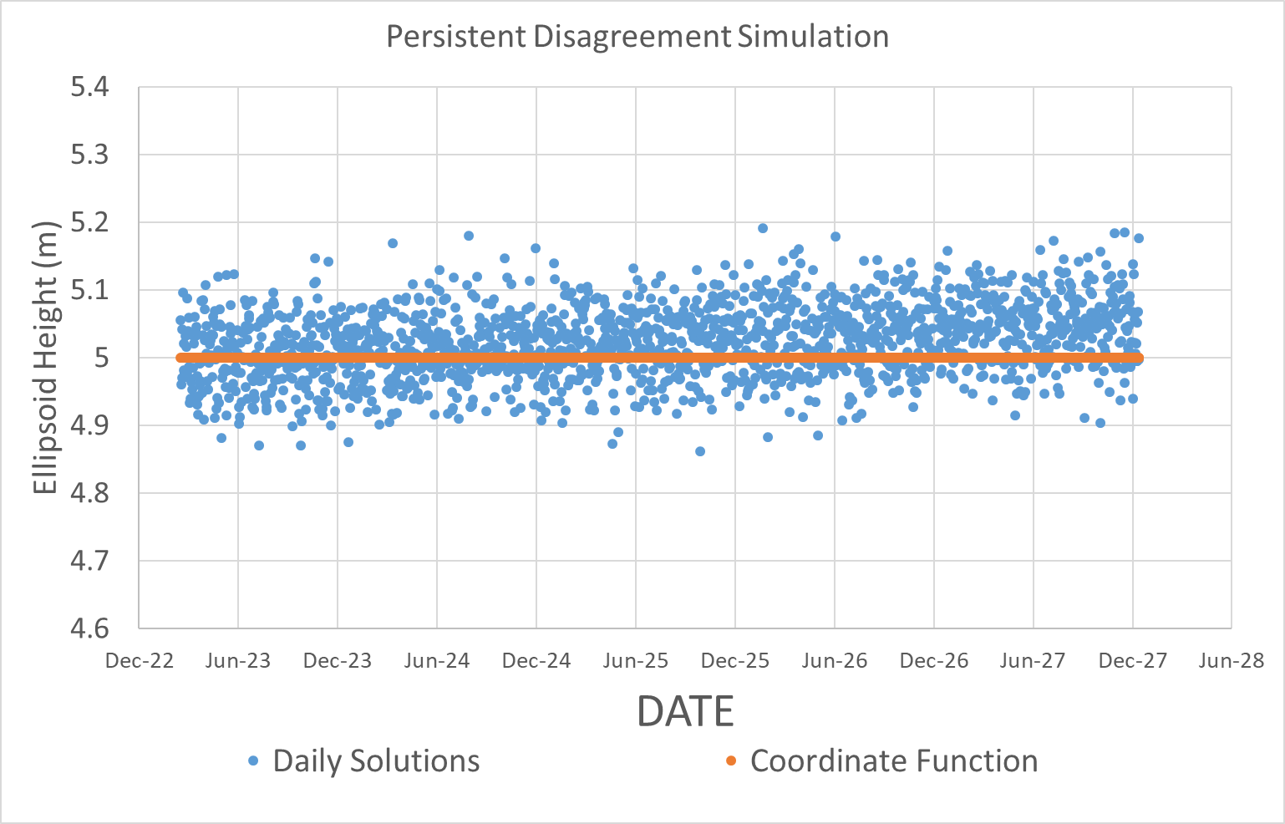
Persistent Disagreement
Notes:
Begin with daily solutions on a CORS, and an assigned coordinate function, in this case for ellipsoid height. While subtle, it should be clear that the daily solutions are drifting away from the assigned coordinate function.
And while, day to day, there is a large (5-10 cm) disagreement between the daily solutions and the coordinate function, due *mostly* to noise in the daily solutions, that disagreement begins to show a small (mm/year) non-random nature as time goes on. That is, there is seen a “persistent disagreement”. The question is “how to quantify that persistent disagreement”. The answer is: “by looking at the average of daily disagreements over some period of time, and seeing a consistent deviation from zero”.

Slide 65
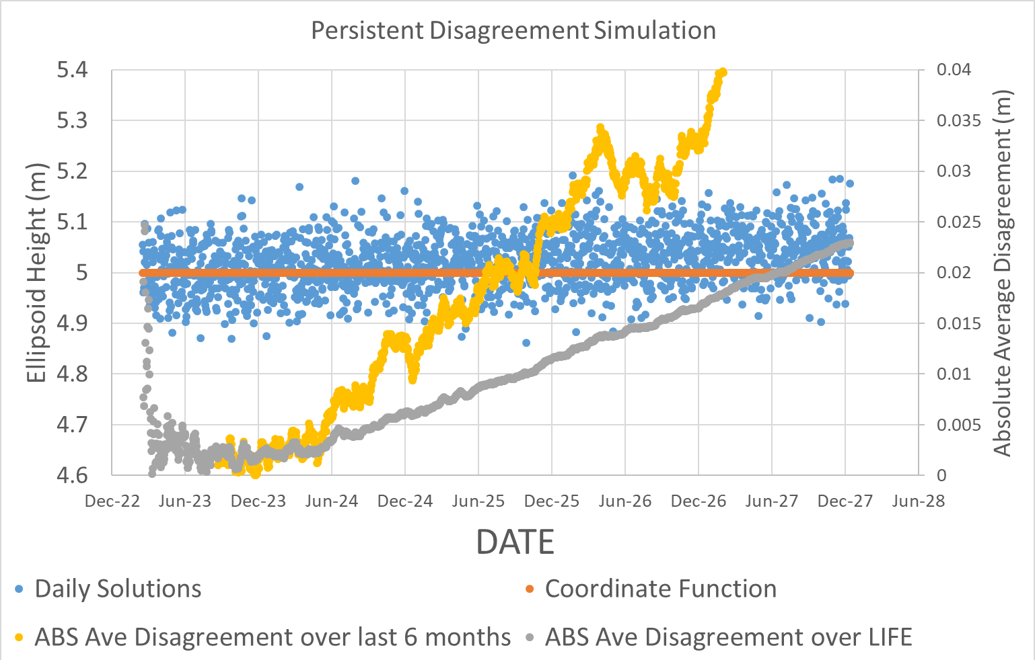
Persistent Disagreement…
Notes:
We now introduce the “absolute value of the average difference between daily solutions and coordinate functions over ‘some span of time’ ”. The time span for the averages shown is:
Yellow: Just the last 6 months of data
Gray: The lifespan of the CORS

Slide 66
Persistent Disagreement…
Notes:
For the first 6 months or so, the absolute value of the average disagreement between the daily solutions and the assigned coordinate function is highly unstable, ruled mostly by the noise in the daily solutions

Slide 67
Persistent Disagreement…
Notes:
After six month, things settle down.
Note that, as would be expected, the good disagreement during the early life of the CORS causes the gray line to grow SLOWER than the yellow line. That is because the statistics of the gray line are always influenced by early, good data. The yellow line grows more quickly because it dismisses any data older than 6 months and so, as the systematic disagreement persists (see what I did there? “persistent disagreement”…), each new 6 month window gets a little worse than its predecessor and is not “improved” by good data at the beginning of the life of the CORS.

Slide 68
Persistent Disagreement…
14 days in a row, the absolute
average disagreement (looking
back the life of this CORS)
exceeded 1 cm.
CORS went “bad” at 2 ½ years
after last known discontinuity
Notes:
The persistent disagreement test might read “For 14 days in a row, the absolute value of the average disagreement between daily solutions and the CORS coordinate function exceeded 1 cm”, where “average” is over some time span:
Yellow: Just the last 6 months
Gray: Since the last discontinuity
In this case, it means that it takes 2 ½ years for persistent disagreement to occur at this CORS, under the “since last discontinuity” average.

Slide 69
Persistent Disagreement…
14 days in a row, the absolute average
disagreement (looking back just 6 months)
exceeded 1 cm.
CORS went “bad” at 1 ½ years
after last known discontinuity
Notes:
In this case, it means that it takes only 1 ½ years for persistent disagreement to occur at this CORS, under the “last six months” average.

