Slide 1
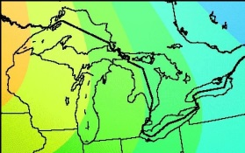
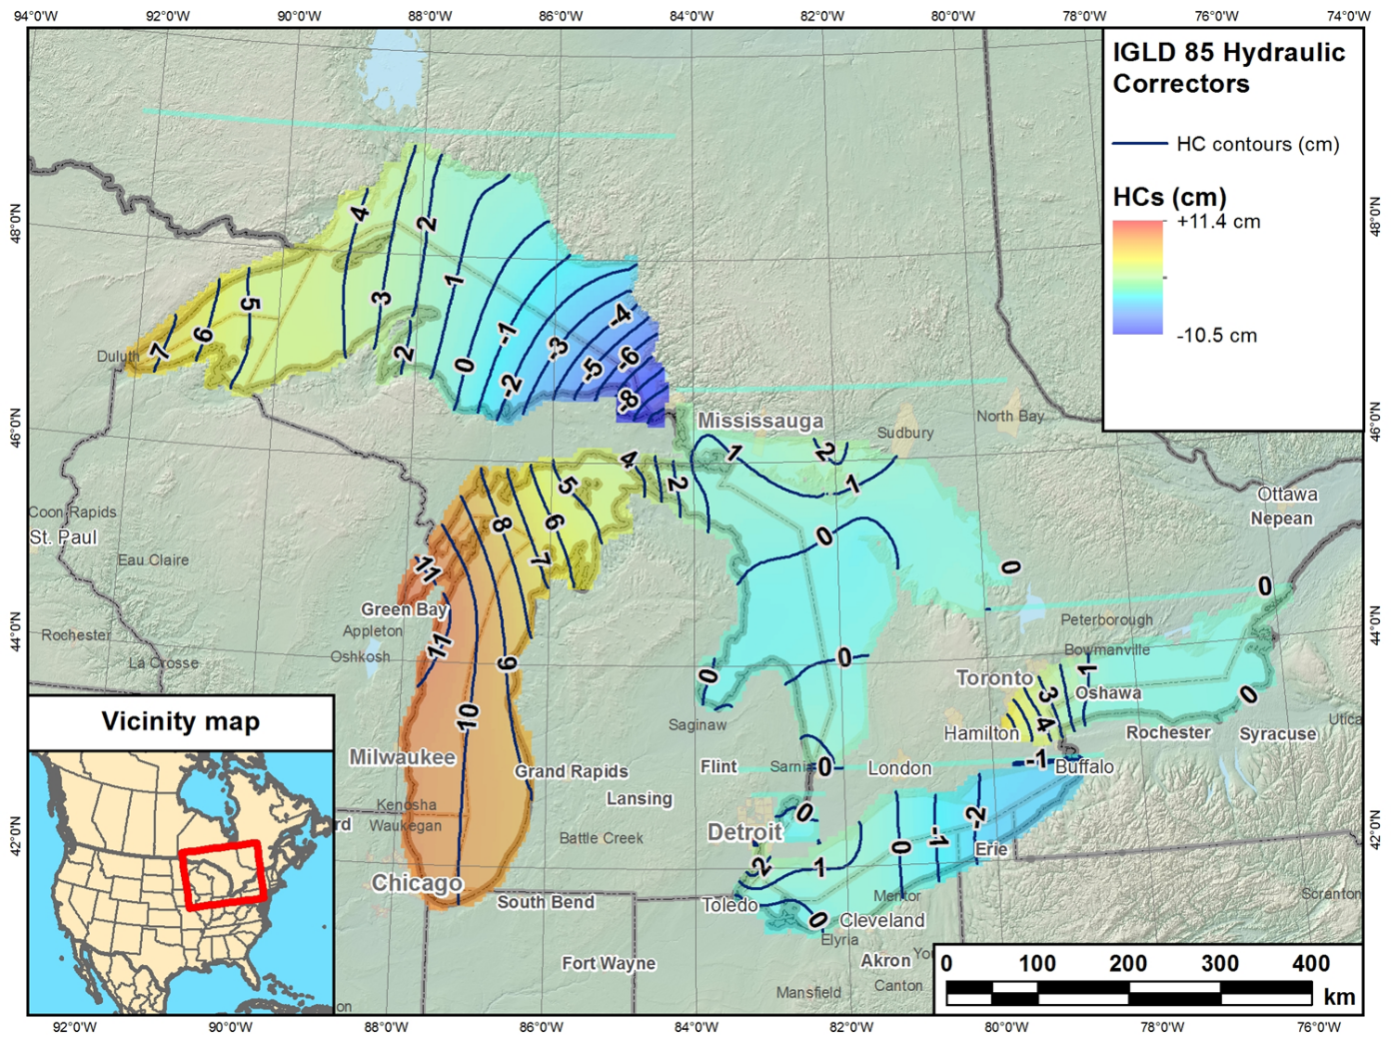
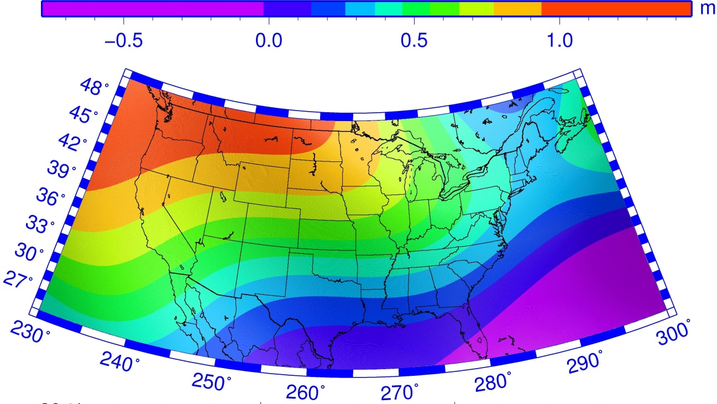
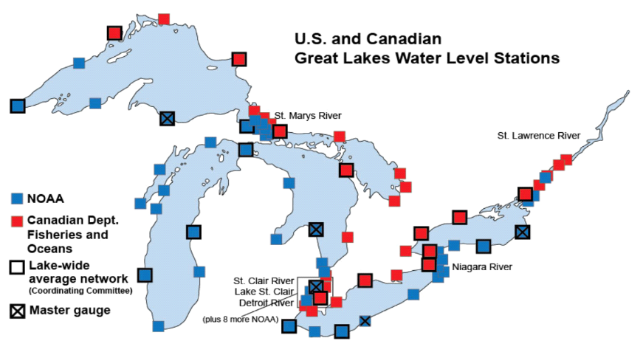
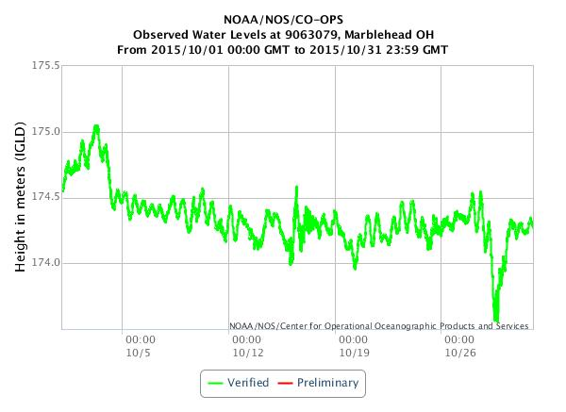
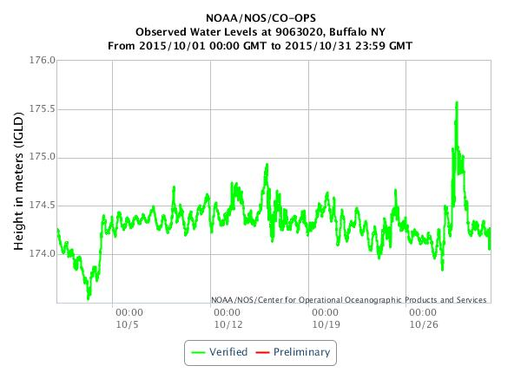
Physical Heights Realized Through GNSS and Geopotential Models
D.R. Roman(1), X. Li(2)
(1) Chief, Spatial Reference System Division, U.S. National Geodetic Survey, 1315 East-West Highway, SSMC3,N/NGS2, Silver Spring MD 20910 U.S.A. (dan.roman@noaa.gov / +1-301-713-3200)
(2) DST, Inc., U.S. National Geodetic Survey, 1315 East-West Highway, SSMC3, N/NGS6, Silver Spring MD 20910 U.S.A. (xiaopeng.li@noaa.gov / +1-301-713-3202)
21/09/2016 | 17:00 | Session 5: Height systems and vertical datum unification, Paper OB12-14
Introduction
This paper will discuss the determination of both orthometric and dynamic heights using geopotential models and GNSS-derived coordinates in the Great Lakes region. The U.S.A. will be adopting this approach to define official coordinates within the National Spatial Reference System (NSRS) in 2022. The Gravity for the Redefinition of the American Vertical Datum (GRAV-D) Project has been underway for the past eight years with the specific goal of providing the geopotential model that will serve as the basis for geoid model development and height determination in that new datum.
This is necessary because the current vertical datum (NAVD 88) has demonstrated meter-level tilts when compared to GRACE-based EGM models at continental scales. The geopotential numbers developed for NAVD 88 were also used in defining the International Great Lakes Datum of 1985 (IGLD 85). Figure 1 highlights this and compares to Hydraulic Correctors (HC) developed primarily to ensure that the dynamic heights for IGLD 85 are level when comparing on the same Lake.
Available Data
Figure 2 shows the locations of WLS located in the Great Lakes. Three sites are circled in Lake Superior and three in Lake Erie. These sites contain a CORS antenna and receiver at the WLS site. Figure 3 shows the relationship between the CORS, WLS sensor, and the Lake surface. An Electronic Tape Gauge (ETG) sited on a table (datum) in the WLS housing drops a plumb into a well connected to the Lake. When the plumb touches the surface, a circuit completes and the water surface is measured. Knowing the offset between the CORS ARP and ETG table, as well as the ETG table and the water surface, provides geometric coordinates for the water surface.
A mean value for the Summer months in 2015 was used. Figure 4 shows the monthly means in October for Buffalo (east end of Lake Erie) and Marblehead (west end of Lake Erie). Note the meter level changes in Lake level due to a Winter storm event. Hence monthly means can be skewed especially from October through December. Winter months are ice covered and problematic. So only data from June through September (Summer) were used (column G in Table 1). Ultimately, the ellipsoid heights of the water surface were derived (column O Table 1). The coordinates in Table 1 were used in Table 2 to develop physical heights.
Analysis
The xGEOID16B geoid height model was developed using the xGEOID16B_REF model. It is a one arcminute resolution model developed using R-C-R technique. It provides geoid heights only (column P) and can determine orthometric heights (Q). However, orthometric heights are not suited for use in determining water levels. Hence, dynamic heights were determined using geopotential values were derived from five arcminute EGM’s. Models include : EGM2008 (R), EIGEN6c4 (S), xGEOID16A_REF (T), and xGEOID16B_REF (U). A W₀ value of 62,636,856.00 m²/s² was used, because that is the value adopted by the U.S. for the future vertical datum. Finally, the geoid height derived from the xGEOID16B_REF model was removed from the xGEOID16B value to determine the residual geoid signal for one to five arcminutes. Gravity values from xGEOID16B_REF were used to develop approximate residual geopotential numbers that were applied to develop more complete estimates of the dynamic height (V).
Next to each estimate of the dynamic height, a difference is developed between the maximum and minimum estimate of the dynamic heights for each of the two Lakes. Ideally, all value on the Lake surface would be nearly the same with some potential slope towards the ocean-side. As can be seen, the xGEOID16B full signal estimate of the dynamic heights provides the most agreement for both Lakes.
Conclusion
Use of a geopotential model by itself is not yet sufficient to derive cm-level accurate dynamic heights. Incorporating shorter wavelength signal from a higher resolution geoid model holds some promise. This correlates with earlier analysis that showed a one arcminute model was necessary to keep omission errors at cm-level. Water topography issues must also be addressed.
Figure 1. NAVD 88 trend w.r.t. GRACE-based EGM (bottom left) with Great Lakes region zoom (upper left) corresponds to hydraulic Correctors (HC) for each Lake. Relative trends conform to NAVD 88 trend surface.
Grand Marais
TBM# 9099090
Marquette
TBM# 9099018
Point Iroquois
TBM# 9099004
Marblehead
TBM# 9063079
Cleveland
TBM# 9063063
Buffalo
TBM# 9063020
Figure 2. Location of Great Lakes Water Level Stations (WLS) used to define IGLD 85. Three stations on Lake Superior and three on Lake Erie (red circles) have collocated CORS and are examined in this paper.
GPS Antenna
H
J
CORS ARP
WLS Housing
ETG
GPS Receiver
D
ETG Datum w/out HC
I
ETG Datum w/ HC
Great Lake
Water Surface
B
C
E
G
IGLD 85 Datum surface
Figure 3. Graphic showing relationship between various datum points at sites with CORS and WLS. Letters refer to Table 1 columns. Note that ETG table doesn’t move but that positions in HC & non-HC frames differ.
Figure 4. Observed water levels above IGLD 85 for the month of October 2015 at Marblehead (west end of Lake Erie) and Buffalo (east end of Lake Erie). Note inverse relationship of water levels. Storms blow strongly west to east starting in October and has significant (meter-level) effects on heights and monthly means.
Table 1. Six sites were selected – three on Lake Erie (highlighted in blue) and three on Lake Superior (highlighted in orange). These are sites where a NOAA Water Level Station (WLS) is collocated with a GNSS Continuously Operating Reference Station (CORS). Heights to various references are given above the IGLD 85 datum and are reflected in Figure 3. While mean values were determined for all sites (column F), only the mean determined from Summer months (June-September) Is used due to significant winds and water topography issues in the Fall and ice build up in the Winter. The offset between the CORS ARP and the Summer mean water surface (column J) is used to estimate the ellipsoidal height of the mean water surface (column O).
Column | A | B | C | D | E | F | G | H | I | J | K | L | M | N | O
Station | Location | CORS ARP HT | ETG Table HT | Hydraulic Correctors (HC) | ETG (HC) Table HT | 2015 mean WL HT | Summer mean (HC) WL HT | CORS ARP to ETG Table | ETG (HC) Table to Summer mean (HC) WL | CORS ARP to Summer mean WL | CORS Site ID | Latitude of CORS ARP | Longitude of CORS ARP | HAE of CORS ARP | HAE of Summer mean WL
Units |  | m | m | m | m | m | m | m | m | m |  | dec. deg. (N) | dec. Deg. (E) | m | m
Datum |  | IGLD85 | IGLD85 |  | IGLD85 | IGLD85 | IGLD85 |  |  |  |  | IGS08 | IGS08 | IGS08 | IGS08
9063020 | Buffalo | 181.784 | 178.283 | -0.026 | 178.309 | 174.306 | 174.559 | 3.501 | 3.747 | 7.248 | BFNY | 42.87755697 | 281.10955496 | 145.462 | 138.214
9063063 | Cleveland | 180.097 | 177.151 | 0.010 | 177.141 | 174.314 | 174.599 | 2.947 | 2.544 | 5.491 | OHCD | 41.54074488 | 278.36485371 | 144.582 | 139.091
9063079 | Marblehead | 179.493 | 177.187 | -0.006 | 177.193 | 174.310 | 174.606 | 2.307 | 2.588 | 4.895 | OHMH | 41.54368360 | 277.26854509 | 142.866 | 137.971
9099004 | Pt. Iroquois | 188.880 | 186.091 | -0.100 | 186.191 | 183.565 | 183.660 | 2.789 | 2.530 | 5.319 | PTIR | 46.48458324 | 275.36915966 | 151.362 | 146.043
9099018 | Marquette | 190.951 | 187.506 | 0.000 | 187.506 | 183.597 | 183.694 | 3.445 | 3.812 | 7.257 | MIMQ | 46.54554809 | 272.62130392 | 155.102 | 147.845
9099090 | Grand Marais | 189.158 | 186.239 | 0.046 | 186.193 | 183.592 | 183.692 | 2.918 | 2.500 | 5.418 | GDMA | 47.74855226 | 269.65874853 | 157.364 | 151.946
Table 2. For the same sites identified in Table (1), the geometric coordinates of the water surface are used to determine physical heights. The xGEOID16B model (at one arcminute) is used to derive orthometric heights. These are not identical due to gravity field variations – a not unexpected result. For comparison of water surfaces, dynamic heights are preferred. Comparisons are made to several geopotential models: EGM2008, EIGEN6c4, xGEOID16A_REF, and xGEOID16B_REF (all complete through d/o 2160). The datum value adopted by the U.S. and Canada (W₀ = 62,636,856.00 m²/s²) was used to determine geopotential numbers that were divided by γ₄₅ (980620.00 m²/s²) to derive dynamic heights for each model. The last model comes closest to having consistent dynamic heights at each of the three sites for each Lake. Accounting for the residual geoid from xGEOID16B and xGEOID16B_REF (1’-5’ arcminute) adds signal that achieves cm-level agreement.
Column | A | G |  | L | M | O | P | Q |  | R |  | S |  | T |  | U |  | V
Station | Location | Summer mean (HC) WL HT | Max – Min | Latitude of CORS ARP | Longitude of CORS ARP | HAE of Summer mean WL | Geoid Height | Ortho Height | Max – Min | Dynamic Height | Max – Min | Dynamic Height | Max – Min | Dynamic Height | Max – Min | Dynamic Height | Max – Min | Dynamic Height | Max – Min
Units |  | m | m | dec. deg. (N) | dec. Deg. (E) | m | m | m | m | m | m | m | m | m | m | m | m | m | m
Datum |  | IGLD85 | << | IGS08 | IGS08 | IGS08 | xGEOID16B | xGEOID16B | << | EGM2008 | << | EIGEN6c4 | << | xGEOID16A_REF | << | xGEOID16B_Ref | << | xGEOID16B
9063020 | Buffalo | 174.559 |  | 42.87755697 | 78.89044504 | 138.214 | -35.838 | 174.052 |  | 174.014 |  | 173.997 |  | 174.016 |  | 174.011 |  | 174.004
9063063 | Cleveland | 174.599 | 0.048 | 41.54074488 | 81.63514629 | 139.091 | -34.996 | 174.087 | 0.036 | 174.023 | 0.021 | 174.011 | 0.014 | 174.011 | 0.013 | 174.033 | 0.022 | 174.019 | 0.015
9063079 | Marblehead | 174.606 |  | 41.54368360 | 82.73145491 | 137.971 | -36.117 | 174.088 |  | 174.002 |  | 174.005 |  | 174.024 |  | 174.026 |  | 174.016
9099004 | Pt. Iroquois | 183.660 |  | 46.48458324 | 84.63084034 | 146.043 | -36.940 | 182.983 |  | 182.981 |  | 182.977 |  | 183.000 |  | 182.990 |  | 182.992
9099018 | Marquette | 183.694 | 0.034 | 46.54554809 | 87.37869608 | 147.845 | -35.131 | 182.976 | 0.048 | 182.997 | 0.027 | 183.012 | 0.042 | 183.026 | 0.040 | 183.013 | 0.018 | 182.992 | 0.012
9099090 | Grand Marais | 183.692 |  | 47.74855226 | 90.34125147 | 151.946 | -30.989 | 182.935 |  | 182.970 |  | 182.970 |  | 182.986 |  | 182.995 |  | 182.980

