Slide 1
NCAT
NSRS Database and
Web Services
Krishna Tadepalli
05/08/2018

Slide 2
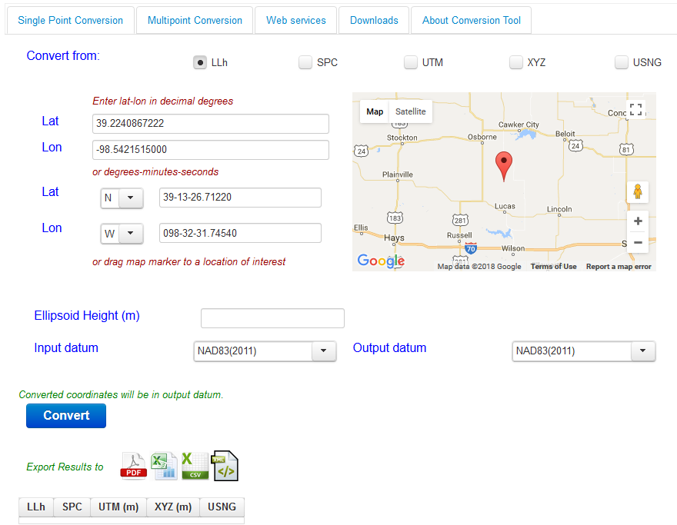
NCAT

Slide 3
NCAT
Integrated platform for coordinate conversion and transformation
Deprecates legacy tools
Single and multipoint conversions/transformations, and web services
Multiple formats for export
Responsive web design

Slide 4
NCAT
What’s Next?
Vertcon
Geoid
and more …
Notes:
Work done under Comprehensive toolkit improvements

Slide 5
Web Services
RESTful
JSON format
Integrated, easy to discover
NCAT API (available now)
API for Gravity, Geoid, Data Explorer, VDatum (to be launched soon)
Aligns with NOS IT 2020 Vision
Deprecate software downloads
Notes:
Deprecate WMS and WFS and use GeoJSON

Slide 6
NSRS Database
Geospatial Database
Extensible metadata
Raw data and metadata about tools/processes preserved
Retrievals support geospatial formats and web services; modernized datasheet
Design ties into a unified web-centric workflow being developed for survey projects
Notes:
Prefer to deprecate shapefiles?

