Slide 1

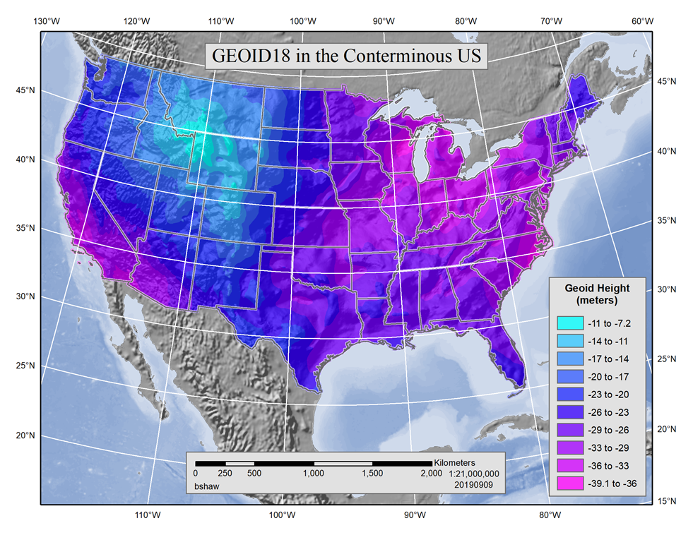
GPS on Bench Marks (GPSonBM):
GEOID18 and Preparing for
the Modernized NSRS
NSRS 2022 Overview Workshop
University of Florida
September 20, 2019
Galen Scott, GEOID18 Project Manager
GPSonBM Team:
Kevin Ahlgren, Geoid Modeler / Brain Shaw, GIS Lead / Amy Whetter, OPUS Analyst

Slide 2
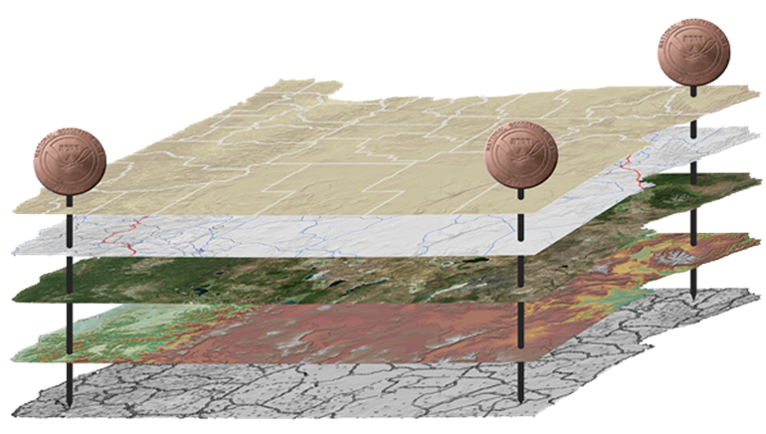
The National Spatial Reference System (NSRS)
NGS defines, maintains and provides access to the NSRS
North American Datum of 1983 (NAD 83)
North American Vertical Datum of 1988 (NAVD 88)
Latitude • Longitude • Elevation • Gravity • Shoreline Position
+ changes over time
Today’s NSRS
Notes:
The National Spatial Reference System
The system that NGS has created that meets these requirements and expectations is the National Spatial Reference System.
The National Spatial Reference System (NSRS) includes latitude, longitude and elevation in addition to the National Shoreline and geodetic control.
You can think about geodetic control is the “base map” layer at the base of GIS applications that will get everything aligned.
Two datums that make up the backbone of the NSRS today are:
North American Datum of 1983 (NAD 83)
North American Vertical Datum of 1988 (NAVD 88)

Slide 3
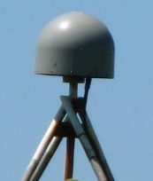
The National Spatial Reference System (NSRS)
NGS defines, maintains and provides access to the NSRS
Latitude • Longitude • Elevation • Gravity • Shoreline Position
+ changes over time
North American Terrestrial Reference Frame (NATREF 2022)
Caribbean Terrestrial Reference Frame (CATREF 2022)
Pacific Terrestrial Reference Frame (PATREF 2022)
Marianas Terrestrial Reference Frame (MATREF 2022)
North America and Pacific Geopotential Datum (NAPGD 2022)
Tomorrow’s NSRS
Notes:
The National Spatial Reference System
The system that NGS has created that meets these requirements and expectations is the National Spatial Reference System.
The National Spatial Reference System (NSRS) includes latitude, longitude and elevation in addition to the National Shoreline and geodetic control.
You can think about geodetic control is the “base map” layer at the base of GIS applications that will get everything aligned.
There will be four Terrestrial Reference Frames, one per tectonic plate.
North American Terrestrial Reference Frame (NATREF 2022)
Caribbean Terrestrial Reference Frame (CATREF 2022)
Pacific Terrestrial Reference Frame (PATREF 2022)
Marianas Terrestrial Reference Frame (MATREF 2022)
And one gravimeteric geoid model that will cover the entire north western Hemisphere of the Earth
North America and Pacific Geopotential Datum (NAPGD 2022)

Slide 4

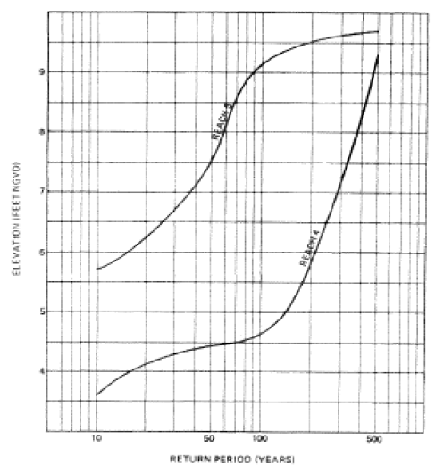
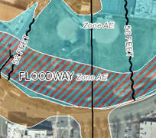
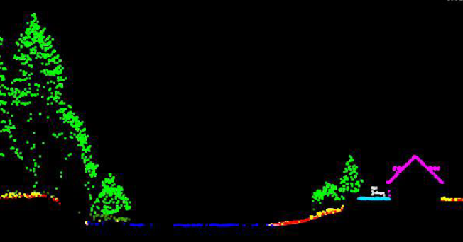
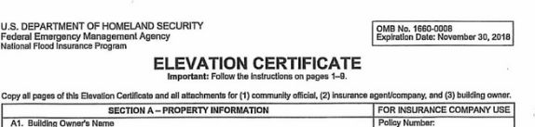
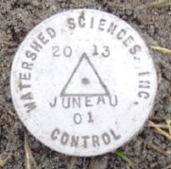
NSRS Use Case: Aligning Floodplain Mapping Data
Reliable FIRMs require data from disparate sources and dates be consistently aligned.
+
+
=
Airborne or mobile lidar data.
Stream hydrograph
Elevation certificate
Flood Insurance Rate Map
Notes:
Aligning Floodplain Mapping Data
Aligning everything sounds good, but I thought I’d spend a moment to give a floodplain mapping example to illustrate the importance. In my example,
we might collect airborne or mobile lidar data at some point in time using a particular type of technology;
next we’d generate a stream hydrograph, based on different data collected by a different group at a different point of time.
then, we have a surveyor would complete an elevation certificate using her technology at a different point of time.
Then, finally, we have our final product of a flood insurance rate map.
As you can see - just in the making of a single FIRM, data is collected a different points in time using difference methods, and must reliably be aligned and combined with historical data (in both horizontal and vertical), all to produce a final product in which all of this information is available in one place to assist the planner in appropriate flood mitigation.

Slide 5


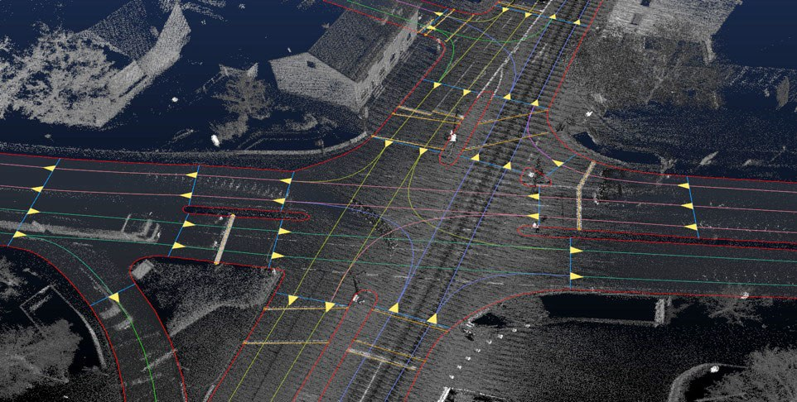
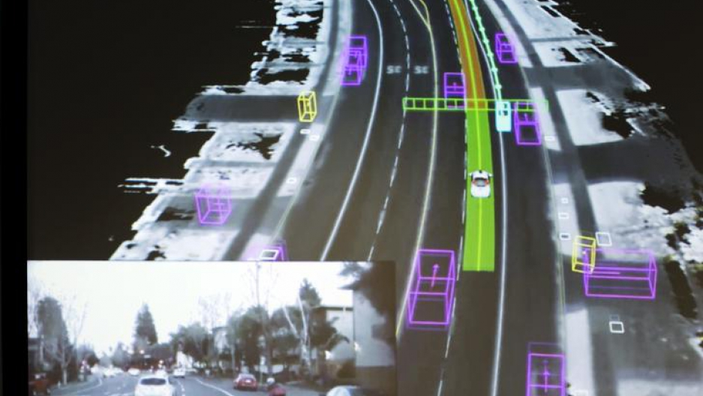
Modernized NSRS Use Case: Autonomous Vehicles
Consistent, accurate, and precise reference frame for navigation
NASA tests air traffic control system for drones
Autonomous Cars Will Require a Totally New Kind of Map
Autonomous Cars Infographic Workgroup
Credit: Elijah Nouvelage/Reuters

Slide 6
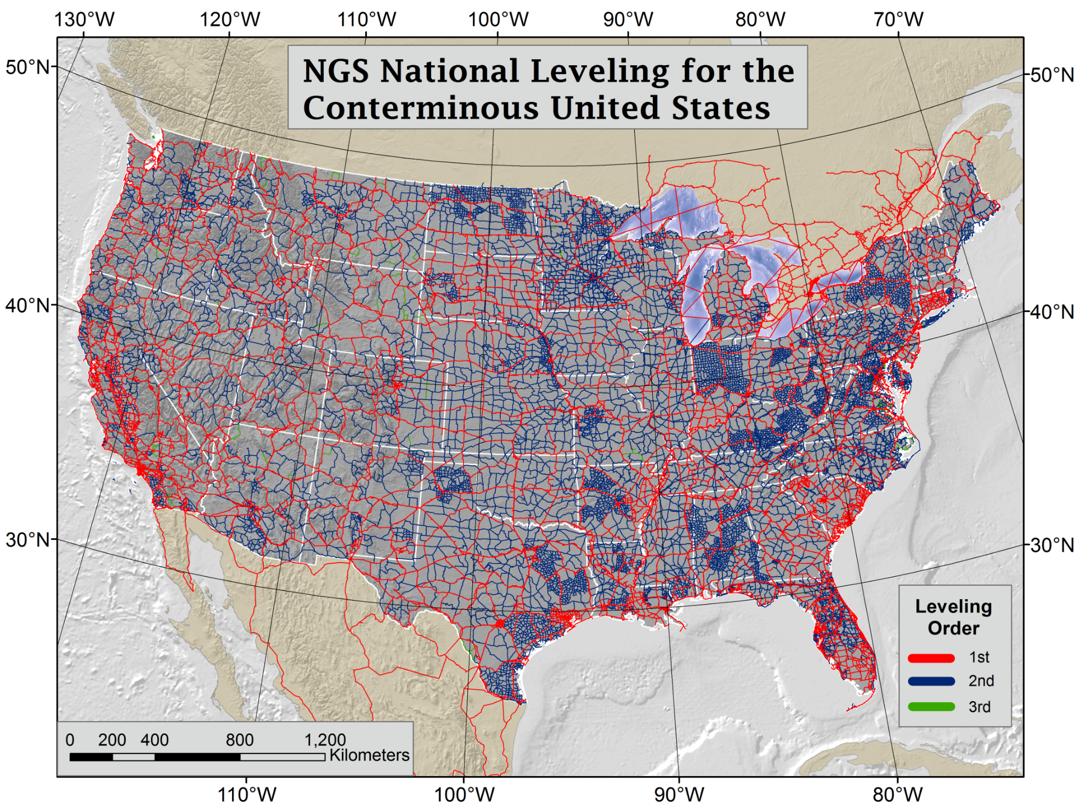
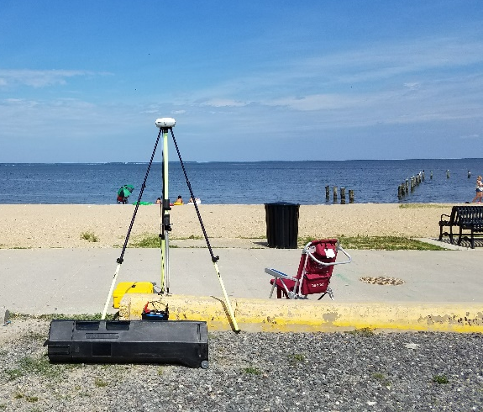
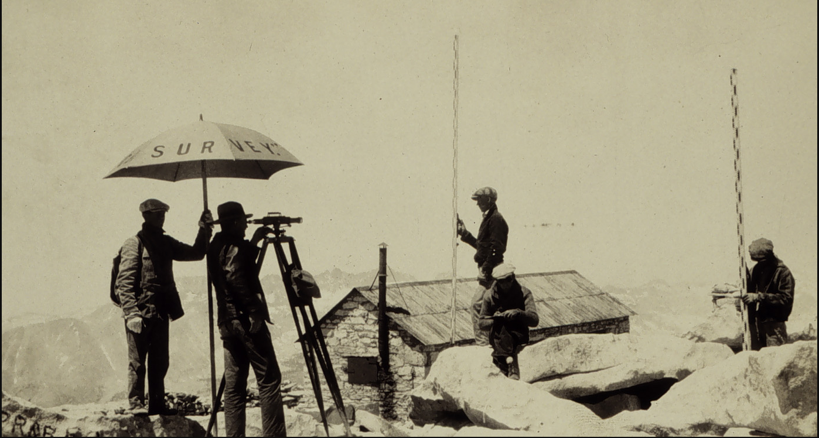
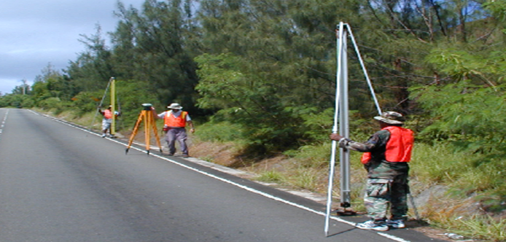
NAVD 88 is Based on Continental Scale
Geodetic Leveling
Current Vertical Datums:
NAVD88
CONUS & AK
PRVD02
Puerto Rico
VIVD09
US Virgin Islands
GUVD04
Guam
NMVD03
Commonwealth of the Northern Marianas
Notes:
NAVD 88 consists of about 800,000 benchmarks and ~2.2M km of leveling. Data was collecting over many decades by roving bands of surveyors who walked across the country multiple times over the years, east to west, north to south and back again. It is currently the official vertical datum of the US and is required for federal mapping projects.
GPS data on those leveled marks will be used to create GEOID18 – the model used to derive NAVD88 heights from GPS ellipsoid heights, as well as the transformation tools that will be released with NAPGD2022.
GPS data on those leveled marks will be used to create the transformation tools that will be released with NAPGD2022.
Incredible effort – best tech at the time
BUT:
ACCESS!
Leveling is time intensive and expensive
Access has historically been through passive control, bench marks that you must find
Accuracy!
Distance dependent errors can build up, making the overall network less reliable
Bench mark can move over time , Only as reliable as the last observationtability (referenced to CORS)
Consistency!
Eliminates systematic errors in current datums
Aligned with global reference frames
Integrated system for both positions and heights (“elevations”)
But, long time period during which things were moving that we could not adequately account for
New reference frames will give coordinates at specific reference epochs and the IFVM will move coordinates through time from the survey epoch to the reference epoch.

Slide 7
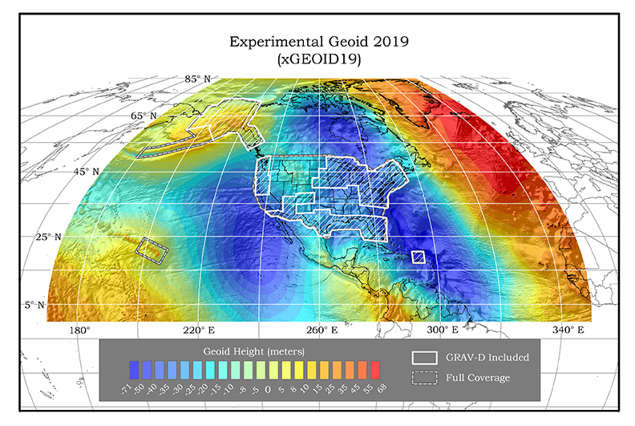
Why 2022 NSRS Modernization?
NSRS Modernization will better serve communities in regions experiencing vertical land motion such as subsidence or uplift.
Main Driver: Align with Global Navigation Satellite Systems (GNSS)
ACCESS ACCURACY CONSISTENCY
Notes:
ACCESS!
GNSS equipment is fast, inexpensive, reliable (and improving)
Reduces reliance on finding survey control (“bench marks”)
Accuracy!
Insensitive to distance dependent errors; reliable
Immune to bench mark stability (referenced to CORS)
Consistency!
Eliminates systematic errors in current datums
Aligned with global reference frames
Integrated system for both positions and heights (“elevations”)

Slide 8
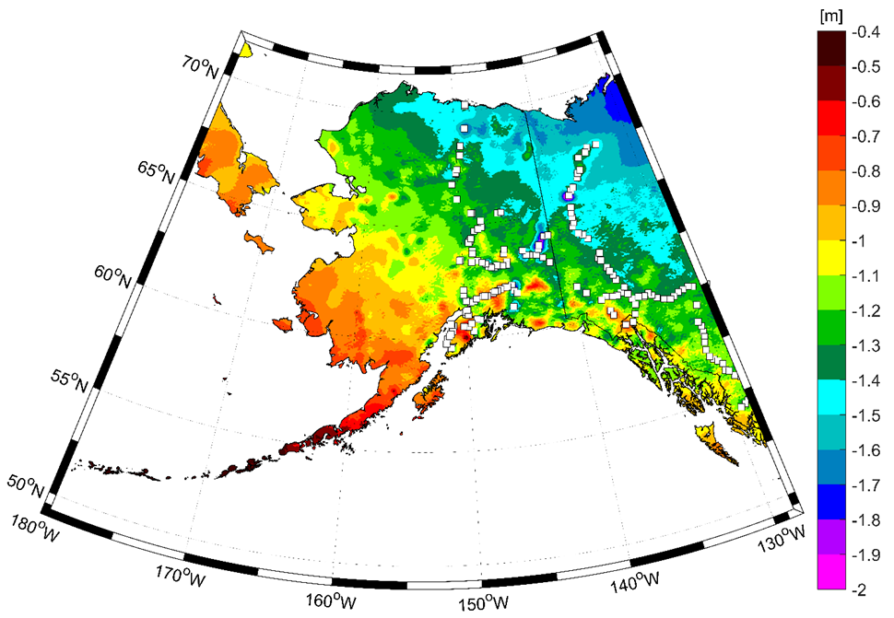
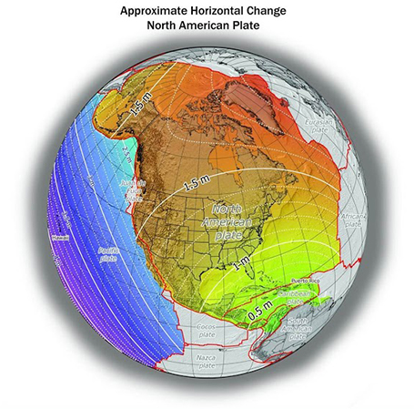
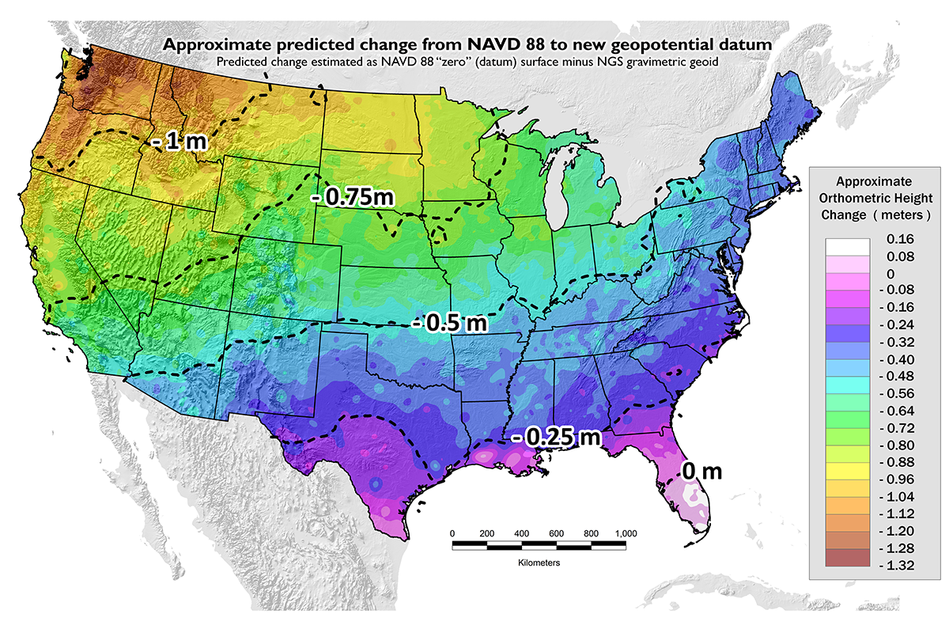
Approximate Predicted Differences between Old & New:
NAVD 88 minus NAPGD2022
~0.4 to 2 meters in Alaska
~0 to 1.3 meters CONUS
GPSonBM data collection efforts are focused on the vertical datum transformations to resolve the irregular relationship between the surfaces.
Horizontal transformations are smooth and will be done primary with CORS data.
Notes:
New Datums What to expect https://geodesy.noaa.gov/datums/newdatums/WhatToExpect.shtml
NGS is not shifting the land, merely shifting the reference surfaces to which we reference the geospatial data to.

Slide 9

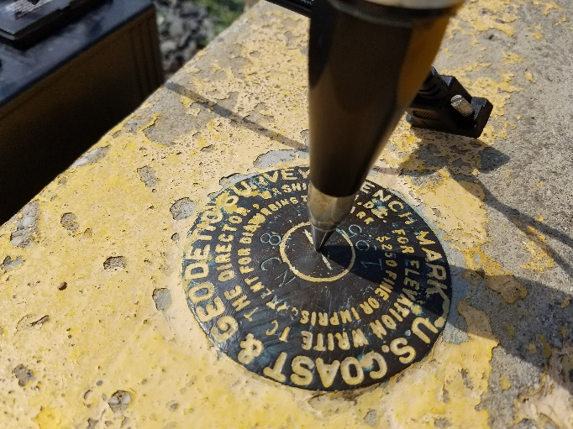
GPSonBM Measurements Connect
Old & New Datums
Because the relationships between the old and new datums vary by location, the accuracy of the transformations in any particular place is directly related to the density of GPSonBM data available in that area.

Slide 10
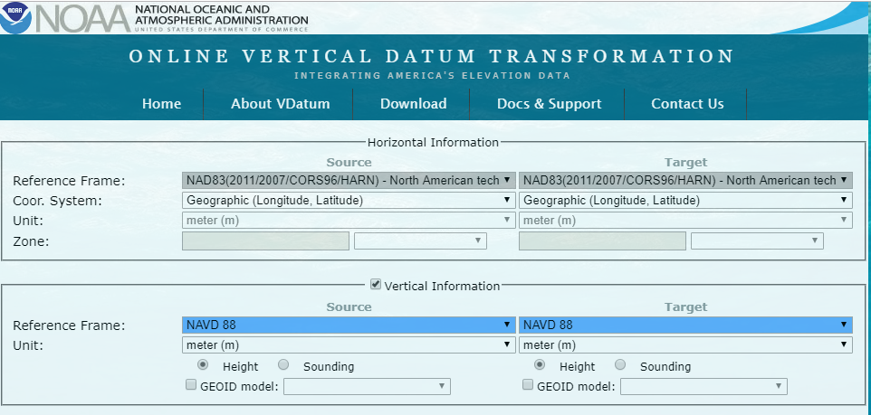
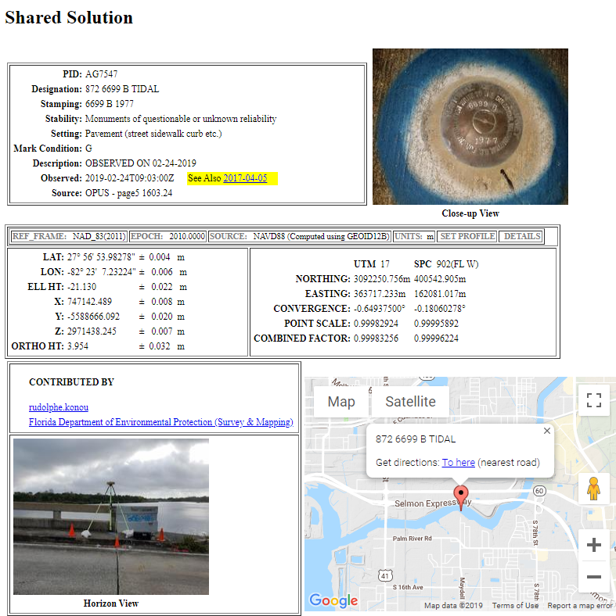
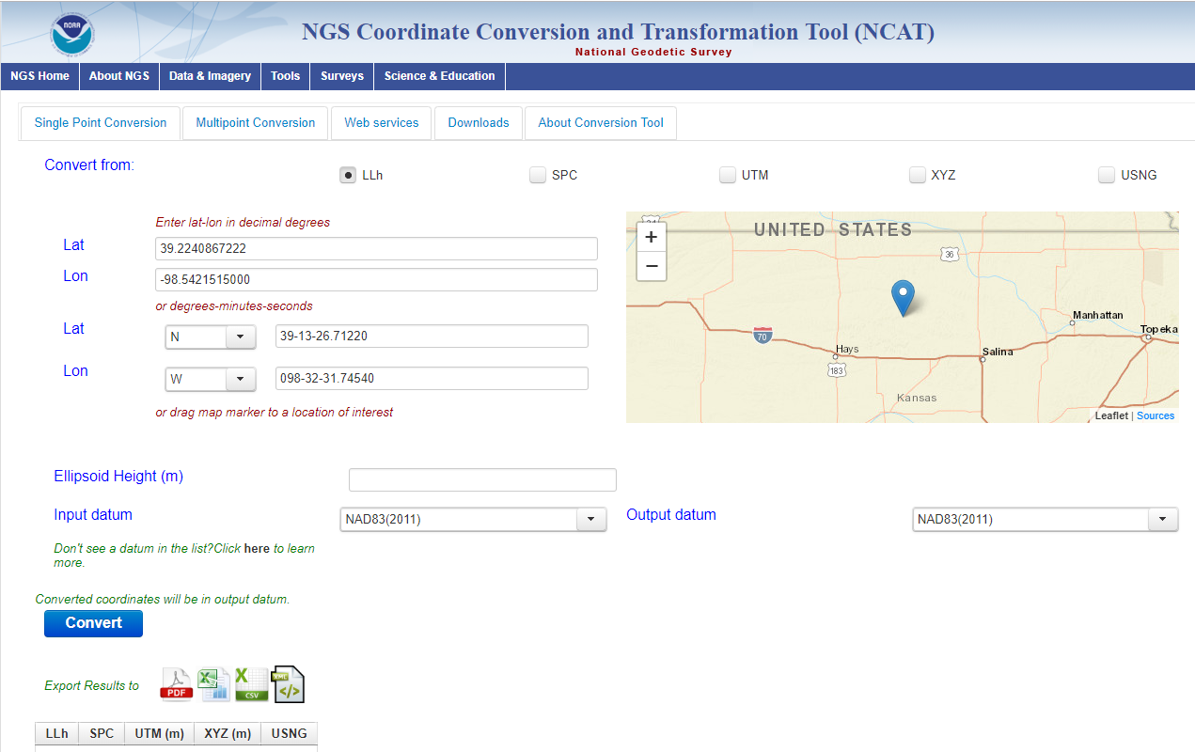
GPSonBM:
Going From New Data to Better Models and Tools
Provide Data for GEOID18 DONE
Improve VDatum and NCAT
Update Passive Control Status
Automatic Reprocessing in 2022
Validate Static Gravimetric Geoid
Evaluate Intra-frame Velocity Model (IFVM)
Identify marks suspected of movement
Establish RTN Check Stations

Slide 11
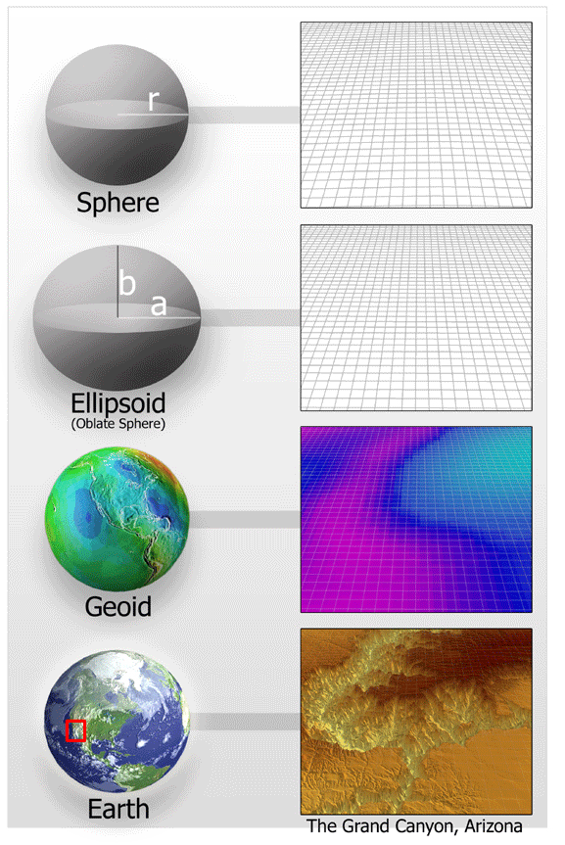
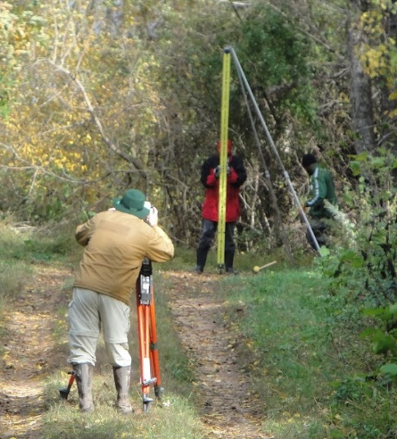
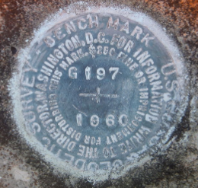
Residual Analysis: Assess Validity of Passive Control Residual = h - H - N
-
-
h is ellipsoid height measured using GPS
H is NAVD 88 Orthometric Height from Leveling
N is geoid height from geoid model
Theoretically, the difference between these three values should be zero. In practice, using actual observations produces a residual, or measure of the misfit between the values.
Notes:
Residuals and metadata are then used to evaluate the observations and attempt to determine whether the leveling or GPS observations were more likely to be the source to fht error. If leveling, then throw the mark out as we will likely not get new leveling observations. If the error appears to come from the GPS observations, we added the mark to the priority list for new GPSonBM observations and then use this mark with the new data in our tools, GEOID18, TT, etc
Consider adding Slide showing that this Equation will define orthometric heights in NAPGD2022
Tremendous amount of work done in-house on state-by-state basis, looking at regional patterns, finding and removing outliers, and evaluating metadata
15 Regional webinars to incorporate local knowledge of passive control netwrok
NGS a high level of confidence in this (See NE Pennsylvania)
Provided much cleaner dataset
Impacts will be felt by surveyors

Slide 12
GPSonBM is Driving Surge in Shared OPUS Solutions
2018 GPSonBM GEOID18 Campaign Launch
2019 GPSonBM Transformation Tool Campaign Launch
Transformation Tool Campaign:
June 2019 - December 31, 2021
Recent* Bluebooked & Shared OPUS Solutions will be used to compute 2020.0 Reference Epoch Coordinates in NAPGD2022
Notes:
Waiting for Amy

Slide 13
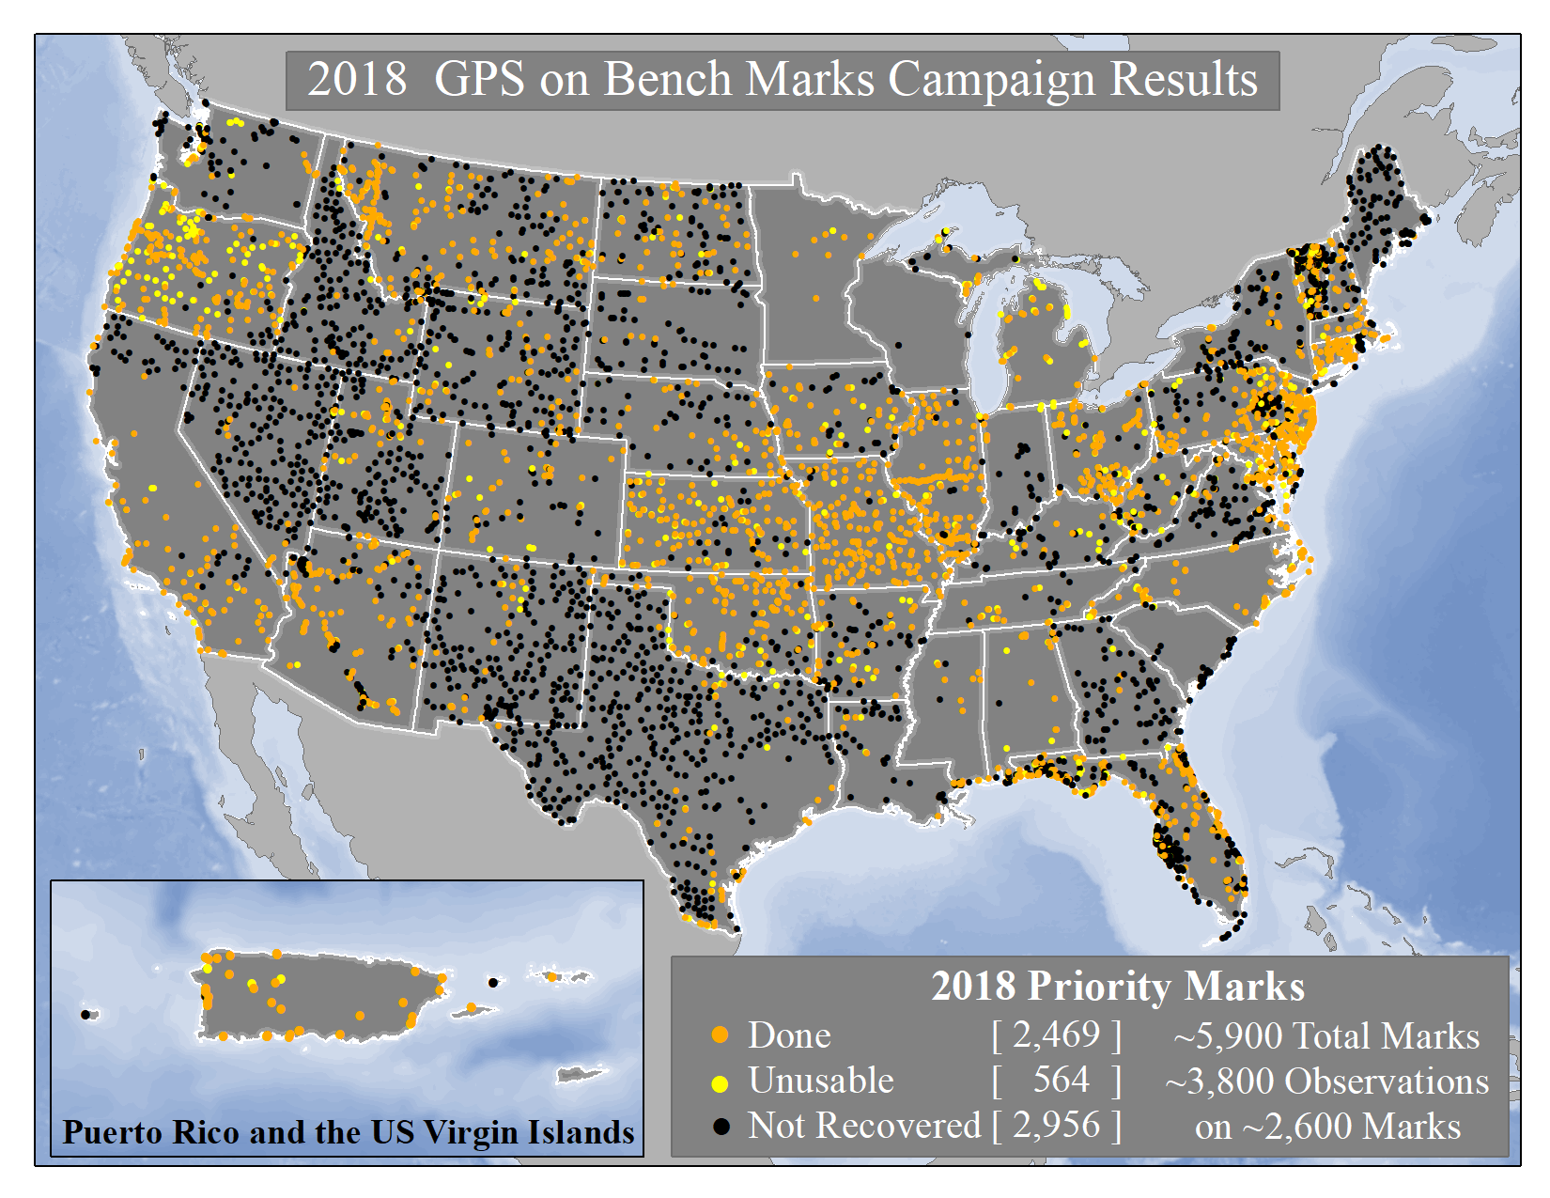
Notes:
The 2019 GPSonBM Campaign will be kicking off during Surveyor’s Week in March.
Local data improves the local accuracy of national scale products and tools.
2018 GPSonBM Priority marks were targeted to fill data gaps and reduce uncertainty in GEOID18 which will replace GEOID12B
New GSPonBM efforts in 2019 will focus on collecting data to improve the transformation tools to the new datums in 2022

Slide 14
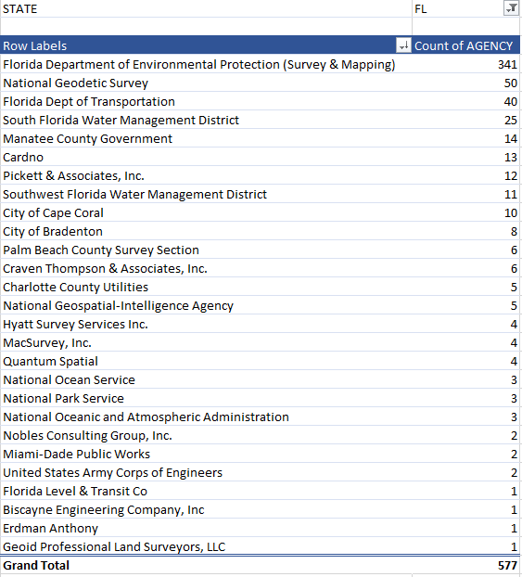
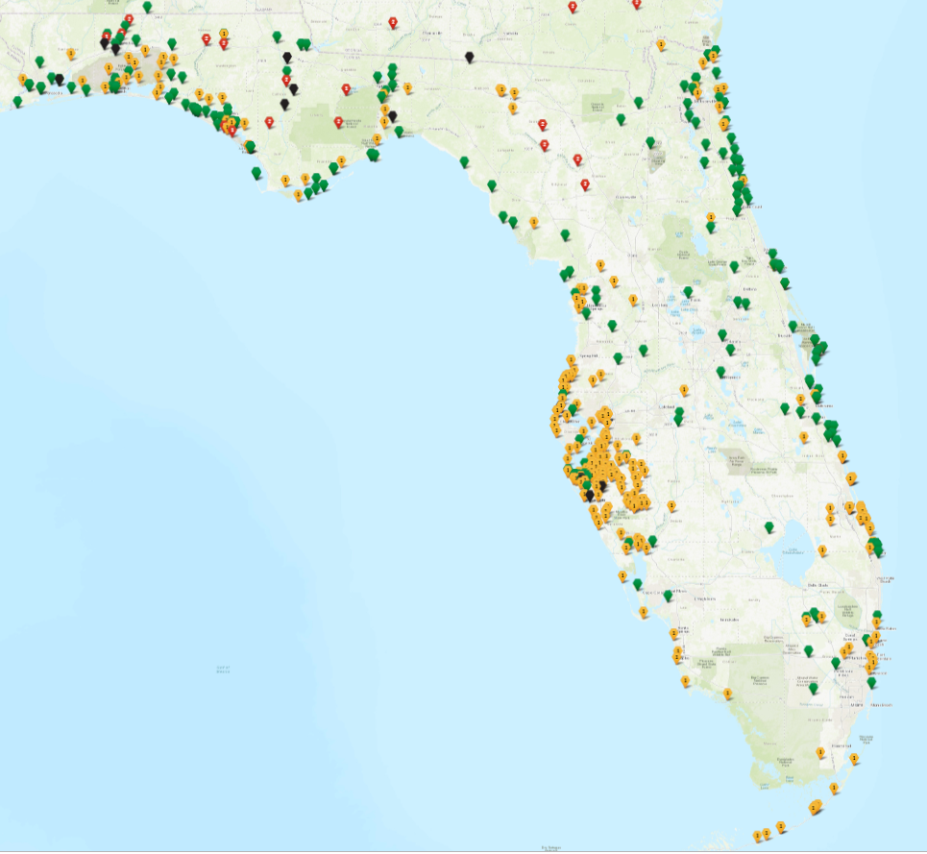
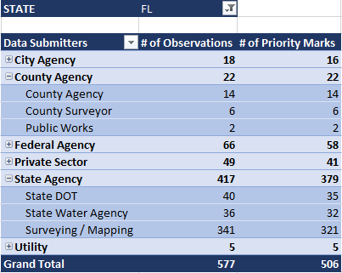
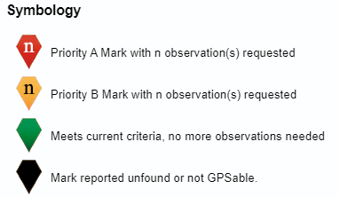
2018 GPSonBM GEOID18 Campaign
Results for Florida
577 observations on 506 unique marks were submitted for Florida
Notes:
Local data improves the local accuracy of national scale products and tools.
2018 GPSonBM Priority marks were targeted to fill data gaps and reduce uncertainty in GEOID18 which will replace GEOID12B
New GSPonBM efforts in 2019 will focus on collecting data to improve the transformation tools to the new datums in 2022

Slide 15
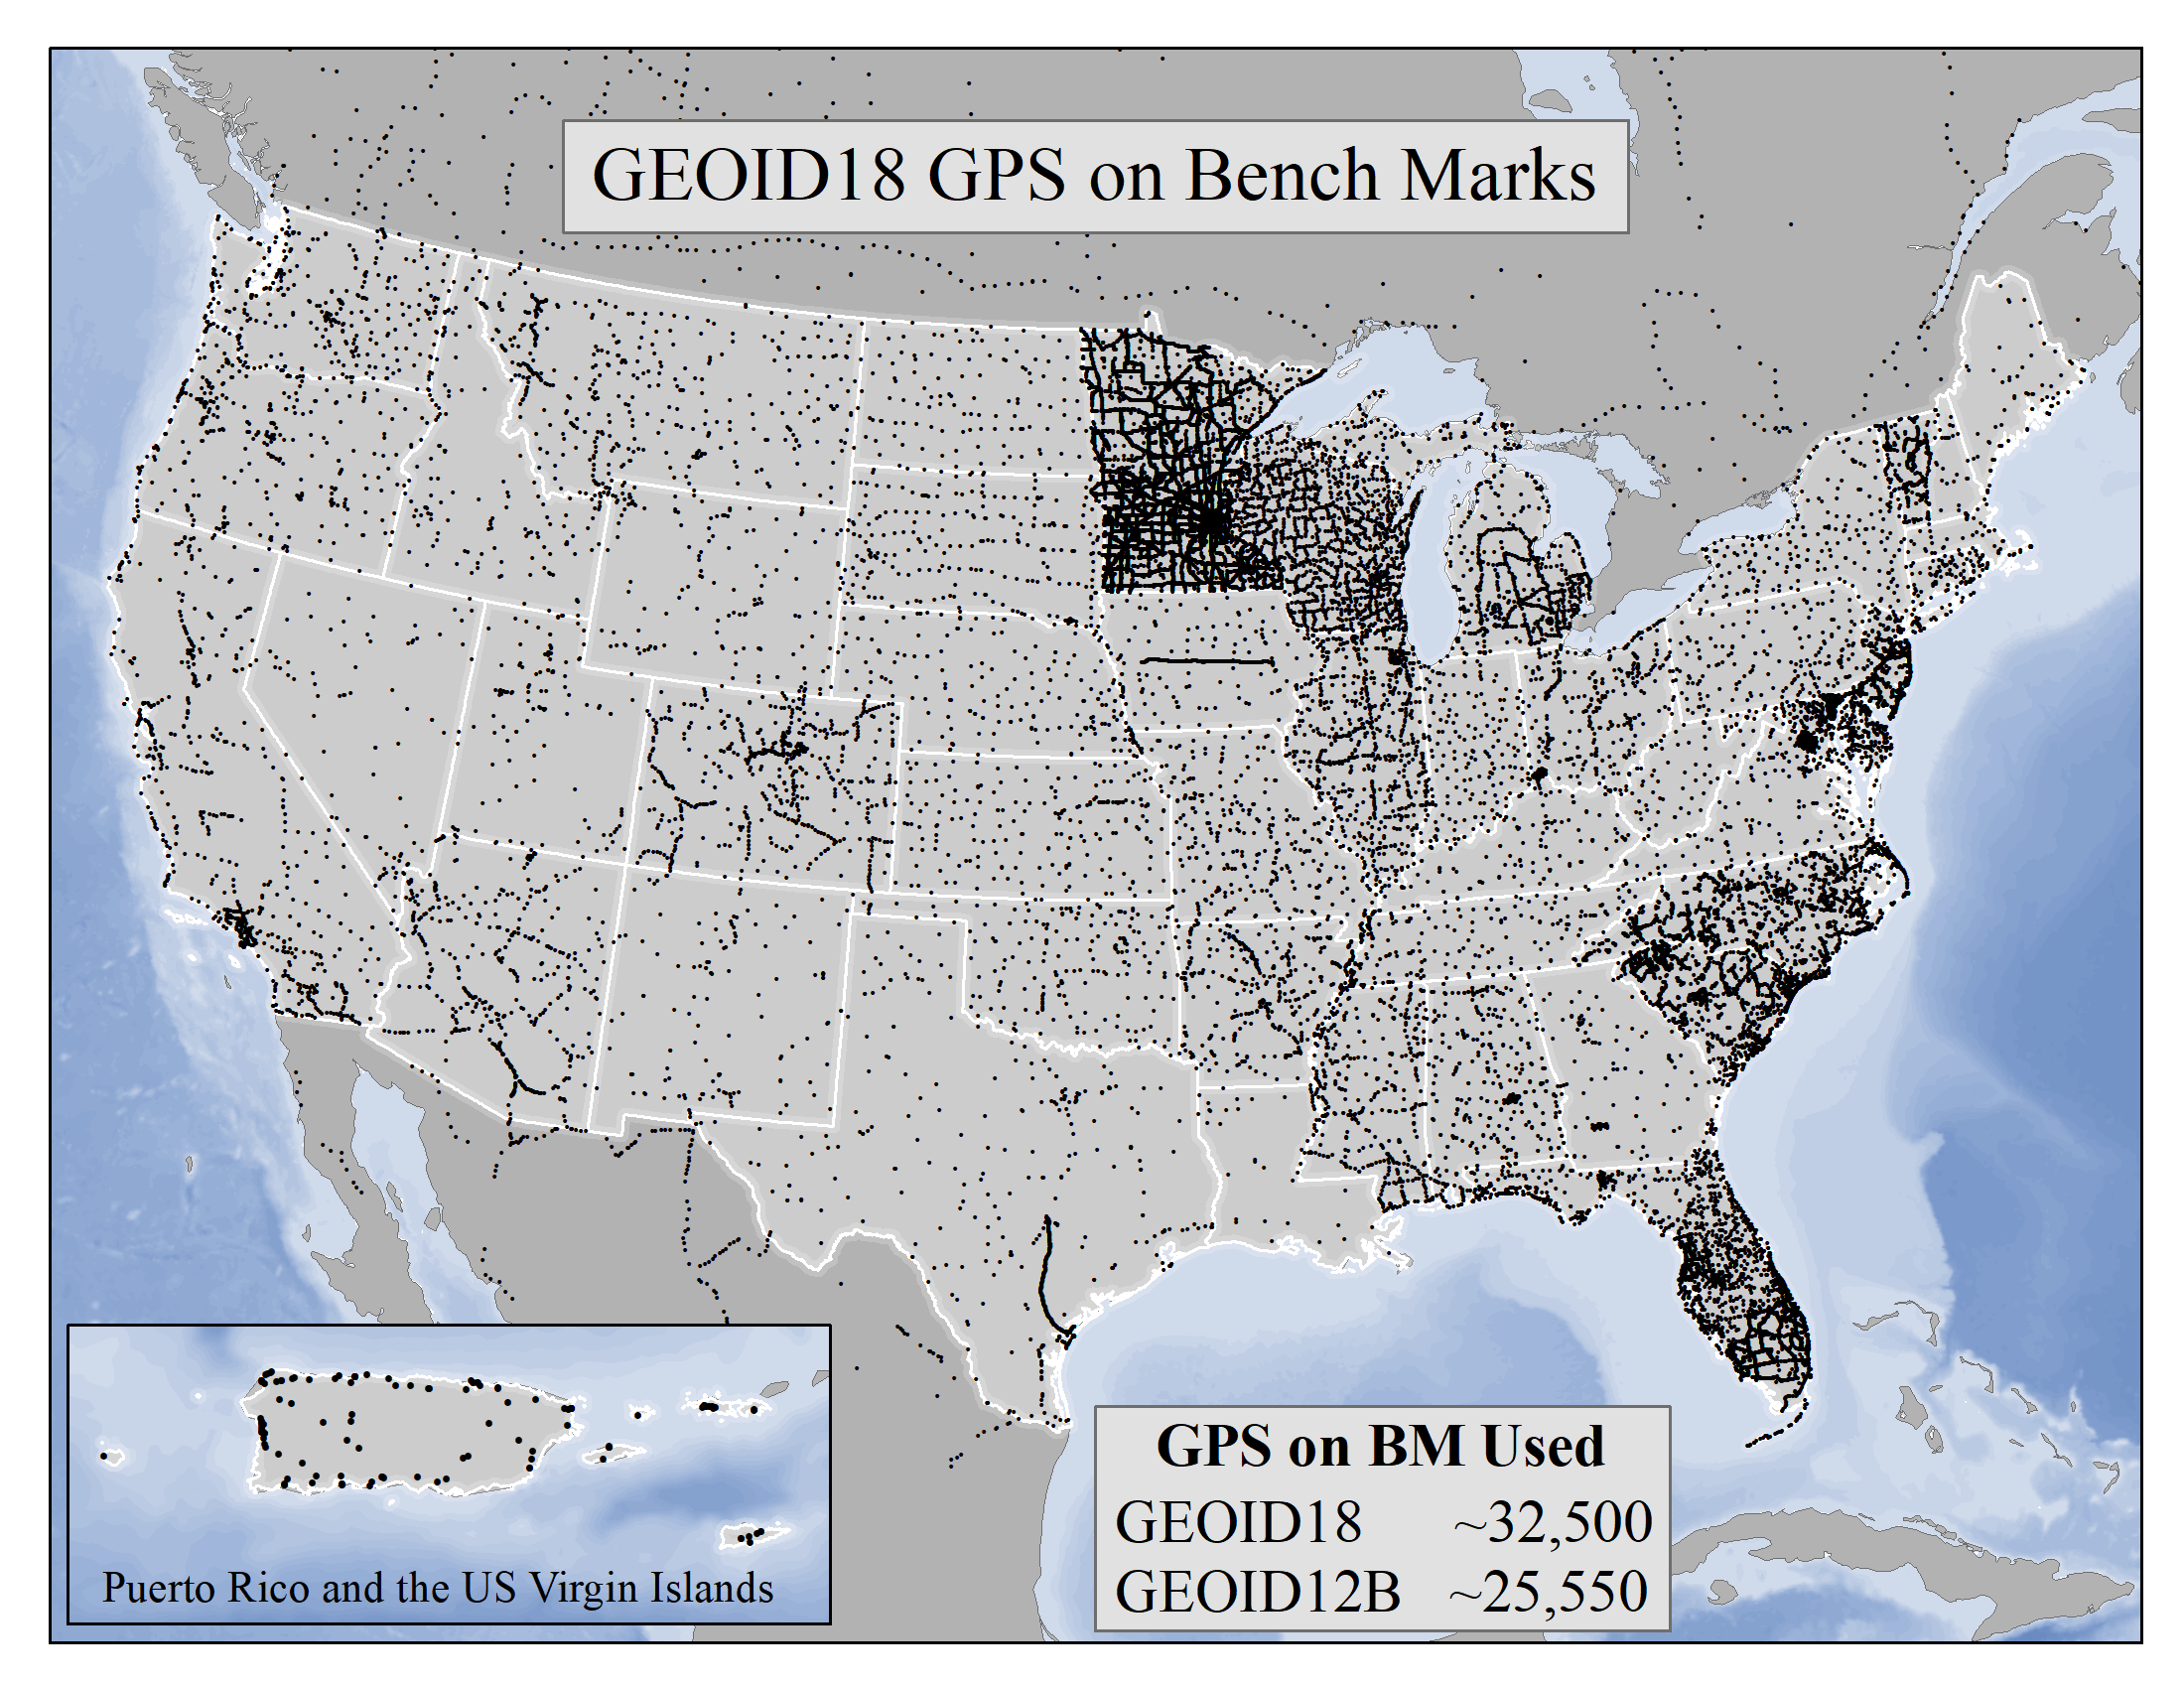
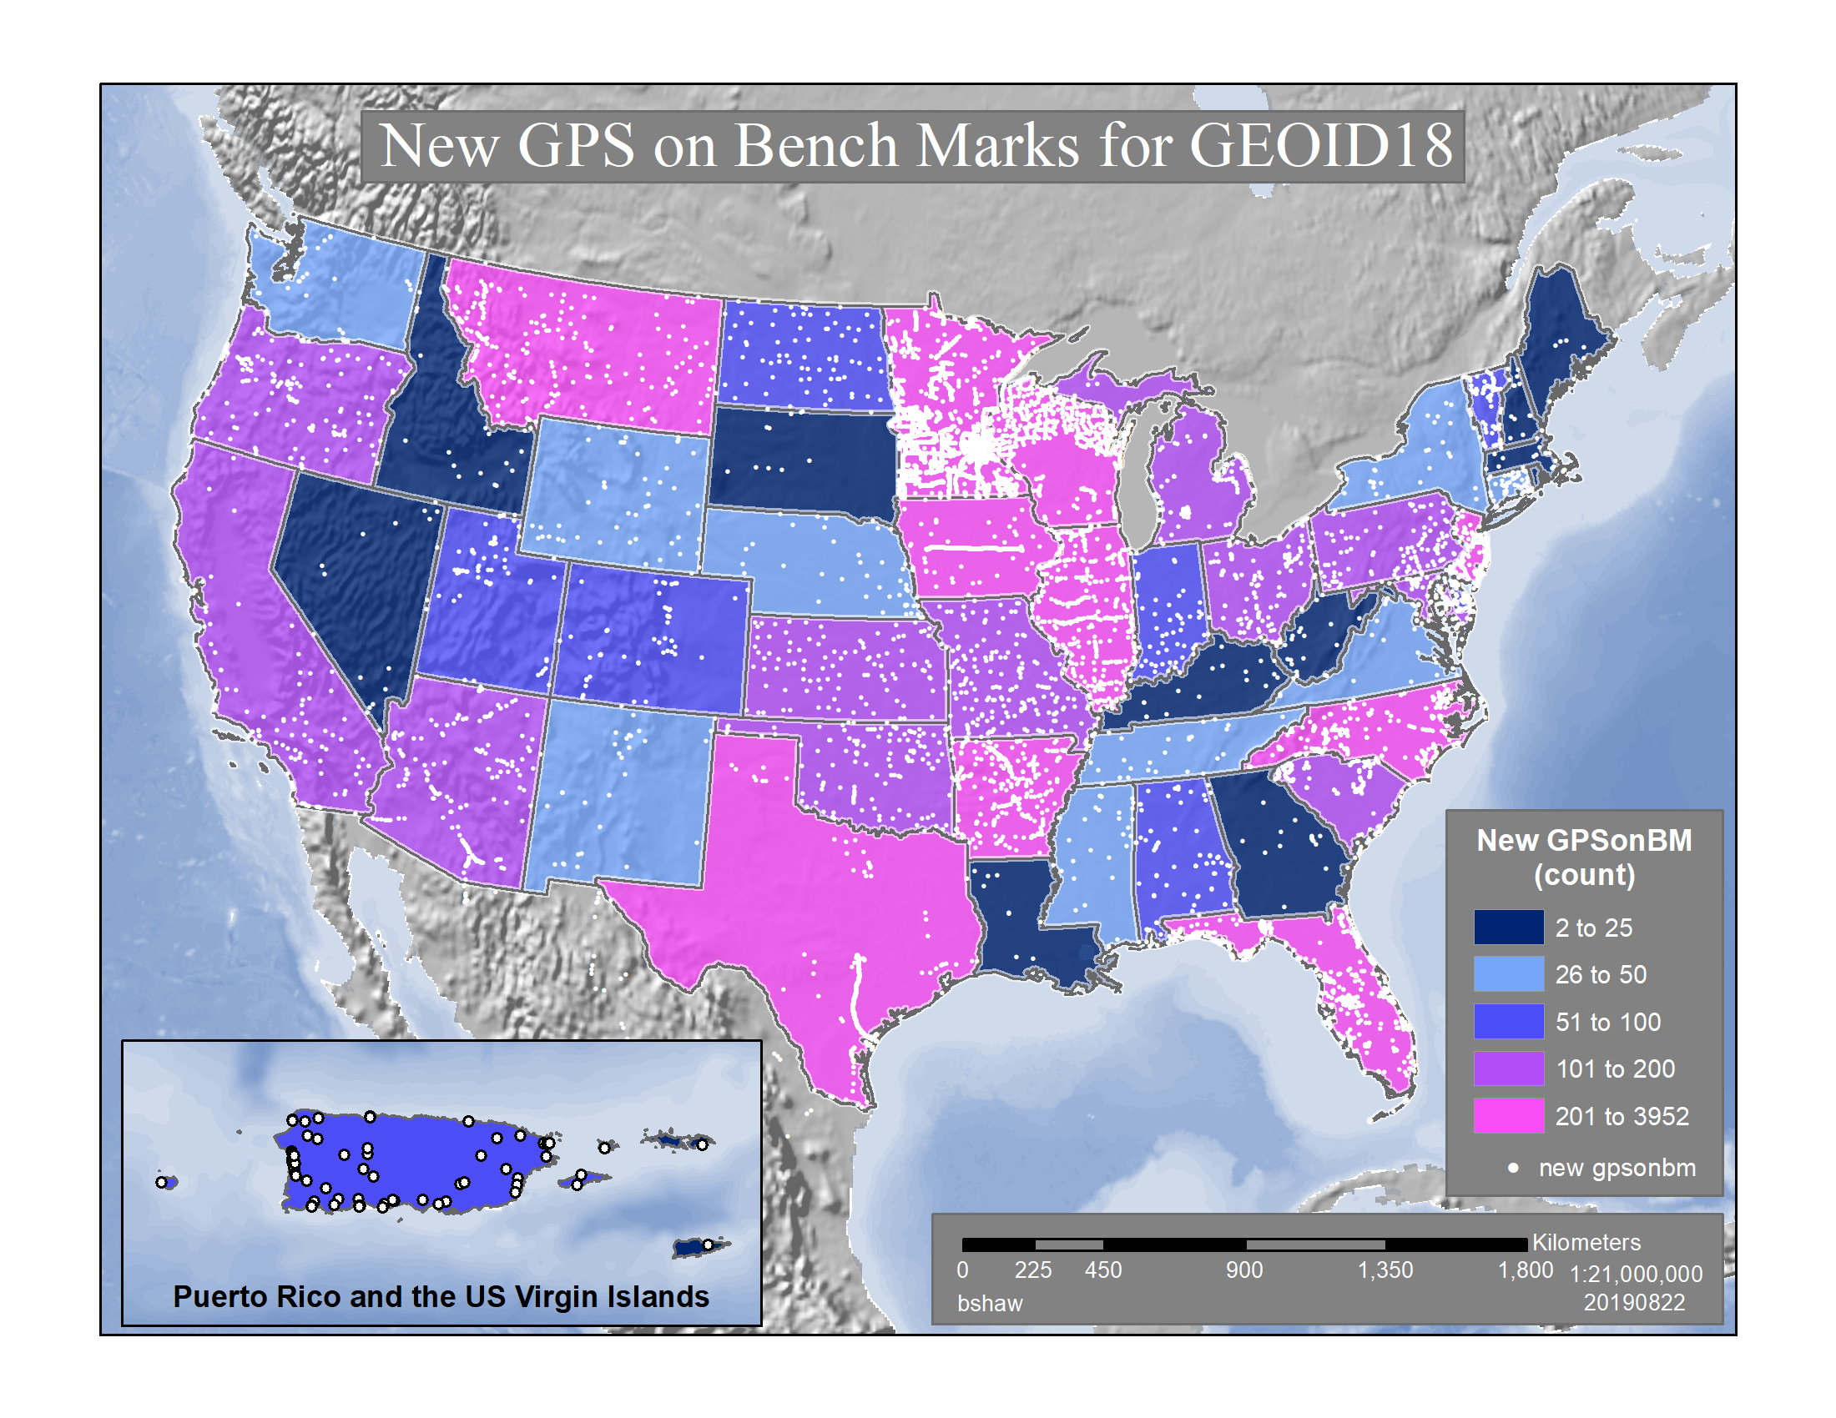
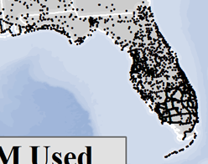

GEOID18 -Released
Improvements
2,894 GPSonBM’s used in Florida in GEOID18
413 more GPSonBM used than in GEOID12B

Slide 16
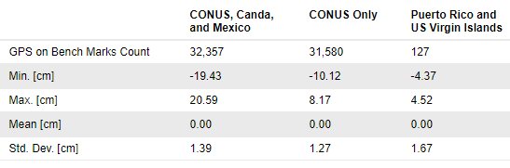
GEOID18 Model Improvements
32,357 GPS on Bench Marks data points were used to constrain the model to NAVD 88, PRVD02 and VIVD09, an increase of ~6,800 marks (26%) over GEOID12B
Significant new analysis of GPSonBM data resulted in a much cleaner dataset
Includes better elevation data and improved digital elevation modelling techniques
Uses better gravity data and improved geoid modeling techniques
New space-based gravity data from satellite gravity missions (GRACE & GOCE)
Includes all available airborne gravity data - 53 completed GRAV-D blocks
The overall fit of the final GEOID18 model to used bench marks is excellent. Over all of CONUS, the standard deviation is 1.27 cm
(GEOID12B was approximately 1.7 cm)

Slide 17
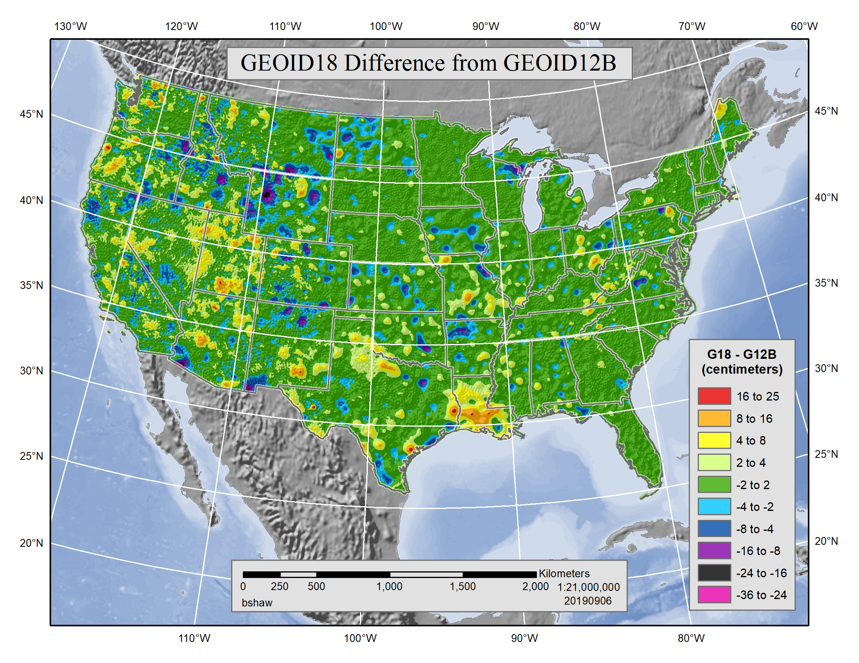
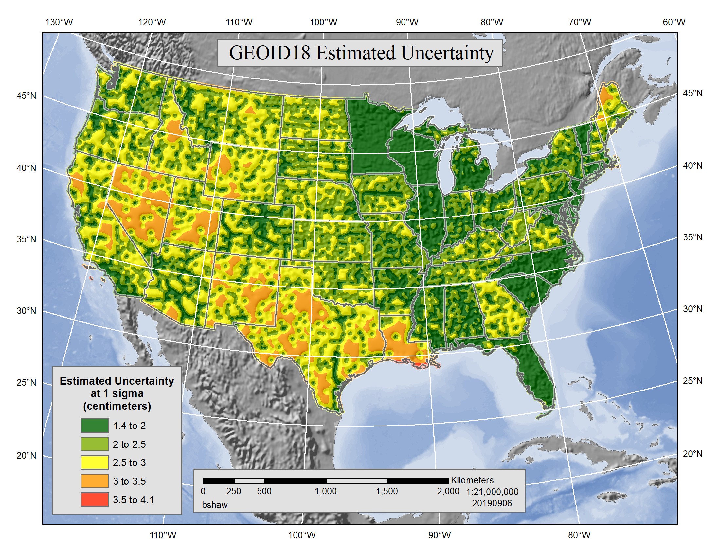
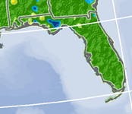

GEOID18 -Released
Improvements
Estimated uncertainty – how well the model matches published NAVD88 orthometric heights- is generally low in Florida
Max change from GEOID12B in Florida is ~-4 to -8 cm

Slide 18
2022 Transformation Tool Campaign Goals
NGS will make a national scale, mapping grade transformation tool with the data we have in the NGS Database or Shared through OPUS
To produce transformation results with an reasonable amount of uncertainty, NGS has a goal of GPSonBM data at 10 km spacing
We must interpolate over areas with data gaps
Uncertainties in the transformed coordinates will grow larger as the distance from a GPSonBM data point increases
Opportunity exists to densify local areas with data at up to 2 km spacing to increase accuracy and better resolve complex areas with topographic relief

Slide 19
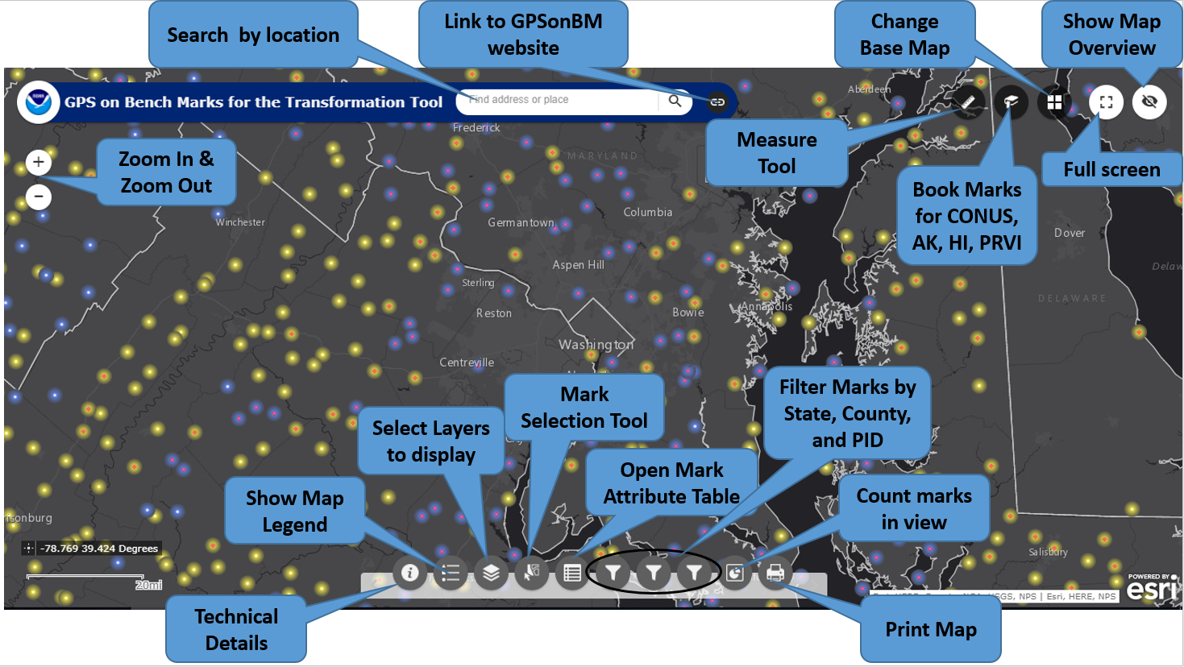
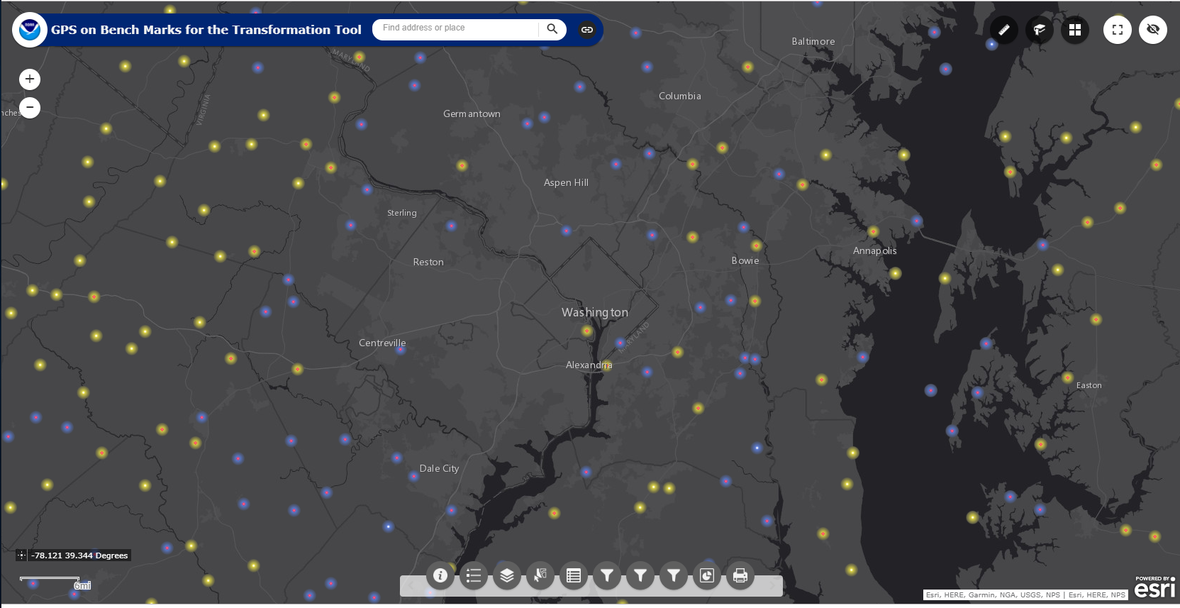
2022 Transformation Tool Campaign GPSonBM Web Map Application
The web map has several functions that allow users to search, explore, filter, and export the data
Notes:
Move up to intro

Slide 20

Which Marks First? How Many Observations?
Marks are classified as Priority A or B
  Priority A marks meet quality standards for use in the transformation tool
  Priority B marks are lower quality marks, less likely to be used to make the tool, but may be used to test the tool
NGS needs 2 consistent GPS observations on a mark to use it in the tool. At least on observation within last 5 years (since 2014)
List and map indicate whether 1 or 2 observations are requested

Slide 21
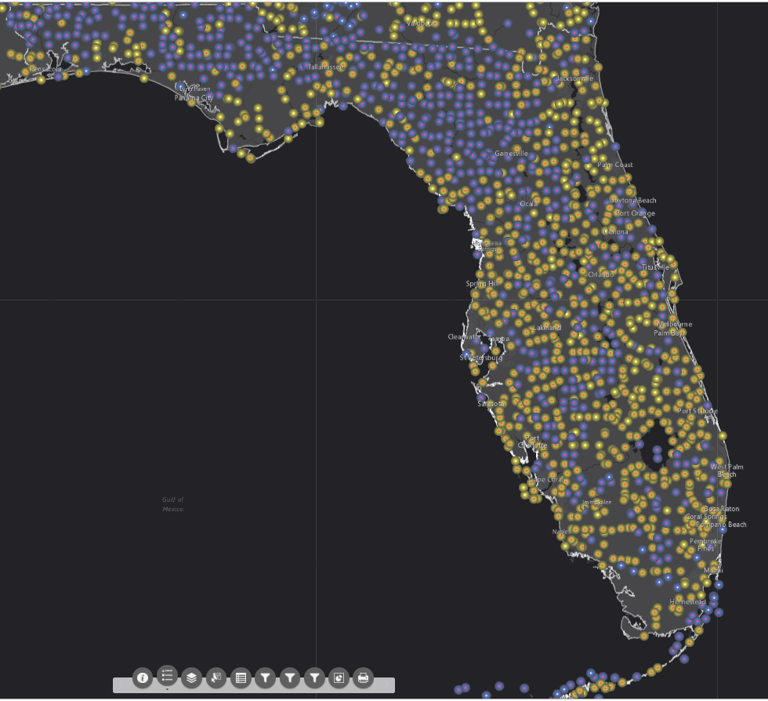
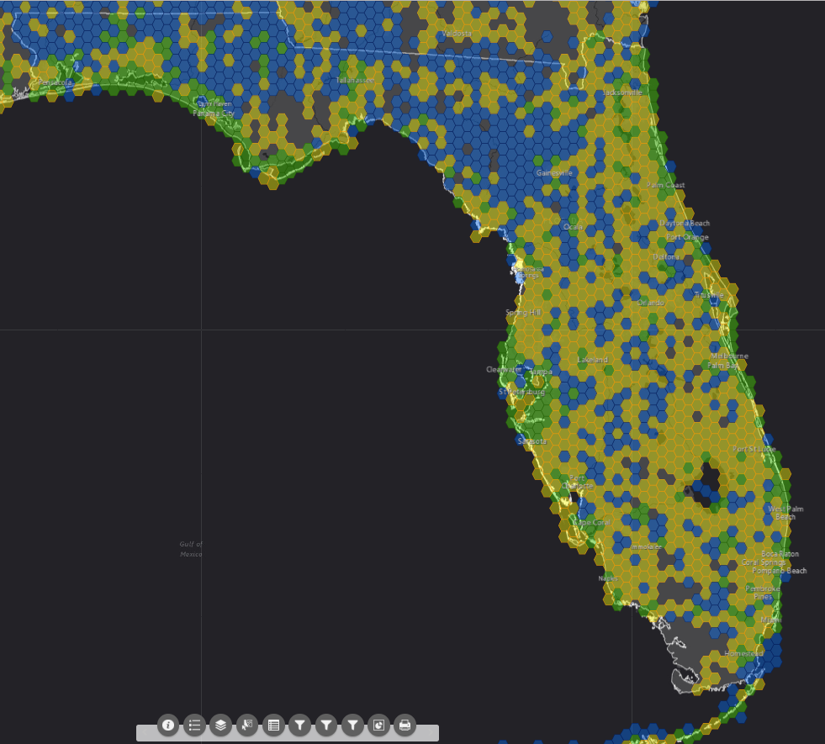
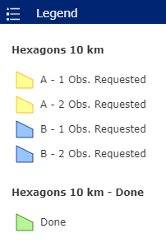
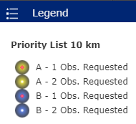
GPSonBM 2022 Transformation Tool Campaign
Priority Marks Requested
Geographic Coverage Areas

Slide 22
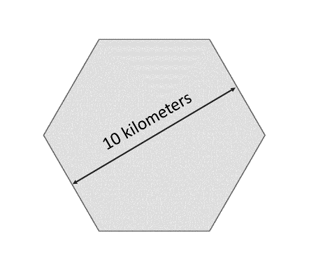
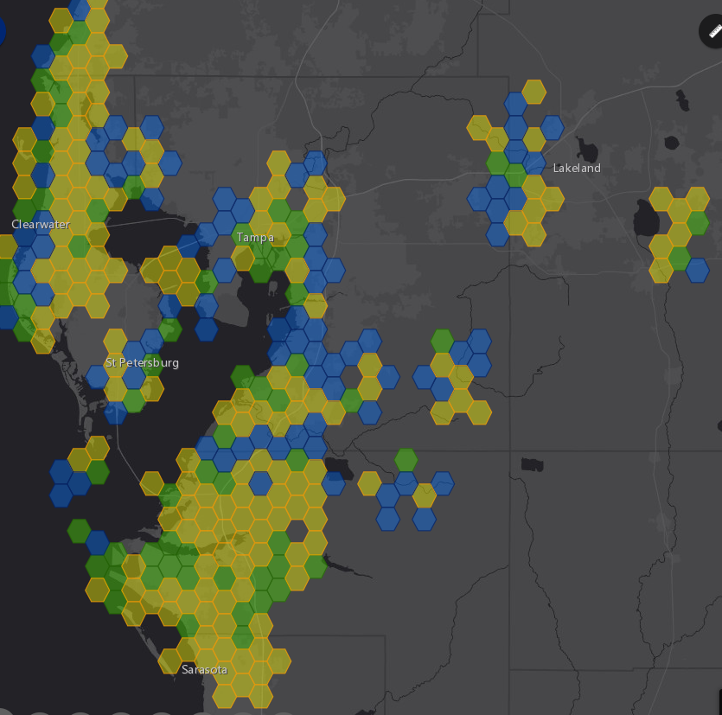
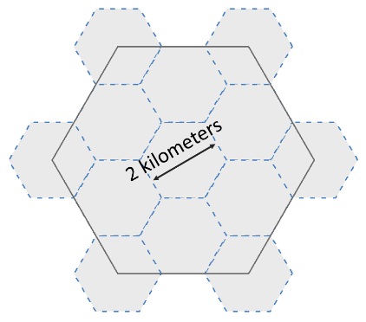

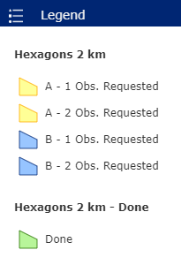


National Coverage and Local Densification
NGS has a National Coverage goal of 10 km spacing. 10 km hexagons illustrate this coverage on the map.
Priority marks within each hexagon are selected automatically based on their metadata
Once the 10 km goal is reached, the opportunity to densify the model and improve local results is unlocked. 2 km hexagons appear along with new priority marks within those hexagons
Priority A Hexagons are Gold
Hexagons where we have the data we need are marked Done and colored Green
Priority B hexagons are Blue

Slide 23
Update Frequency:
Weekly & Monthly & Quarterly
To maximize efficiency for all contributors, the Priority List & Web Map will be updated regularly as new data comes in
Check the list prior to field work so effort can be focused on marks that will make the biggest impact in your area
In 2020, NGS will release quarterly prototype transformation tools and accuracy grids to track improvements in accuracy as new data comes in, coverage expands, and densification takes place
Notes:
New Shared OPUS Solutions will be added weekly
New Bluebooked information will be added monthly – but soon will be weekly also
New Mark Recovery information currently take 4-6 weeks to be added

Slide 24
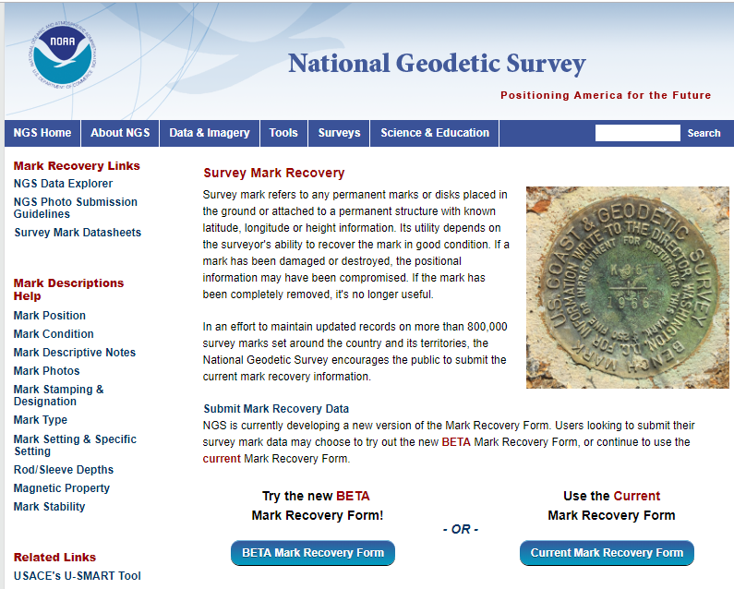
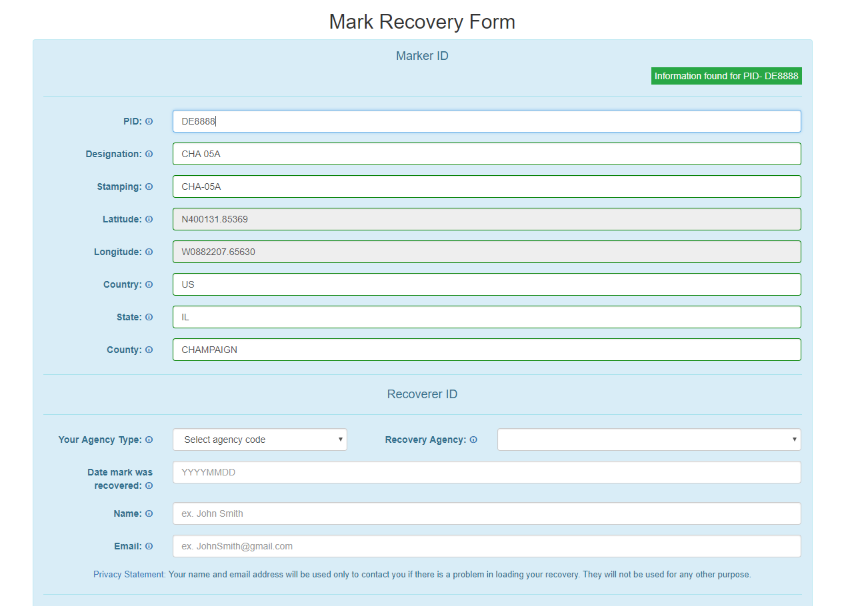
New Mark Recovery Webpage
Submitting recovery information will let NGS and others know if the mark is still usable and pictures will make it easier to find.
Add New animation: AND it will update the priority list on the map – show image of mark with datasheet info bubble
www.ngs.noaa.gov/surveys/mark-recovery

Slide 25
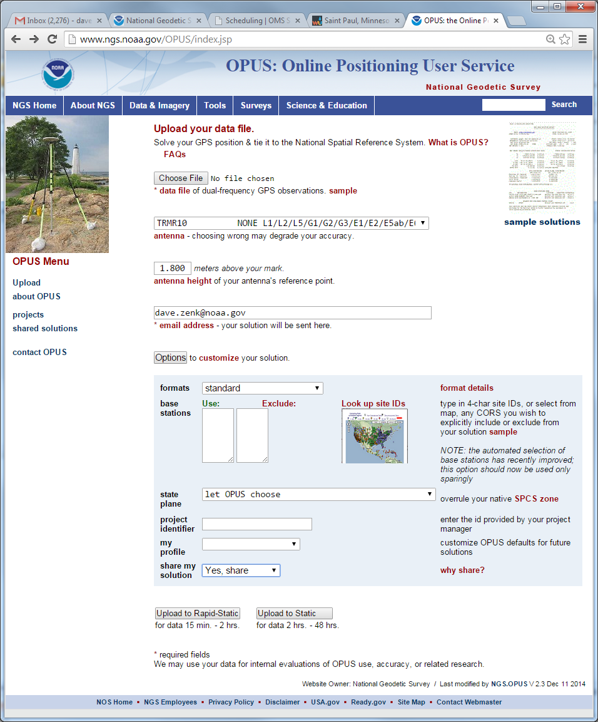
Share GPS observations through OPUS
Upload 4+hour GPS observation file
Provide antenna type, antenna height, and email address
Select “Yes, Share”
Identify the Mark by PID
Write a “To Reach” description
Attach 2 photos: Close up & Horizon
Respond to confirmation email

Slide 26




Antenna Type & Antenna Height are crucial for accurate results
rotate NRP to face true north
ARP
Each Antenna Type has unique biases
antenna height
For antenna calibrations, photos,
ARP and NRP diagrams, see geodesy.noaa.gov/ANTCAL/
mark
JGE, 2015

Slide 27


Why do we need 4 hours of data?
NGS is working on OPUS for RTK that will accept 3 minute observations, however the accuracy will NOT be as good as 4 hour observations.
1 sigma
Graph Courtesy of Dr. Daniel Gillins
Notes:
Better solutions with lower RMS are important for creating the hybrid geoid model. The Transformation Tools will need a higher density of data, so we are willing to trade a decrease in accuracy for the ability to get data on many more marks.

Slide 28



Example: Process Static Data in OPUS-Projects
Upload Vectors

Slide 29

Example: Upload RTN Vectors to OPUS-Projects
LEGEND
CORS
User Mark
Processed Vector (OPUS-Projects)
Uploaded Vector
NGS is proposing a new Standardized GNSS Vector EXchange Format (GVX) that will be used to ingest vectors into OPUS Projects
Upload Vectors
Notes:
GVX Contains:
Mark-to-mark ECEF vector components (dX, dY, dZ)
Standard deviations of vector components
Covariances of vector components
Reference frame
Start and stop time of observation
A-priori coordinates

Slide 30
How Can You Prepare
Stay up to date and check available resources
  Participate in NGS webinars, Geospatial summits, and online training
  Contact NGS Regional Advisor
Metadata is essential
  Improves reliability and accuracy of data
  Increases value and usefulness
Transform and/or collect new data
  Know your accuracy requirements

Slide 31
How Can You Prepare
Require/provide complete metadata for all mapping contracts
    What datum(s)
    How data was collected and processed
Preserve all original observations
    particularly when referenced to ellipsoid (GNSS)

Slide 32
Use Complete Nomenclature
NAD83
NAVD88
MLLW
Notes:
METADATA - you must document the datum you are referencing, but the datum itself is not enough.
Particularly in time leading up to 2022!

Slide 33
Use Complete Nomenclature
NAD83(2011) epoch 2010.00
H. Datum
Realization/Adjustment
Reference Epoch
NAVD88 (GRS80, GEOID18)
V. Datum
Reference Ellipsoid
Geoid Model
MLLW(9452210; 1960-78 #2128)
Tidal Datum
NOAA Tide Station
National Tidal Datum Epoch & Published Sheet Number (if available)
Notes:
Note: exact content and format may vary; these general recommendations are specific to projects with a vertical emphasis.
Also keep a record of source/date of survey whenever possible, even before 2022.
Start now: Also keep a record of source/date of survey whenever possible, even before 2022.

Slide 34


Get Involved!
Use the GPSonBM web map to find marks near you
Submit Mark Recoveries using the new Mark Recovery Form
Collect static GPS data and Share through OPUS
Track local progress on Dashboard

Slide 35

Visit the updated GPSonBM Webpage
www.ngs.noaa.gov/GPSonBM
New priority marks list
New interactive web map
New mark recovery form
Technical details explained

Slide 36
The future is already here —
it's just not very evenly distributed.
- William Gibson
Contact the team:
ngs.gpsonbm@noaa.gov

Slide 37




NGS Training Material
GPS on Bench Marks Webpages
NGS Video Library
NGS Online Lessons

Slide 38


FAQ’s #1
Q: What is the deadline to submit GPSonBM for the Transformation Tool?
A: December 31, 2021 – so that observations can be used to create 2020.0 Reference Epoch Coordinates (See Blueprint 3 -Working in the Modernized NSRS)
Q: Can we submit previous observations?
A: Yes! Observations made within the past 3 years may be submitted if you have the required metadata and pictures.
Q: What do we do if we can’t find the priority mark or if it not observable with GPS?
A: 1) Submit a Mark Recovery with the new Mark Recovery Form.
2) Find and observe an secondary mark listed in the hexagon layer on the web map.

Slide 39
FAQ’s #2
Q: Can we submit offset observations for marks that are not GPS-able?
A: For now, only by following Mark Reset Procedures. In the future, will be able to use OPUS to process and adjust GPS, leveling, and total station observation together.
Q: Can we submit less than 4 hours of data?
A: Yes, but only by using OPUS Projects to Bluebook the data.
Q: Can we submit RTK observations?
A: Not yet, but soon. In early 2020, OPUS Projects will enable processing of Hybrid Survey Networks that include both static and real-time observations.

