Slide 1
GPS on Bench Marks:
Building the Bridge to the Future
2019 NGS Geospatial Summit
Silver Spring Civic Center
May 7th, 2019
Galen Scott
Acting NGS Constituent Resource Manager

Slide 2
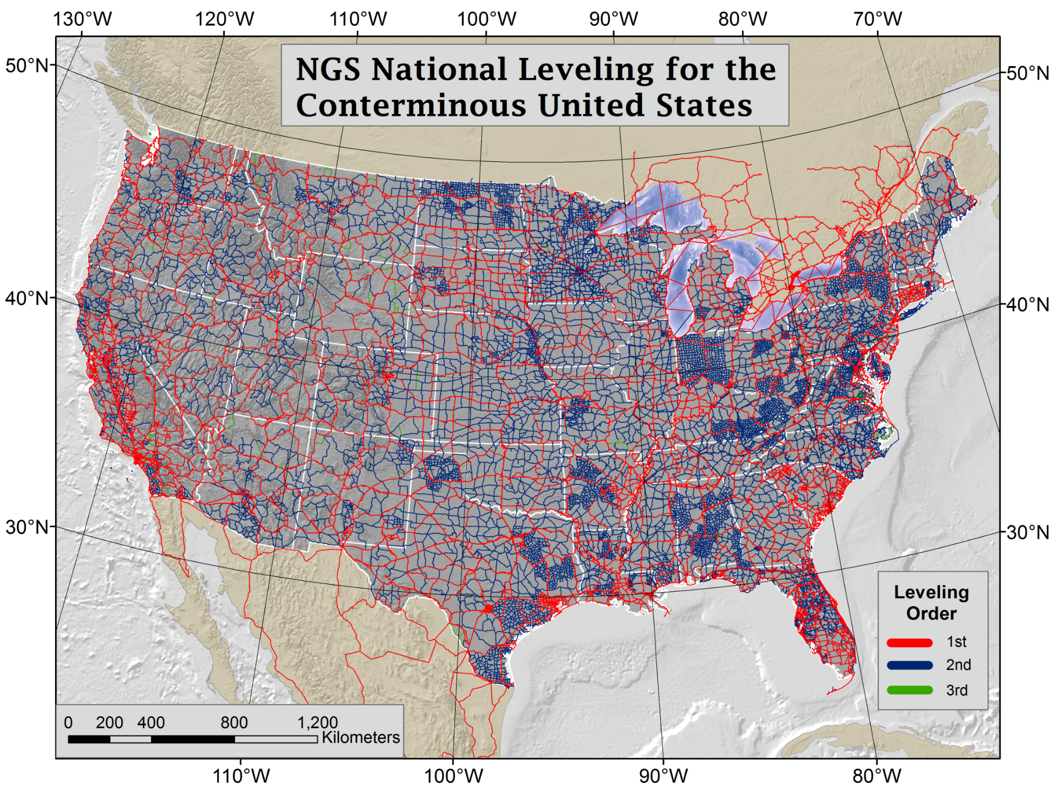
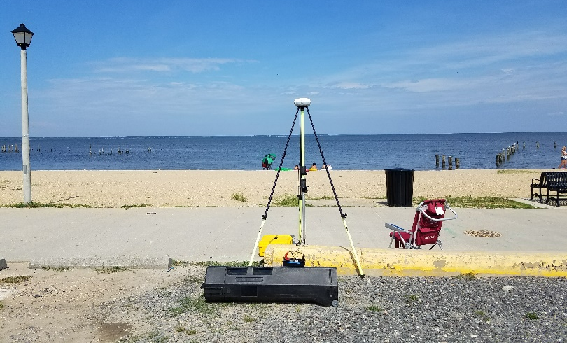
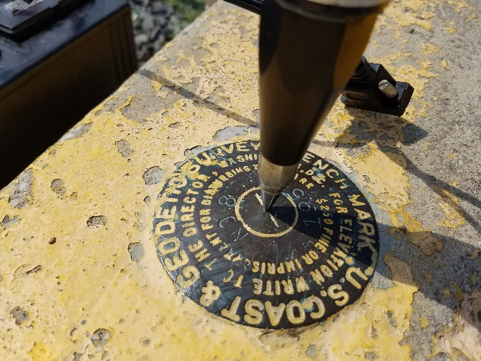
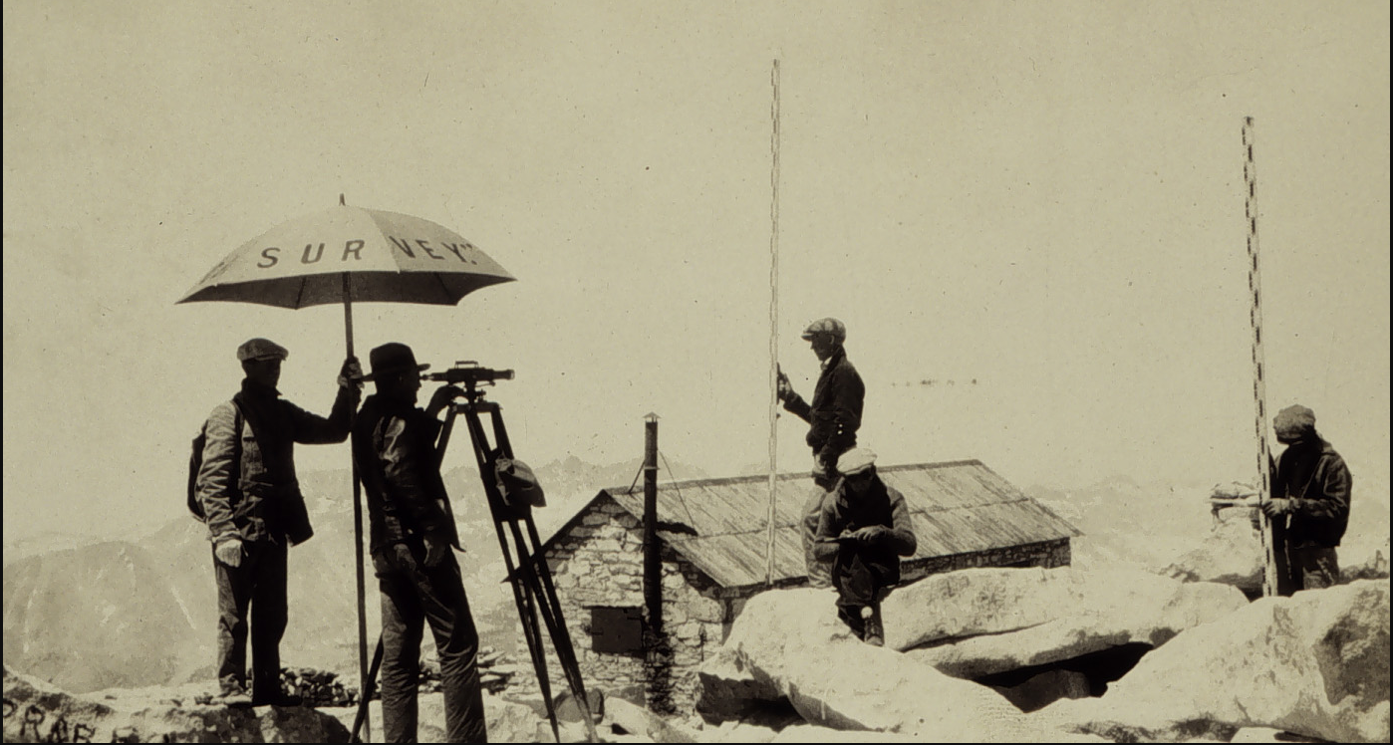
The Journey to the Modernized NSRS Begins with GPS Data on Leveled Bench Marks
Notes:
NAVD 88 consists of about 800,000 benchmarks and ~2.2M km of leveling. Data was collecting over many decades by roving bands of surveyors who walked across the country multiple times over the years, east to west, north to south and back again. It is currently the official vertical datum of the US and is required for federal mapping projects.
GPS data on those leveled marks will be used to create GEOID18 – the model used to derive NAVD88 heights from GPS ellipsoid heights, as well as the transformation tools that will be released with NAPGD2022.

Slide 3
Extensive Residual Analysis: Individual Marks and Regional Patterns
Residual = h - H - N
-
-
h is ellipsoid height measured using GPS
H is an NAVD 88 Orthometric Height from Leveling
N is from a geoid model – hybrid or gravimetric
In theory, the difference between these three values should be zero.
In practice, using actual observations gives a residual, or measure of misfit between the three.
We use the residuals and details about each survey to evaluate the GPS and Leveling observations and decide which marks we need further observations on.
Notes:
Described by Dave Zilkoski in GPS World

Slide 4
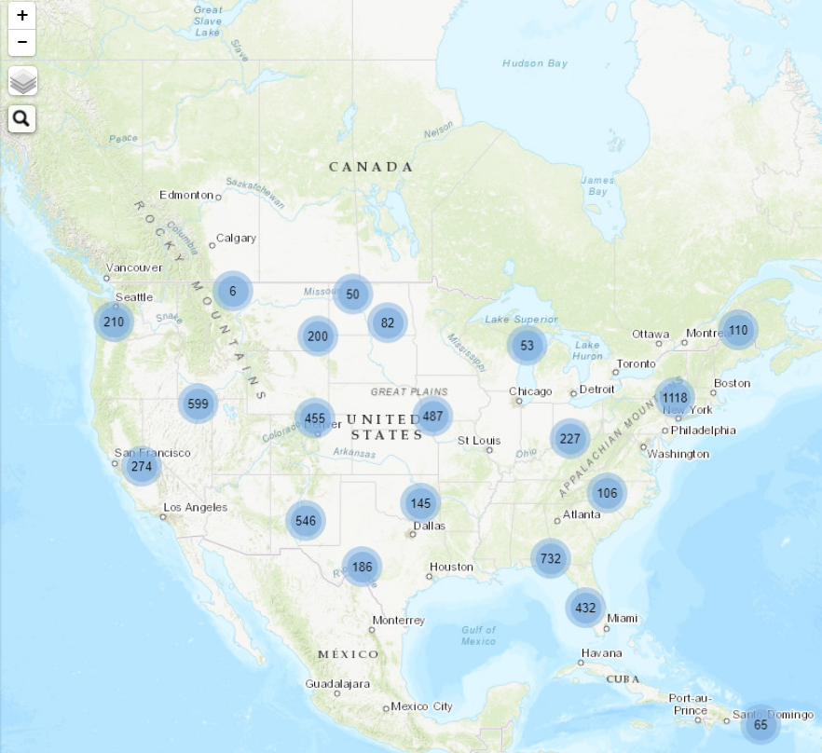
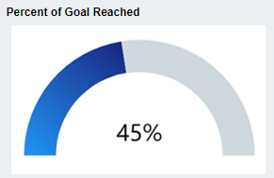
2018 Tracking Map
2018 GPSonBM
Target: GEOID18 data
Requested: ~5,900 Marks
Received:
~3,800 observations
~2,600+ marks Received
Agency Type | % of Marks Submitted
State Agency | 76%
Private Sector | 14%
Federal Agency | 6%
County Agency | 4%
Academic | 2%
City Agency | 2%
Professional Society | 0.5%
Utility | 0.5%
Notes:
Use at end with teaser for new Priority List

Slide 5
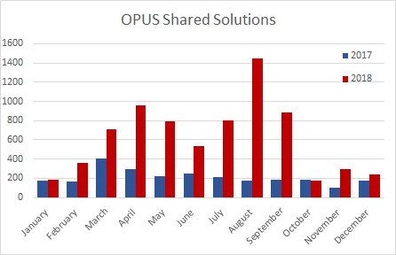
OPUS Share broke records (almost) every month in 2018
Thank You!
Notes:
Waiting for Amy

Slide 6
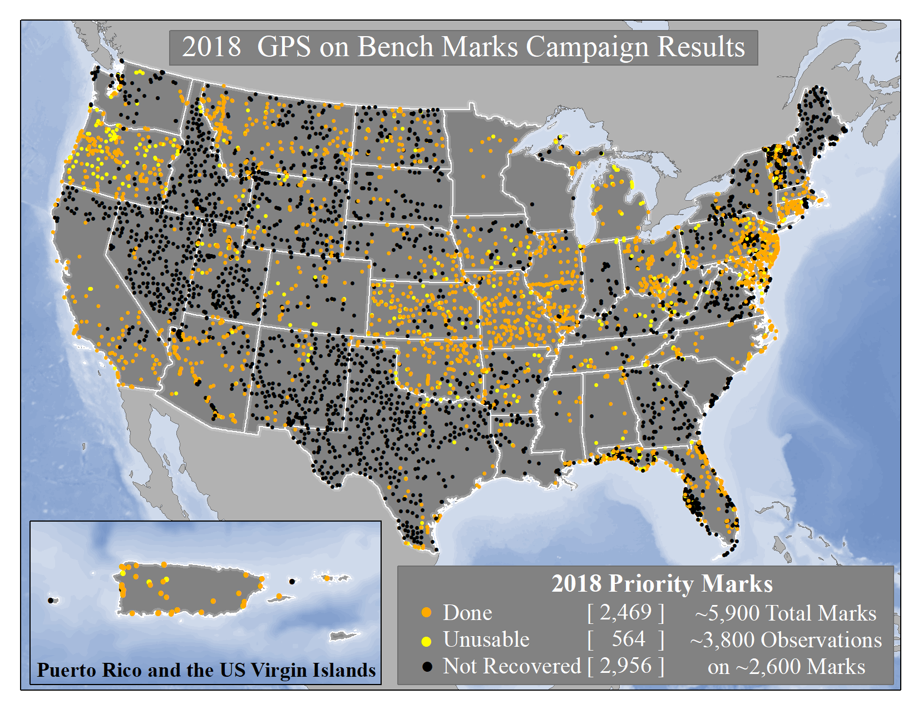
Notes:
The 2019 GPSonBM Campaign will be kicking off during Surveyor’s Week in March.
Local data improves the local accuracy of national scale products and tools.
2018 GPSonBM Priority marks were targeted to fill data gaps and reduce uncertainty in GEOID18 which will replace GEOID12B
New GSPonBM efforts in 2019 will focus on collecting data to improve the transformation tools to the new datums in 2022

Slide 7
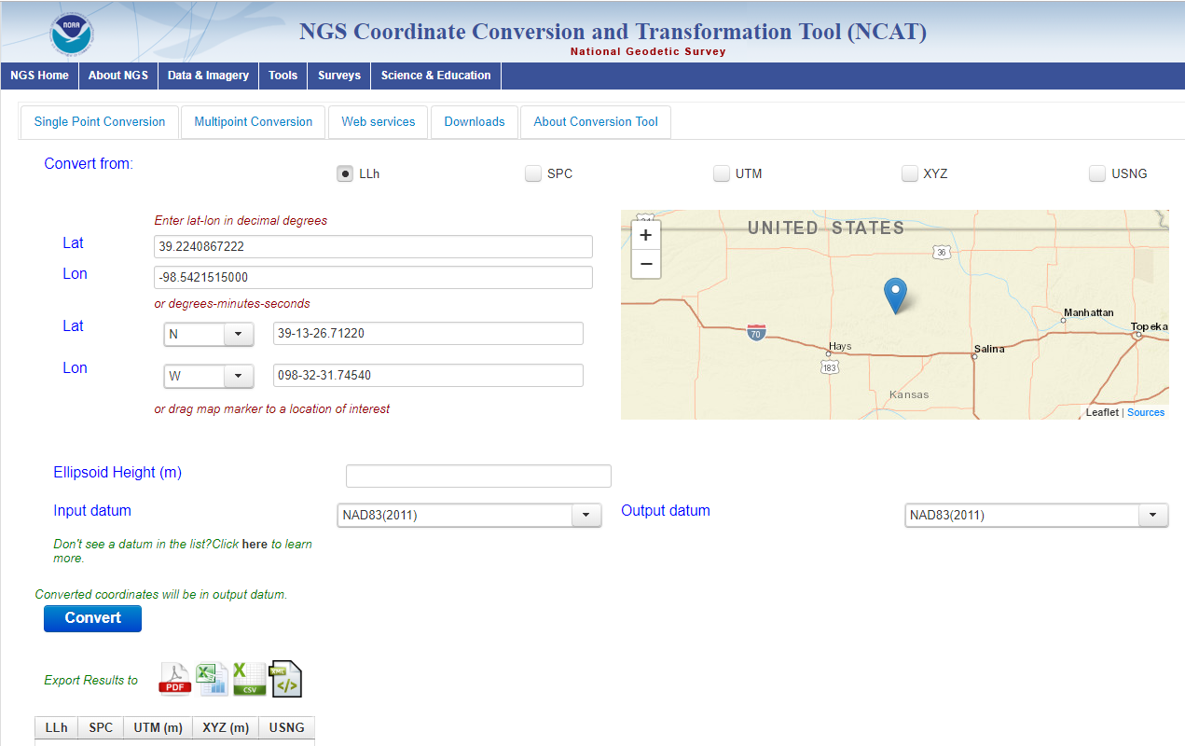
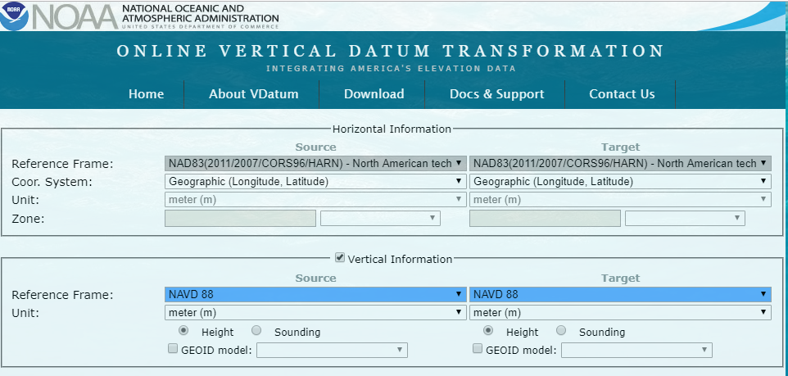
Next Targets for GPSonBM: NCAT and VDatum
The GPSonBM program will now shift gears to focus on collecting data to provide local improvements to other national scale NGS products.

Slide 8
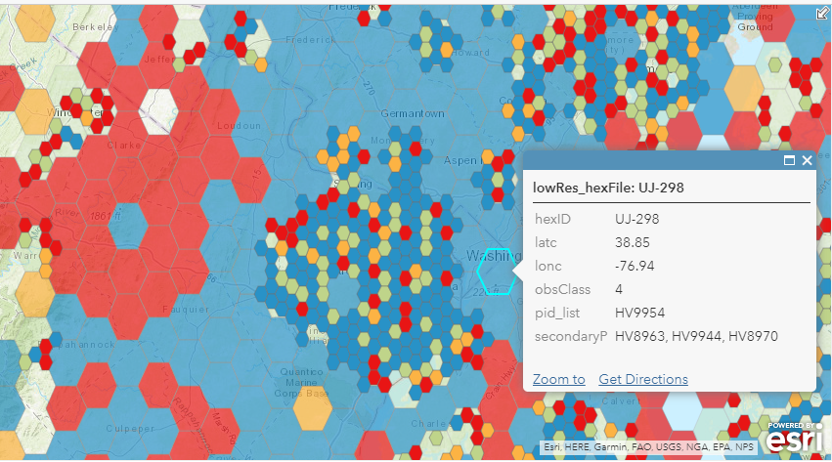
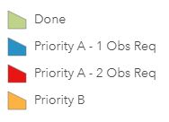
GPSonBM Priority List for Transformation Tools
10 km optimal minimum data spacing requires ~90,000 marks by mid-2022
(was 30 km / 5,900 for GEOID18)
Grid cells will be 2 km. Where local data exists, this will capture geographical nuances in transformation relationships
Automatic updates as new data comes in
New OPUS Share data: weekly
Mark Recoveries & Bluebooked data: monthly
Priority map shows where data is needed for minimum coverage as well as where densification can take place to “buy up” the quality of the transformation. Prioritization algorithm picks the best marks in each area.
Notes:
Improve NCAT and VDatum (GPS for Transformation Tool PRB Project): Shared solutions provide local data to improve the local quality of Transformation Tools that will be developed with the New Datums.
Update Passive Control Status: shared solutions provide NGS and other users with a window to the health of the passive control network and form a reconnaissance tool for project planning.
Identify marks suspected of movement: With a background processing scheme that includes age and quality of leveling and historic GPS observations, GPSonBM data could be used to automatically flag unstable marks.
Automatic Reprocessing in 2022: Shared data will be reprocessed after New Datums release in 2022 and shared marks will be given new coordinates automatically
Establish RTN Check Stations: Marks with required observation length and data quality standards can be used as RTN Check Stations (for X amount of time after the Shared observation)
Test and Evaluate Intra-frame Velocity Model (IFVM): repeat OPUS shared solutions over time can provide NGS with a way to evaluate IFVM performance in modeling land motion in gaps between CORS.
Validate Static/Dynamic Gravimetric Geoid: GPS\Leveling data is one of the few independent datasets and one of the most common ways to validate a gravimetric geoid model. Assuming high-quality data, NGS will continue to use GPS on Bench marks to perform this external validation.

Slide 9
Further Benefits of Sharing GPSonBM Data Beyond NCAT & VDatum
Automatic Reprocessing in 2022
Update Passive Control Status
Validate Static Gravimetric Geoid
Identify marks suspected of movement
Establish RTN Check Stations
Test and Evaluate Intra-frame Velocity Model (IFVM)
Notes:
Improve NCAT and VDatum (GPS for Transformation Tool PRB Project): Shared solutions provide local data to improve the local quality of Transformation Tools that will be developed with the New Datums.
Update Passive Control Status: shared solutions provide NGS and other users with a window to the health of the passive control network and form a reconnaissance tool for project planning.
Identify marks suspected of movement: With a background processing scheme that includes age and quality of leveling and historic GPS observations, GPSonBM data could be used to automatically flag unstable marks.
Automatic Reprocessing in 2022: Shared data will be reprocessed after New Datums release in 2022 and shared marks will be given new coordinates automatically
Establish RTN Check Stations: Marks with required observation length and data quality standards can be used as RTN Check Stations (for X amount of time after the Shared observation)
Test and Evaluate Intra-frame Velocity Model (IFVM): repeat OPUS shared solutions over time can provide NGS with a way to evaluate IFVM performance in modeling land motion in gaps between CORS.
Validate Static/Dynamic Gravimetric Geoid: GPS\Leveling data is one of the few independent datasets and one of the most common ways to validate a gravimetric geoid model. Assuming high-quality data, NGS will continue to use GPS on Bench marks to perform this external validation.

Slide 10
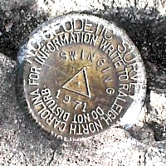
OPUS Requirements for Sharing
GPS Observation: Collect 4+ hours of data on a bench mark
Description: Provide details of how to locate mark (To Reach)
Example: Located in the SW corner of a 2 ft square concrete pad projecting 0.3 ft above ground, 3.3 ft S from S edge of sidewalk...
Accurate antenna height and type values
2 photos:
close-up photo (avoid dark/blurry/dirt-covered)
horizon photo (show equipment in use)
Notes:
- We keep the minimum session time at 4 hours for OPUS share
- Longer sessions = better probability of fixing ambiguities and cancelling some errors in GNSS
Incorrect antenna height is often the cause of an inaccurate orthometric height
Example description at the top
OPUS share requirements
https://geodesy.noaa.gov/OPUS/about.jsp#sharing
OPUS webinar from Dec 2016
https://geodesy.noaa.gov/web/science_edu/webinar_series/understanding-opus.shtml

Slide 11
Why do we need 4 hours of data?
NGS is working on OPUS for RTK that will accept 3 minute observations, however the accuracy will NOT be as good as 4 hour observations.
1 sigma
Graph Courtesy of Dr. Daniel Gillins
Notes:
Better solutions with lower RMS are important for creating the hybrid geoid model. The Transformation Tools will need a higher density of data, so we are willing to trade a decrease in accuracy for the ability to get data on many more marks.

Slide 12
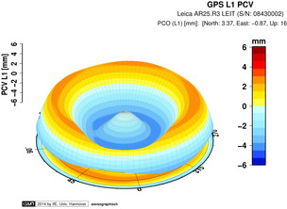
Antenna Type & Antenna Height are crucial for accurate results
rotate NRP to face true north
ARP
Each Antenna Type has unique biases
antenna height
For antenna calibrations, photos, ARP and NRP diagrams, see geodesy.noaa.gov/ANTCAL/
mark
JGE, 2015

Slide 13
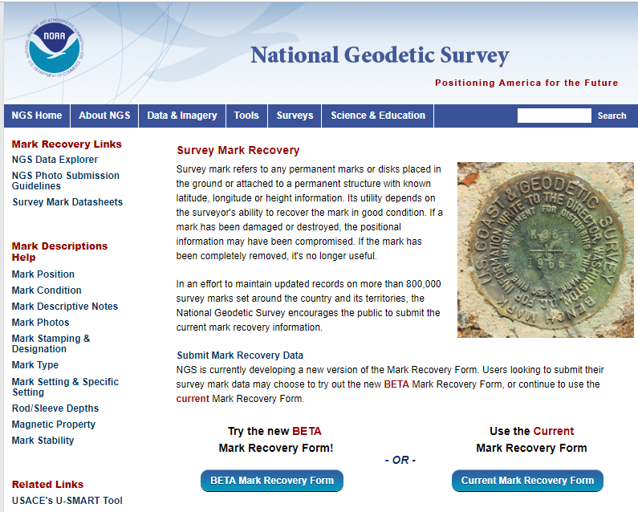
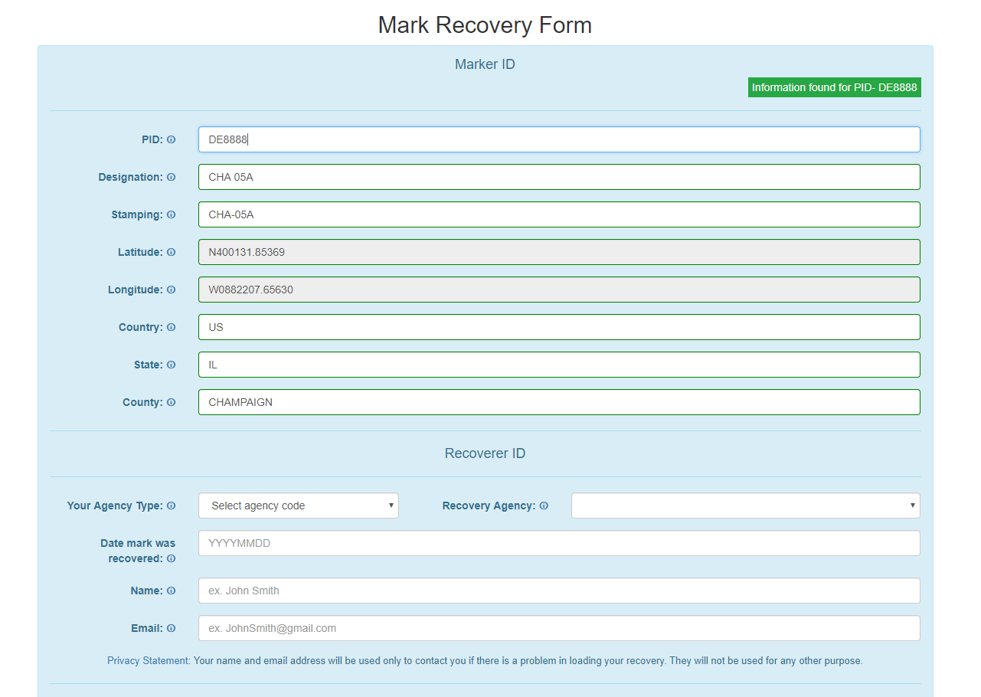
New Beta Mark Recovery Webpage
Mark Recoveries will update the NGS Datasheet and let NGS and others know if the mark is still usable. Pictures will make it easier to find.
www.ngs.noaa.gov/surveys/mark-recovery
Is the mark still there?
Is it GPS’able?
Does the “To Reach” description or other metadata need to be updated?
Beta recovery page can not accept pictures yet – for picture submissions use DSWorld
Notes:
Add link to new beta Mark Recovery page

Slide 14
Submit Mark Recoveries & Photos through DSWorld
DSWorld is a powerful multifunction application that enables you to plot bench marks in Google Earth and submit bench mark recoveries and other metadata updates to NGS Datasheets. For now DSWorld is the preferred method for submitting photos of marks and their surroundings.
https://geodesy.noaa.gov/PC_PROD/PARTNERS/

Slide 15
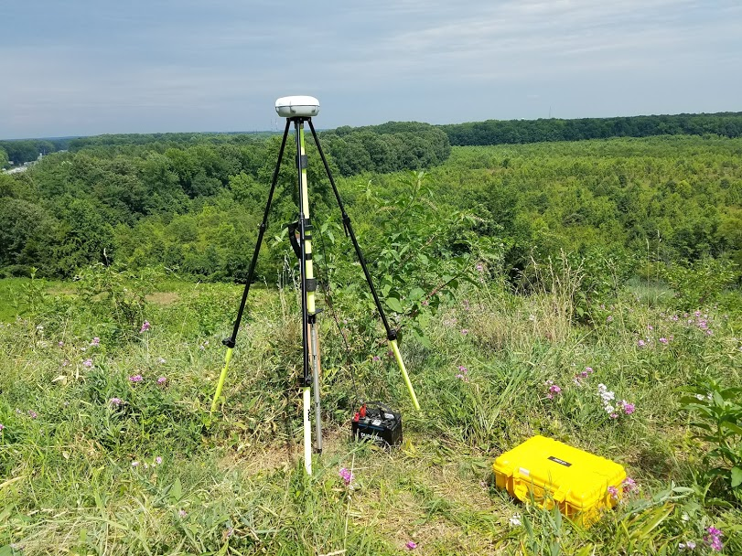
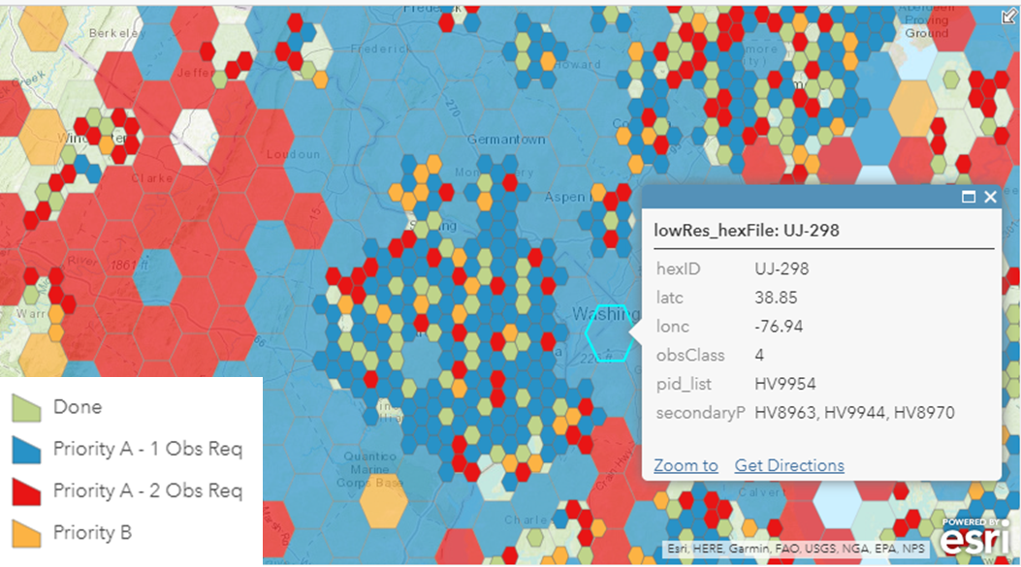
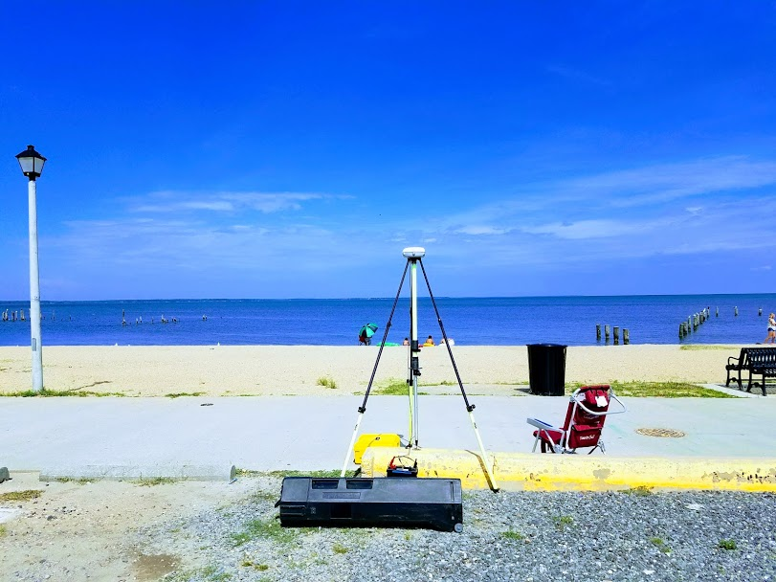
Call to Action: Ramp It Up Thru 2022
Consult GPSonBM webpage for the latest Priority Marks in your area
Find marks & submit mark recoveries online
Collect 4+ hours of GPS data and Share through OPUS
Check out our new webpage!
RTK coming soon!

Slide 16
The future is already here —
it's just not very evenly distributed.
- William Gibson
Contact the team:
ngs.gpsonbm@noaa.gov

Slide 17
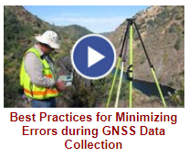
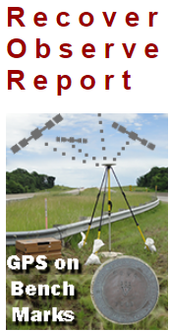
NGS Training Material
GPS on Bench Marks Webpages
NGS Video Library
NGS Online Lessons

Slide 18
Additional Resources
Podcast on why this is important-
Geodesy: The Invisible Backbone of Navigation
https://oceanservice.noaa.gov/podcast/jan18/nop12-geodesy.html
GPS World Article by Dave Zilkoski –
NGS 2018 GPS on BMs program in support of NAPGD2022 — Part 5
http://gpsworld.com/ngs-2018-gps-on-bms-program-in-support-of-napgd2022-part-5/
xyHt Article by Caccamise & Ahlgren:
GEOID18: Make Your Mark and Improve Your Heights

