Slide 1

Criteria for Selection Continuous GNSS Sites through North America in Support of NATRF 2022
Daniel R. Roman
Chief Geodesist
North American Geodesy: Updates to Geopotential Datums and Reference Frames

Slide 2
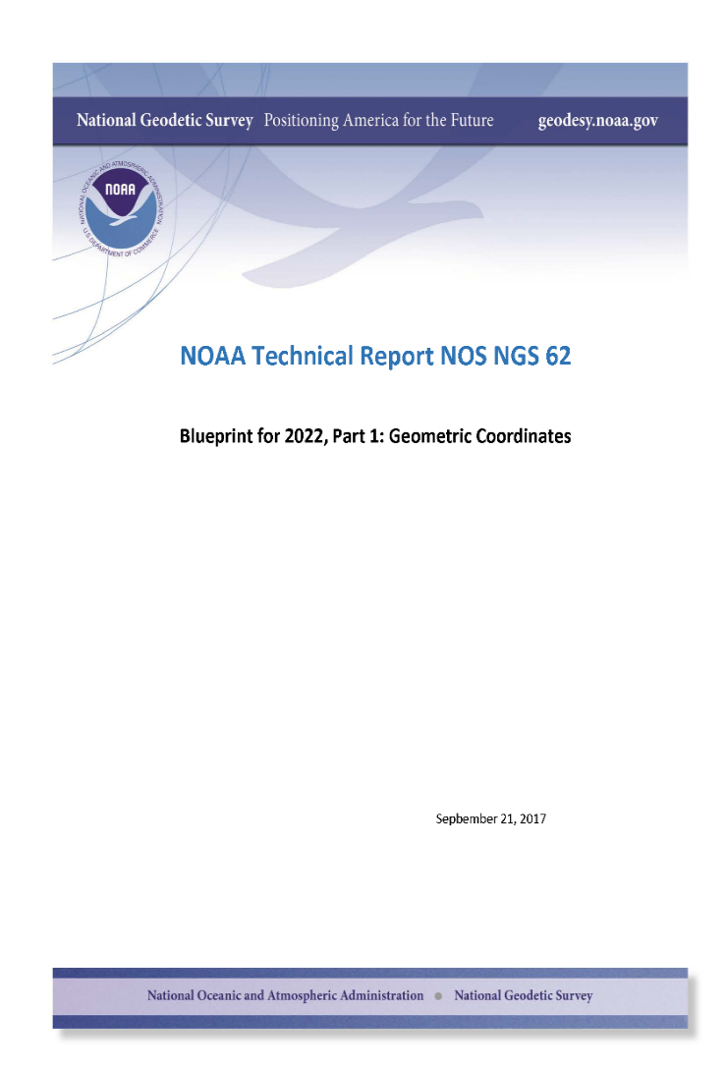
Blueprint Part 1
Tied to most recent ITRF
Epoch date – likely 2020.0
Four regions : North America, Pacific, Caribbean and Mariana
At epoch date, all TRF = ITRF
Then TRF’s rotate about EPP
Velocity models describe motion in each frame
Access via OPUS tool

Slide 3
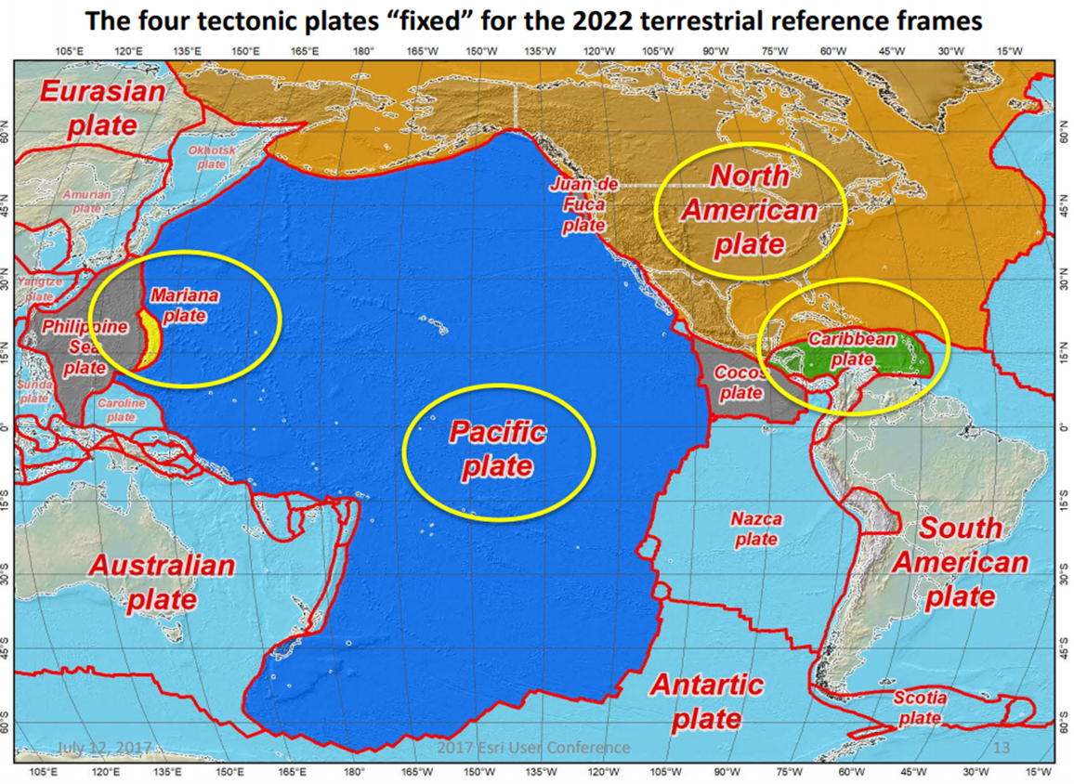
NSRS in 2022
Densified ITRF model
Control stations
  FCORS/IGS sites <=> ITRF
  Subset chosen for EPP
Four Frames after EPP
  CATRF (w/SIRGAS)
  MATRF (~ w/GGIM-AP/C.S.)
  PATRF (w/GGIM-AP)
  NATRF (IAG 1.3c/SNARF 2.0)
Intra-Frame Velocity Models
Notes:
We have four plates/regions in which we are involved

Slide 4
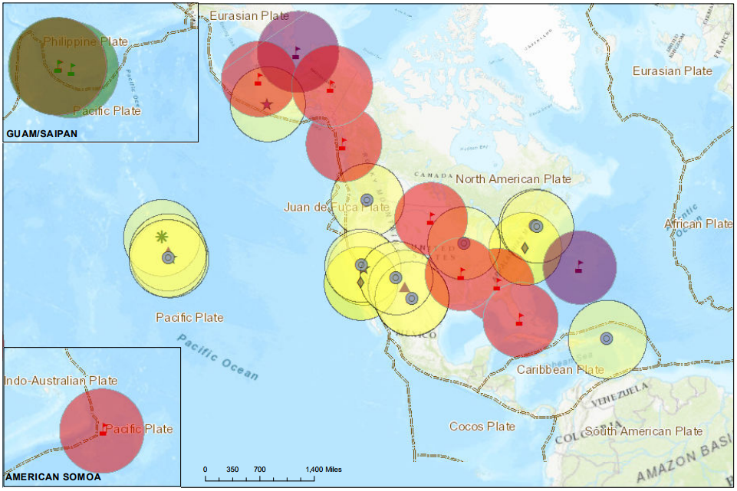
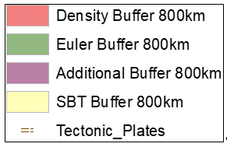
Collocated + Density + Euler + Additional
Notes:
Plenty of sites are available.
Guam/CNMI is a unique issue but one we’re moving forward on with recent work
The Pacific has nominally enough for the EPP but we’ll collaborate with GGIM-AP to make it more robust (use of IGS sites)
NA has plenty of options
However, only site exists on the Caribbean
Plenty of other stations exist, but we necessarily want them to be
in a stable region – eliminates boundary sites (the most numerous)
have demonstrated stability
have a time series of several years
not have too many gaps (though this would be mitigated by adoption as FCORS through a MOA)

Slide 5
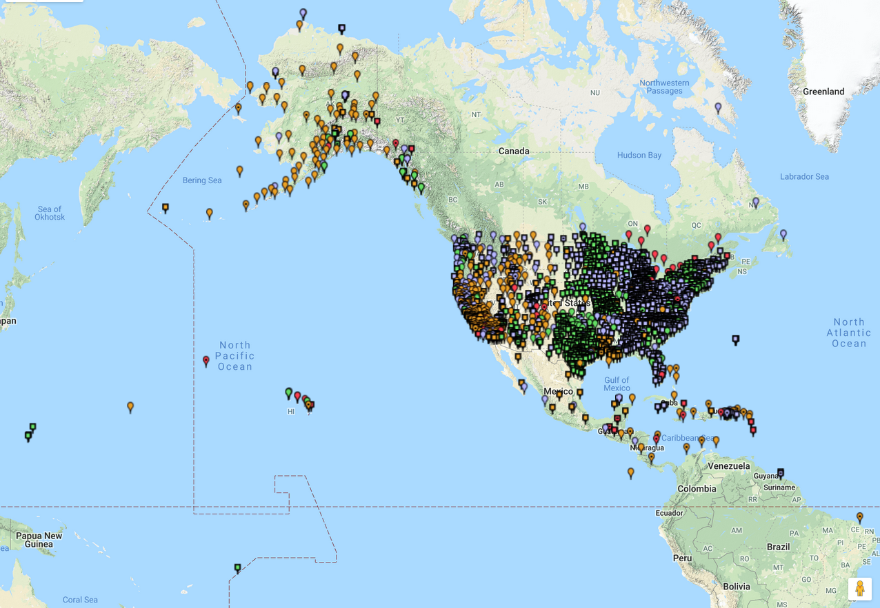
NGS CORS Network

Slide 6
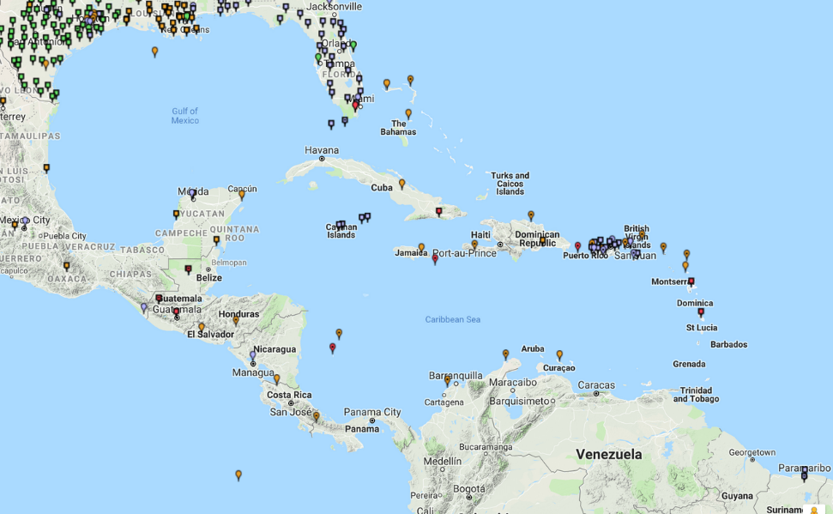
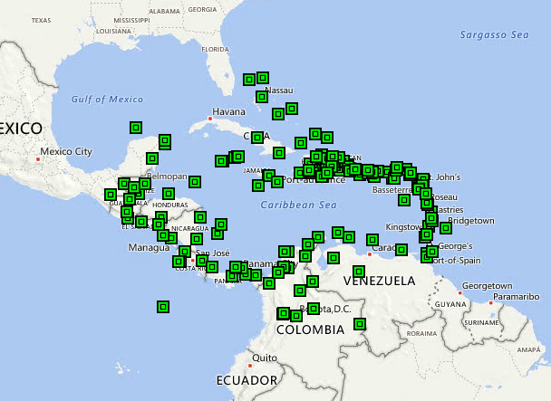
CATRF
CORS-Caribbean
COCONet

Slide 7
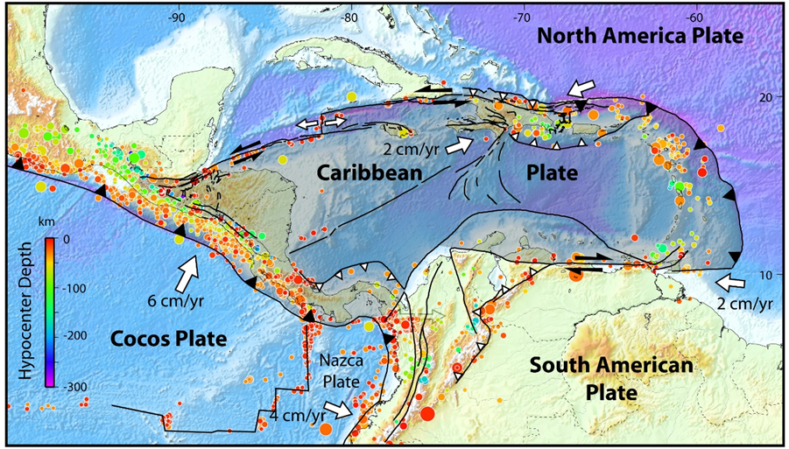
Structure (DEMETS 2007)
Notes:
Much work on determining geologic stability already exists.
However, the more stable regions typically don’t have many islands and, therefore, available cGNSS stations in these regions.
With St. Croix in he east, another station in the west and one near the middle would be optimal.

Slide 8
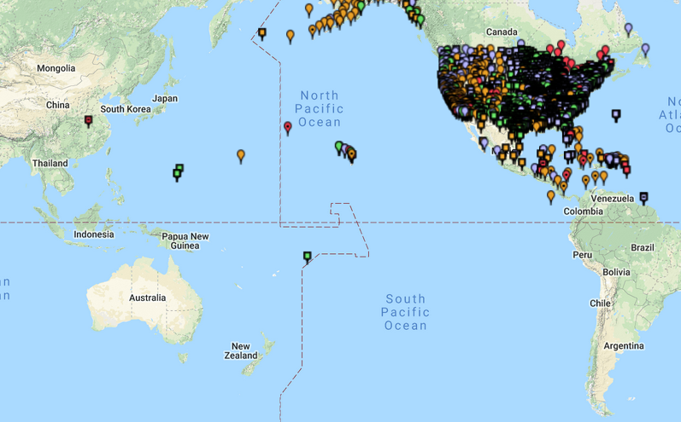
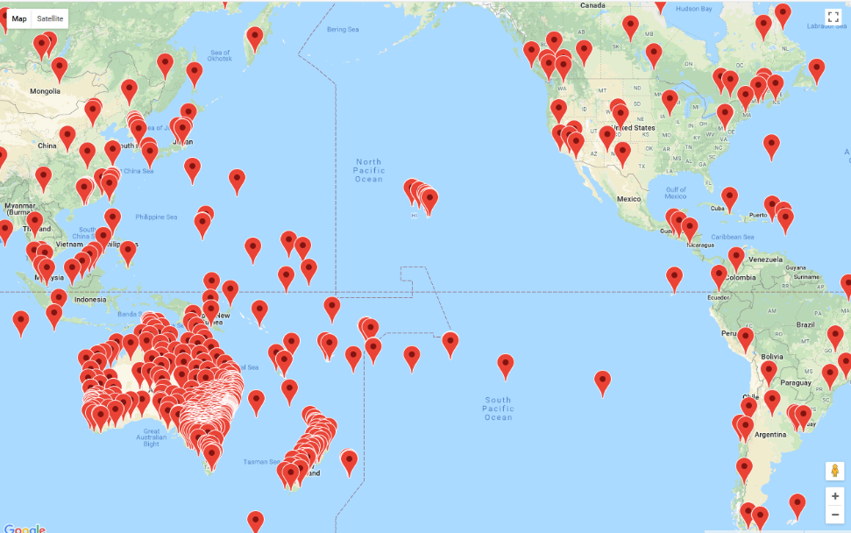
PATRF/MATRF
CORS-Pacific
APREF (Geosciences Australia)

Slide 9
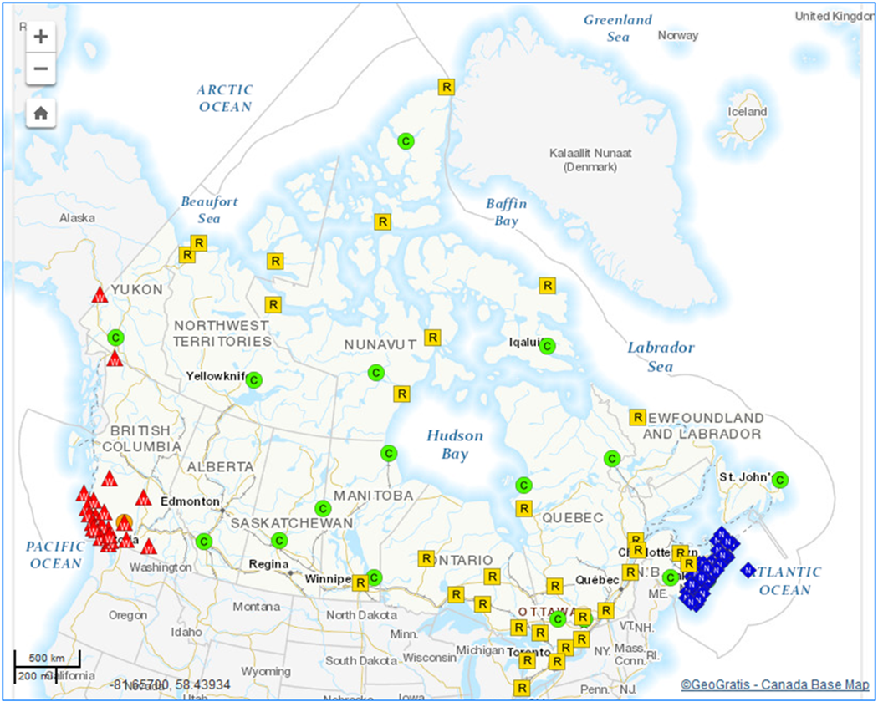
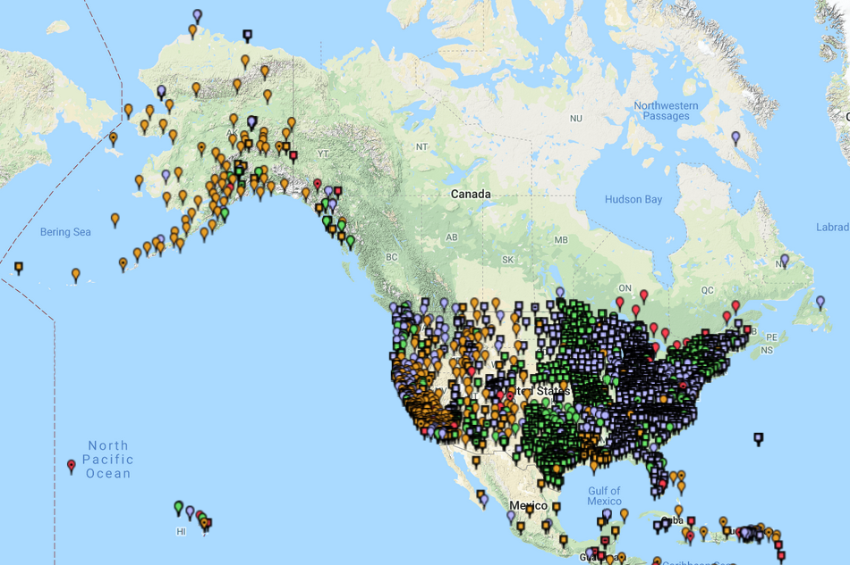
NATRF
CORS-North America
CACS

Slide 10
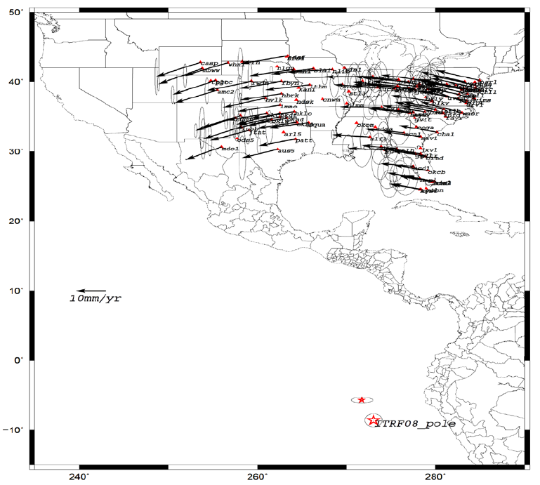
What’s Needed for NATRF 2022?
Each frame will get 3 parameters
  Euler Pole Latitude
  Euler Pole Longitude
  Rotation rate (rad/yr)
Used to compute time-dependent TRF2022 coordinates from time-dependent ITRF coordinates
To calculate a Stable North America Reference Frame, you need “stable” points

Slide 11
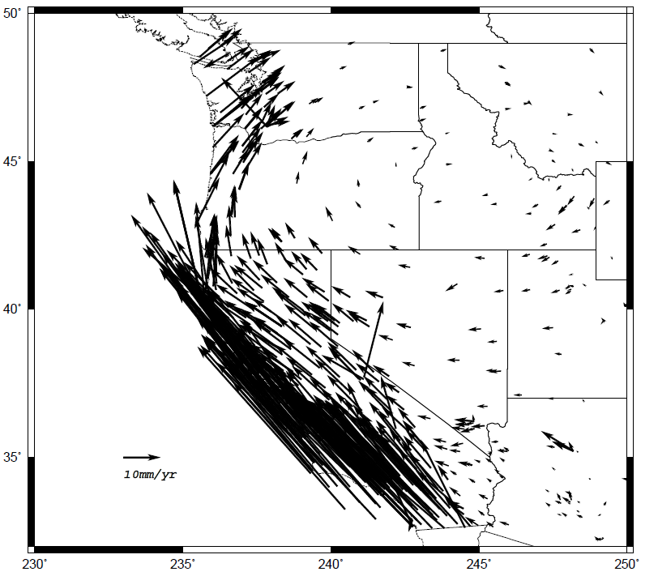
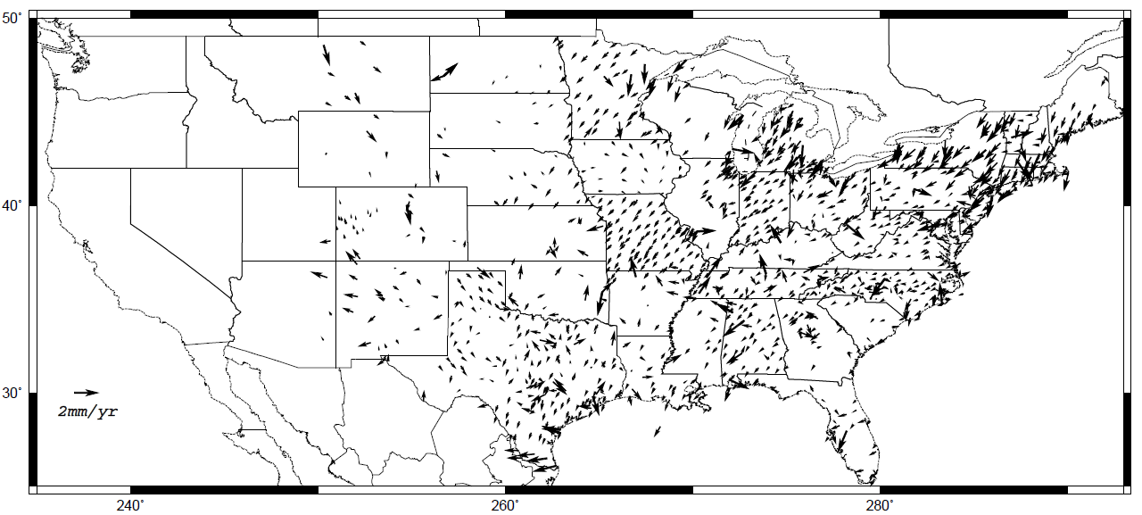
Horizontal velocities after Repro1
Residuals after ITRF2008 rotation removed
Note scale difference between West (10 mm/yr) and east (2 mm/yr)
Note also residual motion towards GIA uplift region

Slide 12
Summary
Coordination is necessary for four plates
Supplemental data available via collaboration
  CATRF – UNAVCO/SIRGAS/Others
  MATRF – largely handled by Campaign Surveys
    Too few CORS at this time
  PATRF – APREF
  NATRF – CACS network and possibly Mexico/Cuba
    NATRF problematic because of convolution of GIA and plate rotation

