Slide 1
Geodetic Capacity Development
UN Subcommittee on Geodesy
Working Group on Education, Training and Capacity Development
Dr. Daniel Roman, Chair

Slide 2

Reference Frame Competency Survey – 2018
A summary of the results and findings from the 2018 Survey was published at FIG 2020 WW Amsterdam
“A Global Survey of Reference Frame Competency in terms of Education, Training and Capacity Building (ETCB): Results, Analysis and Update”
  Ryan Keenan (Australia), Allison Craddock (USA), Mikael Lilje (Sweden), Rob Sarib (Australia) and Demian Gomez (USA)
https://www.fig.net/resources/proceedings/fig_proceedings/fig2020/papers/ts02g/TS02 G_keenan_craddock_et_al_10753.pdf

Slide 3

Reference Frame Competency Survey – 2021
A summary of the results and findings from the 2021 Survey was published at FIG 2023 WW Orlando
“A Global Survey of Reference Frame Competency in terms of Education, Training and Capacity Building (ETCB): Results, Analysis and Update’
  Ryan Keenan (Australia), Allison Craddock (USA), Mikael Lilje (Sweden), Robert Sarib (Australia) and Graeme Blick (New Zealand)
https://www.fig.net/resources/proceedings/fig_proceedings/fig2023/papers/ts05g/TS05G_keenan_craddock_et_al_12230.pdf

Slide 4

Reference Frame Competency Survey – 2018
Key Takeaways:
Majority aimed to increase their competencies
by at least 1 level within the next 3 years
Very strong need for continued ETCB contributions from developed countries
Very strong support for a global facilitator of all ETCB resources (e.g. proposed GGCE)
More insights needed into the current (and target) competencies across the UN-GGIM Regions

Slide 5
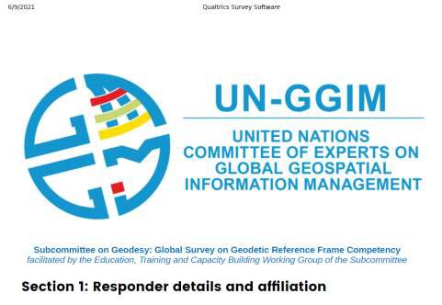
Reference Frame Competency Survey – 2021
ETCB WG created an updated Survey
  To better understand regional ‘Geodetic
Capacity Development’ needs
  What competencies are already possessed? What will needed for the future?
Invite sent to all UN-GGIM Regions in June 2021
  Motivation for 2021 Survey and Who-How- Why they should respond
  Deadline end of Feb 2022

Slide 6
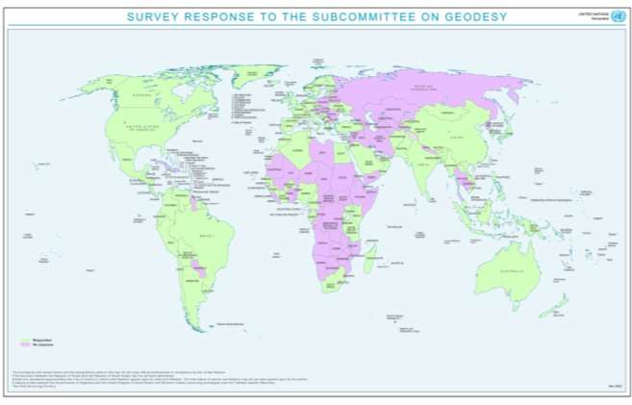
Survey 2021 – Preliminary Results I
Increased responses and details
RFC SURVEY | 2018 | 2021
No. of Questions | 28 | 66
No. of Responses | 98 | 207
No. of Member States | 65 | 101
Deeper insights into the current competencies, qualifications and skill sets of the respondents

Slide 7
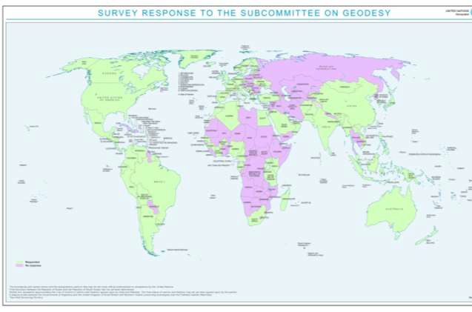
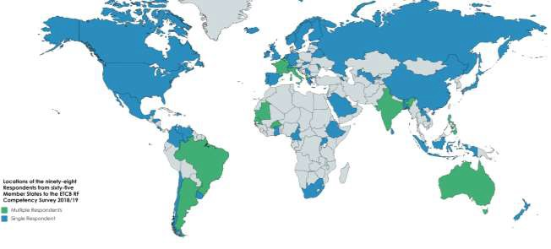
Survey 2021
Survey 2018

Slide 8
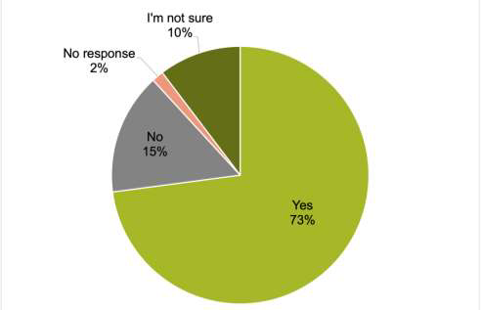
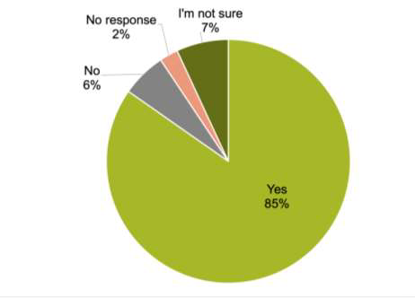
Survey 2021 – Preliminary Results II – Reference Frames
Geocentric Reference Frame on ITRF? • National Vertical Reference Frame?

Slide 9
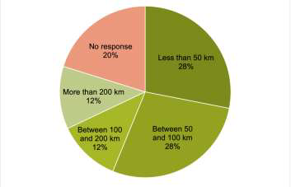
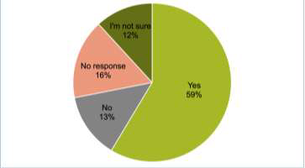
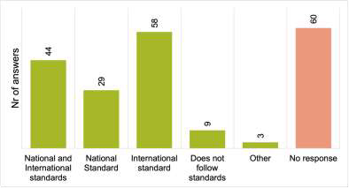
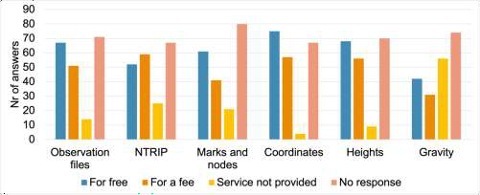
Survey 2021 – Preliminary Results III – CORS Infrastructure
CORS
Presence?
 |  | CORS Spacing?
CORS Service | s?
CORS
Standards?

Slide 10
Survey 2021 – Major Findings
Continued agreement with 2018 Survey
Clear need for sustained GGRF
Challenges in maintaining capability and capacity, resources (human & fiscal)
Clear need of developing nations to receive assistance ETCB / knowledge transfer from Developed nations
CC (Capacity & Capability) should be part of a CADP (Country Action Development Plan)

Slide 11
Next Steps for These Analyses … and Beyond
Findings & Results will be shared with SCoG in support of their Strategy for ensuring GGRF sustainability
Expectations that the GGCE can facilitate and further action some findings
Final Report expected in 2024 Q1
  ?Presentation to UN SCoG 2024?
  ?Presentation at FIG WW 2024 Accra?
While these analyses will continue, new factors are changing roles and activities …
Ultimately ‘making Geodetic Capacity Development’ FAIR
(findable, accessible, interoperable and reusable)

Slide 12
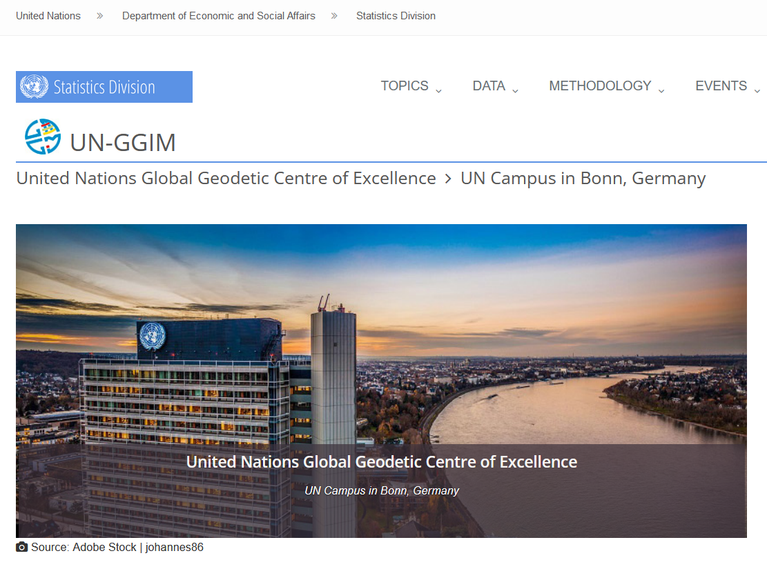
UN Global Geodetic Centre of Excellence (UN GGCE)
Overarching goal
  to assist Member States & geodetic organizations
  to coordinate and collaborate
  to sustain, enhance, access & utilize an accurate, accessible and sustainable GGRF
  to support science, society & global development
The objective is to support, within available resources, the implementation of General Assembly resolution 69/266 (UN GGRF)
Strengthening and advancing:
  Global geodetic cooperation and coordination;
  Worldwide geodetic infrastructure;
  Standards and policies;
  Education, training and capacity development;
  Communication and awareness.

Slide 13
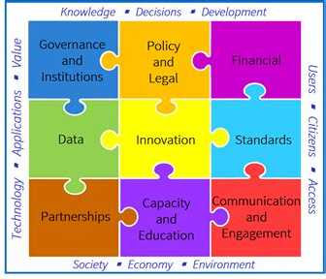
UN SCoG WG Actions – Joint with IAG and FIG
Global Geodesy Needs Assessment
  Global/regional needs vs IGIF Strategic Pathways
State of Geodesy Report
  Geodesy contributions at global/regional
Support the UN GGCE
  Global Geodesy Development Plan
Support and promote sustainable GGRF
  Global coordination, coherence, and partnerships
Raise awareness & advocate for global geodesy
Engage in capacity & capability development
Develop branding and communicate
Governance Technology People
Notes:
There are now three WG’s within the Subcommittee supporting these seven strategic activities:
Global Geodesy Needs Assessment is led by Laila Løvhøiden
State of Geodesy Report is led by Zuheir Altamimi
I lead the The Education and Capacity Development WG, which will focus on 4, 5, 6 and 7
All three support and interact with the GGCE
The major attribute for success in the Subcommittee is ts distributed membership – we draw from all the RC’s
Hence, we netowrk at the regional levels and can bring information between the GGCE, the RC’s, and regional organizations

Slide 14
UN SCoG - Global to Regional Relationships
Coordinates globally with UN GGIM, IAG, FIG, ISO, OGC, GEO, etc.
  Overlapping mission areas – need to examine what is missed
Works with regional Geodetic Reference Frame working groups
  GRFA in UN GGIM Americas
Works with regional bodies focused on geodesy
  APREG, SIRGAS, NAREF, etc.
Part of governance mandate to coordinate efforts and minimize overlap of support to maximize capacity development
Surveys to national reps on geodetic infrastructure, training, education needs
Will coordinate work with GGCE, which will maintain operational picture

Slide 15
Acknowledgements | Questions | Contacts
The authors acknowledge:
  Respondents for their time, constructive feedback and contribution to the survey
  All groups involved with UN-GGIM SCoG and GGCE working to realise the vision of a sustainable and reliable GGRF.
Contacts:
Ryan Keenan (ryan.keenan@me.com)
Rob Sarib (rob.sarib@gmail.com)
Dan Roman (dan.roman@noaa.gov)
Allison Craddock (craddock@igs.org) Mikael Lilje (mikael.lilje@lm.se)
Notes:
Also note that there will be another presentation touching on these issues later today:
Session 4: The Global Geodesy Development Plan
15:45 –16:30 Subcommittee on Geodesy, the UN-GGCE and the Global Geodesy Needs Assessment Teo CheeHai (UN DESA)

