Slide 1

NSRS Modernization Overview:
Blueprint Part 1: Geometric Coordinates
Dan Roman
Chief Geodesist
NOAA’s National Geodetic Survey

Slide 2
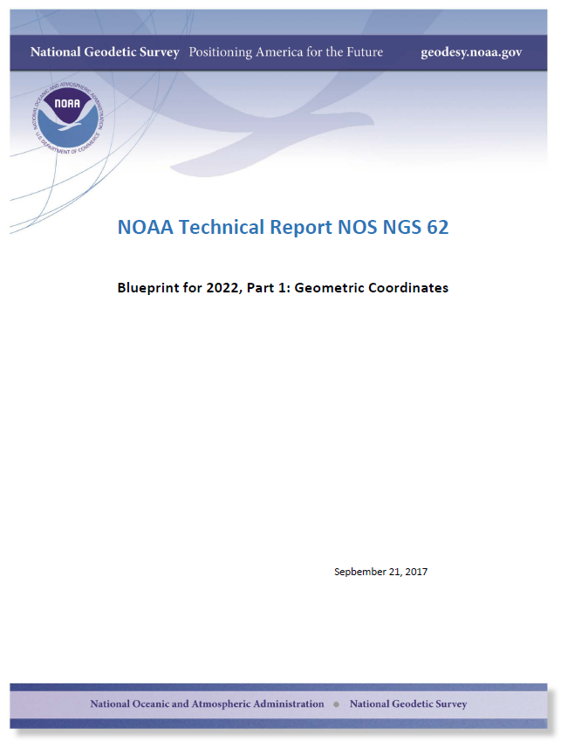
Overview
Why replace NAD 83?
What’s being replaced?
Four Terrestrial Reference Frames (TRFs)
Intra-Frame Velocity Model (IFVM)
Summary

Slide 3
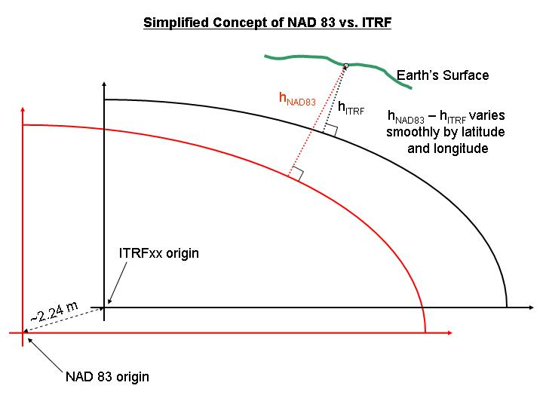
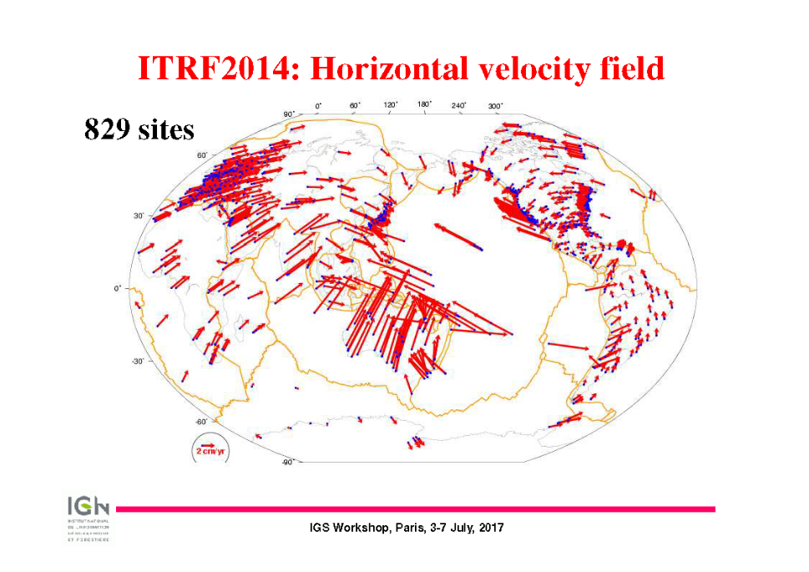
Why?
Non-Geocentricity
Dynamism
Altamimi
Notes:
WGS-84 iterated closer to ITRF – both are now 2+ meters from NAD 83
Fixing this will remove ambiguities in positioning dependent on reference frame
NAD 83 is static while the Earth is not
All plates are moving w.r.t. the frame and each other.
Image also on ly shows the horizontal motion and doesn’t capture any vertical motion

Slide 4
NSRS Modernization
The New:
The North American Terrestrial Reference Frame of 2022
(NATRF2022)
The Caribbean Terrestrial Reference Frame of 2022
(CATRF2022)
The Pacific Terrestrial Reference Frame of 2022
(PATRF2022)
The Mariana Terrestrial Reference Frame of 2022
(MATRF2022)
The Old:
NAD 83(2011)
NAD 83(PA11)
NAD 83(MA11)
EPP2022 (NA)
EPP2022 (CA)
Densified
ITRF2014
EPP2022 (PA)
EPP2022 (MA)
Notes:
ITRF2014 as of now …

Slide 5
Reference Frames
The NSRS in 2022 will contain four terrestrial reference frames
  Each one related to a densified International Terrestrial Reference Frame (ITRF) by a plate rotation model only
    Plate rotations determine Euler Pole Parameters (EPP2022)
    EPP will be defined separately for each plate
    This will leave residual velocities
    EPP will capture significant horizontal motion but not all
    EPP cannot account for any vertical motion (e.g., subsidence)
  NGS will model those residual velocities in an Intra-Frame Velocity Model (IFVM)
    This approach will facilitate work over/near plate boundaries
    Linear relationship between ITRF velocities, EPP rotation and IFVM:
    ITRF = EPP(NA) + IFVM(NA) = EPP(CA) + IFVM(CA)
    = EPP(PA) + IFVM(PA) = EPP(MA) + IFVM(MA)
    The absolute velocity can be described equally by all the above
EPP
ITRF
IFVM

Slide 6
The relation of five global reference frames through time.
Rotations are not to scale
NATRF2022
MATRF2022
Rotation of North American Plate
CATRF2022
PATRF2022
Rotation of Pacific Plate
ITRF frame
IGS frame through time
ITRF frame
Rotation of Caribbean Plate
PATRF2022
CATRF2022
Rotation of Mariana Plate
NATRF2022
Time “t ” when
all four TRFs and the
IGS are identical.
(2020.00)
MATRF2022
0
t=t - Δt
(“the past”)
t=t + Δt
(“the future”)
0
0

Slide 7
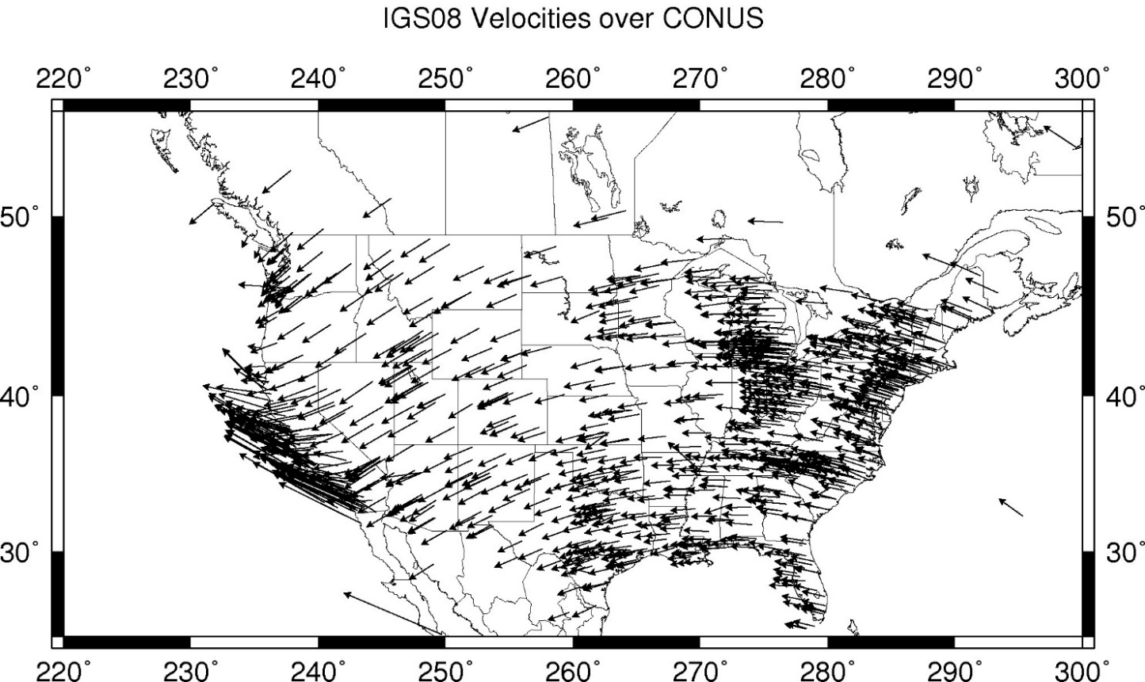
CORS Velocities – IGS08

Slide 8
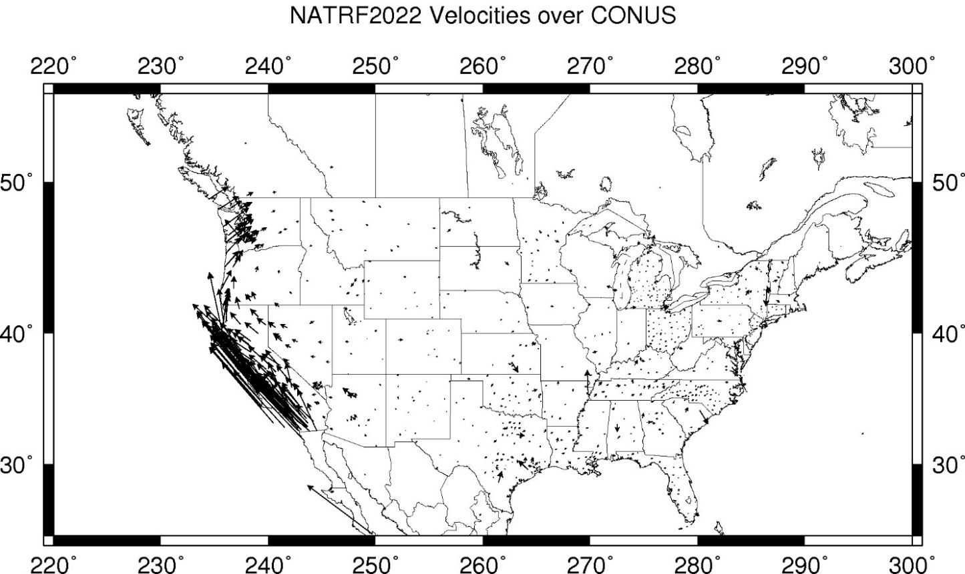
CORS Velocities – NATRF2022
Notes:
These velocities were arrived at by taking IGS08 velocities and removing the 3 parameter Euler Pole rotation of the North American plate as currently known (ITRF08 plate motion model).
These residual velocities will then be modeled into the IFVM for NATRF2022

Slide 9
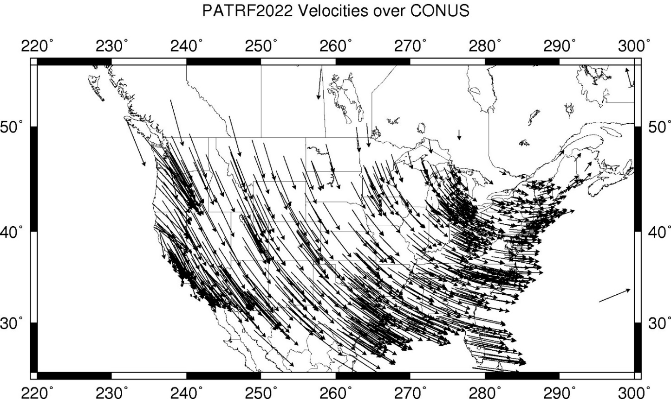
CORS Velocities – PATRF2022

Slide 10
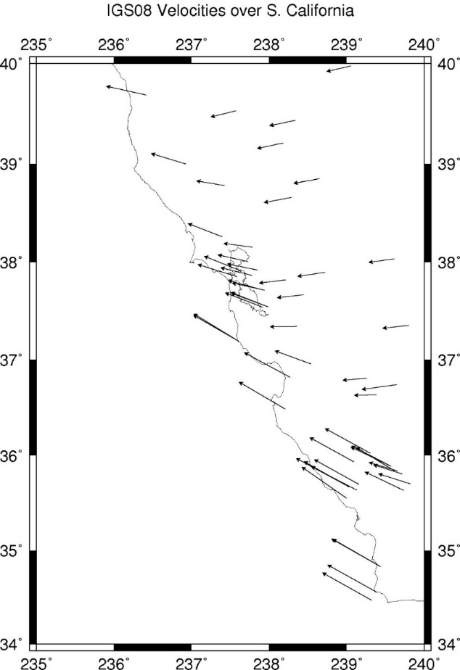
CORS Velocities – IGS08
Looking at West Coast more closely
Vectors in absolute frame vary
Not consistent with the bulk of NA vectors
Indicates there will be residual vectors

Slide 11
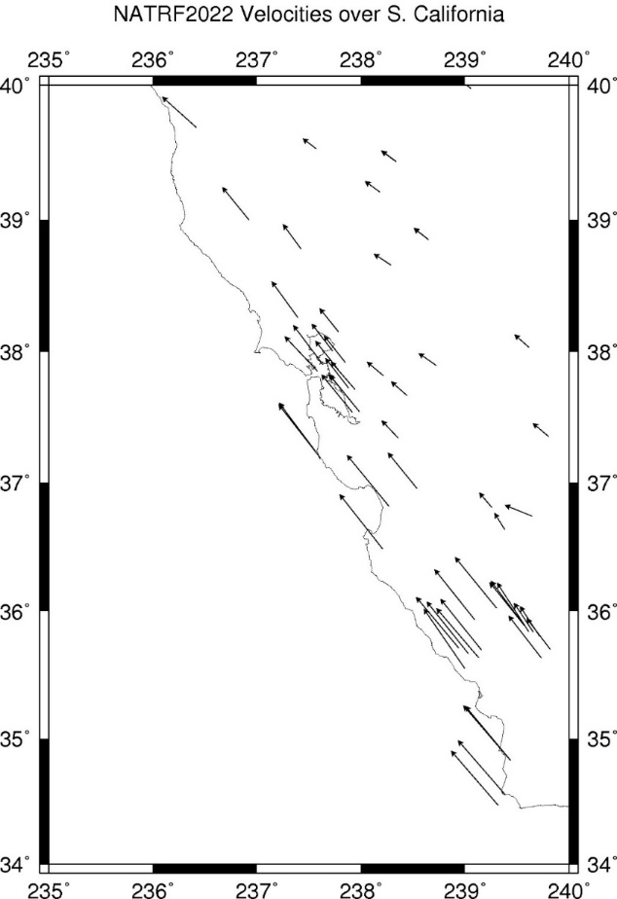
CORS Velocities – NATRF2022
Same as previous except now w.r.t. a North American Frame
Some residual velocities in interior
More significant residual velocities in southern California

Slide 12
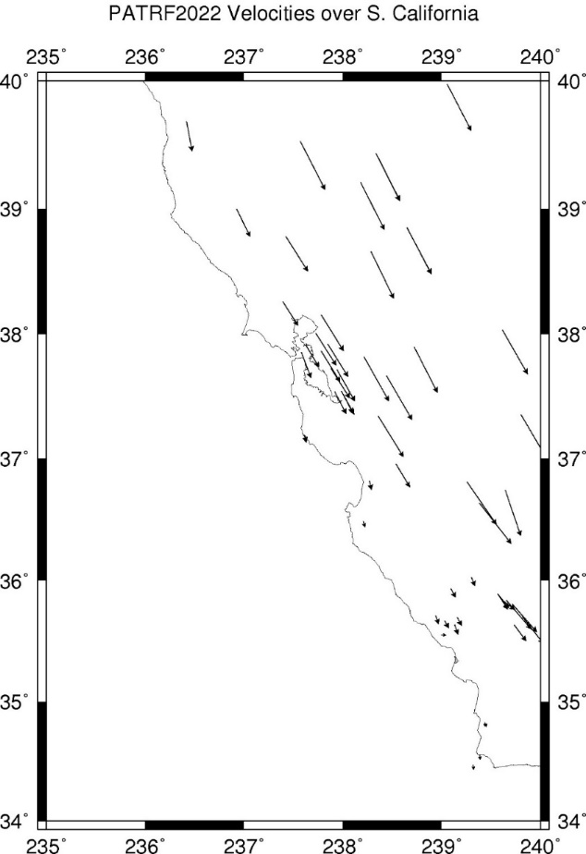
CORS Velocities – PATRF2022
Residual velocities now w.r.t. Pacific plate
More significant residual velocities in interior
Southern California has almost none

Slide 13
Modeling Considerations
EPP
IFVM
Computation is straight forward
Difficulty is what to include
Modeling from CORS or CORS-like data
Which to include?
  All?
  Selected?
  Exclude western sites (deformation)?
Not restricted to NA determination
  Caribbean has significant deformation
  Pacific has better but fewer sites
  Marianas is very difficult
IAG 1.3c WG focused on EPP determination
Aim of IFVM is to describe expected motion in between CORS through time
While EPP may seek to restrict, IFVM benefits from more inclusion:
  NOAA (NGS) CORS Network
  Other CORS Networks, cGNSS sites
    SIRGAS-CON, APREF
    SCGN, other RTN’s
  Geophysical modeling (akin to HTDP)
  InSAR (Sentinel-1, NISAR, etc.)
  All of the above?
Horizontal motion after EPP removed
All vertical motion
Signal: regional to continental scales

Slide 14
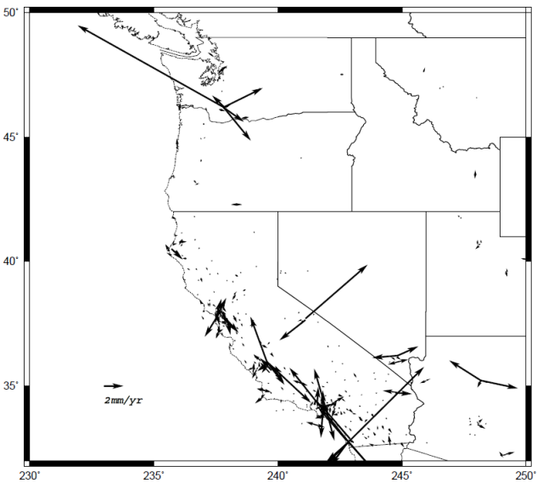
Can CORS alone serve as an IFVM?
Eastern CONUS will largely be resolved
It is “stable” and “monolithic” - only not really
Western CONUS has some more significant anomalies
Significant variability can occur between CORS

Slide 15
Summary
NAD 83 variants replaced in 2022
Position and motion are measured in absolute frame (ITRF)
EPP will be defined four plates:
North America, Caribbean, Pacific and Mariana
Removing the EPP’s results in the four new TRF’s:
NATRF, CATRF, PATRF, and MATRF, respectively
IFVM for each is the residual horizontal and all vertical motion
ITRF = EPP + IFVM
IFVM will require more detail than the NGS CORS Network
Possibly use other CORS Networks in between, geophysical models, and/or InSAR

Slide 16
Hold questions until the end.
Next up, Blueprint Part 2

Slide 17
Break

