Slide 1
Kick Off
May 10, 2015
Milestone #2
Jul 21
Milestone #5
Sign Off
Jan 30, 2016
Oct 30
Milestone #1
Checkpoint A
Milestone #3
Checkpoint B
Jun 7
Aug 12
Sep 20
Dec 20
2015
May
Jun
Jul
Aug
Sep
Oct
Nov
Dec
2016
2016
8 days
Today
Preparatory Phase
100
Jul 25 - Aug 1
24 days
Phase 1 Work Effort
100%
Aug 15 - Sep 7
34 days
Phase 2 Work Effort
80%
Aug 15 - Sep 17
23 days
Phase 3 Work Effort
60%
Sep 8 - Sep 30
35 days
Testing Phase
Oct 4 - Nov 7
31 days
Delivery Phase
Nov 11 - Dec 11

Slide 2
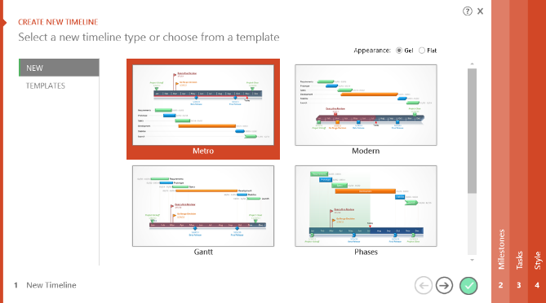

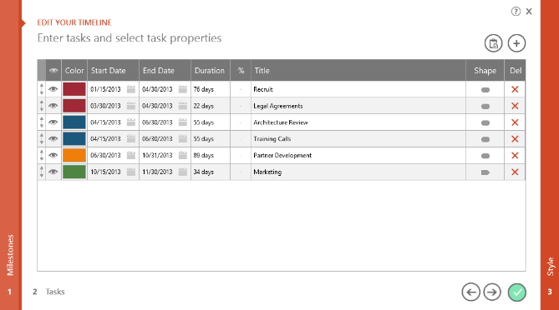
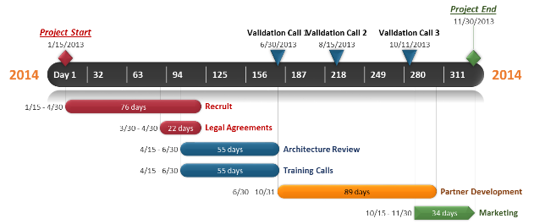
To change and update this template automatically,
download the free Office Timeline PowerPoint add-in!
Office Timeline is a free, award winning, timeline maker that's really easy to use.
Simple, easy-to-use wizards.
Professional, quick results.
Built directly into PowerPoint

