Slide 1

NSRS Modernization
PLSO Western Reserve Chapter
December 2019
Jeff Jalbrzikowski, P.S., GISP
Appalachian Regional Geodetic Advisor
jeff.jalbrzikowski@noaa.gov
240-988-5486

Slide 2
My Background
Licensed Surveyor in OH, PA, and WV
Certified GIS Professional
University of Akron graduate
Came to NGS from USACE (Pittsburgh, PA)
  primary experience is engineering surveys, including structural deformation, hydrographic/bathymetric, terrestrial LiDAR, GNSS control, local/legacy datum resolution
  previously survey intern, Cadastral Surveyor, GIS Technician, warehouse picker/packer, busboy…

Slide 3
Have you already heard that NAD83 and NAVD88 are scheduled to be replaced?
Who’s nervous?
Who’s ready?
Who’s already working in ITRF?

Slide 4



Organizational Structure
Federal Government – Executive Branch
  -Department of Commerce (DoC)
  (~47,000 employees)
  -National Oceanic and Atmospheric Administration (NOAA)
  -National Ocean Service (NOS)
  -National Geodetic Survey (NGS)
  (~175 employees)

Slide 5
NGS Mission
To define, maintain and provide access to the National Spatial Reference System (NSRS) to meet our Nation’s economic, social, and environmental needs.

Slide 6
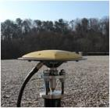
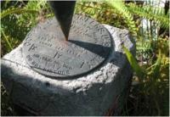

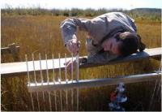
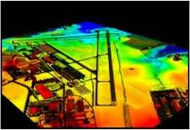
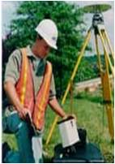
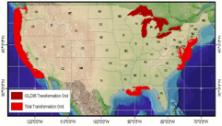
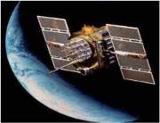
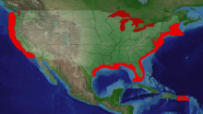
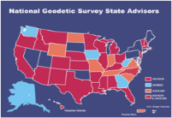
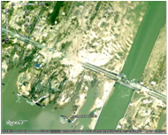
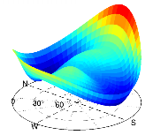
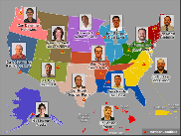
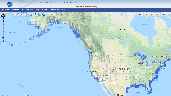
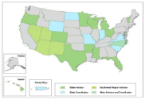
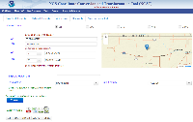
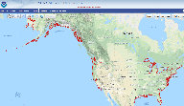
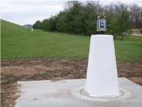
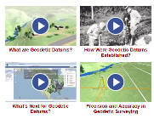
NGS Overview
Modernizing the NSRS
CORS
NHMP
GRAV-D
ECO
NGS Products and Services
ASP
OPUS
VDatum
Orbit Data
National Shoreline
Geodetic Advisors
ERI
Antenna Calibrations
NCAT
CUSP
CBL
Outreach/COMET

Slide 7
NGS Overview
Modernizing the NSRS
CORS
NHMP
GRAV-D
ECO
NGS Products and Services
ASP
OPUS
VDatum
Orbit Data
National Shoreline
Geodetic Advisors
ERI
Antenna Calibrations
NCAT
CUSP
CBL
Outreach/COMET

Slide 8
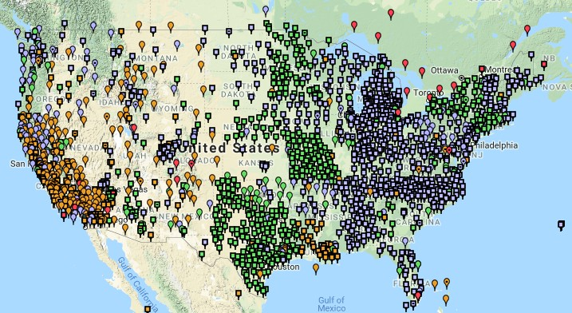
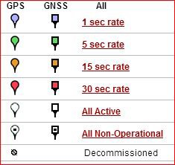
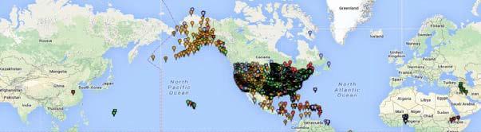
Continuously Operating Reference Station (CORS)
2000+ sites
~225 organizations

Slide 9
NOAA CORS Network (NCN)
2000+ sites
~225 organizations

Slide 10
NGS Overview
Modernizing the NSRS
CORS
NHMP
GRAV-D
ECO
NGS Products and Services
ASP
OPUS
VDatum
Orbit Data
National Shoreline
Geodetic Advisors
ERI
Antenna Calibrations
NCAT
CUSP
CBL
Outreach/COMET

Slide 11
National Height Modernization Program
…the establishment of accurate, reliable heights using GNSS technology in conjunction with traditional leveling, gravity, and modern remote sensing information…
-propagation and long-term monitoring (for subsidence) of control thru static GPS campaigns, GPS on BMs, digital leveling
-combined with relative gravity data, LiDAR, etc

Slide 12
National Height Modernization Program
Participating and Interested States
States engaged in HM without federal funding assistance
Spatial Reference Centers
Regional Leaders
Other funded partners
Current Funded Partners

Slide 13
National Height Modernization Program
supports various non-NGS Federal Programs
  FEMA: FIRMs, ECs, etc.
  USACE: Levee/Dam Safety Programs, etc.
and countless non-Federal programs
still an active program but there have not been any grants in a few years

Slide 14
NGS Overview
Modernizing the NSRS
CORS
NHMP
GRAV-D
ECO
NGS Products and Services
ASP
OPUS
VDatum
Orbit Data
National Shoreline
Geodetic Advisors
ERI
Antenna Calibrations
NCAT
CUSP
CBL
Outreach/COMET

Slide 15
Gravity for the Redefinition of the American Vertical Datum
Two major campaigns within GRAV-D
High-resolution snapshot of gravity
  primarily airborne observations, all relative gravity, estimated cost of ~$39 million
Low-resolution “movie” of gravity changes
  primarily terrestrial, episodic observations of absolute gravity sites

Slide 16
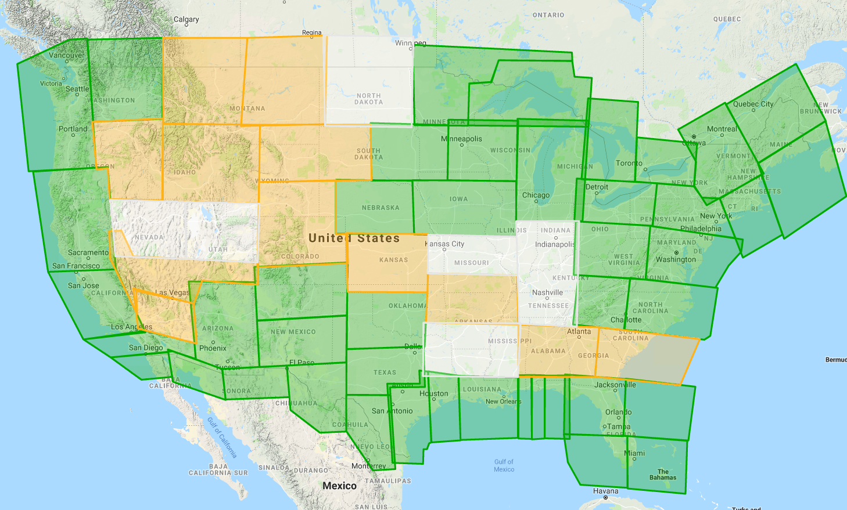
Gravity for the Redefinition of the American Vertical Datum
Green = Complete
Blue = In Processing
Yellow = Underway
White = Planned
10 km data lines
70 km cross lines
20,000 ft altitude
230 kt flight speed
As of AUG2019:
78% complete

Slide 17
NGS Overview
Modernizing the NSRS
CORS
NHMP
GRAV-D
ECO
NGS Products and Services
ASP
OPUS
VDatum
Orbit Data
National Shoreline
Geodetic Advisors
ERI
Antenna Calibrations
NCAT
CUSP
CBL
Outreach/COMET

Slide 18
Aeronautical Survey Program
Interagency Program with the FAA
  Primary Airport Control Station (PACS) and Secondary Airport Control Stations (SACS)
  Airports GIS (AGIS)
  Airport Obstruction Charts (AOC)
Primary function of NGS is to serve as QA and SME for airport surveys (of all types) that are contracted by airports

Slide 19
NGS Overview
Modernizing the NSRS
CORS
NHMP
GRAV-D
ECO
NGS Products and Services
ASP
OPUS
VDatum
Orbit Data
National Shoreline
Geodetic Advisors
ERI
Antenna Calibrations
NCAT
CUSP
CBL
Outreach/COMET

Slide 20
GPS Orbit Data aka Ephemerides
NGS orbit analysis and computation is performed together with, and as a component of, the International GNSS Service (IGS)
  IGS coordinates the collection of satellite tracking data
Designated with this responsibility by the Civil GPS Service Interface Committee (CGSIC)
If you’re using OPUS, it’s all behind-the-curtain

Slide 21
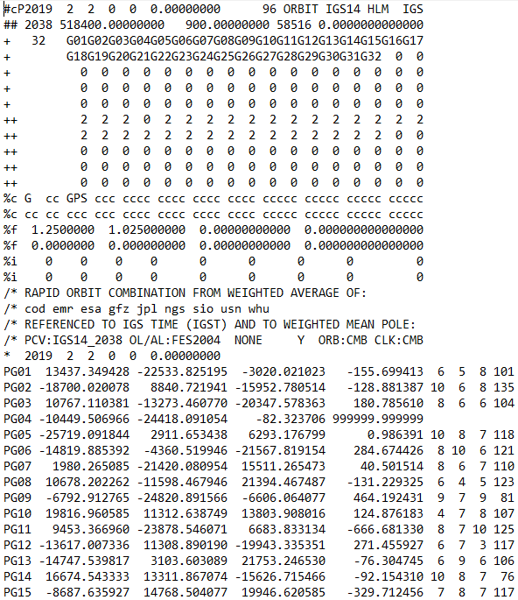
Link to NGS GPS Calendar

Slide 22
NGS Overview
Modernizing the NSRS
CORS
NHMP
GRAV-D
ECO
NGS Products and Services
ASP
OPUS
VDatum
Orbit Data
National Shoreline
Geodetic Advisors
ERI
Antenna Calibrations
NCAT
CUSP
CBL
Outreach/COMET

Slide 23
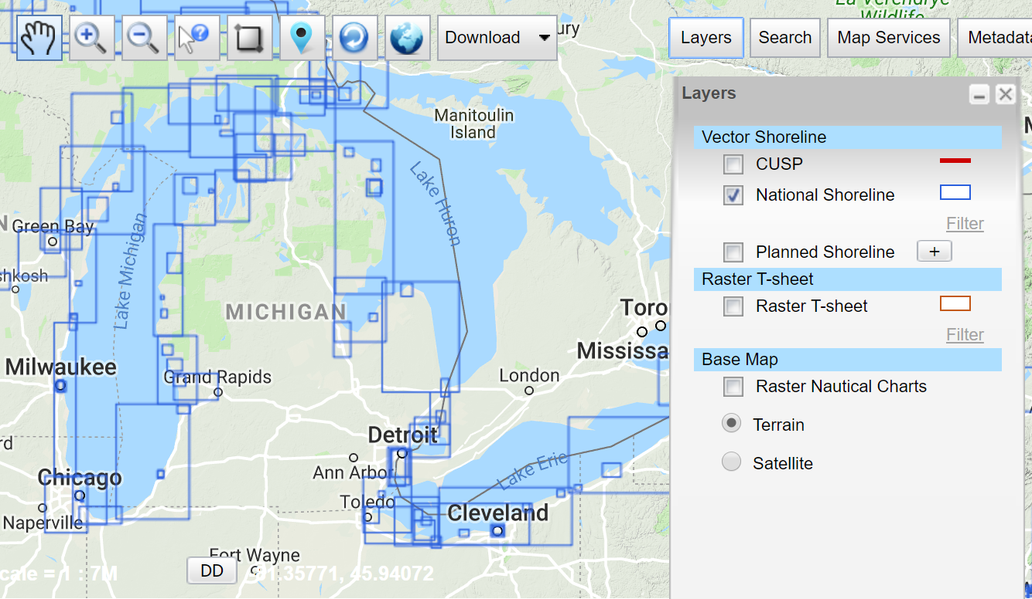
National Shoreline
The official national shoreline data, in support of NOAA nautical charting mission
Available for download as Shapefile in Mean High Water and Mean Lower Low Water datum
Organized by “Project Area”
hyperlink to the National Shoreline homepage

Slide 24
NGS Overview
Modernizing the NSRS
CORS
NHMP
GRAV-D
ECO
NGS Products and Services
ASP
OPUS
VDatum
Orbit Data
National Shoreline
Geodetic Advisors
ERI
Antenna Calibrations
NCAT
CUSP
CBL
Outreach/COMET

Slide 25
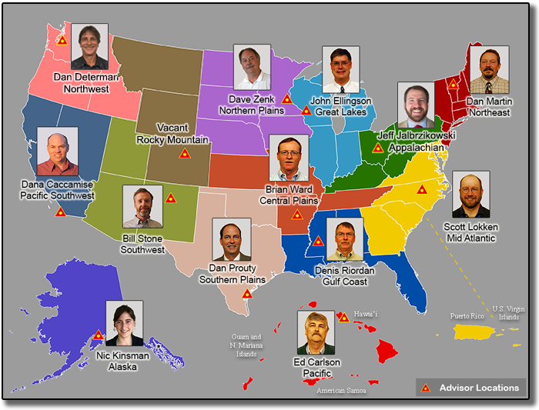
https://www.ngs.noaa.gov/ADVISORS/

Slide 26

Regional Geodetic Advisor Program
www.ngs.noaa.gov/ADVISORS/
query any major search engine: “ngs advisors”

Slide 27

State Geodetic Coordinators
not an NGS employee
a liaison between the State’s geospatial community and the NGS
Ray is here!

Slide 28
NGS Overview
Modernizing the NSRS
CORS
NHMP
GRAV-D
ECO
NGS Products and Services
ASP
OPUS
VDatum
Orbit Data
National Shoreline
Geodetic Advisors
ERI
Antenna Calibrations
NCAT
CUSP
CBL
Outreach/COMET

Slide 29
Emergency Response Imagery
Mission of the Remote Sensing Division
Pre-Storm and Post-Storm photos are taken along the coastal CONUS
Supports Homeland Security (DHS) and Emergency Response (FEMA, etc.) events

Slide 30
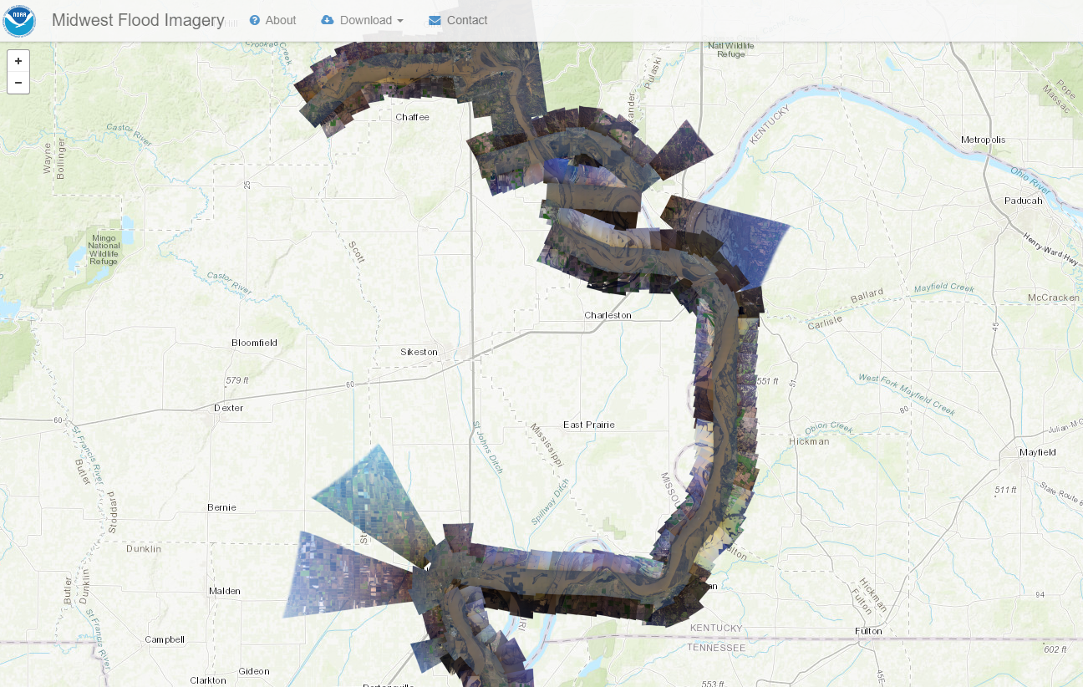
Emergency Response Imagery

Slide 31
NGS Overview
Modernizing the NSRS
CORS
NHMP
GRAV-D
ECO
NGS Products and Services
ASP
OPUS
VDatum
Orbit Data
National Shoreline
Geodetic Advisors
ERI
Antenna Calibrations
NCAT
CUSP
CBL
Outreach/COMET

Slide 32
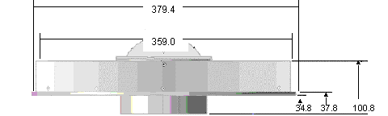
Phase Center Offset - conceptual
Orange dot = mean point of signal reception
Blue dot = Antenna Reference Point (ARP)
Red line = Phase Center Offset (PCO)

Slide 33
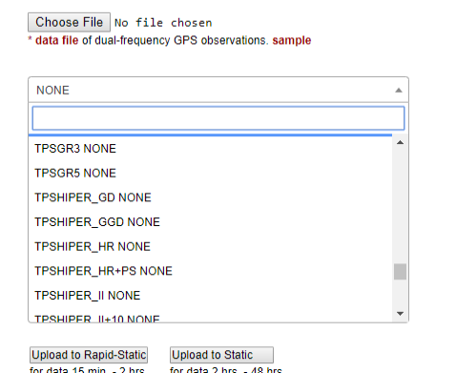
Phase Center Offset - conceptual
The PCO is one reason it is important to select the correct antenna for OPUS upload!

Slide 34
NGS Overview
Modernizing the NSRS
CORS
NHMP
GRAV-D
ECO
NGS Products and Services
ASP
OPUS
VDatum
Orbit Data
National Shoreline
Geodetic Advisors
ERI
Antenna Calibrations
NCAT
CUSP
CBL
Outreach/COMET

Slide 35
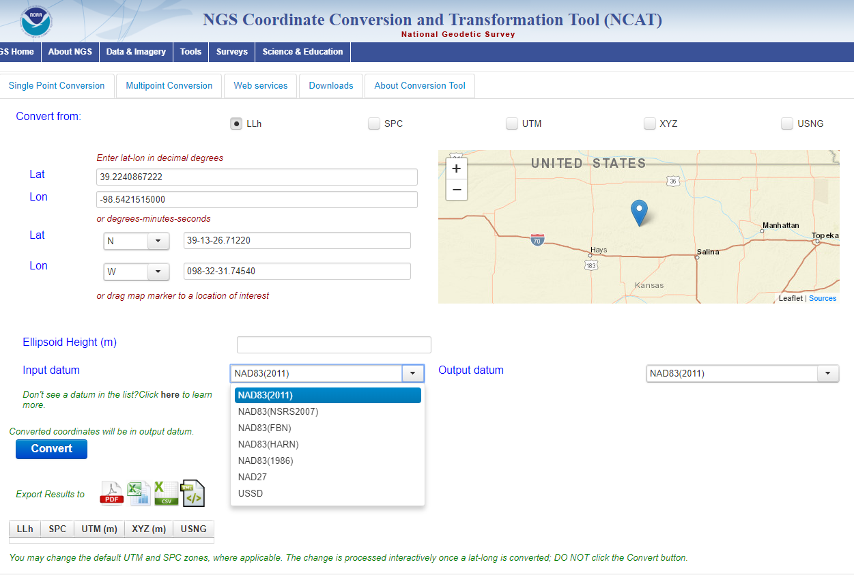
NGS Coordinate Conversion and Transformation Tool
NCAT

Slide 36
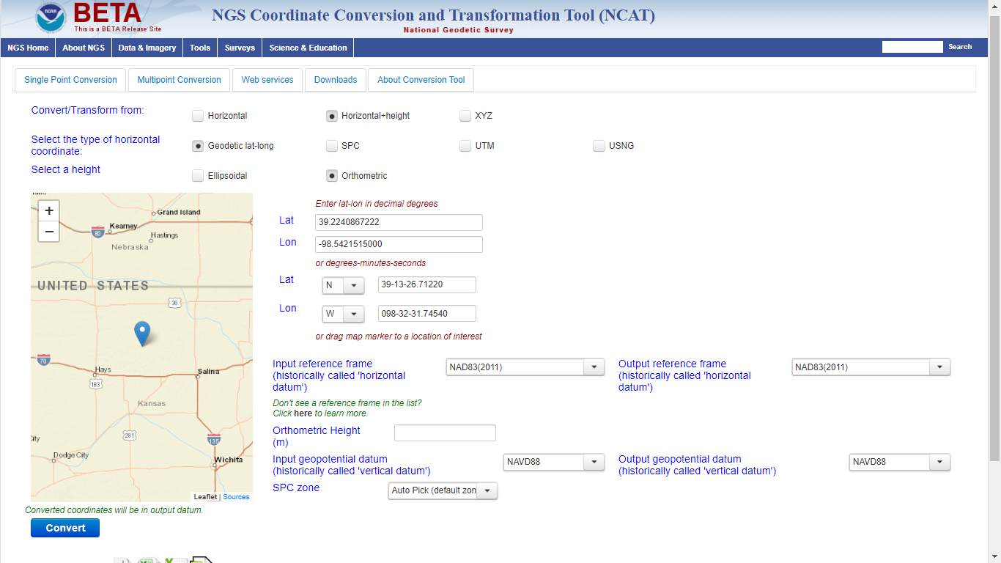
Beta NCAT – includes VERTCON 3.0 for NGVD29 to NAVD88 transformation

Slide 37
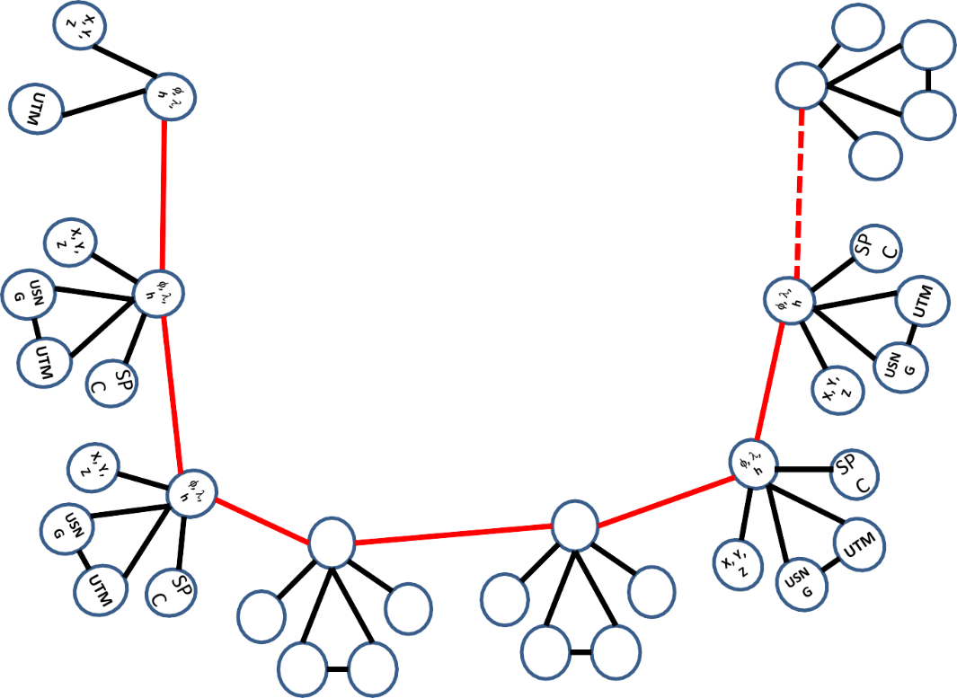
Coordinate Transformation Tool
SP
C
UTM
(NCAT / NADCON 5.0)
2022
φ, λ, h
USSD
USN
G
Relating coordinates: then & now
NAD 83 (2011)
X, Y,
Z
NAD 27
NAD 83 (NSRS2007)
NAD 83 (1986)
NAD 83 (FBN)
φ, λ, h
NAD 83 (HARN)
φ, λ, h
SP C
X, Y, Z
SP C
X, Y, Z
USN G
USN G
UTM
UTM

Slide 38
NGS Overview
Modernizing the NSRS
CORS
NHMP
GRAV-D
ECO
NGS Products and Services
ASP
OPUS
VDatum
Orbit Data
National Shoreline
Geodetic Advisors
ERI
Antenna Calibrations
NCAT
CUSP
CBL
Outreach/COMET

Slide 39
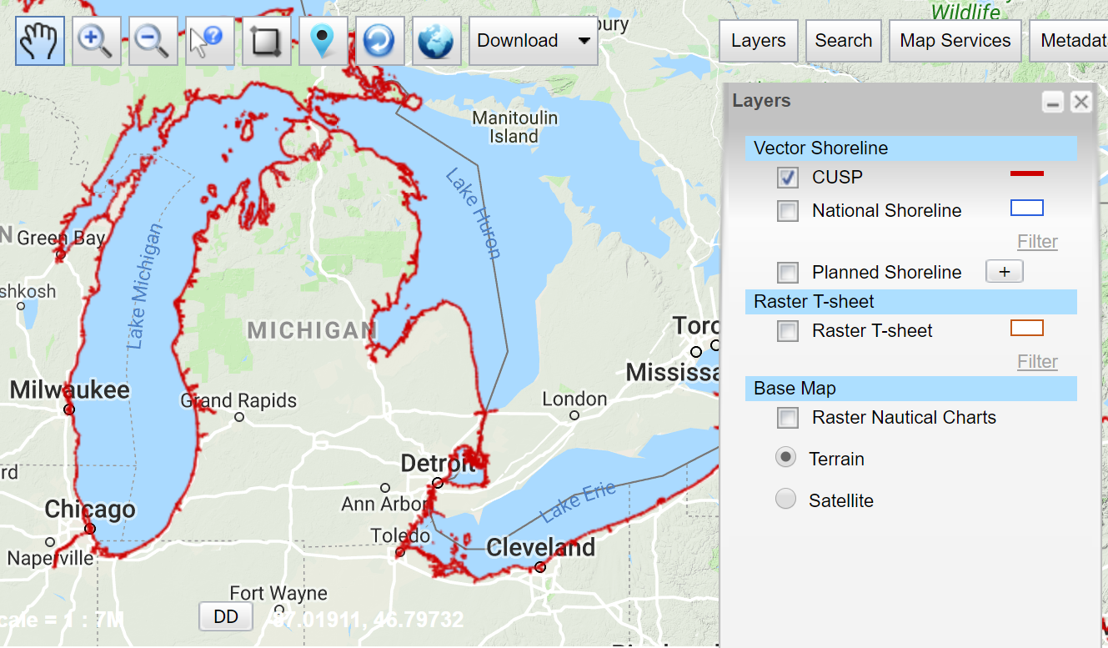
Continually Updated Shoreline Product
Just what it says, a dynamic product
Available for download as Shapefiles
Developed by image interpretation and/or vertical modeling using water level stations (tide or lake gages)
Referenced to a computed Mean High Water
hyperlink to the CUSP homepage

Slide 40
NGS Overview
Modernizing the NSRS
CORS
NHMP
GRAV-D
ECO
NGS Products and Services
ASP
OPUS
VDatum
Orbit Data
National Shoreline
Geodetic Advisors
ERI
Antenna Calibrations
NCAT
CUSP
CBL
Outreach/COMET

Slide 41
Calibration Base Lines
Three types of CBL defined by NGS
  Primary CBL (PCBL): in Woodford, VA at NGS TTC; it is open for use to organizations like the PLSO
  Federal CBL (FCBL): established with EDM checked at the NGS PCBL and IAW NOAA TM NGS-8
      13 across Ohio, 1 reported unstable condition in Defiance
  Cooperative CBL (CCBL): established with EDM checked on an FCBL and IAW that same NGS-8 manual

Slide 42
Calibration Base Lines
NGS commitment to the CBL Program:
  A minimum of one FCBL per State
  Establishment procedures document
  Public access to the CBL database
  Software to process your observations
  Verification and re-measurement data review
  Technical support (Advisors or other personnel)

Slide 43
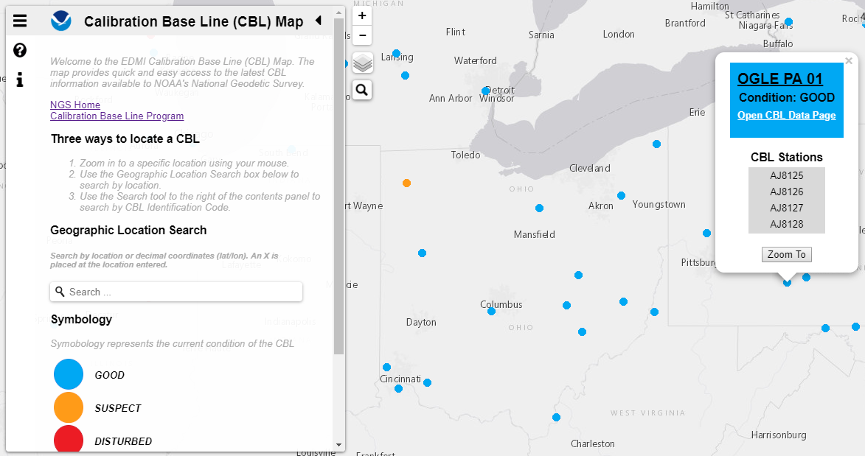
Beta CBL Map Viewer

Slide 44
NGS Overview
Modernizing the NSRS
CORS
NHMP
GRAV-D
ECO
NGS Products and Services
ASP
OPUS
VDatum
Orbit Data
National Shoreline
Geodetic Advisors
ERI
Antenna Calibrations
NCAT
CUSP
CBL
Outreach/COMET

Slide 45
Cooperative program for Operational Meteorology, Education, and Training
Meteorology… why?
The origin of the program was the National Weather Service, also a NOAA sub-agency.
It expanded to various NOAA missions, including NGS

Slide 46
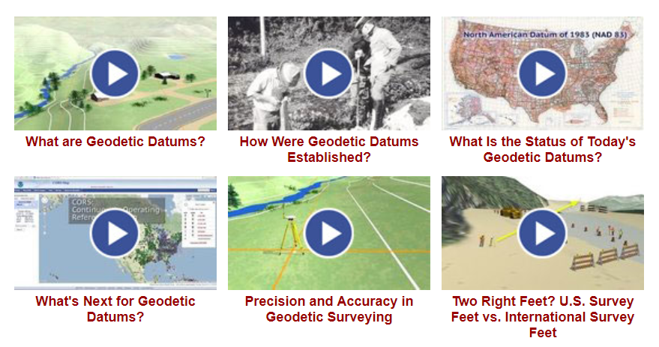
Outreach and COMET

Slide 47
NGS Mission
To define, maintain and provide access to the National Spatial Reference System (NSRS) to meet our Nation’s economic, social, and environmental needs.

Slide 48
National Spatial Reference System (NSRS)
A consistent coordinate system that defines
latitude
longitude
height
scale
orientation
gravity
throughout the United States.
…and their time variants

Slide 49
National Spatial Reference System (NSRS)
These items ARE part of the NSRS
Horizontal Datums (aka Geometric Reference Frames) | Vertical Datums | Great Lakes Datums | Geoid Models | Transformations and Conversions
NAD83 | NAVD88 | IGLD85 | GEOID18 | NADCON
NAD27 | NGVD29 | IGLD55 | GEOID12A & B | VERTCON
USSD | VIVD09 |  | GEOID09
 | GUVD04 |  | GEOID06 | SPCS83
 | NMVD03 |  | GEOID03 | SPCS27
 | ASVD02 |  | GEOID99
 | PRVD02 |  | GEOID96
 |  |  | ALASKA94
 |  |  | GEOID93
 |  |  | GEOID90

Slide 50
National Spatial Reference System (NSRS)
These items are NOT part of the NSRS
Horizontal Datums (aka Geometric Reference Frames) | Vertical Datums | Geoid Models | Transformations and Conversions
WGS84 | IHRS (by IAG) | OSU91A | CORPSCON
WGS72 |  | EGM96 | Appendix B.6 of DMA TR 8350.2 (WGS 84)
ITRF (Intl. Terrestrial Reference Frame by IERS) |  | EGM2008 | Oregon Coordinate Reference System (ORCS)
IGS (Intl. GNSS Service reference frame) |  |  | The Kansas Regional Coordinate System
Hyperlink to ITRF station map

Slide 51
NSRS … do I have to use it?
Office of Management and Budget: Circular A-16
  requires all Federal civilian agencies to utilize geodetic control for their geospatial activities
  places DoC in responsible charge of that control
  NGS has defined that control as the NSRS
  FGCS has issued requirements, via FRNs, to reference data to the most recent components of the NSRS
            1989 FRN designated NAD 83
            1993 FRN designated NAVD 88
Hyperlink to NAVD88 FRN
Hyperlink to NAD83 FRN

Slide 52
NSRS … do I have to use it?
No, not really! But it is a good idea.
States may mandate use (not Ohio)
All spatial data and GIS activities financed directly or indirectly, in whole or in part, by federal funds
But if you want to get involved in survey contracting with the Federal Government it’s a necessity

Slide 53
Not just new datums…
  NSRS Modernization
Replace NAD83
Replace NAVD88
Re-invent Bluebooking
Improve Geodetic Toolkit
Better Surveying Methods
Blueprint for 2022, Part 1
Blueprint for 2022, Part 2
Blueprint for 2022, Part 3

Slide 54
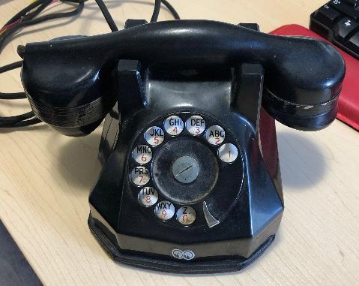
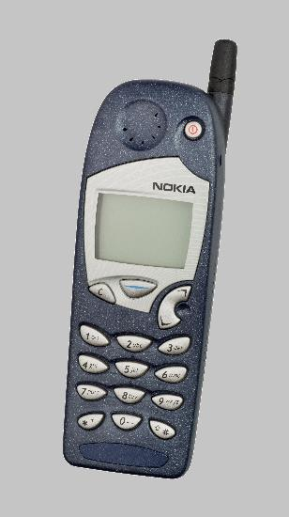
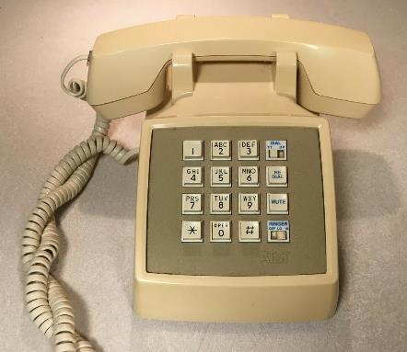
Evolution of the NSRS
NAD27
NAD83 (1986)
NAD83 (2011)

Slide 55
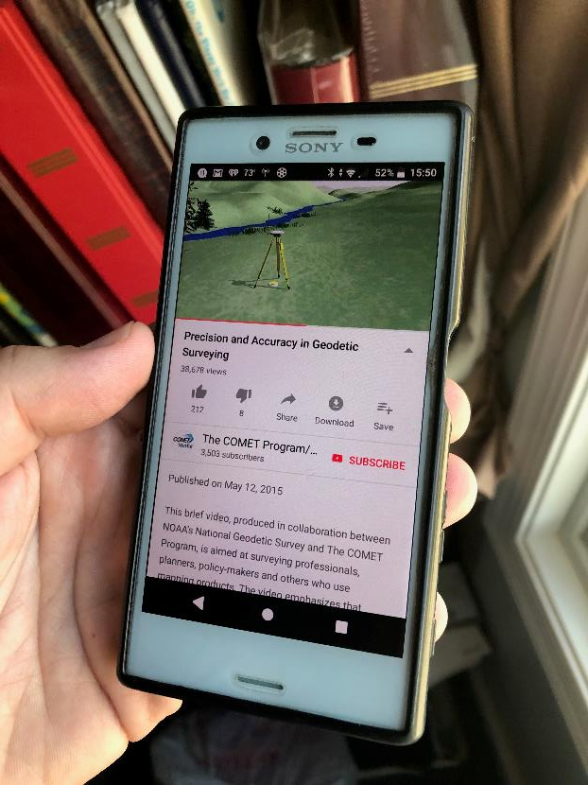
Modernized NSRS is our “smartphone”
You resisted it for a while…
It was a little cumbersome to get used to…
But you were soon hooked!

Slide 56
Two Major Components of Modernized NSRS
Geometric (LLh)
Latitude, Longitude, Ellipsoid Height
Geopotential (H)
Orthometric Height

Slide 57
North American Terrestrial Reference Frame of 2022
NATRF2022
(pronounced: nat-ref)

Slide 58
Reference Frame ≈ Datum
Reference Frame is a more scientifically appropriate way of saying “datum”
could be debated that “datum” was misused
you will continue to see NGS use the phrase “New Datums” for 2022

Slide 59
Reference Frame Defined
A point of view or a ‘frame of reference’.
If your reference frame is North America, you are standing somewhere within North America, seeing how other places move from your point of view.

Slide 60
Why replace NAD83?
Main driver: Global Navigation Satellite System (GNSS)
ACCESS
  GNSS equipment is fast, inexpensive, reliable
  Reduces reliance on physical control marks
ACCURACY
  Insensitive to distance-dependent errors
  Immune to instability; active control via CORS
CONSISTENCY
Eliminates systematic errors in current datums
Aligned with global reference frame

Slide 61
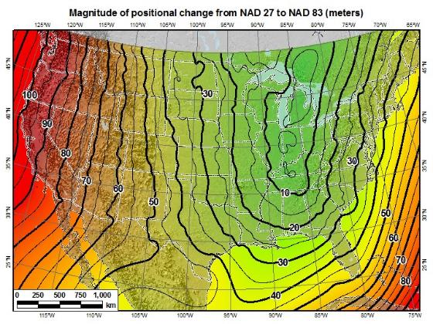
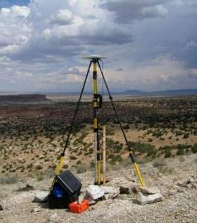
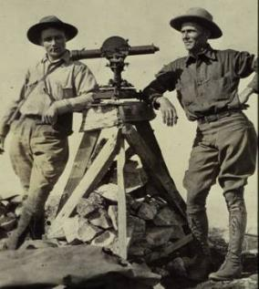
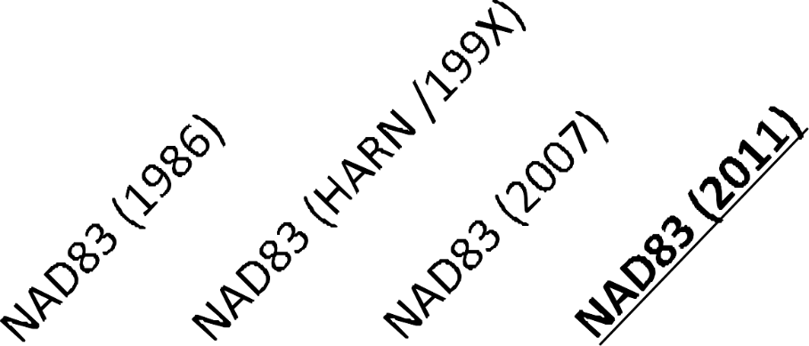
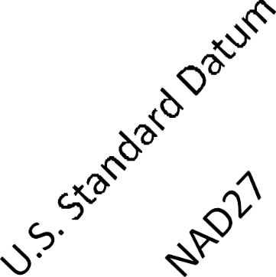
A very brief history of U.S. horizontal & geometric datums
GNSS
triangulation
NATRF2022
+
+
+
+
+
+
time
tens of meters
few 0.1m
few 0.01m
few 0.01m
<10 m
<2m
shift

Slide 62
Replacing NAD83
develop four "plate-fixed" reference frames
remove non-geocentricity of NAD83
align to ITRF2014 at epoch 2020.00
remove most of tectonic plate rotation from ITRF2014 via Euler Pole Parameters
(pronounced: “oiler”)
Shift and Drift…

Slide 63
Replacing NAD83
develop four "plate-fixed" reference frames
remove non-geocentricity of NAD83
align to ITRF2014 at epoch 2020.00
remove most of tectonic plate rotation from ITRF2014 via Euler Pole Parameters
(pronounced: “oiler”)
Shift and Drift…

Slide 64
Four “Plate-Fixed” Reference Frames
North American Terrestrial Reference Frame of 2022
(NATRF2022)
Pacific Terrestrial Reference Frame of 2022
(PATRF2022)
Caribbean Terrestrial Reference Frame of 2022
(CATRF2022)
Mariana Terrestrial Reference Frame of 2022
(MATRF2022)

Slide 65
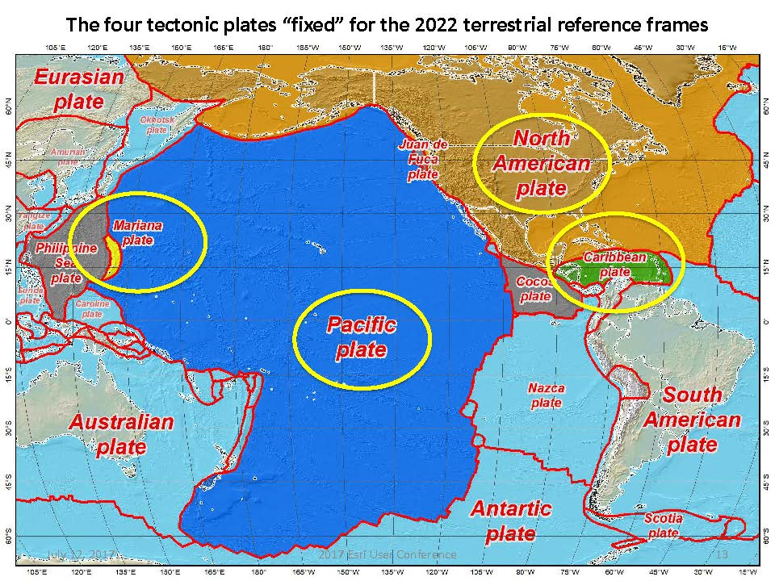


Slide 66
Four “Plate-Fixed” Reference Frames
North American Terrestrial Reference Frame of 2022
(NATRF2022)
Pacific Terrestrial Reference Frame of 2022
(PATRF2022)
Caribbean Terrestrial Reference Frame of 2022
(CATRF2022)
Mariana Terrestrial Reference Frame of 2022
(MATRF2022)

Slide 67
Replacing NAD83
develop four "plate-fixed" reference frames
remove non-geocentricity of NAD83
align to ITRF2014 at epoch 2020.00
remove most of tectonic plate rotation from ITRF2014 via Euler Pole Parameters
(pronounced: “oiler”)
Shift and Drift…

Slide 68
Non-geocentricity of NAD83
Earth’s
Surface
h₁₄
h₈₃
NAD83
origin
ITRF2014
origin
~2.2 meters
GRS80
ellipsoid

Slide 69
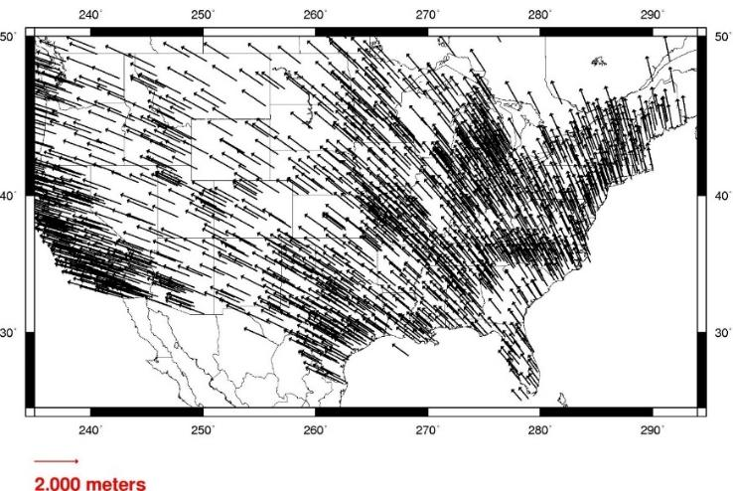
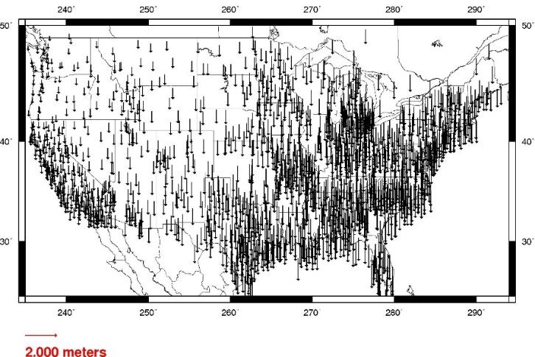
Geometric change due to ellipsoid non-geocentricity
Horizontal (Lat, Lon)
Ellipsoidal (h)
Shift…

Slide 70
Replacing NAD83
develop four "plate-fixed" reference frames
remove non-geocentricity of NAD83
align to ITRF2014 at epoch 2020.00
remove most of tectonic plate rotation from ITRF2014 via Euler Pole Parameters
(pronounced: “oiler”)
Shift and Drift…

Slide 71


International Terrestrial Reference Frame
(ITRF)
International Earth Rotation and Reference Systems Service (IERS)
International Union of Geodesy and Geophysics (IUGG)

Slide 72
International Terrestrial Reference Frame
The stable coordinate system that allows us to measure change over space, time and evolving technologies.
An accurate, stable set of station positions and velocities.
Network measurements interconnected by co-location of different space geodetic techniques.
“Approximately represents the motions of the tectonic plates with respect to the Earth's deep interior”… huh?

Slide 73
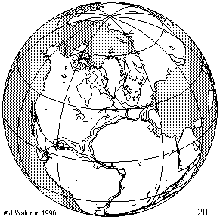
ITRF concept
Watch the grid!
Drift…

Slide 74
Replacing NAD83
develop four "plate-fixed" reference frames
remove non-geocentricity of NAD83
align to ITRF2014 at epoch 2020.00
remove most of tectonic plate rotation from ITRF2014 via Euler Pole Parameters
(pronounced: “oiler”)
Shift and Drift…

Slide 75
The wrong question, circa 2022:
“What’s the position of that point?”
The right question, circa 2022:
“What’s the position of that point, on some specific date?”
Drift…

Slide 76
Two types of drift
Tectonic Plate Rotation
    horizontal
Everything Else
    residual motions left after rotation
    regional linear motions
    localized subsidence or uplift
simple to model
complex

Slide 77
Tectonic Plate Rotation
    horizontal
simple to model

Slide 78
Euler Pole Parameters
of 2022
EPP2022

Slide 79
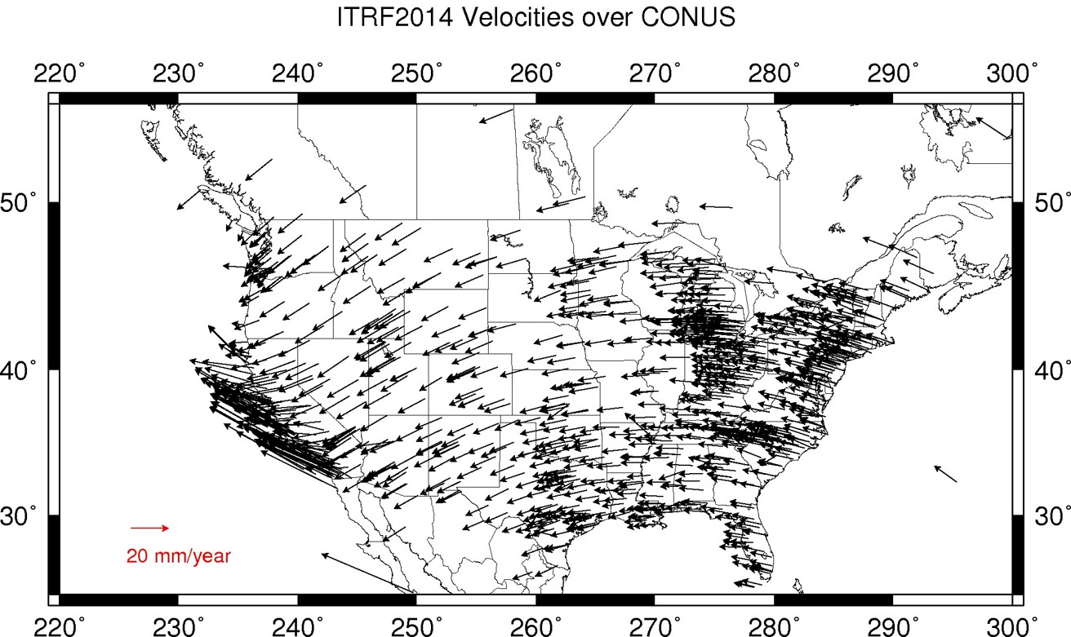
Plate Rotation visualized
Drift…

Slide 80
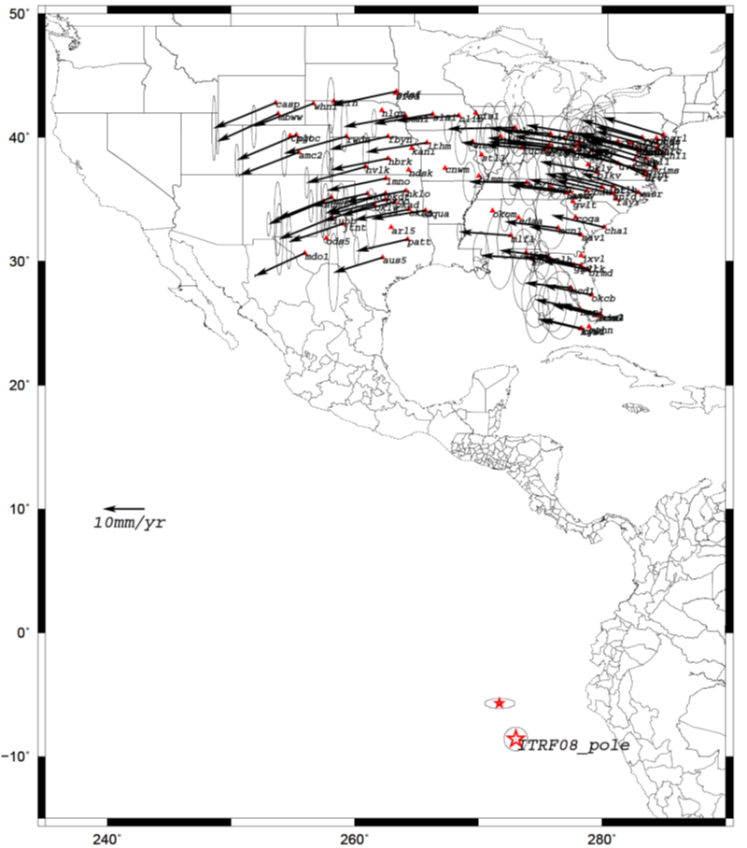
Euler Poles and “Plate-Fixed”
  In the ITRF, many tectonic plates have a dominant motion: rotation
  Euler Pole - point about which a plate rotates (yellow star)
NATRF2022 Euler Pole

Slide 81
Euler Poles and “Plate-Fixed”
ITRF
Frame = constant
NA Plate = rotating
NATRF
Frame = rotating
NA Plate = constant

Slide 82
Euler Poles and “Plate-Fixed”
ITRF
Frame = constant
NA Plate = rotating
NATRF
Frame = rotating
(relative to ITRF)
NA Plate = constant
(relative to NATRF2022)

Slide 83
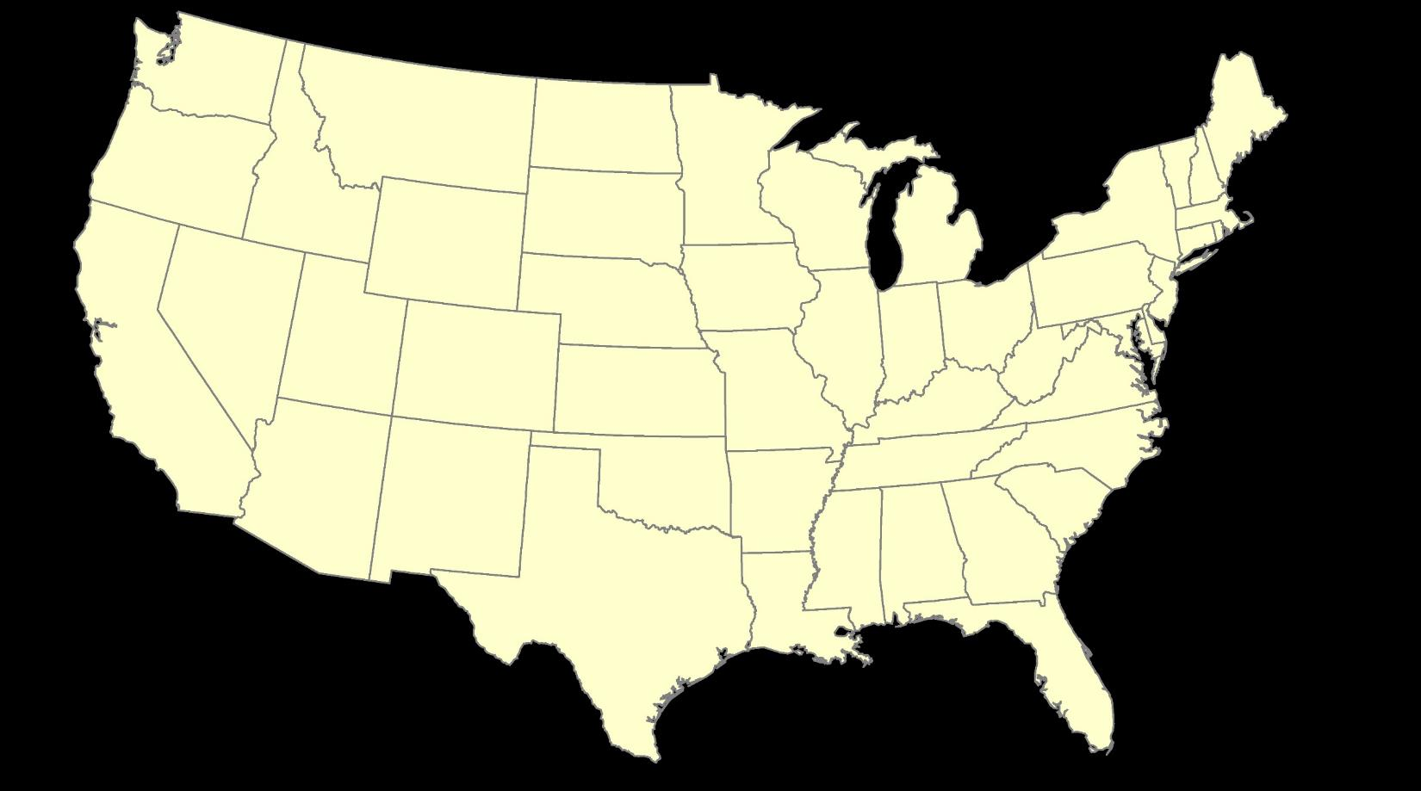
ITRF – constant frame, rotating plate

Slide 84
“Plate-Fixed”
NATRF – rotating frame, constant with plate

Slide 85
ITRF or NATRF – your choice, just use EPP

Slide 86
EPP – Euler Pole Parameters
Latitude
Longitude
Rotation Speed
yellow star off west coast of S. America

Slide 87
CORS Velocities in ITRF2014
Drift…

Slide 88

CORS Velocities in NATRF2022
Think of this map as ITRF2014 + EPP2022
Still SomeDrift…

Slide 89
ITRF2014 + EPP2022 = --TRF2022
Rotation of the
North American Plate
NATRF2022
CATRF2022
PATRF2022
MATRF2022
Rotation of the
Caribbean Plate
ITRF2014
Rotation of the
Pacific Plate
Rotation of the
Mariana Plate
EPP2022

Slide 90
ITRF2014 + EPP2022 = --TRF2022
Rotation of the
North American Plate
NATRF2022
EPP2022
ITRF2014

Slide 91
Two types of drift
Tectonic Plate Rotation
    horizontal
Everything Else
    residual motions left after rotation
    regional linear motions
    localized subsidence or uplift
simple to model
complex

Slide 92
Everything Else
    residual motions left after rotation
    regional linear motions
    localized subsidence or uplift
Still SomeDrift…
complex

Slide 93
Intra-Frame Velocity Model of 2022
IFVM2022

Slide 94
Concept of goal of IFVM
Longitude (Easting) History of DI4044
Trend: -1.7 mm / year
RED IS NATRF2022
COORDINATE
Still Some Drift…
Trend: -14.3 mm / year
BLUE IS ITRF COORDINATE
2004 2006 2008 2010 2012 2014 2016 2018

Slide 95
CORS Velocities in NATRF2022
Think of this map as ITRF2014 + EPP2022
Still SomeDrift…

Slide 96

IFVM goal = model all velocities
Think of this map as ITRF2014 + EPP2022 + IFVM2022

Slide 97
Still Some Drift…
  Everything in the world moves
  Coordinates will be associated with the actual date when the data was collected!
  Velocities at all marks can be estimated using this Intra-Frame Velocity Model
  IFVM goal being to move collected data thru time to Reference Epochs for coordinate comparisons/analysis

Slide 98
Intra-Frame Velocity Model
A model of all residual velocities, after removal of tectonic rotation via EPP:
  Horizontal residual motion
  Total vertical motion (ellipsoid heights)
  Replaces / Improves upon HTDP
Given t₁ and t₂, compute Δλ, Δϕ, Δh at any point, accounting for all motions
Likely be built upon CORS data, geodynamic models and InSAR, but not yet finalized

Slide 99
EPP2022 – Euler Pole Parameters – Simple Rotation
  Three parameters: lat, lon, rotation speed
  Horizontal only: just latitude and longitude
  Changes the frame: ITRF2014 + EPP2022 = NATRF2022
  Does not change the epoch
IFVM2022 – Intra-Frame Velocity Model - Complex
  Complex set of parameters
  Residual horizontal motion: all the motion leftover after Euler Pole rotation
  All vertical motion: localized subsidence or uplift
  Changes the epoch
  Does not change the frame: “intra” = on the inside; within

Slide 100
EPP2022
IFVM2022
Two new tools that will make time dependent geodetic control practical
They work together to account for the Drift…

Slide 101
Example of application of EPP and IFVM
It’s 2039 and you are working in San Diego using NATRF2022
And you want to compare your work to another survey from 2028
Important: This slide only covers geometric coordinates.
…the catch is, that survey was done in PATRF2022
PATRF2022
ep. 2028.048
EPP2022
(PA)
ITRF2014
ep. 2028.048
EPP2022
(NA)
NATRF2022
ep. 2028.048
IFVM2022
(PA)
IFVM2022
(NA)
PATRF2022
ep. 2039.704
EPP2022
(PA)
ITRF2014
ep. 2039.704
EPP2022
(NA)
NATRF2022
ep. 2039.704

Slide 102
Alright Jeff... enough jibba-jabba, what’s the impact?

Slide 103


Slide 104

What’s that going to look like?
PHOTO = NAD83
RED = NAD83 shoreline data
GREEN = shoreline transformed to NATRF2022

Slide 105

If you’re only working in this region…
North American Terrestrial Reference Frame of 2022
(NATRF2022)

Slide 106
North American-Pacific Geopotential Datum of 2022
NAPGD2022
(pronounced: nap-jee-dee)

Slide 107
A very brief history of (the most prevalent) U.S. vertical datums

Slide 108

NGVD29
Referenced to 26 tide gauges in the US and Canada

Slide 109

Referenced to a single tide gauge in Canada
Why one gage fixed this time?
removed local sea level variation problem of NGVD29
But it did introduce possibility of cross-continent error build-up…
Father Point Lighthouse, Quebec

Slide 110

Approximate Error in NAVD88 "zero elevation” (H=0)
Map is the H=0 surface overlaid onto satellite gravity data

Slide 111

NAVD 88
Referenced to 1 Tide Gauge
(Father’s Point)
NGVD 29
Referenced to 26 Tide Gages
-11 cm
125 cm
-23 cm
85 cm
102 cm
NAVD88 minus LMSL(1960-1978)
70 cm
-11 cm
4 cm
-23 cm

Slide 112


Why Replace NAVD88?
tilt/bias in zero reference surface
subsidence, uplift, freeze/thaw of BMs
limited access, availability of undisturbed marks
Approximate Error in NAVD88 "zero elevation”

Slide 113
Known Issues with NAVD88
tilt/bias in zero reference surface
subsidence, uplift, freeze/thaw of BMs
limited access, availability of undisturbed marks
Approximate Error in NAVD88 "zero elevation”

Slide 114

Passive marks may lie still… but they still may lie! small instability x long time = large inaccuracy

Slide 115
Replacing NAVD88
primary access via GNSS and geoid (OPUS, etc.)
accurate continental gravimetric geoid (1-2 cm)
aligned with:
  NATRF2022 (or CATRF, PATRF, MATRF)
  global mean sea level (GMSL)
monitor time-varying nature of gravity (NGS Geoid Monitoring Service GeMS)

Slide 116
Two flavors of geoid models…
  Gravimetric
  Hybrid

Slide 117
Gravimetric → Hybrid
  Gravimetric geoid is created from “scratch” with various types of gravity data
      USGG2003, USGG2009, USGG2012, xGEOID19
  Hybrid geoid is simply a gravimetric geoid warped to fit some vertical datum… like NAVD88
      GEOID03, GEOID09, GEOID12B, GEOID18

Slide 118
Gravimetric → Hybrid
      USGG2003, USGG2009, USGG2012, xGEOID19
      GEOID03, GEOID09, GEOID12B, GEOID18
best fit to NAVD88
best fit to NAVD88
best fit to NAVD88
best fit to NAVD88

Slide 119
Which NAD83 with which geoid?
GEOID18
GEOID12B
NAD83(2011) →
NAD83(2007) →
NAD83(HARN/FBN)
NAD83(CORS96)
GEOID09
GEOID06 (AK only)
GEOID03
GEOID99
GEOID96

Slide 120


Slide 121

Obtaining N_{g} is not easy!
First you need a gravity field (data from diff. distances)
  combine satellite, airborne, terrestrial, ship track data, etc.
Next calculate gravity anomaly, or ∆g
Then, just solve Stokes’ integral!
R is the mean radius of the earth
ɣ0 is mean surface gravity on ellipsoid
S is a geometric function of position
…there’s a catch
Need to know ∆g over entire surface of the earth

Slide 122
Obtaining N_{g} is not easy!
First you need a gravity field (data from diff. distances)
  combine satellite, airborne, terrestrial, ship track data, etc.
Next calculate gravity anomaly, or ∆g
Then, just solve Stokes’ integral!
R is the mean radius of the earth
ɣ0 is mean surface gravity on ellipsoid
S is a geometric function of position
…there’s a catch
Need to know ∆g over entire surface of the earth

Slide 123







Building a Geopotential Field Model
Long Wavelengths (> 250 km)
GRACE/GOCE/Satellite Altimetry
+
Intermediate Wavelengths (20km to 300 km)
Airborne Observations
+
Short Wavelengths (< 100 km)
Terrestrial/Surface Observations and Predicted Gravity from Topography

Slide 124

GRACE - 2 Satellites measuring separation

Slide 125

GRAV-D – airborne relative gravimeters

Slide 126

Terrestrial Gravimeter - Relative

Slide 127

Terrestrial Gravimeter - Relative

Slide 128

Terrestrial Gravimeter - Absolute

Slide 129

Terrestrial Gravimeters - Absolute and Relative

Slide 130
Individual Components of NAPGD2022
Global Model of the geopotential field
  GM2022
Geoid undulation models by region
  GEOID2022 aka “0 elevation”
Deflection of the Vertical (DoV) models by region
  DEFLEC2022
Surface Gravity models by region
  GRAV2022

Slide 131


Slide 132

Sea Level Change and the Geoid

Slide 133

Sea Level Change and the Geoid

Slide 134

Sea Level Change and the Geoid

Slide 135

Estimated change in orthometric heights from NAVD88 to NAPGD2022
(NAPGD2022 approximated using xGEOID16B)

Slide 136


Estimated change in orthometric heights from NAVD88 to NAPGD2022
(NAPGD2022 approximated using xGEOID16B)
Vertical change of about -0.6 to -2.0 feet

Slide 137

North American-Pacific Geopotential Datum of 2022
(NAPGD2022)

Slide 138
How can I prepare?
Where did this all start?
How is all this possible?
What’s the benefit to me?
Well, besides learning a whole new set of terminology and methods…

Slide 139
How can surveyors prepare?
Get familiar with terms, ask now, be ready
Set/occupy RTN Validation Stations (OPUS)
Research your published control
    pre-1995 will NOT get new coordinates (GPS only)
Use OPUS Projects to re-observe/process

Slide 140

NGS Ten-Year Strategic Plan
  By 2022, reduce all definitional & access-related errors in geometric reference frame to 1 cm when using 15 min of GNSS data
  aka “Replace NAD83”
  By 2022, reduce all definitional & access-related errors in orthometric heights in geopotential datum to 2 cm when using 15 min of GNSS data
  aka “Replace NAVD88”
https://geodesy.noaa.gov/web/about_ngs/info/tenyearfinal.shtml

Slide 141

How is all this possible?
CORS
Co-location of space geodetic instruments worldwide that feed into ITRF development
Teamwork with other geodetic organizations
Research and Development
Testing
Science!

Slide 142





Co-location Site
NASA Goddard Space Flight Center, Greenbelt MD, USA
  GNSS, SLR, VLBI, DORIS

Slide 143

Co-location Site
NASA Goddard Space Flight Center, Greenbelt MD, USA
  GNSS, SLR, VLBI, DORIS

Slide 144
Co-location Site
NASA Goddard Space Flight Center, Greenbelt MD, USA
  GNSS, SLR, VLBI, DORIS

Slide 145
SLR
Satellite Laser Ranging

Slide 146


Slide 147
Co-location Site
NASA Goddard Space Flight Center, Greenbelt MD, USA
  GNSS, SLR, VLBI, DORIS

Slide 148
VLBI
Very Long Baseline Interferometry

Slide 149

VLBI

Slide 150
Co-location Site
NASA Goddard Space Flight Center, Greenbelt MD, USA
  GNSS, SLR, VLBI, DORIS

Slide 151
DORIS
Doppler Orbitography and Radiopositioning Integrated by Satellite

Slide 152

Doppler Orbitography and Radiopositioning Integrated by Satellite

Slide 153

Space Geodesy Co-location Diagram
Generic concept of “co-location survey”, typically more complex.

Slide 154


Altogether now!
All these techniques work together to create a well-defined, robust reference frame that improves positioning for users globally.

Slide 155
Not just new datums…
  NSRS Modernization
-OPUS enhancements/additions
-retire the US Survey Foot
-new types of coordinates
-new methods for establishing control
-streamlined Bluebooking

Slide 156
Online Positioning User Service
  OPUS Rapid Static (OPUS-RS)
      dual frequency receiver data
      static sessions only
      30 seconds epoch rate (aka recording interval)
      15 minutes to 2 hours of GPS data
  OPUS Static (OPUS-S)
      same requirements as above
      2 to 48 hours of GPS data
  OPUS Projects (OP)
      adds session processing and network adjustment
      training by NGS required; typically 12 hours
      files uploaded to OPUS with a “Project ID” keyed in Options
  Beta OPUS Projects (BOP)
      enhancements and added features

Slide 157

a note on OPUS “my profile”
be careful!

Slide 158
Online Positioning User Service
But wait… there’s more!
Coming soon…

Slide 159

Hybrid Control Networks = Static + RTK/RTN
OPUS for RTK/RTN-GNSS

Slide 160
“What’s the benefit?” they say…
OPUS for RTK/RTN-GNSS
Run least squares adjustment(s) of the combined Static and RTN vectors
Hold NCN CORS (and possibly other published coordinates) in adjustments
Check quality of results
Submit survey project to NGS for review and publication in national database
…you’ll be able to Bluebook RTK/RTN data!

Slide 161

US Survey Foot
and
International Foot
…or Feets Don’t Fail Me Now

Slide 162
The problem
Two versions of same unit in current use
  “New” international foot and “old” U.S. survey foot
  “New” shorter than “old” by 2 ppm (0.01 ft per mile)
  A real problem with real costs
What’s in a name?
  “U.S. survey” versus “international”
Who is using U.S. survey feet?
  Surveyors exclusively, in most (not all) states
  But it impacts everyone

Slide 163

2 parts per million (ppm)
1,000,000.00 sft = 999,998.00 ift
10,000,000.00 sft = 9,999,980.00 ift
International → 1 ft = .3048 m
US → 1 ft = .30480061 m (approx.)
  frequently calculated by $\frac{1200}{3937}$

Slide 164
What’s impacted?
When does this matter?
  Not typically in lengths/distances
  But in published planar coordinate systems
Like what?
  SPCS and UTM are very popular and both fall victim to mix-ups
Why?
  Large false eastings and northings

Slide 165




Who is responsible for standards?
National Institute of Standards and Technology

Slide 166
Adopted International Foot in 1959
1 foot = 0.3048 meter exactly (1 yard = 0.9144 m)
New foot definition adopted by NASA predecessor
National Bureau of Standards created
Adopted as “new” foot for entire U.S.
1901
1933
1952
1954
1959
With one little exception…
New foot definition adopted by ANSI predecessor
International nautical mile
1,852 m exact

Slide 167
With one little exception…
“Any data expressed in feet derived from and published as a result of geodetic surveys within the United States will continue to bear the following relationship as defined in 1893: 1 foot = 1200/3937 meter
The foot unit defined by this equation shall be referred to as the U.S. Survey Foot and it shall continue to be used, for the purpose given herein, until such a time as it becomes desirable and expedient to readjust the basic geodetic survey networks in the United States, after which the ratio of a yard, equal to 0.9144 meter, shall apply.”

Slide 168
More Federal Register Notices
Surveying and mapping only (pending analysis, never resolved)
Proposed permanent use of U.S. Survey Foot
Restatement that metric used for U.S.
International vs. U.S. Survey Foot
1975
1977
1988
1989
1990
NGS goes entirely metric (for NAD 83)
NAD 83 announced
International foot used for “engineering”
U.S. survey foot used for “mapping and land measurement”
We readjusted the basic geodetic network!

Slide 169

Out of order, chaos
A foot still in limbo
2008 - NIST “Guide to the
Use of the SI”
U.S. survey foot still used
  but never officially permanently adopted
Repeats 1975 FRN ideas
about the two feet:
  International ft used for engineering
  U.S. ft used for surveying & mapping
At odds with very idea of “standards”

Slide 170

Oops!
Problem created and perpetuated by NGS
In 1959. Then in 1986. And again in 2016…

Slide 171
What are the choices?
Do nothing (i.e., NGS stays “metric” only)
  States choose whatever foot they want
  Both feet will creep back into NGS products & services
Officially adopt U.S. survey foot for specific things
  U.S. survey foot for surveying and mapping
  International foot for engineering (and everything else)
Use international foot for everything
  Support only foot = 0.3048 meter after 2022
Use U.S. survey foot for everything (highly unlikely)
Go entirely metric (ideal situation, but also unlikely)

Slide 172
NGS proposal
Only one foot after 2022 (1 foot = 0.3048 meter)
  Make official through NIST
  NO option for U.S. survey foot in NATRF/SPCS2022
NGS will help with the transition
  Will fully support backward compatibility
  Use “correct” foot for SPCS83 and SPCS27
  Automatically done by NGS products and services
Guiding ideas
  Of all changes in 2022, this is the least significant
  About the future, not the past

Slide 173
Putting our best “foot” forward…
NGS created problem, will help fix it
  Fully support backward compatibility (NAD83, NAD27)
  Unit change minor compared to other 2022 changes
  Contact us at NGS.Feedback@noaa.gov
Federal Register Notice – 17 October 2019
  Deprecate US Survey Foot on 31 December 2022
  After, use International conversion (1 ft = 0.3048 m)
  Drop “International” refer to unit simply as “foot”
  Comment period open thru 02 December 2019
  FRN follow-up webinar on 12 December @ 14:00

Slide 174

Blueprint for 2022, Part 3

Slide 175
Let’s look at some new terminology

Slide 176
The NOAA CORS Network (NCN)
As of 2019, this is the official name of the network managed at NGS
  Historically referred to as “CORS” or “the CORS”

Slide 177
GPS Month
A span of four consecutive GPS weeks, where the first GPS week in the GPS month is an integer multiple of 4
  GPS Month 0 = GPS Weeks 0, 1, 2 and 3
  GPS Month 1 = GPS Weeks 4, 5, 6 and 7
  GPS Month 2 = GPS Weeks 8, 9, 10, and 11
  Etc.

Slide 178
New Types of Coordinates

Slide 179
Five types of coordinates in Modernized NSRS
Name | Generally on… | Description
Reported | Passive | “Quick and Dirty”. Smartphone accuracy. (aka HD_HELD)
Preliminary | Passive | Computed by you with OPUS using your data. Unchecked by NGS.
Final Discrete | Passive | Most accurate. Time-dependent. Computed by NGS every four weeks.
Final Running | CORS | Continuous time-dependent CORS coordinates. Checked by NGS every day.
Reference Epoch | Passive and CORS | Modeled from Final Discrete, Final Running, IFVM2022 and GeMS. Computed by NGS every five years.

Slide 180
Coordinates - Reported
Reported
  “These are from any source where the coordinate is directly reported to NGS without the data necessary for NGS to replicate the coordinate.”
    Scaled
    From NCAT or Vdatum
    Hand Held (HD_HELD) / Smartphone
    Reported directly from RTK/RTN rover without data files

Slide 181


Reported Coordinates

Slide 182
Coordinates - Preliminary
Preliminary
  “These are coordinates at survey epoch that have been computed from OPUS, but not yet quality checked and loaded into the National Spatial Reference System Database (NSRS DB).”
    User-computed values, such as they might get today from either OPUS-S or OPUS-Projects
    “Preliminary” coordinates are the only coordinates a user will get directly from OPUS

Slide 183
Coordinates – Final Discrete
Final Discrete
  “These are coordinates computed by NGS using submitted data and metadata, checked and adjusted and referenced to a single survey epoch.”
    Represent the best estimates of the time-dependent coordinates at any mark
    Survey epochs:
      GNSS: Each GPS Month
        Stand-alone occupations, RTK/RTN, Campaigns, etc
      Leveling: Annually
        Orthometric heights: Leveling will be adjusted to GNSS-based orthometric heights

Slide 184
Coordinates – Final Running
Final Running
  “Of all types of coordinates on a mark, these are the only ones which will have a coordinate at any time.”
    Generally will only be available at each CORS
      Also being called the coordinate function
      Which will be generated by a “fit” to daily processed data

Slide 185
Coordinates – Reference Epoch
Reference Epoch
  “These are coordinates which have been estimated by NGS, from time-dependent (final discrete and final running) coordinates, at an Official NSRS Reference Epoch (ONRE)”
    NAD 83(2011) epoch 2010.00 would (kinda) fall under this category
    These will be computed by NGS every 5 years
      On a schedule 2-3 years past ONRE
        2020.00 coordinates will be computed in CY 2022
        2025.00 coordinates will be computed in CY 2027

Slide 186
EPP2022
IFVM2022
Two new tools that will make time dependent geodetic control practical
They work together to account for the Drift…

Slide 187
Example of application of EPP and IFVM
It’s 2039 and you are working in San Diego using NATRF2022
And you want to compare your work to another survey from 2028
Important: This slide only covers geometric coordinates.
…the catch is, that survey was done in PATRF2022
PATRF2022
ep. 2028.048
EPP2022
(PA)
ITRF2014
ep. 2028.048
EPP2022
(NA)
NATRF2022
ep. 2028.048
IFVM2022
(PA)
IFVM2022
(NA)
PATRF2022
ep. 2039.704
EPP2022
(PA)
ITRF2014
ep. 2039.704
EPP2022
(NA)
NATRF2022
ep. 2039.704

Slide 188
Daily Epochs?!?
It seems unlikely that the majority of surveyors will embrace these (e.g. 2028.048, 2039.074 from last slide)
To mitigate that, NGS will issue “snapshots” of the NSRS every five years
  We’re calling these Reference Epochs
  These will be estimates of coordinates at specific 5 year intervals - based on historic coordinates and the IFVM2022
Beginning with 2020.00
  Each “snapshot” will be published 2-3 years after the reference epoch, so the 2020.00 Reference Epoch Coordinates get published by the end of calendar year 2022… thus the name/date of 2022

Slide 189
Reference Epoch Coordinates from
Time-Dependent Coordinates

Slide 190
Assume “h” was determined four different times:
1990: 2.100
1994: 2.110
2002: 2.190
2009: 2.180
h
2.250
2.200
2.150
2.100
2.050
2.000
1990
‘95
‘00
‘05
‘10
‘15
‘20
‘25
‘30
time

Slide 191
All measurements have error. Shown here are the same
Values of “h”, but with their error estimates.
1990: 2.100 +/- 0.0375 (3.75 cm)
1994: 2.110 +/- 0.0250 (2.50 cm)
2002: 2.190 +/- 0.0200 (2.00 cm)
2009: 2.180 +/- 0.0250 (2.50 cm)
h
2.250
2.200
2.150
In the modernized NSRS these time-dependent
coordinates, estimated at the actual date when
the surveys took place, will be called
Final Discrete Coordinates
2.100
2.050
2.000
1990
‘95
‘00
‘05
‘10
‘15
‘20
‘25
‘30
time

Slide 192
h
In today’s NSRS, a height is held fixed until replaced. So plotting the height of these Final Discrete Coordinates as seen on a datasheet over time would look like this:
2.250
2.200
2.150
2.100
2.050
2.000
1990
‘95
‘00
‘05
‘10
‘15
‘20
‘25
‘30
time

Slide 193
In the modernized NSRS we will also have an estimate of
crustal motion from IFVM2022
h
2.250
2.200
2.150
2.100
Combining Final Discrete Coordinates
with IFVM2022 allows NGS to estimate Reference Epoch Coordinates
2.050
2.000
1990
‘95
‘00
‘05
‘10
‘15
‘20
‘25
‘30
time

Slide 194
The IFVM2022 will (statistically)
align to these Reference Epoch Coordinates.
h
2.250
2.200
2.150
2.100
2.050
2.000
1990
‘95
‘00
‘05
‘10
‘15
‘20
‘25
‘30
time

Slide 195
h
2.250
2.200
2.150
2.100
2.050
In the absence of new survey data, error estimates will
grow through time.
2.000
1990
‘95
‘00
‘05
‘10
‘15
‘20
‘25
‘30
time

Slide 196
The (in)ability of current approach to
properly inform users of the height of
this mark can be seen in blue.
2.250
2.200
2.150
2.100
2.050
2.000
1990
‘95
‘00
‘05
‘10
‘15
‘20
‘25
‘30

Slide 197
EPP and IFVM with Reference Epochs
It’s 2039 and you are working in San Diego using NATRF2022 (epoch 2035.00)
And you need to compare your work to another survey from 2028
Important: This slide only covers geometric coordinates.
…the catch is, that survey was done in PATRF2022 (epoch 2025.00)
PATRF2022
ep. 2025.00
EPP2022
(PA)
ITRF2014
ep. 2025.00
EPP2022
(NA)
NATRF2022
ep. 2025.00
IFVM2022
(PA)
This would’ve been a NADCON function in the past
IFVM2022
(NA)
PATRF2022
ep. 2035.00
EPP2022
(PA)
ITRF2014
ep. 2035.00
EPP2022
(NA)
NATRF2022
ep. 2035.00

Slide 198
Using the modernized NSRS
OPUS
  Guidance (such as pre-selected CORSs and assistance in locating marks in project areas)
  Users will decide what control to hold fixed and what epochs they wish to set for the adjustment
    “Preliminary coordinates”
  If submitted to NGS (aka “Shared”), we will harvest your raw GNSS data and use it to compute Final Discrete coordinates

Slide 199
Using the modernized NSRS
GNSS is your only entry (for now)
  Leveling and Classical/TS surveys will need some GNSS if you wish to submit your survey to NGS for inclusion in the NSRS database
    Some GNSS = RTK or RTN is fine
    No decision yet on whether OP will operate if projects have no GNSS
      If it does, this tends to encourage reliance upon passive control
        which is “so 90’s” …1890s brah!

Slide 200
So much more to NSRS Modernization!
New version of PAGES
  Multi-Constellation → GPS, Galileo, GLONASS, Beidou, QZSS, etc.
  Target: 15 minute occupations
OPUS expansion plan
  RTK/RTN: 2020 rollout, already mentioned
  Leveling, Classical, Gravity: 2020-2025
  Fully integrated (GPS projects with leveling and gravity? No problem!)
  Ease of submission to NGS for inclusion in the NSRS
New Mark Recovery Tool
  mentioned earlier, search: “NGS mark recovery” and go to Beta
Fully integrated toolkit
  NCAT and VDatum

Slide 201
Bluebooking a Project now
geodesy.noaa.gov/ project_tracking/
GPS survey
data files
photos
descriptions
etc.
Process data using vendor software or PAGE-NT.
Construct bluebook files using software and editor.
Run ADJUST.
review and publish to IDB

Slide 202
Bluebooking with OPUS Projects in the future
geodesy.noaa.gov/ project_tracking/
GPS survey
data files
photos
descriptions
etc.
Process data using vendor software or PAGE-NT.
Construct bluebook files using software and editor.
Run ADJUST.
review and publish to IDB
Available now!
(with certain caveats)
Upload to OPUS-Projects
Process in OPUS-Projects

Slide 203

Mark Recovery – mobile browser compatible
use your smartphone to submit recovery
Any major search engine:
  “NGS survey mark recovery”
beta.ngs.noaa.gov/cgi-bin/recvy_entry_www.prl
Try it out! Give us feedback!
NGS.Feedback@noaa.gov

Slide 204


Mark Recovery – mobile browser compatible

Slide 205
What new tools are already live?
VERTCON 3.0 – functionality in Beta NCAT
Mark Recovery – mobile browser compatible
VDatum 4.0.1 – released in October
GEOID18 – latest, greatest, and last hybrid
GPSonBM – updated tracking map (AGOL)
    for NAVD88→NAPGD2022 transformation

Slide 206
https://www.ngs.noaa.gov/ADVISORS/
-use any major search engine: “NGS advisors”
Jeff Jalbrzikowski, P.S., GISP
Appalachian Regional Geodetic Advisor
jeff.jalbrzikowski@noaa.gov
240-988-5486

Slide 207
www.ngs.noaa.gov
beta.ngs.noaa.gov

