Slide 1

NSRS Modernization
PLSO Fall Seminar
October 2019
Jeff Jalbrzikowski, P.S., GISP
Appalachian Regional Geodetic Advisor
jeff.jalbrzikowski@noaa.gov
240-988-5486

Slide 2
My Background
Licensed Surveyor in OH, PA, and WV
Certified GIS Professional
University of Akron graduate
Came to NGS from USACE (Pittsburgh, PA)
primary experience is engineering surveys, including structural deformation, hydrographic/bathymetric, terrestrial LiDAR, GNSS control, local/legacy datum resolution
previously survey intern, Cadastral Surveyor, GIS Technician, warehouse picker/packer, busboy…

Slide 3
Have you already heard that NAD83 and NAVD88 are scheduled to be replaced?
Who’s nervous?
Who’s ready?
Who’s already working in ITRF?

Slide 4



Organizational Structure
Federal Government – Executive Branch
-Department of Commerce (DoC)
(~47,000 employees)
-National Oceanic and Atmospheric Administration (NOAA)
-National Ocean Service (NOS)
-National Geodetic Survey (NGS)
(~175 employees)

Slide 5
NGS Mission
To define, maintain and provide access to the National Spatial Reference System (NSRS) to meet our Nation’s economic, social, and environmental needs.

Slide 6
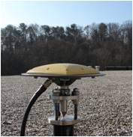
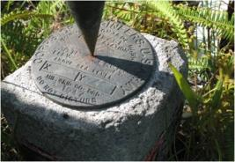
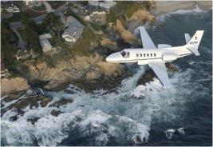
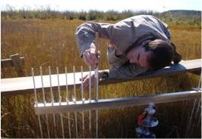
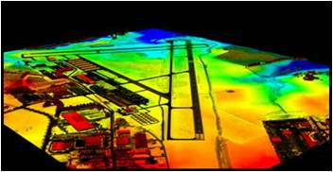
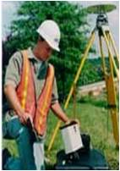
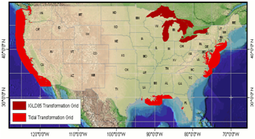
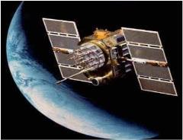
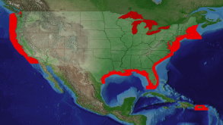
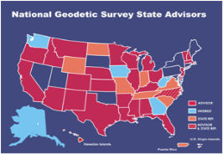
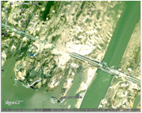
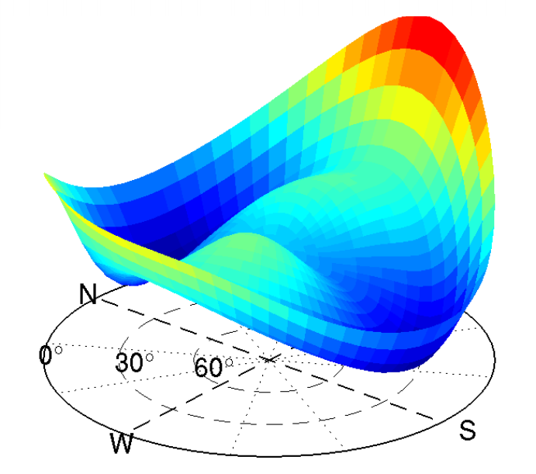
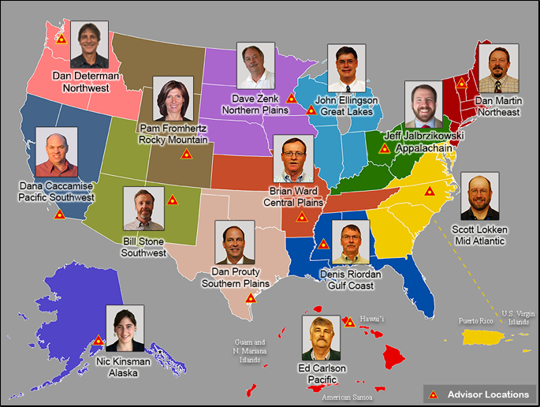
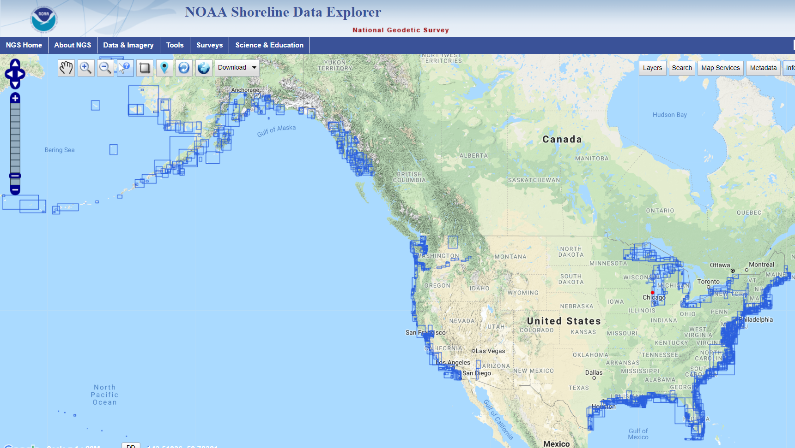
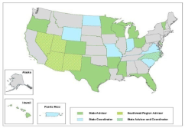
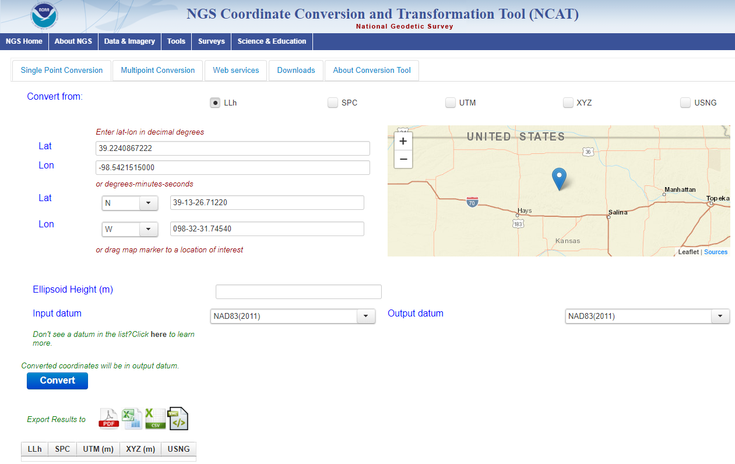
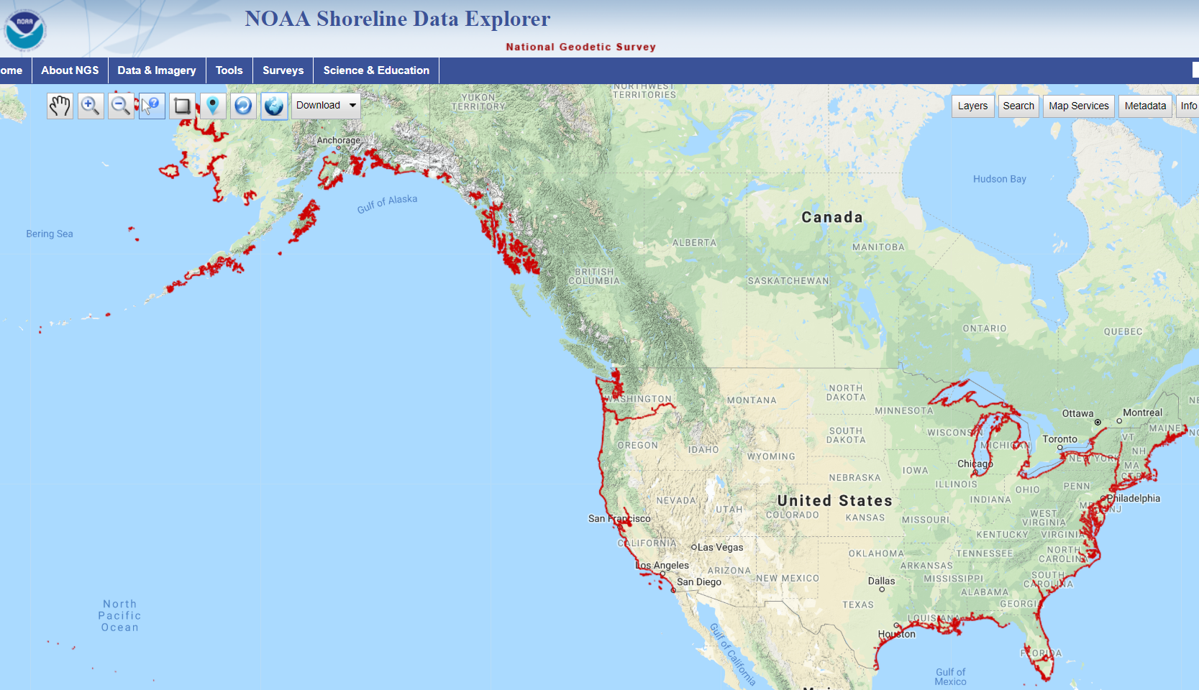
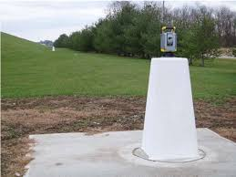
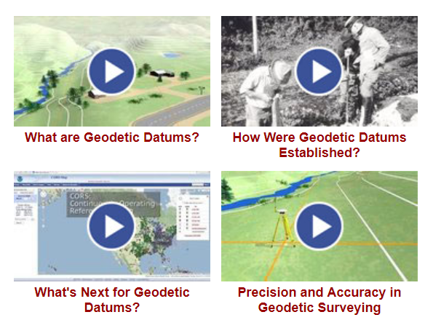
NGS Overview
Modernizing the NSRS
CORS
NHMP
GRAV-D
ECO
NGS Products and Services
ASP
OPUS
VDatum
Orbit Data
National Shoreline
Geodetic Advisors
ERI
Antenna Calibrations
NCAT
CUSP
CBL
Outreach/COMET

Slide 7
NGS Overview
Modernizing the NSRS
CORS
NHMP
GRAV-D
ECO
NGS Products and Services
ASP
OPUS
VDatum
Orbit Data
National Shoreline
Geodetic Advisors
ERI
Antenna Calibrations
NCAT
CUSP
CBL
Outreach/COMET

Slide 8
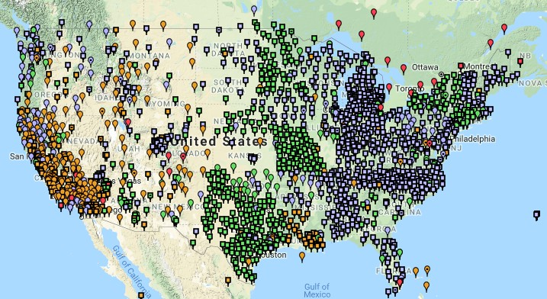
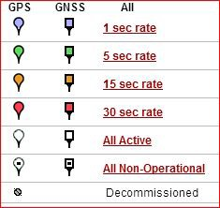
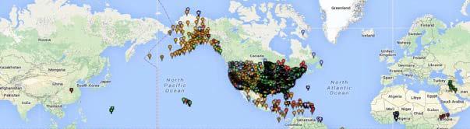
Continuously Operating Reference Station (CORS)
2000+ sites
~225 organizations

Slide 9
NOAA CORS Network (NCN)
2000+ sites
~225 organizations

Slide 10
NGS Overview
Modernizing the NSRS
CORS
NHMP
GRAV-D
ECO
NGS Products and Services
ASP
OPUS
VDatum
Orbit Data
National Shoreline
Geodetic Advisors
ERI
Antenna Calibrations
NCAT
CUSP
CBL
Outreach/COMET

Slide 11
National Height Modernization Program
…the establishment of accurate, reliable heights using GNSS technology in conjunction with traditional leveling, gravity, and modern remote sensing information…
-propagation and long-term monitoring (for subsidence) of control thru static GPS campaigns, GPS on BMs, digital leveling
-combined with relative gravity data, LiDAR, etc

Slide 12
National Height Modernization Program
Participating and Interested States
States engaged in HM without federal funding assistance
Spatial Reference Centers
Regional Leaders
Other funded partners
Current Funded Partners

Slide 13
National Height Modernization Program
supports various non-NGS Federal Programs
FEMA: FIRMs, ECs, etc.
USACE: Levee/Dam Safety Programs, etc.
and countless non-Federal programs
still an active program but there have not been any grants in a few years

Slide 14
NGS Overview
Modernizing the NSRS
CORS
NHMP
GRAV-D
ECO
NGS Products and Services
ASP
OPUS
VDatum
Orbit Data
National Shoreline
Geodetic Advisors
ERI
Antenna Calibrations
NCAT
CUSP
CBL
Outreach/COMET

Slide 15
Gravity for the Redefinition of the American Vertical Datum
Two major campaigns within GRAV-D
High-resolution snapshot of gravity
primarily airborne observations, all relative gravity, estimated cost of ~$39 million
Low-resolution “movie” of gravity changes
primarily terrestrial, episodic observations of absolute gravity sites

Slide 16
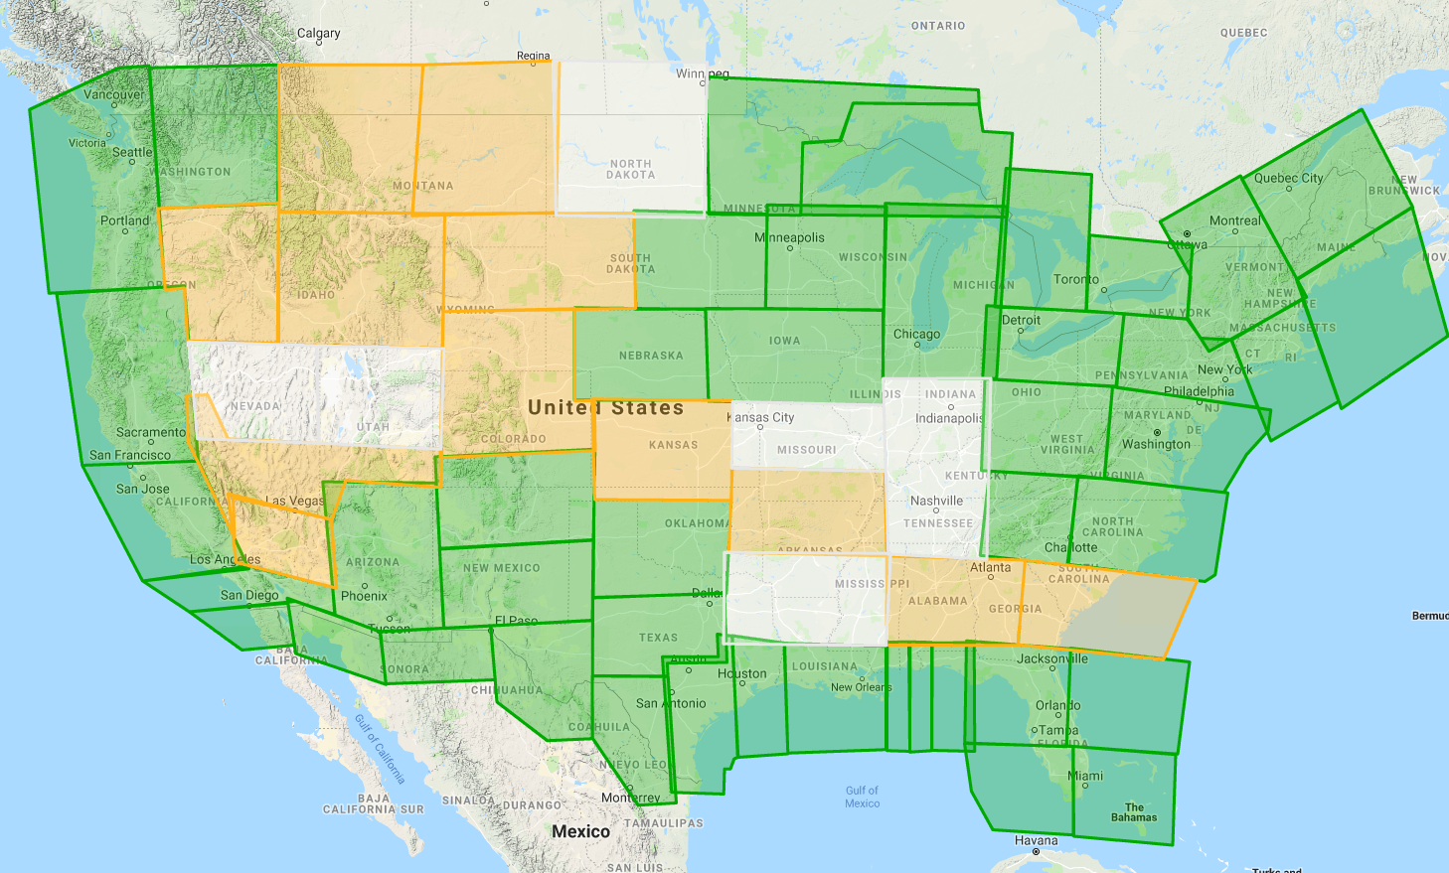
Gravity for the Redefinition of the American Vertical Datum
Green = Complete
Blue = In Processing
Yellow = Underway
White = Planned
10 km data lines
70 km cross lines
20,000 ft altitude
230 kt flight speed
As of AUG2019:
78% complete

Slide 17
NGS Overview
Modernizing the NSRS
CORS
NHMP
GRAV-D
ECO
NGS Products and Services
ASP
OPUS
VDatum
Orbit Data
National Shoreline
Geodetic Advisors
ERI
Antenna Calibrations
NCAT
CUSP
CBL
Outreach/COMET

Slide 18
Aeronautical Survey Program
Interagency Program with the FAA
Primary Airport Control Station (PACS) and Secondary Airport Control Stations (SACS)
Airports GIS (AGIS)
Airport Obstruction Charts (AOC)
Primary function of NGS is to serve as QA and SME for airport surveys (of all types) that are contracted by airports

Slide 19
NGS Overview
Modernizing the NSRS
CORS
NHMP
GRAV-D
ECO
NGS Products and Services
ASP
OPUS
VDatum
Orbit Data
National Shoreline
Geodetic Advisors
ERI
Antenna Calibrations
NCAT
CUSP
CBL
Outreach/COMET

Slide 20
GPS Orbit Data aka Ephemerides
NGS orbit analysis and computation is performed together with, and as a component of, the International GNSS Service (IGS)
IGS coordinates the collection of satellite tracking data
Designated with this responsibility by the Civil GPS Service Interface Committee (CGSIC)
If you’re using OPUS, it’s all behind-the-curtain

Slide 21
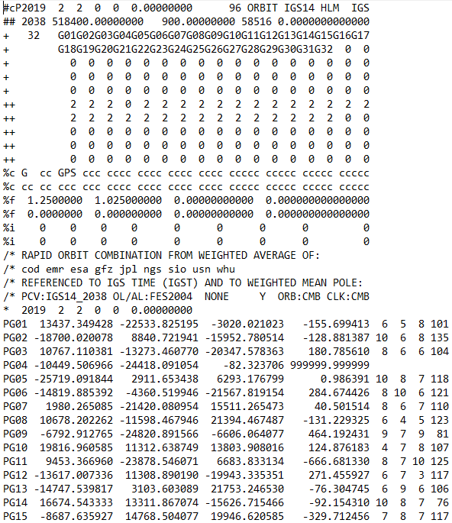
Link to NGS GPS Calendar

Slide 22
NGS Overview
Modernizing the NSRS
CORS
NHMP
GRAV-D
ECO
NGS Products and Services
ASP
OPUS
VDatum
Orbit Data
National Shoreline
Geodetic Advisors
ERI
Antenna Calibrations
NCAT
CUSP
CBL
Outreach/COMET

Slide 23
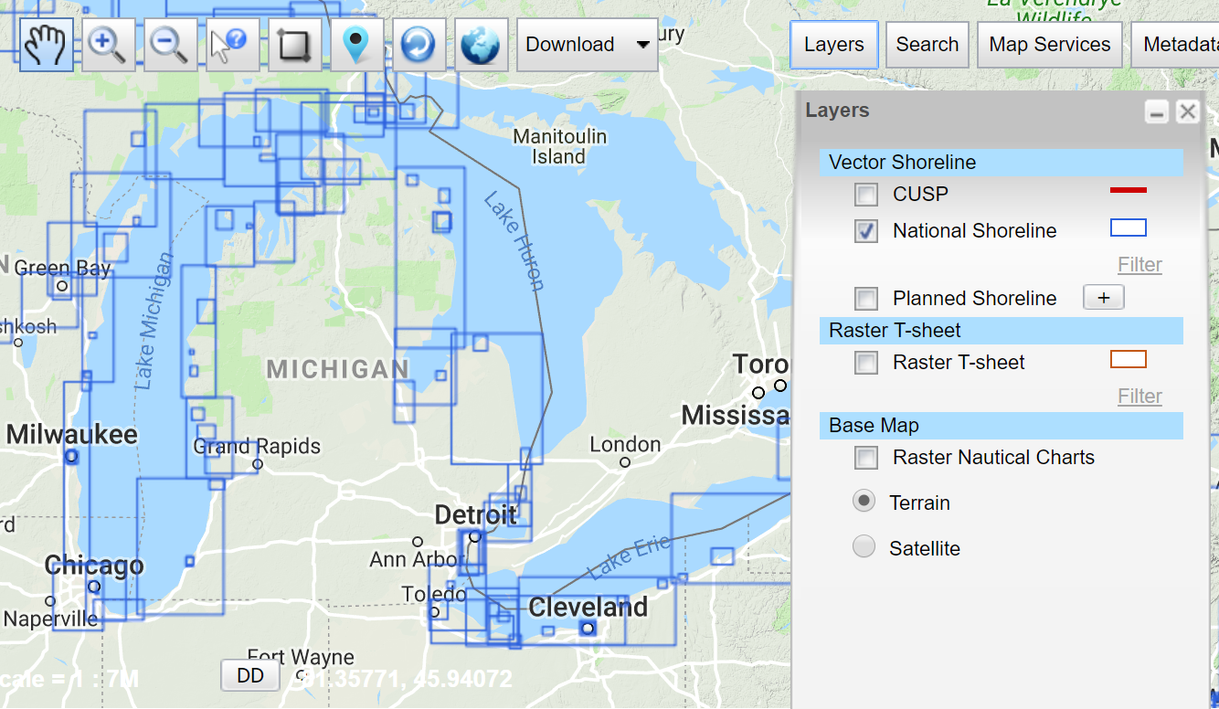
National Shoreline
The official national shoreline data, in support of NOAA nautical charting mission
Available for download as Shapefile in Mean High Water and Mean Lower Low Water datum
Organized by “Project Area”
hyperlink to the National Shoreline homepage

Slide 24
NGS Overview
Modernizing the NSRS
CORS
NHMP
GRAV-D
ECO
NGS Products and Services
ASP
OPUS
VDatum
Orbit Data
National Shoreline
Geodetic Advisors
ERI
Antenna Calibrations
NCAT
CUSP
CBL
Outreach/COMET

Slide 25
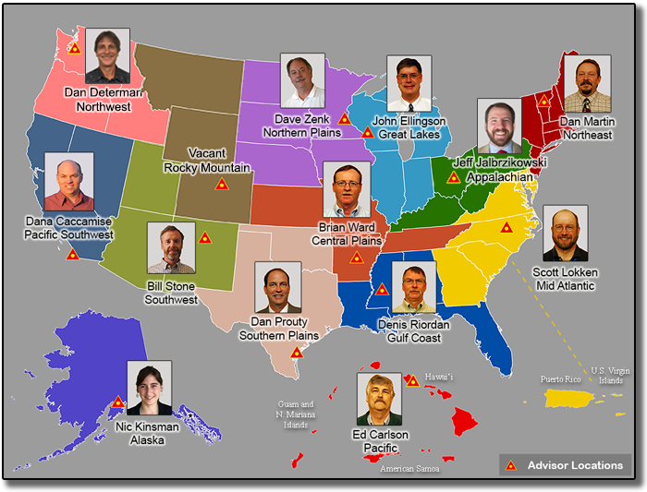
https://www.ngs.noaa.gov/ADVISORS/

Slide 26
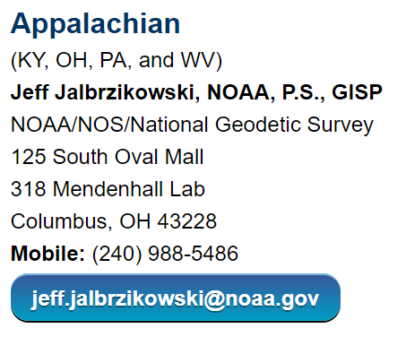
Regional Geodetic Advisor Program
www.ngs.noaa.gov/ADVISORS/
query any major search engine: “ngs advisors”

Slide 27

State Geodetic Coordinators
not an NGS employee
a liaison between the State’s geospatial community and the NGS

Slide 28
NGS Overview
Modernizing the NSRS
CORS
NHMP
GRAV-D
ECO
NGS Products and Services
ASP
OPUS
VDatum
Orbit Data
National Shoreline
Geodetic Advisors
ERI
Antenna Calibrations
NCAT
CUSP
CBL
Outreach/COMET

Slide 29
Emergency Response Imagery
Mission of the Remote Sensing Division
Pre-Storm and Post-Storm photos are taken along the coastal CONUS
Supports Homeland Security (DHS) and Emergency Response (FEMA, etc.) events

Slide 30
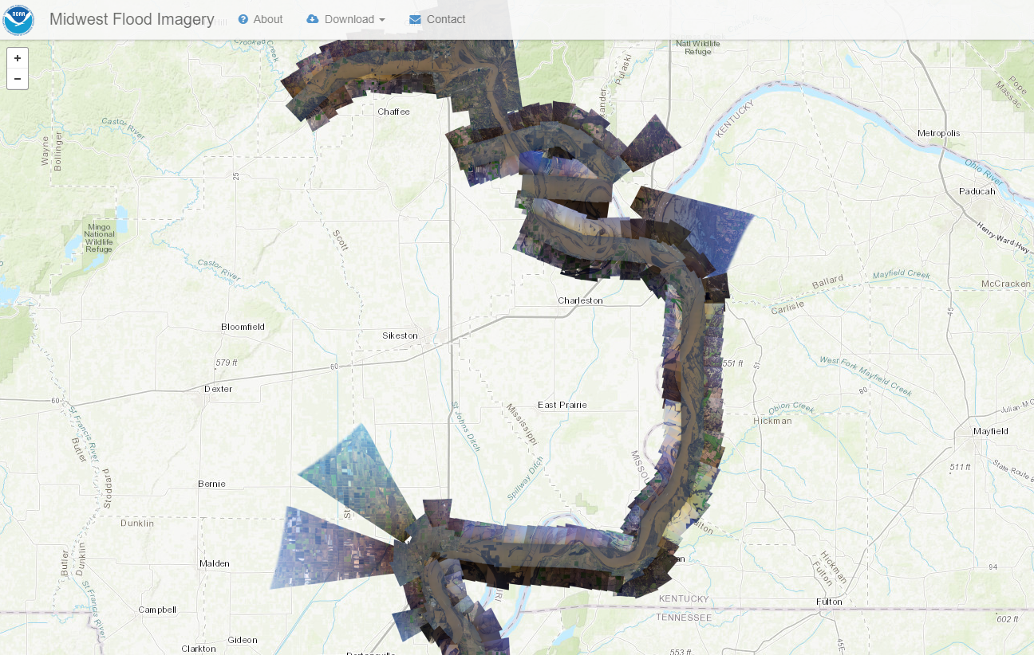
Emergency Response Imagery

Slide 31
NGS Overview
Modernizing the NSRS
CORS
NHMP
GRAV-D
ECO
NGS Products and Services
ASP
OPUS
VDatum
Orbit Data
National Shoreline
Geodetic Advisors
ERI
Antenna Calibrations
NCAT
CUSP
CBL
Outreach/COMET

Slide 32
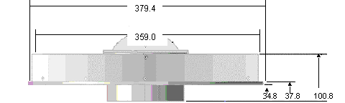
Phase Center Offset - conceptual
Orange dot = mean point of signal reception
Blue dot = Antenna Reference Point (ARP)
Red line = Phase Center Offset (PCO)

Slide 33
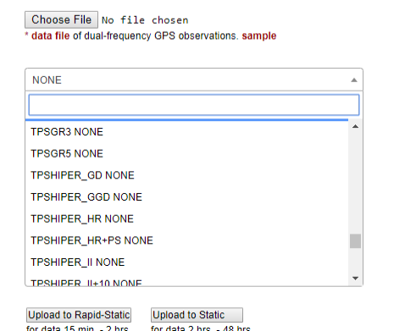
Phase Center Offset - conceptual
The PCO is one reason it is important to select the correct antenna for OPUS upload!

Slide 34
NGS Overview
Modernizing the NSRS
CORS
NHMP
GRAV-D
ECO
NGS Products and Services
ASP
OPUS
VDatum
Orbit Data
National Shoreline
Geodetic Advisors
ERI
Antenna Calibrations
NCAT
CUSP
CBL
Outreach/COMET

Slide 35
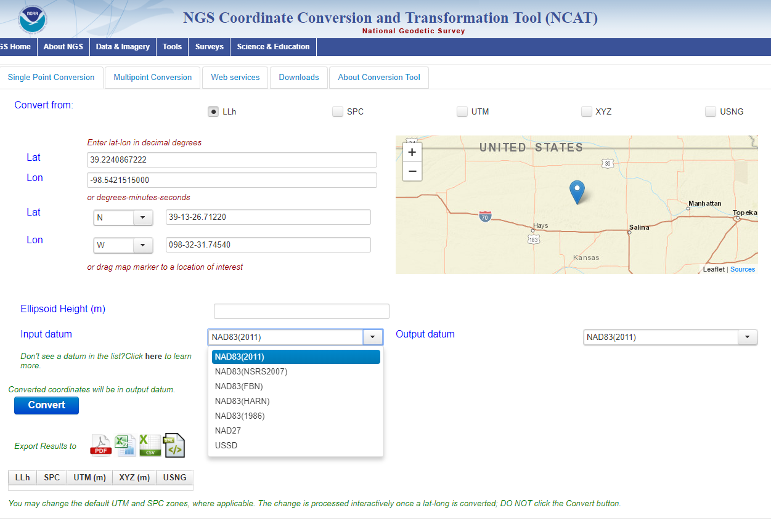
NGS Coordinate Conversion and Transformation Tool

Slide 36
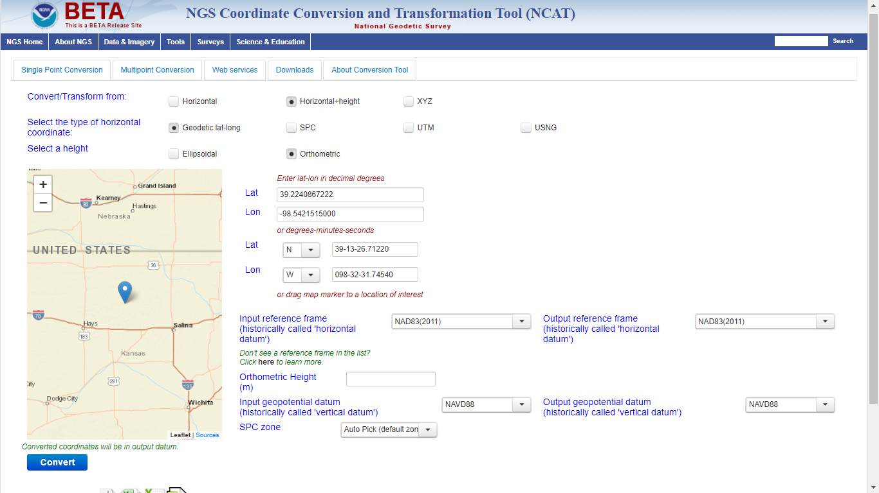
Beta NCAT – includes VERTCON 3.0 for NGVD29 to NAVD88 transformation

Slide 37
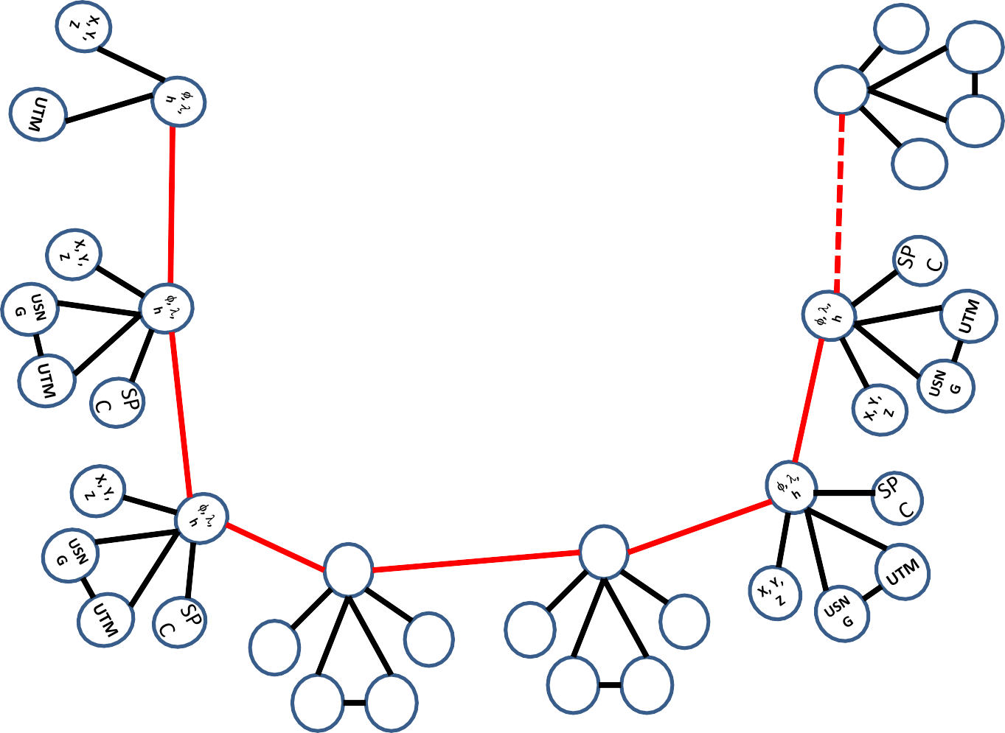
Coordinate Transformation Tool
SP
C
UTM
(NCAT / NADCON 5.0)
2022
φ, λ, h
USSD
USN
G
Relating coordinates: then & now
NAD 83 (2011)
X, Y,
Z
NAD 27
NAD 83 (NSRS2007)
NAD 83 (1986)
NAD 83 (FBN)
φ, λ, h
NAD 83 (HARN)
φ, λ, h
SP C
X, Y, Z
SP C
X, Y, Z
USN G
USN G
UTM
UTM

Slide 38
NGS Overview
Modernizing the NSRS
CORS
NHMP
GRAV-D
ECO
NGS Products and Services
ASP
OPUS
VDatum
Orbit Data
National Shoreline
Geodetic Advisors
ERI
Antenna Calibrations
NCAT
CUSP
CBL
Outreach/COMET

Slide 39
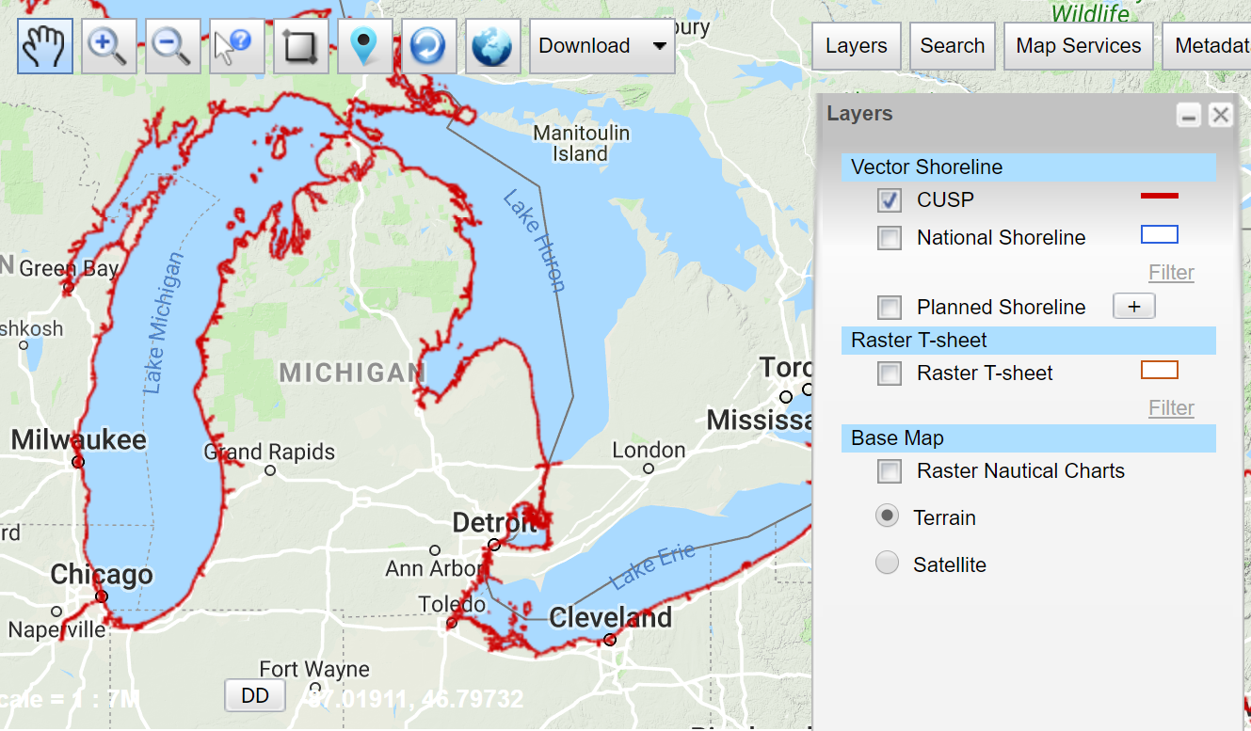
Continually Updated Shoreline Product
Just what it says, a dynamic product
Available for download as Shapefiles
Developed by image interpretation and/or vertical modeling using water level stations (tide or lake gages)
Referenced to a computed Mean High Water
hyperlink to the CUSP homepage

Slide 40
NGS Overview
Modernizing the NSRS
CORS
NHMP
GRAV-D
ECO
NGS Products and Services
ASP
OPUS
VDatum
Orbit Data
National Shoreline
Geodetic Advisors
ERI
Antenna Calibrations
NCAT
CUSP
CBL
Outreach/COMET

Slide 41
Calibration Base Lines
Three types of CBL defined by NGS
Primary CBL (PCBL): in Woodford, VA at NGS TTC; it is open for use to organizations like the PLSO
Federal CBL (FCBL): established with EDM checked at the NGS PCBL and IAW NOAA TM NGS-8
13 across Ohio, 1 reported unstable condition in Defiance
Cooperative CBL (CCBL): established with EDM checked on an FCBL and IAW that same NGS-8 manual

Slide 42
Calibration Base Lines
NGS commitment to the CBL Program:
A minimum of one FCBL per State
Establishment procedures document
Public access to the CBL database
Software to process your observations
Verification and re-measurement data review
Technical support (Advisors or other personnel)

Slide 43
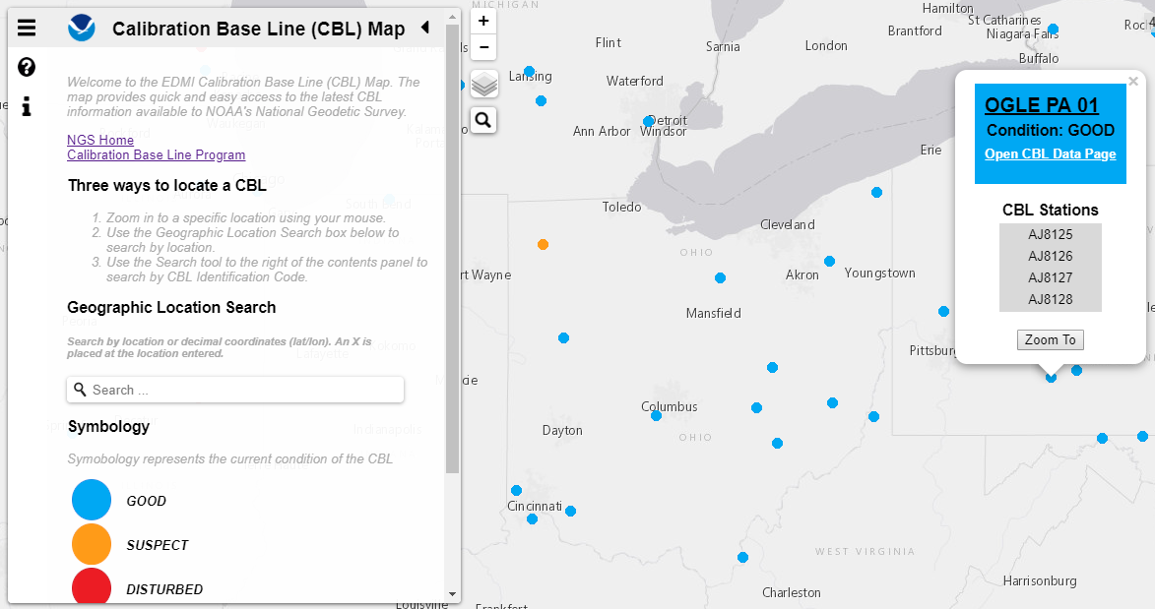
Beta CBL Map Viewer

Slide 44
NGS Overview
Modernizing the NSRS
CORS
NHMP
GRAV-D
ECO
NGS Products and Services
ASP
OPUS
VDatum
Orbit Data
National Shoreline
Geodetic Advisors
ERI
Antenna Calibrations
NCAT
CUSP
CBL
Outreach/COMET

Slide 45
Cooperative program for Operational Meteorology, Education, and Training
Meteorology… why?
The origin of the program was the National Weather Service, also a NOAA sub-agency.
It expanded to various NOAA missions, cinluding NGS

Slide 46
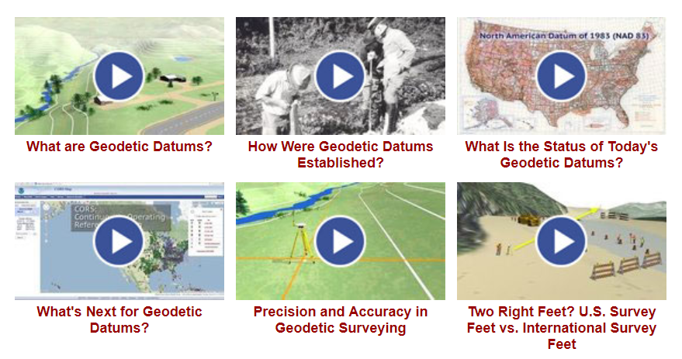
Outreach and COMET

Slide 47
Note on NGS Outreach
All the Regional Advisors are considered a part of the overall outreach mission.
Get in touch if you are coordinating a meeting, info session, or some sort of educational event.
Availability based on first-come first-serve and travel funding.

Slide 48
NGS Mission
To define, maintain and provide access to the National Spatial Reference System (NSRS) to meet our Nation’s economic, social, and environmental needs.

Slide 49
National Spatial Reference System (NSRS)
A consistent coordinate system that defines
latitude
longitude
height
scale
orientation
gravity
throughout the United States.
…and their time variants

Slide 50
National Spatial Reference System (NSRS)
These items ARE part of the NSRS
Horizontal Datums (aka Geometric Reference Frames) | Vertical Datums | Great Lakes Datums | Geoid Models | Transformations and Conversions
NAD83 | NAVD88 | IGLD85 | GEOID12A & B | NADCON
NAD27 | NGVD29 | IGLD55 | GEOID09 | VERTCON
USSD | VIVD09 |  | GEOID06
 | GUVD04 |  | GEOID03 | SPCS83
 | NMVD03 |  | GEOID99 | SPCS27
 | ASVD02 |  | GEOID96
 | PRVD02 |  | ALASKA94
 |  |  | GEOID93
 |  |  | GEOID90

Slide 51
National Spatial Reference System (NSRS)
These items are NOT part of the NSRS
Horizontal Datums (aka Geometric Reference Frames) | Vertical Datums | Geoid Models | Transformations and Conversions
WGS84 | IHRS (by IAG) | OSU91A | CORPSCON
WGS72 |  | EGM96 | Appendix B.6 of DMA TR 8350.2 (WGS 84)
ITRF (Intl. Terrestrial Reference Frame by IERS) |  | EGM2008 | Oregon Coordinate Reference System (ORCS)
IGS (Intl. GNSS Service reference frame) |  |  | The Kansas Regional Coordinate System
Hyperlink to ITRF station map

Slide 52
NSRS … do I have to use it?
Office of Management and Budget: Circular A-16
requires all Federal civilian agencies to utilize geodetic control for their geospatial activities
dictates DoC in responsible charge of that control
NGS has defined that control as the NSRS
FGCS has issued requirements, via FRNs, to reference data to the most recent components of the NSRS
1989 FRN designated NAD 83
1993 FRN designated NAVD 88
Hyperlink to NAVD88 FRN
Hyperlink to NAD83 FRN

Slide 53
NSRS … do I have to use it?
No, not really! But it is a good idea.
States may mandate use
State, Local, Regional entities, or the Private Sector have no requirement to maintain their data in reference to the NSRS
But if you want to get involved in survey contracting with the Federal Government it’s a necessity

Slide 54
Not just new datums…
NSRS Modernization
Replace NAD83
Replace NAVD88
Re-invent Bluebooking
Improve Geodetic Toolkit
Better Surveying Methods
Blueprint for 2022, Part 1
Blueprint for 2022, Part 2
Blueprint for 2022, Part 3

Slide 55
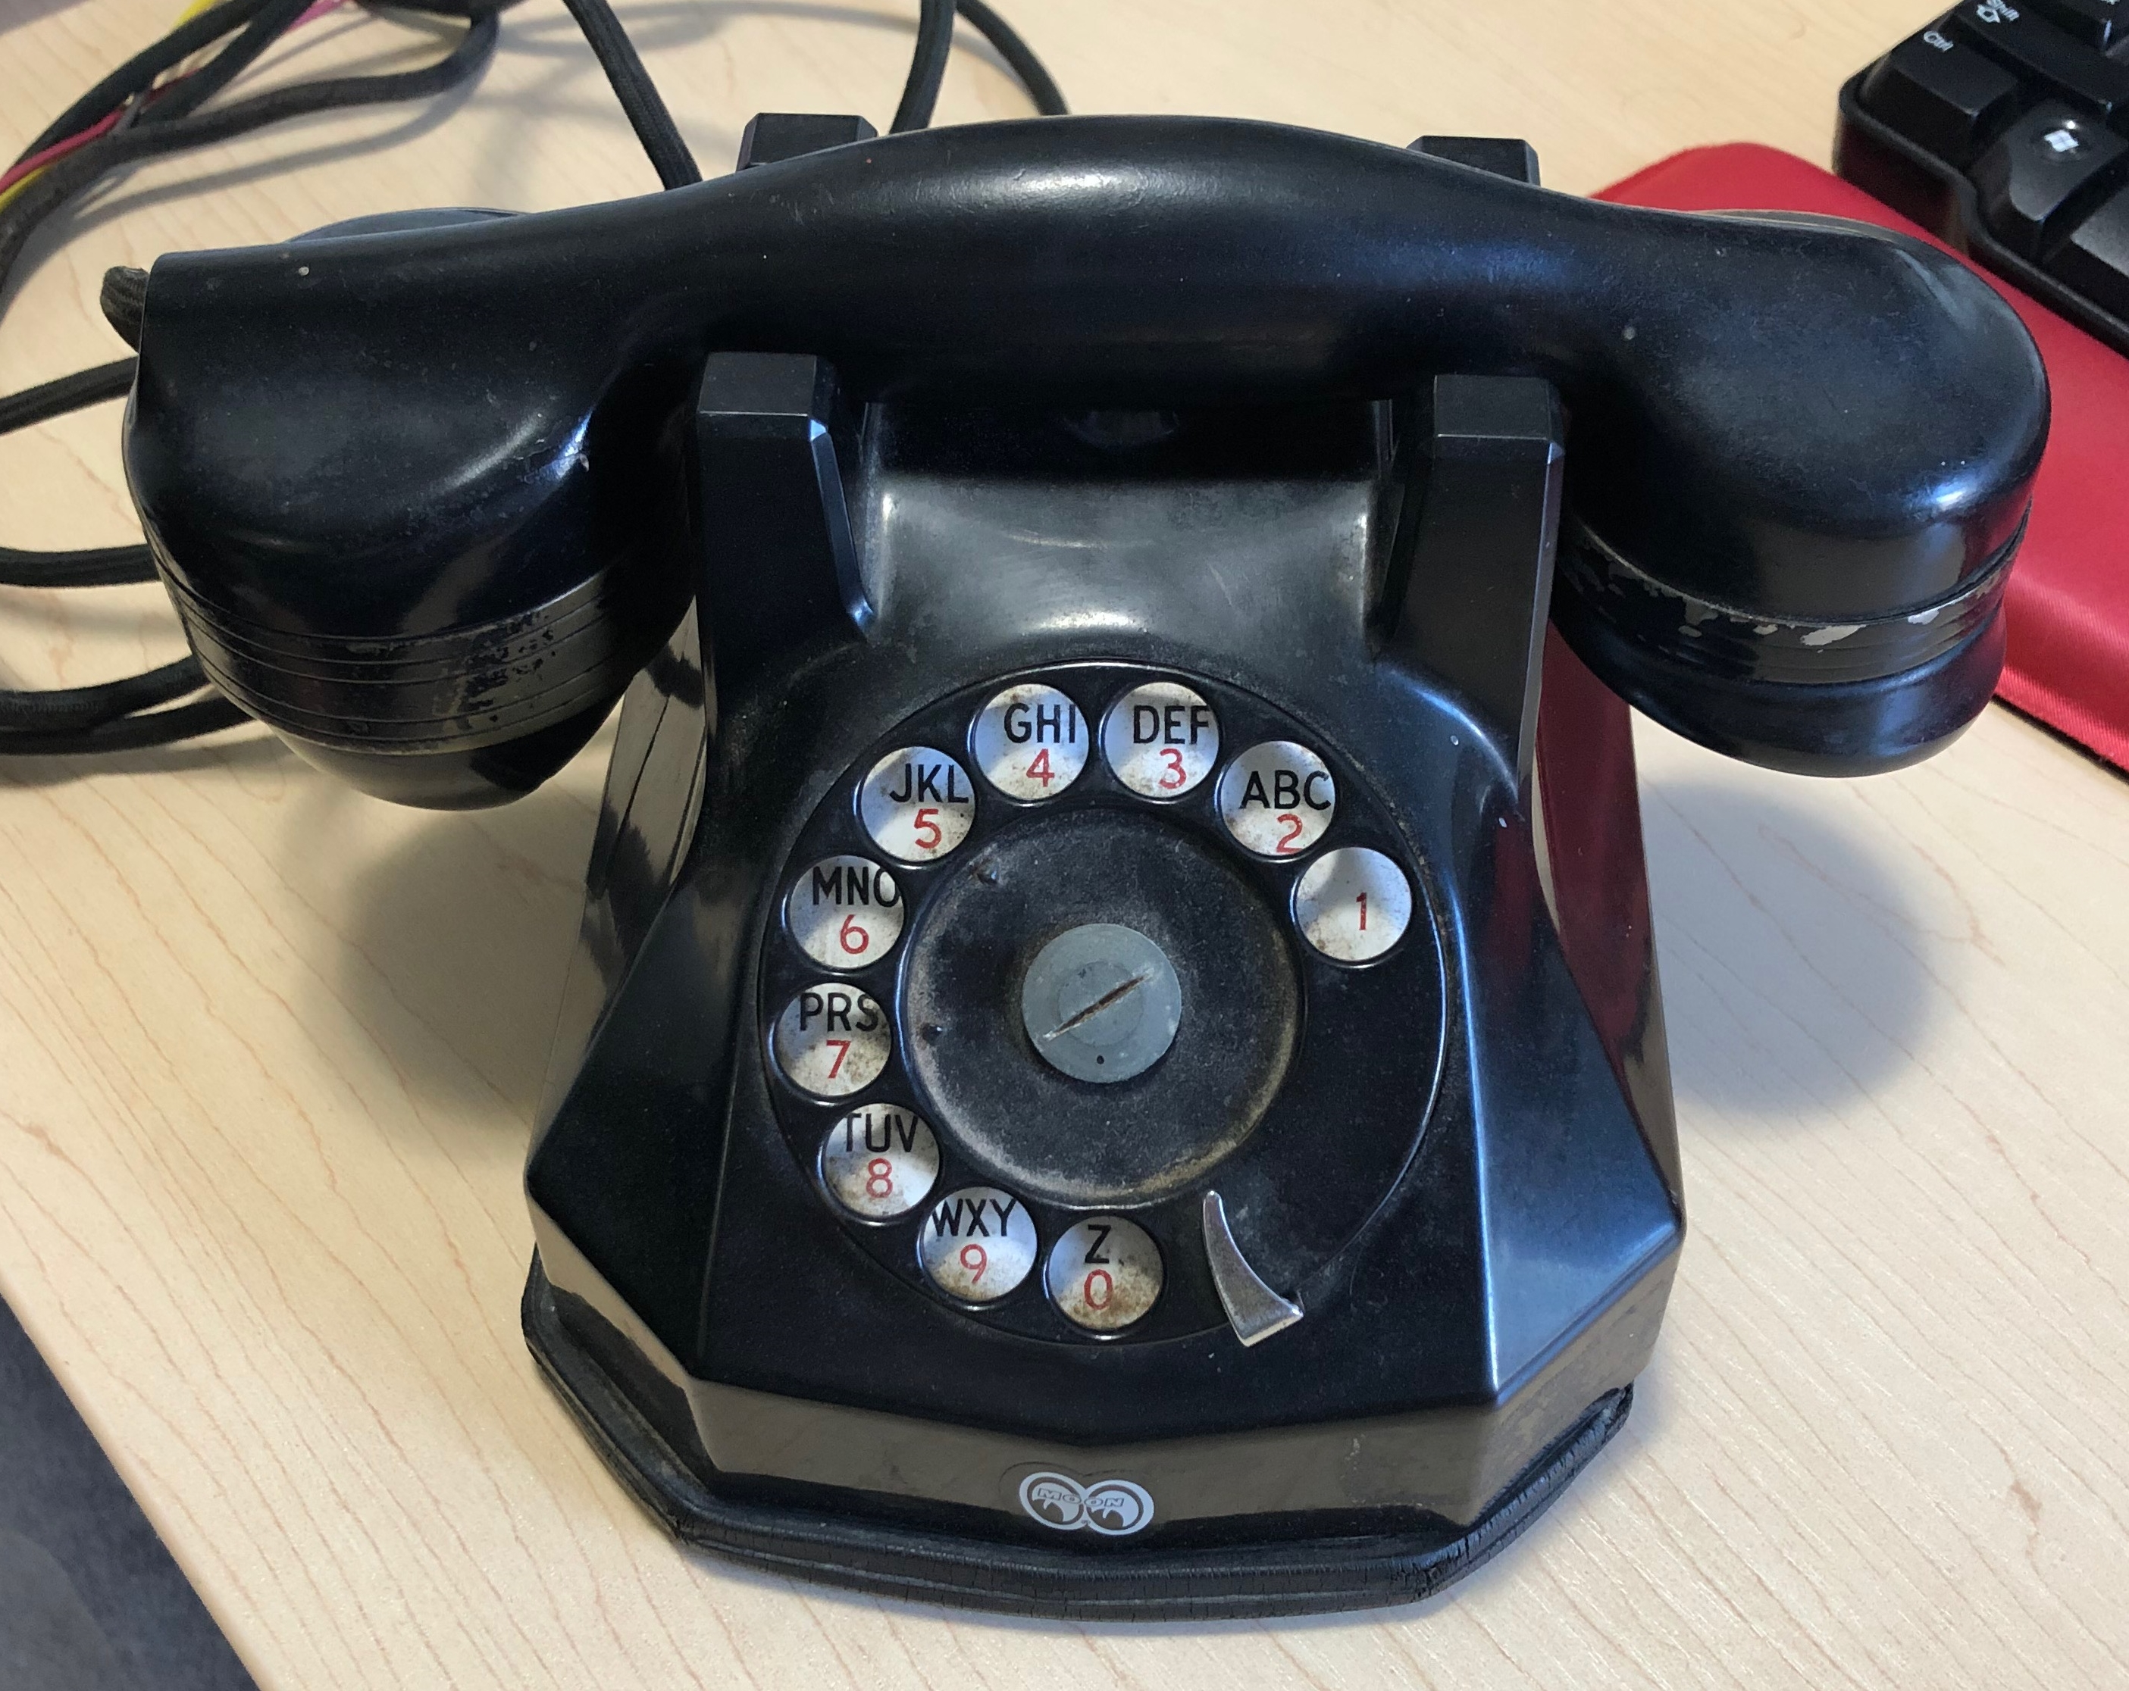
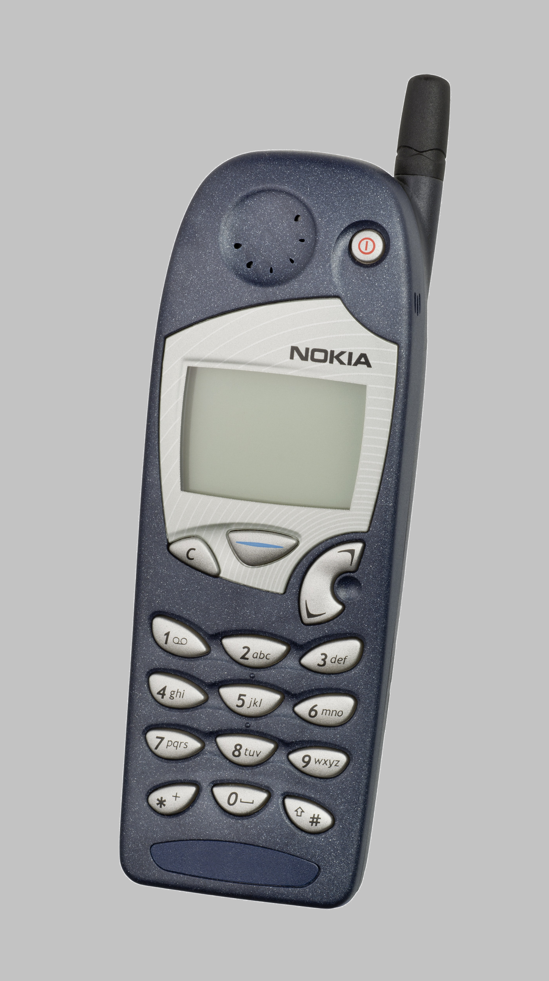
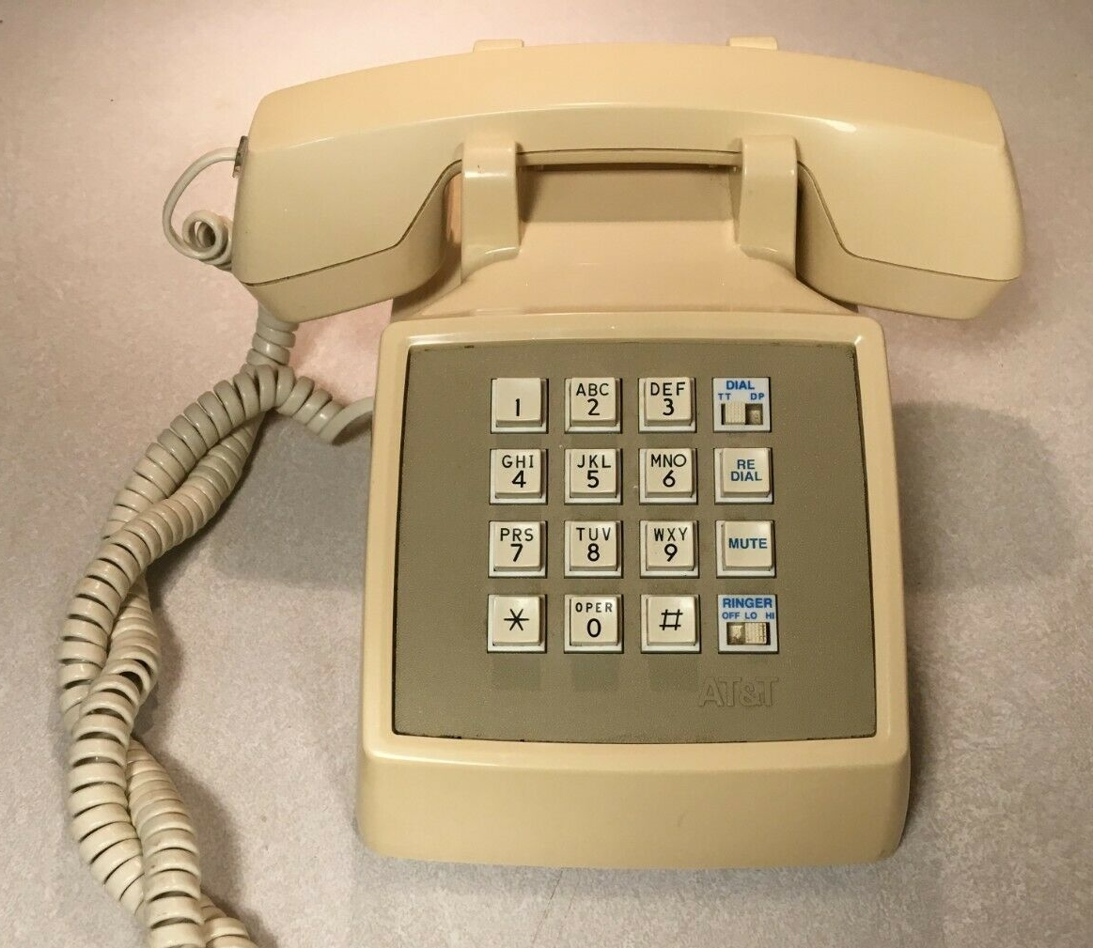
Evolution of the NSRS
NAD27
NAD83 (1986)
NAD83 (2011)

Slide 56
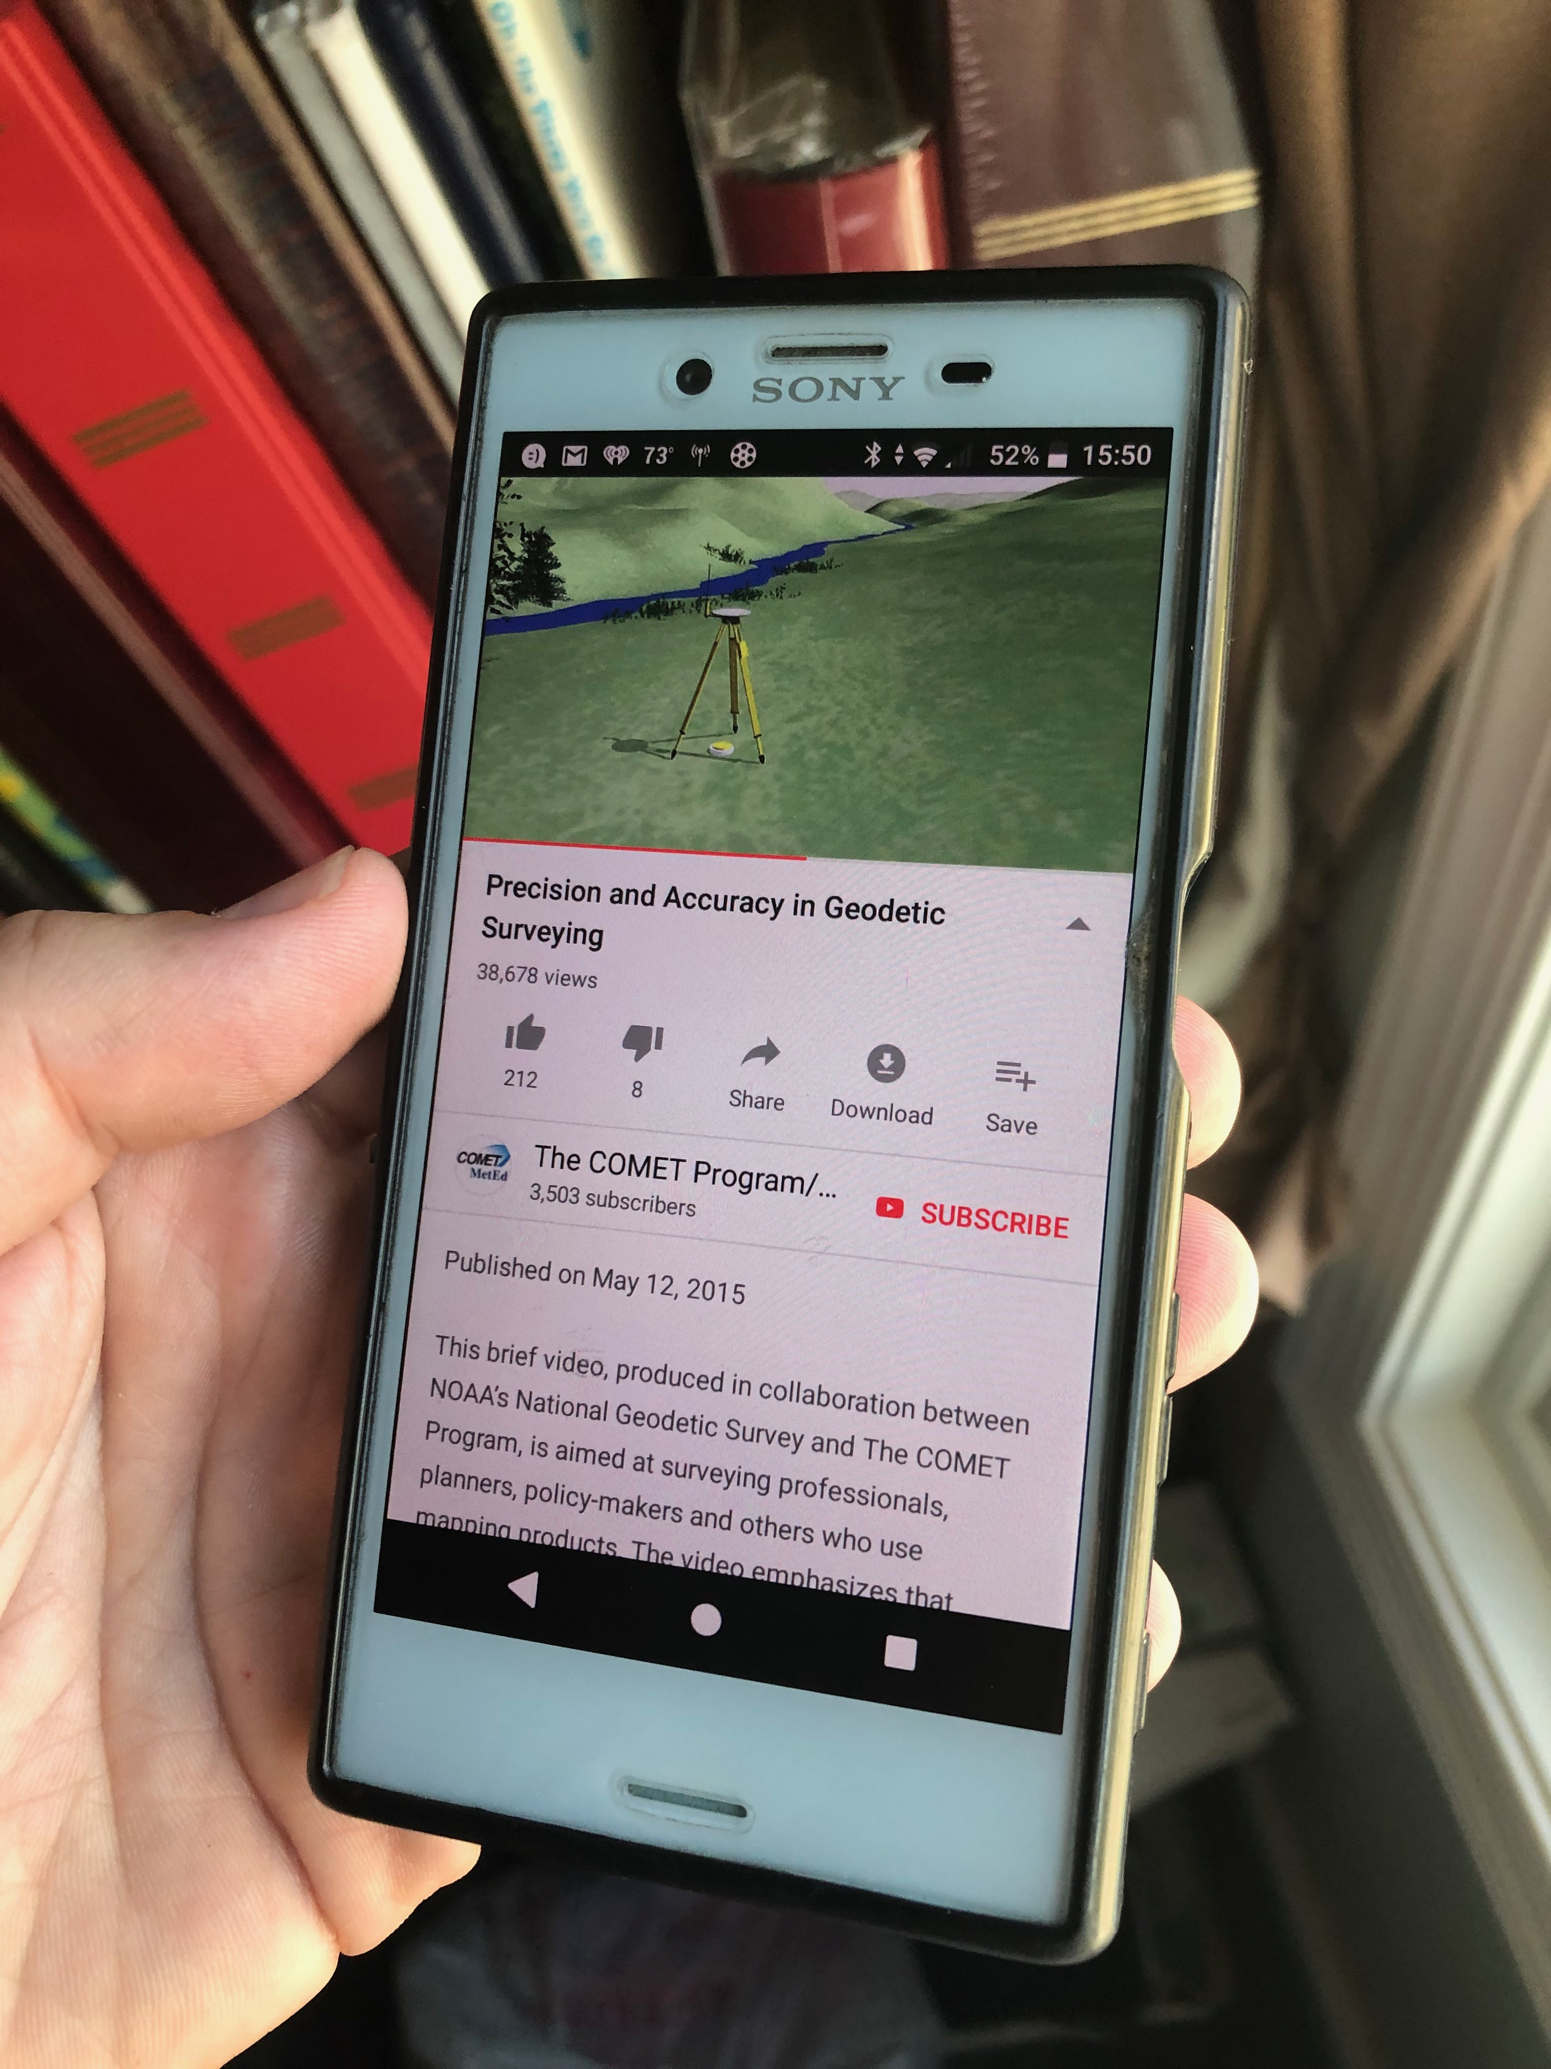
Modernized NSRS is our “smartphone”
You resisted it for a while…
It was a little cumbersome to get used to…
But you were soon hooked!

Slide 57
Two Major Components of Modernized NSRS
NATRF2022 – geometric (LLh)
NAPGD2022 – geopotential (H)

Slide 58
North American Terrestrial Reference Frame of 2022
NATRF2022
(pronounced: nat-ref)

Slide 59
Reference Frame ≈ Datum
Reference Frame is a more scientifically appropriate way of saying “datum”
could be debated that “datum” was misused
you will continue to see NGS use the phrase “New Datums” for 2022

Slide 60
Reference Frame Defined
A point of view or a ‘frame of reference’.
If your reference frame is North America, you are standing somewhere within North America, seeing how other places move from your point of view.

Slide 61
Why replace NAD83?
Main driver: Global Navigation Satellite System (GNSS)
ACCESS
GNSS equipment is fast, inexpensive, reliable
Reduces reliance on physical control marks
ACCURACY
Insensitive to distance-dependent errors
Immune to monument instability; active control via CORS
CONSISTENCY
Eliminates systematic errors in current datums
Aligned with global reference frames
Integrated system for both position and height

Slide 62
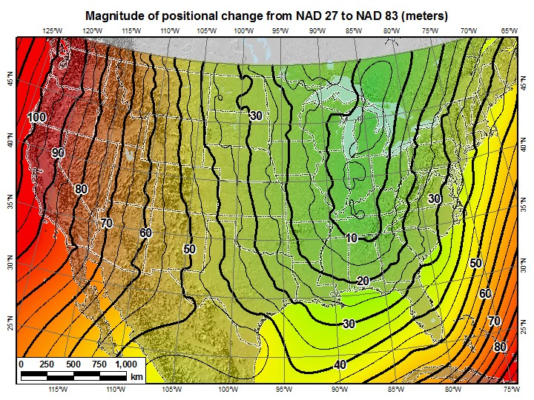
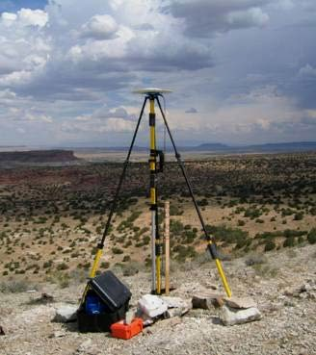
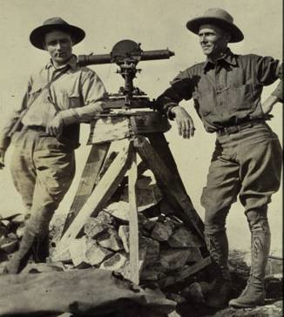
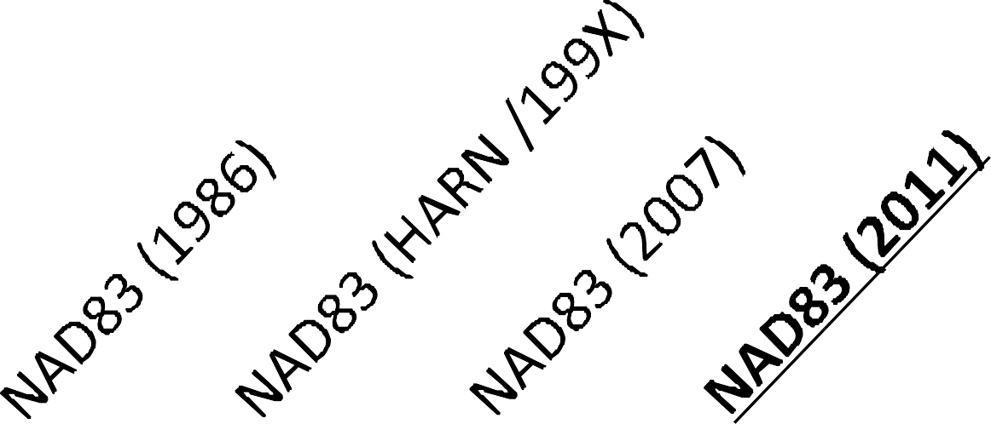
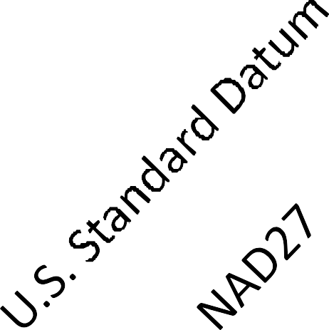
A very brief history of U.S. horizontal & geometric datums
GNSS
triangulation
NATRF2022
+
+
+
+
+
+
time
tens of meters
few 0.1m
few 0.01m
few 0.01m
<10 m
<2m
shift

Slide 63
Replacing NAD83
develop four "plate-fixed" reference frames
remove non-geocentricity of NAD83
align to ITRF2014 at epoch 2020.00
remove most of tectonic plate rotation from ITRF2014 via Euler Pole Parameters
(pronounced: “oiler”)
Shift and Drift…

Slide 64
Replacing NAD83
develop four "plate-fixed" reference frames
remove non-geocentricity of NAD83
align to ITRF2014 at epoch 2020.00
remove most of tectonic plate rotation from ITRF2014 via Euler Pole Parameters
(pronounced: “oiler”)
Shift and Drift…

Slide 65
Four “Plate-Fixed” Reference Frames
+
North American Terrestrial Reference Frame of 2022
(NATRF2022)
Pacific Terrestrial Reference Frame of 2022
(PATRF2022)
Caribbean Terrestrial Reference Frame of 2022
(CATRF2022)
Mariana Terrestrial Reference Frame of 2022
(MATRF2022)

Slide 66
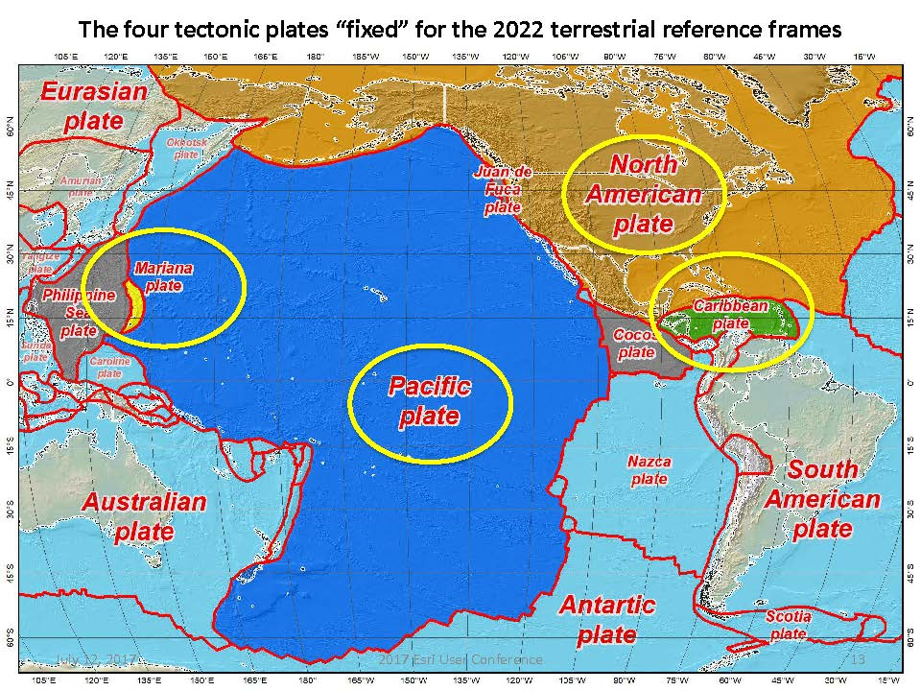


Slide 67
Four “Plate-Fixed” Reference Frames
North American Terrestrial Reference Frame of 2022
(NATRF2022)
Pacific Terrestrial Reference Frame of 2022
(PATRF2022)
Caribbean Terrestrial Reference Frame of 2022
(CATRF2022)
Mariana Terrestrial Reference Frame of 2022
(MATRF2022)

Slide 68
Replacing NAD83
develop four "plate-fixed" reference frames
remove non-geocentricity of NAD83
align to ITRF2014 at epoch 2020.00
remove most of tectonic plate rotation from ITRF2014 via Euler Pole Parameters
(pronounced: “oiler”)
Shift and Drift…

Slide 69
Non-geocentricity of NAD83
Earth’s
Surface
h₁₄
h₈₃
NAD83
origin
ITRF2014
origin
~2.2 meters
GRS80
ellipsoid

Slide 70
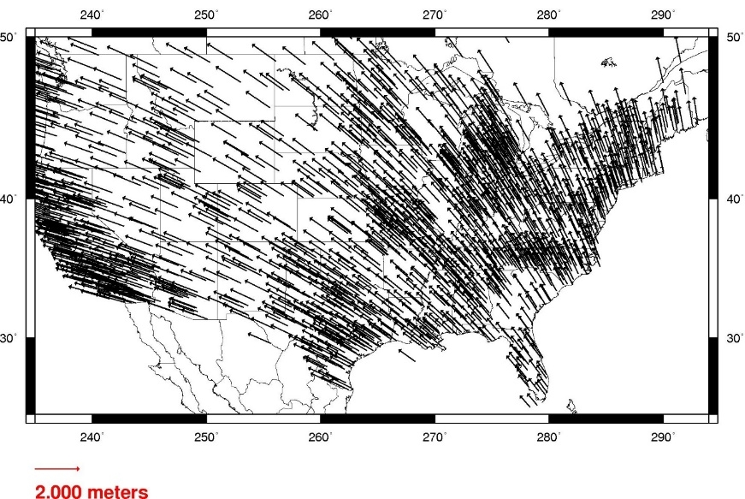
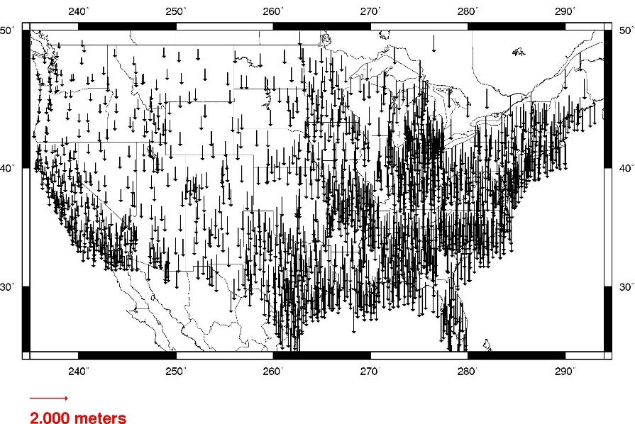
Geometric change due to ellipsoid non-geocentricity
Horizontal (Lat, Lon)
Ellipsoidal (h)
Shift…

Slide 71
Replacing NAD83
develop four "plate-fixed" reference frames
remove non-geocentricity of NAD83
align to ITRF2014 at epoch 2020.00
remove most of tectonic plate rotation from ITRF2014 via Euler Pole Parameters
(pronounced: “oiler”)
Shift and Drift…

Slide 72


International Terrestrial Reference Frame
(ITRF)
International Earth Rotation and Reference Systems Service (IERS)
International Union of Geodesy and Geophysics (IUGG)

Slide 73
International Terrestrial Reference Frame
The stable coordinate system that allows us to measure change over space, time and evolving technologies.
An accurate, stable set of station positions and velocities.
Network measurements interconnected by co-location of different space geodetic techniques.
“Approximately represents the motions of the tectonic plates with respect to the Earth's deep interior”… huh?

Slide 74
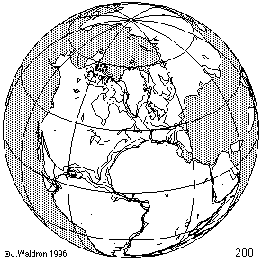
ITRF concept
Watch the grid!
Drift…

Slide 75
Replacing NAD83
develop four "plate-fixed" reference frames
remove non-geocentricity of NAD83
align to ITRF2014 at epoch 2020.00
remove most of tectonic plate rotation from ITRF2014 via Euler Pole Parameters
(pronounced: “oiler”)
Shift and Drift…

Slide 76
The wrong question, circa 2022:
“What’s the position of that point?”
The right question, circa 2022:
“What’s the position of that point, on some specific date?”
Drift…

Slide 77
Two types of drift
Tectonic Plate Rotation
horizontal
Everything Else
residual motions left after rotation
regional linear motions
localized subsidence or uplift
simple to model
complex

Slide 78
Tectonic Plate Rotation
horizontal
simple to model

Slide 79
Euler Pole Parameters
of 2022
EPP2022

Slide 80
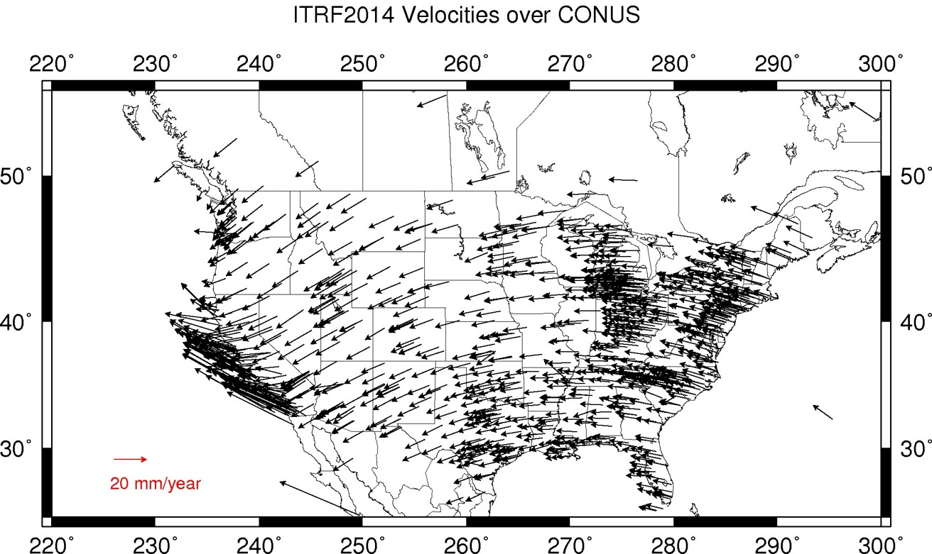
Plate Rotation visualized
Drift…

Slide 81

Euler Poles and “Plate-Fixed”
In the ITRF, many tectonic plates have a dominant motion: rotation
Euler Pole - point about which a plate rotates (yellow star)
NATRF2022 Euler Pole

Slide 82
Euler Poles and “Plate-Fixed”
ITRF
Frame = constant
NA Plate = rotating
NATRF
Frame = rotating
NA Plate = constant

Slide 83
Euler Poles and “Plate-Fixed”
ITRF
Frame = constant
NA Plate = rotating
NATRF
Frame = rotating
(relative to ITRF)
NA Plate = constant
(relative to NATRF2022)

Slide 84

ITRF – constant frame, rotating plate

Slide 85
“Plate-Fixed”
NATRF – rotating frame, constant with plate

Slide 86
ITRF or NATRF – your choice, just use EPP

Slide 87
EPP – Euler Pole Parameters
Latitude
Longitude
Rotation Speed
yellow star off west coast of S. America

Slide 88
CORS Velocities in ITRF2014
Drift…

Slide 89

CORS Velocities in NATRF2022
Think of this map as ITRF2014 + EPP2022
Still SomeDrift…

Slide 90
ITRF2014 + EPP2022 = --TRF2022
Rotation of the
North American Plate
The North American Terrestrial Reference Frame of 2022
(NATRF2022)
The Caribbean Terrestrial Reference Frame of 2022
(CATRF2022)
The Pacific Terrestrial Reference Frame of 2022
(PATRF2022)
The Mariana Terrestrial Reference Frame of 2022
(MATRF2022)
Rotation of the
Caribbean Plate
ITRF2014
Rotation of the
Pacific Plate
Rotation of the
Mariana Plate
EPP2022

Slide 91
ITRF2014 + EPP2022 = --TRF2022
Rotation of the
North American Plate
The North American Terrestrial Reference Frame of 2022
(NATRF2022)
The Caribbean Terrestrial Reference Frame of 2022
(CATRF2022)
The Pacific Terrestrial Reference Frame of 2022
(PATRF2022)
The Mariana Terrestrial Reference Frame of 2022
(MATRF2022)
EPP2022
ITRF2014

Slide 92
Two types of drift
Tectonic Plate Rotation
horizontal
Everything Else
residual motions left after rotation
regional linear motions
localized subsidence or uplift
simple to model
complex

Slide 93
Everything Else
residual motions left after rotation
regional linear motions
localized subsidence or uplift
Still SomeDrift…
complex

Slide 94
Intra-Frame Velocity Model of 2022
IFVM2022

Slide 95
Concept of goal of IFVM
Longitude (Easting) History of DI4044
Trend: -1.7 mm / year
RED IS NATRF2022
COORDINATE
Still Some Drift…
Trend: -14.3 mm / year
BLUE IS ITRF COORDINATE
2004 2006 2008 2010 2012 2014 2016 2018

Slide 96
Still Some Drift…
Everything in the world moves
Coordinates will be associated with the actual date when the data was collected!
Velocities at all marks can be estimated using this Intra-Frame Velocity Model
IFVM goal being to move collected data thru time to Reference Epochs for coordinate comparisons/analysis

Slide 97
Intra-Frame Velocity Model
A model of all residual velocities, after removal of tectonic rotation via EPP:
Horizontal residual motion
Total vertical motion (ellipsoid heights)
Replaces / Improves upon HTDP
Given t₁ and t₂, compute Df, Dl, Dh at any point, accounting for all motions (drifts, earthquakes, GIA, etc.)
Likely be built upon CORS data, geodynamic models and InSAR

Slide 98
EPP2022 – Euler Pole Parameters – Simple Rotation
Three parameters: lat, lon, rotation speed
Horizontal only: just latitude and longitude
Changes the frame: ITRF2014 + EPP2022 = NATRF2022
Does not change the epoch
IFVM2022 – Intra-Frame Velocity Model - Complex
Complex set of parameters
Residual horizontal motion: all the motion leftover after Euler Pole rotation
All vertical motion: localized subsidence or uplift
Changes the epoch
Does not change the frame: “intra” = on the inside; within

Slide 99
EPP2022 IFVM2022
Two new tools that will make time dependent geodetic control practical
They work together to account for the Drift…

Slide 100
Example of application of EPP and IFVM
It’s 2039 and you are working in San Diego using NATRF2022
And you need to compare your work to another survey from 2028
Important: This slide only covers geometric coordinates.
…the catch is, that survey was done in PATRF2022
PATRF2022
ep. 2028.048
EPP2022
(PA)
ITRF2014
ep. 2028.048
EPP2022
(NA)
NATRF2022
ep. 2028.048
IFVM2022
(PA)
IFVM2022
(NA)
PATRF2022
ep. 2039.704
EPP2022
(PA)
ITRF2014
ep. 2039.704
EPP2022
(NA)
NATRF2022
ep. 2039.704

Slide 101
Alright Jeff... enough jibba-jabba, what’s the impact?

Slide 102


Slide 103

What’s that going to look like?
PHOTO = NAD83
RED = NAD83 shoreline data
GREEN = shoreline transformed to NATRF2022

Slide 104

If you’re only working in this region…
North American Terrestrial Reference Frame of 2022
(NATRF2022)

Slide 105
North American-Pacific Geopotential Datum of 2022
NAPGD2022
(pronounced: nap-jee-dee)

Slide 106
A very brief history of (the most prevalent) U.S. vertical datums

Slide 107

NGVD29
The National Geodetic Vertical Datum of 1929 is referenced to 26 tide gauges in the US and Canada

Slide 108

NAVD 88
Referenced to 1 Tide Gauge
(Father’s Point)
NGVD 29
Referenced to 26 Tide Gages
-11 cm
125 cm
-23 cm
85 cm
102 cm
NAVD88 minus LMSL(1960-1978)
70 cm
-11 cm
4 cm
-23 cm

Slide 109



Why Replace NAVD88?
tilt/bias in zero reference surface
subsidence, uplift, freeze/thaw of BMs
limited access, availability of undisturbed marks
Approximate Error in NAVD88 "zero elevation”

Slide 110
Known Issues with NAVD88
tilt/bias in zero reference surface
subsidence, uplift, freeze/thaw of BMs
limited access, availability of undisturbed marks
Approximate Error in NAVD88 "zero elevation”

Slide 111

Passive marks may lie still… but they still may lie! small instability x long time = large inaccuracy

Slide 112
Replacing NAVD88
primary access via GNSS and geoid (OPUS, etc.)
accurate continental gravimetric geoid (1-2 cm)
aligned with:
NATRF2022 (or CATRF, PATRF, MATRF)
global mean sea level (GMSL)
monitor time-varying nature of gravity (NGS Geoid Monitoring Service GeMS)

Slide 113
Replacing NAVD88
Two types of geoid models
Gravimetric
Hybrid

Slide 114
Replacing NAVD88
Gravimetric geoid is created from “scratch” with various types of gravity data
USGG2003, USGG2009, USGG2012, xGEOID19
Hybrid geoid is simply a gravimetric geoid warped to fit some vertical datum… like NAVD88
GEOID03, GEOID09, GEOID12B, GEOID18

Slide 115
Replacing NAVD88
USGG2003, USGG2009, USGG2012, xGEOID19
GEOID03, GEOID09, GEOID12B, GEOID18
best fit to NAVD88
best fit to NAVD88
best fit to NAVD88
best fit to NAVD88

Slide 116








Building a Geopotential Field Model
Long Wavelengths
(> 250 km)
GRACE/GOCE/Satellite Altimetry
+
Intermediate Wavelengths
(20km to 300 km)
Airborne Observations
(GRAV-D)
Short Wavelengths (< 100 km)
Terrestrial/Surface Measurement and Predicted Gravity from Topography

Slide 117

GRACE - 2 Satellites measuring separation

Slide 118

GRAV-D – airborne relative gravimeters

Slide 119

Terrestrial Gravimeter - Relative

Slide 120

Terrestrial Gravimeter - Relative

Slide 121

Terrestrial Gravimeter - Absolute

Slide 122

Terrestrial Gravimeters - Absolute and Relative

Slide 123
Individual Components of NAPGD2022
global model of the geopotential field
GM2022
geoid undulation models by region
GEOID2022 aka “0 elevation”
deflection of the vertical (DoV) models by region
DEFLEC2022
surface gravity models by region
GRAV2022
static – SGRAV2022
dynamic – DGRAV2022

Slide 124

Sea Level Change and the Geoid

Slide 125

Sea Level Change and the Geoid

Slide 126

Sea Level Change and the Geoid

Slide 127

Estimated change in orthometric heights from NAVD88 to NAPGD2022
(NAPGD2022 approximated using xGEOID16B)

Slide 128


Estimated change in orthometric heights from NAVD88 to NAPGD2022
(NAPGD2022 approximated using xGEOID16B)
Vertical change of about -0.6 to -2.0 feet

Slide 129

North American-Pacific Geopotential Datum of 2022
(NAPGD2022)

Slide 130
Where did this all start? How is all this possible? And what will users get out of it?
Well, besides learning a whole new set of terminology and methods…

Slide 131

National Geodetic Survey Ten-Year Strategic Plan
By 2022, reduce all definitional & access-related errors in geometric reference frame to 1 cm when using 15 min of GNSS data
aka “Replace NAD83”
By 2022, reduce all definitional & access-related errors in orthometric heights in geopotential datum to 2 cm when using 15 min of GNSS data
aka “Replace NAVD88”
https://geodesy.noaa.gov/web/about_ngs/info/tenyearfinal.shtml

Slide 132

How is all this possible?
CORS
Co-location of space geodetic instruments worldwide
Teamwork with other geodetic organizations
Research and Development
Testing
Science!

Slide 133





Co-location Site
NASA Goddard Space Flight Center, Greenbelt MD, USA
GNSS, SLR, VLBI, DORIS

Slide 134

Co-location Site
NASA Goddard Space Flight Center, Greenbelt MD, USA
GNSS, SLR, VLBI, DORIS

Slide 135
Co-location Site
NASA Goddard Space Flight Center, Greenbelt MD, USA
GNSS, SLR, VLBI, DORIS

Slide 136
SLR
Satellite Laser Ranging

Slide 137


Slide 138
Co-location Site
NASA Goddard Space Flight Center, Greenbelt MD, USA
GNSS, SLR, VLBI, DORIS

Slide 139
VLBI
Very Long Baseline Interferometry

Slide 140

VLBI

Slide 141
Co-location Site
NASA Goddard Space Flight Center, Greenbelt MD, USA
GNSS, SLR, VLBI, DORIS

Slide 142
DORIS
Doppler Orbitography and Radiopositioning Integrated by Satellite

Slide 143

Doppler Orbitography and Radiopositioning Integrated by Satellite

Slide 144

Space Geodesy Co-location Diagram
Generic concept of “co-location survey”, typically more complex.

Slide 145


Altogether now!
All these techniques work together to create a well-defined, robust reference frame that improves positioning for users globally.

Slide 146
Not just new datums…
NSRS Modernization
-OPUS enhancements/additions
-new types of coordinates
-new methods for establishing control
-streamlined Bluebooking

Slide 147
https://www.ngs.noaa.gov/ADVISORS/
-use any major search engine: “NGS advisors”
Jeff Jalbrzikowski, P.S., GISP
Appalachian Regional Geodetic Advisor
jeff.jalbrzikowski@noaa.gov
240-988-5486

