Slide 1
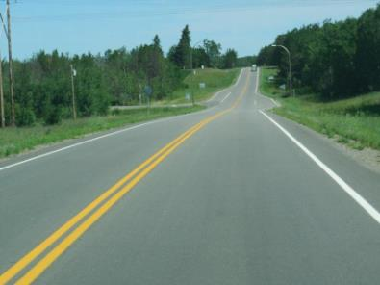
Paving the Road to the Future NSRS*
*National Spatial Reference System
Overview of the status of NGS’ current critical tools and point to resources which explain how geospatial professionals can expect to work with the new NSRS, including the expanded role of the OPUS service.
Minnesota Department of Transportation Bituminous Manual, 2019, page 16
November 01, 2021
Notes:
Welcome to “Paving the Road to the Future NSRS”

Slide 2


Lynda Bell
lynda.bell@noaa.gov
National Geodetic Survey
Advisor, Southwest Region
Arizona, New Mexico, Utah
David Zenk
dave.zenk@noaa.gov
National Geodetic Survey
Advisor, Northern Plains Region
Minnesota, North Dakota, South Dakota, Iowa, and Nebraska
Notes:
I’m Lynda Bell, the National Geodetic Survey Advisor for the Southwest Region.
I’m David Zenk, the National Geodetic Survey Advisor for the Northern Plains Region.
We will be your narrators for this presentation.

Slide 3
Focus on the present and anticipate the future.
The road to NSRS includes:
  supporting and improving the existing datum and tools, as well as
  building the all new science and tools that will be needed to fully enable the new datum.
NGS has written and published the needed preview and planning documents in support of NSRS.
This presentation will focus primarily on the status and improvements to current tools which support the present and which anticipate the future.
Notes:
The road to the future NSRS includes supporting the present datums and tools while also building the science and tools that will enable the future datum.
Since NGS has written and published the needed preview and planning documents in support of NSRS - this presentation will focus primarily on the status of the current tools and recent improvements of them.

Slide 4
Guide toward online NGS Tools
The presentation will be a guide to the location and content of the many online NGS Tools.
The scope will not allow for in-depth exploration of any single tool, since NGS is focusing on making sure you have on-demand resources for self-training.
My goal is that you will learn about the existence and the location of the tools you need for your job.
Notes:
The presentation will be a guide to the location and content of the many online NGS Tools.
However, the scope will not allow for in-depth exploration of any single tool, since NGS is focusing on making sure you have on-demand resources for self-training.
Our goal is that you will learn about the existence and the location of the tools that you need for your job.

Slide 5


At NGS, Science and Detail Matter
https://www.dot.state.mn.us/mnroad/roadresearch.html
Delayed Release of the Modernized NSRS
NOAA’s National Geodetic Survey (NGS) is announcing a delay in the release of the modernized National Spatial Reference System (NSRS).
NGS is currently conducting a comprehensive analysis of ongoing projects, programs, and resources required to complete NSRS modernization and will continue to provide regular updates on our progress. To get the latest news on NSRS modernization and track our progress, subscribe to NGS News or visit our "New Datums" web pages.
Notes:
At NGS, Science and Detail Matter.
NGS is conducting a comprehensive analysis of its ongoing projects, programs, and resources that are required for the NSRS modernization.
Developing a scientifically correct datum and having all the needed data and techniques available has necessitated a delay in the earlier anticipated schedule.
The NGS’ “New Datums” page will have periodic updates.
Lynda!

Slide 6
NGS Webpage – Your Starting Point
NGS Webpage Layout
Notes:
The NGS Webpage is your starting point for all NGS resources and tools.
So, let’s begin there.

Slide 7
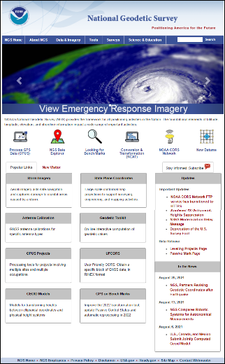
The NGS Webpage – Layout
The NGS webpage is organized by
Topic groups
Popular topics
Featured/popular links.
Some links appear in several places – example
“NGS Data Explorer”
Notes:
The NGS webpage is organized in 3 sections -
Topic groups – where related subjects are gathered together
Popular topics – which feature often searched for topics with icons, and
Featured/popular links – listed in a newspaper style.
Note that some links may be found in several places – example: the “NGS Data Explorer”

Slide 8
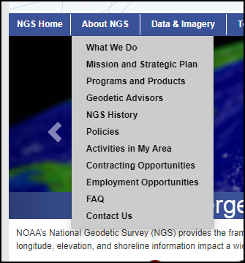
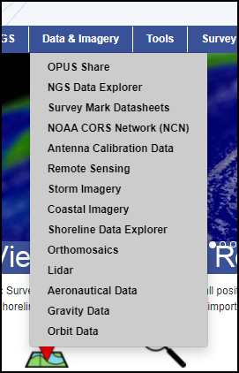
TOPIC Groups
ABOUT NGS Group
DATA & IMAGERY Group
Notes:
The ABOUT NGS Group focuses on high-level general topics that help you learn about the NGS and its mission.
The NGS Strategic Plan is posted here – as is the link to the Geodetic Advisors page.
The DATA and IMAGERY Group focuses on various data and imagery that NGS makes available.
The NGS Data Explorer is located here and so is recent Storm Imagery.

Slide 9
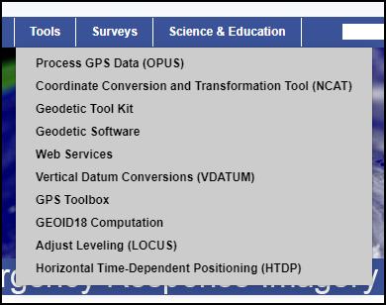
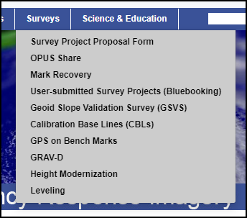
TOPIC Groups
TOOLS Group
SURVEYS Group
Notes:
The TOOLS Group focuses on the Tools and Software that are needed for geodetic purposes.
OPUS and NCAT are found here.
The SURVEYS Group focuses on supporting materials and descriptions of NGS survey projects.
OPUS SHARE, Mark Recovery, and GPS on BM are available here.

Slide 10
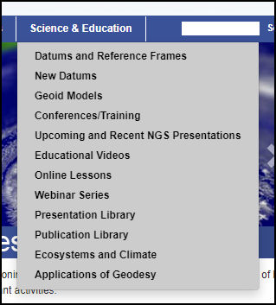
TOPIC Groups
SCIENCE AND EDUCATION Group
Notes:
The SCIENCE AND EDUCATION Group focuses on the many self-education and teaching resources that NGS has produced.
In particular, surveyors will be interested in
New Datums
Webinar Series – both recorded and upcoming webinars.
Presentations Library and the
Publications Library

Slide 11
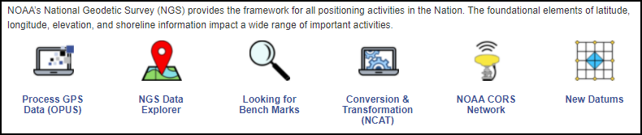

POPULAR Topics
The SUBSCRIBE link
For NGS Newsletters and webinar notices
Notes:
Moving on to POPULAR TOPICS, there are 6 ICONS representing some frequently accessed NGS webpages.
Note that the “SUBSCRIBE to NGS Newsletters” link is here too.

Slide 12
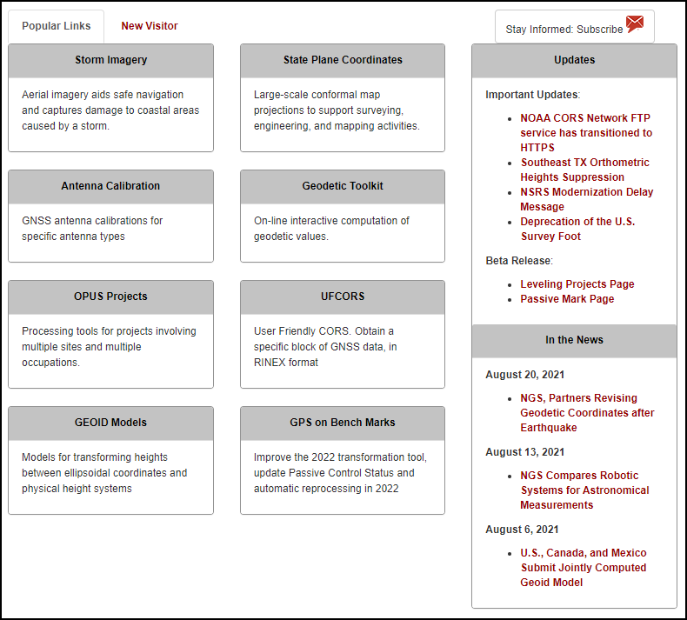
FEATURED / POPULAR links
Some links appear in several places.
Notes:
The FEATURED / POPULAR links are listed in a newspaper-style and may change from time-to-time.
Dave!

Slide 13
NGS Road Map
NGS Strategic Plan
Notes:
The NGS is following its Strategic Plan, which I view as a sort of road map to the future.

Slide 14

The Road Map
NGS Activities can be viewed as
Building the Bridge between Datums
Supporting the Current Datum
Building the New Datum
http://www.dot.state.mn.us/stcroixcrossing/
Notes:
No such road would be complete without a bridge between the present and the future.

Slide 15
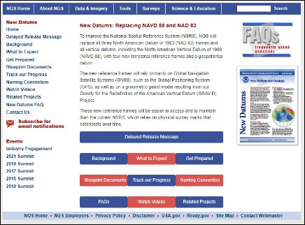
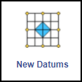
Building the New Datum
This presentation will focus more on current datums and near-term enhancements.
But, there are several existing presentations available for you which look closely at the building blocks of the new datum.
Refer to NEW DATUMS
  Blueprints 1,2,&3
  FAQ’s
  Related Projects
Notes:
This presentation will focus more on the current datums and their near-term enhancements.
But, there are several existing presentations available which look more closely at the building blocks of the new datum.
Refer to the NEW DATUMS page, specifically
Blueprints 1,2,&3
the FAQ’s
Related Projects

Slide 16
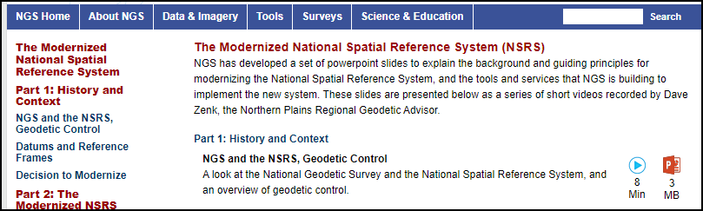
Building the New Datum
NSRS Official Presentation on New Datums (Blueprints 1,2,&3)
  The Modernized National Spatial Reference System (NSRS)
  12 parts, 2.5 hours total
https://geodesy.noaa.gov/training/nsrs-modernization/index.shtml
Notes:
And, there is a 12 part, 2.5 hour recording of the NSRS Official Presentation on New Datums
(focusing on Blueprints 1,2,&3)

Slide 17
What is Geodetic Control
How to Obtain Existing Geodetic Control
Notes:
Let’s now focus on what geodetic control is and how to obtain it.

Slide 18

NGS Mission
Mission
  To define, maintain, and provide access to the National Spatial Reference System (NSRS) to meet our nation’s economic, social, and environmental needs.
    NGS Strategic Plan 2019-2023, page 7
“provide access” has generally meant providing geodetic control.
Notes:
The NGS’ Mission is
“To define, maintain, and provide access to the National Spatial Reference System (the NSRS) to meet our nation’s economic, social, and environmental needs.”
(this is from the - NGS Strategic Plan 2019-2023, page 7)
“…provide access to the NSRS…”
has generally meant providing “geodetic control”.

Slide 19
What is Geodetic Control
Geodetic Control is what is in the NSRS and is published on NGS Datasheets. (but see next 2 slides)
What is NOT Geodetic Control
  OPUS STATIC results
  OPUS RAPID STATIC results
  OPUS SHARE results
  OPUS PROJECTS results
    unless submitted, reviewed, accepted, and published on datasheets.
One could and should say that OPUS results are
TIED TO, but are not PART OF the NSRS.
Notes:
So, what is geodetic control?
Geodetic Control is what is in the NSRS and is published on NGS Datasheets.
(but see next 2 slides for a better description )
What is NOT Geodetic Control includes:
OPUS STATIC results
OPUS RAPID STATIC results
OPUS SHARE results
OPUS PROJECTS results - unless submitted, reviewed, accepted, and published on datasheets.
One could and should say that OPUS results are TIED TO, but are not PART OF the NSRS.

Slide 20
Users Can Create New Geodetic Control by Submitting (bluebook) using OPUS PROJECTS
Bluebooking leads to the updated geodetic control on NGS datasheets
Geodetic control surveys are usually performed to establish the basic positional framework from which supplemental surveying and mapping are performed. Geodetic control surveys are distinguished by use of redundant, interconnected, permanently monumented control points that comprise the National Spatial Reference System (NSRS) or are often incorporated into NSRS.
Geodetic control surveys are performed to far more rigorous accuracy and quality assurance standards than those for local control surveys for general engineering, construction, or topographic mapping purposes. Geodetic control surveys included in NSRS meet automated data recording, submittal, project review, and least squares adjustment requirements established by the Federal Geodetic Control Subcommittee (FGCS).
Federal Geographic Data Committee, FGDC-STD-014.4-2008
Geographic Information Framework Data Content Standard
Part 4: Geodetic Control 1 1 Scope
https://www.fgdc.gov/standards/projects/framework-data-standard/GI_FrameworkDataStandard_Part4_GeodeticControl.pdf
Notes:
NGS has recently released OPUS PROJECTS (version 4.0) to enable users to submit and create new geodetic control.
Here’s an explanation about what geodetic control is as published in the:
Federal Geographic Data Committee
Geographic Information Framework Data Content Standard
Part 4: Geodetic Control, Section 1 1 - Scope
(see the hyperlink on the slide)
Note the keywords – redundant – more rigorous – network

Slide 21
Users Can Create New Geodetic Control by Submitting (bluebook) using OPUS PROJECTS
An OPUS Share solution is simply a result of taking one GPS receiver out, occupying one mark for a number of hours, and submitting this dataset to NGS.
  It does not have the requisite redundancy and does not meet automated data recording, submittal, project review, and least squares adjustment requirements established by the Federal Geodetic Control Subcommittee (FGCS).
So, OPUS Share solutions cannot be included in the NSRS as geodetic control.
Notes:
It is clear that an OPUS Share solution lacks redundancy and is not subjected to the considerable rigor that is applied to the publication process.
So, OPUS Share solutions cannot be included in the NSRS as geodetic control.

Slide 22
Let’s Locate Existing Control
NGS provides several important ways to locate existing control as needed for your project.
  Map Search
    (via the Data Explorer tool)
  Text Searches
    (by PID, by designation, by lat/lon, archived datasheets by state, etc.)
  DSWorld software
    (download from NGS)
Notes:
NGS provides several important ways to locate existing control as needed for your project.
Map Search (via the Data Explorer tool)
Text Searches (by PID, by designation, by lat/lon, archived datasheets by state) and
DSWorld software (download from NGS)

Slide 23
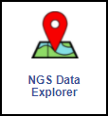
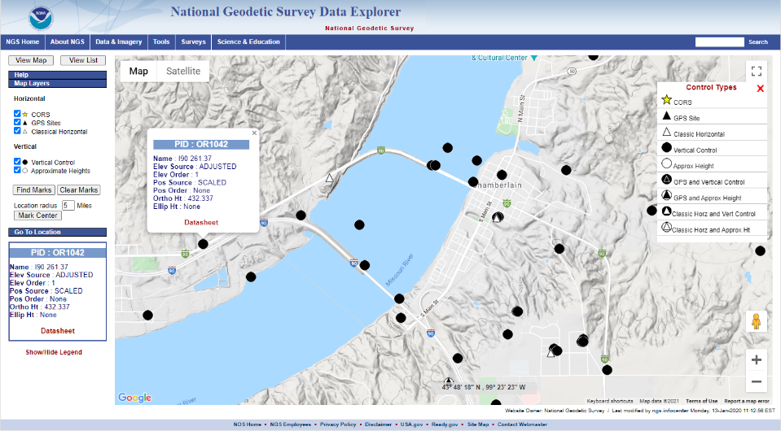
Map Search - Data Explorer Tool
Chamberlain SD
Notes:
You can reach the NGS Data Explorer by clicking on the icon.
Then, zoom in on the area of interest.
“Find Marks” will search and display nearby control marks.
Then, click on a symbol to pop-up an informational balloon to show some of the mark’s data.
Finally click on the Datasheet link.

Slide 24

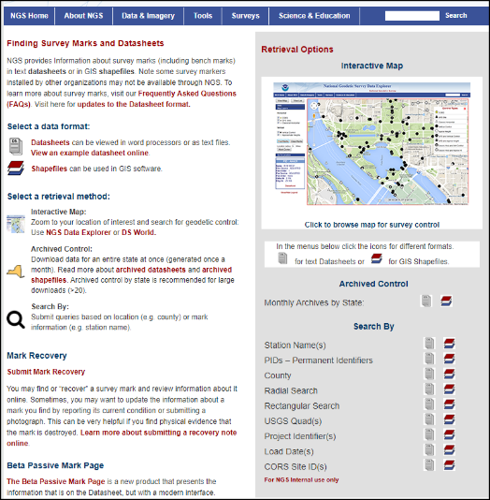
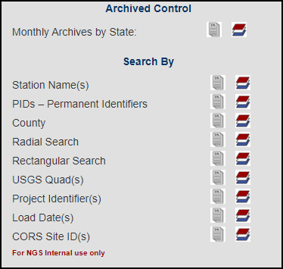
Text Searches – Looking for Bench Marks
Notes:
You can search for geodetic control using a “text” oriented approach.
Click on the “Looking for Bench Marks” icon.
Search by a variety of more focused methods.
These tools allow locating and selecting larger numbers of datasheets.
You can also access the interactive map just discussed.

Slide 25
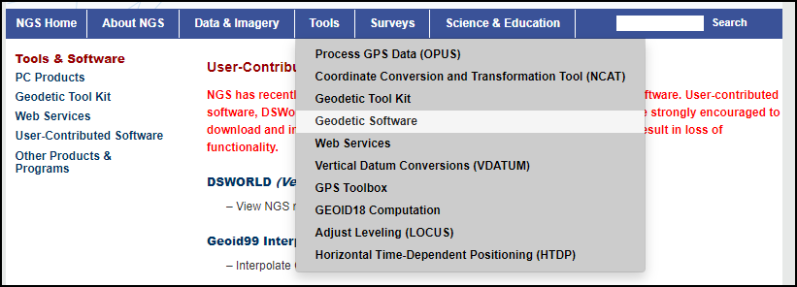
DSWorld (download from NGS)
Located under TOOLS, then Geodetic Software, then
USER-CONTRIBUTED SOFTWARE
Notes:
The DSWorld software is located under TOOLS,
then Geodetic Software,
then USER-CONTRIBUTED SOFTWARE.

Slide 26
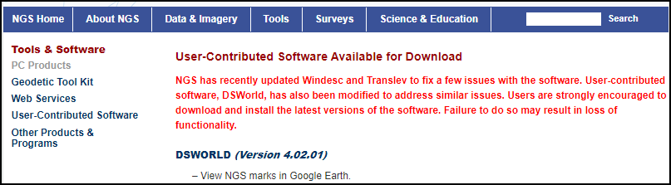
DSWorld (download from NGS)
Note: You may need local IT support to install software.
Notes:
There is no online version of DSWorld, so it must be installed.
Note that you may need local IT support to install software.

Slide 27
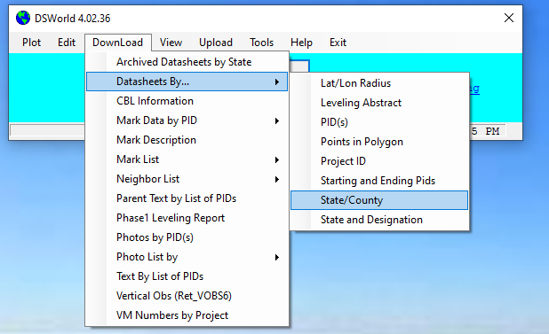
DSWorld (download from NGS)
Download control by a variety of methods (and much more!!!)
Notes:
Once installed, this powerful multi-functional tool will allow you to download geodetic control by a variety of methods
– here showing the “by state/county” choice.

Slide 28
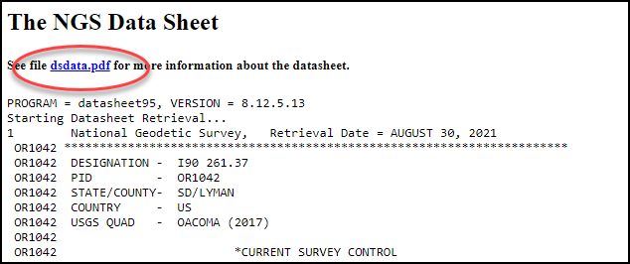
Understanding an NGS Datasheet
Strongly suggest: read the dsdata.pdf link - found at top of every datasheet
Notes:
Once retrieved, an NGS datasheet contains many pieces of information on a mark.
While most of the information is readily understood, it is important to consult the DSDATA.PDF link for a full understanding of the datasheet.
The DSDATA.PDF link is on the top of every datasheet.

Slide 29
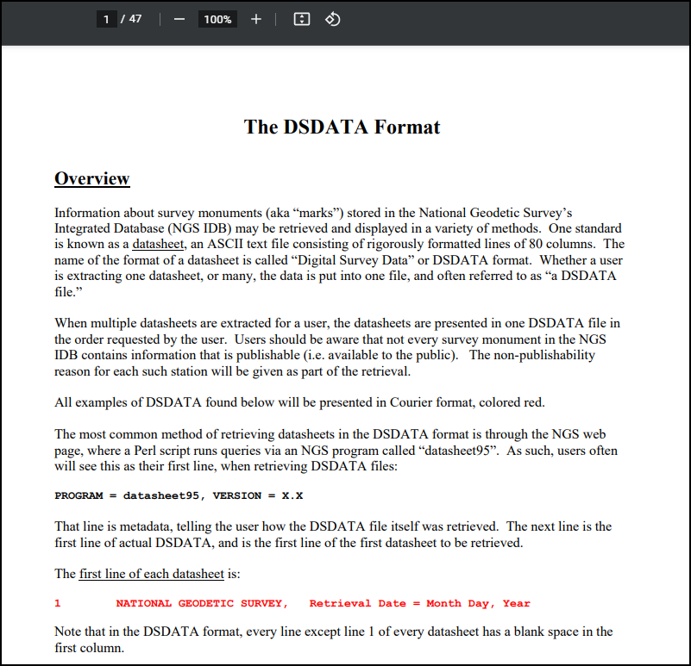
Understanding an NGS Datasheet
DSDATA.PDF
  47 pages
  Explains the datasheet’s contents.
Notes:
The DSDATA.PDF is 47 pages and explains the datasheet’s contents.
Lynda!

Slide 30
Improve NGS Database
Recovery Notes
OPUS Share
OPUS Projects
NCN (CORS) Contributor
Notes:
The NGS database needs to be maintained in order to be as correct and current as possible.
Users can help in several important ways.
Recovery Notes
OPUS Share
OPUS Projects
NCN (CORS) Contributor

Slide 31
Improve NGS Database – Recovery Notes
When you submit a recovery note, you will improve the NGS Database by:
  Verifying the mark’s stamping
  Updating mark’s condition and ties to local objects
  Updating scaled lat/lon to handheld or better GPS location
  Updating the “to reach” to reflect current road names and distances
  Uploading digital photographs
No Recovery Note = No Improvement
If you want it to be better, you have to help.
Notes:
The simplest and arguably most important way is submitting a recovery note each time you visit a mark.
When you submit a recovery note, you will improve the NGS Database by:
Verifying the mark’s stamping
Updating the mark’s condition and ties to local objects
Updating the scaled lat/lon to a handheld or better GPS location
Updating the “to reach” to reflect current road names and distances
Uploading digital photographs
No Recovery Note = No Improvement
If you want it to be better, you have to help

Slide 32
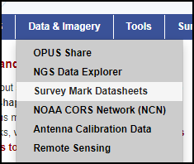
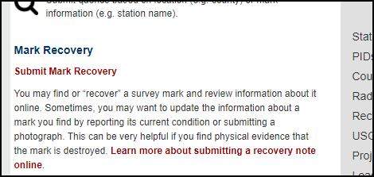
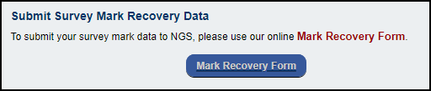
After You Find a Mark – Submit Recovery Note
NGS will not know the current condition, location, nor status of any passive survey mark – unless YOU tell us!
We need Recovery Notes
Use any of these Tools to submit a recovery note
  Online Recovery Tool
  DSWorld
  WinDesc (note this is required in OPUS PROJECTS submissions)
Notes:
NGS will not know the current condition, location, nor status of any passive survey mark – unless YOU tell us!
So, we need Recovery Notes.
Use any of these Tools to submit a recovery note
Online Recovery Tool
DSWorld
WinDesc (note this is required in OPUS PROJECTS submissions)

Slide 33
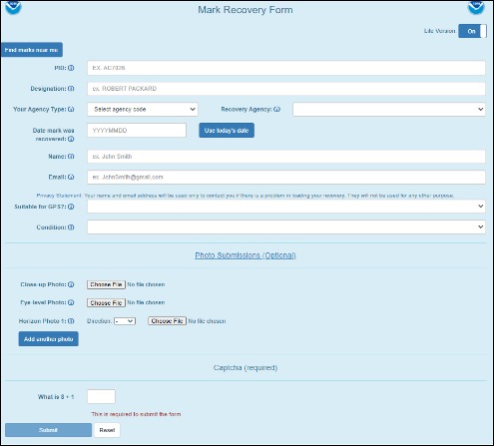
Online Recovery Tool
LITE version shown
(toggle for detailed version)
Fill in PID, make edits
Attach up to 6 photos
  (1 close-up, 1 eye-level, & 4 horizon)
Answer the CAPTCHA
Submit
Approval ~ 20 days
The Online Recovery Tool is “mobile browser-capable”,
but is not a stand-alone “app”.
Notes:
The Online Recovery Tool is the easiest to use.
Choose the LITE or DETAILED version,
then fill in the PID, click into the next field and the form will partially self-fill.
EDIT the various fields as needed, attach up to 6 photos - (1 close-up, 1 eye-level, & 4 horizon)
Answer the CAPTCHA question, and click Submit.
Allow about 20 days for approval.
Please note - the Online Recovery Tool is “mobile browser-capable”, but is not a stand-alone “app”.

Slide 34
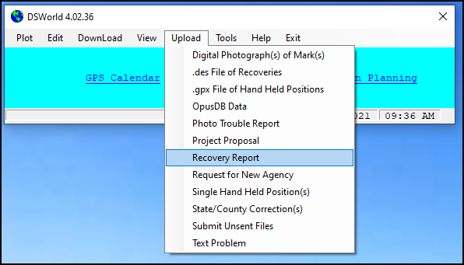
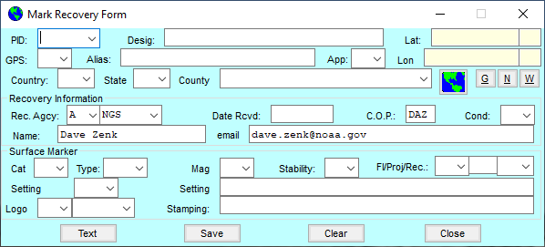
DSWorld
Upload:
Recovery Report
Digital Photographs
Approval ~ 20 days
Notes:
The DSWorld software allows you to upload recovery notes and digital photos.
Allow about 20 days for approval.

Slide 35
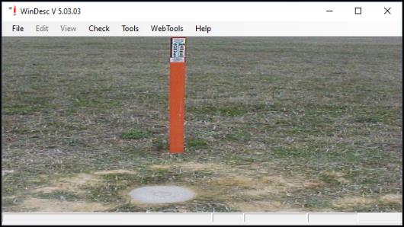
WinDesc
Recovery Notes can be submitted using WinDesc,
  But, NGS prefers the Online Mark Recovery Form.
WinDesc is required when submitting projects via OPUS PROJECTS
Notes:
Recovery Notes can be submitted using WinDesc,
But, NGS prefers the Online Mark Recovery Form.
WinDesc is required when submitting projects via OPUS PROJECTS

Slide 36
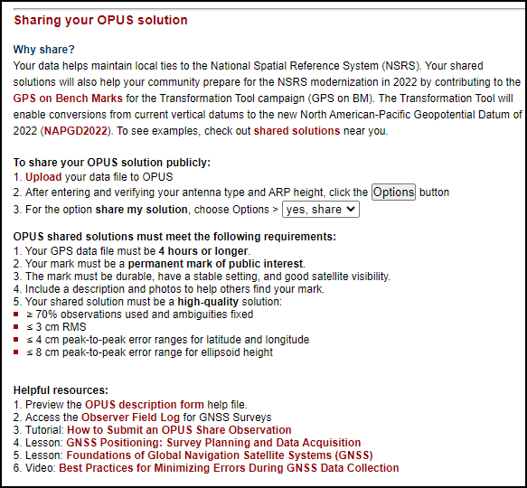
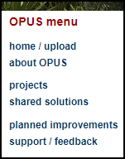
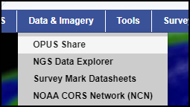
Improve NGS Database – OPUS SHARE
You can improve the NGS’ knowledge base and improve certain tools by submitting one or more OPUS SHARE’s on recovered marks. NGS will use the data to:
  Verify/improve geoid models
  Contribute to vertical datum transformation tool
See OPUS SHARE’s “about” page
  sharing your OPUS solution
Notes:
You can improve the NGS’ knowledge base and improve certain tools by submitting one or more OPUS SHARE’s on recovered marks.
NGS will use the data to:
Verify or improve geoid models and
Contribute to the vertical datum transformation tool
See OPUS Share’s “about OPUS” page,
then look for the “sharing your OPUS solution” section

Slide 37
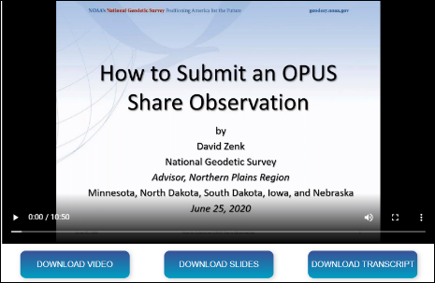
Improve NGS Database – OPUS SHARE
Read requirements for OPUS SHARE
Watch the 10 minute video
  “How to Submit an OPUS Share Observation” tutorial.
  https://geodesy.noaa.gov/corbin/class_description/opus-share-tutorial/
Notes:
In addition to the webpages, NGS has made available a 10 minute video which summarizes the process.
See “How to Submit an OPUS Share Observation” tutorial at the link shown on the screen.

Slide 38
Improve NGS Database – OPUS PROJECTS
OPUS PROJECTS is a major new release by NGS in June 2021
Using OPUS PROJECTS, users can submit their survey projects to NGS.
  If submitted, reviewed, and accepted, your survey may be published on datasheets.
Notes:
OPUS PROJECTS is a major new release by NGS in June 2021
Using OPUS PROJECTS, users can submit their survey projects to NGS.
If submitted, reviewed, and accepted, your survey may be published on datasheets.

Slide 39
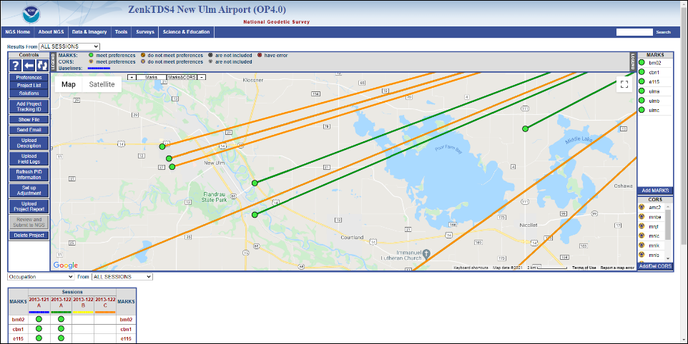
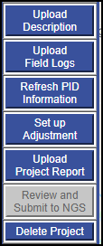
Improve NGS Database – OPUS PROJECTS
The OPUS PROJECTS 4.0 interface screen
Notes:
Here is a sample OPUS PROJECTS interface screen.
Notice the added controls that support the “Review and Submit to NGS” button.

Slide 40
Improve NGS Database – OPUS PROJECTS
OPUS PROJECTS can be used to process multiple observations on a single mark or on multiple marks, and give users more control over how the survey is tied to the NSRS.
  Choose “Submit to NGS” to create new geodetic control
  Replaces “bluebook” procedures and software
  Some training is needed.
New!
Notes:
OPUS PROJECTS can be used to process multiple observations on a single mark or on multiple marks, and give users more control over how the survey is tied to the NSRS.
Choose “Submit to NGS” to create new geodetic control
Replaces “bluebook” procedures and software
Some training is needed.

Slide 41

Improve NGS Database – OPUS PROJECTS
OPUS PROJECTS training links
  See “What is OPUS PROJECTS” video by Dan Martin, NGS Advisor in Northeast Region (11.5 minutes)
    https://geodesy.noaa.gov/corbin/class_description/What_is_OPUS_Projects2.shtml
  See “OPUS Projects Manager's Training Videos” (2.5 hours)
    https://geodesy.noaa.gov/optrainingvideos/
  Also register for free online class at NGS Testing and Training Center
    https://www.ngs.noaa.gov/corbin/index.shtml
Notes:
To start using OPUS PROJECTS, you should consult the initial self-help links shown on the slide.
In particular, see
“What is OPUS PROJECTS” video by Dan Martin, NGS Advisor in Northeast Region (11.5 minutes)
and
“OPUS Projects Manager's Training Videos” (2.5 hours)
Then enroll in a free online training class at the NGS Testing and Training Center.

Slide 42
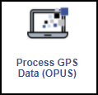
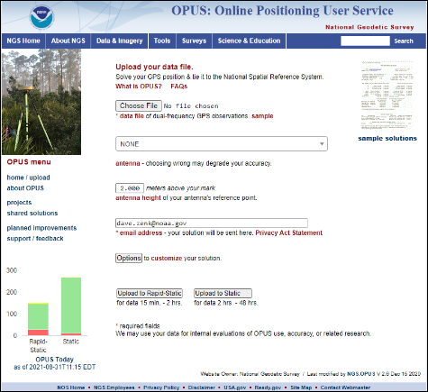
OPUS Home Page
All OPUS actions begin at OPUS home page
About OPUS
OPUS Static
OPUS Rapid Static
OPUS Share
OPUS Projects
View Shared Solutions
OPUS Today status bars
Notes:
Remember that all OPUS actions begin on the OPUS home page.

Slide 43

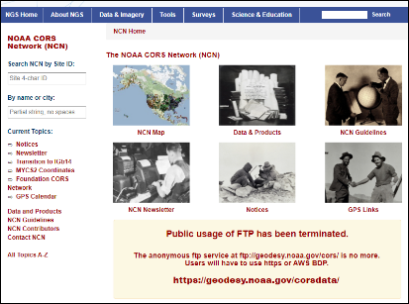
NOAA CORS Network (NCN)
The current datum and future datums depend on the NOAA CORS Network (NCN) to provide the highest level of accuracy and reliability.
Obtaining data files, metadata, and other information about the CORS network starts at the CORS home page
Notes:
The current datum and future datums depend on the NOAA CORS Network (NCN) to provide the highest level of accuracy and reliability.
Obtaining data files, metadata, and other information about the CORS network starts at the CORS home page.

Slide 44
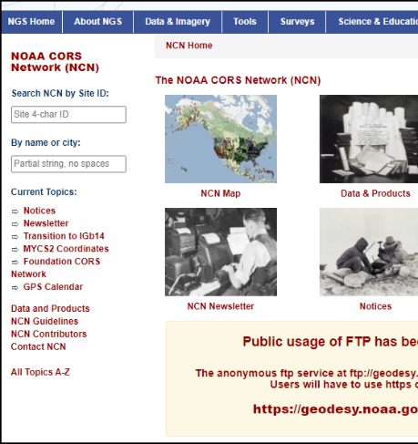
NOAA CORS Network
Popular links are
  Search by CORS ID
  NCN Map
  Obtain data files
    (note FTP replaced by HTTPS)
Can you help NGS fill in CORS gaps?
Become an NCN Contributor
Notes:
Popular links are
Search by CORS ID
The NCN Map
Obtain data files
(note that FTP has been replaced by HTTPS)

Slide 45
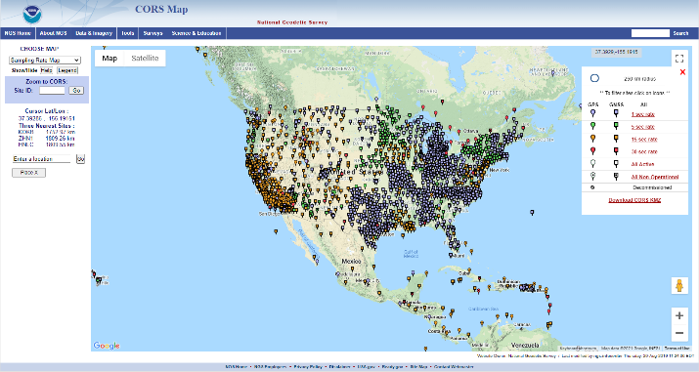
NOAA CORS Network
Can you help NGS fill in CORS gaps?
Become an NCN Contributor
NCN CORS map
Notes:
Look at your state on the NCN CORS Map.
If there are gaps in CORS coverage perhaps you can fill the gap.

Slide 46
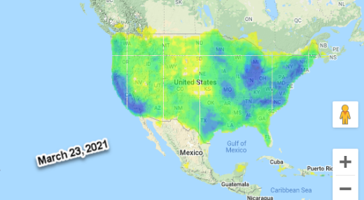
NOAA CORS Network
OPUS-Rapid Static will be improved as gaps are filled.
Note lower accuracy in areas of less-dense CORS coverage
Notes:
OPUS-Rapid Static will be improved as gaps are filled.
Note the lower accuracy in areas of less-dense CORS coverage
Consult the NGS CORS Team to discuss your options.
Dave!

Slide 47
Migration of Legacy Data
NCAT
VDATUM
Notes:
Legacy data management is an ongoing need that supports former datums and will continue to be needed in the future datum.
NGS has reviewed its legacy data conversion tools and created a new tool (called NCAT) to organize the process and put it online.
VDATUM remains in place to support other useful datums.

Slide 48
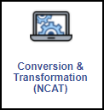
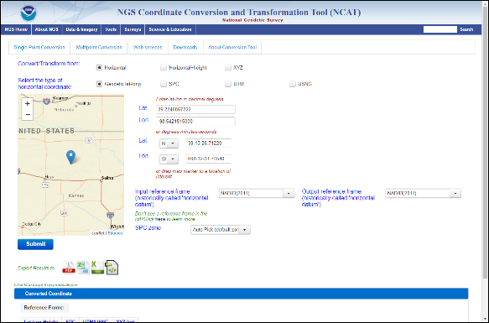
Data Conversion Tools
NGS Coordinate Conversion and Transformation Tool (NCAT)
  it should be used as the primary tool to convert data among the various HORIZONTAL and VERTICAL datums .
Notes:
NGS has released the NGS Coordinate Conversion and Transformation Tool (or NCAT) – it should be used as the primary tool to convert data among the various HORIZONTAL and VERTICAL datums .

Slide 49
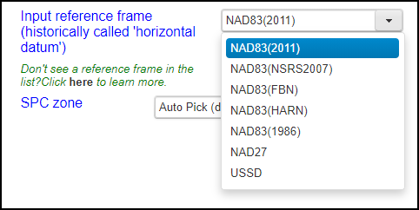
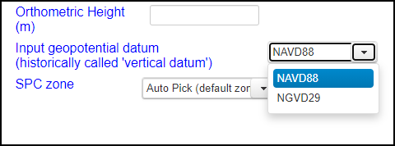
Data Conversion Tools
NCAT supports
HORIZONTAL datums/realizations
and VERTICAL datums
  (and NAPGD2022 when avail.)
Notes:
NCAT supports
HORIZONTAL datums & realizations
and VERTICAL datums
(and it will support NATRF2022 and NAPGD2022 when they become available).

Slide 50
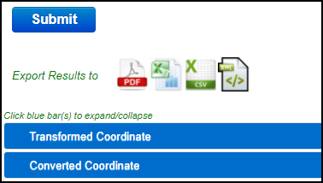
Data Conversion Tools
NCAT results are available in flexible ways:
PDF XLS CSV XML
On-screen
Notes:
NCAT results are available in flexible ways
PDF XLS CSV XML
And on-screen

Slide 51
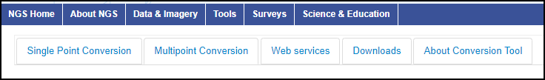
Data Conversion Tools
NCAT will handle single point or multipoint conversions.
Web services are available (API).
  https://www.ngs.noaa.gov/web_services/ncat/index.shtml
For large datasets, NGS recommends the download version.
Notes:
NCAT will handle single point or multipoint conversions.
And web services are available (API)
For large datasets, NGS recommends the download version.

Slide 52

Data Conversion Tools
Use VDATUM for other datums https://vdatum.noaa.gov/
VDatum is a free software tool developed jointly by NOAA's National Geodetic Survey (NGS) and others.
VDATUM is designed to vertically transform geospatial data among a variety of tidal, orthometric and ellipsoidal vertical datums
  allowing users to convert their data from different horizontal/vertical references into a common system and enabling the fusion of diverse geospatial data in desired reference levels.
Online or Download
Notes:
Use VDATUM for other datums.
VDatum is a free software tool developed jointly by NOAA's National Geodetic Survey (NGS) and others.
VDATUM is designed to vertically transform geospatial data among
a variety of tidal, orthometric and ellipsoidal vertical datums
allowing users to convert their data from different horizontal/vertical references into a common system and enabling the fusion of diverse geospatial data in desired reference levels.
It can be used in online or download versions.
Lynda!

Slide 53
Improve the Future and the Present
Notes:
Let’s take a rapid fire look at tools and projects that improve the future and the present.

Slide 54
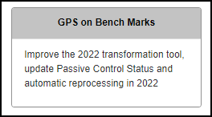
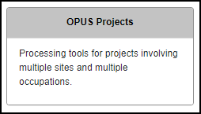
Building the Bridge to the Future
NGS needs some help from you to enhance existing tools and to build new tools for the future.
  GPS on BM
  OPUS Share
  OPUS Projects
Notes:
NGS needs some help from you to enhance existing tools and to build new tools for the future.
Notably:
GPS on BM
OPUS Share
OPUS Projects

Slide 55
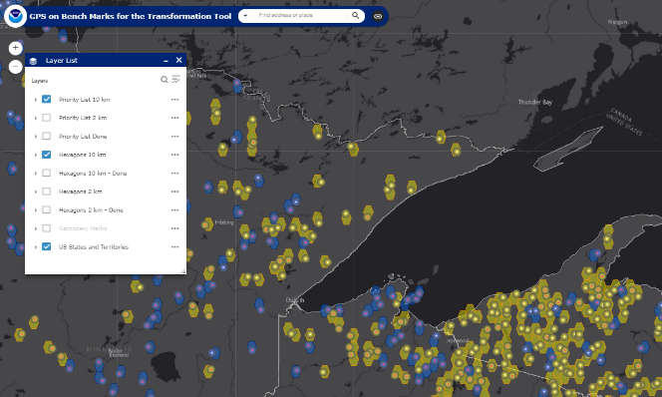
Building the Bridge to the Future
“GPS on BM” map: https://geodesy.noaa.gov/GPSonBM/index.shtml
  Shows priority hexagons and priority mark listings
Lake Superior
Notes:
The “GPS on BM” map shows priority hexagons and priority mark listings

Slide 56
Building the Bridge to the Future
Two or more occupations on the same mark will provide full benefits.
OPUS SHARE benefits:
Establishes useful lat/lon/ellht and ortho ht in current NSRS for use today.
Establishes lat/lon/ellht and ortho ht in the future NSRS.
  Automatic generation of 2020.0 Reference Epoch Coordinates (REC) and Survey Epoch Coordinates (SEC) upon release of modernized NSRS.
Update Condition and Status of Passive Control
  mark recoveries and shared solutions provide NGS and other users of the NSRS with insight into the health of the passive control network and updated information for project planning.
RTN Check Stations
  Get updated coordinates on marks in your area for field checks of RTN rovers to ensure consistency with NSRS coordinates
If mark is part of GPS on BM Campaign, benefits also include
Local improvements to the 2022 Transformation Tool,
  which will enable conversions from current vertical datums to the North American-Pacific Geopotential Datum of 2022 (NAPGD2022) and will be integrated into the NGS Coordinate Conversion and Transformation Tool (NCAT).
Notes:
If you participate in OPUS SHARE there are 4 important benefits, both now and future.
Establishes useful lat/lon/ellht and ortho height in the current NSRS for use today.
Establishes lat/lon/ellht and ortho height in the future NSRS.
Updates condition and status of Passive Control
RTN Check Stations for you and others to use
In addition, the GPS on BM campaign adds one more important future benefit.
Local improvements to the 2022 Transformation Tool,
NGS recommends two or more occupations on the same mark to provide full benefits.

Slide 57
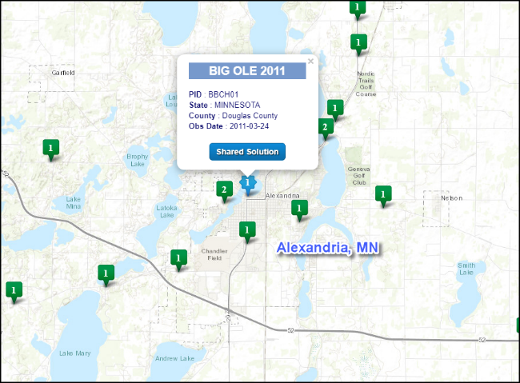
Building the Bridge to the Future
OPUS SHARE -
Example:
BIG OLE 2011 is a survey mark located near a large statue in the City Park.
Notes:
Here’s an example of a typical OPUS SHARE located in Alexandria MN.
BIG OLE 2011 is a survey mark located near a large statue in the City Park.

Slide 58




Building the Bridge to the Future
OPUS SHARE example
  Provides an updated recovery record of a passive mark
  Verification or improvement of the lat/lon/ellht/ortho
  Shares locations of useful local marks for community use
    (example is near statue of Big Ole the Viking in Alexandria MN park)
Notes:
Note that it provides an updated recovery record of the mark, verifies or improves the lat/lon/ellht/orthoht and provides 2 photos.
In this case it makes available a permanent mark of public interest for the local community to use – one of the purposes of OPUS SHARE.

Slide 59

Building the Bridge to the Future
You can add NEW geodetic control in your local area.
Submit via OPUS PROJECTS !
Self-education links
Notes:
The recently released OPUS PROJECTS (version 4.0) allows users to submit their survey project to NGS.
If the project is successfully reviewed and approved by NGS, it will be loaded to the NGS database and become geodetic control.
Review the self-education links and enroll in a free online class to learn how to use OPUS PROJECTS.

Slide 60

Building the Bridge to the Future
Use OPUS SHARE and OPUS PROJECTS to create useful geodetic positions in areas of sparse geodetic control.
NGS Control in South Dakota
Note some big gaps
Notes:
Use OPUS SHARE and OPUS PROJECTS to create useful geodetic positions in areas of sparse geodetic control.

Slide 61
Building the Bridge to the Future
Deprecation of the Survey Foot Unit – December 31, 2022
  Recorded Webinar
    Fate of the U.S. Survey Foot after 2022: A Conversation with NGS
    April 25, 2019 | 2-3 pm, Eastern Time
    Dr. Michael Dennis, National Geodetic Survey
    https://www.ngs.noaa.gov/web/science_edu/webinar_series/fate-of-us-survey-foot.shtml
  NIST release on US Survey Foot
    https://www.nist.gov/pml/us-surveyfoot
    FAQ’s
  Federal Register (Document Number: 2020-21902)
    https://www.federalregister.gov/documents/2020/10/05/2020-21902/deprecation-of-the-united-states-us-survey-foot
Notes:
The survey foot should no longer be used after December 31, 2022.
Please view the recorded webinar by Dr. Michael Dennis and the other resources listed here.

Slide 62
Deprecation of the Survey Foot Unit – December 31, 2022
Impact on constituents
  NGS will continue supporting the U.S. survey foot in legacy applications where it is and was used. That means we will always give U.S. survey feet for SPCS 83 for states that currently use the U.S. survey foot, and for all SPCS 27 zones. So the U.S. survey foot will continue to be available for such states for SPCS 83 coordinates on Datasheets after 12/31/2022.
  However, the U.S. survey foot will NOT be available for any SPCS2022 zones (or any other component of the modernized NSRS).
Notes:
The deprecation of the US Survey Foot will have minimal impact on legacy applications.
However, the new NSRS (and its component parts) will NOT use the Survey Foot.

Slide 63

Deprecation of the Survey Foot Unit – December 31, 2022
NIST Frequently Asked Questions (FAQ) Page
https://www.nist.gov/pml/us-surveyfoot/frequently-asked-questions-faqs
Notes:
The NIST agency webpage has a Frequently Asked Questions (FAQ) regarding the US Survey Foot.

Slide 64

Building the Bridge to the Future
GRAV-D Status (https://geodesy.noaa.gov/GRAV-D/)
  Builds the gravity-based geoid for NAPGD2022
Airborne Gravity Data - Map Key
Green: Available data and metadata
Blue: Data being processed
Orange: Data collection underway
White: Planned for data collection
Notes:
The GRAV-D Project is a key to building the gravity-based geoid for NAPGD2022
The GRAV-D Project is nearing completion.
The GREEN and BLUE shades represent complete or near-complete.
The ORANGE is underway, and the WHITE is planned.

Slide 65

Building the Bridge to the Future
GEOID Models and Geoid Slope Validation Surveys
  Builds the science that supports NAPGD2022
  https://geodesy.noaa.gov/GEOID/
Notes:
NGS has completed 3 Geoid Slope Validation Surveys to prove that the science for the future vertical datum is correct.

Slide 66

Building the Bridge to the Future
Calibration Baseline Policy (February 2021)
https://geodesy.noaa.gov/CBLINES/calibration.shtml
https://www.ngs.noaa.gov/INFO/Policy/2021-1208-01_Final_CBLProgramPolicy.pdf
In support of the NGS EDMI CBL Program, NGS will:
Maintain a minimum of one CBL per state
Provide software and procedures for the EDMI community to maintain and establish additional CBLs in each state
Provide software and procedures suitable for testing EDMI over a CBL
Maintain a database of CBL data accessible through the NGS EDMI CBL webpage
The NGS EDMI CBL Program is voluntary.
Notes:
In February 2021, NGS released an update to its EDMI Calibration Baseline Policy, affirming support for one CBL in each state.

Slide 67
Building the Bridge to the Future
Recruitment and Retention
  USAJOBS Events:
    https://www.usajobs.gov/notification/events
  Pathways Internship – high school to college students
  Hollings Scholarship – undergraduate students
  Knauss Fellowship - graduate students
    https://research.noaa.gov/External-Affairs/Students
Notes:
To carry out its current and future missions, NGS needs talented, dedicated employees.
USAJOBS is the gateway to Federal employment.
NOAA has several scholarship opportunities for high school to graduate students.

Slide 68


Building the Bridge to the Future
Written Guidance Documents
Blueprints Part 1,2,&3 – see NEW DATUMS page
Science and Education
  NGS Presentation Library
NGS Newsletter Subscription Service
  NGS News, NGS Webinars,
  NGS Training, NGS GPS on BM
  https://geodesy.noaa.gov/INFO/subscribe.shtml
Notes:
There is written guidance from NGS. Particularly:
NEW DATUMS webpage
Blueprints parts 1,2,&3
Presentation Library and Publications Library
NGS Newsletter Subscription Service
Dave!

Slide 69
Become Future Ready
Suggestions for Personal Readiness
Notes:
Here are a few suggestions to become future ready.

Slide 70
Become Future Ready
Participate in GPS on BM Campaign (via OPUS SHARE)
OPUS will be the key tool in the future.
  Become familiar with all the tools in the OPUS suite
  Including how to submit NEW control via OPUS PROJECTS
Learn how to convert and transform data using NCAT.
  Review and document metadata on your current and past surveys!
CORS is the foundation of the NSRS - but there are gaps.
  Can you fill gaps in the NOAA CORS Network in your local area?
Read the BLUEPRINTS 1,2,&3
Notes:
Participate in the GPS on BM Campaign (via OPUS SHARE)
OPUS will be the key tool in the future.
So, you should become familiar with all the tools in the OPUS suite
Including how to submit NEW control via OPUS PROJECTS
Learn how to convert and transform data using NCAT.
Review and document the metadata on your current and past surveys!
CORS is the foundation of the NSRS - but there are gaps.
Can you fill gaps in the NOAA CORS Network in your local area?
Read the BLUEPRINTS 1,2,&3

Slide 71
Become Future Ready
Remember that you can make the future better.
  OPUS SHARE submissions (includes GPS on BM)
    create useful geodetic coordinates on local marks for use today and in the future.
  OPUS PROJECTS is a powerful least squares analysis of local networks.
    Use optional “SUBMIT to NGS” feature to create geodetic control on local marks for use today and in the future
  RECOVERY NOTES
    Improve passive mark datasheets
Notes:
Remember that you can make the future better.
OPUS SHARE submissions (which includes GPS on BM)
create useful geodetic coordinates on local marks for use today and in the future.
OPUS PROJECTS is a powerful least squares analysis of local networks.
Use optional “SUBMIT to NGS” feature to create geodetic control on local marks for use today and in the future.
RECOVERY NOTES
Improve passive mark datasheets
Lynda!

Slide 72

Thank You
- The End
  Contact your NGS Regional Advisor for local questions and support.
https://geodesy.noaa.gov/ADVISORS/index.shtml#RM
Notes:
Contact your NGS Regional Advisor for local questions and support.
This is the end of ”Paving the Road to the Future NSRS.”
Thank you.

Slide 73
The End

