Slide 1
OPUS Demo
Mark Schenewerk
2021-04-26

Slide 2
OPUS Problem Definition
Estimate the instantaneous position of a point on the Earth using GNSS:
with sub-centimeter accuracy at 95% confidence.
with ~100% reliability.
using as little data as possible.

Slide 3
GNSS Positioning Error Budget
In the broadest strokes, the error budget for a satellite - ground receiver measurement is:
Pseudorange: ≫ 1 cm level, but phase can be measured ≪ 1 cm level.
Satellites: IGS claims positional accuracy at the ~2.5 cm level (https://www.igs.org/products/).
Modeled and unmodeled effects: generally at the ~1 cm.
  Charged and neutral atmosphere: ≳1 cm*.
  Regional/local geophysical effects like tectonic motion, subsidence, loading: ≳1 cm*.
  Antenna model: <1 cm*.
  Multipath and other E/M noise: ≳1 cm*.
  Data quality control: <1 cm*.
  *Your results might vary.
Uh-oh! You cannot produce a sub-centimeter measurement from a tool whose intrinsic accuracy is >1 cm without repeated measurements over time.

Slide 4
Differential Positioning
However, by collecting observations from two (or more) ground receivers simultaneously and differencing them, we can achieve a relative accuracy better than the absolute accuracy of point positioning. In other words, with GNSS, we can estimate the position of an unknown mark relative to a known, reference mark better than we can estimate the position of either mark relative to the constellation of orbiting satellites.
This is because differential processing is more forgiving of our technology … errors common to the unknown and known marks “difference away” and experience has shown that we can achieve sub-centimeter relative accuracies in many, but not all, circumstances.
This isn’t to say that error mitigation and model accuracy isn’t important, but some of the more “pesky” errors are largely eliminated with differential processing.

Slide 5
A Pleasant Bonus
NGS refers to measuring vectors (A.K.A. baselines), i.e. the coordinate vector differences from one mark to another (left). Differential GNSS measurements between two marks produces a baseline measurement (right) making the differential GNSS technique palatable to NGS - surveying has “always” used differential measurements.
S
B-A
B-A = S-A - S-B
B
B
A
A

Slide 6
“There Ain’t No Such Thing As A Free Lunch.”
While we still need the general infrastructure for GNSS processing, we need more infrastructure for differential GNSS processing:
We need a suitably distributed collection of passive (they just sit there: brass disks, rods, chisel marks in stone) or active (actively collecting GNSS data and regularly monitored) reference marks whose positions are known to ≲1 cm throughout the lifetime of their existence.
We need software capable of differential GNSS processing.
Moreover, these should be easy to use (no or limited training) and easy to access (online) to help ensure that our stakeholders will want to use them.

Slide 7
Thus, The Justification For The NOAA CORS Network And OPUS
NOAA CORS Network = NCN:
  Active marks.
  75 km spacing.
  ~0.2 cm median positional accuracy if the station has been in continuous operation for more than 3 yrs without a geophysical or maintenance event.
  (Multi-year CORS Solution 2 = MYCS2)
Online Positioning User Service = OPUS:
  Differential positioning to the NCN using “geodetic-quality” software and models requiring virtually no input from or training needed for our stakeholders.

Slide 8
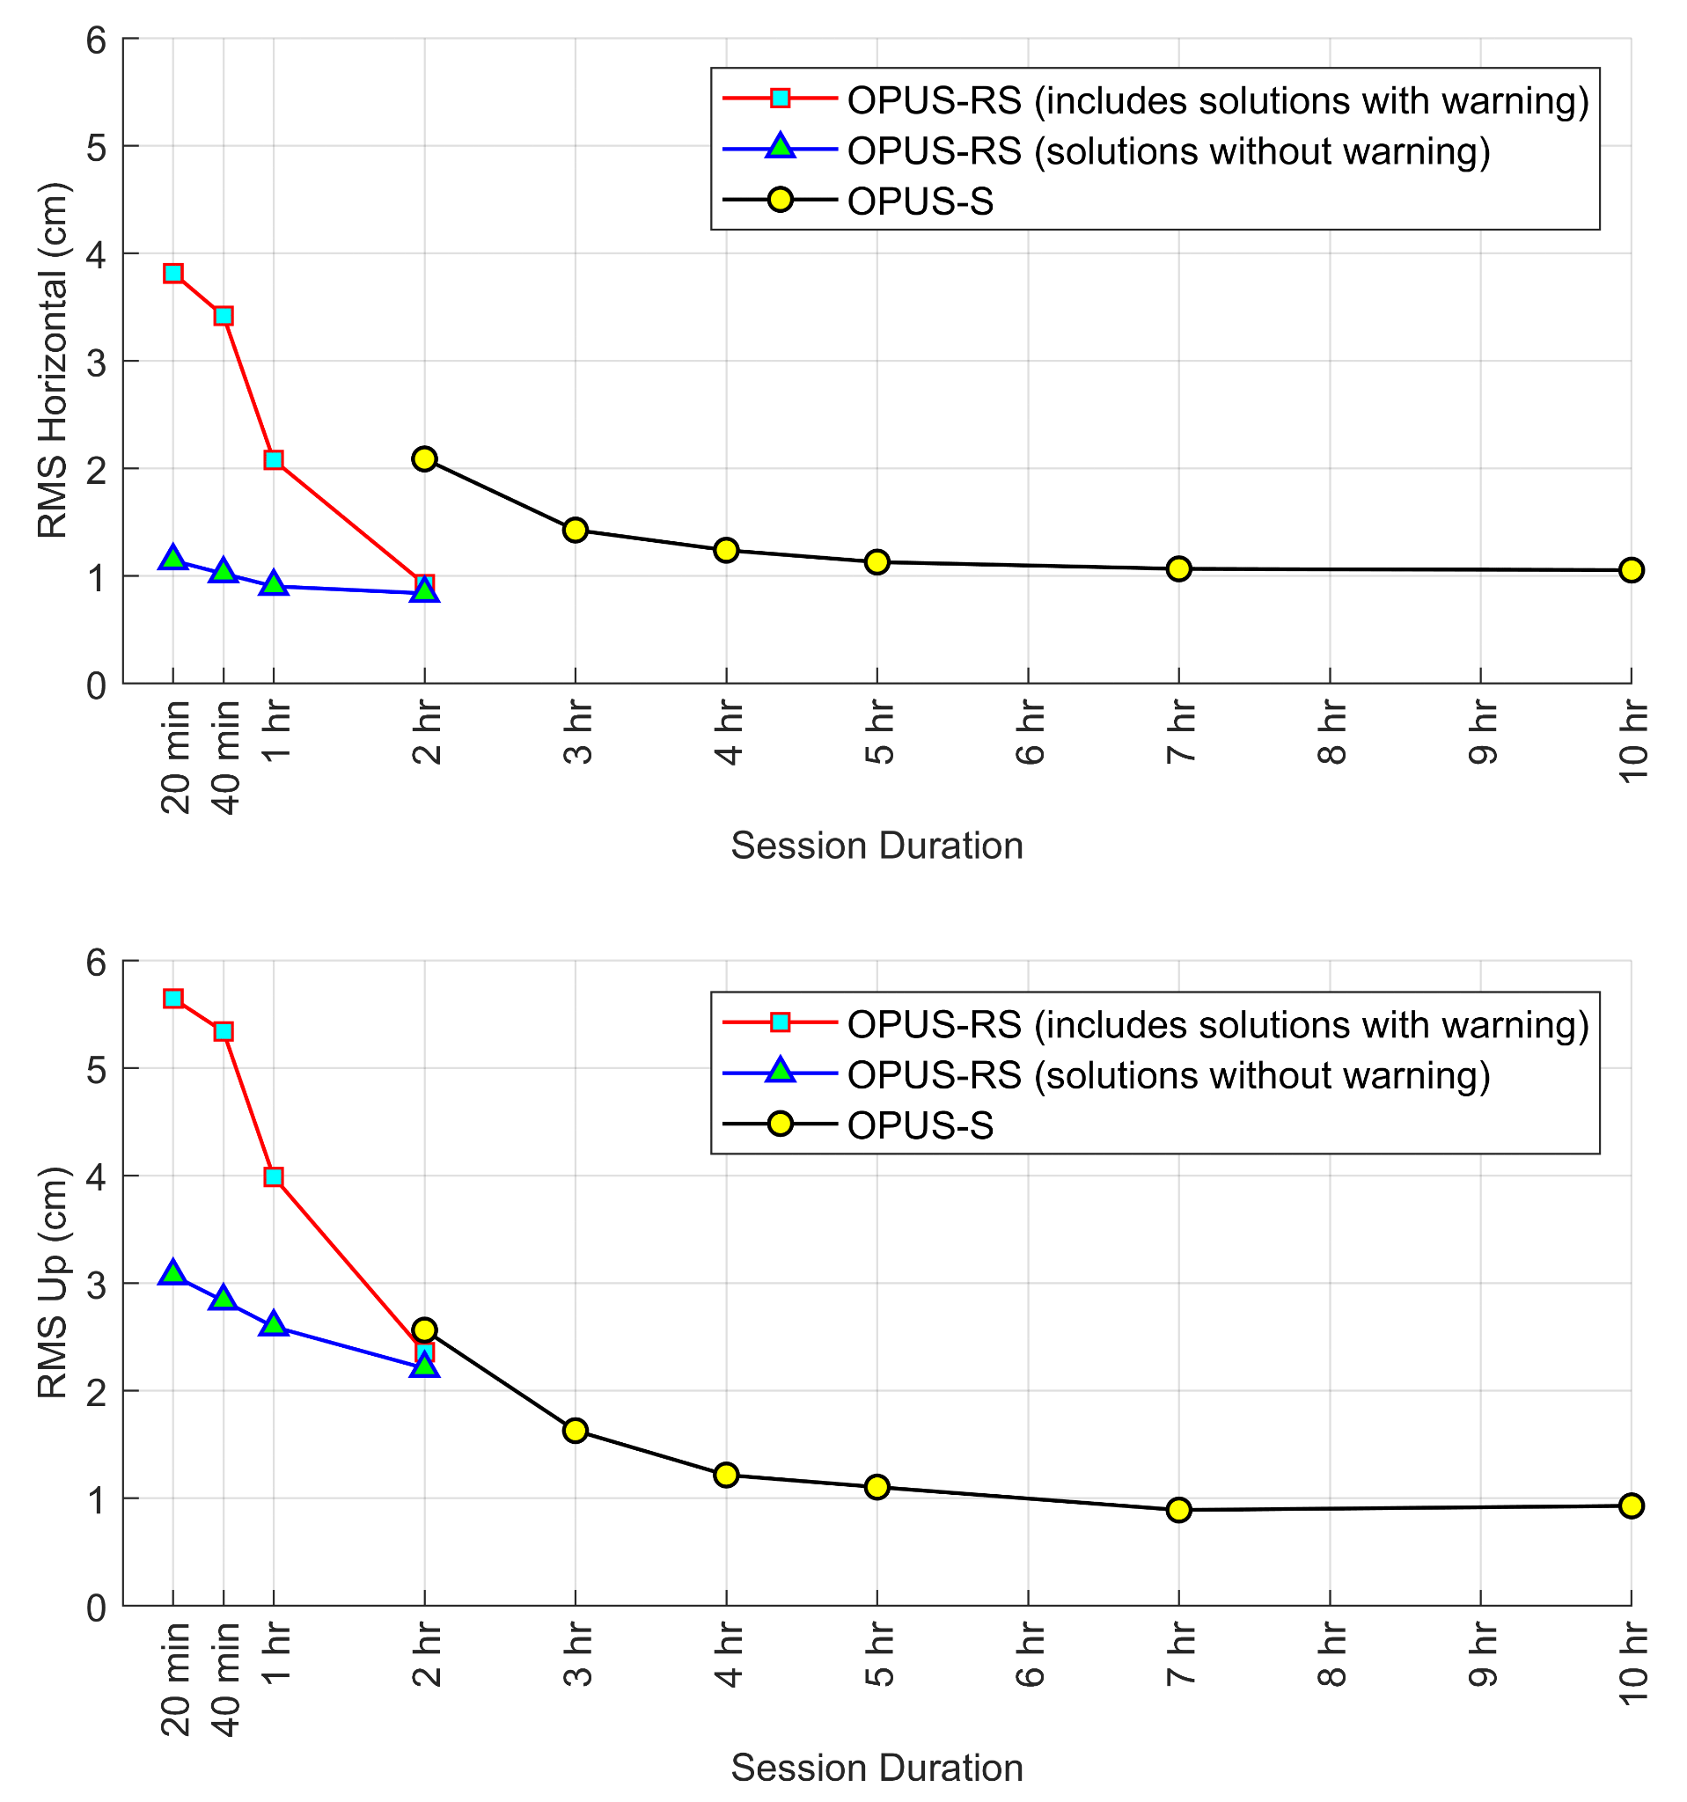
Reality Check: Sub-centimeter Accuracy At 95% Confidence
OPUS results are usually poorer than 1 cm because of less than optimal circumstances:
The conditions surveyors must face in the field: obstructions / multipath / interference.
Imperfect models for local effects: “tropo” / subsidence / loading.
NCN coordinate maintenance goals are only 2 cm horizontally or 4 cm vertically.
(https://www.ngs.noaa.gov/CORS/Articles/Reference-Systems-Part-2.pdf)
Gillins, D.T., Kerr, D., and Weaver, B. (2019)
OPUS approaches 1 cm accuracy, but only for longer data spans.

Slide 9
Reality Check: Sub-centimeter Accuracy At Near 100% Reliability
NCN
  Median data reliability for the NCN is 100%; the average is 96.4%.
  Full GNSS capability is limited, but improving.
OPUS
  OPUS-S has a 95% success rate simply by requiring longer data spans.
  (Based on OPUS logs GPS weeks 2149 - 2152: 2021-03-14 - 2021-04-10.)
  OPUS-RS has a 78% success rate.
  (Based on OPUS logs for GPS weeks 2149 - 2152: 2021-03-14 - 2021-04-10.)
  OPUS processing is dependent upon OPUS itself, NCN and the IGS, but the OPUS report has many hardware and resource dependencies: HTDP, NCAT, GEOID(s), the IDB and OPUS databases, and its own “project” archive. All have to be online for success.
But the bottom line is that OPUS, excluding OPUS-RS, exceeds 90% reliability.

Slide 10
Reality Check: Sub-centimeter Accuracy Using As Little Data As Possible
When OPUS was released in 2000, requiring a minimum of 2 hrs of data was considered more than adequate.
But by the release of OPUS-RS in 2007, reducing the minimum data span to 15 min, was considered a major - and necessary - improvement.
Now, even 15 min of data is considered a burden. RTK is increasingly common and can provide cm-level accuracies in seconds.
But the reputation of NGS and any RTK network’s spatial limits plus the common use of a subscription business model keeps OPUS meaningful.
OPUS lags behind stakeholder hopes/expectations for data duration.
Note: NGS will always be one of the biggest users of OPUS, so bear in mind that NGS needs aren’t necessarily those of our stakeholders. NGS is willing to sacrifice time for accuracy, i.e. longer, repeated occupations of a mark.

Slide 11
Reality Check: Overall Summary
OPUS remains meaningful, but increasingly struggles to meet expectations.

Slide 12
Conceptual Schematic of OPUS
Other Action
Processing Thread 1
Processing Thread 2
Web Form
Queue
Processing Thread 1
Processing Thread 1
Processing Thread N-1
Processing Thread N
Email To User
A specifically designated directory, the “queue” in OPUS jargon, acts as a repository for transient data files and instructions enabling the outward-facing servers (red) to communicate to the inward-facing servers (green) asynchronously.
Both outward- and inward-facing servers can exist without the other.
Both outward- and inward-facing servers quality control and “throttle” uploads.

Slide 13
Code Summaries (1 / 2)
OPUS-S
  ~20,000 lines of Perl.
  Essential, but negligible lines of other languages in this context.
  PAGES suite*.
OPUS-RS
  ~20,000 lines of Perl.
  Essential, but negligible lines of other languages in this context.
  RSGPS suite**.
OPUS-Net
  ~20,000 lines of Perl.
  Essential, but negligible lines of other languages in this context.
  PAGES suite*.
*Soon, no one in NGS will have meaningful experience with this software.
**No one in NGS has meaningful experience with this software.

Slide 14
Code Summaries (2 / 2)
OPUS-Sharing
  I don’t know much about OPUS-Sharing.
OPUS-Projects 4.0.
  6,000 lines of HTML
  3,000 lines of CSS
  23,000 lines of working Javascript + some third-party code.
  136,000 lines of working Perl + some third party code.
  Essential, but negligible lines of other languages in this context.
  ADJUST and PAGES suite*.
OPUS-Projects 5.0.
  The number of primary web pages increases from three to five.
  Assume at least a 25% increase in the number of lines of code.
  ADJUST and PAGES suite*.
*Soon, no one in NGS will have meaningful experience with this software.

Slide 15
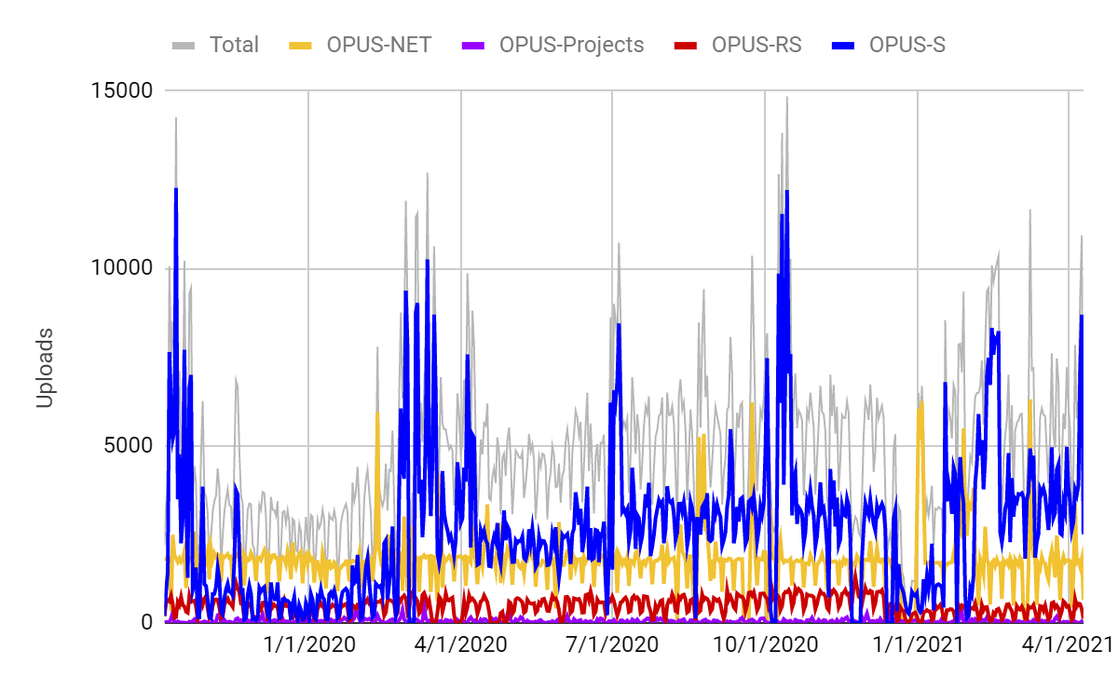
OPUS Use

Slide 16
OPUS Use Trends
Version 2019 2021
OPUS-S : 815 / day : 3672 / day
OPUS-RS : 417 / day : 329 / day
OPUS-Net : 1629 / day : 1609 / day
OPUS-Projects : 54 / day : 30 / day
A subjective interpretation of these trends:
  OPUS-S: one stakeholder (https://digifarm.com/) figured out how to circumvent the upload form around Feb, 2020. They are using OPUS-S for network monitoring and account for approximately three-fourths of all uploads.
  OPUS-RS: upload counts now are accidentally(?) driven by the same user.
  OPUS-Net: the number of NCN stations isn’t changing.
  OPUS-Projects: chicken-and-egg? declining interest ↔ declining training.

Slide 17
OPUS Usage Limits
Version Threads Median Runtime 2021
(average April 4 - 10, 2021) Uploads
OPUS-S : 23 threads : 1.3 min : 3672 / day
OPUS-RS : 19 threads : 2.6 min : 329 / day
OPUS-Net : 19 threads : 3.9 min : 1609 / day
OPUS-Projects : 6 threads : 3.0 min : 30 / day
Projecting forward:
  If all variant loads increased proportionately, OPUS could handle 18,500 uploads per day reaching this limit in 2031.
  But only the OPUS-S load has increasing significantly over the last few years. If OPUS-S use suffers another 2020-like increase, stakeholder dissatisfaction with its runtimes will force action as a few “power” users swamp the more numerous “common” users.
  Circumstantial evidence indicates that a few others have also learned to circumvent the upload webpage GUI.

Slide 18
OPUS Throttling
OPUS-S and -RS prevent zipped uploads containing more than 100 files.
OPUS-S and -RS limit the threads available to users with more than 100 files in queue.
  This is based upon the user’s email address.
  Email addresses are easy to get these days limiting the effectiveness of this throttle.
  Matching variants of email addresses can be described as challenging.
OPUS-Projects limits the number of data files in a single session processing request to 100.
The human actions required by the OPUS-S, -RS and -Projects interfaces acts as a throttle.
The OPUS-Projects interface effectively limits projects sizes to ~1000 data files.
The queues are FIFO. Although all uploads eventually get processed, the delays during active times acts as a throttle for some users.

Slide 19
OPUS Demos
OPUS-S.
opus_s_demo.rnx: “TRMR10 NONE”, 2.0500
OPUS-RS.
opus_rs_demo.rnx: “TRMR10 NONE”, 2.0500
What does the upload file look like?
################mark_schenewerk#noaa.gov+opus092p.18o.out
(beta) OPUS-Projects.
  mss04a: no processing
  mss04b: processing

