Slide 1

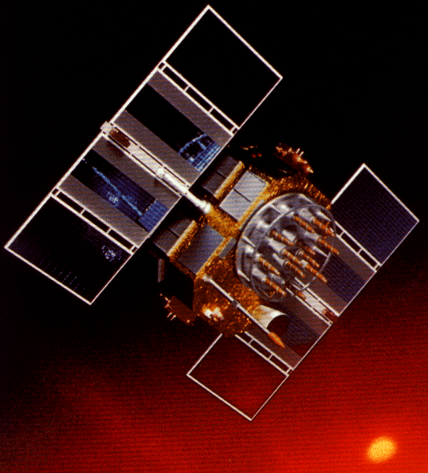
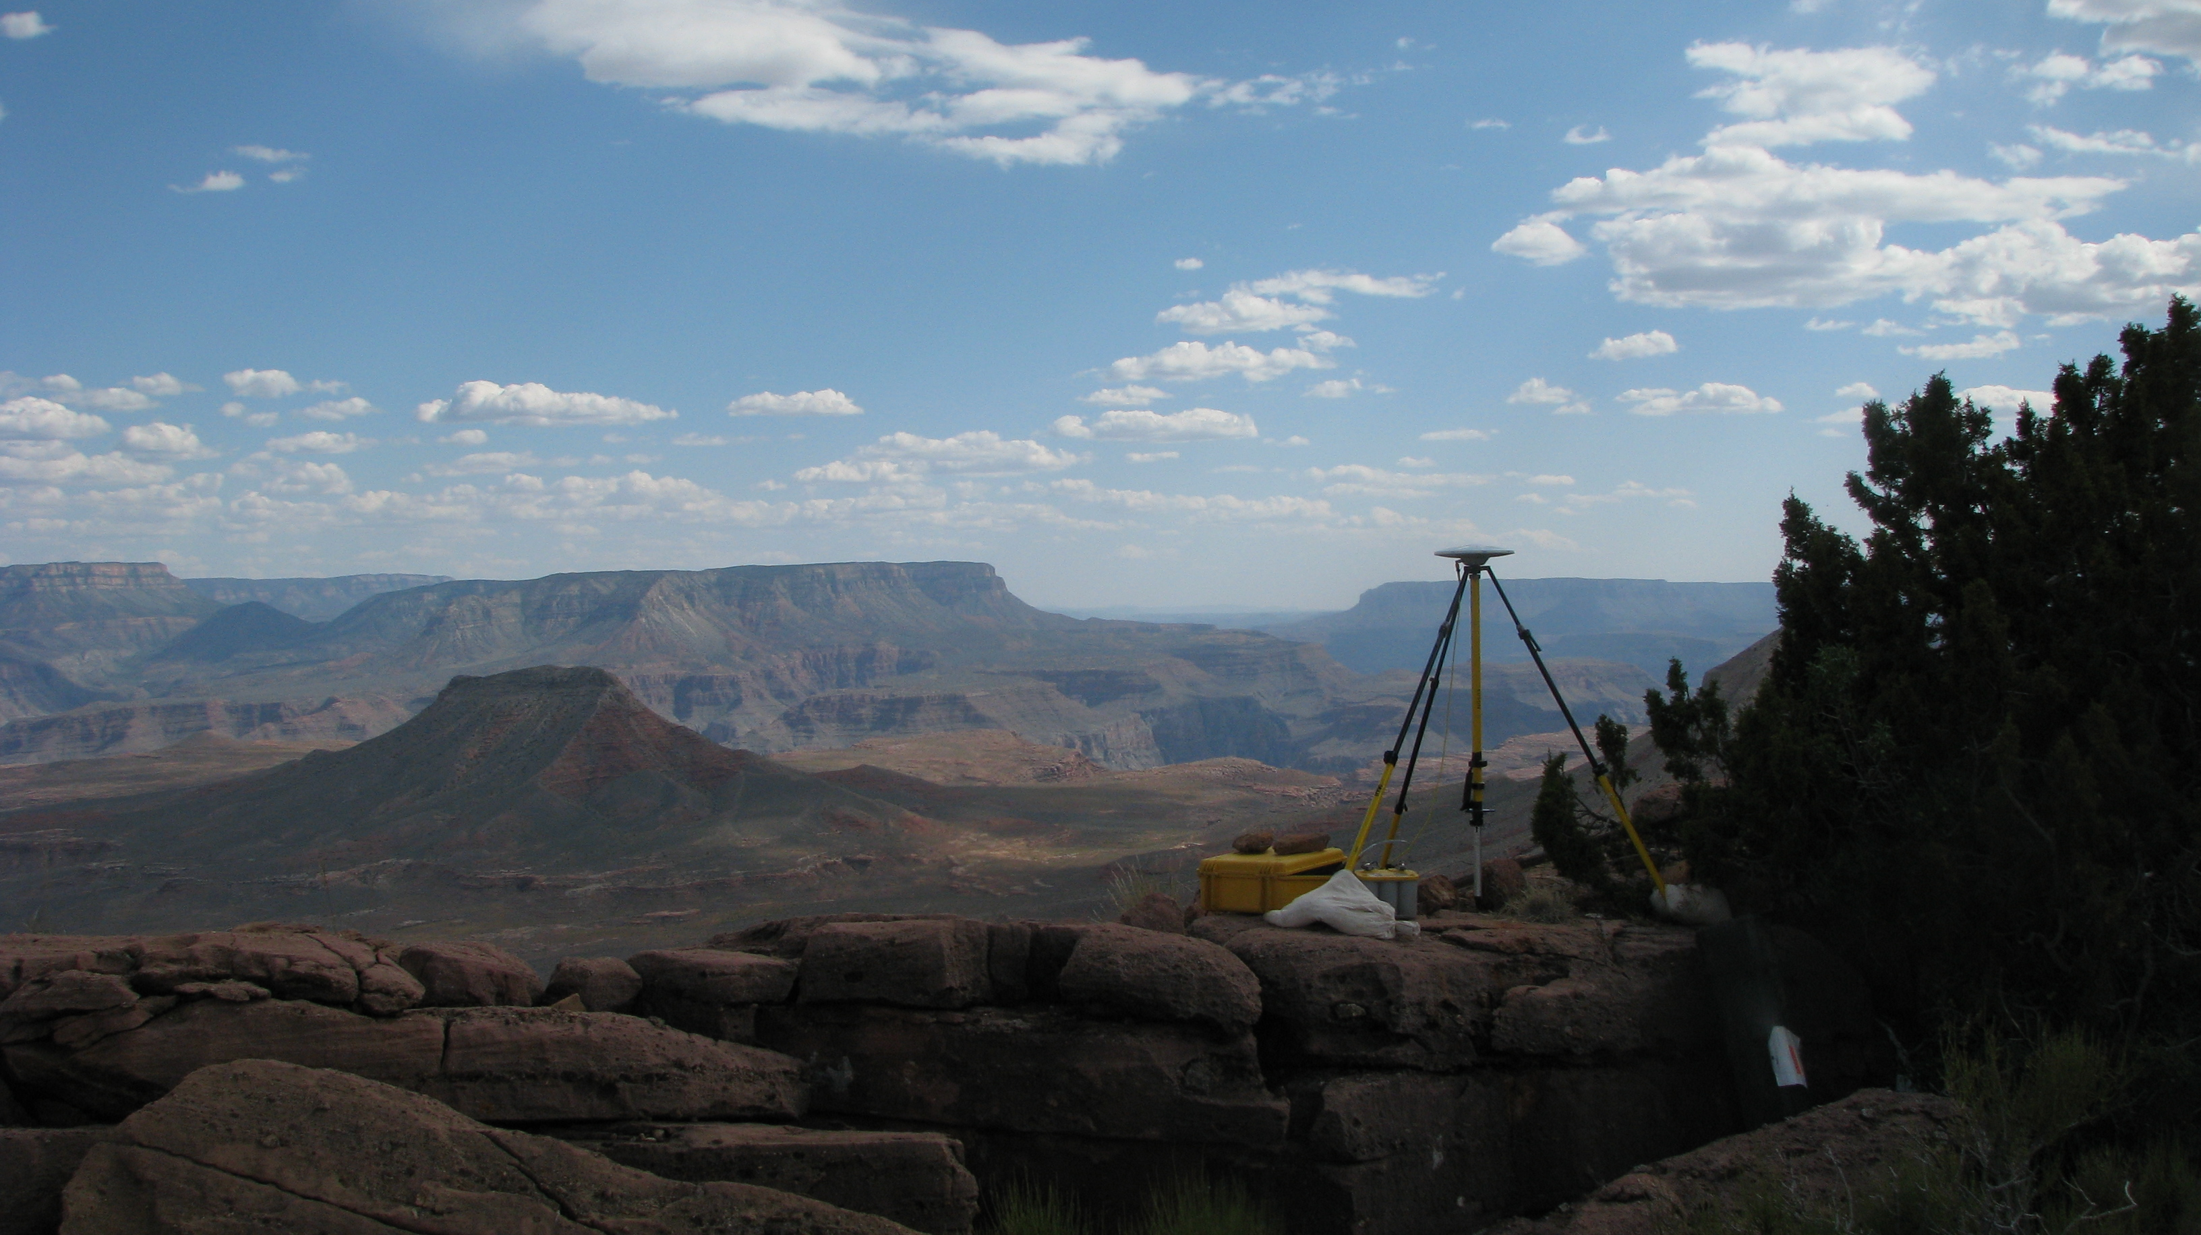
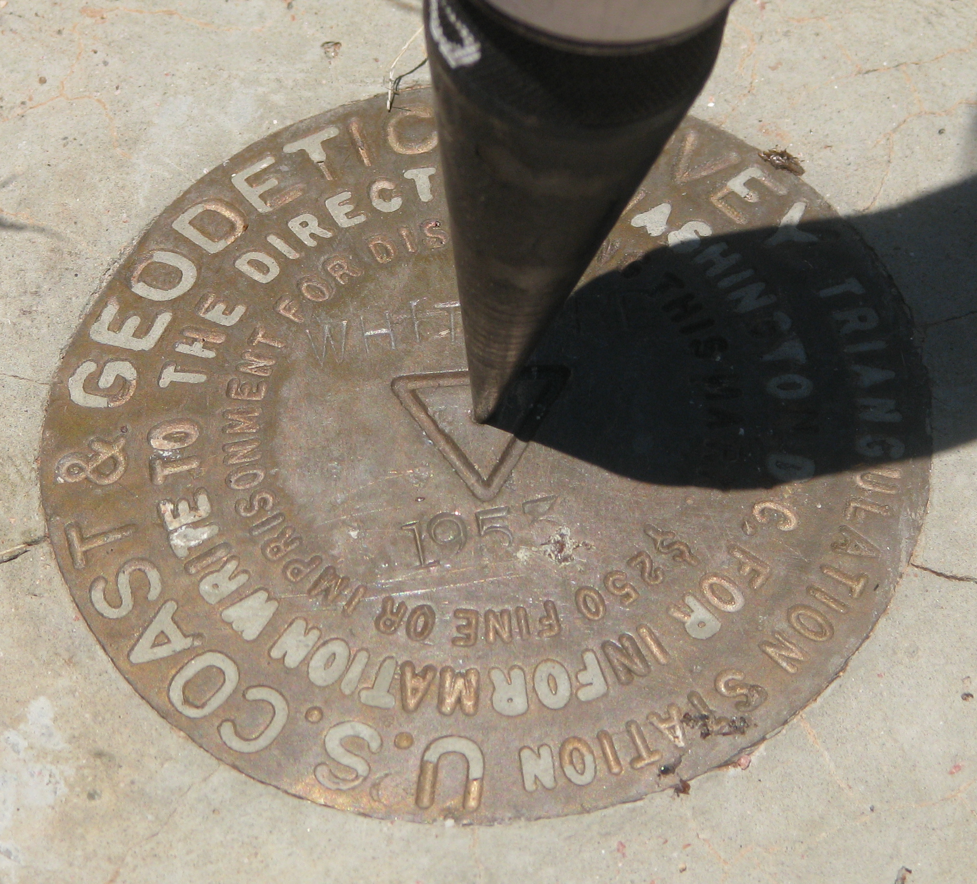
OPUS-Projects and Bluebooking
Part II: Bluebooking
Franklin County Engineer's Office
April 22-25, 2014 ● Columbus, OH
Michael Dennis, RLS, PE
michael.dennis@noaa.gov

Slide 2
The Plan (Syllabus)
Introduction to Bluebooking and Height Mod
The Bluebooking software (mainly ADJUST)
Setting up a project for ADJUST
Performing a network adjustment using ADJUST
Analysis of results from ADJUST
Finalize project for submission to NGS
Additional discussion items (as time allows)

Slide 3
Introduction
What this training will cover
  Bluebooking using bfiles and gfiles created by OP
  Most of training focused on using NGS program ADJUST
What this training will NOT cover (at least not in detail)
  Reconnaissance, project planning, Height Mod guidelines
  Execution of Height Mod survey field work
  Details of creating descriptions (WinDesc) or NGS GIS GPS tools
How the training will be done
  Work through sample Height Mod GPS project together
  Mostly done using live software, not so much PowerPoint
  Interaction, comments, and questions highly encouraged!

Slide 4
Matters of Mission and Policy
The NGS Mission
  Define, maintain, and provide access to the NSRS

Slide 5
At NOAA’s NGS, location is our mission
National Spatial Reference System
NSRS
Define
Maintain
Access

Slide 6
Matters of Mission and Policy
The NGS Mission
  Define, maintain, and provide access to the NSRS
  Interpreted as providing authoritative geodetic control
  Non-unique current coordinates at odds with NGS mission
  Different results from different processes are problematic
Governing policies
  Encapsulated within existing FGDC and FGCS documents
    Derived also from executive orders, congressional acts, etc.
    The NGSIDB and “Bluebook” are part of such policy
    Changes must go through FGCS and FGDC
  OPUS-DB “Publication” in conflict with existing NGS policy

Slide 7
“Share” vs. “Publish”
Share. The act of a user releasing to NGS the observations, metadata, and results of geodetic surveys tied to the NSRS for public dissemination.
Submit. The act of a user releasing to NGS the observations, metadata and results of geodetic surveys tied to the NSRS for the express purpose of NGS evaluating and publishing if appropriate.
Publish. The action of NGS providing to the public, the official NSRS geodetic coordinates set on a mark.
Datasheet. A report containing the published NSRS coordinates on a mark, as well as subsidiary information and metadata such as superseded coordinates, descriptions, and recovery history.

Slide 8
Sharing OPUS results
To share or not to share?
The intent is to make sharing as easy as possible. The requirements are minimal:
4 or more hours of data.
A quality, “GPS-able” mark.
Good field practices.
Good data.
Good description.
http://geodesy.noaa.gov/OPUS/about.jsp#publishing
Only OPUS-Static results can be shared at this time. In the near future will be able to share OPUS-Projects results.
No longer called “Publish” through OPUS interface.

Slide 9
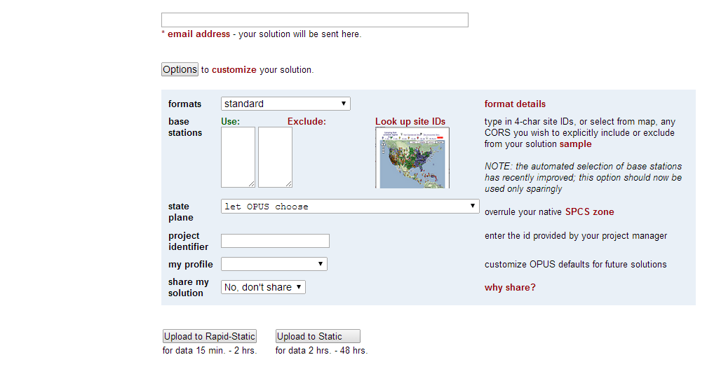
OPUS Sharing Interface
The first step in OPUS Sharing is to upload suitable data to OPUS. At that time, you must explicitly designate that your results should be shared. This is done through the “share my solution” option near the bottom of the Options list.

Slide 10
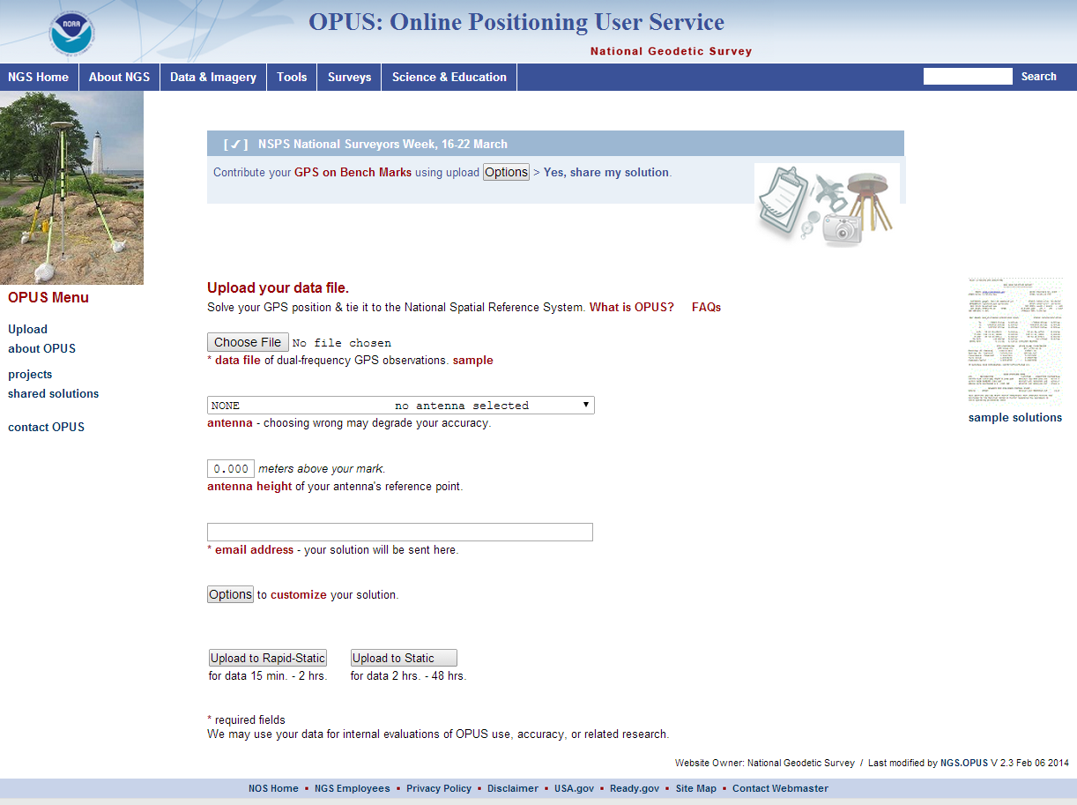
Viewing Shared Solutions
To a view shared solution, use the Shared Solutions link in the menu on the left of the OPUS upload page.

Slide 11
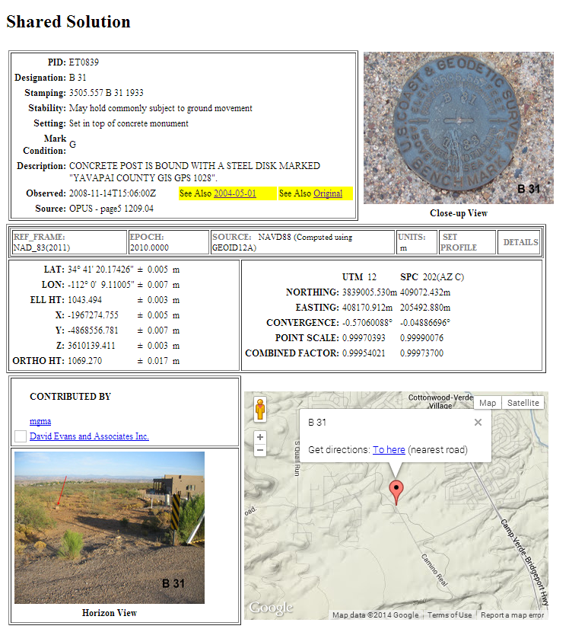
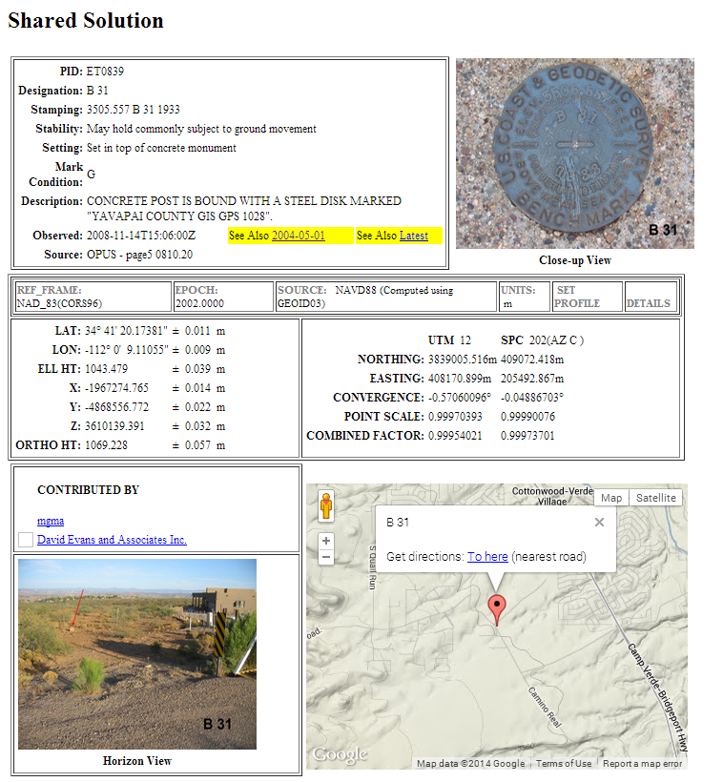
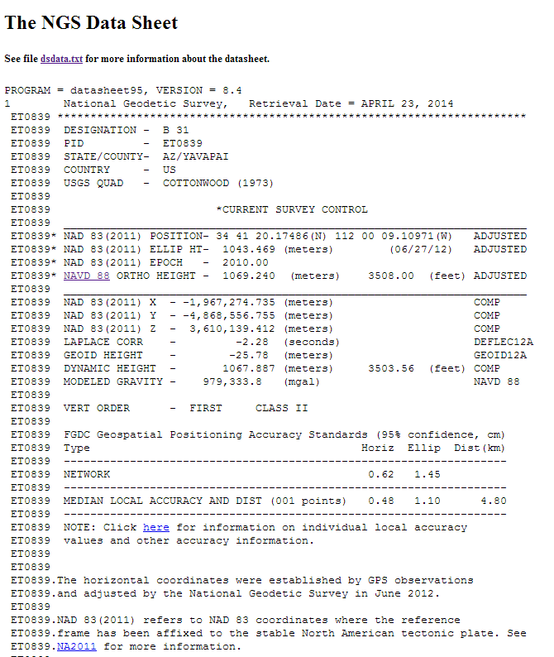
Viewing Shared Solutions
Here’s an example of a shared solution from OPUS-Static.
Note that this station has two shared solutions
Note also that it is published in the NGSIDB

Slide 12
“Published” vs. “shared” survey results
Published: The NGS Integrated Database (NGSIDB)
  Official repository for “authoritative” NSRS geodetic control
  Specific FGDC/FGCS metadata and QA/QC requirements
  Process for populating referred to as “Bluebooking”
Shared: OPUS Data Base
  Created to allow sharing of OPUS results by public
  Content not vetted or reviewed by NGS (not “control”)
    But OPUS data and results must meet certain requirements

Slide 13
Database Blues
The NGS Integrated Data Base (NGSIDB)
  Every mark has a single set of current coordinates
    Latitude, longitude, ellipsoid height, orthometric height, etc.
  Includes geometric and vertical control
  But Bluebooking to populate NGSIDB is overly onerous
OPUS Database
  Individual marks can have multiple coordinates
  Marks in common with NGSIDB do not have same coords
  Currently only contains geometric positions
    Orthometric heights are directly from a geoid model
  But easy to populate with minimal effort (no Bluebooking!)

Slide 14

Everyone has an opinion about “Bluebooking”
I’d rather be
Bluebooking
Friends …
don’t let friends …
Bluebook

Slide 15
What is “Bluebooking” anyway?
The NGS “Bluebook” is a set of data formats
  For electronic transfer of geodetic data to NGS database
  Defined by NGS and formally part of FGDC
  So “Bluebooking” is just putting data into specified formats
A means for our customers to help build the NSRS
  Users get the control they want, where they want it
  NGS gets data for small fraction of total cost of performing work
  Great example of Fed, local gov’t, and private cooperation
“Bluebooking” now viewed as much more than formats
  Standards & specifications for performing control work
  Strongly associated with high-quality data and results
  But difficult, expensive, inefficient, and (somewhat) error-prone

Slide 16
Adjustment for GNSS Bluebooking
NGS policy (June 2012)
  ADJUST is ONLY software that can be used to submit GNSS projects for publishing in NGS Integrated Data Base
  www.ngs.noaa.gov/INFO/Policy/files/062012_Data_Submission_Policy.pdf
Documentation
  “Constrained Adjustment Guidelines”
  www.ngs.noaa.gov/PC_PROD/ADJUST/adjustment_guidelines.pdf
  Original ADJUST documentation (TM NOS NGS-47)
  www.ngs.noaa.gov/PUBS_LIB/Adjust_TheHorizontalObservationAdjustmentProgram_TM_NOS_NGS_47.pdf
  Supplemental ADJUST documentation
  beta.ngs.noaa.gov/PC_PROD/ADJUST/adjust_supplemental.txt
Entire process needs to be updated

Slide 17
The way forward
Another fine mess – NGS created this problem, and now NGS will fix it. There are five aspects to this:
WHAT we are (and are not) doing
WHY we are doing it
WHERE we are going
HOW we will get there
WHEN all this is going to happen

Slide 18
What is “Height Modernization”?
Height Modernization is an NGS program
  Improve access to accurate, reliable, consistent “heights”
  Here, focus is obtaining orthometric heights using GNSS
    Done with campaign-style GNSS surveys
    Occupy bench marks with accurate leveled ortho heights
    Perform network adjustment of GNSS vectors to get ortho heights
    Constrained to leveled heights while using hybrid geoid model
Additional information and associated documents
  Height Mod website: www.ngs.noaa.gov/heightmod/
  Guidelines for GNSS-derived ellipsoid and orthometric heights
    NGS-58 (ellipsoid heights)
    NGS-59 (orthometric heights)

Slide 19
Bluebooking Software
OPUS-Projects (of course!)
ADJUST program suite
  “adjust_all.zip” at beta.ngs.noaa.gov/PC_PROD/ADJUST/
  ADJUST 6.2.3 plus various utility and checking programs
  Includes documents and a sample project
WinDesc (latest version 4.17.26)
  Create ADJUST constraint files and descriptions
  www.ngs.noaa.gov/PC_PROD/pc_prod.shtml#WinDesc
GIS GPS Toolset: Display and analysis of ADJUST results
  Run using Esri ArcGIS software (ArcMap and ArcToolbox)
Miscellaneous programs
  htdp.exe, preplt2.exe, diflatlon.exe, compVecs.exe, etc.

Slide 20
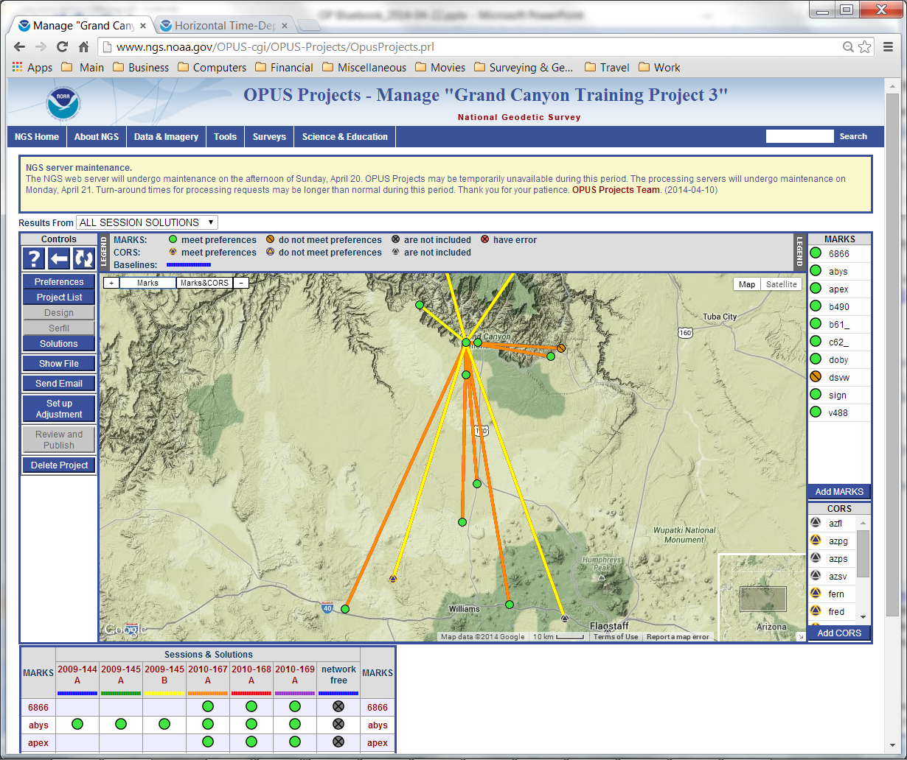
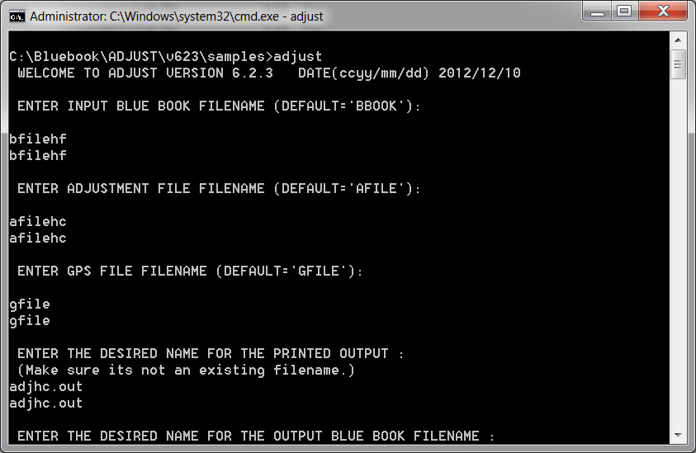
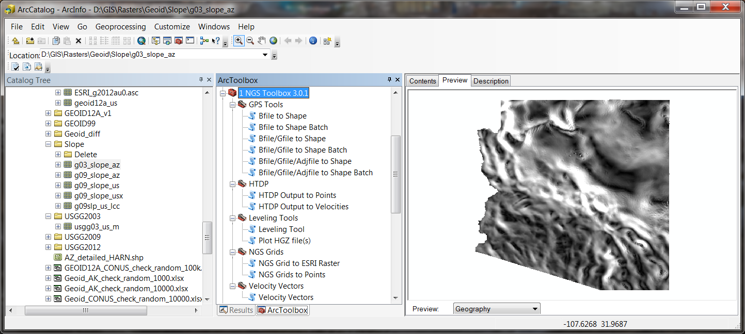
Bluebooking Software
We will be using some very modern programs
  …and some not-so-modern programs (and data formats)
0 1 2 3 4 5 6 7 8
12345678901234567890123456789012345678901234567890123456789012345678901234567890
000770*80*0002JOYNER 36274043492N077361617205W NCBA
000780*86*0002 38281A22Y88NGS -340492 4232A41A
000790*80*0003ROANPORT 36263621510N077422648864W NCBA
000800*86*0003 77378A21Y88NGS -339422 43436A41A

Slide 21
An OP Project created for you!
Part of an actual Height Mod survey project
  Located at Grand Canyon (Arizona)
  Most occupations in June 2010, some in May 2009
  14 marks total (10 passive plus 4 CORS)
    71 marks total in actual project (61 passive plus 10 CORS)
Tried for realistic, “interesting” characteristics
  Some noisy data, control of variable quality
  Different types of CORS, mix short and long vectors
  Missing sessions, uneven occupations, long time span
  Nice scenery!

Slide 22
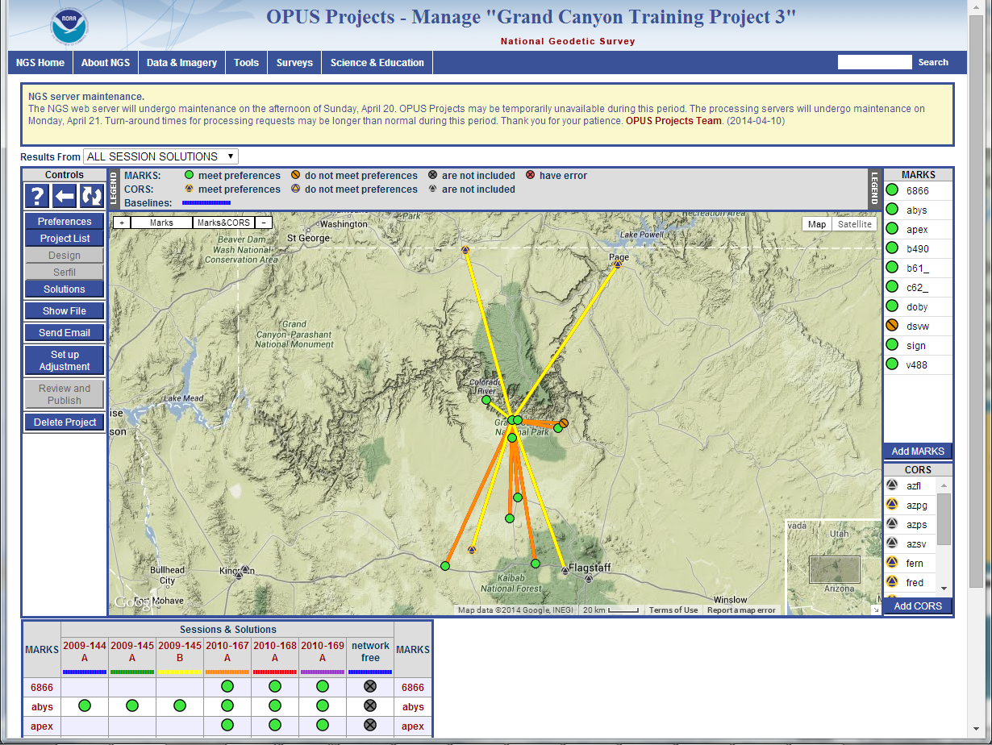

Slide 23
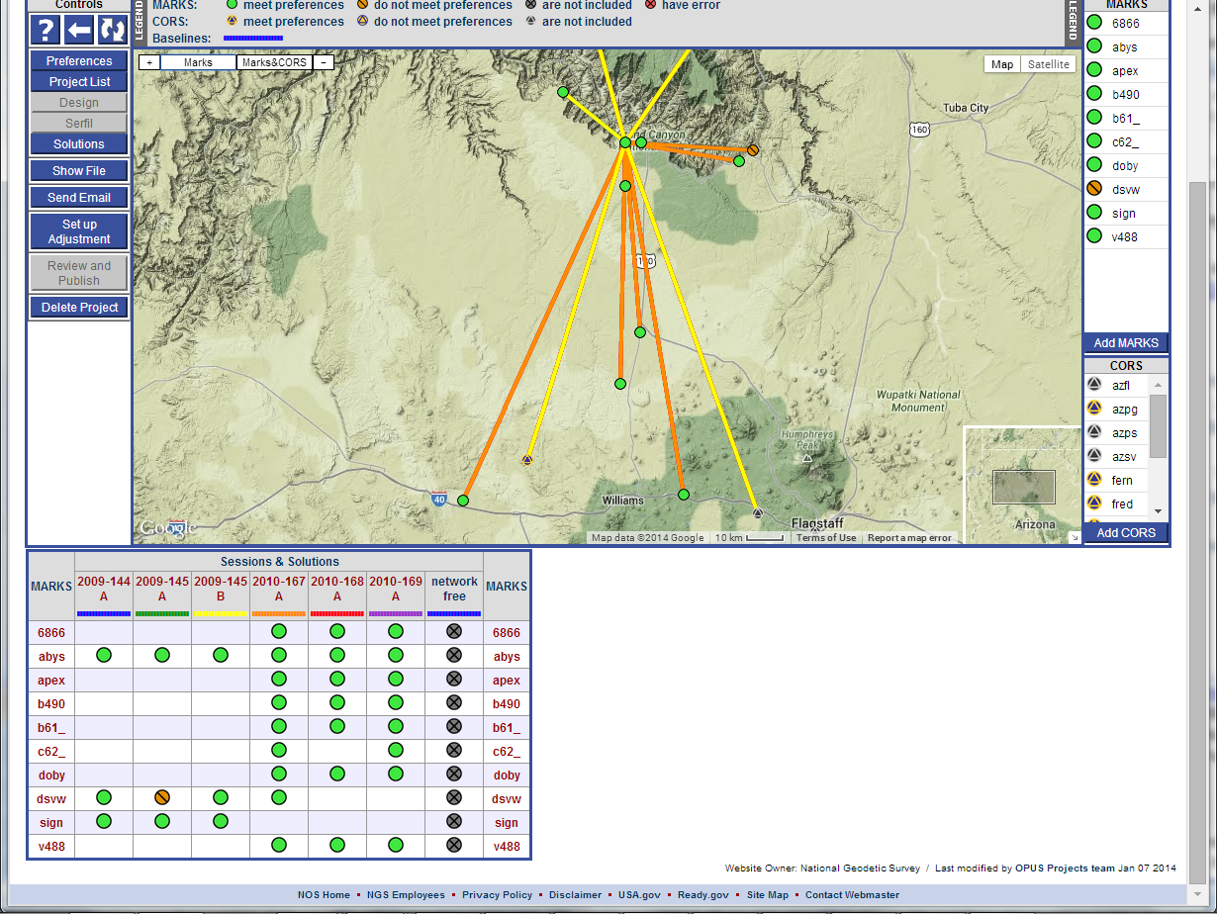

Slide 24
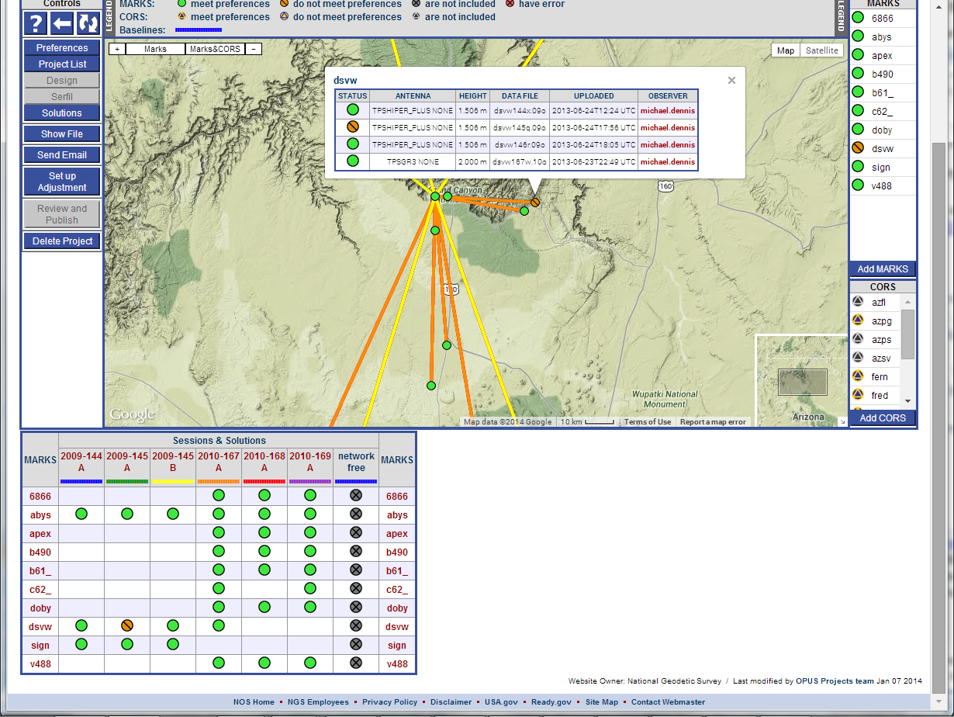

Slide 25
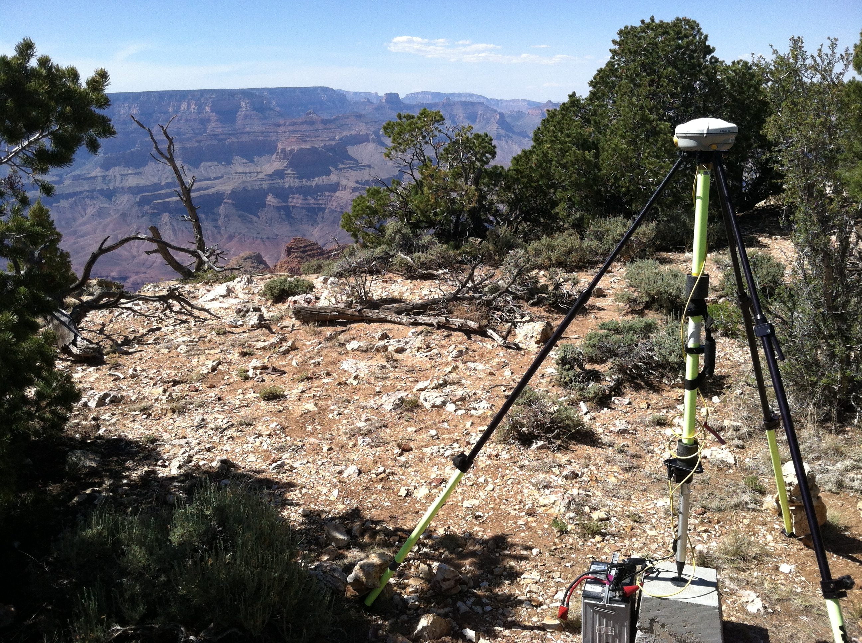

Slide 26
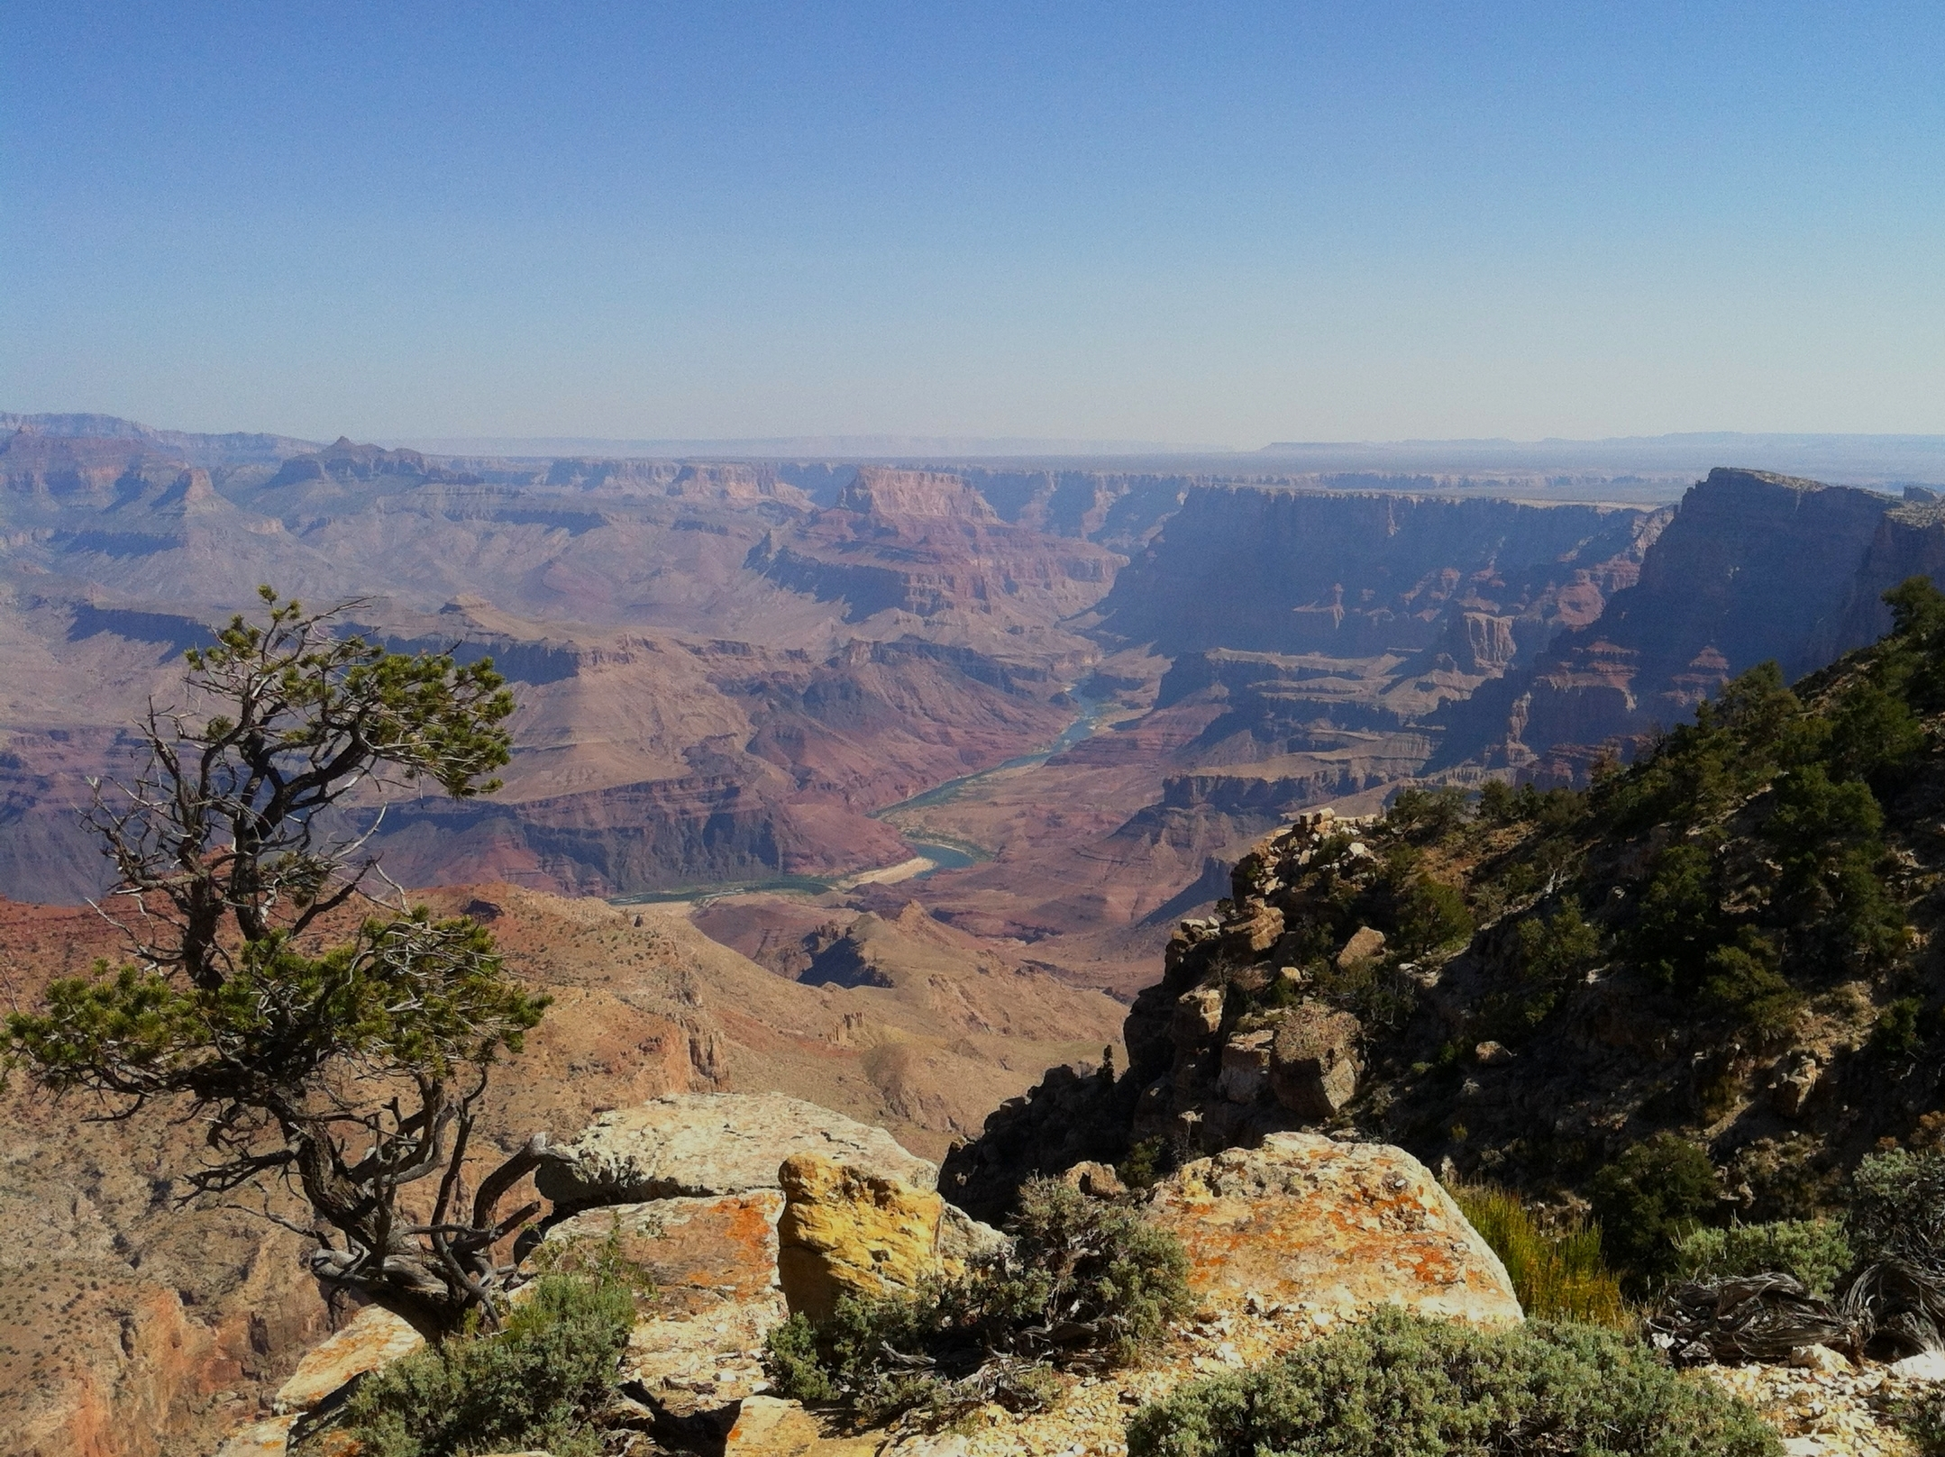

Slide 27
OP Grand Canyon Training Project 3
Marks
  10 passive marks
    3 geometric (“horizontal”) control marks
      2 are also vertical control marks
    6 leveled bench marks (1st order, posted, and offset)
  4 CORS
    2 CORS are referenced to external “monument”
    1 CORS based on “modeled” velocities (no formal accuracies)
Occupations
  6 sessions (3 in May 2009 and 3 in June 2010)
  Highly variable occupation durations (for useable data)

Slide 28
Mark ID | Designation | PID | Geom 3D | Vertical
6866 | 6866 CANYON | GQ0054 |  | Posted
abys | ABYSS | DG5946 | Passive
apex | APEX | DN3518 |  | Offset
b490 | B 490 | FR0789 | Passive | 1st order
b61_ | B 61 | FR0111 |  | Posted
c62_ | C 62 | GP0178 |  | Posted
dsvw | DESERT VIEW
doby | DOBY
sign | SIGNAL HILL | GQ0298 | Passive
v488 | V 488 | FR0757 |  | 1st order
azpg | CITY OF PAGE CORS ARP | DK8419 | CORS
fern | FERN ECC REF DIMPLE | AI8822 | CORS
fred | FRED ECC REF DIMPLE | AI8807 | CORS
fst5 | FLAGSTAFF 5 CORS ARP | DJ8983 | CORS

Slide 29
OP Grand Canyon Training Project 3
OP Grand Canyon Training Project 3
  Used default OP settings
  Mark details not populated
  Used OP essentially as online GPS baseline processor
    Focus is on session processing not network adjustment
    gfiles are created in session processing ONLY
    Network adjustment concatenates session gfiles
Let’s take a look at the OP training project…

Slide 30
OP Grand Canyon Training Project 3

Slide 31
OPUS-Projects output for Bluebooking
Three ASCII text files
Two files serve as input files for ADJUST
  bfile: Station coordinates, occupation info
  gfile: GPS vectors, uncertainties, correlations
Serfil: Relates station 4-character code to SSN
  SSN is 4-digit “Station Serial Number” in b- and gfiles

Slide 32
Adjustment options files (afiles)
afile is also required by ADJUST
afile is an adjustment options file
  Controls how ADJUST is run
  Gives constrained coordinates for marks
  Gives uncertainties on constrained components
NOT generated by OPUS-Projects (yet)
  Simplest way to create now is using WinDesc

Slide 33
Files and data for Bluebooking
Files sent to you in email
Includes following:
  ADJUST input files
  Datasheets and CORS coordinate files
  OPUS-Projects session and network results
Will send additional files later
  Final ADJUST output files
  Checking program output files
Can provide RINEX (GPS data) files separately
  Too big to email (36 GB zipped)

Slide 34
Overview of OP Bluebooking process
Create and process project in OPUS-Projects
  Use network adjustment bfile and gfile
Run ADJUST using OP bfile and gfile
  Create afiles (using WinDesc)
  Perform adjustments and analyses
    Geometric adjustments (free then constrained)
    Vertical adjustments (free then constrained)
  Combine final geometric and vertical adjustments
Run checking programs
Create descriptions (using WinDesc)
Prepare report
Submit report and results to NGS

Slide 35
Setting up a project for Bluebooking
Bluebook file output provided by OPUS-Projects
  Bfile: Mark coordinates, accuracies, occupation metadata
  Gfile: GPS vectors, uncertainties, session metadata
  Serfil: Correlates station serial number with mark ID
Download and install WinDesc
  http://www.geodesy.noaa.gov/PC_PROD/pc_prod.shtml#WinDesc
Download and “install” ADJUST
  From http://beta.ngs.noaa.gov/PC_PROD/ADJUST/
  What’s in the “adjust_all.zip” file?

Slide 36
Sample project in “adjust_all.zip”
ADJUST input files
  afiles, gfile, initial input bfile (“bfile.86”)
ADJUST output files
  ADJUST report (“adj”) files, output bfiles
Final bfile for loading into NGSIDB (“bfile.fnl”)
Checking program files
  “chkobs.out”
  “obschks.out” and “obschkl.out” (short and long)
  Contributing organizations list (“contrib.dat”)
Datasheet files, list of station PIDs

Slide 37
Running ADJUST
ADJUST input files
  bfile (from OPUS-Projects)
  gfile (from OPUS-Projects)
  afile (create using WinDesc)
Supporting data
  Published positions, heights, and accuracies for afile
ADJUST output files
  ADJUST output report
  Output bfile with adjusted coordinates and accuracies

Slide 38
The NGS “Bluebook”
Input Formats and Specifications of the
National Geodetic Survey Data Base
  Volume I: Horizontal Control
  Volume II: Vertical Control
  Volume III: Gravity Control
  Annexes (A-P)
bfile defined in Volume I, Chapter 2
  Horizontal Observation Data
gfile defined in Annex N
  Global Positioning System Data Transfer Format
Annex L: Guidelines for Submitting GPS Relative Positioning Data

Slide 39
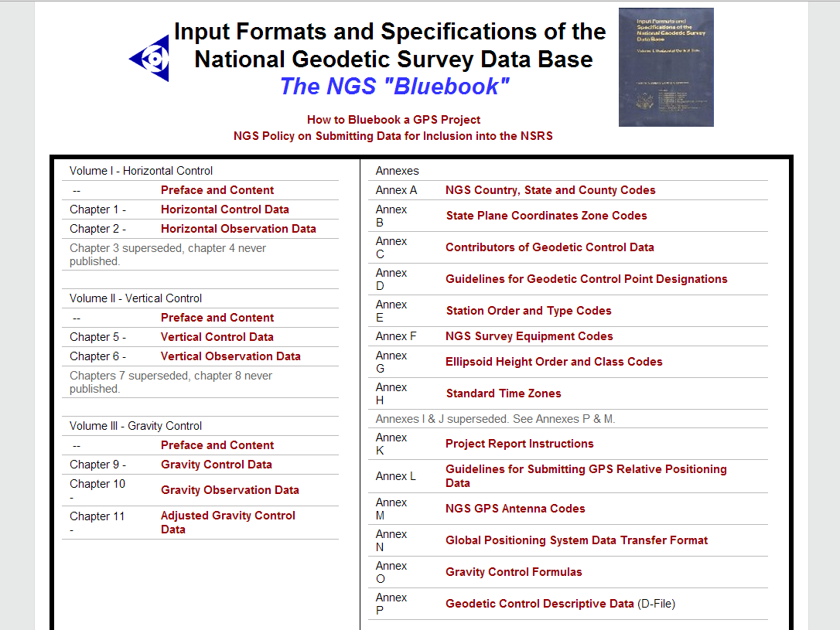
The Bluebook

Slide 40
The bfile (Bluebook station file)
Volume I, Chapter 2 of Bluebook
Overall structure for GNSS projects
  Header (*10*, *11*, *12*, and *13* records)
  Occupation (*25*, *26*, and *27* records)
  GNSS receivers (*70* record)
  GNSS antennas (*72* record)
  Mark designation and position (*80* record)
  Orthometric, geoid, and ellipsoid heights (*86* record)
  Accuracies (*91* and *92* records)
  Variance scalar (*93* record)

Slide 41
The gfile (GNSS vector file)
Annex N of Bluebook
Overall structure for GNSS projects
  A record: Project information
  B record: Session information
  C record: Vector components and standard deviations
    Uses F record if vector component length > 9,999 km
    This is record edited to reject a vector
      Place “R” in column 58 for C record, in column 64 for F record
  D record: Vector correlation coefficients
    Uses E record if covariances used instead of correlations
    CovXY = (std dev X) * (std dev Y) * (corrXY)

Slide 42
The afile (adjustment option file)
Afile is adjustment option file
  Controls how ADJUST is run
  Gives constrained coordinates for marks
  Gives uncertainties on constrained components
    Provided as standard deviation (in cm)
    Values obtained from NGSIDB (e.g., datasheets)
  One needed for each type of adjustment
    e.g., free, geometrically constrained, vertically constrained
Simplest way to create is using WinDesc (for now)
  Uses list of PIDs for constrained stations
  Creates 4 afiles (plus serfil and bfile)
    Free and constrained geometric
    Free and constrained vertical

Slide 43
The afile (adjustment options file)
Defined in “adjust_supplemental.txt”
  Included in “adjust_all.zip”
Records in afile
  CC record: Coordinate constraints
  DD record: Dimensionality
  II record: Iteration record
  MM record: Adjustment mode
  PP record: Print output
  NL record: Network and local accuracy
  VVHU record: Horizontal and up variance factors
  VS record: Scales standard dev of GPS vectors

Slide 44
The ADJUST output file
See NOAA Technical Memorandum NOS NGS-47
  “ADJUST: The Horizontal Observation Adjustment Program”
  http://www.ngs.noaa.gov/PUBS_LIB/pub_index.shtml
Main sections
  Input
    Input and output file names, constraints, settings
    Observation, adjustment, and job summaries
  Residuals
    Given in XYZ, NEU, and length components
    Includes summary statistics
  Adjusted coordinates
  Network and local accuracies

Slide 45
Adjustment sequence overview
Typically 4 adjustments performed for a project
  Minimally constrained (“free”) geometric
    Constrain single mark 3-D
    Internal integrity (mainly vector residuals)
  Geometrically (“horizontally”) constrained
    Constrain multiple mark 3-D, 2-D, or 1-D (ellipsoid height)
    Geoid heights added to final bfile for vertical adjustments
  Minimally constrained (“free”) vertical
    Constrain orthometric height for single mark
  Vertically constrained
    Constrain vertical control 1-D (orthometric height)

Slide 46
Mark ID | Designation | PID | Geom 3D | Vertical
6866 | 6866 CANYON | GQ0054 |  | Posted
abys | ABYSS | DG5946 | Passive
apex | APEX | DN3518 |  | Offset
b490 | B 490 | FR0789 | Passive | 1st order
b61_ | B 61 | FR0111 |  | Posted
c62_ | C 62 | GP0178 |  | Posted
dsvw | DESERT VIEW
doby | DOBY
sign | SIGNAL HILL | GQ0298 | Passive
v488 | V 488 | FR0757 |  | 1st order
azpg | CITY OF PAGE CORS ARP | DK8419 | CORS
fern | FERN ECC REF DIMPLE | AI8822 | CORS
fred | FRED ECC REF DIMPLE | AI8807 | CORS
fst5 | FLAGSTAFF 5 CORS ARP | DJ8983 | CORS

Slide 47
Constrained coordinates
Mark ID | Latitude | Longitude | Ellipsoid ht | Ortho ht | Vert source
6866 |  |  |  | 2091.918 | Posted
abys | 36°03’31.28963”N | 112°11’00.97932”W | 2054.481
apex |  |  |  | 1988.54 | Offset
b490 | 35°15’47.94332”N | 112°01’21.80336”W | 2112.746 | 2136.194 | 1st order
b61_ |  |  |  | 1850.076 | Posted
c62_ |  |  |  | 2201.259 | Posted
sign | 36°10’13.49415”N | 112°21’26.58322”W | 2042.378
v488 |  |  |  | 1597.410 | 1st order
azpg | 36°54’31.19183”N | 111°27’45.63634”W | 1302.744
fern | 35°20’30.72354”N | 112°27’17.00705”W | 1768.733
fred | 36°59’17.97848”N | 112°29’57.13502”W | 1530.512
fst5 | 35°13’18.37175”N | 111°49’02.58254”W | 2137.186

Slide 48
1. Free geometric adjustment
ADJUST is run from DOS command prompt
  <shift>+<right click> folder in Windows Explorer
Minimally constrained (“free”) geometric
  Input is bfile and gfile from OP
  Constrain single mark 3-D
  Internal integrity (mainly vector residuals)
    Identify and reject “large” residuals if necessary
    Often an iterative process as vectors rejected
  “VVHU” option in afile scales vector errors
    Horizontal and vertical components scaled separately
    Standard deviation of unit weight = 1.000
    Must be run again if any vectors rejected

Slide 49
1. Free geometric adjustment
Getting acquainted with ADJUST output file
  Network statistics
  Observation residuals
  Coordinate shifts
  Station accuracies
Analysis programs
  diflatlon.exe, preplt2.exe, compVecs.exe
The NGS GIS GPS Toolbox (not covered in detail)
  Input: bfile and/or gfile and/or ADJUST output file
  Output: Shapefiles of adjusted stations and vectors
    Stations in point shapefile, vectors in line shapefile
    Coordinates, shifts, network accuracies, number vector ties
    Vector components, residuals, occupation date & time, software used

Slide 50
1. Free geometric adjustment
Analysis
  Magnitude and distribution of vector residuals
    Generally horiz resid < 2 cm, vert residuals < 5 cm
    But overall distribution matters (< 5 x residual RMS)
    RMS of vertical residuals > horizontal residuals
  Accuracies
    Ratio of vertical to horizontal network accuracies > 1
    All accuracy values more-or-less similar
  Avoid “no check” stations (tied by single enabled vector)
  Are trivial vectors present?
Final free adjustment
  Contains no outliers
  Defines input for subsequent adjustments
  Gfile and variance scalar (VS) will not change

Slide 51
2. Constrained geom adjustment
Geometrically (“horizontally”) constrained
  Input is bfile from free adjustment
  Variance scalar (VS) value in afile is from free adjust
  Constrain multiple marks 3-D, 2-D, or 1-D
    Height component ellipsoid height (not orthometric height)
  External integrity check on quality of control
    Also can be iterative process if not all control “fits”
  Vectors should NOT be rejected in constrained adjust
Analysis
  “Large” changes in residuals and coordinate changes from free
  Standard deviation of unit weight < ~2
  Constrained coordinate shifts < 2 cm horiz, 4 cm height
  Ratio of vertical to horizontal network accuracies > 1
  Consistent accuracy values

Slide 52
3: Free vertical adjustment
Minimally constrained (“free”) vertical
  Input is geometric constrained bfile
    Geoid heights added before using in vertical adjustment
    Add using geoid interactive computation web page
    http://www.ngs.noaa.gov/cgi-bin/GEOID_STUFF/geoid12A_prompt1.prl
  Constrain orthometric height for single mark
    Also constrain one horizontal position (can be different mark)
  Variance scalar (VS) value in afile is from free adjust
  Statistics IDENTICAL to free geometric
    NO additional vector rejections (or “unrejections”)
  Provides check that VS value is correct
  Also provides baseline for constrained vertical

Slide 53
4: Constrained vertical adjustment
Vertically constrained
  Input is bfile from free adjustment, same VS value
  Constrain vertical control 1-D (orthometric height)
    But constrain one horizontal position
  Variable (stochastic) constraint weights NOT used
    Thus no accuracy values computed for orthometric heights
    ADJUST assigns default sigma of 0.1 mm
Analysis similar to constrained geometric
  External integrity check
    Assess appropriateness of constraints
  Large changes in residuals
  Standard deviation of unit weight < ~2
  Change in heights from free vertical adjustment
  Constrained heights will not shift

Slide 54
Finalize for submittal to NGS
Final output of ADJUST results
  Add ortho heights from vertical adjustment to final bfile
  Manual editing of final bfile (especially vertical metadata)
Create descriptions using WinDesc
  Not covered in detail in this training
Run checking programs
  chkobs.exe, obschk.exe, obsdes.exe
Project report
  See “Constrained Adjustment Guidelines” for requirements
  Plan to provide report template to make this simpler
Submittal to NGS for review and publication
  Mail report and data files (typically on CD or DVD)
  Submittal via Internet is not yet available

Slide 55
Compare OP to ADJUST (free adjust)
Free adjustment OPUS-Projects minus ADJUST results (cm)
Constrained to mark "abys"
OPUS-Projects "normal" constraints weight
 | Delta Horz | Delta EHT | Delta OHT
Min | 0.1 (c62_) | -0.5 (dsvw) | N/A
Max | 0.5 (sign) | 0.0 (azpg) | N/A
Mean | 0.3 | -0.4 | N/A
Std dev | ±0.1 | ±0.1 | N/A

Slide 56
Compare OP to ADJUST (const adjust)
OPUS-Projects results minus final ADJUST results (cm)
OPUS-Projects "normal" constraints weight
 | Delta Horz | Delta EHT | Delta OHT
Min | 0.2 (b490) | -0.4 (dsvw) | -3.7 (v488)
Max | 0.8 (sign) | +0.2 (b490) | +2.5 (apex)
Mean | 0.4 | -0.1 | 0.0
Std dev | ±0.1 | ±0.1 | ±1.4
OPUS-Projects "tight" constraints weight
 | Delta Horz | Delta EHT | Delta OHT
Min | 0.1 (abys) | -0.7 (b490) | -0.2 (dsvw)
Max | 0.8 (sign) | +1.4 (fern, fst5) | +0.3 (azpg)
Mean | 0.4 | +0.5 | +0.1
Std dev | ±0.2 | ±0.6 | ±0.1

Slide 57
Compare OP to ADJUST (accuracies)
Accuracy comparison (at 95% confidence)
OPUS-Projects "normal" constraints weight
 | Horizontal (cm) |  | Ellipsoid height (cm) |  | Ratio ADJUST/OP
 | ADJUST | OP | ADJUST | OP | Horiz | Ellipsoid ht
Min | 0.18 (abys) | 0.37 (all) | 0.35 (abys) | 0.20 (9 sta) | 0.5 (abys) | 1.8 (abys)
Max | 1.36 (c62_) | 0.37 (all) | 1.63 (c62_) | 0.39 (5 sta) | 3.7 (c62_) | 4.5 (dsvw)
Mean | 0.59 | 0.37 | 0.77 | 0.27 | 1.6 | 2.9
OPUS-Projects "tight" constraints weight
 | Horizontal (cm) |  | Ellipsoid height (cm) |  | Ratio ADJUST/OP
 | ADJUST | OP | ADJUST | OP | Horiz | Ellipsoid ht
Min | 0.18 (abys) | 0.00 | 0.35 (abys) | 0.00 | ∞ | 3.9 (6866)
Max | 1.36 (c62_) | 0.00 | 1.63 (c62_) | 0.39 (c62_) | ∞ | ∞
Mean | 0.59 | 0.00 | 0.77 | 0.11 | ∞ | 4.7

Slide 58
Compare OP and ADJUST to published
Results minus published for constrained marks (cm)
 | ADJUST final |  |  | OPUS-Projects "normal" weight
 | Delta Horz | Delta EHT | Delta OHT | Delta Horz | Delta EHT | Delta OHT
Min | 0.05 (sign) | -1.5 (fst5) | -0.1 (b61_) | 0.15 (azpg) | -1.6 (fst5) | -3.7 (v488)
Max | 0.59 (fred) | +0.7 (b490) | 0.0 | 0.85 (sign) | +0.9 (b490) | +2.5 (apex)
Mean | 0.37 | -0.7 | 0.0 | 0.37 | -0.5 | 0.0
 | ADJUST final (same as above) |  |  | OPUS-Projects "tight" weight
 | Delta Horz | Delta EHT | Delta OHT | Delta Horz | Delta EHT | Delta OHT
Min | 0.05 (sign) | -1.5 (fst5) | -0.1 (b61_) | 0.04 (fst5) | -0.1 (fst5) | -0.1 (b61_)
Max | 0.59 (fred) | +0.7 (b490) | 0.0 | 0.87 (sign) | +0.1 (azpg, fern) | +0.1 (3 sta)
Mean | 0.37 | -0.7 | 0.0 | 0.29 | 0.0 | 0.0

Slide 59
Why do OP and ADJUST results differ?
OP does not adjust both ellipsoid and ortho heights
  OP always uses relationship h = H + N
OP uses different sigmas on constraints
  Sigmas in XYZ rotated to NEU without covariances
  Passive mark sigmas from OPUS peak-to-peak
ADJUST scales horizontal and vertical errors separately
ADJUST multiplies final sigmas by std dev unit weight
  Not sure if OP does or not…
OP adjusted observables are double differences
  ADJUST adjusted observables are GPS vector components
  But should this cause a difference?

Slide 60
Recap of OP Bluebooking process
Create and process project in OPUS-Projects
  Use network adjustment bfile and gfile
Run ADJUST using OP bfile and gfile
  Create afiles (using WinDesc)
  Perform adjustments and analyses
    Geometric adjustments (free then constrained)
    Vertical adjustments (free then constrained)
  Combine final geometric and vertical adjustments
Create descriptions (using WinDesc)
Run checking programs
Prepare report
Submit report and results to NGS

Slide 61
Additional discussion items
Where is NGS going with all this?
How do you analyze OPUS-Projects results?
  There are no vector residuals to analyze
  There are no vectors to reject
Dependent (“trivial”) vectors
Impact of network design on OP results
Impact of OP session processing constraints on gfile
Bluebooking with commercial GNSS baseline processing software
FAA projects

Slide 62

Questions?

