Slide 1


Working with OPUS Projects 5 & New Standards and Specifications
NYSAPLS Fall Seminar
October 18, 2023
Dan Martin
Northeast Regional Geodetic Advisor
ME, NH, VT, MA, CT, RI, NY, NJ
Dan.martin@noaa.gov
240-676-4762

Slide 2
What is OPUS Projects?
OPUS Projects offers Web-based access to simple visualization, management and processing tools for multiple marks and multiple occupations. Some of its advantages include:
Data uploading through OPUS.
Processing using the PAGES software.
Graphical visualization and management aids.
Significant support of bluebooking (submitting to NGS for publication).

Slide 3
Why complicate OPUS?
OPUS
Session
Adjustment
CORS3
CORS5
CORS2
CORS1
CORS4
solution HATFIELD
solution MCCOY
Notes:
OPUS solutions are independent of each other, but they may be indirectly related …
Marks might “share” their environment (similar atmosphere over both).
Data might “share” the same GNSS constellation geometry.
OPUS solutions may “share” some or all of the same CORS.
Etc.
These correlations can increase with project size.

Slide 4
Why complicate OPUS?
OPUS
Session
Adjustment
CORS3
CORS5
CORS2
CORS1
CORS4
solution HATFIELD
solution MCCOY
session 001
Notes:
Combining your data logically can improve results:
Neutral atmosphere (tropo) corrections can be improved which, in turn, can help with other things like phase ambiguity resolution.
Common mode effects, like baselines connecting the same CORS common to different marks, can be de-correlated.
OPUS Projects tries to logically group data together:
Data from the same mark are associated with that mark.
Marks simultaneously occupied are grouped into sessions. Session processing improve consistency and accuracy.

Slide 5
Why complicate OPUS?
OPUS
Session
Adjustment
CORS3
CORS5
CORS2
CORS1
CORS4
solution HATFIELD
solution MCCOY
session 001
session 002
session N
Notes:
These concepts can be extended to other marks and other sessions.

Slide 6
Why complicate OPUS?
OPUS
Session
Adjustment
CORS3
CORS5
CORS2
CORS1
CORS4
solution HATFIELD
solution MCCOY
session 001
session 002
session N
network adjustment
Notes:
Ultimately, combining session solutions into an adjustment can improve accuracy for the entire network.

Slide 7


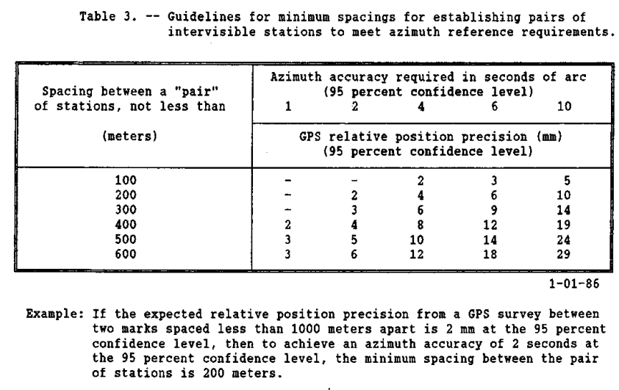
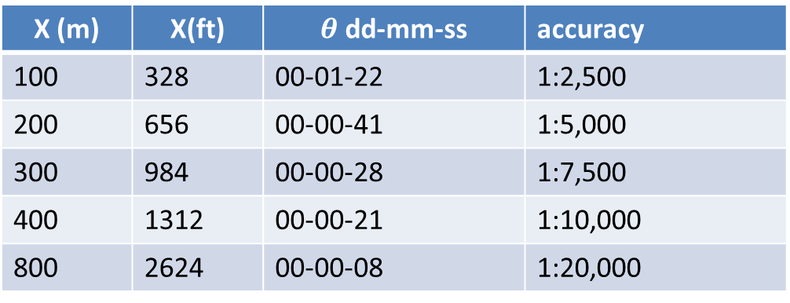
4 cm (0.16 ft)
X (m) | X(ft) |  | accuracy
100 | 328 | 00-01-22 | 1:2,500
200 | 656 | 00-00-41 | 1:5,000
300 | 984 | 00-00-28 | 1:7,500
400 | 1312 | 00-00-21 | 1:10,000
800 | 2624 | 00-00-08 | 1:20,000
2 cm
X
Geometric Geodetic Accuracy Standards and Specifications for using GPS Relative Positioning Techniques
2 cm

Slide 8
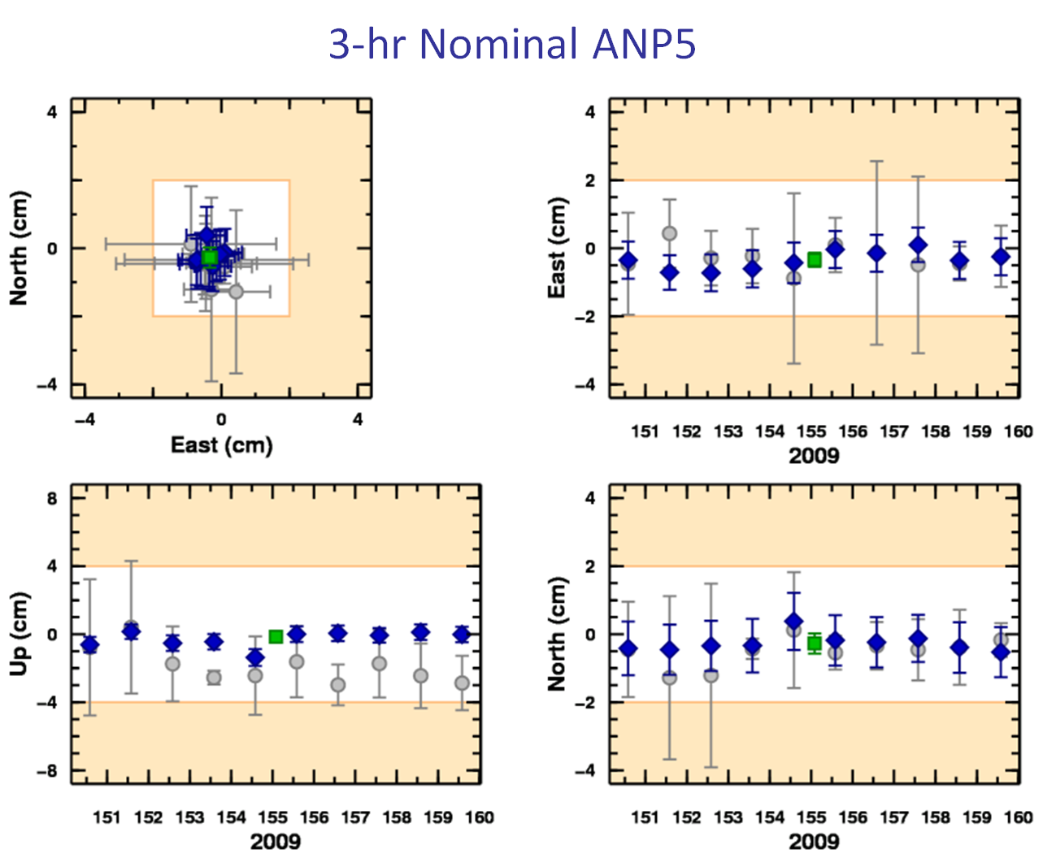
What’s in it for me?
OPUS solutions = pretty good, but each treated as independent and assumes “perfect” CORS.
Sessions = simultaneously-observed marks processed together in sessions increases consistency.
Adjustments = interlinking sessions through network adjustments increases accuracy.

Slide 9
Do we really need another OPUS version?
The practical answer is probably yes.
The NGS and other groups have a history of projects whose specifications can’t be entirely supported by OPUS.
The academic answer is probably yes.
As good as OPUS does, and that is very good indeed, sacrificing simplicity for flexibility can improve results.

Slide 10
What does this mean operationally?
Plan your project
Collect data and metadata (photos and mark descriptions)
Gather data and metadata onto one computer
Process the data
Perform a network adjustment
Create Report/Publish
Notes:
Very broadly, you probably go through these or very similar steps for every project.

Slide 11
What does this mean operationally?
Plan your project
Create an OPUS project
Collect data and metadata
Upload data to your project using OPUS
Process sessions
Perform network adjustment
Publish (if desired).
Notes:
The steps when using OPUS Projects are very similar, but the steps in black use OPUS Projects rather than your own resources.

Slide 12
What does this mean operationally?
Admittedly an oversimplification, nevertheless there is value in thinking of OPUS Projects as four steps with an optional fifth step.
Creating A Project
Uploading Data
Session Processing
Network Adjustment
Publishing to the NGS Integrated Database
Notes:
Publishing to the NGS Integrated Database is covered separately (Bluebooking using OPUS Projects).

Slide 13
The steps represented graphically.
Your OPUS Project
OPUS Solution
Data &
Metadata
Session
Solution
OPUS Solution
Processor or Manager
Session
Solution
Manager
Network
Adjustment
Publish
To NGSIDB
Session
Solution
Session
Solution
OPUS Solution
Copy
To User
Copy
To User
Copy
To User
Notes:
Projects exists on an NGS server and are only accessible through the OPUS Projects Web interface.
The entire white box represents a project.
The allocation of resources for a project is step 1.
The orange icons on the left represent step 2: uploading data into the project.
The green icons in the middle represent step 3: processing individual sessions and solution quality control.
The blue icons on the right represent step 4: network adjustment.
The purple icons on the far right represent the publishing options.

Slide 14
Are there any side effects?
Exploiting a Web-based application like OPUS Projects can mean:
Less backtracking.
  Data consolidated while teams are in the field.
  Rapid data quality assessment.
Simpler logistics.
  Data are immediate availability through on-line storage.
  Automated organization.
Less worry.
  Share information.
  Share results.

Slide 15

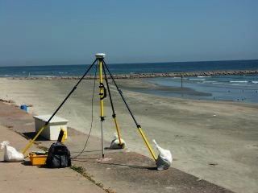

G.I.G.O.
We still need surveyors. We hope OPUS Projects can help, but it can’t do your job for you.
Follow your project’s
specifications.
Use best practices and
careful field procedures.
Select permanent marks
of public interest.
Good coordinates come
from good data.
http://gis.larc.nasa.gov/
Notes:
G.I.G.O. = garbage in, garbage out

Slide 16
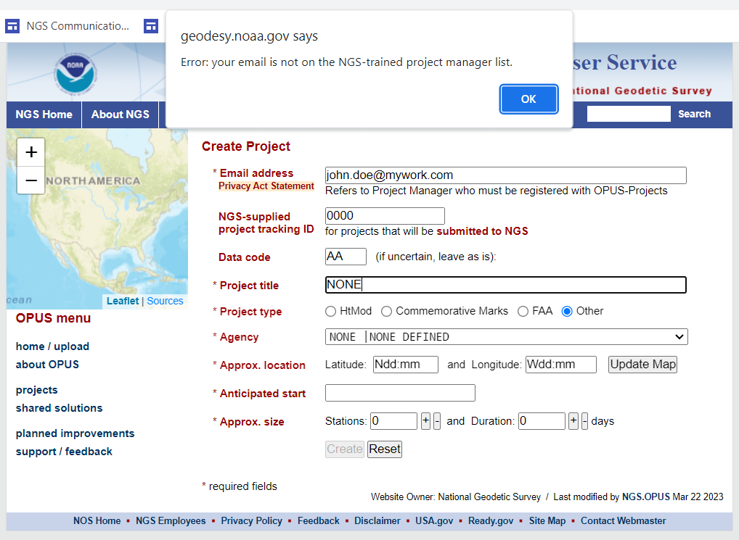
I can’t get into OPUS Project!!
Currently, OPUS Projects requires a multi-day training class.

Slide 17
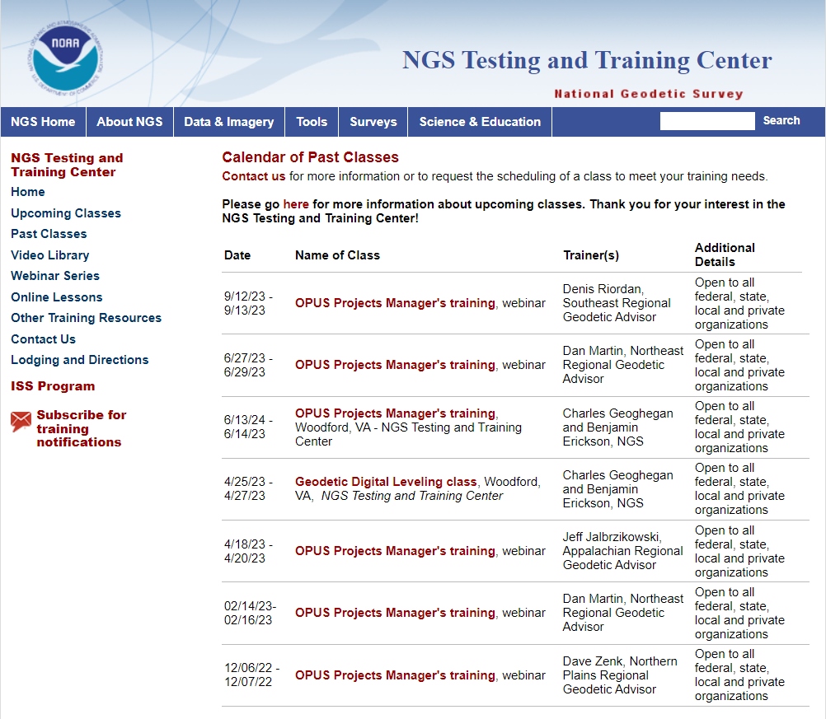

Slide 18
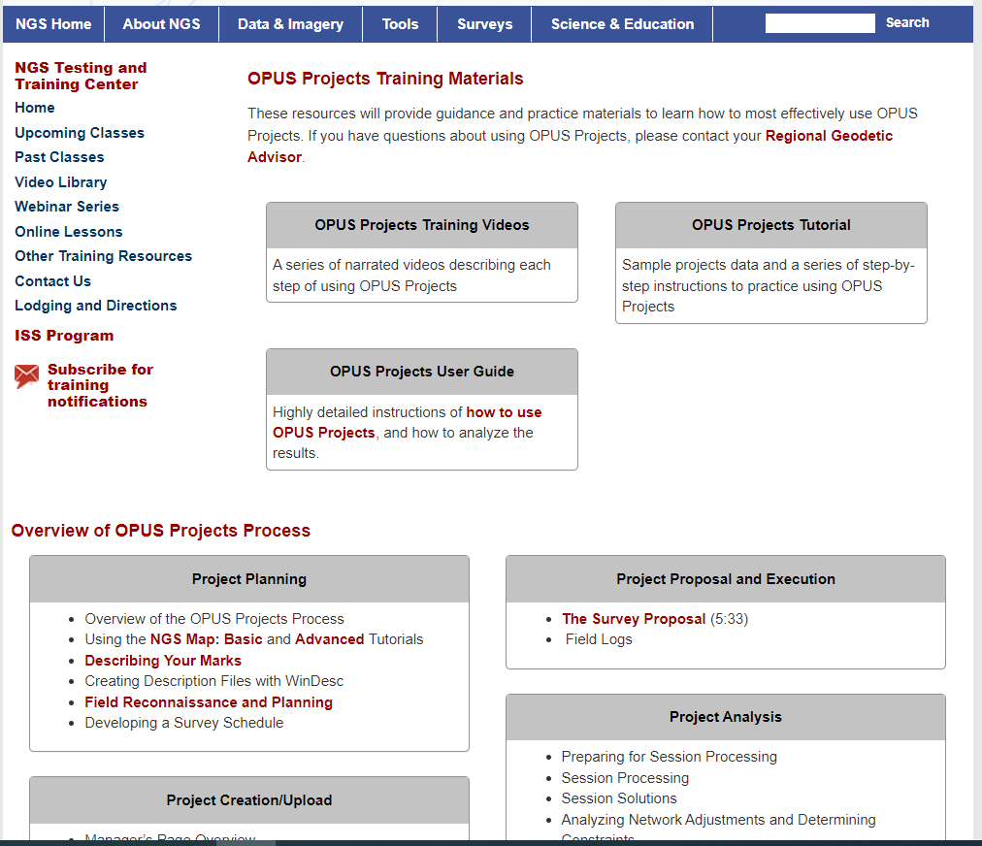
Self-Paced online training is coming

Slide 19
A Little Background Information
Understanding a little about how processing is done within OPUS Projects informs your planning and helps ensure that you observation meet your project needs.
Plan the work and work the plan

Slide 20
Independent vs Dependent Baselines
Number of independent (non-trivial) baselines = n-1
Independent (non-trivial)
Total number of baselines = n(n-1)/2
Dependent (trivial)

Slide 21
Sequential or (Baseline) Processing vs
Simultaneous or (Session) Processing
Baseline Solution
  One baseline at a time
  Ignores mathematical correlations between baselines observed in the same session.
  Must include all independent and dependent baselines for each session
  Must be properly scaled before combining sessions into network adjustment
Session Solution
  Solution from simultaneous processing of all independent baselines with mathematical correlations between baselines

Slide 22
Which Baselines to Create? (non-OPUS Projects)

Slide 23
Independent Baselines Only by Session

Slide 25
OPUS Projects uses Session Processing
By default, independent baselines for each session are created from a single “HUB”
  Think of the hub and spokes of a wheel
By default, OPUS Projects will select the most central CORS within a session and designate it as the HUB
The relationship between all (non-HUB) marks (dependent baselines) are represented by mathematical correlations.
This approach has some significant benefits, and will be discussed further in the session processing module.

Slide 27
GNSS Vector EXchange Format (GVX)
Website: https://www.ngs.noaa.gov/data/formats/GVX/index.shtml
Detailed documentation
Schema (XSD)
Example vector files
GVX is written in Extensible Markup Language (XML)
Designed to store and carry data in plain text format
Flexible representation of arbitrary data structures
Extensible – new elements can be added later without breaking applications
Both machine-readable and human-readable
Schemas can be used to define “must haves” and “should haves”

Slide 28
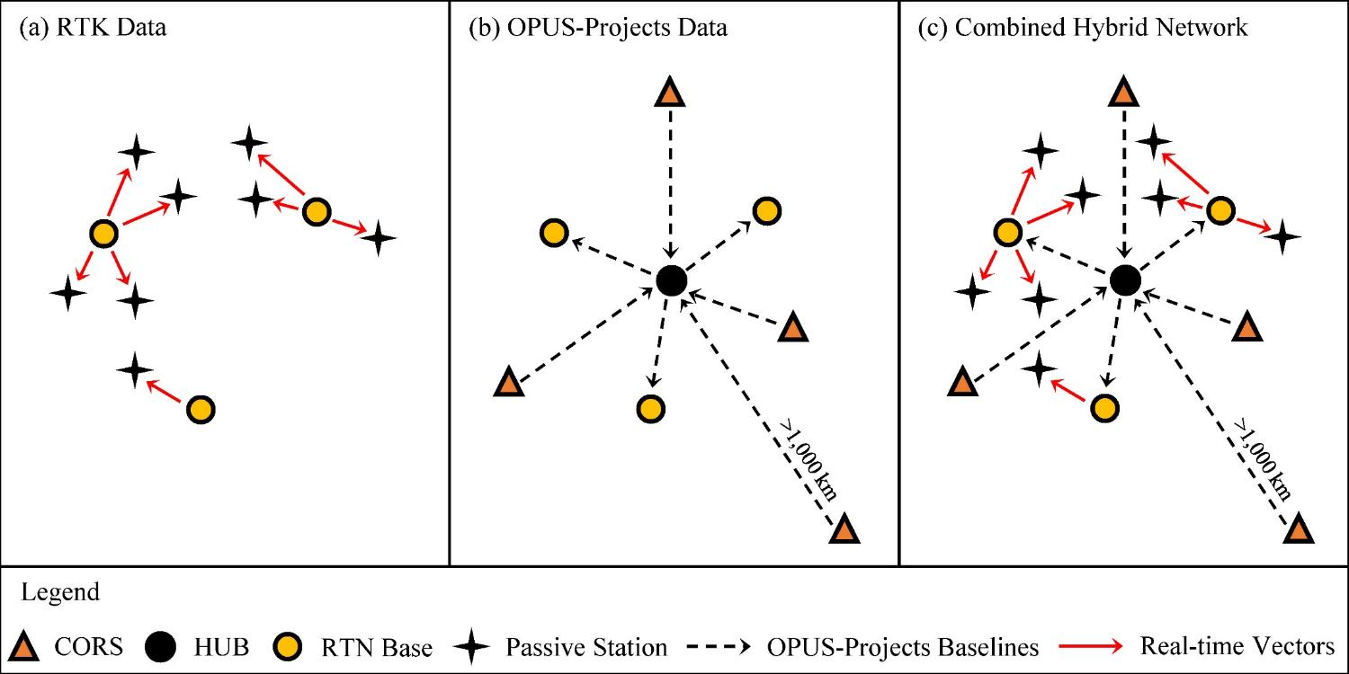
Design for OPUS-Projects and GVX
GVX file (from RTK survey or baseline processing in other software)
OPUS-Projects (from static GNSS session processing)
500-800 km
500-800 km
RTK Base or “From” Mark
RTK Rover or “To” Mark
Vector
Vector in GVX File
[Adapted from Weaver et al. 2018]

Slide 29
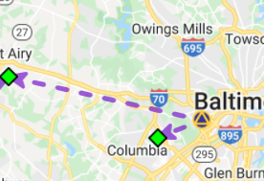
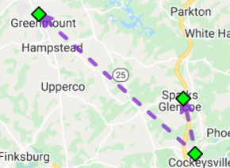
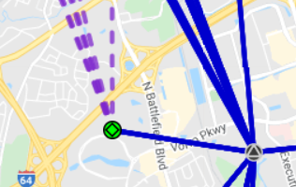
Three Cases for RTK/RTN Bases
RTN Base = CORS
Automatically attaches GVX vectors to official coordinates for CORS
Constrain CORSs
RTK/RTN Base = Not a CORS and new to NGS
Upload static GPS data logged at the base during the days of the RTK survey
Perform session baseline processing to connect to CORSs
Constrain CORSs
3. RTK/RTN Base = Not a CORS but has a datasheet
Could constrain coordinates on datasheet
Or, upload static data at the RTN base, logged during the days of the RTK survey; perform session baseline processing; constrain CORSs

Slide 30
Network Design and Schedule Considerations
Which marks to include in an observation session?
Standard/Specification
  Session length
  Number of occupations
  Repeat occupation criteria
  Baseline length
  Ties to existing passive marks
Resources available
  Equipment
  Observers
Field constraints
  Travel between stations
  Site access
  Site safety

Slide 31
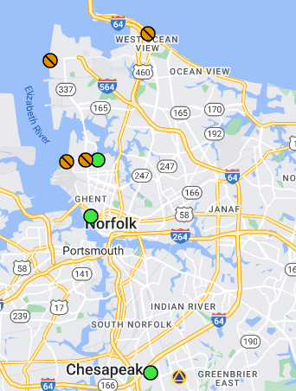
Which Marks to Observe together in a Session
Marks that are intervisible, e.g., a mark and it’s azimuth mark
Any group of marks for which relative “Local Accuracies” are desired
  Points that will control the beginning and end of a future traverse
  Any place where you want to maximize the internal precision between points
Existing Passive Control (especially vertical) and nearest neighbors
Vertical Control
Real Time Base Station

Slide 32
Network Design and Schedule Considerations
Which marks to include in an observation session?
Standard/Specification
  Session length
  Number of occupations
  Repeat occupation criteria
  Baseline length
  Ties to existing passive marks
Resources available
  Equipment
  Observers
Field constraints
  Travel between stations
  Site access
  Site safety

Slide 33
Table 4 - Standards for Observation Requirements by Method
 | Requirement | PRIMARY | SECONDARY | LOCAL
4.1 | Requirements for ALL METHODS Repeat occupations and offset time | Offset sessions/occupations by 3 to 21 hours. See Specifications for detailed explanation.
4.2 | Requirements for OPUS PP Required TOTAL Static GNSS Observation Time (T) Recommended GNSS Session Durations | 0 to 200 km T = 20 hours (2) 10 hour sessions or (3) 7 hour sessions or (4) 5 hour sessions Requires at least 1 session on a different day. | 0 to 100 km T = 4 hours 0 to 150 km T = 6 hours 0 to 200 km T = 8 hours (2) 2 hour sessions (2) 3 hour sessions (2) 4 hour sessions | 0 to 200 km T = 4 hours (2) 2 hour sessions
4.3 | Requirements for GDX PP - Number and duration of sessions | 3 sessions 0 to 25 km 60 minutes each 25-50 km 90 minutes each Requires at least 1 session on a different day. | 3 sessions 0 to 25 km 30 minutes each 25-50 km 60 minutes each | 3 sessions 0 to 25 km 15 minutes each 25-50 km 30 minutes each
4.4 | Requirements for GDX NRTK - Number and duration of occupations | (6) 5 minutes Requires at least 3 occupations on a different day. | (3) 5 minutes | (3) 5 minutes
4.5 | Requirements for GDX SRTK - Number and duration of occupations | Not allowed | (5) 5 minutes Requires at least 2 occupations on a different day. | (4) 5 minutes Requires at least 1 occupation on a different day.

Slide 34
Network Design and Schedule Considerations
Which marks to include in an observation session?
Standard/Specification
  Session length
  Number of occupations
  Repeat occupation criteria
  Baseline length
  Ties to existing passive marks
Resources available
  Equipment
  Observers
Field constraints
  Travel between stations
  Site access
  Site safety

Slide 35
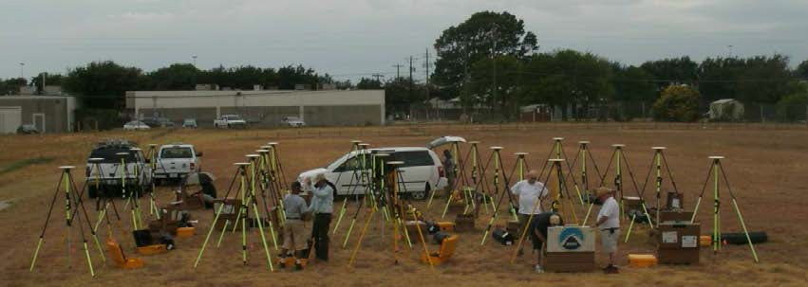
What Resources are Available?

Slide 36
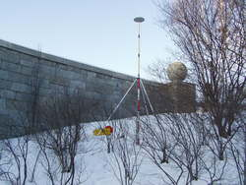
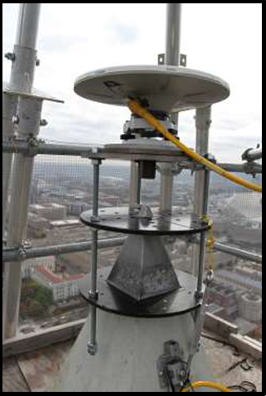
Resources
How many field observers are available?
  Are there a different number of observers available on different days?
  Are there certain marks the require specific observers?
    Hike required
    4WD vehicle required
How many sets of equipment are available?
  Certain antenna, tripod, extension, cable length needed because of how/where the mark is set?

Slide 37
Network Design and Schedule Considerations
Which marks to include in an observation session?
Standard/Specification
  Session length
  Number of occupations
  Repeat occupation criteria
  Baseline length
  Ties to existing passive marks
Resources available
  Equipment
  Observers
Field constraints
  Travel between stations
  Site access
  Site safety

Slide 38
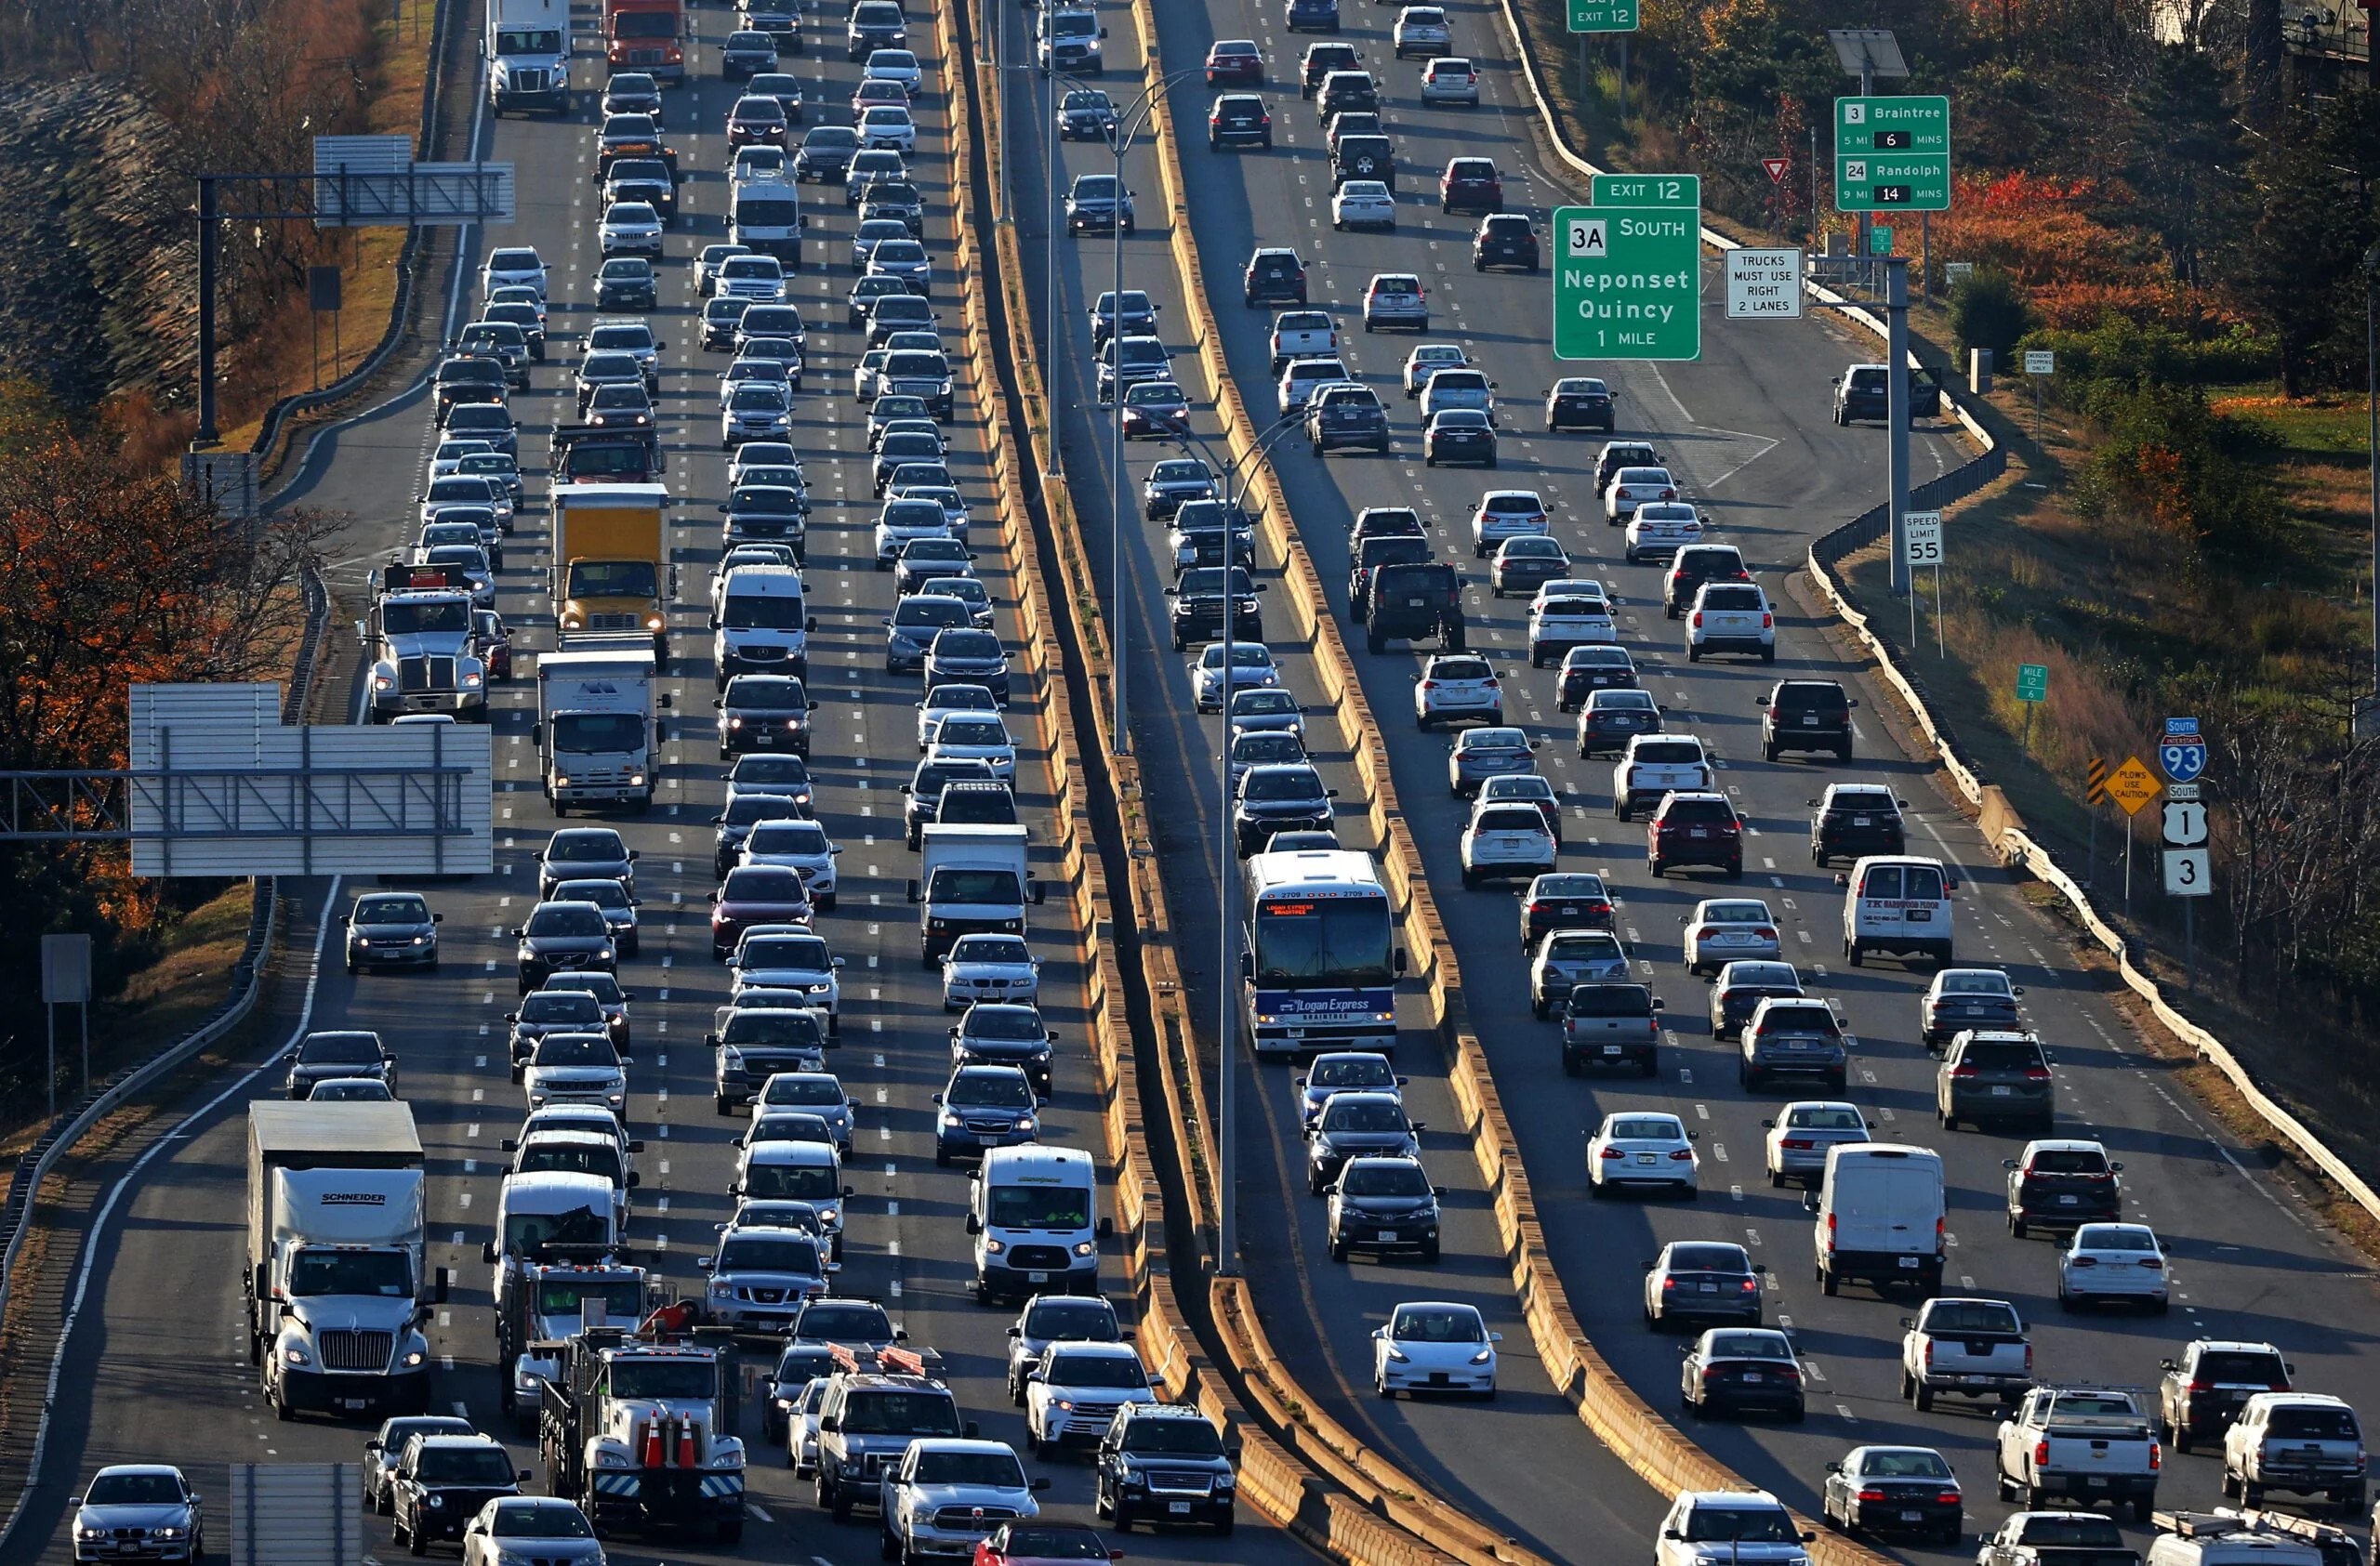
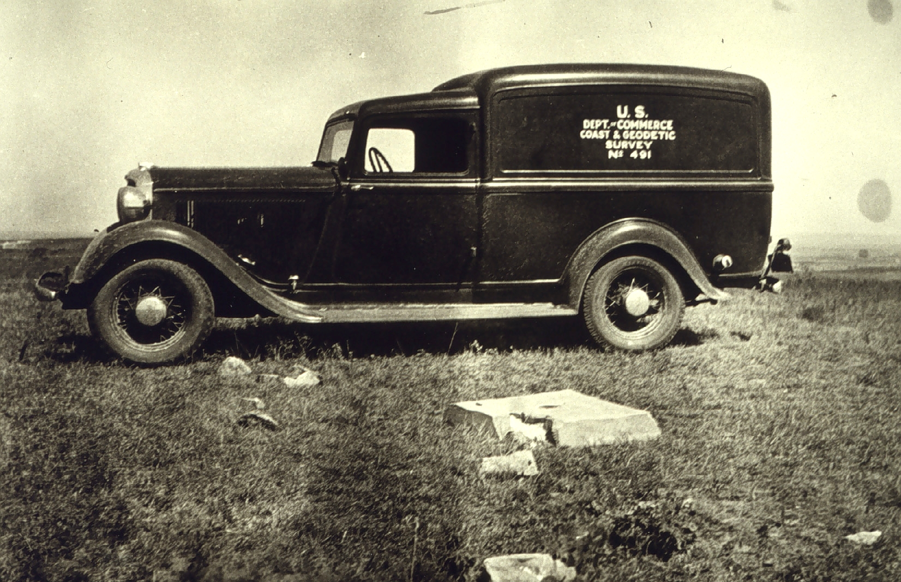
Field Constraints - Travel
How much time is needed for all observers to get to next station/session?
  Miles/speed limits
  Traffic/City driving
  Off-road travel or hike required

Slide 39
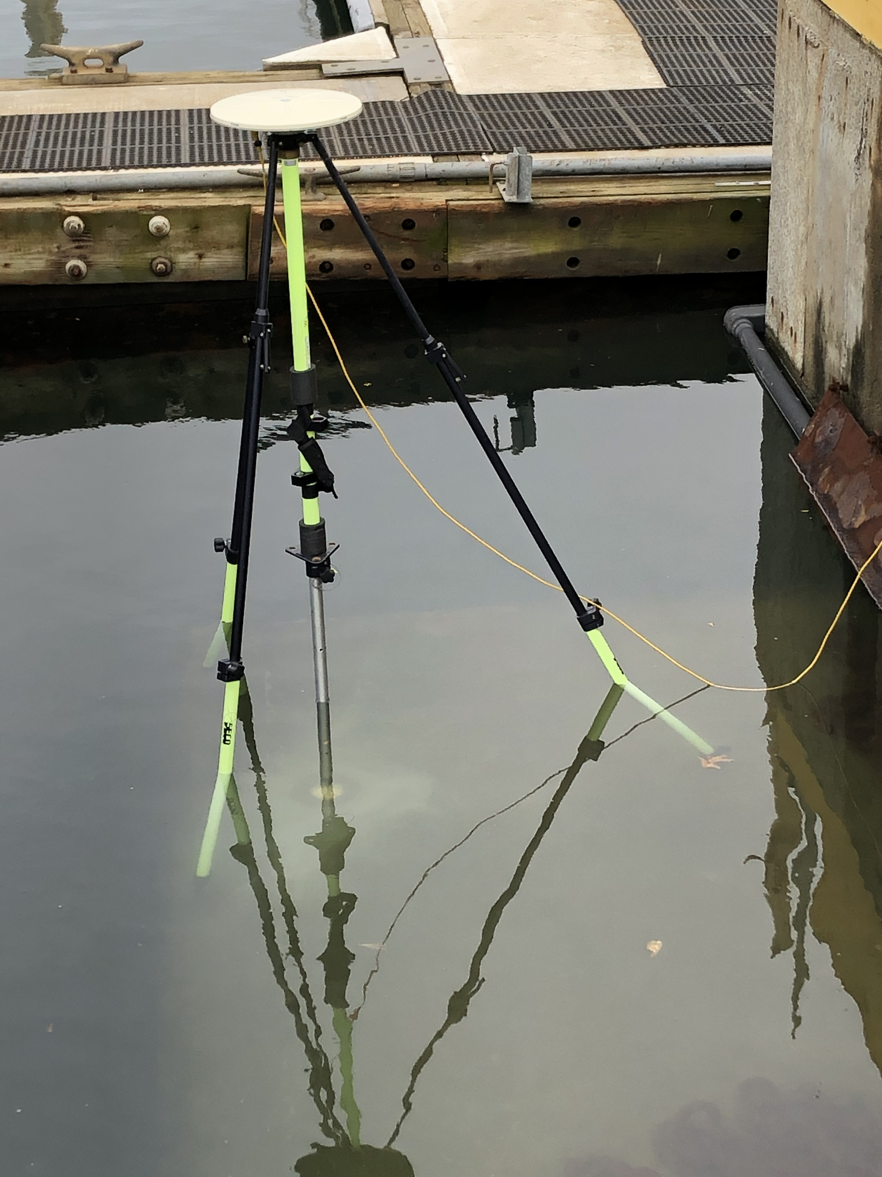
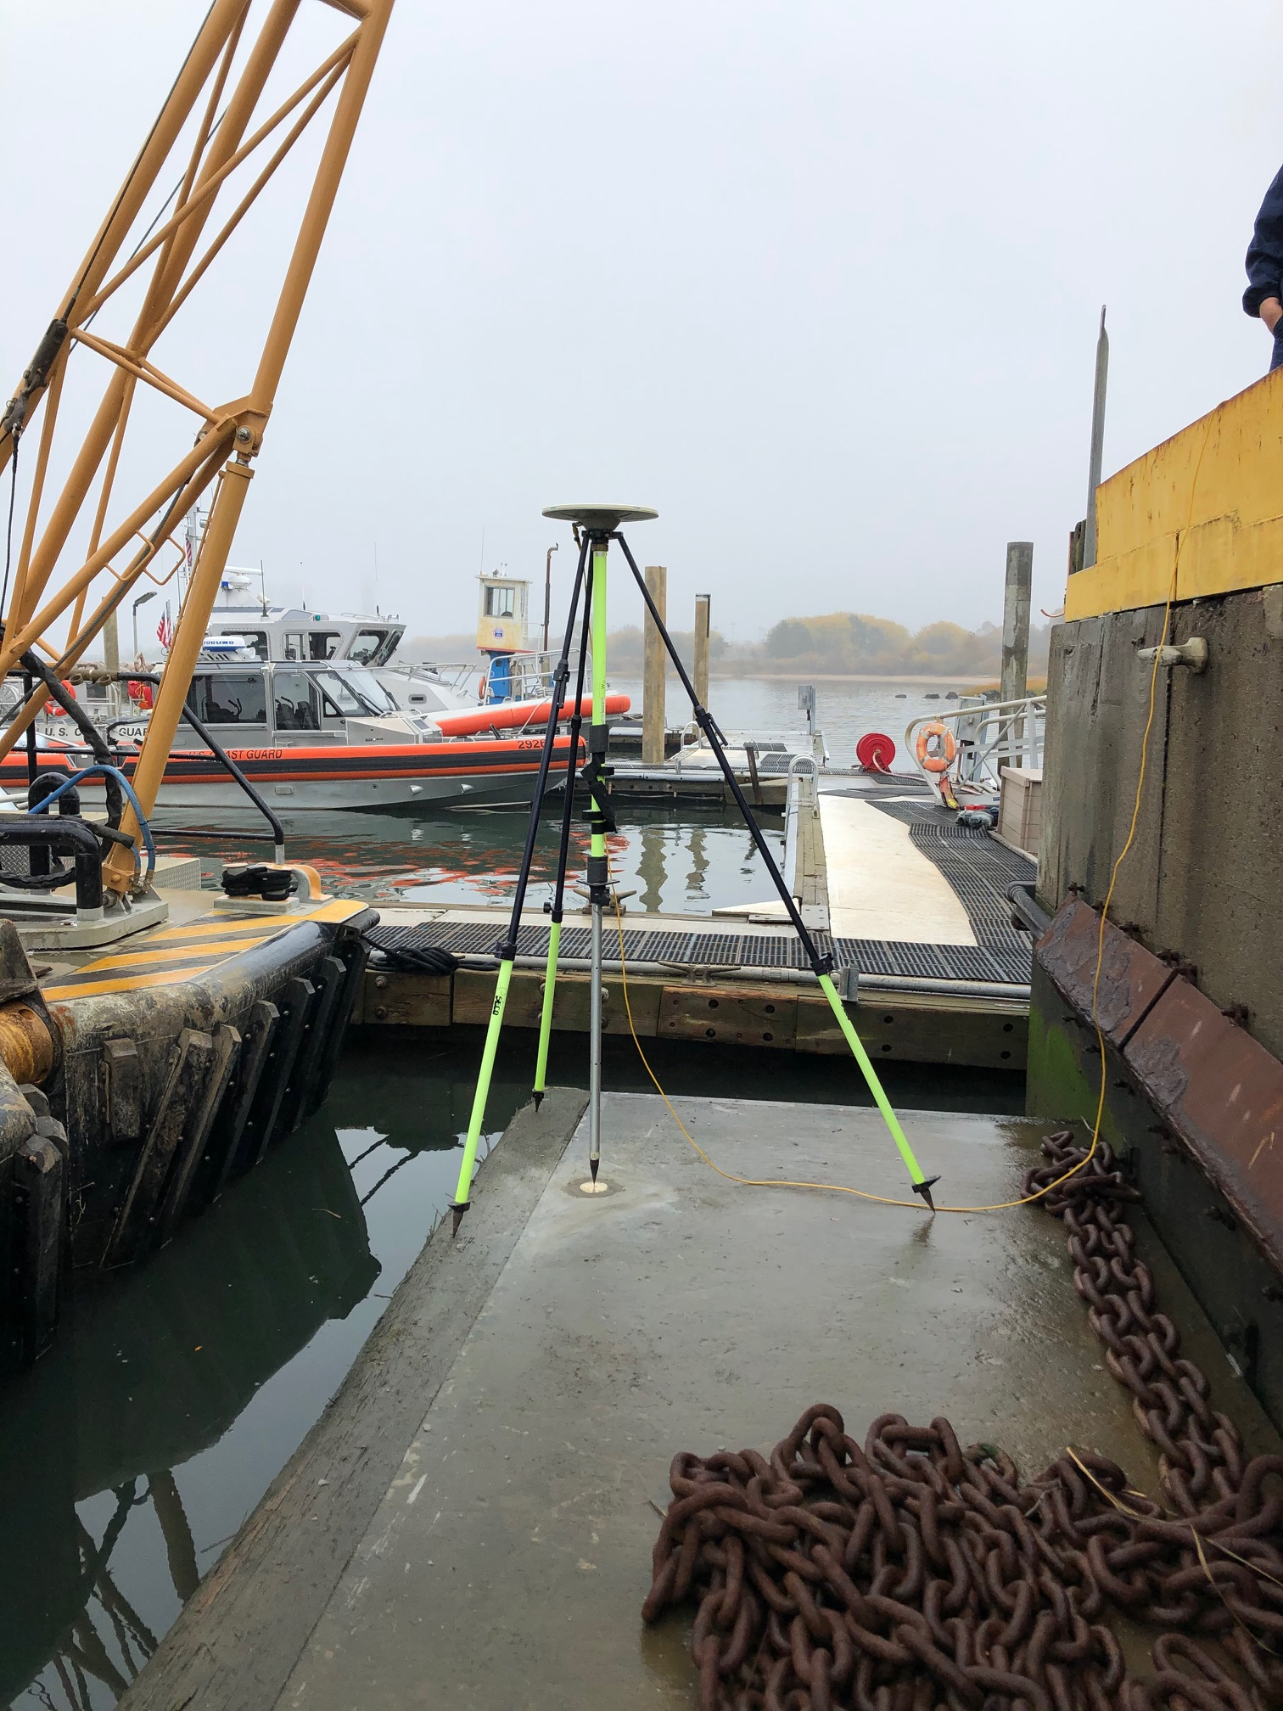
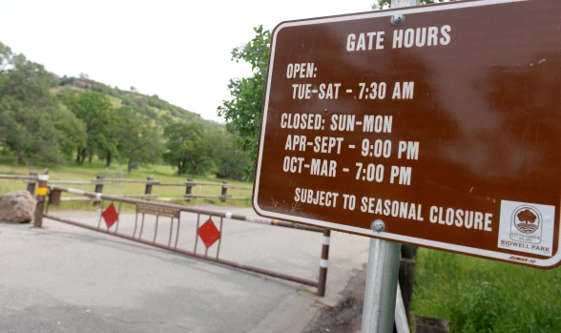
Field Constraints – Site Access
Hours of access
  Restricted to certain days/hours
  Gated
  Security
  High water/tide

Slide 40
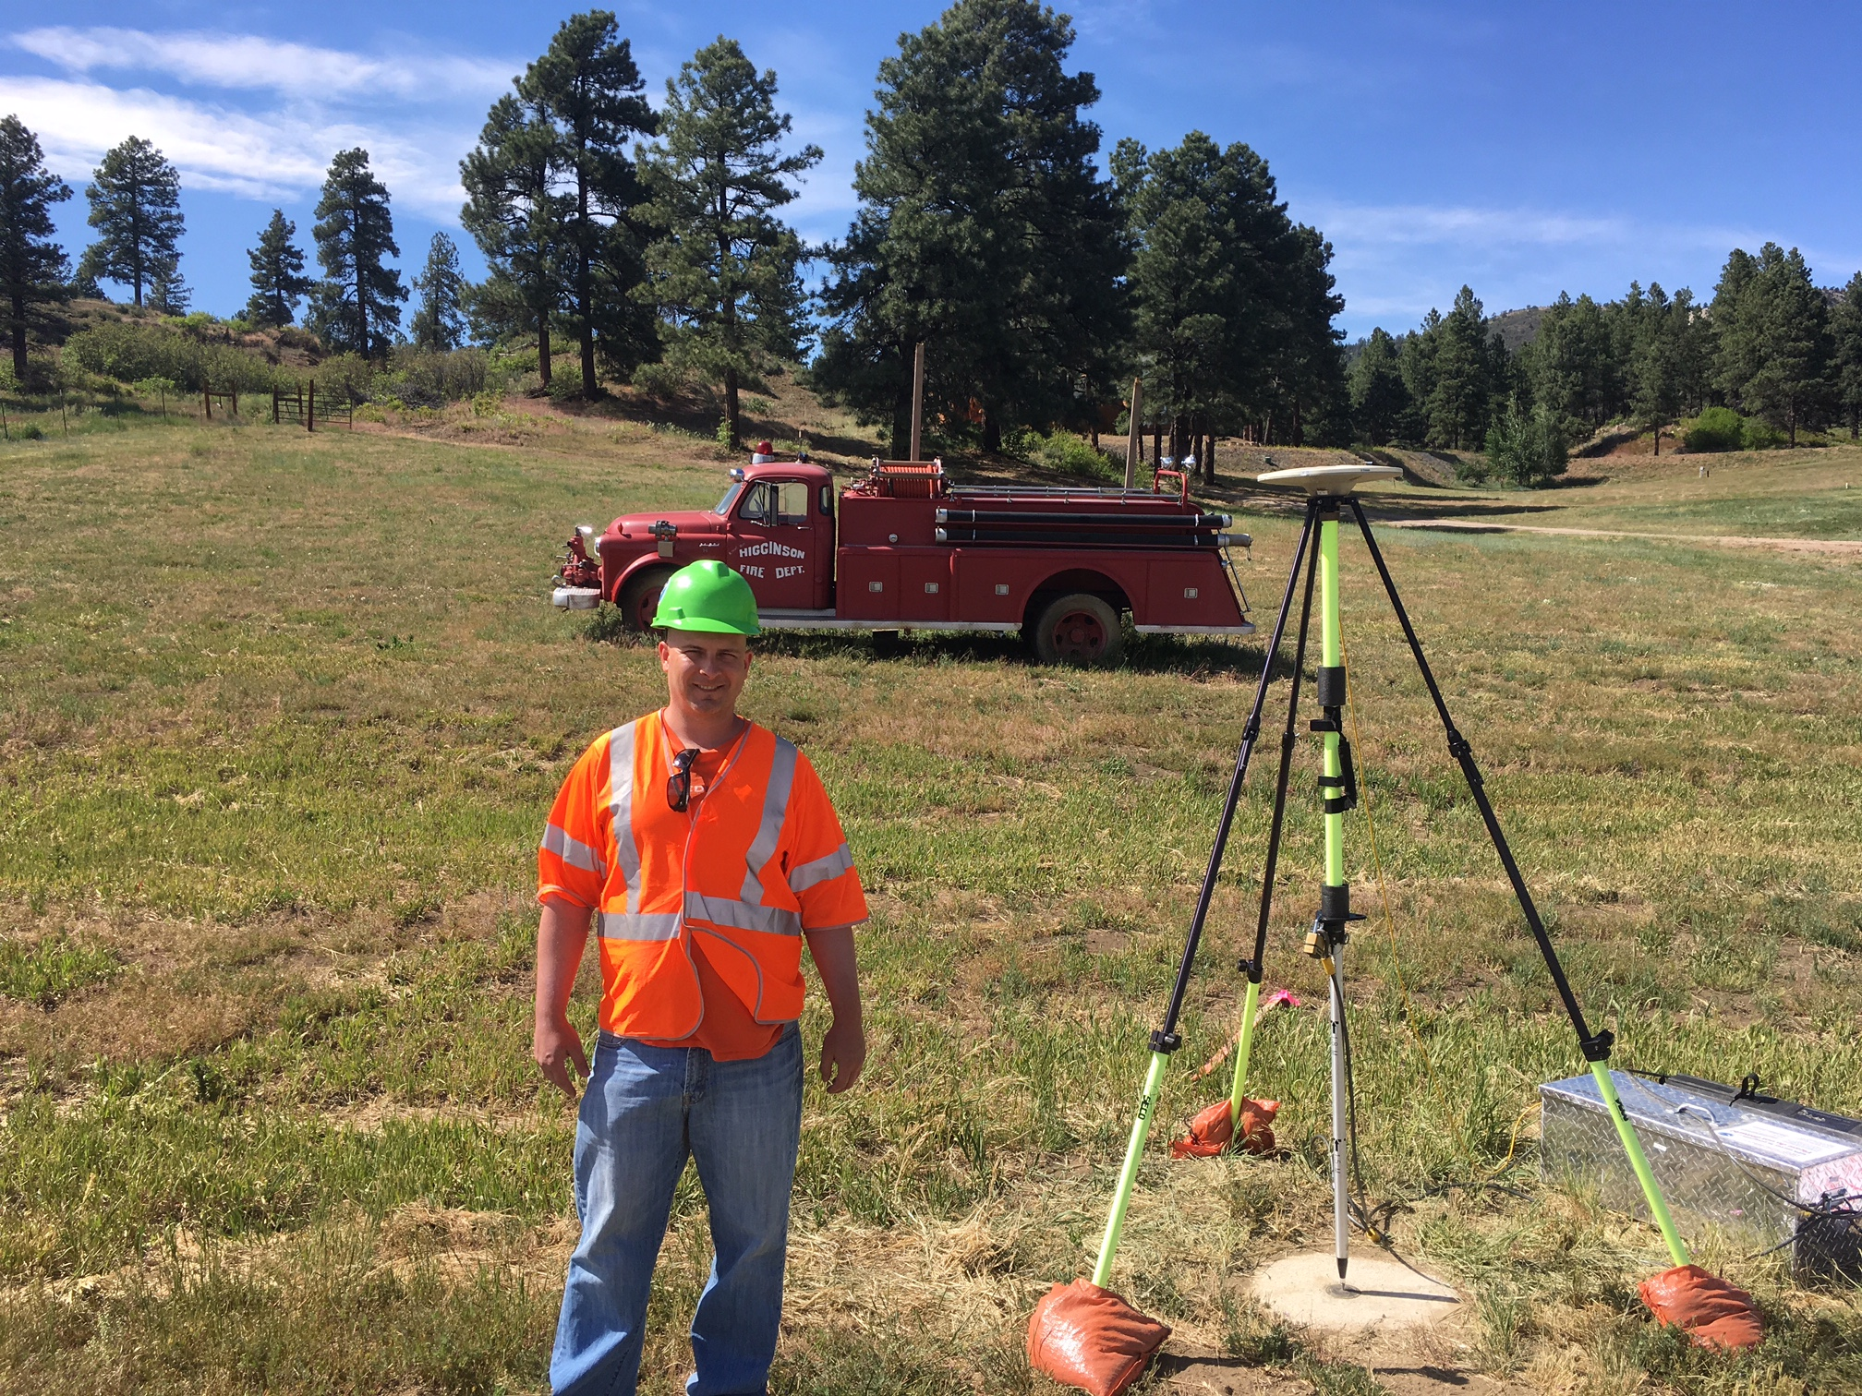
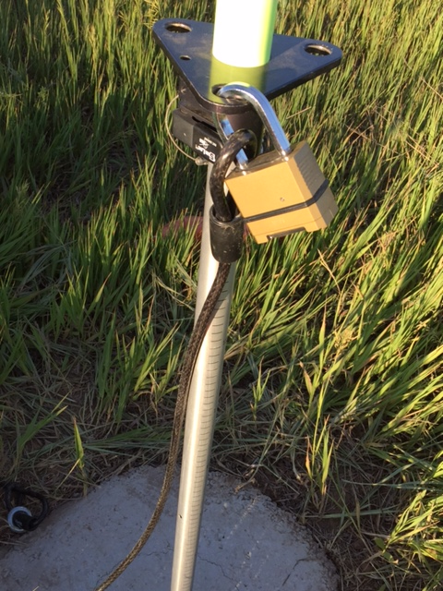
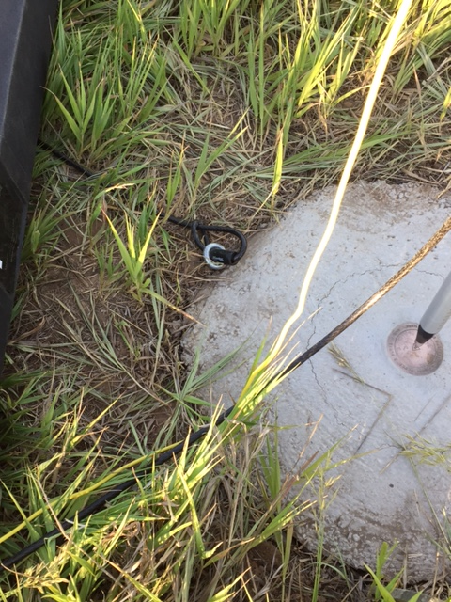
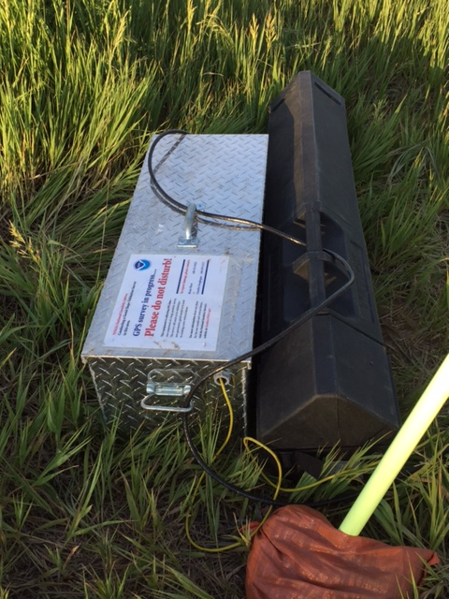
Field Constraints – Site Safety
Can the equipment be left unattended during long observations?
  Can the equipment be secured (lock, cable, etc…)

Slide 41
Develop the Schedule
0002
Draw sessions based on available resources
Assign Day, Start time, and duration to the first session
If conducting more than one session per day
  Determine longest travel time between session A and session B stations and use that to determine what time the next session will begin.
Write stations for each session onto schedule grid for the first day
Repeat process for next day. Stagger start time by 3-hours if it is a repeat observation
0001
0003
0004
0005
Session | Start UTC | End UTC | dd/mm/yyyy Julian Day ddd
 |  |  | John | Bill | Dan
A | 1200 | 1500 | 0001 | 0003 | 0005
B | 1530 | 1830 | 0002 | 0005 | 0004

Slide 42
Live Demo

Slide 43
NOAA Technical Memorandum NOS NGS 92
Classifications, Standards, and Specifications for GNSS Geodetic Control Surveys using OPUS Projects

Slide 44
NOS NGS 92
This publication replaces the NOAA Technical Memorandum NOS NGS 58 “Guidelines For Establishing GPS-Derived Ellipsoid Heights, (Standards: 2 cm and 5 cm), Version 4.3” (Zilkoski et al. 1997).\
This publication replaces the NOAA Technical Memorandum NOS NGS 59 “Guidelines for Establishing GPS-Derived Orthometric Heights” (Zilkoski et al. 2008).
This publication provides Classification, Standards, and Specifications for GNSS geodetic control surveys which use Global Navigation Satellite Systems (GNSS) and which will be submitted to NGS using OPUS Projects for review and publication
These Classifications, Standards, and Specifications are required for GNSS geodetic control surveys which will be submitted to NGS for review and publication using the OPUS Projects software suite. These Classifications, Standards, and Specifications are recommended for all other GNSS control surveys which use the OPUS Projects software suite.

Slide 45
What is a Classification?
(geodesy) Placing surveys in hierarchical classes according to certain criteria, such as accuracy, application, etc
  Surveys may be classified according to the type of application, as, e.g., geodetic, mining, hydrographic, topographic, cadastral, land, engineering, etc
  Classified by method: leveling, horizontal, satellite geodesy, inertial, etc.

Slide 46
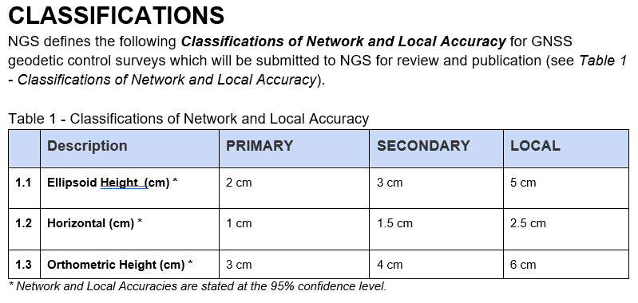

Slide 47
What is a Standard?
An object, force, or other physical entity that, under specified conditions, defines, represents, or records the magnitude of a unit of measurement.
An agreed-upon procedure within a particular industry or profession, that is to be followed in producing a particular product or result.

Slide 48
What is a Standard Continued…
A set of characteristics, such as dimensions or color, that must, by agreement within a profession or industry, be possessed by a pro
duct of that profession or industry
A number, or set of numbers, established within an industry, a science, or a technology, setting limits on precision or accuracy with which operations, measurements, or products are to be made

Slide 49
Observation Methods (Static)
OPUS PP vectors - refers to a baseline solution (vector) derived from post-processing static GNSS observations in OPUS Projects. The baseline processor in OPUS Projects (PAGES) uses simultaneous processing techniques; therefore, all OPUS PP vectors have cross-correlations with the other vectors measured simultaneously in a session solution.
GVX PP - GNSS vectors derived from post-processing static or rapid static data using external software (i.e., other than OPUS Projects). These vectors are uploaded into OPUS Projects via the GVX file format. GVX PP supports vectors from 2 styles of baseline post processing: (1) Sequential processing: vectors derived individually without any consideration of their possible cross-correlations. These vectors do not have a session record in the GVX file format. (2) Simultaneous processing: vectors derived from a session of simultaneous observations, with cross-correlations defined in a session record.

Slide 50
Observation Methods (Real-Time)
GVX NRTK - GNSS vectors collected with RTK methods using a full network corrector of a real-time GNSS network. Examples of full network correctors include using the Virtual Reference Station (VRS) method, Master Auxiliary Concept (MAC), etc. These vectors are uploaded into OPUS Projects via the GVX file format
GVX SRTK - GNSS vectors collected with RTK methods using correctors from a single base station. The single base station can be a temporary base, or it can be a permanent base that is part of a real-time network. These vectors are uploaded into OPUS Projects via the GVX file format.

Slide 51
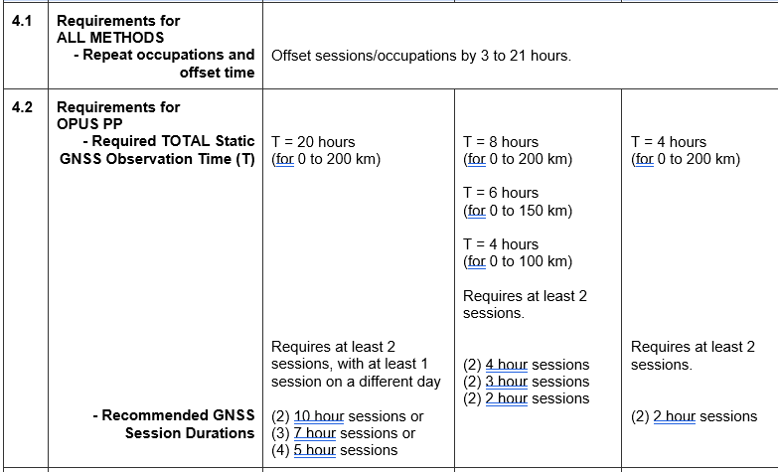
Table 4 – Standards for Observations required by method

Slide 52
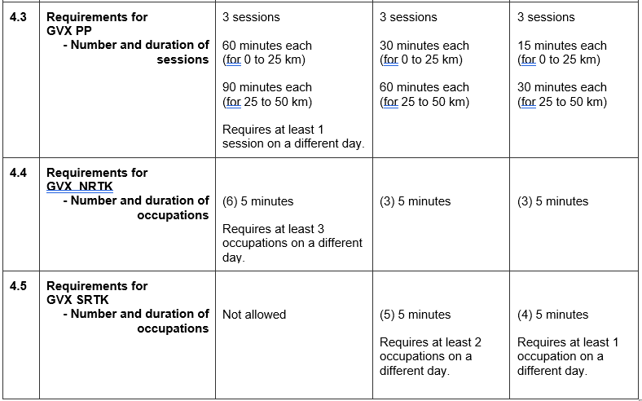
Table 4 Cont…

Slide 53
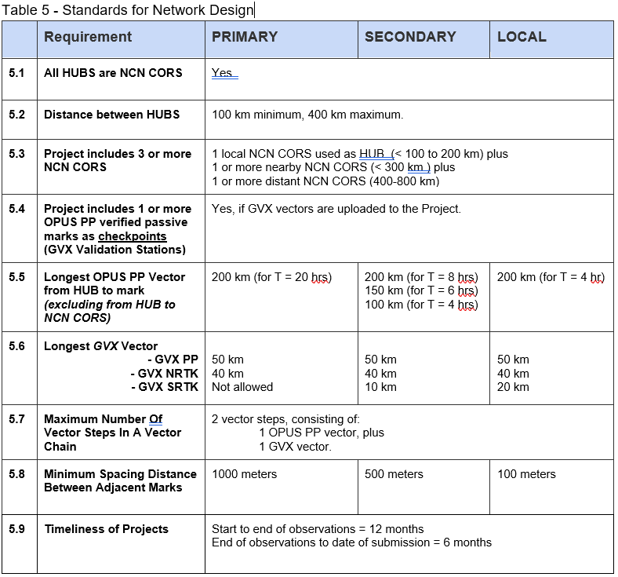

Slide 54
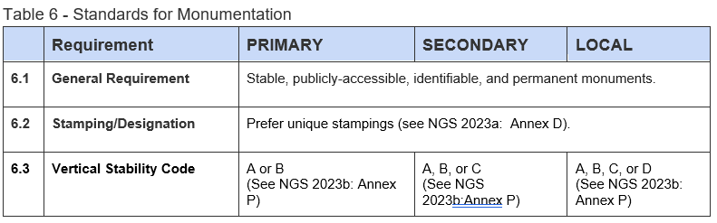

Slide 55
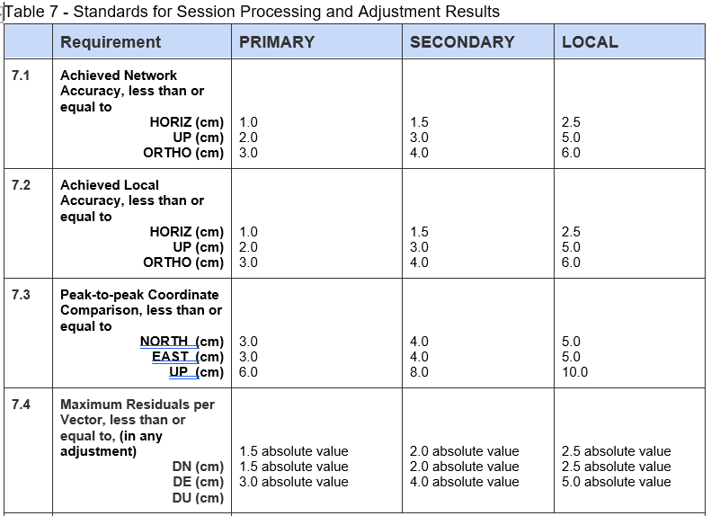

Slide 56
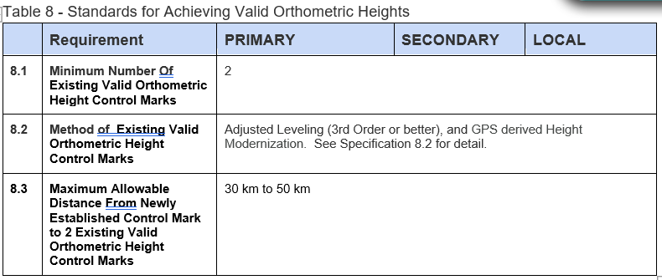

Slide 57
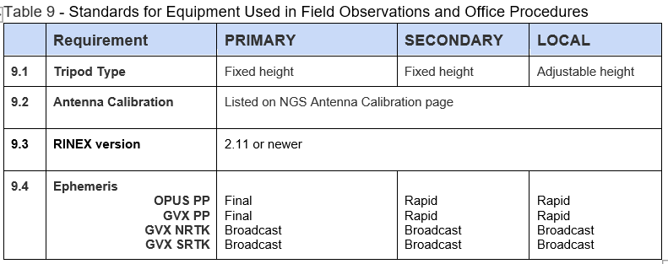

Slide 58
What is a Specification
(geodesy) - Those elements of a survey that are considered essential for the survey to meet the standards of accuracy for a particular category.
  In the practice of the U.S. National Geodetic Survey, the scheme of classification is based on specified standards of accuracy and not on the procedures needed to attain these accuracies. However, in practice, the criteria used for classification appear to be discretionary, and certain specifications may be used as criteria. See classification. Among the elements specified are the number of observations to be made, the length of time and sequence of observations, the quality of the instruments used, the greatest or least distance permitted between observer and observed object, the shapes of the geometric figures involved, and the spacing of control points.

Slide 59
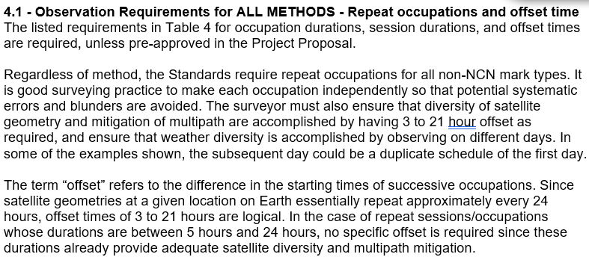
Table 4

Slide 60
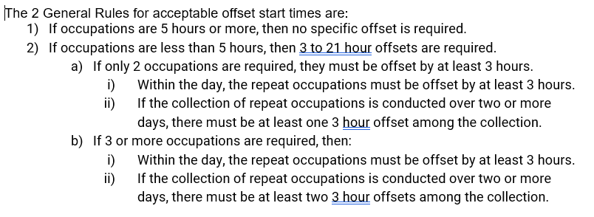
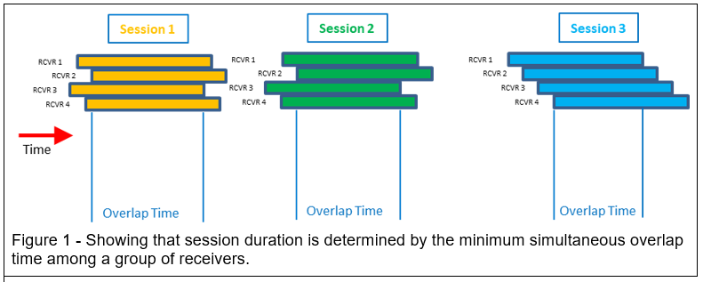
4.1 Cont..

Slide 62
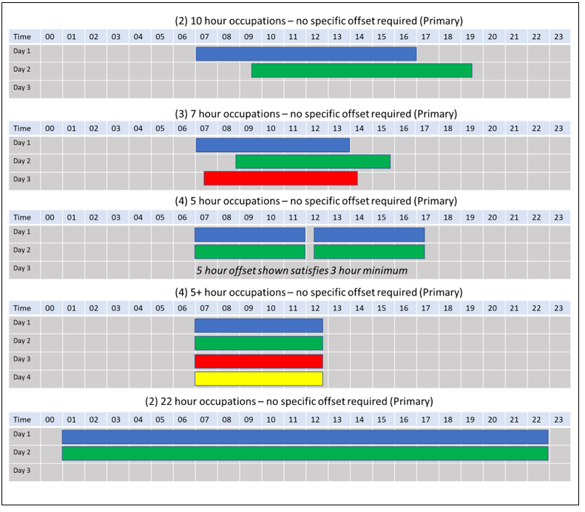
4.2 – Observational requirement by method (OPUS PP)

Slide 63
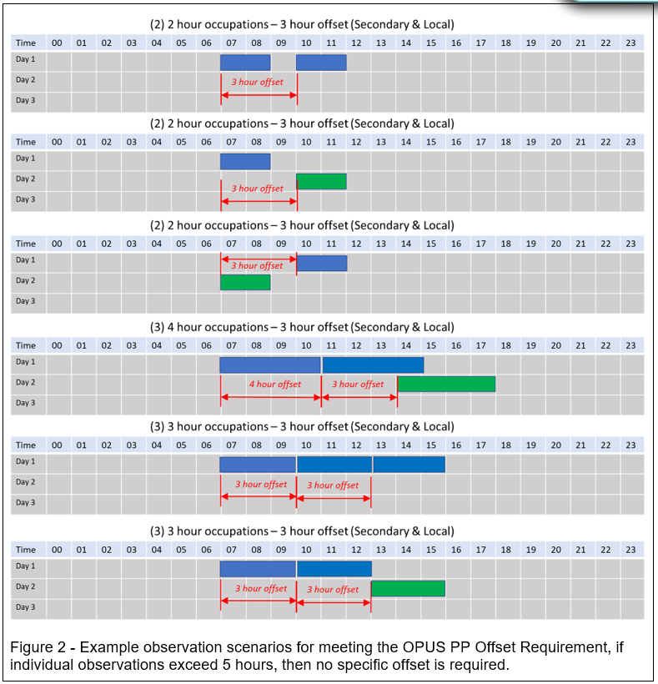
4.2 Cont…

Slide 64
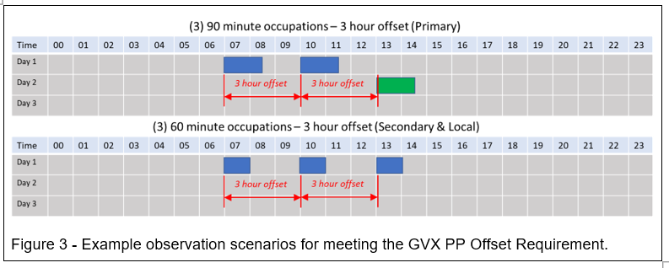
4.3 – Observational requirement by method (GVX PP)

Slide 65
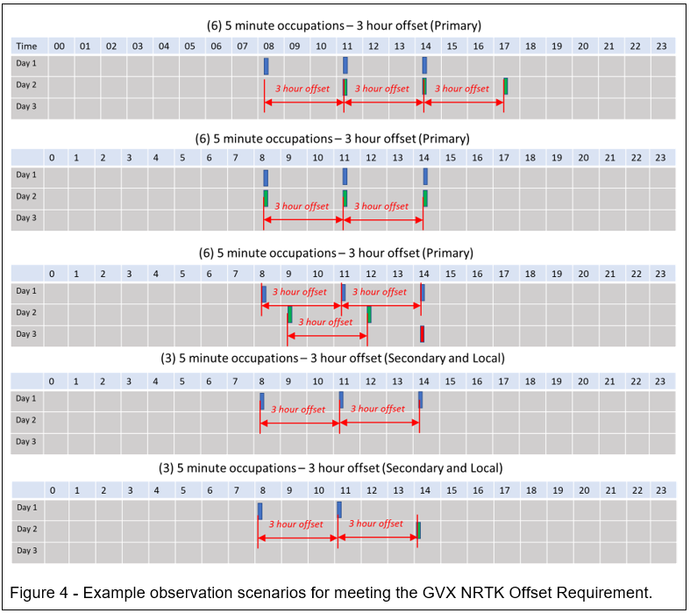
4.4 – Observational requirement by method (GVX NRTK)

Slide 66
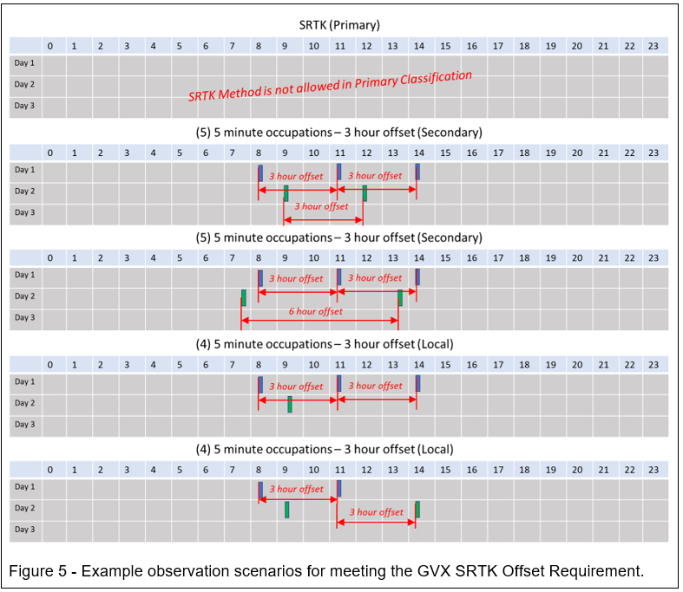
4.5 – Observational requirement by method (GVX SRTK)

Slide 67
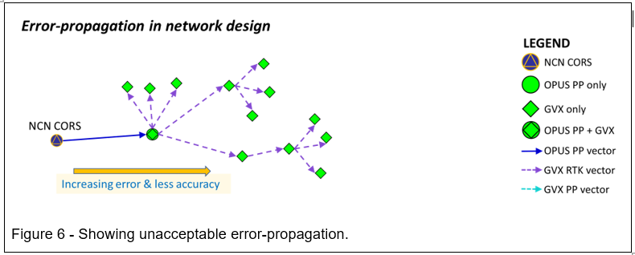
Table 5 – Standards for Network Design

Slide 68
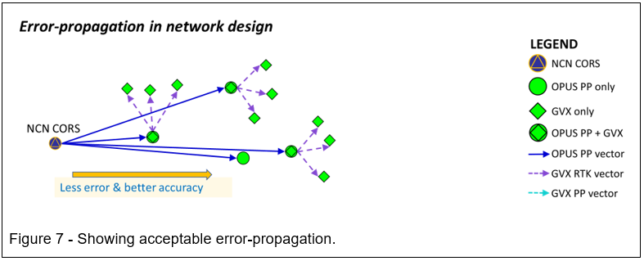
5 Cont…

Slide 69
5 Cont…
5.1 – All HUBs are NCN CORS
  If not, must be pre-approved
5.2 – Distance Between HUBs
  100km to 400km
5.3 - Project includes 3 or more NCN CORS
5.4 – Project includes 1 or GVX Validation Stations

Slide 70
Questions?
Dan Martin
Northeast Regional Geodetic Advisor
ME, NH, VT, MA, CT, RI, NY, NJ
Dan.martin@noaa.gov
240-676-4762

