Slide 1

Overview and Status of the Modernized
National Spatial Reference System (NSRS)
Dru Smith
NSRS Modernization Manager
NOAA’s National Geodetic Survey

Slide 2
Outline
Overview
Delay / Updated Timeline
Updates to the Blueprint Documents

Slide 3
Overview

Slide 4











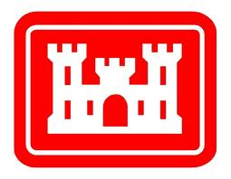













Federal Users of the NSRS
Notes:
Many of these users also sit on the Federal Geodetic Control Subcommittee, so there is a feedback loop between the providers of geodetic control (NGS) and the users of that control.

Slide 5
“Modernizing the NSRS” means…
Replacing NAD 83
Replacing NAVD 88
Re-inventing Bluebooking
Improving the Geodetic Toolkit
Better Surveying Methodologies
Blueprint for the Modernized NSRS, Part 1
Blueprint for the Modernized NSRS, Part 2
Blueprint for the Modernized NSRS, Part 3
Notes:
There are actually 3 “NAD 83”s, NAD 83(2011), NAD 83(PA11) and NAD 83(MA11)
There are also many more vertical datums than NAVD 88 in the NSRS, each one for specific states or territories that have no line of sight to CONUS/Alaska

Slide 6
“Modernization”
There’s “Modernization” and “modernization”
  NGS has been constantly modernizing components of its mission for all of its existence
    Bilby Towers allowed long distance sights
    EDMs replaced tapes
    GPS replaced line-of-sight surveying
    NAD 83 replaced NAD 27
    NAVD 88 replaced NGVD 29
    Height Mod replaced/enhanced leveling
    CORSs replaced passive marks as primary control

Slide 7
“Modernization”
But when I talk about “Modernization” I’m restricting myself to “Goal 2” of our recent Ten Year Strategic plan
  Replace NAD 83, Replace NAVD 88, and etc.
NGS continues to modernize in ways related to Goal 2, but which are independent from the rollout of the new frames/datum:
  RTN alignment service
  NOAA Foundation CORS Network

Slide 8
New Reference Frames / Datum

Slide 9
Replacing NAD 83
The Old:
NAD 83(2011)
NAD 83(PA11)
NAD 83(MA11)
The New:
The North American Terrestrial Reference Frame of 2022
(NATRF2022)
The Caribbean Terrestrial Reference Frame of 2022
(CATRF2022)
The Pacific Terrestrial Reference Frame of 2022
(PATRF2022)
The Mariana Terrestrial Reference Frame of 2022
(MATRF2022)

Slide 10
Replacing NAVD 88
  The Old:
  NAVD 88
  PRVD 02
  VIVD09
  ASVD02
  NMVD03
  GUVD04
  IGLD 85
  IGSN71
  GEOID12B
  DEFLEC12B
  The New:
  The North American-Pacific Geopotential Datum of 2022 (NAPGD2022)
  Will include:
  GEOID2022
  DEFLEC2022
  GRAV2022
  DEM2022
  More
Orthometric
Heights
Normal
Orthometric
Heights
A HUGE component of this
effort is GRAV-D:
Gravity for the Redefinition of
the American Vertical Datum
Dynamic
Heights
Gravity
Geoid
Undulations
Deflections of
the Vertical

Slide 11
Delay / Updated Timeline

Slide 12
Original Timeline / Delay
In 2007, NGS assumed we would be done by 2018
By 2013, a finish of 2022 seemed correct
By 2020 four issues derailed that date:
  Government shutdowns
  Final clarity on the complexity of the task
  Loss of personnel without backfill
  “2020”
In June 2020, NGS issued a “delay” message that the modernized NSRS would not be released in 2022
  Actual date? Unknown. When we know, you’ll know.
Notes:
A friend called 2020 “the longest decade of our lives”

Slide 13
Bottom Line
At current funding and staffing levels, NSRS Modernization will complete sometime after 2025

Slide 14

Chronological dependency
Many parts of NSRS Modernization rely on the completion of earlier parts. This is the primary determinant of “when we’ll be done”
The “long pole in the tent” is GRAV-D
GRAV-D done by June 2024 (at current levels)
  Follow-on work which must be done in order without overlap:
    Process GRAV-D
      GM2022
        GEOID2022
          DEFLEC2022
            Geometric REC 2020.00
              NADCON
              Orthometric REC 2020.00
                VERTCON

Slide 15
New approach
NGS will build an alpha version of the Modernized NSRS in the next 2 years
  Will speed up final work when the time comes
We will do a phased rollout of OPUS 6
  Of many years, starting later in 2021
  Showcasing new capabilities as they are added
    GPS, Sharing/Submitting, GNSS, ITRF20
    Classical, Leveling, Gravity (in projects)

Slide 16
What was that about “OPUS 6”…?
Attend Jeff Jalbrzikowski’s talk at 3:00 on Wed May 5
Basically:
  Supporting current NSRS:
    OPUS-Projects 4 (www.ngs.noaa.gov)
    OPUS-Projects 5 (beta.ngs.noaa.gov)
  OPUS 6.0 will replace all previous versions of OPUS (-Projects, -S, -Share)
    One do-it-all application for the Modernized NSRS
    Supports leveling, classical surveying and gravity projects

Slide 17
How will we build the alpha version?
Load every existing piece of data, metadata and alpha product into the NSRS database as soon as possible
  Post-1994 is priority, but not a hard stop at 1994
  To provide a basis upon which to build tools for testing (OPUS, DDS, RECs, etc.)
Prioritize tasks in order, but along different parallel tracks
  Geopotential
  Geometric
  OPUS
  NSRS DB/DDS
  Coordinates/LSA
  Toolkit

Slide 18
How will we build the alpha version?
Identify “flex” projects, and move them as needed
Phased rollout of tools, but not of the modernized NSRS
  This is a modification to my previous recommendation
  Release OPUS 6 and DDS to beta as each component is added
  Rather than all at once
Create a thin “alpha” modernized NSRS by the end of 2022
  Built on xGEOID20, IGS14 (maybe 20) coordinate functions and plate motion models, Geom/Ortho RECs, Few SECs
    Missing: Grav RECs, most SECs, final geoid, final NADCON/VERTCON

Slide 19
Updates to the Blueprint Documents

Slide 20
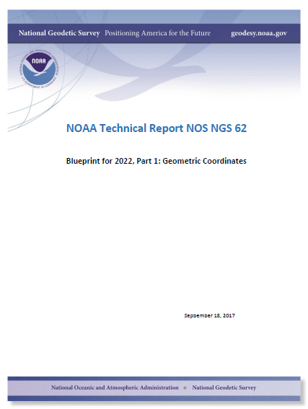
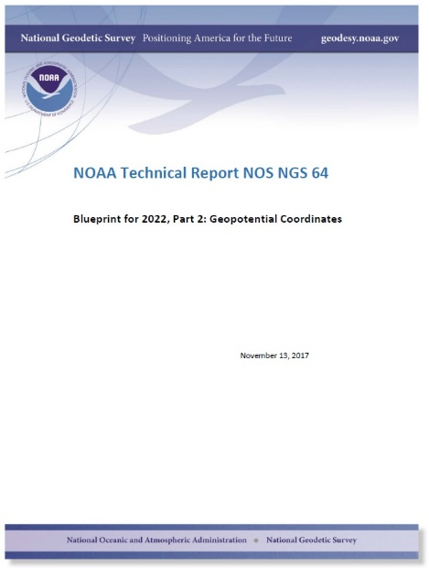
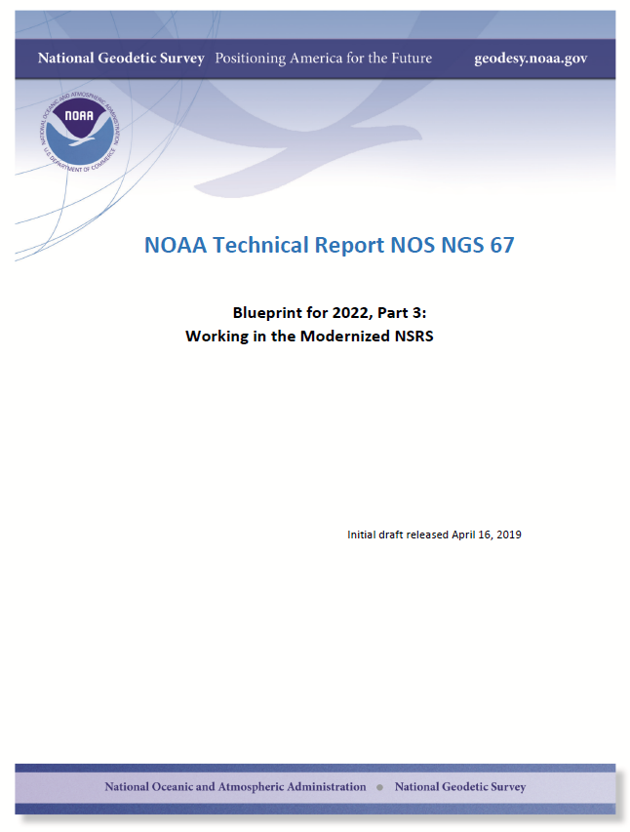
Modernizing the NSRS
The “blueprint” documents: Your best source for information
All three have been updated and were released in early 2021
Geometric:
Sep 2017
NOAA TR NOS NGS 62
Geopotential:
Nov 2017
NOAA TR NOS NGS 64
Working in the modernized NSRS:
April 2019
NOAA TR NOS NGS 67
Apr 2021
Feb 2021
Feb 2021

Slide 21
What I’ll be skipping…
Most of the content of the Blueprint documents
  Released in 2017-2019
  Multiple webinars, talks and previous summits have addressed them
What I’ll be covering…
The 2021 changes to the Blueprint documents
  They’ve only been available a few months
  Few webinars, talks and no summits have addressed them

Slide 22
Blueprint for the Modernized NSRS, Part 1:
Geometric Coordinates and Terrestrial Reference Frames

Slide 23
BLUF
Originally released in 2017
Updated and re-released in 2021
Major changes:
  Build upon ITRF2020, not ITRF2014
  EPP2022 equations updated
  Pre-eminence of XYZ, over φλh, as definitive coordinates
  A joint committee with Canada established re: version numbers
  Policy on ITRFs after ITRF2020 established

Slide 24
The relation of five global reference
frames through time.
NATRF2022
MATRF2022
Rotations are not to scale
CATRF2022
Rotation of North American Plate
PATRF2022
Rotation of Pacific Plate
ITRF2020
ITRF2020 through time
ITRF2020
Rotation of Caribbean Plate
PATRF2022
CATRF2022
Rotation of Mariana Plate
NATRF2022
Time “t ” when
all four TRFs and the
ITRF2020 are identical.
(2020.00)
MATRF2022
0
t=t - Δt
(“the past”)
t=t + Δt
(“the future”)
0
0

Slide 25
From Blueprint Part 1 (2017):
$${{\left[\begin{matrix}X \\ Y \\ Z\end{matrix}\right]}_{NATRF2022,t}=M_{N.A.}^{−1}\left[\begin{matrix}X \\ Y \\ Z\end{matrix}\right]}_{ITRF2014,t}$$
$$M^{−1}={\left[{\left[\begin{matrix}\cos{λ_{0}} & \sin{λ_{0}} & 0 \\ −sin{λ_{0}} & \cos{λ_{0}} & 0 \\ 0 & 0 & 1\end{matrix}\right]}^{−1}{\left[\begin{matrix}\cos{θ_{0}} & 0 & −sin{θ_{0}} \\ 0 & 1 & 0 \\ \sin{θ_{0}} & 0 & \cos{θ_{0}}\end{matrix}\right]}^{−1}\left[\begin{matrix}\cos{[{\dot{ω}}_{0}\left(t−2020.00\right)]} & −\sin{[{\dot{ω}}_{0}\left(t−2020.00\right)]} & 0 \\ \sin{[{\dot{ω}}_{0}\left(t−2020.00\right)]} & \cos{[{\dot{ω}}_{0}\left(t−2020.00\right)]} & 0 \\ 0 & 0 & 1\end{matrix}\right]\left[\begin{matrix}\cos{θ_{0}} & 0 & −sin{θ_{0}} \\ 0 & 1 & 0 \\ \sin{θ_{0}} & 0 & \cos{θ_{0}}\end{matrix}\right]\left[\begin{matrix}\cos{λ_{0}} & \sin{λ_{0}} & 0 \\ −sin{λ_{0}} & \cos{λ_{0}} & 0 \\ 0 & 0 & 1\end{matrix}\right]\right]}^{−1}$$
From Blueprint Part 1 (2021):
$${{\left[\begin{matrix}X \\ Y \\ Z\end{matrix}\right]}_{NATRF2022,t}=R_{N.A.}\left[\begin{matrix}X \\ Y \\ Z\end{matrix}\right]}_{ITRF2020,t}$$
$$R=\left[\begin{matrix}1 & {\left(t−2020.00\right)\dot{ω}}_{Z} & −\left(t−2020.00\right){\dot{ω}}_{Y} \\ −{\left(t−2020.00\right)\dot{ω}}_{Z} & 1 & \left(t−2020.00\right){\dot{ω}}_{X} \\ \left(t−2020.00\right){\dot{ω}}_{Y} & {−\left(t−2020.00\right)\dot{ω}}_{X} & 1\end{matrix}\right]$$

Slide 26
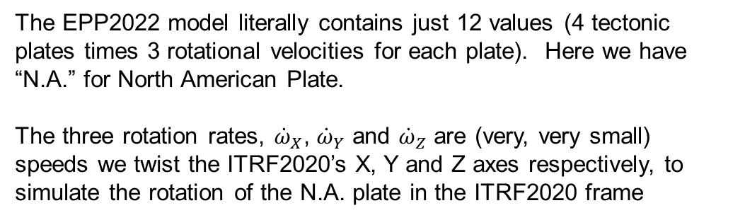

Definitional Relationship
$${\left[\begin{matrix}X(t) \\ Y(t) \\ Z(t)\end{matrix}\right]}_{NATRF2022}={\left[\begin{matrix}1 & (t−2020.00){\dot{\text{ω}}}_{X} & −(t−2020.00){\dot{\text{ω}}}_{Y} \\ {−(t−2020.00)\dot{\text{ω}}}_{Z} & 1 & (t−2020.00){\dot{\text{ω}}}_{X} \\ (t−2020.00){\dot{\text{ω}}}_{Y} & {−(t−2020.00)\dot{\text{ω}}}_{X} & 1\end{matrix}\right]}_{N.A.}{\left[\begin{matrix}X(t) \\ Y(t) \\ Z(t)\end{matrix}\right]}_{ITRF2020}$$
All work is done in ITRF2020 XYZ coordinates first.
They are associated with the epoch of the data collection (survey) “t”
We end with XYZ values in NATRF2022, still at the same epoch “t” in which we started
The EPP2022 model literally contains just 12 values (4 tectonic plates times 3 rotational velocities for each plate). Here we have “N.A.” for North American Plate.
The three rotation rates, ${\dot{\text{ω}}}_{X}$, ${\dot{\text{ω}}}_{Y}$ and ${\dot{\text{ω}}}_{Z}$ are (very, very small) speeds we twist the ITRF2020’s X, Y and Z axes respectively, to simulate the rotation of the N.A. plate in the ITRF2020 frame

Slide 27
Pre-eminence of XYZ
All geometric computations/adjustments in the Modernized NSRS will be performed first in ITRF2020 XYZ
Can derive other coordinates after
  φλh in ITRF2020/GRS80
  φλh in NATRF2022, CATRF2022, MATRF2022, PATRF2022
  XYZ in NATRF2022, CATRF2022, MATRF2022, PATRF2022
  SPCS2022 in NATRF2022, CATRF2022, MATRF2022, PATRF2022
  UTM
  USNG

Slide 28
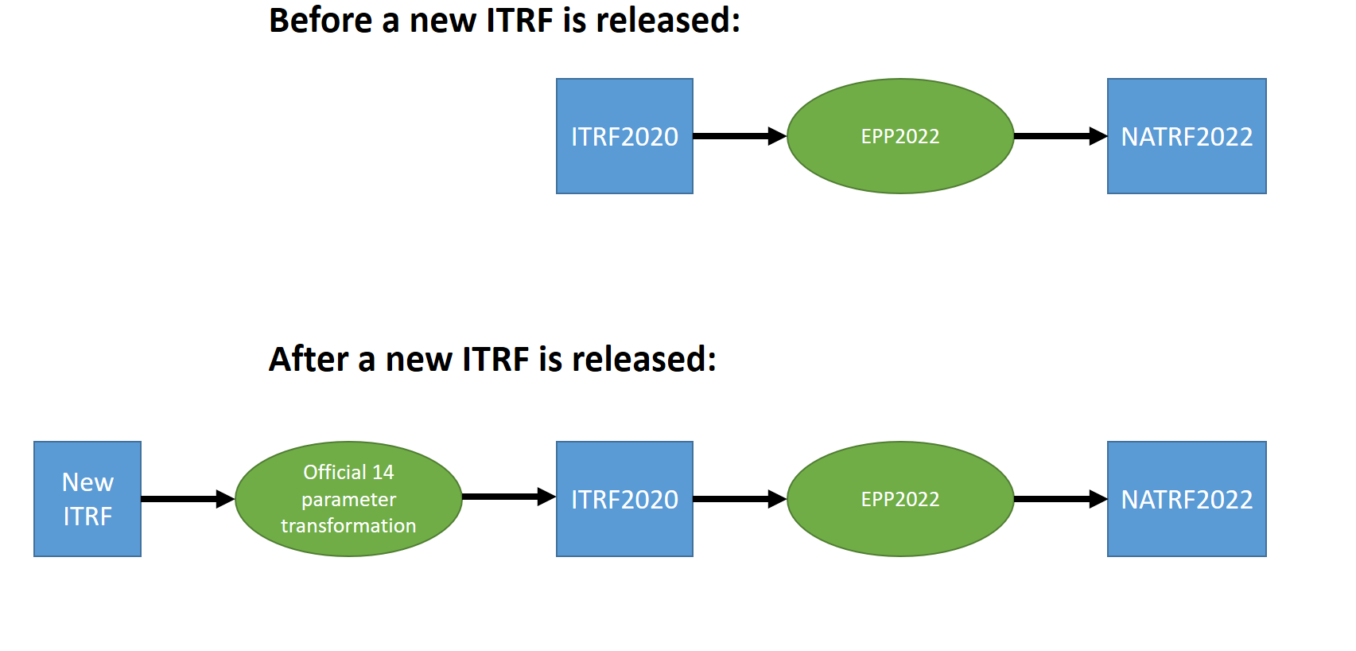
Policy changes/decisions
When a new ITRF is released, NGS will rely upon the official transformations to “daisy chain” all ITRFs in line back to ITRF2020

Slide 29
Blueprint for the Modernized NSRS, Part 2:
Geopotential Coordinates and Geopotential Datum

Slide 30
BLUF
Originally released in 2017
Updated and re-released in 2021
Major changes:
  Epoch of SGEOID2022 set to 2020.00
  Official expected accuracies of the geoid, from three GSVSs
    See Derek van Westrum’s talk at 3:15

Slide 31
Policy changes/decisions
SGEOID2022 will refer to epoch 2020.00
${N\left(t\right)}_{GEOID2022}={N\left(2020.00\right)}_{SGEOID2022}$+${ΔN\left(t,2020.00\right)}_{DGEOID2022}$

Slide 32
Blueprint for the Modernized NSRS, Part 3:
Working in the Modernized NSRS

Slide 33
BLUF
Originally released in 2019
Updated and re-released in 2021
Major changes:
  Terminology, policy, functionality…too many to list

Slide 34
Terminology Changes
Was… | Now is…
Final Discrete Coordinates (FDCs) | Survey epoch coordinates (SECs)
Reference Epoch Coordinates (RECs) | Reference epoch coordinates (RECs)
Final Running Coordinates | Active coordinates (ACs)
Preliminary Coordinates | OPUS coordinates
GPS Month | Geometric adjustment window
Blueprint for 2022 | Blueprint for the Modernized NSRS

Slide 35
Terminology Decisions
“Intra-frame velocity model” (IFVM) stands, for now
  ‘Velocity’ may be replaced with ‘deformation’ or ‘motion’ before roll-out
“Bluebooking” (one word; no space; capitalized)
Adjustment project vs Survey project
[Geometric ; Orthometric ; Gravimetric] adjustment window
Component parts with “2022” in the name will retain those names (GEOID2022, NATRF2022, etc.)

Slide 36
Policy changes/decisions
Reference epochs might be every 5 years or every 10 years
  Still planning on creating 2020.00 RECs
    Geometric, Orthometric & Gravimetric
  In 2027, NGS should create 2025.00 RECs
    Then debate whether or not to adopt them
Notes:
Every 5 years would be too frequent for our Canadian colleagues
Every 10 years would be too infrequent for our California colleagues

Slide 37
Policy changes/decisions
OPUS will provide “OPUS recommendations”
  Which CORSs to use, what weights to assign, what a-priori values to use, etc.
See Phillip MacFarland’s talk tomorrow at 3:15
Basically it’ll come down to:
  Follow the “OPUS recommendations” to ensure your results are “tied to the NSRS”

Slide 38
Policy changes/decisions
OPUS will allow leveling to use passive control as constraints
  This will generally not be an “OPUS recommendation” unless the passive control has fairly current coordinates (TBD)
OPUS will allow leveling to have no constraints
  Yielding only differential coordinates
  This will also not be an “OPUS recommendation”

Slide 39
Policy changes/decisions
OPUS will allow classical surveying to use passive control as constraints
  This will generally not be an “OPUS recommendation” unless the passive control has fairly current coordinates (TBD)
OPUS will not allow classical surveying to have no constraints
  Needs to be some way to get the data into the NSRS.

Slide 40
Policy changes/decisions
OPUS will only work with one type of data per survey type:
  Raw GNSS: RINEX
  GNSS vectors: GVX
  Classical surveying: CVX
  Leveling: LVX
  Relative gravity: RGX

Slide 41
Policy changes/decisions
OPUS will allow any epoch(s) (within reason) for an adjustment
  OPUS recommendations will be limited to:
    Mean epoch of the data in the survey
    The most recent reference epoch (if every 10 years) or most recent two reference epochs (if every 5 years)

Slide 42
Policy changes/decisions
REC adjustment schedule:
  Every 5 or 10 years a massive, nationwide adjustment of new RECs will occur
    Beginning/Ending 2/3 years after the reference epoch
    Geometric, Orthometric, Gravimetric(?) RECs computed
  After that, every four weeks (geometric) or every 1 year (orthometric) or every TBD (gravimetric) new data submissions will be used in a small REC adjustment project as follows:
    Only to create RECs for points that do not currently have an REC in the most recent reference epoch
    Points which do have RECs will be held as constraints and no change made to them
  This differs from earlier BP3 where this data was to go into a “holding bin” for up to a year before being used
  This now aligns with the already-established workflow for SEC adjustment projects

Slide 43
Policy changes/decisions
A CORS “data quality assessment system” will be built
  Formerly “CORS grading system”
  Will be part of “OPUS recommendations”

Slide 44
Use Cases

Slide 45
Use Cases
BP3 contains four examples (use cases) of how today’s work becomes tomorrow’s work, in the modernized NSRS
  Flood Mapping
  Passive Control for a Multi-year Corridor Project
  Transitioning Data to the Modernized NSRS
  Leveraging the Modernized NSRS for Airport and Other Infrastructure Monitoring
For details, attend tomorrow’s talk by Nic Kinsman at 4:10

Slide 46
Thank you!

Slide 47
Questions?

Slide 48
Extra Slides

Slide 49
New Schedule with 6 tracks

Slide 50
Geopotential track
GRAV-D to ITRF20
✓
✓
GRAV-D Airborne Campaign
Reprocesing
Process as we go
xsGM22
xsGM23
xsGM24
sGM022
xSGEOID22
xSGEOID23
xSGEOID24
SGEOID2022
DGM2022
xSD22
xSD23
xSD24
SD22
DGEOID2022
DDEFLEC2022
Geom REC
Ortho REC
Alaska Survey
NADCON
VERTCON
DYNAFROG
SDEM2022
!
!
SGRAV2022
Notes:
Blue ! = N/P/M/CATRF2022 exist definitionally
Black ! = NAPGD2022 exists, definitionally, but with no coordinates on passive control
White = geopotential track
Dark blue = geometric track, Light blue = geometric track out of NGS control
Light purple = OPUS track
Orange = DB track, Red = DDS track
Yellow = coordinates/LSA track
Green = toolkit track
Red Checkmarks = Resource estimates exist for this task/project

Slide 51
Geometric track
NOAA Foundation CORS Network
✓
IFVM2022 alpha
+ vert.
+ EQ sigmas
+ NGS self build
+ITRF20
ITRF2020
ITRF2026???
EPP2022
Alpha
IGS20
IGS26
✓
OP 4.0 goes live
NGS making IGS20 GPS orbits
NGS making IGS26 GPS orbits
OP 5.0 goes BETA
✓
OP 5.0 retired
NCN on IGS20
OP 5.1 to live
Geom REC
NCN on IGS26
SPCS2022
Non-NCN/IGS stations on IGS20
OP 5.1 +IGS20=
5.2 (BETA)
Ortho REC
Non-NCN/IGS stations on IGS26
✓
M-PAGES
GNSS
posn
M-PAGES
GNSS
orbits
EPP2022, NA
Beta
M-PAGES (GPS)
NADCON
✓
NGS making IGS14 GNSS practice orbits
VERTCON
NGS making IGS14 GPS orbits
Goal 1
NGS making IGS20 GNSS orbits
EPP2022
Station Selection Criteria
IGS making IGS14 GPS orbits
IGS making IGS20 GPS orbits
!
!
IGS making IGS26 GPS orbits
OP 4.0 retired
OP 5.0 to live
IGS making IGS14 GNSS orbits
IGS making IGS20 GNSS orbits
OP 5.0 +GNSS = 5.1 (BETA)
IGS making IGS26 GNSS orbits
Notes:
Blue ! = N/P/M/CATRF2022 exist definitionally
Black ! = NAPGD2022 exists, definitionally, but with no coordinates on passive control
White = geopotential track
Dark blue = geometric track, Light blue = geometric track out of NGS control
Light purple = OPUS track
Orange = DB track
Red = DDS track
Yellow = coordinates/LSA track
Green = toolkit track
Red Checkmarks = Resource estimates exist for this task/project

Slide 52
OPUS track
Organize post 1994 observations:
Gravity
Leveling
GPS vectors
Raw GPS*
Classical
✓
OP 4.0 goes live
PAPER: NGS 58 replacement
OP 4.0 retired
OP 5.0 retired
OP 5.1 retired
OP 5.2 retired
✓
OP 5.0 goes BETA
OP 5.0 to live
OP 5.1 to live
OP 5.2 to live
OP 6 to live
OP 5.0 +GNSS = 5.1 (BETA)
OP 5.1 +IGS20=
5.2 (BETA)
OP 6 (NSRS2022) on BETA
Goal 1
OPUS recommendations
Geom REC
Goal 2
Station Selection Criteria
IFVM2022 in ITRF2020
Initial
IGS14
GPS
PAGES
xGEOID20
+Data Subm.
+URL
+SPCS2022
+GNSS
+IFVM alpha
+IGS20
+OPUS Rec
Ortho REC
+ Dyn Hts
+N/P/M/CATRF2022
+NAPGD2022
O6 –S
Beta
Mark Recov and add to project
RelGrv Red. Sftwr
EPP2022
RGX
+Passive contrrol
Lev. Red. Sftwr
+NAPGD2022
LVX
PAPER: New Leveling Manual
Cls. Red. Sftwr
!
!
CVX
+N/P/M/CATRF2022
Initial
IGS14
GPS
PAGES
xGEOID20
+Data Subm.
+URL
+SPCS2022
+GNSS
+Classical
+Leveling
+IFVM alpha
+Gravity
+IGS20
+OPUS Rec
O6 –P
Beta
Notes:
Blue ! = N/P/M/CATRF2022 exist definitionally
Black ! = NAPGD2022 exists, definitionally, but with no coordinates on passive control
White = geopotential track
Dark blue = geometric track, Light blue = geometric track out of NGS control
Light purple = OPUS track
Orange = DB track
Red = DDS track
Yellow = coordinates/LSA track
Green = toolkit track
Red Checkmarks = Resource estimates exist for this task/project
OPUS 6 will be built and released on Beta, with ever expanding releases, but never going LIVE until roll-out. So expect OPUS 6.0 followed by 6.0.1, etc., one replacing the other on Beta. This will be parallel to, but separate from the existing OPUS-S and OPUS-Projects supporting the existing NSRS.
For the existing NSRS, we will see OPUS-Projects (and OPUS-S) move from DEV to Beta to Live in the normal cycle.

Slide 53
DB/DDS track
✓
Organize post 1994 observations:
Gravity
Leveling
GPS vectors
Raw GPS*
Classical
IGSN IGS20 Acs, IGS/GPS – IGS20 orbits, IGS/GNSS – IGS20 orbits
✓
REC alpha geometric
DDS:
Geometric REC alpha
Geom REC
Load:
Stations:
NCN metadata
IGS metadata
NCN IGS14 ACs
IGSN IGS14 ACs
Orbits
NGS/GPS – IGS14
IGS/GPS – IGS14
IGS/GNSS – IGS14
Marks:
Metadata
Last known coord
Models:
xGEOID20 et al
IFVM2022 alpha
EPP2022 alpha
Antenna Calibrations
Obs (post 1994):
Gravity
Leveling
GPS vectors
Raw GPS*
Classical
RINEX @ stations
REC alpha orthometric
NGS/GPS – IGS20 orbits
DDS:
Orthometric REC alpha
Ortho REC
NCN IGS20 Acs
NADCON
SEC alpha geometric
DDS:
Geometric SEC alpha
VERTCON
DDS: Geometric REC final
NGS/GNSS – IGS20 orbits
Load EPP2022
Load Geom RECs
Load Ortho RECs
DDS: Orthometric REC final
NGS/GNSS – IGS14 orbits
SEC alpha orthometric
DDS:
Orthometric SEC alpha
DDS:
Update NCN to IGS20, but allow for IGS14!
DDS:
Update IGSN to IGS20, but allow for IGS14!
!
!
SECs Geometric post-1994
DDS:
Stations, Marks
Orbits
SECs Geometric pre-1994
SECs Orthometric post-1994
SECs Orthometric pre-1994
Notes:
Blue ! = N/P/M/CATRF2022 exist definitionally
Black ! = NAPGD2022 exists, definitionally, but with no coordinates on passive control
White = geopotential track
Dark blue = geometric track, Light blue = geometric track out of NGS control
Light purple = OPUS track
Orange = DB track
Red = DDS track
Yellow = coordinates/LSA track
Green = toolkit track
Red Checkmarks = Resource estimates exist for this task/project

Slide 54
Coordinates/LSA track
Load:
Stations:
NCN metadata
IGS metadata
NCN IGS14 ACs
IGSN IGS14 ACs
Orbits
NGS/GPS – IGS14
IGS/GPS – IGS14
IGS/GNSS – IGS14
Marks:
Metadata
Last known coord
Models:
xGEOID20 et al
IFVM2022 alpha
EPP2022 alpha
Obs (post 1994):
Gravity
Leveling
GPS vectors
Raw GPS*
Classical
RINEX @ stations
REC alpha
Geometric
ITRF2014
Geom REC
REC alpha
Orthometric
ITRF2014/
xGEOID20/
SGRAV2022
Ortho REC
✓
GILEAD
NADCON
LASER
DDS:
Geometric SEC alpha
VERTCON
Paper: Grav SEC
SECs alpha
Grav.
SECs alpha
Geom.
Paper: Geom REC
DDS:
Geometric REC alpha
Paper: Grav REC?
EPP2022, NA
Beta
Grav
REC??
Paper: Ortho REC
DDS:
Gravimetric SEC alpha
SECs alpha
Ortho.
DDS:
Orthometric REC alpha
DDS:
Orthometric SEC alpha
SECs Geometric post-1994
Paper: Geom SEC
SECs Geometric pre-1994
✓
Paper: Classical data in ECEF frame
SECs Orthometric post-1994
Paper: LSA epoch change
Paper: Ortho SEC
SECs Orthometric pre-1994
REC alpha
Gravimetric
DDS:
Update to IGS20, but allow for IGS14!
!
!
DDS:
Stations
Marks
Orbits
Notes:
Blue ! = N/P/M/CATRF2022 exist definitionally
Black ! = NAPGD2022 exists, definitionally, but with no coordinates on passive control
White = geopotential track
Dark blue = geometric track, Light blue = geometric track out of NGS control
Light purple = OPUS track
Orange = DB track
Red = DDS track
Yellow = coordinates/LSA track
Green = toolkit track
Red Checkmarks = Resource estimates exist for this task/project

Slide 55
Toolkit track
Load:
Stations:
NCN metadata
IGS metadata
NCN IGS14 ACs
IGSN IGS14 ACs
Orbits
NGS/GPS – IGS14
IGS/GPS – IGS14
IGS/GNSS – IGS14
Marks:
Metadata
Last known coord
Models:
xGEOID20 et al
IFVM2022 alpha
EPP2022 alpha
Obs (post 1994):
Gravity
Leveling
GPS vectors
Raw GPS*
Classical
RINEX @ stations
REC alpha
Geometric
ITRF2014
Geom REC
REC alpha
Orthometric
ITRF2014/xGEOID20/SGRAV2022
Ortho REC
NADCON
Grav
REC
VERTCON
NADCON
alpha
Paper: IFVM / EPP relation within NCAT
VERTCON
alpha
!
!
Comprehensive Toolkit Improvements
✓
GPS Campaign for transformations
Notes:
Blue ! = N/P/M/CATRF2022 exist definitionally
Black ! = NAPGD2022 exists, definitionally, but with no coordinates on passive control
White = geopotential track
Dark blue = geometric track, Light blue = geometric track out of NGS control
Light purple = OPUS track
Orange = DB track
Red = DDS track
Yellow = coordinates/LSA track
Green = toolkit track
Red Checkmarks = Resource estimates exist for this task/project

Slide 56
Initial NADCON Master Grids
Once the 2020.00 geometric REC adjustment project has been completed and loaded into the NSRS DB, NADCON will be expanded. Master grids will be created as below.
Region | Old Datum | New Reference Frame
CONUS | NAD 83(2011) epoch 2010.00 | *ATRF2022 epoch 2020.00
Alaska | NAD 83(2011) epoch 2010.00 | *ATRF2022 epoch 2020.00
Hawaii | NAD 83(PA11) epoch 2010.00 | *ATRF2022 epoch 2020.00
PR / VI | NAD 83(2011) epoch 2010.00 | *ATRF2022 epoch 2020.00
American Samoa | NAD 83(PA11) epoch 2010.00 | *ATRF2022 epoch 2020.00
Guam / CNMI | NAD 83(MA11) epoch 2010.00 | *ATRF2022 epoch 2020.00
* Why isn’t this specified? Because by design, NATRF2022, PATRF2022, CATRF2022, MATRF2022 and ITRF2020 are all identical at epoch 2020.00. They will drift apart after that! But the initial jump into 2020.00 via NADCON will land you at the exact same coordinates no matter which of the five frames you choose.

Slide 57
Latter NADCON Master Grids
Once the first geometric REC adjustment project beyond 2020.00 has been completed and loaded into the NSRS DB, NADCON will be expanded. Master grids will be created in specific frames for specific regions:
Region | Frame for master NADCON grids
CONUS | NATRF2022
Alaska | NATRF2022
Hawaii | PATRF2022
PR / VI | CATRF2022
American Samoa | PATRF2022
Guam / CNMI | MATRF2022
However, once the master grids are made, they can be transformed with exact accuracy into grids in different frames. For example, in the region “CONUS”, the master grid connects REC coordinates in NATRF2022. However, it is a simple matter (using EPP2022) to have it connect to PATRF2022. This flexibility will be built into tools such as NCAT and VDatum.

Slide 58
Initial VERTCON Master Grids
Once the 2020.00 geometric REC adjustment project and the 2020.00 orthometric REC adjustment project has been completed and loaded into the NSRS DB, VERTCON will be expanded. Master grids will be created as below.
Region | Old Datum | New Geopotential Datum
CONUS | NAVD 88 | NAPGD2022 epoch 2020.00
Alaska | NAVD 88 | NAPGD2022 epoch 2020.00
Hawaii | N/A | NAPGD2022 epoch 2020.00
PR | PRVD 02 | NAPGD2022 epoch 2020.00
VI | VIVD 09 | NAPGD2022 epoch 2020.00
American Samoa | ASVD 02 | NAPGD2022 epoch 2020.00
Guam | GUVD 04 | NAPGD2022 epoch 2020.00
CNMI | NMVD 03 | NAPGD2022 epoch 2020.00
Unlike NADCON there is no choice on what the destination (geopotential datum) will be.

Slide 59
The NSRS database replaces the NGS IDB
The NSRS database is a geospatial database
Observations will be translated into geospatial formats (e.g. GeoJSON) and moved
Metadata will be moved (e.g. PID, Designation, Stamping)
Old coordinates will be frozen and moved
  No attempt to “NADCON/VERTCON” them into the new system
New coordinates will be computed from observations
  RECs and SECs (see later)

Slide 60
Shift and Drift: Summary
Shift
Drift
When?
Why?
How much?
Who?
Once, at rollout
Correcting systematic errors in the current datums
Decimeters-to-meters of one-time immediate coordinate changes
Will affect everyone
Impact will grow as time goes on
Embracing the dynamic planet upon which we live
Centimeters of persistent annual coordinate changes (plus potential meter-level jumps from earthquakes)
Can mostly be ignored or mitigated through NGS’s creation of plate-fixed frames and reference epoch coordinates

Slide 61
EPP2022 and IFVM2022:
The two tools that make time dependent geodetic control useable

Slide 62
EPP2022 and IFVM2022
Remember this from an earlier slide?
  Two types of “Drift” (AKA “every type of motion…”)
    Tectonic rotation (affects latitude and longitude only)
    Residual motion
      Everything left over after accounting for tectonic rotation, including all vertical motion
Tectonic Rotation: EPP2022
Residual Motion: IFVM2022

Slide 63
The two parts of drift
The plate rotation is simple (3 parameters per plate)
  Captured in EPP2022
  Horizontal (latitude/longitude) only
  Changes the frame
    ITRF2020 to NATRF2022, PATRF2022, CATRF2022 & MATRF2022
  Doesn’t change the epoch
The residual motions (after removing plate rotation) are complex
  Captured in IFVM2022
  Residual horizontal motion
  All vertical motion
  Changes the epoch
  Doesn’t change the frame
    IFVM = “Intra-frame” velocity model

Slide 64
EPP2022 and IFVM2022 as equations
EPP2022
IFVM2022
N = NATRF2022
I = ITRF2020
t₀ = 2020.00
$${\left[\begin{matrix}X\left(t\right) \\ Y\left(t\right) \\ Z\left(t\right)\end{matrix}\right]}_{N}=R_{N,I}\left(t,t_{0}\right){\left[\begin{matrix}X\left(t\right) \\ Y\left(t\right) \\ Z\left(t\right)\end{matrix}\right]}_{I}$$
$${\left[\begin{matrix}φ\left(t_{2}\right) \\ λ\left(t_{2}\right) \\ h\left(t_{2}\right)\end{matrix}\right]}_{I}={\left[\begin{matrix}φ\left(t_{1}\right) \\ λ\left(t_{1}\right) \\ h\left(t_{1}\right)\end{matrix}\right]}_{I}+{\left[\begin{matrix}δφ\left(t_{1},t_{2}\right) \\ δλ\left(t_{1},t_{2}\right) \\ δh\left(t_{1},t_{2}\right)\end{matrix}\right]}_{I}$$
Changes the frame
Changes the epoch
But not the epoch
But not the frame
Describes differences in X, Y, Z
between frames at a common epoch
Describes differences in φ, λ, h
between epochs in a common frame

Slide 65
Example
Important: This slide only covers geometric coordinates.
It’s 2039 and you are working in San Diego using NATRF2022
You need to compare your work against a competitor’s survey
  Done in 2028, using PATRF2022
XYZ
PATRF2022
ep. 2028.048
EPP2022
XYZ
ITRF2020
ep. 2028.048
EPP2022
XYZ
NATRF2022
ep. 2028.048
XYZ2PLH
XYZ2PLH
XYZ2PLH
φλh
PATRF2022
ep. 2028.048
φλh
ITRF2020
ep. 2028.048
φλh
NATRF2022
ep. 2028.048
IFVM2022*
IFVM2022
IFVM2022*
φλh
PATRF2022
ep. 2039.704
φλh
ITRF2020
ep. 2039.704
φλh
NATRF2022
ep. 2039.704
XYZ2PLH
XYZ2PLH
XYZ2PLH
XYZ
PATRF2022
ep. 2039.704
EPP2022
XYZ
ITRF2020
ep. 2039.704
EPP2022
XYZ
NATRF2022
ep. 2039.704
Notes:
This slide shows how EPP2022 changes frames (at the XYZ level), IFVM2022 changes epochs (at the πηι/λαμδα/h level), and that the master IFVM2022 model will be stored in ITRF2020, but derivative versions will exist in N/P/M/C)ATRF2022 to avoid unnecessarily long treks through the master copy.

Slide 66
Terminology

Slide 67
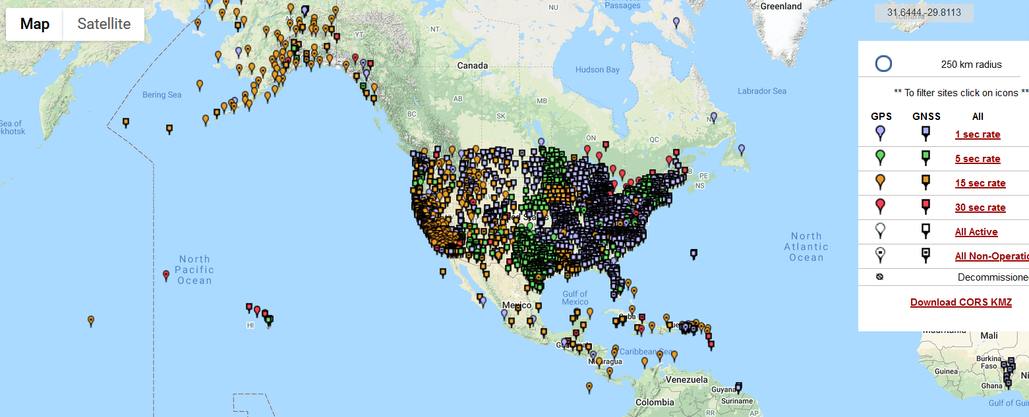
The NOAA CORS Network (NCN)
As of 2019, this is the official name of the network managed at NGS
  Historically referred to as “CORS” or “the CORS”

Slide 68
ARP vs GRP
The purpose of a CORS can be debated
  But at NGS: the continuous collection of GNSS data for the express purpose of determining the continuous coordinates of a unique, permanent, antenna-independent point at each CORS
  Such a point is called the Geometric Reference Point, or GRP
    Not to be confused with the Antenna Reference Point, or ARP
      Which is part of each antenna, not a permanent, unique physical part of a CORS
  Identification of GRPs has begun
    Coordinates on a CORS will eventually be fully transitioned to be “coordinates of the GRP of the CORS”. Right now they are…unclear.

Slide 69
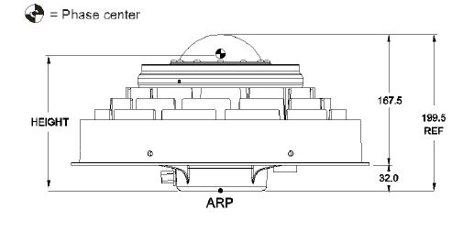
The NCN – ARP/GRP issues
In a perfect world, the ARP and GRP will physically coincide at a CORS while an antenna is mounted at that CORS
  Without endorsement, consider the NovAtel GNSS-750

Slide 70
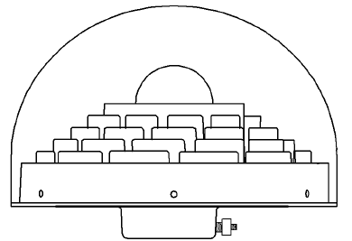

The NCN – ARP/GRP issues
The ARP is on the lowest non-removable plane of the antenna, usually coinciding with the axis of attachment
The GRP is:
a unique point that is part of a particular station
the point to which any coordinate functions of the station should* refer.
identified by the operator of each station
(for a CORS) part of the fixed (=non-removable) part of the antenna mount
In this example, we find it convenient to identify the GRP as the point on the axis of attachment which will coincide with the lowest non-removable plane of the antenna when the antenna is mounted.
* MUCH easier said than done!!!

Slide 71
The NCN – ARP/GRP issues
When the antenna goes away, so does the ARP
Leaving the GRP

Slide 72
OPUS and the
Data Delivery System (DDS)

Slide 73
OPUS and the DDS
Use OPUS 6.0 if you wish to:
Use the DDS if you wish to:
Report a mark to NGS
Turn a RINEX file into a coordinate (much like OPUS-S today)
Upload a project, reduce the data, adjust it, get OPUS coordinates and submit your data to NGS to turn into RECs and SECs
  Supports GNSS (including BYOV*), Classical (Total Station), Leveling and Relative gravity observations
Find marks near you
  and add them to a project if you like
Get information about a mark or station (like datasheets today, but much better)
Query the NSRS Database for anything (orbits, observations, reports, etc.) but especially if it’s a spatial query:
  Show me every mark with ‘WAS’ in the designation, occupied with GPS between 1995 and 2005, leveled on any date after 2000, within 50 km of a CORS and over 10 km from a state border…go!
* Bring your own vectors, whether from industry
software, historic databases or RTK/RTN

Slide 74
OPUS Coordinates
Whether or not you use the “-S module” or the “-Projects module”, your final coordinates from OPUS 6.0 will be labeled OPUS coordinates
  Additionally, if you follow OPUS recommendations, you will see
    “Tied to the NSRS”
  If you do not follow OPUS recommendations, you will see
    “Not tied to the NSRS”
      But you will still get coordinates, and they will be called OPUS coordinates
  OPUS coordinates will not be labeled: “Part of the NSRS”
    That is reserved for NGS-computed coordinates (SECs, RECs and ACs) in the NSRS database

Slide 75
OPUS Recommendations
OPUS will recommend:
  What control to use, what weights to use, etc.
When recommending active control
  Will use the (upcoming) station selection criteria
    Emphasizing high quality, available data at stable stations
When recommending passive control
  Will probably recommend active control first, if appropriate
    Then, will likely limit recommendations by date of most recent occupation, REC or SEC uncertainty estimates or other factors
Notes:
You are free to adopt all/some/none of these recommendations. But if you don’t adopt ALL of them, you will not get OPUS coordinates that are “tied to the NSRS”.

Slide 76
OPUS: Submitting
Unlike traditional “Bluebooking”, future submissions to NGS:
  Will not be your completed projects and coordinates
    But will come from those completed projects
  Will be the raw observations you loaded to your project
    Which will then be used in the computation of RECs and SECs
  Submitted with a simple “submit” button
    Not the more arduous “Bluebooking” process
Without your submissions, passive control will become outdated with growing error bars
  PLEASE always submit your projects.

Slide 77
OPUS: Sharing
Your OPUS work can be shared with the world
  This is different from submitting to NGS!
  This is similar to today’s “OPUS Share” feature
Request to share your results and:
  OPUS will create a summary of your OPUS work (whether from a single RINEX file or a massive project)
  That summary will be formatted with graphs, maps and other info into a single web page
    That web page will be stored on NGS web servers and assigned a random URL for you to share with whom you like.

Slide 78
Survey data
OPUS
Did you follow OPUS recommendations?
yes
no
OPUS Coordinates that are
“tied to the NSRS”
OPUS Coordinates that are
“not tied to the NSRS”
yes
Did you submit your data to NGS?
no
Do you want to “share” your results with the world?
yes
no
NGS will use your survey data in future REC and SEC adjustments
NGS will not use your survey data in future REC and SEC adjustments
Unique, public URL for this survey which you can share with anyone
Your results are shown to you on screen or via email only

Slide 79
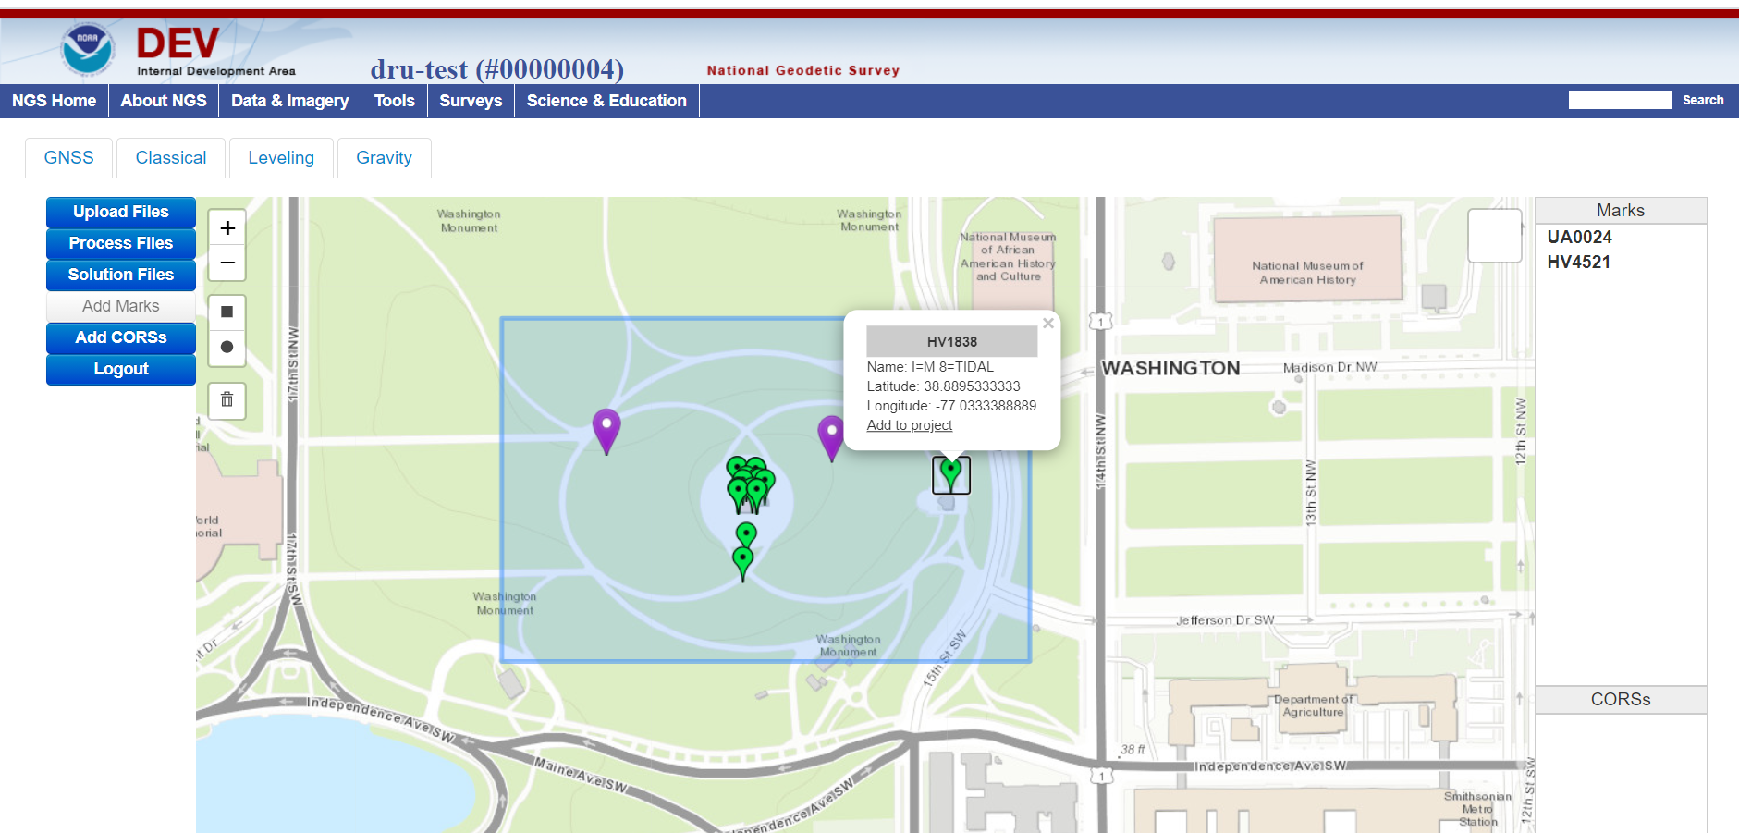
A sneak peak at how projects will look
Notes:
Note the simple add/remove function to put marks into and out of the project.
Note the four tabs to upload and process four types of geodetic control data.

Slide 80
OPUS: Common Data Formats
OPUS will only accept data in one unique format, per instrument type
  NGS is developing each of these (except RINEX)
  In coordination with the IAG’s GeodesyML initiative
  NGS is working with instrument manufacturers to adopt these
Data/Instrument type | Name of format | Notes
Raw GNSS | RINEX (3.* preferred, 2.* allowed for now)
GNSS vectors | GVX | Released Feb 2021
Leveling (raw & reduced) | LVX (tentative name) | Expected release in 2021
Classical Angles/Distances (raw & reduced) | CVX (tentative name) | Expected release in 2021
Relative gravity | RGX (tentative name) | Expected release in 2021

Slide 81
RECs and SECs
What are they?
How should they be used?
How are they computed?
  Adjustment Windows

Slide 82
Assume “h” was determined four different times:
1995: 2.210
1999: 2.200
2007: 2.140
2014: 2.145
2.250
2.200
h
2.150
2.100
2.050
2.000
‘95
‘00
‘05
‘10
‘15
‘20
‘25
‘30
time

Slide 83
All measurements have error. Shown here are the same
Values of “h”, but with their error estimates.
1995: 2.210 +/- 0.0375 (3.75 cm)
1999: 2.200 +/- 0.0250 (2.50 cm)
2007: 2.140 +/- 0.0200 (2.00 cm)
2014: 2.145 +/- 0.0250 (2.50 cm)
2.250
2.200
h
2.150
2.100
In the modernized NSRS these time-dependent
coordinates, estimated at (or very near) the actual date when
the surveys took place, will be called
survey epoch coordinates (SECs)
2.050
2.000
‘95
‘00
‘05
‘10
‘15
‘20
‘25
‘30
time

Slide 84
In today’s NSRS, a height is held fixed until replaced.
So plotting the height as seen on a datasheet over time might look like this:
2.250
2.200
h
2.150
2.100
2.050
2.000
‘95
‘00
‘05
‘10
‘15
‘20
‘25
‘30
time

Slide 85
In the modernized NSRS we will also have an estimate of
3-D mark motion (estimated from crustal motion) called IFVM2022
IFVM2022 (intra-frame velocity model) will be fairly coarse, showing broad regional estimates of mark motion through time
2.250
In general, IFVM2022 will not fit perfectly through SECs
2.200
h
2.150
2.100
2.050
2.000
‘95
‘00
‘05
‘10
‘15
‘20
‘25
‘30
time

Slide 86
Combining the same observations that were used to create SECs with IFVM2022 allows NGS to estimate reference epoch coordinates (RECs)
2.250
2.200
h
2.150
2.100
2.050
2.000
‘95
‘00
‘05
‘10
‘15
‘20
‘25
‘30
time

Slide 87
In the absence of new survey data, error estimates will
grow through time.
2.250
2.200
h
2.150
2.100
2.050
2.000
‘95
‘00
‘05
‘10
‘15
‘20
‘25
‘30
time

Slide 88
Side note: As each new REC set is created beyond the first, a NADCON expansion will occur, which will be identical to expanding IFVM2022 between the two REC sets. The IFVM2022 model should fit RECs better than SECs (but still not perfectly).
2.250
Can, with equal accuracy, be considered “NADCON” or “IFVM2022 between these two reference epochs”
2.200
h
2.150
Will be incorporated into
NCAT and VDatum
2.100
2.050
2.000
‘95
‘00
‘05
‘10
‘15
‘20
‘25
‘30
time

Slide 89
The (in)ability of current approach to
properly inform users of the height of
this mark can be seen in green below.
2.250
2.200
h
2.150
2.100
2.050
2.000
‘95
‘00
‘05
‘10
‘15
‘20
‘25
‘30
time

Slide 90
Example 2
Important: This slide only covers geometric coordinates.
It’s 2043 and you are working in San Diego using NATRF2022 (epoch 2040.00)
You need to compare your work against a competitor’s survey
  Done in 2024, using PATRF2022 (epoch 2020.00)
XYZ
PATRF2022
ep. 2020.00
EPP2022
XYZ
ITRF2020
ep. 2020.00
EPP2022
XYZ
NATRF2022
ep. 2020.00
XYZ2PLH
XYZ2PLH
XYZ2PLH
φλh
PATRF2022
ep. 2020.00
φλh
ITRF2020
ep. 2020.00
φλh
NATRF2022
ep. 2020.00
IFVM2022*
NADCON*
NADCON*
NADCON
IFVM2022
IFVM2022*
φλh
PATRF2022
ep. 2040.00
φλh
ITRF2020
ep. 2040.00
φλh
NATRF2022
ep. 2040.00
XYZ2PLH
XYZ2PLH
XYZ2PLH
XYZ
PATRF2022
ep. 2040.00
EPP2022
XYZ
ITRF2020
ep. 2040.00
EPP2022
XYZ
NATRF2022
ep. 2040.00
Notes:
This slide shows how EPP2022 changes frames (at the XYZ level), IFVM2022 changes epochs (at the πηι/λαμδα/h level), and that the master IFVM2022 model will be stored in ITRF2020, but derivative versions will exist in N/P/M/C)ATRF2022 to avoid unnecessarily long treks through the master copy.

Slide 91
RECs and SECs: How NGS will create them
Complicated topic, of limited interest to users of NSRS
Here’s how our work will impact your work:
  Your data will be adjusted into SECs and RECs
  Adjustments, especially SECs, will be done in “adjustment windows”
    GNSS: 4 weeks (tentative)
    Leveling: 1 year (tentative)
    Gravity: Unclear
  NGS will appreciate and encourage redundant observations on marks within adjustment windows.

Slide 92
Policy changes/decisions
IFVM2022 will be modeled using residual velocities in NATRF2022, PATRF2022, CATRF2022 or MATRF2022, but will be stored in ITRF2020
  Thus one model is stored, not four
  Can be transformed back to NATRF2022 et al by removing EPP2022
IFVM2022 will be stored as changes to geodetic latitude, geodetic longitude and ellipsoid height
  In contrast to most other modernized tools which will work in XYZ

Slide 93
Policy changes/decisions
IFVM2022 will be modeled using residual velocities in NATRF2022, PATRF2022, CATRF2022 or MATRF2022, but will be stored in ITRF2020
  Thus one model is stored, not four
  Can be transformed back to NATRF2022 et al by removing EPP2022
IFVM2022 will be stored as changes to geodetic latitude, geodetic longitude and ellipsoid height
  In contrast to most other modernized tools which will work in XYZ

