Slide 1

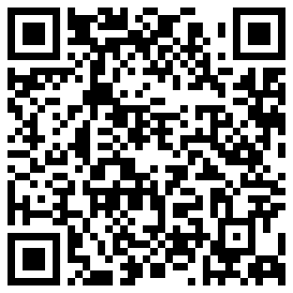
Preparing for the Impending Modernization of the U.S. National Spatial Reference System
and Impacts on Geospatial Data Providers and Users
American Geophysical Union
2024 Annual Meeting
Washington DC, December 9-13
Dru A. Smith, PhD
Michael L. Dennis, PhD, PE, PLS
NGS Presentations Library

Slide 2
The National Spatial Reference System
The NSRS
Official coordinate system for the USA
Defined by the National Geodetic Survey
Required to be used by all Federal Government agencies
Often used by many state and local government agencies or private surveyors

Slide 3
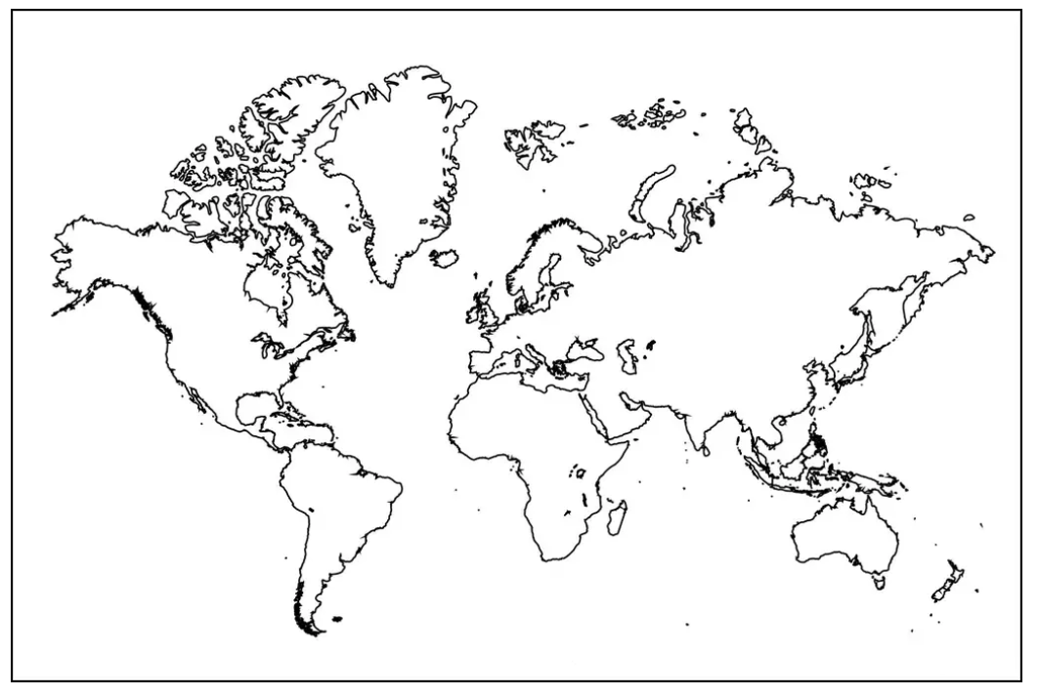
Extent of the current NSRS
Geometric Reference Frames:
NAD 83(2011)
NAD 83(PA11)
NAD 83(MA11)
Truly global but used regionally
Geoid models/Vertical Datums:
Regional
  Conterminous US (CONUS; “Lower 48”)
  Alaska
  Hawaii
  Territories: Puerto Rico, U.S. Virgin Islands, American Samoa, Guam, CNM

Slide 4
NSRS Modernization
Has been ongoing since 2007
This talk presumes some existing knowledge of NSRS Modernization. For finer details look here:
  NGS Presentation Library (https://geodesy.noaa.gov/web/science_edu/presentations_library/)
  NGS New Datums Page (https://geodesy.noaa.gov/datums/newdatums/index.shtml)
  The Blueprint Documents (https://geodesy.noaa.gov/datums/newdatums/policy.shtml)

Slide 5
NSRS Modernization in (very) brief
NATRF2022
NAD 83(2011)
NAD 83(PA11)
PATRF2022
Hybrid geoids
GEOID2022
NAD 83(MA11)
CATRF2022
MATRF2022
NAVD 88
ASVD 02
PRVD 02
NAPGD2022
Bluebooking
FORTRAN
Disparate tools
Outdated manuals
GDX / OPUS
Modern coding
Integrated tools
Updated manuals
NMVD 03
GUVD 04
VIVD 09

Slide 6
Modernized NSRS Tools and Applications
Data Delivery System
  Serves as public access to NSRS Database (replaces NGS Integrated Data Base)
  Detailed information on National CORS Network stations
  Reference Epoch Coordinates and other information on geodetic control marks
Online Positioning User Service (OPUS)
  GNSS baseline processing and network adjustments
  Mechanism for submitting geodetic control observations to NGS
NGS Coordinate Conversion and Transformation Tool (NCAT)
  Conversion between coordinate types (e.g., map projected, ellipsoidal, geocentric)
  Transformation between reference frames, geopotential datums, height systems
  Time projection (“propagation”) between different dates (epochs)

Slide 7
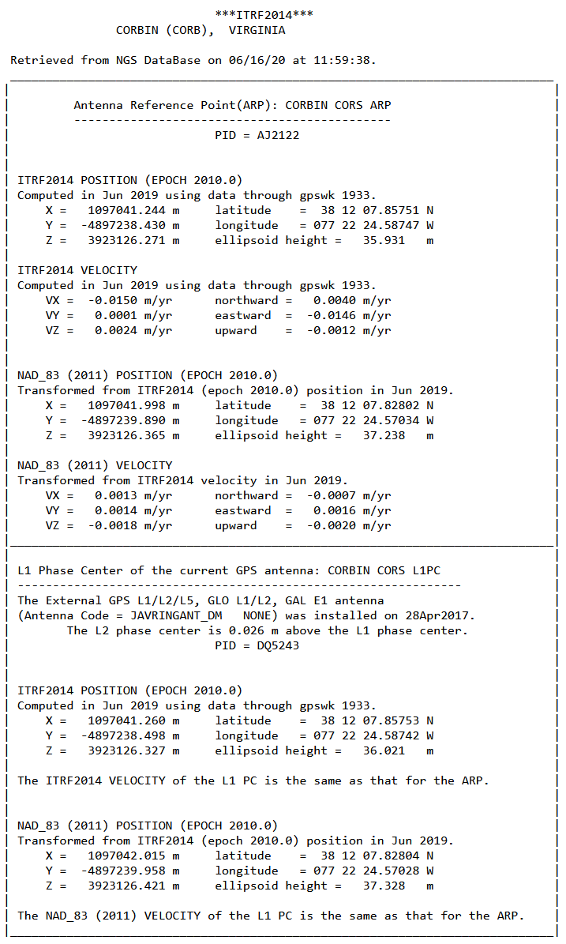
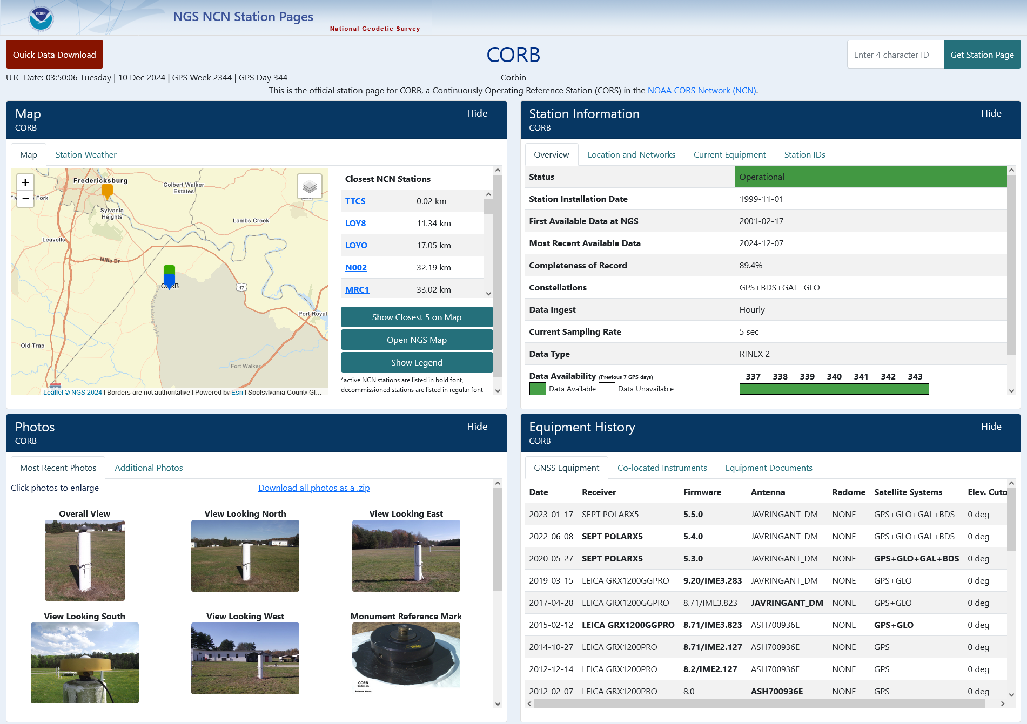
Data Delivery System: CORS stations
OLD

Slide 8
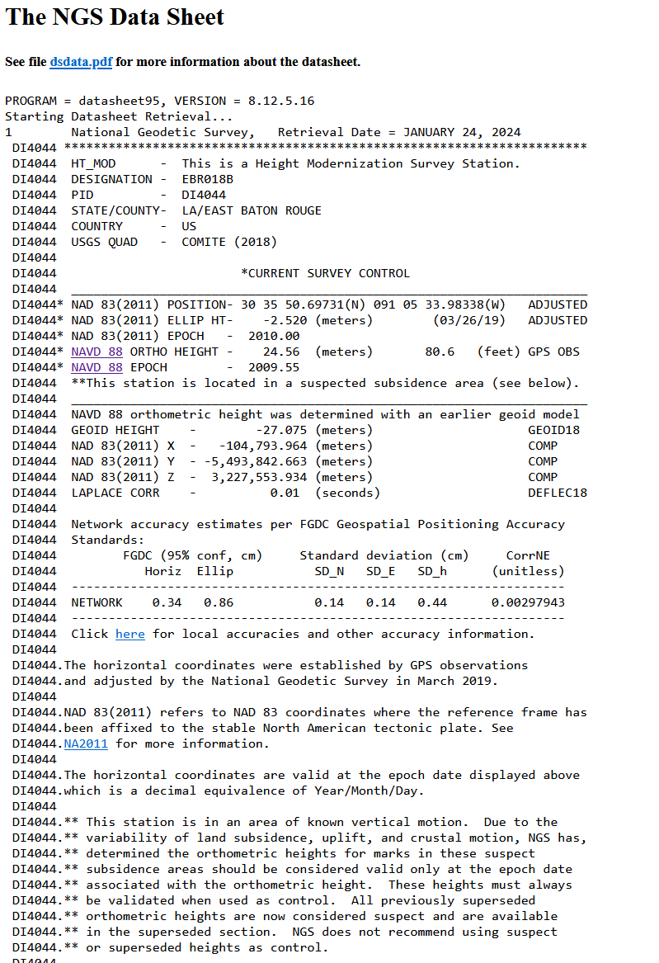
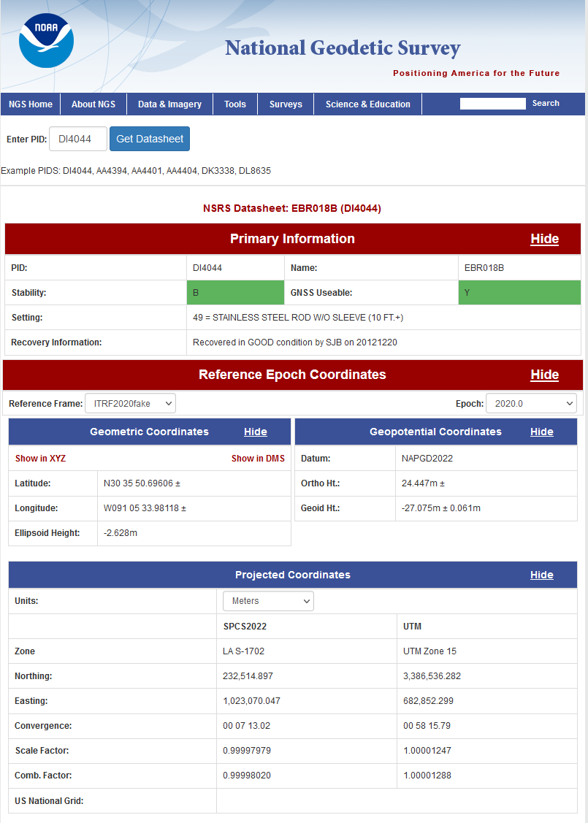
Data Delivery System: Geodetic control marks
OLD

Slide 9
Online Positioning User Service (OPUS)
OPUS-Static: singles mark positioned from multiple CORSs
  M-PAGES: Multi-constellation GNSS
  Optimized CORS selection algorithm
OPUS-Projects: multiple-mark (campaign-style) GNSS projects
  SPROCCET / 14H
    Software for PRojecting Observations, Constraints and Cofactor matrices/Errors through Time
    14H = 14-parameter Helmert transformations
    Project and transform observations to common frame and time (epoch) for network adjustments
    Replaces Horizontal Time-Dependent Positioning (HTDP) software
  LASER
    Least-squares Adjustments: Statistics, Estimates, and Residuals
    Least-squares adjustment (LSA) software for wide variety of geodetic observations
    Replaces multiple LSA programs used by NGS

Slide 10
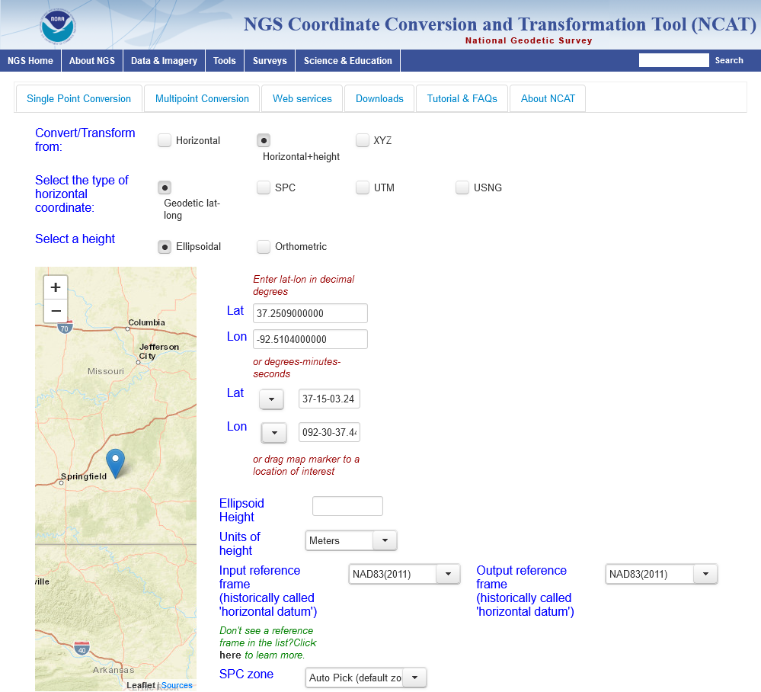
NGS Coord Conversion & Transformation Tool (NCAT)
State Plane Coordinate System of 2022
Intra-Frame Deformation Model of 2022 (IFDM2022)
Helmert transformations between reference frames (14H)
GEOID2022
NADCON and VERTCON

Slide 11
NSRS Modernization is nearly done!
Beta releases (for testing and evaluation only!)
  Begin early 2025 with NCAT (includes SPCS2022, IFDM2022, 14H, GEOID2022)
  End late 2025 (last beta release likely will be adding VERTCON to NCAT)
Replaces current datums in 2026
  At least 6 months after last item added to beta release
  After Federal Geodetic Control Subcommittee votes to approve in 2026
NGS Presentations Library
Thank you!
Questions? Comments?

