Slide 1

NSRS Modernization
USACE Geospatial CoP Meeting
October 2019
Jeff Jalbrzikowski, P.S., GISP
Appalachian Regional Geodetic Advisor
jeff.jalbrzikowski@noaa.gov
240-988-5486
Notes:
-First, thanks for allowing NGS to be a part of this meeting.
-We’re aware that USACE has some folks who have a really good handle on this, we appreciate that you let us present today.
-In a world where all the land is constantly in motion… the NGS is here to help you factor out that motion from your surveys…

Slide 2



Who is NGS?
Federal Government – Executive Branch
  -Department of Commerce (DoC)
  (~47,000 employees)
  -National Oceanic and Atmospheric Administration (NOAA)
  -National Ocean Service (NOS)
  -National Geodetic Survey (NGS)
  (~175 employees)
Notes:
-We are the Federal Government’s oldest scientific agency.
-I know it can seem kind of strange that NGS is part of the NOS, but the origins of NGS lie with the C&GS.
-we are a “Program Office” of the NOS
Survey of the Coast – 1807
Coast Survey – 1836
Coast and Geodetic Survey – 1878
NGS since 1970

Slide 3
NGS Mission
To define, maintain and provide access to the National Spatial Reference System (NSRS) to meet our Nation’s economic, social, and environmental needs.
Notes:
NGS develops and maintains the National Spatial Reference System, a national coordinate system that provides the foundation for transportation, navigation, land record systems, mapping and charting efforts, and a multitude of scientific and engineering applications.
But there are many ancillary programs and products we will also discuss.

Slide 4
National Spatial Reference System (NSRS)
A consistent coordinate system that defines
latitude
longitude
height
scale
orientation
gravity
throughout the United States.
…and their time variants
Notes:
Let’s talk about the NSRS some more before we move on to looking at all of NGS.
This system defines position (latitude, longitude, and elevation), distances and directions between points, strength and direction of gravity (no, it is not simply “straight down”), shoreline, and their “time variants”.
Or how these change over time.
Some documents will reference the National Shoreline as a component of the NSRS., we’ll briefly look at that later.

Slide 5
National Spatial Reference System (NSRS)
These items ARE part of the NSRS
Horizontal Datums (aka Geometric Reference Frames) | Vertical Datums | Great Lakes Datums | Geoid Models | Transformations and Conversions
NAD83 | NAVD88 | IGLD85 | GEOID12A & B | NADCON
NAD27 | NGVD29 | IGLD55 | GEOID09 | VERTCON
USSD | VIVD09 |  | GEOID06
 | GUVD04 |  | GEOID03 | SPCS83
 | NMVD03 |  | GEOID99 | SPCS27
 | ASVD02 |  | GEOID96
 | PRVD02 |  | ALASKA94
 |  |  | GEOID93
 |  |  | GEOID90
Notes:
Note the US Standard Datum, anyone done any work in the old USSD?
Good example highlighting that the term “NSRS” is used to encompass all historic datums of NGS and its predecessors.
Saw one project during my work with the USACE, in Johnstown, PA, that had original survey records in what turned out to be US Standard Datum.
All those vertical datums below NGVD29, I greyed them out slightly because those are all Caribbean and Pacific Island datums, so in CONUS it’s just those two that you hopefully already use… and hopefully are mostly using NAVD88.

Slide 6
National Spatial Reference System (NSRS)
These items are NOT part of the NSRS
Horizontal Datums (aka Geometric Reference Frames) | Vertical Datums | Geoid Models | Transformations and Conversions
WGS84 | IHRS (by IAG) | OSU91A | CORPSCON
WGS72 |  | EGM96 | Appendix B.6 of DMA TR 8350.2 (WGS 84)
ITRF (Intl. Terrestrial Reference Frame by IERS) |  | EGM2008 | Oregon Coordinate Reference System (ORCS)
IGS (Intl. GNSS Service reference frame) |  |  | The Kansas Regional Coordinate System
Hyperlink to ITRF station map
Notes:
WGS is a DoD system. Yes, that is the system native to the Global Positioning System, but it isn’t true that you “have to” work in WGS84 to get the most accurate coordinates. I’ve heard people say that.
The Intl. Terrestrial Ref. Frame is a product of the Intl. Earth Rotation and Reference Systems Service. More on that later.
The Intl. GNSS Service Ref. Frame is, well, it’s a reference frame based on that ITRF just mentioned, but with improvements, like a more dense network of stations and is more easily accessible.
The IHRS is an International Height Reference System, which is a product that was formally adopted by the IAG (Intl. Association of Geodesy) in 2015. Not an NGS product but folks from NGS were involved.
OSU geoid, it was a research thing and I don’t know much about it.
The Earth Gravity Models are DoD products just like the WGS products, used around the world by our Nation’s military (I used EGM based height sin Iraq and Afghanistan)… but are not at all tied to NSRS geoids. Future DoD geoid models may have a closer tie to future NGS geoid models.
CorpsCon. Ah yes, Corpscon. Everyone loves Corpscon, unfortunately as convenient as it is it isn’t truly an NGS product and has not been updated in well, a long time, and there are no plans to update it in the future. (confirmed via phone call to AGC personnel on 20FEB2019)
I like Mark Huber, awesome dude, I spent some time with him surveying on some god-forsaken island in the Indian Ocean, but the USACE doesn’t seem to want to support him in funding an update to Corpscon. So it is what it is.
Those regional coordinates systems, like the ORCS in Oregon and that one in Kansas, although they have rigorously defined transformations to the NSRS (which is great, they did it right) they are not part of the NSRS.

Slide 7
NSRS … do I have to use it?
OMB Circular A-16
  Requires Federal agencies to utilize geodetic control for their geospatial activities
  Places DoC in responsible charge of that control
  NGS has defined that control as the NSRS
  FGCS has issued requirements, via FRNs, to reference data to the most recent components of the NSRS
            1989 FRN designated NAD83
            1993 FRN designated NAVD88
Hyperlink to NAVD88 FRN
Hyperlink to NAD83 FRN
Notes:
What’s the Office of Management and Budget Jeff? It’s an agency within the Executive Office of the President, they too are part of the Executive Branch of Gov’t.
There’s four really important takeaways from OMB A-16.
*1
So it’s Federal policy at one of the highest levels of policy that Federal agencies (civilian agencies not the military/DoD/Intelligence) maintain their data in reference to the NSRS.
Why not DoD, NGA, and the Intelligence agencies? Well, they have their own DoD Directive that requires them to tie everything to WGS84 and EGM08.
*2
Ok, I got a little acronym heavy there so I broke up the four takeaways into 2 slides.
NGS had defined that A-16 required control as “the NSRS” (term adopted in 1994).
Why? Create one term to outlive trends & technology, reduce the need to keep spending time and money re-writing policy and documentation every time a new datum name.
The FGCS, the Federal Geodetic Control Subcommittee is a part of the FGDC, the Federal Geographic Data Committee
Anyway, the FGCS has issued Federal Register Notices

Slide 8
NSRS … do I have to use it?
OMB Circular A-16
All spatial data and GIS activities financed directly or indirectly, in whole or in part, by federal funds.
“this Circular applies to, but is not limited to: … the U.S. Army Corps of Engineers (USACE) inland waterway charting program … and other federal activities that involve national surveying, mapping, remote sensing, spatially referenced statistical data, and Global Positioning System”
Notes:
tribal activities not paid for by federal funds.
Classified DoD activities as determined by the SecDef (unless declassified by Executive Order 12951); also DoE activities, as determined by the Sec of Energy.
Intelligence activities, as specifically determined by the Director of the CIA.

Slide 9
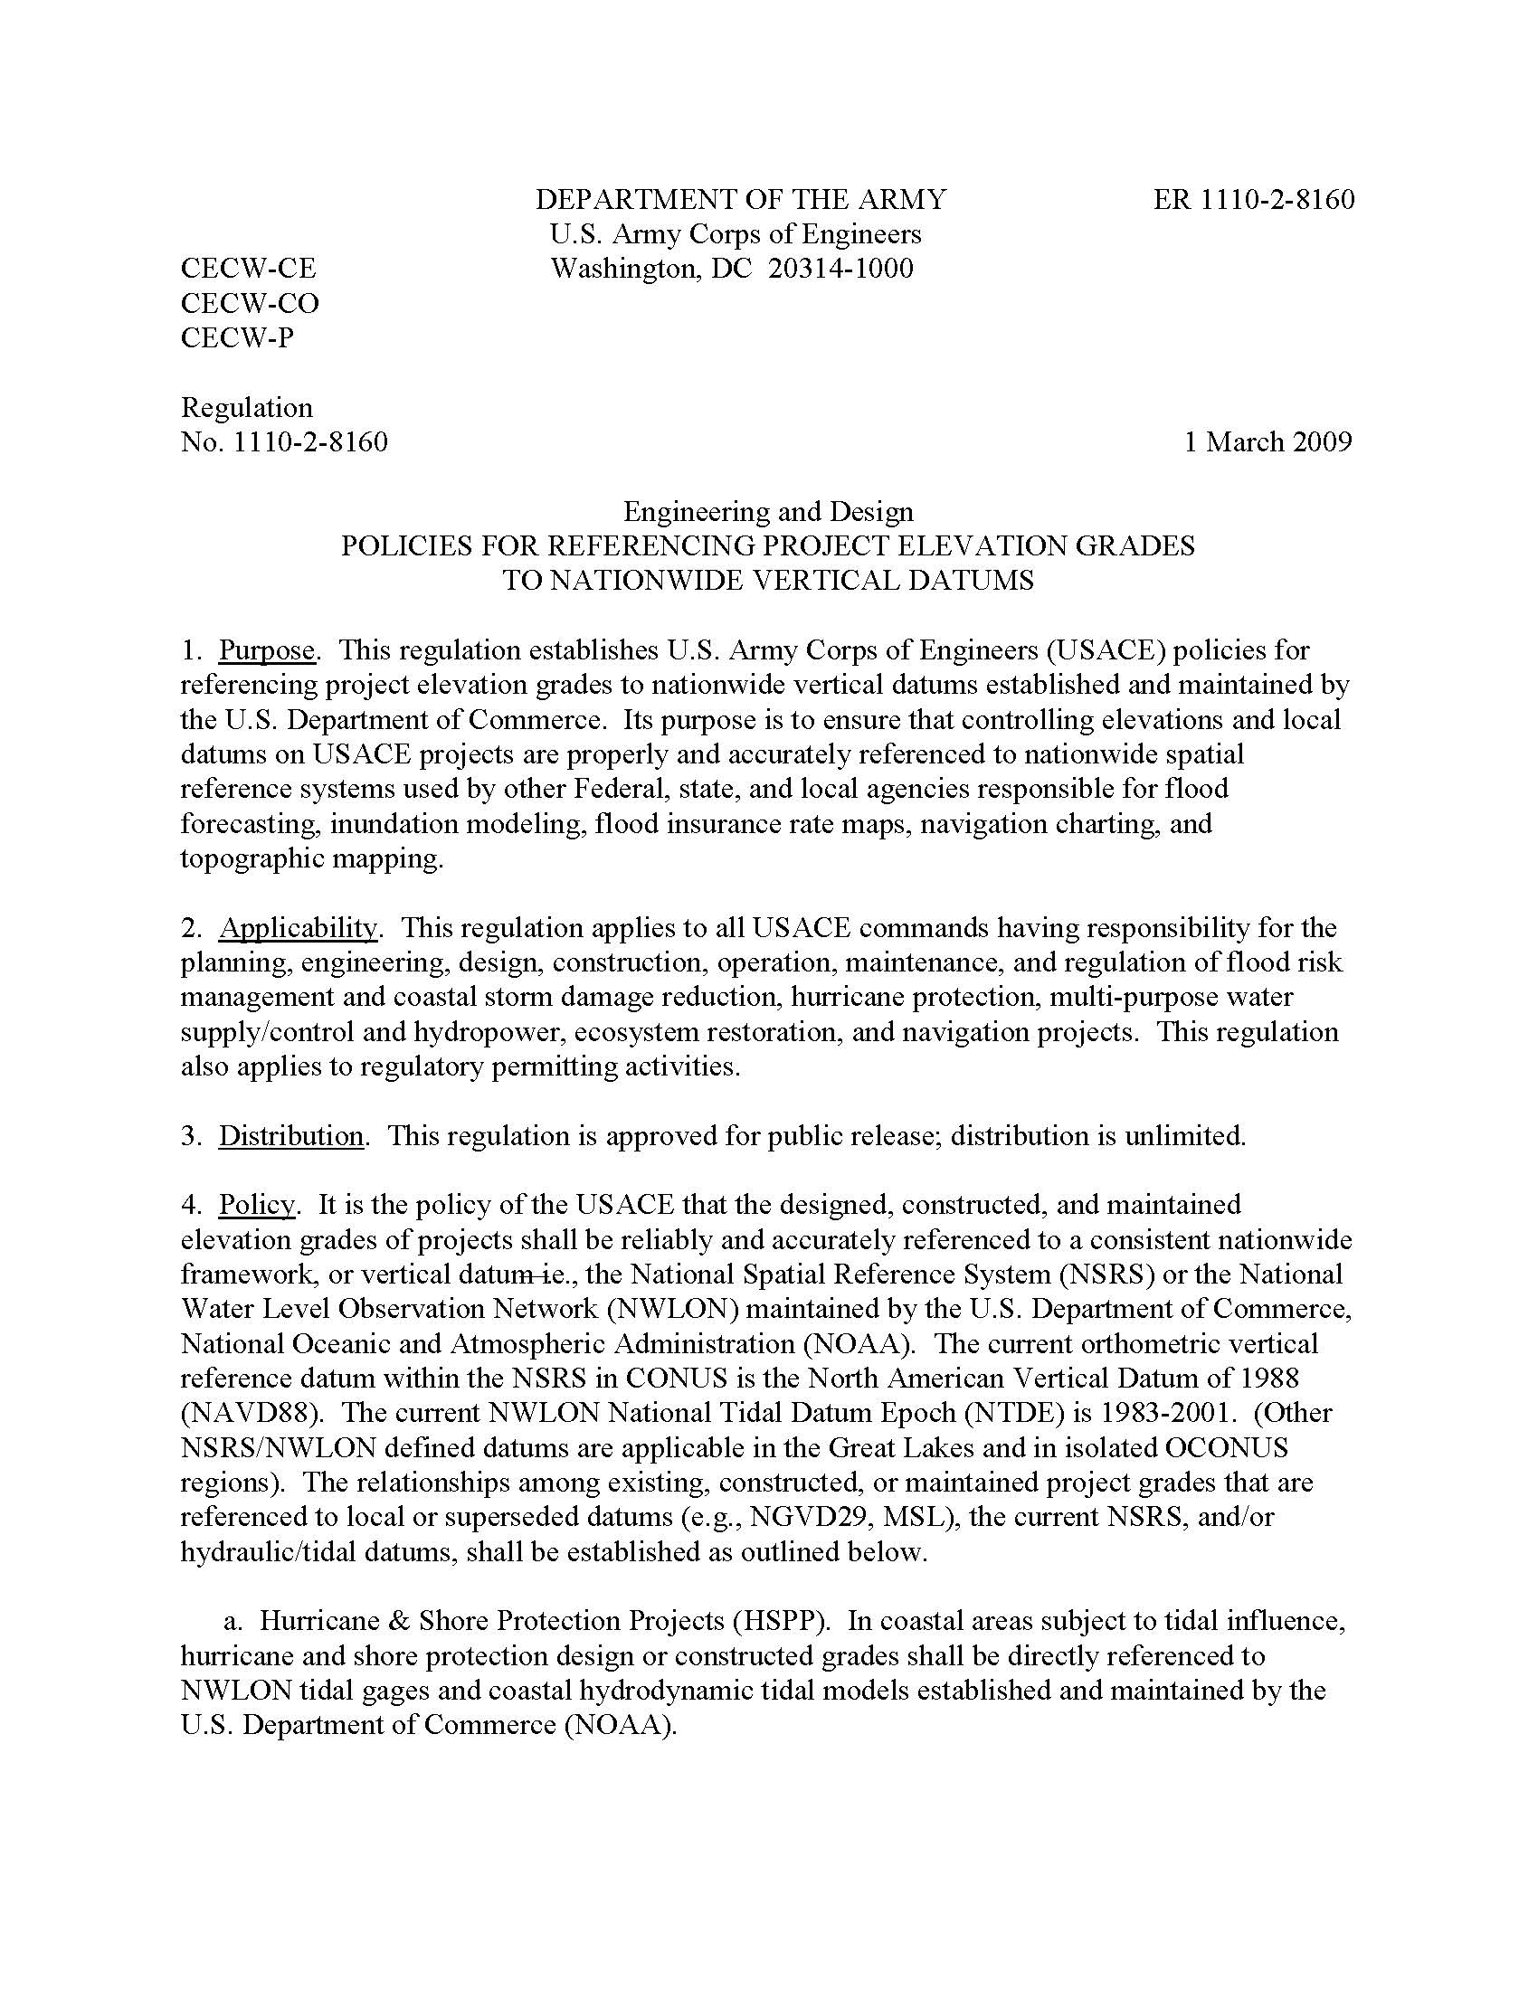
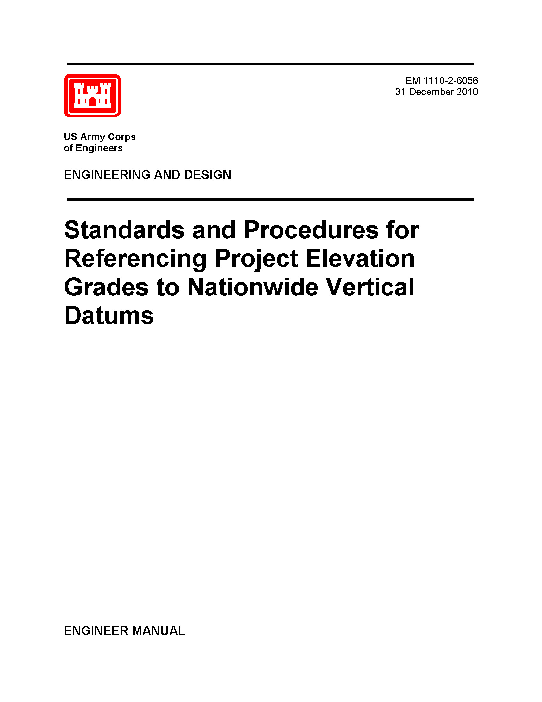
NSRS … do I have to use it?
Aside from OMB A-16, there are:
  ER 1110-2-8160 - Policies for Referencing Project Elevation Grades to Nationwide Vertical Datums
  EM 1110-2-6056 - Standards and Procedures for Referencing Project Elevation Grades to Nationwide Vertical Datums
Notes:
-EM is 422 pages of goodness! But there are a few items I’d love to follow up on that are a little ambiguous in that manual.
-what I’m trying to say here is … you should have all your dam data CLICK in the NSRS

Slide 10
In other words…
…you should have all your dam data referenced to the NSRS.

Slide 11
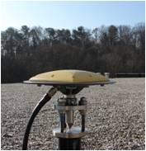
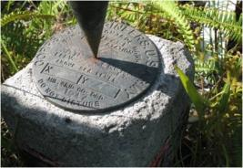
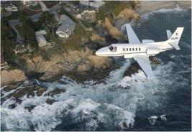
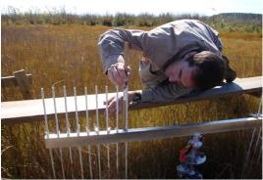
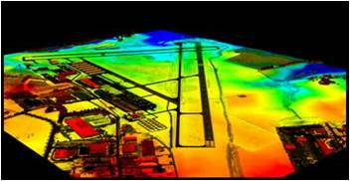
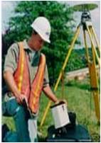
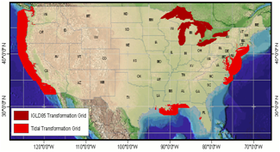
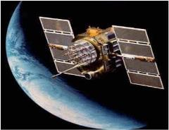
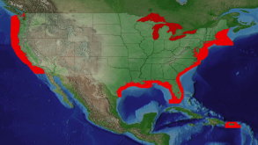
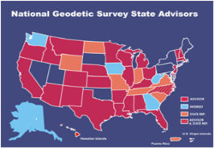

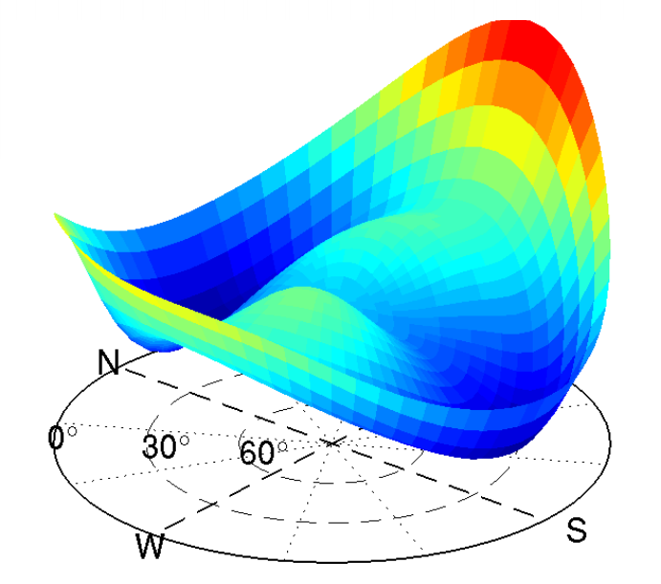
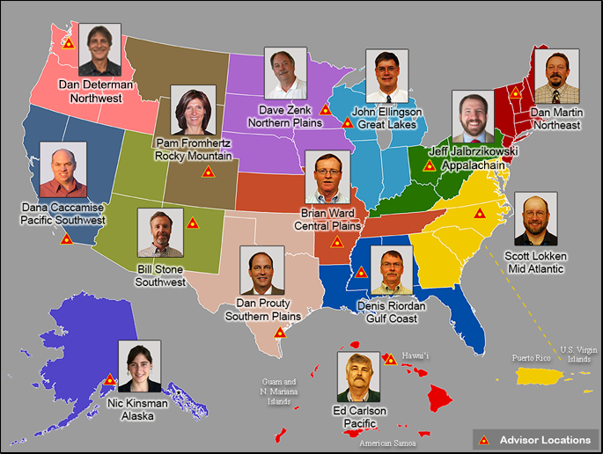
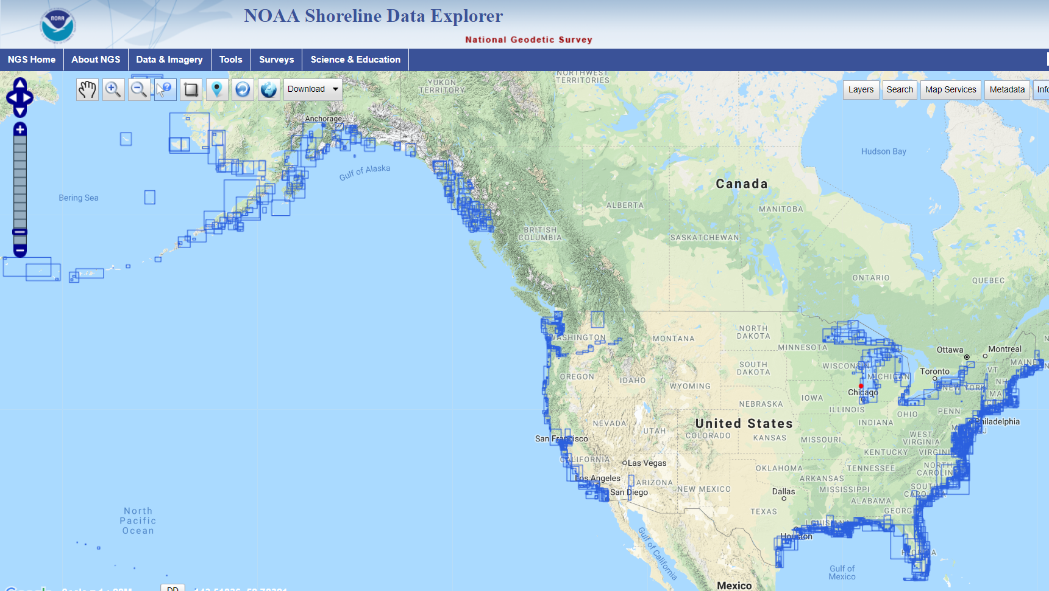
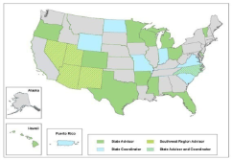
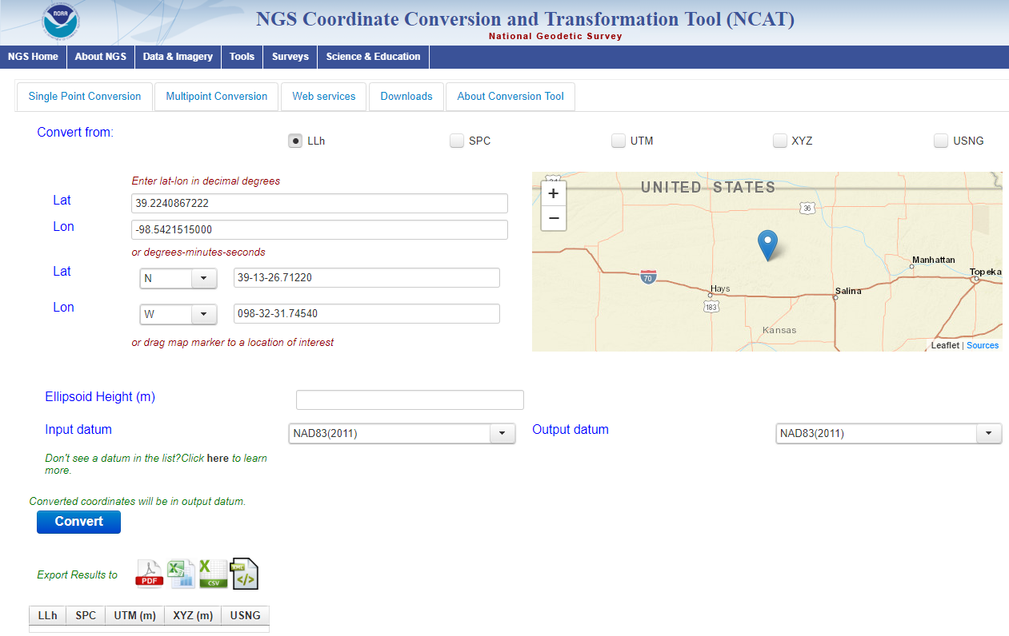
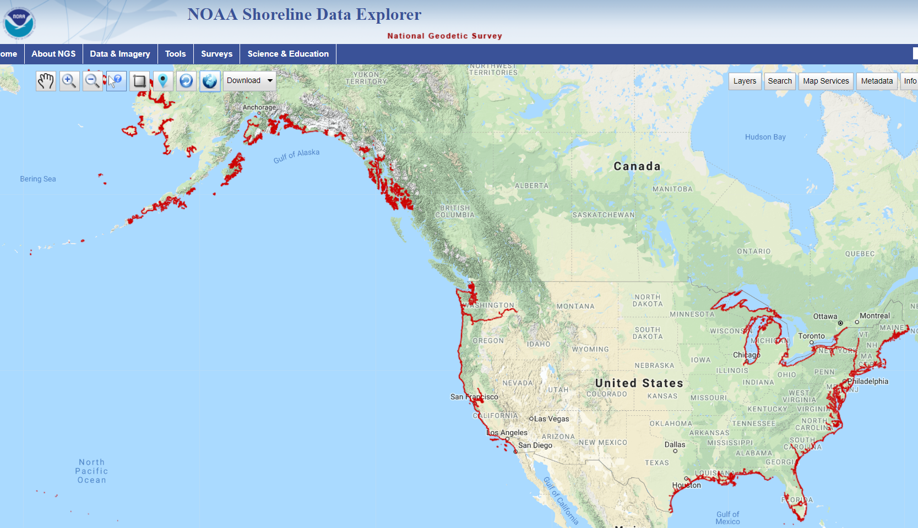
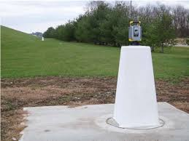
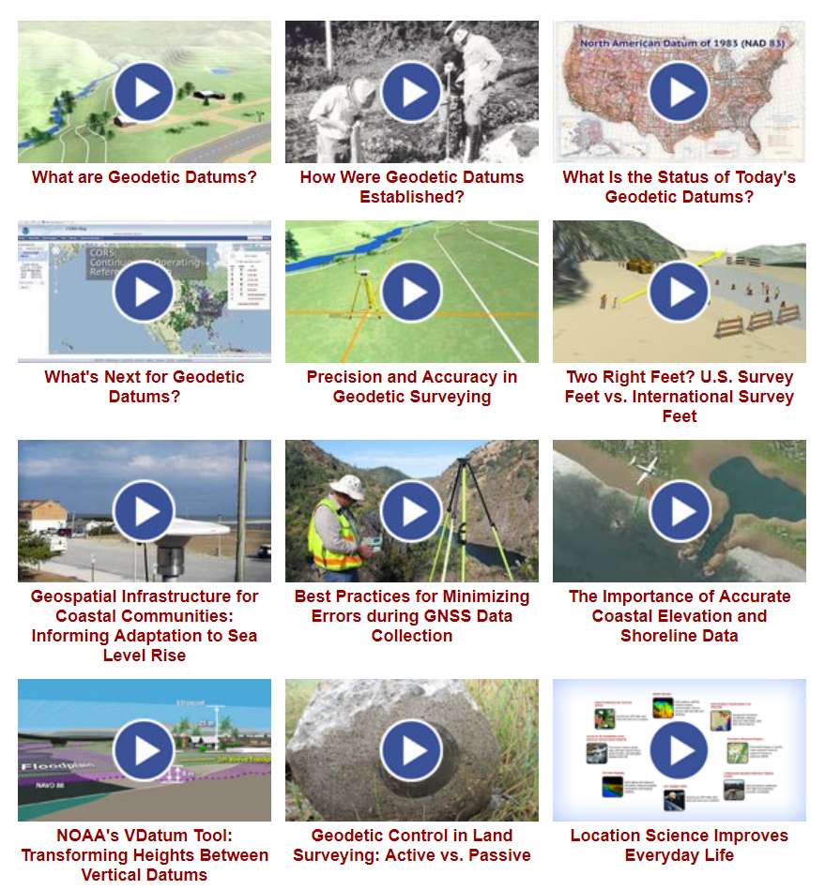
NGS Overview
Modernizing the NSRS
CORS
NHMP
GRAV-D
ECO
NGS Products and Services
ASP
OPUS
VDatum
Orbit Data
National Shoreline
Geodetic Advisors
ERI
Antenna Calibrations
NCAT
CUSP
CBL
Outreach/COMET
Notes:
This is not an exhaustive list of NGS programs

Slide 12
NGS Overview
Modernizing the NSRS
CORS
NHMP
GRAV-D
ECO
NGS Products and Services
ASP
OPUS
VDatum
Orbit Data
National Shoreline
Geodetic Advisors
ERI
Antenna Calibrations
NCAT
CUSP
CBL
Outreach/COMET
Notes:
This is not an exhaustive list of NGS programs

Slide 13
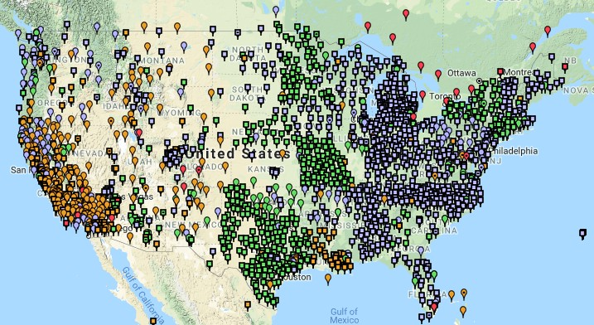
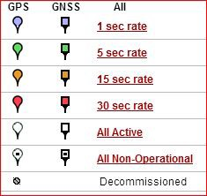
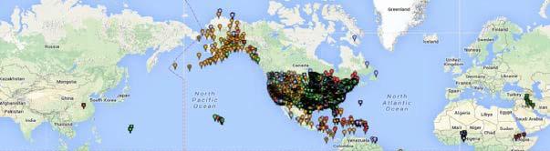
Continuously Operating Reference Station (CORS)
2000+ sites
~225 organizations
Notes:
-If you are not familiar with CORS, these are GNSS receivers that collect data 24/7, and the data is posted on NGS website for anyone to download.
-I’ve got some statistics up there, but the NOAA CORS Network is ever changing, with frequent additions and decommissionings

Slide 14
NOAA CORS Network (NCN)
2000+ sites
~225 organizations
Notes:
-I would like to point out we have a new, official name for the network you see represented on this map,
-The NOAA CORS Network, or NCN

Slide 15
NGS Overview
Modernizing the NSRS
CORS
NHMP
GRAV-D
ECO
NGS Products and Services
ASP
OPUS
VDatum
Orbit Data
National Shoreline
Geodetic Advisors
ERI
Antenna Calibrations
NCAT
CUSP
CBL
Outreach/COMET
Notes:
This is not an exhaustive list of NGS programs

Slide 16
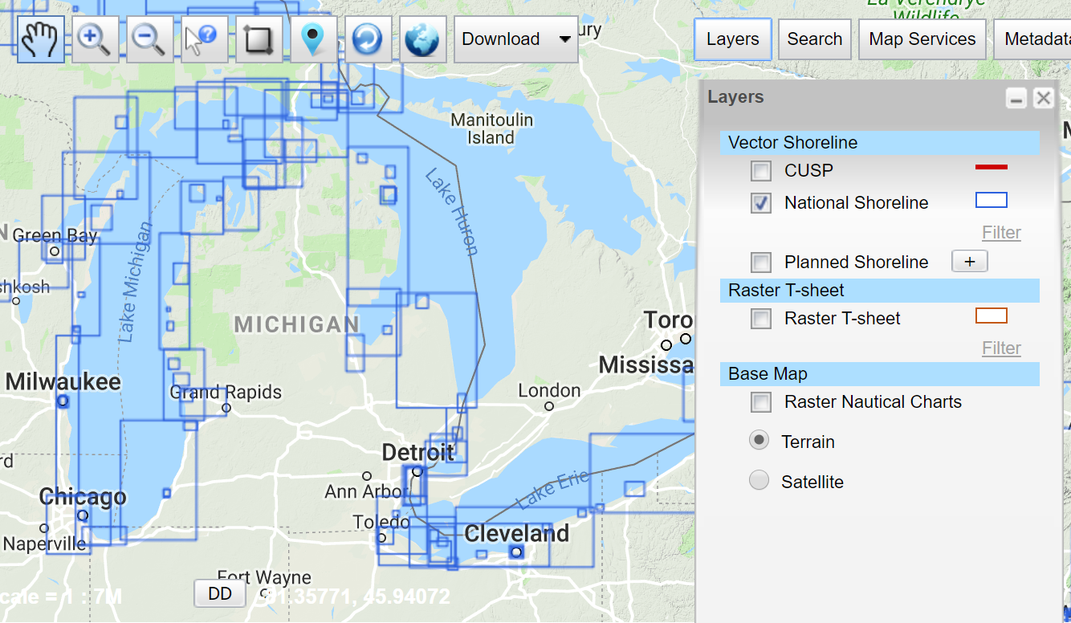
National Shoreline
The official national shoreline data, in support of NOAA nautical charting mission
Available for download as Shapefile in Mean High Water and Mean Lower Low Water datum
Organized by “Project Area”
hyperlink to the National Shoreline homepage
Notes:
This is an NGS product, highlights the origins of NGS as the Survey of the Coast, Coast & Geodetic Survey.

Slide 17
NGS Overview
Modernizing the NSRS
CORS
NHMP
GRAV-D
ECO
NGS Products and Services
ASP
OPUS
VDatum
Orbit Data
National Shoreline
Geodetic Advisors
ERI
Antenna Calibrations
NCAT
CUSP
CBL
Outreach/COMET
Notes:
This is not an exhaustive list of NGS programs

Slide 18
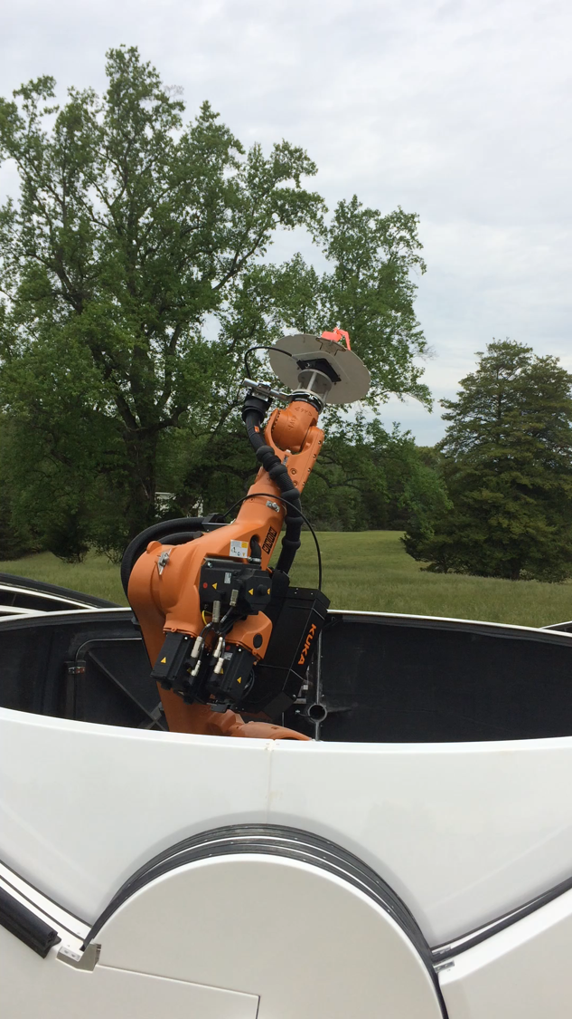
Notes:
-the arm is for absolute GNSS antenna calibrations, the IGS standard
-3D centering of the physical center within 0.1mm
-it’s not gong to be operational until the end of 2019, pending IGS approval/acceptance
-what’s being done here? we’re creating a 3D “map” or model of the antenna’s characteristics: where the different signals are received, or what’s known as a Phase Center Offset

Slide 19
NGS Overview
Modernizing the NSRS
CORS
NHMP
GRAV-D
ECO
NGS Products and Services
ASP
OPUS
VDatum
Orbit Data
National Shoreline
Geodetic Advisors
ERI
Antenna Calibrations
NCAT
CUSP
CBL
Outreach/COMET
Notes:
This is not an exhaustive list of NGS programs

Slide 20
Outreach and COMET
search: NGS video library
Notes:
-COMET videos = 5min or less
-Just a few clicks from our homepage we’ve also got:
Recorded Webinars
Presentation Library
COMET Lessons
Everything from 5 minute videos to 2 hour quiz based lessons.
-All the Regional Advisors are considered a part of the overall outreach mission.

Slide 21
NGS Overview
Modernizing the NSRS
CORS
NHMP
GRAV-D
ECO
NGS Products and Services
ASP
OPUS
VDatum
Orbit Data
National Shoreline
Geodetic Advisors
ERI
Antenna Calibrations
NCAT
CUSP
CBL
Outreach/COMET
Notes:
This is not an exhaustive list of NGS programs

Slide 22

NGS Ten-Year Strategic Plan
  Reduce all definitional & access-related errors in geometric reference frame to 1 cm when using 15 min of GNSS data
  (aka “Replace NAD83”)
  Reduce all definitional & access-related errors in orthometric heights in geopotential datum to 2 cm when using 15 min of GNSS data
  (aka “Replace NAVD88”)
https://geodesy.noaa.gov/web/about_ngs/info/tenyearfinal.shtml
Notes:
Where did this all start?
How is all this possible?
And what will users get out of it?
It started before 2013, origins in NHMP and GRAV-D, but it became truly official once published in our 2013 strategic plan
What you get is more accurate positions and faster. (sure, most of you are using RTN for a lot, but static has its place)
We’re on track to achieve the goal of obtaining a 2cm by 1cm error ellipse with only 15 minutes of static GPS data.
Is that going to include other constellations, such as GLONASS and Galileo satellites? Yes, the Geodetic Research Division is already working to re-write software to include orbit data for those other constellations. (Jan 2021 is target)

Slide 23
Not just new datums…
  NSRS Modernization
Replace NAD83
Replace NAVD88
Re-invent Bluebooking
Improve Geodetic Toolkit
Better Surveying Methods
Blueprint for 2022, Part 1
Blueprint for 2022, Part 2
Blueprint for 2022, Part 3
Notes:
-so you’ve probably seen that phrase that I have front and center here, NSRS Modernization
-that’s the blanket term we use to refer to not just the new datums but other updates
-another phrase I want to mention are these “Blueprints for 2022”
-just about everything I cover today is mentioned in one of the Blueprints
-the Geodetic Toolkit, what’s that? another term that just refers to all those softwares NGS provides, like PAGES, ADJUST, etc.
-better methods – updating manuals like NGS-58 and 59 for example

Slide 24
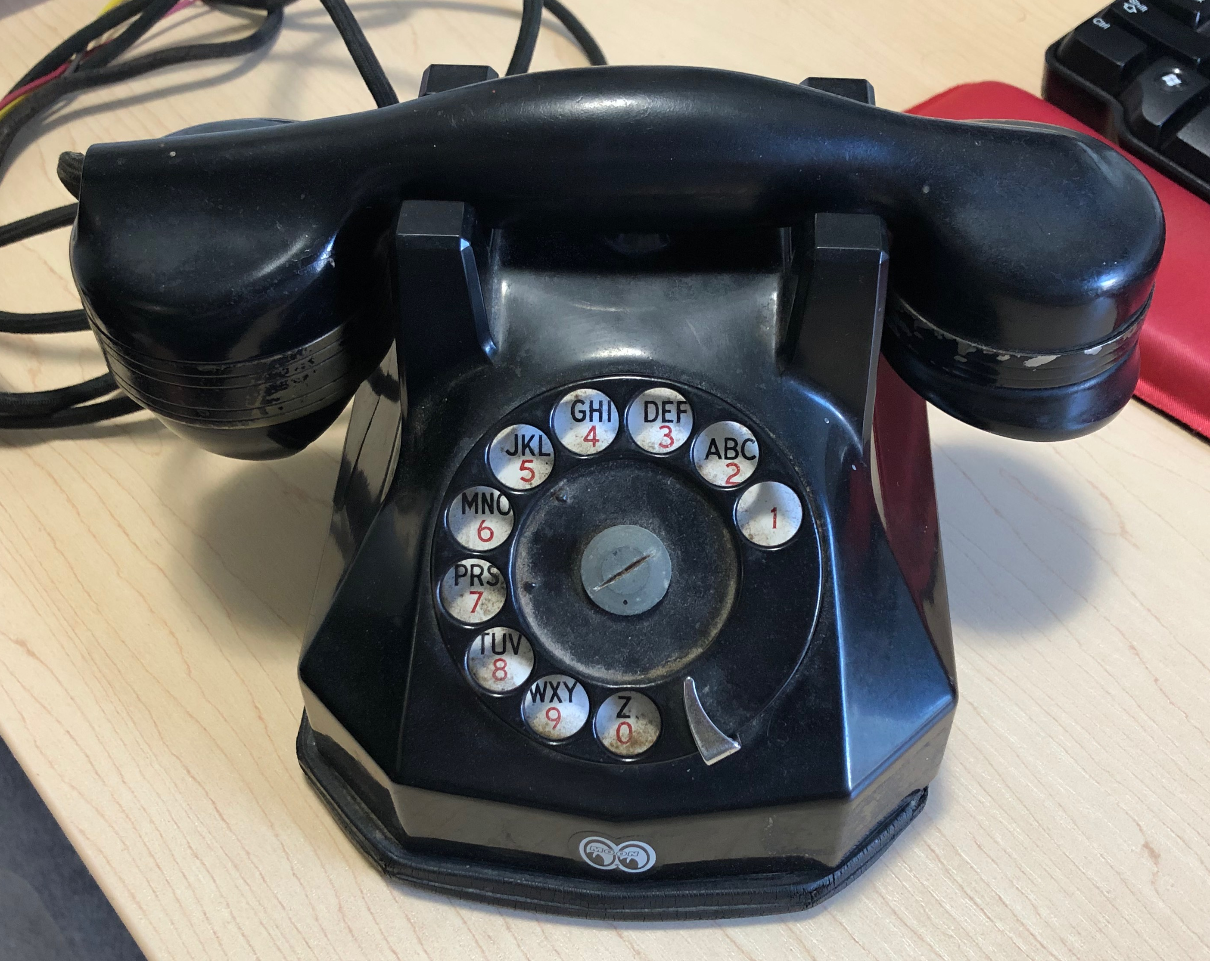
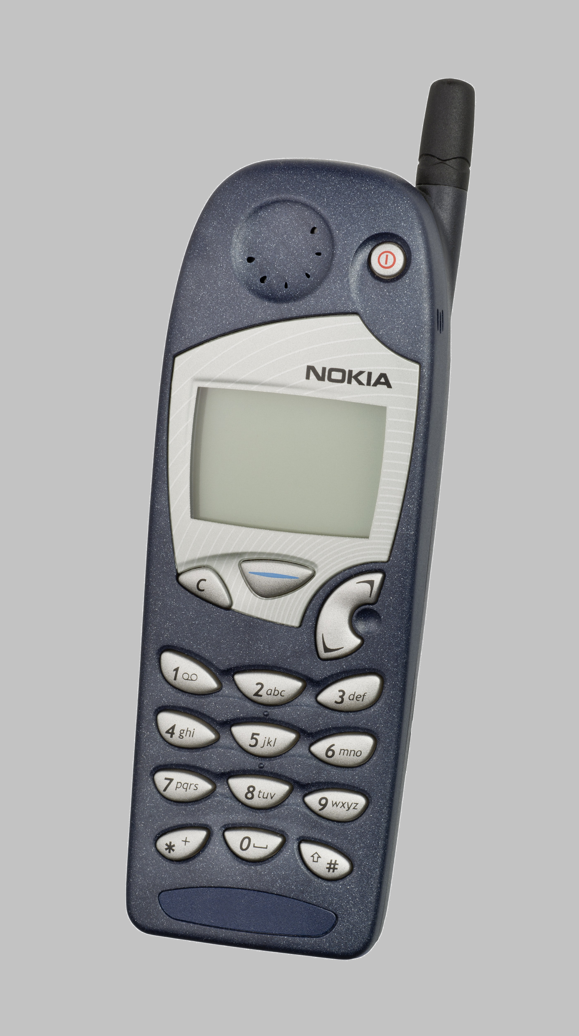

Evolution of the NSRS
NAD27
NAD83 (1986)
NAD83 (2011)
Notes:
My way of visualizing the evolution of the NSRS
NAD27
-like the dial of a rotary phone, you were out there spinning a theodolite around, running resections and solar shots to get a position… am I right?
-and you’d get a position, but it might not be that great, and if you set a mark then everybody wanted your data, like sharing the old party lines
NAD83(1986)
-we brought in a more accurate network, it was easier to access
-you were using an early total station and data collector, just like pushing the buttons on a touchtone phone
NAD83(2007/2011)
-the network was maturing with more CORS just like the cell towers
-just as cell phones were becoming ubiquitous, so too was the use of OPUS

Slide 25
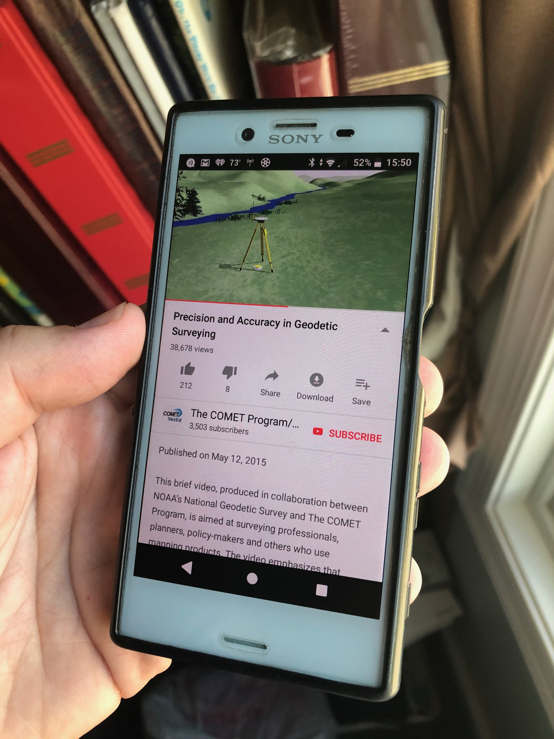
Modernized NSRS is our “smartphone”
You resisted it for a while…
It was a little cumbersome to get used to…
But you were soon hooked!
Notes:
-so if you think about the NSRS that way, then NATRF2022 is our smartphone, in more ways than one, right?
-some folks were excited to get a smartphone, but some (show of hands?) were reluctant to embrace the idea… kind of like this whole NSRS Modernization deal huh?
-some of us are excited for this development and some folks, well some are ready to retire as soon as NGS rolls this out, am I right?

Slide 26
Two Major Components of Modernized NSRS
Geometric (LLh)
Geopotential (H)
Notes:
-geometric component is latitude, longitude, and ellipsoid height
-geopotential component is combined with the geometric components to calculate an ortho height or capital H

Slide 27
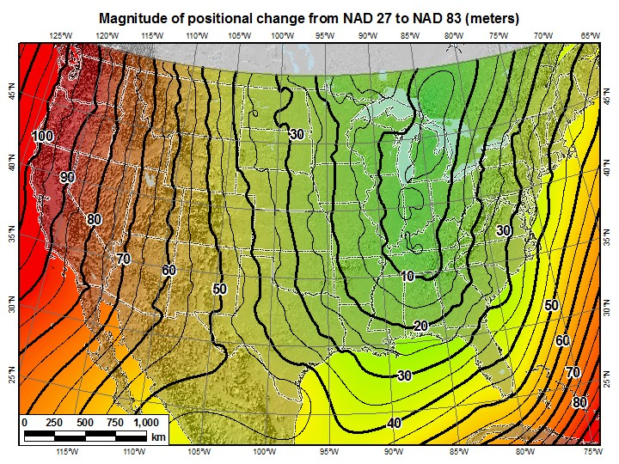
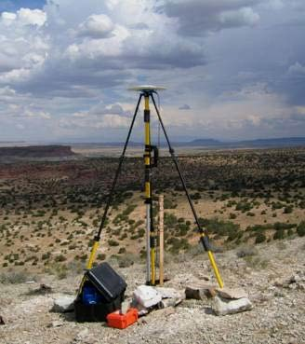
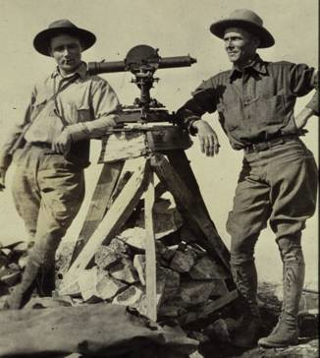
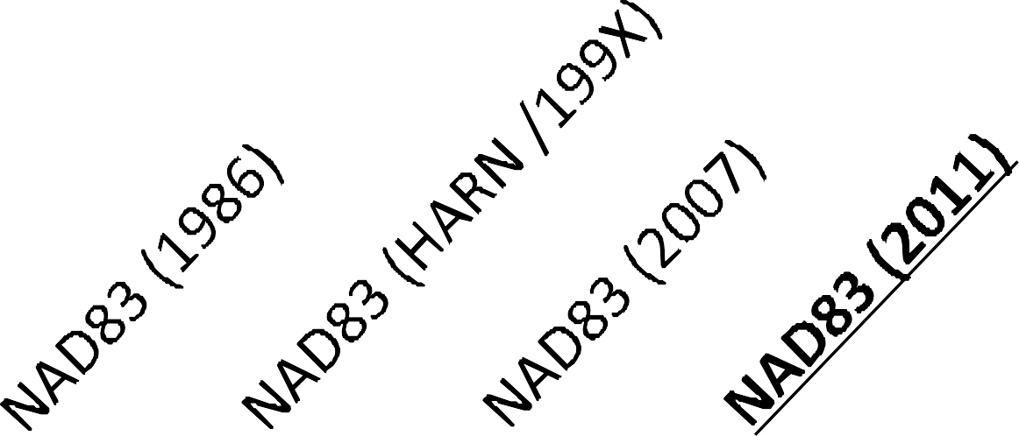
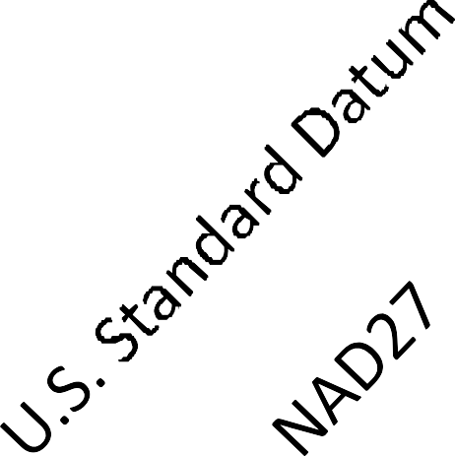
A very brief history of U.S. horizontal & geometric datums
GNSS
triangulation
NATRF2022
+
+
+
+
+
+
time
tens of meters
few 0.1m
few 0.01m
few 0.01m
<10 m
<2m
shift
Notes:
-so you can see the change from USSD to NAD27 was under 10 meters mostly
-then look at the change from NAD27 to 83, tens of meters…why because we switched the origin from where??
-Meade’s Ranch Kansas…
-to… Center Mass of the earth
-then it was just iterative improvements as new realizations of NAD83 were published
**-NAD83(2011) was more about maintaining alignment with CORS than making accuracy improvements
-so based on that, anyone know why we have such a comparably large shift moving to NATRF2022??? … shifting Center Mass again!

Slide 28
North American Terrestrial Reference Frame of 2022
NATRF2022 - pronounced: nat-ref
Pacific Terrestrial Reference Frame of 2022
PATRF2022 - pronounced: pat-ref
Caribbean Terrestrial Reference Frame of 2022
CATRF2022 - pronounced: cat-ref
Mariana Terrestrial Reference Frame of 2022
MATRF2022 - pronounced: mat-ref
Notes:
-We refer them as “plate-fixed” because the frame moves with the plate, to minimize time-based coordinate shift. We’ll cover that in more detail, I have some slides I put together that I guarantee you’ll understand it, if not I’ll buy you a beer later. No, not really.

Slide 29
The wrong question, circa 2022:
“What’s the position of that point?”
The right question, circa 2022:
“What’s the position of that point, on some specific date?”
Drift…
Notes:
-why??
-because of that word down there: drift

Slide 30
North American Terrestrial Reference Frame of 2022
NATRF2022
I will use NATRF2022 as my examples, but same applies for each TRF.

Slide 31
Reference Frame ≈ Datum
Reference Frame is a more scientifically appropriate way of saying “datum”
could be debated that “datum” was misused
you will continue to see NGS use the phrase “New Datums” for 2022
Notes:
-for sanity and brevity’s sake…
-could be debated that “datum” was misused for many years in ellipsoidal coordinates
-even though the geometric/horizontal portion will officially be titled a “reference frame”

Slide 32
Reference Frame Defined
A point of view or a ‘frame of reference’.
If your reference frame is North America, you are standing somewhere within North America, seeing how other places move from your point of view.
Notes:
--Also table/podium example

Slide 33
Replacing NAD83
develop four "plate-fixed" reference frames
remove non-geocentricity of NAD83
align to ITRF2014 at epoch 2020.00
remove most of tectonic plate rotation from ITRF2014 via Euler Pole Parameters
(pronounced: “oiler”)
Shift and Drift…
Notes:
-four geodetic tasks to this part of modernizing the NSRS
-note that afterthought at the bottom “shift and drift”

Slide 34
Replacing NAD83
develop four "plate-fixed" reference frames
remove non-geocentricity of NAD83
align to ITRF2014 at epoch 2020.00
remove most of tectonic plate rotation from ITRF2014 via Euler Pole Parameters
(pronounced: “oiler”)
Shift and Drift…

Slide 35
Four “Plate-Fixed” Reference Frames
North American Terrestrial Reference Frame of 2022
(NATRF2022)
Pacific Terrestrial Reference Frame of 2022
(PATRF2022)
Caribbean Terrestrial Reference Frame of 2022
(CATRF2022)
Mariana Terrestrial Reference Frame of 2022
(MATRF2022)
Notes:
-We refer them as “plate-fixed” because the frame moves with the plate, to minimize time-based coordinate shift. We’ll cover that in more detail, I have some slides I put together that I guarantee you’ll understand it, if not I’ll buy you a beer later. No, not really.

Slide 36
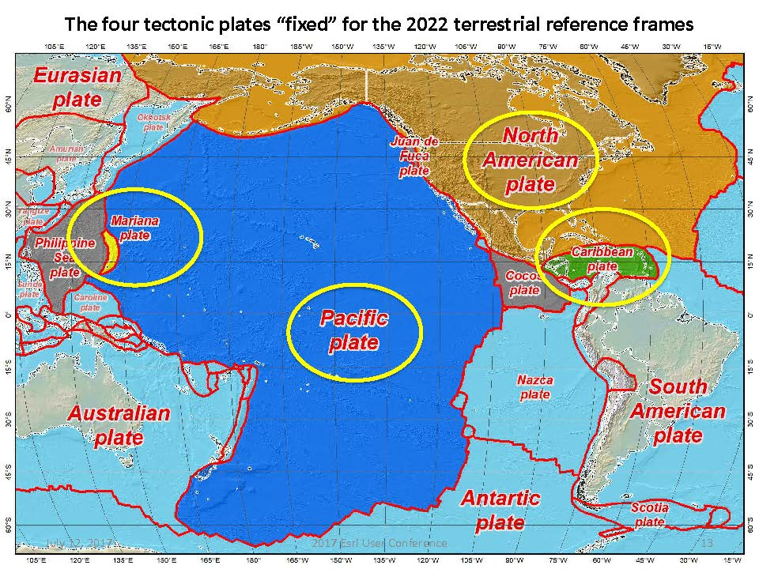
Notes:
-there’s four reference frames because there are four major tectonic plates within the NGS Area of Responsibility.
-As the National Geodetic Survey, we’re part of the DoC so we must cater to all US States and Territories
-thus we’ve got four tectonic plates in our Area of Operations, so four Ref Frames
-But…

Slide 37
Replacing NAD83
develop four "plate-fixed" reference frames
remove non-geocentricity of NAD83
align to ITRF2014 at epoch 2020.00
remove most of tectonic plate rotation from ITRF2014 via Euler Pole Parameters
(pronounced: “oiler”)
Shift and Drift…
Notes:
-NON-geocentricity… well the goal was a geocentric NAD but it was the 80s, so they were off a little bit

Slide 38
Non-geocentricity of NAD83
Earth’s
Surface
h₁₄
h₈₃
NAD83
origin
ITRF2014
origin
~2.2 meters
GRS80
ellipsoid
Notes:
-picture this, there’s one quarter of an ellipsoid, notice they are the same geometry (size, shape) but different origin

Slide 39
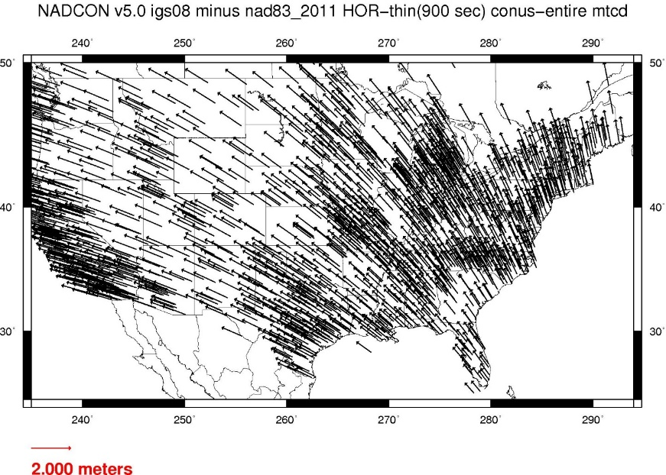
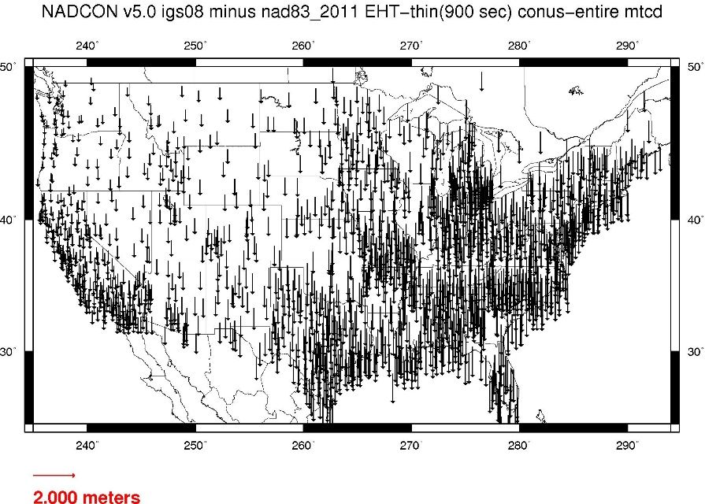
Geometric change due to ellipsoid non-geocentricity
Horizontal (Lat, Lon)
Ellipsoidal (h)
Shift…
Notes:
-Estimate of shift from NAD83(2011) epoch 2010.00 to NATRF2022 epoch 2020.00
-so this represents the positional shift due to non-geocentricity that we’re addressing/fixing
-now remember this is the Geometric component only, so the graphic on the right illustrates a somewhat constant shift because it is representing Ellipsoidal shift, not Orthometric
-Look at the size of those arrows, based on the scale bar there we’re looking at about 1 meter-ish lat,lon shift and somewhere around the same ellipsoidally around here
-REMEMBER, this is easy to address compared to geoid/ortho heights!

Slide 40
Replacing NAD83
develop four "plate-fixed" reference frames
remove non-geocentricity of NAD83
align to ITRF2014 at epoch 2020.00
remove most of tectonic plate rotation from ITRF2014 via Euler Pole Parameters
(pronounced: “oiler”)
Shift and Drift…
Notes:
We’ll talk about that ‘plate fixed’ later.
Now wait a minute Jeff, what is the IGS? You just explained the ITRF and told us about that!!
IGS Reference Frame is pretty much equivalent to the ITRF, created by the Intl. GNSS Service, of which NGS is a contributing partner.
The Intl. GNSS Service, let’s take a look at their website for a minute.
-pronounced “oiler” poles

Slide 41
International Terrestrial Reference Frame
The stable coordinate system that allows us to measure change over space, time and evolving technologies.
An accurate, stable set of station positions and velocities.
Network measurements interconnected by co-location of different space geodetic techniques.
“Approximately represents the motions of the tectonic plates with respect to the Earth's deep interior”… huh?
Notes:
What is the International Terrestrial Reference Frame
(ITRF)?
You’ve heard me mention the ITRF, but if you’ve been paying attention to OPUS Solution Reports you may’ve noticed the ITRF2014 coordinates over on the right hand side
Let’s try to visualize the ITRF. Last bullet,

Slide 42
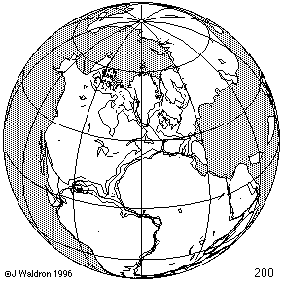
ITRF concept
Watch the grid!
Drift…
Notes:
Most simplistic way to explain ITRF is to watch this animation.
This is a very loose representation/visualization of what the ITRF is, a characterization only.

Slide 43
Replacing NAD83
develop four "plate-fixed" reference frames
remove non-geocentricity of NAD83
align to ITRF2014 at epoch 2020.00
remove most of tectonic plate rotation from ITRF2014 via Euler Pole Parameters
(pronounced: “oiler”)
Shift and Drift…
Notes:
We’ll talk about that ‘plate fixed’ later.
Now wait a minute Jeff, what is the IGS? You just explained the ITRF and told us about that!!
IGS Reference Frame is pretty much equivalent to the ITRF, created by the Intl. GNSS Service, of which NGS is a contributing partner.
The Intl. GNSS Service, let’s take a look at their website for a minute.
-pronounced “oiler” poles

Slide 44
Two types of drift
Tectonic Plate Rotation
    horizontal
Everything Else
    residual motions left after rotation
    regional linear motions
    localized subsidence or uplift
simple to model
complex
Notes:
-there’s two types of drift you’ll see

Slide 45
Tectonic Plate Rotation
    horizontal
simple to model
Notes:
-there’s two types of drift you’ll see

Slide 46
Euler Pole Parameters
of 2022
EPP2022

Slide 47
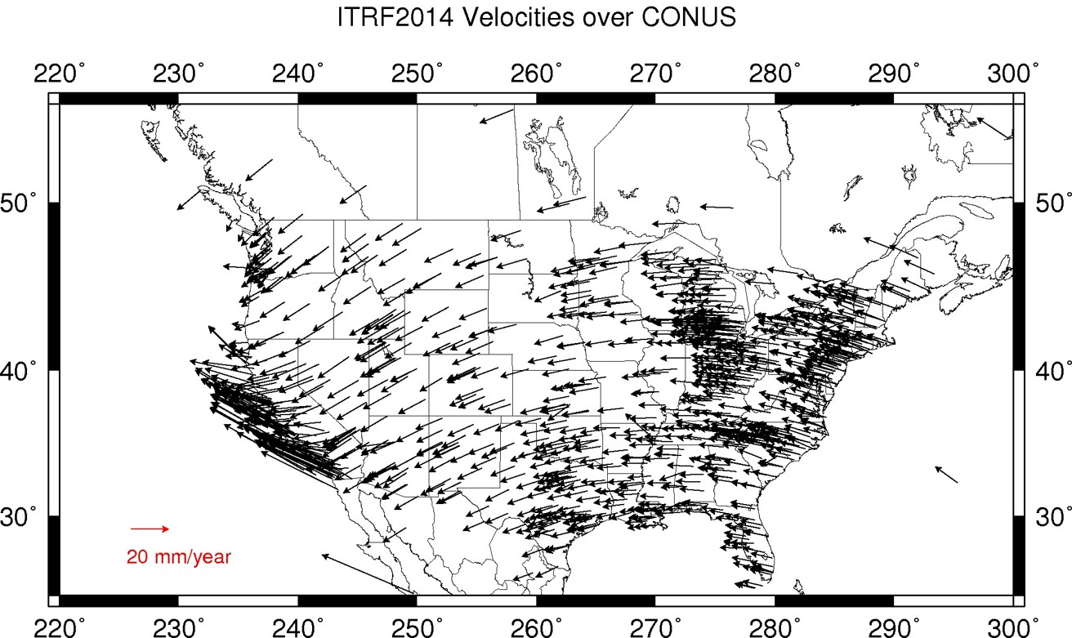
Plate Rotation visualized
Drift…
Notes:
-these are ground-level horizontal velocities
-the arrows illustrate the positions and velocities of CORS plotted in ITRF2014
-our scale is on the left there, with that arrow representing 20mm of motion per year
-so right thru Ohio it’s a little cluttered but we’re seeing arrows about that length so about 2cm/20mm per yr
-what do we notice about the direction of these arrows?
-they look rotational, don’t they?
CLICK HERE
-Note the arrows in California do not conform to the rotation… those are CORS on a different PLATE which is moving in a different direction
CLICK HERE
-so when you look at those arrows you can see the rotation, but the point of rotation is obviously off the map, way down below the screen right?
-that point is what’s known as an Euler Pole

Slide 48
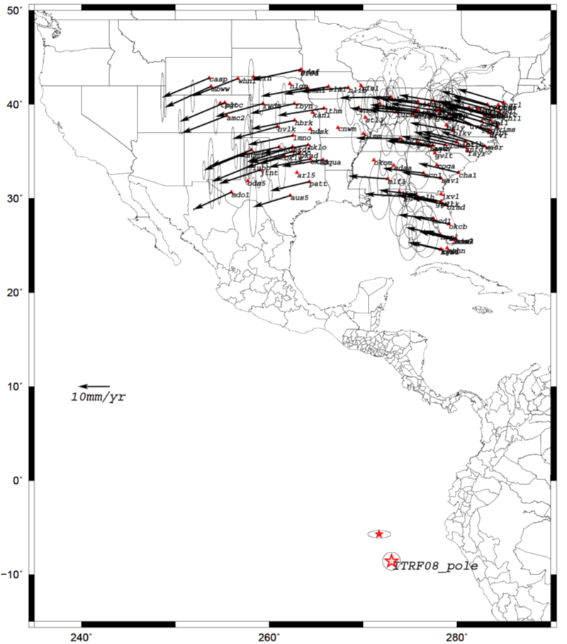
Euler Poles and “Plate-Fixed”
  In the ITRF, many tectonic plates have a dominant motion: rotation
  Euler Pole - point about which a plate rotates (yellow star)
NATRF2022 Euler Pole
Notes:
We say “NATRF2022” is “fixed” to the N.A. Plate, making it a “plate fixed” frame
-the frame is constant to itself, but rotating within ITRF, and moving in a different direction than the other 3 frames

Slide 49
Euler Poles and “Plate-Fixed”
ITRF
Frame = constant
NA Plate = rotating
NATRF
Frame = rotating
NA Plate = constant
Notes:
We say “NATRF2022” is “fixed” to the N.A. Plate, making it a “plate fixed” frame
-the frame is constant to itself, but rotating within ITRF, and moving in a different direction than the other 3 frames

Slide 50
Euler Poles and “Plate-Fixed”
ITRF
Frame = constant
NA Plate = rotating
NATRF
Frame = rotating
(relative to ITRF)
NA Plate = constant
(relative to NATRF2022)
Notes:
We say “NATRF2022” is “fixed” to the N.A. Plate, making it a “plate fixed” frame
-the frame is constant to itself, but rotating within ITRF, and moving in a different direction than the other 3 frames

Slide 51
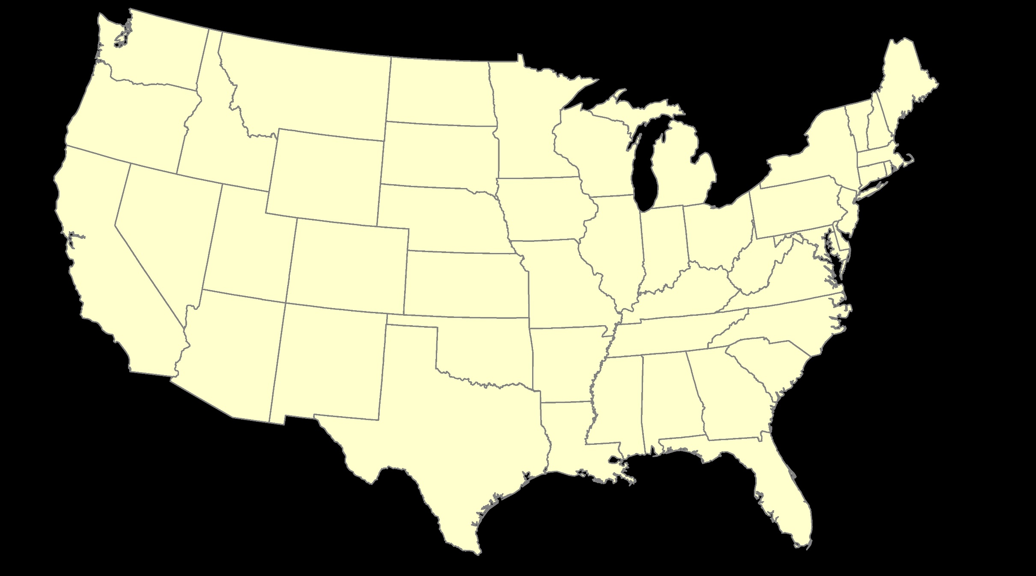
ITRF – constant frame, rotating plate

Slide 52
“Plate-Fixed”
NATRF – rotating frame, constant with plate

Slide 53
ITRF or NATRF – your choice, just use EPP

Slide 54
EPP – Euler Pole Parameters
Latitude
Longitude
Rotation Speed
yellow star off west coast of S. America
Notes:
-our EPP are that green arrow from the last slide
-the lat,lon being the good ol’ yellow star from a few slides ago

Slide 55
CORS Velocities in ITRF2014
Drift…

Slide 56
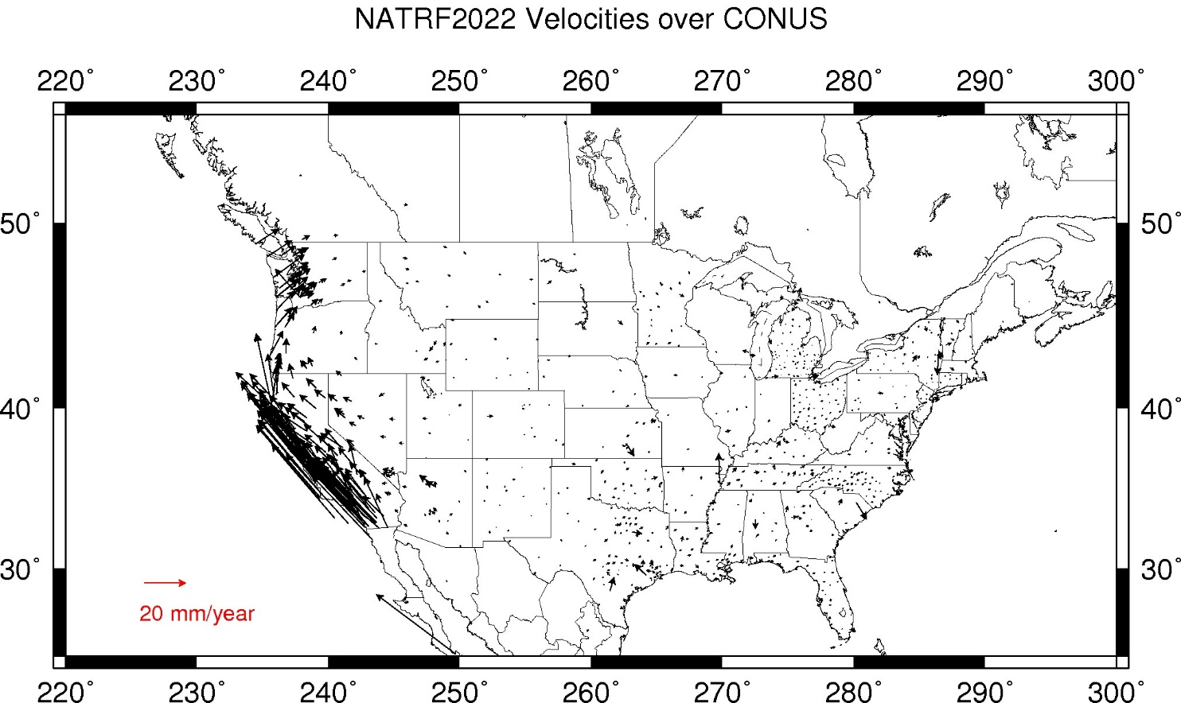
CORS Velocities in NATRF2022
Think of this map as ITRF2014 + EPP2022
Still SomeDrift…
Notes:
These velocities the motion that is left after removing Euler Pole rotation via it’s defining parameters, known simply as Euler Pole Parameters or EPP
These small bare visible arrows in our region are residual velocities leftover after modeling that Euler pole, which will then be modeled into the IFVM for NATRF2022.

Slide 57
ITRF2014 + EPP2022 = --TRF2022
Rotation of the
North American Plate
North American Terrestrial Reference Frame of 2022
(NATRF2022)
Caribbean Terrestrial Reference Frame of 2022
(CATRF2022)
Pacific Terrestrial Reference Frame of 2022
(PATRF2022)
Mariana Terrestrial Reference Frame of 2022
(MATRF2022)
Rotation of the
Caribbean Plate
ITRF2014
Rotation of the
Pacific Plate
Rotation of the
Mariana Plate
EPP2022
Notes:
-So it all starts with ITRF
-OPUS is already running all your processing in ITRF, take a look at one of your recent solution reports and you’ll see ITRF2014 coordinates on the right hand side (or IGS/IGb08)
-Not just North America, Each plate gets a set of EPP associated with it, as each plate is rotating around a different Euler Pole

Slide 58
Two types of drift
Tectonic Plate Rotation
    horizontal
Everything Else
    residual motions left after rotation
    regional linear motions
    localized subsidence or uplift
simple to model
complex
Notes:
-there’s two types of drift you’ll see

Slide 59
Everything Else
    residual motions left after rotation
    regional linear motions
    localized subsidence or uplift
Still SomeDrift…
complex
Notes:
-there’s two types of drift you’ll see

Slide 60
Intra-Frame Velocity Model of 2022
IFVM2022

Slide 61
Concept of goal of IFVM
Longitude (Easting) History of DI4044
Trend: -1.7 mm / year
RED IS NATRF2022
COORDINATE
Still Some Drift…
Trend: -14.3 mm / year
BLUE IS ITRF COORDINATE
2004 2006 2008 2010 2012 2014 2016 2018
Notes:
First look at that blue line, that is the velocity of DI4044 if we graph it’s easting coordinate in ITRF over 10+ years.
So look at the reddish line, that’s the longitude/easting of PID DI4044 after the EPP (rotation) is modeled and factored in, but before the IFVM is applied.
This is the velocity of the point in NATRF2022
Rotation of plate removed. It is not constant because the point still suffers small “intra-frame” velocities.
Such IFVs will be captured in a model by NGS.
The intent of the IFVM is to remove even that movement to better support coordinate comparisons, etc.

Slide 62
CORS Velocities in NATRF2022
Think of this map as ITRF2014 + EPP2022
Still SomeDrift…
Notes:
These velocities the motion that is left after removing Euler Pole rotation via it’s defining parameters, known simply as Euler Pole Parameters or EPP
These small bare visible arrows in our region are residual velocities leftover after modeling that Euler pole, which will then be modeled into the IFVM for NATRF2022.

Slide 63
Still Some Drift…
  Everything in the world moves
  Coordinates will be associated with the actual date when the data was collected!
  Velocities at all marks can be estimated using the IFVM
  IFVM goal is to move collected data thru time to Reference Epochs for coordinate comparisons/analysis
Notes:
Model of all residual velocities, after removal of tectonic rotation via EPP
Horizontal residual motion
Total vertical motion (ellipsoid heights)
Replaces / Improves upon HTDP

Slide 64
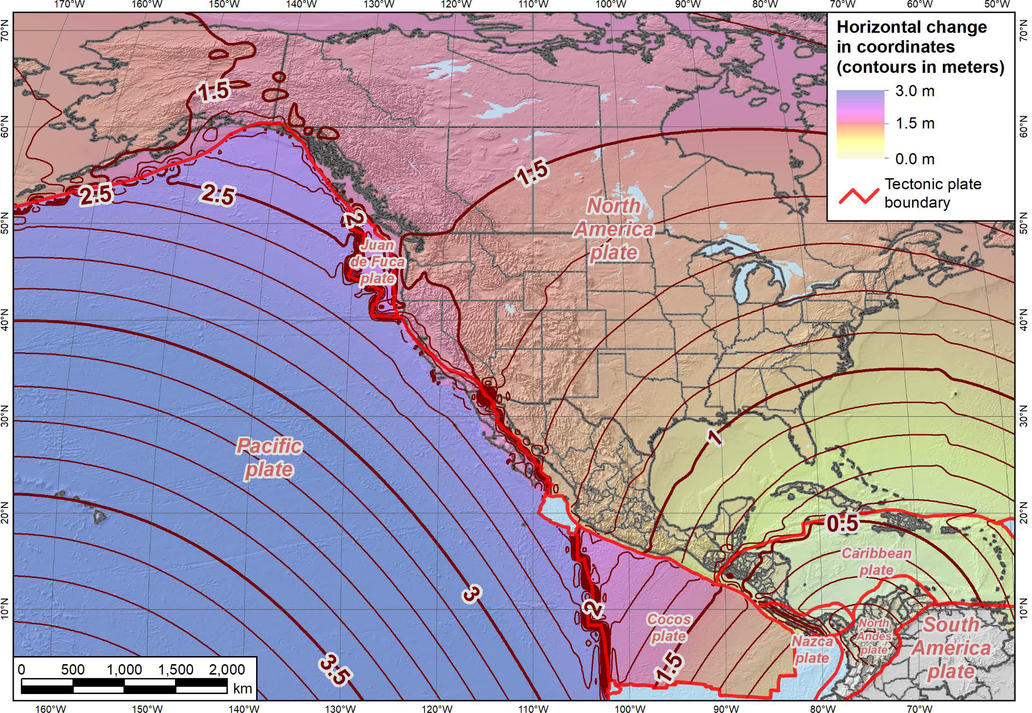
Notes:
-what’s the Magnitude of Horizontal Change?
-we will have tools online to simplify the process of estimating NAD83→NATRF2022
-see the 1.1 and 1.2m contour lines are south and just thru Northern OH, so you’ll see a northwesterly shift of less than 4 feet throughout the vast majority of Ohio, between 3.7 and 4 feet

Slide 65
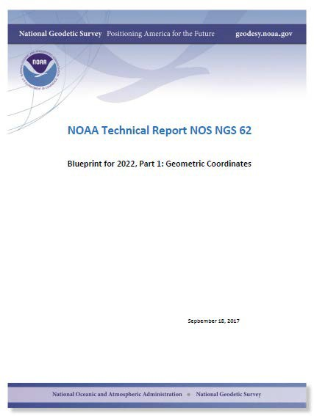
Majority of audience working in stable regions of North America…
North American Terrestrial Reference Frame of 2022
(NATRF2022)
Notes:
-remember, we covered 4 reference frames but if you’re just working in this region, you only have to be concerned with NATRF
-almost everything I’ve covered thus far is in this TR or Technical Report available on our website

Slide 66
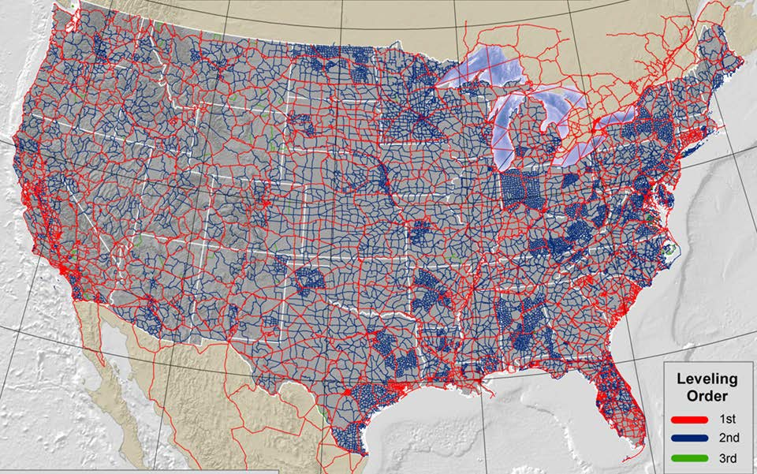
North American-Pacific Geopotential Datum of 2022
NAPGD2022
(pronounced: nap-jee-dee)
Notes:
There’s the NAVD88 leveling network
So… out with the old… and in with the new

Slide 67
Overview of NAPGD2022
North American-Pacific Geopotential Datum
primary access via GNSS + geoid (think OPUS)
continental gravimetric geoid
aligned with:
  --TRF2022
  global mean sea level (GMSL)
monitor time-varying nature of gravity
  via the Geoid Monitoring Service (GeMS)
Notes:
The goal stated in the NGS strategic plan is to achieve 2cm accuracy vertically with a 15 minutes GPS session.
Note the datum will be aligned to global mean sea level, not continental as with previous datums
Like I”d said, the community wants an easier to access, no need to go recover a BM, nationwide datum. GNSS is the most efficient way to accomplish that, which mean geoid-based ortho heights, which means gravity observations.
So let’s talk about that.

Slide 68
Gravity for the Redefinition of the American Vertical Datum
There are two major campaigns within GRAV-D
High-resolution snapshot of gravity
  primarily airborne observations, all relative gravity, covering the US and Territories at an estimated cost of ~$39 million
Low-resolution “movie” of gravity changes
  primarily terrestrial, episodic observations of absolute gravity sites to monitor long-term change
Notes:
-GRAV-D is one of the programs that will make the NSRS modernization possible, the NAPGD2022 relies on it. Really it was GRAVD-D and the NHMP that birthed the new datums.
-airborne gravimetry functions as the bridge for blending terrestrial/surface gravity data with satellite gravity data
-satellite data is global, airborne data is continental, terrestrial/surface is spot-shots or gridded

Slide 69
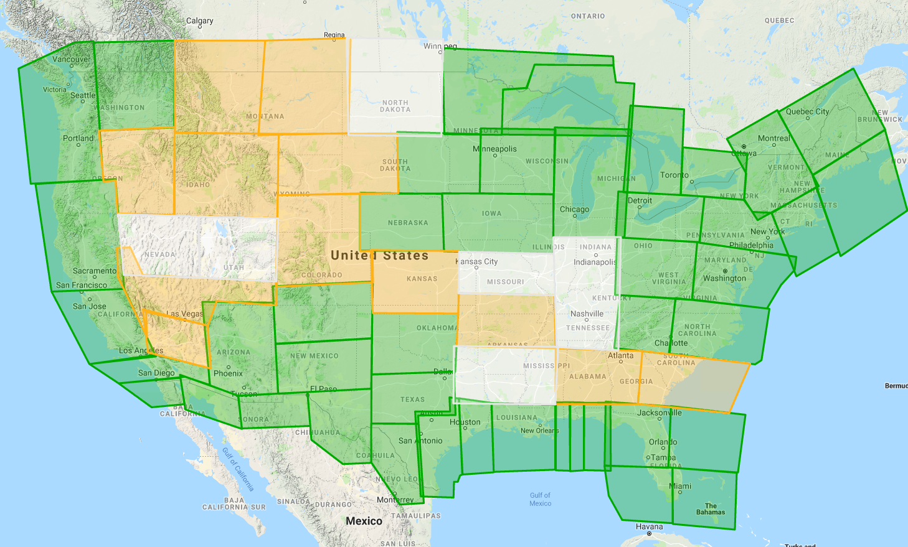
Gravity for the Redefinition of the American Vertical Datum
Green = Complete
Blue = In Processing
Yellow = Underway
White = Planned
10 km data lines
70 km cross lines
20,000 ft altitude
230 kt flight speed
As of AUG2019:
78% complete
Notes:
230 kts = 265 mph
-

Slide 70
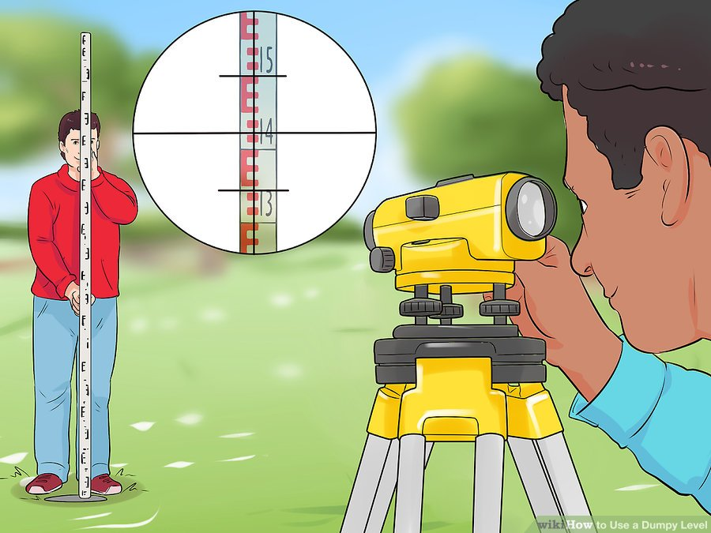
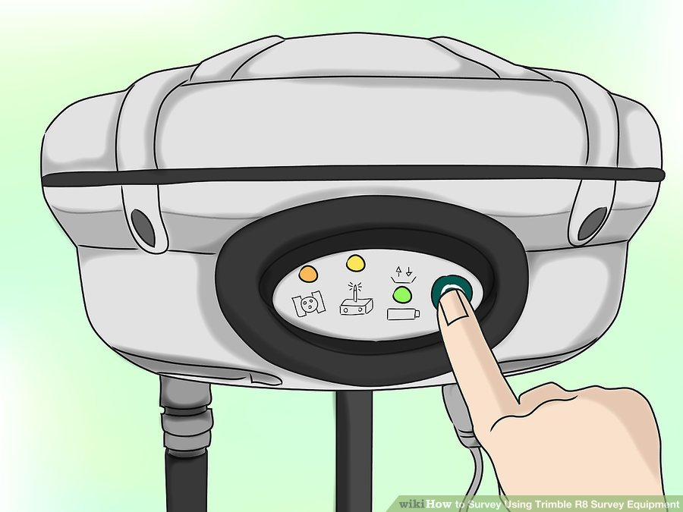
What is a Vertical Datum?
A surface representing zero elevation
A system for determining heights above a zero elevation surface
Thus, a vertical datum is comprised of it’s:
  Definition: parameters and other descriptors
  Realization: the physical method of accessibility
NGVD29 & NAVD88
NAVD88… sort of
leveling
GNSS

Slide 71
What is a Geopotential Datum?
It’s unprecedented, hasn’t really been done before.
In this case, for NAPGD2022, it will be accessed via GNSS.
  No need for leveling to get a direct tie.
  Can still use a level, but GNSS ties will be required.
NAPGD2022
GNSS
Notes:
So let’s move on to a little history of the vertical datums in the NSRS and then cover NAPGD in more detail.

Slide 72
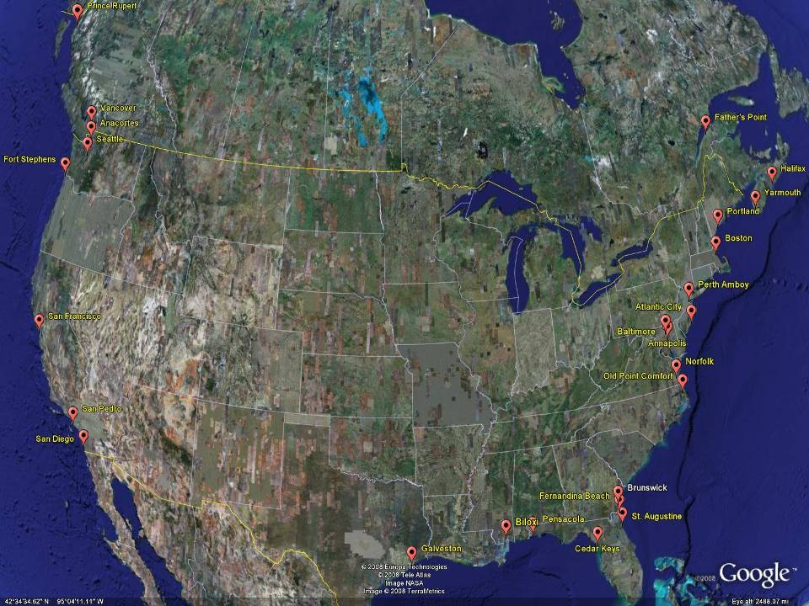
NGVD29
Referenced to 26 tide gauges in the US and Canada
Notes:
It turns out that MSL is a close approximation to another surface, defined by gravity, called the geoid, which is the true zero surface for measuring elevations. Because we cannot directly see the geoid surface, we cannot actually measure the heights above or below the geoid surface. We must infer where this surface is by making gravity measurements and by modeling it mathematically. For practical purposes, we assume that at the coastline the geoid and the MSL surfaces are essentially the same. Nevertheless, as we move inland we measure heights relative to the zero height at the coast, which in effect means relative to MSL.
Definition: NGVD29 – The National Geodetic Vertical Datum of 1929…
The Sea Level Datum of 1929 was the vertical control datum established for vertical control surveying in the United States of America by the General Adjustment of 1929. The datum was used to measure elevation or altitude above, and depression or depth below, mean sea level (MSL).
Mean sea level was measured at 26 tide gauges: 21 in the United States and 5 in Canada. The datum was defined by the observed heights of mean sea level at the 26 tide gauges and by the set of elevations of all bench marks resulting from the adjustment. The adjustment required a total of 66,315 miles (106,724 km) of leveling with 246 closed circuits and 25 circuits at sea level.
Since the Sea Level Datum of 1929 was a hybrid model, it was not a pure model of mean sea level, the geoid, or any other equipotential surface. Therefore, it was renamed the National Geodetic Vertical Datum of 1929 (NGVD 29) in 1973. The NGVD 29 was subsequently replaced by the North American Vertical Datum of 1988 (NAVD 88) based upon the General Adjustment of the North American Datum of 1988.

Slide 73
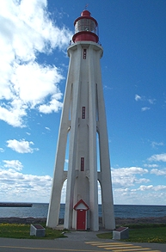
Referenced to a single tide gauge in Canada
Why one gage fixed this time?
removed local sea level variation problem of NGVD29
But it did introduce possibility of cross-continent error build-up…
Father Point Lighthouse, Quebec
Notes:
Definition: The surface of equal gravity potential to which orthometric heights shall refer in North America
One height held fixed [at 6.271 meters along the plumb line below the geodetic mark] at “Father Point” (Rimouski, Canada).
By fixing the geopotential value at the origin point, it was possible to ensure that the origins of IGLD 85 and NAVD 88 aligned.
But perhaps more importantly, the height chosen was to minimize 29→88 differences on USGS topo maps in the eastern U.S. … thus, the “zero height surface” of NAVD 88 was NOT chosen for its closeness to the geoid (but it was close…few decimeters)
Use of one fixed height removed local sea level variation problem of NGVD 29
*It should be pointed out that while the datum was defined in such a way as to be usable on the North American continent, it was never actually adopted in Canada. It can be used there, but it’s not their official civilian datum.
Note that the designation of the vertical control point at Father Point is “1250 G=NAVD 88 DATUM POINT” for PID# TY5255 and is not available from the publicly accessible NGSIDB.

Slide 74
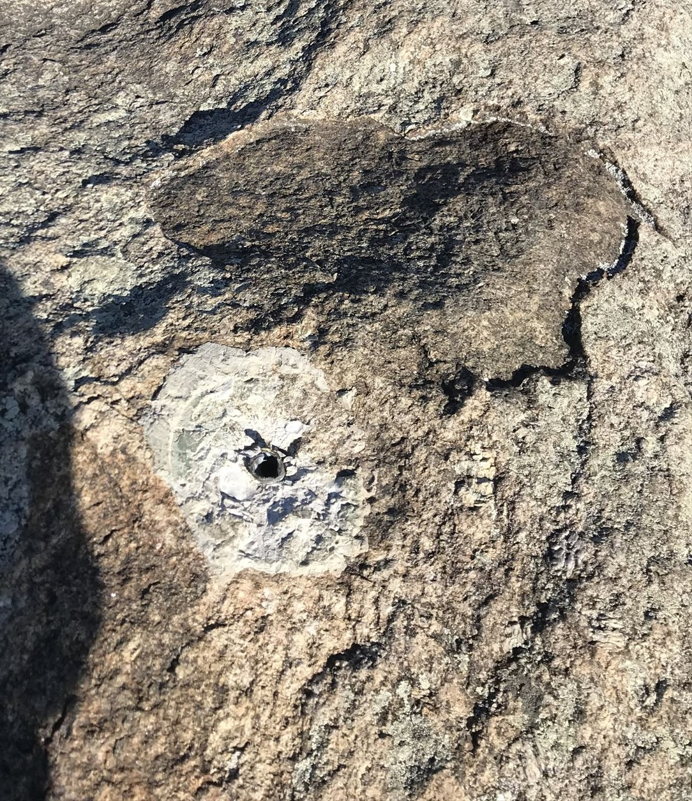

Why Replace NAVD88?
tilt/bias in zero reference surface
subsidence, uplift, freeze/thaw of BMs
limited access, availability of undisturbed marks
Approximate Error in NAVD88 "zero elevation”
Notes:
About 20% (or 90,000 mi.) of the old leveling either is in crustal motion areas or did not fit the new observations. These data, identified as POSTED, will be adjusted separately and the results published in the near future.
Map highlights the tilt/bias to the zero reference surface, that’s another item that was discovered later on with the advent and proliferation of satellite positioning and remote sensing technology.
How was the map created, that is the NAVD88 zero surface (H=0) overlaid onto a satellite based geoid model, then color shaded by vertical difference

Slide 75

Passive marks may lie still… but they still may lie! small instability x long time = large inaccuracy
Notes:
There’s Ms. Michelle Sneed, a hydrologist at USGS, and they’ve done further leveling in the area that observed 6.2 feet of subsidence by 2016.
Another 1 foot plus in 3 years.

Slide 76
Two flavors of geoid models…
  Gravimetric
  Hybrid
Notes:
So… all the geoids you’re using to get elevations from your GNSS data

Slide 77
Gravimetric → Hybrid
  Gravimetric geoid is created from “scratch” with various types of gravity data
      USGG2003, USGG2009, USGG2012, xGEOID19
  Hybrid geoid is simply a gravimetric geoid warped to fit some vertical datum… like NAVD88
      GEOID03, GEOID09, GEOID12B, GEOID18
Notes:
So… all the geoids you’re using to get elevations from your GNSS data

Slide 78
Gravimetric → Hybrid
      USGG2003, USGG2009, USGG2012, xGEOID19
      GEOID03, GEOID09, GEOID12B, GEOID18
best fit to NAVD88
best fit to NAVD88
best fit to NAVD88
best fit to NAVD88
Notes:
So… all the geoids you’re using to get elevations from your GNSS data

Slide 79

Notes:
GNSS Users get an ellipsoid height calculated from GNSS satellite data.
Ultimately we need an orthometric height (height in relationship to the geoid) to know where water will flow
Problem: we need to know the difference between the ellipsoid height and geoid (aka geoid height or undulation)
In the past this geoid height was calculated by NGS using large scale leveling and GNSS campaigns. Then provided to users through a realization of NAVD-88
The new NGS vertical datum North American-Pacific Geopotential Datum of 2022 will be based on gravimetric calculations rather than traditional leveling surveys

Slide 80

Obtaining N_{g} is not easy!
First you need a gravity field (data from diff. distances)
  combine satellite, airborne, terrestrial, ship track data, etc.
Next calculate gravity anomaly, or ∆g
Then, just solve Stokes’ integral!
R is the mean radius of the earth
ɣ0 is mean surface gravity on ellipsoid
S is a geometric function of position
…there’s a catch
Need to know ∆g over entire surface of the earth
Notes:
To get Geoid Heights we need a well defined gravity field with gravity observed at multiple distances away from the earths surface.
Then we can calculate the gravity anomaly (difference between observed gravity and normal gravity). Requires complete coverage of the area you want to model.
Fancy Math happens (Stokes Formula)
Geoid Model provides height correctors at given latitude, longitude and ellipsoid heights.

Slide 81
Obtaining N_{g} is not easy!
First you need a gravity field (data from diff. distances)
  combine satellite, airborne, terrestrial, ship track data, etc.
Next calculate gravity anomaly, or ∆g
Then, just solve Stokes’ integral!
R is the mean radius of the earth
ɣ0 is mean surface gravity on ellipsoid
S is a geometric function of position
…there’s a catch
Need to know ∆g over entire surface of the earth
Notes:
-so… you likely remember this slide from earlier
CLICK
-Let’s get back to that gravity field item there

Slide 82







Building a Geopotential Field Model
Long Wavelengths (> 250 km)
GRACE/GOCE/Satellite Altimetry
+
Intermediate Wavelengths (20km to 300 km)
Airborne Observations
+
Short Wavelengths (< 100 km)
Terrestrial/Surface Observations and Predicted Gravity from Topography
Notes:
-that gravity/geopotential field
-gravity data used to create NAPGD will come from all of these sources
-The airborne observations are all a part of the GRAV-D program already discussed
-A relative gravity campaign of terrestrial was performed countrywide in the early 2000s. It was, as far as I was told, this one dude who just rode around the country hitting up all the major gravity points in the Intl Gravity Standardization Network of 1971.

Slide 83

GRACE – satellite observations
Notes:
-Gravity and Climate Experiment
-2 Satellites measuring separation

Slide 84

GRAV-D – airborne relative observations
Notes:
-last I heard, all GRAV-D flights are in compliance with FAA regulations

Slide 85

Relative Gravimeter – terrestrial obs.
Notes:
CG-6 by Scintrex
Scintrex essentially bought out others
I think it was about 75k when I asked

Slide 86

Absolute Gravimeter – terrestrial obs.
Notes:
Absolute meter, that’s an A-10
Approx 300k

Slide 87

Terrestrial Gravimeters - Absolute & Relative
Notes:
Why are you showing us all this Jeff?
Well, NGS is already getting asked by 3-4 States, including the KYTC, about contributing to the gravity database… which hasn’t even been finalized yet.
I believe that if you’re early on in your career you will have some exposure to the terrestrial gravity survey process.

Slide 88
Individual Components of NAPGD2022
Global Model of the geopotential field
  GM2022
Geoid undulation models by region
  GEOID2022 aka “0 elevation”
Deflection of the Vertical (DoV) models by region
  DEFLEC2022
Surface Gravity models by region
  GRAV2022
Notes:
GM2022 - a spherical harmonic model of Earth’s external gravitational potential (energy)
-these items each will have both a static version and a dynamic version that will be published
So all those models work together to get you a 2cm height with a 15 minutes GNSS session

Slide 89


Slide 90

Sea Level Change and the Geoid
Notes:
Is that what we want? Continuously changing elevations?
No, not many folks anyway. It’s too dynamic for almost everyone’s purposes/

Slide 91

Sea Level Change and the Geoid
Notes:
Is this what we want?
Stable ground elevations even though global water levels are rising?
No, think about flood mapping of coastal areas? This would make it extremely difficult to maintain FEMA NFIP and other flood-related programs.

Slide 92

Sea Level Change and the Geoid
Notes:
The illustrated strategy will be adopted at NGS. Again, a graphic characterization of this approach
What this means is that NGS will adopt Scenario 2, decouple geoid, until the geoid and GMSL have diverged by some threshold amount, currently defined as 20cm.
When that threshold is reached a new geoid will be defined and held fixed until reaching next threshold. In this way, the impact of the change of GMSL is accounted for in the heights of the NSRS, while the appearance of stability is maintained for “decades at a time” (BP2 Section 14).
If we calculate how long that might be based on existing rates of sea level rise of 3ish mm/yr then we’re talking about easily 50 years

Slide 93

Estimated change in orthometric heights from NAVD88 to NAPGD2022
(NAPGD2022 approximated using xGEOID16B)

Slide 94
Estimated change in orthometric heights from NAVD88 to NAPGD2022
(NAPGD2022 approximated using xGEOID16B)
Great Lakes: vertical change of about -1.3 to -2.0 feet
Notes:
Previously estimated values are matching xGEOIDs!
I have that estimate down there, and that’s true except for that little area, not sure what that’s all about, hard to get answers from the Geoid Team since the shutdown. They’re behind schedule but working frantically to get back on track.

Slide 95

North American-Pacific Geopotential Datum of 2022
(NAPGD2022)
Notes:
-I already mentioned Blueprint Part 1, geopotential coordinates are covered in detail oin Blueprint part 2
-also easy to find on our website

Slide 96
How can surveyors prepare?
Research your published control
    pre-1995 will NOT get new coordinates (GPS only)
Use OPUS Projects to re-observe/process
Set/occupy RTN Validation Stations (OPUS)
Get familiar with terms, ask now, be ready
Notes:
-dam sites (flood risk management and navigation) are perfect candidates
-retain central and local parameters…if you lose the parameters you’re screwed
-doesn’t require familiarity with the sites to design the projections, just analysis
-NGS is committed to having a tool in the Modernized NSRS in which users upload a set of projection parameters for OPUS solutions or other
**that tool will not be online in conjunction with 2022 rollout, it is lower on the priority list
-what’s the goal in this? to minimize the difference between grid and ground coordinates and distances, ideally to the point of being small enough to ignore.

Slide 97
How can GIS experts prepare?
start thinking about epochs/dates
Consider how you will store epoch dates
Maps in ITRF2014 for LLh changes
download xGEOID for elevation changes
  could make difference maps
Get familiar with terms, ask now, be ready
Time dependency - some datasets will be good with transformations (example NID)
Notes:
-dam sites (flood risk management and navigation) are perfect candidates
-retain central and local parameters…if you lose the parameters you’re screwed
-doesn’t require familiarity with the sites to design the projections, just analysis
-NGS is committed to having a tool in the Modernized NSRS in which users upload a set of projection parameters for OPUS solutions or other
**that tool will not be online in conjunction with 2022 rollout, it is lower on the priority list
-what’s the goal in this? to minimize the difference between grid and ground coordinates and distances, ideally to the point of being small enough to ignore.

Slide 98
How will LDPs affect USACE?
Low Distortion Projections (in SPCS2022)
Dam sites are ideal candidates
Retain parameters in U-SMART
Could centralize design process
User-based projections in Modernized NSRS
Minimize difference b/w grid and ground
If States implement, use & reap the benefits
Notes:
-dam sites (flood risk management and navigation) are perfect candidates
-retain central and local parameters…if you lose the parameters you’re screwed
-doesn’t require familiarity with the sites to design the projections, just analysis
-NGS is committed to having a tool in the Modernized NSRS in which users upload a set of projection parameters for OPUS solutions or other
**that tool will not be online in conjunction with 2022 rollout, it is lower on the priority list
-what’s the goal in this? to minimize the difference between grid and ground coordinates and distances, ideally to the point of being small enough to ignore.

Slide 99

US Survey Foot
and
International Foot
…or Feets Don’t Fail Me Now

Slide 100
The problem
Two versions of same unit in current use
  “New” international foot and “old” U.S. survey foot
  “New” shorter than “old” by 2 ppm (0.01 ft per mile)
  A real problem with real costs
What’s in a name?
  “U.S. survey” versus “international”
Who is using U.S. survey feet?
  Surveyors exclusively, in most (not all) states
  But it impacts everyone
Notes:
It’s likely everyone watching this webinar knows about the problem: there are two nearly identical versions of the foot in current use in the U.S.;
They differ by 2 parts per million (ppm), or only 0.01 ft per mile, or slightly more than a tenth of an inch in a mile.
Despite (or actually because of) the very small difference, it has become a REAL problem with REAL costs.
What’s in a name? That which we call a “foot” by any other word would smell as… sweet? Maybe that’s not he best analogy for the foot…
“U.S. survey foot” sounds patriotic, is surveyor-centric…
“International foot” sounds like a New World Order, UN sanctioned sort of thing, with perhaps a whiff of socialism…
Is the name really part of the problem? I hope not, but emotion does play a role. We are not entirely rational creatures after all (myself included).
Surveyors are really the only users of the U.S. survey foot (sft). They are also among the very few who even know of its existence. In schools and colleges they only teach students about the official international foot (ift). However, because people use the products created by surveyors, they end up using the sft without even knowing it.
Want to have a conversation about this, get all of us on the same page. So I will present facts to facilitate informed discussion (sprinkled with some opinions…)

Slide 101

2 parts per million (ppm)
1,000,000.00 sft = 999,998.00 ift
10,000,000.00 sft = 9,999,980.00 ift
International → 1 ft = .3048 m
US → 1 ft = .30480061 m (approx.)
  frequently calculated by $\frac{1200}{3937}$
Notes:
It’s likely everyone watching this webinar knows about the problem: there are two nearly identical versions of the foot in current use in the U.S.;
They differ by 2 parts per million (ppm), or only 0.01 ft per mile, or slightly more than a tenth of an inch in a mile.
Despite (or actually because of) the very small difference, it has become a REAL problem with REAL costs.
What’s in a name? That which we call a “foot” by any other word would smell as… sweet? Maybe that’s not he best analogy for the foot…
“U.S. survey foot” sounds patriotic, is surveyor-centric…
“International foot” sounds like a New World Order, UN sanctioned sort of thing, with perhaps a whiff of socialism…
Is the name really part of the problem? I hope not, but emotion does play a role. We are not entirely rational creatures after all (myself included).
Surveyors are really the only users of the U.S. survey foot (sft). They are also among the very few who even know of its existence. In schools and colleges they only teach students about the official international foot (ift). However, because people use the products created by surveyors, they end up using the sft without even knowing it.
Want to have a conversation about this, get all of us on the same page. So I will present facts to facilitate informed discussion (sprinkled with some opinions…)

Slide 102
What’s impacted?
When does this matter?
  Not typically in lengths/distances
  Published planar coordinate systems
    large false eastings and northings
Like what?
  SPCS and UTM are very popular and both fall victim to mix-ups due to large false eastings and/or northings
Notes:
It’s likely everyone watching this webinar knows about the problem: there are two nearly identical versions of the foot in current use in the U.S.;
They differ by 2 parts per million (ppm), or only 0.01 ft per mile, or slightly more than a tenth of an inch in a mile.
Despite (or actually because of) the very small difference, it has become a REAL problem with REAL costs.
What’s in a name? That which we call a “foot” by any other word would smell as… sweet? Maybe that’s not he best analogy for the foot…
“U.S. survey foot” sounds patriotic, is surveyor-centric…
“International foot” sounds like a New World Order, UN sanctioned sort of thing, with perhaps a whiff of socialism…
Is the name really part of the problem? I hope not, but emotion does play a role. We are not entirely rational creatures after all (myself included).
Surveyors are really the only users of the U.S. survey foot (sft). They are also among the very few who even know of its existence. In schools and colleges they only teach students about the official international foot (ift). However, because people use the products created by surveyors, they end up using the sft without even knowing it.
Want to have a conversation about this, get all of us on the same page. So I will present facts to facilitate informed discussion (sprinkled with some opinions…)

Slide 103




Who is responsible for standards?
National Institute of Standards and Technology
Notes:
Today, the National Institute of Standards and Technology (NIST) is responsible for defining and establishing standards. It is within their authority.
NIST is a bureau of the Department of Commerce (DOC)
The National Oceanic and Atmospheric Administration (NOAA) is also a bureau of DOC.
The National Geodetic Survey (NGS) is a program office in NOAA. It’s actually within the National Ocean Service (NOS) in NOAA.
It may seem odd to show NGS here along with NIST, but there is a reason for it, as you will soon see.

Slide 104
Adopted International Foot in 1959
1 foot = 0.3048 meter exactly (1 yard = 0.9144 m)
New foot definition adopted by NASA predecessor
National Bureau of Standards created
Adopted as “new” foot for entire U.S.
1901
1933
1952
1954
1959
With one little exception…
New foot definition adopted by ANSI predecessor
International nautical mile
1,852 m exact
Notes:
With increasing measurement precision and global trade, it became necessary to adopt a more precise definition of the foot, and one that agreed with international usage.
A motivation for a new definition of the foot was in gage-block standardization for precise machine shop work used by industry. It was a practical solution to a practical problem. Note this has nothing whatsoever to do with surveying.
The new (international) foot definition was 1 ft = 0.3048 m (exact), and is the same to this day (it will not change). The adoption of the ift was a gradual process (as such things often are):
1959. NSB officially adopts ift for the entire U.S., with one little notable exception…

Slide 105
With one little exception…
“Any data expressed in feet derived from and published as a result of geodetic surveys within the United States will continue to bear the following relationship as defined in 1893: 1 foot = 1200/3937 meter
The foot unit defined by this equation shall be referred to as the U.S. Survey Foot and it shall continue to be used, for the purpose given herein, until such a time as it becomes desirable and expedient to readjust the basic geodetic survey networks in the United States, after which the ratio of a yard, equal to 0.9144 meter, shall apply.”
Notes:
Federal Register Notice (1959) establishing ift and (temporary) sft
Official adoption of ift (1 ft = 0.3048 m) nationwide.
Temporary exception granted for geodetic surveys (including State Plane coordinates), to accommodate C&GS.
Mandates that ift shall be adopted after readjustment of U.S. geodetic network. This is not a “recommendation” or a “suggestion.” At the time this was published, “shall” was used in legal documents as mandatory (nowadays the usage of “shall” as mandatory is discouraged in legal documents).
Co-issued and signed by NBS and C&GS directors.
This FRN delayed full adoption of the ift, and promoted continued use of the sft for all surveying (not just geodetic surveys), and it is how we got into the situation we are in today.

Slide 106
More Federal Register Notices
Surveying and mapping only (pending analysis, never resolved)
Proposed permanent use of U.S. Survey Foot
Restatement that metric used for U.S.
International vs. U.S. Survey Foot
1975
1977
1988
1989
1990
NGS goes entirely metric (for NAD 83)
NAD 83 announced
We readjusted the basic geodetic network!
Notes:
Other FRNs relevant to the ift vs. sft issue:
1975. states that the ift is used for “engineering” and the sft is used for “mapping and land measurement”, which by itself creates problems (since engineering and surveying are often done together for projects, so which should be used?).
1977. NGS policy on publication of plane coordinates based on NAD 83, stating that NGS will officially adopt the metric system. This effectively (but probably inadvertently) allowed NGS to side step the requirement of ending use of the sft, as required in the 1959 FRN.
NOTE: In the webinar, I inadvertently mischaracterized the 1975 FR as saying the ift was “exact” and the sft was “approximate.” What that FRN actually says is that conversions in a previous (1968) FRN were only for the ift, and were therefore approximate for sft conversions. The 1975 FRN provides the exact sft conversions as a correction/clarification to the 1968 FRN. My apologies for any confusion this may have caused.

Slide 107
NGS proposal
Only one foot after 2022 (1 foot = 0.3048 meter)
  Make official through NIST
  NO option for U.S. survey foot
NGS will help with the transition
  Will fully support backward compatibility
  Use “correct” foot for SPCS 83 and SPCS 27
  Automatically done by NGS products and services
Guiding ideas
  Of all changes in 2022, this is the least significant
  About the future, not the past
Notes:
NGS proposes that there be only ONE official definition of the foot after 2022, and if done will be accomplished through NIST.
Considering getting rid of word “international”, and just call it the “foot” (that is how it is handled in some software, such Esri’s). People just seem to not like the “international” label. Maybe call if the “American freedom foot.” But seriously, dropping a descriptor solidifies the idea that there is only one foot in the U.S. Keeping the descriptor implies there is more than one foot.
Have NO option for sft after 2022. It will only be used for the past (legacy applications).
NGS will help!
We will try to make the change as simple and painless as possible.
Our products and services will automatically support backward compatibility.
Idea here is that we are trying to make things better by fixing a long-standing problem for the future (not the past). Yes, there will be some difficulties. But at least they will diminish over time. If we do nothing, these problems will never go away.
If you think changing from sft to ift is a big problem, then perhaps you don’t quite understand the other changes that are coming in 2022:
The change from sft to ift is really just a small (2 ppm) scale change. That is smaller than the change in scale for SPCS2022 zones, and that is only PART of the change that will occur for State Plane.
Coordinates in NSRS2022 will change with time. In fact, the entire frame will be time-dependent. Assumptions about control coordinates never changing will have to be abandoned.
The “vertical” datum will be replaced with a geopotential datum based on a gravimetric geoid (rather than leveling). This, too, will have a time-dependent component.
There will be changes in how GNSS, leveling, and total station survey surveys are performed, reduced, processed, and adjusted.
By comparison, the change from sft to ift is so miniscule that it is well within the noise of the other changes.
In short, if you think the change in foot definition is too difficult, then its hard to see how you could deal with these other much larger and vastly more complex changes.

Slide 108
Putting our best “foot” forward…
NGS created problem, will help fix it
  Fully support backward compatibility (NAD83, NAD27)
  Unit change minor compared to other 2022 changes
  Contact us at NGS.Feedback@noaa.gov
Federal Register Notice – 17 October 2019
  Deprecate US Survey Foot on 31 December 2022
  After, use International conversion (1 ft = 0.3048 m)
  Drop “International” refer to unit simply as “foot”
  Comment period open thru 02 December 2019
Notes:
In closing, I want to reiterate that NGS essentially created this problem, and now we want to help fix it. Yes, we are coming at this some 30+ years late, but there is no better time to do this than when we are updating the entire NSRS. A change in the foot definition will be a minor part of the overall changes that will occur when we make the transition to a modernized NSRS in 2022. NGS will do everything we can to make a foot change – and all the other 2022 changes – as simple and painless as possible. Remember, the idea here is not change for its own sake, but change to make things better. And these changes will make things better.
I encourage you to provide questions and comments to NGS.Feedback@noaa.gov. If this change for the foot goes forward, there will also be opportunities for comments as part of issuing an FRN.
I remind you, again, that this is about the future, not the past. The past will always exist and will not change. But the future is something we can change, and make better. Please remember our heroes, and the incredible work they put into establishing standards for weights and measures. Their eyes were also on the future, and we are the beneficiaries of their vision.
For those of you who are surveyors (as I am), this is more than about how you practice surveying today, wherever you may work, and whatever type of surveying you do. For those who want to retain the U.S. survey foot, I implore you to please consider the larger picture, and the future. That future will be inherited by the young surveyors, GIS professionals, and all other U.S. citizens. We should strive to do well by them, and for them.

Slide 109
Not just new datums…
  NSRS Modernization
-OPUS enhancements/additions
-new types of coordinates
-new methods for establishing control
-streamlined Bluebooking
Notes:
-so you’ve probably seen that phrase that I have front and center here, NSRS Modernization
-that’s the blanket term we use to refer to not just the new datums but other updates
-another phrase I want to mention are these “Blueprints for 2022”
-just about everything I cover today is mentioned in one of the Blueprints
-the Geodetic Toolkit, what’s that? another term that just refers to all those softwares NGS provides, like PAGES, ADJUST, etc.
-better methods – updating manuals like NGS-58 and 59 for example

Slide 110
https://www.ngs.noaa.gov/ADVISORS/
-use any major search engine: “NGS advisors”
Jeff Jalbrzikowski, P.S., GISP
Appalachian Regional Geodetic Advisor
jeff.jalbrzikowski@noaa.gov
240-988-5486

Slide 111
EPP2022
IFVM2022
Two new tools that will make time dependent geodetic control practical
They work together to account for the Drift…

Slide 112
EPP2022 – Euler Pole Parameters – Simple Rotation
  Three parameters: lat, lon, rotation speed
  Horizontal only: just latitude and longitude
  Changes the frame: ITRF2014 + EPP2022 = NATRF2022
  Does not change the epoch
IFVM2022 – Intra-Frame Velocity Model - Complex
  Complex set of parameters
  Residual horizontal motion: all the motion leftover after Euler Pole rotation
  All vertical motion: localized subsidence or uplift
  Changes the epoch
  Does not change the frame: “intra” = on the inside; within

Slide 113
Example of application of EPP and IFVM
It’s 2039 and you are working in San Diego using NATRF2022
And you need to compare your work to another survey from 2028
Important: This slide only covers geometric coordinates.
…the catch is, that survey was done in PATRF2022
PATRF2022
ep. 2028.048
EPP2022
(PA)
ITRF2014
ep. 2028.048
EPP2022
(NA)
NATRF2022
ep. 2028.048
IFVM2022
(PA)
IFVM2022
(NA)
PATRF2022
ep. 2039.704
EPP2022
(PA)
ITRF2014
ep. 2039.704
EPP2022
(NA)
NATRF2022
ep. 2039.704

Slide 114
Example of application of IFVM
It’s 2039 and you are working in Chicago using NATRF2022
And you need to compare your work to another survey from 2028
Important: This slide only covers geometric coordinates.
NATRF2022
ep. 2028.048
IFVM2022
(NA)
NATRF2022
ep. 2039.704

Slide 115

Hybrid Control Networks = Static + RTK/RTN
OPUS for RTK/RTN-GNSS
Notes:
OPUS-RTK/RTN … it’s coming, planned release date of Jan 2020. I’ve seen the Development/Alpha version
1 - Download RTN data from a data collector to software.
2 - Then, identify which base stations were chosen by the RTN as references during the survey.
3 - Go download the static data logged at the RTN base stations on the day(s) of the RTN survey.
4 - Upload this static data, preferably as 24-h files, to OPUS-Projects.

Slide 116
“What’s the benefit?”
OPUS for RTK/RTN-GNSS
Run least squares adjustment(s) of the combined Static and RTN vectors
Hold NCN CORS (and possibly other published coordinates) in adjustments
Check quality of results
Submit survey project to NGS for review and publication in national database
…you’ll be able to Bluebook RTK/RTN data!
Notes:
-planned rollout date of Jan 2020.
-I said RTN vectors a lot there, so really important to keep in mind that to do any of this, you will need to be logging your vectors!
-if you’re using the ODOT network, or the KYCORS, and all you’re doing id

Slide 117

OPUS Projects – enter a Project ID
Project ID
for OP
Notes:
-orange box highlights on the OPUS upload where the user keys in a “project id”

Slide 118
a note on OPUS “my profile”
be careful!
Notes:
-be careful when using this, many folks experience their profile options being used even though they don’t select it

Slide 119
What new tools are already live?
VERTCON 3.0 – functionality in Beta NCAT
Mark Recovery – mobile browser compatible
VDatum 4.0.1 – just dropped this week!
GEOID18 – latest, greatest, and last hybrid
GPSonBM – updated tracking map (AGOL)
    for NAVD88→NAPGD2022 transformation
Notes:
-so you’ve probably seen that phrase that I have front and center here, NSRS Modernization
-that’s the blanket term we use to refer to not just the new datums but other updates
-another phrase I want to mention are these “Blueprints for 2022”
-just about everything I cover today is mentioned in one of the Blueprints
-the Geodetic Toolkit, what’s that? another term that just refers to all those softwares NGS provides, like PAGES, ADJUST, etc.
-better methods – updating manuals like NGS-58 and 59 for example

Slide 120


Mark Recovery – mobile browser compatible

Slide 121

Mark Recovery – mobile browser compatible
use your smartphone to submit recovery
Any major search engine:
  “NGS survey mark recovery”
beta.ngs.noaa.gov/cgi-bin/recvy_entry_www.prl
Try it out! Give us feedback!
NGS.Feedback@noaa.gov
Notes:
-INCLUDES A DIRECT PHOTO UPLOAD
--CURRENTLY HAVE A FEATURE TO SEARCH YOUR CURRENT AREA

Slide 122

VERTCON 3.0 – functionality in Beta NCAT

Slide 123
New Types of Coordinates

Slide 124
Five types of published coordinates
Name | Generally on… | Description
Reported | Passive | “Quick and Dirty”. Smartphone accuracy. (aka HD_HELD)
Preliminary | Passive | Computed by you with OPUS using your data. Unchecked by NGS.
Final Discrete | Passive | Most accurate. Time-dependent. Computed by NGS every four weeks.
Final Running | CORS | Continuous time-dependent CORS coordinates. Checked by NGS every day.
Reference Epoch | Passive and CORS | Modeled from Final Discrete, Final Running, IFVM2022 and GeMS. Computed by NGS every five years.
Notes:
-is this necessary or does Dr. Dru just like to name things??
-it is necessary to accomplish what the community said they wanted during the early time period of public presentations on the new datums

Slide 125
Coordinates - Reported
Reported
  “These are from any source where the coordinate is directly reported to NGS without the data necessary for NGS to replicate the coordinate.”
    Scaled
    From NCAT or Vdatum
    Hand Held (HD_HELD) / Smartphone
    Reported directly from RTK/RTN rover without data files
Notes:
-whats NCAT again? The NGS Coordiante Conversion and Transformation Tool, it’s online now with fully NADCON functionality and VERTCON currently in Development. I’ve seen that, it’s nice additions.

Slide 126


Reported Coordinates

Slide 127
Coordinates - Preliminary
Preliminary
  “These are coordinates at survey epoch that have been computed from OPUS, but not yet quality checked and loaded into the National Spatial Reference System Database (NSRS DB).”
    User-computed values, such as they might get today from either OPUS-S or OPUS-Projects
    “Preliminary” coordinates are the only coordinates a user will get directly from OPUS
Notes:
-example … OPUS Static or Rapid Static

Slide 128
Coordinates – Final Discrete
Final Discrete
  “These are coordinates computed by NGS using submitted data and metadata, checked and adjusted and referenced to a single survey epoch.”
    Represent the best estimates of the time-dependent coordinates at any mark
    Survey epochs:
      GNSS: Each GPS Month
        Stand-alone occupations, RTK/RTN, Campaigns, etc
      Leveling: Annually
        Orthometric heights: Leveling will be adjusted to GNSS-based orthometric heights
Notes:
-leveling projects to be submitted for inclusion in the NSRS will require GNSS ties
-perhaps any leveling you do in the future OPUS tool for that, no final decision made yet

Slide 129
Coordinates – Final Running
Final Running
  “Of all types of coordinates on a mark, these are the only ones which will have a coordinate at any time.”
    Generally will only be available at each CORS
      Also being called the coordinate function
      Which will be generated by a “fit” to daily processed data

Slide 130
Coordinates – Reference Epoch
Reference Epoch
  “These are coordinates which have been estimated by NGS, from time-dependent (final discrete and final running) coordinates, at an Official NSRS Reference Epoch (ONRE)”
    NAD 83(2011) epoch 2010.00 would (kinda) fall under this category
    These will be computed by NGS every 5 years
      On a schedule 2-3 years past ONRE
        2020.00 coordinates will be computed in CY 2022
        2025.00 coordinates will be computed in CY 2027

Slide 131
Which NAD83 with which geoid?
Geoid18
Geoid12A/B
NAD83(2011) →
NAD83(2007) →
NAD83(HARN/FBN)
NAD83(CORS96)
Geoid09
Geoid06 (AK only)
Geoid03
Geoid99
Geoid96

Slide 132

Notes:
Despite the mandate of the 1959 FRN, and the change to a new datum in 1986, NGS allowed states to choose whether they want State Plane coordinates in feet, including which type of foot.
Over time various states have taken actions to select the foot they want to use. Of the 40 states that have selected the sft, 28 have done so in statute, and 12 have done so by working with NGS to issue an FRN (the latest being in 2009, for Utah). So the situation with the 40 “green” states is more complicated than it appears.
Simply put, this is again chaos, just as it was before the Mendenhall Order of 1893. This is exactly the type of situation our five heroes wanted to avoid, having different standards of measure for different parts of the U.S. It is far worse than this map indicates, since jurisdictions within a state use a different foot than on this map. For example, Hawaii shows no foot selection (not even SPCS 83 legislation), yet it uses sft for most areas but ift on military bases. Arizona is shown as an ift state, yet the National Park Service uses sft within Arizona. It is a complete mess. There is no way for me to know for sure, but it is my opinion that our heroes would be spinning in their graves if they saw this.
Addendum: Some surveyors look at the CONUS map and ask why NGS is proposing the ift rather than the sft, since more states have officially selected the sft for SPCS 83 (40 vs. 6). It seems a reasonable question, but it is flawed, for the following reasons:
Minority vs. majority. This is not an issue of a minority overruling a majority. Although most states have adopted the sft (for SPCS 83), it’s important to recognize that surveying and mapping represents only a tiny fraction of overall economic activity in the U.S. Other major parts of the U.S. economy make use of the ift. For example, one of the reasons the ift was adopted in 1959 was for standardizing gauge blocks (the primary means of length standardization used by industry). So surveying is actually a small part of this issue. Because of that, there is essentially no chance that NIST will go back to the sft definition for the entire U.S. If there is going to be one foot, it will certainly be 1 ft = 0.3048 m (exact).
Uniformity. For standards to be useful, they must be uniform. That is why Congress is empowered by the U.S. Constitution to establish standards of weights and measures. Having two concurrent nearly identical definitions of the foot is inconsistent with the very idea of standards. And it is bad for business (i.e., commerce). Keeping the sft for surveying and mapping while using the ift for everything else would perpetuate the inconsistency.
Original intent. In the 1959 FRN that announced nationwide adoption of the ift, the previous foot was named the sft with the intent that it be temporary. It was an accommodation by NBS to C&GS, exclusively for geodetic work. The 1959 FRN mandated that the ift be adopted after readjustment of the U.S. geodetic networks. That occurred in 1986 with the change from NAD 27 to NAD 83. So use of the sft was supposed to end at that time, but it did not. It appears the main reason is that NGS side-stepped the issue by going metric in 1977, perhaps in the hope that the entire nation would go metric. Instead the “temporary” sft became embedded as part of how SPCS 83 is used (but not in how SPCS 83 is defined – the definitions for every zone are metric).
SPCS 83 vs. SPCS2022. In those states where the sft is specified (by state statute or FRN), it is associated with SPCS 83. Such specifications will not apply for SPCS2022. A state could legislate sft for SPCS2022, but if NIST mandates use of the ift, that would likely override state statute, per the U.S. Constitution.
Authority. Only NIST has the authority to deprecate the sft, not NGS. In the end, the fate of the sft will be up to NIST. The reason NGS is involved is that the existence of the sft is due entirely to NIST accommodating NGS in 1959. Because of that, NGS bears responsibility in trying to resolve the issue, as we should have done in 1986, and NGS will work with NIST to that end. If the decision is to deprecate the sft after 2022, it will be announced in an FRN, and NGS will also take other steps to inform our customers. But NGS will continue to support the sft for legacy applications in SPCS 83 and 27 in our products and services.

Slide 133
www.ngs.noaa.gov
beta.ngs.noaa.gov

