Slide 1


Navigating the Modernized National Spatial Reference System
A Geospatial Odyssey
Brad Kearse
Galen Scott
Dru Smith, PhD
Michael Dennis, PhD, PE, PLS
Transportation Research Board
104th Annual Meeting
Washington DC, January 5-9, 2025
NGS Presentations Library

Slide 2
Outline
Introduction & BLUF
Overview & Context: NGS and the NSRS
Magnitudes and transformations
Timeline
Rollout/testing/replacement
Tools and applications
State Plane Coordinates
The erstwhile U.S. survey foot
Benefits for surveying, engineering, and transportation
2

Slide 3
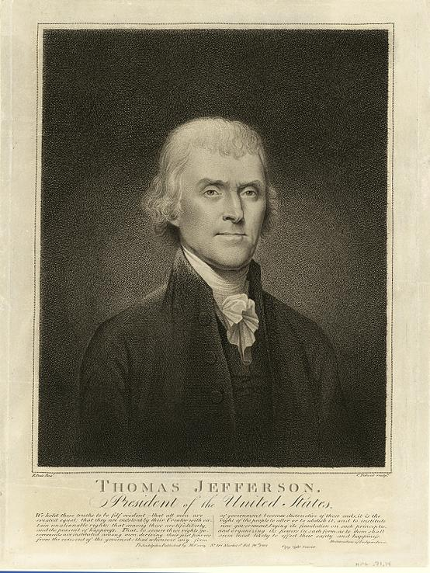
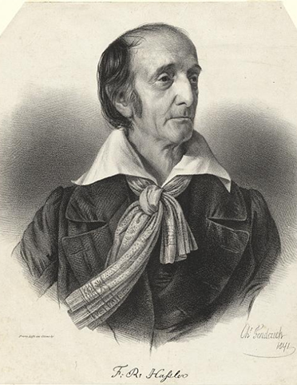



National Geodetic Survey (NGS)
Our Nation’s First Civilian Science Agency
1807
Thomas Jefferson
Survey of the Coast
1811
Ferdinand Hassler
Superintendent
1836
U.S. Coast
Survey
1878
U.S. Coast and
Geodetic Survey
1970
NOAA is established
3
Notes:
NGS has been around a long time. For more than 200 years, NGS and its predecessor agencies have collaborated with public and private organizations to establish reference stations at precisely determined locations.
We began on a mission established by Thomas Jefferson in 1807 to conduct a “Survey of the Coast” (as the United States Coast Survey).
(Pictured are Thomas Jefferson and Ferdinand Hassler, the first Superintendent of the Coast Survey). We were renamed the U.S. Coast and Geodetic Survey in 1878. NOAA was established in 1970.
Traditionally, precise positioning locations have been identified by setting a survey mark—usually a brass, bronze, or aluminum disk. Locations might also be identified by a deeply driven rod, or a prominent object, such as a water tower or church spire.

Slide 4
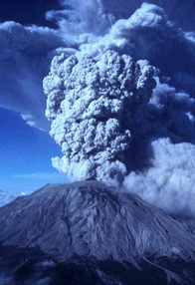
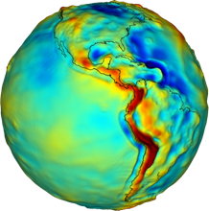
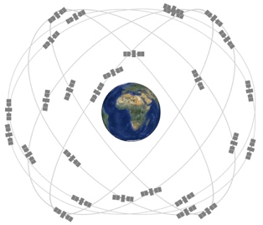

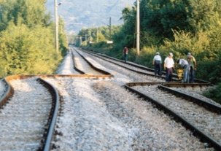
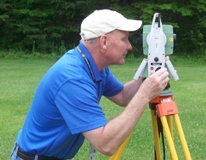


Geodesy and the Nation
Timing
Earth Observation
Positioning
Navigation
Communications
Water and Ice
Gravity
Volcanoes
Spacecraft Navigation
Disaster Cleanup
Earthquakes
Surveying
Public Safety
Precision Agriculture
Financial Transactions
Transportation
Utilities
Aviation
4

Slide 5

Consistent Geospatial Framework for the Nation
Proper alignment of geospatial data can avoid costly mistakes
5

Slide 6




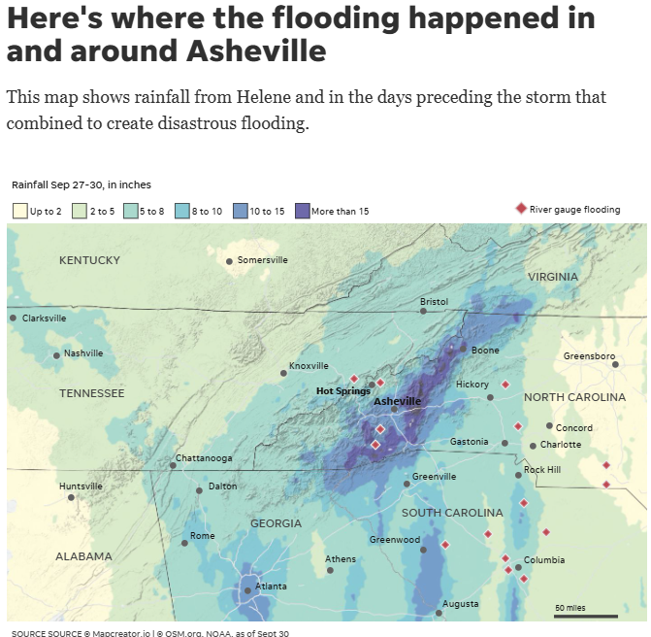
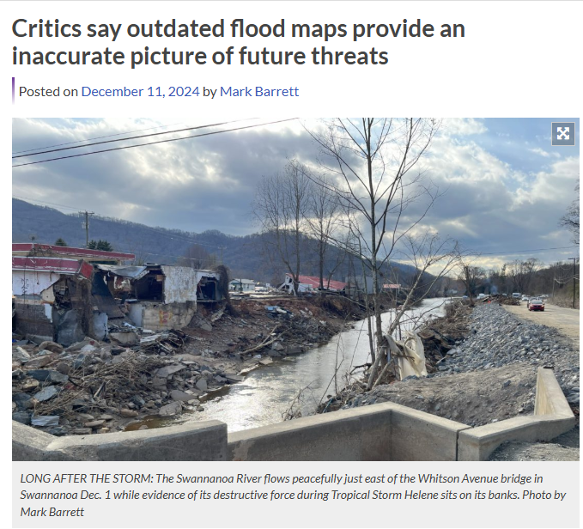
Accurate Elevations Required for Flood Mapping
6

Slide 7
Bottom Line Up Front (BLUF)
In 2026, the coordinates of every point on every map, chart, survey or other geospatial data set will change.
Every latitude, longitude and ellipsoid height will change from its current values by +/- 2 meters (median) with extremes up to 4 meters
Every orthometric (“Mean Sea Level”) height will change from its current values by +/-2 meters (median) with an unknown limit on change due to (as yet) unquantified subsidence impacts
7

Slide 8
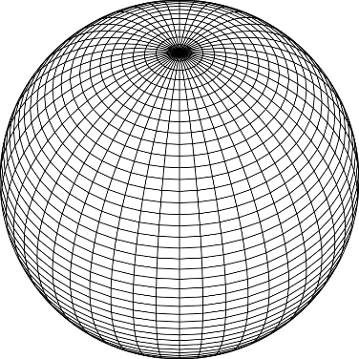
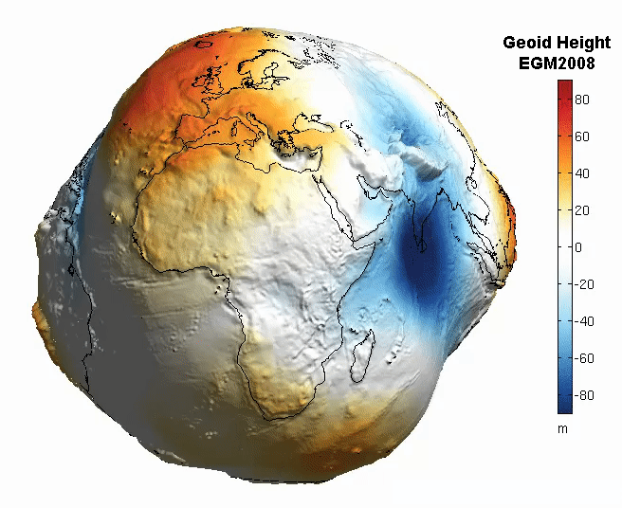
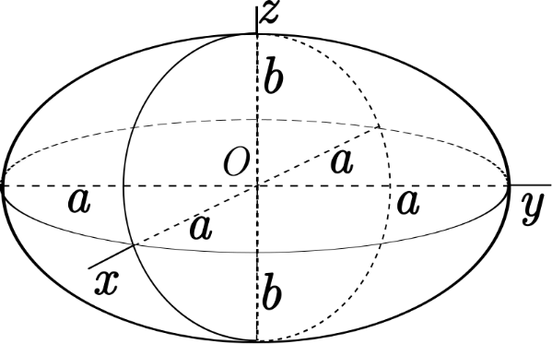
The Earth is Infinitely Complex
Build Models to Simplify
8
Notes:
Models are used to simplify complex phenomena for humans and computers to understand and perform calculations and analysis.
The geoid is an approximation of sea level and used to calculate elevations (orthometric heights) above this “sea level” surface
Spheroid image https://www.kisspng.com/png-sphere-shape-ball-grid-line-circle-draw-5378189/
Ellipsoid image https://www.kisspng.com/png-figure-of-the-earth-oblate-spheroid-ellipsoid-4129812/
Geoid Image https://www.reddit.com/r/MapPorn/comments/3xf6a0/geoid_height_of_new_global_gravity_field_models/

Slide 9
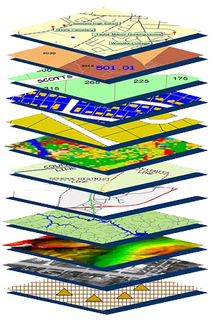
Accurate maps begin with
accurate coordinates!
Geodetic control (NSRS) is the foundation layer for all geospatial products.
Geodetic control = Points with accurate coordinates
Without a geodetic control “base map” layer, GIS applications will not align properly!
Geodetic control needs to be more accurate than any survey or map which builds upon it
9
Notes:
There are three ways to organize geospatial data:
Have transformations stored to convert between reference systems
Put all the data into one database
Provide a set of tools to enable users to create the geodetic components in the same reference system
Digital services should ensure geo-referenced data collected and published are consistent with NOAA’s National Spatial Reference System (NSRS), which provides the foundation for all positioning and navigation activities in the United States and is defined and maintained by NGS.
This is more adamant for US Agencies but a good guideline for others as well

Slide 10
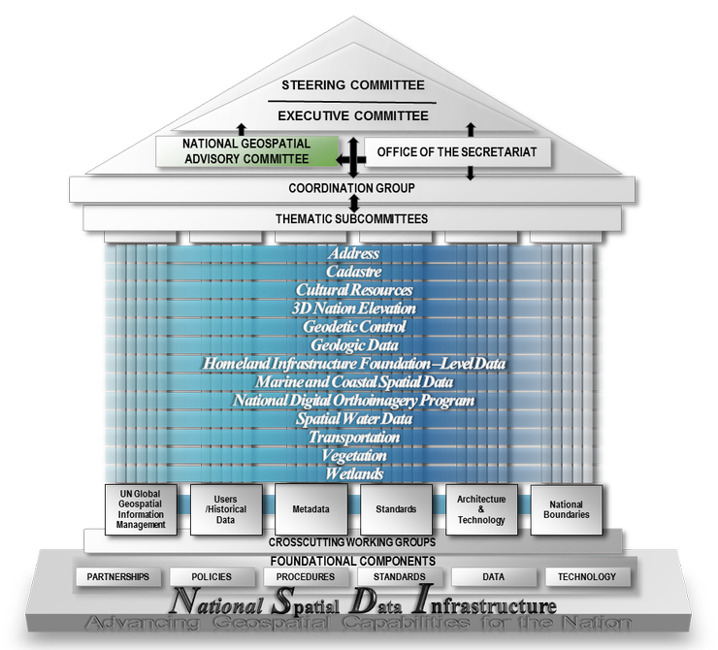

Federal Geographic Data Committee
FGDC Coordinates policy and laws for National Geospatial Data Assets (NGDA)
Newly released Strategic Plan for National Spatial Data Infrastructure (NSDI) emphasizes need for geospatial data to be tied to the NSRS
Making U.S. Government data F.A.I.R.
Findable, Accessible, Interoperable and Reusable
10

Slide 11
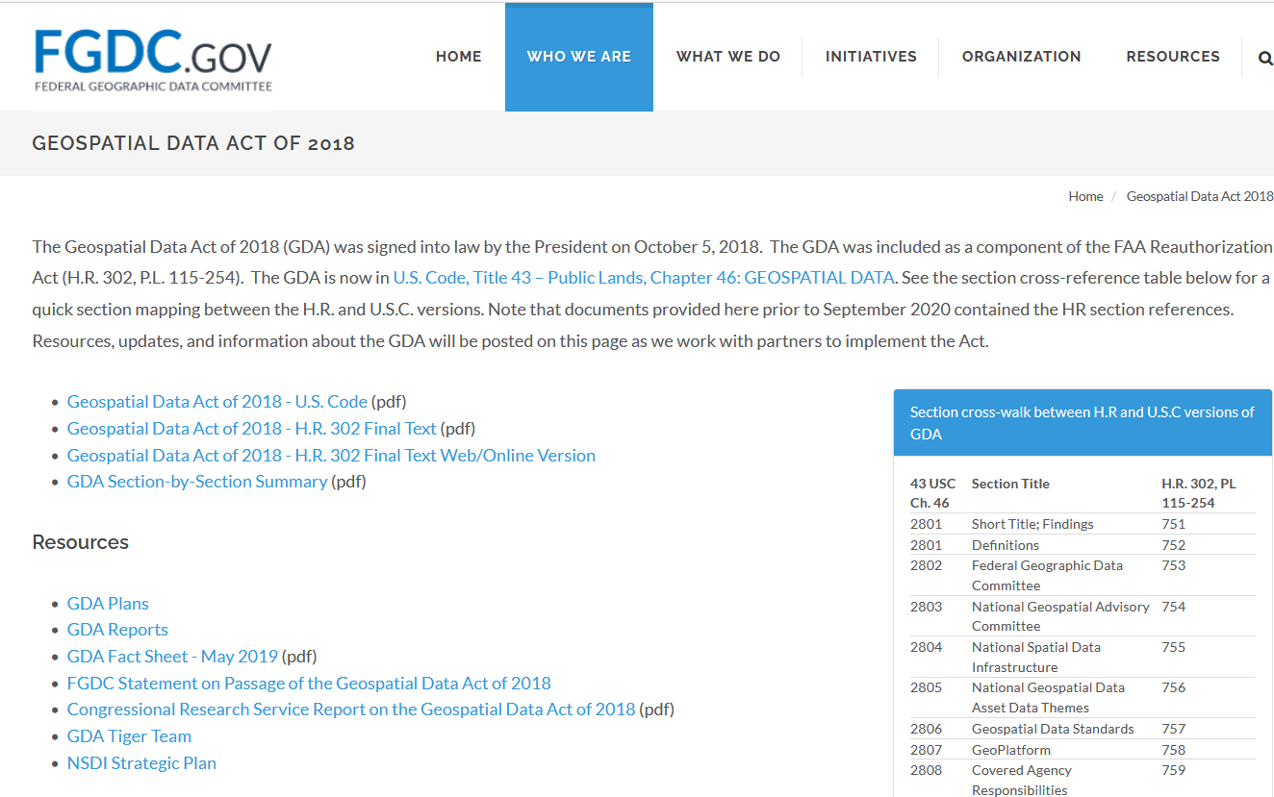
National Motivations: the GDA and FGDC
Geospatial Data Act
Adherence to Standards, etc.
Empowered the FGDC
NGDA’s and other data
FGDC sets data standards
"Limitation on the use of Federal funds" starts 5+ years after establishment
Data archived to GeoPlatform.gov
11
Notes:
In support of that, the U.S. passed the Geospatial Data Act of 2018 that codified many previous Directives and better aligned the US to global norms.
Hence, NOAA/NGS is the tip of the spear implementing what has been agreed to internationally and codified into law inside the U.S.

Slide 12

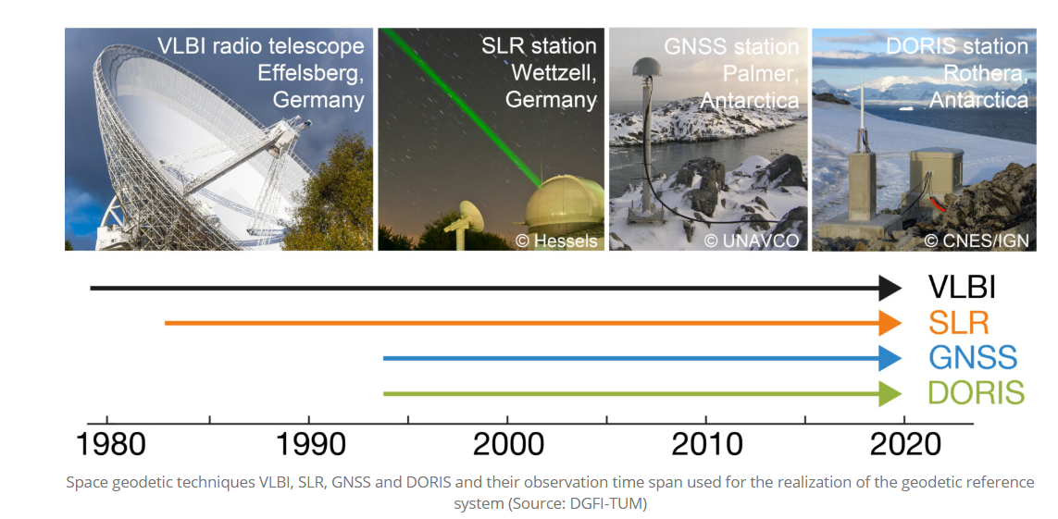
International Cooperation
International Terrestrial Reference Frame (ITRF)
Globally consistent
Multi-technique, not just GNSS
Endorsed by UN Global Geospatial Information Management Program
WGS 84 is aligned with ITRF
Modernized NSRS will be based on ITRF
12
Notes:
UN Integrated Geospatial Information Framework
It provides a basis and guide for developing, integrating and strengthening geospatial information management
Anchored by nine strategic pathways, the Framework is a mechanism for articulating and demonstrating national leadership in geospatial information, and the capacity to take positive steps.
Underpinning that effort, the UN voted on resolutions supporting the Global Geodetic Reference Frame (GGRF).
The GGRF is being implemented by the Subcommittee on Geodesy and now the Global Geodetic Centre of Excellence.

Slide 13
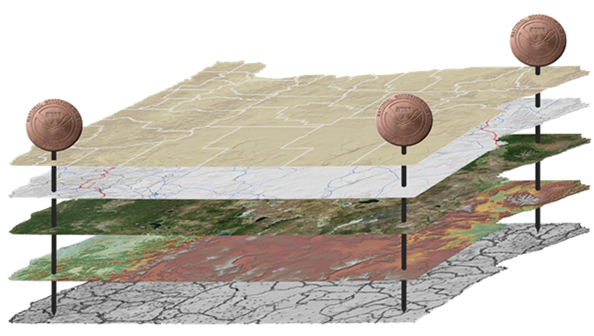
The National Spatial Reference System (NSRS)
NGS defines, maintains and provides access to the NSRS
North American Datum of 1983 (NAD 83)
North American Vertical Datum of 1988 (NAVD 88)
Latitude • Longitude • Elevation • Gravity • Shoreline Position
+ changes over time
Today’s NSRS
13
Notes:
The National Spatial Reference System is the United States’ geospatial infrastructure from which all positioning (with the exclusion of military/Department of Defense) is referenced to.
This system provides a consistent framework that allows people to use data in the same reference system to perform analysis and make meaningful comparisons and decisions from that analysis.
The National Spatial Reference System (NSRS) includes latitude, longitude and elevation in addition to the National Shoreline and geodetic control. You can think about geodetic control is the “base map” layer at the base of GIS applications that will get everything aligned.
Two datums that make up the backbone of the NSRS today are:
North American Datum of 1983 (NAD 83)
North American Vertical Datum of 1988 (NAVD 88)
In the future, there will be four Terrestrial Reference Frames, one per tectonic plate.
North American Terrestrial Reference Frame (NATREF 2022)
Caribbean Terrestrial Reference Frame (CATREF 2022)
Pacific Terrestrial Reference Frame (PATREF 2022)
Marianas Terrestrial Reference Frame (MATREF 2022)
And one gravimetric geoid model (GEOID2022) that will cover the entire north western Hemisphere of the Earth and serve as the foundation for the :
North America and Pacific Geopotential Datum (NAPGD 2022)

Slide 14
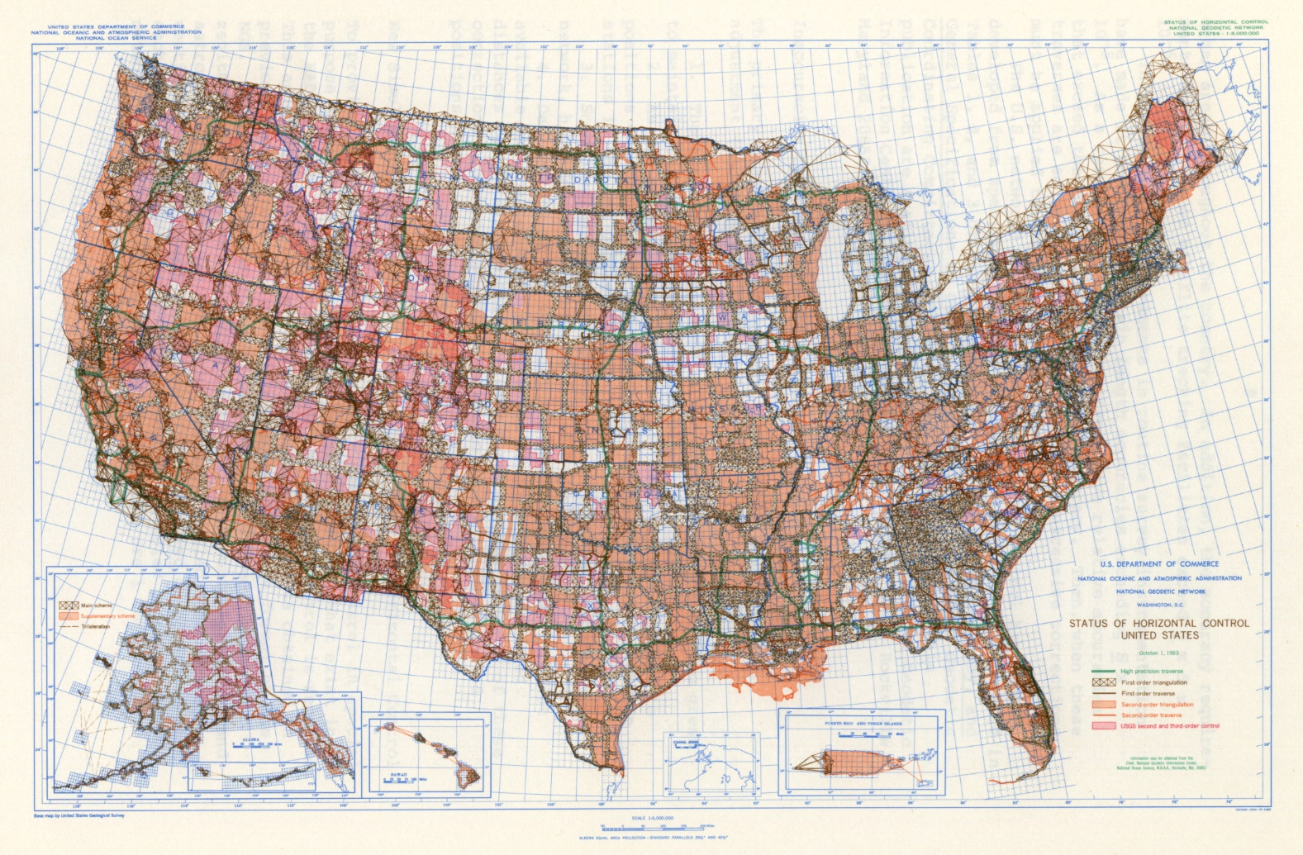
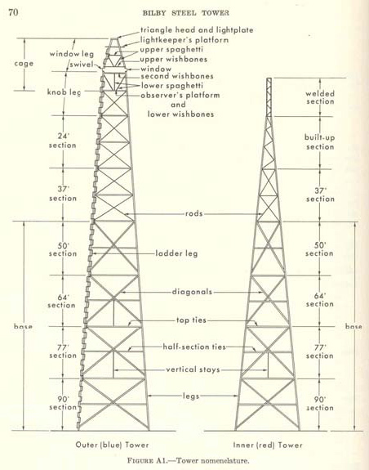
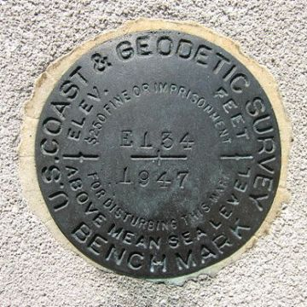
NAD 83 released in 1986 – Built from Angles and Distances
14
Notes:
The National Spatial Reference System is our nations geospatial infrastructure from which all positioning (with the exclusion of military/DOD) is referenced to.
This system provides a consistent framework that allows people to use data in the same reference system to perform analysis and make meaningful comparisons and decisions from that analysis.

Slide 15
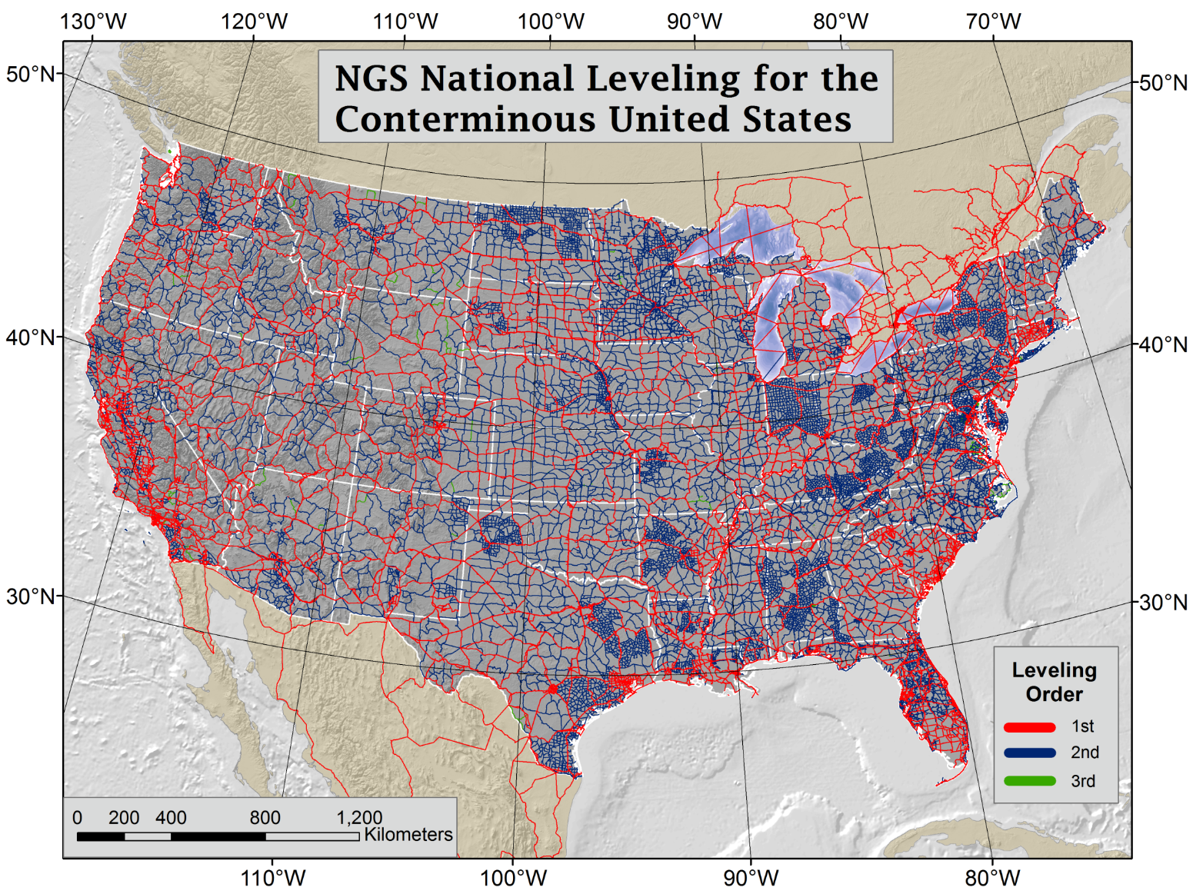

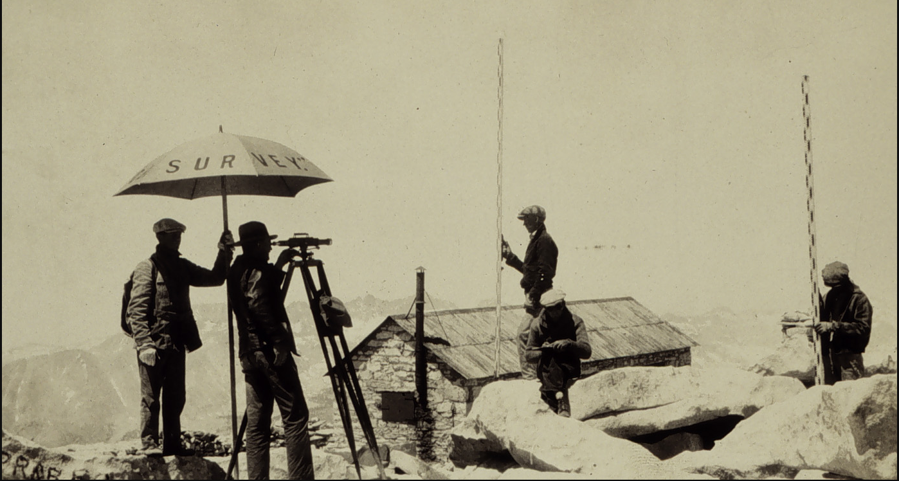
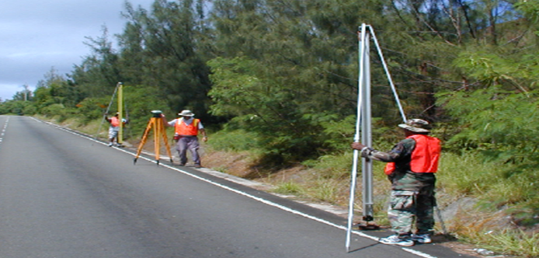
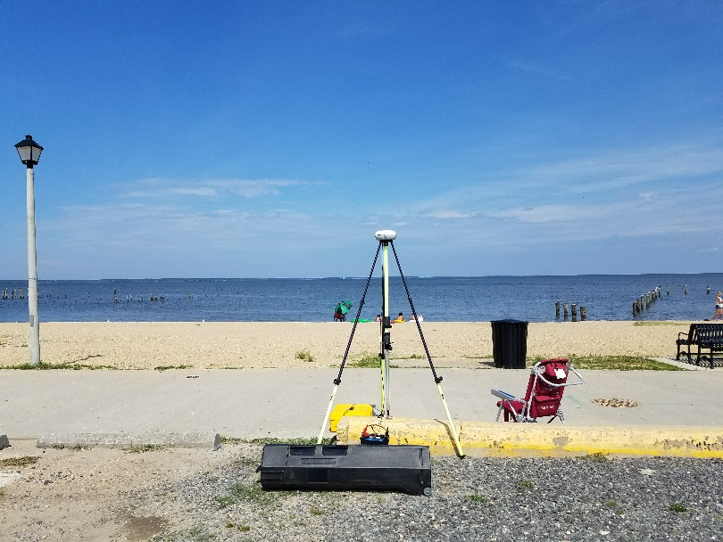
NAVD 88 released in 1991 – built from Geodetic Leveling
Then, along came GPS!
NAVD 88 consists of about 800,000 bench marks connected by about 2.2M km of leveling over 80 years. Orthometric heights tell you which way water will flow.
Notes:
NAVD 88, the US current Orthometric height datum, consists of about 800,000 benchmarks and ~2.2M km of leveling. Data was collected over many decades by roving bands of surveyors who walked across the country multiple times over the years, east to west, north to south and back again. It is currently the official vertical datum of the US and is required for federal mapping projects. It would cost tens to hundreds of millions of US dollars to do again.
GPS data on those leveled marks were used to create GEOID18 – the model used to derive NAVD88 heights from GPS ellipsoid heights, as well as the transformation tools that will be released with NAPGD2022.

Slide 16
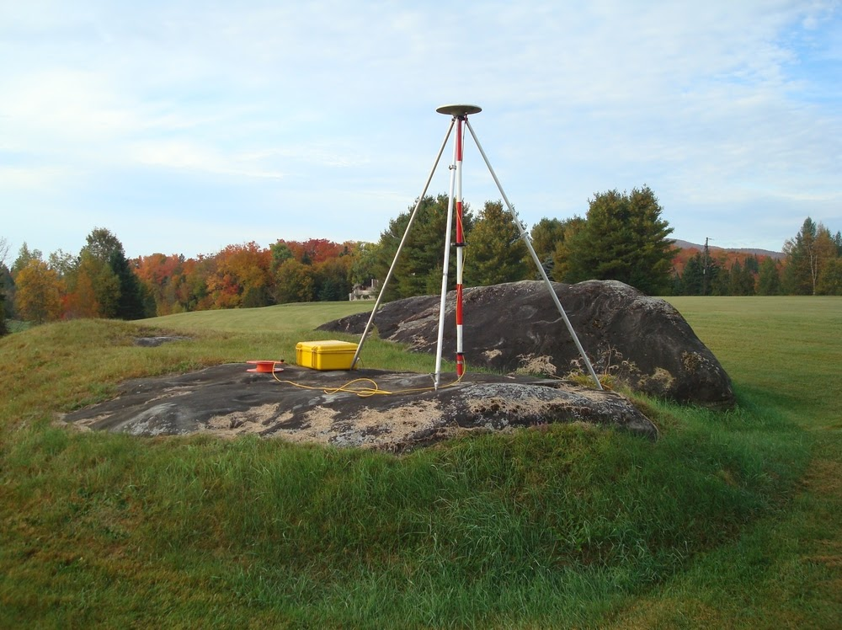
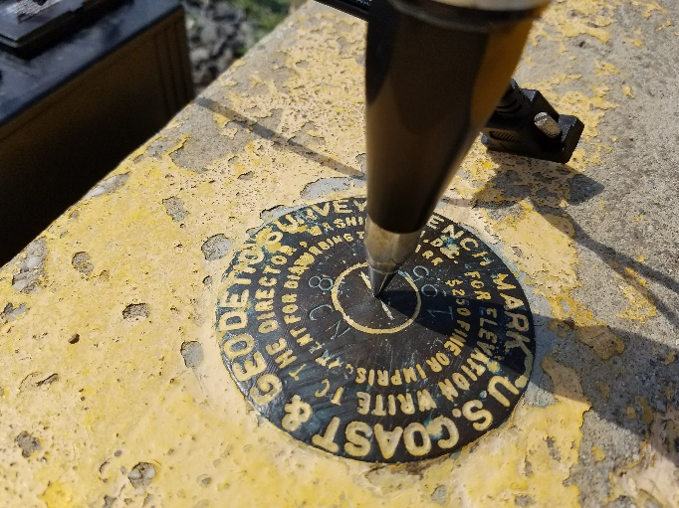
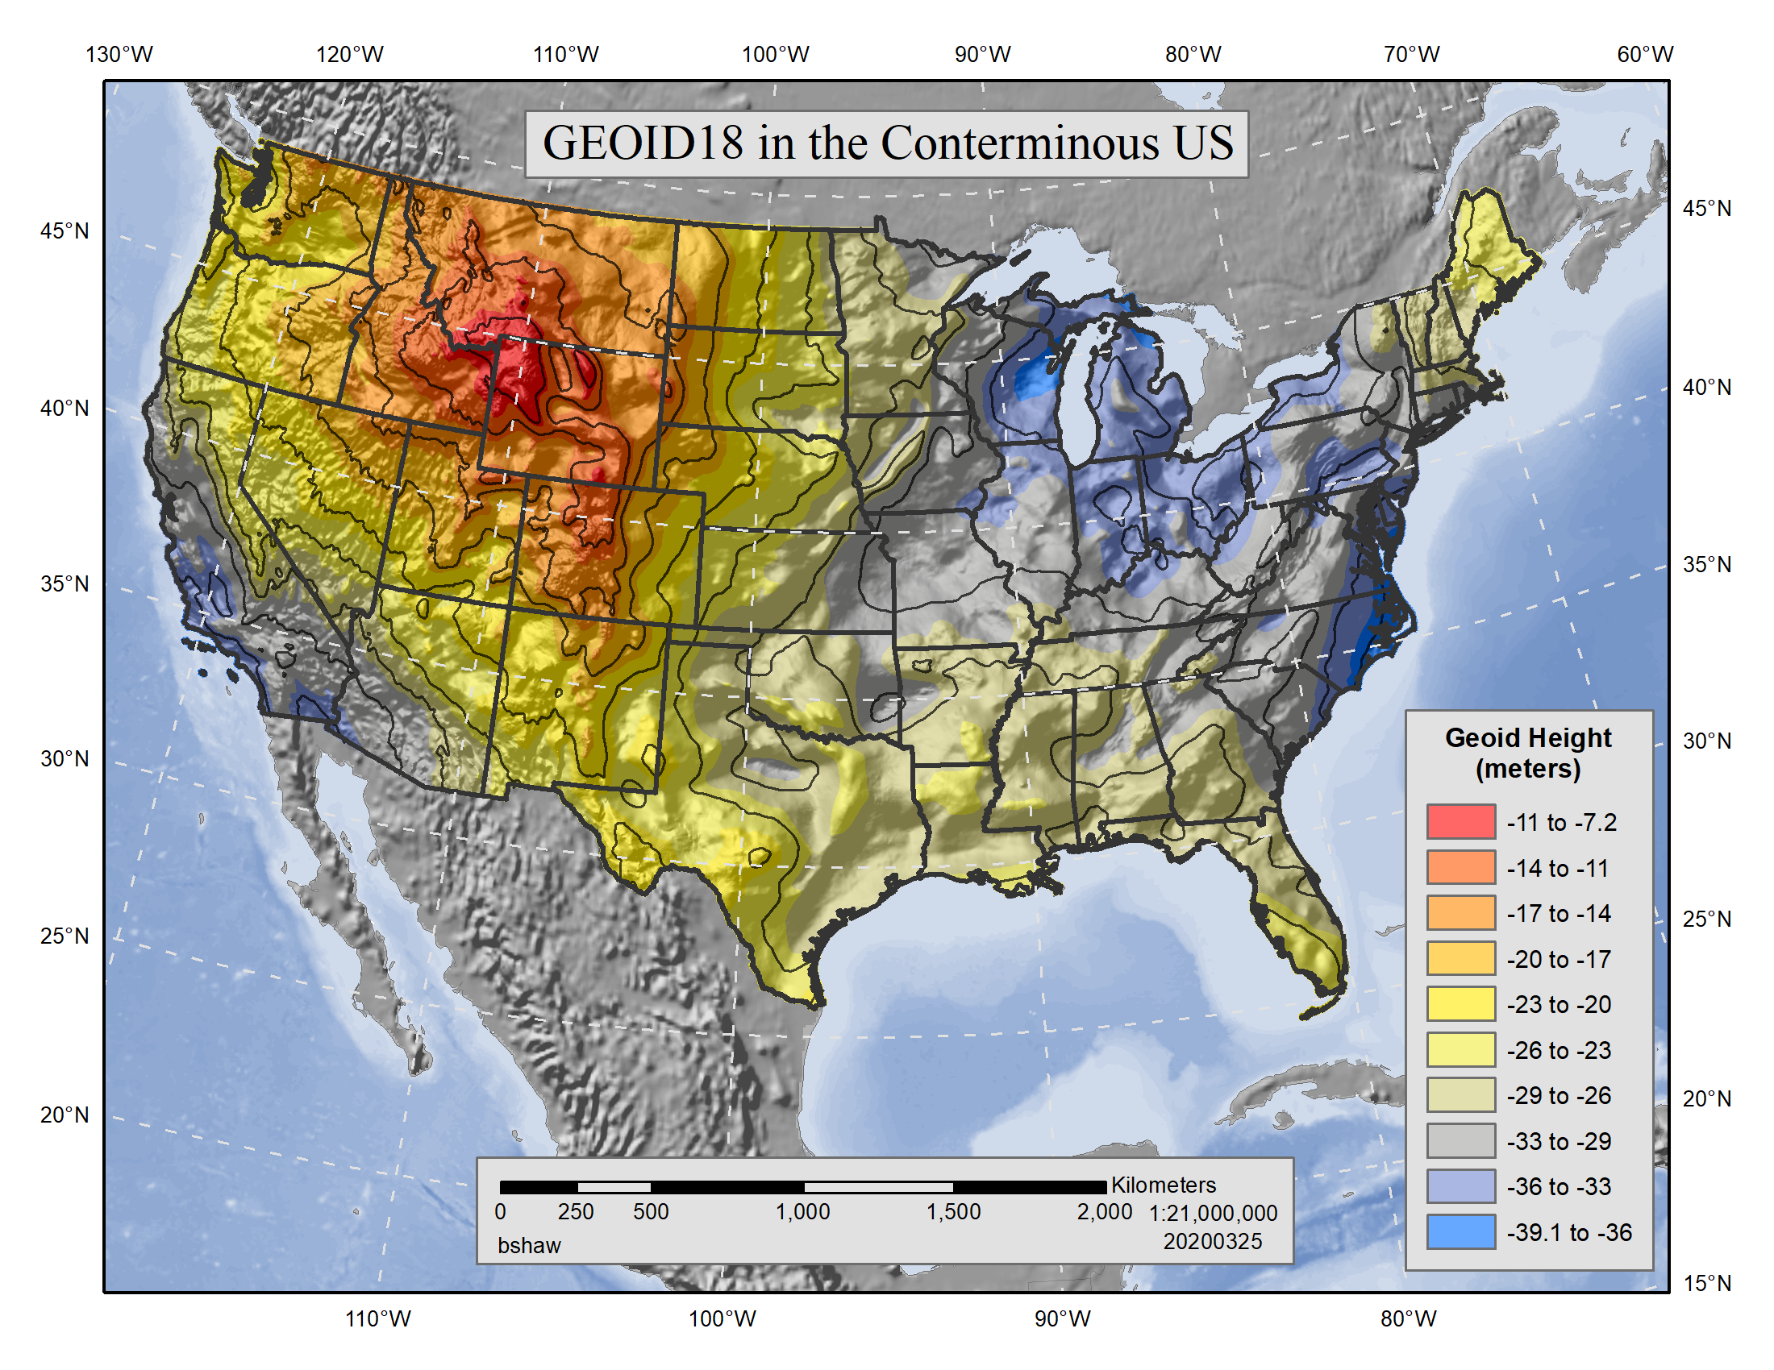
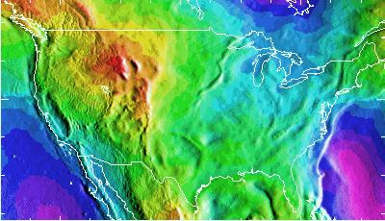
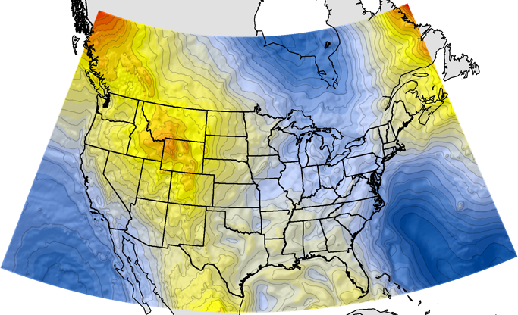
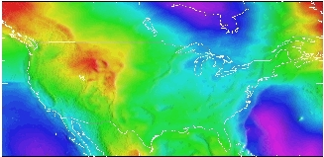
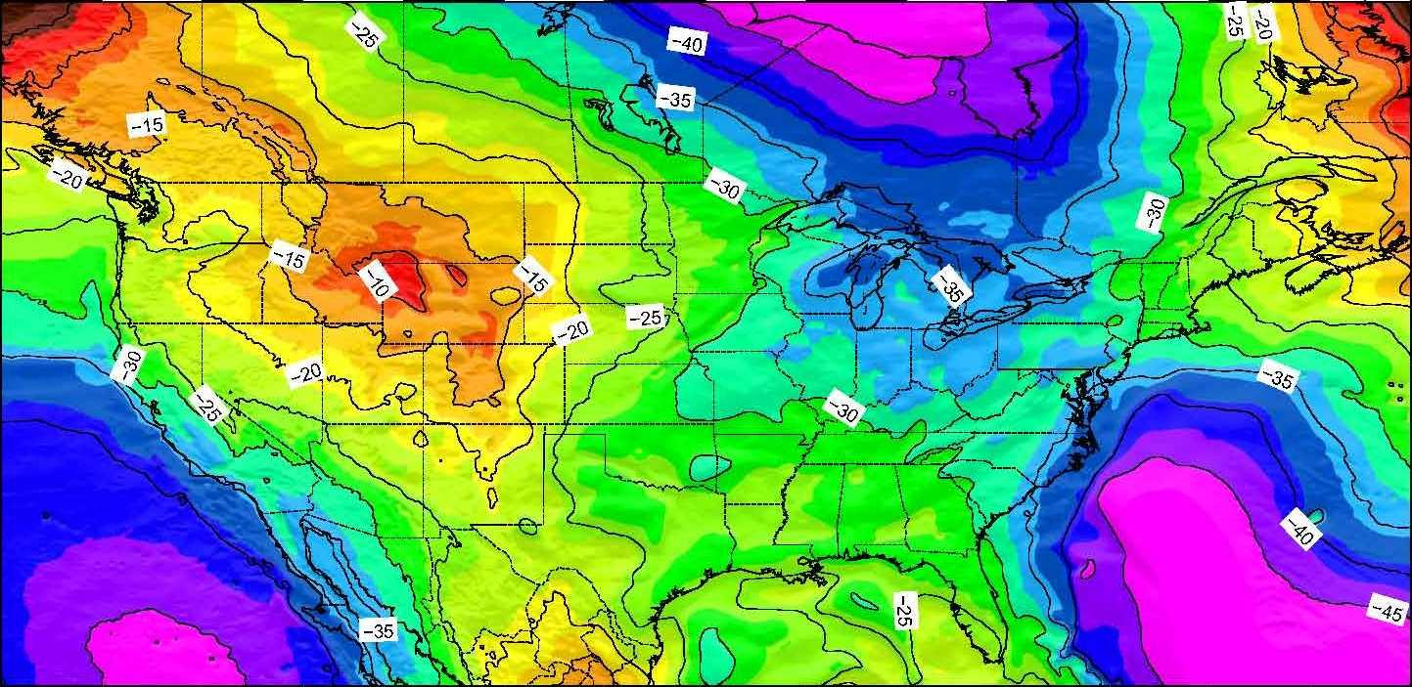
Getting NAVD 88 elevations with GPS required a workaround called “hybrid” geoid models
16
Notes:
NAVD 88, the US current Orthometric height datum, consists of about 800,000 benchmarks and ~2.2M km of leveling. Data was collected over many decades by roving bands of surveyors who walked across the country multiple times over the years, east to west, north to south and back again. It is currently the official vertical datum of the US and is required for federal mapping projects. It would cost tens to hundreds of millions of US dollars to do again.
GPS data on those leveled marks were used to create GEOID18 – the model used to derive NAVD88 heights from GPS ellipsoid heights, as well as the transformation tools that will be released with NAPGD2022.

Slide 17
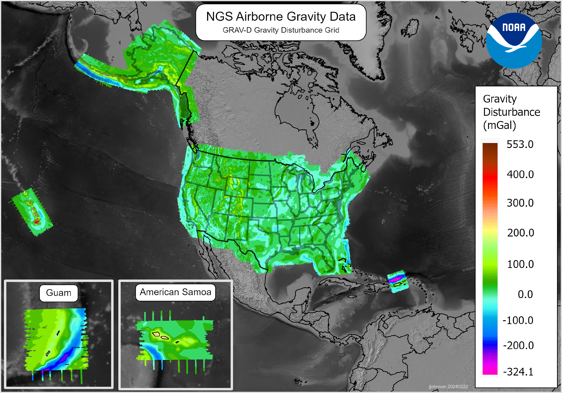
Gravity for the Redefinition of the American Vertical Datum (GRAV-D)
Provide a way to get elevations with GPS efficiently and accurately
17 years collecting airborne gravity data
15.7 million sq km
4,759 flight lines
2.3 million linear km flown
Nearly 3 times to the moon and back!!
Final data set was sent to the geoid team in February 2024
17

Slide 18

The Modernized NSRS
NGS defines, maintains and provides access to the NSRS
Latitude • Longitude • Elevation • Gravity • Shoreline Position
+ changes over time
Tomorrow’s NSRS
Four Terrestrial Reference Frames (xxTRF 2022)
North America and Pacific Geopotential Datum (NAPGD 2022)
18
Notes:
The National Spatial Reference System
The system that NGS has created that meets these requirements and expectations is the National Spatial Reference System.
The National Spatial Reference System (NSRS) includes latitude, longitude and elevation in addition to the National Shoreline and geodetic control.
You can think about geodetic control is the “base map” layer at the base of GIS applications that will get everything aligned.
There will be four Terrestrial Reference Frames, one per tectonic plate.
North American Terrestrial Reference Frame (NATREF 2022)
Caribbean Terrestrial Reference Frame (CATREF 2022)
Pacific Terrestrial Reference Frame (PATREF 2022)
Marianas Terrestrial Reference Frame (MATREF 2022)
And one gravimeteric geoid model that will cover the entire north western Hemisphere of the Earth
North America and Pacific Geopotential Datum (NAPGD 2022)

Slide 19
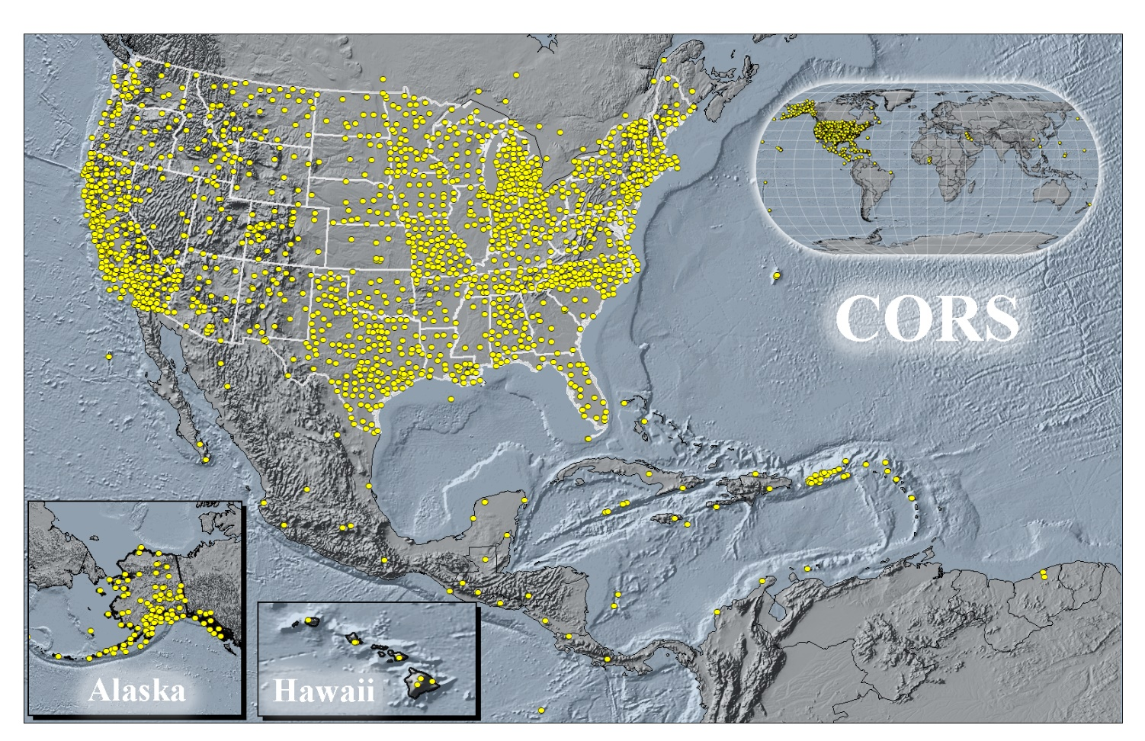
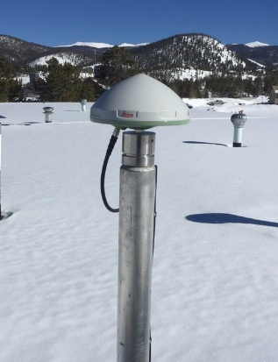
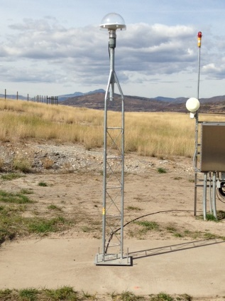
Continuously Operating Reference Stations
Active Control
COBK
Breckenridge
Colorado
STBT
Steamboat Springs
Colorado
19

Slide 20
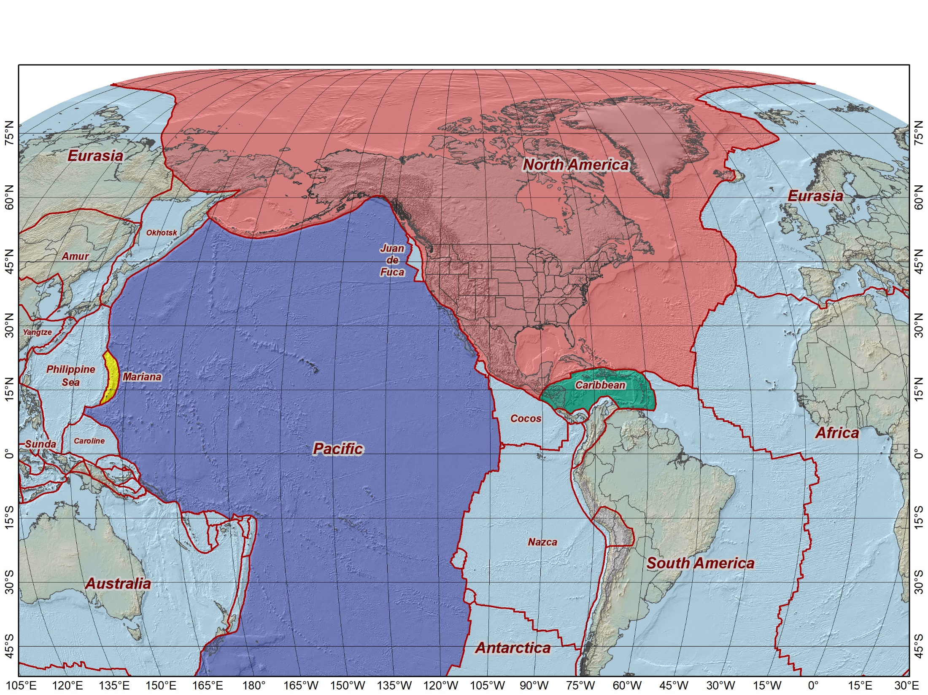
2022 Terrestrial Reference Frames (plate fixed)
North American Terrestrial Reference Frame of 2022 (NATRF2022)
Pacific Terrestrial Reference Frame of 2022 (PATRF2022)
Mariana Terrestrial Reference Frame of 2022 (MATRF2022)
Caribbean Terrestrial Reference Frame of 2022 (CATRF2022)
NATRF2022
MATRF2022
PATRF2022
CATRF2022
Initially at epoch 2020.0 (Jan 1, 2020) and same as ITRF2020 at that epoch
20

Slide 21
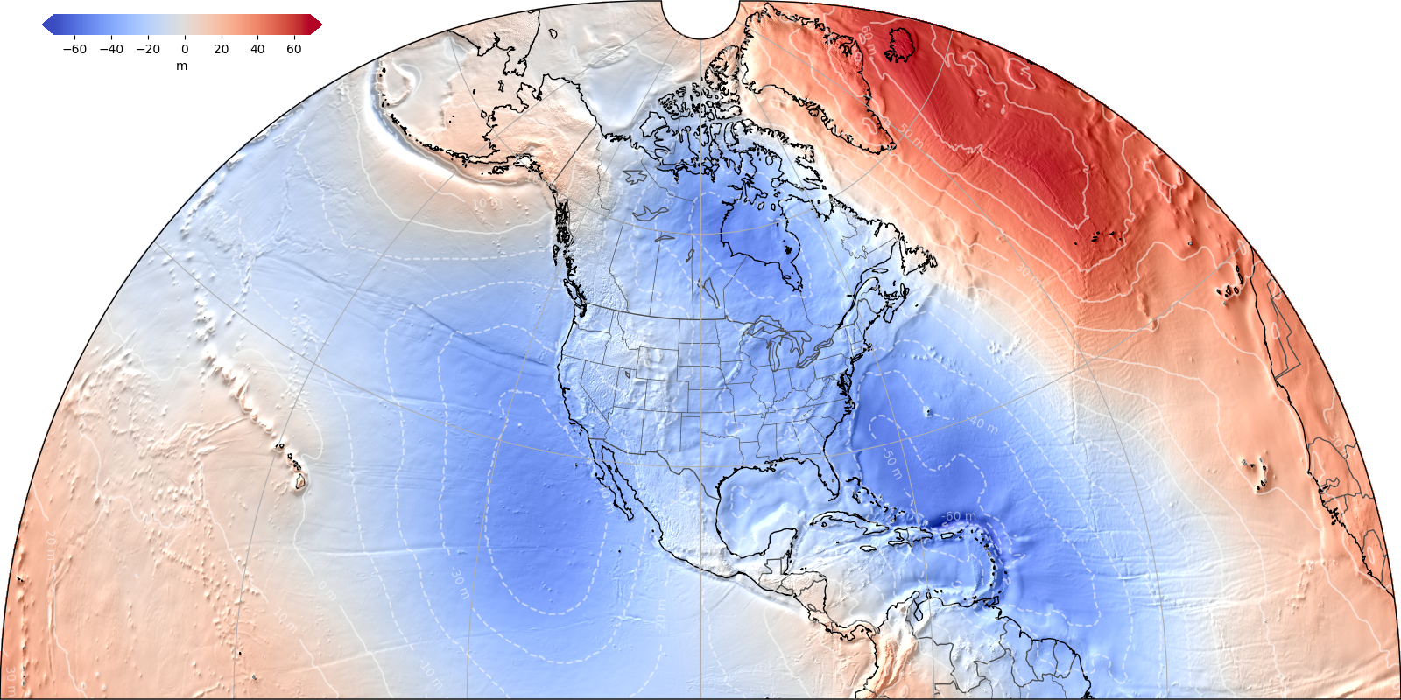
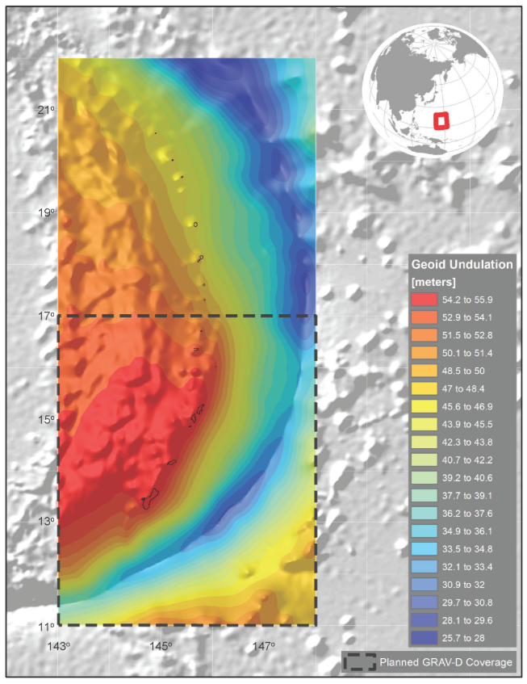
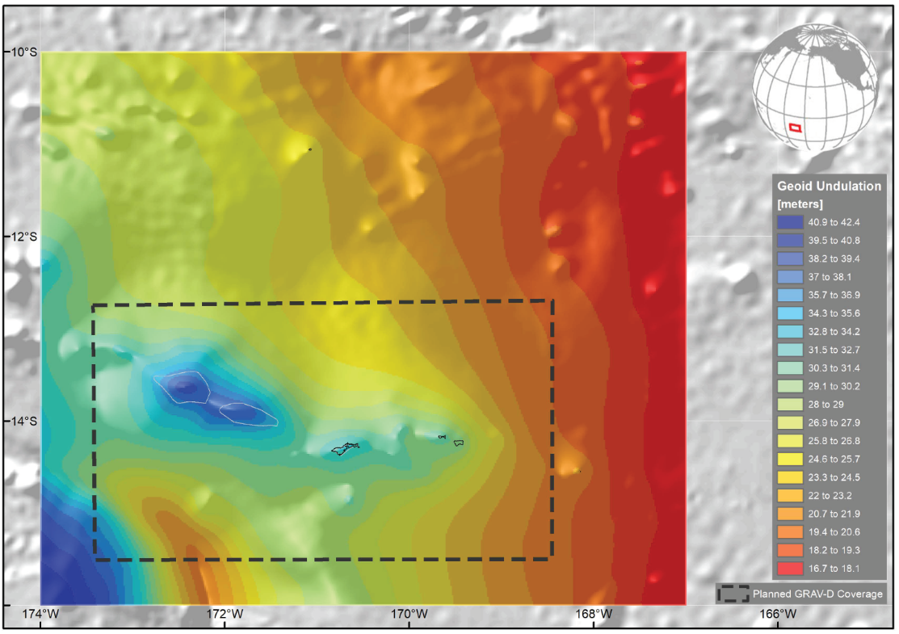
NAPGD2022 Geopotential Datum
North American-Pacific Geopotential Datum of 2022
Not a vertical datum, it is more than just heights.
Models included: *Geopotential *Deflection *Gravity
*Geoid
Alpha Geoid2022
¼ Earth’s Surface
Guam/CNMI
American Samoa
Notes:
NSRS Modernization News
https://geodesy.noaa.gov/datums/newdatums/TrackOurProgress.shtml
Experimental Geoid Models
https://beta.ngs.noaa.gov/GEOID/xGEOID20/
As noted in the Blueprint 2 document
https://geodesy.noaa.gov/library/pdfs/NOAA_TR_NOS_NGS_0064.pdf
NAPGD2022 will include all of the following
Geopotential Model of 2022 (GM2022) will include:
Static Geopotential model of 2022 (SGM2022)
Dynamic Geopotential model of 2022 (DGM2022)
GEOID2022 will include:
Static Geoid model of 2022 (SGEOID2022)
Dynamic Geoid model of 2022 (DGEOID2022)
DEFLEC2022 will include:
Static Deflection of the Vertical model of 2022 (SDEFLEC2022)
Dynamic Deflection of the Vertical model of 2022 (DDEFLEC2022)
GRAV2022
Static Gravity model of 2022 (SGRAV2022)

Slide 22
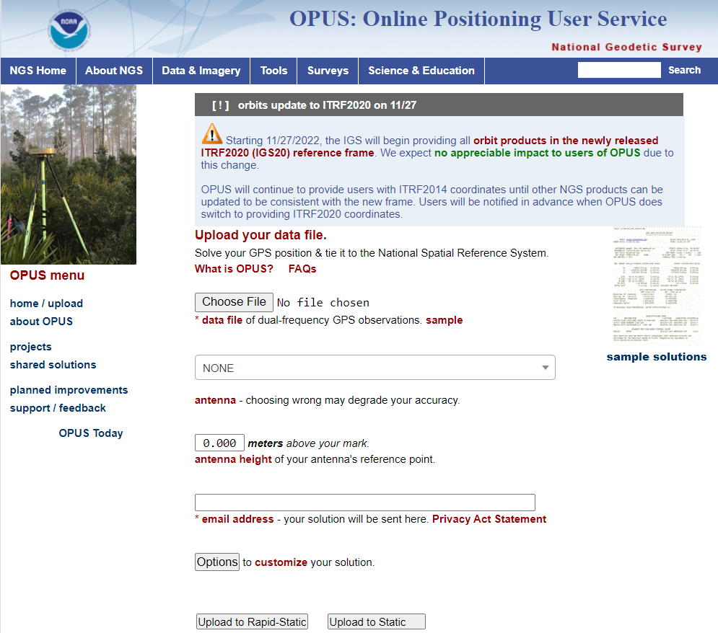
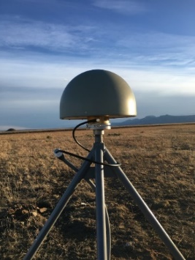
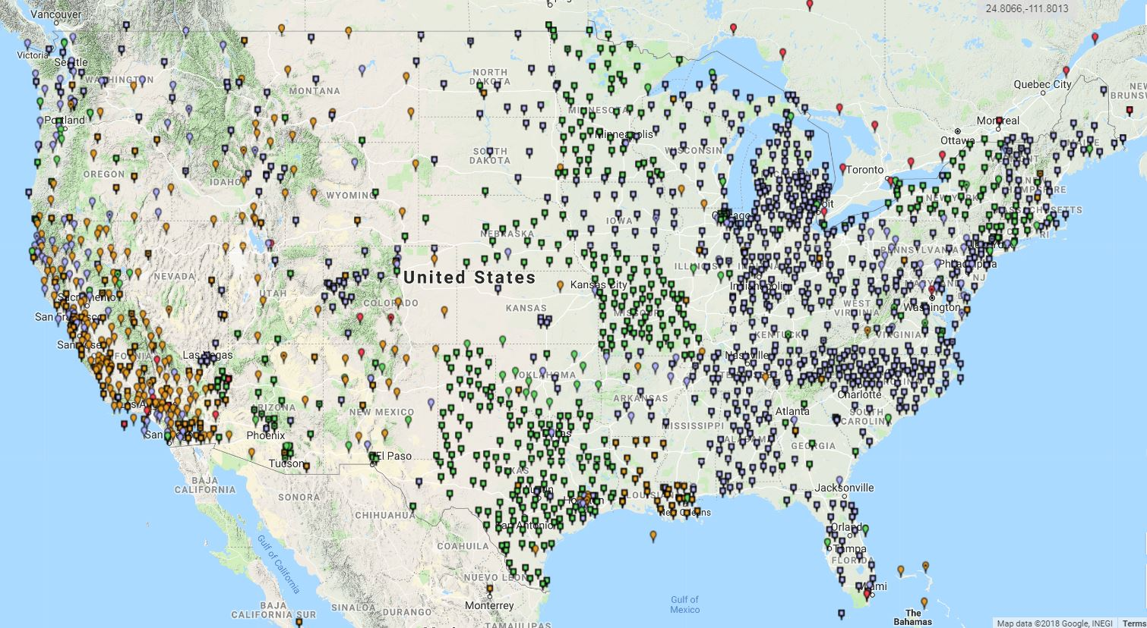
Modernized Access: Through the CORS and OPUS
NGS provides data and coordinate functions with NOAA CORS Network
And one definitive coordinate function for each one
And the software (M-PAGES / OPUS / OPUS Projects) to determine accurate positions with respect to the NSRS
22
Notes:
Very similar philosophically:
The NSRS remains “geodetic control” for you to “access”
Geospatial information and metadata about various points
Passive control will exist…we aren’t getting out bulldozers and shovels
But gone are the days of getting “the coordinate” on a point from a “datasheet”

Slide 23
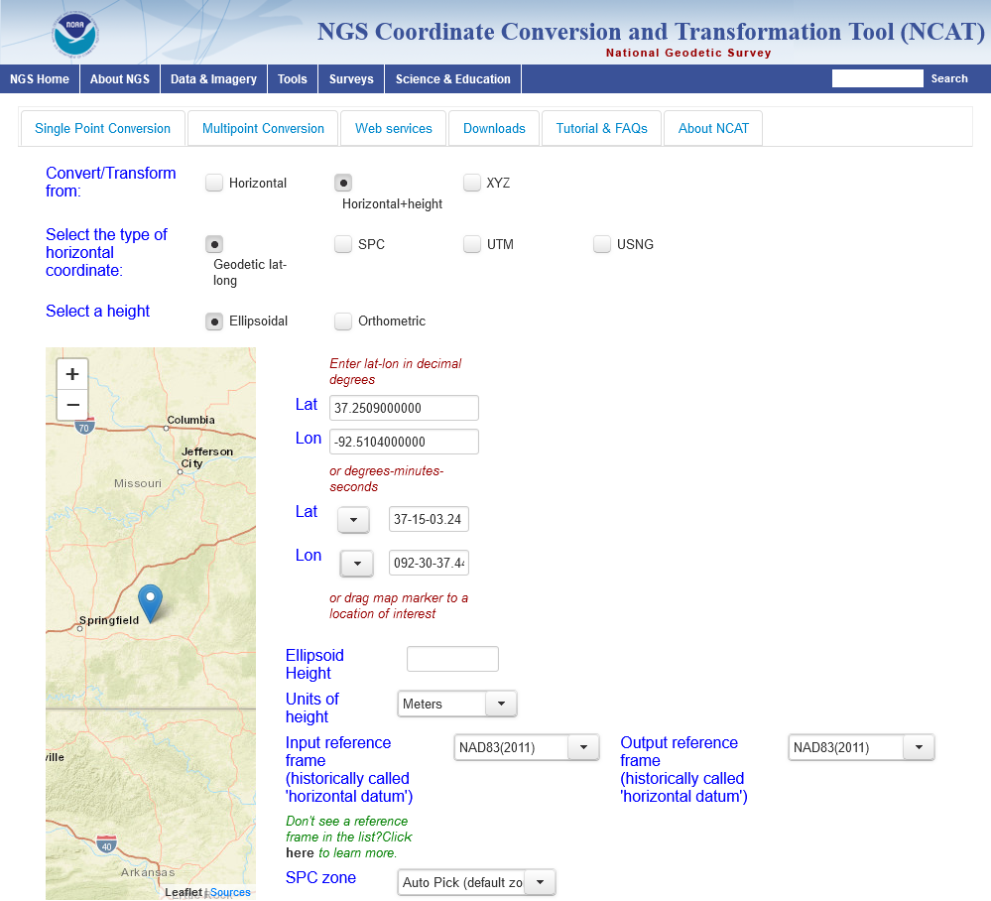
NGS Coord Conversion & Transformation Tool (NCAT)
Conversions
State Plane Coordinate System of 2022
Previous versions of State Plane
UTM and US National Grid
Will account for type of foot
Transformations
Between all datums of NSRS (NADCON and VERTCON)
Between NSRS and global reference frames (all ITRF and WGS 84 versions)
Between ellipsoid and orthometric heights (GEOID2022)
23

Slide 24
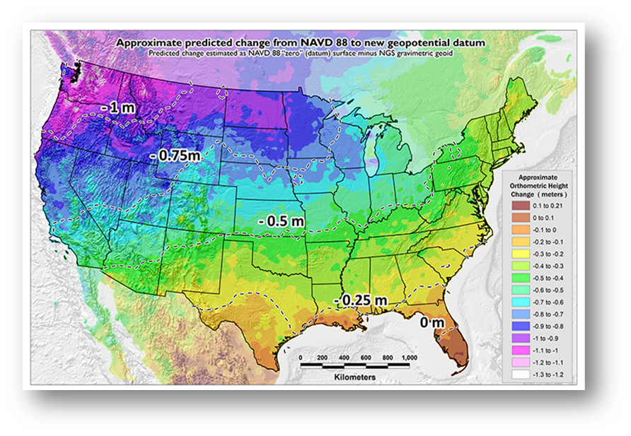
Benefits of Modernizing the NSRS
Why Modernize?
Current Datums were defined before GPS technology, so not geo-centric (~2.2m)
They rely on old tech & physical survey marks in the ground
Today’s technology requires better accuracy
Modernization will:
Improve accuracy, access, and alignment of our positioning systems
Generate ~$8.7 B in benefits to the nation over 10 years, more for early adopters
Provide the framework to reliaby use and share geospatial data from mulitple sources for a wide array of applications
24
Notes:
The current NSRS was:
Defined in the pre-GPS era
Without GPS, the Earth’s center (frame origin) was very hard to detect
Defined without aid of gravity-mission satellites
Leveling, terrestrial gravity, disconnected from the geometric frame
Defined right after punch-cards went away
Tools relied upon 80-character ASCII files and FORTRAN
Defined without a long-term strategy to acknowledge Earth’s dynamics
In short, the current NSRS has failed to keep up with emerging needs
Sea level rise, floodplain mapping, coastal geohazards

Slide 25
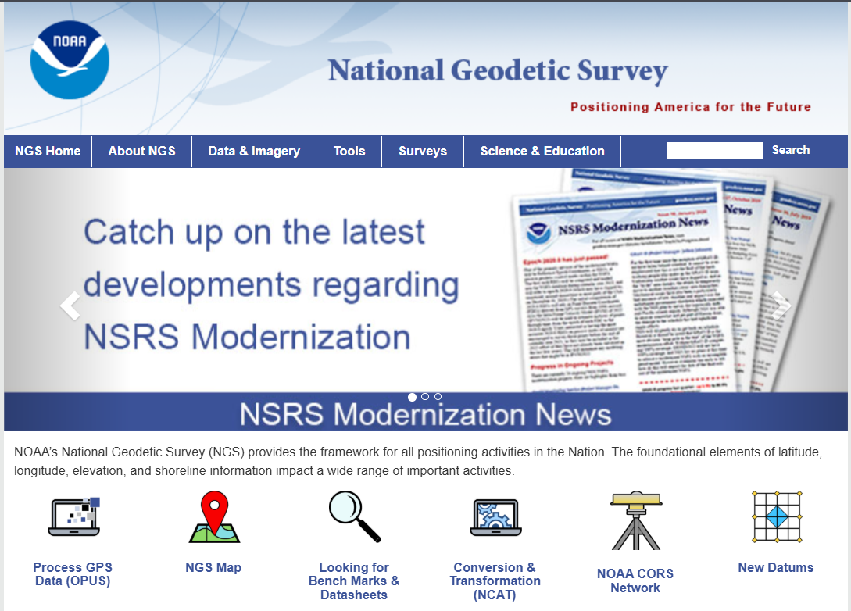
Preparation Steps You Can Take
Everyone’s situation is different, so no set of steps is universal.
Managing existing data:
Inventory your existing geospatial data and metadata to enable transition to the new system based on your accuracy requirements
Determine whether existing projects should be migrated to Modernized NSRS
Going forward:
Focus on metadata - Require complete metadata in all surveying and mapping field activities and contracts.
Preserve all original observations.
25
Notes:
2. Record Metadata
Inventory the metadata of your existing geospatial files to enable prioritizing their transformations
Knowing the datums and epochs for your geospatial files will simplify their datum transformations
Require complete metadata in all surveying and mapping contracts.

Slide 26
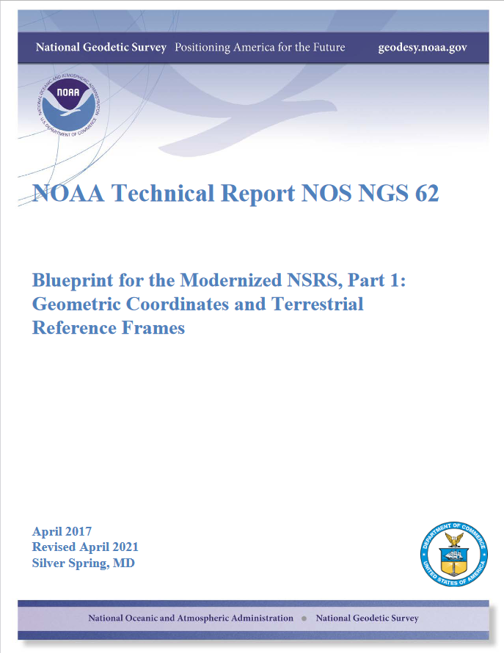
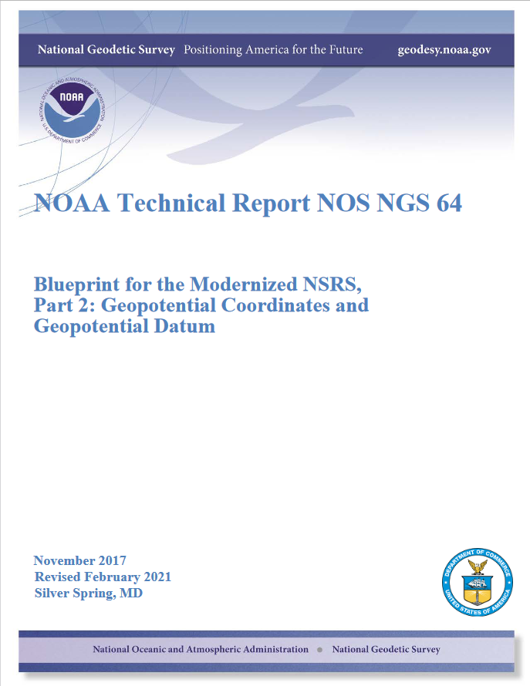
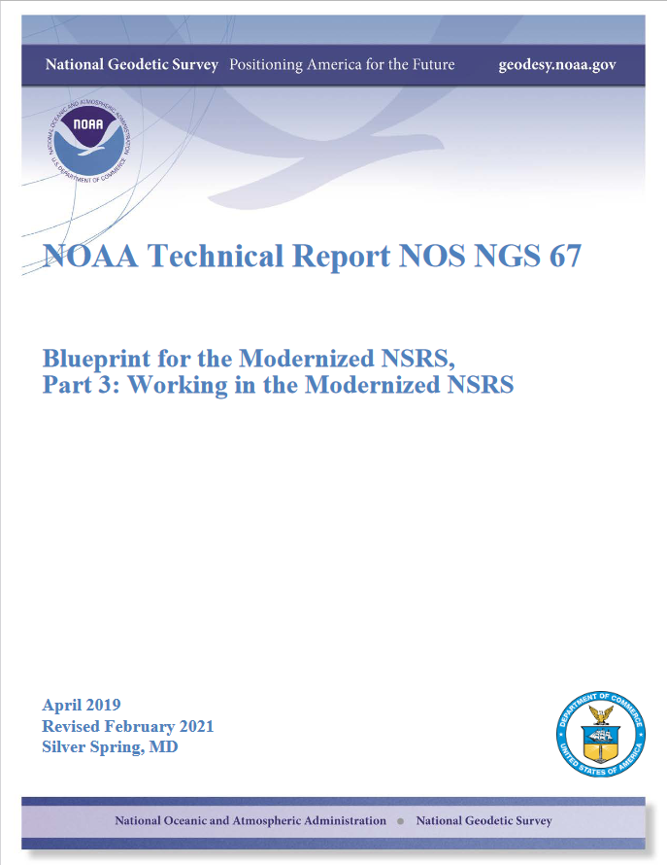
NSRS Modernization “Blueprint” documents
Geometric Coordinates and Terrestrial Reference Frames
Geopotential Coordinates and Geopotential Datum
Working in the Modernized NSRS
26

Slide 27
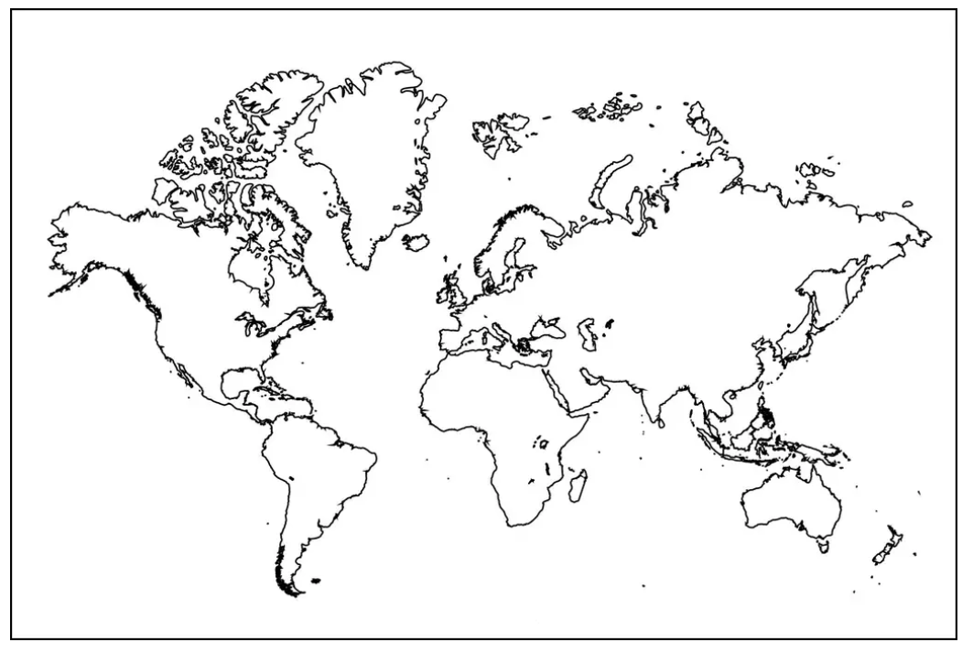
Extent of the current NSRS
Geometric Reference Frames:
NAD 83(2011)
NAD 83(PA11)
NAD 83(MA11)
Truly global but used regionally
Geoid models/Vertical Datums:
Regional
Conterminous US (CONUS; “Lower 48”)
Alaska
Hawaii
Territories: Puerto Rico, U.S. Virgin Islands, American Samoa, Guam, CNM
27

Slide 28
Preeminence of ITRF
Remove the rotation of the North American Plate
North American Terrestrial Reference Frame of 2022 (NATRF2022)
Caribbean Terrestrial Reference Frame of 2022 (CATRF2022)
Pacific Terrestrial Reference Frame of 2022 (PATRF2022)
Mariana Terrestrial Reference Frame of 2022 (MATRF2022)
Why 5 frames?
The ITRF is the international gold standard, and is fixed to no particular plate (latitude/longitude will drift ~ few cm/year). It is global and geocentric.
The USA has population centers on four plates, and many users wish to see the drift of latitude and longitude “hidden” over time, so we fix the frames to those four plates. They will also be global (but meant to be used on one plate) and geocentric.
Remove the rotation of the Caribbean Plate
ITRF2020
Remove the rotation of the Pacific Plate
Remove the rotation of the Mariana Plate
EPP2022
EPP for “Euler pole parameters”
(a way of describing a plate’s rotation)
28

Slide 29
NSRS Modernization in (very) brief
ITRF2020
NAD 83(2011)
NATRF2022
NAD 83(PA11)
Hybrid geoids
GEOID2022
PATRF2022
NAD 83(MA11)
CATRF2022
MATRF2022
NAVD 88
ASVD 02
PRVD 02
NAPGD2022
Bluebooking
FORTRAN
Disparate tools
Outdated manuals
GVX / OPUS
Modern coding
Integrated tools
Updated manuals
NMVD 03
GUVD 04
VIVD 09
29

Slide 30
Magnitudes and Transformations
30

Slide 31
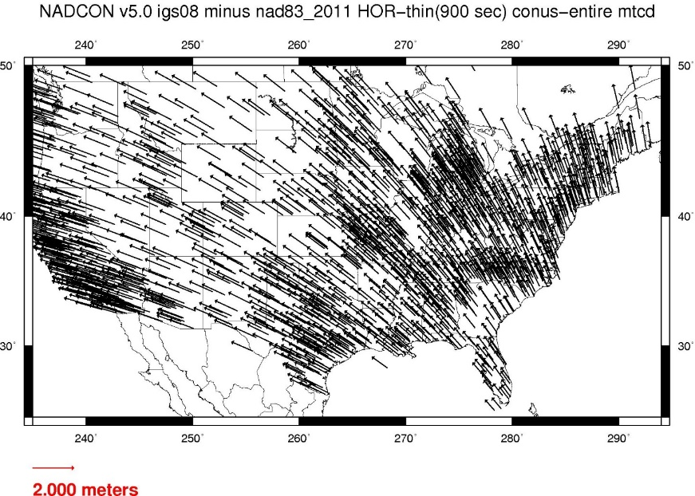




Changes from NAD 83 to NATRF2022
31

Slide 32

Changes from NAVD 88 to NAPGD2022
32

Slide 33
Transformation tools
NADCON
Latitudes, longitudes, ellipsoid heights
NAD 83 to ITRF2020, NATRF2022, PATRF2022, MATRF2022, CATRF2022
VERTCON
Orthometric (“MSL”) heights
NAVD 88 (and others) to the NAPGD2022
Both of these tools are built into NGS’s flagship product NCAT
NCAT : NGS Coordinate Conversion and Transformation Tool
33

Slide 34
Rollout, Testing, Replacement
34

Slide 35
Rollout, Testing, Replacement
NGS will roll out components of the modernized NSRS over time (2024-2025)
As each component is rolled out, it can be tested
Once the final component (likely VERTCON) is rolled out (likely late 2025), testing will continue for at least 6 months
Once enough testing is done, and all modernized NSRS components seem stable and correct, the FGCS will vote (likely 2026)
If affirmative, the modernized NSRS will replace the current NSRS
35

Slide 36
Current NSRS during rollout and testing
While the modernized NSRS is being rolled out and tested, the current NSRS will remain the official NSRS of the United States
This will not change until the FGCS vote (probably 2026)
URL www.ngs.noaa.gov will only hold the current NSRS
URL beta.ngs.noaa.gov will only hold the modernized NSRS
36

Slide 37
Testing into replacement
From late 2025 into sometime in 2026, all modernized NSRS components on Beta will go through testing and feedback
After the FGCS vote, a few months of work remain:
The FGCS will issue an FRN officially announcing the adoption of the modernized NSRS
The beta website may be wiped of submitted data*
All modernized NSRS components moved to the Live website
Submissions will then begin in earnest and won’t be deleted
All current NSRS components moved “elsewhere”
No further submissions to the NGS IDB will be allowed at this point
37
Notes:
Notes: NGS is considering what to do with data submitted during testing. The cleanest solution is to delete it as “test data” and not attempt to move it onto the Live website. If we were to consider moving it to Live, we would need to re-submit the data to ourselves, which is a tremendous amount of work. It is best to assume that NGS will ask submitters to re-submit after the switch.

Slide 38
What about (map) projected coordinates?
Surveyors (and engineers) projected coordinate reference systems
(geodesists, not so much)
SPCS2022
Making the Earth flat again
…one zone at a time
38

Slide 39

The problem: we have this

Slide 40

But we want this
Credit: Scott Gelber, The Atlantic

Slide 41

What is the solution?
Just click this button in your favorite geospatial software!
My Map Projection
My Map Projection
Powered by AI
What could possibly go wrong?

Slide 42

State Plane Coordinate System of 2022 (SPCS2022)
Third generation of State Plane
First in 1930s (SPCS 27), second in 1980s (SPCS 83)
Widely used in surveying, engineering, and GIS
Same 3 map projection types
Same ellipsoid as SPCS 83 (GRS80)
Same as existing State Plane, but different…
Based on new terrestrial reference frames instead of NAD 83
More zones, most designed by state stakeholders
Designed to reduce linear distortion at topographic surface (i.e., reduce difference between “grid” and “ground” distances)
Lambert Conformal Conic
Transverse Mercator
Hotine Oblique Mercator
42

Slide 43

State Plane Coordinate Systems of 1983 and 1927
43

Slide 44

State Plane Coordinate System of 2022
44

Slide 45

SPCS2022 zone layers
1 layer: 12 states plus 6 territories
2 layers: 28 states plus Gulf of Mexico
3 layers: 9 states
Plus 10 special use zones (2 zones overlap 5 states)
Every state and territory has a statewide zone layer
45

Slide 46

Number of SPCS2022 zones (preliminary)
Designs by NGS
153 zones
Includes 54 statewide zones…
…and 10 “special use” zones (in more than one state or no state at all)
Designs by state stakeholders
819 zones in 28 states
Total = 972 zones for 56 states and territories
Compare to 125 zones in existing State Plane (SPCS 83)
46

Slide 47

SPCS2022 linear distortion (preliminary)
Green is ±50 ppm (±0.26 ft/mile)
Distortion performance: ±46 ppm
Performance percentages:
90% population
87% cities & towns
70% total area
Mean weighted by population: -3 ppm
Grid versus ground distance
BLUE: grid SHORTER than ground
RED: grid LONGER than ground
GREEN: grid = ground (within ±50 ppm)

Slide 48

SPCS 83 linear distortion (existing)
Green is ±50 ppm (±0.26 ft/mile)
Distortion performance: ±159 ppm
Performance percentages:
90% population
85% cities & towns
59% total area
Mean weighted by population: -75 ppm

Slide 49


ArcGIS Online SPCS2022 Experience
Online interactive maps
Shows distortion and gives zone definitions
Recently updated
Accessible on mobile devices

Slide 50




Slide 51

A tale of two feet
Two versions of “foot” in current use:
“Old” U.S. survey foot (adopted 1893)
“New” international foot (adopted 1959)
‭1 ft = 1200/3937 m (0.3048006096…‬ m)
1 ft = 0.3048 m exactly
Differ by
2 parts per million (ppm) or ~0.01 ft (~1/8 inch) per mile
A real problem with real costs (especially for State Plane of the NSRS)
51

Slide 52

Horizontal error when mixing up feet…
SPCS 83 Nevada East Zone
52

Slide 53






SPCS 83 legislation and foot version
56 U.S. jurisdictions
Legislation
International foot: 6
U.S. survey foot: 28
Neither: 16
No legislation at all: 6
Fed Register Notice
U.S. survey foot: 12
In lieu of legislation
Done 2006-2009
53
53

Slide 54

End of an era for the U.S. survey foot
U.S. survey foot has been “deprecated” (retired)
Not supported for State Plane Coordinate System of 2022 (or any part of modernized NSRS)
Only international foot will be supported by NGS
Effective December 31, 2022
But U.S. survey foot will still be supported for legacy products (e.g., existing State Plane)
However, NGS will NOT support NAD 83 after NSRS Modernization complete
NGS will always support U.S. survey foot for SPCS 83 and 27
Thank you.
54

Slide 55
Benefits for surveying, engineering, & transportation
More accurate and consistent, locally and nationwide
Improved ability to use and share geospatial data
Consistent with GNSS
Simpler determination of elevations using GNSS
Better tools (Data Delivery System, OPUS, NCAT)
Defined transformations between datums
Reduction in difference between “grid” and “ground”
Single version of the foot everywhere
Development coordinated with industry, stakeholders, other agencies
Accuracy is telling the truth.
Precision is telling the same story over and over again…
55

Slide 56



Why Modernize the NSRS?
Our society and economy are becoming more “spatially enabled”
The Modernized NSRS will help make this a reality
Digital twins
Project life cycles
Autonomous vehicles
Emergency response
Smart infrastructure
Facilities asset management
2D, 3D, 4D, 5D, etc. design
56

Slide 57


NGS Educational Resources
Monthly Webinars (~60 minutes)
Educational Videos (~4 minutes)
Online Lessons (~60 minutes)
Testing and Training Center (free in-person and online)
57

Slide 58


Regional Geodetic Advisors & State Coordinators
58
Notes:
NGS Regional Geodetic Advisors
https://geodesy.noaa.gov/ADVISORS/
State Geodetic Coordinators
https://geodesy.noaa.gov/ADVISORS/state-geodetic-coordinators.shtml

Slide 59
Binational Geospatial Software Developers Summit
April 23-25, 2025
Virtual
Hosted by NGS and the Canadian Geodetic Survey
Attended by a wide array of geospatial software companies
Working together to ensure the Modernized NSRS is correctly implemented in commercial software
Goal: to make the transition to the Modernized NSRS is seamless as possible for our mutual customers
59

Slide 60

Points of Contact
Brad Kearse, NGS Deputy Director, Brad.Kearse@noaa.gov
Dru Smith, NSRS Modernization Manager, NGS, Dru.Smith@noaa.gov
Michael Dennis, SPCS2022 Lead, Michael.Dennis@noaa.gov
Boris Kanazir, Acting Chief, Data Analysis Branch, boris.kanazir@noaa.gov
Galen Scott, NGS Constituent Manager, Galen.Scott@noaa.gov
Regional Geodetic Advisors
NGS Webpage, Presentation Library
Publication Library, Webinars
Educational Videos
Send us feedback: NGS.Feedback@noaa.gov
NGS Home Page
NGS Presentations Library
60

