Slide 1

NSRS Modernization –
Big Steps Forward and What Comes Next
Dru Smith
NSRS Modernization Manager
NOAA’s National Geodetic Survey

Slide 2
Outline
Background
Recent decisions
Recent big steps: The first products are released!
What comes next

Slide 3
Background

Slide 4
Background
GPS “Z” axis
Center of Earth, about which GPS satellites orbit
NSRS Modernization began with a dream in 2007:
What if we could fix all of the problems of NAD 83 and NAVD 88?
Like…
Correcting the 2+ meter discrepancy between NAD 83 and GPS?
NAD 83
“Z” axis
Earth’s surface
GPS “X” axis
2+ meter discrepancy
NAD 83
“X” axis

Slide 5

Background
NSRS Modernization began with a dream in 2007:
What if we could fix all of the problems of NAD 83 and NAVD 88?
Like…
What if we could collect enough gravity to build a geoid good enough to define a cm-accurate vertical datum?
GRAV-D

Slide 6

Background
And so NSRS Modernization was born!
Accuracy, modern tools, improvements focusing on both science and customer service
NGS 10 year plan

Slide 7
Background
NSRS Modernization morphed, grew, clarified
Deadlines changed:
2018 became 2022 which became 2025
Which has recently become 2025-2026 (FRN Doc. 2024-23347; Oct 9, 2024)
Definitions changed:
2008-2018 ten year plan
2013-2023 ten year plan
Blueprint documents (v1; 2017), then Blueprint documents (v2; 2021)
Adjusted to currently available resources

Slide 8

Background (Geometric example)
Geometric REC project puts N/P/C/MATRF2022 epoch 2020.00 coordinates on over 100,000 geodetic control points
NADCON / NCAT updated
Formal
approval
process
MYCS3 / ITRF2020
EPP2022:
N/P/C/MATRF2022 defined
NSRS DB
and
Data Delivery System
IFDM2022
SPROCCET
M-PAGES
LASER
SPCS2022
OPUS-S
and
OPUS-Projects
Notes:
So where does that bring us today? The dominoes on the slide represent a list of milestones or deliverables (in our *geometric* track. There is a similar one for our *geopotential* track, but the two charts would meet at the “Formal approval process” line) – many internal to NGS. The dominoes are beginning to “fall into place” as we move toward attaining a formal recommendation to approve of the “whole package” of the modernized products and services.
NGS wants all NSRS users to eventually use the modernized NSRS, but the bulk of today’s presentation will focus on some recent decisions and updates related to these milestones.

Slide 9
Recent decisions

Slide 10
Recent decisions
External Input | Internal Changes

Slide 11
Recent decisions
External Input | Internal Changes
2025 Industry workshop participants told us “finalizing" products early would accelerate preparation and adoption

Slide 12
Recent decisions
External Input | Internal Changes
2025 Industry workshop participants told us “finalizing" products early would accelerate preparation and adoption | A phased release/approval approach. First products released: June 2025

Slide 13
Recent decisions
External Input | Internal Changes
2025 Industry workshop participants told us “finalizing" products early would accelerate preparation and adoption | A phased release/approval approach. First products released: June 2025
Staffing changes

Slide 14
Recent decisions
External Input | Internal Changes
2025 Industry workshop participants told us “finalizing" products early would accelerate preparation and adoption | A phased release/approval approach. First products released: June 2025
Staffing changes | Removed plans to “update” OPUS-Projects, in favor of an accelerated build of an entirely new suite, called OPUS 6. Extend the deadline into 2026
Notes:
The change to OPUS plans was sent out in a NEWS bulletin earlier this month. While we strive to minimize changes, when they occur we'll create news bulletins and update our web pages accordingly. Please subscribe to NGS NEWS if you haven't already.

Slide 15
The new approach
Approve the first subset of products
Approve the whole package
“The first subset”
Everything Else
NCN on ITRF2020
N/P/C/MATRF2022 defined
NAPGD2022 defined
SPCS2022 defined
SPCS2022 available through a limited beta version of NCAT
Notes:
The “second subset” of products in the initial set of products and services of the modernized NSRS will be “everything else”, though each product or service in that subset will be released on its own date, as opposed to how five products/services were released en masse in subset #1. We do not expect the release of a third subset.

Slide 16
Recent big steps: The first products are released!

Slide 17
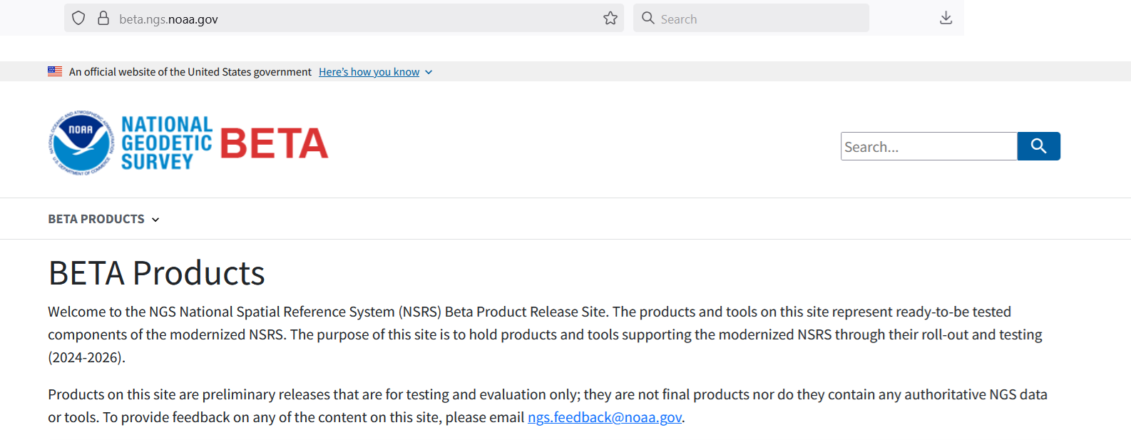
beta.ngs.noaa.gov
Note: A very different look/feel from previous NGS web designs
Using U.S. Web Design Standards

Slide 18
MYCS3: The entry point to ITRF2020
Multi-Year CORS Solution #3
Re-processing all NOAA CORS Network (NCN) data to estimate CORS Coordinate Functions (CCFs) in ITRF2020
Not on Beta, but is behind everything
ITRF2020 is the foundation for every part of the modernized NSRS
CCFs are now non-linear
Periodic + Exponential/Logarithmic post-seismic relaxation
Notes:
This is a pretty technical slide. It is important to be sure, but may be of interest to only a smaller portion of the audience.

Slide 19
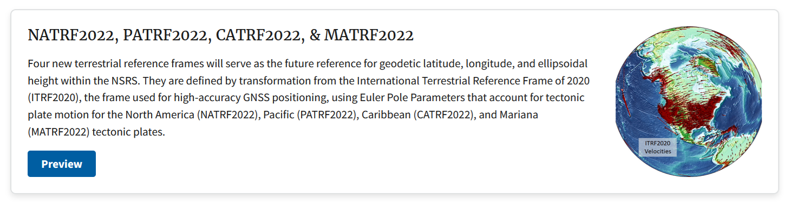
Defined N/P/C/MATRF2022

Slide 20
Defined N/P/C/MATRF2022
XYZ coordinates in N/P/C/MATRF2022 are defined through three simple plate rotation parameters relative to ITRF2020
These rotation parameters are in a model called the Euler Pole Parameters of 2022 (EPP2022)
Tends to stabilize latitude and longitude, over time, in the stable parts of each plate

Slide 21
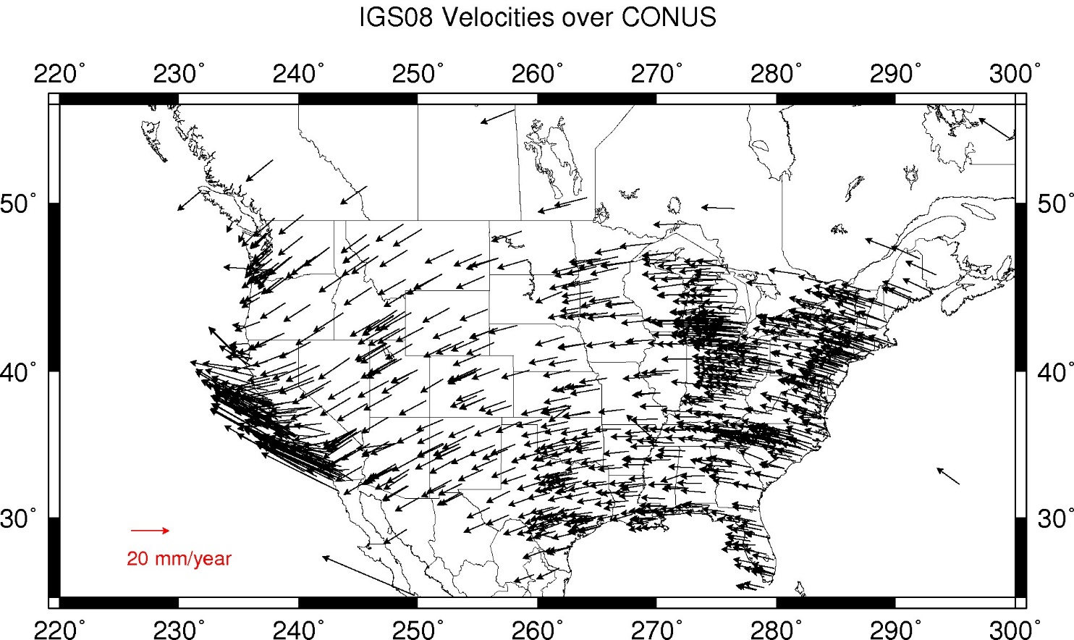
CORS Velocities – ITRF2020

Slide 22
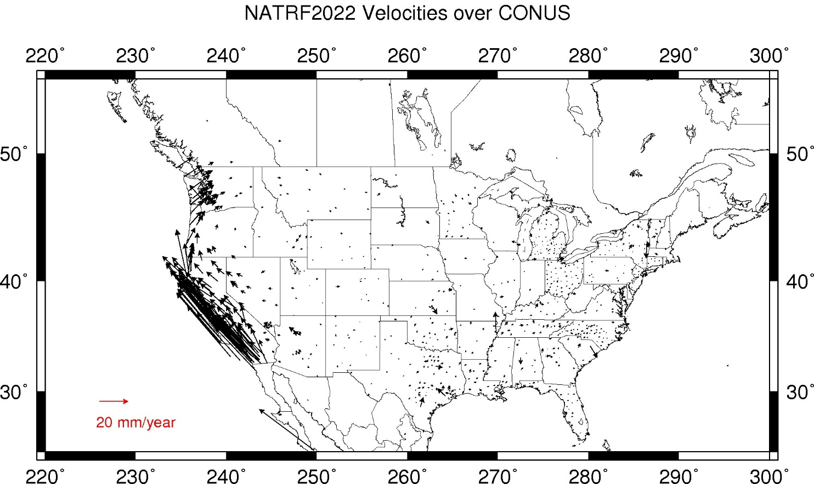
CORS Velocities – NATRF2022

Slide 23
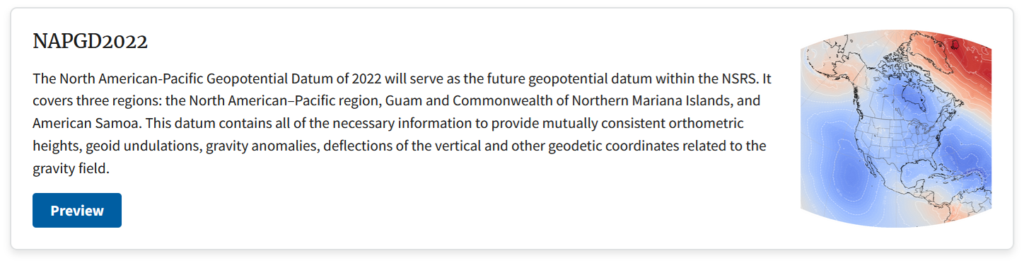
NAPGD2022 defined
Notes:
Officially GEOID2022 defines the relationship between h(ITRF2020) and H(NAPGD2022).

Slide 24
NAPGD2022 defined
The big star: GEOID2022
Defines the official relationship between ellipsoid heights in ITRF2020 and orthometric heights in NAPGD2022
The other excellent components:
DEFLEC2022
GM2022
Surface gravity estimator
Dynamic height estimator
Notes:
Officially GEOID2022 defines the relationship between h(ITRF2020) and H(NAPGD2022).

Slide 25
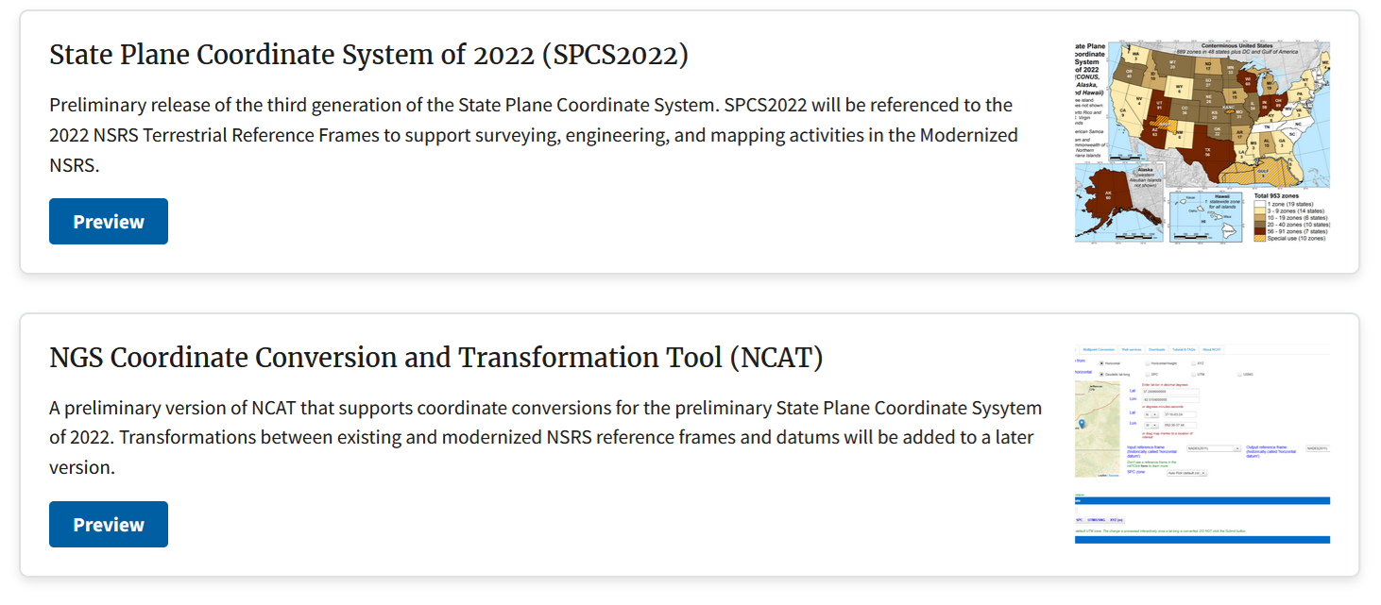
SPCS2022 defined and NCAT updated

Slide 26
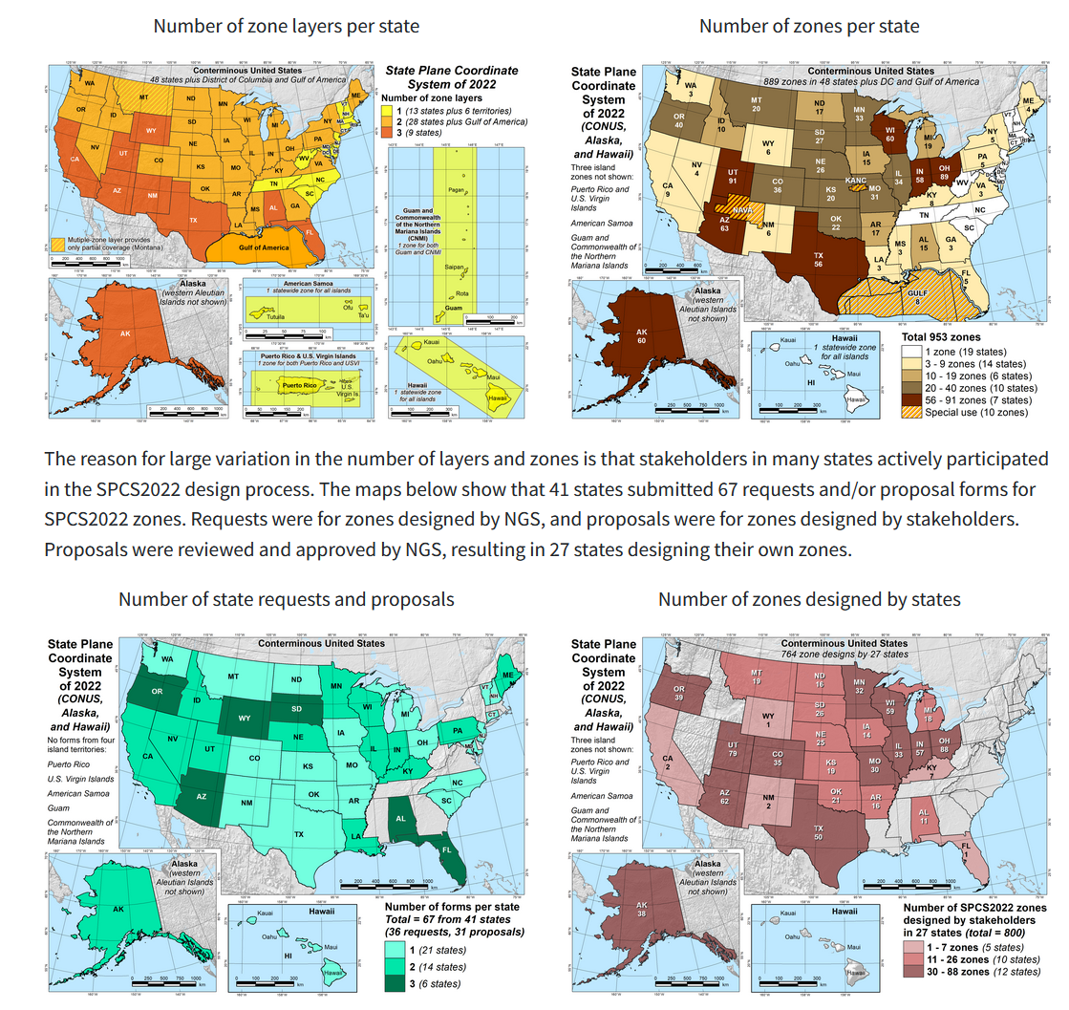
SPCS2022
A significant change from SPCS27 and SPCS83
Very customer-driven
Low-distortion projections

Slide 27
NCAT (beta)
Maintains existing functions:
Converting: (XYZ, lat/lon/ht, SPCS, etc.)
Transforming: (NAD 27, NAD 83, etc.)
Adds:
SPCS2022, but
Does not yet support N/P/C/MATRF2022
Thus input latitude and longitude in (say) NAD 83(2011) epoch 2010.00 will yield SPCS2022 answers that will differ from true SPCS2022 coordinates, since SPCS2022 is built to support input from N/P/C/MATRF2022
Does not yet add:
Geometric to geopotential conversions
Global 14-parameter Helmert transformations between terrestrial reference frames

Slide 28
Next steps for the first subset of products
NGS is proactively engaging federal partners
Education about NSRS Modernization
Seeking top-down support
Send comments or questions to NGS.Feedback@noaa.gov

Slide 29
What comes next

Slide 30
Prioritizing the order of releasing products
NGS promised a modernized NSRS with certain features and functionality. These promises were put out in our “Blueprint Documents”
Most of those promises stand, though some have required minor changes
In 2022 we fully realized that we would only fulfill a limited number of our promises by our self-imposed deadline of 2025
This required prioritizing what comes before 2025 and what comes after

Slide 31
Preliminary releases (Beta) for testing and evaluation
The modernized NSRS will be limited, at first
“The initial set of products and services of the modernized NSRS”
Good data now, then better tools
After approval of the initial set, we will continue to move toward improving and expanding the products of the modernized NSRS
But after the initial set becomes official, the term “modernized NSRS” will simply become “NSRS”

Slide 32
What are the remaining preliminary releases for testing/evaluation?
Promise | Will this be part of the preliminary testing and initial roll-out? | What does this mean to you?
Reference epoch coordinates (geometric) | Yes (~100k points) | N/P/C/MATRF2022 epoch 2020.0 coordinates and NAPGD2022 epoch 2020.00 orthometric heights on 100k existing geodetic control marks
Reference epoch coordinates (orthometric) | Yes (~1M points) | NAPGD2022 epoch 2020.00 orthometric heights on an additional 900k existing geodetic control marks
NADCON expansion (in NCAT) | Yes | Ability to transform from NAD 83 and NAVD 88 (et al) to the new reference frames and geopotential datum
VERTCON expansion (in NCAT) | Yes
OPUS-S | Yes | OPUS-Static functionality
Data Delivery System (Limited) | Yes | Searchable/downloadable “Geodetic Mark Pages” and “Geodetic Station Pages” to replace current datasheets and CORS station pages
OPUS-Projects for GPS | No | No OPUS-Projects for GPS functionality
OPUS-Projects for leveling, and others | No | No OPUS-Projects for leveling, and other functionalities

Slide 33
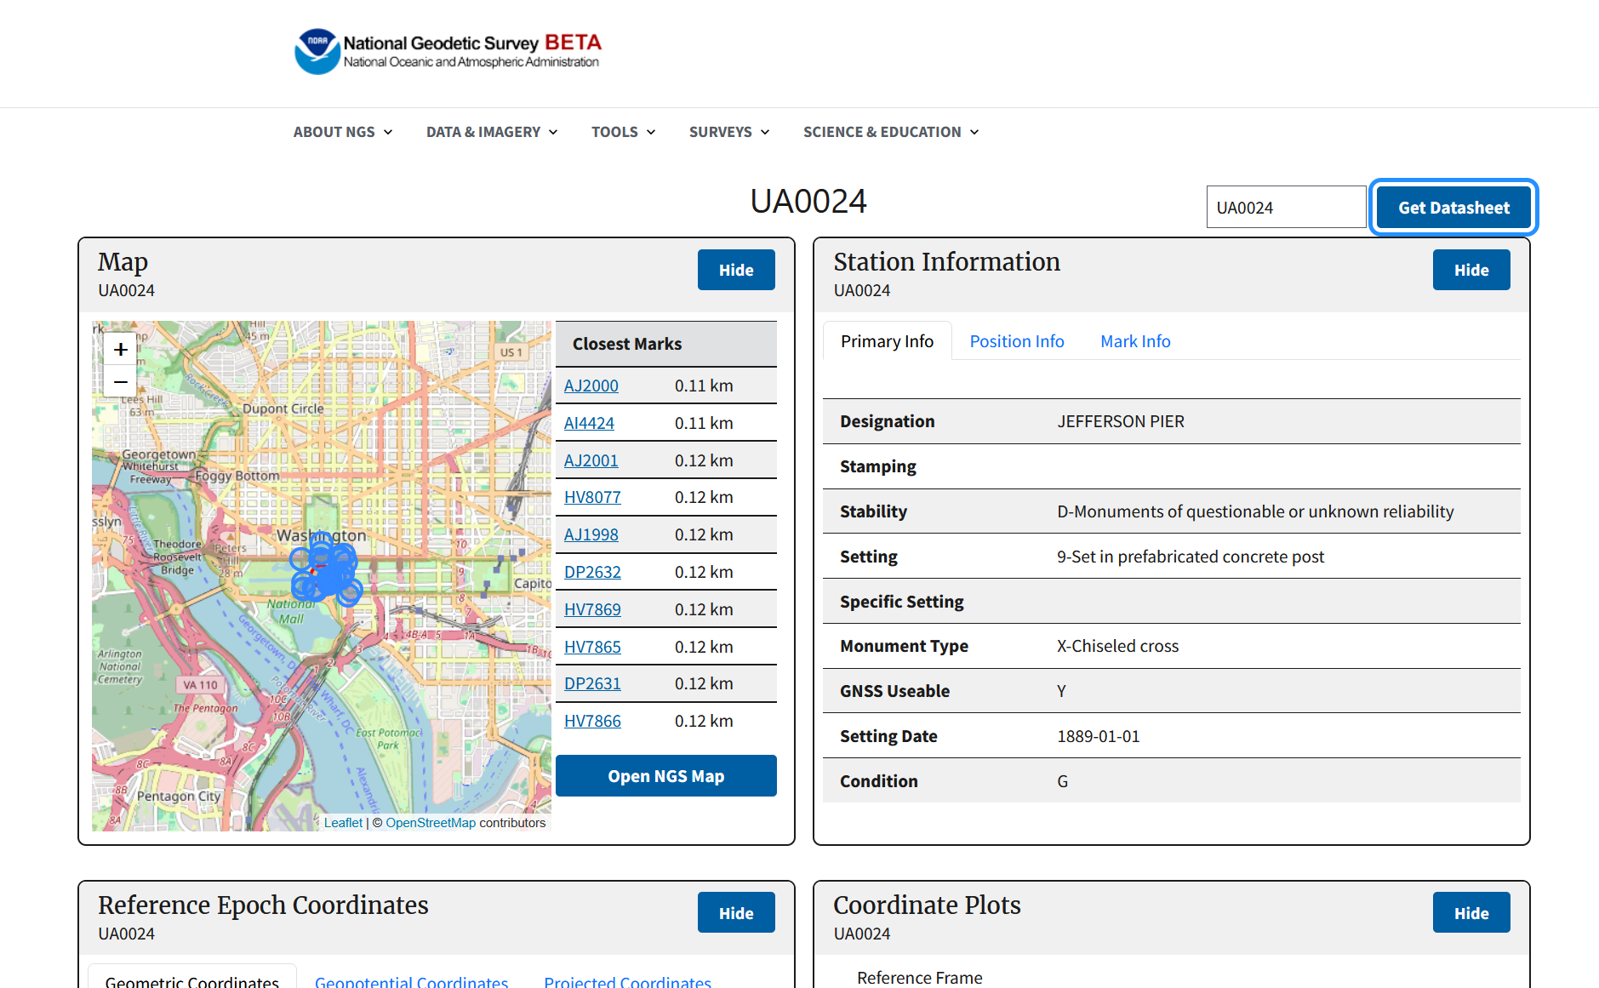
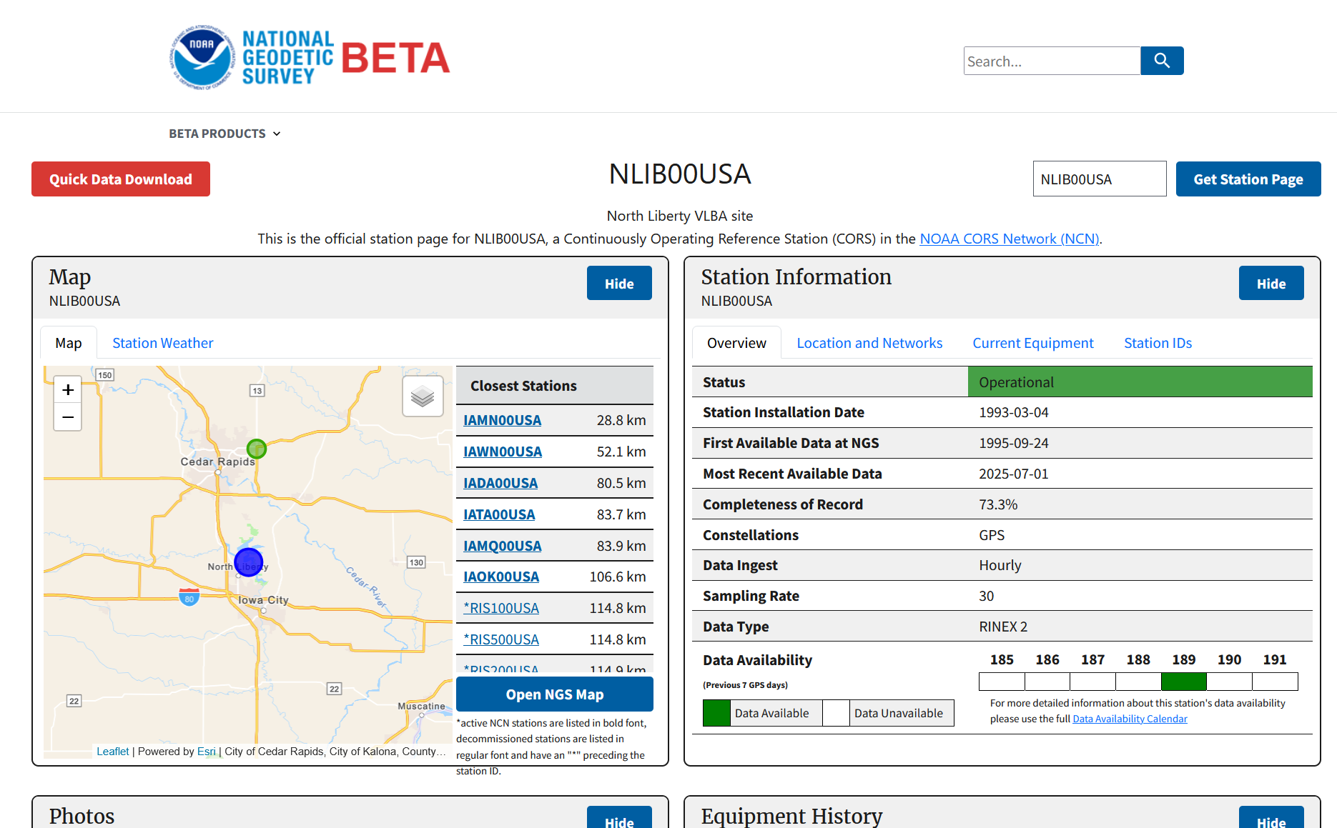
Data Delivery System (Limited)
Users will be able to query the NSRS Database (our new database!) for information about geodetic marks and geodetic stations
Replacing “Datasheets” and “CORS pages”
The DDS will continue to expand for years

Slide 34
OPUS-Projects
NGS has decided to stop efforts to modify the existing OPUS-Projects to work in the modernized NSRS
Rather, we have engaged on a fresh build
An OPUS suite, called “OPUS 6”
From reconnaissance to network adjustment
GNSS, leveling, other
Timeline: Start now
GNSS first
Minimize the gap where users have no “OPUS-Projects” in the modernized NSRS
OPUS-6 will not be released as part of the initial set of products and services in the modernized NSRS

Slide 35
Preliminary vs Final vs Official

Slide 36
Definitions
Preliminary = This is when the component is first introduced to the public by being released on the Beta website.
While on the Beta website, this component will undergo testing and evaluation.
Final = After testing and evaluation, NGS will stop making changes to a preliminary component.
This means that the component is not expected to change before being made official.
Official = A final component becomes official when NGS has moved it from the Beta website and fully integrated it into existing components of the modernized NSRS on the production website/production database

Slide 37
The official NSRS
The current NSRS (NAD 83, NAVD 88, etc.) remains the official NSRS of the United States.
It resides at the main NGS web site: geodesy.noaa.gov
The initial set of products and services of the modernized NSRS will be released in phases
It will reside at the Beta web site: beta.ngs.noaa.gov

Slide 38
The official NSRS
The current NSRS (NAD 83, NAVD 88, etc.) will remain the official NSRS of the United States until two things happen:
The initial set of products and services of the modernized NSRS is approved
Every component of that initial set has been successfully moved from the Beta web site to the main NGS web site, and fully integrated into production
Afterwards, the current NSRS will become superseded
NGS is considering a short overlap period between the two before ultimately shutting down all tools which actively work in the current NSRS

Slide 39
The official NSRS
Some modernized products and services may be finalized before approval of the entire initial rollout
Such final products remain unofficial!
For instance, SPCS2022 might be finalized in late 2025
Meaning no further changes to it will happen.
But that does not mean it is part of the official NSRS yet.
That only happens after the entire initial set has been approved and all beta products moved to the main NGS web page
Once the initial set of products and services of the modernized NSRS is “official”, the modernized NSRS becomes “the NSRS”

Slide 40
Summary

Slide 41
Summary
NSRS Modernization is still happening!
We’ve already released some products!
Awaiting feedback and testing
Will be finalized later this year (but still not “official”!!)
The “switch” to making the modernized NSRS “official” is planned for 2026
But work will continue to add functionality and tools to the (you don’t need to call it “modernized” anymore) NSRS for many years after 2026

Slide 42
What can you do to get prepared?
Review NGS webpages about assessing your datasets, workflows and requirements
NGS Engagement Team is proactively working with targeted groups that span a variety of workflows
Today’s timelines “ended” with the modernized NSRS becoming “official”
However, we recognize that will just mark the beginning for our partners and users
NGS is committed to working with our users through the transition
Subscribe to NGS News and NGS Webinars where we’ll announce future information

Slide 43
Thank you!

Slide 44
Questions?

