Slide 1
The National Geodetic Survey toolkit: OPUS improvements and plans
Dr. Mark Schenewerk
Edited & Presented by
Joe.Evjen@noaa.gov
National Geodetic Survey
Silver Spring, MD
SurvCon 2012, February 2, 2012
Bally's Park Place, Atlantic City, NJ

Slide 2
Description: The Online Positioning User Service (OPUS) is a National Geodetic Survey tool that provides you with National Spatial Reference System coordinates via email using your own GPS data file. Several recent improvements will be discussed, including new processing strategies, publishing options, and OPUS-Projects, a new BETA option providing tools to handle GPS projects involving several sites occupied over several days. Underlying these enhancements are new CORS coordinates derived from a recently completed global GNSS network solution.

Slide 3
Workshop Outline
OPUS Static
OPUS Rapid Static
OPUS published solutions
Reference Frames
OPUS Net, mapper, GNSS
OPUS Projects

Slide 4
Workshop Outline
I’m an informal speaker, so feel free to ask questions.
I will show examples of the web pages for completeness, but I am assuming a basic familiarity with the existing OPUS web sites. If you find any discussion about a web page too terse, ask for clarification.
4

Slide 5
What is OPUS?
To better understand where OPUS is going, let’s begin by reviewing the who, what, when, where and why of OPUS as it is today.
5

Slide 6
What is OPUS?
OPUS, the On-line Positioning User Service, is a growing set of applications offering web-based access to the tools and resources provided by the NGS.
Currently, OPUS is composed of:
OPUS-S . . . . . . . static processing
OPUS-RS. . . . . . rapid-static processing
publishing. . . . . . data base of solutions
Reviewing each of these individually…
6

Slide 7
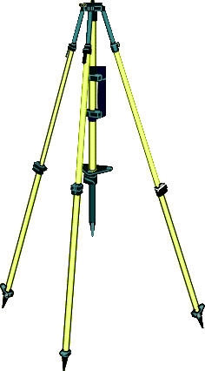
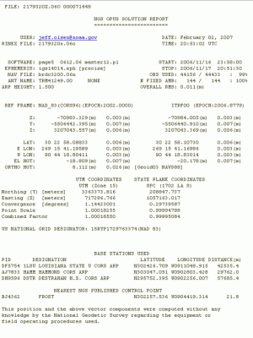
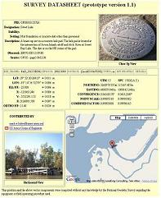

your GPS data
IGS & NGS base stations & site information files IGS antenna calibrations & satellite orbits & reference frames
UNAVCO teqc converter PAGES baseline processor
var. geophysical models
NGS geodetic toolkit
geodetic standard data
Online Positioning User Service OPUS geodesy.noaa.gov/OPUS/
JGE 2011v1
your solution
options:
projects & publishing
mark description

Slide 8
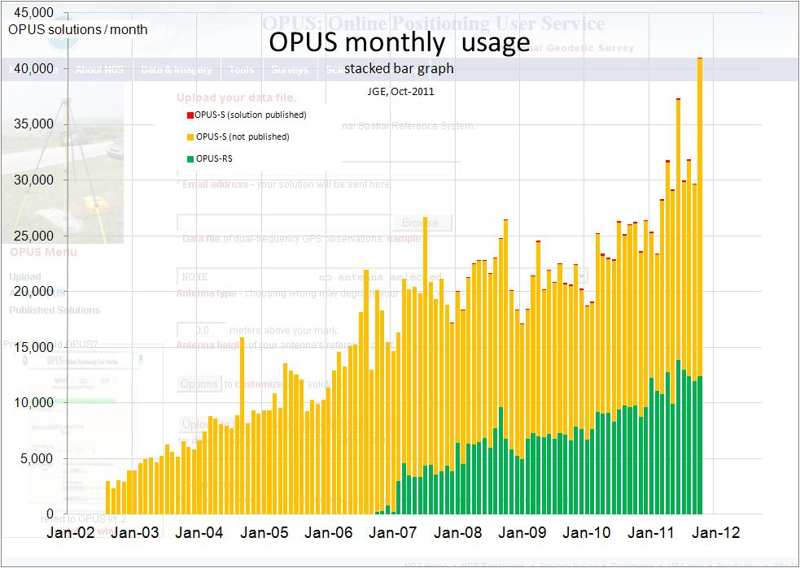

Slide 9
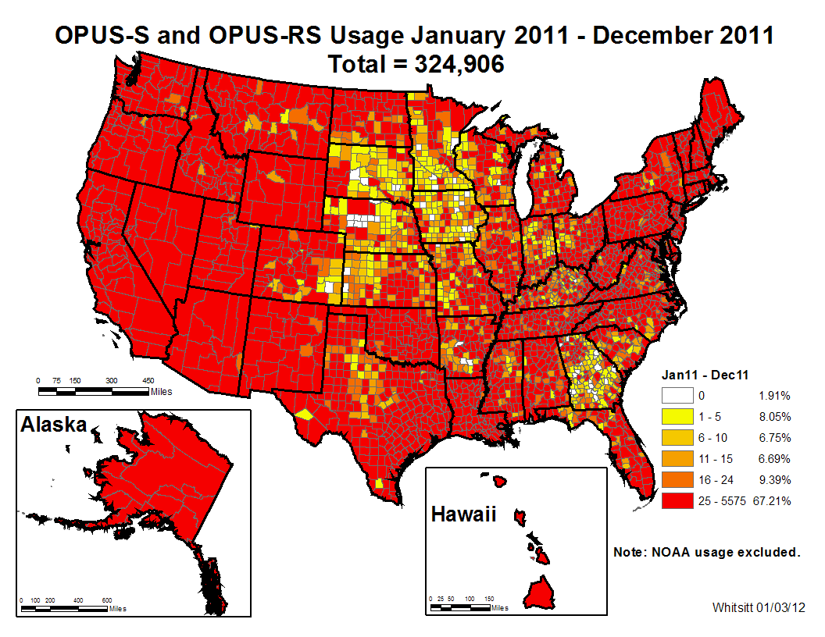
Notes:
1012 users in July

Slide 10
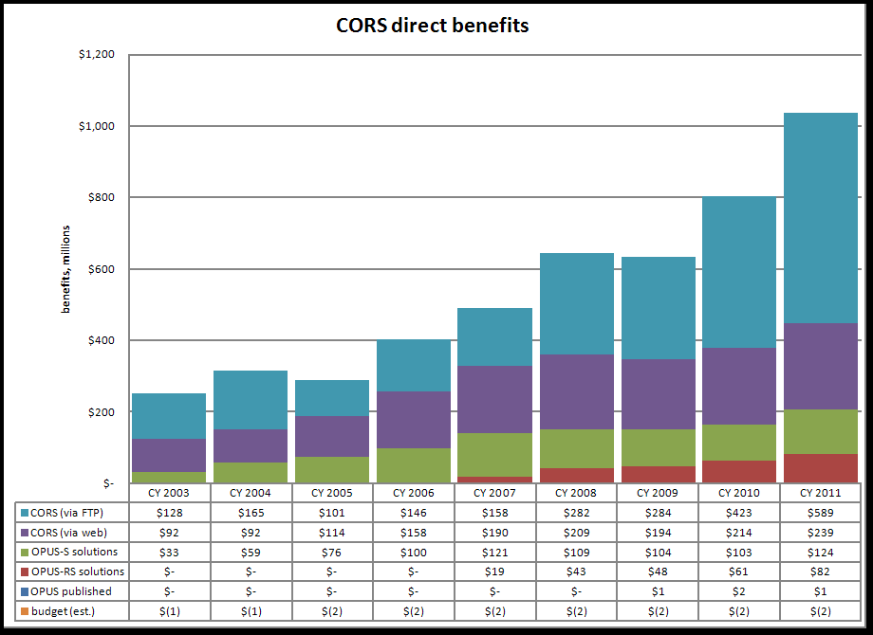

Slide 11
OPUS-S - static processing
A Little OPUS-S History.
The OPUS-S Interface.
How Good Can I Do With OPUS-S?
A Quick Example.
The Extended Report.
Back To Our Quick Example.
How Does OPUS-S Work?
OPUS-S Uploads By Month.
11

Slide 12
A Little OPUS-S History
In the late 1990’s, a growing number of organizations were making their Continuously Operating Reference Station (CORS) data publically available with a short latency.
Supporting products such as precise ephemerides were improving and also becoming available with a short latency.
Many organizations recognized that the time seemed ripe for some sort of on-line, processing service.
12

Slide 13
A Little OPUS-S History
In the NGS, Gerry Mader started promoting the idea of a processing service.
Specifically he envisioned a web-based service that was as simple as possible without significantly sacrificing accuracy thereby creating a tool useful to the largest possible group of potential users.
The NGS recognized that such a service could also be an effective tool to disseminate the National Spatial Reference System (NSRS).
13

Slide 14
A Little OPUS-S History
Mader and Weston (NGS) cloistered themselves and, with the help others too numerous to be mentioned here, created OPUS, now called OPUS-S, essentially as it exists today.
After an extended trial period, OPUS was formally made available to the public in 2002.
14

Slide 15
The OPUS-S Interface
Beautiful in its simplicity, the user need only provide:
Their email address.
The antenna type.
The offset to the antenna reference point (ARP).
2- to 48-hours of GPS L1 + L2 data.
In turn, the user receives:
Coordinates accurate to a few centimeters.
15

Slide 16
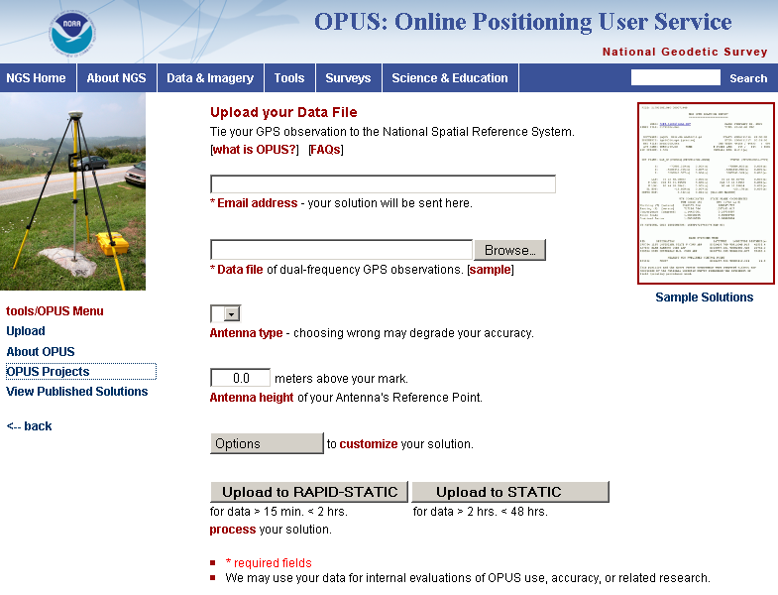
The OPUS-S Interface
http://geodesy.noaa.gov/OPUS/
This is the OPUS home page used to submit data to the OPUS processing queues. To use OPUS-S, complete the four fields, then click the “Upload to STATIC” button. In a few minutes, an email arrives with the results.
16

Slide 17
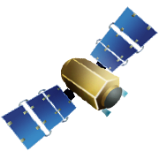

Static: OPUS determines your position with a differential GPS static solution, using hours of data.
This process is repeated twice from other CORS.
solution 2
CORS solution 1
solution 3

Slide 18
How Does OPUS-S Work?
The primary steps of OPUS-S processing are:
Prepare and quality control the submitted data.
Estimate a crude point-position using TEQC.
Compute distances to every available CORS.
Select the three “best” CORS based upon:
Being closest to the user’s site.
Having common satellite visibility with the user data.
Having more than 80% of the possible data available.
Having low multipath measures.
Complete the single-baseline processing using PAGES.
Check the solution quality and replace a CORS if needed.
Generate and email the report to the user.
18

Slide 19
How Does OPUS-S Work?
OPUS-S uses PAGES for data processing.
PAGES is a state-of-the-art processing engine developed by the NGS.
Besides OPUS-S, PAGES is used for orbit production, reference frame definition, network monitoring and many other GPS data processing tasks.
http://geodesy.noaa.gov/GRD/GPS/DOC/toc.html
http://igscb.jpl.nasa.gov/igscb/center/analysis/noaa.acn
19

Slide 20
How Does OPUS-S Work?
OPUS-S modeling highlights:
Satellite coordinates from the International GNSS Service (IGS) precise ephemerides. http://igscb.jpl.nasa.gov/components/usage.html.
CORS coordinates and hardware histories from the NGS site information data base.
Receiver antenna phase center offsets and variations from the NGS absolute antenna model data base. http://geodesy.noaa.gov/ANTCAL/.
International Earth Rotation Service (IERS) 2003 solid Earth tide model. http://www.iers.org/nn_11216/IERS/EN/Publications/TechnicalNotes/tn32.html.
Surface met from a climatological model. Boehm et al., “Short Note: A global model of pressure and temperature for geodetic applications”, J. Geod., 2007.
20

Slide 21
How Does OPUS-S Work?
OPUS-S processing highlights:
Everything is “done” in the International Terrestrial Reference Frame (ITRF).
SV coordinates are held rigidly fixed.
CORS coordinates are heavily constrained.
Neutral atmosphere (tropo) dry component modeled.
Neutral atmosphere (tropo) wet component estimated.
Double-differenced, ion-free carrier phase observable.
Carrier phase ambiguities are fixed to their integer values where possible; float ambiguities are estimated otherwise.
Individual baselines are processed and the results combined generating mean coordinates and peak-to-peak uncertainties.
21

Slide 22
How Does OPUS-S Work?
Some thoughts on phase ambiguity integer fixing.
The ambiguities, (charged and neutral) atmosphere delays and station heights strongly alias into each other.
There are really only two ways to “break” this aliasing:
Introduce more data.
Introduce additional information.
22

Slide 23
How Does OPUS-S Work?
OPUS-S uses the former strategy.
Depending upon the circumstances, 1- to 2-hours of observations are sufficient to decorrelate the ambiguities, atmosphere and heights allowing reliable estimation of all. Thus the requirement for a minimum of 2-hours in OPUS-S.
As an aside, be aware that while simply having more data helps, it is actually the change in orientation of the satellites over the data span that forces the decorrelation.
23

Slide 24
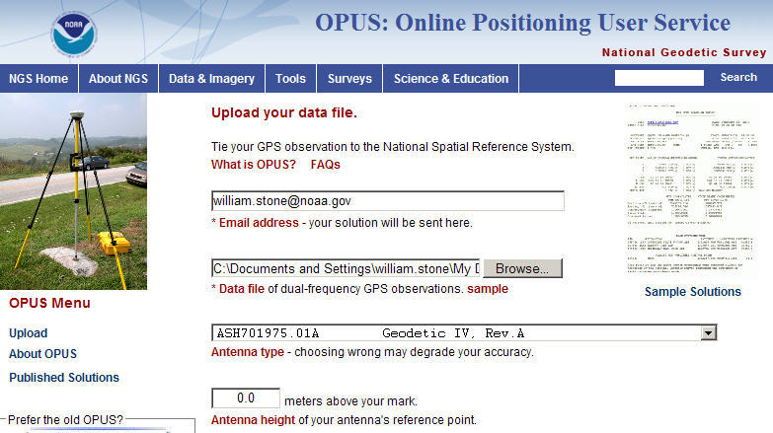
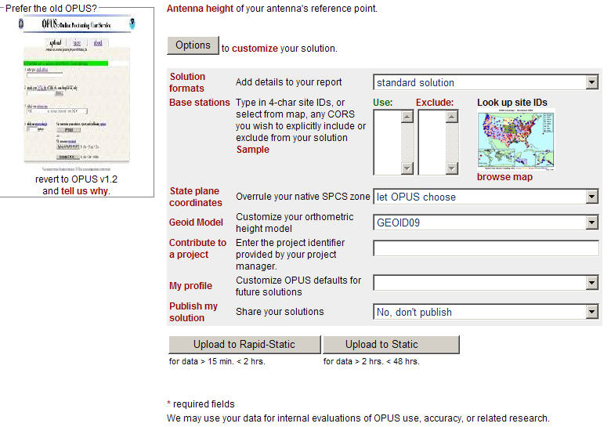
OPTIONS
extended solution
e-mail
in/exclude CORS
GPS file
SPC zone
antenna
geoid model – ‘03/‘09
antenna height
project
profile
publish
OPUS-RS or OPUS-Static
(15 min-2 hr) (2-48 hr)

Slide 25
Antenna Type, height – easy, right?
Type?
Verify by looking up in ANTCAL
Orient the antenna indicator to true north
Centered over the mark? (check plummet or bubble)
Height?
Height to what? (antenna ARP, not L1-phase center)
Fixed-height tripods are easier than slip-legs.
Vertical, NOT slant-height.
Is your fixed-height tripod really fixed? (measure!)

Slide 26
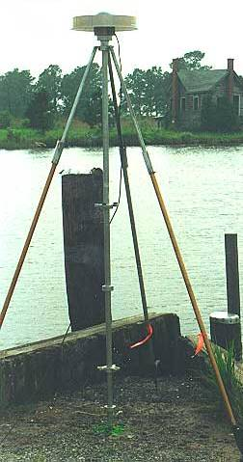
HOW IS THE ANTENNA HEIGHT MEASURED?
ARP
The height is measured vertically (NOT the slant height) from the mark to the ARP of the antenna.
The height is measured in meters.
The ARP is almost always the center of the bottom-most, permanently attached, surface of the antenna.
See GPS Antenna Calibration for photo’s and diagrams that show where the ARP is on most antennas:
http://geodesy.noaa.gov/ANTCAL/
If the default height of 0.0000 is entered, OPUS will return the position of the ARP.
MARK
Notes:
I promised we would talk more about antenna heights.
The height of the antenna is measure vertically from the from the mark, to the Antenna Reference Point which is almost always the center of the bottom-most, permanently attached piece o f the antenna.
Some antennas have a short pipe or extension to them.
If in doubt you can find photo’s and diagrams of each antenna (that we have calibrated) at the URL shown.
So if you leave the antenna height as “0” this will be the height OPUS returns.

Slide 27
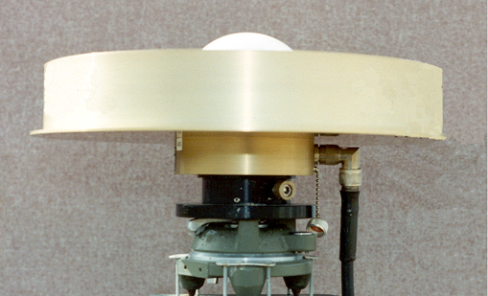
WHY DO I NEED THE ANTENNA TYPE?
The antenna phase centers are located somewhere around here.
phase ctr.
The antenna offsets are the distance between the phase centers and the ARP
ARP
You do not need to know these offsets. They are passed to the processing software through the antenna type
The Antenna Reference Point (ARP) is almost always located in the center of the bottom surface of the antenna.
Incorrect or missing antenna type → big vertical errors
Notes:
This is a close up of the last slide. You can see where the ARP is.
When you enter the correct Antenna type OPUS knows the antenna offsets and passes them to the software to determine the ARP
NGS uses the ARP rather than the phase center. The ARP is a known point on the antenna whereas the phase center varies depending on the elevation angle from the antenna to the satellite.

Slide 28
What else can go wrong?
Site
instability, multi-path
mark ID (search database, check stamping)
Weather
wild, local troposphere issues?
space weather: ionospheric issues?
“Truth” (orbits, CORS, etc.)
Rapid (next-day) orbits required for publishing

Slide 29
How Good Can I Do With OPUS-S?
OPUS-S reliably addresses the more historically conventional requirements for GPS data processing. It typically yields accuracies of:
1 – 2 cm horizontally
2 – 4 cm vertically
However, there is no guarantee that this stated accuracy will result from any given data set. Confirming the quality of the OPUS solution remains the user’s responsibility. That’s the “price” for automated processing.
29

Slide 30
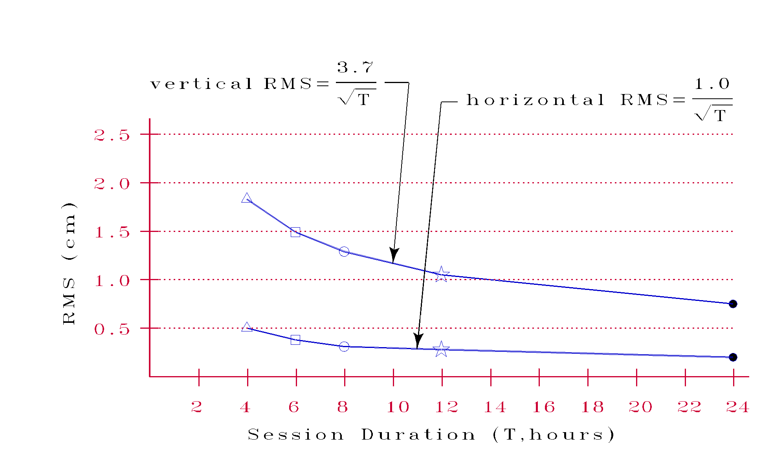
How Good Can I Do With OPUS-S?
More generally, Eckl et al. (NGS, 1999) preformed a similar but more extensive test using the same software but outside OPUS.
Eckl et al., 2001, “Accuracy of GPS-derived relative positions as a function of interstation distance and observing-session duration”, J. of Geod. 75, 633-640).
Their results provide a good “rule of thumb” for accuracy versus session duration when using OPUS-S and in many other applications.
30
Notes:
Studies performed in 1999 indicate that the standard error of computed horizontal coordinates, expressed in centimeters, may be approximated by the mathematical expression: one divided by the square root of the length of the observing session in hours. Similarly, these studies indicate that the standard error of computed vertical coordinates, again in centimeters, may be approximated by the mathematical expression: 3.7 divided by the square root of the length of the observing session in hours. Newer studies of achievable accuracies are now being conducted, and these studies indicate that the same level of accuracy can be obtained with shorter observing sessions, when the atmospheric conditions measured at CORS sites are interpolated to the location where the user collected his/her data.

Slide 31
How Good Can I Do With OPUS-S?
As a quality test, 2-hour data sets from more than 200 CORS were submitted to OPUS-S and the results compared to the accepted coordinates.
Mean: <0.1 cm
N-S RMS: 0.8 cm
E-W RMS: 1.4 cm
Weston, N. “OPUS: Online Positioning User Service”, CGSIC USSLS MEETING, 2008-07-08, NEW ORLEANS, LA.
31

Slide 32
How Good Can I Do With OPUS-S?
Same data sets.
Same analysis but for the vertical.
The vertical is always a little more interesting.
Mean: <0.1 cm
U-D RMS: 1.9 cm
Weston, “OPUS: Online Positioning User Service”, CGSIC USSLS MEETING, 2008-07-08, NEW ORLEANS, LA
32

Slide 33
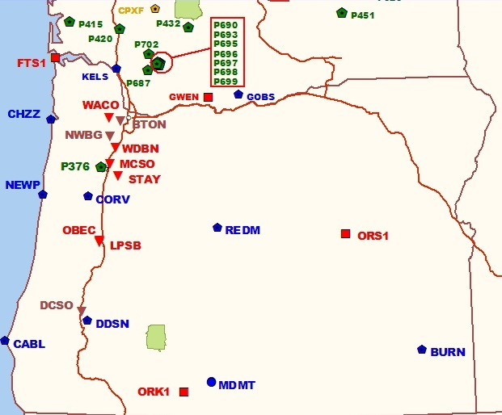
A Quick Example
As an example,
2-hours of 2009-059 data from CORV, a PBO CORS in Oregon were submitted to OPUS-S.
33

Slide 34
A Quick Example
USER: mark.schenewerk@noaa.gov DATE: March 31, 2010 RINEX FILE: corv059f.09o TIME: 19:43:42 UTC SOFTWARE: page5 0909.08 master40.pl 081023 START: 2009/02/28 05:00:00 EPHEMERIS: igs15206.eph [precise] STOP: 2009/02/28 06:59:00 NAV FILE: brdc0590.09n OBS USED: 5984 / 6181 : 97% ANT NAME: ASH700936C_M NONE # FIXED AMB: 31 / 31 : 100% ARP HEIGHT: 1.521 OVERALL RMS: 0.009(m) REF FRAME: NAD_83(CORS96)(EPOCH:2002.0000) ITRF00 (EPOCH:2009.1596) X: -2498422.603(m) 0.011(m) -2498423.344(m) 0.011(m) Y: -3802821.159(m) 0.007(m) -3802819.941(m) 0.007(m) Z: 4454736.661(m) 0.021(m) 4454736.734(m) 0.021(m) LAT: 44 35 7.91060 0.016(m) 44 35 7.92618 0.016(m) E LON: 236 41 43.48046 0.013(m) 236 41 43.42207 0.013(m) W LON: 123 18 16.51954 0.013(m) 123 18 16.57793 0.013(m) EL HGT: 106.011(m) 0.014(m) 105.627(m) 0.014(m) ORTHO HGT: 128.542(m) 0.020(m) [NAVD88 (Computed using GEOID09)] UTM COORDINATES STATE PLANE COORDINATES UTM (Zone 10) SPC (3601 OR N) Northing (Y) [meters] 4936954.909 105971.559 Easting (X) [meters] 475821.304 2277335.367 Convergence [degrees] -0.21381419 -1.98897513 Point Scale 0.99960719 0.99994603 Combined Factor 0.99959057 0.99992941 US NATIONAL GRID DESIGNATOR: 10TDQ7582136954(NAD 83) BASE STATIONS USED PID DESIGNATION LATITUDE LONGITUDE DISTANCE(m) DH4503 P376 EOLARESVR_OR2004 CORS ARP N445628.313 W1230608.100 42648.2 DE6258 MCSO MARION CNTY COOP CORS ARP N445825.701 W1225720.639 51226.8 DG5352 STAY STAYTON COOP CORS ARP N444950.530 W1224915.036 47030.9
Here is part of the report for this submission.
FYI, these results differ 2.1 cm horizontally and 1.6 cm vertically from the accepted position projected to the epoch of the data.
34

Slide 35
A Quick Example
USER: mark.schenewerk@noaa.gov DATE: March 31, 2010 RINEX FILE: corv059f.09o TIME: 19:43:42 UTC SOFTWARE: page5 0909.08 master40.pl 081023 START: 2009/02/28 05:00:00 EPHEMERIS: igs15206.eph [precise] STOP: 2009/02/28 06:59:00 NAV FILE: brdc0590.09n OBS USED: 5984 / 6181 : 97% ANT NAME: ASH700936C_M NONE # FIXED AMB: 31 / 31 : 100% ARP HEIGHT: 1.521 OVERALL RMS: 0.009(m) REF FRAME: NAD_83(CORS96)(EPOCH:2002.0000) ITRF00 (EPOCH:2009.1596) X: -2498422.603(m) 0.011(m) -2498423.344(m) 0.011(m) Y: -3802821.159(m) 0.007(m) -3802819.941(m) 0.007(m) Z: 4454736.661(m) 0.021(m) 4454736.734(m) 0.021(m) LAT: 44 35 7.91060 0.016(m) 44 35 7.92618 0.016(m) E LON: 236 41 43.48046 0.013(m) 236 41 43.42207 0.013(m) W LON: 123 18 16.51954 0.013(m) 123 18 16.57793 0.013(m) EL HGT: 106.011(m) 0.014(m) 105.627(m) 0.014(m) ORTHO HGT: 128.542(m) 0.020(m) [NAVD88 (Computed using GEOID09)] UTM COORDINATES STATE PLANE COORDINATES UTM (Zone 10) SPC (3601 OR N) Northing (Y) [meters] 4936954.909 105971.559 Easting (X) [meters] 475821.304 2277335.367 Convergence [degrees] -0.21381419 -1.98897513 Point Scale 0.99960719 0.99994603 Combined Factor 0.99959057 0.99992941 US NATIONAL GRID DESIGNATOR: 10TDQ7582136954(NAD 83) BASE STATIONS USED PID DESIGNATION LATITUDE LONGITUDE DISTANCE(m) DH4503 P376 EOLARESVR_OR2004 CORS ARP N445628.313 W1230608.100 42648.2 DE6258 MCSO MARION CNTY COOP CORS ARP N445825.701 W1225720.639 51226.8 DG5352 STAY STAYTON COOP CORS ARP N444950.530 W1224915.036 47030.9
Again, I’m assuming familiarity with the report, but …
… at the risk of stating the obvious, there are a few items I want to draw attention to.
35

Slide 36
A Quick Example
USER: mark.schenewerk@noaa.gov DATE: March 31, 2010 RINEX FILE: corv059f.09o TIME: 19:43:42 UTC SOFTWARE: page5 0909.08 master40.pl 081023 START: 2009/02/28 05:00:00 EPHEMERIS: igs15206.eph [precise] STOP: 2009/02/28 06:59:00 NAV FILE: brdc0590.09n OBS USED: 5984 / 6181 : 97% ANT NAME: ASH700936C_M NONE # FIXED AMB: 31 / 31 : 100% ARP HEIGHT: 1.521 OVERALL RMS: 0.009(m) REF FRAME: NAD_83(CORS96)(EPOCH:2002.0000) ITRF00 (EPOCH:2009.1596) X: -2498422.603(m) 0.011(m) -2498423.344(m) 0.011(m) Y: -3802821.159(m) 0.007(m) -3802819.941(m) 0.007(m) Z: 4454736.661(m) 0.021(m) 4454736.734(m) 0.021(m) LAT: 44 35 7.91060 0.016(m) 44 35 7.92618 0.016(m) E LON: 236 41 43.48046 0.013(m) 236 41 43.42207 0.013(m) W LON: 123 18 16.51954 0.013(m) 123 18 16.57793 0.013(m) EL HGT: 106.011(m) 0.014(m) 105.627(m) 0.014(m) ORTHO HGT: 128.542(m) 0.020(m) [NAVD88 (Computed using GEOID09)] UTM COORDINATES STATE PLANE COORDINATES UTM (Zone 10) SPC (3601 OR N) Northing (Y) [meters] 4936954.909 105971.559 Easting (X) [meters] 475821.304 2277335.367 Convergence [degrees] -0.21381419 -1.98897513 Point Scale 0.99960719 0.99994603 Combined Factor 0.99959057 0.99992941 US NATIONAL GRID DESIGNATOR: 10TDQ7582136954(NAD 83) BASE STATIONS USED PID DESIGNATION LATITUDE LONGITUDE DISTANCE(m) DH4503 P376 EOLARESVR_OR2004 CORS ARP N445628.313 W1230608.100 42648.2 DE6258 MCSO MARION CNTY COOP CORS ARP N445825.701 W1225720.639 51226.8 DG5352 STAY STAYTON COOP CORS ARP N444950.530 W1224915.036 47030.9
RINEX FILE: corv059f.09o
START: 2009/02/28 05:00:00 STOP: 2009/02/28 06:59:00
I apologize for stating the obvious, but …
When reviewing your OPUS solution, double check that the information you provided is correct.
ANT NAME: ASH700936C_M NONE
ARP HEIGHT: 1.521
36

Slide 37

A Quick Example
USER: mark.schenewerk@noaa.gov DATE: March 31, 2010 RINEX FILE: corv059f.09o TIME: 19:43:42 UTC SOFTWARE: page5 0909.08 master40.pl 081023 START: 2009/02/28 05:00:00 EPHEMERIS: igs15206.eph [precise] STOP: 2009/02/28 06:59:00 NAV FILE: brdc0590.09n OBS USED: 5984 / 6181 : 97% ANT NAME: ASH700936C_M NONE # FIXED AMB: 31 / 31 : 100% ARP HEIGHT: 1.521 OVERALL RMS: 0.009(m) REF FRAME: NAD_83(CORS96)(EPOCH:2002.0000) ITRF00 (EPOCH:2009.1596) X: -2498422.603(m) 0.011(m) -2498423.344(m) 0.011(m) Y: -3802821.159(m) 0.007(m) -3802819.941(m) 0.007(m) Z: 4454736.661(m) 0.021(m) 4454736.734(m) 0.021(m) LAT: 44 35 7.91060 0.016(m) 44 35 7.92618 0.016(m) E LON: 236 41 43.48046 0.013(m) 236 41 43.42207 0.013(m) W LON: 123 18 16.51954 0.013(m) 123 18 16.57793 0.013(m) EL HGT: 106.011(m) 0.014(m) 105.627(m) 0.014(m) ORTHO HGT: 128.542(m) 0.020(m) [NAVD88 (Computed using GEOID09)] UTM COORDINATES STATE PLANE COORDINATES UTM (Zone 10) SPC (3601 OR N) Northing (Y) [meters] 4936954.909 105971.559 Easting (X) [meters] 475821.304 2277335.367 Convergence [degrees] -0.21381419 -1.98897513 Point Scale 0.99960719 0.99994603 Combined Factor 0.99959057 0.99992941 US NATIONAL GRID DESIGNATOR: 10TDQ7582136954(NAD 83) BASE STATIONS USED PID DESIGNATION LATITUDE LONGITUDE DISTANCE(m) DH4503 P376 EOLARESVR_OR2004 CORS ARP N445628.313 W1230608.100 42648.2 DE6258 MCSO MARION CNTY COOP CORS ARP N445825.701 W1225720.639 51226.8 DG5352 STAY STAYTON COOP CORS ARP N444950.530 W1224915.036 47030.9
I apologize for stating the obvious, but …
Check the quality control measures provided:
OBS USED > 90%
# FIXED AMB > 50%
OVERALL RMS < 3 cm
peak-to-peak < 5 cm
In this example, we have a .
OBS USED: 5984 / 6181 : 97% # FIXED AMB: 31 / 31 : 100% OVERALL RMS: 0.009(m)
0.011(m)
0.007(m)
0.021(m)
37

Slide 38
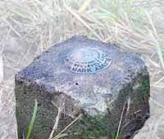
solution 2
=
h
your position: averaged from the 3 CORS solutions
φ
CORS solution 1
λ
=
=
solution 3
your peak-to-peaks: scaled from the spread of the 3 CORS solutions

Slide 39
The Extended Report
BASE STATION INFORMATION STATION NAME: p376 a 2 (EOLARESVR_OR2004; Salem, OR United States) MONUMENT: NO DOMES NUMBER XYZ -2469806.7634 -3788348.6049 4482853.4377 MON @ 1997.0000 (M) XYZ -0.0141 0.0030 -0.0043 VEL (M/YR) NEU -0.0000 0.0000 0.0083 MON TO ARP (M) NEU 0.0009 0.0009 0.1068 ARP TO L1 PHASE CENTER (M) NEU 0.0002 0.0017 0.1251 ARP TO L2 PHASE CENTER (M) XYZ -0.1715 0.0365 -0.0523 VEL TIMES 12.1597 YRS XYZ -0.0032 -0.0049 0.0059 MON TO ARP XYZ -0.0402 -0.0633 0.0761 ARP TO L1 PHASE CENTER XYZ -2469806.9782 -3788348.6366 4482853.4674 L1 PHS CEN @ 2009.1596 XYZ 0.0000 0.0000 0.0000 + XYZ ADJUSTMENTS XYZ -2469806.9782 -3788348.6366 4482853.4674 NEW L1 PHS CEN @ 2009.1596 XYZ -2469806.9381 -3788348.5733 4482853.3913 NEW ARP @ 2009.1596 XYZ -2469806.9348 -3788348.5684 4482853.3855 NEW MON @ 2009.1596 LLH 44 56 28.32921 236 53 51.83975 180.9607 NEW L1 PHS CEN @ 2009.1596 LLH 44 56 28.32918 236 53 51.83971 180.8539 NEW ARP @ 2009.1596 LLH 44 56 28.32918 236 53 51.83971 180.8456 NEW MON @ 2009.1596 STATION NAME: mcso a 1 (MARION CNTY COOP; Salem, Oregon, U.S.A.) MONUMENT: NO DOMES NUMBER XYZ -2458668.9460 -3792427.4770 4485327.2930 MON @ 1997.0000 (M) XYZ -0.0131 0.0018 -0.0047 VEL (M/YR) NEU 0.0000 0.0000 0.0000 MON TO ARP (M) NEU 0.0025 0.0013 0.1065 ARP TO L1 PHASE CENTER (M) NEU -0.0007 0.0013 0.1254 ARP TO L2 PHASE CENTER (M) XYZ -0.1593 0.0219 -0.0572 VEL TIMES 12.1597 YRS XYZ 0.0000 0.0000 0.0000 MON TO ARP XYZ -0.0389 -0.0624 0.0770 ARP TO L1 PHASE CENTER XYZ -2458669.1442 -3792427.5176 4485327.3129 L1 PHS CEN @ 2009.1596 XYZ -0.0000 -0.0000 -0.0000 + XYZ ADJUSTMENTS XYZ -2458669.1442 -3792427.5176 4485327.3129 NEW L1 PHS CEN @ 2009.1596 XYZ -2458669.1053 -3792427.4551 4485327.2358 NEW ARP @ 2009.1596 XYZ -2458669.1053 -3792427.4551 4485327.2358 NEW MON @ 2009.1596 LLH 44 58 25.71729 237 2 39.30118 52.9227 NEW L1 PHS CEN @ 2009.1596 LLH 44 58 25.71721 237 2 39.30112 52.8162 NEW ARP @ 2009.1596 LLH 44 58 25.71721 237 2 39.30112 52.8162 NEW MON @ 2009.1596
If the extended report option was selected, next you’ll see the BASE STATION section.
Here, the components contributing to the base stations’ coordinates are shown in detail. These and the following information are expressed in the ITRF currently in use.
39

Slide 40
The Extended Report
BASE STATION INFORMATION STATION NAME: p376 a 2 (EOLARESVR_OR2004; Salem, OR United States) MONUMENT: NO DOMES NUMBER XYZ -2469806.7634 -3788348.6049 4482853.4377 MON @ 1997.0000 (M) XYZ -0.0141 0.0030 -0.0043 VEL (M/YR) NEU -0.0000 0.0000 0.0083 MON TO ARP (M) NEU 0.0009 0.0009 0.1068 ARP TO L1 PHASE CENTER (M) NEU 0.0002 0.0017 0.1251 ARP TO L2 PHASE CENTER (M) XYZ -0.1715 0.0365 -0.0523 VEL TIMES 12.1597 YRS XYZ -0.0032 -0.0049 0.0059 MON TO ARP XYZ -0.0402 -0.0633 0.0761 ARP TO L1 PHASE CENTER XYZ -2469806.9782 -3788348.6366 4482853.4674 L1 PHS CEN @ 2009.1596 XYZ 0.0000 0.0000 0.0000 + XYZ ADJUSTMENTS XYZ -2469806.9782 -3788348.6366 4482853.4674 NEW L1 PHS CEN @ 2009.1596 XYZ -2469806.9381 -3788348.5733 4482853.3913 NEW ARP @ 2009.1596 XYZ -2469806.9348 -3788348.5684 4482853.3855 NEW MON @ 2009.1596 LLH 44 56 28.32921 236 53 51.83975 180.9607 NEW L1 PHS CEN @ 2009.1596 LLH 44 56 28.32918 236 53 51.83971 180.8539 NEW ARP @ 2009.1596 LLH 44 56 28.32918 236 53 51.83971 180.8456 NEW MON @ 2009.1596 STATION NAME: mcso a 1 (MARION CNTY COOP; Salem, Oregon, U.S.A.) MONUMENT: NO DOMES NUMBER XYZ -2458668.9460 -3792427.4770 4485327.2930 MON @ 1997.0000 (M) XYZ -0.0131 0.0018 -0.0047 VEL (M/YR) NEU 0.0000 0.0000 0.0000 MON TO ARP (M) NEU 0.0025 0.0013 0.1065 ARP TO L1 PHASE CENTER (M) NEU -0.0007 0.0013 0.1254 ARP TO L2 PHASE CENTER (M) XYZ -0.1593 0.0219 -0.0572 VEL TIMES 12.1597 YRS XYZ 0.0000 0.0000 0.0000 MON TO ARP XYZ -0.0389 -0.0624 0.0770 ARP TO L1 PHASE CENTER XYZ -2458669.1442 -3792427.5176 4485327.3129 L1 PHS CEN @ 2009.1596 XYZ -0.0000 -0.0000 -0.0000 + XYZ ADJUSTMENTS XYZ -2458669.1442 -3792427.5176 4485327.3129 NEW L1 PHS CEN @ 2009.1596 XYZ -2458669.1053 -3792427.4551 4485327.2358 NEW ARP @ 2009.1596 XYZ -2458669.1053 -3792427.4551 4485327.2358 NEW MON @ 2009.1596 LLH 44 58 25.71729 237 2 39.30118 52.9227 NEW L1 PHS CEN @ 2009.1596 LLH 44 58 25.71721 237 2 39.30112 52.8162 NEW ARP @ 2009.1596 LLH 44 58 25.71721 237 2 39.30112 52.8162 NEW MON @ 2009.1596
STATION NAME: p376 a 2 (EOLARESVR_OR2004; Salem, OR United States) MONUMENT: NO DOMES NUMBER XYZ -2469806.7634 -3788348.6049 4482853.4377 MON @ 1997.0000 (M) XYZ -0.0141 0.0030 -0.0043 VEL (M/YR) NEU -0.0000 0.0000 0.0083 MON TO ARP (M) NEU 0.0009 0.0009 0.1068 ARP TO L1 PHASE CENTER (M) NEU 0.0002 0.0017 0.1251 ARP TO L2 PHASE CENTER (M)
This section includes a priori information.
40

Slide 41
The Extended Report
BASE STATION INFORMATION STATION NAME: p376 a 2 (EOLARESVR_OR2004; Salem, OR United States) MONUMENT: NO DOMES NUMBER XYZ -2469806.7634 -3788348.6049 4482853.4377 MON @ 1997.0000 (M) XYZ -0.0141 0.0030 -0.0043 VEL (M/YR) NEU -0.0000 0.0000 0.0083 MON TO ARP (M) NEU 0.0009 0.0009 0.1068 ARP TO L1 PHASE CENTER (M) NEU 0.0002 0.0017 0.1251 ARP TO L2 PHASE CENTER (M) XYZ -0.1715 0.0365 -0.0523 VEL TIMES 12.1597 YRS XYZ -0.0032 -0.0049 0.0059 MON TO ARP XYZ -0.0402 -0.0633 0.0761 ARP TO L1 PHASE CENTER XYZ -2469806.9782 -3788348.6366 4482853.4674 L1 PHS CEN @ 2009.1596 XYZ 0.0000 0.0000 0.0000 + XYZ ADJUSTMENTS XYZ -2469806.9782 -3788348.6366 4482853.4674 NEW L1 PHS CEN @ 2009.1596 XYZ -2469806.9381 -3788348.5733 4482853.3913 NEW ARP @ 2009.1596 XYZ -2469806.9348 -3788348.5684 4482853.3855 NEW MON @ 2009.1596 LLH 44 56 28.32921 236 53 51.83975 180.9607 NEW L1 PHS CEN @ 2009.1596 LLH 44 56 28.32918 236 53 51.83971 180.8539 NEW ARP @ 2009.1596 LLH 44 56 28.32918 236 53 51.83971 180.8456 NEW MON @ 2009.1596 STATION NAME: mcso a 1 (MARION CNTY COOP; Salem, Oregon, U.S.A.) MONUMENT: NO DOMES NUMBER XYZ -2458668.9460 -3792427.4770 4485327.2930 MON @ 1997.0000 (M) XYZ -0.0131 0.0018 -0.0047 VEL (M/YR) NEU 0.0000 0.0000 0.0000 MON TO ARP (M) NEU 0.0025 0.0013 0.1065 ARP TO L1 PHASE CENTER (M) NEU -0.0007 0.0013 0.1254 ARP TO L2 PHASE CENTER (M) XYZ -0.1593 0.0219 -0.0572 VEL TIMES 12.1597 YRS XYZ 0.0000 0.0000 0.0000 MON TO ARP XYZ -0.0389 -0.0624 0.0770 ARP TO L1 PHASE CENTER XYZ -2458669.1442 -3792427.5176 4485327.3129 L1 PHS CEN @ 2009.1596 XYZ -0.0000 -0.0000 -0.0000 + XYZ ADJUSTMENTS XYZ -2458669.1442 -3792427.5176 4485327.3129 NEW L1 PHS CEN @ 2009.1596 XYZ -2458669.1053 -3792427.4551 4485327.2358 NEW ARP @ 2009.1596 XYZ -2458669.1053 -3792427.4551 4485327.2358 NEW MON @ 2009.1596 LLH 44 58 25.71729 237 2 39.30118 52.9227 NEW L1 PHS CEN @ 2009.1596 LLH 44 58 25.71721 237 2 39.30112 52.8162 NEW ARP @ 2009.1596 LLH 44 58 25.71721 237 2 39.30112 52.8162 NEW MON @ 2009.1596
Computation of the coordinates at the mean epoch of the data.
XYZ -0.1715 0.0365 -0.0523 VEL TIMES 12.1597 YRS XYZ -0.0032 -0.0049 0.0059 MON TO ARP XYZ -0.0402 -0.0633 0.0761 ARP TO L1 PHASE CENTER XYZ -2469806.9782 -3788348.6366 4482853.4674 L1 PHS CEN @ 2009.1596
41

Slide 42
The Extended Report
BASE STATION INFORMATION STATION NAME: p376 a 2 (EOLARESVR_OR2004; Salem, OR United States) MONUMENT: NO DOMES NUMBER XYZ -2469806.7634 -3788348.6049 4482853.4377 MON @ 1997.0000 (M) XYZ -0.0141 0.0030 -0.0043 VEL (M/YR) NEU -0.0000 0.0000 0.0083 MON TO ARP (M) NEU 0.0009 0.0009 0.1068 ARP TO L1 PHASE CENTER (M) NEU 0.0002 0.0017 0.1251 ARP TO L2 PHASE CENTER (M) XYZ -0.1715 0.0365 -0.0523 VEL TIMES 12.1597 YRS XYZ -0.0032 -0.0049 0.0059 MON TO ARP XYZ -0.0402 -0.0633 0.0761 ARP TO L1 PHASE CENTER XYZ -2469806.9782 -3788348.6366 4482853.4674 L1 PHS CEN @ 2009.1596 XYZ 0.0000 0.0000 0.0000 + XYZ ADJUSTMENTS XYZ -2469806.9782 -3788348.6366 4482853.4674 NEW L1 PHS CEN @ 2009.1596 XYZ -2469806.9381 -3788348.5733 4482853.3913 NEW ARP @ 2009.1596 XYZ -2469806.9348 -3788348.5684 4482853.3855 NEW MON @ 2009.1596 LLH 44 56 28.32921 236 53 51.83975 180.9607 NEW L1 PHS CEN @ 2009.1596 LLH 44 56 28.32918 236 53 51.83971 180.8539 NEW ARP @ 2009.1596 LLH 44 56 28.32918 236 53 51.83971 180.8456 NEW MON @ 2009.1596 STATION NAME: mcso a 1 (MARION CNTY COOP; Salem, Oregon, U.S.A.) MONUMENT: NO DOMES NUMBER XYZ -2458668.9460 -3792427.4770 4485327.2930 MON @ 1997.0000 (M) XYZ -0.0131 0.0018 -0.0047 VEL (M/YR) NEU 0.0000 0.0000 0.0000 MON TO ARP (M) NEU 0.0025 0.0013 0.1065 ARP TO L1 PHASE CENTER (M) NEU -0.0007 0.0013 0.1254 ARP TO L2 PHASE CENTER (M) XYZ -0.1593 0.0219 -0.0572 VEL TIMES 12.1597 YRS XYZ 0.0000 0.0000 0.0000 MON TO ARP XYZ -0.0389 -0.0624 0.0770 ARP TO L1 PHASE CENTER XYZ -2458669.1442 -3792427.5176 4485327.3129 L1 PHS CEN @ 2009.1596 XYZ -0.0000 -0.0000 -0.0000 + XYZ ADJUSTMENTS XYZ -2458669.1442 -3792427.5176 4485327.3129 NEW L1 PHS CEN @ 2009.1596 XYZ -2458669.1053 -3792427.4551 4485327.2358 NEW ARP @ 2009.1596 XYZ -2458669.1053 -3792427.4551 4485327.2358 NEW MON @ 2009.1596 LLH 44 58 25.71729 237 2 39.30118 52.9227 NEW L1 PHS CEN @ 2009.1596 LLH 44 58 25.71721 237 2 39.30112 52.8162 NEW ARP @ 2009.1596 LLH 44 58 25.71721 237 2 39.30112 52.8162 NEW MON @ 2009.1596
And the coordinates at the mean epoch of the data.
XYZ -2469806.9782 -3788348.6366 4482853.4674 NEW L1 PHS CEN @ 2009.1596 XYZ -2469806.9381 -3788348.5733 4482853.3913 NEW ARP @ 2009.1596 XYZ -2469806.9348 -3788348.5684 4482853.3855 NEW MON @ 2009.1596 LLH 44 56 28.32921 236 53 51.83975 180.9607 NEW L1 PHS CEN @ 2009.1596 LLH 44 56 28.32918 236 53 51.83971 180.8539 NEW ARP @ 2009.1596 LLH 44 56 28.32918 236 53 51.83971 180.8456 NEW MON @ 2009.1596
42

Slide 43
The Extended Report
BASE STATION INFORMATION STATION NAME: p376 a 2 (EOLARESVR_OR2004; Salem, OR United States) MONUMENT: NO DOMES NUMBER XYZ -2469806.7634 -3788348.6049 4482853.4377 MON @ 1997.0000 (M) XYZ -0.0141 0.0030 -0.0043 VEL (M/YR) NEU -0.0000 0.0000 0.0083 MON TO ARP (M) NEU 0.0009 0.0009 0.1068 ARP TO L1 PHASE CENTER (M) NEU 0.0002 0.0017 0.1251 ARP TO L2 PHASE CENTER (M) XYZ -0.1715 0.0365 -0.0523 VEL TIMES 12.1597 YRS XYZ -0.0032 -0.0049 0.0059 MON TO ARP XYZ -0.0402 -0.0633 0.0761 ARP TO L1 PHASE CENTER XYZ -2469806.9782 -3788348.6366 4482853.4674 L1 PHS CEN @ 2009.1596 XYZ 0.0000 0.0000 0.0000 + XYZ ADJUSTMENTS XYZ -2469806.9782 -3788348.6366 4482853.4674 NEW L1 PHS CEN @ 2009.1596 XYZ -2469806.9381 -3788348.5733 4482853.3913 NEW ARP @ 2009.1596 XYZ -2469806.9348 -3788348.5684 4482853.3855 NEW MON @ 2009.1596 LLH 44 56 28.32921 236 53 51.83975 180.9607 NEW L1 PHS CEN @ 2009.1596 LLH 44 56 28.32918 236 53 51.83971 180.8539 NEW ARP @ 2009.1596 LLH 44 56 28.32918 236 53 51.83971 180.8456 NEW MON @ 2009.1596 STATION NAME: mcso a 1 (MARION CNTY COOP; Salem, Oregon, U.S.A.) MONUMENT: NO DOMES NUMBER XYZ -2458668.9460 -3792427.4770 4485327.2930 MON @ 1997.0000 (M) XYZ -0.0131 0.0018 -0.0047 VEL (M/YR) NEU 0.0000 0.0000 0.0000 MON TO ARP (M) NEU 0.0025 0.0013 0.1065 ARP TO L1 PHASE CENTER (M) NEU -0.0007 0.0013 0.1254 ARP TO L2 PHASE CENTER (M) XYZ -0.1593 0.0219 -0.0572 VEL TIMES 12.1597 YRS XYZ 0.0000 0.0000 0.0000 MON TO ARP XYZ -0.0389 -0.0624 0.0770 ARP TO L1 PHASE CENTER XYZ -2458669.1442 -3792427.5176 4485327.3129 L1 PHS CEN @ 2009.1596 XYZ -0.0000 -0.0000 -0.0000 + XYZ ADJUSTMENTS XYZ -2458669.1442 -3792427.5176 4485327.3129 NEW L1 PHS CEN @ 2009.1596 XYZ -2458669.1053 -3792427.4551 4485327.2358 NEW ARP @ 2009.1596 XYZ -2458669.1053 -3792427.4551 4485327.2358 NEW MON @ 2009.1596 LLH 44 58 25.71729 237 2 39.30118 52.9227 NEW L1 PHS CEN @ 2009.1596 LLH 44 58 25.71721 237 2 39.30112 52.8162 NEW ARP @ 2009.1596 LLH 44 58 25.71721 237 2 39.30112 52.8162 NEW MON @ 2009.1596
So, if you add the a priori coordinates + ARP TO L1, + MON TO ARP + VEL offsets,
you will get the coordinates at the mean epoch of the data, shown here highlighted in yellow, used in the processing.
XYZ -2469806.7634 -3788348.6049 4482853.4377 MON @ 1997.0000 (M)
XYZ -0.1715 0.0365 -0.0523 VEL TIMES 12.1597 YRS
XYZ -0.0032 -0.0049 0.0059 MON TO ARP
XYZ -0.0402 -0.0633 0.0761 ARP TO L1 PHASE CENTER
XYZ -2469806.9782 -3788348.6366 4482853.4674 L1 PHS CEN @ 2009.1596
43

Slide 44
The Extended Report
REMOTE STATION INFORMATION STATION NAME: corv 1 MONUMENT: NO DOMES NUMBER XYZ -2498423.7849 -3802820.9571 4454737.7025 MON @ 2009.1595 (M) NEU -0.0014 0.0010 1.5210 MON TO ARP (M) NEU 0.0014 -0.0010 0.1089 ARP TO L1 PHASE CENTER (M) NEU 0.0010 0.0005 0.1274 ARP TO L2 PHASE CENTER (M) XYZ -0.5945 -0.9067 1.0667 MON TO ARP XYZ -0.0429 -0.0635 0.0774 ARP TO L1 PHASE CENTER XYZ -2498424.4223 -3802821.9273 4454738.8466 L1 PHS CEN @ 2009.1596 BASELINE NAME: p376 corv XYZ 0.4450 1.0132 -0.9754 + XYZ ADJUSTMENTS XYZ -2498423.9773 -3802820.9141 4454737.8713 NEW L1 PHS CEN @ 2009.1596 XYZ -2498423.9344 -3802820.8506 4454737.7938 NEW ARP @ 2009.1596 XYZ -2498423.3399 -3802819.9439 4454736.7271 NEW MON @ 2009.1596 LLH 44 35 7.92601 236 41 43.42229 107.2518 NEW L1 PHS CEN @ 2009.1596 LLH 44 35 7.92597 236 41 43.42234 107.1429 NEW ARP @ 2009.1596 LLH 44 35 7.92601 236 41 43.42229 105.6219 NEW MON @ 2009.1596 BASELINE NAME: mcso corv XYZ 0.4343 1.0202 -0.9746 + XYZ ADJUSTMENTS XYZ -2498423.9880 -3802820.9071 4454737.8721 NEW L1 PHS CEN @ 2009.1596 XYZ -2498423.9451 -3802820.8436 4454737.7946 NEW ARP @ 2009.1596 XYZ -2498423.3506 -3802819.9369 4454736.7279 NEW MON @ 2009.1596 LLH 44 35 7.92603 236 41 43.42171 107.2523 NEW L1 PHS CEN @ 2009.1596 LLH 44 35 7.92599 236 41 43.42176 107.1434 NEW ARP @ 2009.1596 LLH 44 35 7.92603 236 41 43.42171 105.6224 NEW MON @ 2009.1596 BASELINE NAME: stay corv XYZ 0.4437 1.0153 -0.9543 + XYZ ADJUSTMENTS XYZ -2498423.9786 -3802820.9120 4454737.8923 NEW L1 PHS CEN @ 2009.1596 XYZ -2498423.9357 -3802820.8485 4454737.8149 NEW ARP @ 2009.1596 XYZ -2498423.3412 -3802819.9418 4454736.7482 NEW MON @ 2009.1596 LLH 44 35 7.92653 236 41 43.42219 107.2658 NEW L1 PHS CEN @ 2009.1596 LLH 44 35 7.92648 236 41 43.42224 107.1569 NEW ARP @ 2009.1596 LLH 44 35 7.92653 236 41 43.42219 105.6359 NEW MON @ 2009.1596
Next are summaries of the solutions relative to each base station.
We’ll discuss this a few minutes, but, for now, simply be aware that OPUS “solves” each baseline separately, then compares and averages these results to create the report.
44

Slide 45
The Extended Report
REMOTE STATION INFORMATION STATION NAME: corv 1 MONUMENT: NO DOMES NUMBER XYZ -2498423.7849 -3802820.9571 4454737.7025 MON @ 2009.1595 (M) NEU -0.0014 0.0010 1.5210 MON TO ARP (M) NEU 0.0014 -0.0010 0.1089 ARP TO L1 PHASE CENTER (M) NEU 0.0010 0.0005 0.1274 ARP TO L2 PHASE CENTER (M) XYZ -0.5945 -0.9067 1.0667 MON TO ARP XYZ -0.0429 -0.0635 0.0774 ARP TO L1 PHASE CENTER XYZ -2498424.4223 -3802821.9273 4454738.8466 L1 PHS CEN @ 2009.1596 BASELINE NAME: p376 corv XYZ 0.4450 1.0132 -0.9754 + XYZ ADJUSTMENTS XYZ -2498423.9773 -3802820.9141 4454737.8713 NEW L1 PHS CEN @ 2009.1596 XYZ -2498423.9344 -3802820.8506 4454737.7938 NEW ARP @ 2009.1596 XYZ -2498423.3399 -3802819.9439 4454736.7271 NEW MON @ 2009.1596 LLH 44 35 7.92601 236 41 43.42229 107.2518 NEW L1 PHS CEN @ 2009.1596 LLH 44 35 7.92597 236 41 43.42234 107.1429 NEW ARP @ 2009.1596 LLH 44 35 7.92601 236 41 43.42229 105.6219 NEW MON @ 2009.1596 BASELINE NAME: mcso corv XYZ 0.4343 1.0202 -0.9746 + XYZ ADJUSTMENTS XYZ -2498423.9880 -3802820.9071 4454737.8721 NEW L1 PHS CEN @ 2009.1596 XYZ -2498423.9451 -3802820.8436 4454737.7946 NEW ARP @ 2009.1596 XYZ -2498423.3506 -3802819.9369 4454736.7279 NEW MON @ 2009.1596 LLH 44 35 7.92603 236 41 43.42171 107.2523 NEW L1 PHS CEN @ 2009.1596 LLH 44 35 7.92599 236 41 43.42176 107.1434 NEW ARP @ 2009.1596 LLH 44 35 7.92603 236 41 43.42171 105.6224 NEW MON @ 2009.1596 BASELINE NAME: stay corv XYZ 0.4437 1.0153 -0.9543 + XYZ ADJUSTMENTS XYZ -2498423.9786 -3802820.9120 4454737.8923 NEW L1 PHS CEN @ 2009.1596 XYZ -2498423.9357 -3802820.8485 4454737.8149 NEW ARP @ 2009.1596 XYZ -2498423.3412 -3802819.9418 4454736.7482 NEW MON @ 2009.1596 LLH 44 35 7.92653 236 41 43.42219 107.2658 NEW L1 PHS CEN @ 2009.1596 LLH 44 35 7.92648 236 41 43.42224 107.1569 NEW ARP @ 2009.1596 LLH 44 35 7.92653 236 41 43.42219 105.6359 NEW MON @ 2009.1596
STATION NAME: corv 1 MONUMENT: NO DOMES NUMBER XYZ -2498423.7849 -3802820.9571 4454737.7025 MON @ 2009.1595 (M) NEU -0.0014 0.0010 1.5210 MON TO ARP (M) NEU 0.0014 -0.0010 0.1089 ARP TO L1 PHASE CENTER (M) NEU 0.0010 0.0005 0.1274 ARP TO L2 PHASE CENTER (M) XYZ -0.5945 -0.9067 1.0667 MON TO ARP XYZ -0.0429 -0.0635 0.0774 ARP TO L1 PHASE CENTER XYZ -2498424.4223 -3802821.9273 4454738.8466 L1 PHS CEN @ 2009.1596
Here we see the best guess for “my” site’s a priori information. This is based upon the information I provided when I uploaded the data file to OPUS-S and a crude point position solution. Remember that these are also in the ITRF.
45

Slide 46
The Extended Report
REMOTE STATION INFORMATION STATION NAME: corv 1 MONUMENT: NO DOMES NUMBER XYZ -2498423.7849 -3802820.9571 4454737.7025 MON @ 2009.1595 (M) NEU -0.0014 0.0010 1.5210 MON TO ARP (M) NEU 0.0014 -0.0010 0.1089 ARP TO L1 PHASE CENTER (M) NEU 0.0010 0.0005 0.1274 ARP TO L2 PHASE CENTER (M) XYZ -0.5945 -0.9067 1.0667 MON TO ARP XYZ -0.0429 -0.0635 0.0774 ARP TO L1 PHASE CENTER XYZ -2498424.4223 -3802821.9273 4454738.8466 L1 PHS CEN @ 2009.1596 BASELINE NAME: p376 corv XYZ 0.4450 1.0132 -0.9754 + XYZ ADJUSTMENTS XYZ -2498423.9773 -3802820.9141 4454737.8713 NEW L1 PHS CEN @ 2009.1596 XYZ -2498423.9344 -3802820.8506 4454737.7938 NEW ARP @ 2009.1596 XYZ -2498423.3399 -3802819.9439 4454736.7271 NEW MON @ 2009.1596 LLH 44 35 7.92601 236 41 43.42229 107.2518 NEW L1 PHS CEN @ 2009.1596 LLH 44 35 7.92597 236 41 43.42234 107.1429 NEW ARP @ 2009.1596 LLH 44 35 7.92601 236 41 43.42229 105.6219 NEW MON @ 2009.1596 BASELINE NAME: mcso corv XYZ 0.4343 1.0202 -0.9746 + XYZ ADJUSTMENTS XYZ -2498423.9880 -3802820.9071 4454737.8721 NEW L1 PHS CEN @ 2009.1596 XYZ -2498423.9451 -3802820.8436 4454737.7946 NEW ARP @ 2009.1596 XYZ -2498423.3506 -3802819.9369 4454736.7279 NEW MON @ 2009.1596 LLH 44 35 7.92603 236 41 43.42171 107.2523 NEW L1 PHS CEN @ 2009.1596 LLH 44 35 7.92599 236 41 43.42176 107.1434 NEW ARP @ 2009.1596 LLH 44 35 7.92603 236 41 43.42171 105.6224 NEW MON @ 2009.1596 BASELINE NAME: stay corv XYZ 0.4437 1.0153 -0.9543 + XYZ ADJUSTMENTS XYZ -2498423.9786 -3802820.9120 4454737.8923 NEW L1 PHS CEN @ 2009.1596 XYZ -2498423.9357 -3802820.8485 4454737.8149 NEW ARP @ 2009.1596 XYZ -2498423.3412 -3802819.9418 4454736.7482 NEW MON @ 2009.1596 LLH 44 35 7.92653 236 41 43.42219 107.2658 NEW L1 PHS CEN @ 2009.1596 LLH 44 35 7.92648 236 41 43.42224 107.1569 NEW ARP @ 2009.1596 LLH 44 35 7.92653 236 41 43.42219 105.6359 NEW MON @ 2009.1596
In the associated “blocks”, the estimated adjustment and resulting coordinates from each baseline solution are shown.
BASELINE NAME: p376 corv XYZ 0.4450 1.0132 -0.9754 + XYZ ADJUSTMENTS XYZ -2498423.9773 -3802820.9141 4454737.8713 NEW L1 PHS CEN @ 2009.1596 XYZ -2498423.9344 -3802820.8506 4454737.7938 NEW ARP @ 2009.1596 XYZ -2498423.3399 -3802819.9439 4454736.7271 NEW MON @ 2009.1596 LLH 44 35 7.92601 236 41 43.42229 107.2518 NEW L1 PHS CEN @ 2009.1596 LLH 44 35 7.92597 236 41 43.42234 107.1429 NEW ARP @ 2009.1596 LLH 44 35 7.92601 236 41 43.42229 105.6219 NEW MON @ 2009.1596
46

Slide 47
The Extended Report
REMOTE STATION INFORMATION STATION NAME: corv 1 MONUMENT: NO DOMES NUMBER XYZ -2498423.7849 -3802820.9571 4454737.7025 MON @ 2009.1595 (M) NEU -0.0014 0.0010 1.5210 MON TO ARP (M) NEU 0.0014 -0.0010 0.1089 ARP TO L1 PHASE CENTER (M) NEU 0.0010 0.0005 0.1274 ARP TO L2 PHASE CENTER (M) XYZ -0.5945 -0.9067 1.0667 MON TO ARP XYZ -0.0429 -0.0635 0.0774 ARP TO L1 PHASE CENTER XYZ -2498424.4223 -3802821.9273 4454738.8466 L1 PHS CEN @ 2009.1596 BASELINE NAME: p376 corv XYZ 0.4450 1.0132 -0.9754 + XYZ ADJUSTMENTS XYZ -2498423.9773 -3802820.9141 4454737.8713 NEW L1 PHS CEN @ 2009.1596 XYZ -2498423.9344 -3802820.8506 4454737.7938 NEW ARP @ 2009.1596 XYZ -2498423.3399 -3802819.9439 4454736.7271 NEW MON @ 2009.1596 LLH 44 35 7.92601 236 41 43.42229 107.2518 NEW L1 PHS CEN @ 2009.1596 LLH 44 35 7.92597 236 41 43.42234 107.1429 NEW ARP @ 2009.1596 LLH 44 35 7.92601 236 41 43.42229 105.6219 NEW MON @ 2009.1596 BASELINE NAME: mcso corv XYZ 0.4343 1.0202 -0.9746 + XYZ ADJUSTMENTS XYZ -2498423.9880 -3802820.9071 4454737.8721 NEW L1 PHS CEN @ 2009.1596 XYZ -2498423.9451 -3802820.8436 4454737.7946 NEW ARP @ 2009.1596 XYZ -2498423.3506 -3802819.9369 4454736.7279 NEW MON @ 2009.1596 LLH 44 35 7.92603 236 41 43.42171 107.2523 NEW L1 PHS CEN @ 2009.1596 LLH 44 35 7.92599 236 41 43.42176 107.1434 NEW ARP @ 2009.1596 LLH 44 35 7.92603 236 41 43.42171 105.6224 NEW MON @ 2009.1596 BASELINE NAME: stay corv XYZ 0.4437 1.0153 -0.9543 + XYZ ADJUSTMENTS XYZ -2498423.9786 -3802820.9120 4454737.8923 NEW L1 PHS CEN @ 2009.1596 XYZ -2498423.9357 -3802820.8485 4454737.8149 NEW ARP @ 2009.1596 XYZ -2498423.3412 -3802819.9418 4454736.7482 NEW MON @ 2009.1596 LLH 44 35 7.92653 236 41 43.42219 107.2658 NEW L1 PHS CEN @ 2009.1596 LLH 44 35 7.92648 236 41 43.42224 107.1569 NEW ARP @ 2009.1596 LLH 44 35 7.92653 236 41 43.42219 105.6359 NEW MON @ 2009.1596
Near the top, in light blue, you can see the pieces need to compute the estimated (NEW) L1 phase center.
Below, in light green, are the three estimates from the each baseline.
XYZ -2498424.4223 -3802821.9273 4454738.8466 L1 PHS CEN @ 2009.1596
XYZ 0.4450 1.0132 -0.9754 + XYZ ADJUSTMENTS
XYZ -2498423.9773 -3802820.9141 4454737.8713 NEW L1 PHS CEN @ 2009.1596
XYZ -2498423.3399 -3802819.9439 4454736.7271 NEW MON @ 2009.1596
XYZ -2498423.3506 -3802819.9369 4454736.7279 NEW MON @ 2009.1596
XYZ -2498423.3412 -3802819.9418 4454736.7482 NEW MON @ 2009.1596
47

Slide 48
The Extended Report
G-FILES Axx2009 228 9 228 B2009 228 5 0 9 228 659 1 page5 v0909.08IGS 226 1 2 27NGS 2010 7 9IFDDFX Iant_info.003 NGS 20100616 C00090001 286164051 30 144713755 32 281166583 28 X0599ACORVX0599AP376 D 1 2 9032521 1 3 -2281991 2 3 -5618980 Axx2009 228 9 228 B2009 228 5 0 9 228 659 1 page5 v0909.08IGS 226 1 2 27NGS 2010 7 9IFDDFX Iant_info.003 NGS 20100616 C00090002 397542453 32 103924818 30 305905079 27 X0599ACORVX0599AMCSO D 1 2 8318045 1 3 -1709106 2 3 -6334467 Axx2009 228 9 228 B2009 228 5 0 9 228 659 1 page5 v0909.08IGS 226 1 2 27NGS 2010 7 9IFDDFX Iant_info.003 NGS 20100616 C00090003 425824609 35 -48539879 22 193670380 18 X0599ACORVX0599ASTAY D 1 2 6847311 1 3 -1553171 2 3 -7047523
Following the baseline information are some Bluebook records…
48

Slide 49
The Extended Report
POST-FIT RMS BY SATELLITE VS. BASELINE
OVERALL 03 06 07 08 10 13 16 19
p376-corv| 0.009 0.010 0.016 ... 0.007 0.014 0.005 0.015 0.009
20 23 25 27 28
p376-corv| ... 0.008 0.005 ... 0.010
OVERALL 03 06 07 08 10 13 16 19
mcso-corv| 0.009 0.010 0.014 ... 0.010 0.011 0.006 0.015 0.012
20 23 25 27 28
mcso-corv| ... 0.008 0.005 ... 0.010
OVERALL 03 06 07 08 10 13 16 19
stay-corv| 0.010 0.014 0.016 ... 0.009 0.014 0.006 0.013 0.012
20 23 25 27 28
stay-corv| ... 0.011 0.005 ... 0.012
OBS BY SATELLITE VS. BASELINE
OVERALL 03 06 07 08 10 13 16 19
p376-corv| 2000 238 237 ... 238 169 238 99 187
20 23 25 27 28
p376-corv| ... 227 238 ... 129
OVERALL 03 06 07 08 10 13 16 19
mcso-corv| 1973 238 234 ... 238 169 238 93 185
20 23 25 27 28
mcso-corv| ... 211 238 ... 129
OVERALL 03 06 07 08 10 13 16 19
stay-corv| 2011 238 238 ... 238 169 238 99 199
20 23 25 27 28
stay-corv| ... 229 238 ... 125
Following the Bluebook information are solution statistics and observation counts in tabular form ordered by satellite (rows) and baseline (columns)…
49

Slide 50
The Extended Report
These tables can be a challenge to read, especially for longer data spans, because the lines wrap in the standard 80-column format. Here’s the same table without line-wrapping and with the extra header lines removed.
POST-FIT RMS BY SATELLITE VS. BASELINE
OVERALL 03 06 07 08 10 13 16 19 20 23 25 27 28
p376-corv| 0.009 0.010 0.016 ... 0.007 0.014 0.005 0.015 0.009 ... 0.008 0.005 ... 0.010
mcso-corv| 0.009 0.010 0.014 ... 0.010 0.011 0.006 0.015 0.012 ... 0.008 0.005 ... 0.010
stay-corv| 0.010 0.014 0.016 ... 0.009 0.014 0.006 0.013 0.01 ... 0.011 0.005 ... 0.012
OBS BY SATELLITE VS. BASELINE
OVERALL 03 06 07 08 10 13 16 19 20 23 25 27 28
p376-corv| 2000 238 237 ... 238 169 238 99 187 ... 227 238 ... 129
mcso-corv| 1973 238 234 ... 238 169 238 93 185 ... 211 238 ... 129
stay-corv| 2011 238 238 ... 238 169 238 99 199 ... 229 238 ... 125
50

Slide 51
The Extended Report
Next are covariance matrices for the XYZ and NEU vectors, and the network horizontal
and vertical accuracy…
The network horizontal and vertical accuracies are a relatively new addition and will become the standard in the future.
Because of the way OPUS-S works (now), these values are derived from empirically determined relationships in the CORS network plus statistics from the individual baseline solutions.
Covariance Matrix for the xyz OPUS Position (meters^2).
0.0000069978 0.0000004873 -0.0000000972
0.0000004873 0.0000053511 -0.0000002879
-0.0000000972 -0.0000002879 0.0000040822
Covariance Matrix for the enu OPUS Position (meters^2).
0.0000060540 0.0000007189 -0.0000006244
0.0000007189 0.0000048712 -0.0000010998
-0.0000006244 -0.0000010998 0.0000055059
Horizontal network accuracy = 0.00573 meters.
Vertical network accuracy = 0.00460 meters.
51

Slide 52
The Extended Report.
Derivation of NAD 83 vector components
Position of reference station ARP in NAD_83(CORS96)(EPOCH:2002.0000).
Xa(m) Ya(m) Za(m)
P376 -2469806.16816 -3788349.79220 4482853.31622 2002.00
MCSO -2458668.34414 -3792428.66602 4485327.16392 2002.00
STAY -2455840.11392 -3807675.15002 4474103.71103 2002.00
Position of reference station monument in NAD_83(CORS96)(EPOCH:2002.0000).
Xr(m) Yr(m) Zr(m)
P376 -2469806.16496 -3788349.78730 4482853.31032 2002.00
MCSO -2458668.34414 -3792428.66602 4485327.16392 2002.00
STAY -2455840.11392 -3807675.15002 4474103.71103 2002.00
Velocity of reference station monument in NAD_83(CORS96)(EPOCH:2002.0000).
Vx (m/yr) Vy (m/yr) Vz (m/yr)
P376 0.00440 0.00380 0.00560
MCSO 0.00550 0.00260 0.00520
STAY 0.00460 0.00290 0.00490
Vectors from unknown station monument to reference station monument
in NAD_83(CORS96)(EPOCH:2002.0000).
Xr-X= DX(m) Yr-Y= DY(m) Zr-Z= DZ(m)
P376 28616.43804 14471.37170 28116.64932 2002.00
MCSO 39754.25886 10392.49298 30590.50292 2002.00
STAY 42582.48908 -4853.99102 19367.05003 2002.00
Additional information
related to the derivation
of NAD_83(CORS96)
vector components…
You’ll see four “blocks”:
the reference sites’ ARP
and MON coordinates,
their velocities and the
solution vector
components all expressed in the NAD 83(CORS96) frame.
52

Slide 53
The Extended Report
The state plane coordinates expressed using the international foot rather than meters …
STATE PLANE COORDINATES - International Foot
SPC (3601 OR N)
Northing (Y) [feet] 347675.719
Easting (X) [feet] 7471572.725
Convergence [degrees] -1.98897513
Point Scale 0.99994603
Combined Factor 0.99992941
53

Slide 54
OPUS Output - Standard
OPUS Output - XML
FILE: corv0590.05o 000416827
1008 NOTE: Antenna offsets supplied by the user were zero. Coordinates
1008 returned will be for the antenna reference point (ARP).
1008
NGS OPUS SOLUTION REPORT
========================
USER: jeff.olsen@noaa.gov DATE: January 13, 2006
RINEX FILE: corv059f.05o TIME: 19:08:14 UTC
SOFTWARE: page5 0601.10 master3.pl START: 2005/02/28 05:00:00
EPHEMERIS: igs13121.eph [precise] STOP: 2005/02/28 06:59:30
NAV FILE: brdc0590.05n OBS USED: 4228 / 4314 : 98%
ANT NAME: ASH700936B_M NONE # FIXED AMB: 25 / 29 : 86%
ARP HEIGHT: 0.0 OVERALL RMS: 0.013(m)
REF FRAME: NAD_83(CORS96)(EPOCH:2002.0000) ITRF00 (EPOCH:2005.1596)
X: -2498423.165(m) 0.018(m) -2498423.872(m) 0.018(m)
Y: -3802822.048(m) 0.021(m) -3802820.836(m) 0.021(m)
Z: 4454737.695(m) 0.024(m) 4454737.792(m) 0.024(m)
LAT: 44 35 7.91054 0.002(m) 44 35 7.92698 0.002(m)
E LON: 236 41 43.48129 0.014(m) 236 41 43.42434 0.014(m)
W LON: 123 18 16.51871 0.014(m) 123 18 16.57566 0.014(m)
EL HGT: 107.485(m) 0.034(m) 107.108(m) 0.034(m)
ORTHO HGT: 130.010(m) 0.043(m) [Geoid03 NAVD88]
UTM COORDINATES STATE PLANE COORDINATES
UTM (Zone 10) SPC (3601 OR N)
Northing (Y) [meters] 4936954.907 105971.557
Easting (X) [meters] 475821.322 2277335.385
Convergence [degrees] -0.21381402 -1.98897497
Point Scale 0.99960719 0.99994603
Combined Factor 0.99959034 0.99992918
US NATIONAL GRID DESIGNATOR: 10TDQ7582136955(NAD 83)
BASE STATIONS USED
PID DESIGNATION LATITUDE LONGITUDE DISTANCE(m)
AH2489 NEWP NEWPORT CORS ARP N443506.072 W1240342.736 60138.7
AJ6959 CHZZ CAPE MEARS CORS ARP N452911.437 W1235841.187 113322.4
DH4503 P376 EOLARESVR_OR2004 CORS ARP N445628.313 W1230608.100 42648.2
NEAREST NGS PUBLISHED CONTROL POINT
AH2486 CORVALLIS CORS ARP N443507.910 W1231816.519 0.0
FILE: corv0590.05o 000416827
1008 NOTE: Antenna offsets supplied by the user were zero. Coordinates
1008 returned will be for the antenna reference point (ARP).
1008
NGS OPUS SOLUTION REPORT
========================
USER: jeff.olsen@noaa.gov DATE: January 13, 2006
RINEX FILE: corv059f.05o TIME: 19:08:14 UTC
SOFTWARE: page5 0601.10 master3.pl START: 2005/02/28 05:00:00
EPHEMERIS: igs13121.eph [precise] STOP: 2005/02/28 06:59:30
NAV FILE: brdc0590.05n OBS USED: 4228 / 4314 : 98%
ANT NAME: ASH700936B_M NONE # FIXED AMB: 25 / 29 : 86%
ARP HEIGHT: 0.0 OVERALL RMS: 0.013(m)
REF FRAME: NAD_83(CORS96)(EPOCH:2002.0000) ITRF00 (EPOCH:2005.1596)
X: -2498423.165(m) 0.018(m) -2498423.872(m) 0.018(m)
Y: -3802822.048(m) 0.021(m) -3802820.836(m) 0.021(m)
Z: 4454737.695(m) 0.024(m) 4454737.792(m) 0.024(m)
LAT: 44 35 7.91054 0.002(m) 44 35 7.92698 0.002(m)
E LON: 236 41 43.48129 0.014(m) 236 41 43.42434 0.014(m)
W LON: 123 18 16.51871 0.014(m) 123 18 16.57566 0.014(m)
EL HGT: 107.485(m) 0.034(m) 107.108(m) 0.034(m)
ORTHO HGT: 130.010(m) 0.043(m) [Geoid03 NAVD88]
UTM COORDINATES STATE PLANE COORDINATES
UTM (Zone 10) SPC (3601 OR N)
Northing (Y) [meters] 4936954.907 105971.557
Easting (X) [meters] 475821.322 2277335.385
Convergence [degrees] -0.21381402 -1.98897497
Point Scale 0.99960719 0.99994603
Combined Factor 0.99959034 0.99992918
US NATIONAL GRID DESIGNATOR: 10TDQ7582136955(NAD 83)
BASE STATIONS USED
PID DESIGNATION LATITUDE LONGITUDE DISTANCE(m)
AH2489 NEWP NEWPORT CORS ARP N443506.072 W1240342.736 60138.7
AJ6959 CHZZ CAPE MEARS CORS ARP N452911.437 W1235841.187 113322.4
DH4503 P376 EOLARESVR_OR2004 CORS ARP N445628.313 W1230608.100 42648.2
NEAREST NGS PUBLISHED CONTROL POINT
AH2486 CORVALLIS CORS ARP N443507.910 W1231816.519 0.0
<?xml version="1.0" encoding="UTF-8"?>
<OPUS_SOLUTION>
<USER_INFORMATION>
<USER_EMAIL> joe.evjen@gmail.com </USER_EMAIL>
<SOLUTION_DATE> February 19, 2008 </SOLUTION_DATE>
<SOLUTION_TIME> 01:16:22 UTC </SOLUTION_TIME>
<RINEX_FILE_NAME> zzyy1500.07o </RINEX_FILE_NAME>
</USER_INFORMATION>
<DATA_INFORMATION>
<SOFTWARE>
<PAGES_VERSION> page5 0612.06 </PAGES_VERSION>
<OPUS_VERSION> master3.pl </OPUS_VERSION>
</SOFTWARE>
<EMPHEMERIS> igs14293.eph [precise] </EMPHEMERIS>
<NAV_FILE> brdc1500.07n </NAV_FILE>
<ANTENNA_NAME> TRM41249.00 NONE </ANTENNA_NAME>
<ARP_HEIGHT> 0.0 </ARP_HEIGHT>
<START_TIME> 2007/05/30 00:00:00 </START_TIME>
<END_TIME> 2007/05/30 23:59:00 </END_TIME>
<OBS_USED>
<NUMBER_USED> 52955 </NUMBER_USED>
<TOTAL_OBS> 55069 </TOTAL_OBS>
<PERCENTAGE> 96 </PERCENTAGE>
</OBS_USED>
<FIXED_AMB>
<NUMBER_FIXED> 218 </NUMBER_FIXED>
<NUMBER_AMB> 242 </NUMBER_AMB>
<PERCENTAGE> 90 </PERCENTAGE>
</FIXED_AMB>
<OVERALL_RMS UNIT="m"> 0.021 </OVERALL_RMS>
</DATA_INFORMATION>
<POSITION>
<REF_FRAME> NAD_83(CORS96) </REF_FRAME>
<EPOCH> 2002.0000 </EPOCH>
<COORD_SET>
<RECT_COORD>
<COORDINATE AXIS="X" UNIT="m" UNCERTAINTY="0.003"> -496255.901 </COORDINATE>
<COORDINATE AXIS="Y" UNIT="m" UNCERTAINTY="0.022"> -5510741.494 </COORDINATE>
<COORDINATE AXIS="Z" UNIT="m" UNCERTAINTY="0.017"> 3162058.243 </COORDINATE>
</RECT_COORD>
<ELLIP_COORD>
<LAT>
<DEGREES> 29 </DEGREES>
<MINUTES> 54 </MINUTES>
<SECONDS> 48.44070 </SECONDS>
<UNCERTAINTY> 0.003 </UNCERTAINTY>
<UNCERTAINTY_UNIT>m </UNCERTAINTY_UNIT>
</LAT>
<EAST_LONG>
<DEGREES>264 </DEGREES>
<MINUTES>51</MINUTES>
<SECONDS>15.31122</SECONDS>
<UNCERTAINTY>0.002</UNCERTAINTY>
<UNCERTAINTY_UNIT>m</UNCERTAINTY_UNIT>
</EAST_LONG>
<EL_HEIGHT>
<VALUE>-7.199</VALUE>
<UNCERTAINTY>0.027</UNCERTAINTY>
<UNCERTAINTY_UNIT>m</UNCERTAINTY_UNIT>
</EL_HEIGHT>
</ELLIP_COORD>
</COORD_SET>
</POSITION>
<POSITION>
<REF_FRAME>ITRF00 (EPOCH:2007.4096)</REF_FRAME>
<EPOCH>2007.4096</EPOCH>
<COORD_SET>
<RECT_COORD>
<COORDINATE AXIS="X" UNIT="m" UNCERTAINTY="0.003">-496256.585</COORDINATE>
<COORDINATE AXIS="Y" UNIT="m" UNCERTAINTY="0.022">-5510740.027</COORDINATE>
<COORDINATE AXIS="Z" UNIT="m" UNCERTAINTY="0.017">3162058.057</COORDINATE>
</RECT_COORD>
<ELLIP_COORD>
<LAT>
<DEGREES>29</DEGREES>
<MINUTES>54</MINUTES>
<SECONDS>48.45813</SECONDS>
<UNCERTAINTY>0.003</UNCERTAINTY>
<UNCERTAINTY_UNIT>m</UNCERTAINTY_UNIT>
</LAT>
<EAST_LONG>
<DEGREES>264</DEGREES>
<MINUTES>51</MINUTES>
<SECONDS>15.28092</SECONDS>
<UNCERTAINTY>0.002</UNCERTAINTY>
<UNCERTAINTY_UNIT>m</UNCERTAINTY_UNIT>
</EAST_LONG>
<EL_HEIGHT>
<VALUE>-8.505</VALUE>
<UNCERTAINTY>0.027</UNCERTAINTY>
<UNCERTAINTY_UNIT>m</UNCERTAINTY_UNIT>
</EL_HEIGHT>
</ELLIP_COORD>
</COORD_SET>
</POSITION>
<ORTHO_HGT UNCERTAINTY="0.037" UNIT="m" SOURCE="[Geoid03 NAVD88]">20.154</ORTHO_HGT>
<PLANE_COORD_INFO>
<PLANE_COORD_SPEC TYPE="UTM" ZONE="15">
<NORTHING UNIT="m">3311130.625</NORTHING>
<EASTING UNIT="m">292843.826</EASTING>
<CONVERGENCE UNIT="deg">-1.07044705</CONVERGENCE>
<SCALE>1.00012949</SCALE>
<CF>1.00013062</CF>
</PLANE_COORD_SPEC>
<PLANE_COORD_SPEC TYPE="SPC" ZONE="4204(TXSC
)">
<NORTHING UNIT="m">4236668.327</NORTHING>
<EASTING UNIT="m">972105.452</EASTING>
<CONVERGENCE UNIT="deg">1.88824726</CONVERGENCE>
<SCALE>0.99991407</SCALE>
<CF>0.99991520</CF>
</PLANE_COORD_SPEC>
<USNG>15RTP9284411131(NAD 83)
</USNG>
</PLANE_COORD_INFO>
<BASE_STATION_USED>
<PID>DE5999</PID>
<STATION_ID>ADKS</STATION_ID>
<DESIGNATION>ADDICKS 1795 CORS ARP</DESIGNATION>
<LATITUDE>N294727.47185</LATITUDE>
<LONGITUDE>W0953511.04262</LONGITUDE>
<DISTANCE>44692.309</DISTANCE>
</BASE_STATION_USED>
<BASE_STATION_USED>
<PID>DJ8995</PID>
<STATION_ID>ROD1</STATION_ID>
<DESIGNATION>ROD1 CORS ARP</DESIGNATION>
<LATITUDE>N300420.45377</LATITUDE>
<LONGITUDE>W0953136.45801</LONGITUDE>
<DISTANCE>40769.489</DISTANCE>
</BASE_STATION_USED>
<BASE_STATION_USED>
<PID>DH3612</PID>
<STATION_ID>TXLI</STATION_ID>
<DESIGNATION>LIBERTY CORS ARP</DESIGNATION>
<LATITUDE>N300321.18092</LATITUDE>
<LONGITUDE>W0944615.67967</LONGITUDE>
<DISTANCE>39457.656</DISTANCE>
</BASE_STATION_USED>
<NGS_PUBLISHED_CONTROL_POINT>
<PID>AA9861</PID>
<DESIGNATION>LAKE HOUSTON 2050 CORS L1 PHS </DESIGNATION>
<LATITUDE>N295448.44005</LATITUDE>
<LONGITUDE>W0950844.68949</LONGITUDE>
<DISTANCE>0.000</DISTANCE>
</NGS_PUBLISHED_CONTROL_POINT>
<NOTE> This position and the above vector components were computed without any
knowledge by the National Geodetic Survey regarding the equiqment or
field operating procedure used. </NOTE>
</OPUS_SOLUTION>
Notes:
WHAT DOES THE OPUS OUTPUT LOOK LIKE
OPUS was designed to be a one page document that was simple and easy to read.
There’s basically three sections to the it.
The first part is information about the dataset you submitted and the software used.
Here I would check your antenna name and the height you entered.
If you don’t have the correct antenna, well, you know.
Over here, you have the number of possible observations vs the number used, you want to be in, say the 90% range.
Next is the number and ratio of fixed ambiguities and again I like to see this number pretty high at least around 80% if not better.
And I like the overall RMS to be under three.
The second part is the meat and potatoes, the coordinates you were looking for.
You have your NAD83 (CORS96) position reported at the 2002.0 epoch and ITRF00 coordinates at the epoch of the midpoint of your data.
Coordinates are reported in both the Cartesian xyz, and geodetic coordinates systems.
The Orthometric ht. is based on the current geoid model.
You have your UTM coordinates, your US National Grid Designator, and your State Plane coordinates if you chose that option.
Do you remember I said that OPUS performs 3 independent solutions?
These numbers to the right of the solution are Peak to Peak errors.
They are shown for both coordinates systems and may differ between the two.
Peak to peak errors are the difference between the max and min values of the 3 individual solutions.
These numbers are indicative of the CORS that were used in the processing.
If you have large peak to peaks, say over 4 or 5 cm or so, I would try to determine which CORS is the problem by selecting different ones.
Hopefully in the future we will have a “do not use” menu much as there is a choice menu.
And the third part lists which Base Stations were used in the solution along with their position and the distance from the GPS station being solved for.
The closest published station is shown, and in this case, it is itself since this is a published CORS.
And of course the ever more popular disclaimer is at the bottom of every solution.
Now I want you to notice that this solution used the precise orbits.

Slide 55
Back To Our Quick Example
If you’re uncomfortable with your results (we’re not, but speaking hypothetically), check your data first.
Your hardware manufacturer may provide QC software.
Use third-party software such as TEQC. Estes and Meertens, “TEQC: The Multi-Purpose Toolkit for GPS/GLONASS Data”, 1999, GPS Solutions, 3, 1, 42-49.
Resubmit requesting the extended report.
If you’re still uncomfortable, consider checking the CORS used in the OPUS processing. The performance of the CORS is reflected in your results.
55

Slide 56
Back To Our Quick Example
USER: mark.schenewerk@noaa.gov DATE: March 31, 2010 RINEX FILE: corv059f.09o TIME: 19:43:42 UTC SOFTWARE: page5 0909.08 master40.pl 081023 START: 2009/02/28 05:00:00 EPHEMERIS: igs15206.eph [precise] STOP: 2009/02/28 06:59:00 NAV FILE: brdc0590.09n OBS USED: 5984 / 6181 : 97% ANT NAME: ASH700936C_M NONE # FIXED AMB: 31 / 31 : 100% ARP HEIGHT: 1.521 OVERALL RMS: 0.009(m) REF FRAME: NAD_83(CORS96)(EPOCH:2002.0000) ITRF00 (EPOCH:2009.1596) X: -2498422.603(m) 0.011(m) -2498423.344(m) 0.011(m) Y: -3802821.159(m) 0.007(m) -3802819.941(m) 0.007(m) Z: 4454736.661(m) 0.021(m) 4454736.734(m) 0.021(m) LAT: 44 35 7.91060 0.016(m) 44 35 7.92618 0.016(m) E LON: 236 41 43.48046 0.013(m) 236 41 43.42207 0.013(m) W LON: 123 18 16.51954 0.013(m) 123 18 16.57793 0.013(m) EL HGT: 106.011(m) 0.014(m) 105.627(m) 0.014(m) ORTHO HGT: 128.542(m) 0.020(m) [NAVD88 (Computed using GEOID09)] UTM COORDINATES STATE PLANE COORDINATES UTM (Zone 10) SPC (3601 OR N) Northing (Y) [meters] 4936954.909 105971.559 Easting (X) [meters] 475821.304 2277335.367 Convergence [degrees] -0.21381419 -1.98897513 Point Scale 0.99960719 0.99994603 Combined Factor 0.99959057 0.99992941 US NATIONAL GRID DESIGNATOR: 10TDQ7582136954(NAD 83) BASE STATIONS USED PID DESIGNATION LATITUDE LONGITUDE DISTANCE(m) DH4503 P376 EOLARESVR_OR2004 CORS ARP N445628.313 W1230608.100 42648.2 DE6258 MCSO MARION CNTY COOP CORS ARP N445825.701 W1225720.639 51226.8 DG5352 STAY STAYTON COOP CORS ARP N444950.530 W1224915.036 47030.9
The CORS selected as reference sites are listed towards the bottom of the standard report.
OPUS examined the available sites and selected P376, MCSO and STAY.
BASE STATIONS USED PID DESIGNATION LATITUDE LONGITUDE DISTANCE(m) DH4503 P376 EOLARESVR_OR2004 CORS ARP N445628.313 W1230608.100 42648.2 DE6258 MCSO MARION CNTY COOP CORS ARP N445825.701 W1225720.639 51226.8 DG5352 STAY STAYTON COOP CORS ARP N444950.530 W1224915.036 47030.9
56

Slide 57
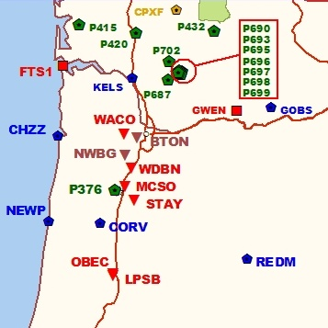
Back To Our Quick Example
Shown are the positions of P376, MCSO and STAY relative to our “test” site, CORV.
A similar, interactive map can be found under the CORS link at the NGS web site. http://geodesy.noaa.gov/CORS/
57

Slide 58
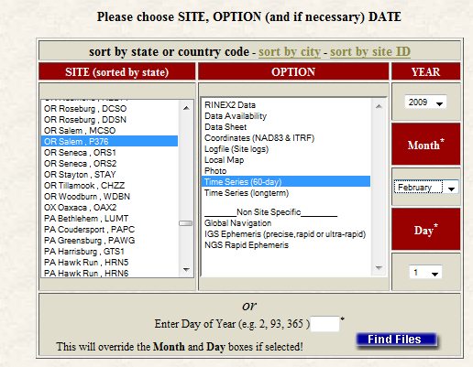
Back To Our Quick Example
http://geodesy.noaa.gov/CORS/logfiles/
The NGS monitors the CORS data daily and provides summaries of those results.
Site logs and coordinate time series for the CORS can be accessed through the Logfiles option under the CORS Site Metadata.
58

Slide 59
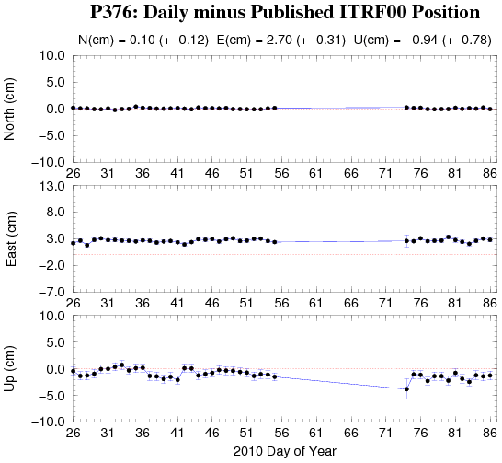
Back To Our Quick Example
Looking at the 60-day time-series for each CORS, we discover that the P376 data for the this day happens to be the last before an extended gap.
59

Slide 60
Back To Our Quick Example
Although this site and the results appears fine otherwise, we may want to consider digging a little deeper.
Possible next steps in evaluating this CORS are:
Resubmit requesting the extended report.
Review the P376 site log.
Resubmit excluding P376.
60

Slide 61
-RS

Slide 62
OPUS-RS. . .rapid-static processing
A Little OPUS-RS History.
The OPUS-RS Interface.
How Good Can I Do With OPUS-RS?
A Quick Example (cont.).
The Extended Report (cont.).
How Does OPUS-RS Work?
OPUS-S and OPUS-RS Uploads By Month.
62

Slide 63
A Little OPUS-RS History
Although successful, OPUS obviously does not satisfy the needs of all users. Discussions with the user community about future development began almost immediately after OPUS was made public.
These early discussions clearly indicated that the most desired enhancement would be a tool capable of producing a similar quality result from a shorter data span.
63

Slide 64
A Little OPUS-RS History
Work by several groups demonstrated that reliably producing results of similar quality to OPUS from shorter data spans was possible.
Collaboration between the NGS and the Satellite Positioning and Inertial Navigation (SPIN) group at The Ohio State University enabled Schwarz (DST) to implement a new processing engine capable of generating those results.
In early 2007, OPUS-RS was made publically available after its own trial period. To better delineate uses, the original OPUS processing stream was renamed OPUS-S.
64

Slide 65
RSGPS
Based (conceptually) on OSU MPGPS program
Similar to Wide Area Rapid Static and Virtual Reference Station (VRS) computations
96 subroutines (21 in LAMBDA)
9739 lines of code (1336 from LAMBDA)

Slide 66
OPUS-RS
Uses RSGPS program instead of PAGES
(based on OSU MPGPS program)
Uses P1 and P2 as well as L1 and L2 obs
Resolves all ambiguities with LAMBDA
Geometry free linear combination used to determine DD ionospheric delays
Notes:
Although the front page looks just like regular OPUS, OPUS-RS is actually a major new program. Internally it uses the RSGPS program rather than the PAGES program NGS has used for baseline processing for many years.
RSGPS is a new program, based on research done by the SPIN group at OSU (see paper on this subject at the ION meeting Friday afternoon).
NGS is still accumulating experience on its behavior.
Tgese are its major features

Slide 67

Rapid-static: OPUS first creates an atmospheric delay model from surrounding CORS data.
Your position is then quickly determined by differential GPS static solution.

Slide 68
The OPUS-RS Interface
With OPUS-RS, the beautiful simplicity remained. In fact the entry form is the same as for OPUS-S. The user provides:
Their email address.
An antenna type.
The vertical offset to the ARP.
15-minutes to 2-hours of GPS L1 + L2 data.
The user receives:
Coordinates accurate to a few centimeters.
68

Slide 69
The OPUS-RS Interface
http://geodesy.noaa.gov/OPUS/
The same interface is used except one clicks the “Upload to RAPID-STATIC” button instead.
69

Slide 70
A Quick Example
USER: mark.schenewerk@noaa.gov DATE: April 01, 2010 RINEX FILE: corv059f.09o TIME: 16:17:51 UTC SOFTWARE: rsgps 1.35 RS11.prl 1.57 START: 2009/02/28 05:00:00 EPHEMERIS: igs15206.eph [precise] STOP: 2009/02/28 06:59:30 NAV FILE: brdc0590.09n OBS USED: 5652 / 11169 : 51% ANT NAME: ASH700936C_M QUALITY IND. 48.23/108.85 ARP HEIGHT: 1.521 NORMALIZED RMS: 0.280 REF FRAME: NAD_83(CORS96)(EPOCH:2002.0000) ITRF00 (EPOCH:2009.15959) X: -2498422.589(m) 0.015(m) -2498423.330(m) 0.015(m) Y: -3802821.147(m) 0.012(m) -3802819.929(m) 0.012(m) Z: 4454736.644(m) 0.021(m) 4454736.717(m) 0.021(m) LAT: 44 35 7.91061 0.004(m) 44 35 7.92619 0.004(m) E LON: 236 41 43.48069 0.011(m) 236 41 43.42230 0.011(m) W LON: 123 18 16.51931 0.011(m) 123 18 16.57770 0.011(m) EL HGT: 105.986(m) 0.026(m) 105.602(m) 0.026(m) ORTHO HGT: 128.517(m) 0.030(m) [NAVD88 (Computed using GEOID09)] UTM COORDINATES STATE PLANE COORDINATES UTM (Zone 10) SPC (3601 OR N) Northing (Y) [meters] 4936954.909 105971.559 Easting (X) [meters] 475821.309 2277335.372 Convergence [degrees] -0.21381414 -1.98897509 Point Scale 0.99960719 0.99994603 Combined Factor 0.99959058 0.99992942 US NATIONAL GRID DESIGNATOR: 10TDQ7582136954(NAD 83) BASE STATIONS USED PID DESIGNATION LATITUDE LONGITUDE DISTANCE(m) DH4503 P376 EOLARESVR_OR2004 CORS ARP N445628.313 W1230608.100 42648.2 DG5352 STAY STAYTON COOP CORS ARP N444950.530 W1224915.036 47030.9 DE6258 MCSO MARION CNTY COOP CORS ARP N445825.701 W1225720.639 51226.8 DI7529 P367 NEWPRTAIR_OR2007 CORS ARP N443506.870 W1240341.598 60113.5
⁞
Shown here is part of the OPUS-RS report for the same CORV data discussed earlier.
The results differ by 2.4 cm horizontally and 0.2 cm vertically from the accepted position projected to the epoch of the data.
70

Slide 71
A Quick Example
USER: mark.schenewerk@noaa.gov DATE: April 01, 2010 RINEX FILE: corv059f.09o TIME: 16:17:51 UTC SOFTWARE: rsgps 1.35 RS11.prl 1.57 START: 2009/02/28 05:00:00 EPHEMERIS: igs15206.eph [precise] STOP: 2009/02/28 06:59:30 NAV FILE: brdc0590.09n OBS USED: 5652 / 11169 : 51% ANT NAME: ASH700936C_M QUALITY IND. 48.23/108.85 ARP HEIGHT: 1.521 NORMALIZED RMS: 0.280 REF FRAME: NAD_83(CORS96)(EPOCH:2002.0000) ITRF00 (EPOCH:2009.15959) X: -2498422.589(m) 0.015(m) -2498423.330(m) 0.015(m) Y: -3802821.147(m) 0.012(m) -3802819.929(m) 0.012(m) Z: 4454736.644(m) 0.021(m) 4454736.717(m) 0.021(m) LAT: 44 35 7.91061 0.004(m) 44 35 7.92619 0.004(m) E LON: 236 41 43.48069 0.011(m) 236 41 43.42230 0.011(m) W LON: 123 18 16.51931 0.011(m) 123 18 16.57770 0.011(m) EL HGT: 105.986(m) 0.026(m) 105.602(m) 0.026(m) ORTHO HGT: 128.517(m) 0.030(m) [NAVD88 (Computed using GEOID09)] UTM COORDINATES STATE PLANE COORDINATES UTM (Zone 10) SPC (3601 OR N) Northing (Y) [meters] 4936954.909 105971.559 Easting (X) [meters] 475821.309 2277335.372 Convergence [degrees] -0.21381414 -1.98897509 Point Scale 0.99960719 0.99994603 Combined Factor 0.99959058 0.99992942 US NATIONAL GRID DESIGNATOR: 10TDQ7582136954(NAD 83) BASE STATIONS USED PID DESIGNATION LATITUDE LONGITUDE DISTANCE(m) DH4503 P376 EOLARESVR_OR2004 CORS ARP N445628.313 W1230608.100 42648.2 DG5352 STAY STAYTON COOP CORS ARP N444950.530 W1224915.036 47030.9 DE6258 MCSO MARION CNTY COOP CORS ARP N445825.701 W1225720.639 51226.8 DI7529 P367 NEWPRTAIR_OR2007 CORS ARP N443506.870 W1240341.598 60113.5
⁞
Note that the solution quality measures are slightly different.
OBS USED > 50%
QUALITY IND. > 3
NORM. RMS ≈ 1
Uncertainties < 5 cm
The uncertainties are standard deviations from the solution, not the peak-to-peak values reported by OPUS-S.
OBS USED: 5652 / 11169 : 51% QUALITY IND. 48.23/108.85 NORMALIZED RMS: 0.280
71

Slide 72

A Quick Example
USER: mark.schenewerk@noaa.gov DATE: April 01, 2010 RINEX FILE: corv059f.09o TIME: 16:17:51 UTC SOFTWARE: rsgps 1.35 RS11.prl 1.57 START: 2009/02/28 05:00:00 EPHEMERIS: igs15206.eph [precise] STOP: 2009/02/28 06:59:30 NAV FILE: brdc0590.09n OBS USED: 5652 / 11169 : 51% ANT NAME: ASH700936C_M QUALITY IND. 48.23/108.85 ARP HEIGHT: 1.521 NORMALIZED RMS: 0.280 REF FRAME: NAD_83(CORS96)(EPOCH:2002.0000) ITRF00 (EPOCH:2009.15959) X: -2498422.589(m) 0.015(m) -2498423.330(m) 0.015(m) Y: -3802821.147(m) 0.012(m) -3802819.929(m) 0.012(m) Z: 4454736.644(m) 0.021(m) 4454736.717(m) 0.021(m) LAT: 44 35 7.91061 0.004(m) 44 35 7.92619 0.004(m) E LON: 236 41 43.48069 0.011(m) 236 41 43.42230 0.011(m) W LON: 123 18 16.51931 0.011(m) 123 18 16.57770 0.011(m) EL HGT: 105.986(m) 0.026(m) 105.602(m) 0.026(m) ORTHO HGT: 128.517(m) 0.030(m) [NAVD88 (Computed using GEOID09)] UTM COORDINATES STATE PLANE COORDINATES UTM (Zone 10) SPC (3601 OR N) Northing (Y) [meters] 4936954.909 105971.559 Easting (X) [meters] 475821.309 2277335.372 Convergence [degrees] -0.21381414 -1.98897509 Point Scale 0.99960719 0.99994603 Combined Factor 0.99959058 0.99992942 US NATIONAL GRID DESIGNATOR: 10TDQ7582136954(NAD 83) BASE STATIONS USED PID DESIGNATION LATITUDE LONGITUDE DISTANCE(m) DH4503 P376 EOLARESVR_OR2004 CORS ARP N445628.313 W1230608.100 42648.2 DG5352 STAY STAYTON COOP CORS ARP N444950.530 W1224915.036 47030.9 DE6258 MCSO MARION CNTY COOP CORS ARP N445825.701 W1225720.639 51226.8 DI7529 P367 NEWPRTAIR_OR2007 CORS ARP N443506.870 W1240341.598 60113.5
⁞
Although the quality indices, normalized RMS and uncertainties are OK, the percentage of observations used gives this solution a .
If you are uncomfortable with your solution, the same diagnostic steps discussed for OPUS-S can be applied here too.
72
Notes:
On the OPUS-RS datasheet, only two entries have changed:
The name and version of the processing program
The number of fixed ambiguities has gone away, since LAMBDA fixes all the ambiguities. In its place are the quality indicators from the network and rover runs of RSGPS. The quality indicator in each run is the average of the W-ratio at the last three epochs. The W-ratio is a statistical measure of how well the best set of integer ambiguities is separated from the second best set. The W-ratio has been shown to be distributed as Student’s t. We like to see both of these numbers greater than 3.0. If the second number (the quality indicator for the rover solution) is less than 1.0, RSGPS may have been unable to find the correct integer ambiguities and the solution may be in error by many centimeters.

Slide 73
The Extended Report
Of necessity, the OPUS-RS extended report is larger than the corresponding OPUS-S solution. Too large to be conveniently shown here. But while seemingly intimidating, the OPUS-RS extended report sections are basically the same as those in the OPUS-S extended report.
Some additional sections include:
A covariance matrix for the reference-station-only solution.
A correlation as well as a covariance matrix.
Various Dilutions Of Precision (DOPs).
73

Slide 74
How Good Can I Do With OPUS-RS?
OPUS-RS can produce quality results from more challenging “short” data sets, but it is slightly more restrictive in the data sets allowed. Because of the restrictions, which will be discussed later, the NGS recently made available the “OPUS-RS Accuracy and Availability” tool (Choi, NGS).
Typical estimated and empirical accuracies within the continental U.S. are comparable to OPUS-S.
Remember that the estimated accuracies suggested by this tool are just that - estimates. Confirming the quality of the OPUS solution remains the user’s responsibility.
74

Slide 75
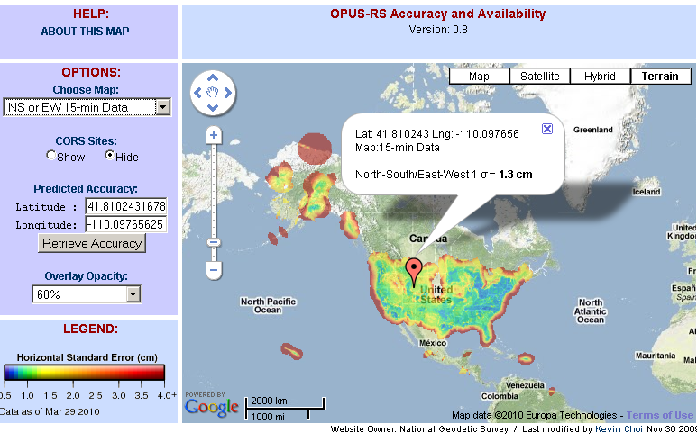
How Good Can I Do With OPUS-RS?
The OPUS-RS Accuracy and Availability Tool.
http://geodesy.noaa.gov/OPUSI/Plots/Gmap/OPUSRS_sigmap.shtml
75

Slide 76
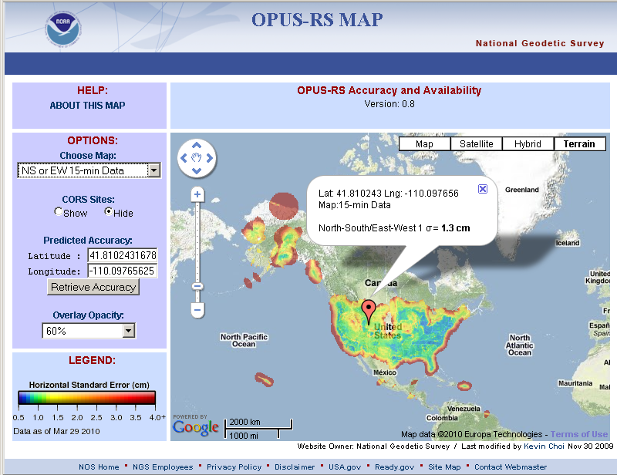
How Good Can I Do With OPUS-RS?
1 σ for each 0.2 degree grid.
Horizontal and vertical standard errors for 15 minutes and 1-hour length data.
Inverse Distance Weighting method to interpolate the sigmas.
Areas outside the color overlay are where there are less than three active CORS sites within 250 km range. OPUS-RS will usually fail at these locations.
Automated Weekly update
Use updated CORS list and observation data availability
Global coverage including non-US territories.
76

Slide 77
How Does OPUS-RS Work?
OPUS-RS uses the RSGPS program which was developed specifically for this purpose.
Like OPUS-S, OPUS-RS uses state-of-the-art models, but the strategy to fix phase ambiguities to their integer values differs.
To fix integers, OPUS-RS introduces more information:
Pseudorange and carrier phase.
More reference stations if possible.
77

Slide 78
How Does OPUS-RS Work?
OPUS-RS selects three to nine “best” CORS based upon:
Having common satellite visibility with the user data.
Having distances from the user’s site <250 km.
This is shown here graphically. The star represents the user’s site. The triangles are CORS.
No CORS farther than 250 km from the user’s site will be included.
The three CORS minimum is shown. No more than nine are used.
s
>250km
250km
Choi, 2010, personal communication.
78

Slide 79
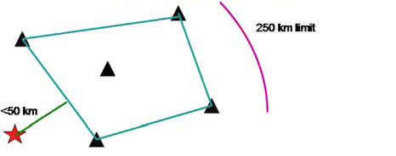
How Does OPUS-RS Work?
In addition, user’s site must be no more than 50 km from the (convex) polygon created by the selected CORS.
Again in this figure, the star represents the user’s site; the
triangles are CORS. Five CORS and their resulting polygon are shown in this example.
If the user’s site, the star, is more than 50 km outside this polygon, alternate CORS will be considered.
If none can be found, the processing will abort.
Schwarz et al., “Accuracy assessment of the National Geodetic Survey's OPUS-RS utility”, 2009, GPS Solutions, 13(2), 119-132.
79

Slide 80
How Does OPUS-RS Work?
OPUS-RS uses no less than 1-hour of CORS data and no more than the submitted data’s span plus 15-minutes before and after.
The CORS data are used to estimate the atmospheric delays at each CORS and predict them at the user’s site.
OPUS-RS then processes each baseline to the user’s site individually to produce an improved a priori position.
Switching modes, the previously determined values and all data are used in an “integer-fixed” solution for the user’s site.
Schwarz et al., “Accuracy assessment of the National Geodetic Survey's OPUS-RS utility”, 2009, GPS Solutions, 13(2), 119-132.
80

Slide 81
OPUS static vs. rapid static
 | static | rapid static
input (dual-frequency GPS) | 2-48 hours | 15 minutes-2 hours
output | normal, extended, XML datasheet, project | normal, extended, XML
accuracy (95%confidence) | 1-2 cm horizontal 3-6 cm ellipsoidal height | 1-2 cm horizontal 4-8 cm ellipsoidal height
network geometry | 3 CORS, preferably within 1000 km of rover | 3-9 CORS, surrounding & within 250 km of rover
availability | global | 90% of CONUS (subject to CORS configuration)

Slide 82
-published solutions

Slide 83
published solutions
A Little History.
The Interface.
How Do published solutions Work?
published solutions By Month.
83

Slide 84
A Little publishing History
With the release of OPUS-RS, the comments about OPUS began to focus on a new issue. Users wanted an equally simple way to share their OPUS results with the community.
84

Slide 85
A Little publishing History
Historically, when in collaboration with or publishing through the NGS, one submitted results to the Integrated Data Base (IDB) and, in this manner, contributed to the NSRS.
Before submitted results could be entered into the IDB, the submissions had to meet a well-defined set of requirements and quality controls.
Reconciling the “open” input philosophy represented by OPUS with the “controlled” input philosophy represented by IDB is a tremendous challenge.
85

Slide 86
A Little Publishing History
A significant step in reconciliation came in 2009 with the release of published solutions.
published solutions allows users to publish their OPUS result in an on-line data base if minimum requirements for quality are met and the associated meta-data, such as photos and descriptions, are provided.
86

Slide 87
A Little publishing History
For now, published solutions and the IDB exist as two separate tools.
As the NGS begins to more fully understand the characteristics of the published solutions, the published solutions and the IDB will be more fully reconciled.
In the meantime, publishing via OPUS may be eligible for, but not guaranteed to be included in the IDB.
87

Slide 88
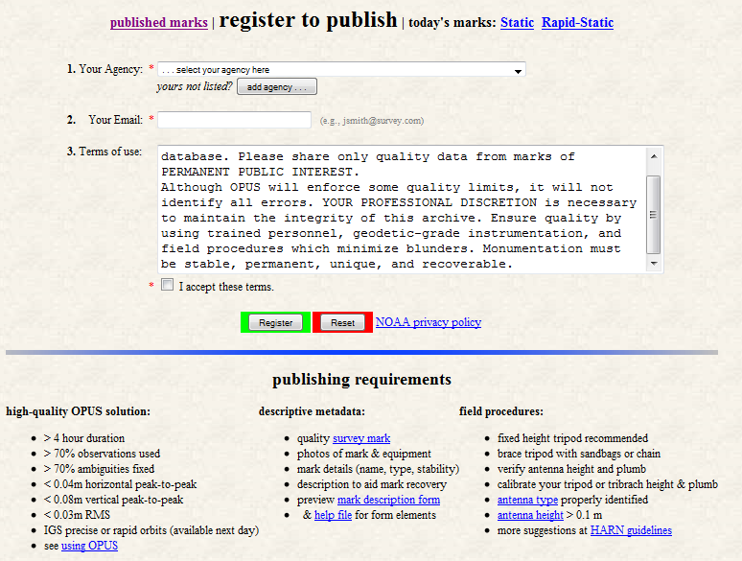
Interface
You must register upon publishing your first solution.
http://geodesy.noaa.gov/OPUS/view.jsp
88

Slide 89

Interface
The first step in publishing via OPUS is to submit data to OPUS.
The user completes the OPUS form normally, but must explicitly designate that the results should be published. This is done through the Options.
The “Submit to Data Base”, i.e. publish, option is near the bottom of the Options list.
89

Slide 90
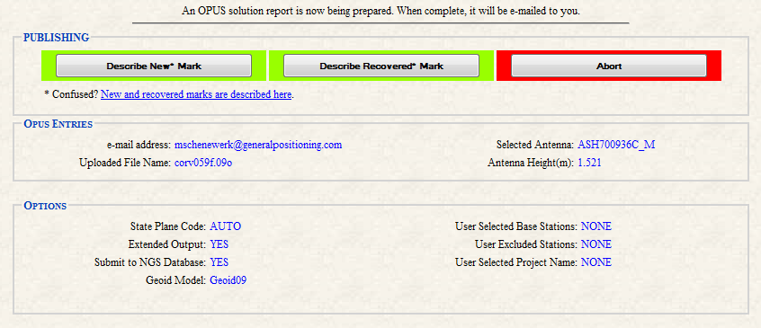
Interface
The user is taken to a new page where they designate the mark associated with their data as “new” or “recovered”.
90

Slide 91
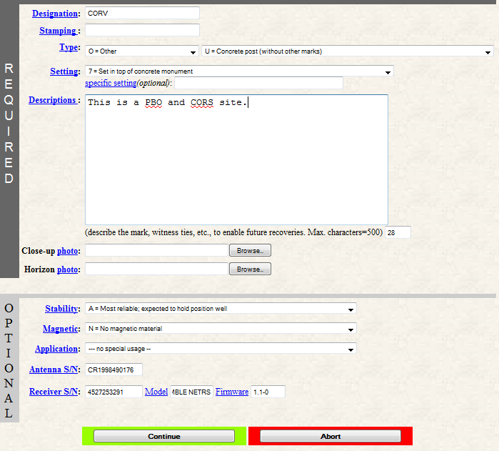
Interface
After making that selection, the user is offered the appropriate form for entering the meta-data.
In this example, we’re following the “new” mark designation.
91

Slide 92
Interface
Many of you will recognize these fields as a subset of the information required to “blue book” a mark.
92

Slide 93
Interface
This is not blue booking per se because the process is streamlined.
This is possible, in part, because some information is provided by the data processing itself.
93

Slide 94
Interface
As a last step, the user is given a chance to review the submission in the form of a mock-up of the datasheet for their submission.
If the meta-data is complete, the quality control restrictions are met and the user gives the “OK”, the submission is entered into the data base after review by NGS.
94

Slide 95
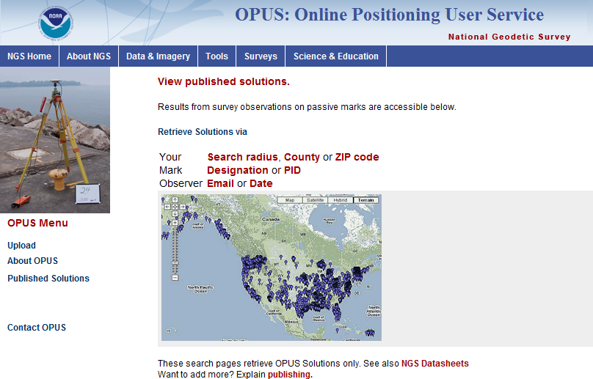
Interface
http://geodesy.noaa.gov/OPUS/view.jsp
95

Slide 96
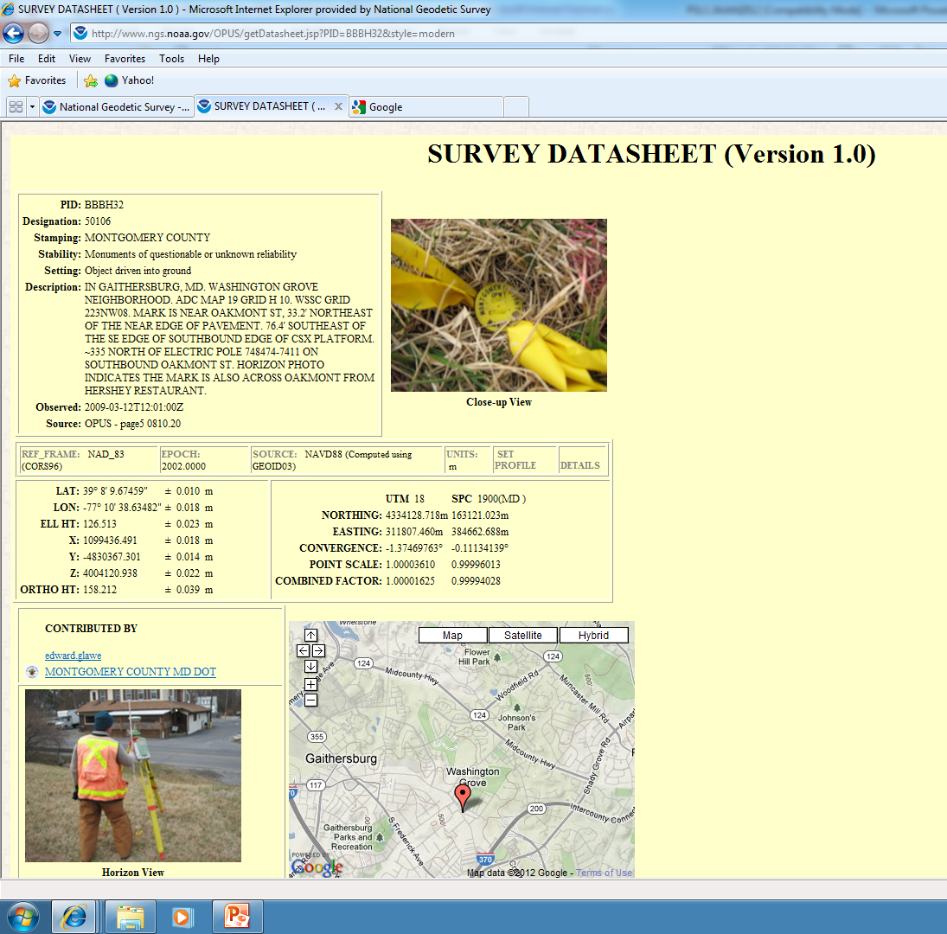

Slide 97
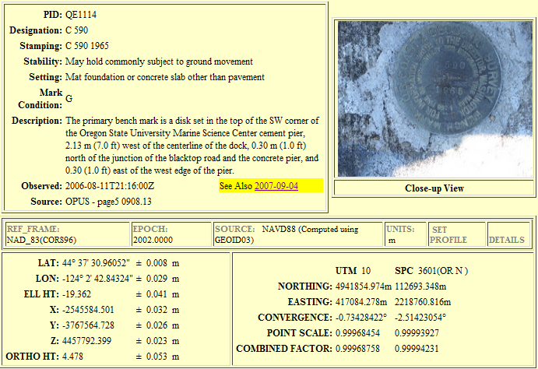
Interface
This is part of a published
data sheet.
Note the “See Also” highlight.
Note the “See Also” highlight. This provides access to other data base and IDB entries for this mark.
97

Slide 98
How Do published solutions Work?
OPUS uses a data base in the sense that we think of electronic, software-driven data bases today.
This implies that entries in the data base can be sorted and sampled by any of the individual data elements provided with each submission.
For example, users normally search the data base by PID, descriptor or location, but, of course, one could search for all the marks in by county or zip code.
98

Slide 99
How Do published solutions Work?
The publishing interface has started as a small, logical extension of the IDB interface, but, in a sense, it is a “blank sheet”.
Given a fully functional data base with graphical user interface, it’s not clear how publishing will evolve in the future.
99

Slide 100
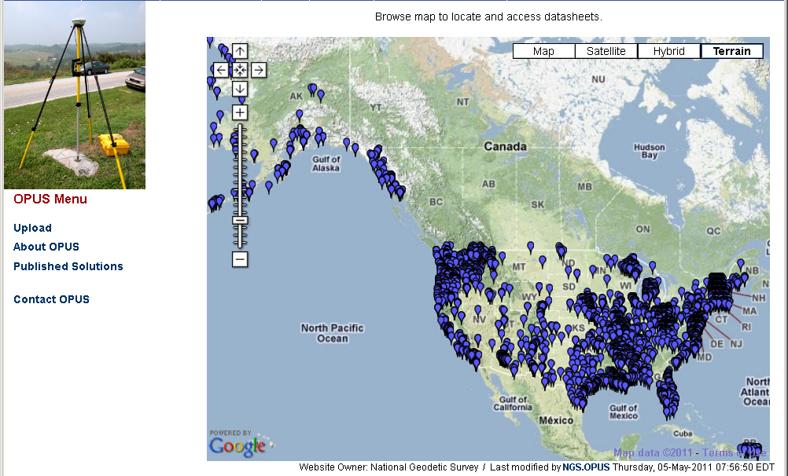
4,000 OPUS-Published Solutions, July 2011

Slide 101
Marks Published.
OPUS
is showing steady growth in registered users and published marks.
2011-03-03
101

Slide 102

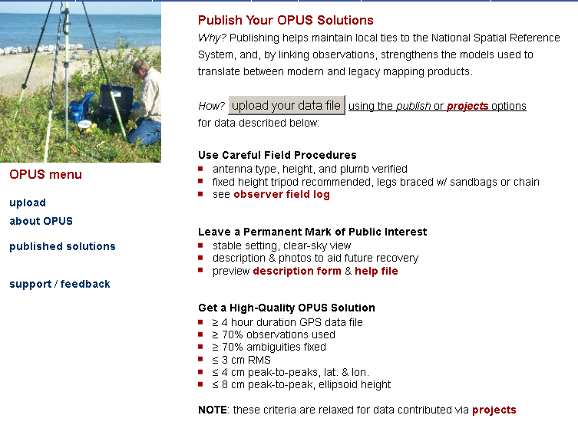

Slide 103
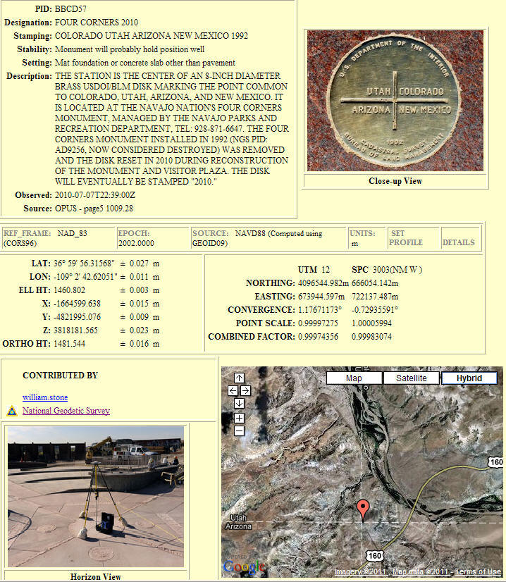
OPUS –
Datasheet Publishing
Publishing Criteria:
NGS-calibrated GPS antenna
> 4 hour data span
> 70% observations used
> 70% fixed ambiguities
< 0.04m H peak-to-peak
< 0.08m V peak-to-peak
Uses:
GPS on BMs
PLSS / GCDB
Data archive
Data sharing

Slide 104
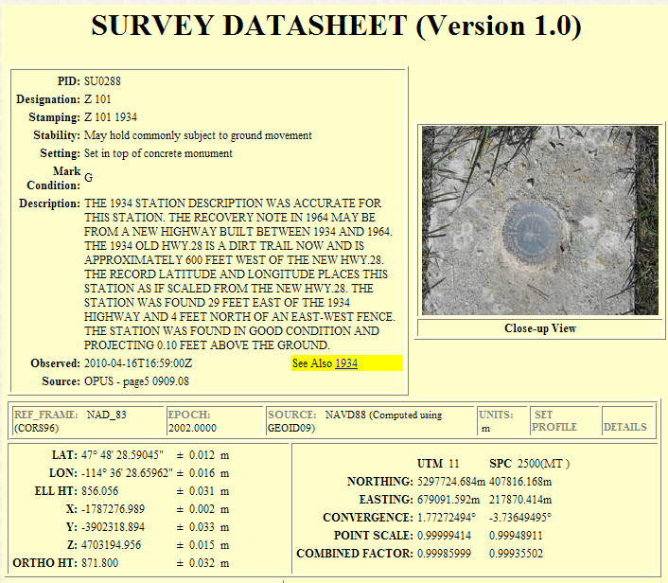
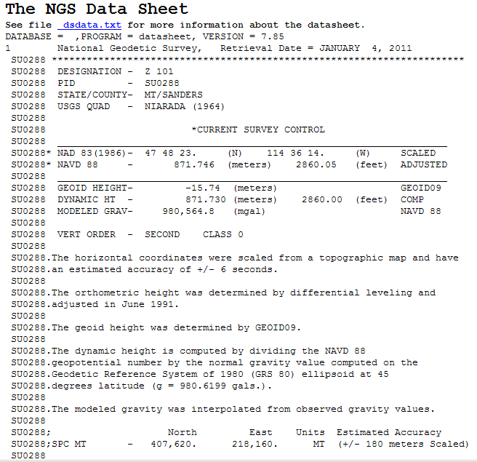
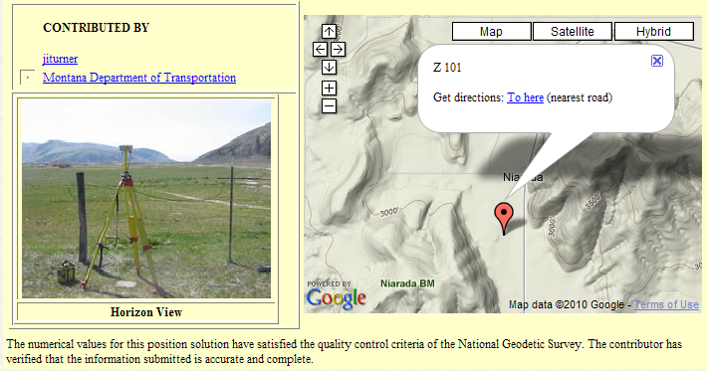
Orthometric Height Comparison
871.746 m Published NAVD88
871.800 m OPUS GEOID09
0.054 m (0.18 ft) Difference

Slide 105
New Developments for OPUS
Lots of things are in the works for OPUS. Here is a sample.
ITRF2008, IGS08, NGSTRF08 And NAD 83(CORS96A).
New Look And Feel.
OPUS-Net.
OPUS-Mapper.
Other GNSS.
OPUS-Projects.
105

Slide 106
ITRF2008, IGS08 And NAD 83(2011)

Slide 107
ITRF2008
For the geodesy, geophysics and surveying communities, the best the International Terrestrial Reference Frame is the “gold standard.”
The global community recently adopted an updated expression for the reference frame, the ITRF2008.
107

Slide 108
Densification
The ITRF2008 is expressed through the coordinates and velocities of marks on the ground plus ancillary data.
Other organizations can take that information, add additional marks, perform their own adjustment and align their results to the ITRF2008 (A.K.A. densifying).
The variants try to be as consistent with the ITRF2008 as possible, but in the most formal sense, they are unique from the ITRF2008. Therefore, they are given unique names.
108

Slide 109
The IGS08
The IGS has densified reference frame with much larger, global subset of GNSS tracking sites thereby creating a GNSS-only expression of the ITRF2008 called the IGS08. All IGS products have been recreated so as to be consistent with the IGS08 including GNSS ephemerides and antenna models. Information about the IGS08 can be found at the IGS web sites: igscb.jpl.nasa.gov. I would suggest starting with IGSMAIL‐6354, ‐6355 and ‐6356, all dated 2011‐03‐07.
109
Notes:
Many of the sites contributing to the IGS08 also contributed to the ITRF2008, but because other space geodesy techniques contributed to the ITRF2008 and because the IGS08 contains sites not included in the ITRF2008, it should not be called the ITRF2008.
Nonetheless, IGS08 has the same geocenter, orientation and scale as the ITRF2008.

Slide 110
NAD 83 (2011)
NGS used its contribution to the IGS08 plus the additional CORS to produce improved IGS08 coordinates and velocities for the CORS network. From this, improved CORS coordinates and velocities in the NAD 83 frame were defined.
To distinguish this from earlier realizations, this reference frame is called the NAD 83 (2011). This is not a new datum: the origin, scale and orientation are the same as in the previous realization.
In September 2011, NGS formally released IGS08 and NAD 83 (2011) coordinates and velocities for the CORS. Information about the IGS08 and NAD 83 (2011) can be found at geodesy.noaa.gov/CORS/coords.shtml.
110

Slide 111
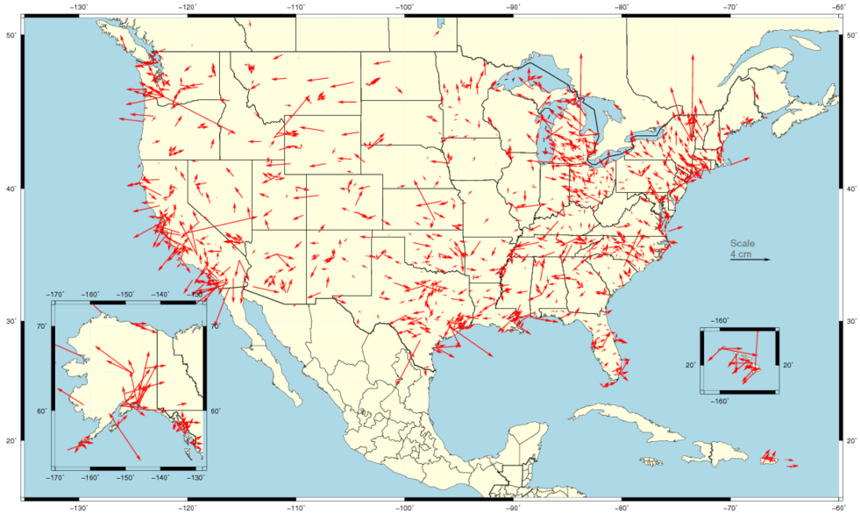
Horizontal Differences In CORS Positions
Horizontal difference in positions of NAD 83(2011) epoch 2002.00 minus NAD 83(CORS96) epoch 2002.00.
111

Slide 112
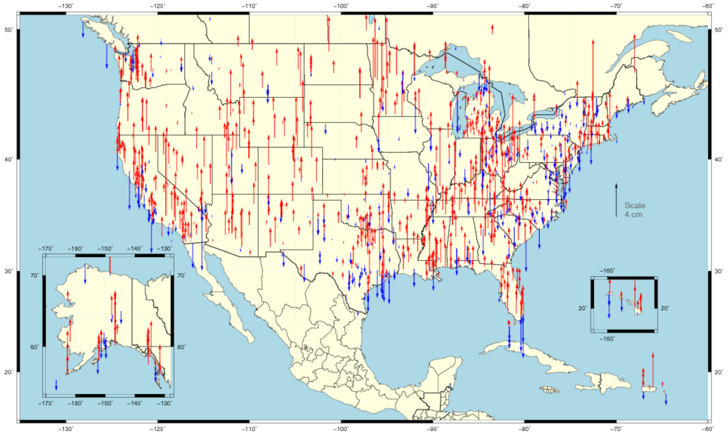
Vertical Differences In CORS Positions
Vertical difference in positions of NAD 83(2011) epoch 2002.00 minus NAD 83(CORS96) epoch 2002.00.
112

Slide 113
NAD 83 (2011) And OPUS
The OPUS also began offering results in the IGS08 and NAD 83(2011) reference frames in September 2011.
Although the NAD 83 (2011) is not a new datum, the CORS coordinates used by OPUS in generating its results are different. NGS recognizes that this change poses a challenge for some. To help those users confidently switch to the new references frames, OPUS users can choose to have their results reported in the IGS08 and NAD 83(2011) or in the previous ITRF2000 and NAD 83 (CORS96). But users are strongly encouraged to switch to the improved datum as soon as possible. This transition period will end after a few months.
A short FAQ about this change can be found on the OPUS page: geodesy.noaa.gov/OPUS/.
113

Slide 114
NAD 83 (2011) And Passive Control Marks
In addition, 80,000+ passive control marks are being readjusted to provide the best possible consistency with the improved CORS coordinates and velocities. Known as the National Adjustment of 2011 (NA2011), these results will be released by the end of 2011.
A new hybrid geoid model (likely named GEOID12) is being produced too and will be released shortly after or in conjunction with the NA2011 results.
For more information, visit geodesy.noaa.gov/web/news/NA2011_Project.shtml
geodesy.noaa.gov/web/surveys/NA2011/NA2011_FAQ.shtml
114

Slide 115
National Adjustment of 2011
An improvement of the National Spatial Reference system.
NA2011 will yield updated NAD 83 coordinates on nearly 80,000 NGS passive control marks positioned using Global Navigation Satellite System (GNSS) technology.
Covering CONUS, AK, Caribbean, and Pacific region.

Slide 116
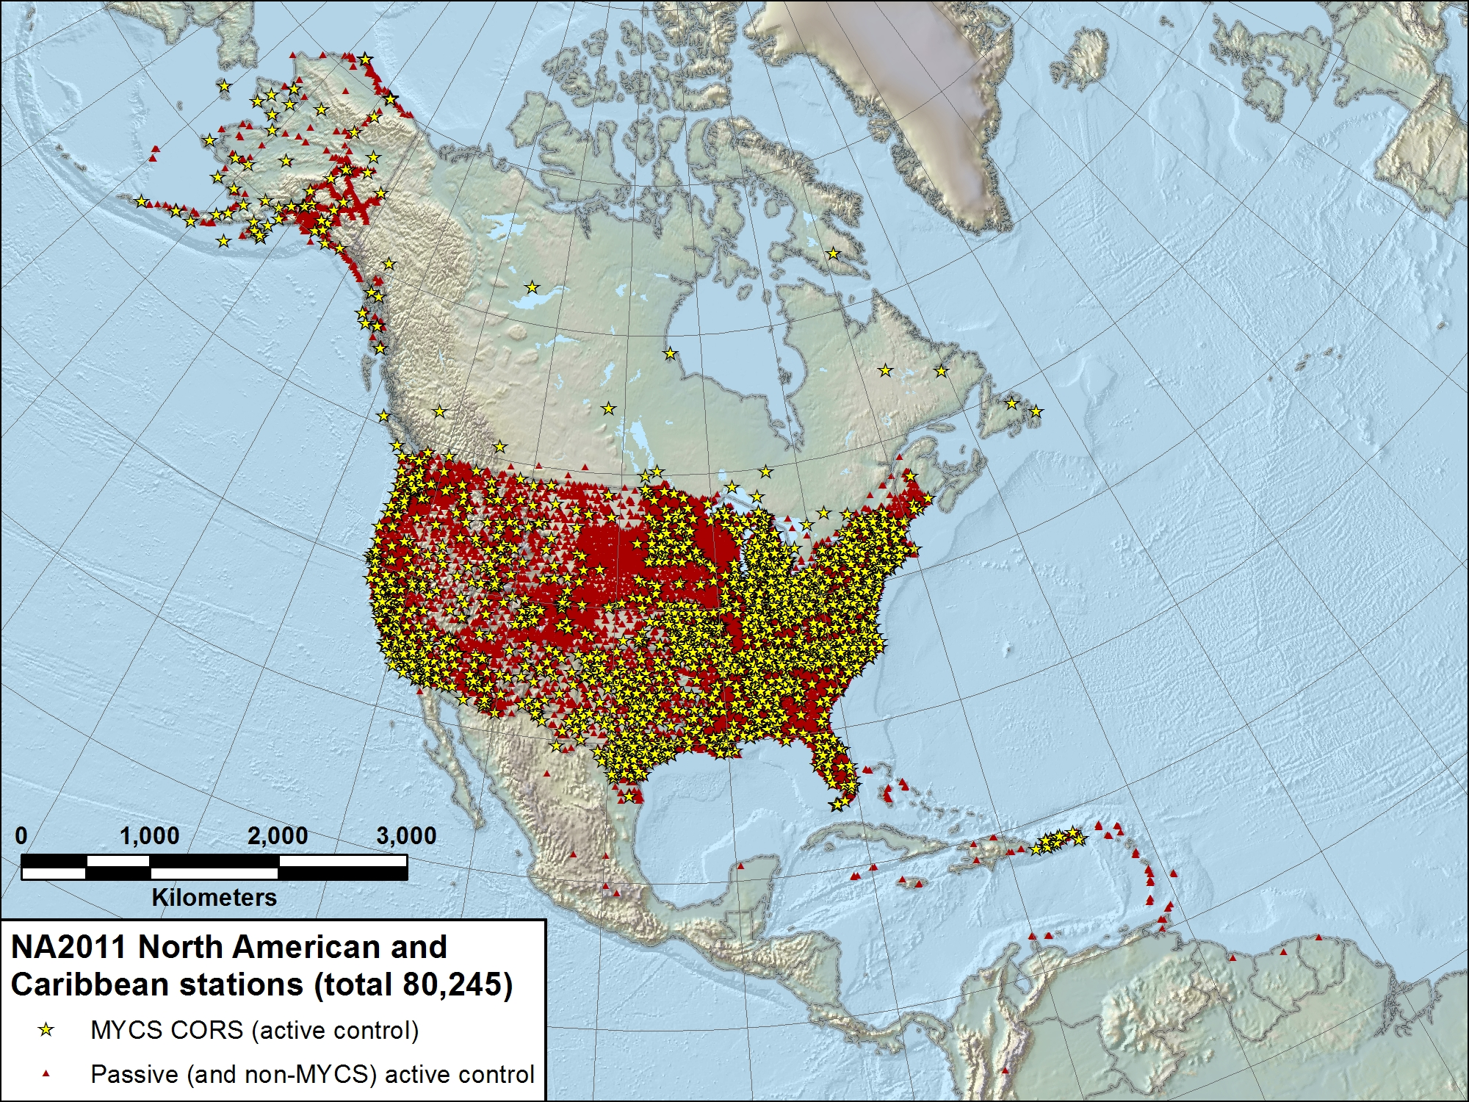

Slide 117
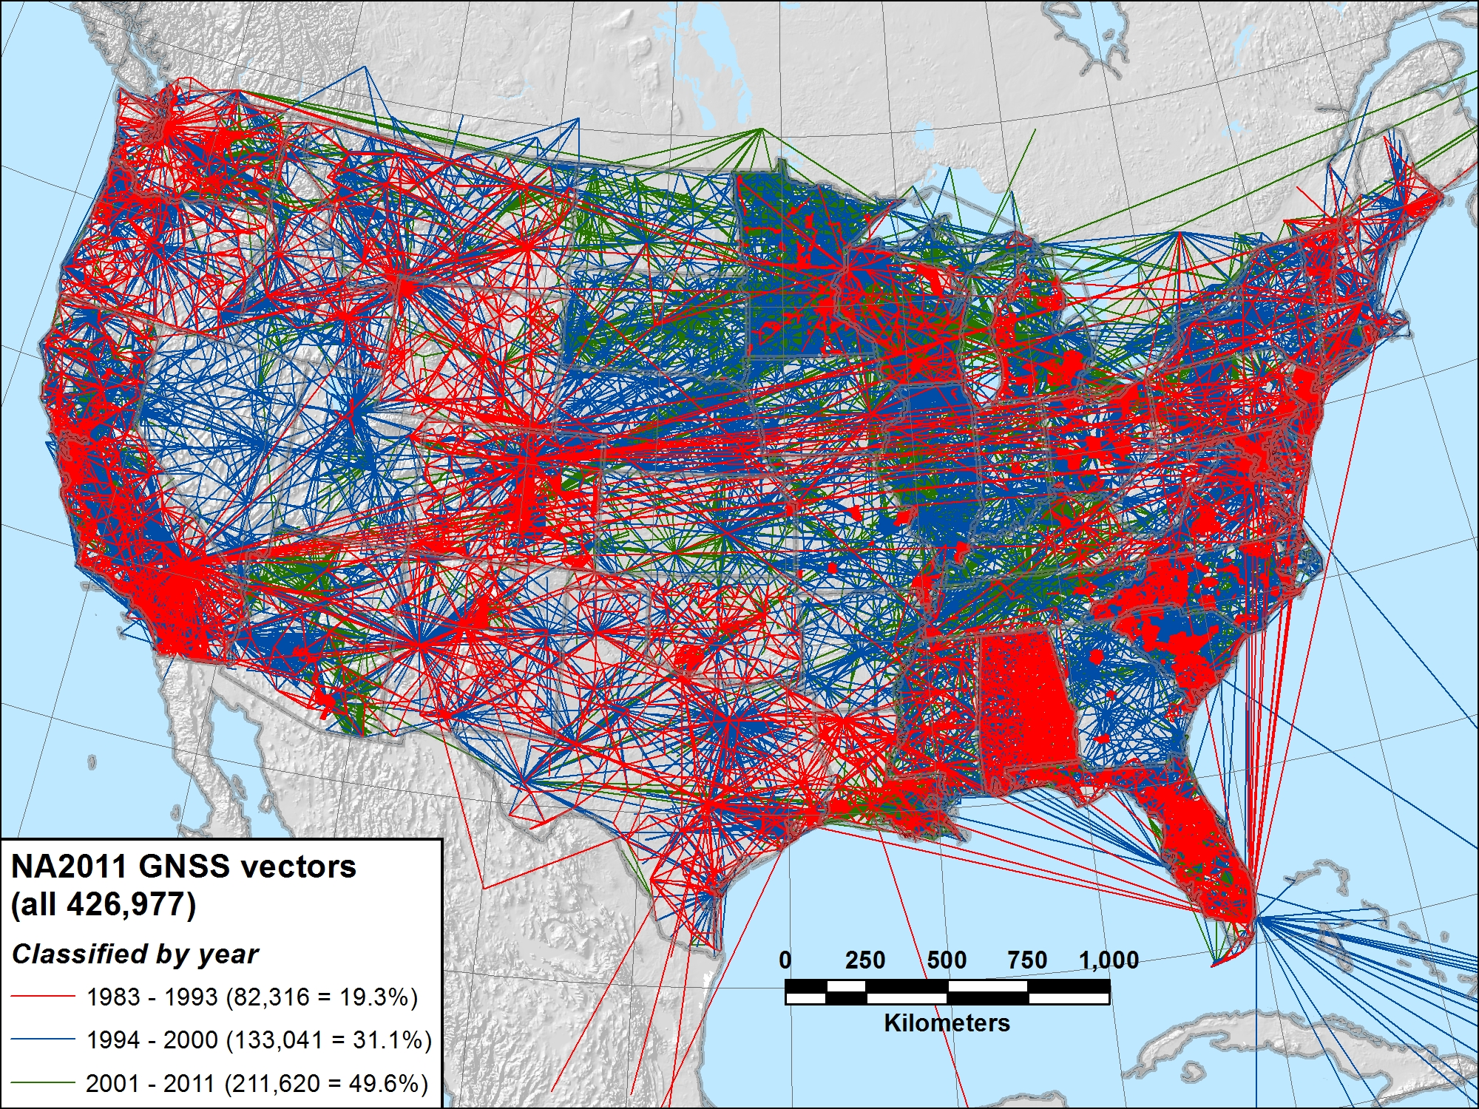

Slide 118
Expected overall coordinate change from NA2011
Horizontal: Mean ~2 cm (±6 cm), median ~0 cm
Vertical: Mean ~ -1 cm (±2 cm), median ~ -1 cm
This is for change in realization and reference epoch
NAD 83(CORS96) epoch 2002.00 → NAD 83(2011) epoch 2010.00

Slide 119
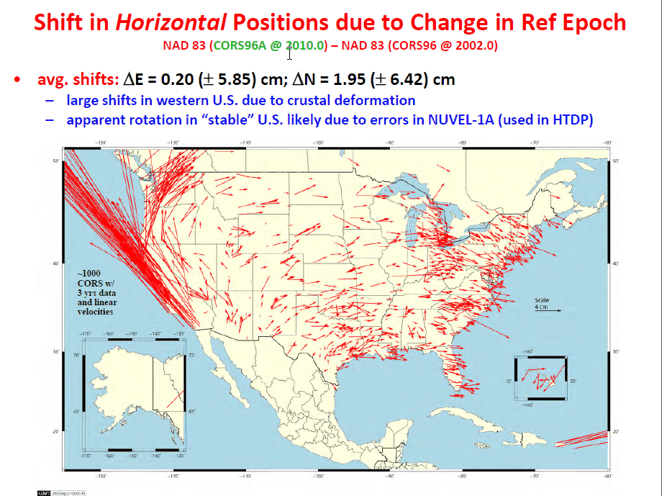

Slide 120
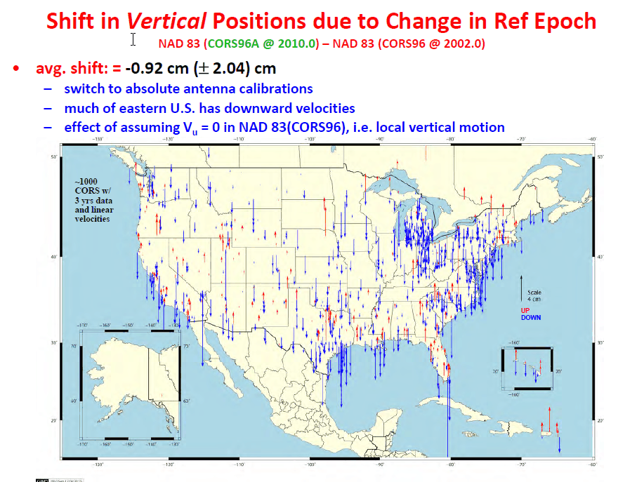

Slide 121
When will NA2011 be done?
Multi-Year CORS Solution
Officially released coordinates September 2011
Will publish in NGS database simultaneously with NA2011
National Adjustment of 2011
Goal: Complete in March 2012, publish early April 2012
Final data added to NA2011 network mid-Dec 2011
OPUS (Online Positioning User Service)
Dual solutions (CORS96 and MYC) will be available until NA2011 complete
NAD 83(HARN)←→(NSRS2007/CORS96) coordinate transformation tool
Expect completion by end of February 2012
Will create (NSRS2007/CORS96) ←→(2011) tool after NA2011 complete
New hybrid geoid model (GEOID12)
Use NAD 83(2011) ellipsoid heights on leveled NAVD 88 benchmarks
Plan release same time as NA2011

Slide 122

More information…
geodesy.noaa.gov

Slide 123
OPUS-Net

Slide 124
OPUS-Net
Weston and Ray (NGS) have found that by more fully implementing the available processing models in conjunction with changing the CORS selection criteria, at a minimum the scatter in the north and east components can be significantly reduced with no degradation in the scatter in the height produced by OPUS-S.
Moreover, the resulting coordinates agree better with other sources such as the IGS weekly combinations.
Weston and Ray, “Test of the Use of Regional Networks for OPUS Processing”, 2010, EGU General Assembly 2010, Geophysical Research Abstracts.
124

Slide 125
NET:
first, run OPUS to solve for CORS from IGS CORS
then run OPUS-Static using improved CORS positions and tropospheric corrections, along with ocean-tide loading & absolute antenna calibration models

Slide 126
OPUS-Net
This processing strategy was implemented in an OPUS-like application, called OPUS-Net during its testing phase. It includes
An ocean-tide loading (OTL) model.
Absolute antenna phase correction models.
A combination of near-by and more-distant CORS.
Let’s look at these individually.
126

Slide 127
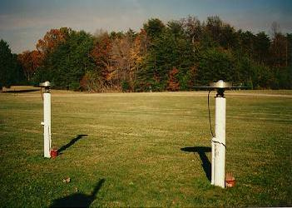
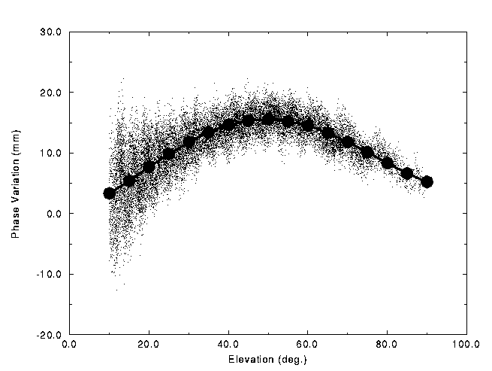
OPUS-Net
What are absolute antenna phase correction models? No antenna is physically or electro- magnetically perfect.
For about two decades, some sort of antenna correction has been applied as part of processing.
Historically, these corrections have been relative to a specific antenna type.
The NGS antenna test range and a sample relative correction pattern are shown. http://geodesy.noaa.gov/ANTCAL/
127

Slide 128
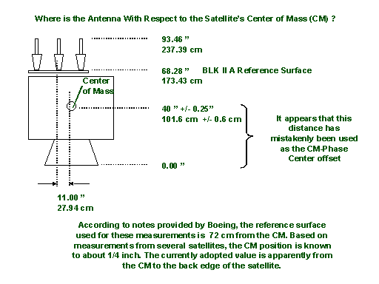
OPUS-Net
The “relative” antenna corrections work well, particularly if the antennas are close together.
But, as data processing has improved, the limitations of relative antenna corrections have become increas- ingly evident. One example: satellite antenna corrections can not be fully applied when using a relative model.
http://geodesy.noaa.gov/ANTCAL/
128

Slide 129
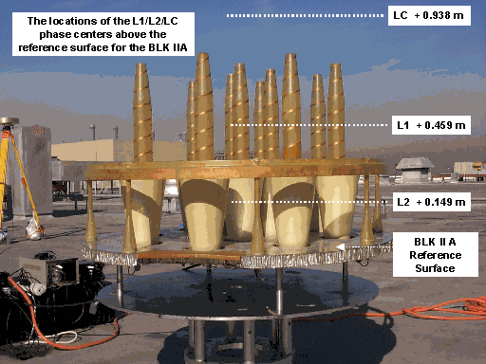
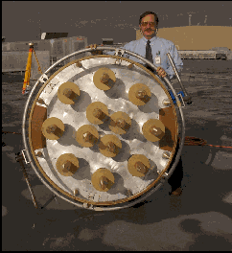
OPUS-Net
Calibrating the BLK 2A GPS antenna

Slide 130
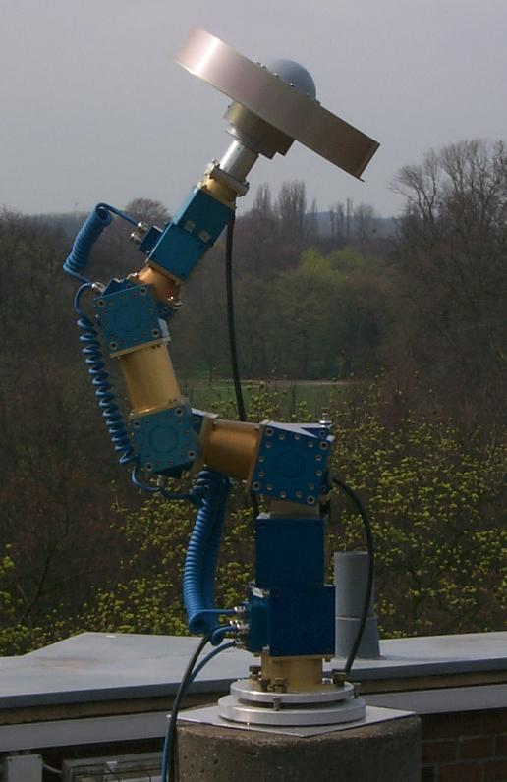
OPUS-Net
By using data from a spatially large network with diverse equipment, and by including data from new tools such as robotic arms which shift the orientation of the antenna being tested on demand, “absolute” antenna phase patterns can be produced.
Absolute antenna corrections:
More fully implement the corrections.
Help minimize the effects of baseline lengths.
Help minimize hardware changes.
http://www.geopp.de/
130

Slide 131
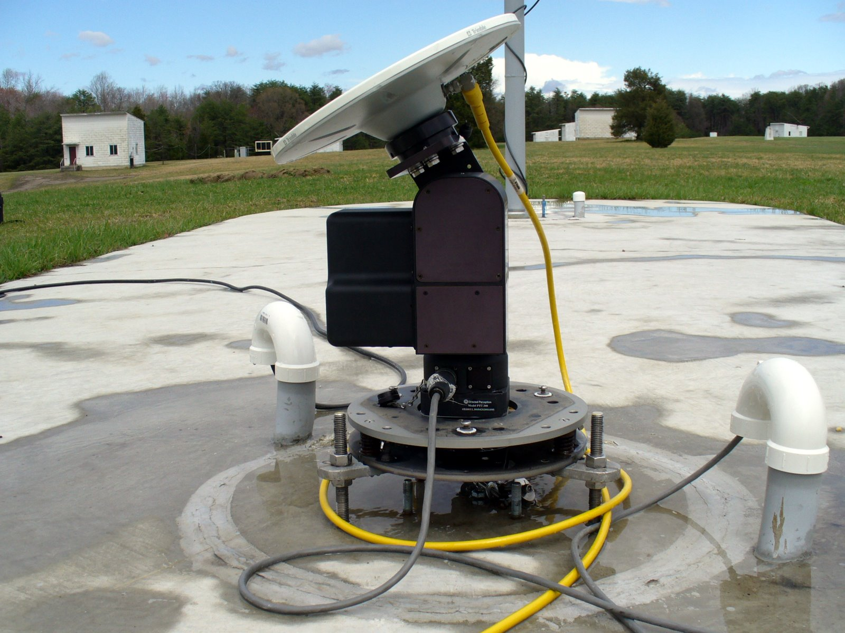
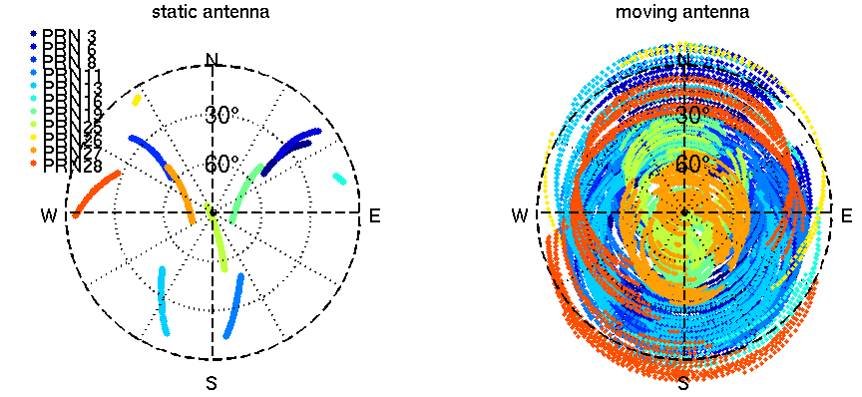
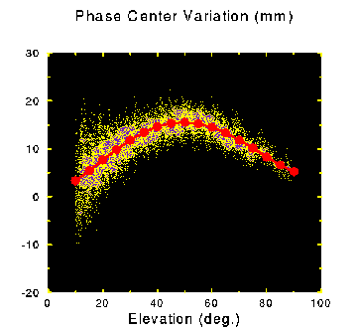
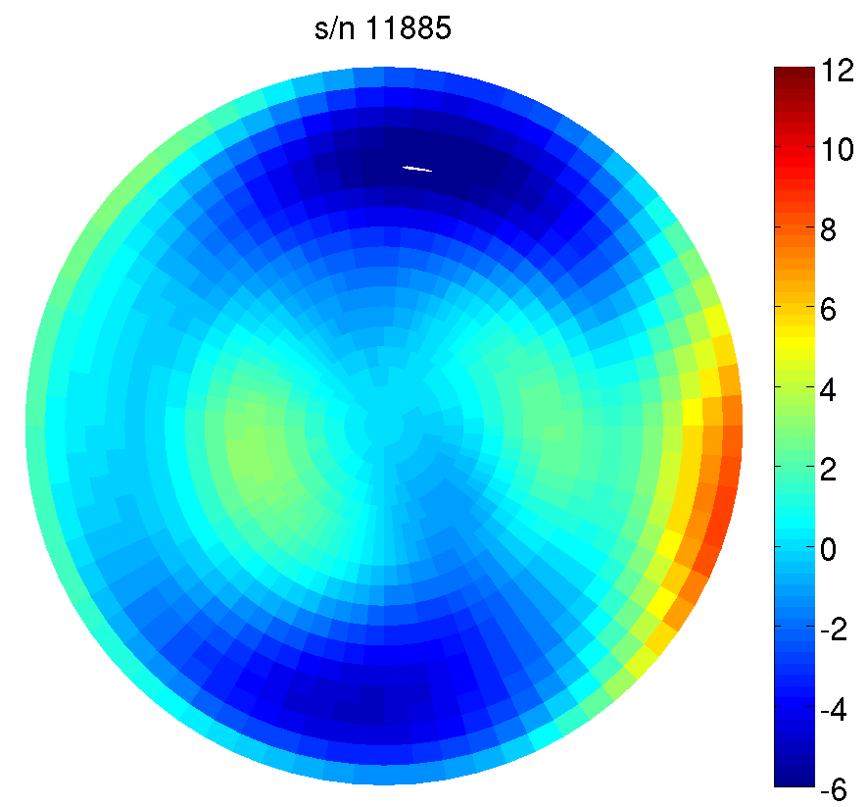
NGS Antenna Calibration – Relative vs. Absolute GNSS Antenna Calibration
relative
absolute
2 hours
GPS tracking

Slide 135
OPUS-Net
Why use near-by and more-distant CORS?
Although it may seem counter-intuitive, using a combination of near and distant CORS has a number of advantages.
CORS “quality” can be emphasized as well as data quantity.
Longer baselines enable better atmosphere corrections.
More CORS minimizes the effects of missing data and changes.
135

Slide 136
OPUS-mapper

Slide 137
OPUS-Mapper
Traditionally, NGS products have supported higher-accuracy uses: conventional surveying, geodetic and geophysical research, et cetera. Nevertheless, these products also support other uses such as GIS, kinematic and hand-held tracking to list a few.
To support activities that are dynamic by their very nature and often depend upon short latency, OPUS seems an appropriate gateway.
But, do we need another flavor of OPUS?
The answer is unclear, but may be yes. A limited accuracy application fits nicely into NGS plans and may be a valuable service to this large user community.
137

Slide 138
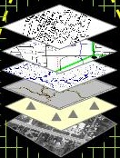
OPUS-Mapper
# of People Who Care
NGS Works Here
GIS Works Here
mm
cm
dm
m
dam
hm
km
Position Accuracy
Mader and Weston, “An On-Line Positioning User Service For Geographic Information Systems”, 2007, 2007 ESRI Survey & Engineering GIS Summit.
138

Slide 139
OPUS-Mapper
What does OPUS-Mapper offer?
Accepts single- and dual-frequency data.
Accepts kinematic data.
Differential pseudorange solution to CORS.
Kinematic trajectory report.
Static occupation report.
Shape files are coming.
139

Slide 140


OPUS-Mapper
Why opt for differential over point positioning?
N
N
W
E
W
E
S
S
Point Positioning
Differential Positioning
140

Slide 141
OPUS-Mapper
Although some trials were completed, there is no active web interface for OPUS-Mapper at this time. This is because:
Often, results like these are only part of a more comprehensive data set. It was realized that a means for “connecting” user-supplied data and meta-data needed to be developed.
Sometimes the developer needs a “kick in the pants.” If you feel this application has value for your work, let me know or contact the NGS.
141

Slide 142
OPUS-Mapper
OPUS–Mapper Kinematic Trajectory Report
2005/12/ 3 17: 1:31.0 2.9 1.160 954480.027 -5680360.821 2729931.909 1.056 2.848 1.418 25.5077314 -80.4616043 -27.099 0.913 1.239 2.977
2005/12/ 3 17: 1:32.0 3.2 1.236 954481.086 -5680362.067 2729932.279 1.441 3.341 1.528 25.5077290 -80.4615959 -25.672 1.070 1.474 3.500
2005/12/ 3 17: 1:33.0 3.2 1.222 954481.036 -5680362.056 2729932.286 1.426 3.303 1.511 25.5077291 -80.4615964 -25.687 1.059 1.458 3.461
2005/12/ 3 17: 1:34.0 3.2 1.083 954481.059 -5680362.424 2729932.291 1.263 2.926 1.338 25.5077277 -80.4615968 -25.353 0.938 1.292 3.066
2005/12/ 3 17: 1:35.0 3.2 1.067 954480.952 -5680362.523 2729932.256 1.245 2.881 1.318 25.5077271 -80.4615980 -25.297 0.924 1.272 3.018
2005/12/ 3 17: 1:36.0 2.9 1.072 954480.179 -5680361.378 2729932.061 0.975 2.626 1.307 25.5077304 -80.4616037 -26.515 0.844 1.143 2.746
2005/12/ 3 17: 1:37.0 2.9 1.007 954480.317 -5680361.418 2729932.122 0.916 2.467 1.228 25.5077307 -80.4616024 -26.432 0.793 1.074 2.579
2005/12/ 3 17: 1:38.0 2.9 0.926 954480.509 -5680361.612 2729932.255 0.843 2.268 1.129 25.5077309 -80.4616009 -26.174 0.729 0.987 2.370
2005/12/ 3 17: 1:39.0 2.9 0.852 954480.740 -5680361.761 2729932.392 0.776 2.088 1.040 25.5077313 -80.4615988 -25.947 0.671 0.909 2.183
2005/12/ 3 17: 1:40.0 2.9 0.772 954480.960 -5680361.889 2729932.507 0.703 1.891 0.941 25.5077316 -80.4615969 -25.752 0.608 0.824 1.977
2005/12/ 3 17: 1:41.0 2.9 0.751 954481.064 -5680362.026 2729932.598 0.683 1.838 0.915 25.5077317 -80.4615961 -25.575 0.591 0.801 1.921
2005/12/ 3 17: 1:42.0 2.9 0.732 954481.140 -5680362.105 2729932.554 0.666 1.790 0.891 25.5077310 -80.4615955 -25.512 0.576 0.780 1.871
2005/12/ 3 17: 1:43.0 3.2 0.970 954481.362 -5680362.468 2729932.576 1.132 2.613 1.196 25.5077297 -80.4615939 -25.146 0.841 1.157 2.738
2005/12/ 3 17: 1:44.0 2.9 0.671 954481.325 -5680362.341 2729932.577 0.611 1.641 0.818 25.5077302 -80.4615941 -25.264 0.528 0.716 1.716
2005/12/ 3 17: 1:45.0 2.9 0.639 954481.429 -5680362.449 2729932.646 0.582 1.563 0.779 25.5077303 -80.4615932 -25.123 0.504 0.682 1.634
2005/12/ 3 17: 1:46.0 2.9 0.625 954481.526 -5680362.463 2729932.677 0.569 1.528 0.761 25.5077304 -80.4615923 -25.083 0.493 0.666 1.598
2005/12/ 3 17: 1:47.0 2.9 0.621 954481.582 -5680362.499 2729932.724 0.566 1.518 0.756 25.5077306 -80.4615918 -25.022 0.490 0.662 1.587
GPST Date & Time
XYZ
XYZ RMS
LAT, LON, EL HGT
NEU RMS
RDOP
RMS
142

Slide 143
OPUS-Mapper
OPUS–Mapper Static Occupation Report
Station #: 1 File: zzyy337r.05o
2005/12/ 3 17: 1:31 954482.055 0.566 25 1 27.8497 0.603
2005/12/ 3 17: 3:14 -5680362.733 0.590 -80 27 41.7152 0.487
#sec: 103 #pts: 104 2729933.535 0.812 -24.3934 0.855
Station #: 2 File: zzyy337r.05o
2005/12/ 3 17: 4:41 955062.476 0.248 25 4 23.5041 0.268
2005/12/ 3 17: 7:23 -5680325.193 0.257 -80 27 20.9951 0.250
#sec: 162 #pts: 163 2729813.609 0.339 -22.6164 0.330
Station #: 3 File: zzyy337r.05o
2005/12/ 3 17: 9:56 955528.756 0.327 25 9 57.3369 0.179
2005/12/ 3 17:12:31 -5680598.380 0.312 -80 27 6.1520 0.280
#sec: 155 #pts: 156 2729086.863 0.359 -22.5733 0.472
Station #: 4 File: zzyy337r.05o
2005/12/ 3 17:14:13 956928.191 2.125 25 14 57.7295 0.045
2005/12/ 3 17:14:23 -5680357.338 0.525 -80 26 15.3043 2.181
#sec: 10 #pts: 11 2729097.676 0.128 -22.7844 0.206
143

Slide 144
Other gnss

Slide 145
Other GNSS
Other Global Navigation Satellite System, GNSS, are or will be operational in the future.
GLONASS is operational now.
Galileo is in testing and preparing for deployment.
COMPASS is in planning and testing.
Like you, the NGS wants to make use of these systems.
145

Slide 146
Other GNSS
Unfortunately, the infrastructure must also be in place before new GNSS can be incorporated into OPUS.
Precise ephemerides must be available in a timely manner.
A robust and comprehensive CORS network is needed.
Antenna models and other information must be available.
Software must be ready and proven robust.
The community must feel a sufficient level of comfort which is gained by reliably producing quality products.
146

Slide 147
Other GNSS
Looking at these point for GLONASS specifically:
Precise ephemerides are available no sooner than two-weeks and there is limited global support for this product.
The number of GLONASS enabled CORS is limited but growing (approximately 12% in the U.S.).
Antenna models and other information are being produced.
Software development is underway at the NGS.
The NGS has begun activities which will help develop a solid foundation for using GLONASS.
147

Slide 148
Other GNSS
What’s happening now?
Schenewerk is extending the PAGES suite to handle GLONASS and other GNSS.
GLONASS PAGES will be able to process integer-fixed or float GPS and float GLONASS separately or together.
The software is literally an extension of PAGES which has been proven in a variety of operational tasks.
148

Slide 149
Other GNSS
The GLONASS PAGES programming is largely complete.
Orbit production trials should be underway by April, 2011.
Contribution to the IGS GLONASS precise ephemeris combinations is planned by the end of the year.
Recall that the precise ephemerides have a two-week latency, so the viability of a GLONASS rapid product (one day latency or less) will be investigated.
149

Slide 150
Other GNSS
But GLONASS PAGES is just a transitional tool:
It provides useful products in the short-term.
Its products will be regularly compared with similar products from the international community.
It can provide experience with other GNSS.
It can provide a way to experiment with other GNSS.
It is a “benchmark” for the next-generation software.
150

Slide 151
Other GNSS
At the same time, Choi et al. are building the next generation software.
Software requirements:
Ability to process single- or multi-frequency data.
Ability to process single- or multi-constellation data.
Ability to process other many observables.
Ability to fix integers.
151

Slide 152
Other GNSS
At the same time, Choi et al. are building the next generation software.
Technical aspects:
Object oriented programming.
C++ or Java.
Unified formats and a robust interface which supports backward- and forward-compatibility.
152

Slide 153
Other GNSS
Challenges in building the next-generation software.
Understanding the biases within and between GNSS.
Receiver clock biases.
Inter-channel biases: hardware dependent for each frequency.
Other system biases.
The classic double-difference approach won’t work.
Different receiver clock estimates for each GNSS.
Mixing different frequencies.
Inter-channel biases.
Integer ambiguity fixing.
153

Slide 154
OPUS-Projects

Slide 155
OPUS-Projects
A Little OPUS-Projects History.
What Is OPUS-Projects?
The OPUS-Projects Interface.
How Good Can I Do With OPUS-Projects?
155

Slide 156
A Little OPUS-Projects History
The success of OPUS clearly demonstrated the value of web-based tools for some activities. This begged the question, could a web-based utility be made for a more complex task such as an airport or height modernization survey?
In these cases, one or more survey crews would be occupying one or more marks over several hours or days in a manner consistent with predefined project specifications.
156

Slide 157
A Little OPUS-Projects History
The “wish list” for such a web-based utility included:
Visualize and organize multiple, related data submissions.
Process all or subsets of the data according to user specifications.
Offer the results in useful forms and formats.
Do all this as simply as possible.
157

Slide 158
A Little OPUS-Projects History
But do we really need another OPUS flavor?
The practical answer is probably yes. The NGS and other groups have a history of project’s whose specifications can’t be entirely supported by OPUS.
The academic answer is probably yes. As good as OPUS does, and that is very good, sacrificing simplicity for flexibility can improve results - at least in some cases.
158

Slide 159
A Little OPUS-Projects History
In 2005, Weston and Gwinn began initial development on OPUS-Projects.
In 2006, several “proof of concept” tests were completed including one that involved hundreds of occupations spanning several weeks. Many “pros and cons” resulted, but the overall impression was positive.
159

Slide 160
A Little OPUS-Projects History
After a hiatus, Schenewerk began development again in 2007.
Prusky and Schenewerk oversaw a second, more focus test in 2009. Again, many “pros and cons” in the original design were revealed, but a better defined set of desirable capabilities resulted.
A beta version was released via training workshops in December, 2010.
160

Slide 161
What Is OPUS-Projects?
OPUS-Projects gives users web-based access to simple visualization, management and processing tools for multiple sites and multiple occupations.
These tools include:
The advantages of data uploading through OPUS.
Data visualization and management aids.
Enhanced data processing using the PAGES suite.
Solution visualization aids.
Seamless connectivity with other OPUS tools.
161

Slide 162
What Is OPUS-Projects?
OPUS-Projects exists in a hierarchical structure
Create . . . . . . . . creates a project.
Upload . . . . . . . . data submission.
Session . . . . . . . session review & processing.
Manage . . . . . . . network adjustments.
OPUS-Projects czar for general support.
162

Slide 163
What Is OPUS-Projects?
Your OPUS Project
Publish
To OPUS
OPUS Solution
Data &
Metadata
Session
Solution
OPUS Solution
Processor or Manager
Session
Solution
Manager
Network
Solution
Session
Solution
Session
Solution
OPUS Solution
Copy To User
Copy To User
Copy To User
163

Slide 164
The OPUS-Projects Interface
It’s probably easier to show the interface than describe it, so let’s walk through some of the basic steps in creating and reviewing a project.
Please be aware …
OPUS-Projects is actively being developed. The information shown here reflects many, but not all of the recent and pending changes.
164

Slide 165
(Note that the browser’s navigation banners at the top and bottom of each page are omitted.)
165
Notes:
The OPUS BETA gateway page is found at http://beta.ngs.noaa.gov/OPUS/.

Slide 166
166
Notes:
Note the “OPUS-Projects” link in the navigation menu on the left. This is the formal access point to OPUS-Projects.

Slide 167

167
Notes:
Informally, one can access the OPUS-Projects gateway page directly at http://geodesy.noaa.gov/OPUSI/OpusProjects.html

Slide 168
The first step is to create a project. This allocates on-line storage for the project’s data and generates project keywords. Start by clicking the “Create” button.
168

Slide 169

You’ll be taken to the project creation and registration page where you’ll enter your email, a title for, the type of, the approximate location of, start date for and size of your project.
169

Slide 170


If you haven’t completed this training, you’ll be notified. Information about future training classes can be found at
http://geodesy.noaa.gov/corbin/calendar.shtml.
170

Slide 171

If you are registered, you can complete the form and click the (now enabled) Create button.
171

Slide 172

After a moment, the introduction to your newly created project is displayed. You’ll also receive an email with this information.
172

Slide 173
Let’s take a few moments to highlight a few of the critical items.
173

Slide 174
The Project Identifier, and the Manager and Session Keywords enable all other access to your project.
174

Slide 175
Some find these randomly generated strings challenging, so they can be modified from the manager’s page.
175

Slide 176
Your Project Identifier can be shared thereby permitting others to contribute data to your project.
176

Slide 177
Uploading Data to a project
177

Slide 178
UPLOADING DATA TO A PROJECT
The second step is to “Upload” data files to your project.
At this time, this is done through OPUS-S implying the same restrictions:
Your data must be dual frequency pseudorange and phase P1 (or C1), P2, L1 and L2.
A minimum 2-hours data span for each submission.
A collection rate of 1, 2, 3, 5, 10, 15 or 30 seconds.
178

Slide 179
179
Notes:
The OPUS BETA gateway page is found at http://beta.ngs.noaa.gov/OPUS/.

Slide 180

180

Slide 181
181

Slide 182

182
Notes:
The OPUS “upload complete” page.

Slide 183
183
Notes:
Mark 2123 has not been uploaded to the project before so the options to describe appear after upload.

Slide 184

184
Notes:
The Mark 2123 metadata page (top).

Slide 185

185
Notes:
The Mark 2123 metadata page (bottom).

Slide 186

186
Notes:
Now we’re done with this upload. The field people can only upload metadata once per site, so other uploads will be simpler.

Slide 187

187
Notes:
OPUS solution report for 2123275a.06o.

Slide 188
UPLOADING DATA TO A PROJECT
When data are submitted to a project, the OPUS-S results are “quality controlled” using thresholds specified by the project manager.
If the results from a data file exceed any of the thresholds, a warning message is sent to the email address entered when the data were submitted.
Receiving a warning message does not mean the data will be excluded from your project. That is the project’s decision. However, the data are flagged for easy identification by the project.
188

Slide 189

UPLOADING DATA TO A PROJECT
The highlight is mine.
These preferences can be modified by the project manager.
189
Notes:
OPUS quality control report for 2123275a.06o.

Slide 190
UPLOADING DATA TO A PROJECT
Again, receiving a warning does not mean that the uploaded file is rejected. It only means the file will be flagged. It is still copied to the project and is available for processing.
190
Notes:
OPUS quality control report for 2123275a.06o.

Slide 191
View and Process A Session
191

Slide 192
VIEW & PROCESS A SESSION
OPUS-Projects groups the data into sessions.
Sessions are groups of site occupations that overlap significantly in time. Note that
a site may appear in more than one session.
as new data are submitted, the definitions of the sessions may change.
Now that some data has been submitted to the project, processing can begin.
192

Slide 193
VIEW & PROCESS A SESSION
Let’s switch to a project already loaded with data. The project title is: “Training data set 1” The project keywords are:
PROJECT : hrdb86fc
MANAGER : ff5d3zmu
PROCESS : d_ssvk68
Please note that this is a project used for testing and, so, may not always be in this exact state. Nevertheless, feel free to visit and look around.
193

Slide 194


This time we’ll enter through the Session login on the OPUS-Projects gateway page.
194

Slide 195

195
Notes:
This is the page for session 2006-274-A of “Training data set 1”. The components of this page are:

Slide 196
The banner shows the project’s title and session. The session pull-down menu can be used to select another session to view/work with.
196

Slide 197

The left sidebar holds the controls.
197

Slide 198

The map shows the relative location of the marks in this session or solution, and their status.
198

Slide 199

The right sidebar lists the marks.
199

Slide 200


The table below the map summarizes the status for each mark.
200

Slide 201

The table below at the bottom of the page graphically represents the data availability.
201

Slide 202


Someone working with a session can email other members of the project.
202

Slide 203


Review copies of the reports associated with the session.
203

Slide 204



Or process the session’s data.
204

Slide 205

INCLUSION OF IGS SITES
Distant IGS sites
Provide accurate reference frame
Transfer IGS(NSRS) frame to local area
Improve troposphere determination and heights

Slide 206

BASIC HUB SITE STRATEGY
Single 24hr Hub station
Is connected to each IGS station
Gets placed accurately in IGS frame
Provides consistent reference for each remote station
Is suitable for projects up to several hundred km with > 2-4hr of data
Tightly constrain IGS, loosely constrain hub

Slide 207

BASIC HUB SITE STRATEGY – HGTMOD & FAA
Stations with < 1hr of data
Use multiple hub sites
Keep baselines < 20km

Slide 208
Manage a project
208

Slide 209
MANAGE A PROJECT
At any time during its lifetime, the manager can review the project’s status and modify details. Once again we’ll use the more interesting project, “Training data set 1” The project keywords are:
PROJECT : hrdb86fc
MANAGER : ff5d3zmu
PROCESS : d_ssvk68
Recall that this is an active test project and, so, may not always be in this exact state
209

Slide 210


The manager’s tasks are sufficiently numerous and varied to warrant a separate login.
To begin, enter the project and manager keyword, then click the “Manage” button.
210

Slide 211

211
Notes:
Manager’s page for HRDB86FC after Session processing.

Slide 212
The menu at the top of the page selects the type of solution or solutions.
212

Slide 213


Because Session processing has been completed, Session and OPUS solutions are now available. Eventually, network adjustments will be available too.
213

Slide 214

The sidebar on the left contains the controls for the manager’s page.
214

Slide 215

The map shows the relative location of the project’s marks. Here, again, the Session solution results are shown, but the OPUS solution results could be selected and displayed instead.
215

Slide 216

The sidebar on the right lists the sites alphanumerically but segregated by project and CORS marks.
216

Slide 217


The summary table at the bottom of the page also provided convenience links to other pages for the project.
217

Slide 218

The column headers are links to individual Sessions (and later, solutions).
218
Notes:
The column headers are links to individual Sessions (and later, solutions).

Slide 219


The row headers are links to individual sites.
219
Notes:
The row headers are links to individual sites.

Slide 220


The Keywords button opens a window with controls to change the project title, project identifier, the manager keyword or the Session keyword.
220

Slide 221


The Email Lists opens a window with controls instructing OPUS-Projects to carbon copy (CC) the manager’s email to others.
221

Slide 222


Preferences allows the manager to customize the defaults for his or her project.
222

Slide 223

A future enhancements will offer tools to design a project, e.g. create hardware lists and deployment schedules, and communicate that information to other project participants.
223

Slide 224

The Serfil button is a placeholder for pending B-, D- and G-record manipulation. These records comprise part of a “bluebook” submission for publication to the integrated database.
224

Slide 225


The reports created during OPUS, Session or Network processing are available through the Show A File controls. The selected files are display in a separate window for printing or saving locally.
225

Slide 226


Additional CORS can be added to a project using the CORS button.
226

Slide 227

A basic email tool for communicating with project participants or the OPUS-Projects staff through the Email button. Note that project reports can be appended.
227

Slide 228

Session solution matrices can be combined and solved creating an adjustment for this project.
228

Slide 229

Using the Publish button, a final network adjustment can be selected, and its results plus the associated mark metadata published.
229

Slide 230

In the near future, tools will be provided to “clean up” a project in preparation for back-up and removal of a project.
230

Slide 231


Lastly, a request to delete the project can be initiated. This begins a three step confirmation process which, if confirmed at each step, results in the project being deleted.
231

Slide 232
an Individual site page
232

Slide 233


Let’s go to a Mark summary page and examine some results. To navigate to the 2123 page, let’s start on the project manager’s page and click on the Session & Solution table row header for Mark 2123. Similar access is possible from any session page which includes this mark.
233
Notes:
Going back to the manager’s page, now let’s go to a site.

Slide 234

234
Notes:
Mark 2123 page (top).
Note that this is the page the manager sees. Others will see a slightly different presentation.

Slide 235
At the top we see the title and controls.
235

Slide 236

Next is a mockup of the datasheet if the mark were to be published. These can be edited by the manager if errors or omissions are found.
236

Slide 237


Below the datasheet mockup is a summary of site metadata by occupation.
237

Slide 238


Below the summary by occupation are the coordinate and status summary tables.
238

Slide 239

And at the bottom are summary plots and tables for comparison of different solutions.
The orange parts of the plots indicate regions outside the thresholds set by the project manager.
239

Slide 240

2011 Geoid Slope Validation Survey
Initial results presented at AGU:
“Airborne gravity improves the geoid at all wavelengths”
Stay tuned for the next Geoid Slope Validation Survey in 2013…location TBD.

Slide 241

OPUS WORKSHOP TRAINING
Check here for upcoming OPUS-Projects Workshops

Slide 242


Slide 243
New Developments for OPUS
Dr. Mark Schenewerk
Mark.Schenewerk@noaa.gov
816-994-3009

