Slide 1
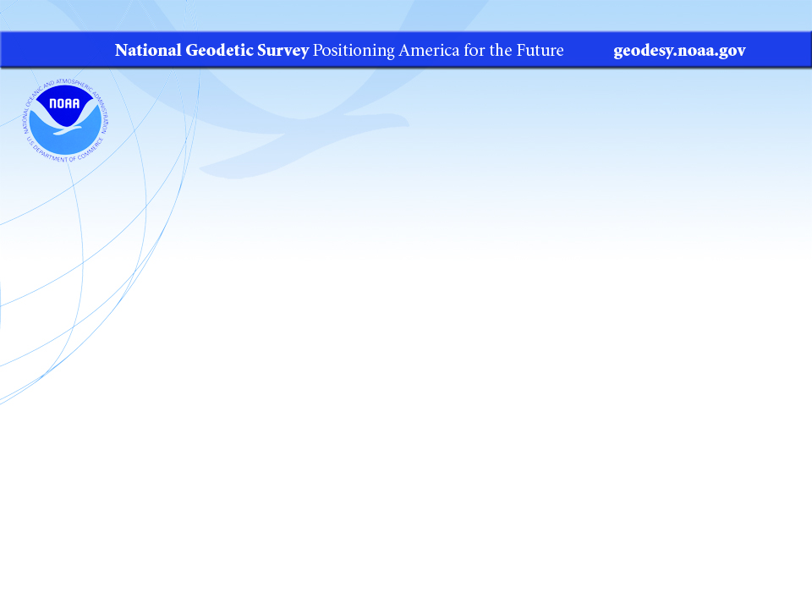
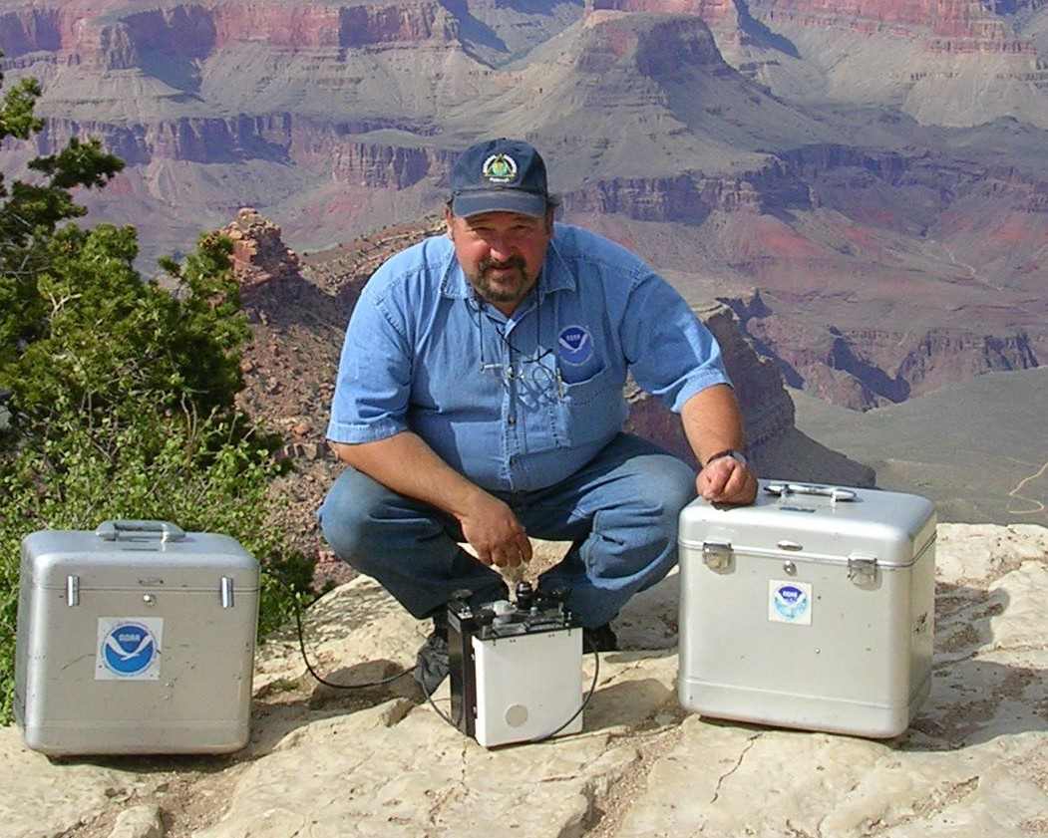
Gravity Monitoring Activities at NGS and an introduction to the New Geodetic Datums
-- A Whirlwind tour
Presented by Daniel Winester, Geodesist, NGS Gravimetry Representative to the Geophysics Committee of U.S. National Section of PAIGH since 2002

Slide 2
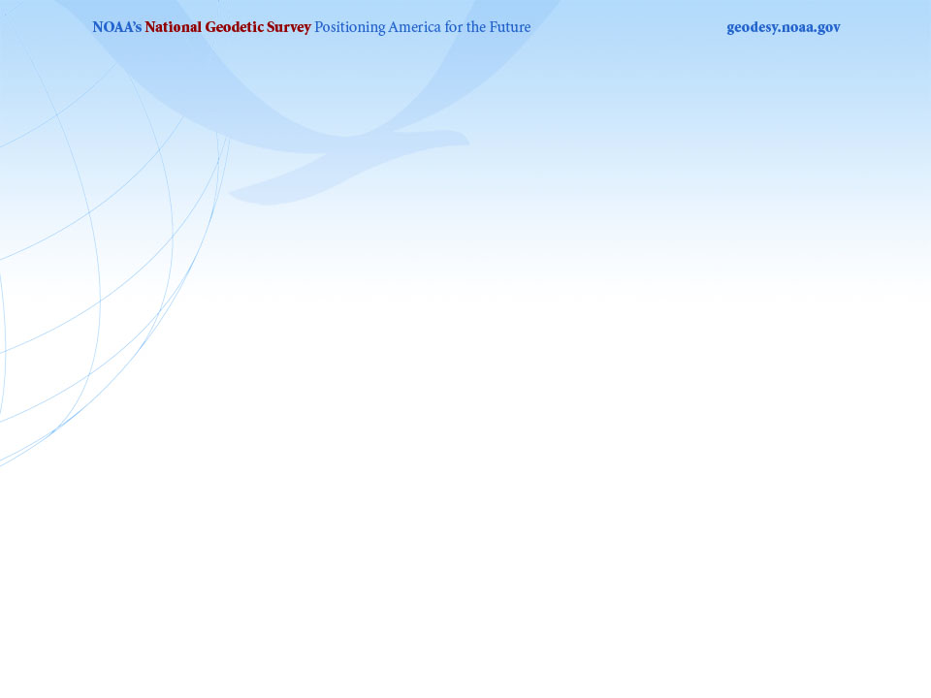
In the past few decades NGS’ gravity work has concentrated on
Temporal gravity change
&
Gravity maps (spatial variation)

Slide 3
Gravity or g refers to
the acceleration of gravity near the Earth’s surface:
g ≅ 9.8 meters/second².
We measure to
g = 9.80 654 321 m/sec²
1 Gal = 1 cm/sec²
So we measure to microGals.
Notes:
As the name implies, an absolute gravimeter measures gravity directly, as compared to a relative gravimeter which measures gravity offset from a reference location. Thus absolute meters can readily determine gravity change over time at various locations. Standard corrections are applied for ‘tides’, air pressure and polar motion.

Slide 4
Things which can cause gravity change:
Elevation change; such as glacial isostatic adjustment (GIA), ground compaction, tectonic movement, ground water effect, etc.
+3 µGal ≈ -1 cm in height change
Nearby mass changes; such as mantle reaction to GIA, water-table, soil moisture or snowpack change, magma or lava movement, tectonic movements, anthropogenic changes, etc.
+1 µGal ≈ +2.5 cm in water-table rise
Notes:
Where possible, we make measurements near other geodetic control; GNSS, VLBI, SLR, tide gauges

Slide 5
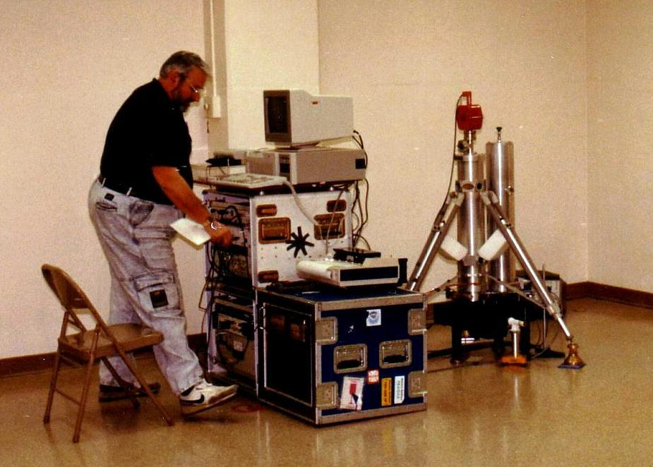
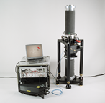
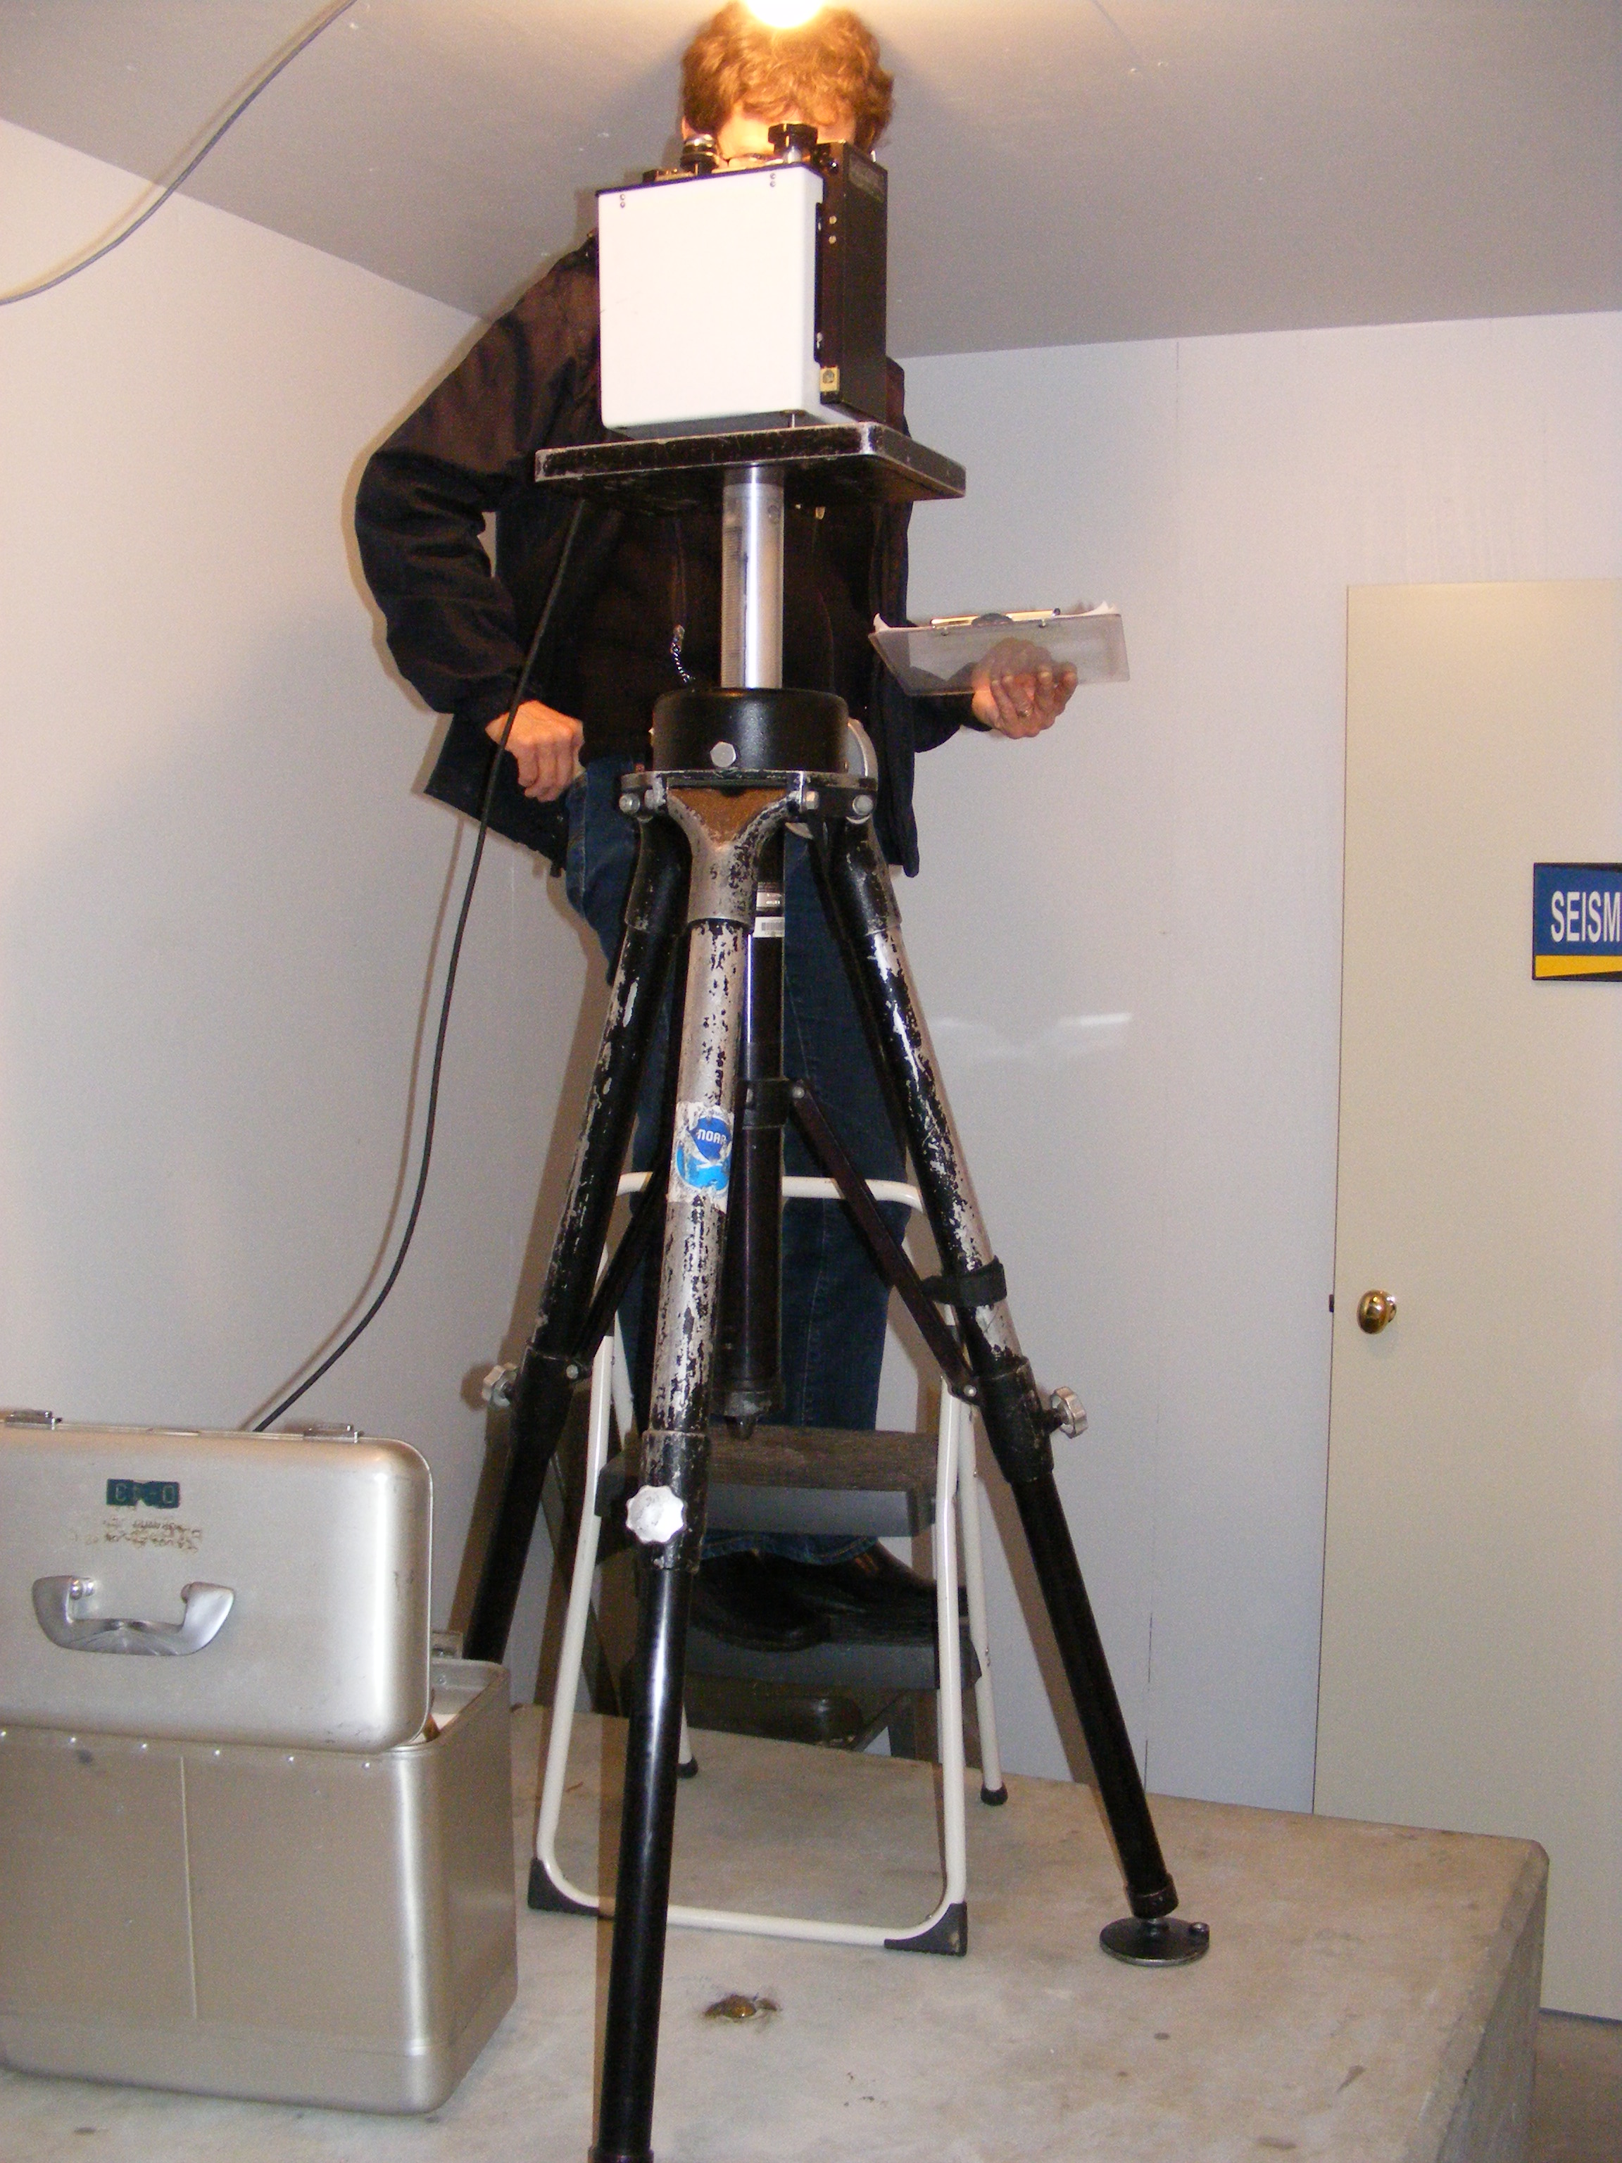
For this we have used absolute gravimeters:
JILAg-4 (accuracy ± 5 µGals)
FG5-102 & -111 (accuracy ± 2 µGals)
(accuracy at top of drop)
And various L&R land gravimeters with feedback systems for gradients

Slide 6
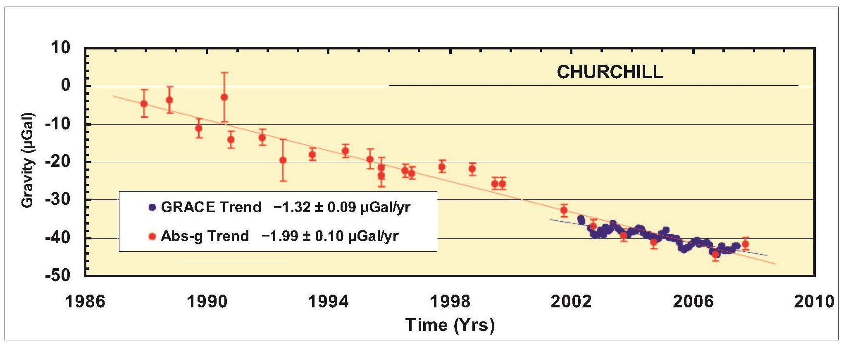
Absolute gravity contributions from NOAA-NGS, Canadian Geodetic Survey & Geological Survey of Canada

Slide 7
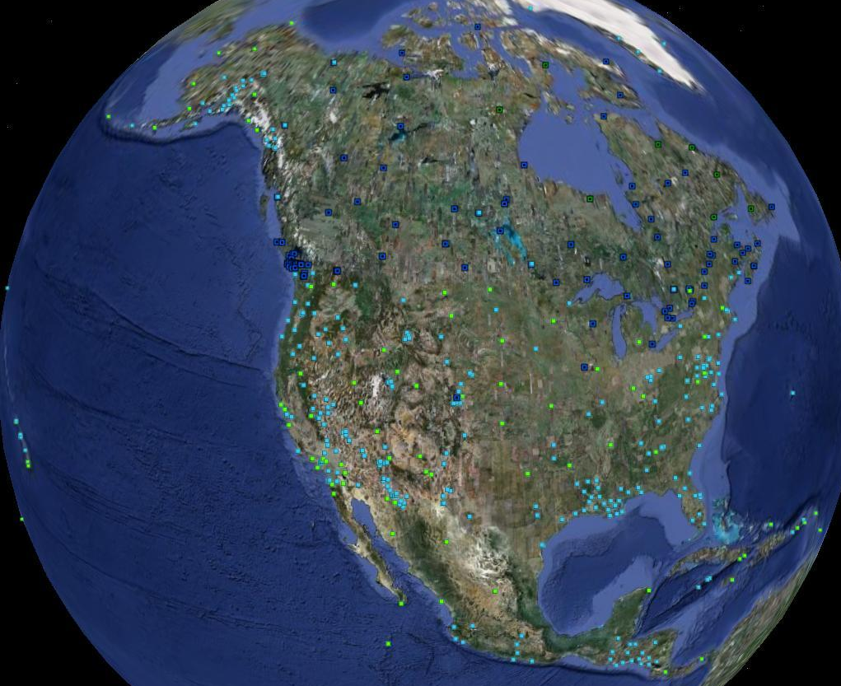
Light blue: observed AG
Green: suggested sites
Blue squares: observed by Canadians

Slide 8
At a recent PAIGH meeting,
I mentioned that NGS (with others) will be redefining the geodetic datums. Since there was interest, I thought I’d cover some of that.

Slide 9
And now, some alphabet soup:
The current horizontal geodetic datum
NAD83 = North American Datum of 1983.
The current vertical geodetic datum
NAVD88 = North American Vertical Datum of 1988.
These had replaced NAD27 and NDVG29.
In 2022, NGS looks to replace them.
Newer & better integrated data (think GNSS data).
Better models.
Tectonic plates have moved.

Slide 10
North American Datum of 1983 (NAD83) will be replaced by
North American Terrestrial Reference Frame of 2022
(NATRF2022)
Note that ‘Reference Frame’ is
preferred over ‘Datum’

Slide 11
Four “Plate-Fixed” Reference Frames
North American Terrestrial Reference Frame of 2022
(NATRF2022)
Pacific Terrestrial Reference Frame of 2022
(PATRF2022)
Caribbean Terrestrial Reference Frame of 2022
(CATRF2022)
Mariana Terrestrial Reference Frame of 2022
(MATRF2022)
These reference frames will fix issues of past movements and a better definition of the Earth’s center of mass. Reference frames will be dynamic. Will be used in Canada and Mexico.

Slide 12
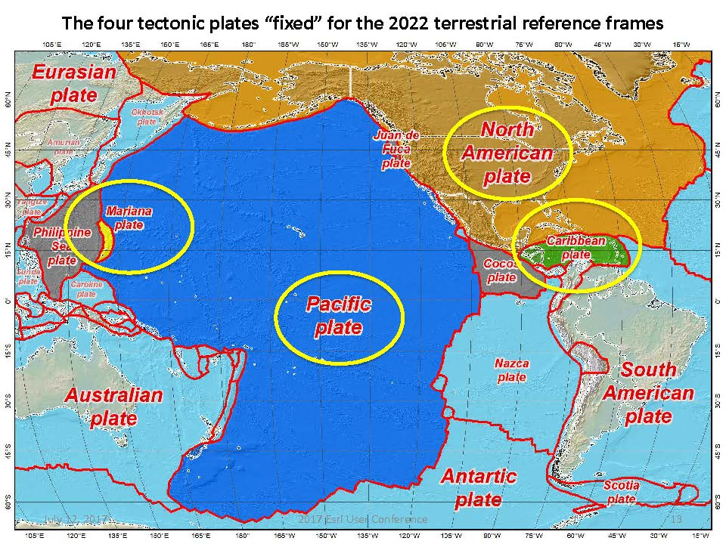


Slide 13
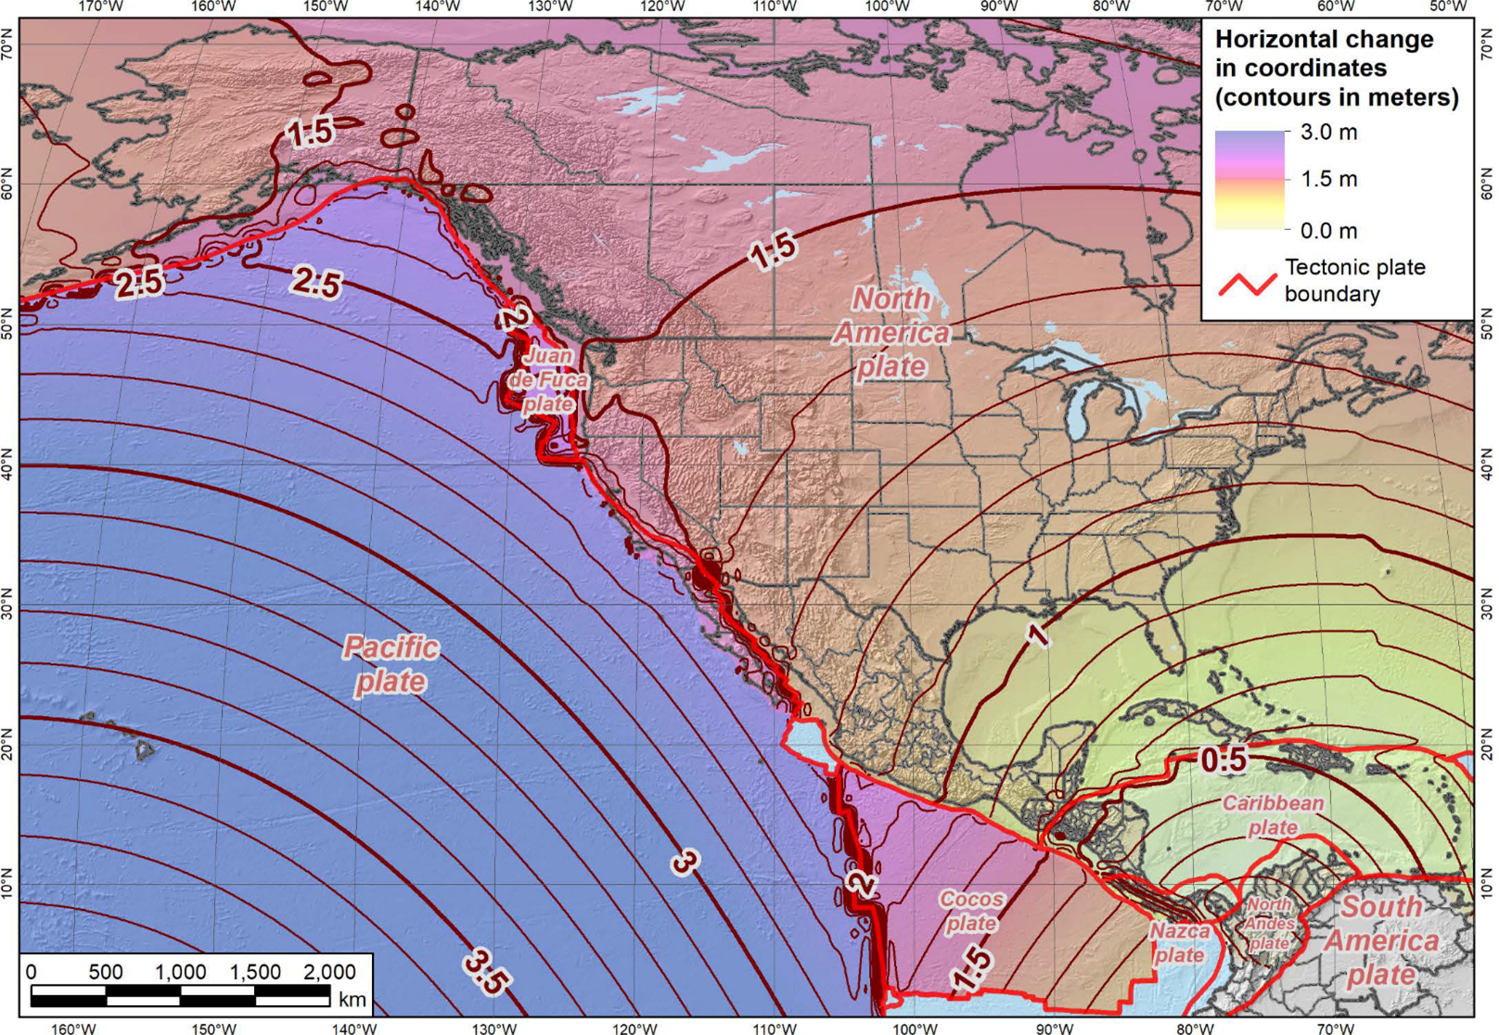

Slide 14
North American Vertical Datum of 1988 (NAVD88)
will be replaced by the
North American-Pacific Geopotential Datum of 2022
(NAPGD2022)

Slide 15
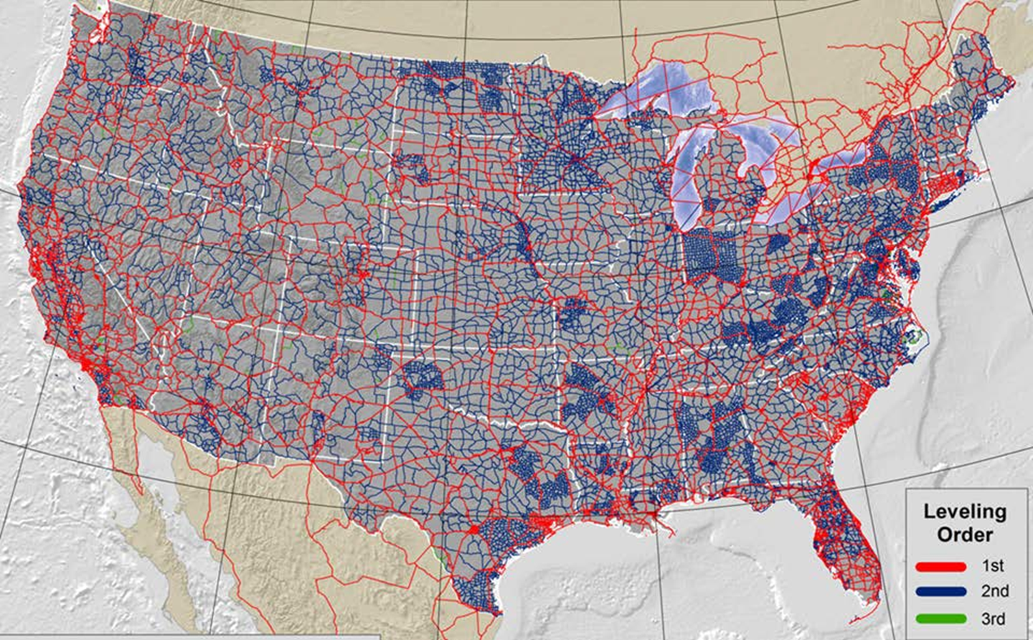
Why Replace NAVD88?

Slide 16
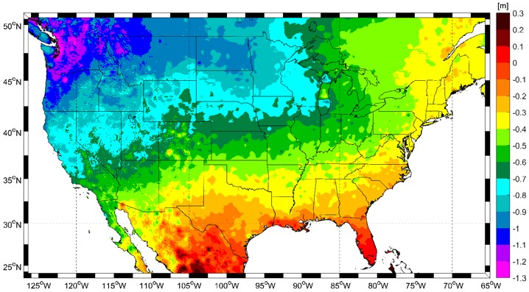
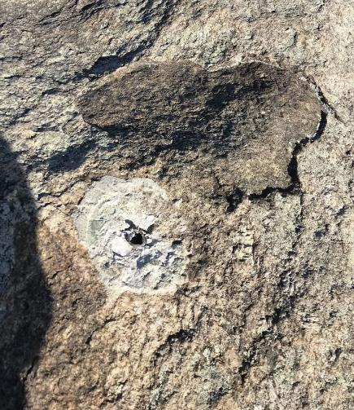
Why Replace NAVD88?
tilt in the "zero surface” (intended to be flat)
had been accessed by BMs in the ground, but many have been disturbed.
Approximate Error in NAVD88 "zero surface” wrt satellite-derived data

Slide 17
Replacing NAVD88
primary access via GNSS and geoid (think OPUS)
accurate continental gravimetric geoid (1-2 cm)
The Geoid is the Equipotential Surface that corresponds to Global Mean Sea Level. Orthometric Elevations are Defined as Height above Geoid.
aligned with:
  NATRF2022 (or CATRF, PATRF, MATRF)
  global mean sea level (GMSL)
monitor time-varying nature of gravity (NGS Geoid Monitoring Service GeMS)

Slide 18
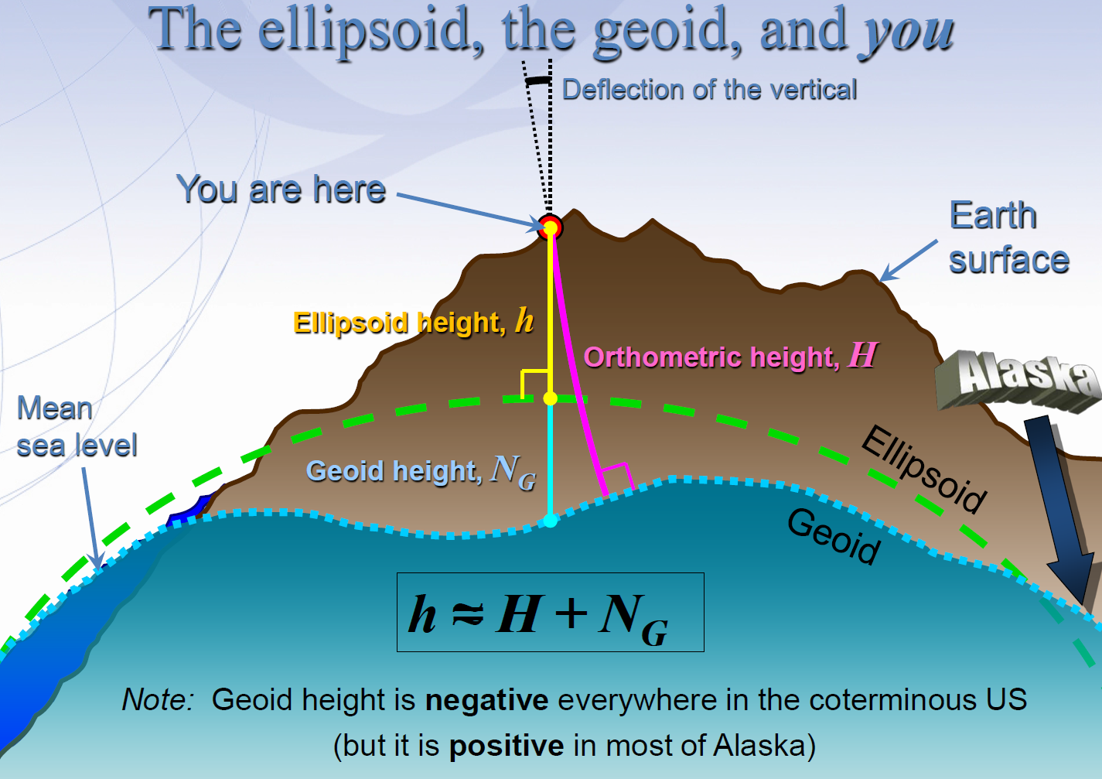

Slide 19

Calculating N_{g} is not easy!
First you need a gravity field
  data collected from different distances away from Earth
Next calculate gravity anomaly, or ∆g
Then, just solve Stokes’ integral!
R is the mean radius of the earth
ɣ0 is mean surface gravity on ellipsoid
S is a geometric function of position
…there’s a catch
Need to know ∆g over entire surface of the earth

Slide 20
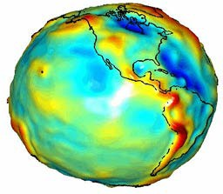

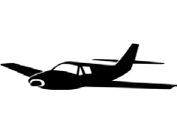
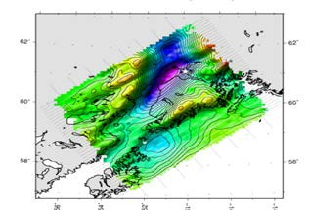

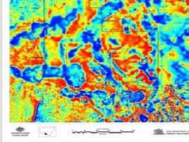

Building a Gravity Field Model
Long Wavelengths (> 250 km)
GRACE/GOCE/Satellite Altimetry
+
Intermediate Wavelengths (20km to 300 km)
Airborne Observations
+
Short Wavelengths (< 100 km)
Terrestrial/Surface Observations and Predicted Gravity from Topography

Slide 21
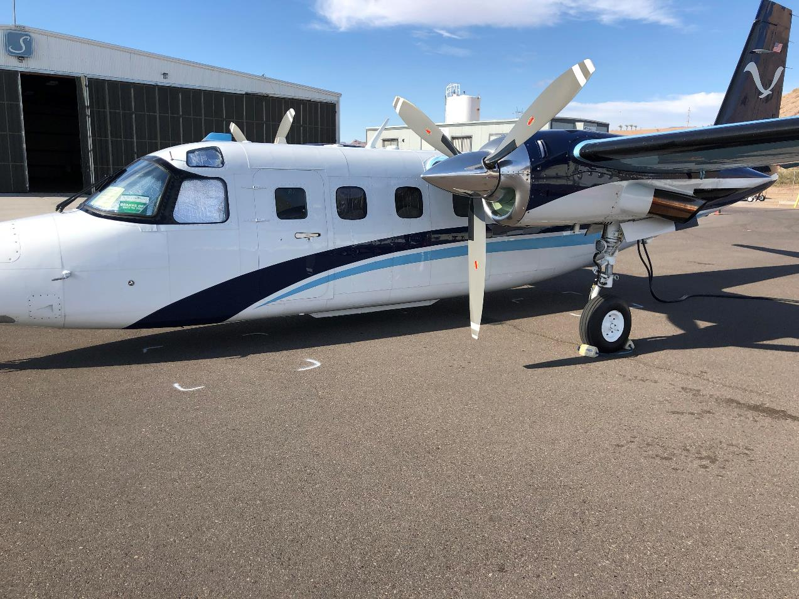
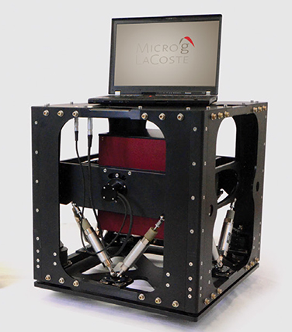
GRAV-D – airborne relative gravimeters
More than 81% flown
For the intermediate wavelength component, fly the country & territories & near shore at spacing of 10 km with airborne relative gravimeters.

Slide 22
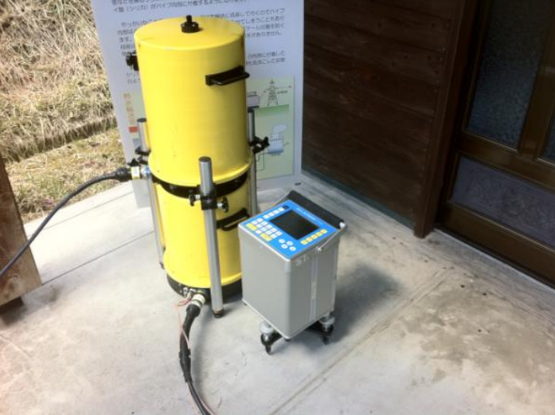
Terrestrial Gravimeters - Absolute and Relative
Constrain data with an absolute gravimeter (A10-025). Make ties to aircraft with a relative gravimeter (CG6)

Slide 23
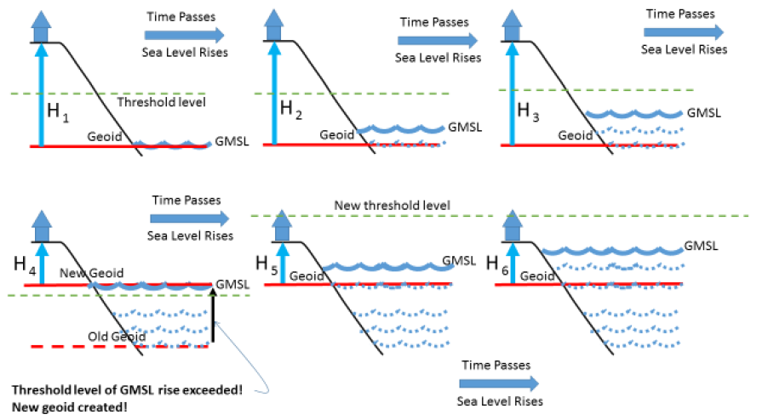
Sea Level Change and the Geoid
Threshold is about 20 cm or about 60 years.
Notes:
Mention GeMS contribution

Slide 24
Obviously, this was a way-too brief explanation of the new reference frames.
For more details see the Blueprint(s) for 2022
Part 1: Geometric Coordinates
NOAA Technical Report NOS NGS 62
Part 2: Geopotential Coordinates
NOAA Technical Report NOS NGS 64
Part 3: Working in the Modernized NSRS
NOAA Technical Report NOS NGS 67
Geodesy.noaa.gov/library/NOAA Technical Reports

Slide 25
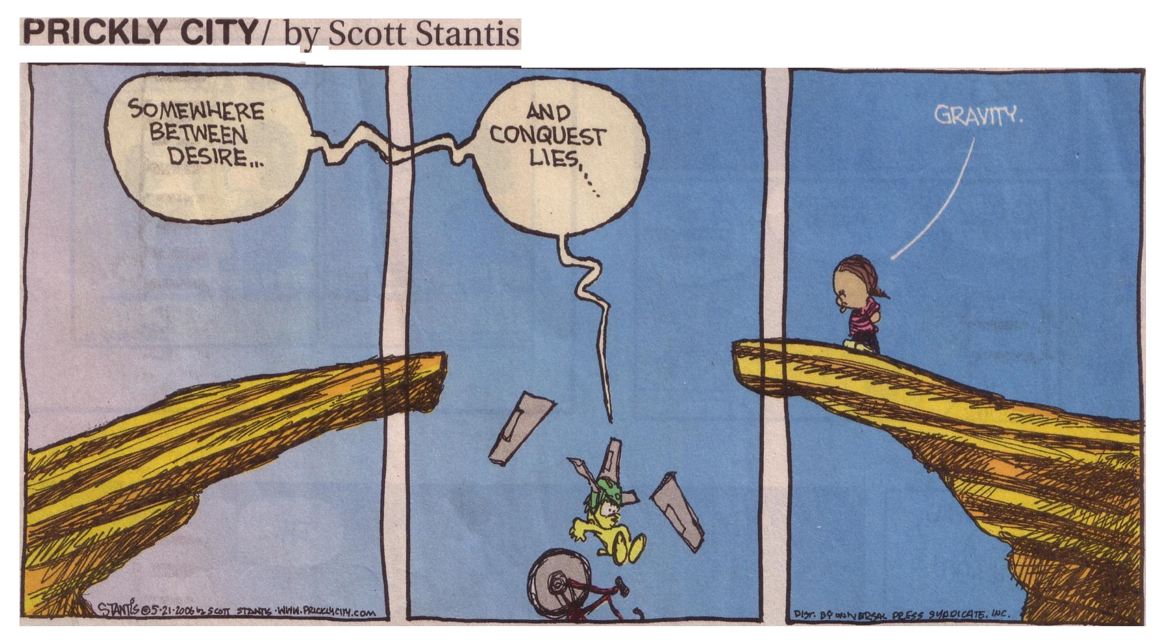
Thank you for your attention
Daniel Winester
NOAA – NGS – Skaggs 2C604
325 South Broadway
Boulder, CO 80305
303-497-6132
Daniel.Winester@noaa.gov
Geodesy.noaa.gov
I acknowledge that NGS’ Jeff Jalbrzilkoski & the NGS presentation library were responsible for the content of many slides presented.

