Slide 1

New CORS Station Webpages: Public Feedback Forum
1.
Dr. Kimber DeGrandpre and Jay Howard
August 10 2023

Slide 2
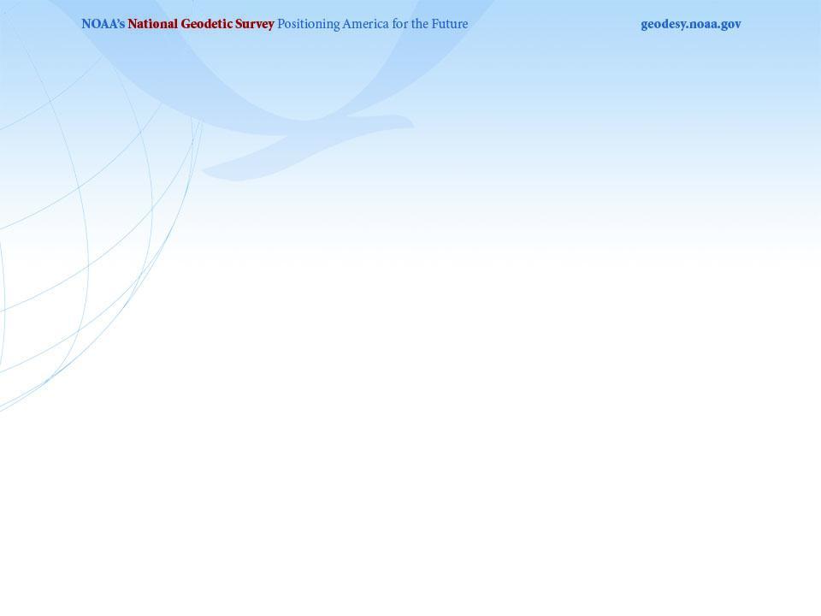
Disclaimers
2.
*This handout includes screenshots of the new CORS Station Pages*
*These new pages will replace the current CORS Station Pages: https://www.ngs.noaa.gov/CORS/Sites/1lsu.html *
*This site is currently in Development*
* This site is not finished, information may be incorrect, and the site is not publicly accessible*
*Public Beta release expected in early 2024*

Slide 3
Feedback
3.
The purpose of this document is to provide a copy of the new pages so that as we build them we are able to provide the information that our user base wants in an easily accessible way.
Please send all thoughts, suggestions, requests, or comments to:
Dr. Kimber DeGrandpre – NGS.Feedback@noaa.gov
I will read every email, but I may not be able to respond to all of them or incorporate all suggestions/requests in the final product. Please be sure to either reference the slide number (top left corner) in this handout, or at least the section that you are referring to (i.e. General Station Information, Data tab).

Slide 4
Feedback
4.
Content
  Is there information you wish we would include
  Is there information presented you do not need (aka takes up space where more relevant information could go)
Format
  Would you prefer to see this information in a different way (i.e. table vs image vs free form)
  Do you have requirements for significant digits?
  Do you have preferences between units (i.e. decimal degrees, deg min sec, meters, miles, millimeters per year)
Aesthetics
  Do the background and box colors help you identify different topics?
  Are the plot colors clear and logical in their organization?

Slide 5
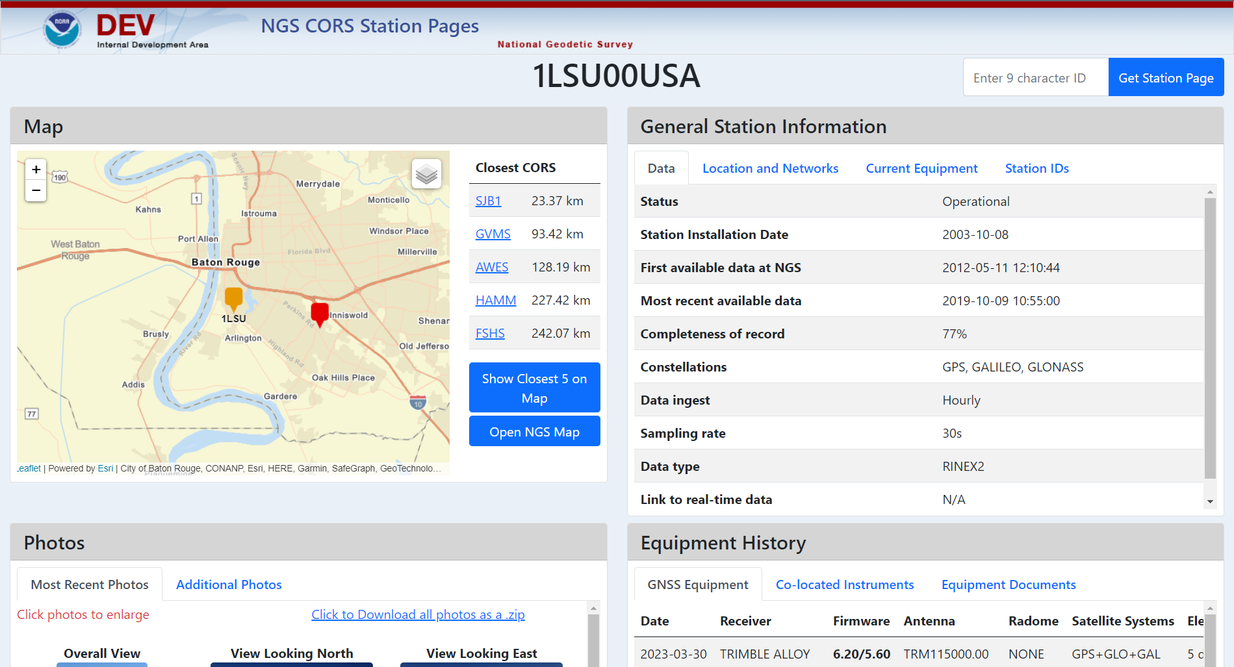
Overall Site Layout
5.

Slide 6
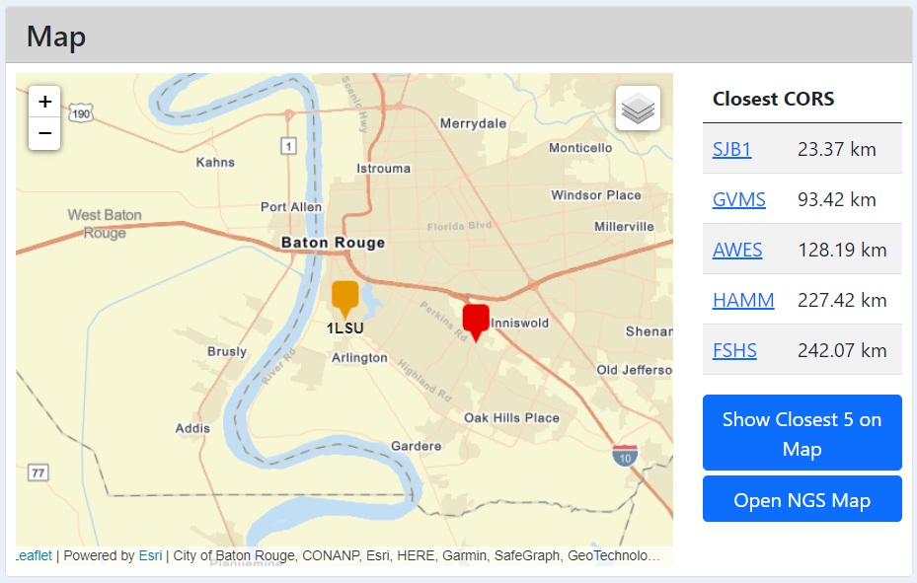
MAP
6.

Slide 7
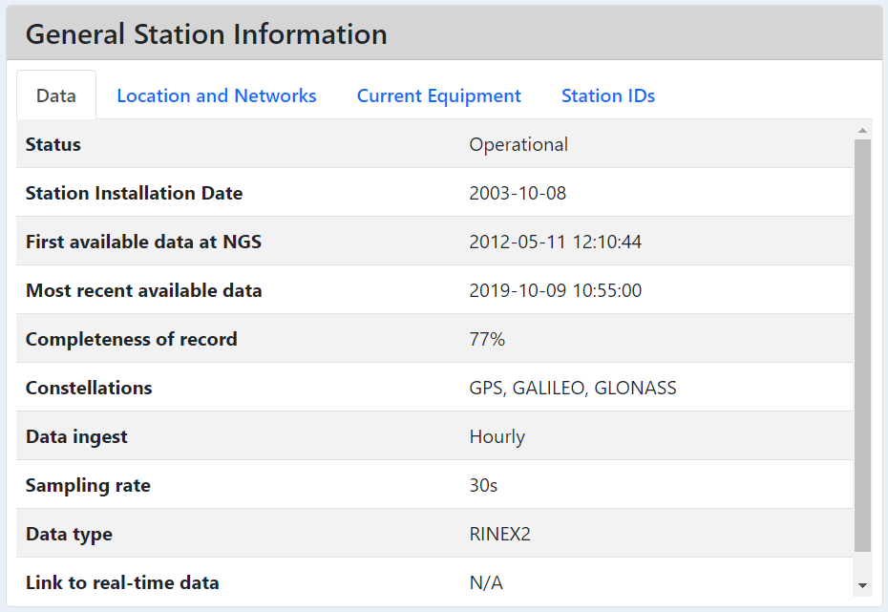
General Station Information - Data
7.

Slide 8
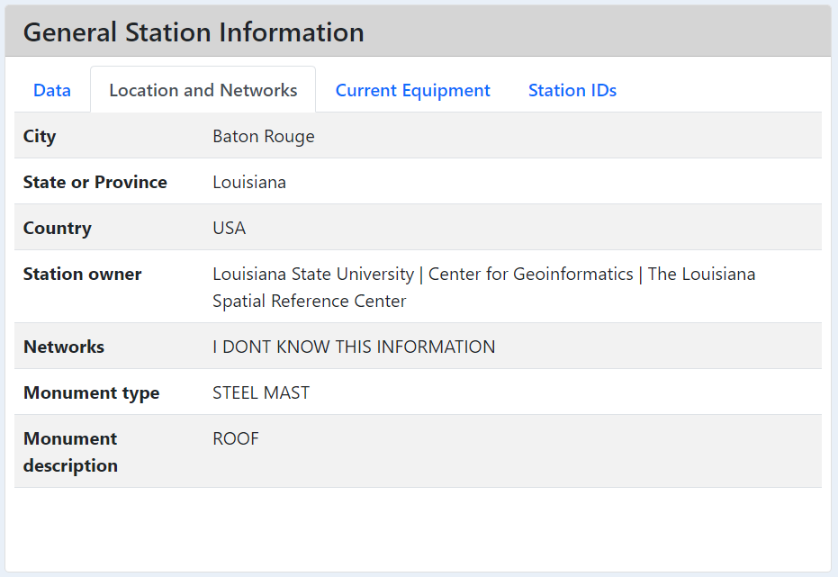
General Station Information – Location and Networks
8.

Slide 9
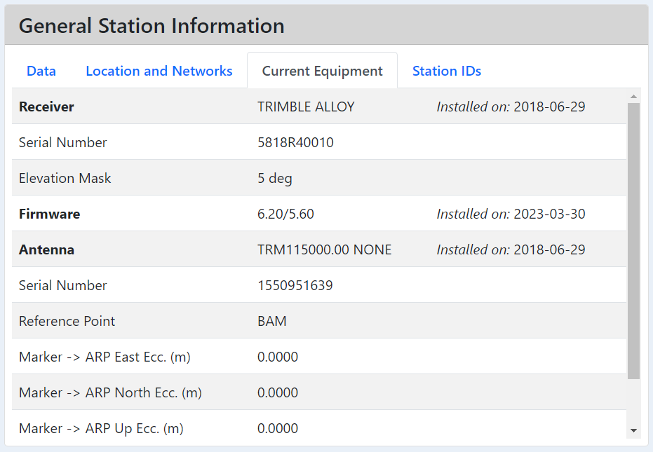
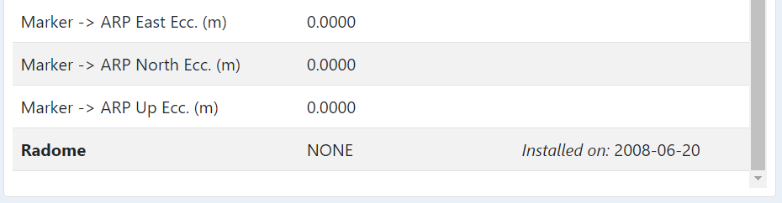
General Station Information – Current Equipment
9.

Slide 10
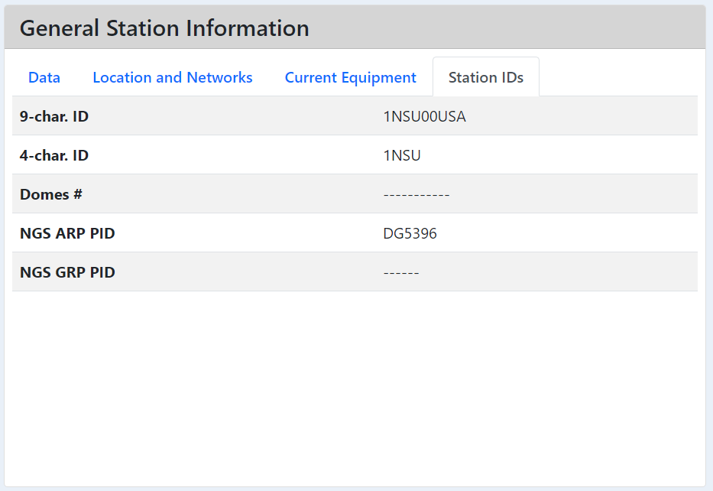
General Station Information – Station IDs
10.

Slide 11
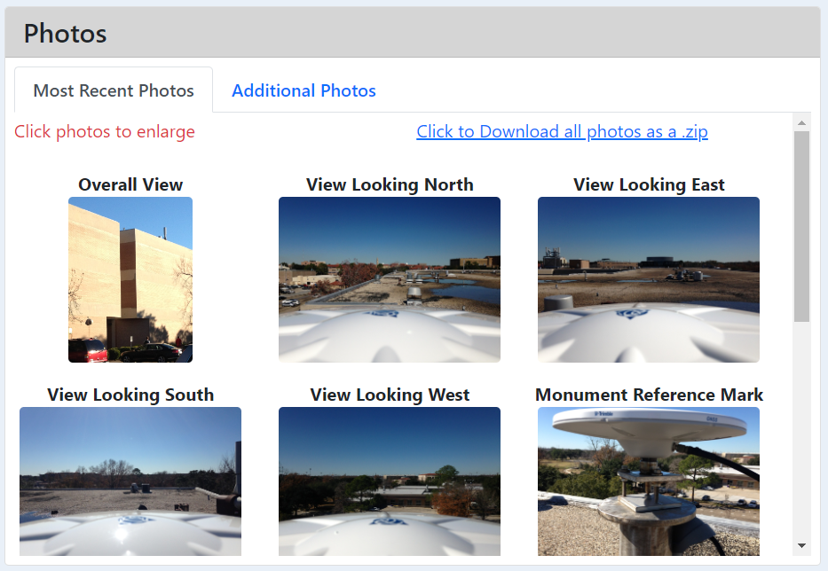
Photos – Most Recent Photos
11.
* All photos on the existing page will be accessible by scrolling down

Slide 12
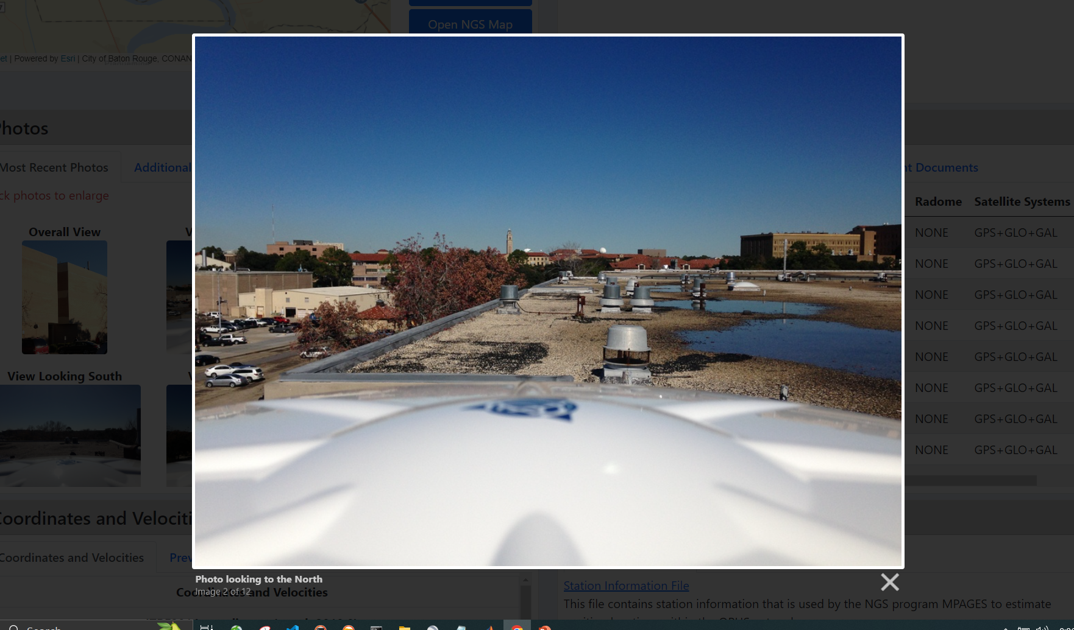
Photos – Most Recent Photos
12.
* Clicking on a photo will pop up a slideshow of larger images

Slide 13
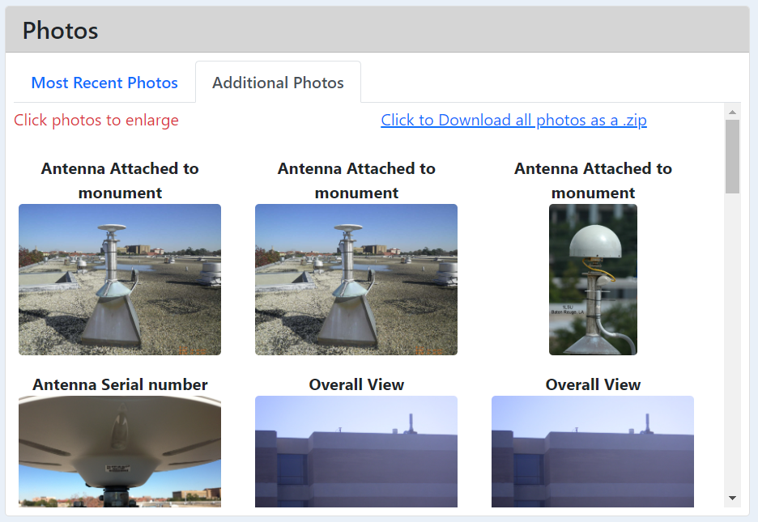
Photos – Additional Photos
13.
* Additional Photos are formatted the same as Most Recent Photos

Slide 14
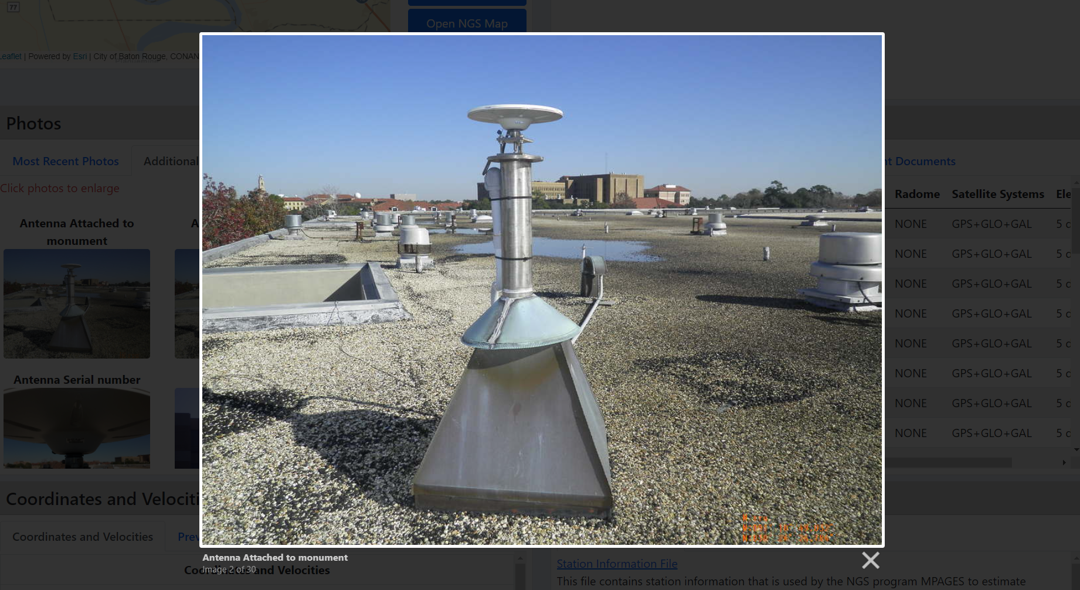
Photos – Additional Photos
14.

Slide 15
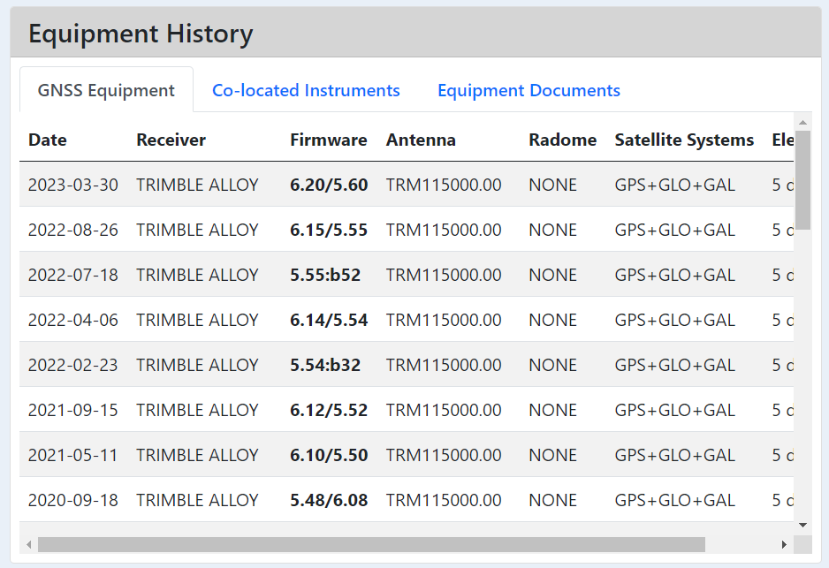
Equipment History – GNSS Equipment (1/3)
15.

Slide 16
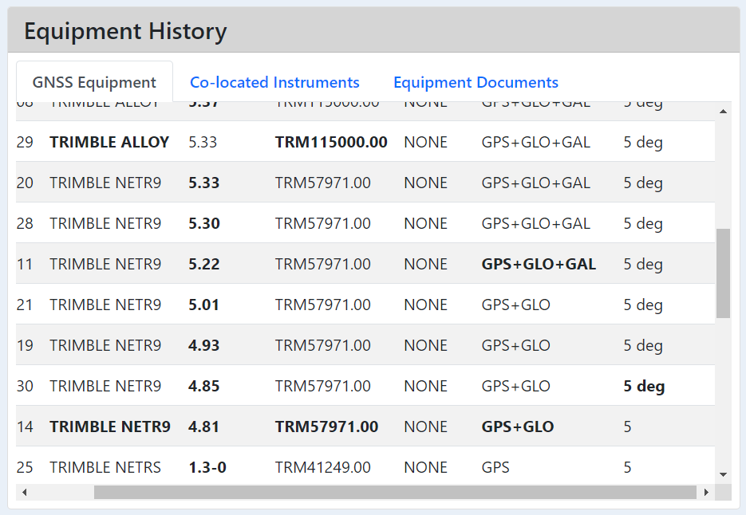
Equipment History – GNSS Equipment (2/3)
16.

Slide 17
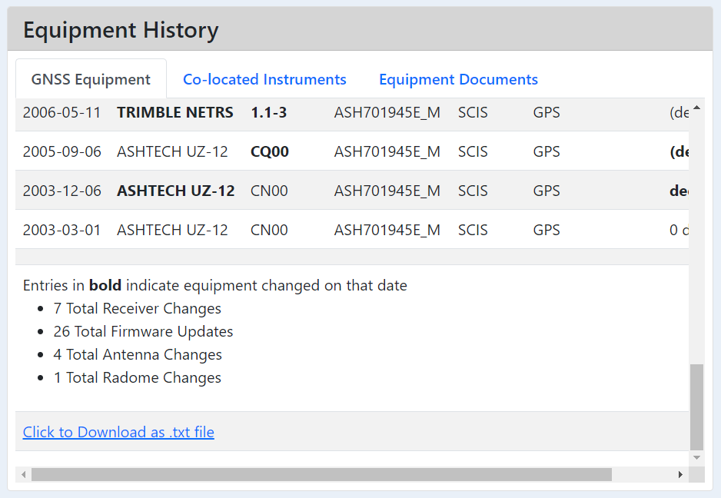
Equipment History – GNSS Equipment (3/3)
17.

Slide 18
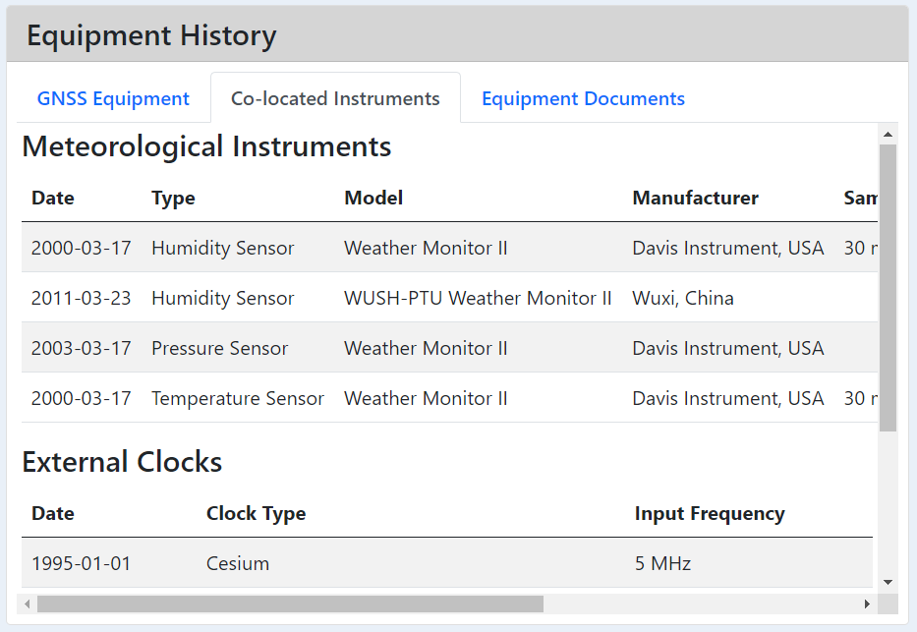
Equipment History – Co-located Instruments (1/2)
18.

Slide 19
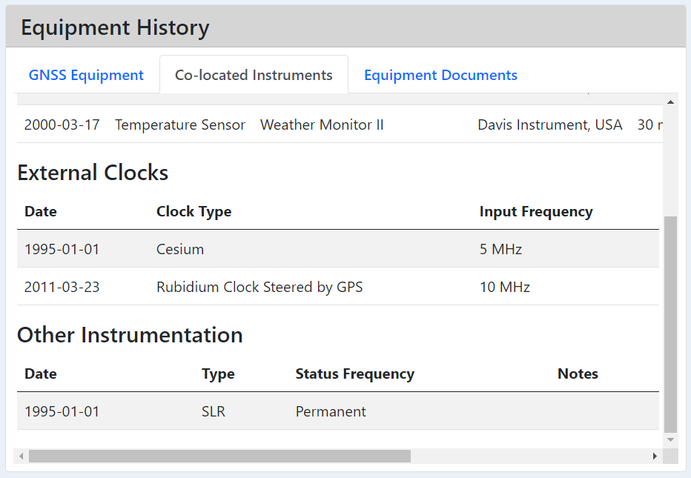
Equipment History – Co-located Instruments (2/2)
19.

Slide 20
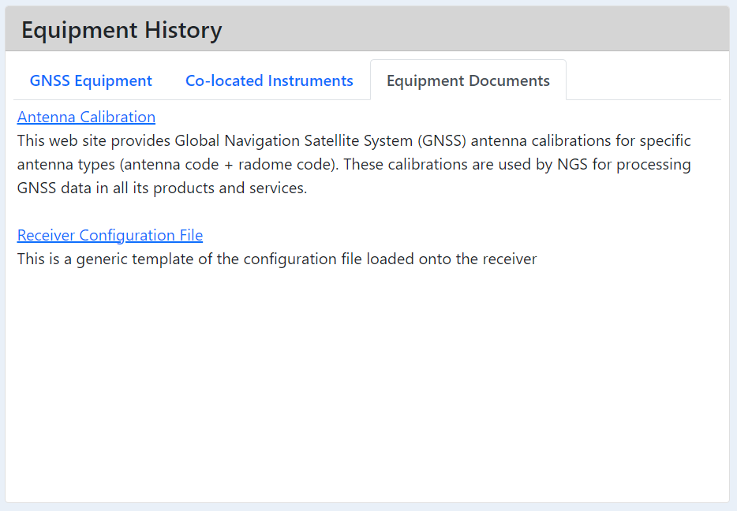
Equipment History – Equipment Documents
20.

Slide 21
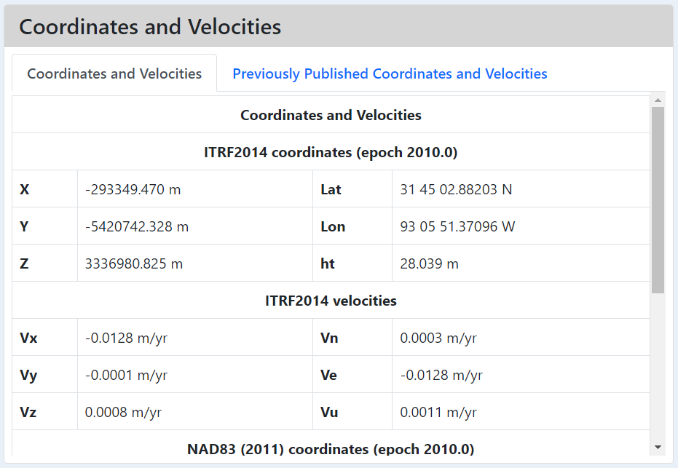
Coordinates and Velocities – Current Coordinates and Velocities
21.
*The section has not been designed yet, at all*
*Please provide ample feedback regarding the reference frames, epochs, format (i.e. xyz vs lat/lon/ht), significant digits, PID reference, layout, etc that you would prefer to have*

Slide 22
Coordinates and Velocities – Current Coordinates and Velocities
22.

Slide 23
Coordinates and Velocities – Previously Published Coordinates and Velocities
23.

Slide 24
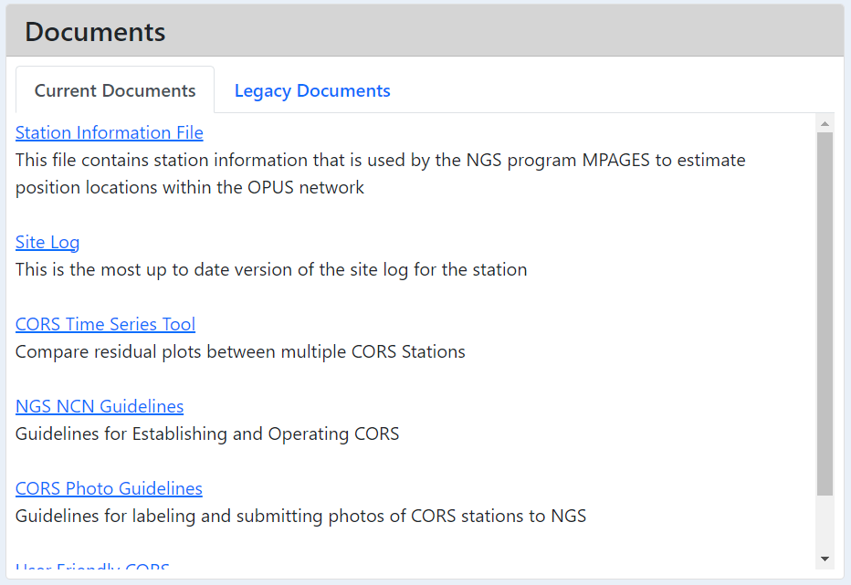
Documents – Current Documents
24.

Slide 25
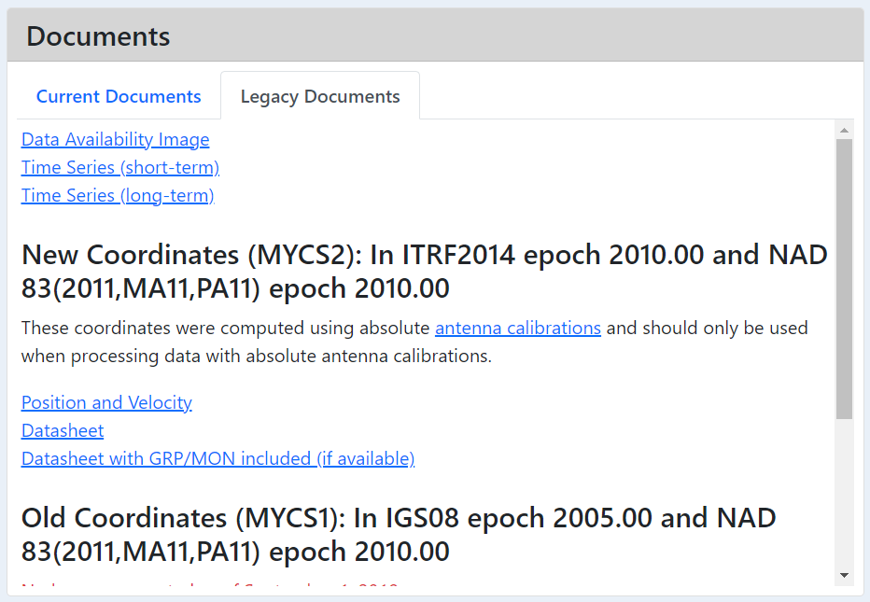
Documents – Legacy Documents (1/2)
25.

Slide 26
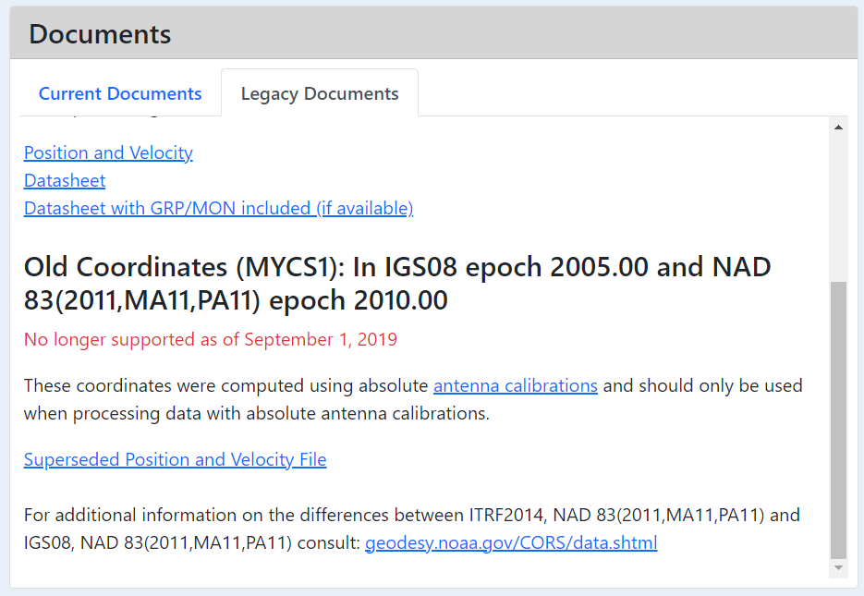
Documents – Legacy Documents (2/2)
26.

Slide 27
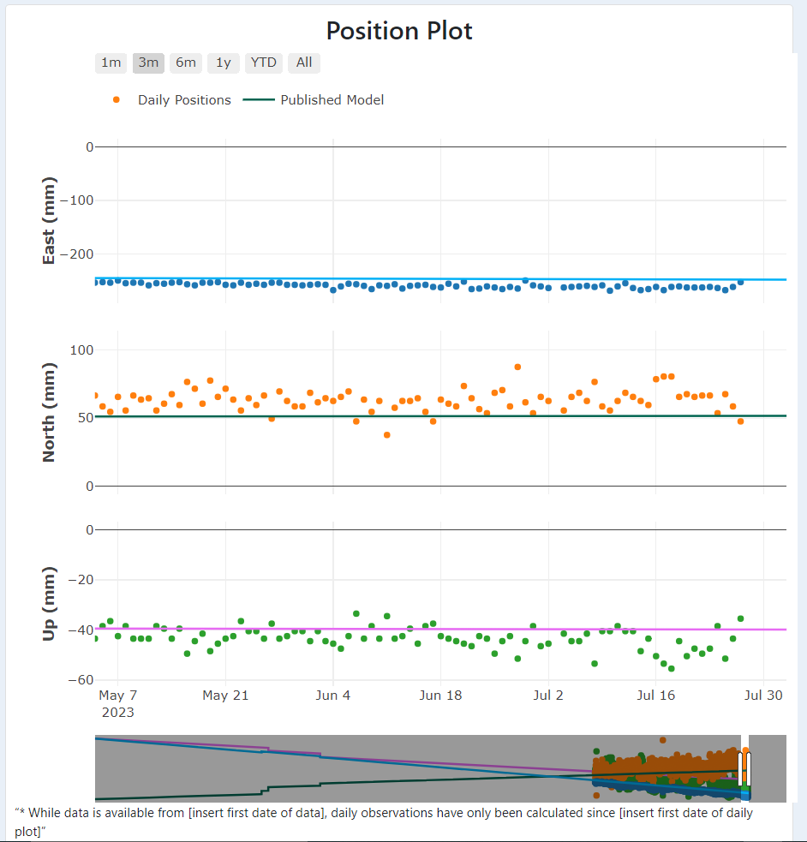
Position Plot (1/2)
27.
*This section will open on the 3 month setting*
*The other buttons will automatically set it to 1 month, 6 months, 1 year, year to date, and all settings*
*Custom ranges can be set by moving the slider bars at in the smaller bottom plot*
*If you hover the cursor over a daily position (dot) or the model (line) it will show you the date and the value for that position*

Slide 28
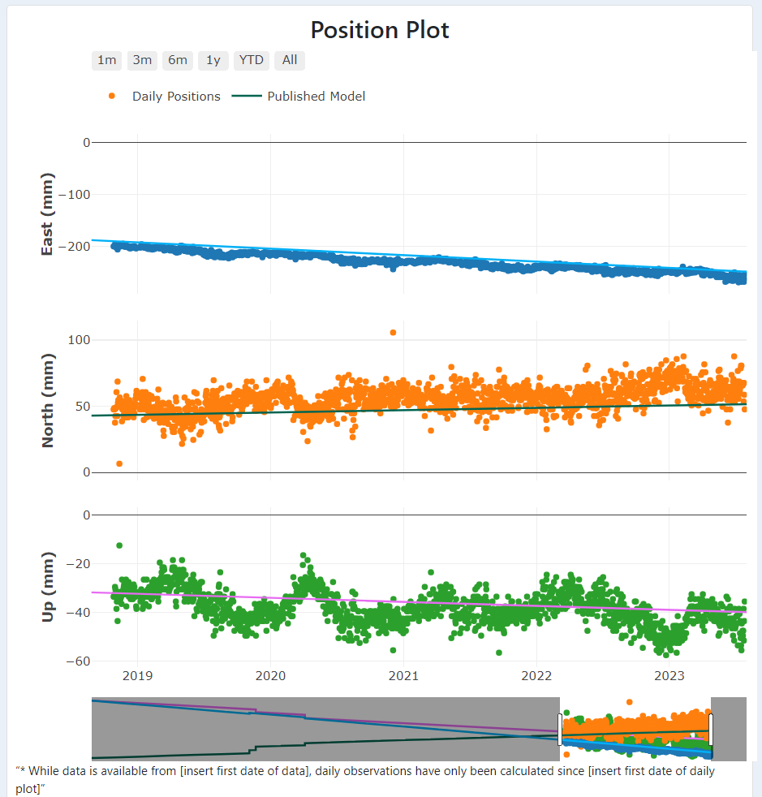
Position Plot (2/2)
28.
*Daily positions will only be able to be shown from 2018 GPS day 343 to present*
*If you would like information for multiple reference frames, antenna offsets, earthquake offsets, how the model is calculated, or data before 2018, please email me and let me know*

Slide 29
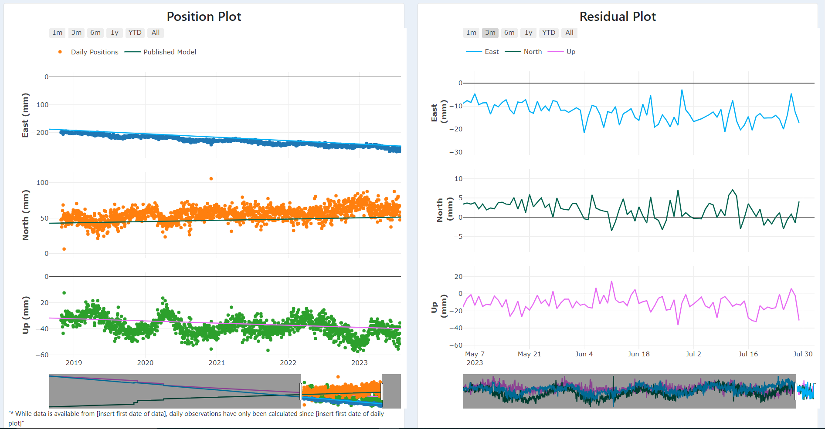
Residual Plot (1/2)
29.
*Daily positions and daily residuals are displayed side by side, but are not linked*

Slide 30
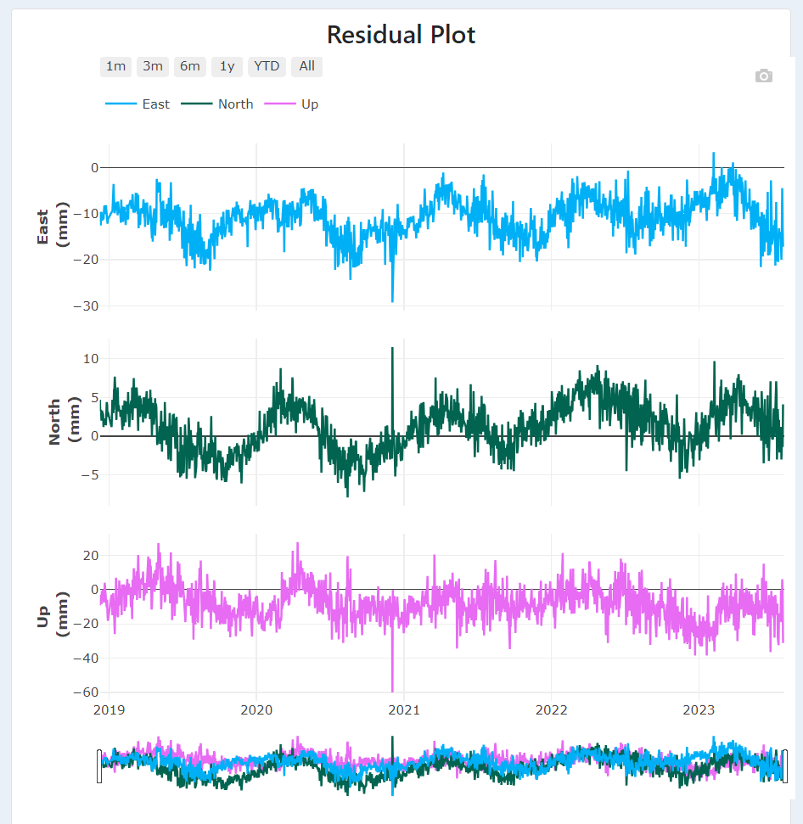
Residual Plot (2/2)
30.
*These plots all function the similarly with the 1 month, 3 month, 6 month, 1 year, year to date, and all auto scaling settings*
*The slider bar at the bottom also functions similarly in all plots*
*Because there are no daily positions before 2018 (343) there are also no residuals prior to that date*
*As always, if there is something you would like to see done differently let me know*

Slide 31
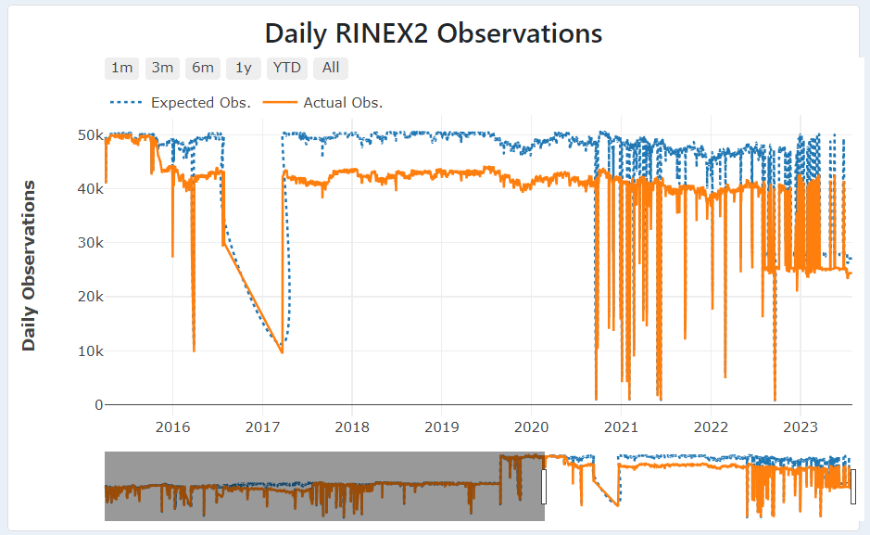
Daily Rinex2 Observations Plot
31.

Slide 32
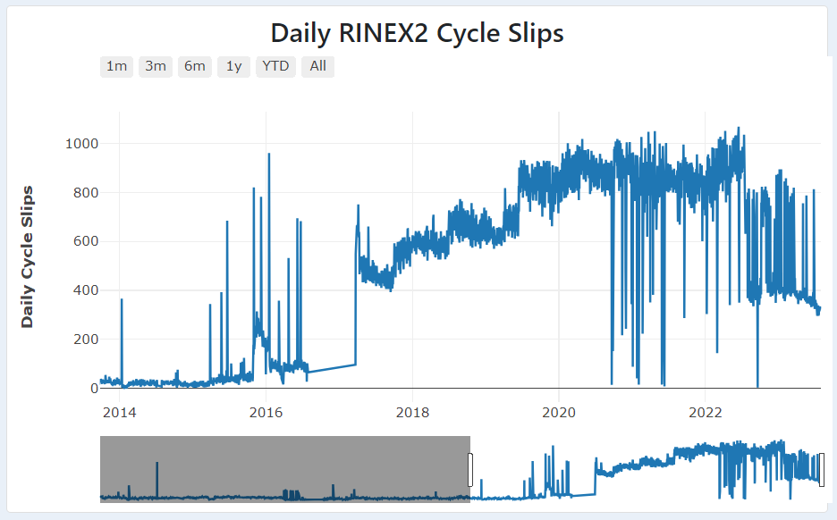
Daily Rinex2 Cycle Slips Plot
32.

Slide 33
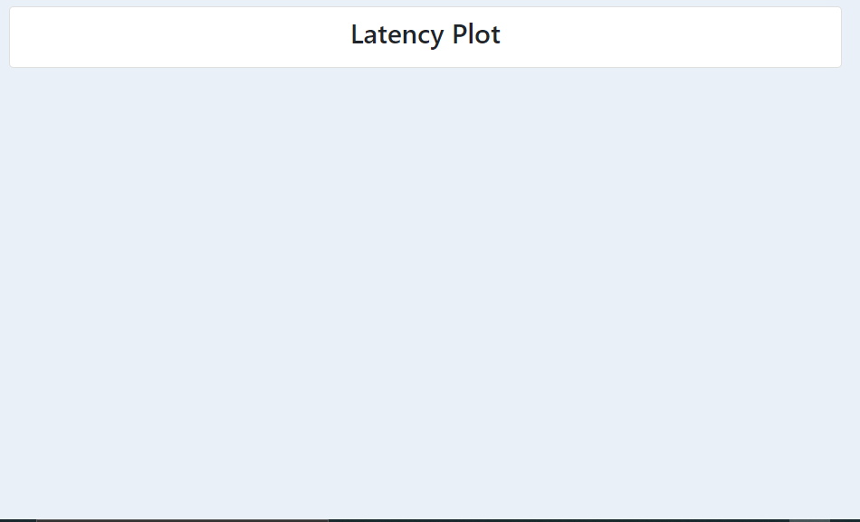
Latency Plot
33.
*We have not yet designed or loaded the data for the latency plot, but it is planned to show the latency of data arriving on the NGS servers*

Slide 34
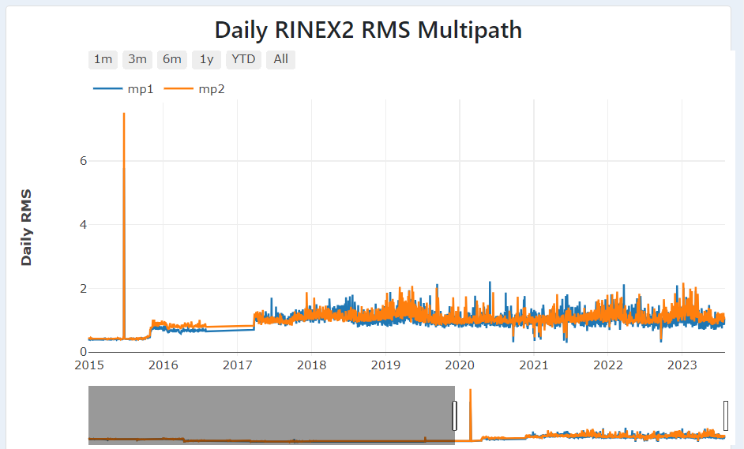
Daily Rinex2 RMS Multipath Plot
34.
*The mp1 and mp2 values are updated daily and represent the total multipath for all constellations*

Slide 35
Any Missing Sections?
35.
Those are all of the sections we currently have plans on providing information for at each station, if you feel there is relevant information missing, please let me know:
Dr. Kimber DeGrandpre NGS.Feedback@noaa.gov
Thank you for your time!

